Slide 1
GEOS-5 River Routing Model

Slide 2
Content
Global River Network
River Routing Model
Model Validation/Applications
Observed streamflow data used
Routing MERRA2 gridded runoff
Routing SMAP L4 and SMAP Nature gridded runoff
Flood events during the SMAP period
Drought indices and teleconnections

Slide 3
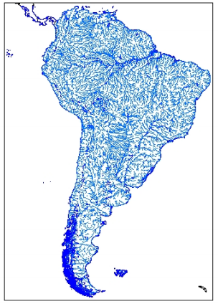
Global River Network
291,284 Pfafstetter Level 12 watersheds globally.
min_lon, max_lon, min_lat, max_lat, mean_elevation, area, length, ElevDiff, dnst_pfaf_index, DN_long, DN_lat, UP_lon, UP_lat, mouth_lon, and mouth_lat have been derived on each watershed.

Slide 4
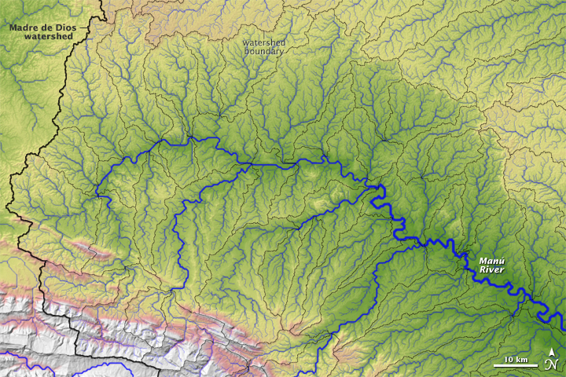
River Routing Model
total runoff from land model
Q_{IN} from upstream watersheds
W_{S}
W_{R}
Q_{OUT} to downstream watershed

Slide 5
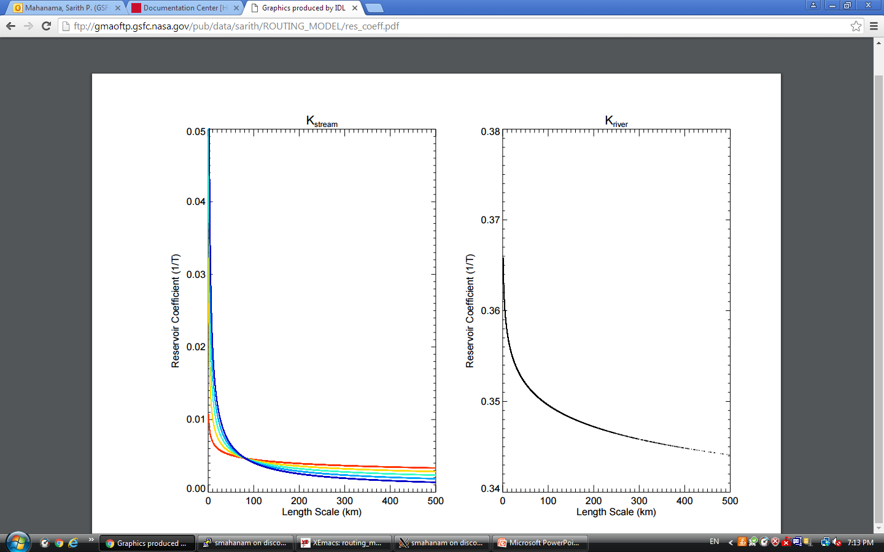
River Routing Model
Linear reservoir model :
Reservoir Coefficient for W_{stream} (K_{stream}):
L = Area / length
If (Q_{run} < 2 ; K = K₂) : a = P1; b = P2
If (Q_{run} > 10 ; K = K₁₀): a = P3; b = P4
If (2 <= Q_{run} <= 10) : K = K₂ + (Q_{run} -2)*(K₁₀ – K₂)/8.
Reservoir Coefficient
for W_{river} (K_{river}):
L = length; a = P5; b = P6; where
P1 = 0.010611
P2 = 0.188556
P3 = 0.096864
P4 = 0.691310
P5 = 0.365747
P6 = 0.009831

Slide 6
Model Validation/Applications
 | Daily Simulations |  | Monthly Simulations
 | US Floods in SMAP period (2015.04-2017.09) | 573 Unregulated basins in the US | Naturalized streamflows from 23 basins in the US (1980-2009) | 554 Global large river basins (1980-2009)
MERRA2 | Y | Y | Y | Y
SMAP L4 Vv3030 | Y | Y | N | N
SMAP Nature OL3001 | Y | Y | N | N

Slide 7
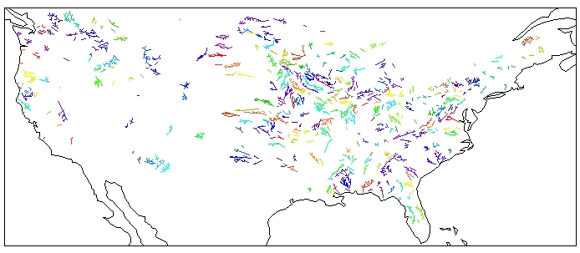
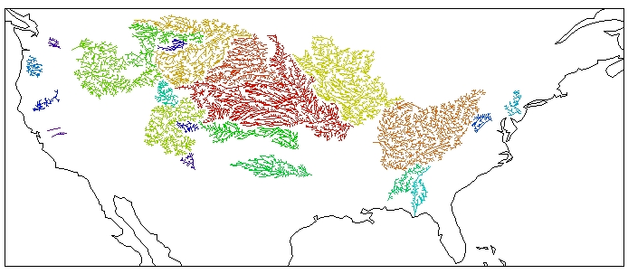
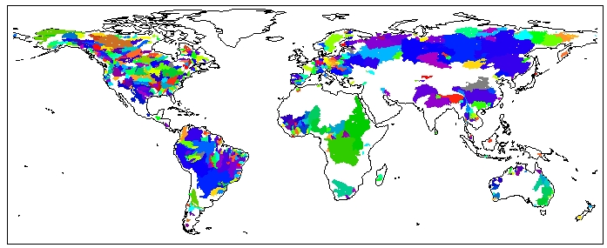
Model Validation/Applications
Unregulated daily streamflow data (1980-2017) from 573 basins
Naturalized monthly streamflow data (1980-2009) from 23 basins
Monthly streamflow data (1980-2009) from 554 large basins

Slide 8
Model Validation/Applications
TIME SERIES COMPARISON
Daily Simulations (1) : US Flood events in the SMAP period (2015.04-2017.09)
ftp://gmaoftp.gsfc.nasa.gov/pub/data/sarith/ROUTING_MODEL/smap_floods.pdf
SMAP Nature SMAP L4 MERRA2
Daily Simulations (2) : Model Validation on 573 basins for 2015.04 – 2017.09
ftp://gmaoftp.gsfc.nasa.gov/pub/data/sarith/ROUTING_MODEL/daily/SMAP-daily573.pdf
Observation SMAP L4 SMAP Nature MERRA2
Daily Simulations (3) : Model Validation on 573 basins for 1980 – 2017
ftp://gmaoftp.gsfc.nasa.gov/pub/data/sarith/ROUTING_MODEL/daily/M2-daily573.pdf
Observation MERRA2

Slide 9
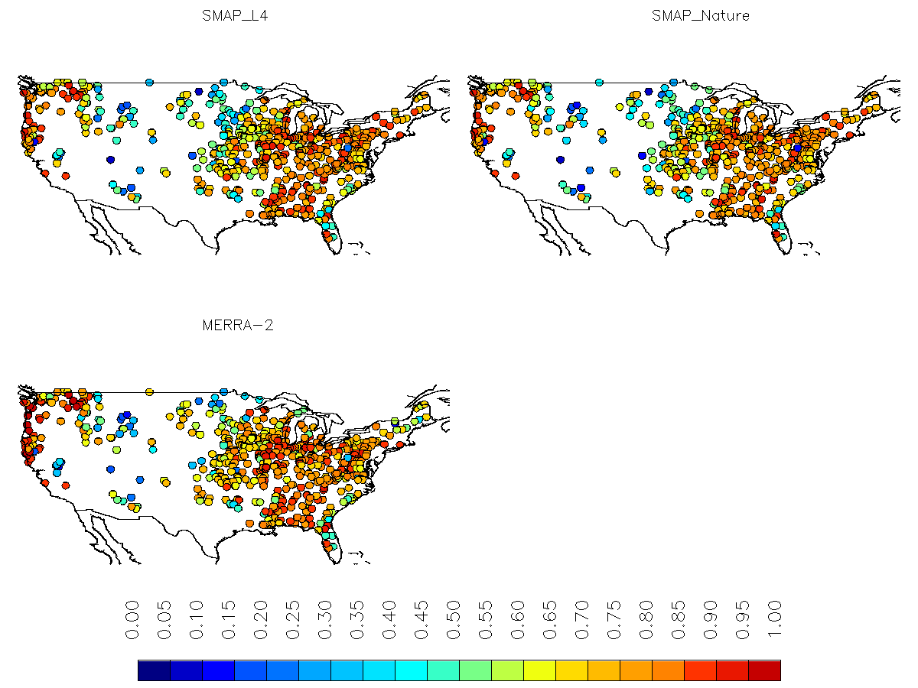
Model Validation/Applications
Skill of Daily Simulations : Correlation R (573 basins 2015 – 2017)
Daily streamflows from a 3-day moving window for the warm period April-Sep were used

Slide 10
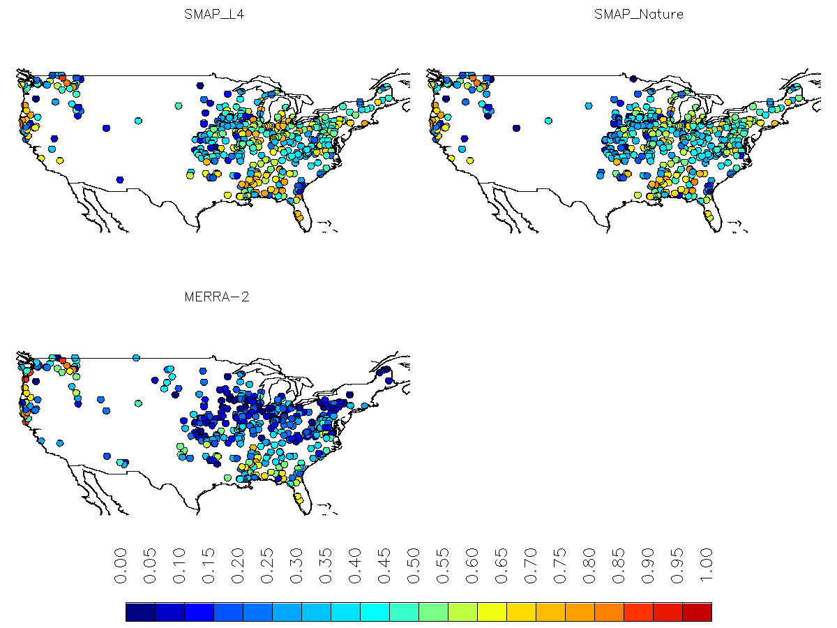
Model Validation/Applications
Skill of Daily Simulations : Nash-Sutcliffe Efficiency (573 basins 2015 – 2017)
Daily streamflows from a 3-day moving window for the warm period April-Sep were used

Slide 11
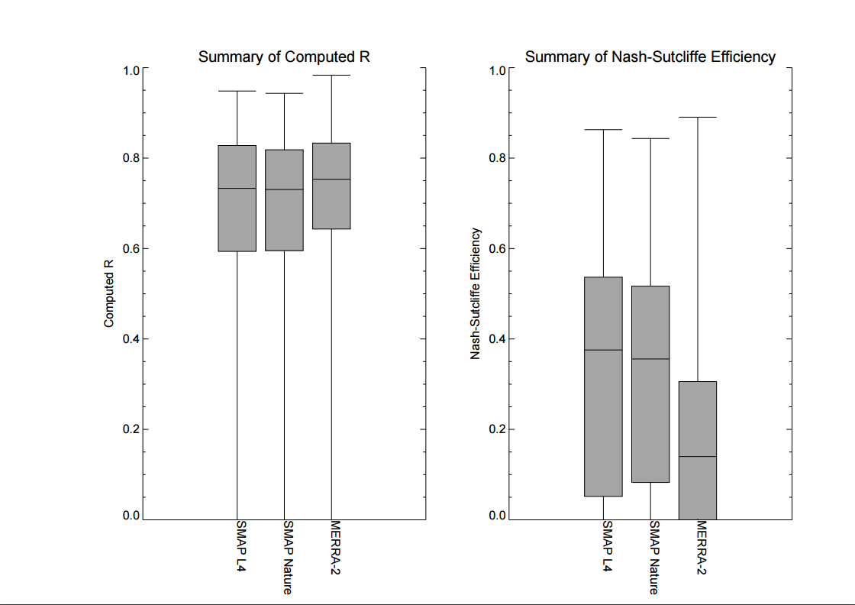
Model Validation/Applications
Skill of Daily Simulations : Summary (573 basins 2015 – 2017)
Daily streamflows from a 3-day moving window for the warm period April-Sep were used

Slide 12
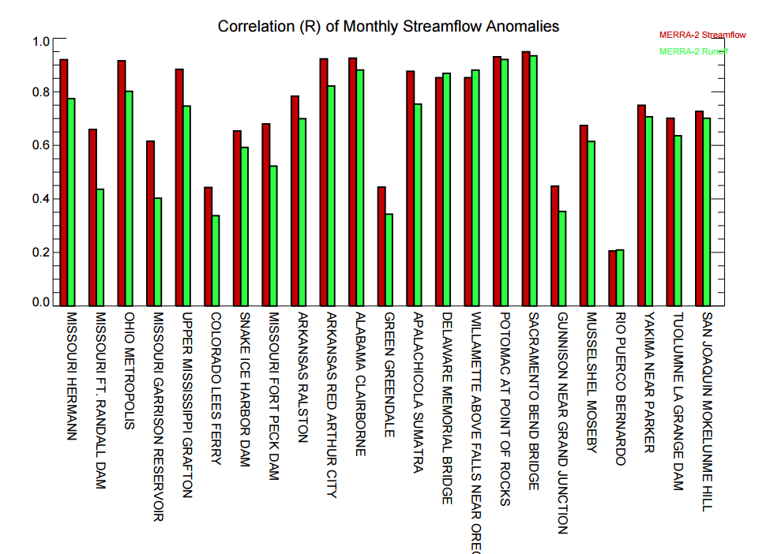
Model Validation/Applications
Skill of Monthly Simulations : Correlation R of monthly streamflow anomalies (23 naturalized basins 1980 – 2009)

Slide 13
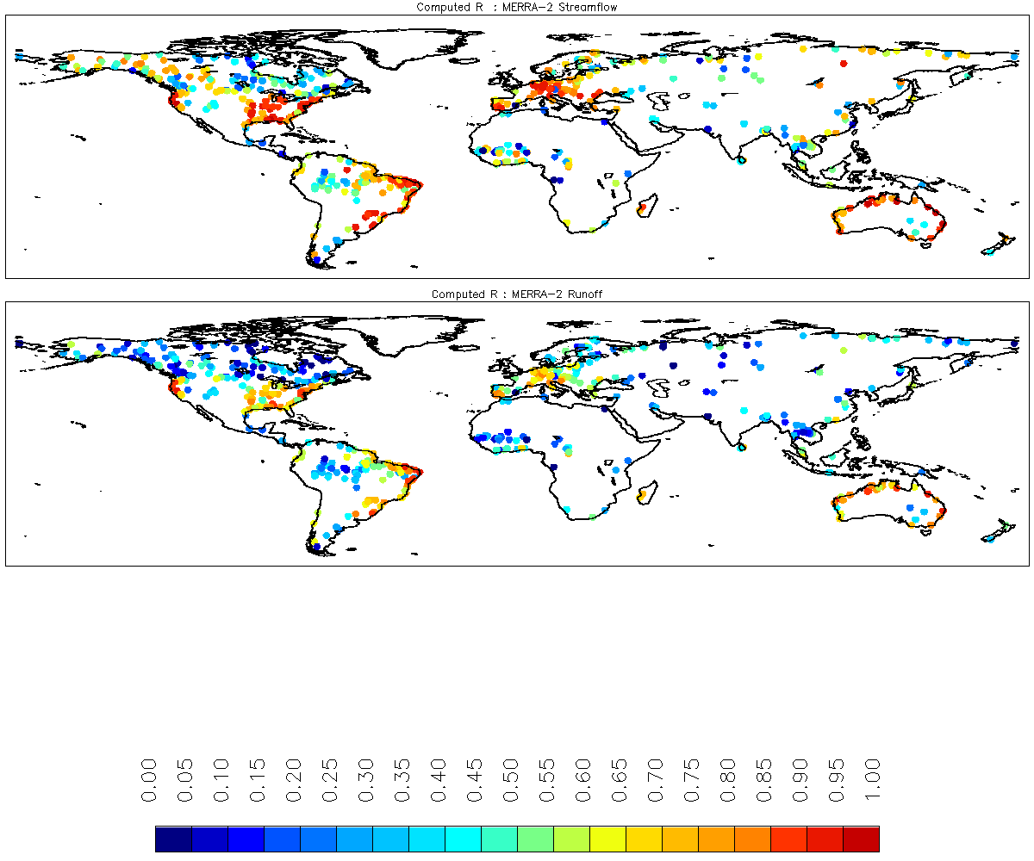
Model Validation/Applications
Skill of Monthly Simulations : Correlation R of monthly streamflow anomalies (554 basins 1980 – 2009)

Slide 14
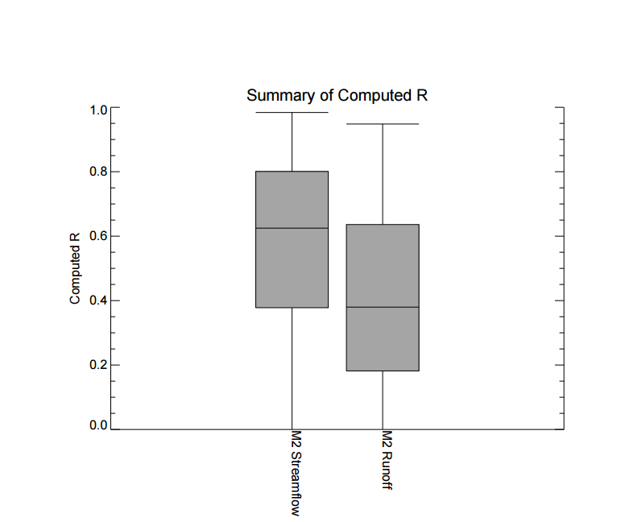
Model Validation/Applications
Summary of Skill of Monthly Simulations : Correlation R of monthly streamflow anomalies (554 basins 1980 – 2009)

Slide 15
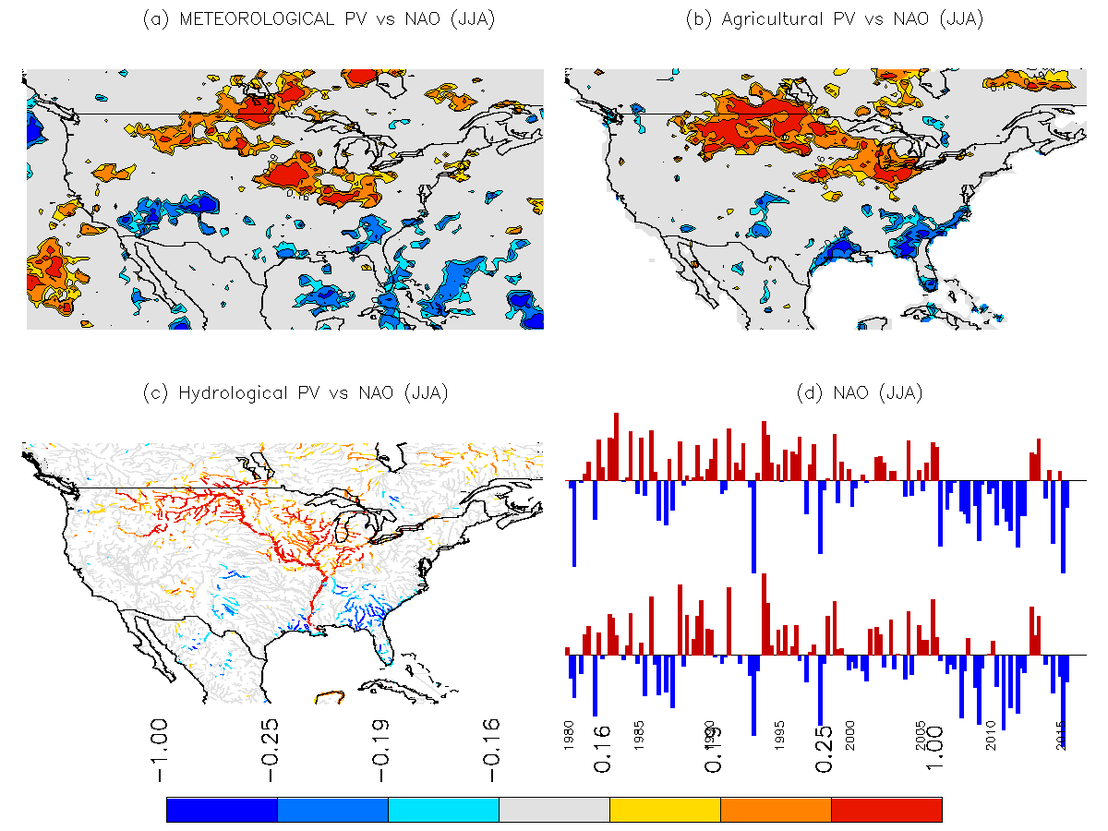
Model Applications
Drought indices and NAO teleconnection

