Slide 1
Scaling CATCHCN fPAR and Albedo to Match MODIS statistics

Slide 2
Content
Objectives: (i) scale CATCHCN fPAR to match Cumulative probability Distribution Functions (CDFs) of MODIS fPAR (ii) match CATCHCN VISDF and NIRDF with MODIS values
Data a. 15-arcsec MCD15A2H.006 8-day composites of fPAR aggregated to EASEv2_M09 grid for the period 2003-2016 b. 30-arcsec MCD43GF 8-day composites of NIRDF and VISDF aggregated to EASEv2_M09 grid for the period 2003-2015 c. Global catchment-CN offline simulation on the EASEv2_M09 grid for the period 2003-2016
Methodology
Preliminary Results : CONUS/GLOBAL sims on the EASEv2_M36 grid (2003-2016) (i) alb/fPAR clim maps (ii) fPAR CDFs, fPAR annual cycles from

Slide 3
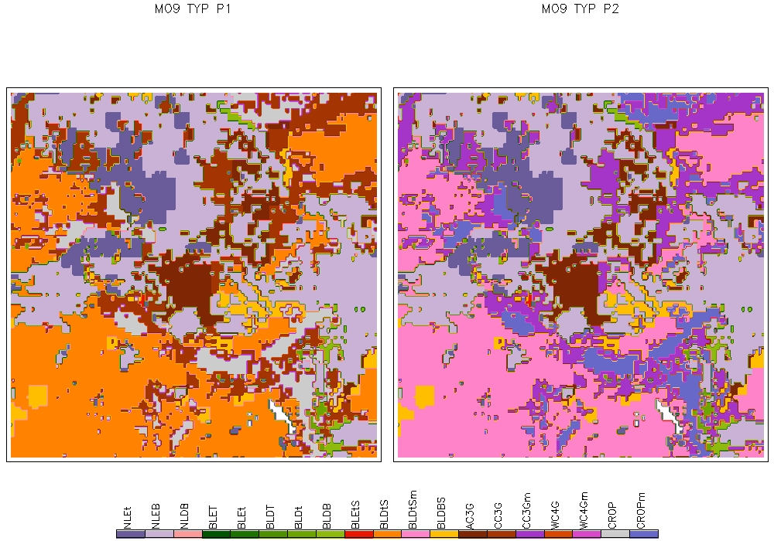
(3) Methodology : background and assumptions
fPAR and albedo at a location depend on Plant Functional Type (PFT), and there is a seasonal cycle and spatial heterogeneity
From the 2 primary PFT types within the 9km cell, the type of the larger fraction was chosen as the dominant PFT of the 9km cell.

Slide 4
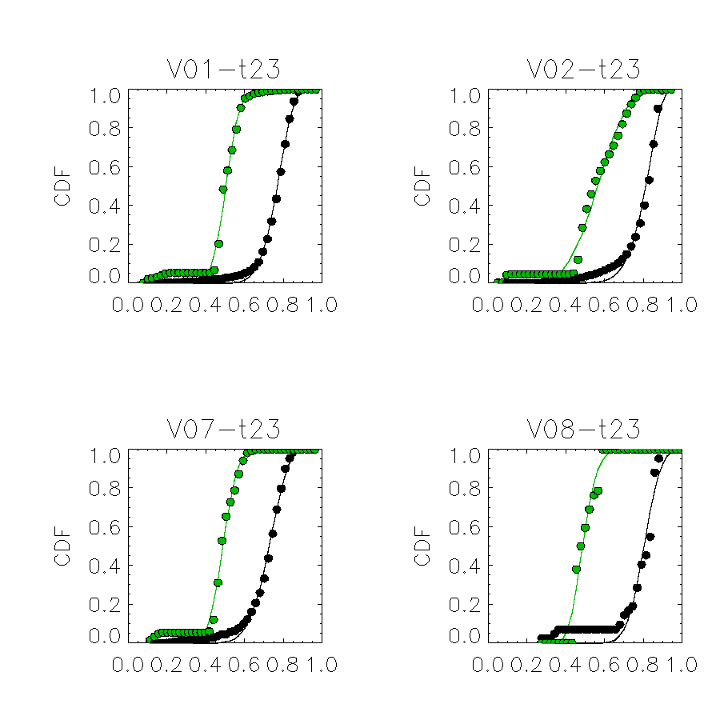
(3) Methodology : CDFs of fPAR for different PFTs
Region : 10ºx10º tile centered around 45N, 117E
Period : D185-192
MODIS CATCHCN

Slide 5
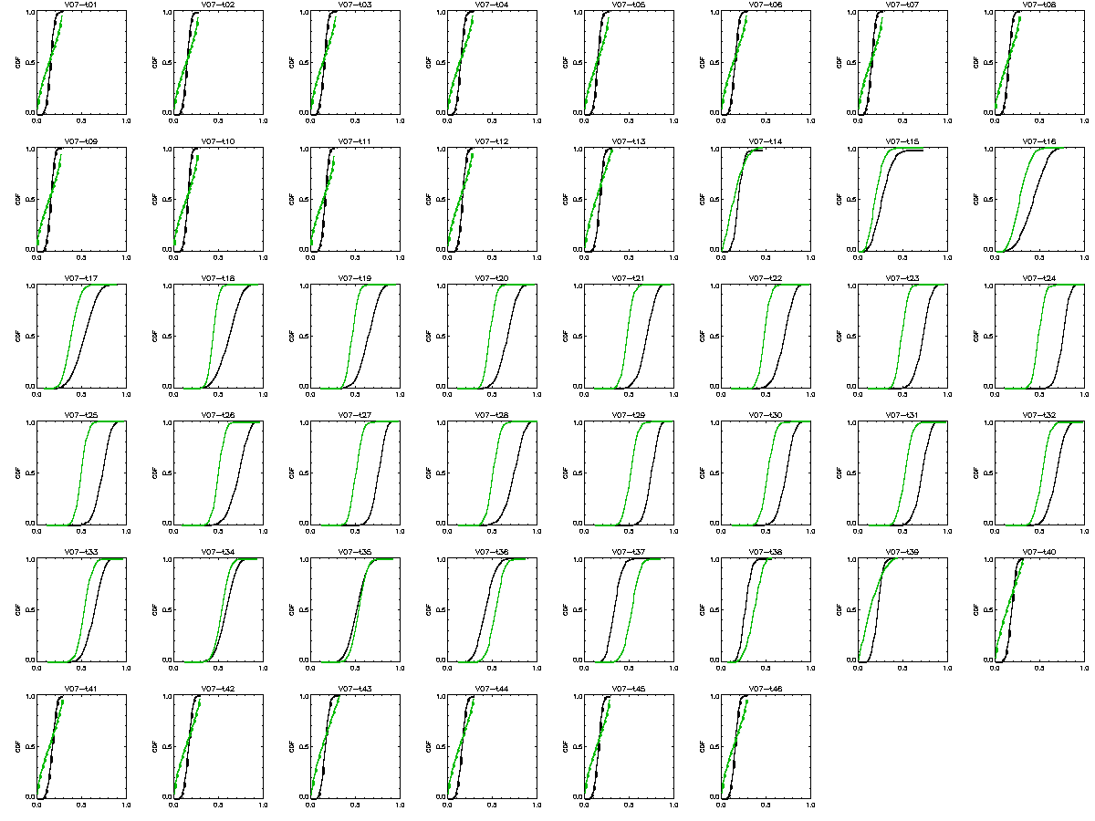
(3) Methodology : Seasonal cycle of CDFs for Broadleaf Deciduous Temperate trees

Slide 6
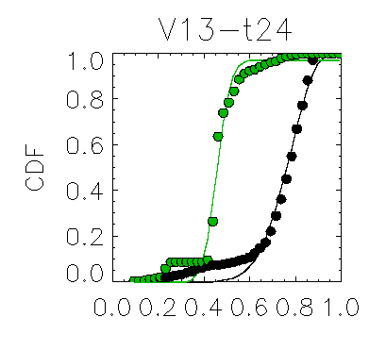
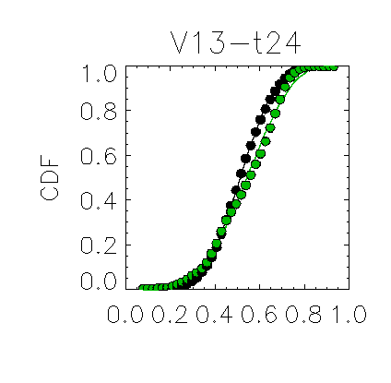
(3) Methodology : CDFs of fPAR (spatial heterogeneity)
10ºx10º tile at 45N, -115E
10ºx10º tile at 45N, 117E

Slide 7
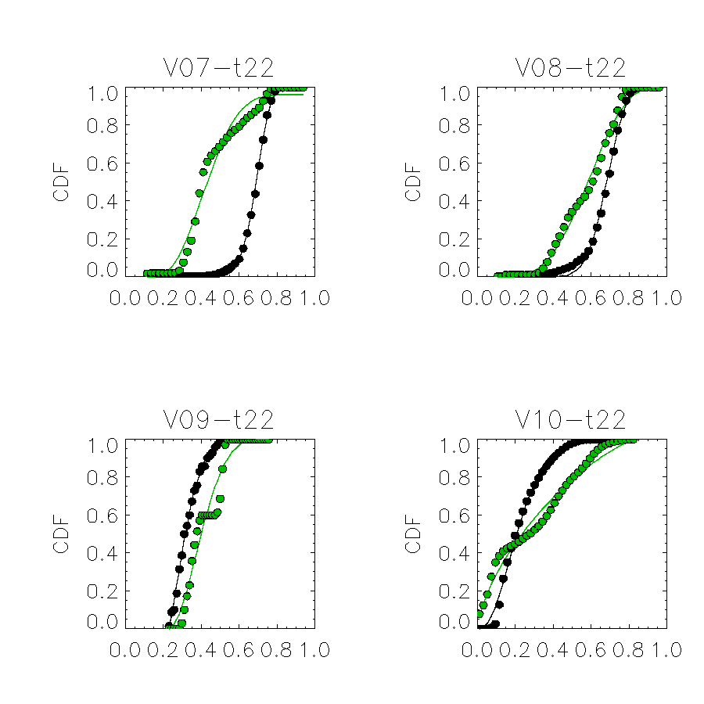
(3) Methodology : Deriving CDF parameters to define continuous functions of fPAR CDFs

Slide 8
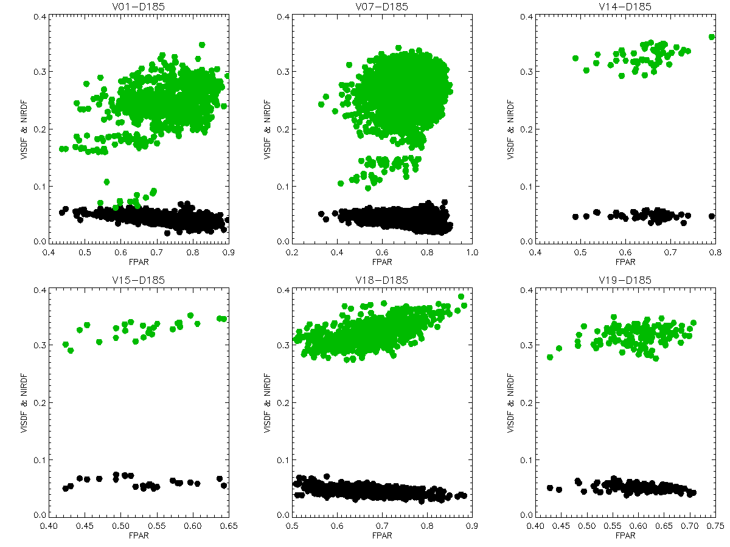
(3) Methodology : Deriving albedo parameters to determine NIRDF and VISDF from fPAR
Region : 10ºx10º tile centered around 37N, -97W
Period : D185-192

Slide 9
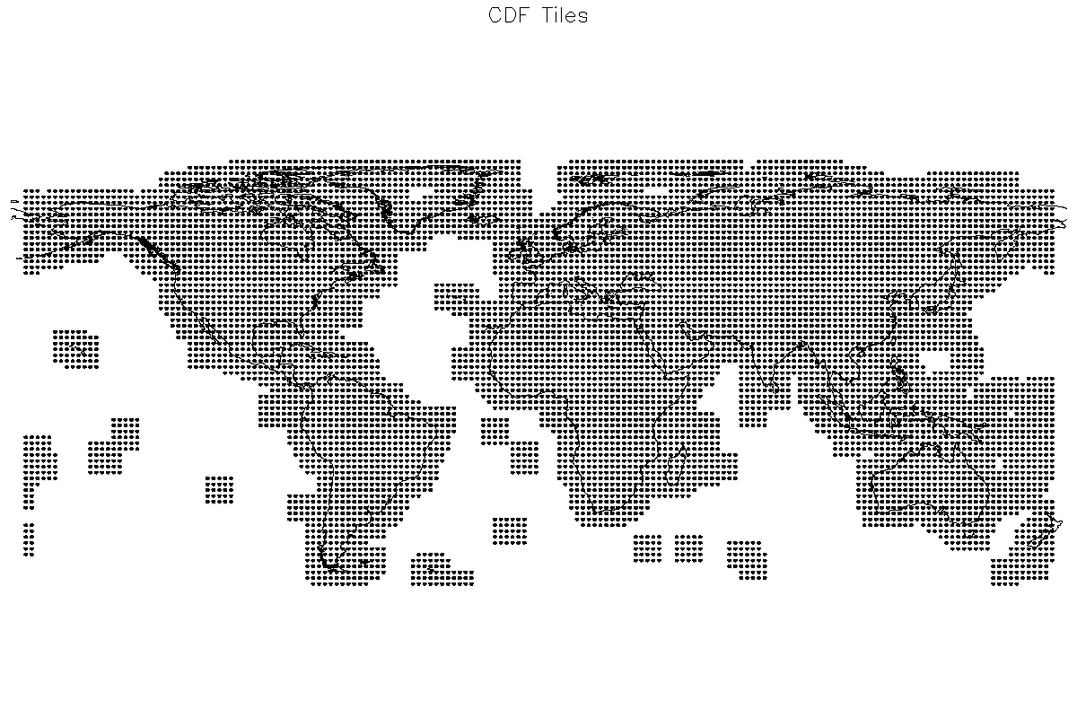
(3) Methodology : locations of 8,282 10ºx10º tiles for scale parameters

Slide 10
(3) Methodology : global parameter file
netcdf FPAR_CDF_Params-M09 {
dimensions:
pft = 19 ;
octad = 46 ;
data = 2 ;
tile10D = UNLIMITED ; // (8282 currently)
variables:
float lon(tile10D) ;
float lat(tile10D) ;
float Kappa(data, octad, pft, tile10D) ;
float Lambda(data, octad, pft, tile10D) ;
float Mu(data, octad, pft, tile10D) ;
float MinVal(octad, pft, tile10D) ;
float MaxVal(octad, pft, tile10D) ;
float VISa(octad, pft, tile10D) ;
float VISb(octad, pft, tile10D) ;
float NIRmean(octad, pft, tile10D) ;

Slide 11
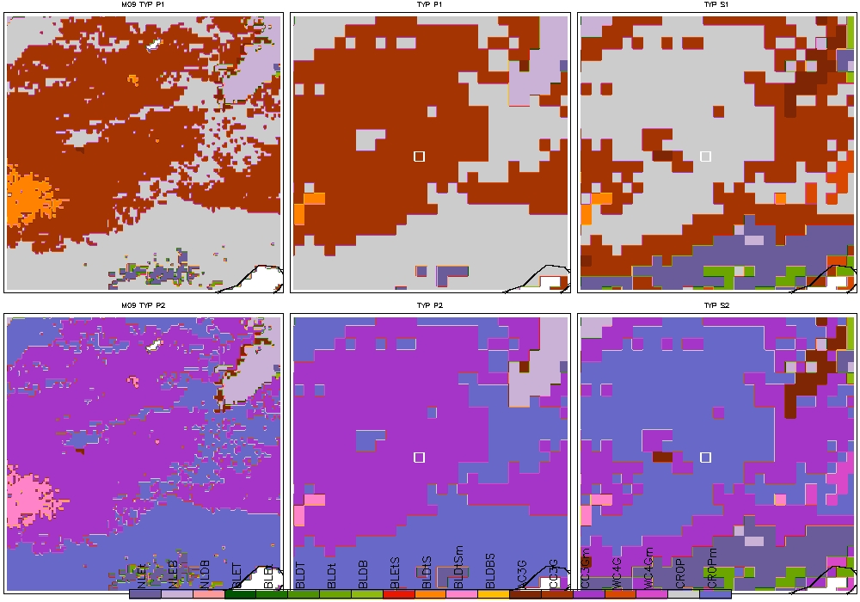
(3) Methodology : implementation (EASEv2_M36 example)
P1
S1
P2
S2

Slide 12
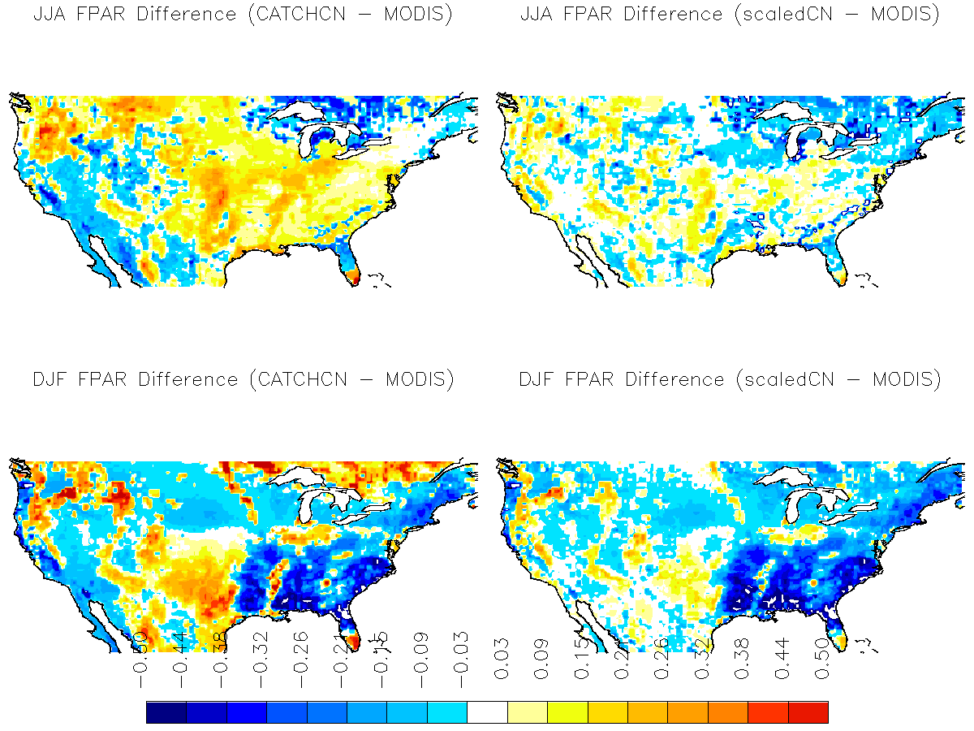
(4) Experiment Analysis : The difference of fPAR clim

Slide 13
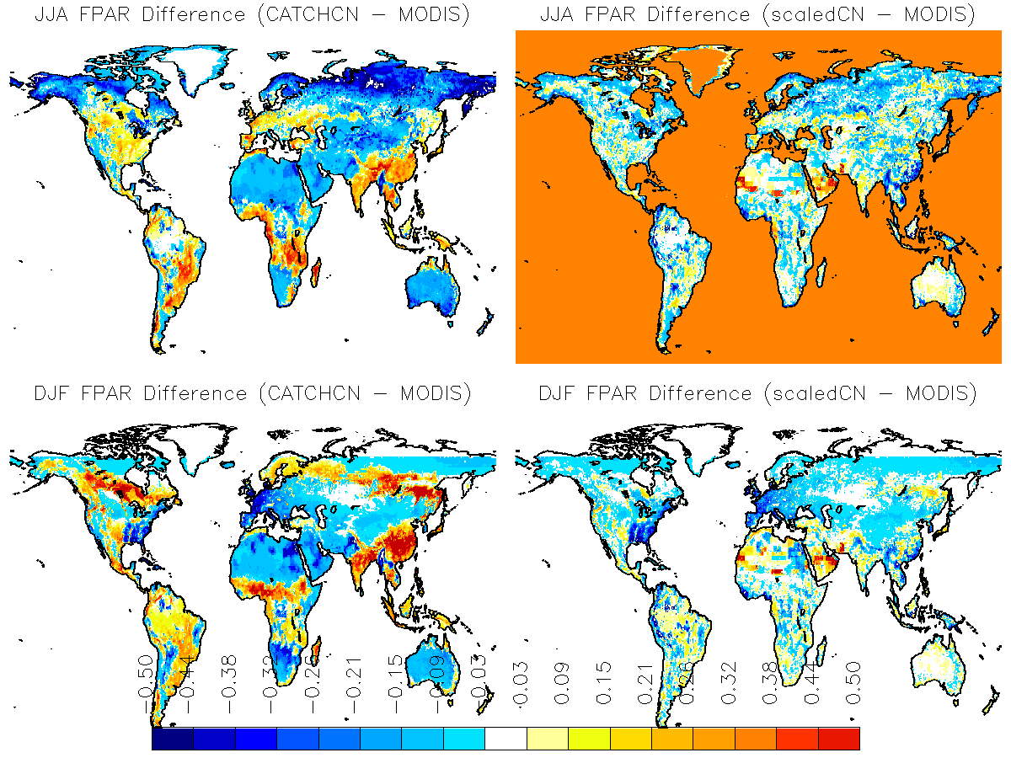

Slide 14
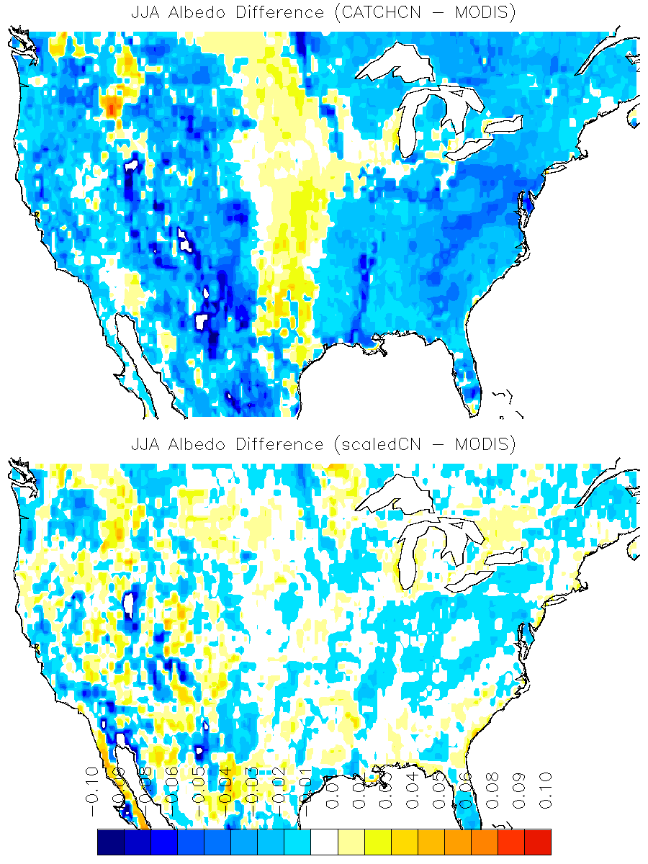
(4) Experiment Analysis : The difference of Albedo clim

Slide 15
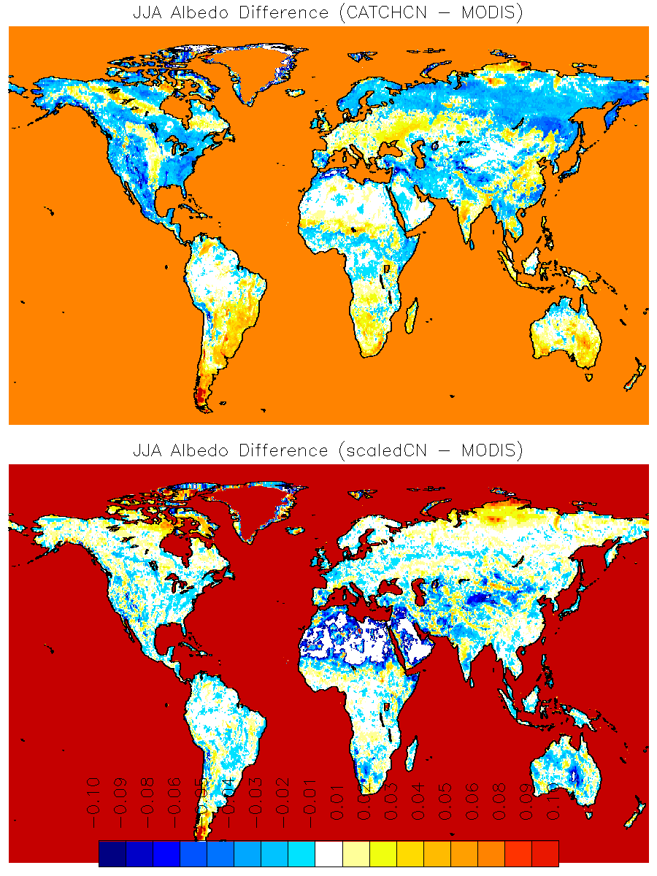

Slide 16
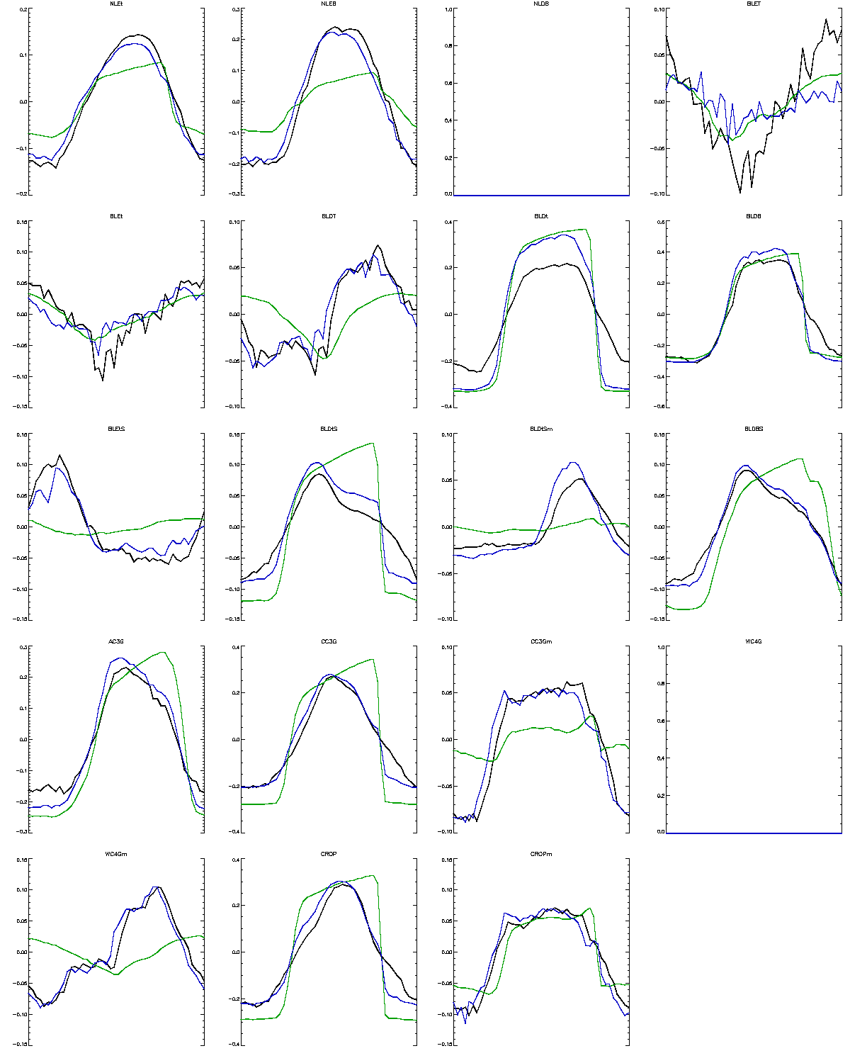
(4) Experiment Analysis : fPAR 8-day climatology
https://gmao.gsfc.nasa.gov/gmaoftp/sarith/FPAR_SCALING/CONUS/fpar_season.png

Slide 17
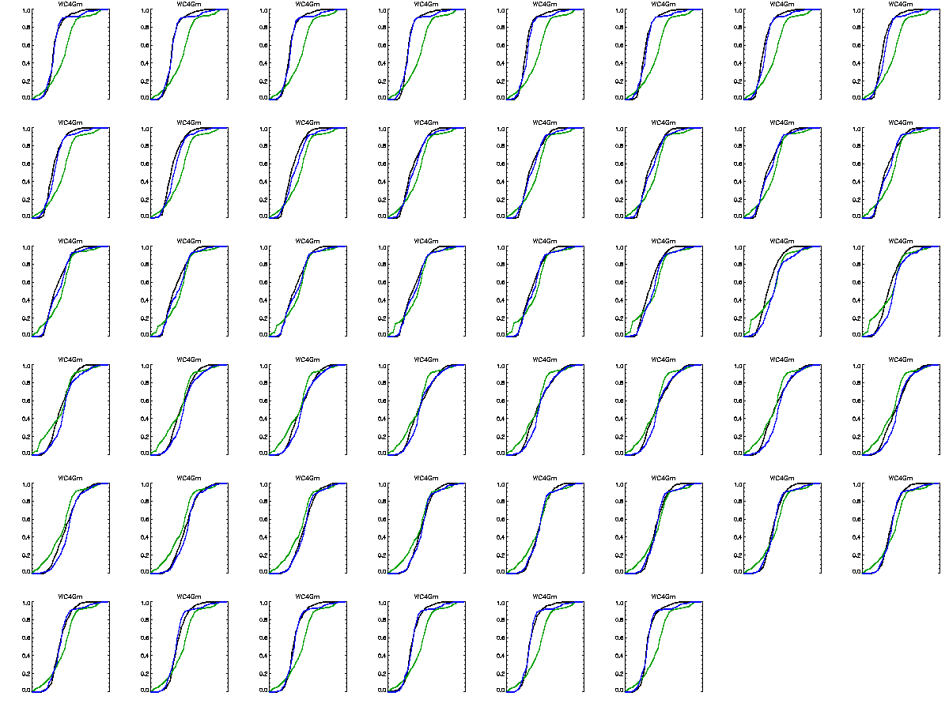
(4) Experiment Analysis : fPAR CDFs

Slide 18
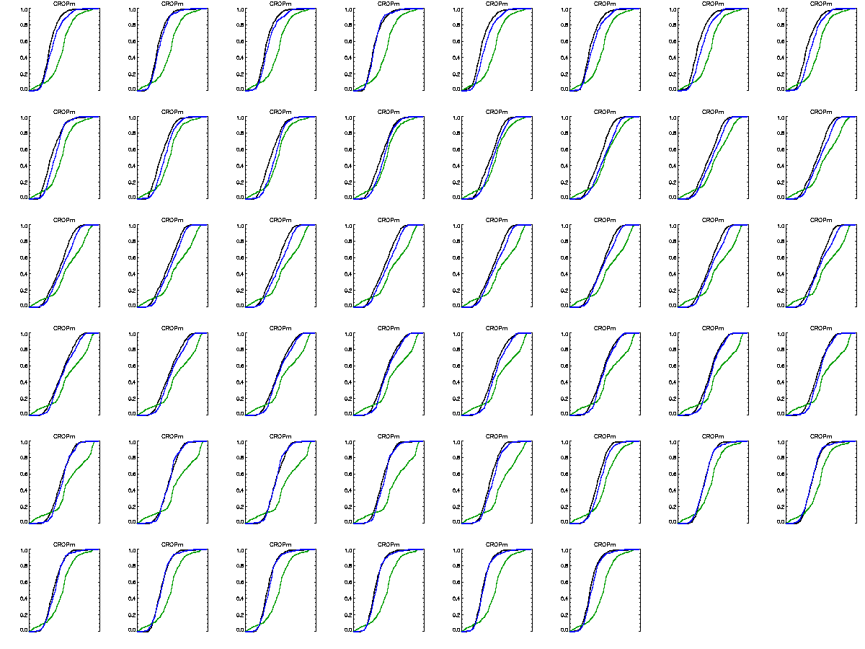

Slide 19
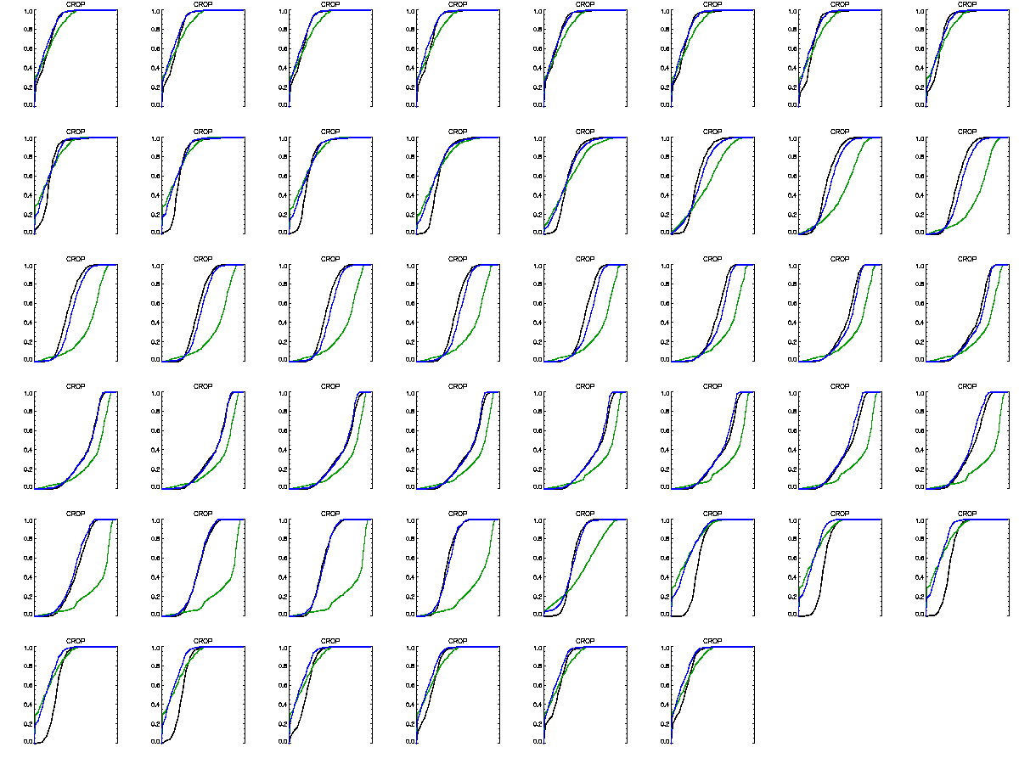

Slide 20
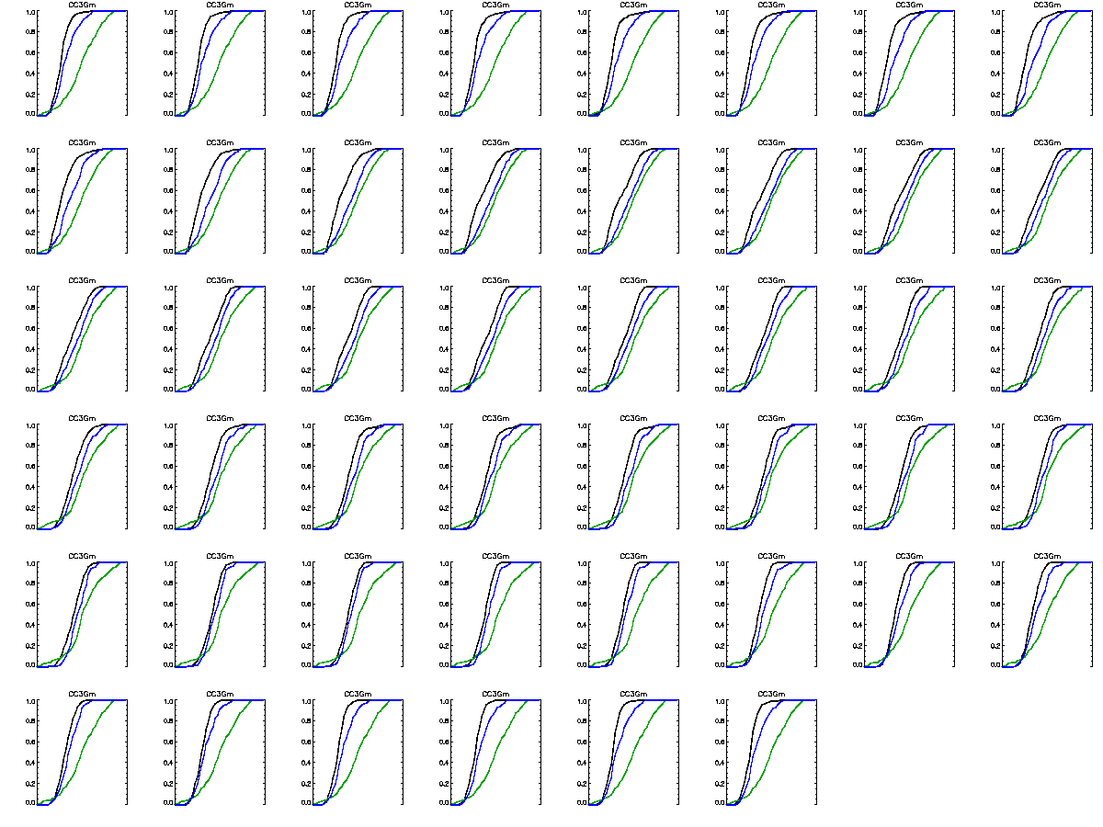

Slide 21
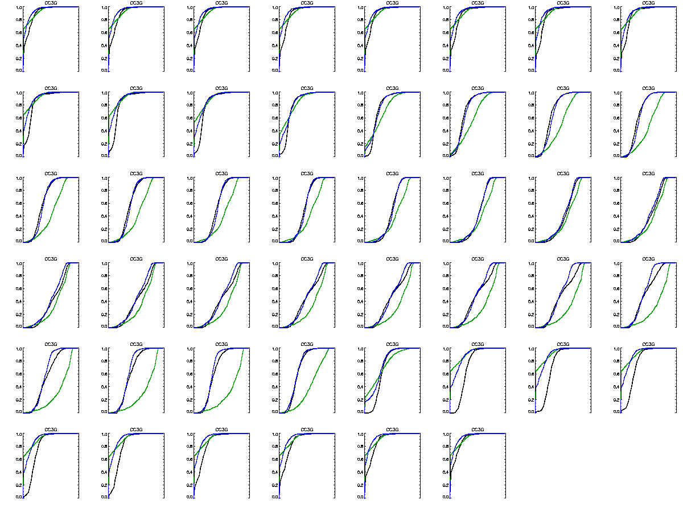

Slide 22
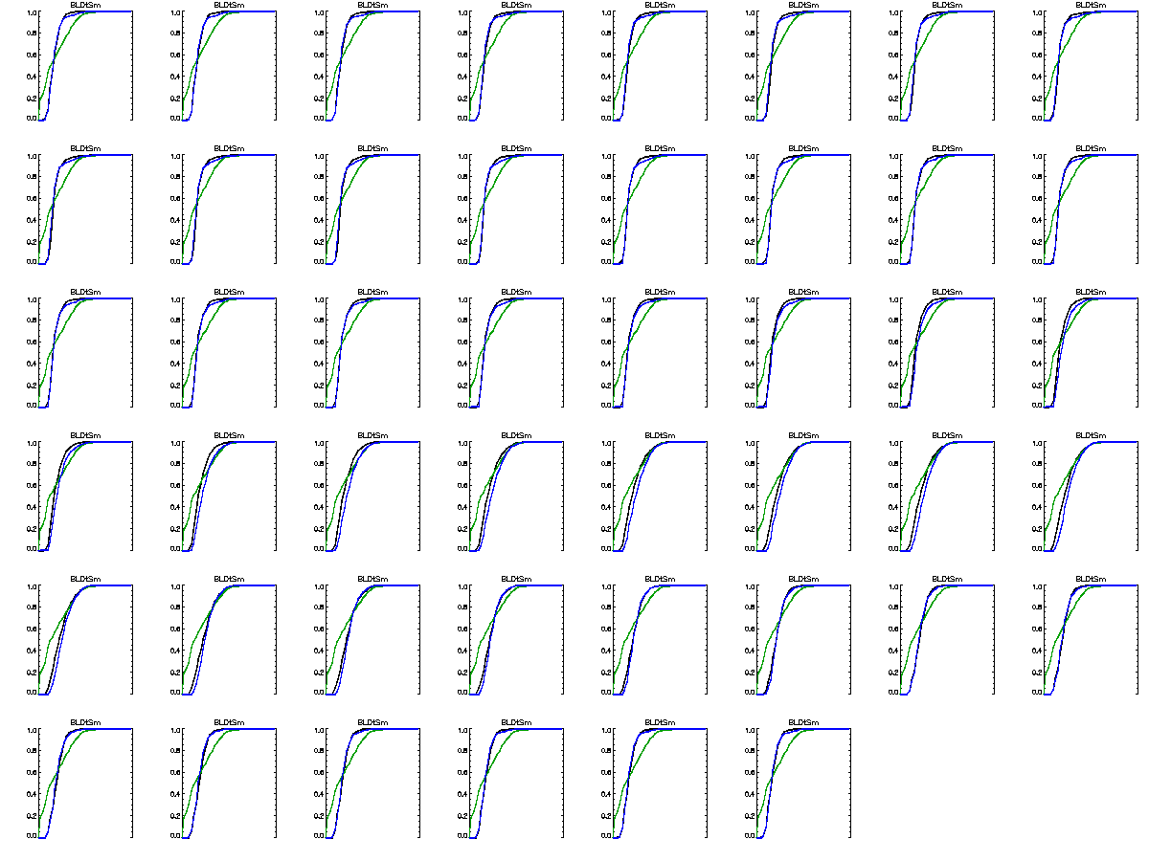

Slide 23
