Slide 1
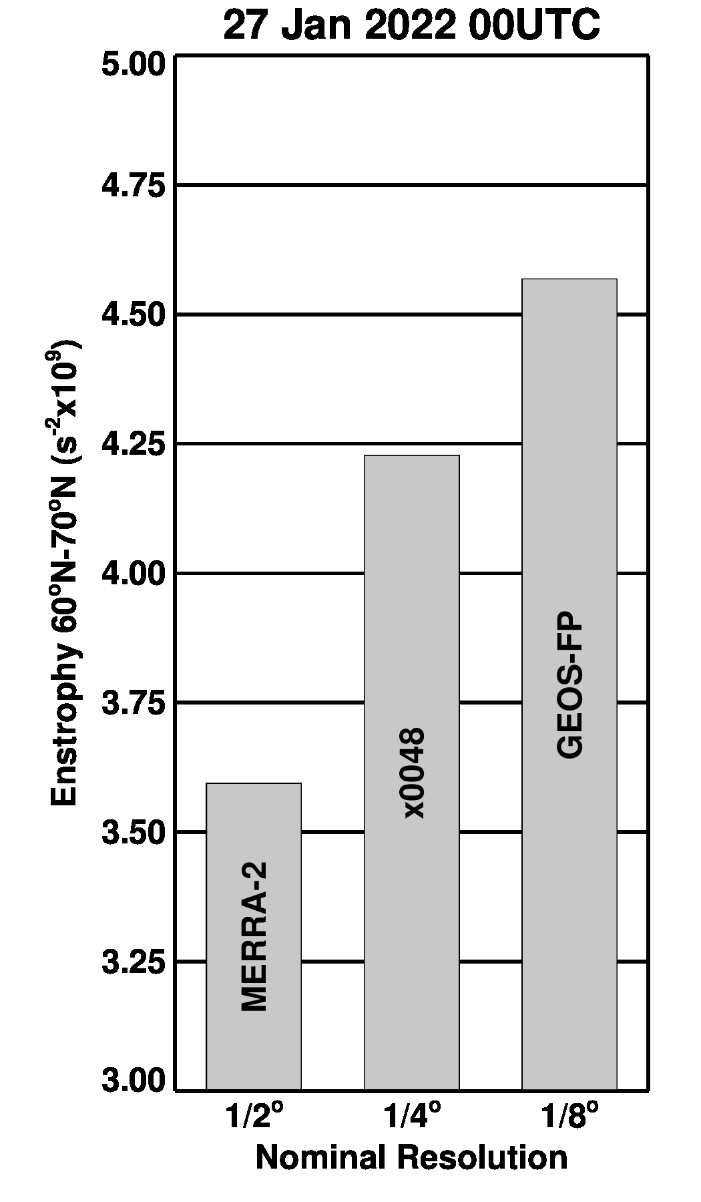
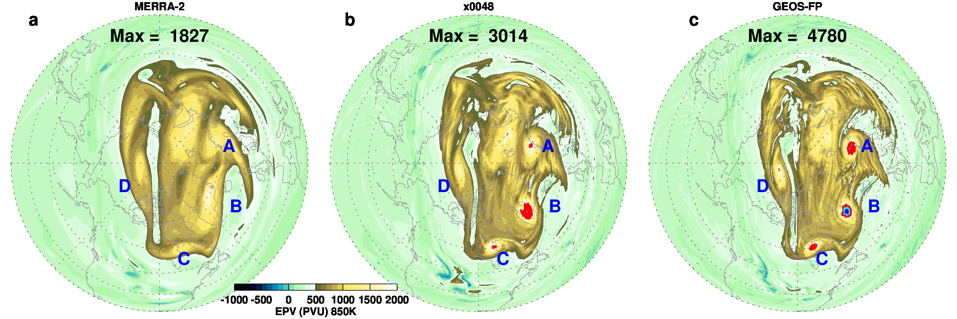
27 January 2022 00UTC
Increasing Resolution
Enstrophy increases with increasing resolution, however, the increase from x0048 is smaller suggesting that the mesoscale features are converging.

