Slide 1
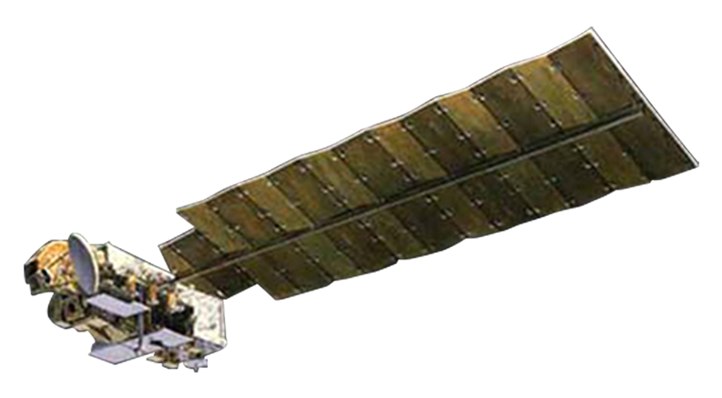
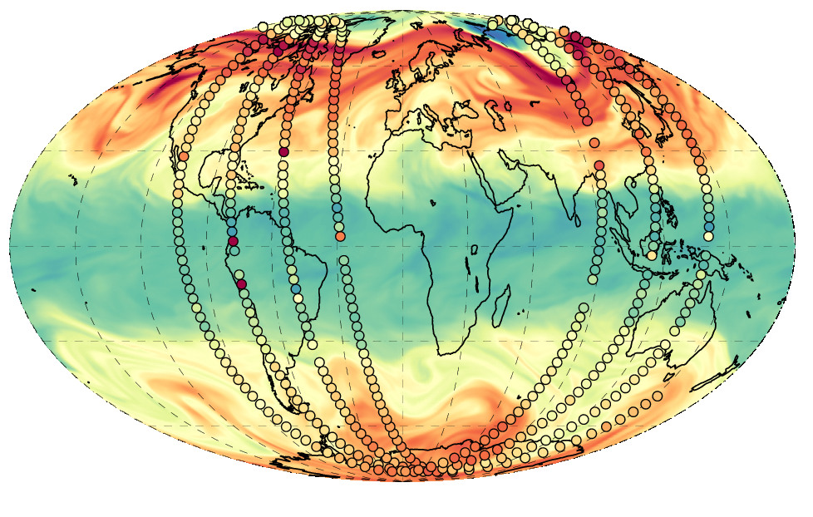
Studying transport and chemistry with the Stratospheric Composition Reanalysis of Aura Microwave Limb Sounder
HNO₃ at 500 K
Kris Wargan, Gloria L. Manney, Brad Weir, K. Emma Knowland, and Steven Pawson
M2-SCREAM
12th International Limb Workshop, Brussels May 2023
Project funded by NASA’s Modeling Analysis and Prediction (MAP)

Slide 2
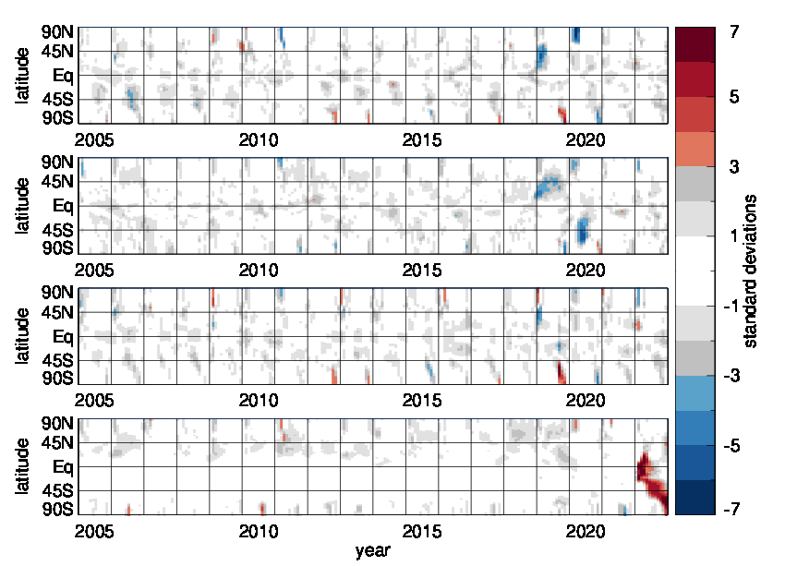
Trace gas and temperature anomalies
Our surprising stratosphere
Ozone, 52 hPa
Early 2019: Dynamically-driven anomaly
Late 2019: Rare sudden stratospheric warming over Antarctica
2020: Exceptionally strong Arctic polar vortex
2020: Australian New Year’s wildfires
2020 and 2021: Long-lasting Antarctic polar vortices
2022: Hunga Tonga eruption
HCl, 52 hPa
T, 52 hPa
H₂O, 26 hPa

Slide 3
This talk
Chemical reanalysis: Long (multiyear) record of atmospheric composition data assimilated with a system equipped with an atmospheric chemistry model and constrained by assimilated meteorological fields
This talk highlights a new stratospheric composition reanalysis, M2-SCREAM produced at NASA’s Global Modeling and Assimilation Office

Slide 4
MERRA-2 Stratospheric Composition Reanalysis of Aura MLS (M2-SCREAM)
Mission long reanalysis of MLS observations of selected species
late 2004-present
Assimilating O₃, H₂O, HCl, HNO₃, and N₂O from MLS and total ozone from OMI; caveat: HNO₃ not assimilated in polar night. These species are important for stratospheric chemistry and as transport tracers.
Constituent Data Assimilation System (CoDAS)
Resolution of the output: 0.625º × 0.5º; vertical resolution in the stratosphere 1–2 km
Meteorology constrained by MERRA-2
Chemistry model: StratChem
  Stratospheric chemistry: gas-phase, heterogeneous, and photolysis reactions
  Family scheme: 51 transported and 18 inferred species
Analysis uncertainties are provided
Publicly available from NASA’s GES DISC

Slide 5
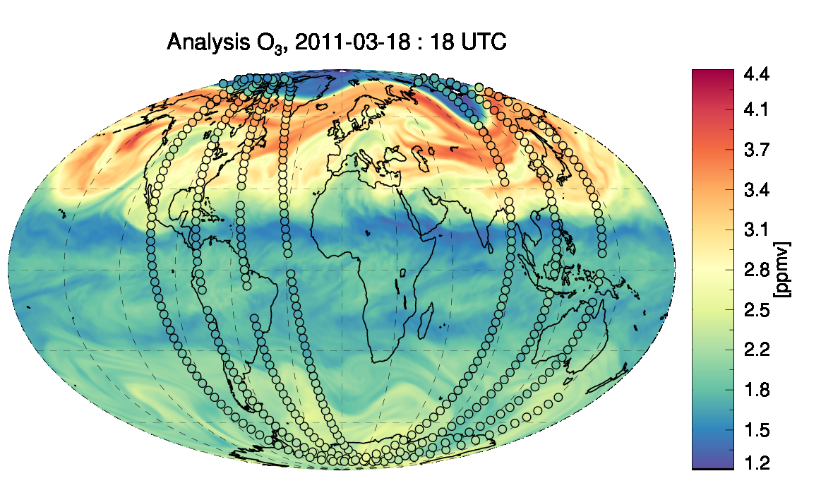
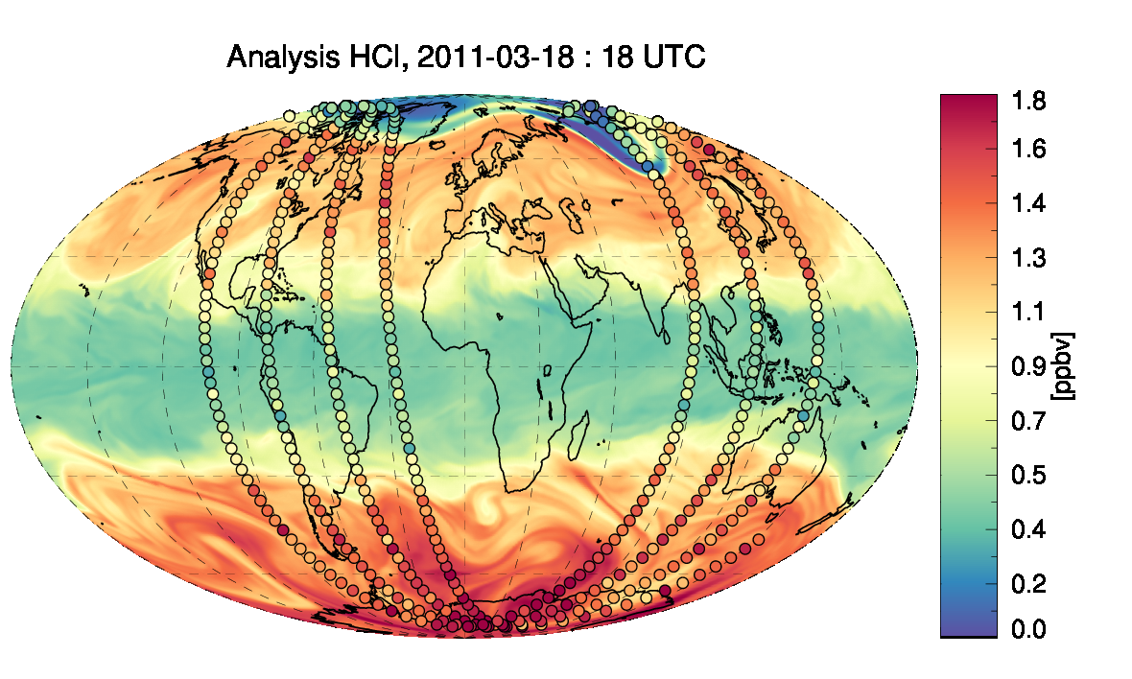
500 K
500 K
Maps of assimilated ozone and HCl and MLS observations (circles)
Close agreement between the constituent fields and assimilated MLS data.
Note dynamically driver features at mid- and high latitudes, and areas of depleted ozone and low HCl within the polar vortex.

Slide 6
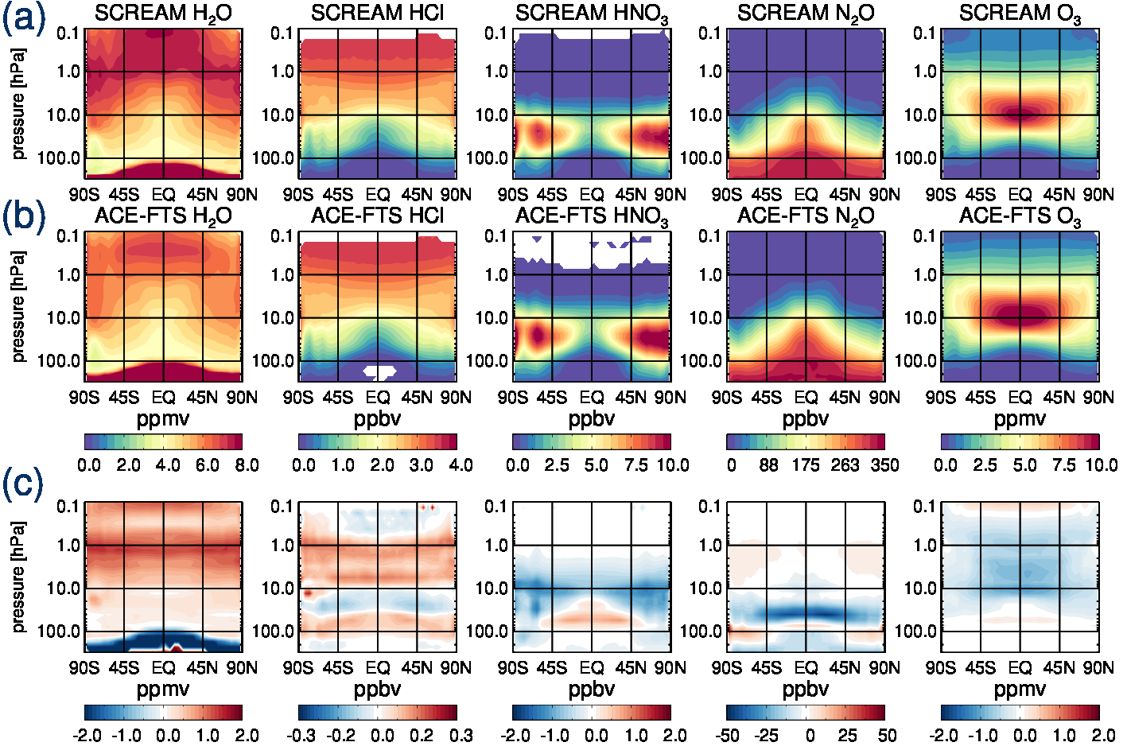
Comparisons with ACE-FTS, 2005-2021 zonal mean
Good overall agreement between the reanalysis and ACE-FTS.
Differences in O₃, H₂O and N₂O reflect those between MLS and ACE-FTS.
Polar HNO₃ is underestimated in SCREAM;

Slide 7
Representing chemical and dynamical processes on a broad range of scales

Slide 8
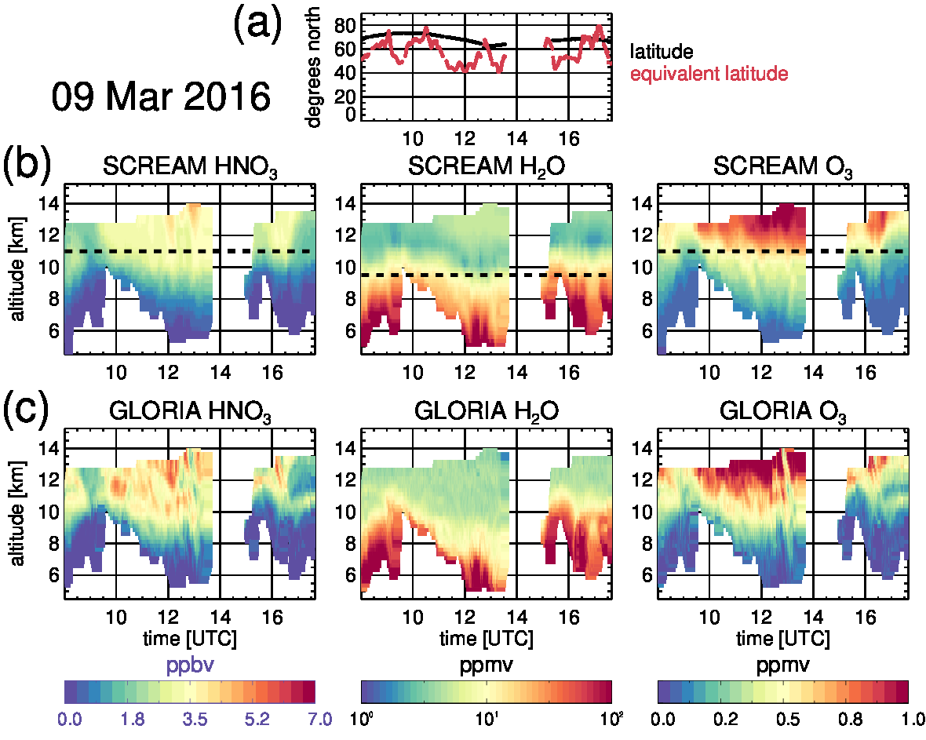
Comparisons with POLSTRACC data; a single flight
Observations made by the Gimballed Limb Observer for Radiance Imaging of the Atmosphere (GLORIA) onboard the HALO aircraft during the PGS campaign (winter-spring 2016, north Atlantic).
Close agreement between M2-SCREAM and GLORIA observations.
Some evidence of low HNO₃ bias
Note the much higher vertical resolution of GLORIA data (250 m) compared to M2-SCREAM (>1 km)
bottom MLS level

Slide 9
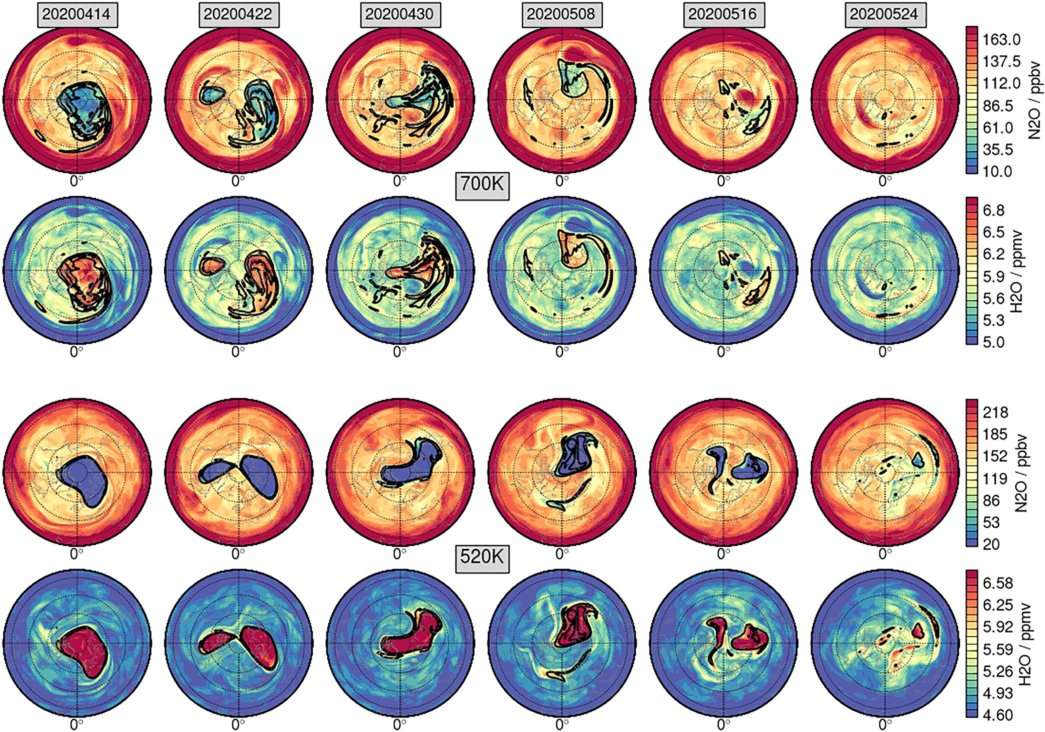
Transport during polar vortex breakup
“High-resolution view of the 2020 polar vortex breakup and the fate of vortex remnants”
Manney et al., 2022
Strong confinement of air within the offspring vortices and filaments through mid-May

Slide 10
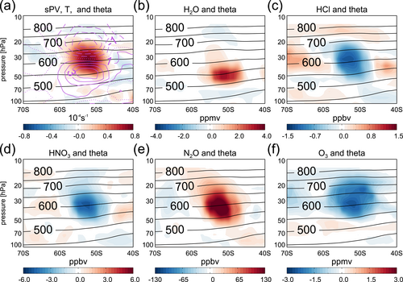
Smoke with Induced Rotation and Lofting (SWIRL) from the Australian New Year’s wildfires of 2019/2020
Departures from the zonal mean for
scaled PV and temperature
water vapor
HCl
HNO₃
N₂O (e)
ozone
at 80°W on 31 January 2020. Also shown are potential temperature contours.

Slide 11
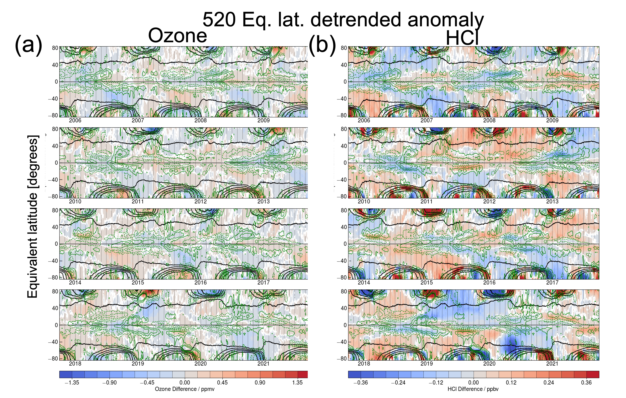
Long view of dynamical and chemical variability of the stratosphere
Strong polar vortex of 2020
Chlorine repartitioning following Australian wild fires
Wargan et al., 2023; plot by G. Manney

Slide 12
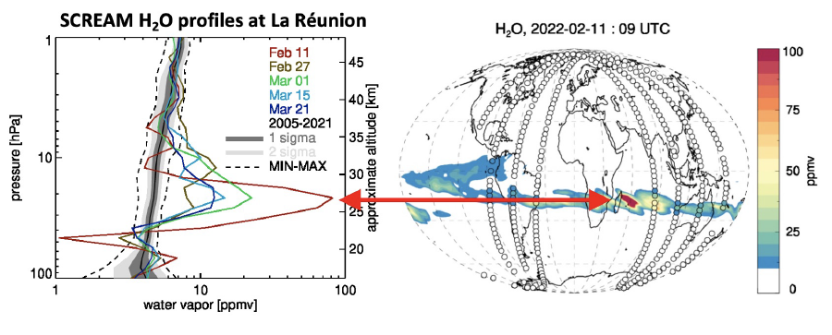
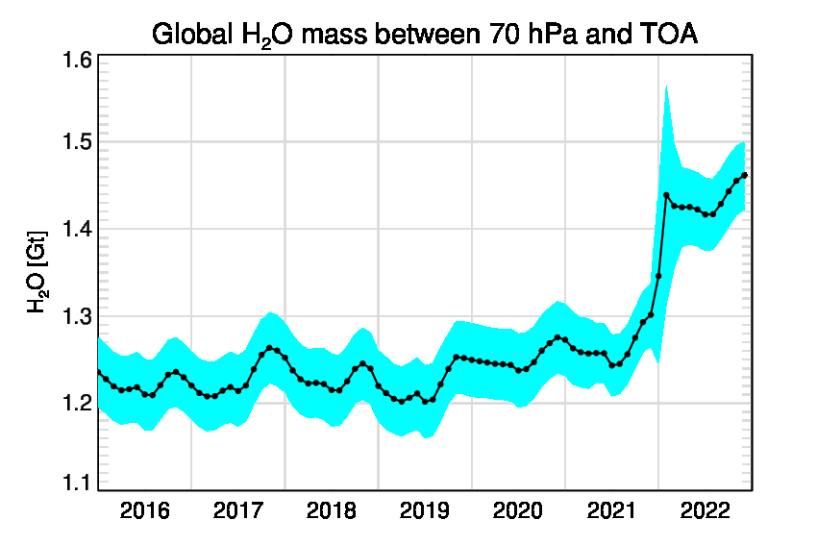
Hunga Tonga – Hunga Ha’apai
Eruption dates: 13 and 15 January 2022
Eruption strength comparable to Mt. Pinatubo
Underwater volcano: large water vapor content, less (but some) SO₂
Stratospheric water vapor enhancement expected to persist for several years.
M2-SCREAM has a realistic representation of the water vapor enhancement
650 K
M2-SCREAM
1-sigma uncertainty
10% increase
No efficient sink for water vapor. The extra moisture is here to stay

Slide 13
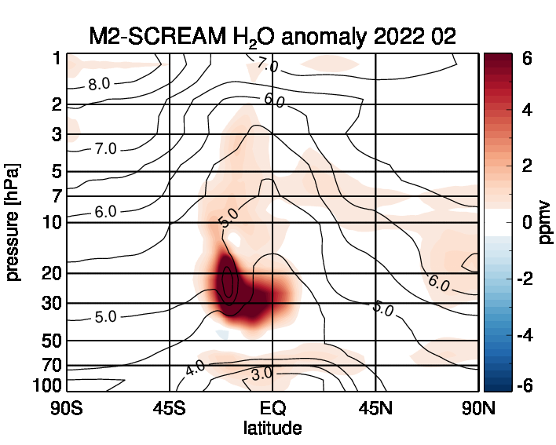
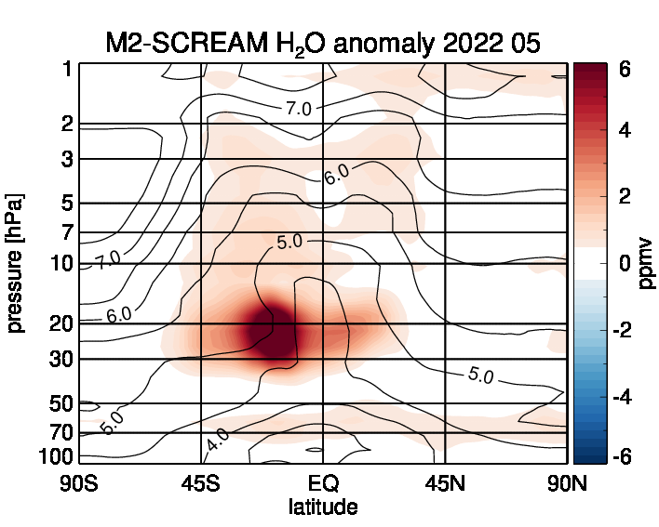
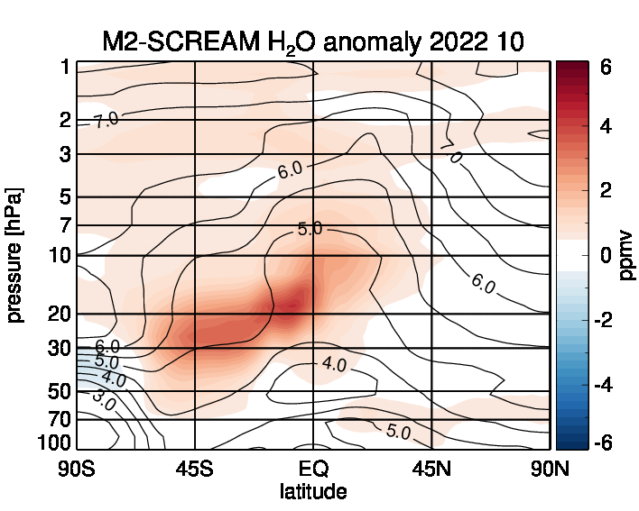
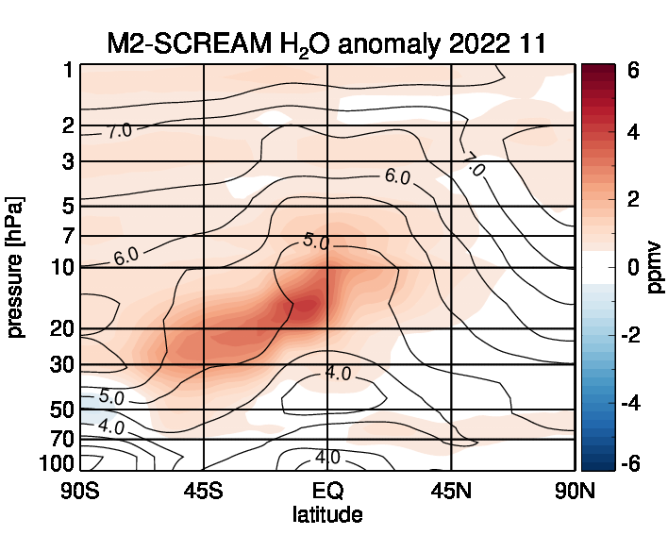
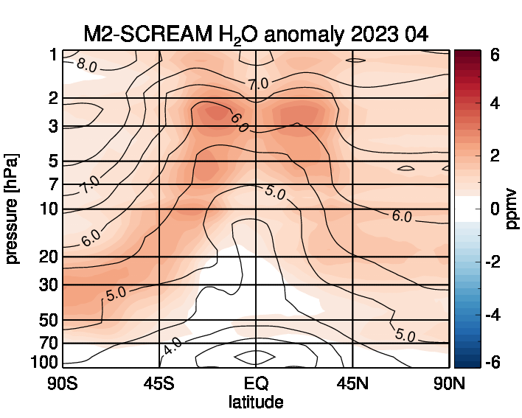
Subtropical transport barrier
Polar vortex
M2-SCREAM shows expansion and redistribution of the extra moisture in agreement with large-scale circulation patterns
Brewer-Dobson circulation
mixing

Slide 14
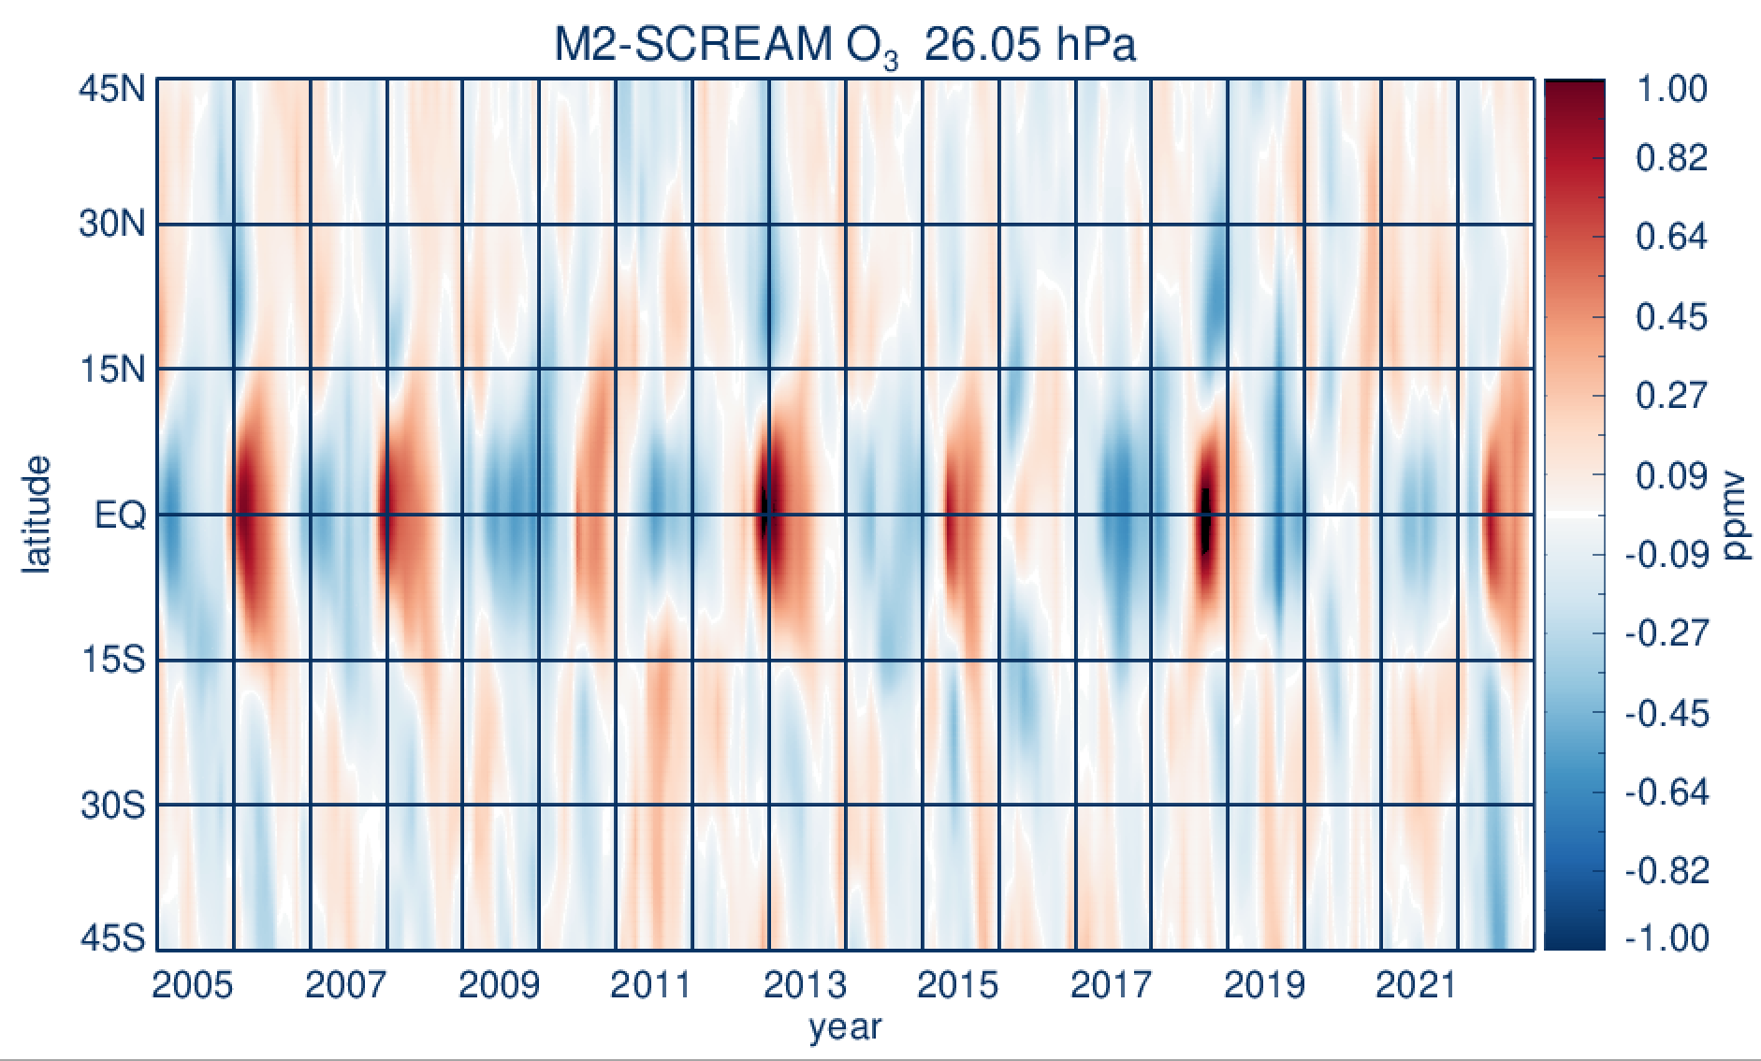
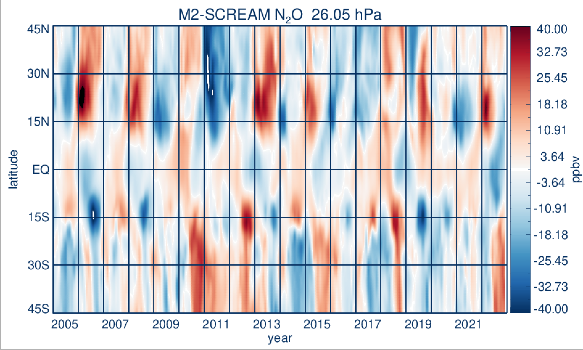
Impacts on circulation and composition
Deseasonalized and detrended ozone and N₂O anomalies at 26 hPa
Low ozone
High N₂O
Trace gas anomalies exhibit a strong QBO signal
Low ozone / high N₂O in the SH in 2022 consistent with the residual circulation anomaly

Slide 15
Summary
M2-SCREAM is a reanalysis of stratospheric ozone, water vapor, HCl, HNO₃, and N₂O data from Aura MLS driven by MERRA-2 meteorology
The reanalysis faithfully represents distributions of those gases on a broad range of scales
M2-SCREAM can be a useful tool for studies of stratospheric composition and transport
NASA GMAO will start production of the Reanalysis of the 21st Century (R21C) with a composition reanalysis, R21C-Chem to follow: tropospheric and stratospheric species
Systematic description and intercomparison of chemical reanalyses will be part of the SPARC Reanalysis Intercomparison Project Phase II
Limb data with dense global coverage essential for stratospheric composition reanalyses

