Slide 1
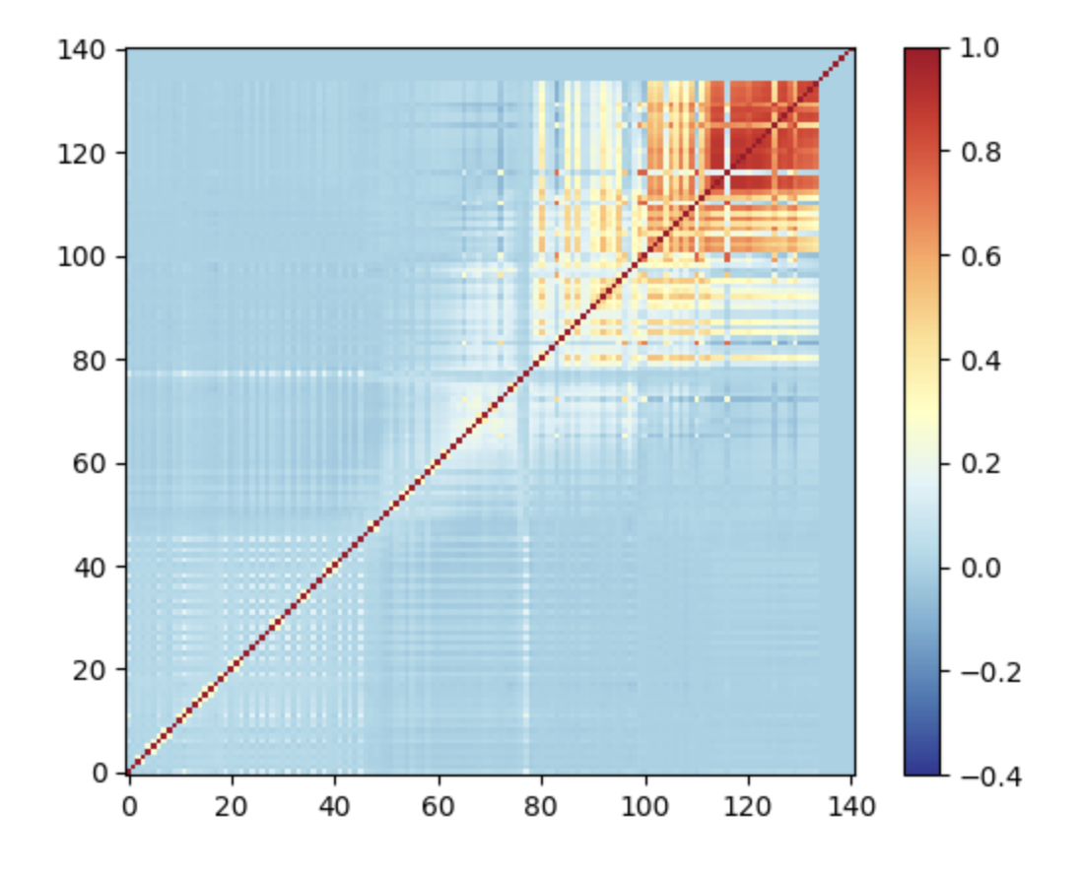
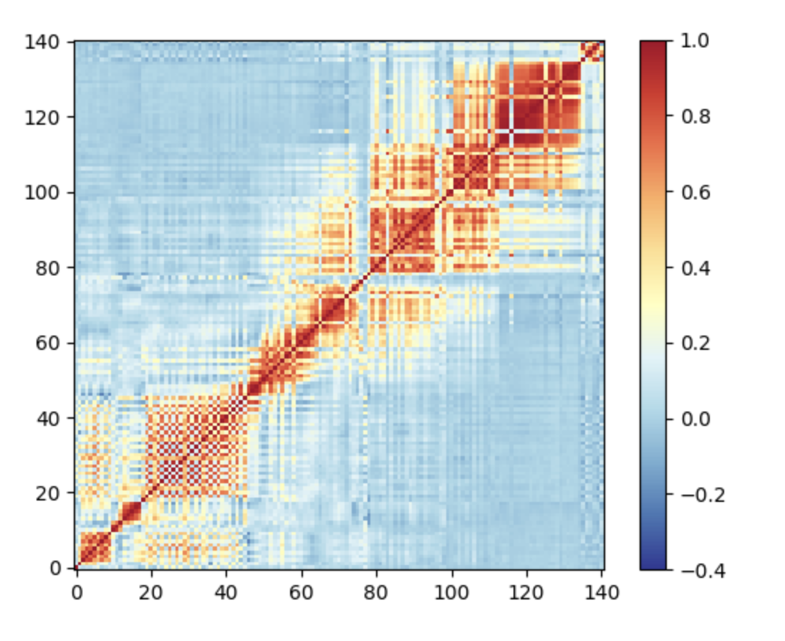
Assimilation of Reconstructed Radiances from IASI Principal Component Scores into the GEOS-ADAS
Bryan Karpowicz and Erica McGrath-Spangler
Observation Error Correlation Matrix IASI Operational
Observation Error Correlation Matrix IASI-PC

