Slide 1

GMAO Science Theme Meeting
October 24, 2019
GMAO Operations Overview
Quasi Operations
Production
Sausage Making
Rob Lucchesi
Notes:
Moving data around ….
While the result might be tasty, the process of making it might not be so pretty!

Slide 2
GMAO production: outline
Who we are
Overview of team interaction
GMAO production history
Product summary
Customers & download stats
A few detailed topics
Online public documentation
Future projects
Notes:
GOAL: FOR the NEWER GMAO members … provide an introduction on how the GMAO runs operations, an overview of the various gmao product streams, and help provide information that may help you find data and information related to GMAO production.

Slide 3

GMAO production: production teams
Operational Software Team
Joe Ardizzone (OC)
Mehandra Karki
Yelena Kondratyeva
Rob Lucchesi (OC)
Brent Smith
Mark Solomon (OC)
OC = On-Call engineer
Production Team
Doug Collins
John Ejalu (OA)
Ruth Labelle (OA)
Ann Melton (OA)
OA = Operations Analyst
Notes:
Joe and Brent contribute directly with SMAP
Mark and I also support their FLUID work – data interfaces to link ops to FLUID
Karki works with customer data requests and helps manage data archives, particularly verification data.
Yelena works with much of the scripting and pre-processing modules

Slide 4



GMAO production: modus operandi
GMAO production runs 24x7, 365 days/year.
OA shift schedules: Monday-Thursday 6am – 10:30pm
(nominal) Friday-Sunday 6am - 2:30pm
Production Team
Ops Software Team
Doug and OA: Ann, Ruth, and John.
gmaomail oa alias
OC: Rob, Mark, Joe
The two teams communicate constantly via e-mail.
  Frequent status reports
  Trouble reporting and fire-fighting (input data interruptions, discover problems, portal issues)
  Planning and questions
Notes:
E-mail load is always 10-20 per day, often double or triple that.
Much time is spent working with NCCS to diagnose problems. I/O problems are particularly disruptive.
POP-UP: Nominal OA shift schedules. NCCS downtimes, overnight outages, fall outside of nominal.

Slide 5
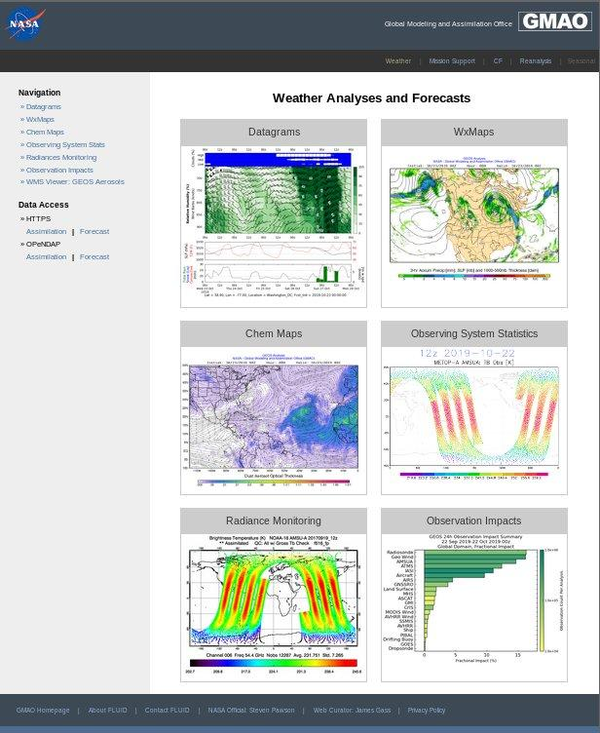

GMAO production: close collaboration with monitoring team
The GMAO monitoring team (Mara, Gary, Christine, Emily, Austin) has their eyes on all of the GMAO product streams.
The ops software team is often contacted first when problems are found.
Special monitoring upon request for operational tests
and transition periods.
Ops workflow generates many
monitoring tools/displays.
Forecast statistics
Observing systems statistics
Observation impacts
Radiance monitoring
QuADS
Notes:
The monitoring products listed here is not a complete list.

Slide 6

GMAO production: frequent interaction with NCCS
Ops software meets with NCCS every two weeks to discuss strategic planning and technical details about discover, the data portal, storage systems, and networks.
Advanced planning of downtime based on operational constraints (i.e., mission support)
OAs and OCs have frequent communication with NCCS via trouble tickets.
Management of product access via the NCCS data portal, including user support and download metrics.
Planning of resource allocations to satisfy new GMAO production requirements.
Notes:
Comment: No slide, but we also interact frequently with the GMAO science developers and the SI team. Mark will cover this in
the development process in his talk.

Slide 7
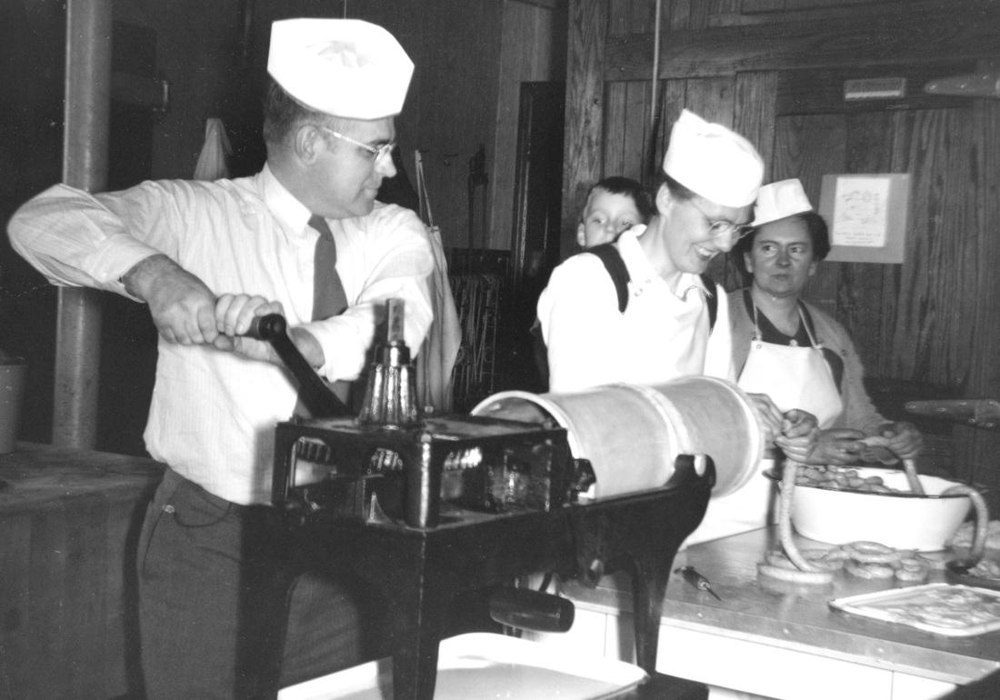
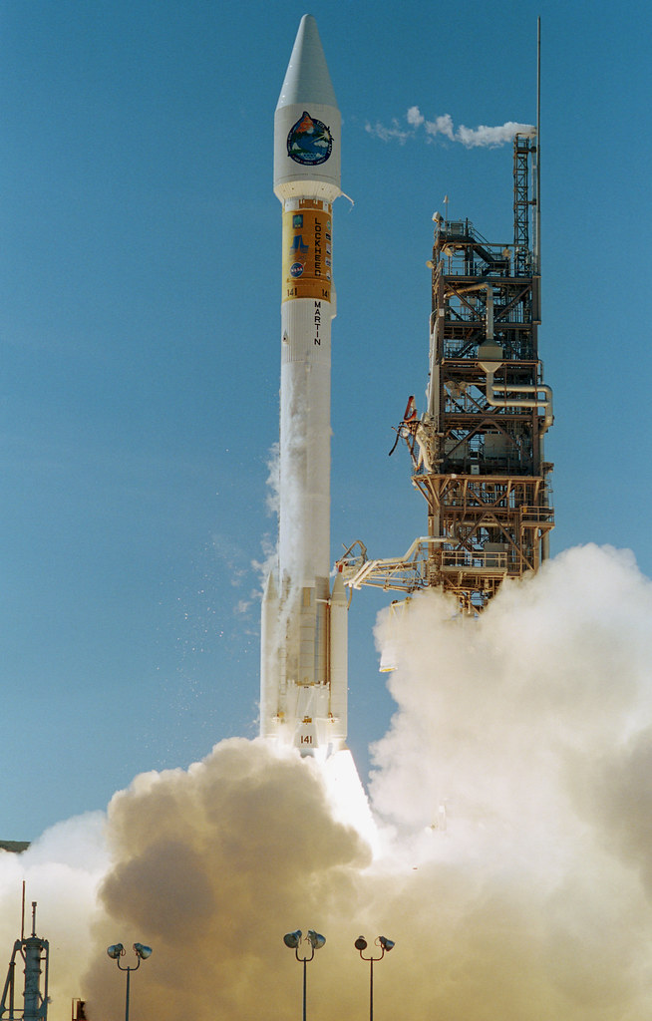
GMAO production: GEOS history
EOS Terra Launch: Dec 18, 1999
Jan 2000: GEOS-3 (2-degree) running in “first-look” and “late-look” production.
2002: GEOS-4 (1-degree) and launch of EOS Aqua
2007: GEOS-5 (1/2-degree) production starts branded as FP
2008: MERRA reanalysis released
2011: GEOS-5.7.2 production start (1/4-degree)
2012: FP-IT stream initiated for instrument teams (1/2-degree)
2013: GEOS-5.11 cubed-sphere (c360)
2015: MERRA-2 released & hybrid analysis implemented
2017: GEOS-5.16 4Dvar (c720) in production
Notes:
Mission support for CERES and TRMM was performed sporadically prior to Terra launch, but there was no continuous NRT production
Note: seasonal forecasts have a long history, also pre-dating the GMAO NSIPP. Routine production of seasonal forecasts has been going since 1997.

Slide 8

GMAO Production: product overview 2019
Forward Processing (FP)
4D ens var (GEOS-5.22)
12 km/c720 (24km output)
2 forecasts/day
~ 10 hour latency
Distribution: NCCS data portal
FP Instrument Teams (FP-IT)
3Dvar/48 km (GEOS-5.12.4)
No forecasts
~ 12 hour latency
Distribution: GES DISC
MERRA-2
3Dvar/48km (GEOS-5.12.4)
Produced daily (10 day latency)
Monthly data release
Distribution: GES DISC
CERES
3Dvar/48km (legacy GEOS-5.4)
Produced daily (10 day latency)
Monthly data release
Distribution: GES DISC
SMAP L4
L4SM delivered daily; 2.5-day latency
L4C delivered every 8 days; 10-day latency
Distribution: NSIDC
GEOS-CF
1 day replay/5-day forecast initialized daily from 12z FP-IT
Replay latency: 24 hours
Distribution: NCCS data portal
S2S
Forecast runs 4X/month, every 5 days, starting at mid-month.
Distribution: 10 forecast members submitted monthly to NMME.
Notes:
FP: 300 nodes/8400 processors (11hrs)
FP-IT: 20 nodes/336 processors (2.5 hrs)
M2: 24 nodes/576 processors (2hrs)

Slide 9

GMAO production: customers
FP-IT: Forward Processing for Instrument Teams
FP-IT products are available only by approved subscription and are delivered by the GES DISC.
Coordinate infrequent upgrades and file specifications with the user community
Upgrades usually involve a re-processing (RP-IT)
Currently there are 34 active subscriptions
HRDLS Landsat
MLS DSCOVR-EPIC
TES ICESAT2
FlashFlux OCO-2
CALIPSO MPLNET
Harvard/CTM GEDI
TCCON OMI
Notes:
The customer list here is just a selection of examples.

Slide 10
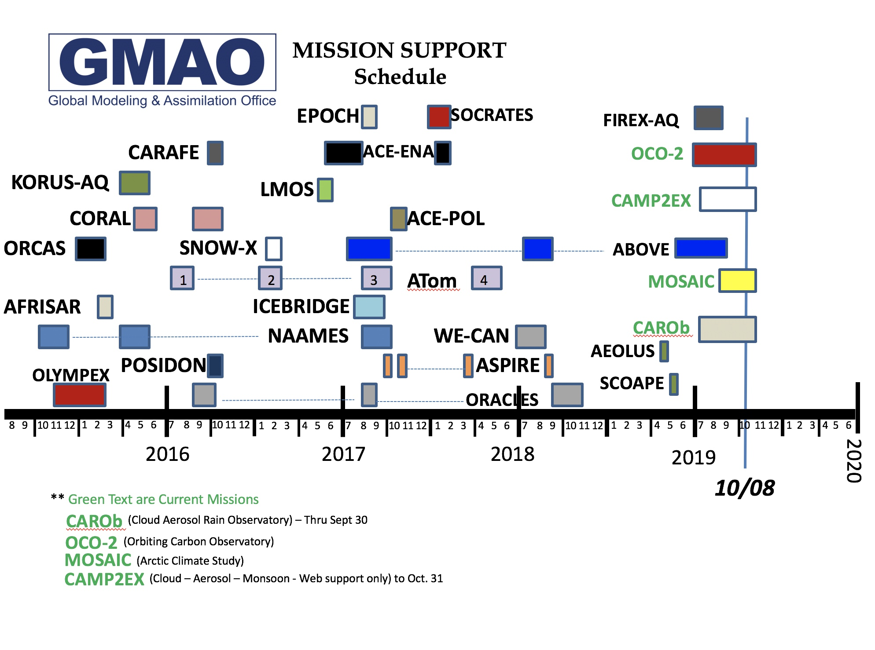
GMAO production: customers
FP: Forward-Processing
Data is available via the NCCS data portal: HTTPS, OpenDAP, FLUID
No login or registration.
geos5-fp-users mailing list: currently 127 subscribed
Diverse user community.
Regular use by news media outlets
Frequent use by field campaigns/mission support
GMAO: please notify us using the mission support request page WELL in advance of the campaign.
Notes:
Mission support request is currently under the 3rd bullet on the left side of the main GMAO web page, on the
“Field Campaign Support” link.

Slide 11
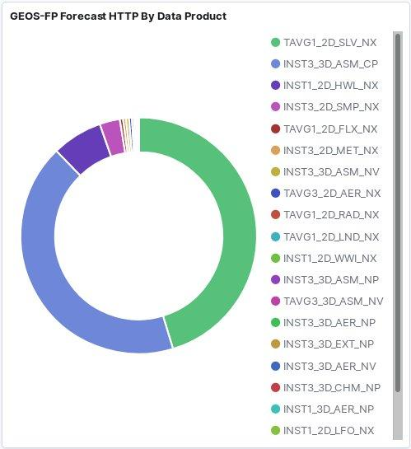
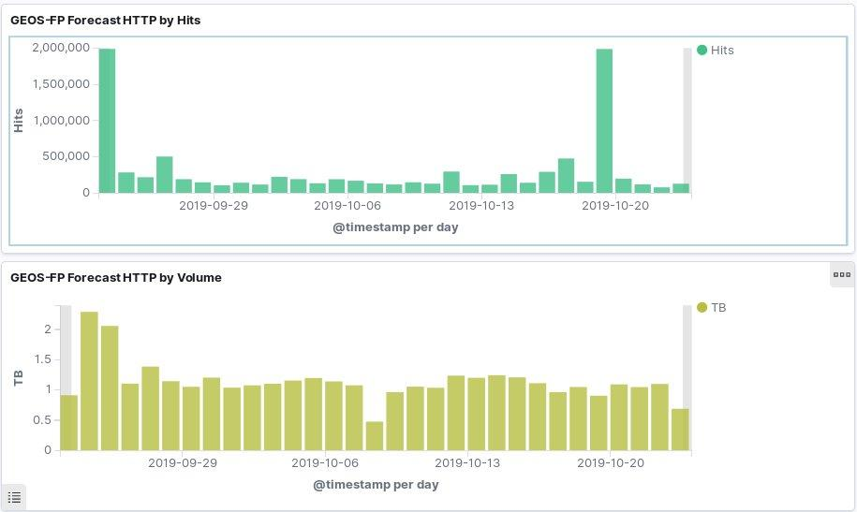
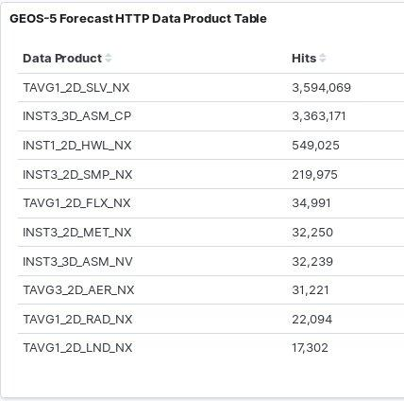
GMAO production: FP HTTPS forecast downloads
Typical day:
150K-300K hits
1 TB download volume
Smaller files are popular.
A reduced-resolution (1/2-degree) 3D file is the 2nd most popular.

Slide 12
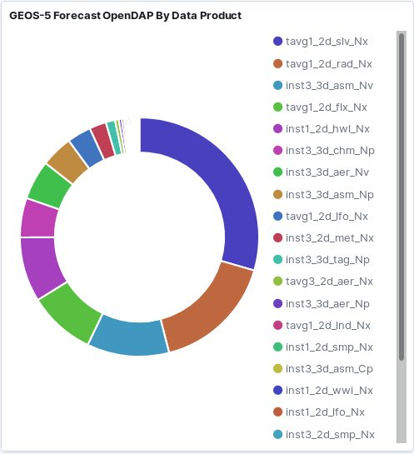
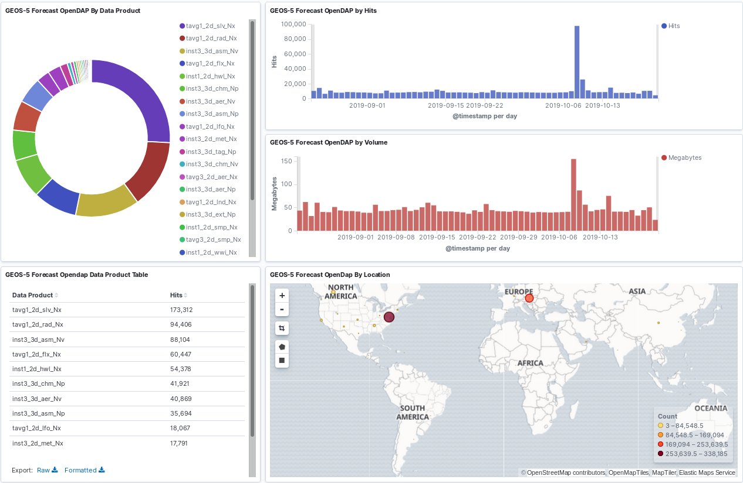
GMAO production: FP OpenDAP forecast downloads
Typical day:
9,000 hits
40 MB volume
Much more balanced access pattern across products.
Notes:
This is a new capability.
OpenDAP is a data service that allows OpenDAP clients to access the data products and display or download only the data the user is interested in … without downloading the entire data set.
OpenDAP: want to get individual variable download information.

Slide 13
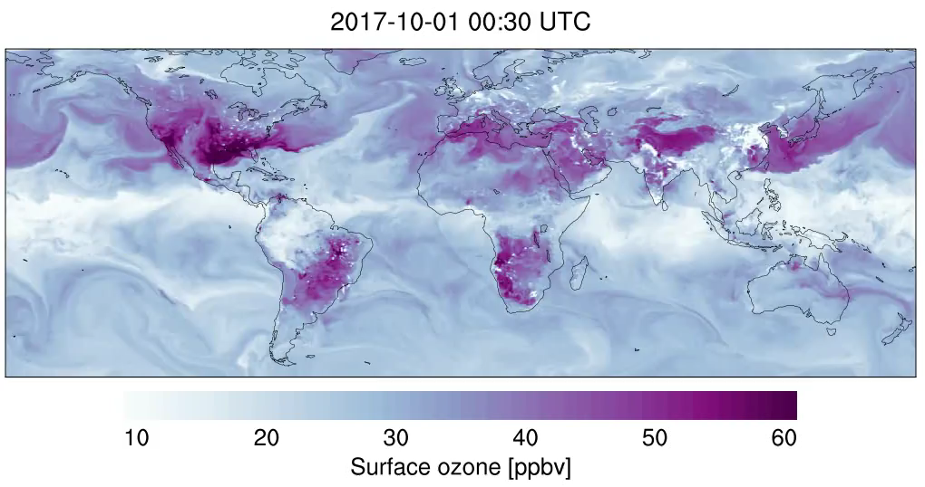

GMAO production: Composition Forecast (CF) stream
25km system. Highest horizontal resolution of any global atmospheric composition forecast.
1-day replay forced with FP-IT meteorology + 5-day GEOS-Chem forecast (also FP for upper-air ozone)
Full chemistry, 250 reactive species, O₃, NO_{x}, VOCs, PM ...
Met variables such as T, U, V, RH ....
Surface output at 15-minute intervals, 1-hour for 2D and 3D.
Runs every day, priority preops queue, 3500 CPUs, almost 12 hours/forecast.
Pre-ops testing started in summer 2018
Operational in FLUID: November 1, 2018
Operational with full data access: mid-September 2019
Debugging, file spec, metadata, distribution planning
Notes:
Over 1 year in pre-ops testing before ready for data release.

Slide 14
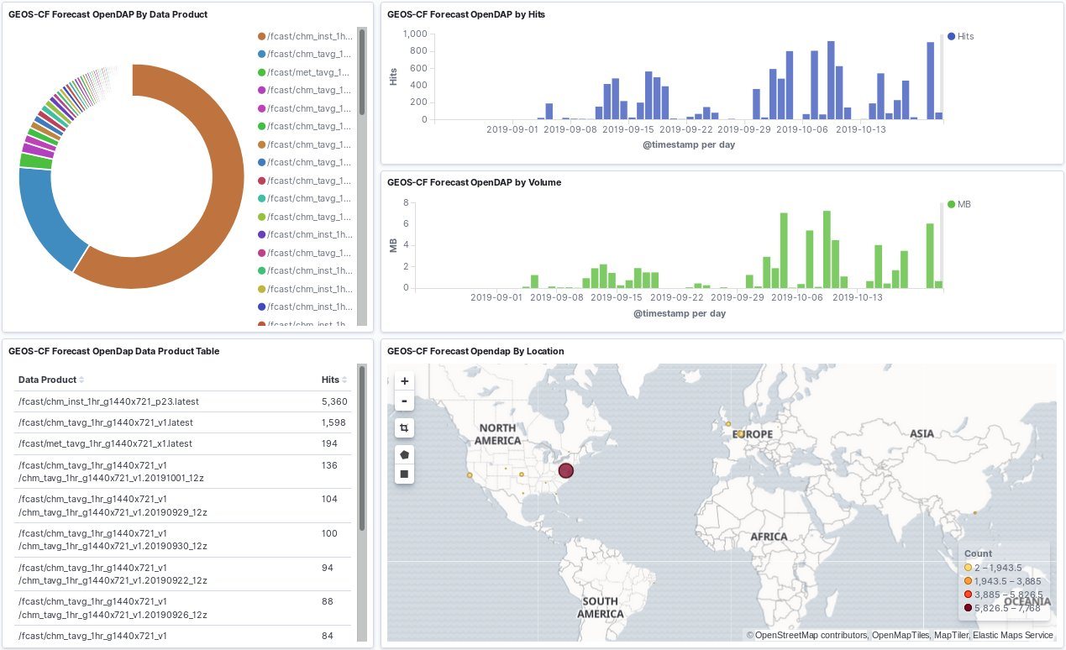
GMAO production: CF forecast OpenDAP statistics
Greatest download activity is via OpenDAP for forecast data.
Activity is still erratic, but hundreds of hits/day is not unusual.
Most popular target is the 1-hour chemistry product on 23 pressure levels.
Notes:
Our first look at CF download info.
NEXT: shift gears and talk about job scheduling.

Slide 15
GMAO production: FP & FP-IT prerequisites
NCEP gdas inputs
(16 different files)
GES DISC
MODIS MYD04/MOD04
MODAPS
AERONET
aeronet.gsfc.nasa.gov
satwnd time-window
FP & FP-IT NRT
GEOS-ADAS
Reynolds SST
NOAA
AIRS & AMSU
GES DISC
OSTIA SST
JPL
GMI
EOSDIS
MLS temperature
GES DISC
OMPS TC ozone
GES DISC
BLEND SST
Notes:
This slide shows the prerequisites that must be complete every 6 hours before FP and FP-IT can start.
This is just an example of the number of jobs that run on the input side for FP & FP-IT. I’ve grouped those two together
Because they generally use much of the same data.

Slide 16
GMAO production: daily job schedule
About 200 jobs each day.
Notes:
Chart shows a 24-hour day in operations.
Lots of jobs!
The length of the blue bars for the primary DAS runs indicate the runtimes.
Doug notes that the chart Is out of date AND incomplete.
NEXT: we need a way to manage and schedule all of this work.

Slide 17


GMAO production: scheduling
D-BOSS:
Dependency-Based Operational Scheduling System
Tool is written in PERL, developed in-house
Runs on a discover interactive node as a daemon
Jobs are defined by a unique job-id and a frequency of execution
Launches jobs based on time-of-day and date, like cron, but …
Jobs are started only if any defined dependencies have been satisfied
Dependencies can be self (prior time) or other job(s) at same or prior times
Automatically retries failed or missing jobs at specified time intervals
Simple job recovery after downtime
Notes:
To coordinate, schedule and manage this large and complex group of inter-related jobs, we need a task good manager.
Downtime recovery is one of the nicest features of this tool, allowing various jobs with complex dependencies to process
In the proper order in a hands-off manner.

Slide 18
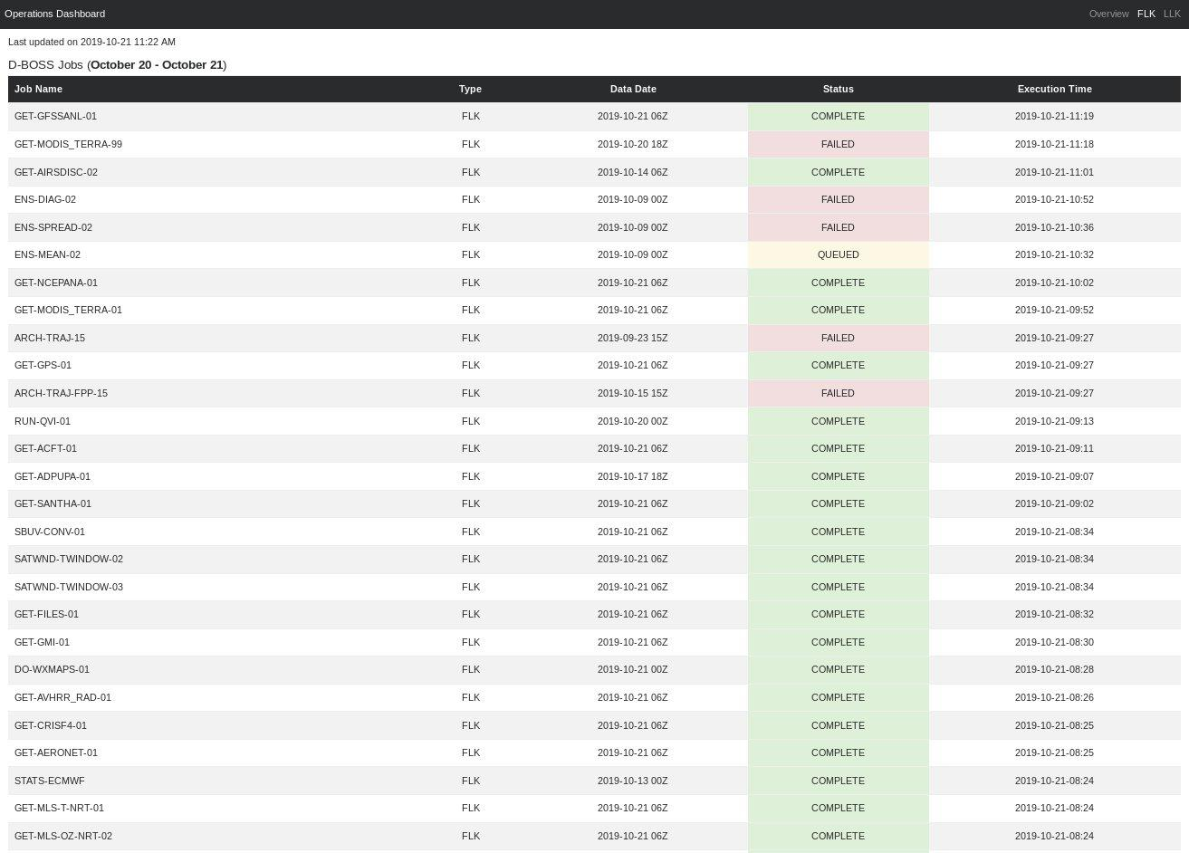
GMAO production: D-BOSS monitor
Dashboard snapshot of D-BOSS job status plus primary SLURM production streams
Uses crontab plus error and event logs
Uses D-BOSS task_status file
Splits jobs into flk/llk categories, i.e., essentially NRT jobs vs. non-NRT
Web page updates every 2 minutes via a cron job.
Script: python

Slide 19


GMAO production: scripting
Primary scripting language: Perl (still … )
In 1999, PERL was king
Stable standard (good for a production environment)
Huge repository of public domain modules
Locally developed modules used by most operational scripts:
  Remote data fetching
  Archiving
  Time manipulation
  Interaction with D-BOSS
  Error logging
  Resource file input
All scripts plugged into D-BOSS are written in Perl or wrapped in Perl
Overall, > 150 scripts: Perl, bash, c-shell, python.
Notes:
I understand that it is now 2019 and Perl is no longer king. There is a new king in town and this camel better watch out!
NEXT: last topic will be public documentation about the GMAO production system.

Slide 20
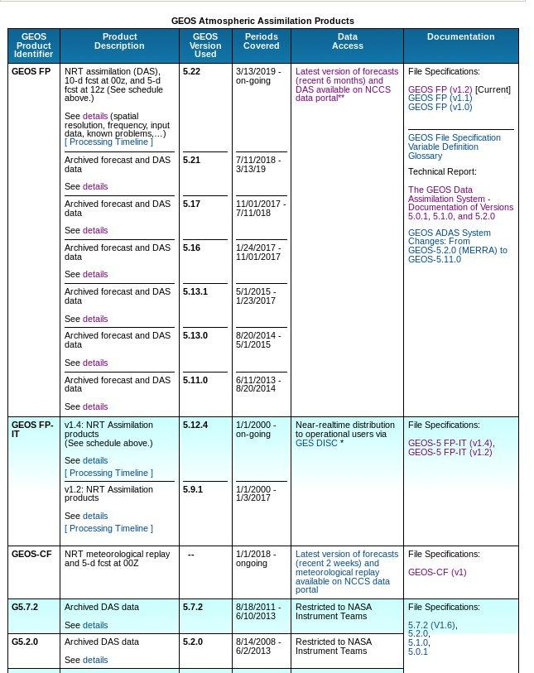
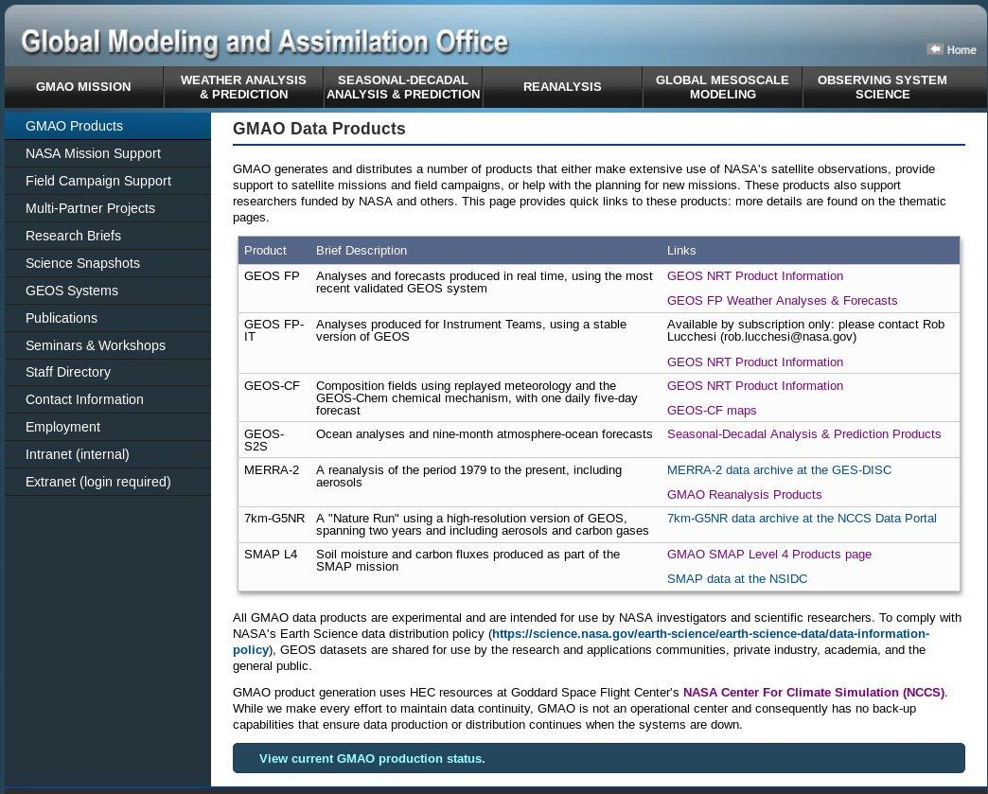
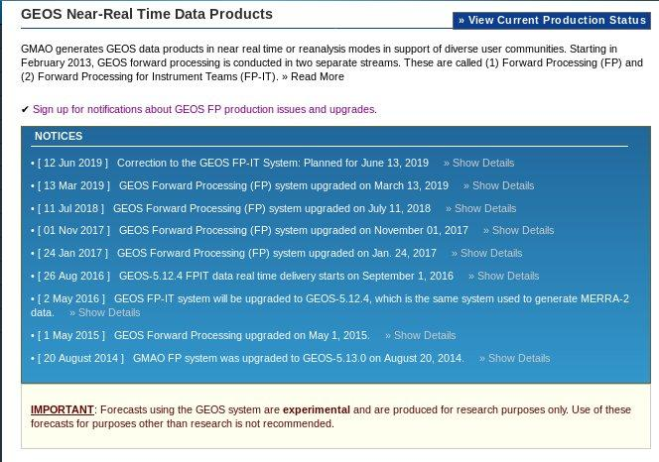
GMAO production: public documentation
Public documentation found on the GMAO main web page, under the left-side tab “GMAO Products”.
There is a summary of all product streams with links to more information.
A link to the GMAO production status.
Upgrade notices for FP and FP-IT are kept on the GEOS NRT Data Products page.
Notes:
We often get asked what changed with the FP upgrade of, say, July 2018. This is the place to find that information.
File specification documents are further down on the page.

Slide 21
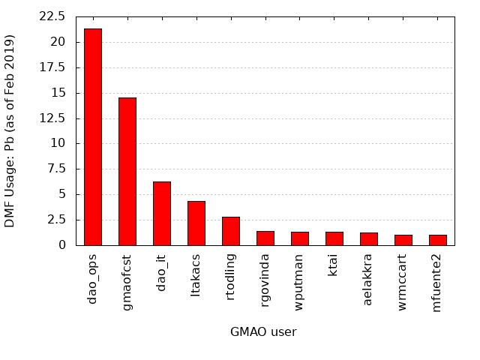
GMAO production: future projects
Intranet FAQ page for production-related information.
Software/configuration documentation for every operational process akin to the production teams detailed procedure pages.
NCCS project disk for input observations
File specification updates for FP that include native GCM grid output.
Update FP-IT system
  Define system characteristics
  Determine file specification changes
  Contact users and determine re-processing requirements
  Test and implement
Adapt production to new workflow
DMF data management
/discover/nobackup/projects/gmao/input/
Online observations for GEOS NRT and reanalysis runs.
No need to use DMF or datamove for acquiring observations.
Will require obsys.rc changes and workflow could benefit from scripting changes.

Slide 22
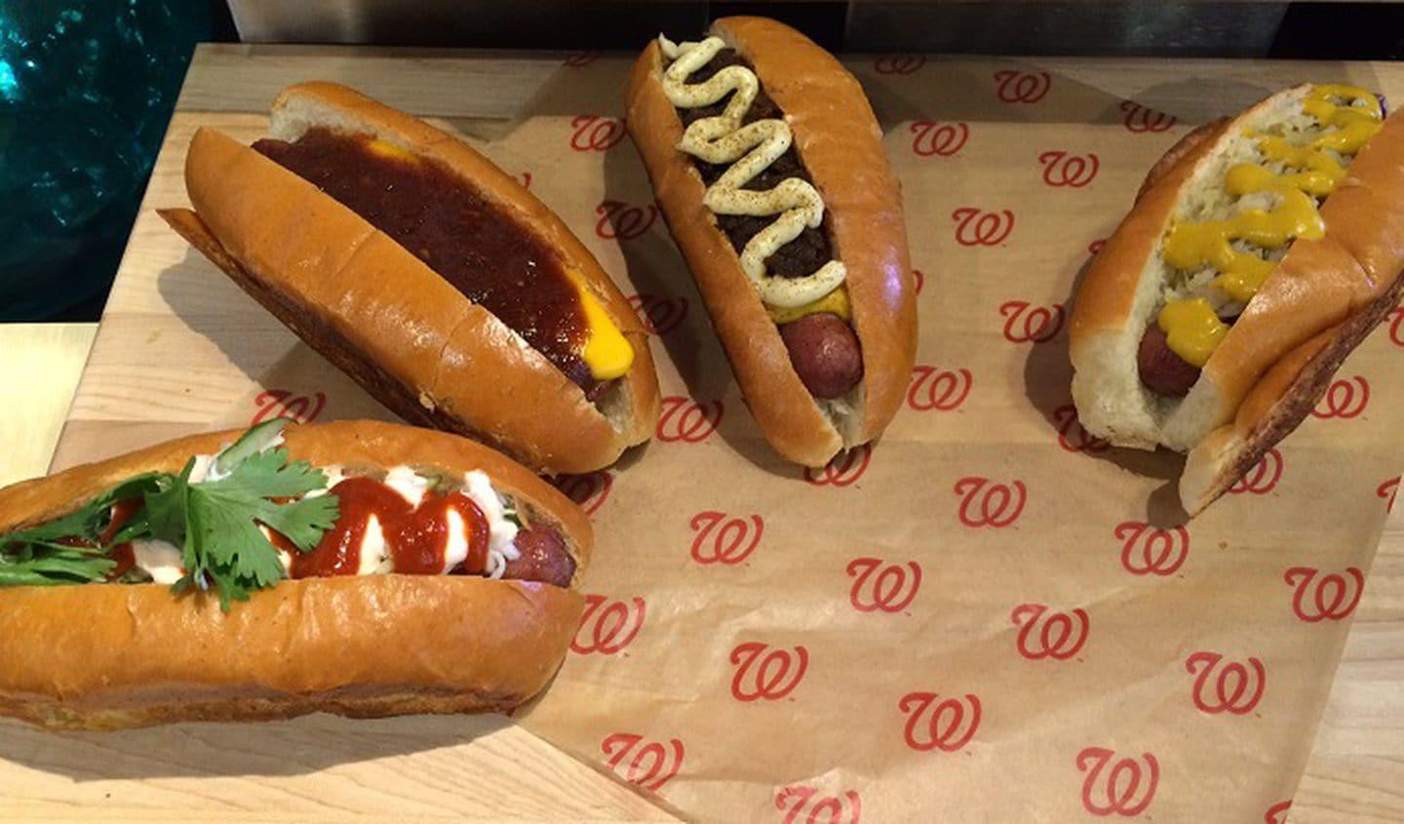

GMAO production
Thank you!
Go Nats!
Notes:
GMAO sausages are tasty but nearly as much as these will be on the night the Nats win the World Series!

