Slide 1
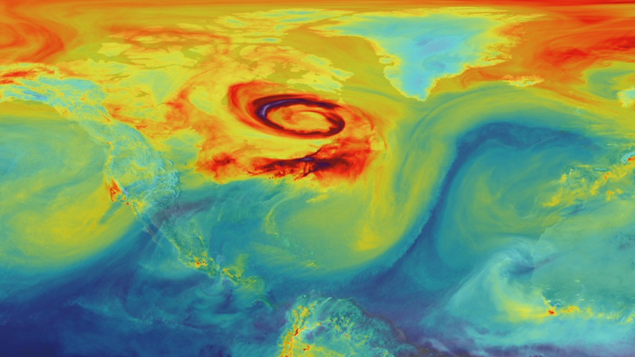
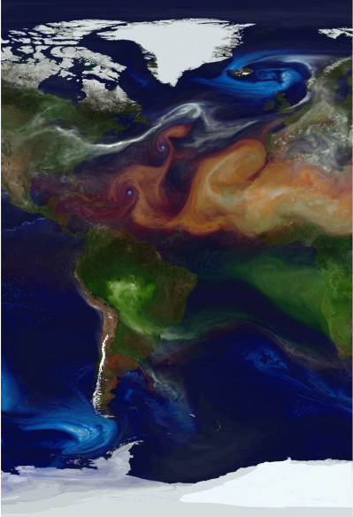
National Aeronautics and Space Administration
GEOS-IT Sample Data
Review by GMAO and
Feedback from
Instrument Teams
on
Presented by Steven Pawson, Rob Lucchesi, Guang-Dih Lei, and Gary Partyka
on behalf of the GMAO GEOS-IT development group
October 20, 2021
Global Modeling and Assimilation Office
gmao.gsfc.nasa.gov
1

Slide 2
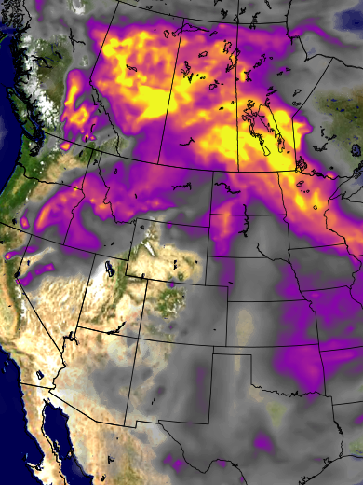
Objectives for Today’s Meeting
Discussion of the sample 2018 GEOS-IT data that were distributed
Integrity of the product: what is better and worse than GEOS-FPIT
Known issues … and potential fixes
Positives and (especially) negatives from the users
A revised timeline for product generation and distribution
Thank you for your patience
GMAO’s new estimate assumes that no major issues arise today
Data formats, files, and distribution
Updates (ISO-compliant) file-name conventions
Latitude-longitude-pressure data largely unchanged
Dual output (cube and lat-lon) for model-level files – at least for now
Distribution via the GES-DISC

Slide 3
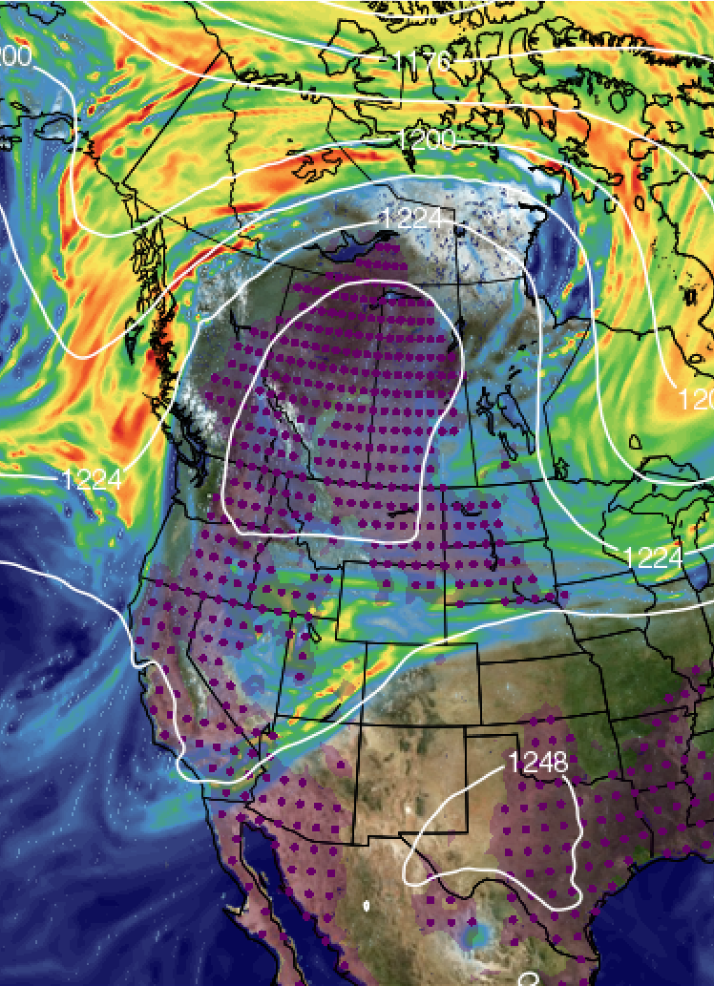
The cube-sphere file question
We have heard the arguments
Some users have a strong desire to retain the lat-lon files
Diagnostic software is the main driver
Propose to retain the lat-lon files for now
Cubed-sphere data remain our objective
Cost (data space) and accuracy advantages
Will necessitate tool developments from the GMAO side
Do not intent to leave you stranded
We will defer this discussion
Smaller group of interested parties
Will continue with the dual output as we go in to production

Slide 4
GEOS-IT Schedule and Status
2021
2022
May
Aug
Nov
July
Dec
GEOS-FPIT
2018 Test Data
NRT
Release
Full
Release
Validate
GEOS-IT NRT stream: Jan 2018 -> NRT
Sample
Release
GEOS-IT stream 2: Jan 2008 -> Dec 2017
GEOS-IT stream 1: Jan 1998 -> Dec 2007
Monitor
Current status:
Sample data (2018) has been distributed.
Validation continues …
Production expected to start in November.

Slide 5
GEOS-IT Collection Status
Sample 2018 data contains 57 collections (monthly volume: 1.3 TB)
Web site that accompanied the sample data release details the changes to filename conventions (including an ISO compatible time format) and ESDT identifiers.
  https://gmao.gsfc.nasa.gov/GMAO_products/GEOS-IT/
Dual lat-lon and cubed-sphere versions at start of production.
Propose to drop the following collections (260GB/month, 19%):
  Upper air ozone tendencies by process
  odt_tavg_3hr_glo_L576x361_v72 & odt_tavg_3hr_glo_C180x180x6_v72
  Upper-air humidity tendencies by process
  qdt_tavg_3hr_glo_L576x361_v72 & qdt_tavg_3hr_glo_C180x180x6_v72
  Upper-air wind tendencies by process
    udt_tavg_3hr_glo_L576x361_v72 & udt_tavg_3hr_glo_C180x180x6_v72

Slide 6
GEOS-IT Production Data Access
GEOS FP-IT is the only data set distributed through the GES DISC without the use of an EarthData Login account.
FP-IT access is restricted to specific IP addresses
GEOS-IT PULL subscriptions will require EarthData authentication.
PULL users will need to set up an EarthData Login account and inform the GES DISC (guang-dih.lei@nasa.gov) of their registered username. PUSH subscriptions will not see any change.
Register here:
https://urs.earthdata.nasa.gov/home
Registration instructions:
https://wiki.earthdata.nasa.gov/display/EL/How+To+Register+For+an+EarthData+Login+Profile
Once registered, data download options:
https://disc.gsfc.nasa.gov/data-access

Slide 7
GEOS-IT represents a system of equal or improved quality
for most fields from the current FPIT system

Slide 8
The climate of GEOS-IT as compared with the system it will replace, FPIT:
GEOS-IT represents a system of equal or improved quality in most quantities
from the current FPIT system
Chronic significant biases in FPIT, especially tropical T and q profiles in the
troposphere are essentially removed in GEOS-IT
TOA energy balance re-established
The land/ocean, snow fraction, and polar cap precipitation distribution is more realistic in GEOS-IT
Updated ozone data sources provide an improved and more consistent data record
We noted some concerning trends in the regime transition of the upper altitudes
of the equatorial QBO winds and SAO in GEOS-IT sample months. We believe that we
understand the source of this discrepancy and will apply a correction in time for production.
We will closely monitor the structure of the upper atmosphere equatorial fields.
✓
✓
✓
✓

Slide 9
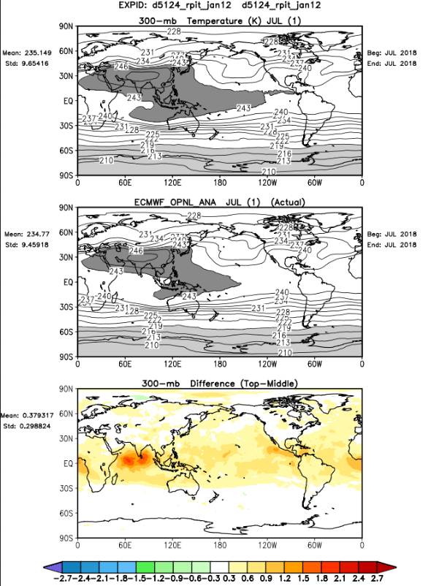
July 2018
FPIT 300hPa Temp
ECMWF 300hPa Temp
difference

Slide 10
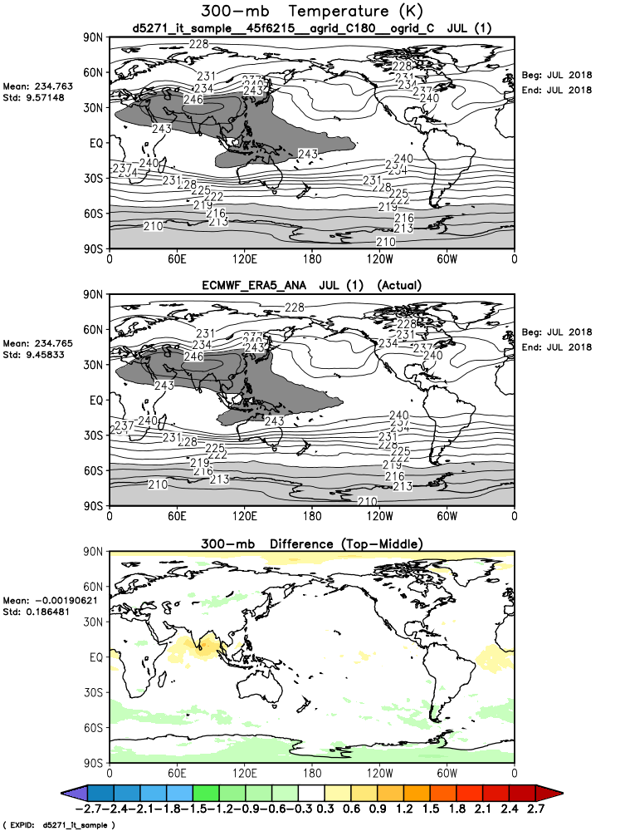
July 2018
GEOS-IT 300hPa Temp
ECMWF 300hPa Temp
difference

Slide 11
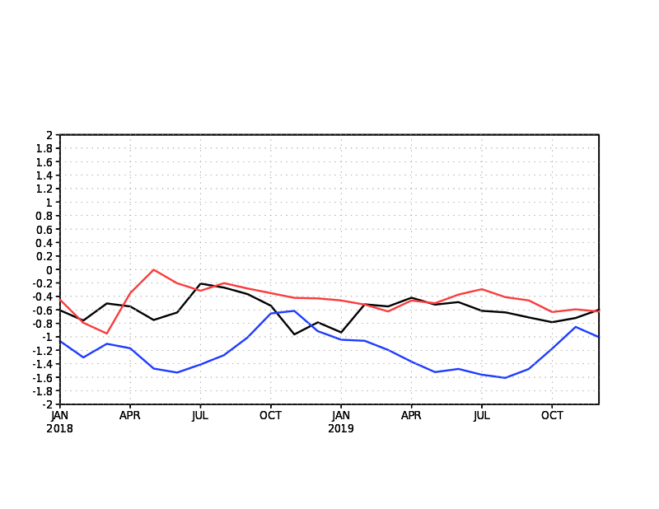
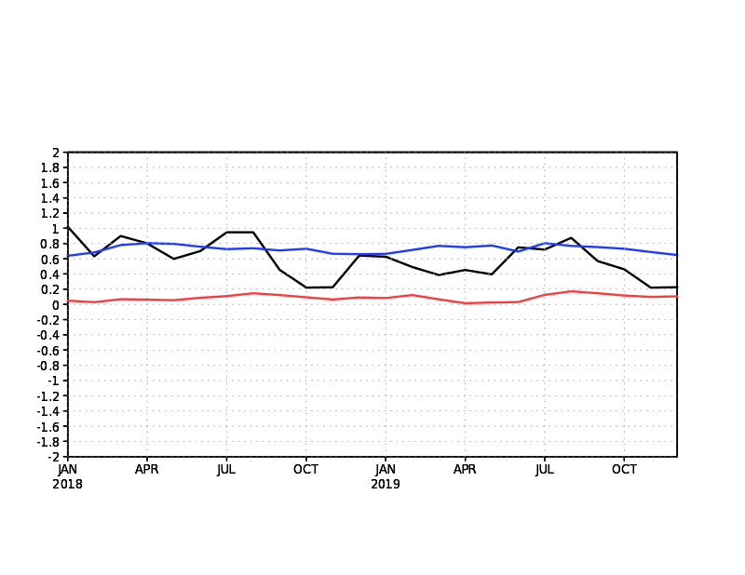
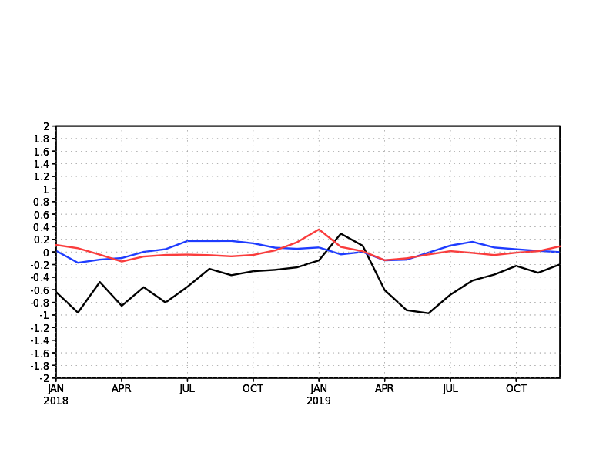
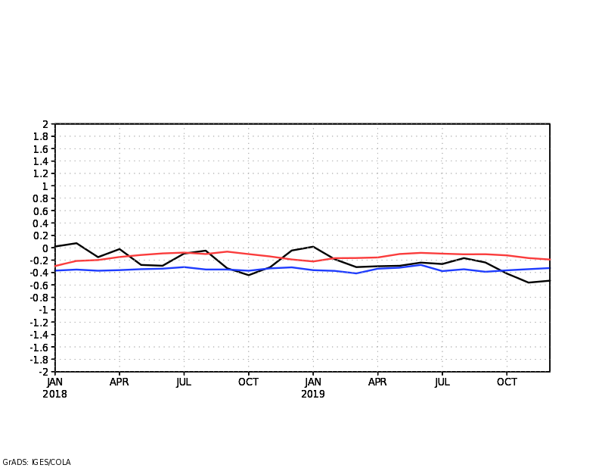
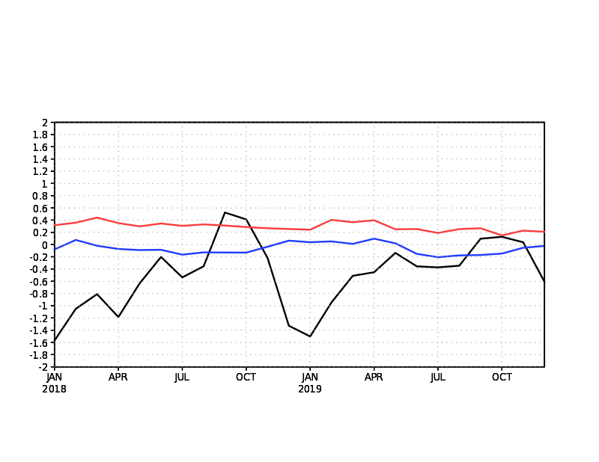
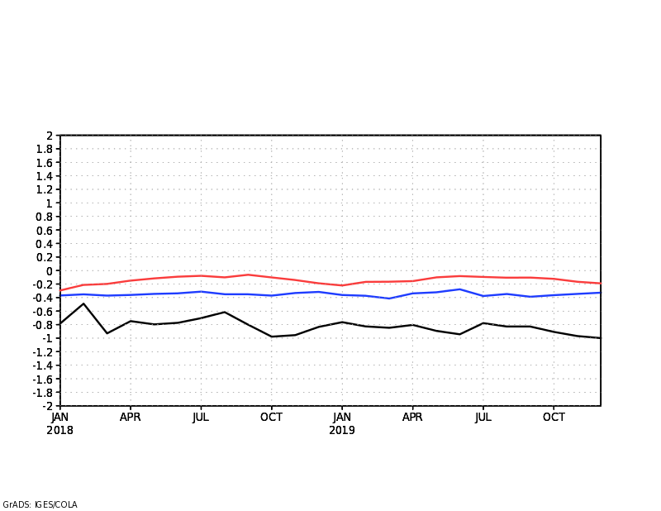
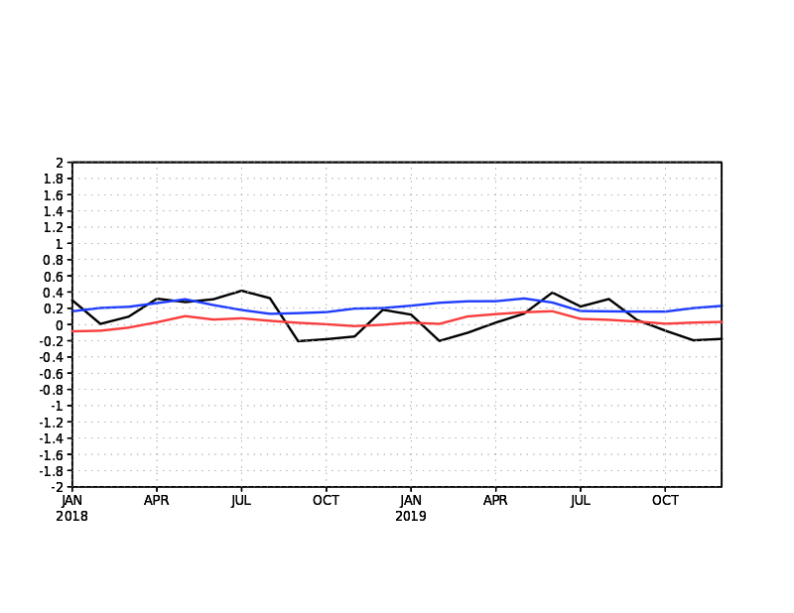
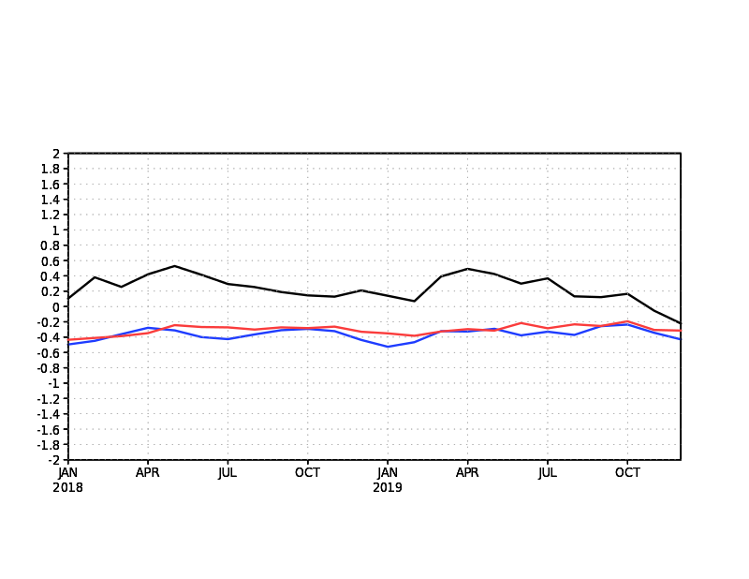
10hPa
300hPa
Tropics
(20N,S)
Monthly Mean
2018 – 2019
Temperature (K)
difference w/ ERA5
__ CERES 5.4.1
__ FPIT
__ GEOS-IT
70hPa
500hPa
100hPa
700hPa
200hPa
850hPa
still have a modest
cold bias at 850mb
(and also 925hPa)

Slide 12
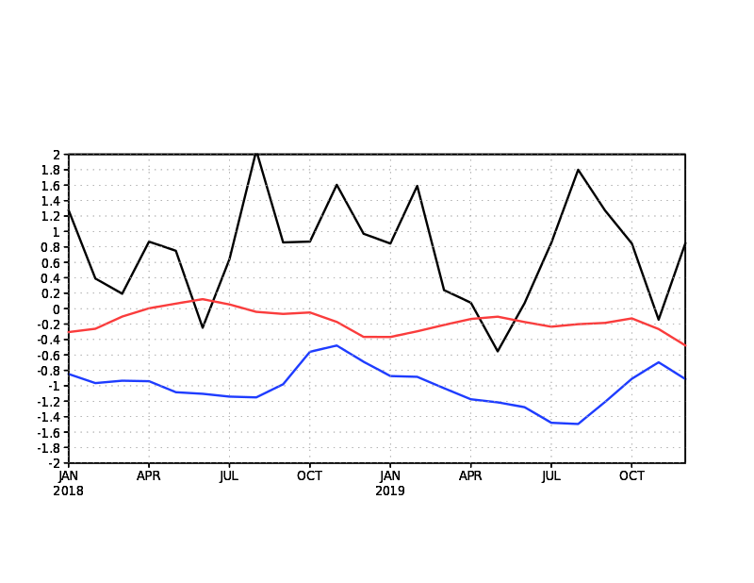
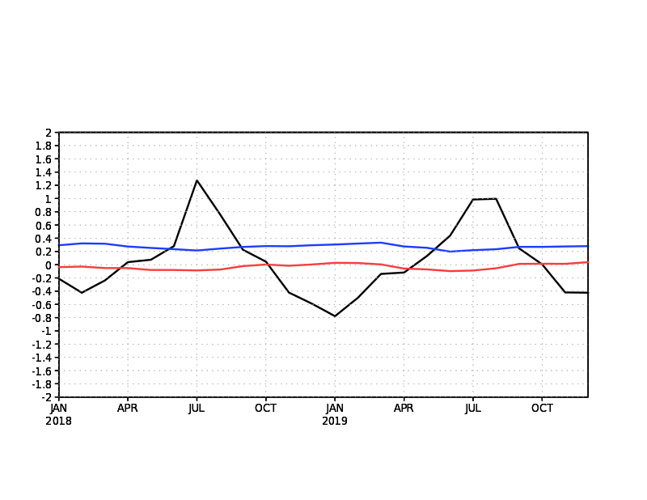
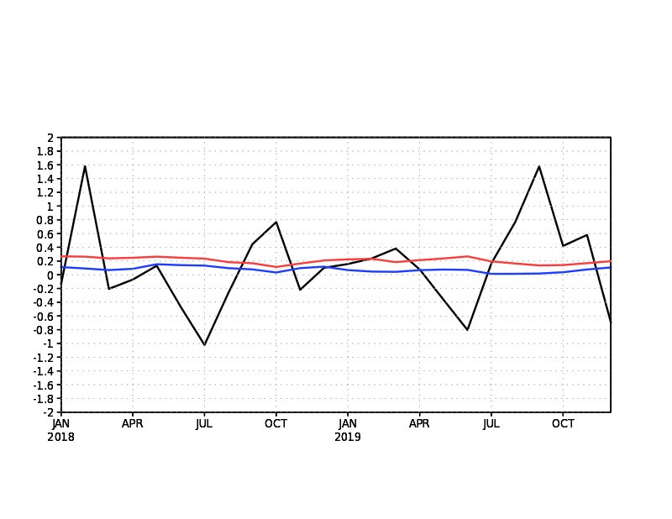
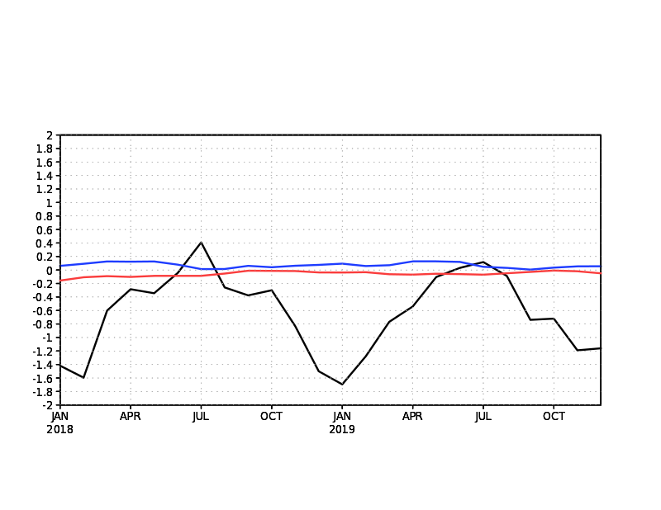
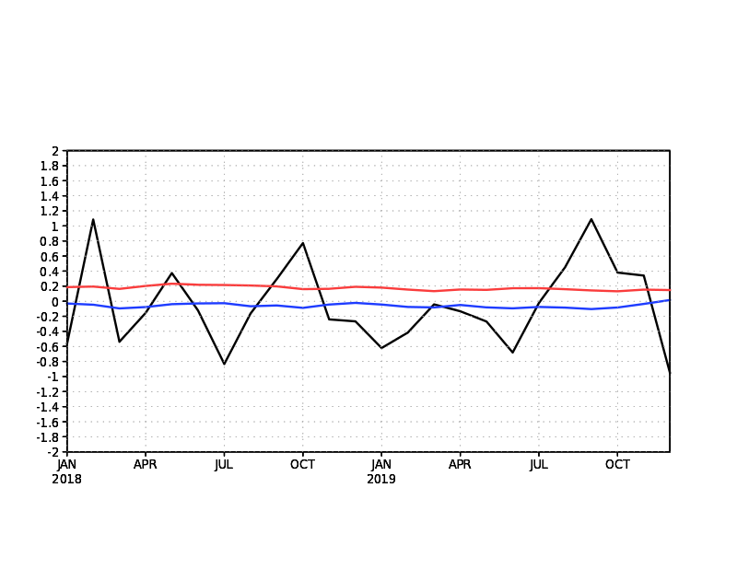
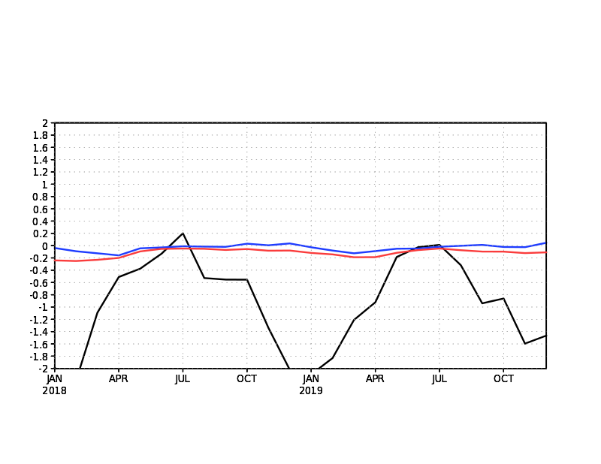
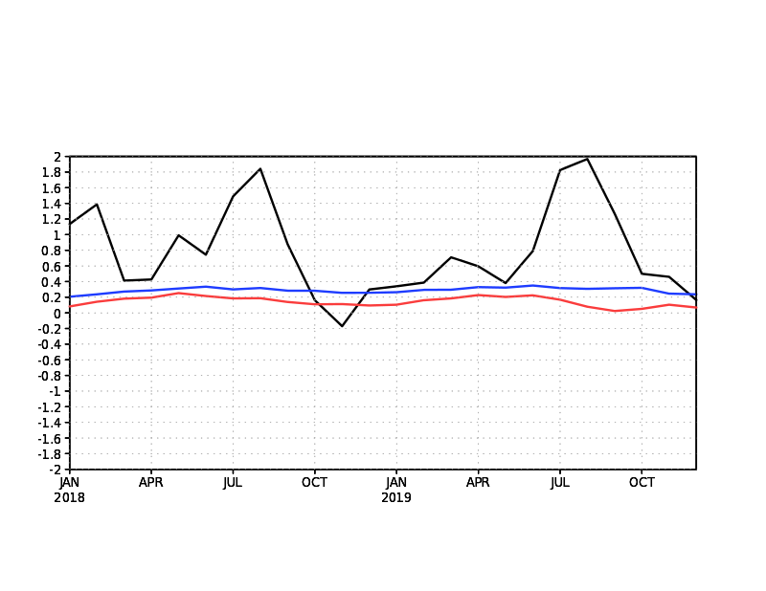
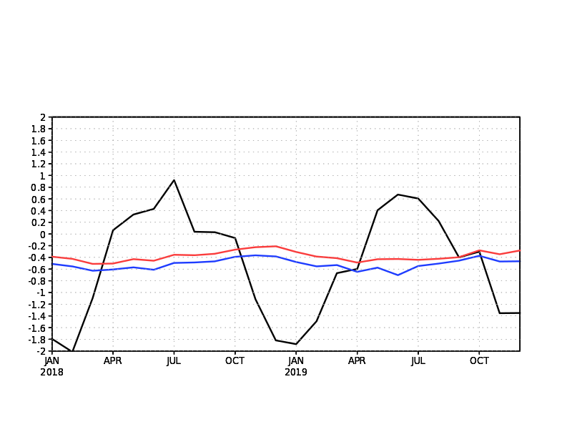
10hPa
300hPa
Middle Latitudes
(30-60N,S)
Monthly Mean
2018 - 2019
Temperature (K)
difference w/ ERA5
__ CERES 5.4.1
__ FPIT
__ GEOS-IT
70hPa
500hPa
100hPa
700hPa
200hPa
850hPa

Slide 13
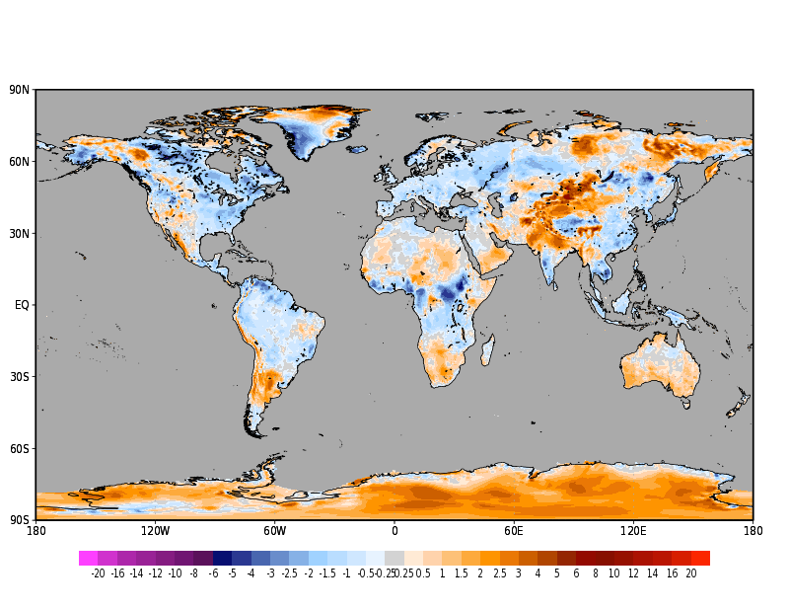
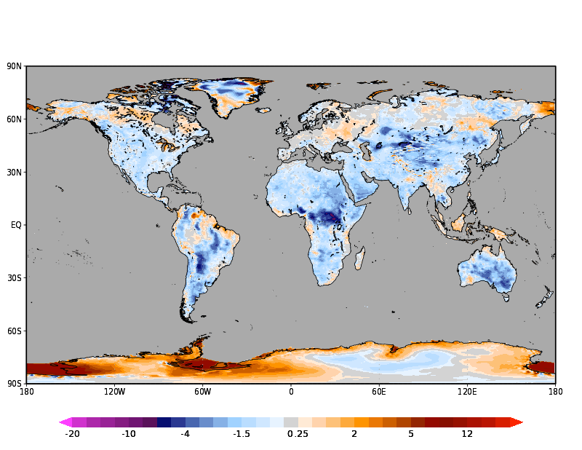
2-meter Temperature Difference (K) with ERA5; January 2018
GEOS-IT minus ERA5
FPIT minus ERA5
more realistic diurnal temperature ranges (not shown) in GEOS-IT
with the higher heat capacity from the updated land model
GEOS-IT has an updated
land model which has been
carefully validated by GMAO

Slide 14
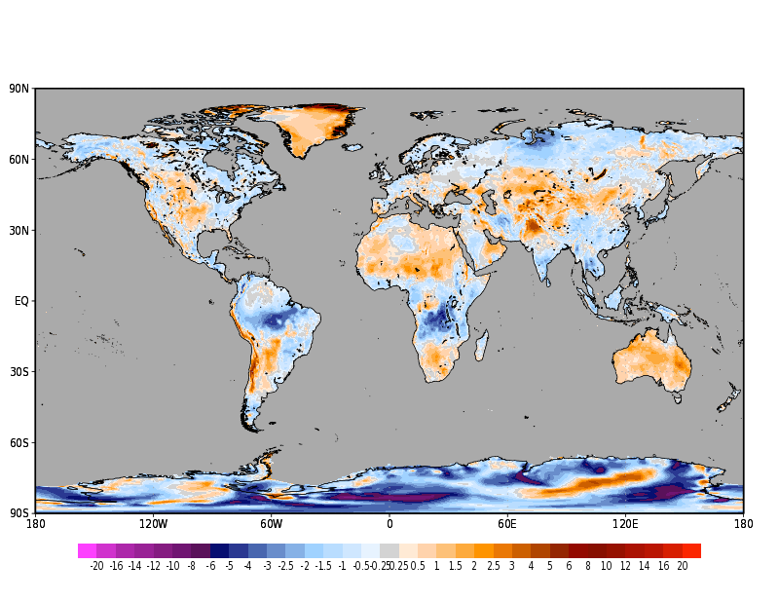
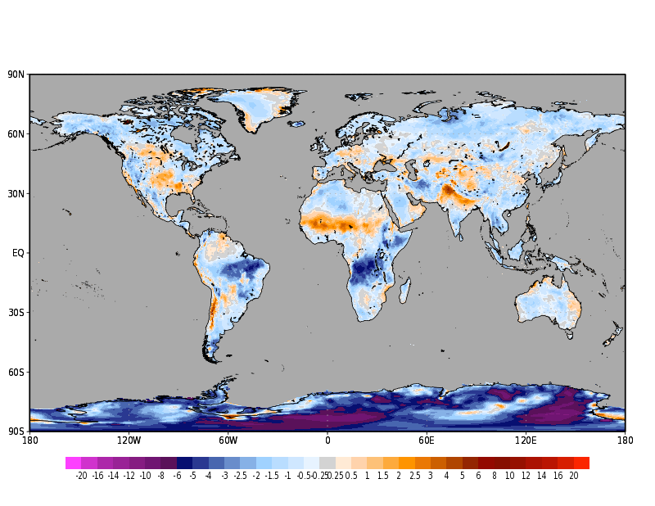
2-meter Temperature Difference (K) with ERA5; July 2018
GEOS-IT minus ERA5
FPIT minus ERA5
GEOS-IT – ERA5
more realistic diurnal temperature ranges (not shown) in GEOS-IT
with the higher heat capacity from the updated land model
regional cold biases (Africa, SAM) result
from an exaggerated water cycle in these
areas (i.e. enhanced evaporation)

Slide 15
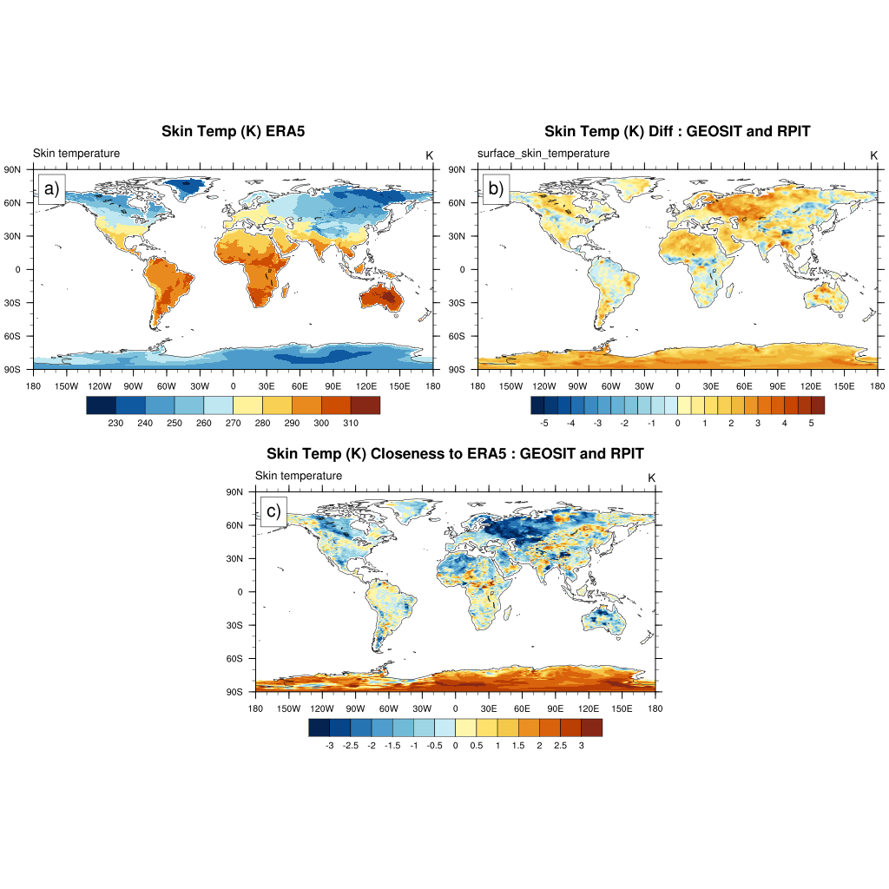
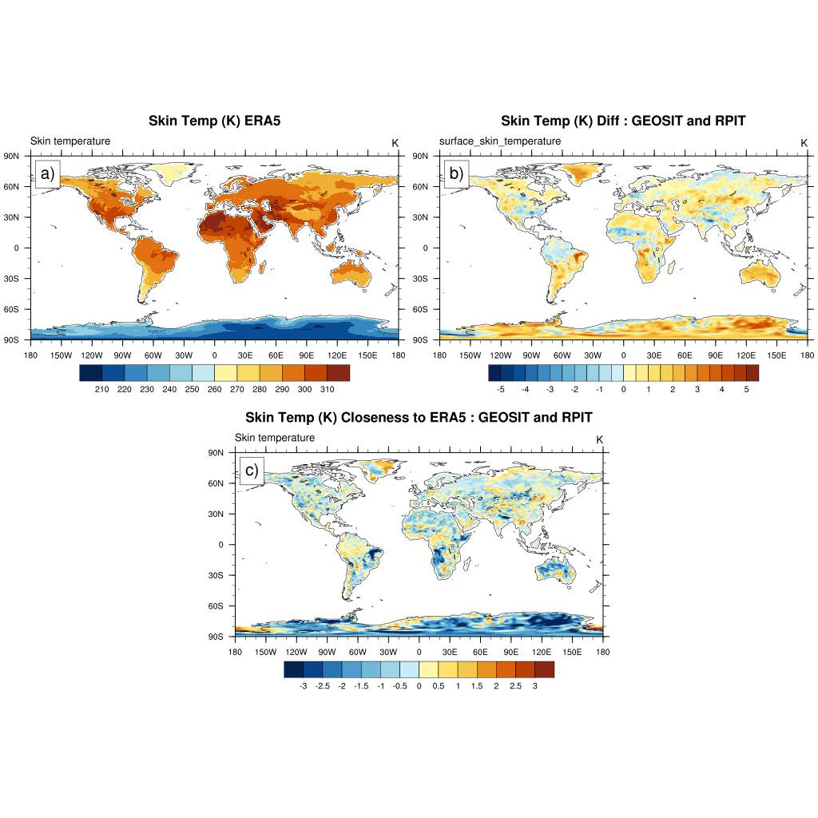
Skin Temperature difference and closeness to ERA5
blue = GEOS-IT closer to ERA5
than FPIT
The GMAO was asked to compare FPIT and GEOS-IT skin temperature rather than T2m. Here, we see that
the majority of the closeness plot exhibits a closer-to-ERA5 distribution for GEOS-IT, especially in January 2018.
(See additional figures on Antarctica)

Slide 16
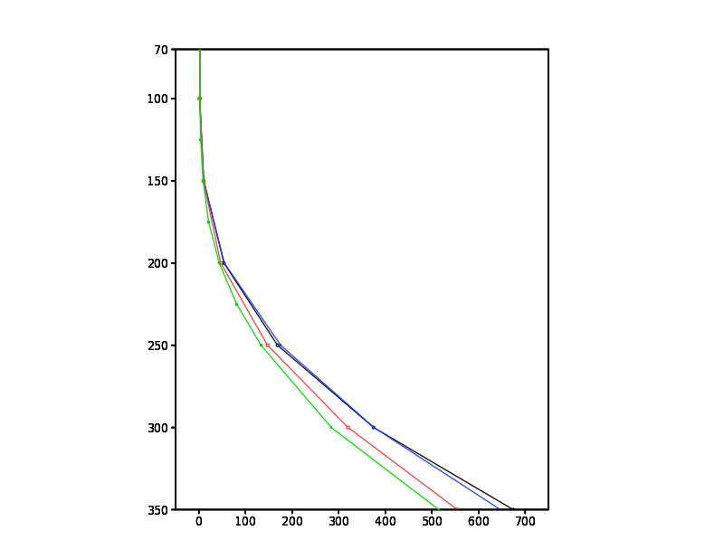
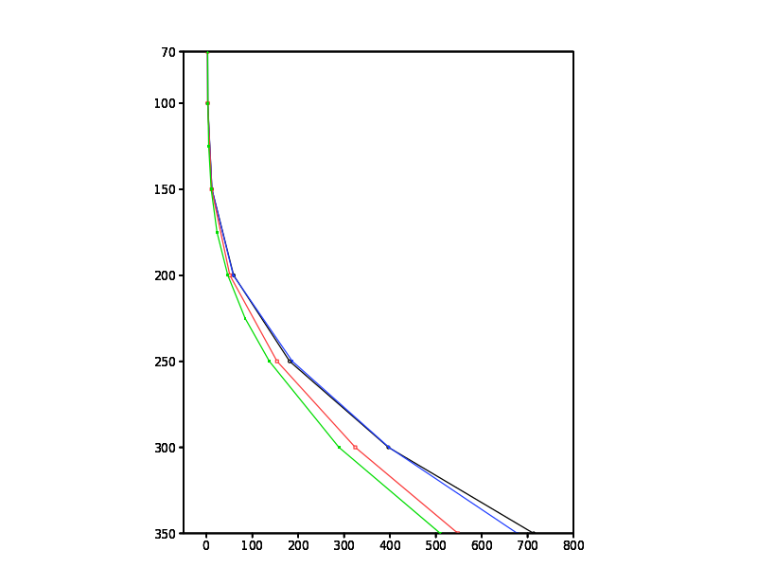
Tropical UTH (mg/kg) Profiles among GMAO Systems
January 2018
July 2018
__ CERES 5.4.1
__ FPIT
__ GEOS-IT
__ ERA5
__ CERES 5.4.1
__ FPIT
__ GEOS-IT
__ ERA5
hPa
hPa

Slide 17
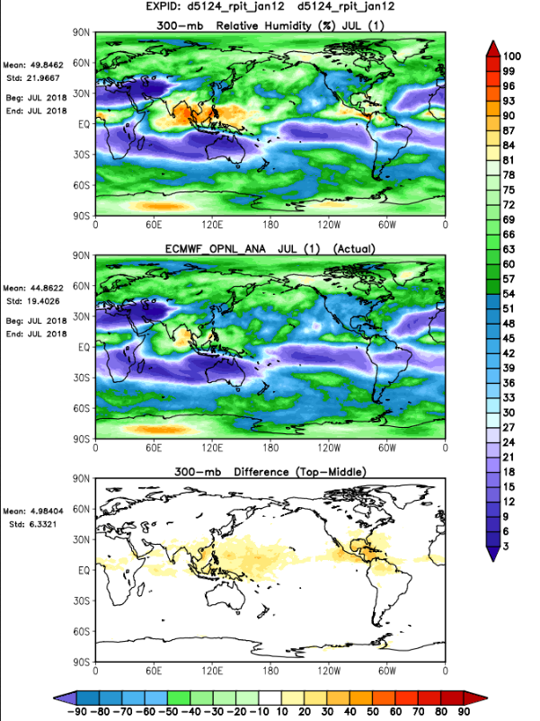
July 2018
FPIT 300hPa Temp
ECMWF 300hPa Temp
difference

Slide 18
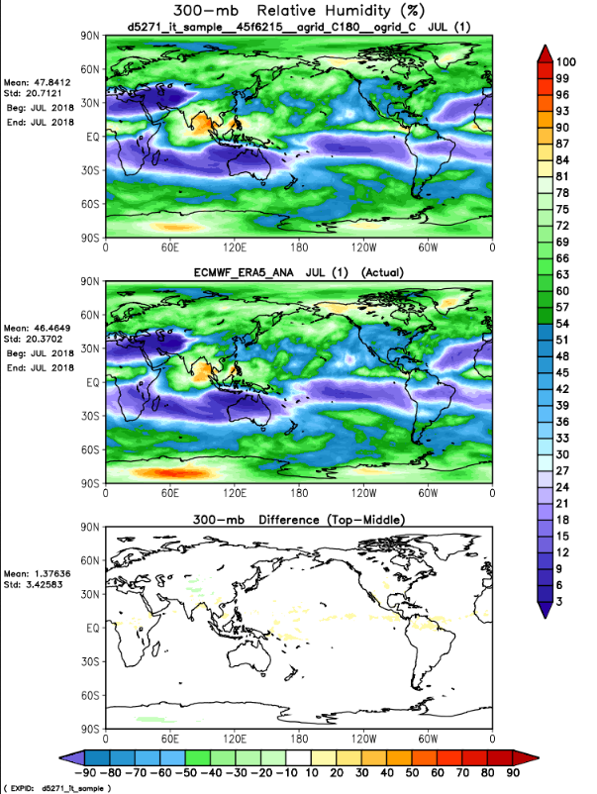
July 2018
GEOS-IT 300hPa Temp
ECMWF 300hPa Temp
difference

Slide 19
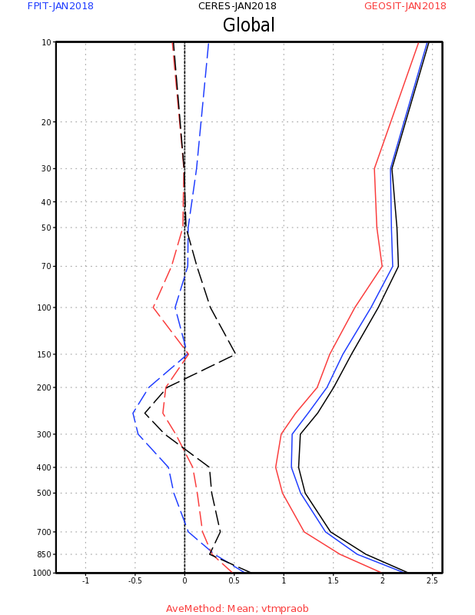
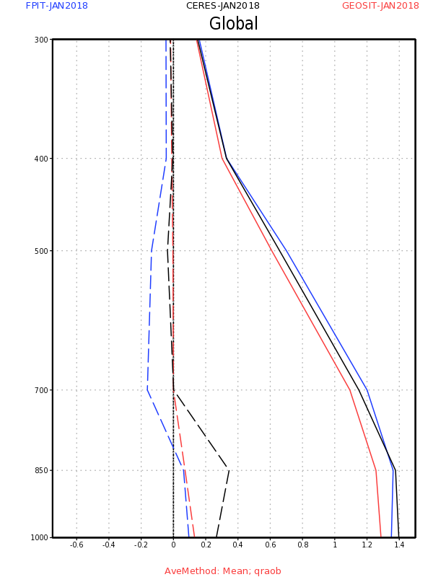
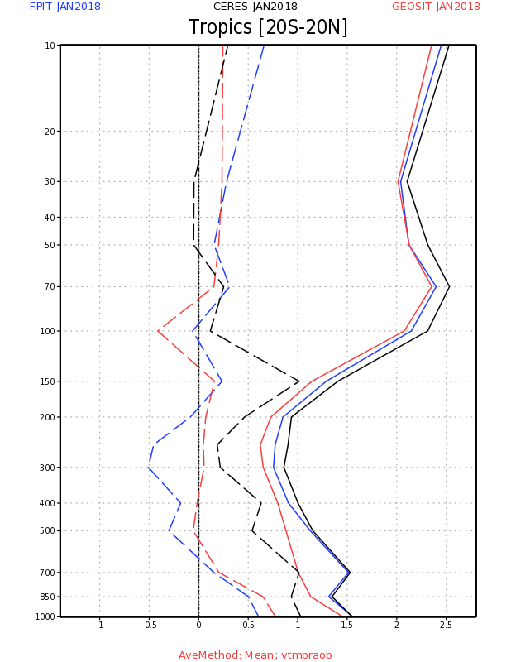
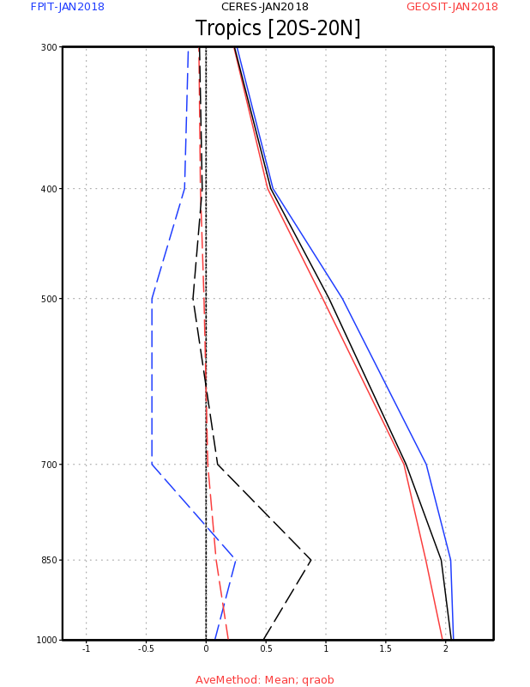
O-F Statistics
vs. RAOB
January 2018
Mean (dash)
Std. Dev. (solid)
Temp
(K)
GLOBAL
SPHU
(g/kg)
__ CERES 5.4.1
__ FPIT
__ GEOS-IT
*
*
note that while there is a mean
increase in the bias, there is a
systematic reduction in the
standard deviation (a more
difficult metric to improve)
Temp
TROPICS
SPHU
__ CERES 5.4.1
__ FPIT
__ GEOS-IT

Slide 20
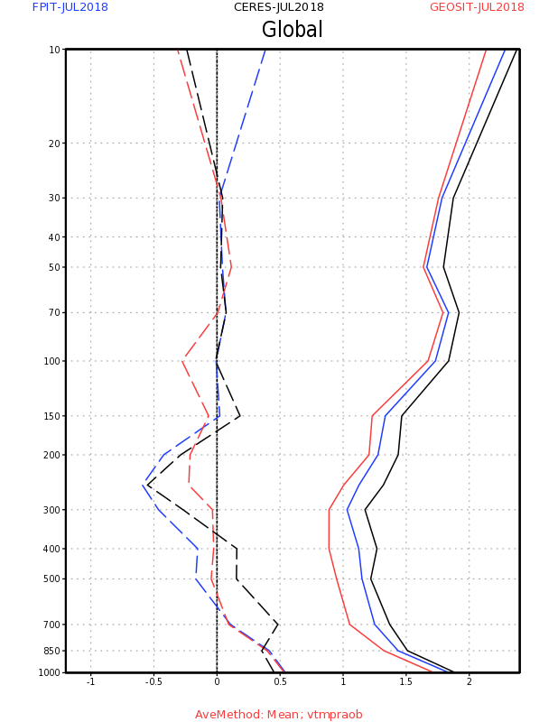
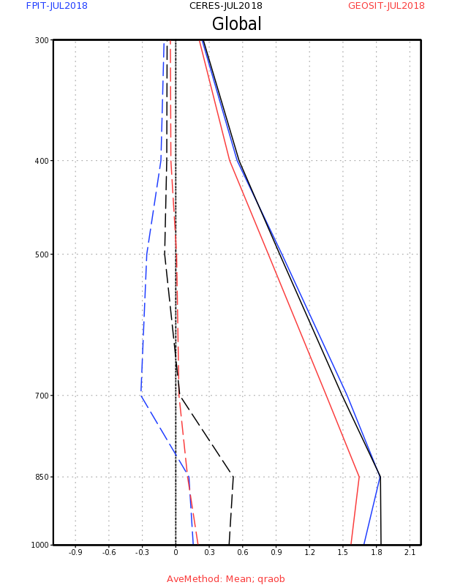
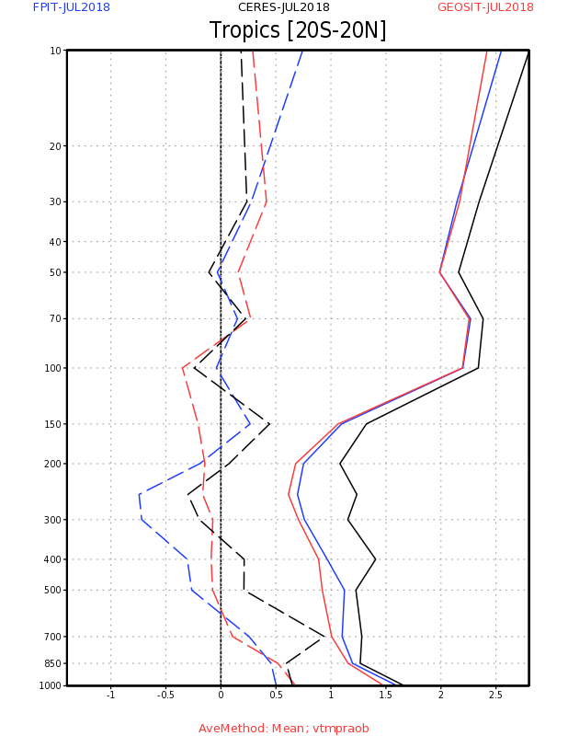
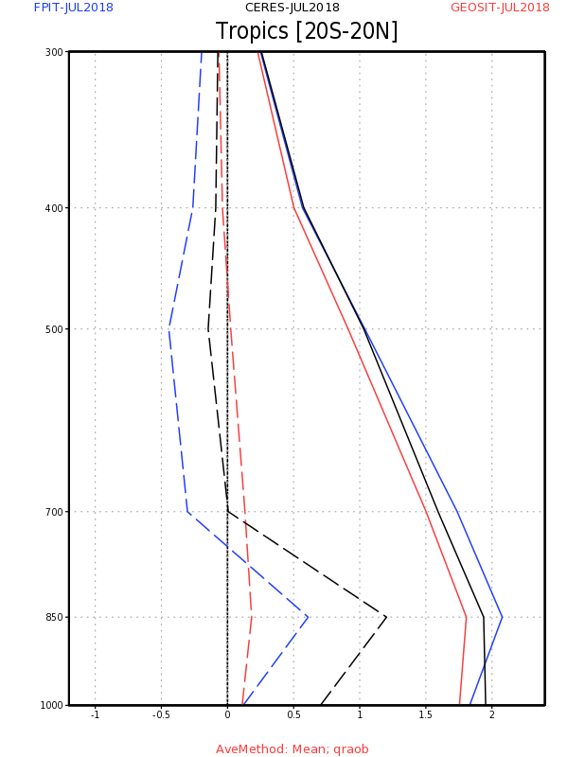
O-F Statistics
vs. RAOB
July 2018
Mean (dash)
Std. Dev. (solid)
Temp
(K)
GLOBAL
SPHU
(g/kg)
__ CERES 5.4.1
__ FPIT
__ GEOS-IT
*
*
note that while there is a mean
increase in the bias, there is a
systematic reduction in the
standard deviation (a more
difficult metric to improve)
Temp
TROPICS
SPHU
__ CERES 5.4.1
__ FPIT
__ GEOS-IT

Slide 21
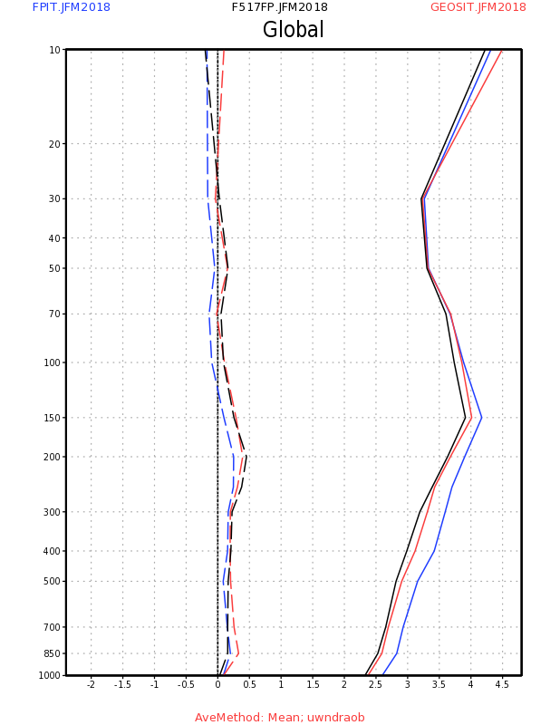
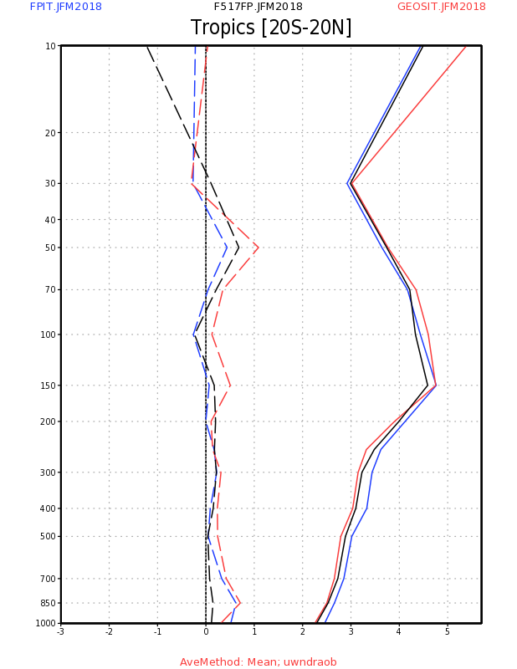
Zonal Wind (UWND) Observation Statistics
black curve was for an internal comparison
Mean
RMS
GLOBAL
TROPICS
__ GEOS-IT
__ FPIT

Slide 22
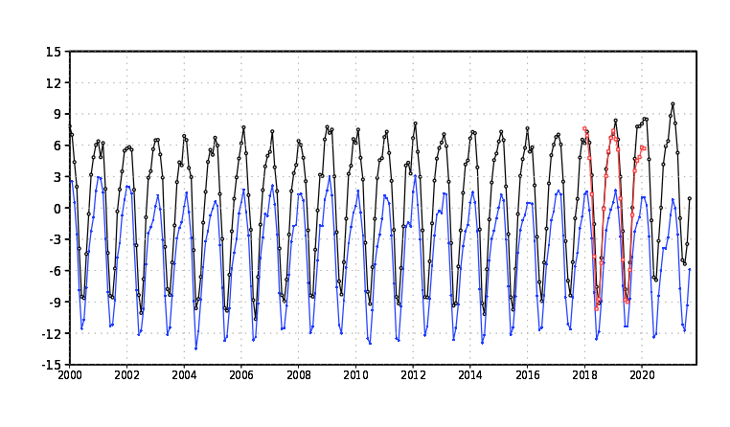
Top of the Atmosphere Energy Balance (W/m2)
___ CERES 5.4.1 ___ FPIT ___GEOS-IT
defined as net shortwave (SWTNT) minus outgoing longwave (LWTUP)

Slide 23
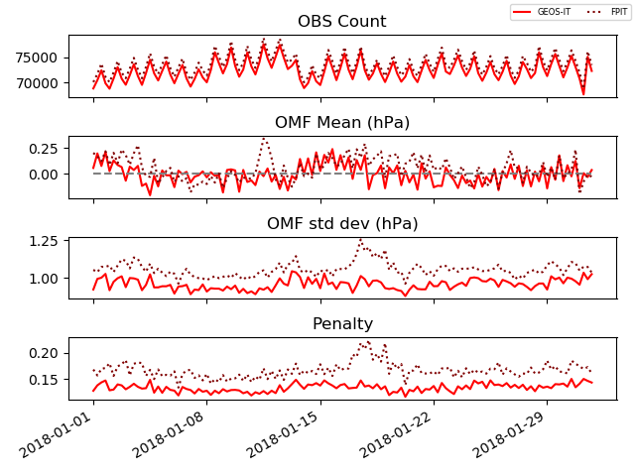
Surface Pressure Observation Statistics
(all sfc. pressure
obs. included)

Slide 24
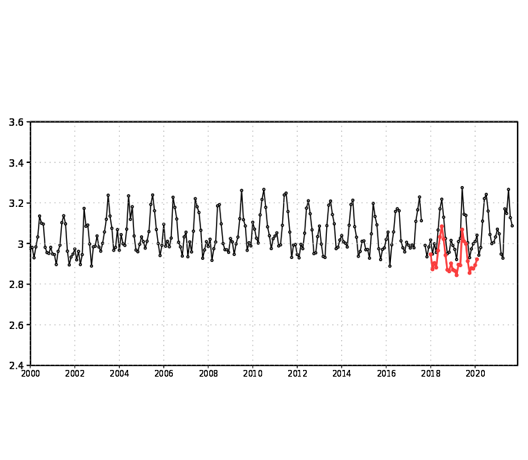
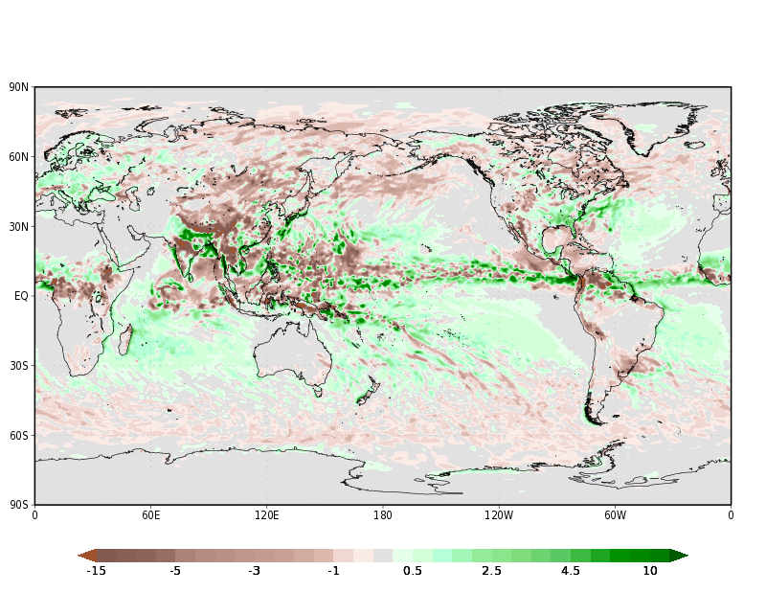
The global mean precipitation and land/ocean distribution is more realistic in GEOS-IT
GEOS-IT minus FPIT Precipitation (mm/d)
July 2018
Global Mean Precipitation (mm/d)
__ GEOS-IT
__FPIT
A notable drift up in land precipitation can even be
detected in FPIT global precipitation. This has been
greatly improved in GEOS-IT with a more realistic
global mean value close to 3.00 mm/d

Slide 25
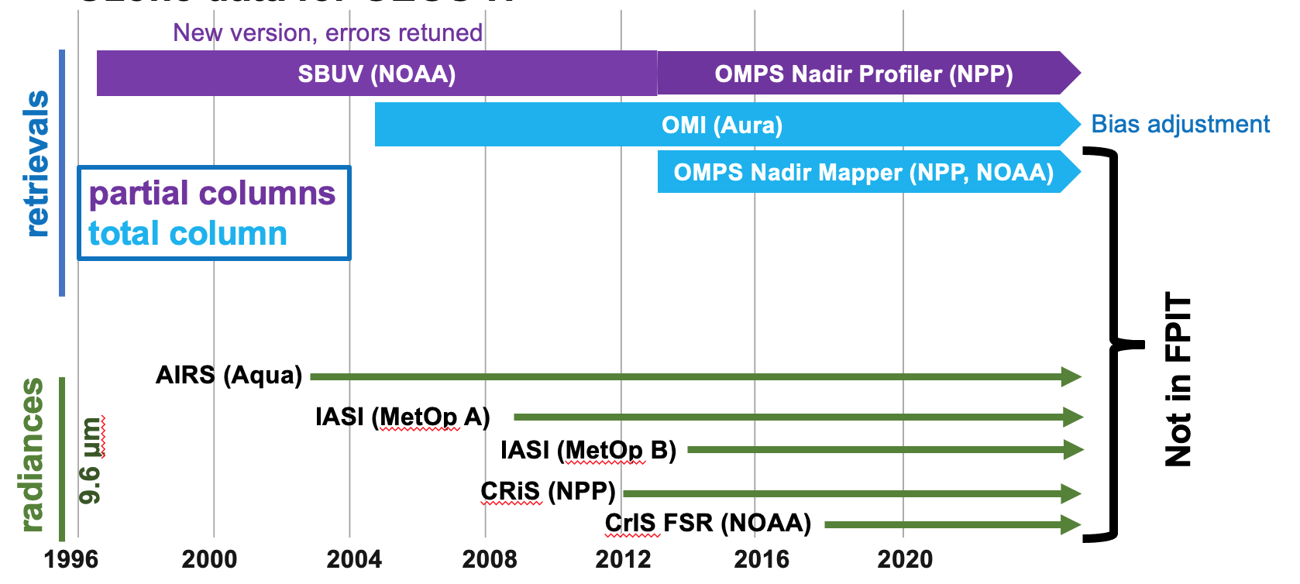
Ozone and upper atmosphere slides prepared by:
Kris Wargan and Jianjun Jin
Ozone data for GEOS-IT

Slide 26
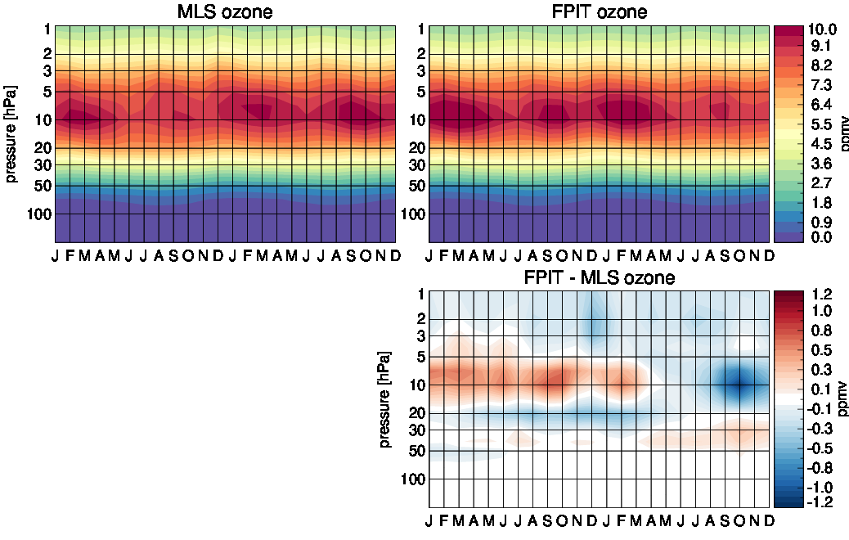
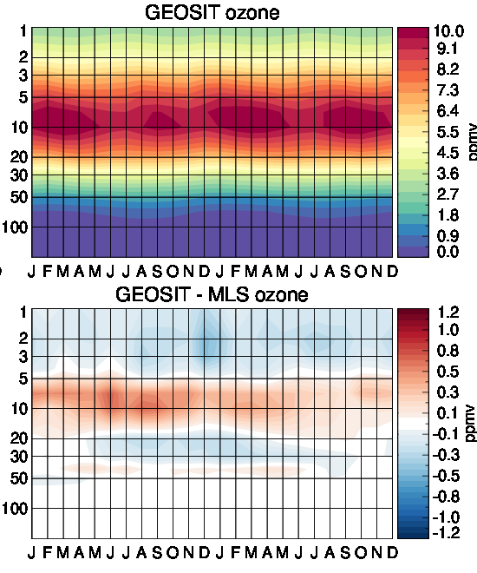
Zonal mean, 30ºS–30ºN
Zonal monthly mean and difference with respect to MLS
Updated observing system: improved and more consistent ozone record

Slide 27
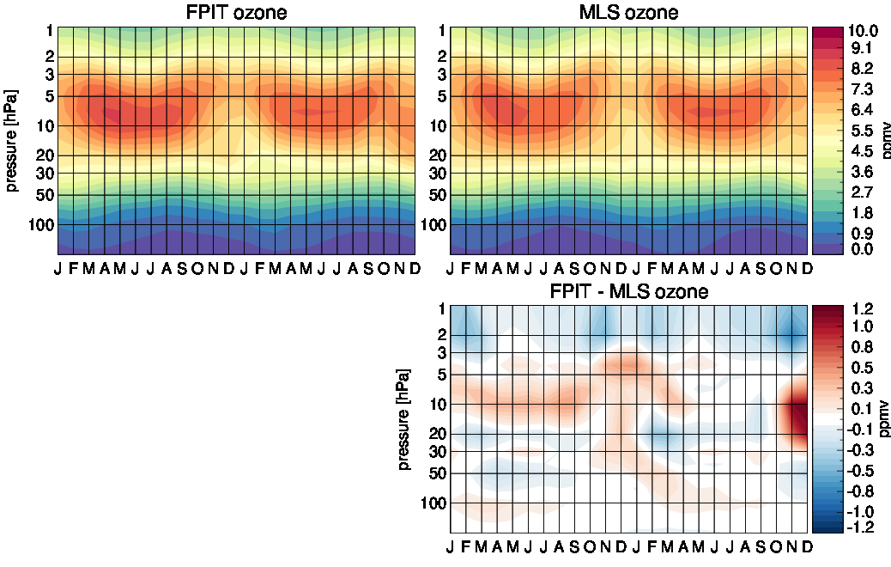

Zonal mean, 30ºN–60ºN
Zonal monthly mean and difference with respect to MLS
Updated observing system: improved and more consistent ozone record

Slide 28

Difference standard deviation, 30ºS–30ºN
Zonal monthly difference standard deviation with respect to MLS
Blue: improvement
Updated observing system: improved and more consistent ozone record

Slide 29

Difference standard deviation, 30ºN–60ºN
Zonal monthly difference standard deviation with respect to MLS
Blue: improvement
Updated observing system: improved and more consistent ozone record

Slide 30

Total Column Ozone avg.’d 60N-60S (DU)
__ GEOS-IT
__ FPIT
Very little difference in the total column ozone from FPIT to GEOS-IT

Slide 31

GEOSIT exhibits less mean bias of SPHU in the
stratosphere than FPIT
The ‘tape recorder’ portion of the time-series
is not very different between FPIT and GEOS-IT
except for a slight shift in time. Both GEOS-IT and
FPIT are too wet in this portion of the lower
stratosphere

Slide 32

GEOSIT exhibits less mean bias of SPHU in the
stratosphere than FPIT
The ‘tape recorder’ portion of the time-series
is not very different between FPIT and GEOS-IT
except for a slight shift in time. Both GEOS-IT and
FPIT are too wet in this portion of the lower
stratosphere

Slide 33

__ GEOS-IT
__ FPIT

Slide 34
T2M, Precip., etc. in GEOS-IT Over Greenland, Antarctica, and the Arctic Ocean vs. Station Observations & FPIT
Prepared by: Richard Cullather

Slide 35

Comparison With Antarctic Station Temperatures
Analysis Minus Station Temperature
Halley Bay
South Pole
Vostok

Slide 36
Reanalysis Vs. Station, South Pole
FP-IT too cold at warmer temperatures
GEOS-IT Sample too warm at colder temps

Slide 37

Comparison With Greenland Station Temperatures
Analysis Minus Station Temperature
EGP AWS
Summit Camp
Kangerlussuaq AWS

Slide 38
Reanalysis Vs. Station, Summit Camp
FP-IT again too cold at warmer temperatures
Both systems have difficulty at colder temps

Slide 39
Halley Bay
South Pole
Vostok
EGP AWS
Summit Camp
Kangerlussuaq AWS

Slide 40
Area Averages – T2M
GEOS_IT Sample and MERRA-2 differ by 1.1° over Greenland, 1.9° over Antarctica, but only 0.2° over the Arctic Ocean.

Slide 41
Area Averages – Annual Atmospheric Moisture

Slide 42
Area Averages - PRECTOT

Slide 43
Cryosphere Summary
Over polar ice sheets, GEOS-IT T2M is consistently warmer than FPIT in many locations, and for all seasons.
For South Pole, GEOS-IT is about 1.8° warmer than the station observation.
The GEOS-IT T2M is closer to station values in summer months for South Pole, Summit Camp & EGP AWS Greenland.
System temperature differences are considerably smaller over the Arctic Ocean.
Annual GEOS-IT precipitation is about 10% less than FPIT, and about 25% less in summer months. FPIT is known to have excessive Arctic Ocean precipitation in comparison to historical climatologies ; the lower GEOS-IT values are likely to be an improvement.

Slide 44




GEOS-IT MSLP analysis (hPa) 10-10-2018 06z
FPIT MSLP analysis (hPa) 10-10-2018 06z
GEOS-IT Hurricane Michael X-section
Wind, Temp 10-10-2018 06z along 28N
FPIT Hurricane Michael X-section
Wind, Temp 10-10-2018 06z along 28N
we do not expect
the representation
of tropical cyclones
to be significantly
different between
FPIT and GEOS-IT

Slide 45
This summary was meant to convey a general overview of the
meteorological quality of the GMAO’s GEOS-IT system as it transitions from FPIT
As with FPIT, we will continue our monitoring and evaluation effort
on a regular basis before and during production of GEOS-IT data streams.
We really do rely heavily on you, the users of this product, to help shape
the quality of GEOS-IT by sharing the exercise of evaluating is alongside of us.
If you point us to what you’d like us to further investigate…we will investigate it!
We are confident in the system about to be launched into production
and that it will serve your needs well into the future.
Thank you!

Slide 46
Slides added November 5, 2021
to address questions from Instrument Teams
in the October 20, 2021 Meeting
Antarctic and polar winds, cryosphere topography and surface pressure/500hPa Z changes between FPIT and GEOS-IT
Land/Ocean precipitation distribution between FPIT and GEOS-IT
Tropopause pressure difference, if any, between FPIT and GEOS-IT
(given some warming around 100hPa in tropics in GEOS-IT)
Shape of the thermal profile near the stratopause between FPIT and GEOS-IT
Slides added November 19, 2021
to address questions from Instrument Teams
in the October 20, 2021 Meeting
Added Skin temperature comparisons in addition to the previous T2m comparisons (requested by CERES Science Team)
Added MSLP comparisons

Slide 47

d5271_it_sample Minus d5124_rpit Topography [m]
rpit/MERRA-2 Antarctic topography based on Radarsat Antarctic Mapping Project (RAMP). Note: No topography over ice shelves.
d5271_it_sample topography based on USGS GMTED2010 (global).
Appears to have weakened coastal escarpment gradient (visual impression: escarpment elevation increases, some decreases just inland).

Slide 48

d5271_it_sample Minus d5124_rpit Topography [m]
rpit/MERRA-2 Greenland topography based on Bamber2001 ERS-1/Geosat altimetry.
Over Greenland, appears to have strengthened coastal gradient - small differences over plateau, some lowering along periphery.(??)

Slide 49



FRLAND - Non-Glaciated Land Fraction
rpit
d5271_it_sample
MODIS Terra 31-July 2019

Slide 50



January 2018 Scalar-Averaged 10m Wind
rpit
d5271_it_sample

Slide 51



July 2018 Scalar-Averaged 10m Wind
rpit
d5271_it_sample

Slide 53


d5271_it_sample Minus d5124_rpit SLP [hPa]
July 2018
Jan 2018

Slide 54

d5271_it_sample Minus d5124_rpit July 2018 Scalar-Averaged Wind Direction

Slide 55


July 2018 d5271_it_sample Minus d5124_rpit H500 [m]
L
H

Slide 57


___ GEOS-IT land precipitation
……. GEOS-IT ocean precipitation
___ FPIT land precipitation
……. FPIT ocean precipitation
Land Precipitation (62.5N,S)
FPIT
M2 - model
JRA55
GEOS-IT
ERA5
mm/d
mm/d
GPCP
M2 – corr.
GEOS-IT is well within the pack of Land Precipitation
(62.5N,S)

Slide 58

January 2018
__ GEOS-IT
__ FPIT

Slide 59

July 2018
__ GEOS-IT
__ FPIT
__ GEOS-IT
__ FPIT

Slide 60


Zachary Fasnacht (GEOS-IT meeting) inquired about any differences between FPIT and GEOS-IT
tropopause heights, given the noted differences in temperature around 100hPa in the tropics.
2018 Tropopause Pressure by month (hPa)
2018 Tropopause Pressure by month (hPa)
GEOS-IT minus FPIT
__ GEOS-IT
__ FPIT
12 monthly means represented by a curve,
red for GEOS-IT and black for FPIT. Only outside
of the tropics do we see any systematic difference
GEOS-IT appears to have lower (in altitude) tropopause pressure
levels over each polar cap region throughout the year at various
magnitudes. The tropical tropopause is essentially the same between the two

Slide 61


MSLP differences and closeness to ERA5
blue = GEOS-IT closer to ERA5
than FPIT
A modest reduction in MSLP over the
warm pool pushes GEOS-IT slightly more
away from ERA5 MSLP in January 2018

