Slide 1
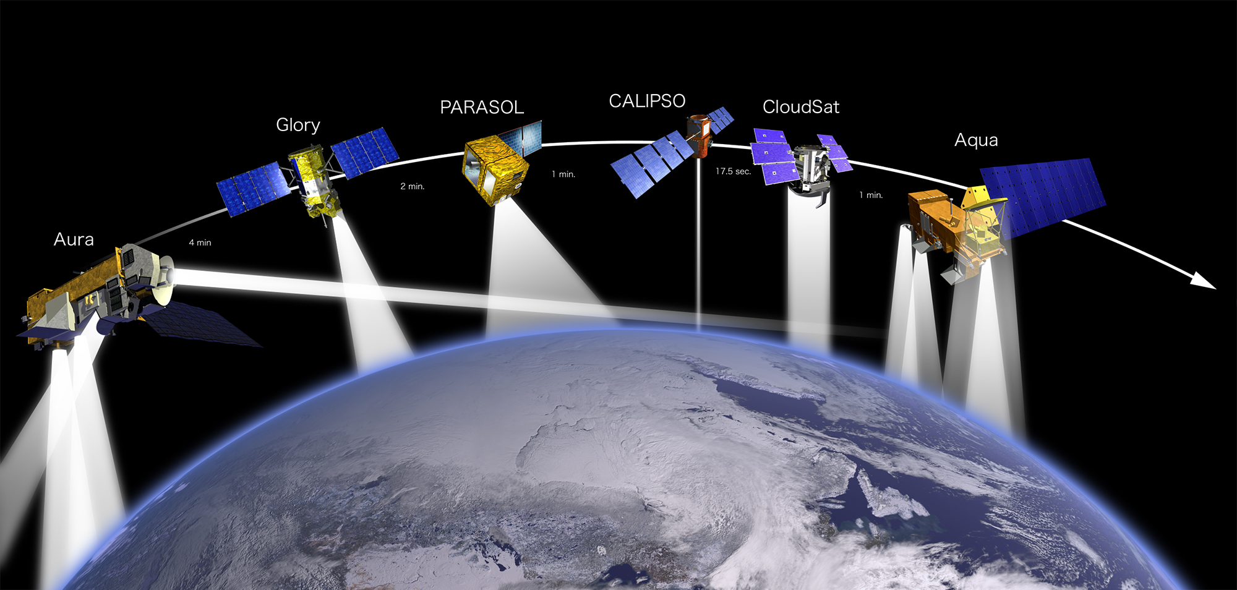

GEOS for Instrument Teams (GEOS-IT)
User Meeting - April 3, 2024
Steven Pawson, Amal El Akkraoui, Gary Partyka, Rob Lucchesi
Acknowledgements: MANY from the GMAO and our partners at the GES DISC
Production status and outstanding tasks
GMAO presents highlights of scientific results from GEOS-IT
Instrument Team feedback: MODIS evapotranspiration and Gross Primary Production/Net Primary Production
Instrument Team use case: SAGE III/ISS expedited products
Instrument Team use case: NLDAS
Instrument Team feedback: CERES
Questions and comments

Slide 2
GEOS-IT User Meeting
Outline
Production status and outstanding tasks
GMAO presents highlights of scientific results from GEOS-IT
Instrument Team feedback: MODIS Evapotranspiration and Gross Primary Production/Net Primary Production
Instrument Team use case: NLDAS
Instrument Team use case: SAGE III/ISS expedited products
Instrument Team feedback: CERES
Questions and comments

Slide 3
GEOS-IT (5.29.4) Production Status
Retrospective period 1998-2023 completed and delivered to GES DISC (Dec 2023)
Data volume generated and transferred: almost 500 TB
Forward-processing commenced in early October 2023 with latency of 24 hours or less
There are 31 active subscribers for GEOS-IT data at the GES DISC
GEOS-FPIT (GEOS-5.12.4) continues to run in parallel
Tentative GEOS-FPIT shutoff date extended until Dec 31, 2024 (initially: Jul 31, 2024)

Slide 4
GEOS-IT (5.29.4) Pending tasks
AMLS mailing list to support NASA and external users
Documentation: file specification office note
Documentation: web site update
Documentation: intention to write a citable science document

Slide 5
GEOS-IT, overall, represents a system of improved or equal quality from the FPIT system

Slide 6
Improvements
Significantly improved mid to upper tropical, and extending into higher latitudes, T and q profiles
Restored TOA energy balance (Net Shortwave – OLR)
MSLP, T2m*, and Total Precipitable Water
Revised land model produces a more realistic surface temperature diurnal cycle (not as cold immediately after sunset)
Updated model physics improves precipitation distribution;
excessive FPIT rain over land largely fixed in GEOS-IT
Elimination of brief and weak, but spurious, tropical cyclones
Improved and more consistent ozone record
Downwelling radiative fluxes improved over ice surfaces
GEOS-IT sea-surface temperature now includes prognostic diurnal warming and empirical cool layer
Update to the latest CEDS release for anthropogenic
aerosol emissions

Slide 7
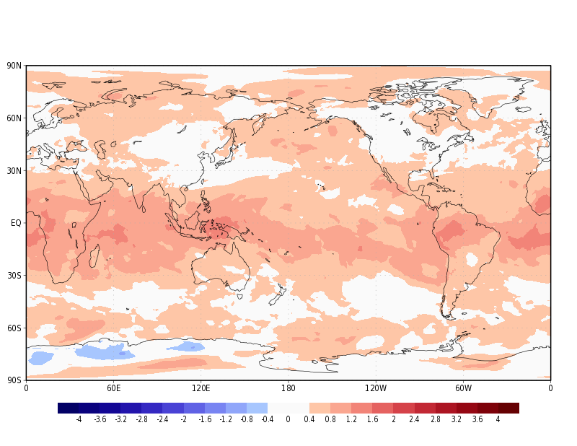
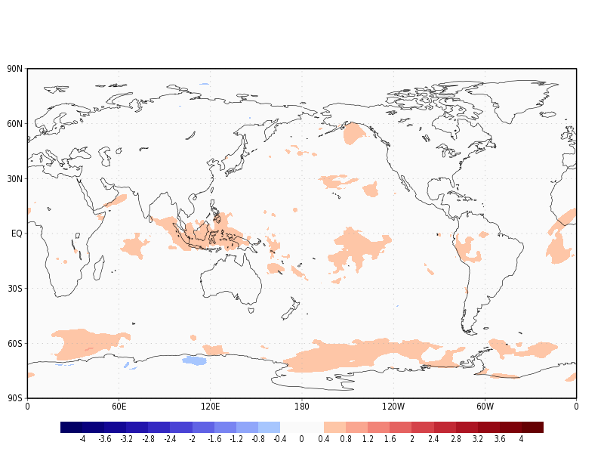
FPIT minus ERA5
300hPa Temperature (K); January 2003
GEOS-IT minus ERA5
300hPa Temperature (K); January 2003
This is representative of the historic record of GEOS-IT

Slide 8
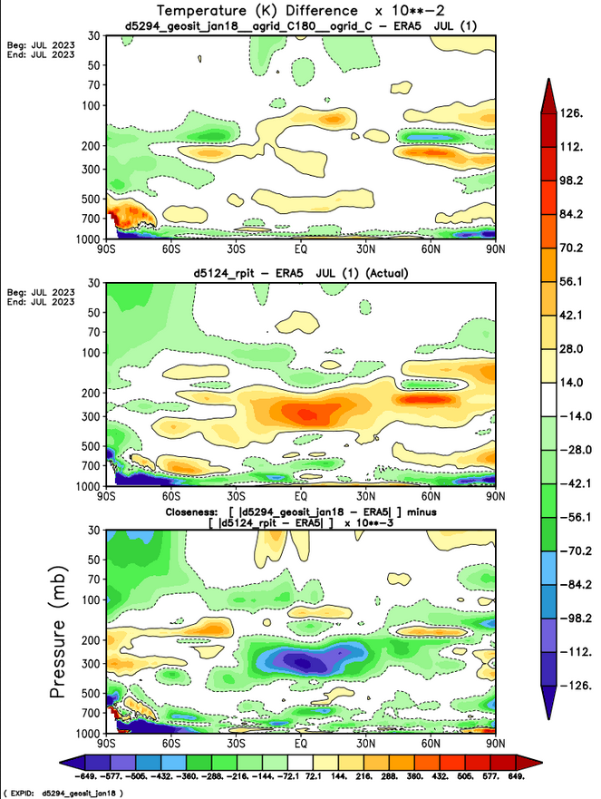
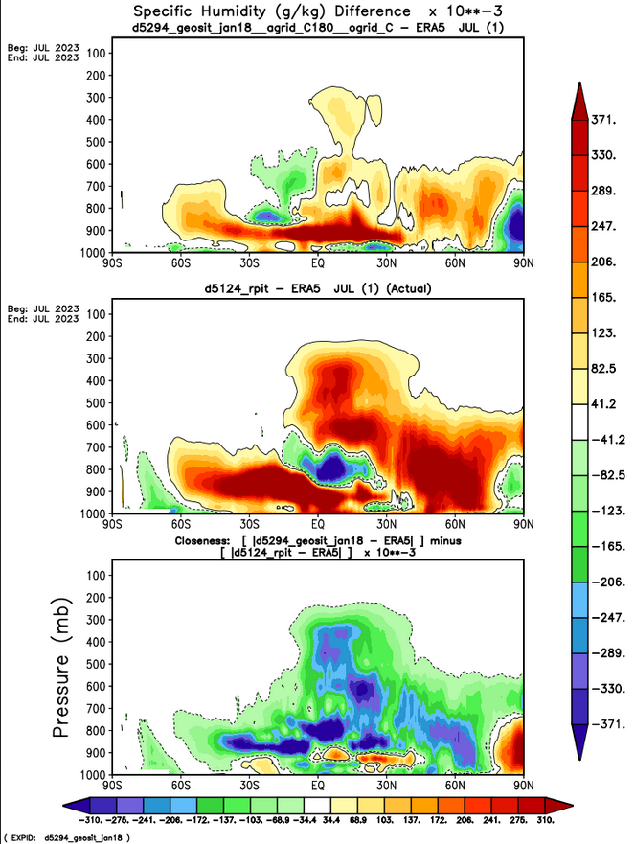
GEOS-IT minus ERA5
Zonal Mean Temp
July 2023 (K)
GEOS-IT minus ERA5
Zonal Mean SPHU
July 2023 (g/kg)
FPT minus ERA5
Zonal Mean Temp
July 2023 (K)
FPIT minus ERA5
Zonal Mean SPHU
July 2023 (g/kg)
Closeness to ERA5
blue/green =
GEOS-IT closer
yellow/red =
FPIT closer
Closeness to ERA5
blue/green =
GEOS-IT closer
yellow/red =
FPIT closer

Slide 9
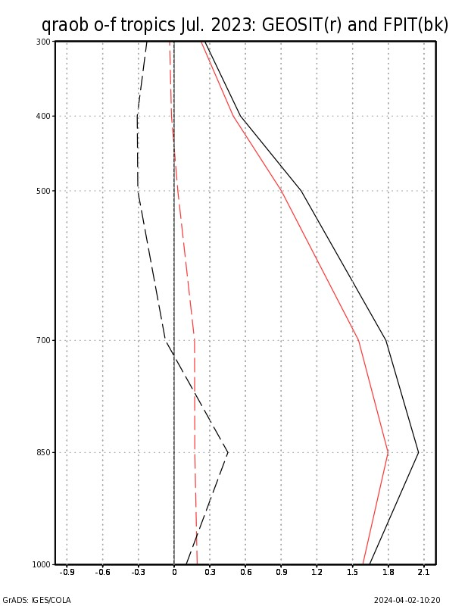
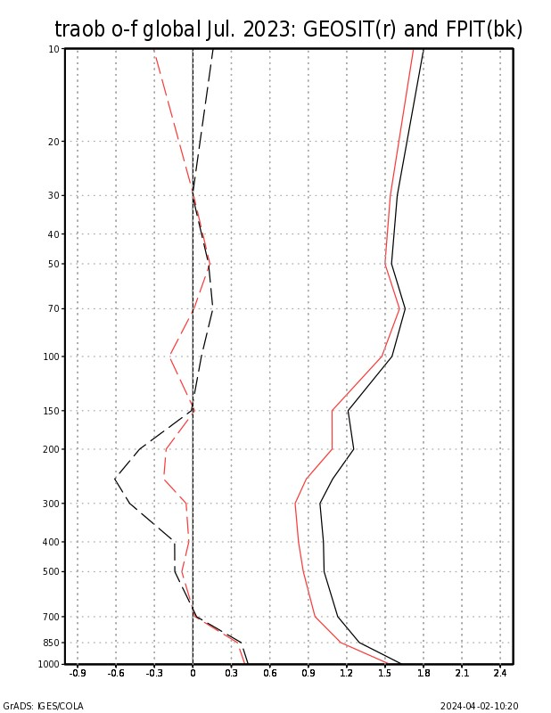
RAOB Temperature
O-F, Global (K)
July 2023
__ GEOS-IT
__ FPIT
RAOB Water Vapor
O-F, Tropics (g/kg)
July 2023
__ GEOS-IT
__ FPIT
10hPa
300hPa
mean
RMS
mean
RMS
500hPa
100hPa
700hPa
250hPa
850hPa
1000hPa
1000hPa

Slide 10
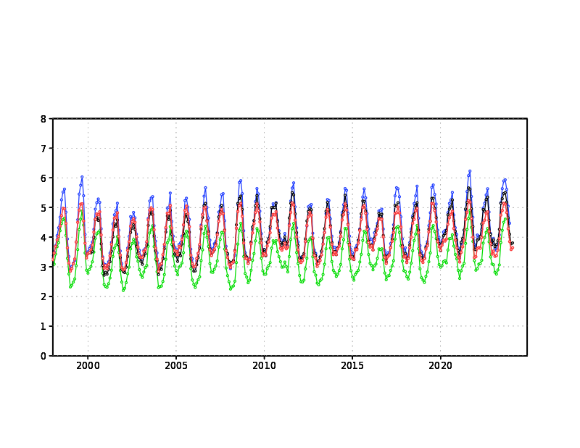
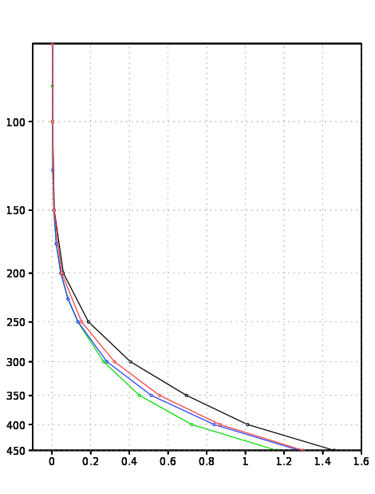
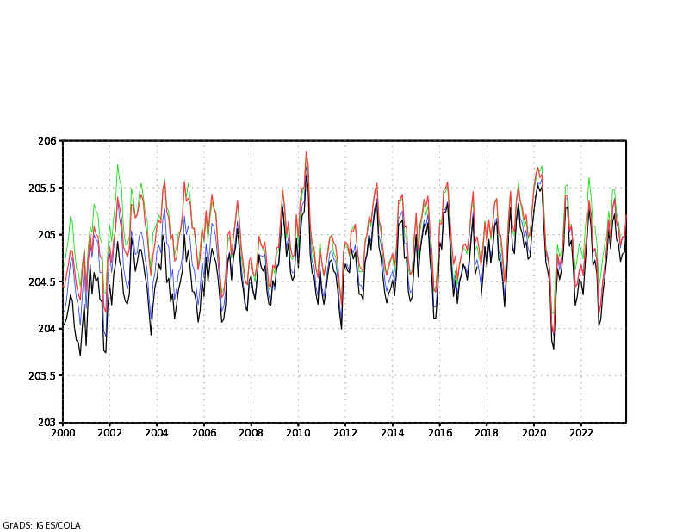
Upper Tropical Humidity (g/kg)
Profile
Year 2022 average
100hPa Tropics Specific Humidity (ppmv)
__ GEOS-IT
__ FPIT
__ ERA5
__ JRA3Q
__ GEOS-IT
__ FPIT
__ ERA5
__ JRA3Q
Similar profiles for
other years; GEOS-IT
agrees more other
reanalysis, but still slightly
on the higher side
250hPa-350hPa
100hPa Tropics Temperature (K)
100hPa Tropics Temperature (K)
__ GEOS-IT
__ FPIT
__ ERA5
__ JRA3Q

Slide 11
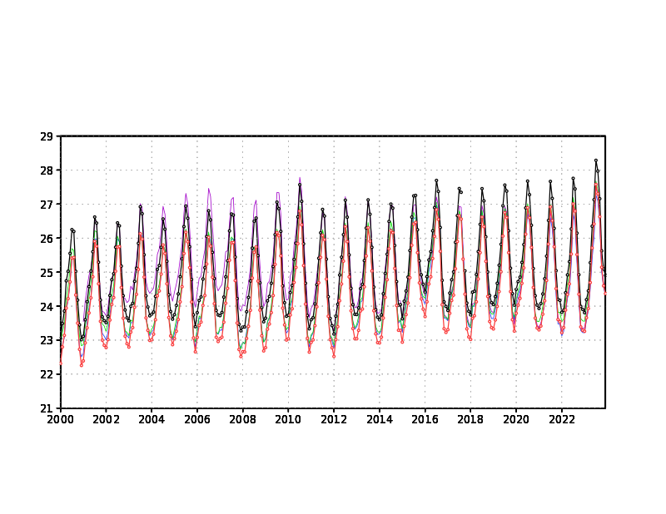
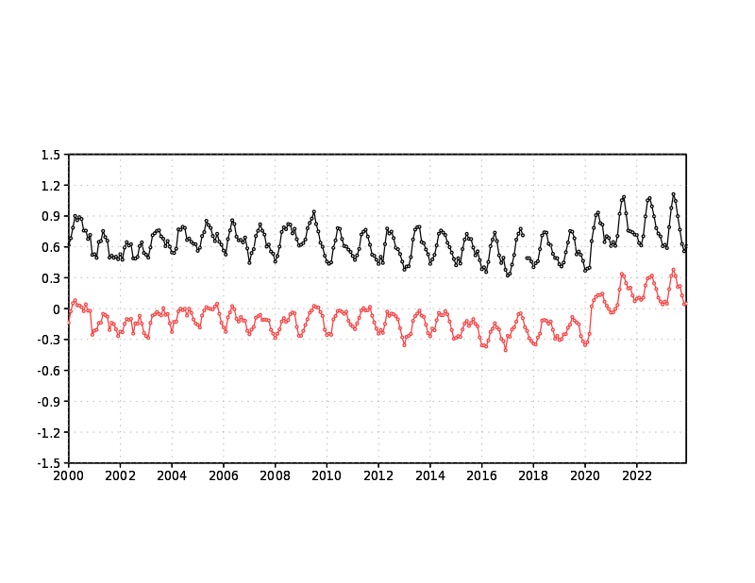
Total Precipitable Water (mm); Global
__ GEOS-IT __ ERA5
__ FPIT __ NCEP
__ JRA3Q
GEOS-IT exhibits a
rise in global TPW
(correlated w/ SST)
GEOS-IT averages
about 0.5 – 1.0 mm lower
than FPIT, aligning
GEOS-IT better with ERA5
highest TPW peak
in the 23 year period
Total Precipitable Water (mm) difference w ERA5
__ GEOS-IT minus ERA5
__ FPIT minus ERA5

Slide 12
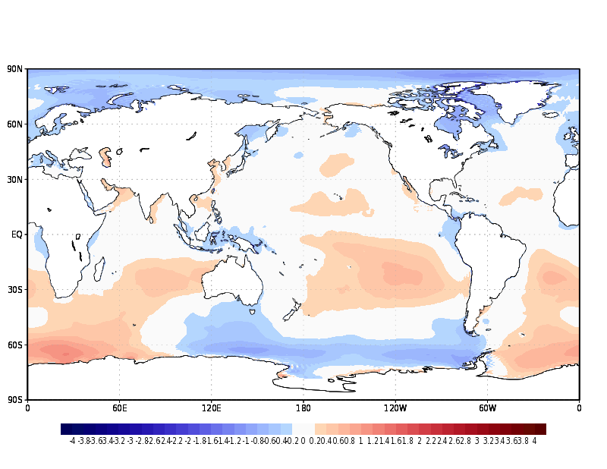
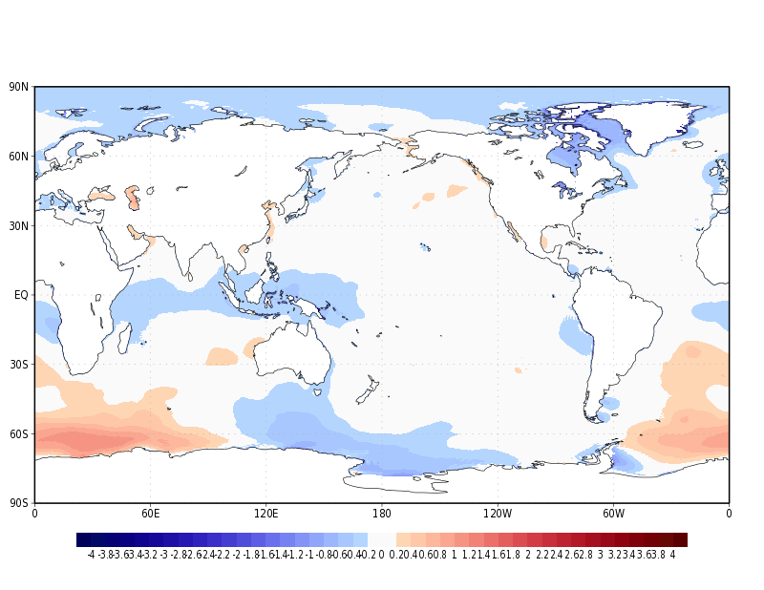
MSLP (land-masked) comparisons to ERA5
FPIT minus ERA5
MSLP (hPa)
Year 2010 mean
GEOS-IT minus ERA5
MSLP (hPa)
Year 2010 mean
The improvement in GEOS-IT is more pronounced in the earlier years
of its record (1998 – 2015). FPIT and GEOS-IT are closer in MSLP more recent years

Slide 13
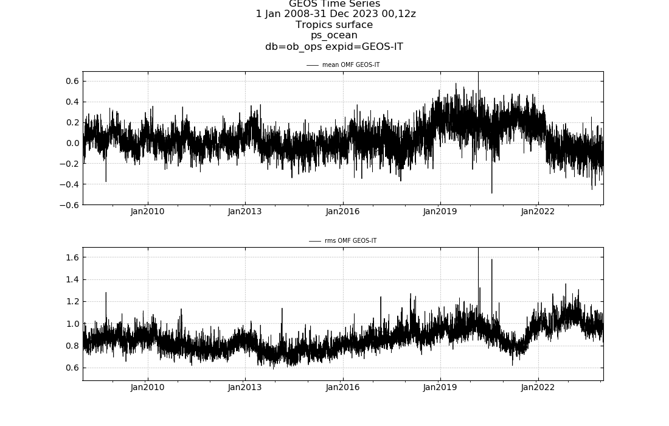
GEOS-IT
Surface Pressure O-F (hPa)
Tropics Ocean (vs. ships, buoys)

Slide 14
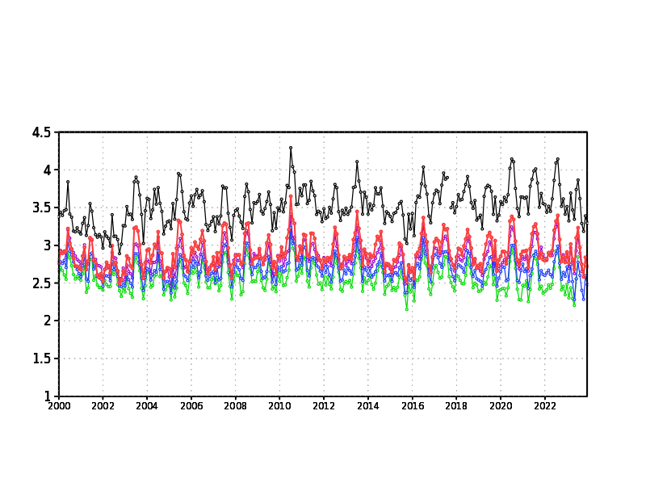
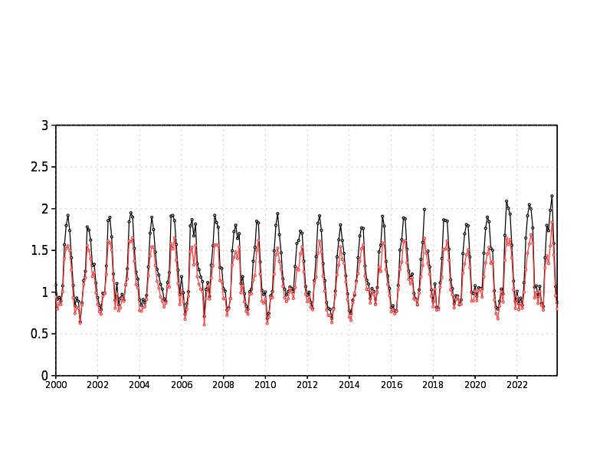
Significant GEOS-IT improvement in precipitation distribution
as in FPIT, GEOS-IT maintains a balanced global mean annual precipitation and evaporations state
Land Precipitation (mm/d)
North Polar Cap Precip. (66N+; mm/d)
__ GEOS-IT
__ FPIT
__ ERA5
__ GPCP v3.2
__ GEOS-IT
__ FPIT
GEOS-IT Land Precipitation now within
the pack of obs. and other reanalysis
GEOS-IT reduction in polar cap precipitation
widely accepted by cryosphere experts as
an improvement

Slide 15
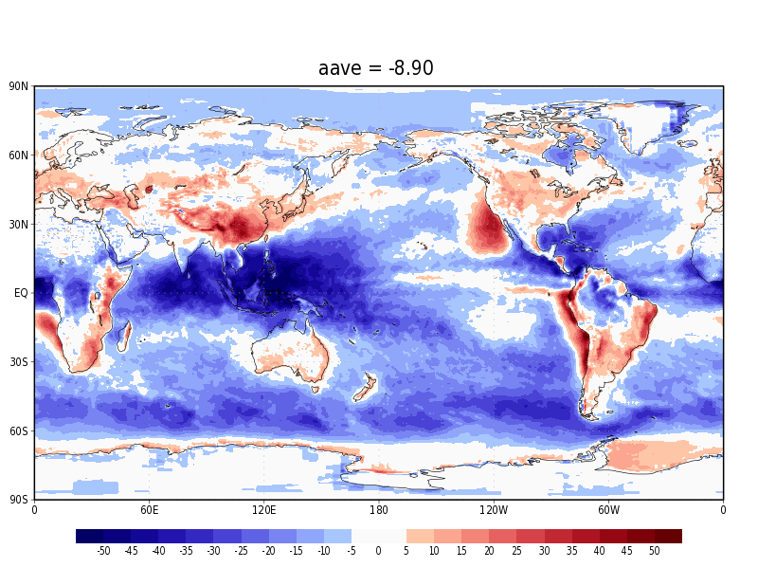
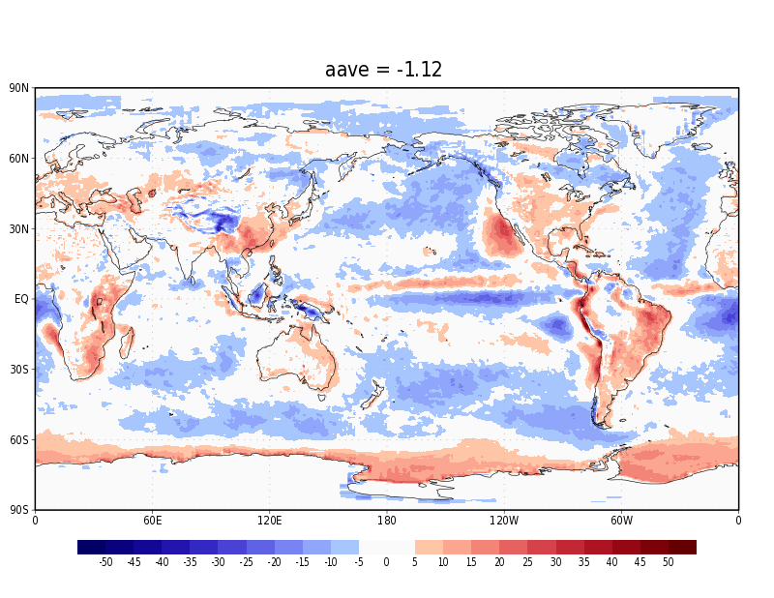
FPIT minus EBAF
TOA SWnet (W/m2)
Year 2021
GEOS-IT minus EBAF
TOA SWnet (W/m2)
Year 2021

Slide 16
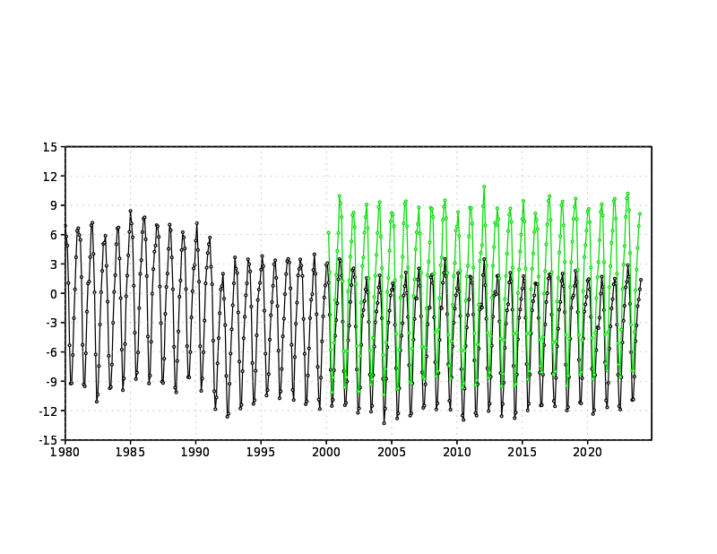
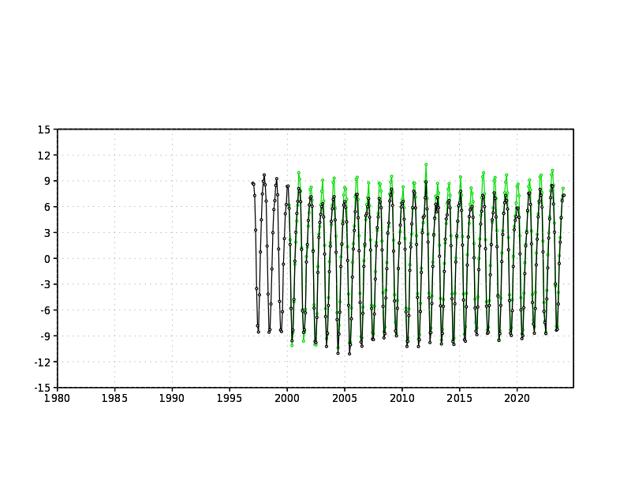
TOA Energy Balance (SWnet – OLR; W/m2)
__ M2 (FPIT similar to M2)
__ CERES-EBAF
TOA Energy Balance (SWnet – OLR; W/m2)
__ GEOS-IT
__ EBAF

Slide 17
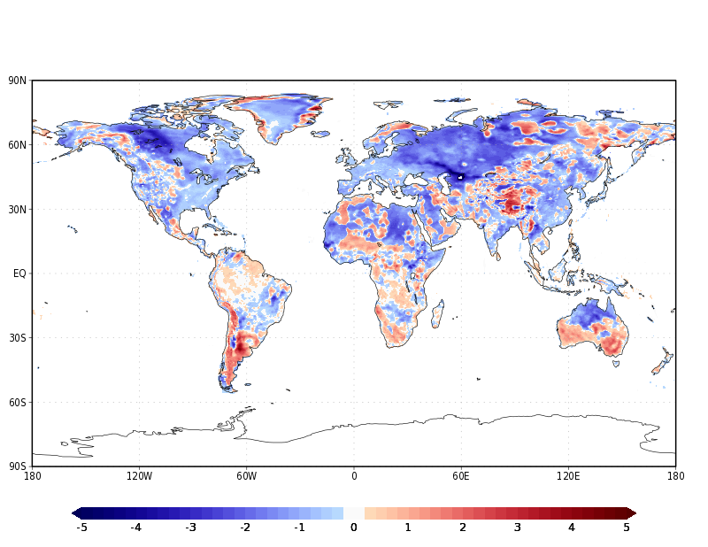
Closeness to Observed* T2m (K)
January 2007
blue = GEOS-IT closer to observed
red = FPIT closer to observed
*
GHCN_CAMS Gridded 2m Temperature (Land) data provided by the NOAA PSL, Boulder, Colorado, USA, from their website at https://psl.noaa.gov

Slide 18
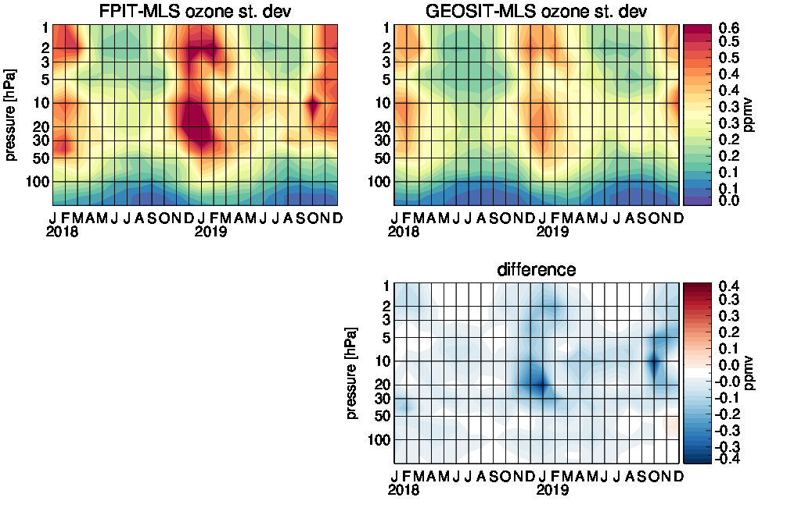
Greater stability and improved quality of Ozone in GEOSIT
30ºN-60ºN
Zonal monthly difference standard deviations with respect to MLS
Blue: improvement

Slide 19
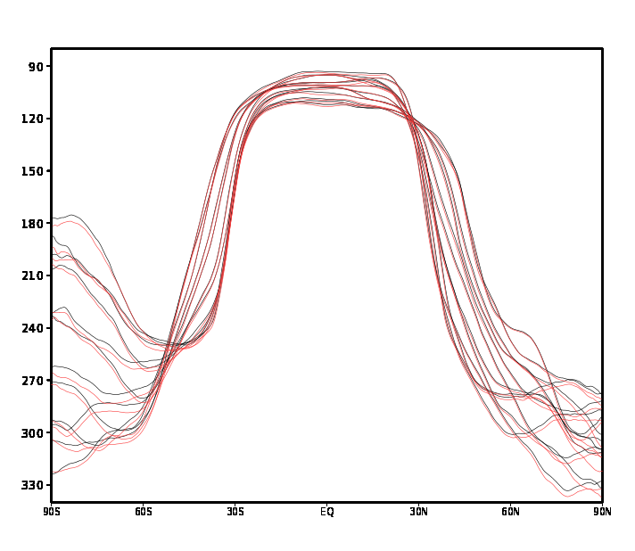
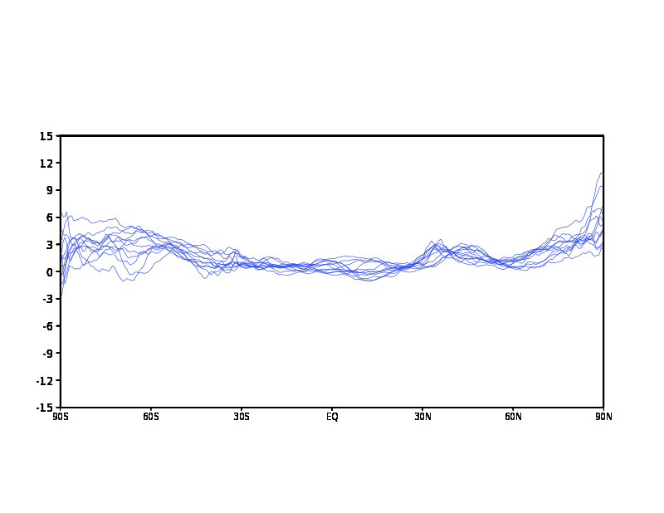
Little change in the Tropical Tropopause Pressure level (TROPP) between GEOS-IT and FPIT
2018 Tropopause Pressure by month (hPa)
2018 Tropopause Pressure by month (hPa)
GEOS-IT minus FPIT
__ GEOS-IT
__ FPIT
GEOS-IT marginally lower (in altitude) TROPP outside of the tropics;
a bit larger drop in TROPP height over the North Polar Cap
12 monthly means in 2018 each represented by a curve

Slide 20
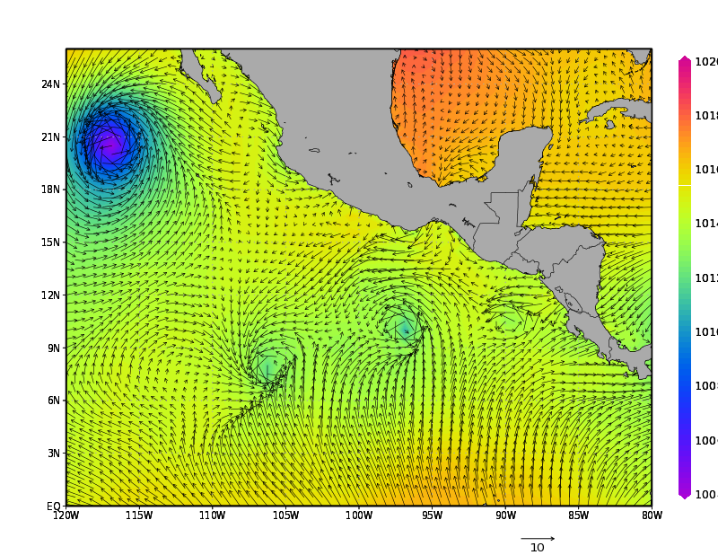
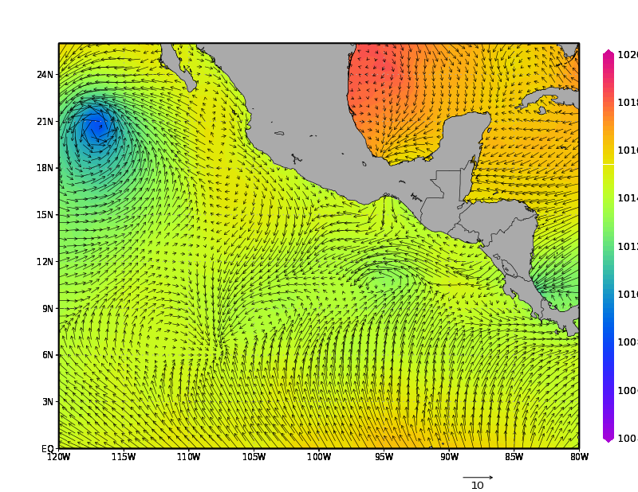
FPIT Analysis 16z Jun. 27, 2022
SLP (shaded; hPa) 10m Wind Vector (m/s)
GEOS-IT Analysis 16z Jun. 27, 2022
SLP (shaded; hPa) 10m Wind Vector (m/s)
Spurious tropical cyclone-like entities (typically short-lived and weak)
periodically/frequently found in FPIT not present in GEOSIT

Slide 21
Known Issues
Upper atmosphere/stratosphere thermal bias has increased, mainly in the earlier production years
Equatorial stratosphere winds exhibit a delay in changing directional regime, and a slower easterly UWND maximum
Ice sheet surface temperatures in GEOS-IT are warmer than FPIT year-round. Greenland temperatures are warmer than observed, while Antarctic temperature comparison with stations is mixed

Slide 22
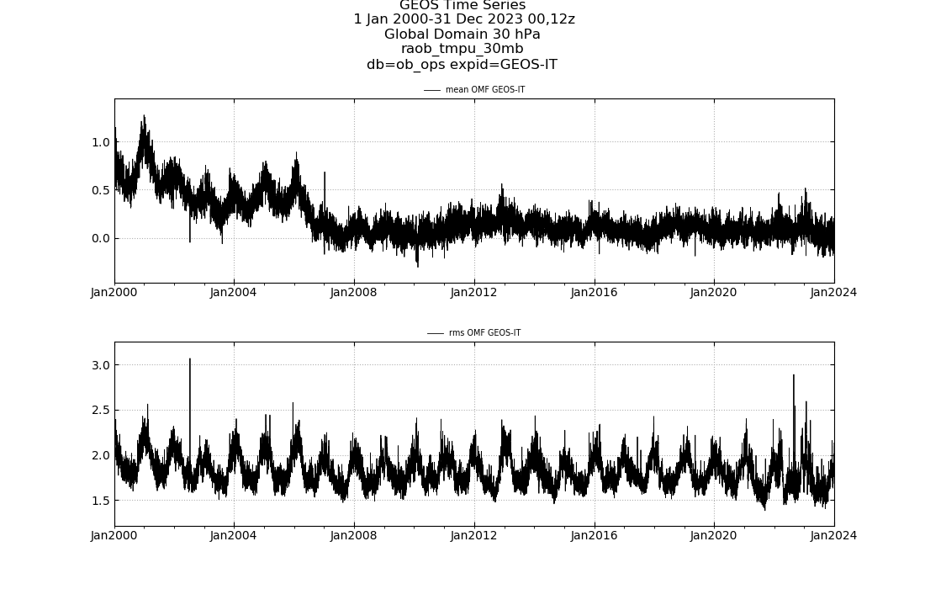
30hPa RAOB Temperature
O-F mean
GEOS-IT time-series (Global; K)
cold bias in GEOS-IT
As more GNSS RO data comes online in the middle and later 2000’s, these obs better anchor
upper atmosphere temperatures in GEOS-IT (generally 10hPa-100hPa; 30hPa shown here)

Slide 23
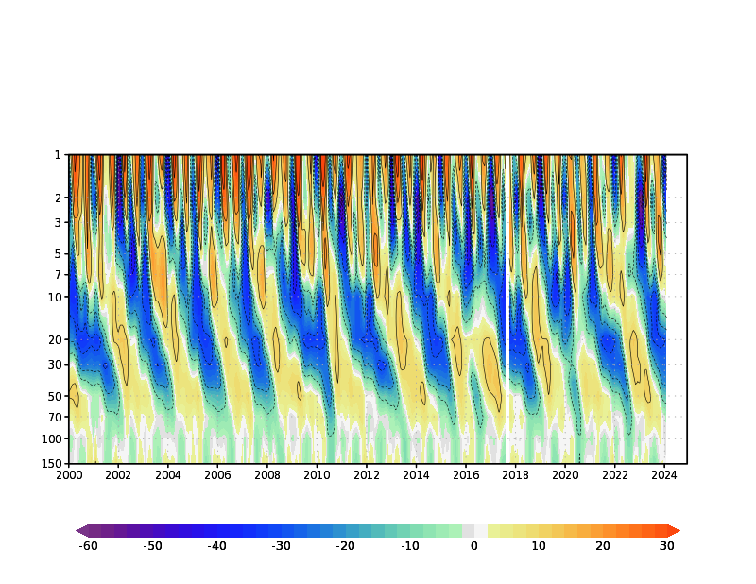
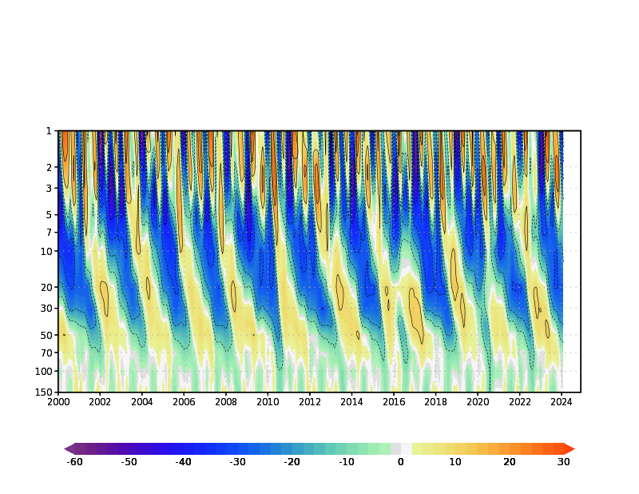
FPIT Equatorial (10N,S) Upper Atmosphere Zonal Wind (m/s)
Both FPIT and GEOS-IT
produce realistic
equatorial upper-atmospheric
zonal wind structures; including
a quasi-biennial oscillation
(QBO) and semi-annual
oscillation (SAO)
GEOS-IT exhibits a delay in
transitioning from the easterly
wind regime to the westerly
regime
A tendency for GEOS-IT
to slower winds in the easterly
phase is noted
GEOS-IT Equatorial (10N,S) Upper Atmosphere Zonal Wind (m/s)

Slide 24
It is thought that an increase in low-level moisture and albedo feedback
is driving this additional undesired warming in GEOS-IT. Summer temperatures
too warm may result in anomalous melt-off, causing water budget errors

Slide 25
We now look forward to hearing from some of the users
of our GEOS-IT system…
GMAO has invested in carefully reviewing and evaluating GEOS-IT, but your feedback is crucial

Slide 26
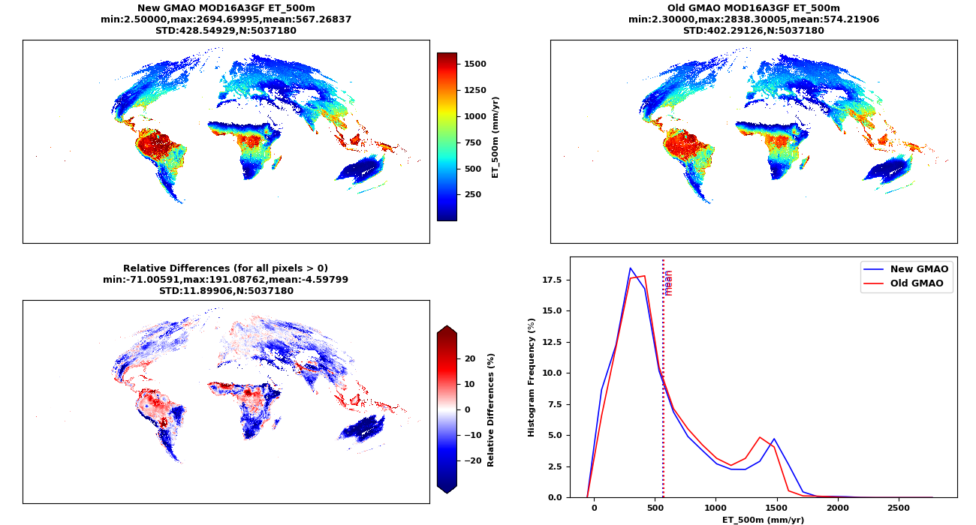
Instrument Team Feedback: MOD16 (Evapotranspiration)
Presented by Maosheng Zhao
Comparisons of annual total ET (mm/yr) in MOD16A3GF for year 2008.

Slide 27
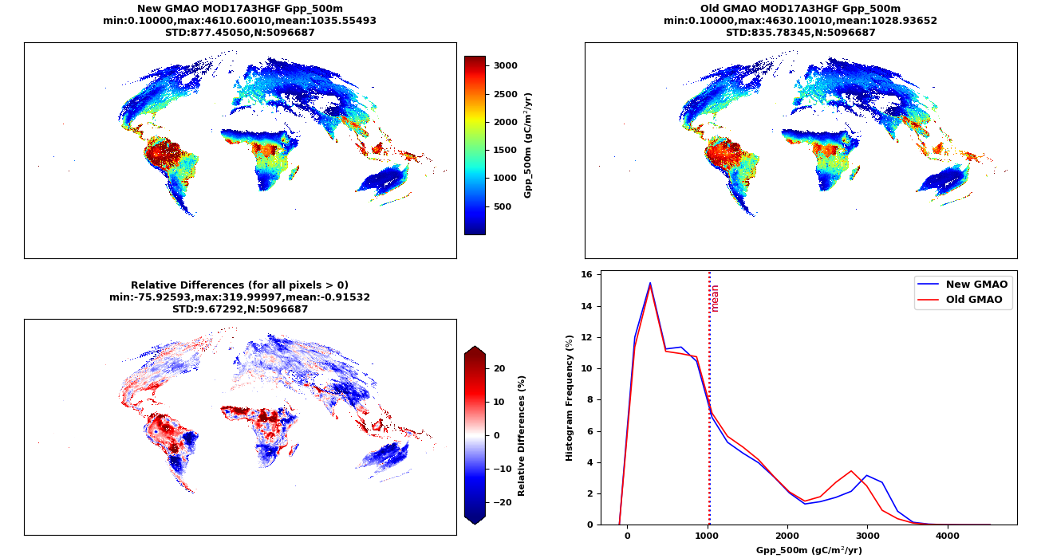
Instrument Team Feedback: MOD17 (GPP/NPP)
Presented by Maosheng Zhao
Comparisons of annual total GPP (gC/m²/yr) in MOD17A3HGF for year 2008.

Slide 28
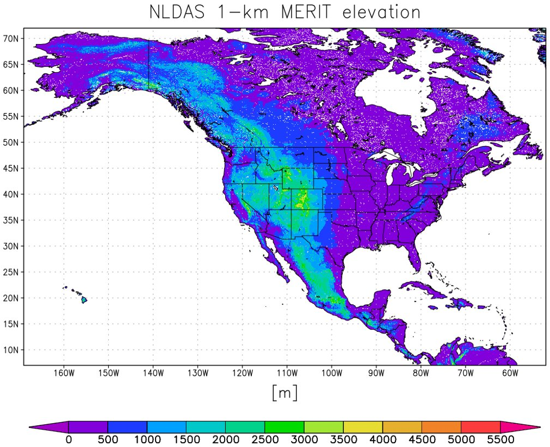
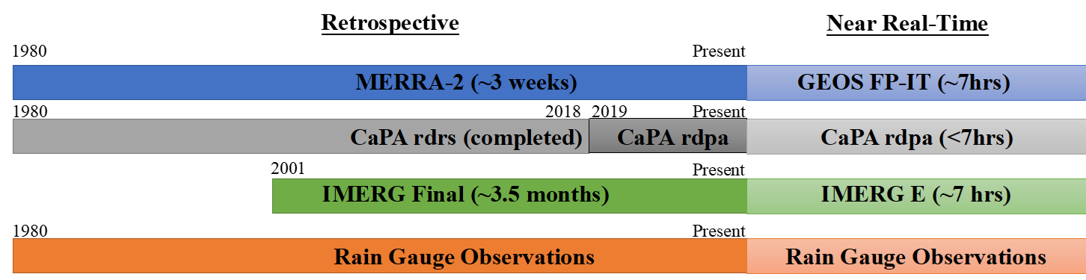

GEOS-IT will be used in the North American Land Data Assimilation System Phase 3 (NLDAS-3)
NLDAS-3 is a fine-scale North American surface meteorological and land-surface model dataset for retrospective and operational applications.
To meet the needs of the large user-base of the current NLDAS-2 system for drought monitoring and other applications, NLDAS-3 will:
1) have a larger domain, 2) finer spatial scale, 3) improved surface meteorology, 4) advanced land data assimilation, 5) near real-time latency
1. NLDAS-3 domain
2. NLDAS-3 precipitation
4. NLDAS-3 land surface
Starting year is still TBD:
~1980: start of MERRA-2/CaPA
OR
~2002: when many remotely-sensed DA products begin and use GEOS-IT data only
GEOS-IT
  NLDAS-3 uses advanced optimal interpolation techniques to blend MERRA-2 (or GEOS-IT) as the background and assimilates IMERG and ECCC Canada’s CaPA analysis to produce a daily 4-km precipitation analysis. A statistical downscaling technique developed by MSFC will be used to get to 1-km daily. IMERG will be used to temporally downscale the daily totals to hourly.
5. NLDAS-3 further info
A multi-national and multi-center collaboration:
NLDAS-3 covers all of North and Central America including Alaska, Hawaii, & Puerto Rico
NLDAS-3 has a spatial resolution of 1-km and a temporal resolution of 1 hour
3. NLDAS-3 surface meteorology
GEOS-IT surface meteorology is downscaled to 1-km
  Temperature adjustments made using a dynamic lapse rate to the 1-km topography. Surface pressure, longwave down radiation, and humidity are also adjusted.
  Shortwave down radiation is downscaled using data from CERES/POWER as well as slope/aspect of 1-km topography.
  Winds are adjusted using the MicroMet methodology, which uses values of topographic slope, slope azimuth, and curvature.
NLDAS-3 aims to accelerate the transition to operations and enhance user and stakeholder engagement
Contact: David Mocko (david.mocko@nasa.gov)
https://ldas.gsfc.nasa.gov/nldas
Stakeholder workshop recording from 08 Nov 2023:
https://weather.ndc.nasa.gov/sport/splash/summits/past/summit_20231108.html

