Slide 1
Large-Scale Drivers of JJA T2m Bias in NH
Evidence is presented (typical of recent versions of the AGCM) that the T2m warm bias over Asia and North America in AGCMs is in part dynamically driven from above (linked to zonal mean wind bias) and amplified at the surface via possible land model issues
An example is given for an AGCM (132 levels) that does not have the zonal wind bias and also has much reduced T2m warm bias (smaller and confined to regions of high topography)
The recent coupled models have very different zonal wind bias (compared to AGCMs) forced by double ITCZ bias (H54p3c90o1_4 is an example) and very different T2m bias (cold over Eurasia though still slightly warm over North America
Also show example of old coupled model run (one that has a better ITCZ- and behaves more like AGCMs in terms of wind, height, and surface temperature biases
Caveat: these are not clean comparisons, and other factors could be at play (would be helpful to have the AMIP companions to the coupled runs)

Slide 2
AMIP runs
IC180_AMIP_asd1: typical (for AGCM) zonal mean wind bias
WMP_F120_AMIP_0: another example of typical AGCM biases
3) a0362 ( 132 levels): unusual in that it has essentially no zonal mean wind bias in middle latitude NH

Slide 3
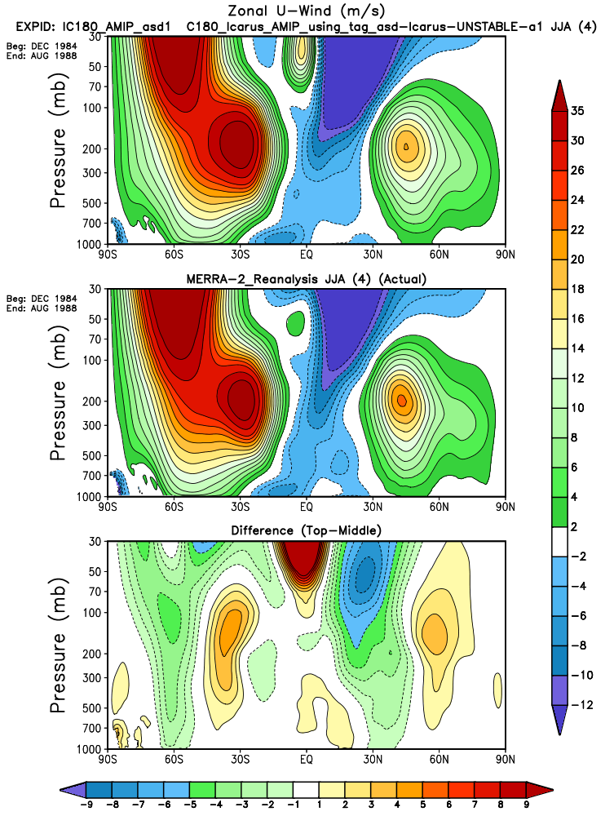
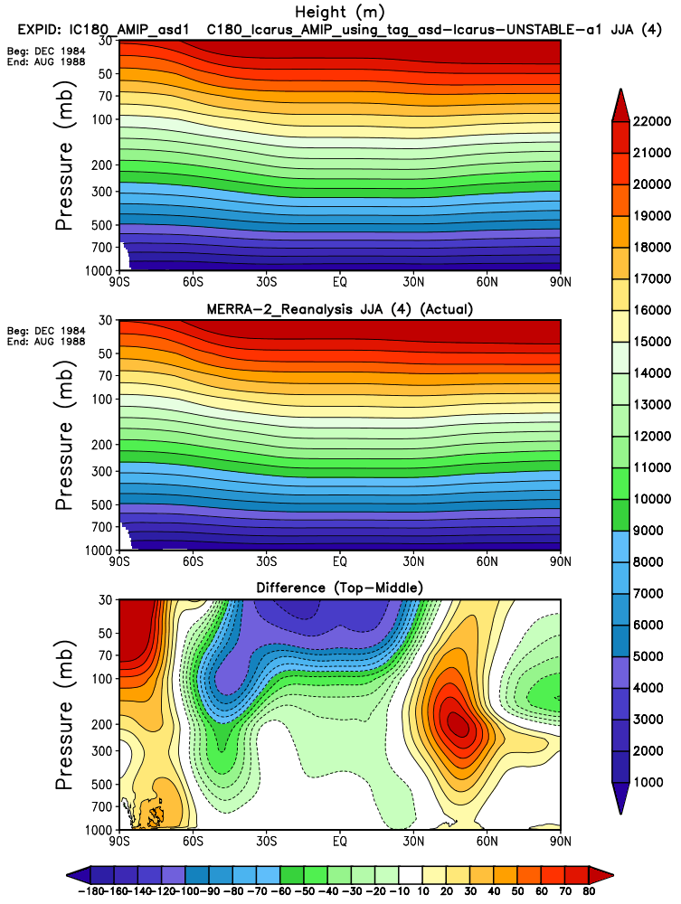
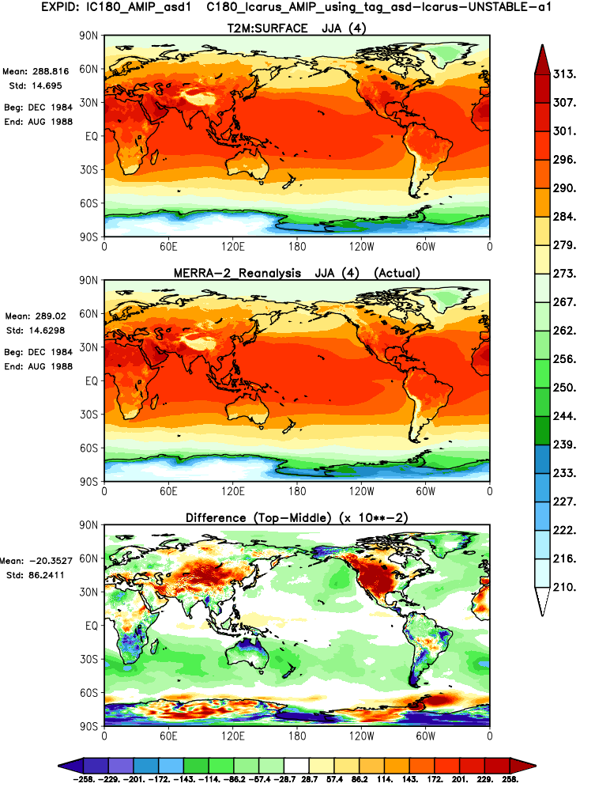
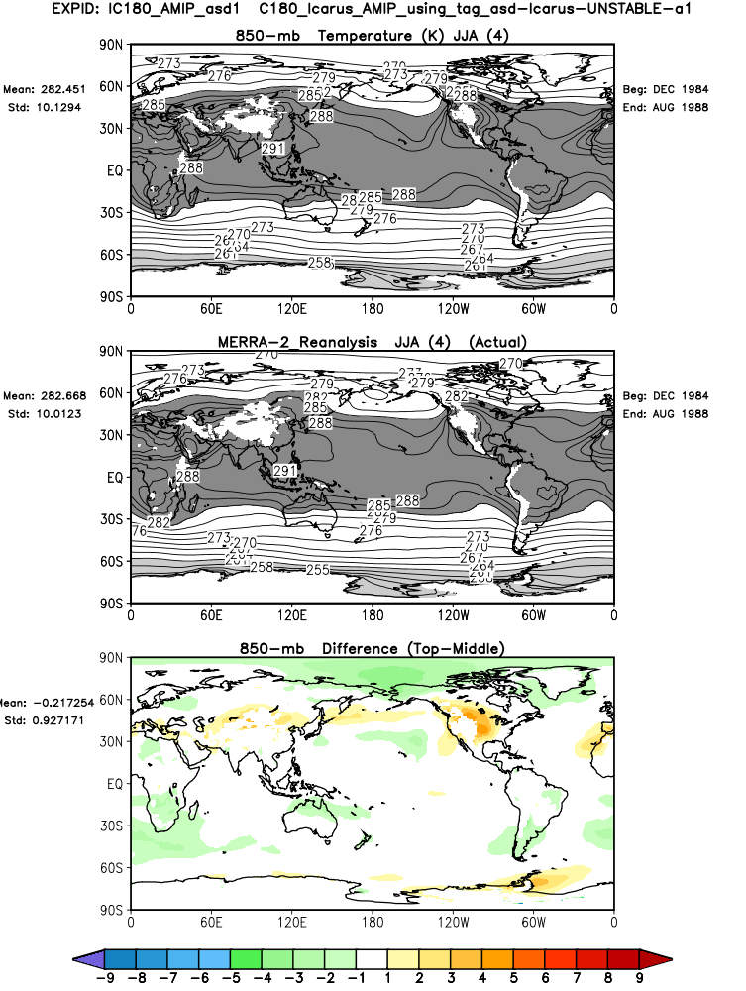
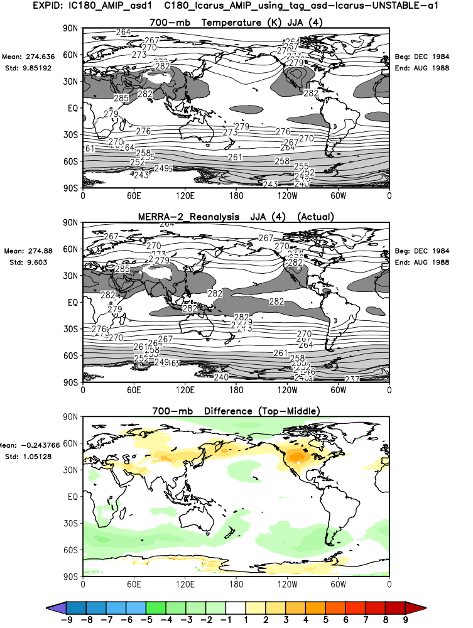
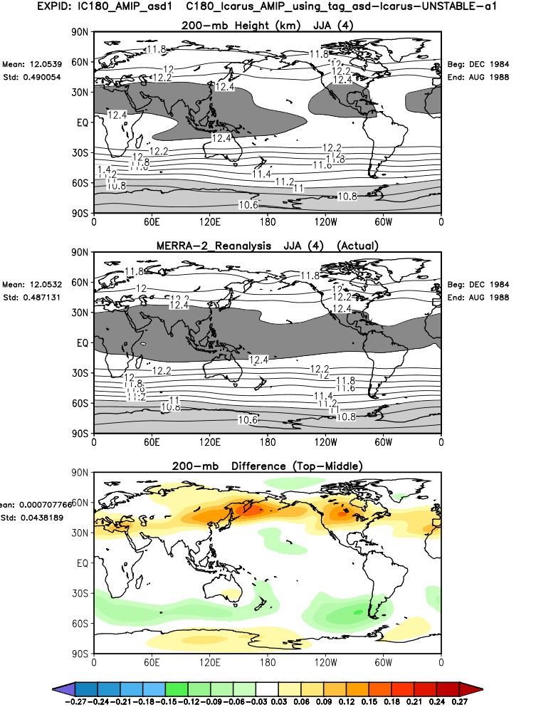
IC180_AMIP_asd1: typical (for AGCM) zonal mean wind bias – northward shift of the jet
Associated positive height bias, similar to that associated with decadal drought in NH
T2m
T850
T700
200z

Slide 4
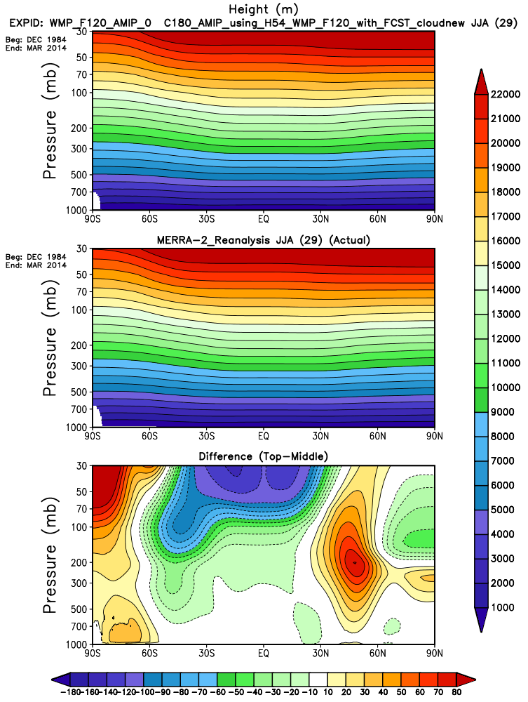
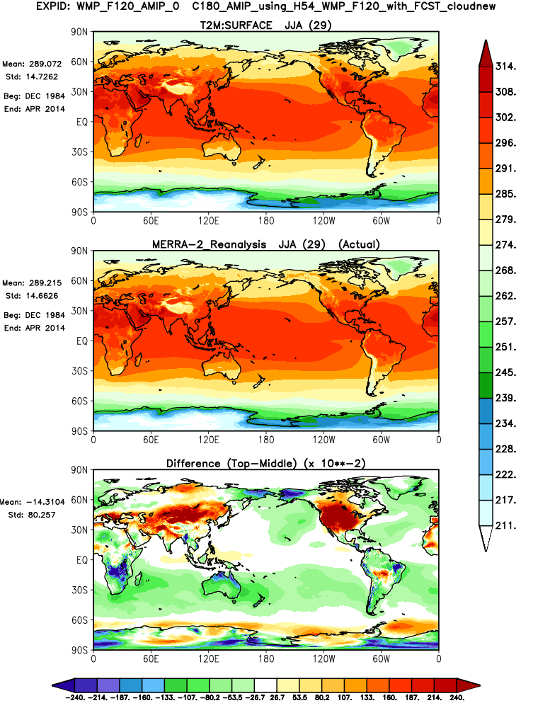
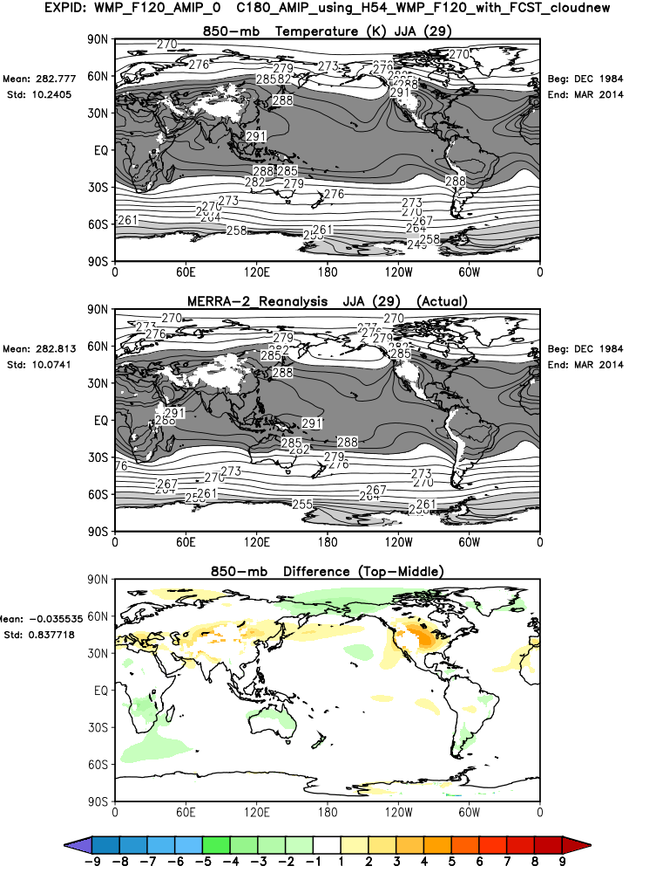
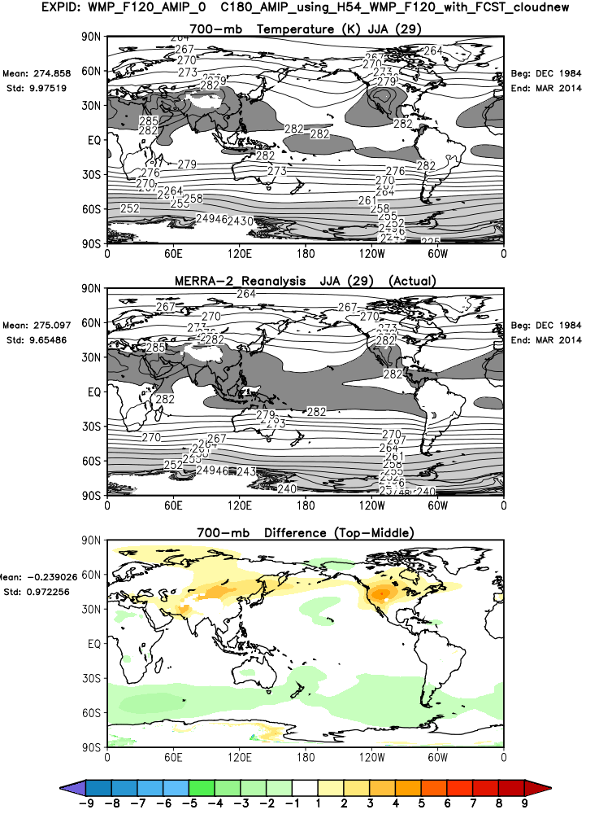
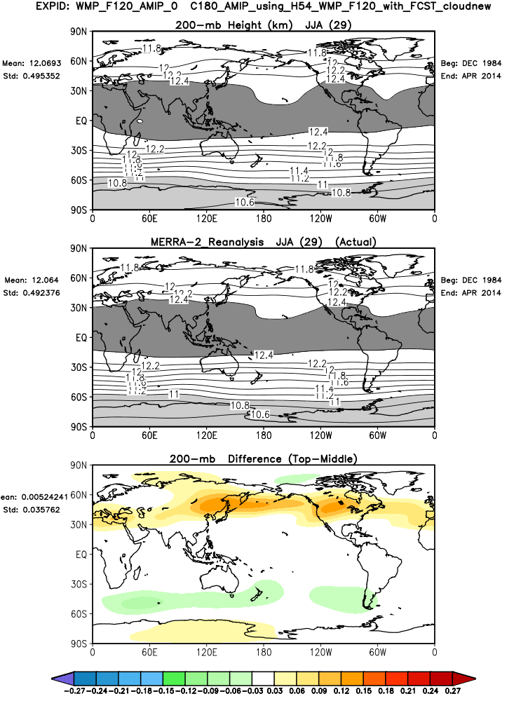
WMP_F120_AMIP_0 : typical (for AGCM) zonal mean wind bias – northward shift of the jet
Associated positive height bias, similar to that associated with decadal drought in NH
T2m
T850
T700
200z

Slide 5
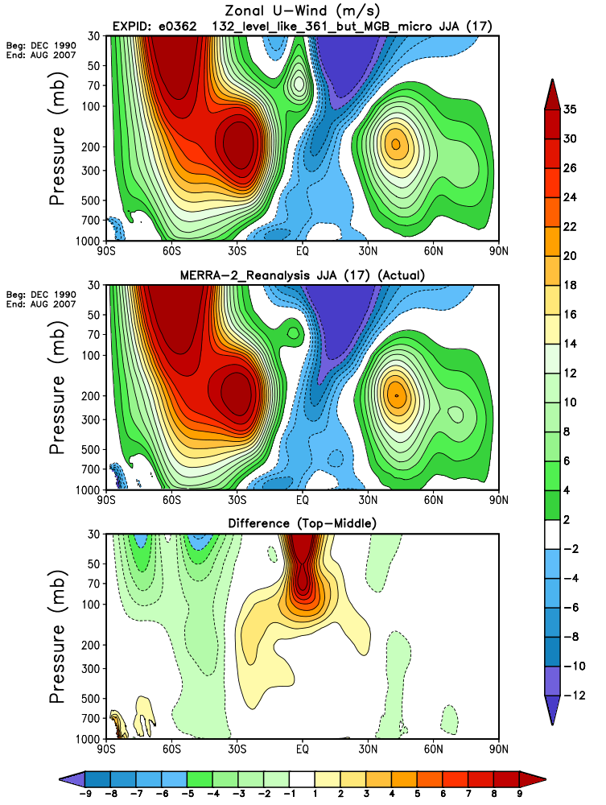
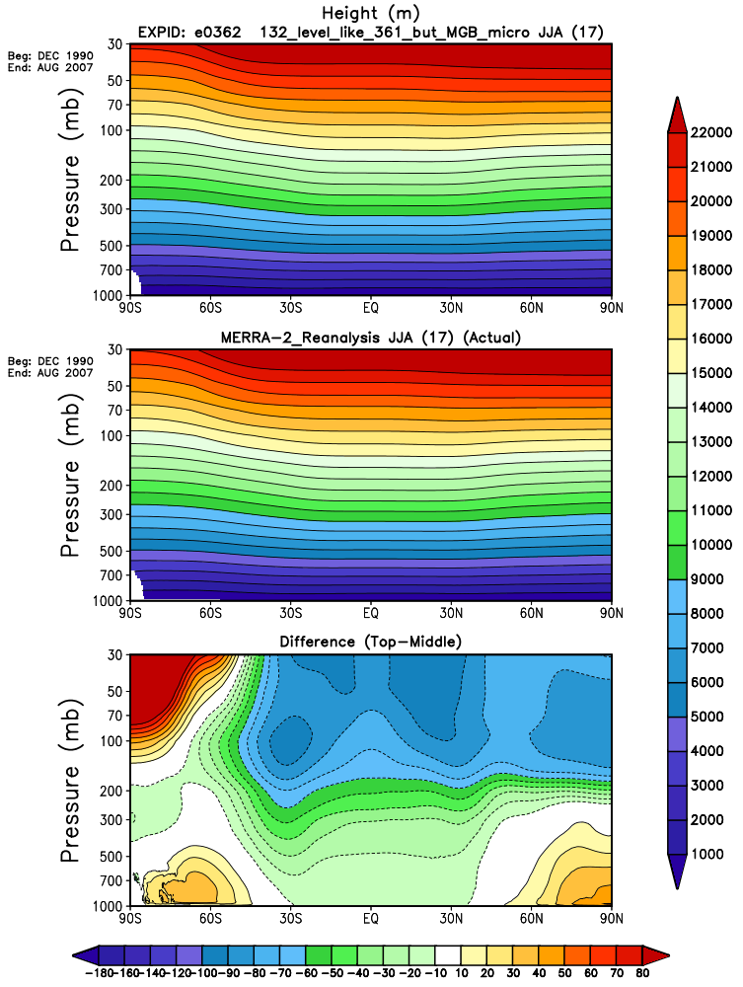
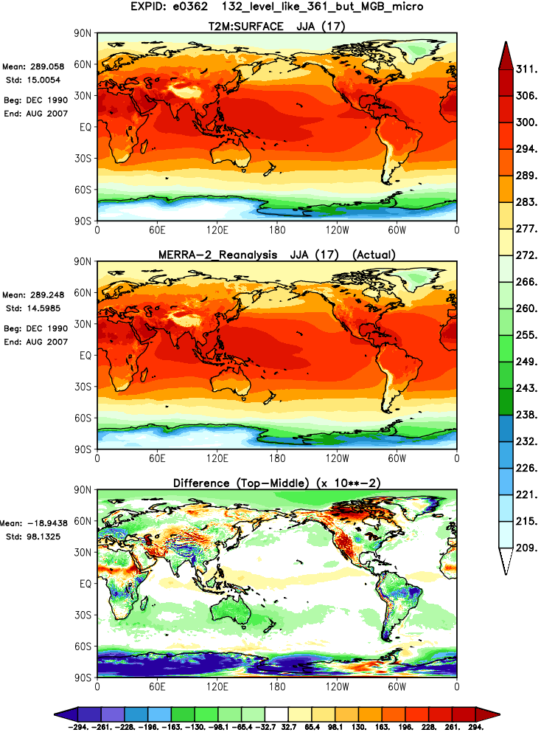
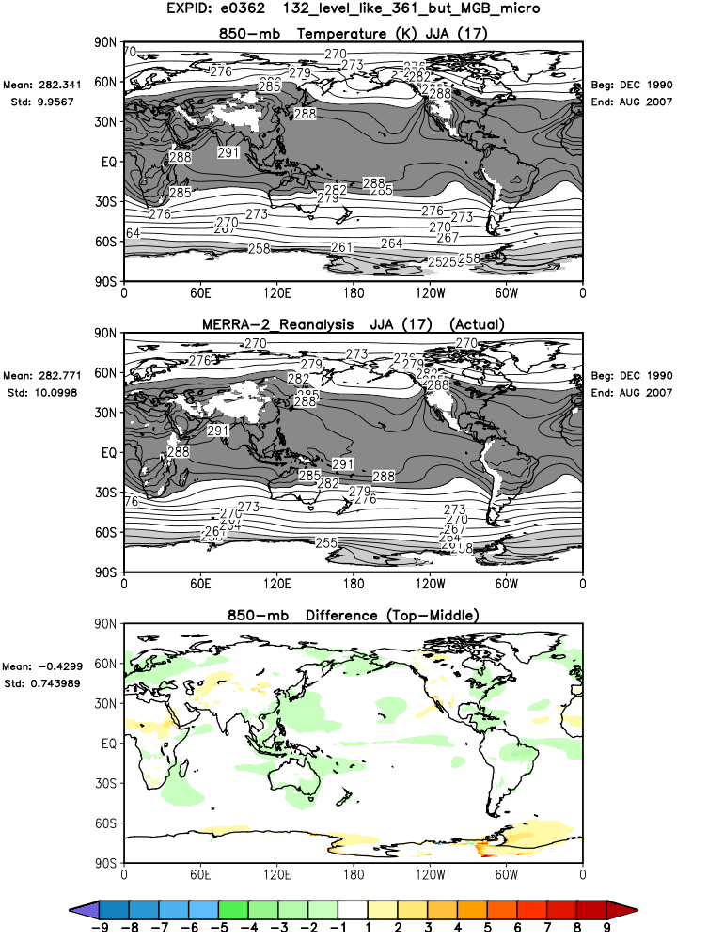
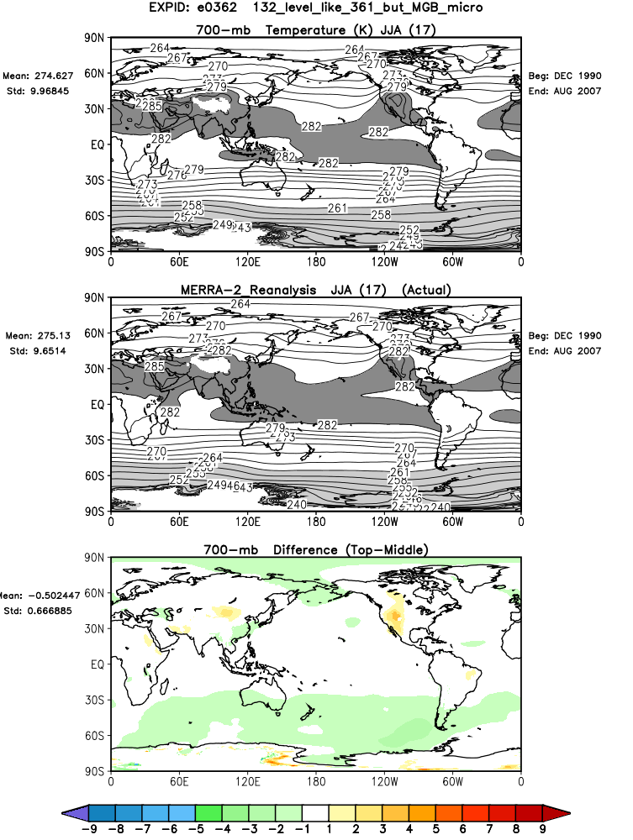
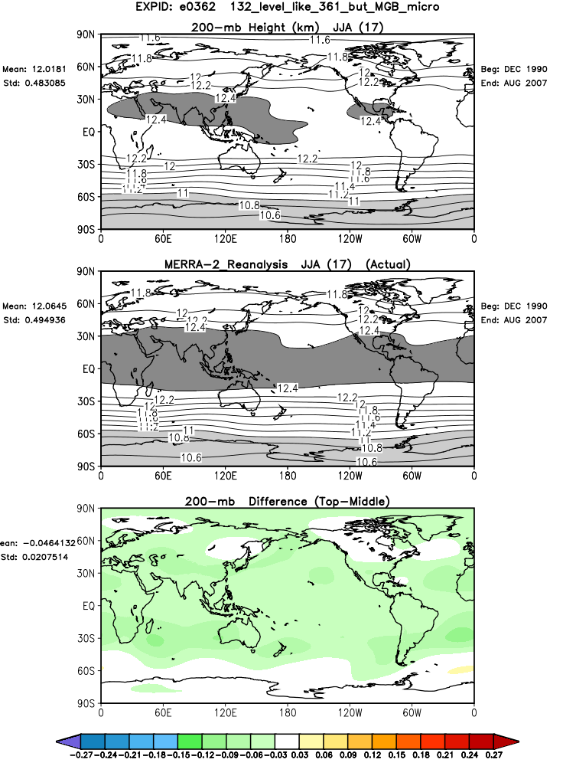
a0362: 132 levels, unusual compared to other AGCM versions in having unbiased zonal mean wind in NH extratropics
Slight negative height bias – though little in middle latitude troposphere
Much reduced T2m bias largely confined to high topography
T2m
T850
T700
200z

Slide 6
Coupled run
H54p3c90o1_4: exhibits typical coupled model zonal mean wind bias (enhanced subtropical westerlies), and considerably different (from AGCM) T2m bias

Slide 7
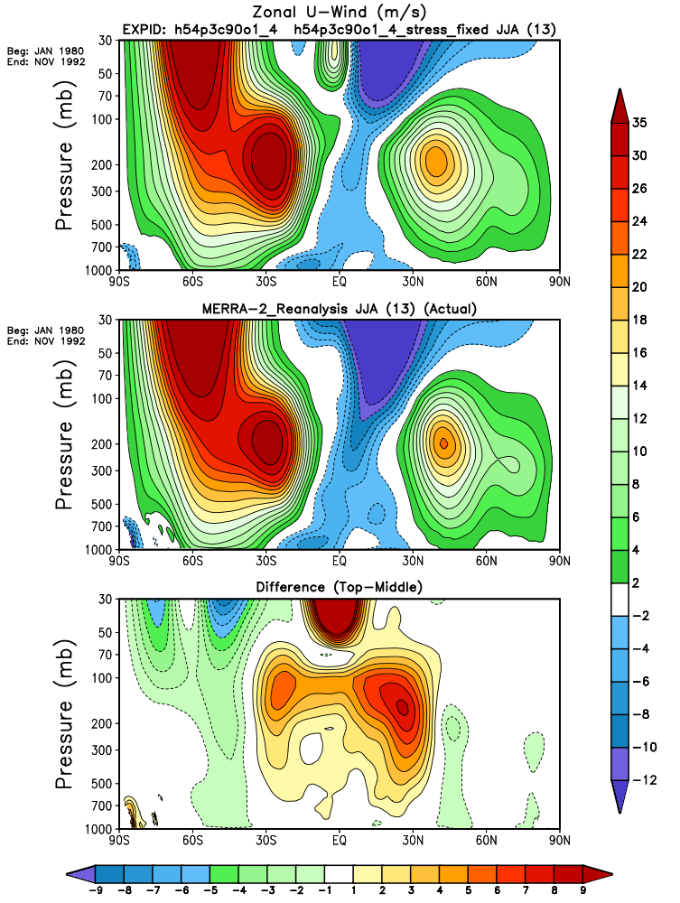
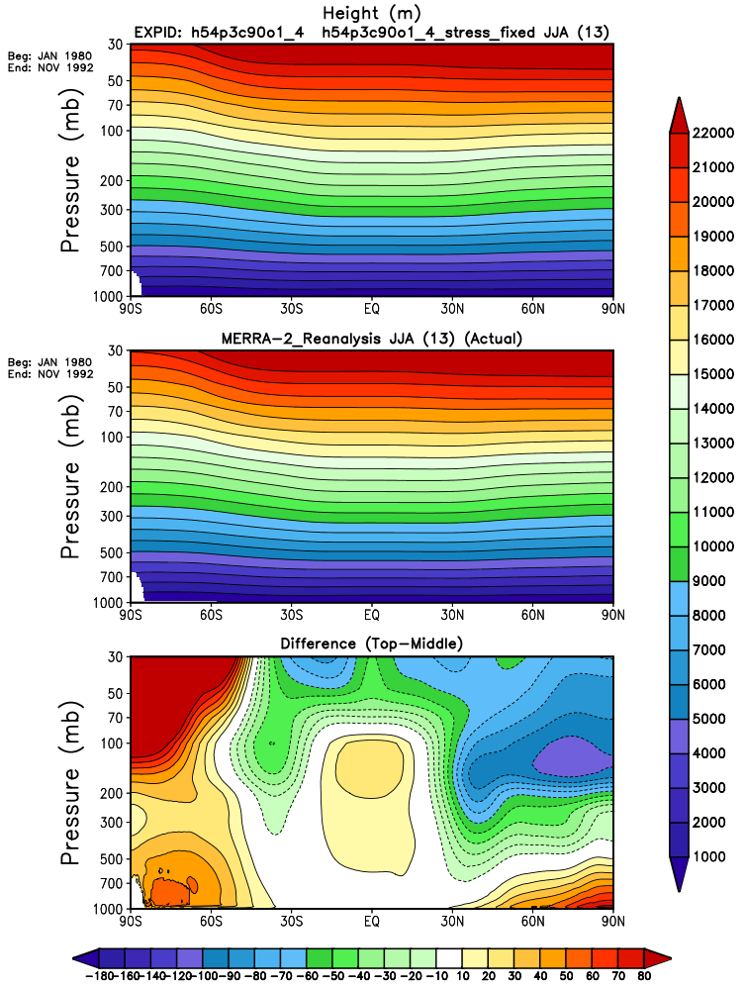
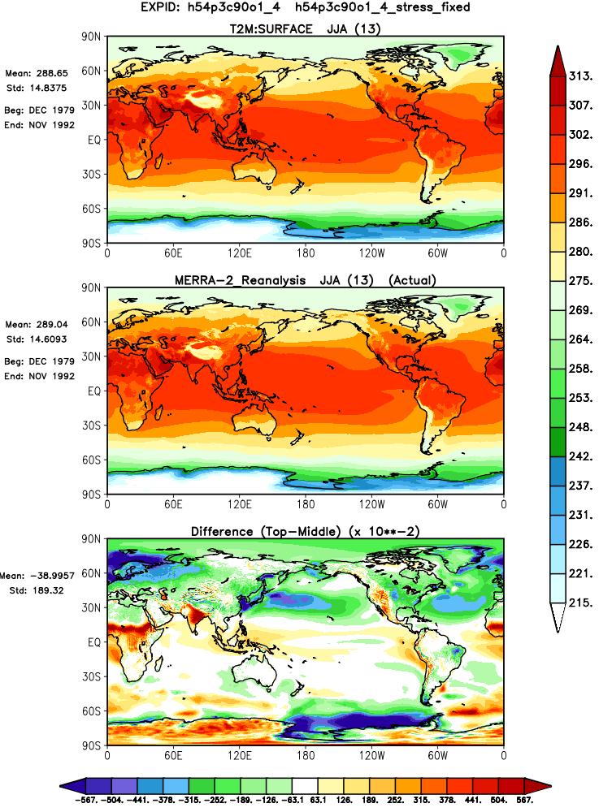
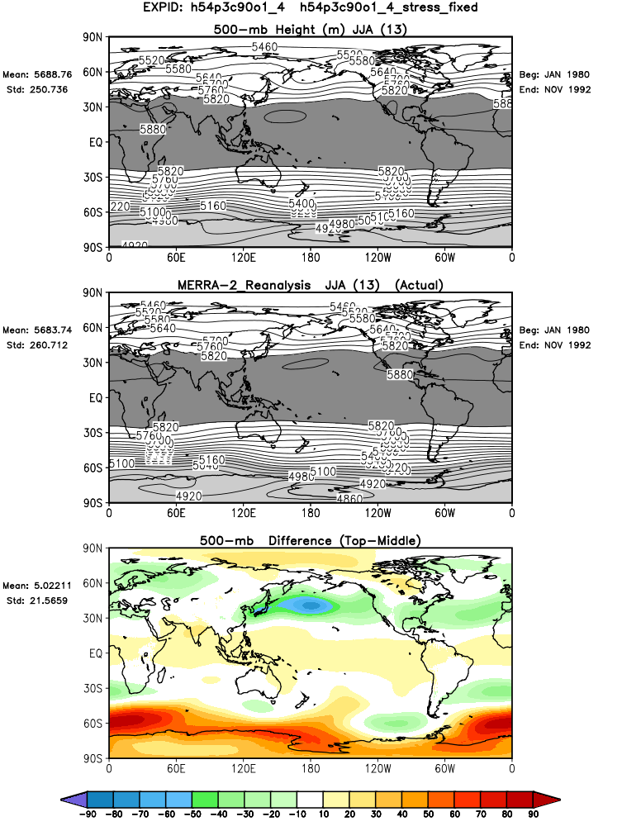
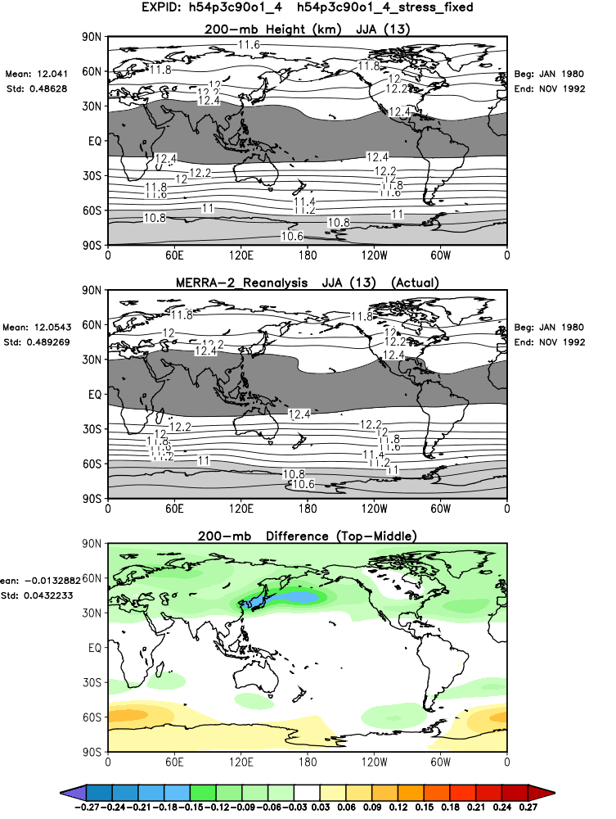
Zonal wind bias likely driven by double ITCZ bias: enhanced subtropical westerlies
Associated negative height bias near 30N
T2m biases more cold than warm
T2m
500z
200z

Slide 8
Additional Coupled Model Example
Test208 is interesting because it has a rather good ITCZ (compared with recent versions that have very strong double ITCZ bias), and so has biases much more like the AGCMs

Slide 9
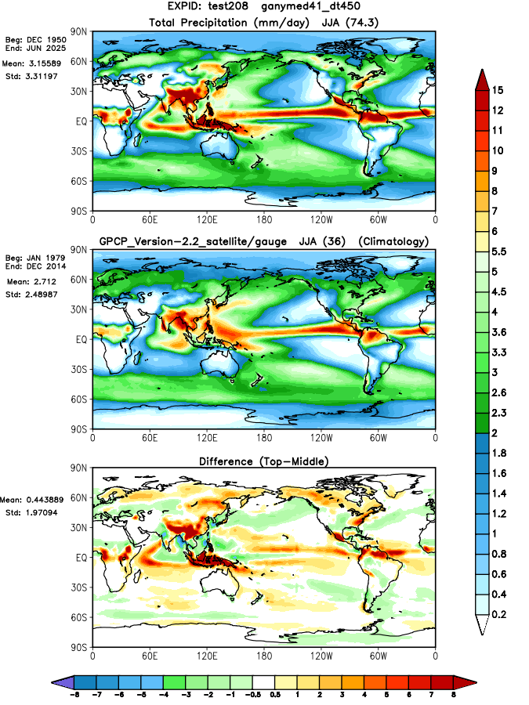
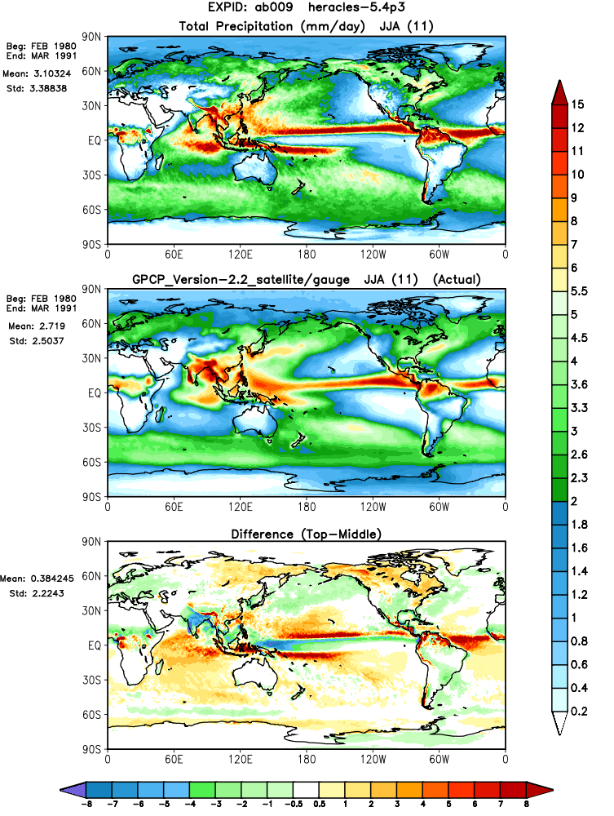
Reduced double ITCZ bias

Slide 10
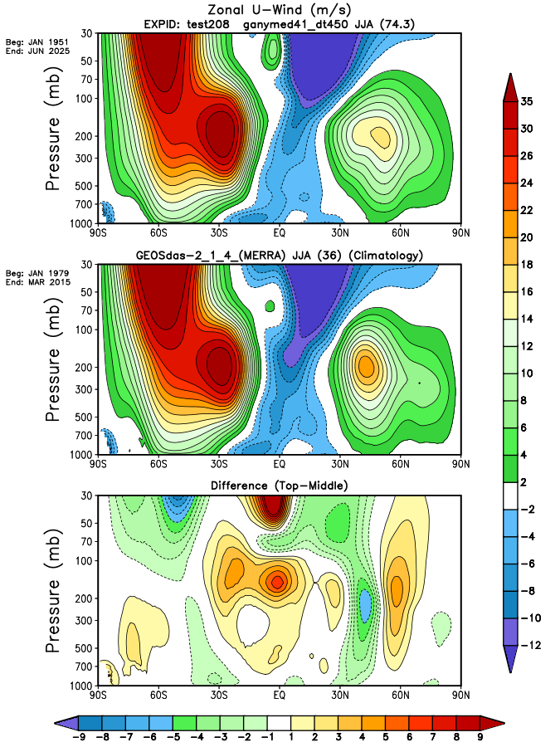
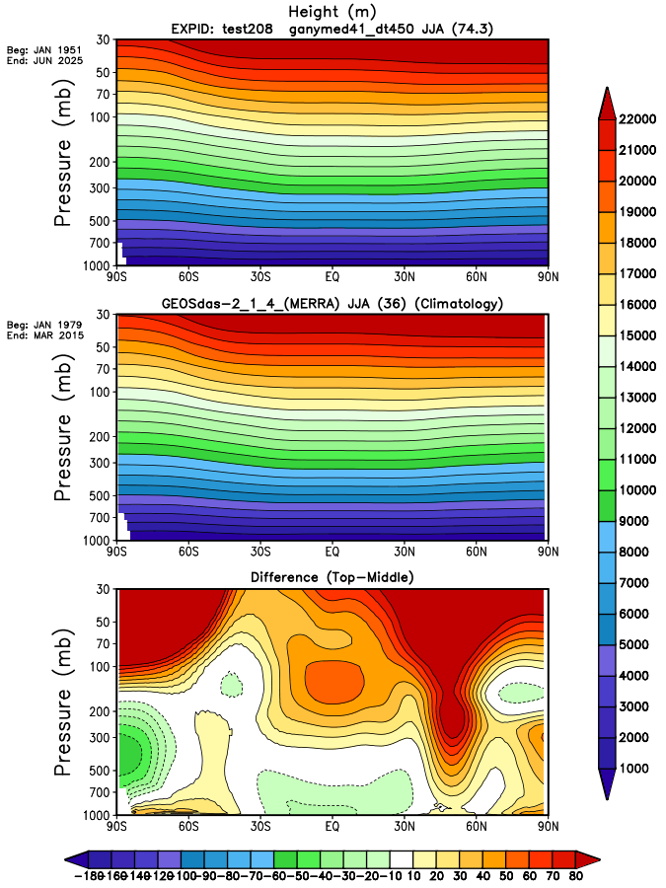
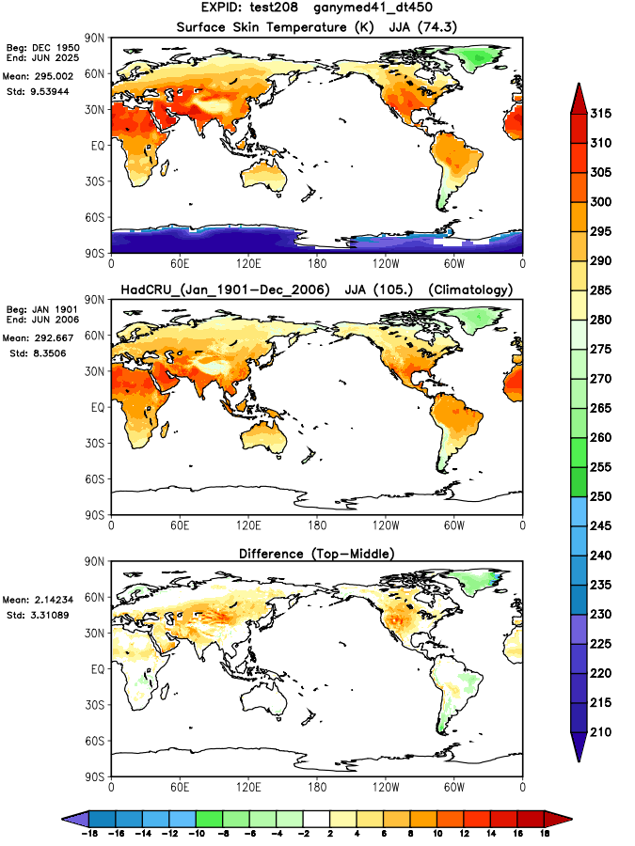
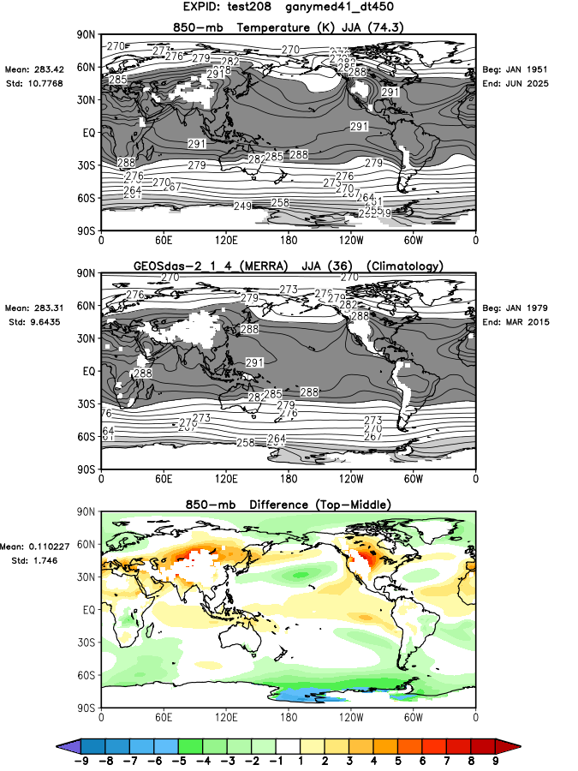
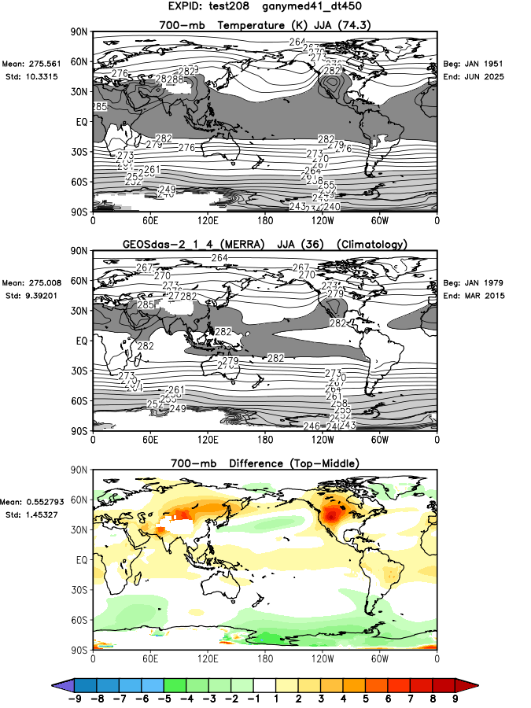
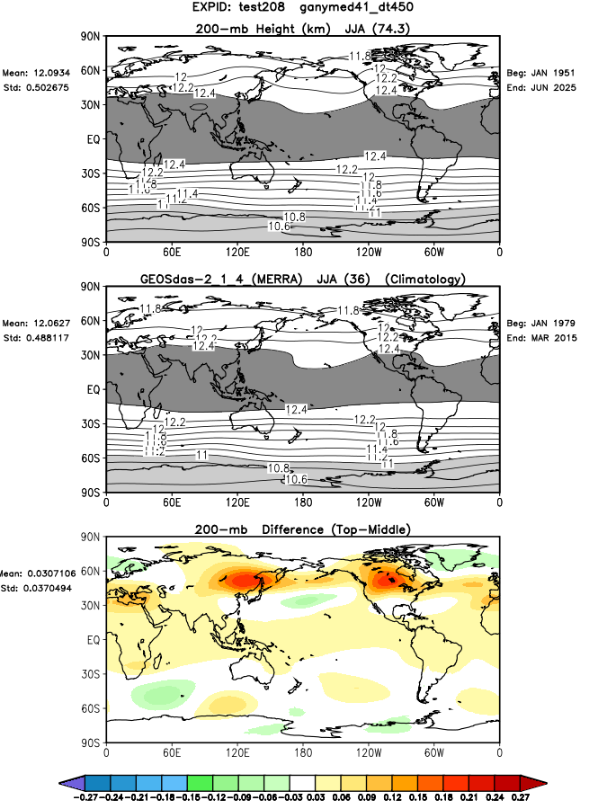
Test208 : coupled but has typical (for AGCM) zonal mean wind bias – northward shift of the jet
Associated positive height bias, similar to that associated with decadal drought in NH
Skin T
T850
T700
200z

