Slide 1
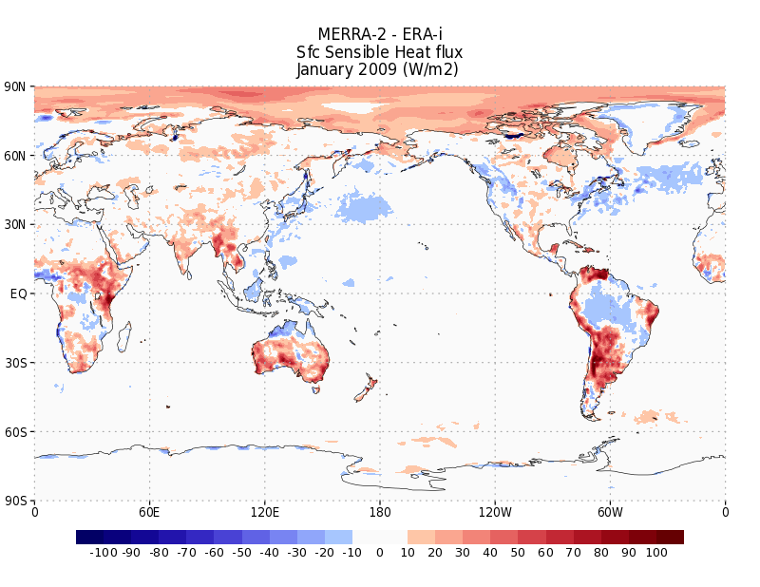
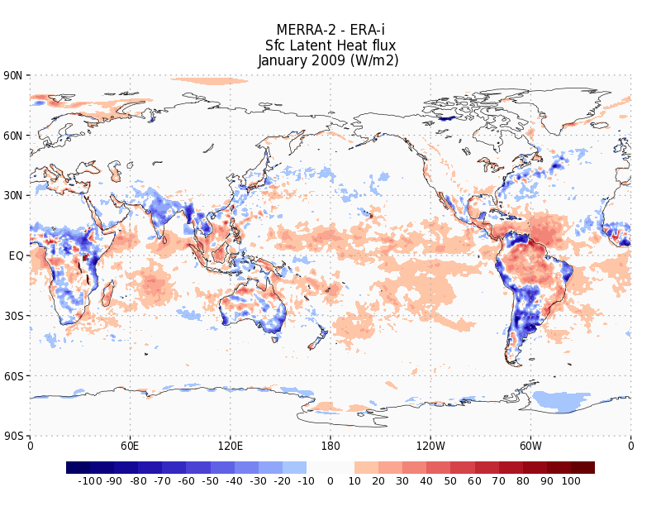
Even though we believe this is strongly diurnal, it still shows up in monthly means
As should some net difference
Sfc ΔT = Qnet – Sensible Heat Flux – Latent Heat Flux + Ground Heat Flow
Qnet = (Downwelling Shortwave + Upwelling Shortwave (albedo)) + (Downwelling Longwave – Upwelling Longwave)
Substituting the GEOS-5 expressions for each of these fields gives:
Sfc DeltaT = (swgdn + (swgdn – swgnt) ) + (lwgdn – (lwgdn – lwgnt) ) - hflux – eflux + ghland
A B C D E F G
…and we have all of these expressions for ERA-interim except ghland (which may turn out to be very important)
We can quickly eliminate terms E and F
It isn’t latent heat flux
In the Sahara Desert

Slide 2
Sfc Delta-T = Qnet – Sensible Heat Flux – Latent Heat Flux + Ground Heat Flow
Qnet = (Downwelling Shortwave + Upwelling Shortwave (albedo)) + (Downwelling Longwave – Upwelling Longwave)
Substituting the GEOS-5 expressions for each of these fields gives:
Sfc DeltaT = (swgdn + (swgdn – swgnt) ) + (lwgdn – (lwgdn – lwgnt) ) + ghland
A B C D G
…and we have all of these expressions for ERA-interim except ghland (which may turn out to be very important)
We can quickly eliminate terms E and F

Slide 3
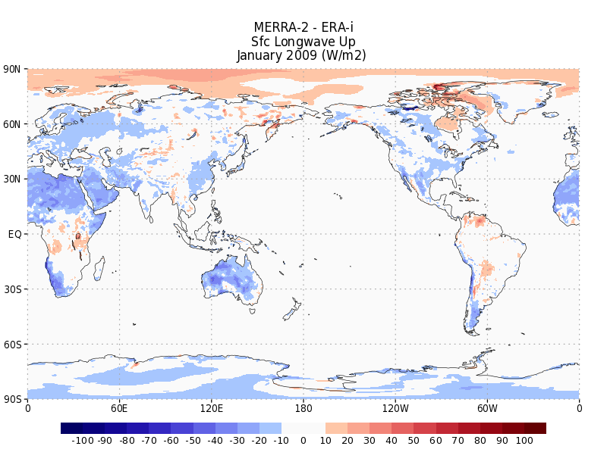
Sfc ΔT = Qnet – Sensible Heat Flux – Latent Heat Flux + Ground Heat Flow
Qnet = (Downwelling Shortwave + Upwelling Shortwave (albedo)) + (Downwelling Longwave – Upwelling Longwave)
Substituting the GEOS-5 expressions for each of these fields gives:
Sfc ΔT = (swgdn + (swgdn – swgnt) ) + (lwgdn) + ghland
A B C G
…and we have all of these expressions for ERA-interim except ghland (which may turn out to be very important)
Term D, upwelling longwave, by definition has
To be lower in MERRA-2, it says that we have
A cold bias…so it isn’t contributing to the bias

Slide 4
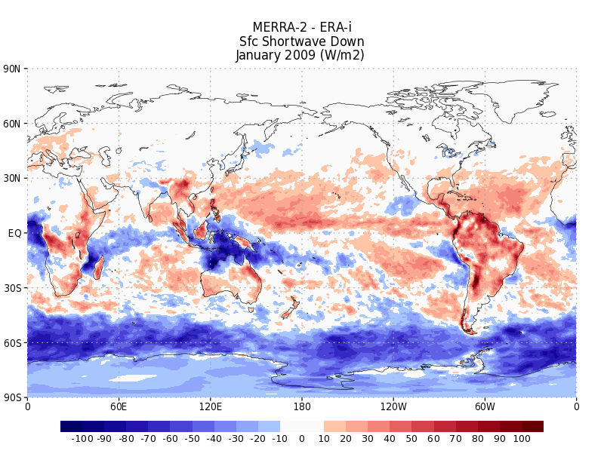
Sfc ΔT = Qnet – Sensible Heat Flux – Latent Heat Flux + Ground Heat Flow
Qnet = (Downwelling Shortwave + Upwelling Shortwave (albedo)) + (Downwelling Longwave – Upwelling Longwave)
Substituting the GEOS-5 expressions for each of these fields gives:
Sfc ΔT = (swgdn – swgnt) ) + (lwgdn) + ghland
B C G
…and we have all of these expressions for ERA-interim except ghland (which may turn out to be very important)
Downwelling Shortwave, A, could be an issue in cloudy regions…but
It looks pretty good compared with ERA-interim in the desert.

Slide 5
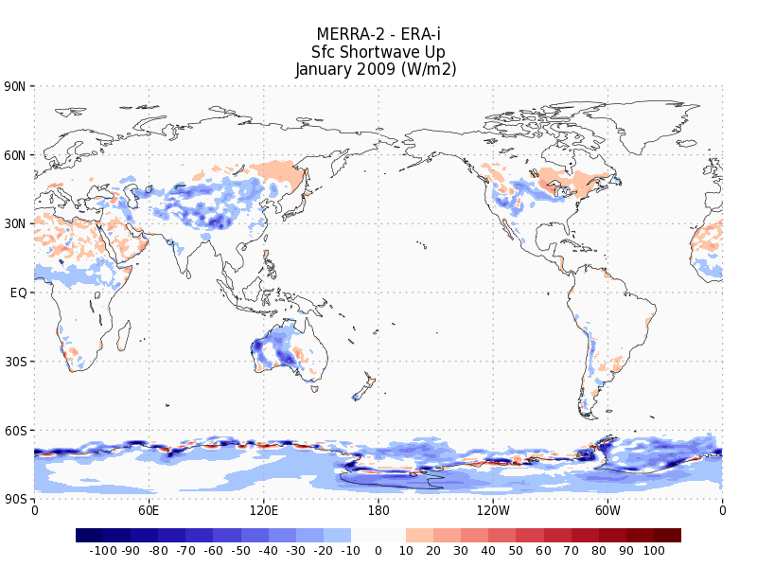
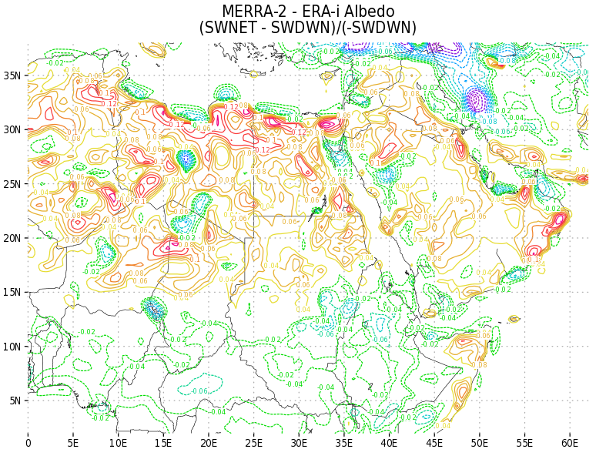
Sfc ΔT = Qnet – Sensible Heat Flux – Latent Heat Flux + Ground Heat Flow
Qnet = (Downwelling Shortwave + Upwelling Shortwave (albedo)) + (Downwelling Longwave – Upwelling Longwave)
Substituting the GEOS-5 expressions for each of these fields gives:
Sfc ΔT = (swgdn – swgnt) ) + (lwgdn) + ghland
B C G
…and we have all of these expressions for ERA-interim except ghland (which may turn out to be very important)
Upwelling shortwave , B…the albedo factor may be contributing
to the cold bias in some small way (slightly brighter, slightly less sfc. net)

Slide 6
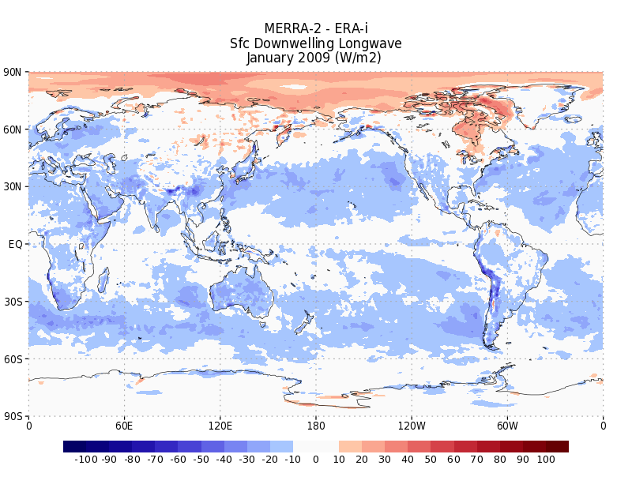
Sfc ΔT = Qnet – Sensible Heat Flux – Latent Heat Flux + Ground Heat Flow
Qnet = (Downwelling Shortwave + Upwelling Shortwave (albedo)) + (Downwelling Longwave – Upwelling Longwave)
Substituting the GEOS-5 expressions for each of these fields gives:
Sfc ΔT = (swgdn – swgnt) ) + (lwgdn) + ghland
B C G
…and we have all of these expressions for ERA-interim except ghland (which may turn out to be very important)
The Downwelling longwave term could be important. If we have clouds and aerosols
Radiating at the appropriate temperature, it should be close to ERA-i. And while not
Exactly like ERA-i , the mean difference is only on order of 10 to maybe 15 W/m2…
not enough to be the 2-3K differences we see
While we see a lot
Of blue over the desert
It is in the 10W/m2 range

Slide 7
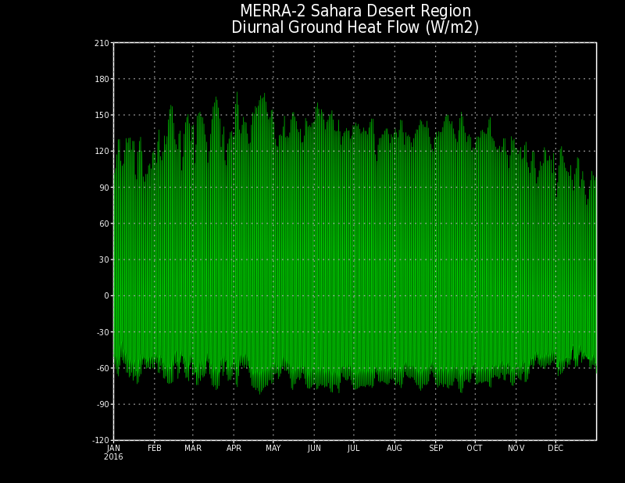
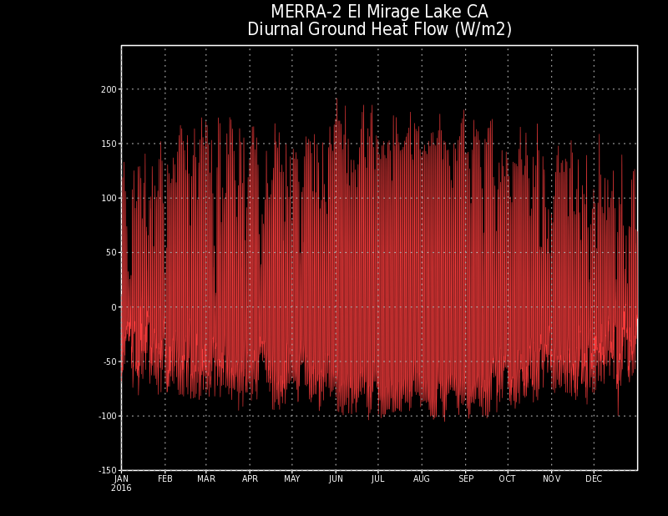
It turns out the ground heat flow term has a large diurnal cycle in deserts
The equation describing the conduction of heat through the ground
G = Ks * ΔT / Δdepth,
where Ks is the thermal conductivity (dependent on ground type soil, clay, sand)

Slide 8
