Slide 1
Update on proposed land surface model changes (code and BCs):
Results from AMIP simulations

Slide 2
Averaged over a long time period (so that storage changes are small), a land surface model partitions precipitation (P) into evapotranspiration (E) and runoff (Q):
P = E + Q
Long known problem: the Catchment LSM overestimates E. Runoff ratios (Q / P) tend to be too small.
Standard version of LSM
Revised version (never implemented in GEOS5)
Obs
Offline simulation results
(from Koster and Mahanama 2012)

Slide 3
[Offline results] Our latest set of changes for the land model largely corrects this problem (as well as addressing other issues):
observations
next bar over (dark blue): current model
final bar: new version

Slide 4
Today: a discussion of what happens when the new version is tested in the coupled environment – particularly in terms of what happens to near surface air temperature (T2M).
Control: H54p3_ctrl4M3 (tag: Heracles-5_4_p3) 7.5 years (7 JJAs, 8 DJFs)
Experiment: H54p3_v24C05_GOSWIM_zerodiff (tag: H54p3_v24C05_GOSWIM_zerodiff - NO GOSWIM)
7.5 years (7 JJAs, 8 DJFs)

Slide 5
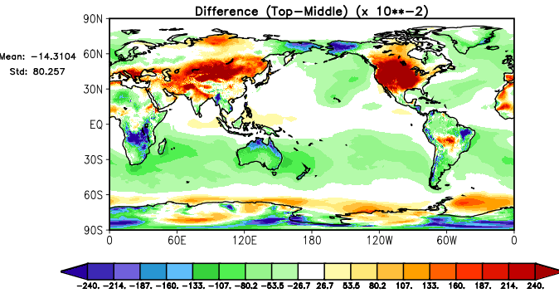
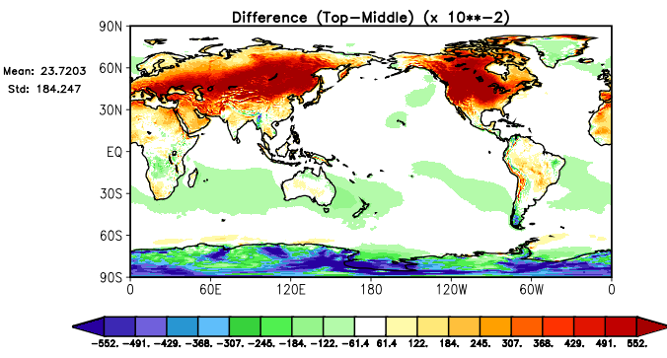
Case 1: JJA
T2M: Control minus observations
GEOS5 already has a warm bias in n.h. summer
T2M: New version minus observations
The bias worsens in the new version
Units: °K (in all temperature plots)

Slide 6
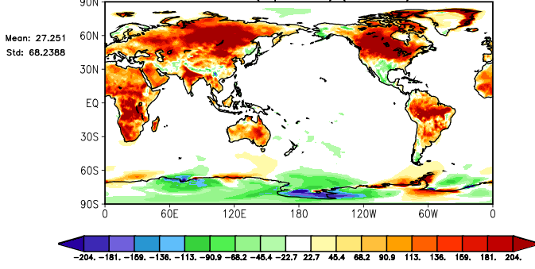
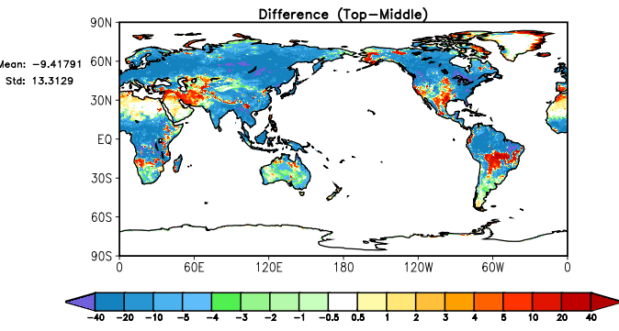
JJA T2M: new version – old version
Differences
JJA latent heat flux: new version – old version
We know why this happens: to produce more realistic runoff ratios, we changed the code to favor runoff at the expense of evaporation (latent heat)
W/m²

Slide 7
At first glance, it looks like our changes are detrimental to the coupled system. However, we hypothesize that the degradation in JJA T2M results (at least partly) from the fact that we corrected half of a set of compensating errors in GEOS5:
Downwelling radiation at surface too high: too much heating
Evapotranspiration too high: too much evaporative cooling
On balance, T2M somewhat overestimated
Current GEOS-5:
Downwelling radiation at surface too high: too much heating
Evapotranspiration and evaporative cooling reasonable
On balance, T2M strongly overestimated
New version:

Slide 8
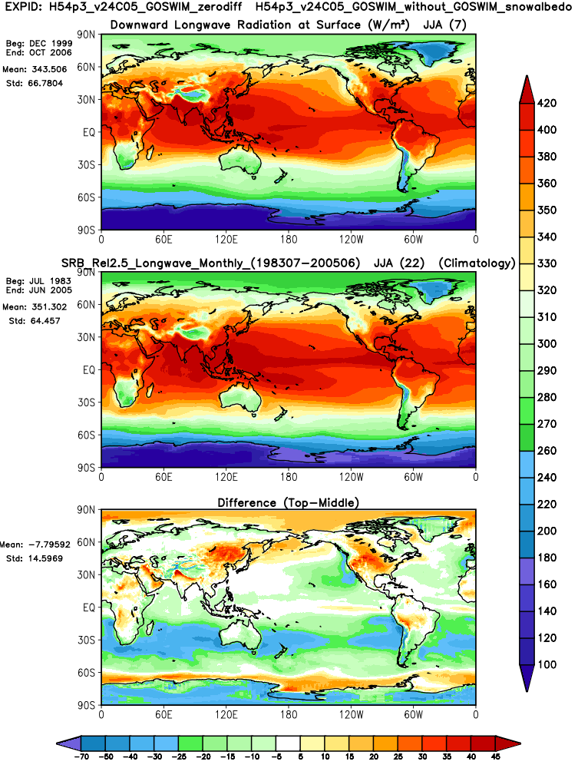
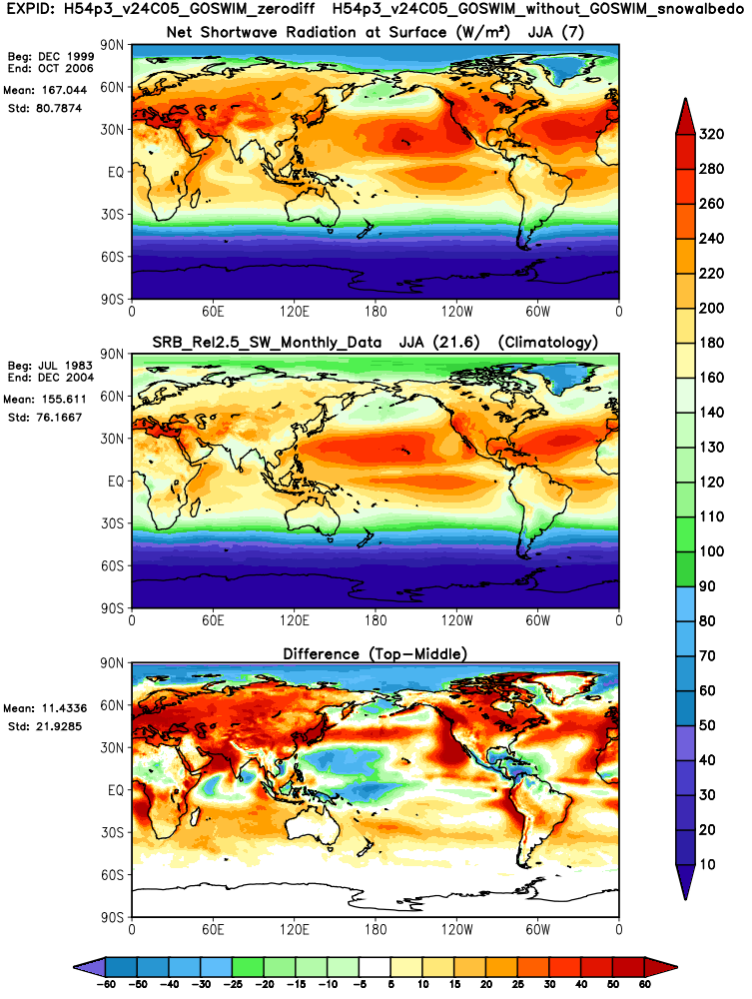
All-sky JJA surface radiation biases in Control simulation (relative to SRB)
downwelling longwave
T2m temperature bias
(new version; relative to SRB)
net shortwave
W/m²

Slide 9
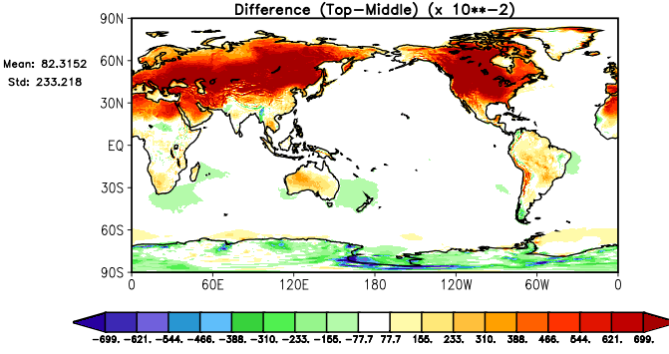
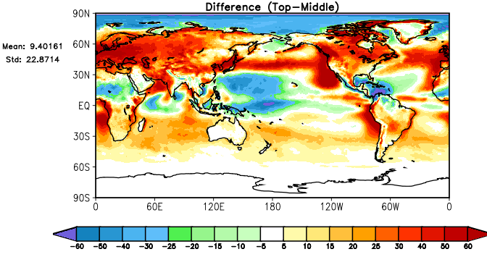
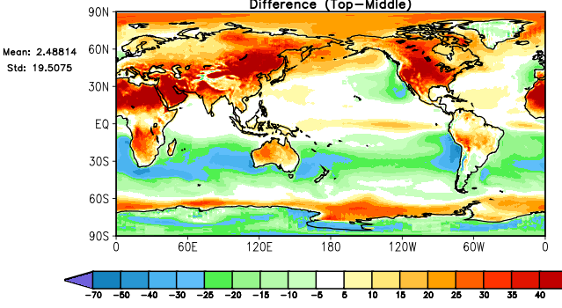
Note: going to RTMG radiation only made things worse, due to increased longwave…
T2m temperature bias
(new version; relative to MERRA2)
all-sky net solar radiation bias
(new version; relative to SRB)
all-sky downward LW bias
(new version; relative to SRB)
T2m temperature bias (new version but w/RTMG; relative to MERRA2)
all-sky net solar radiation bias (new version but w/RTMG; relative to SRB)
all-sky downward LW bias (new version but w/RTMG; relative to SRB)

Slide 10
Philosophical question: if it turns out to be true that our changes fix half of a pair of compensating errors and thereby make one aspect of climate (T2M) worse, should the changes be included?
Downwelling radiation at surface too high: too much heating
Evapotranspiration too high: too much evaporative cooling
On balance, T2M somewhat overestimated
Current GEOS-5:
Downwelling radiation at surface too high: too much heating
Evapotranspiration and evaporative cooling reasonable
On balance, T2M strongly overestimated
New version:

Slide 11
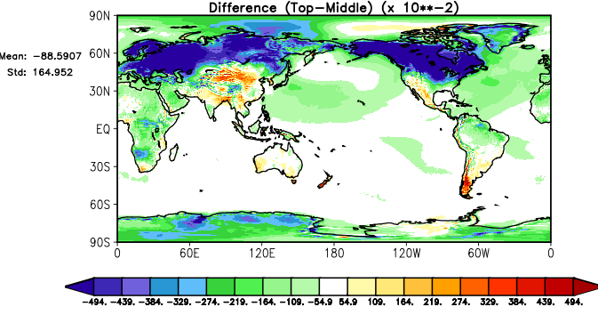
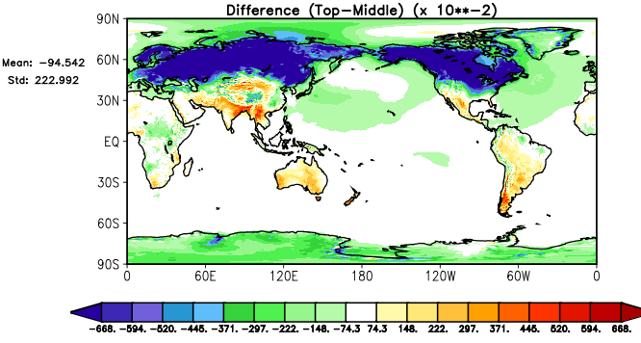
Case 2: DJF
T2M: Control minus observations
GEOS5 already has a cold bias in n.h. winter
T2M: New version minus observations
The bias gets worse in the new version

Slide 12
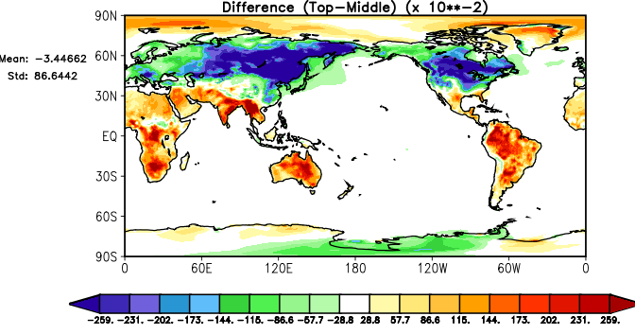
Differences
DJF T2M: new version – old version
Why? We can’t blame increased evapotranspiration, since that is negligible in DJF.
Some other change that we made is responsible…

Slide 13
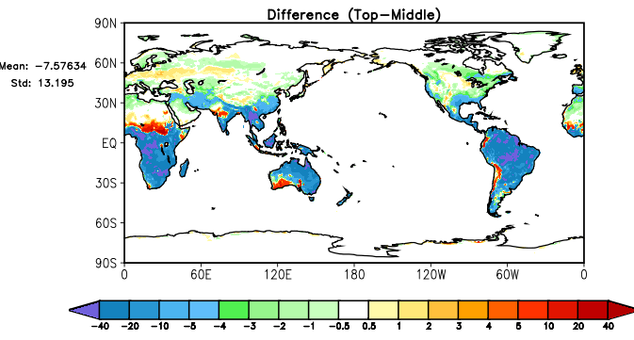
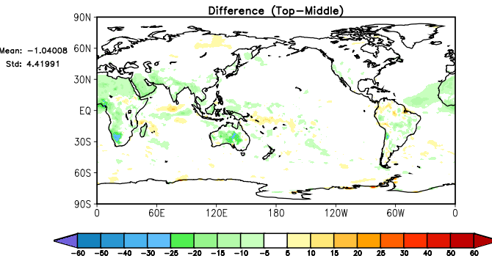
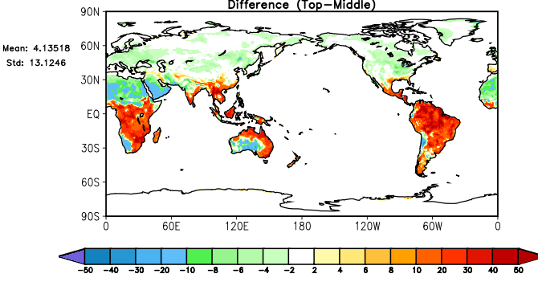
DJF T2M: new version – old version
Changes in DJF energy balance terms
change (exp-ctl) in latent heat flux
change (exp-ctl) in all-sky net radiation
Can’t see any reason for why things get colder!
change (exp-ctl) in sensible heat flux

Slide 14
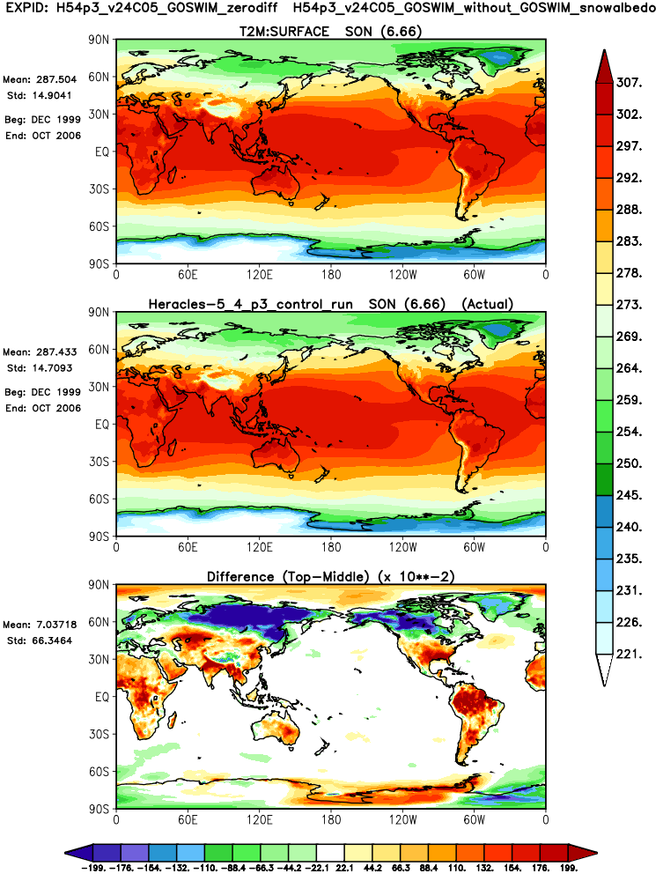
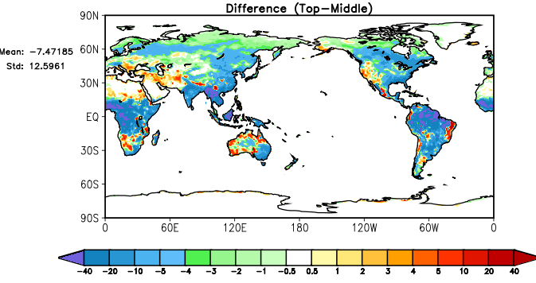
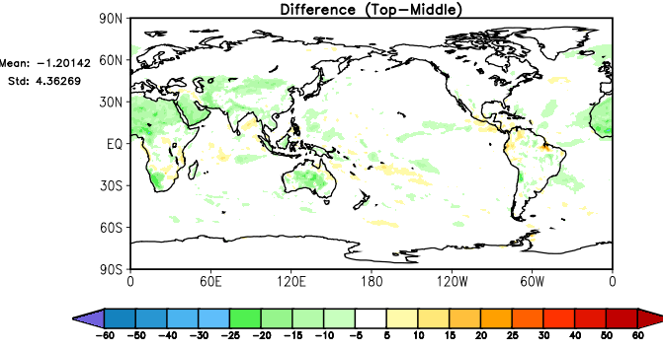
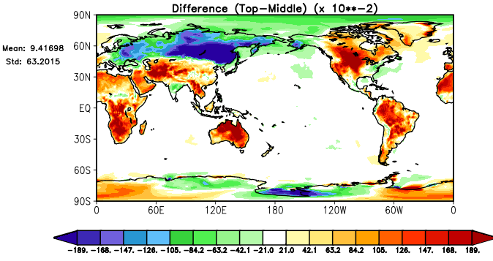
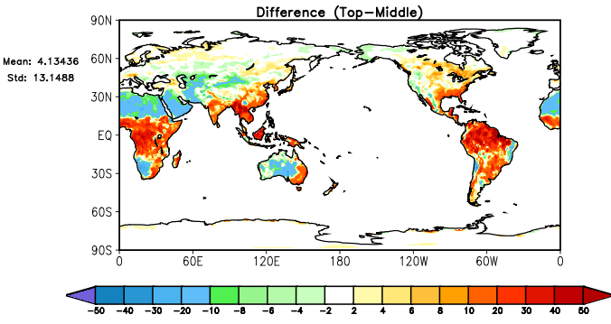

Maybe something happened in the prior season?
No. Changes in SON energy balance terms:
SON T2M: new version – old version
DJF T2M: new version – old version
change (exp-ctl) in latent heat flux
MAM T2M: new version – old version
change (exp-ctl) in all-sky net radiation
JJA T2M: new version – old version
change (exp-ctl) in sensible heat flux

Slide 15
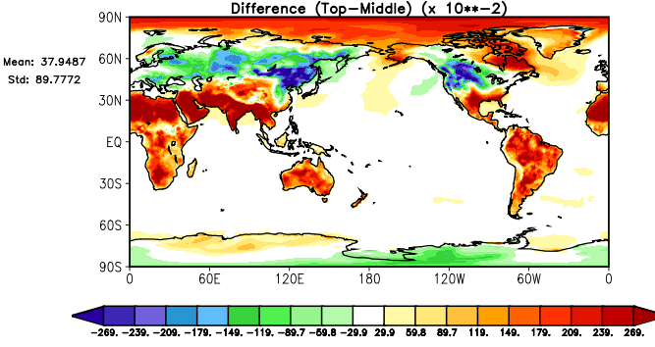
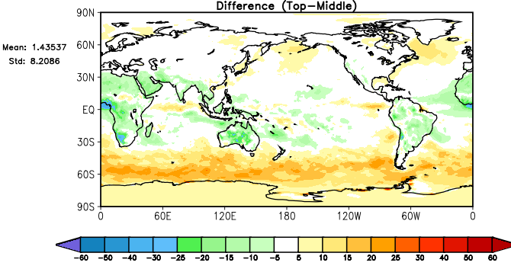
Original Radiation
Using RTMG code
DJF T2M: new version – old version
DJF T2M: new version – old version
change (exp-ctl) in all-sky net radiation
change (exp-ctl) in all-sky net radiation

Slide 16
So, simply put, we don’t know what’s going on in DJF…

