Slide 1
MERRA-2 Water Cycle
Michael Bosilovich
Why the reanalysis water cycle is a challenge
  Water vapor is difficult to assimilate
  Precipitation is very difficult to forecast
Ultimately encompasses weather and climate features of research and societal importance
NASA observations/data assimilated and useful in validation

Slide 2
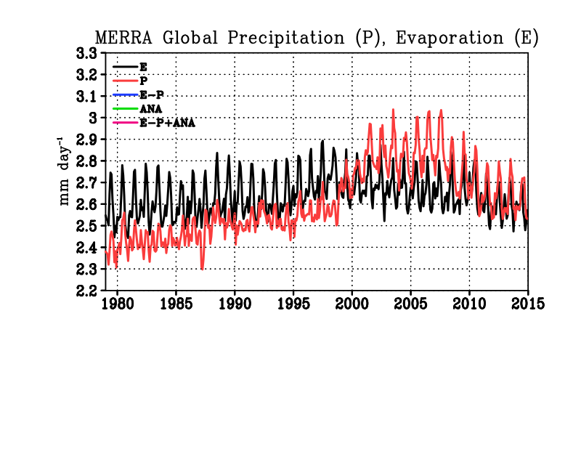
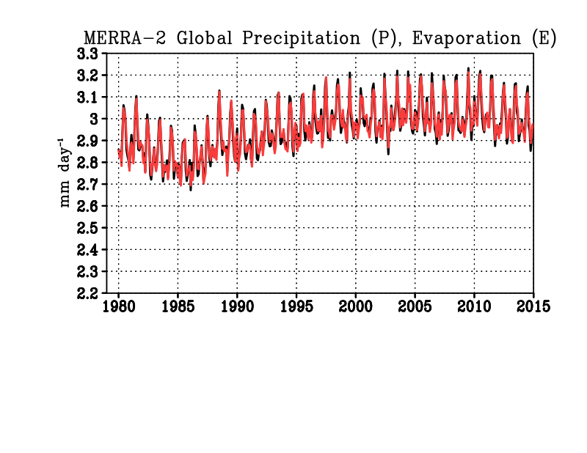
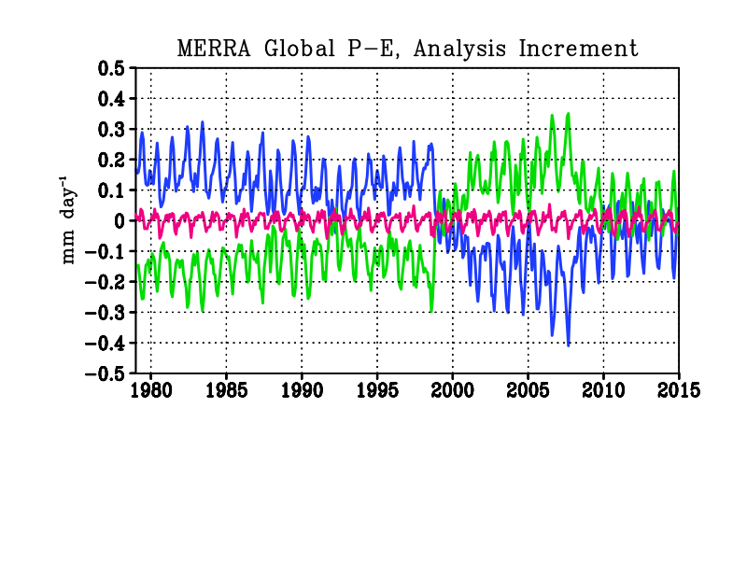
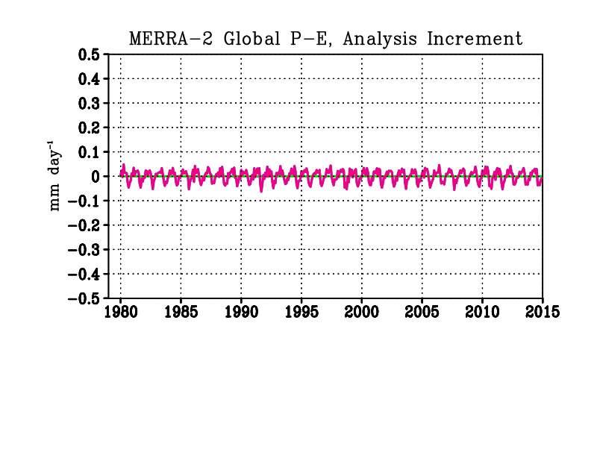
Global precipitation, evaporation and analysis forcing
Model/analysis dry mass conservation allow total mass variations only to water (Takacs et al., NASA GMAO Tech Memo, 2015; recently accepted QJRMS paper)
MERRA-2
MERRA
MERRA-2
In MERRA, imbalances of P and E result from analysis increments, sensitive to changes in the observing system.
In MERRA-2, global mass conservation is enforced and global balance between P, E is maintained
Notes:
MERRA allowed total mass to vary so that when the observing system changed significantly, the increments reverse sign, leading to a sign change in P-E. In the real world, P and E should be in global balance, so in MERRA-2 it is constrained.
Surface pressure and water vapor analyses are penalized for global imbalances

Slide 3
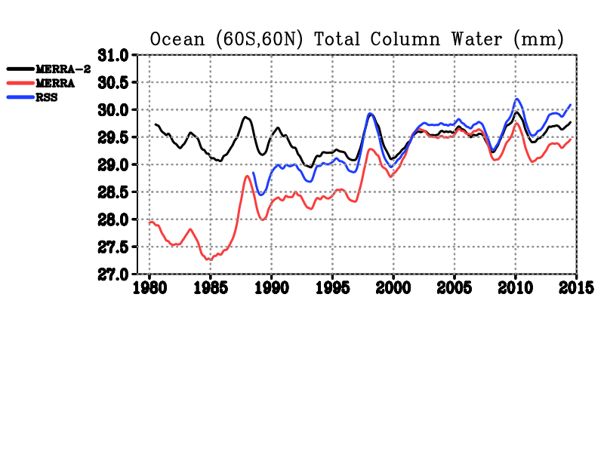
Total Column Water
MERRA-2 has slight increasing trend (as in Interim and JRA-55)
MERRA spurious jumps, not trend
None of the reanalyses match the SSMI trend (not shown)
Ocean (60S,60N) TPW (mm)
Global TPW (mm)
MERRA-2
SSM/I
MERRA
Notes:
The model is wet and getting wetter in time (from M2AMIP runs), while the increment is negative, and gets more negative in time. Not Shown: RSS TPW with Reynolds OISSTv2 shows 11% per degree change of water, MERRA TPW and SST shows 7% per degree (closer to CC)

Slide 4
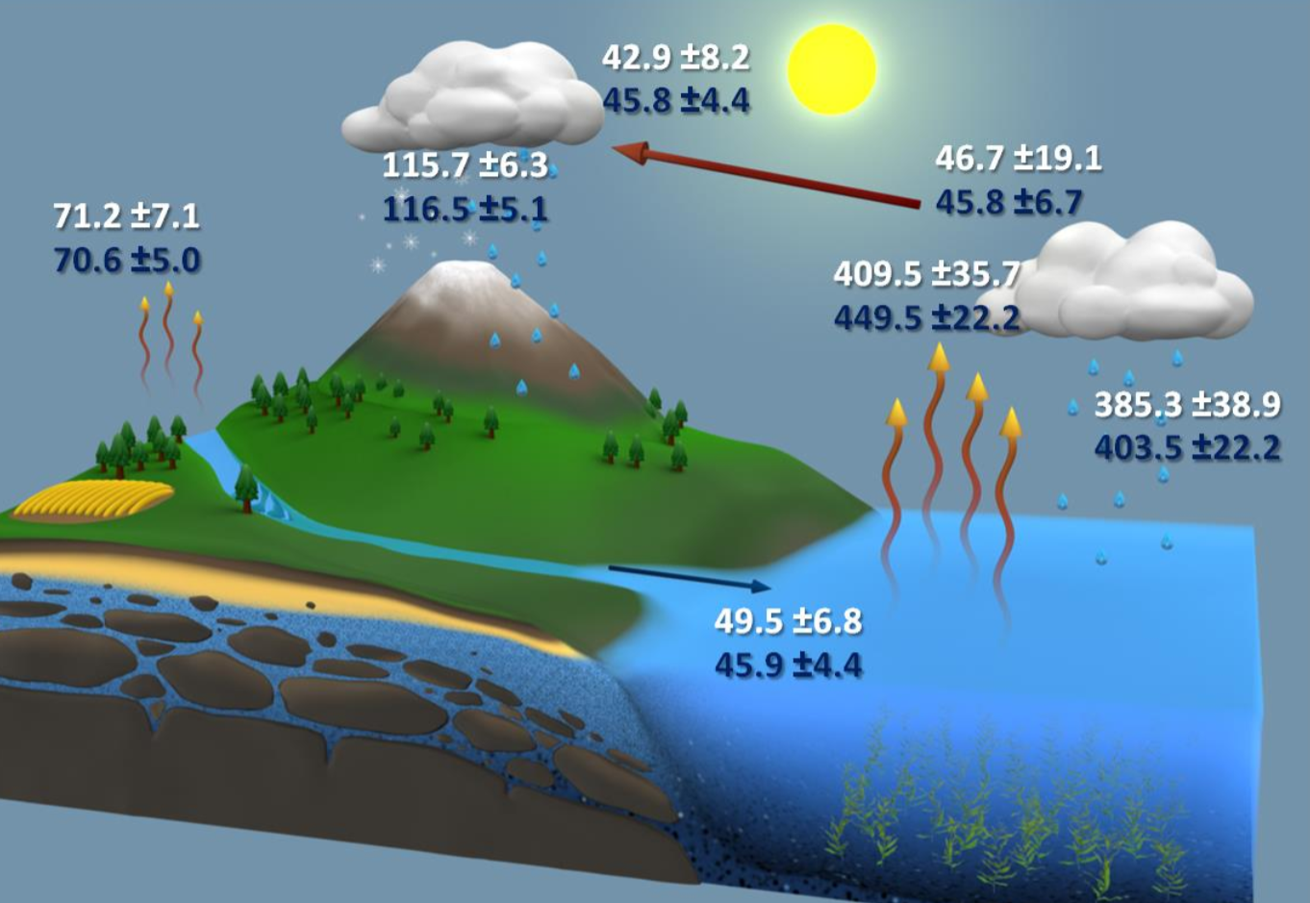

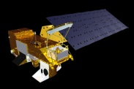
Comparison to NEWS Water Cycle
MERRA-2 water cycle tends to be strong
Overestimate of Ocean E → too much transport
Precipitation overestimated in the Tropical Land
18.2
-18.2
53.8
158.6
53.8
86.5
475.4
403.3
44.6
MERRA-2
×1000km³yr⁻¹
NEWS Optimized and Closed
Courtesy Matt Rodell and the NEWS Team (Rodell et al. 2015)
Notes:
Depiction of the global water cycle developed by NEWS (Rodell et al. 2015) from NASA observing systems for 2000-2010, including the collected data (white) and a balance corrected budget (blue), and MERRA-2 data in yellow. The 18.2×1000km³yr⁻¹value for ocean and land indicates the MERRA-2 analysis increment. The italicized yellow value of precipitation is the bias corrected land forcing precipitation. Uncertainty estimates were given by data providers and refined in the balanced budget. Units are ×1000km³yr⁻¹.
Main point: MERRA-2 water cycle leans to more intensity, where ocean E contributes to too much transoirt.. Over landthere is too much precipitation, generally relating to the tropical land.

Slide 5
Land/Ocean Water Mass Budgets
Land Evap follows the obs corrected Prec. Model precip over land follows the analysis trend
Ocean Precipitation and evaporation track each others variability, than the analysis increment
Increment jump in 2003 due to AIRS
MERRA-2 Transport does not trend over time
Evaporation Precipitation Transport Analysis
Notes:
Main points: the global precipitation time series follows the ocean variability closely. Obs impact the ocean E (SSMI winds, SST). Increments change over time and are noticeably affected by AIRS. The moisture transport has no trend over time, like other reanalyses, which is more comparable to E-P estimates from Global LDAS results.

Slide 6
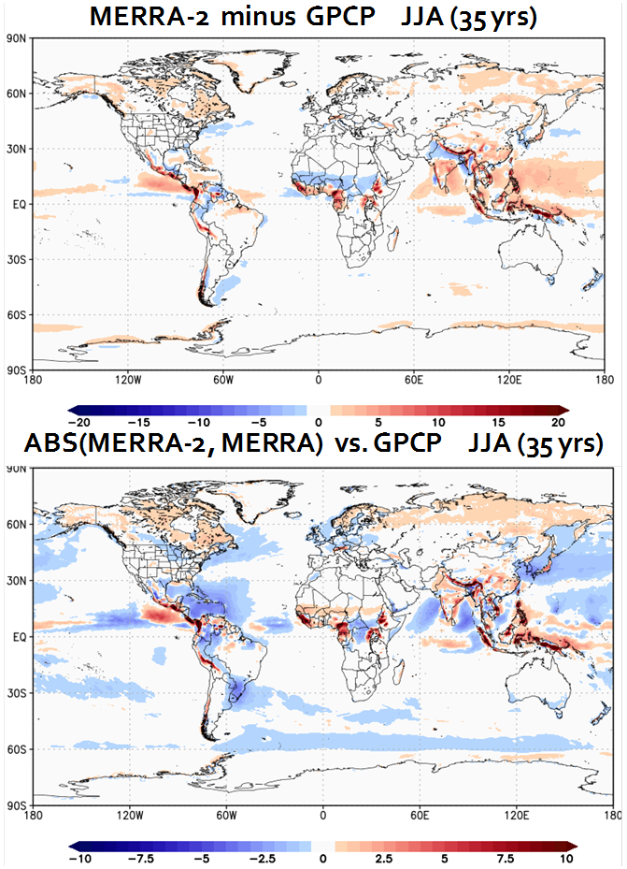
GPCP Climatology Comparison
Overestimate comes from tropical oceans, but also land, especially around topography
Numerous improvements; Intra-America Seas, Indian ocean and around warm currents
Notes:
Main point: broad improvements of mean precipitation are found in MERRA-2, mostly over the ocean. Some biases persist like the warm pool, and the tropical land precipitation has gotten worse.

Slide 7
Significant improvements over the US, Interannual variability
MERRA did not represent well seasonal extremes in the US; much improved in MERRA-2
Summer seasonal interannual correlation of with the observed anomalies is apparent across the US
Notes:
Main point: The MERRA-2 seasonal variations in precipitation are much improved over MERRA and other reanalyses, especially the Summer season

Slide 8
Water Cycle Summary
Global balance is constrained by design
  Total column water does not have spurious increasing jumps
  Global modeled precipitation is controlled by surface evaporation
Most components of the global water cycle tend to be stronger than observed
Excessive modeled precipitation over tropical land
  CONUS interannual summer modeled precipitation is improved
While global increments are constrained, they are affecting regions, and can change with the observing system changes

Slide 9
Total Column Water
MERRA-2 has slight increasing trend (as in Interim and JRA-55)
MERRA spurious jumps, not trend
None of the reanalyses match the SSMI trend
MERRA-2 Increments holding back the SST forcing on Evap
Global TPW (mm)
Ocean (60S,60N) TPW (mm)
SSM/I
MERRA-2
MERRA
Notes:
The model is wet and getting wetter in time (from M2AMIP runs), while the increment is negative, and gets more negative in time. Not Shown: RSS TPW with Reynolds OISSTv2 shows 11% per degree change of water, MERRA TPW and SST shows 7% per degree (closer to CC)

Slide 10
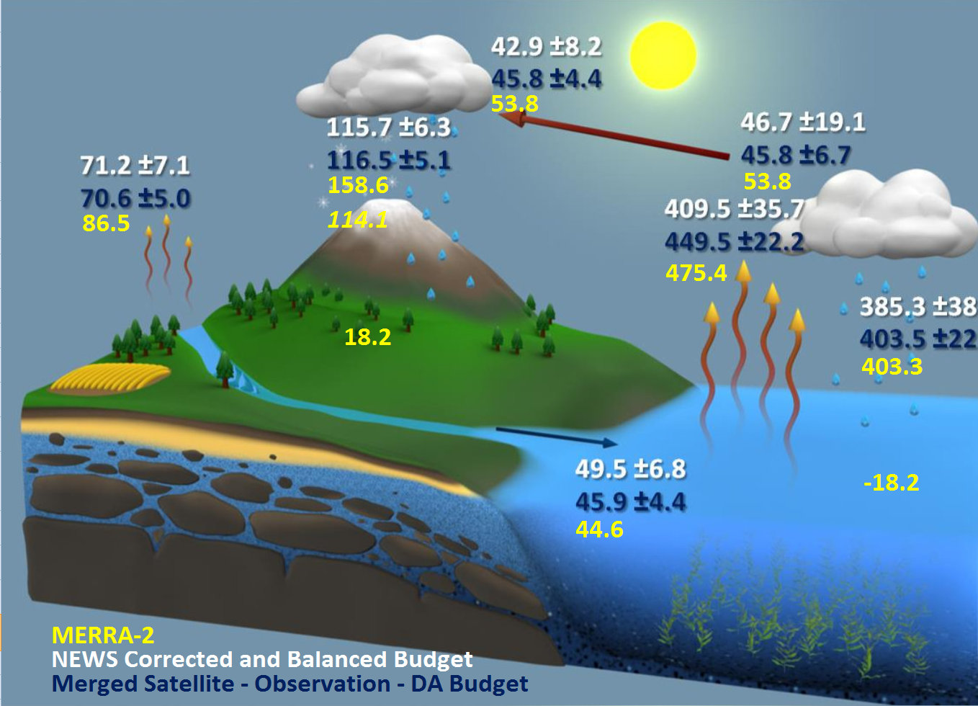
Comparison to NEWS Water Cycle
MERRA-2 water cycle tends to be strong
Overestimate of Ocean E → too much transport
Precipitation overestimated in the Tropic Land
×1000km³yr⁻¹
Depiction of the global water cycle developed by NEWS (Rodell et al. 2015) from NASA observing systems for 2000-2010, including the collected data (white) and a balance corrected budget (blue), and MERRA-2 data in yellow. Units are ×1000km³yr⁻¹.
Notes:
Depiction of the global water cycle developed by NEWS (Rodell et al. 2015) from NASA observing systems for 2000-2010, including the collected data (white) and a balance corrected budget (blue), and MERRA-2 data in yellow. The 18.2×1000km³yr⁻¹value for ocean and land indicates the MERRA-2 analysis increment. The italicized yellow value of precipitation is the bias corrected land forcing precipitation. Uncertainty estimates were given by data providers and refined in the balanced budget. Units are ×1000km³yr⁻¹.
Main point: MERRA-2 water cycle leans to more intensity, where ocean E contributes to too much transoirt.. Over landthere is too much precipitation, generally relating to the tropical land.

