Slide 1
The Global Moisture Balance and Its variability In the MERRA-2 Reanalysis
Michael G. Bosilovich, Franklin R. Robertson, David Mocko, Lawrence Takacs and Andrea Molod with contributions from across the office
Global Modeling and Assimilation Office, NASA GSFC

Slide 2
MERRA-2 Water Cycle
Why the reanalysis water cycle is a challenge
  Water vapor is difficult to assimilate
    Analyzed observations interact with the balance
  Precipitation is very difficult to forecast
Ultimately encompasses weather and climate features of research and societal importance
While we have more observations lately, model or derived quantities are necessary for closure of the water cycle
Notes:
Edit to be an outline

Slide 3
MERRA-2 Water Cycle
Some key developments since MERRA (Gelaro et al 2015)
Dry mass conservation constraint, penalizes increments that lead to a global imbalance (Takacs et al, 2015, TM and QJRMS)
Observation corrected precipitation forcing for land surface, replacing the atmospheric model’s precipitation (Reichle and Liu, 2015, TM)
Notes:
Edit to be an outline

Slide 4
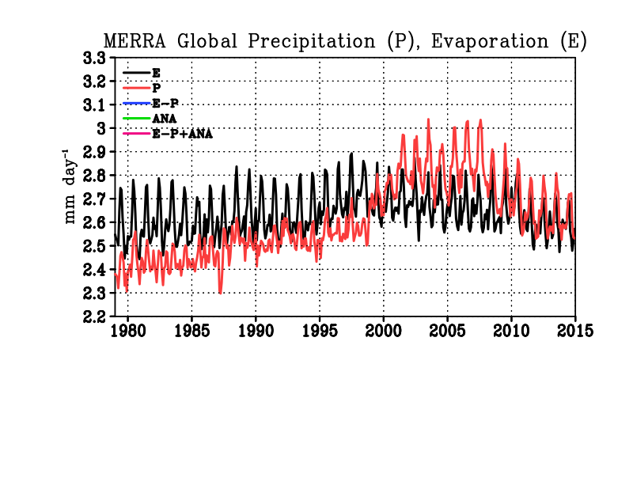
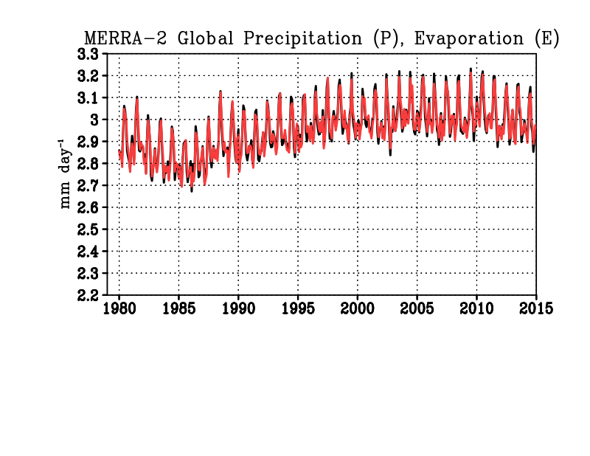
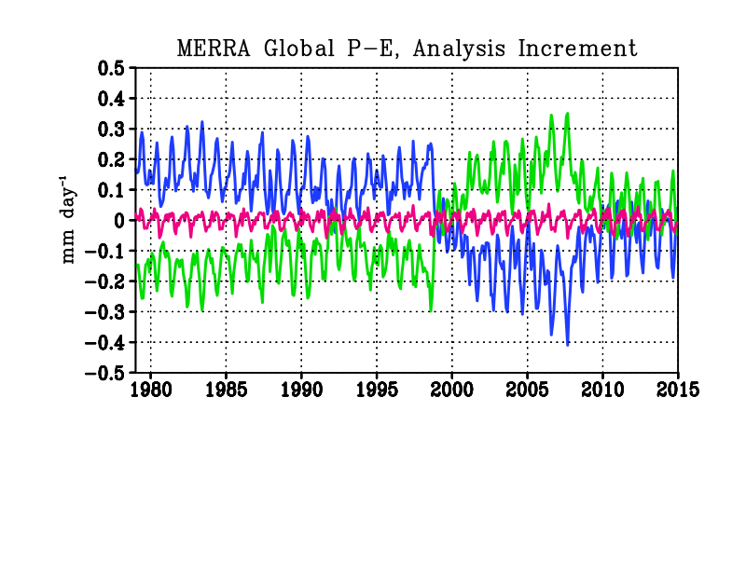
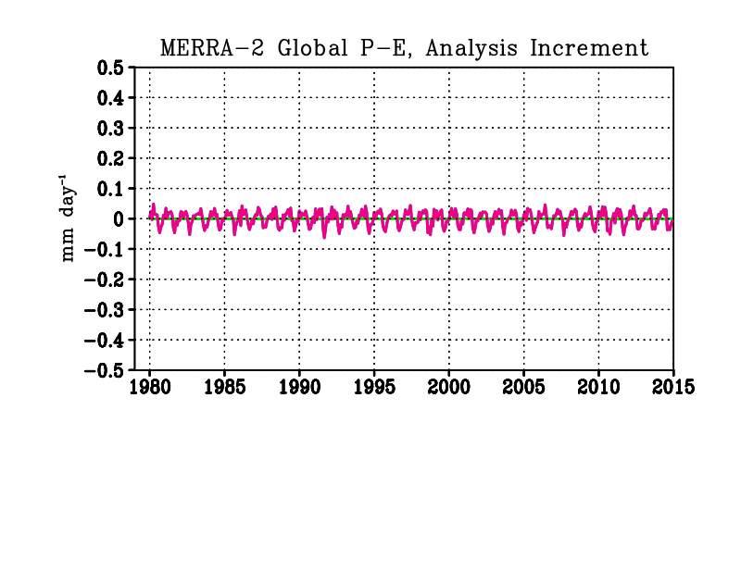
Global precipitation, evaporation and analysis forcing
Model/analysis dry mass conservation allow total mass variations only to water (Takacs et al., NASA GMAO Tech Memo, 2015; recently accepted QJRMS paper)
MERRA-2
MERRA
MERRA-2
In MERRA, imbalances of P and E result from analysis increments, sensitive to changes in the observing system.
In MERRA-2, global mass conservation is enforced and global balance between P, E is maintained
Notes:
MERRA allowed total mass to vary so that when the observing system changed significantly, the increments reverse sign, leading to a sign change in P-E. In the real world, P and E should be in global balance, so in MERRA-2 it is constrained.
Surface pressure and water vapor analyses are penalized for global imbalances

Slide 5
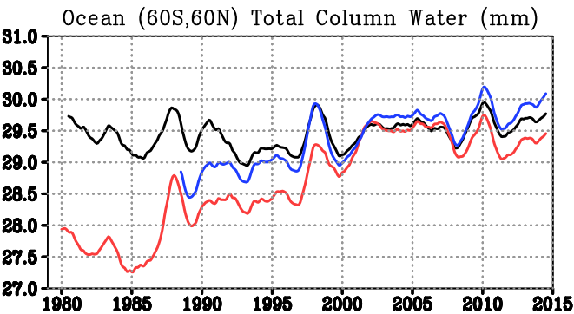
Total Column Water
MERRA-2 has slight increasing trend (as in Interim , JRA-55)
MERRA spurious jumps, not trend
None of the reanalyses match the SSMI trend (discussed later)
Ocean (60S,60N) TPW (mm)
Global TPW (mm)
MERRA-2
RSSv7
MERRA
AIRS
Notes:
The model is wet and getting wetter in time (from M2AMIP runs), while the increment is negative, and gets more negative in time. Not Shown: RSS TPW with Reynolds OISSTv2 shows 11% per degree change of water, MERRA TPW and SST shows 7% per degree (closer to CC)

Slide 6
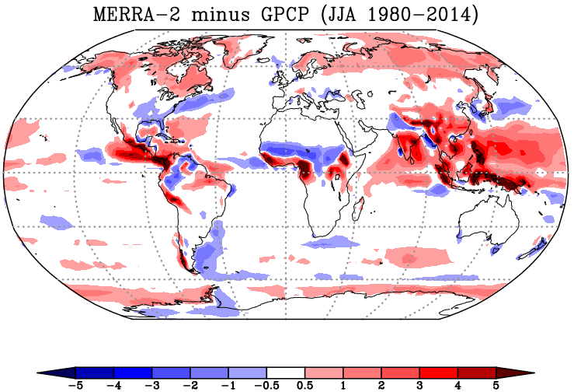
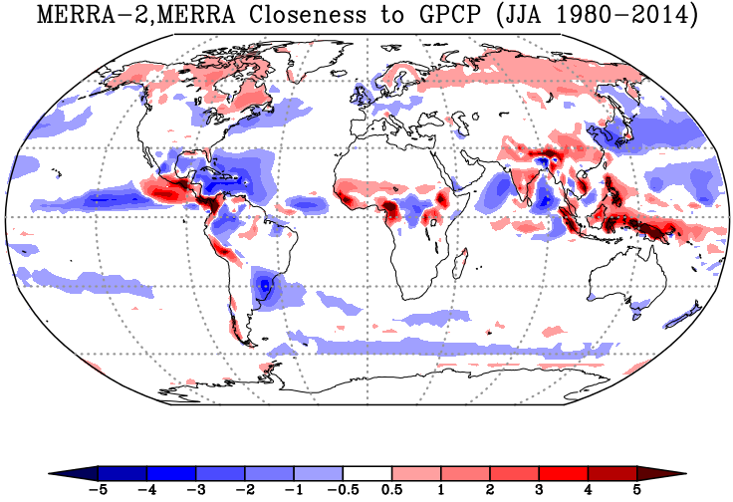
GPCP Climatology Comparison
Overestimate comes from tropical oceans, but also land, especially around topography
Numerous improvements; Intra-America Seas, Indian ocean and around warm currents
Notes:
Main point: broad improvements of mean precipitation are found in MERRA-2, mostly over the ocean. Some biases persist like the warm pool, and the tropical land precipitation has gotten worse.

Slide 7
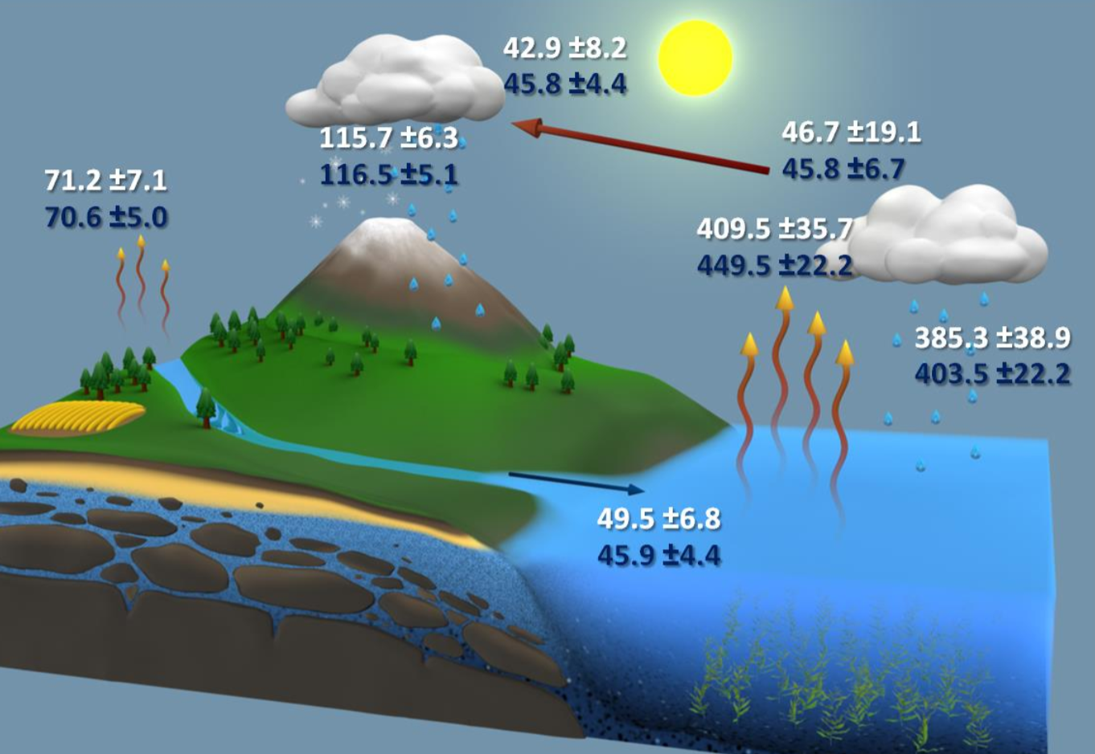

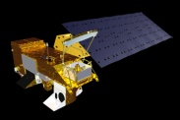
Comparison to NEWS Water Cycle
2000-2010
MERRA-2 water cycle tends to be strong
Overestimate of Ocean E → too much transport
Precipitation overestimated in the Tropical Land
18.2
-18.2
53.8
158.6
53.8
86.5
475.4
403.3
44.6
MERRA-2
×1000km³yr⁻¹
NEWS Optimized and Closed
Courtesy Matt Rodell and the NEWS Team (Rodell et al. 2015)
Notes:
Depiction of the global water cycle developed by NEWS (Rodell et al. 2015) from NASA observing systems for 2000-2010, including the collected data (white) and a balance corrected budget (blue), and MERRA-2 data in yellow. The 18.2×1000km³yr⁻¹value for ocean and land indicates the MERRA-2 analysis increment. The italicized yellow value of precipitation is the bias corrected land forcing precipitation. Uncertainty estimates were given by data providers and refined in the balanced budget. Units are ×1000km³yr⁻¹.
Main point: MERRA-2 water cycle leans to more intensity, where ocean E contributes to too much transoirt.. Over landthere is too much precipitation, generally relating to the tropical land.

Slide 8
Land/Ocean Water Mass Budgets
Land Evap follows the obs corrected Prec. Model precip over land follows the analysis trend
Ocean Precipitation and evaporation track each others variability, than the analysis increment
Increment jump in 2003 due to AIRS
MERRA-2 Transport does not trend over time
Evaporation Precipitation Transport Analysis
Notes:
Main points: the global precipitation time series follows the ocean variability closely. Obs impact the ocean E (SSMI winds, SST). Increments change over time and are noticeably affected by AIRS. The moisture transport has no trend over time, like other reanalyses, which is more comparable to E-P estimates from Global LDAS results.

Slide 9
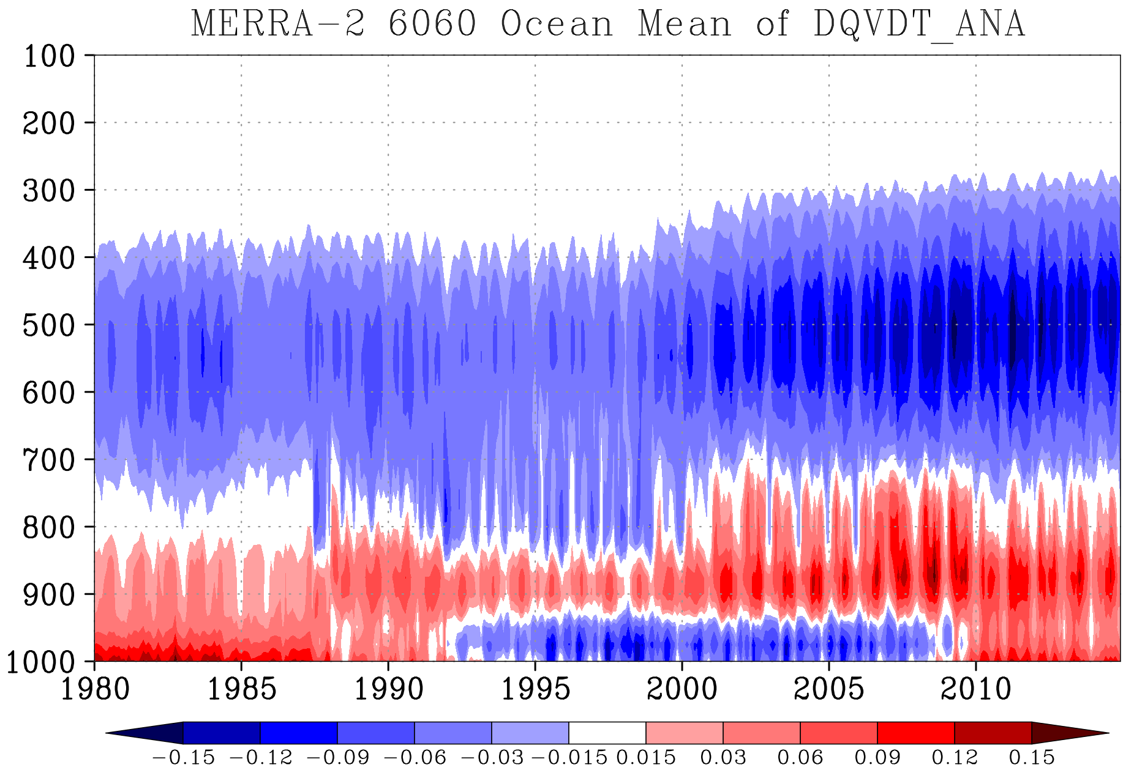
Vertical Q Increment Variations
In addition to temporal variations, vertical variations of the increments are substantial
SSM/I (start and end), AMSU, AIRS and perhaps IASI apparent in different vertical levels
mm day⁻¹

Slide 10
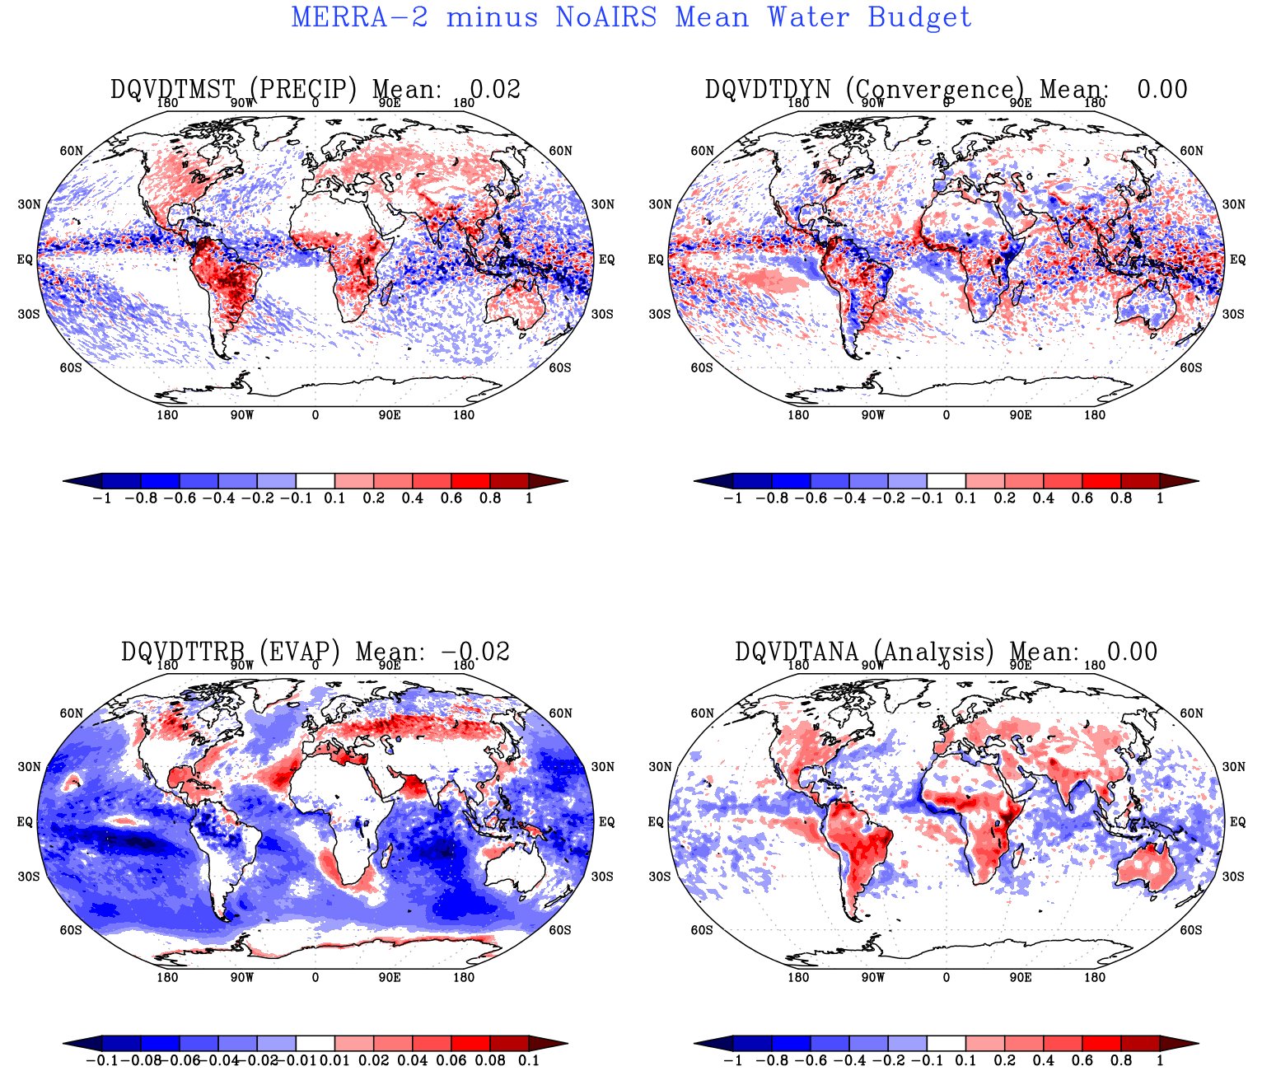
AIRS effect on MERRA-2
Experiment run for 3 years without AIRS assimilation
Effect on analysis shows consistent land ocean contrast
Consistent effect on precip, but mixed result on atmospheric convergence
Mean from Jan 2003 - Dec 2005 mm day⁻¹

Slide 11
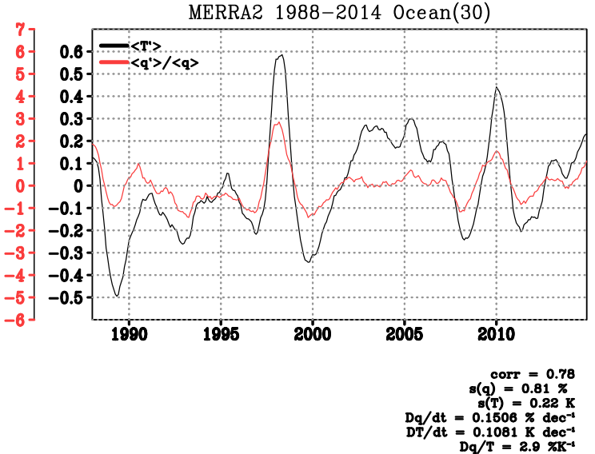
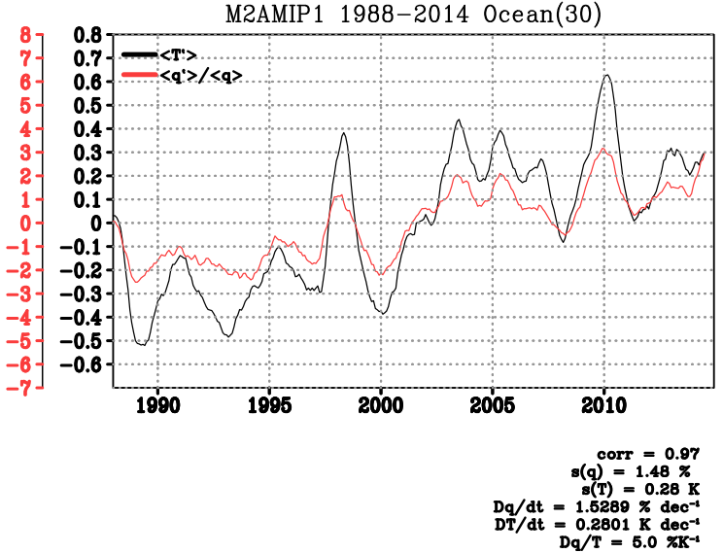
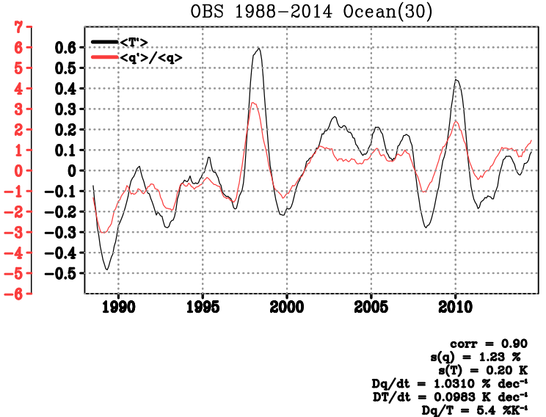
T Q Relationship
Following Sun and Held (1996) remove the seasonal cycle and detrend (here includes the trend)
Compute % moisture using mean map (for spatial consistency) and regress ΔT(K) and Δ q(%)
Here, T is MSU weighted TLT, and q is vertically integrated total column water
MERRA-2 2.9%K⁻¹
M2AMIP 5.0%K⁻¹
RSS 5.4%K⁻¹

Slide 12
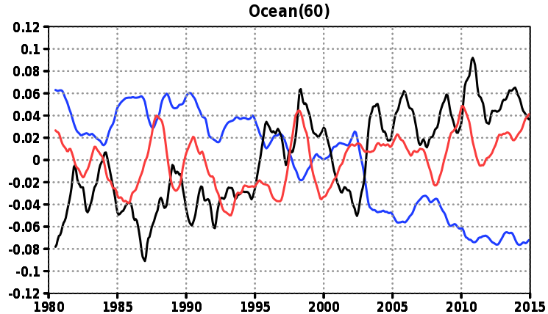
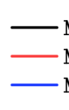
Compensating terms
The analysis increment is negative and becomes more so, as E-P increases in time
So while the SST seems to be increasing the E, the analysis is not providing higher water content
MERRA-2 Ocean Anomalies (60S,60N)
E-P [0.63]
TPW [2.89]
ANA [-0.10]

Slide 13
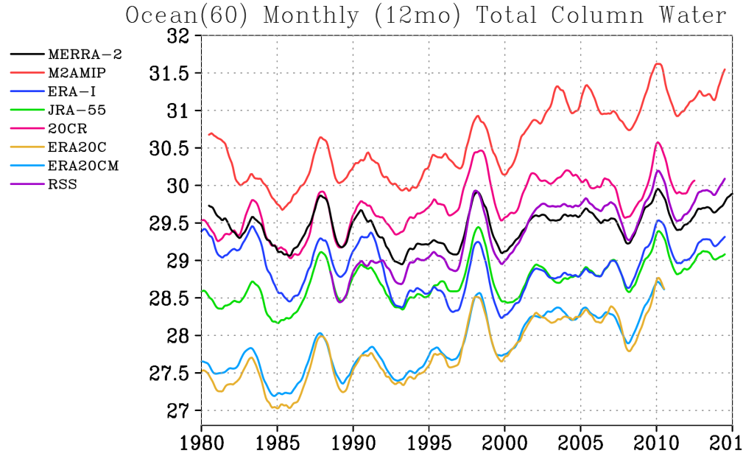
TPW Trends
While MERRA-2 TPW trend is lower than observed, the same can be said for ERA-I and JRA
The MERRA-2 AMIP simulation has a strong trend (also in Temp.)
ERA20c and CM as well as 20CR have larger trends than the satellite reanalyses

Slide 14
MERRA-2 Water Cycle Summary
Global balance is constrained by design
  Total column water does not have spurious increasing jumps
  Global modeled precipitation is controlled by surface evaporation
Most components of the global water cycle tend to be stronger than observed
Excessive modeled precipitation over tropical land
  CONUS interannual summer modeled precipitation is improved
While global increments are constrained, they are affecting regions, and can change with the observing system changes
The temperature / water vapor relationship appears to be muted in satellite reanalyses

Slide 15
MERRA-2 Data Availability
Project page:
http://gmao.gsfc.nasa.gov/reanalysis/MERRA-2/
GES-DISC Data Access
http://disc.sci.gsfc.nasa.gov/uui/search/”MERRA-2”
MERRA will stop production in early 2016

