Slide 1
`Historical’ Tropical Cyclones in MERRA, MERRA-2 and ERA-Int David (1979), Frederick (1979), Allen (1980), Elena (1985)
MERRA-2 GMAO Science Theme Meeting
June 4th 2015
Oreste Reale
And
Marangelly Fuentes

Slide 2
Ongoing work and motivation for this talk
The representation of tropical cyclones’ structure from MERRA to MERRA-2 has drastically improved
Years examined so far: 1979, 1980, 1985, 2005
Consistent improvements noted with respect to MERRA and ERA-I
The improvements are particularly important for the early years.
In fact, reanalyses of early, `historical’ systems
(which have never been studied through global analyses)
have immense implications
in hurricane studies
It is possible to -revisit- those systems in light of MERRA-2

Slide 3
Hurricane David (1979)
Cape Verde system originated off the W African coast on Aug 25th
Reached 924 hPa, 150 kt (cat 5)
Few storms before produced damages so widespread (Lesser Antilles, Puerto Rico, Hispaniola, US)
Considered the most intense storm that ever affected the Dominica island
1000 casualties (floods)

Slide 4
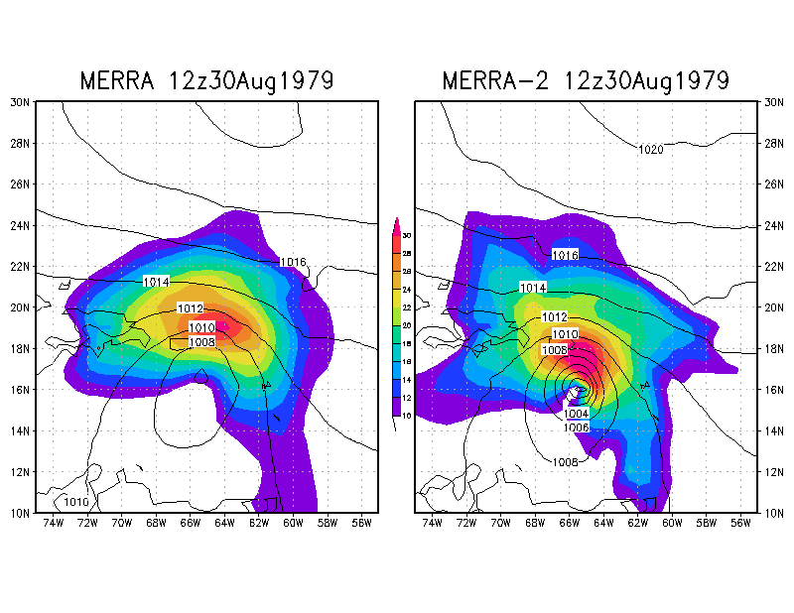
Hurricane David (1979)
Shaded: 850hPa Wind (m/s)
Solid: slp (hPa)

Slide 5
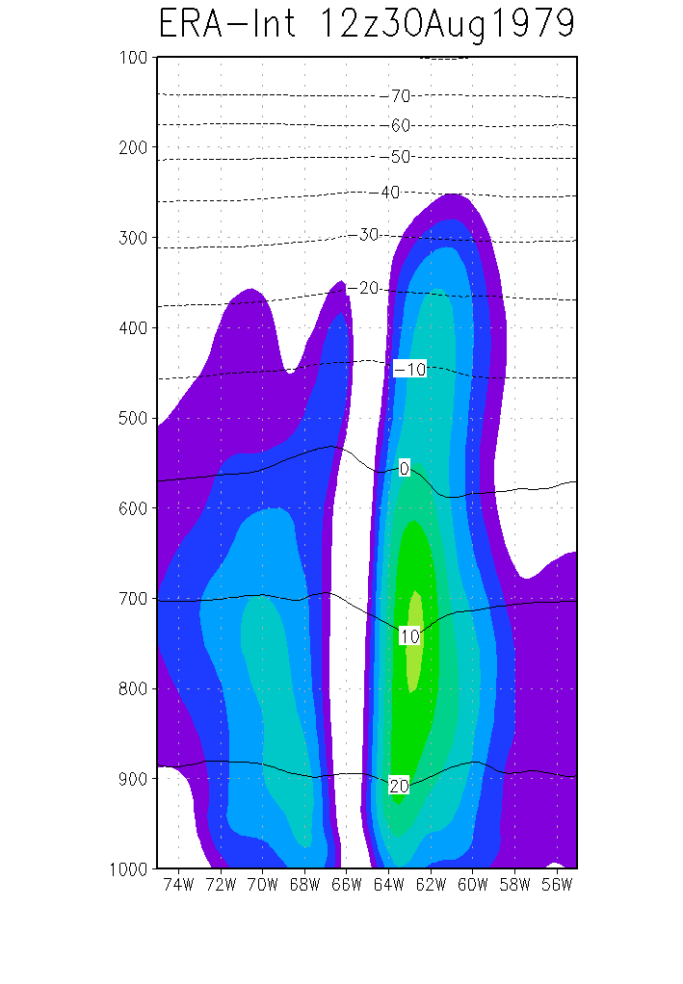
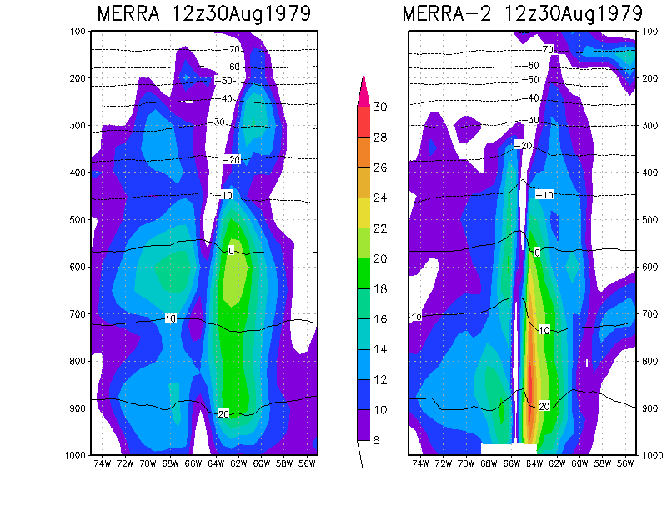
Hurricane David (1979)

Slide 6
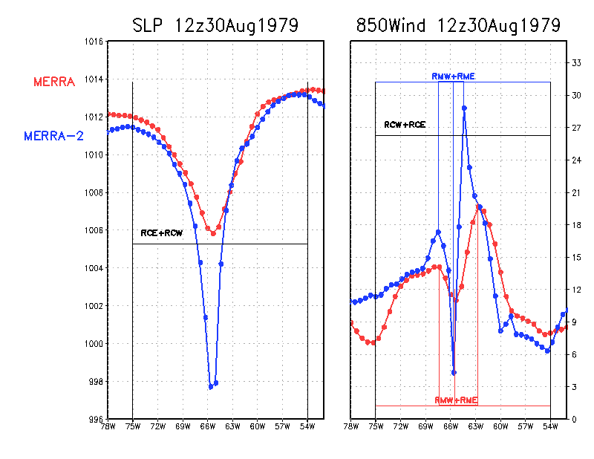
Hurricane David (1979): examining `Compactness’
0.21
0.16

Slide 7
Compactness at peak intensity evaluated from a very small sample (Atlantic only) in free-running models and reanalyses
Obs hurricane (HH flights) = 0.03-0.15
ECMWF NR T511 0.15-0.25
GMAO NR c1440 0.05-0.2
ERA-I 0.2-0.3
MERRA 0.2-0.3
MERRA-2 0.1-0.2
0.1 is the lower limit for a half degree resolution

Slide 8
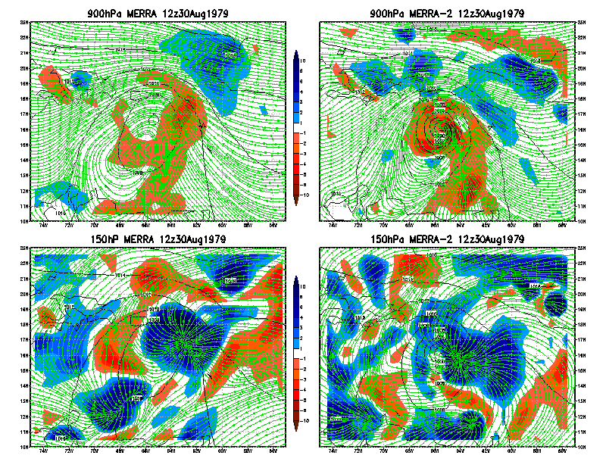
Hurricane David (1979): divergence structure
Divergence
10^-5 s^-1

Slide 9
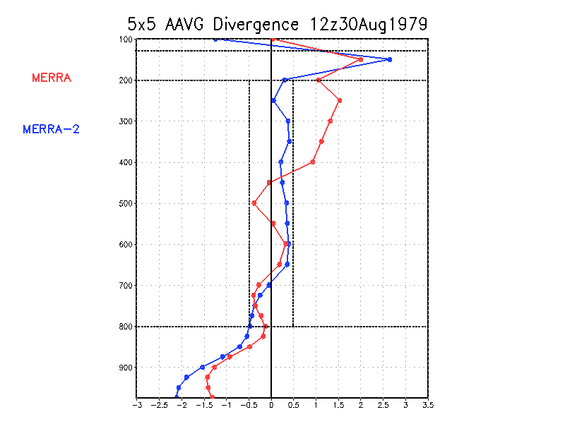
Hurricane David (1979) Divergence Vertical structure
Only divergence
Only convergence
Divergence
10^-5 s^-1

Slide 10
Hurricane Frederic (1979)
Cape Verde originated from a wave off the W African Coast on August 27th
Followed David of a few days
19th costliest mainland TC from 1900 (18th if adjusted for inflation) $2,300,000,000 (mostly AL/MS)
943 hPa and 115 kt at 12z12Sep (Cat3-Cat4), very close to landfall

Slide 11
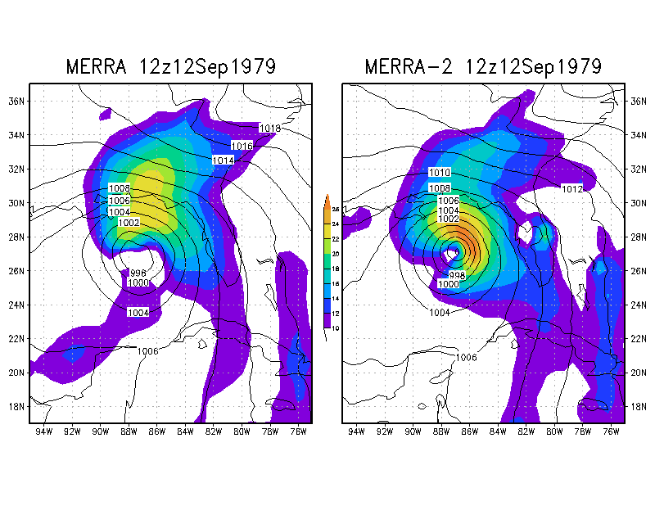
Hurricane Frederic (1979) 12z12Sep 27.4N 87.0W 943 hPa 115 kt
Shaded:
850hPa Wind (m/s)
Solid: slp (hPa)

Slide 12
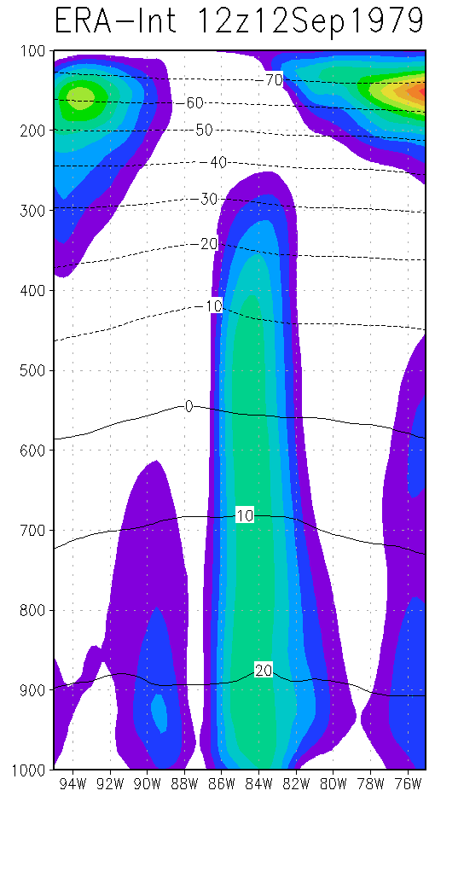
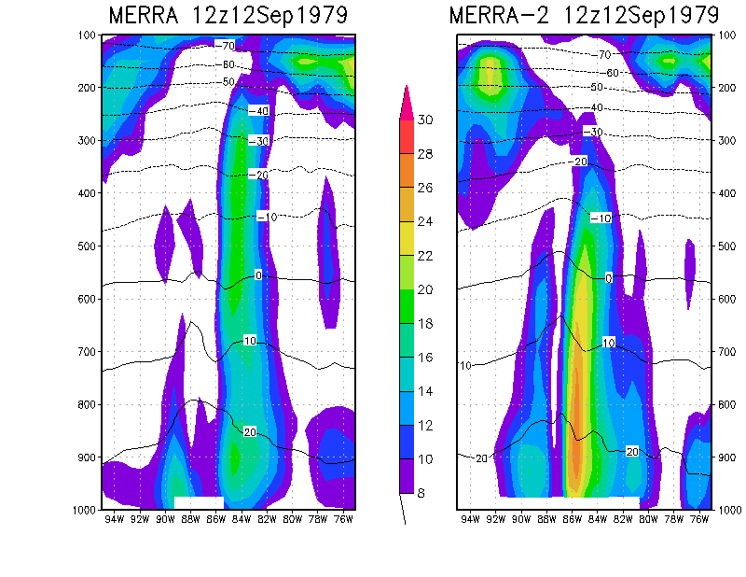
Hurricane Frederic (1979)

Slide 13
Hurricane Allen (1980)
Anomalous Cat5 Cape Verde Hurricane
In 1980 it was considered the second most severe hurricane in modern records
Reached cat5 3 times (911, 899 and 909 hPa)
Survived very strong shear
Exceptional propagation speed (15-20kts) through the Caribbean
>220 casualties in the Caribbean and 835,000 homeless (St. Lucia, Haiti, Jamaica)
500,000 people evacuated from coastal TX and LA
Damages less than feared over the US because of sudden decrease in intensity before landfall

Slide 14
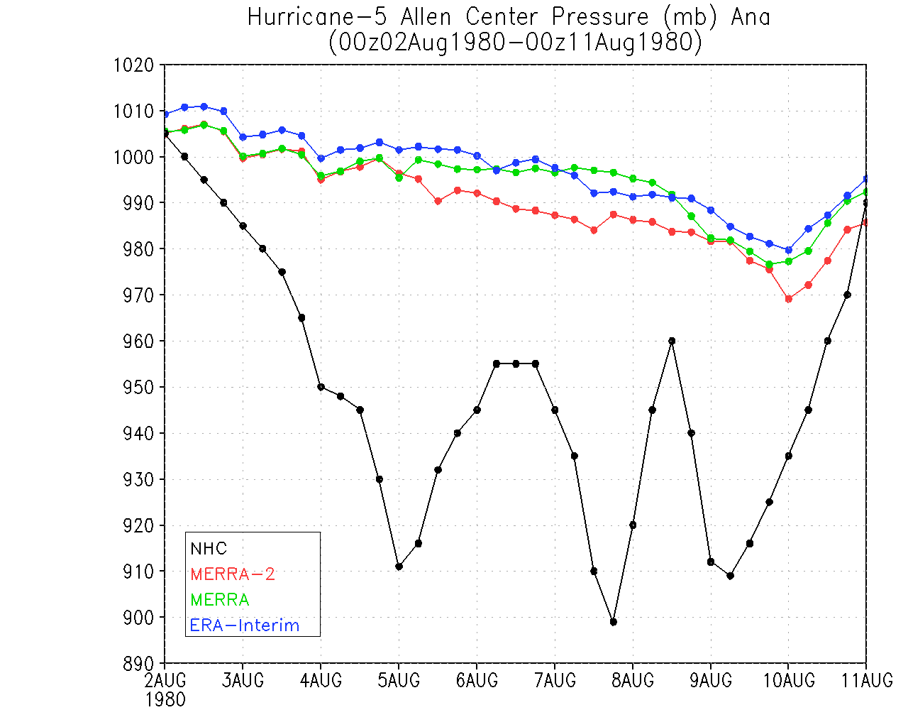

Slide 15
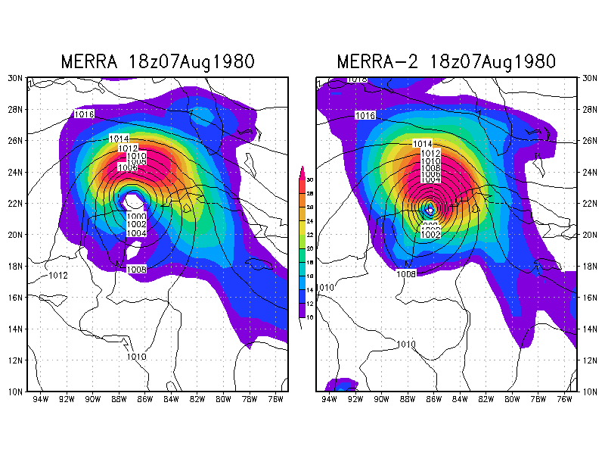
Hurricane Allen (1980) 18z07Aug 21.8N 86.4W 899 hPa 165 kt
Shaded:
850hPa Wind (m/s)
Solid: slp (hPa)

Slide 16
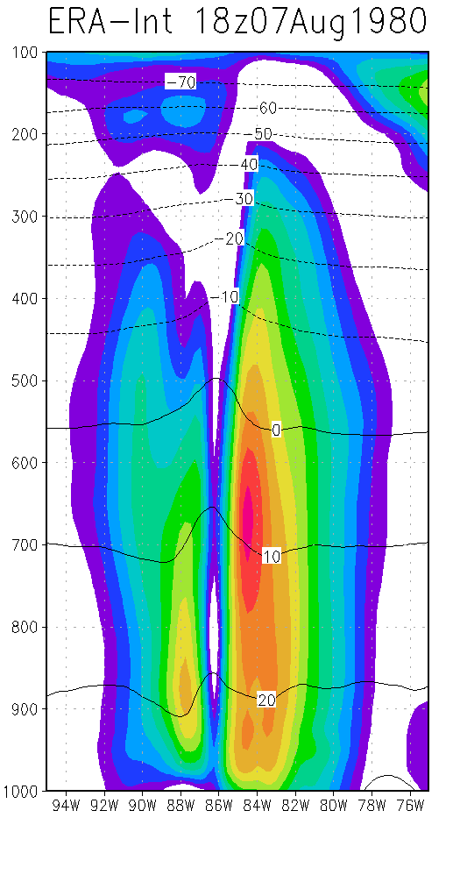
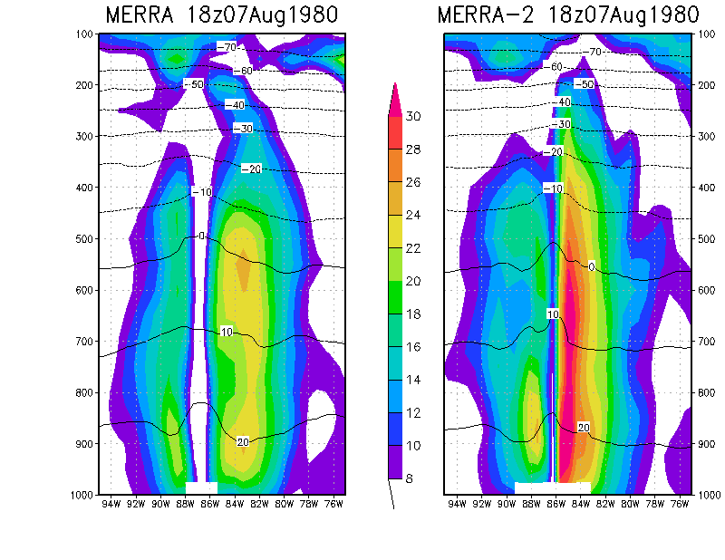
Hurricane Allen (1980)

Slide 17
Hurricane Elena (1985)
Anomalous Cape Verde Hurricane born as a wave around August 23rd
Fought against Saharan Air Layer, developed very little initially
Very fast propagation speed across the Atlantic
Sudden intensification over the Gulf after crossing Cuba on Aug 29th
Extremely erratic track over the Gulf with sharp turn E, full loop near FL panhandle and then track W
1,000,000 people evacuated from coastal TX and LA (largest evacuation in history until that time)
Because of erratic track, people over the Eastern Gulf were requested to evacuate twice within a 3-day period
Landfall near Biloxi (MS) with center pressure of 959 hPa
Damages of 1.25 billion $

Slide 18
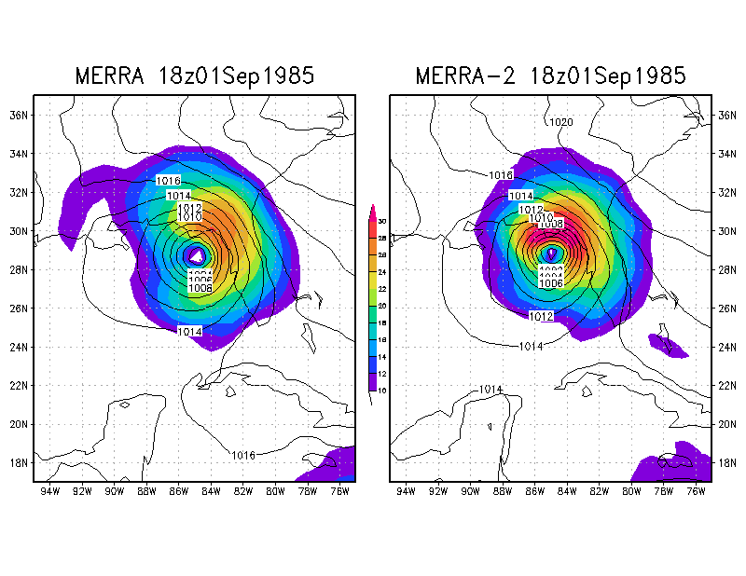
Hurricane Elena (1985) 18z01Sep 28.9N 84.8W 954 hPa 110 kt
Shaded:
850hPa Wind (m/s)
Solid: slp (hPa)

Slide 19
Preliminary conclusions and future work
It is accepted that 0.5 is not a sufficient resolution to resolve TC structure (e.g., Lim et al. 2015) and only broad, diluted, `signatures’ of TCs can be detected
However, MERRA-2 offers a dramatic improvement in the representation of TC structure and intensity with respect to MERRA and ERA-I, reaching the limit for its resolution
Important information about environmental factors controlling TC genesis, development, track and dissipation can be obtained
Immense potential for hurricane studies using downscaling techniques
Future work: comprehensive assessment of all TC activity on all basins on all years (including Polar Lows and Med TC-like storms)
The information on early, `historical’ systems which have only been studied through sfc observations, satellite imagery and synoptic tools, appears particularly valuable

