Slide 1

MERRA-2 Validation:
Polar Regions
Relevant changes between MERRA and MERRA-2
Seasonally-varying Arctic sea ice albedo
Surface representation over glaciated land: The glc Collection
  Surface hydrology (runoff)
  Prognostic surface albedo
New boundary data sets:
  Topography
  Sea ice fraction
Other changes to model physics
Richard Cullather

Slide 2
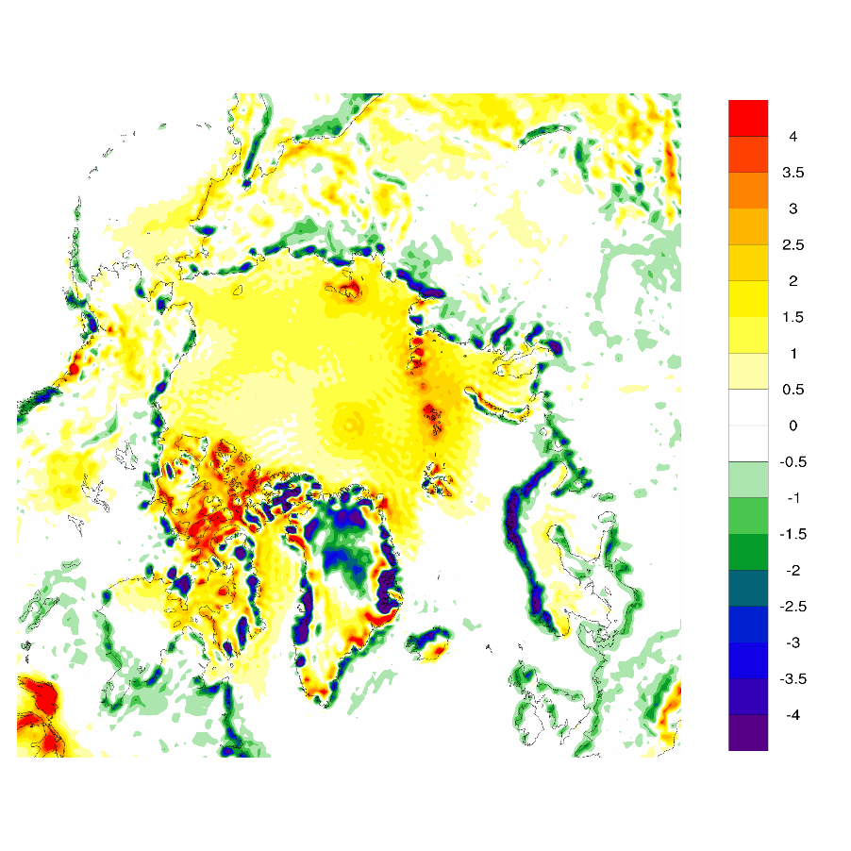
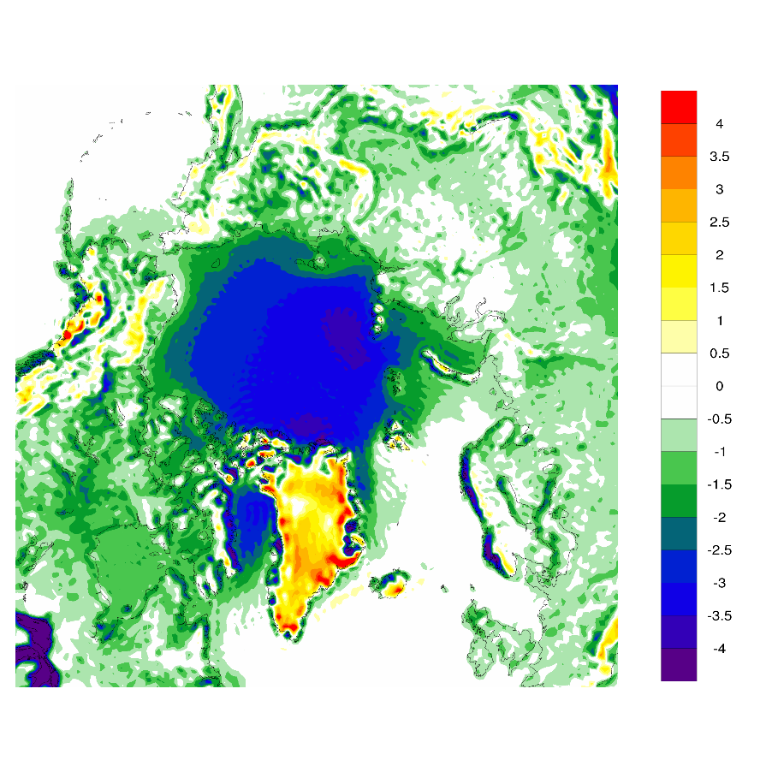
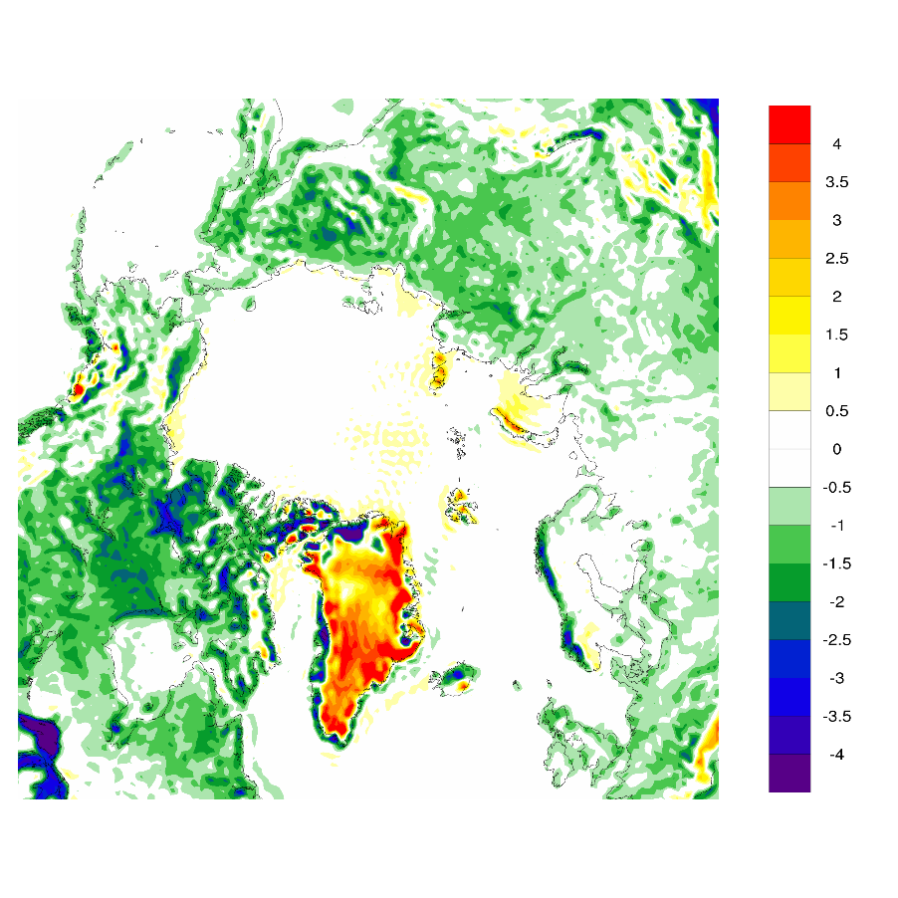
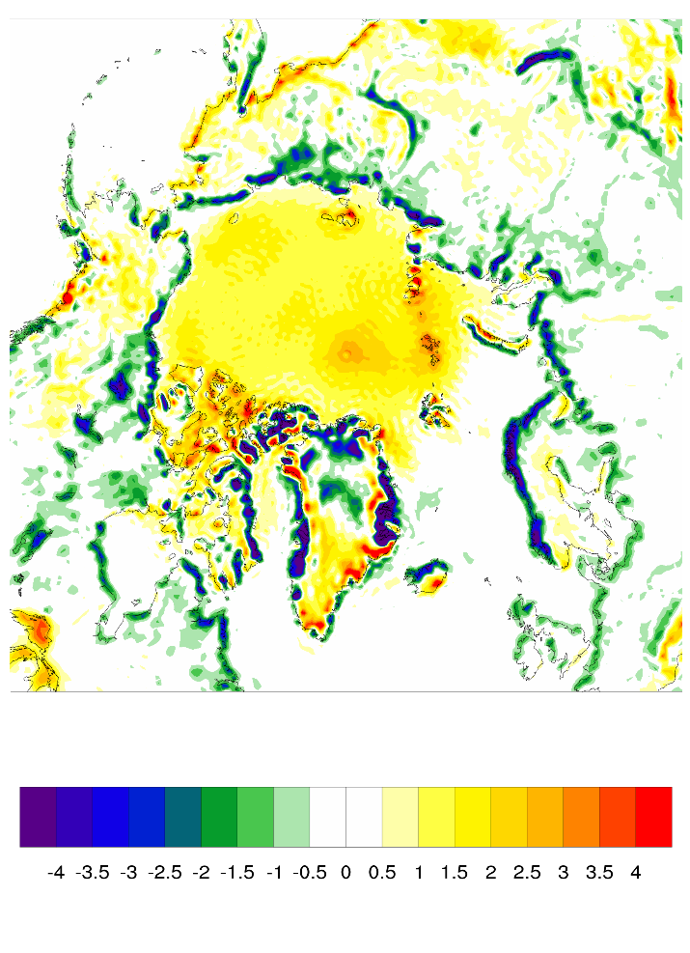
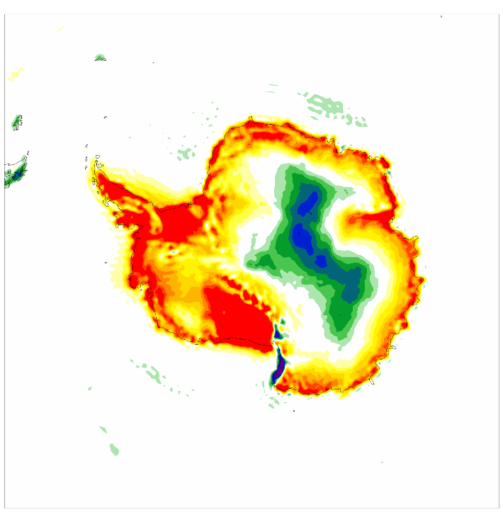
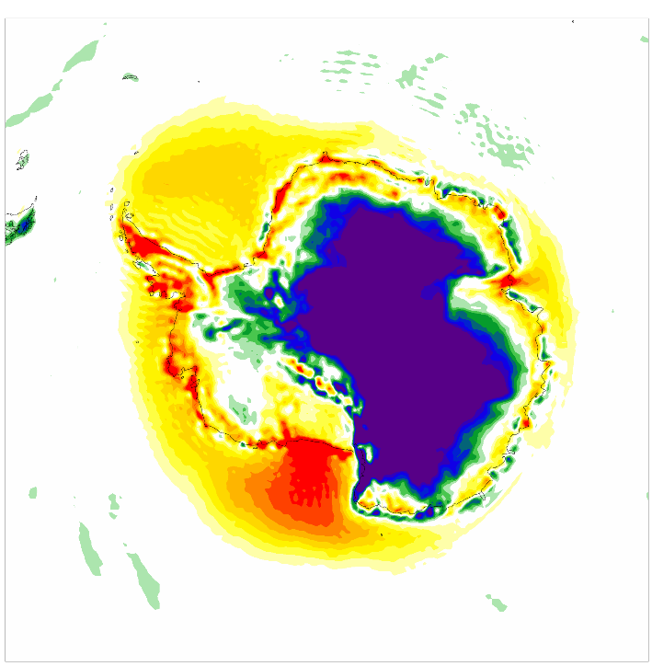
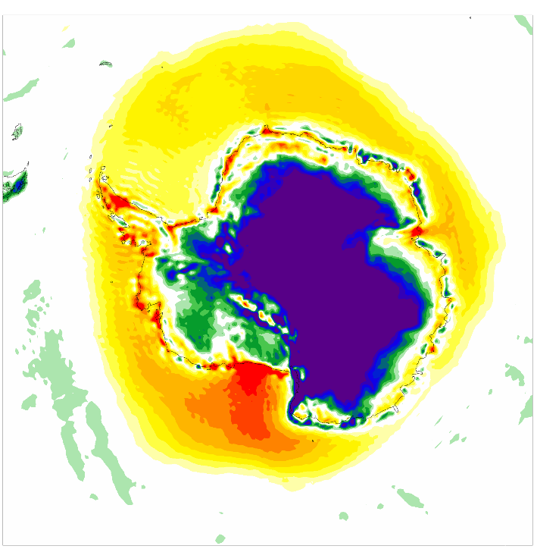
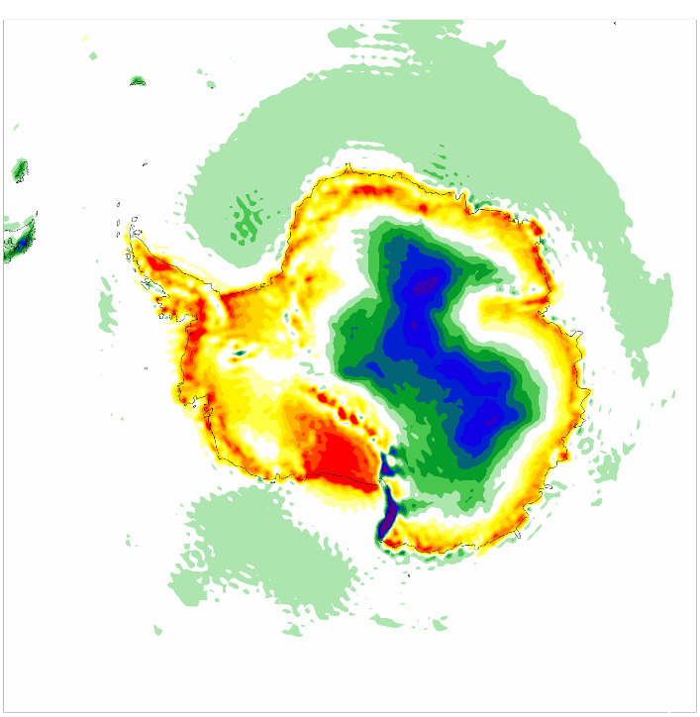

MERRA-2 Minus MERRA 2m Air Temperature [°C]
February
May
August
November
1980-2014

Slide 3
2m Air Temperature Comparisons
6°C cold bias, eliminated.
7°C warm bias, eliminated.
3.5°C cold bias, eliminated.
10°C spring warm bias, reduced.

Slide 4
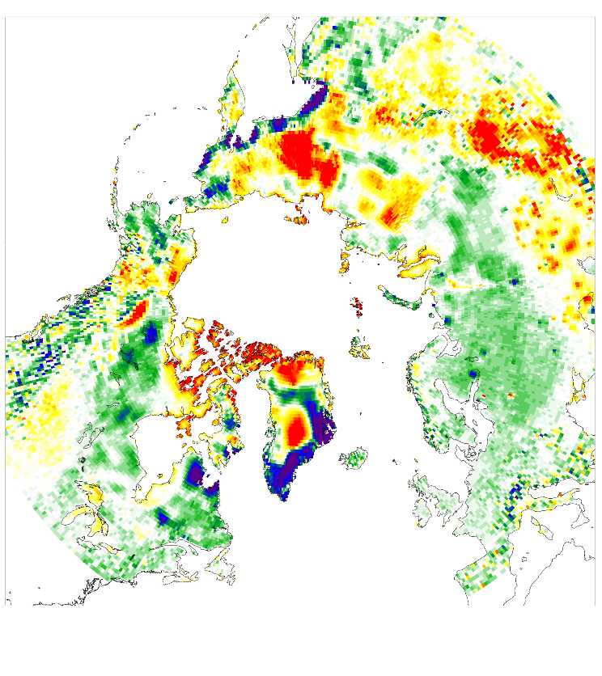
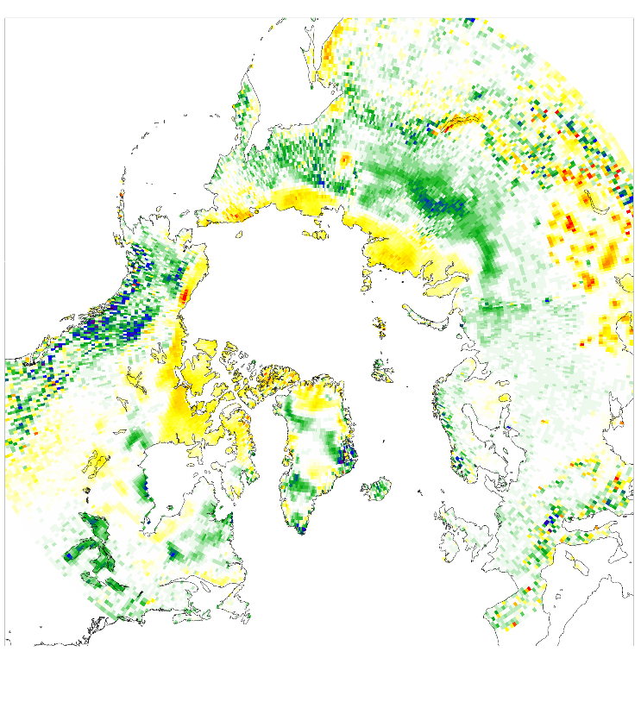
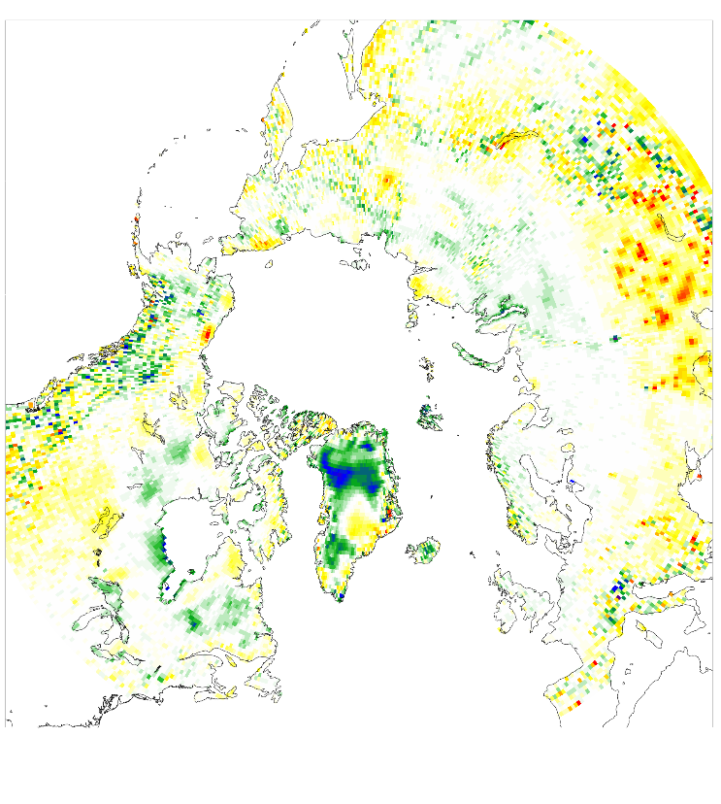
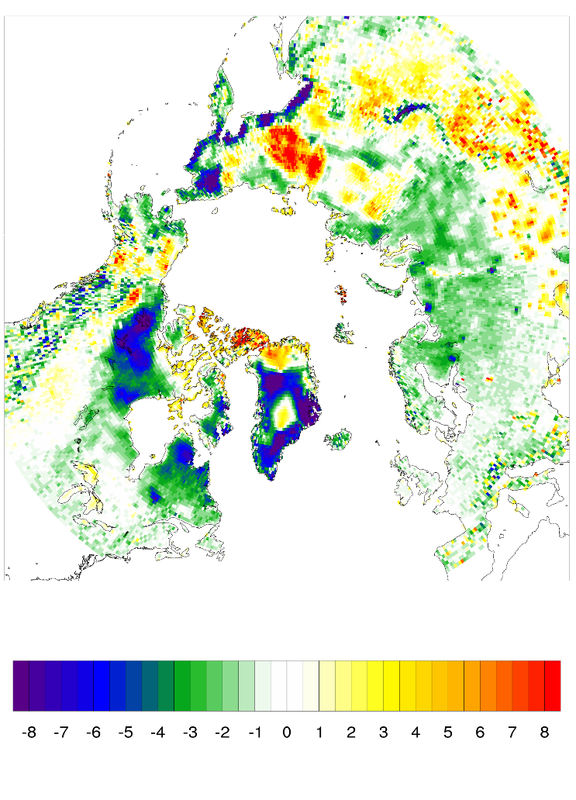
M-2 Minus Univ. Delaware Arctic LandT2M, 1980-2004 [°C]
February
May
August
November

Slide 5
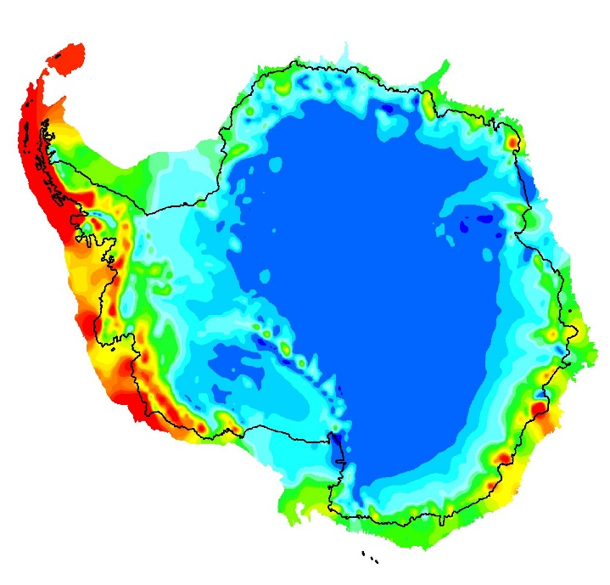
Surface Mass Balance [mm yr⁻¹]
MERRA-2
MERRA-2
RACMO2

Slide 6
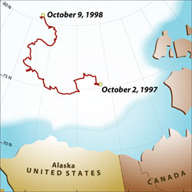
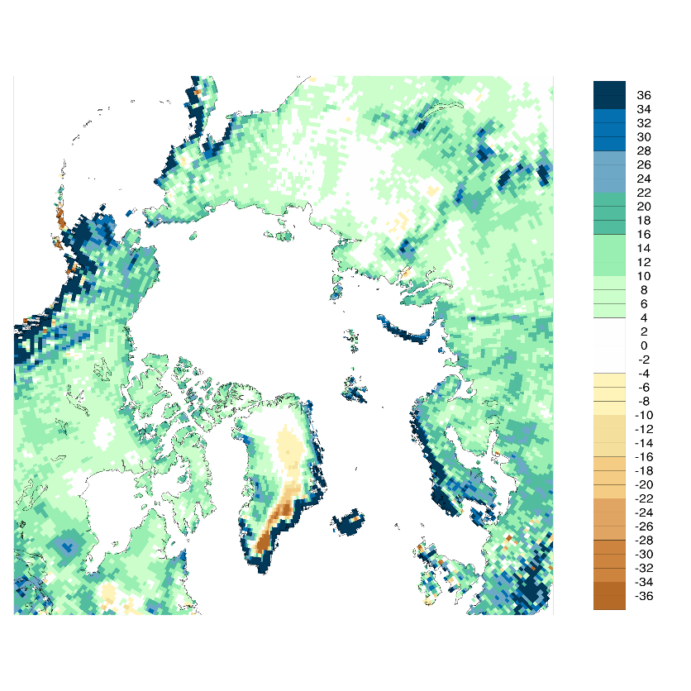
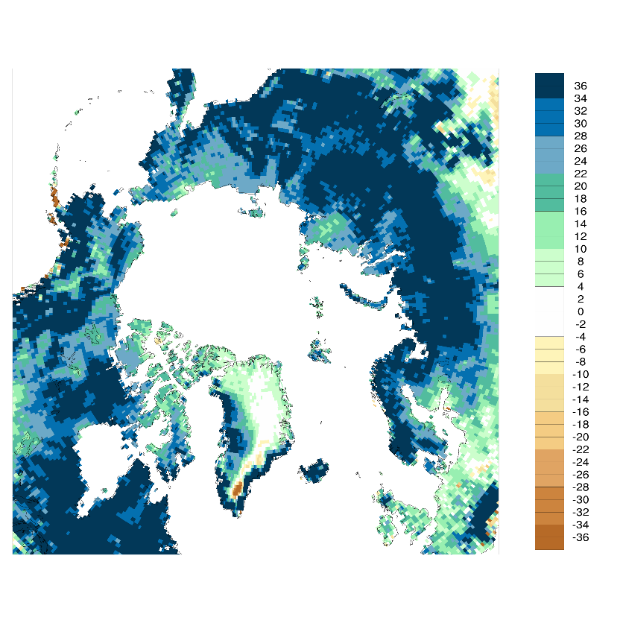
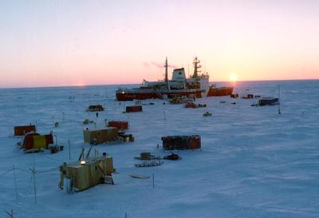
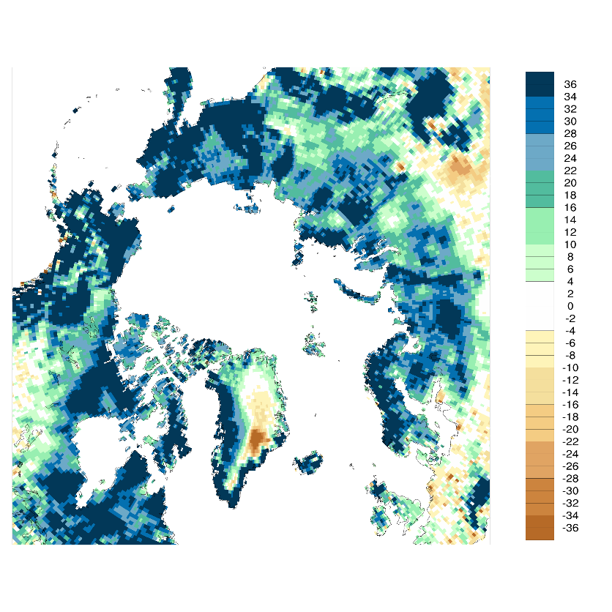
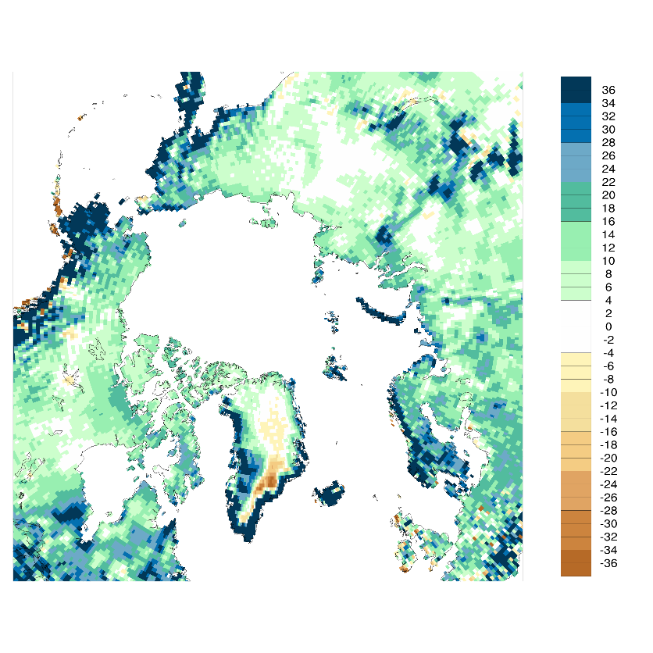
Precipitation: MERRA-2 Minus Univ Del.
[mm month⁻¹]
February
May
August
November

Slide 7
Vertically-Integrated Moisture Analysis Increment [mm month⁻¹]
MERRA
February
May
August
November
MERRA-2

