Slide 1
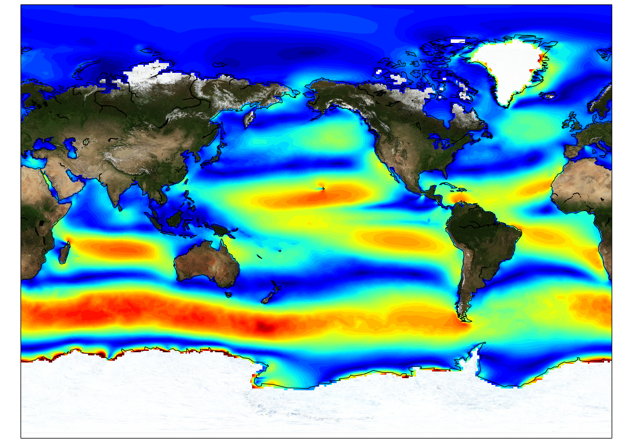
MERRA-2 Validation
Ocean Surface Winds

Slide 2
10-Meter Wind Speed (m/s): 1999-2009
Arabian Sea
Experiment
Subduction
Experiment
Hawaii
TOGA COARE
Samoa
SCOW:
The Scatterometer Climatology of Ocean Winds are from Oregon State University.
Based on 122 months of QuikSCAT scatterometer data from 1999-2009.
For this reason, a climatology from 1999-2009 is used for the global wind fields.
CCMP:
Cross-Calibrated Multi-Platform Ocean Surface Wind Vector L2.5A Monthly Analyses.
Based on microwave satellite data (SSM/I, SSMIS, AMSR, TMI, WindSat), QSCAT, in-situ obs.

Slide 3
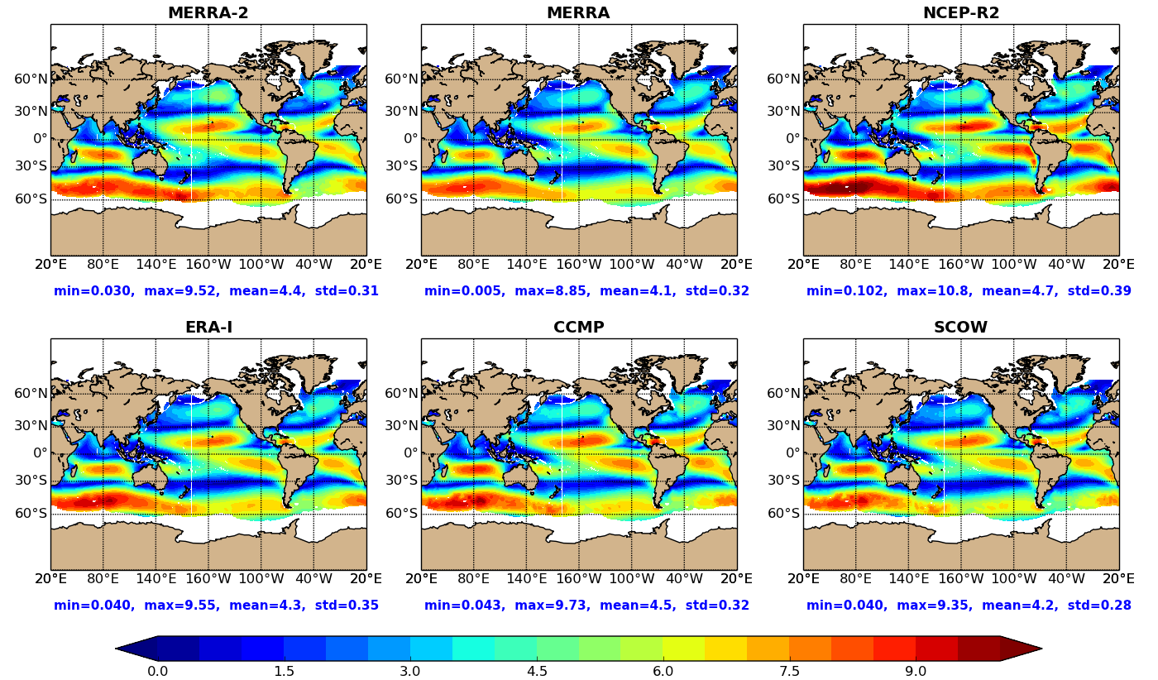
10-Meter Wind Speed (m/s): 1999-2009
Patterns are similar
NCEP-R2: higher intensity, especially 30S-60S
MERRA-2: slightly stronger than MERRA in most regions

Slide 4
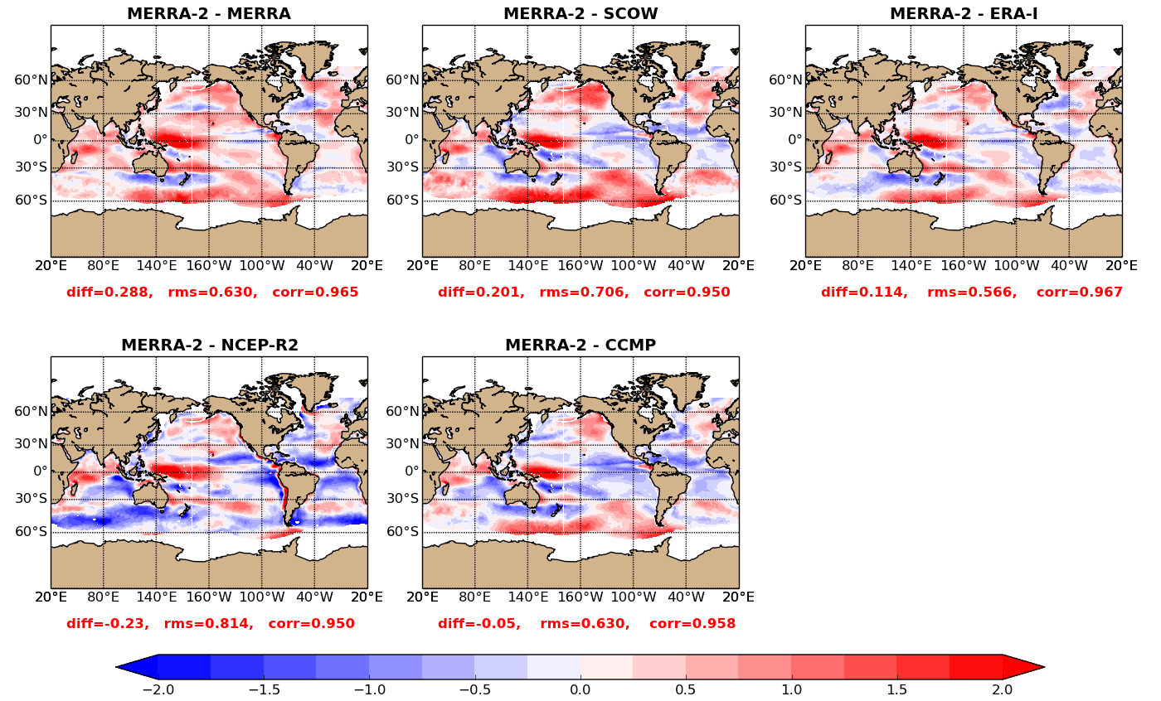
10-Meter Wind Speed Differences (m/s): 1999-2009
 | Mean Bias | RMS
CCMP-MERRA-2 | 0.056 | 0.630
CCMP-MERRA | 0.345 | 0.538
CCMP-SCOW | 0.258 | 0.332
CCMP-ERA-I | 0.170 | 0.376
CCMP-NCEP-R2 | -0.177 | 0.657
MERRA-2 compares best with CCMP with a mean diff of 0.05 m/s
MERRA-2 winds are generally stronger (more red) than MERRA, SCOW, & ERA-I in most regions

Slide 5
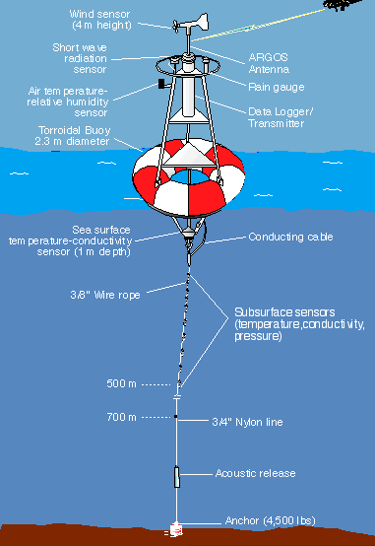
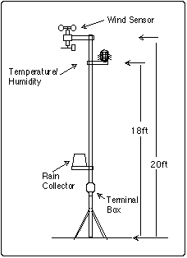
ESRL:10-meter wind speeds
WHOI: Surface wind speeds at 3-meters
TAO: Surface wind speeds at 4-meters

Slide 6
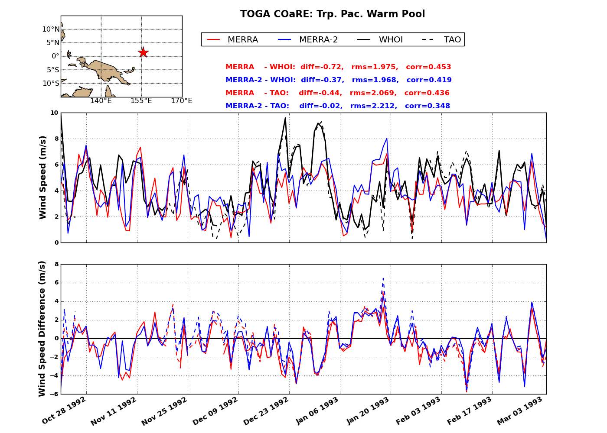
WHOI Mooring, TOGA COARE (1992-1993)

Slide 7
WHOI Mooring, Arabian Sea (1994-1995)
MERRA &
MERRA-2
weaker by
~4 m/s
MERRA-2 and MERRA are slightly weaker than observations by ~1 m/s
Both correlate highly with OBS around 0.95
Not capturing the stronger winds of the Southwest Monsoon (Jun-Aug 1995)

Slide 8
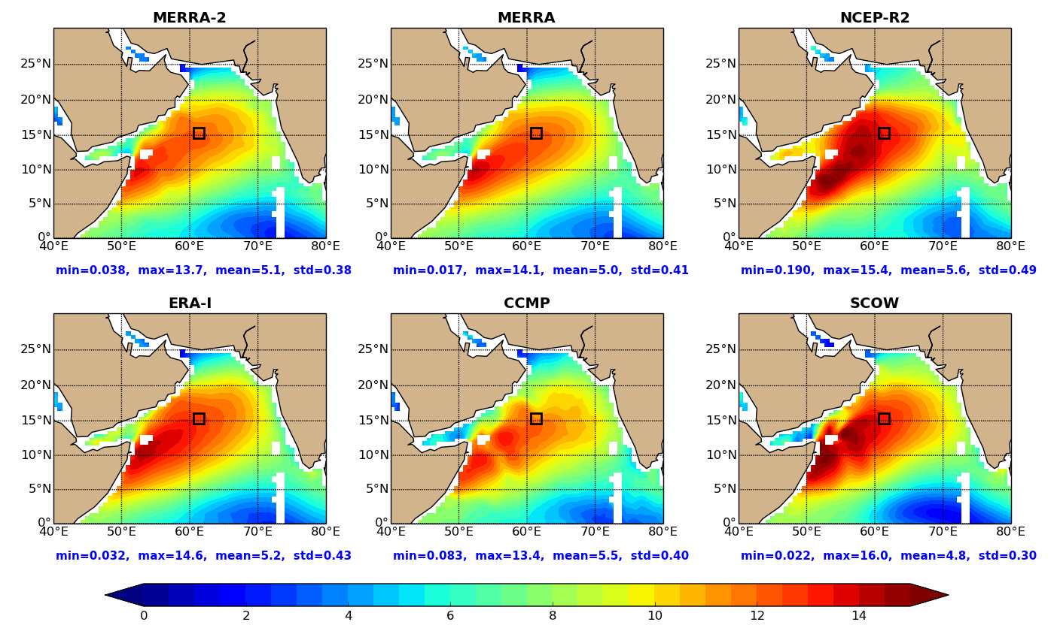
10-Meter Wind Speed: July 1995: Peak of Summer Monsoon
(m/s)
MERRA-2, MERRA, and CCMP underestimate the winds
Why are MERRA-2 winds weak?

Slide 9
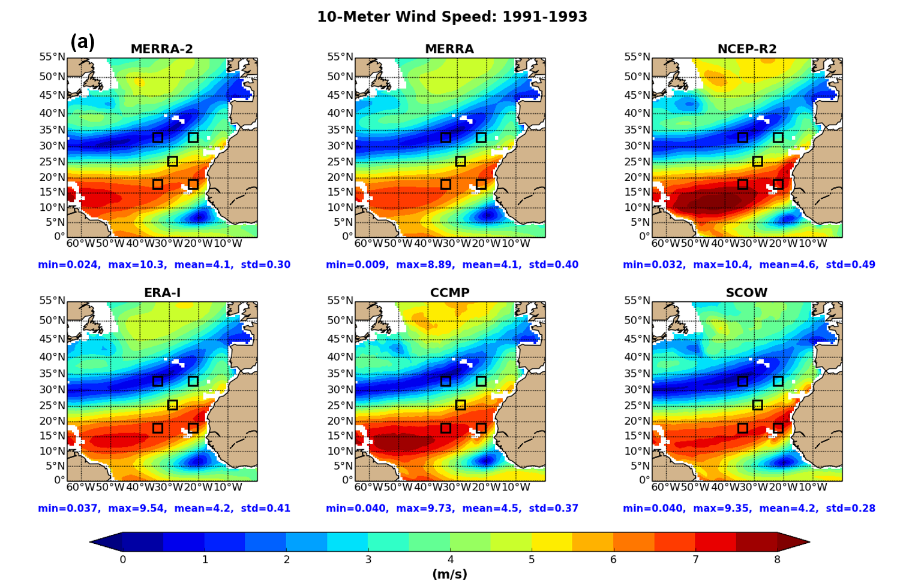
WHOI Moorings, Subduction Experiment (1991-1993)
(m/s)

Slide 10
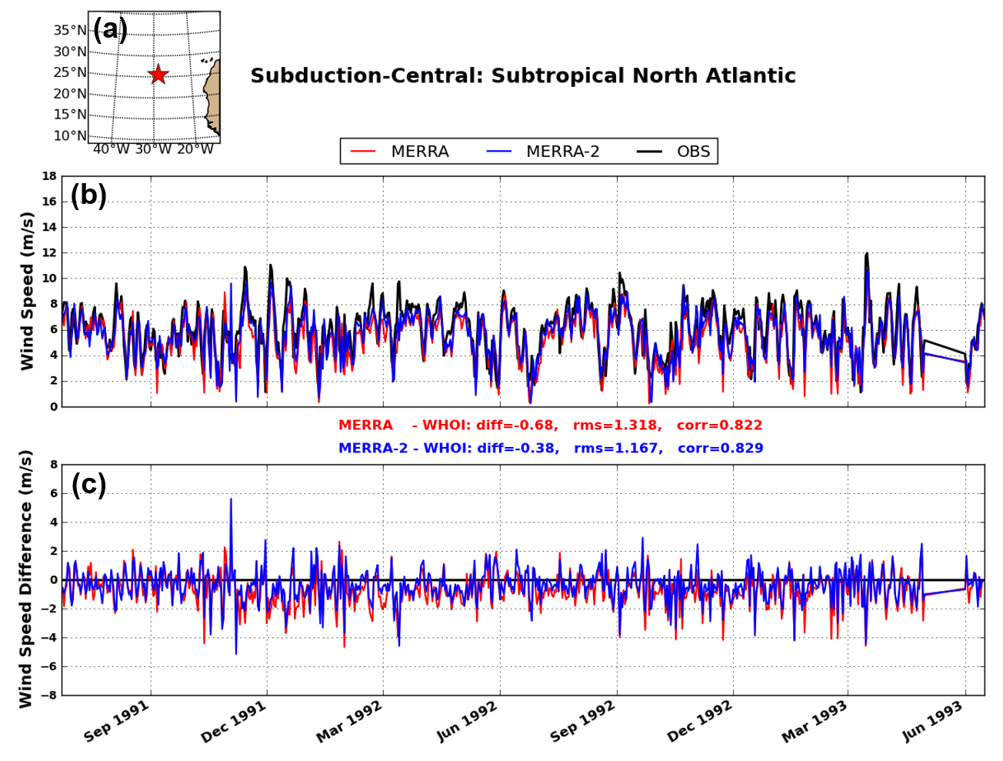
WHOI Mooring, North Atlantic (1991-1993)

Slide 11
Tutuila, Samoa ESRL Station (1981-2013)
MERRA & MERRA-2 winds have
a negative bias from Aug 1999.
QSCAT
July 1999
MERRA-2 and MERRA are weaker than observations by up to 5 m/s, except Apr-Dec 1992
MERRA-2 is closer to obs than MERRA

Slide 12
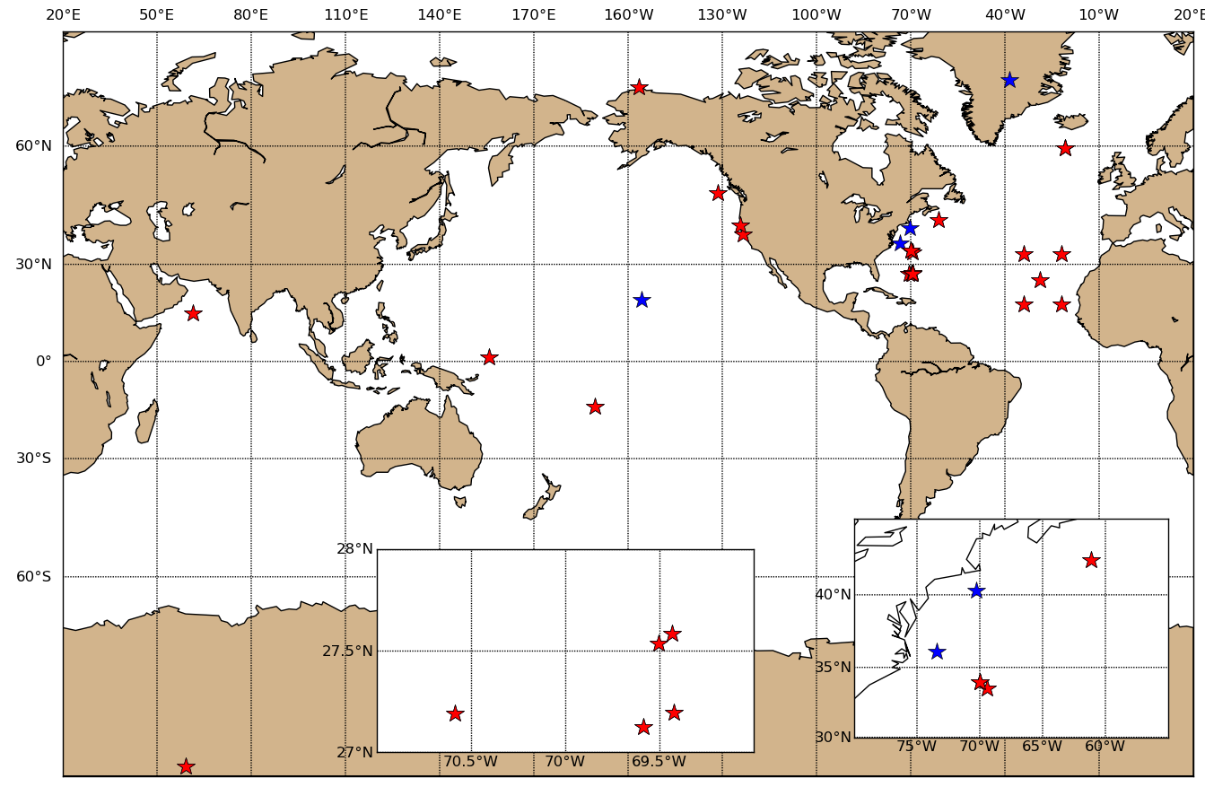
Conclusions
Global wind speed fields (1999-2009 climatology)
Patterns are similar for all six products
MERRA-2 compares best with CCMP
MERRA-2 is stronger than MERRA, SCOW, and ERA-I in most regions
MERRA-2 is weaker than NCEP-R2 and CCMP
In-Situ
Observations
MERRA closer to OBS
MERRA-2 closer to OBS
Stations shown today

Slide 13
Backup

Slide 14
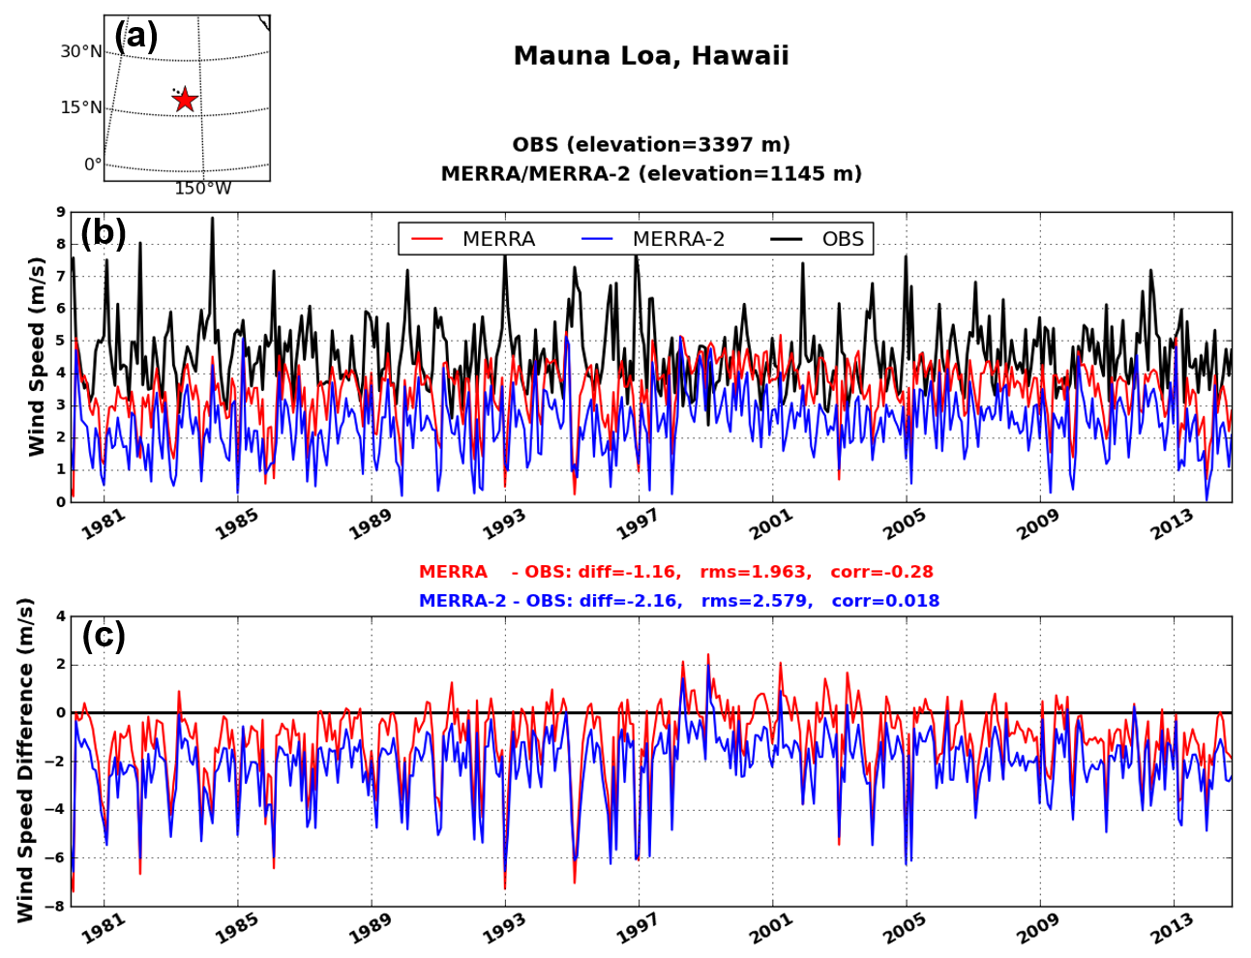
Mauna Loa, Hawaii: ESRL Station (1981-2013)

Slide 15
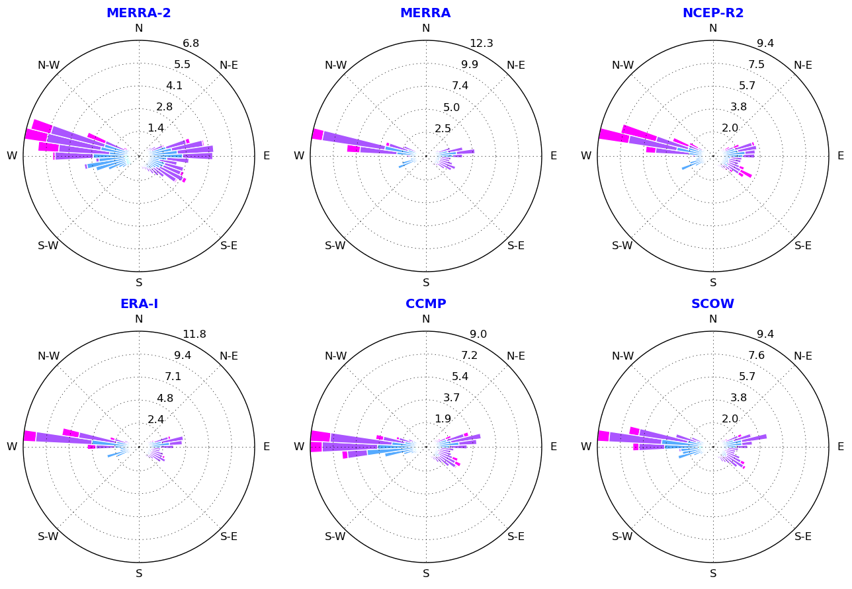
10-Meter Wind Rose: 1999-2009
Speed (knots)
Radial Band
frequency of wind
Pre-dominant winds are the Westerlies (30-60), then NE Trades (0-30N), and SE Trades (0-30S).

