Slide 1
MERRA-2 Cloud Radiative Forcing Validation
Peter Norris
MERRA-2 Rollout, NASA/GSFC, June 4, 2015

Slide 2
Introduction
Compare MERRA-2 TOA cloud radiative forcing against CERES EBAF and MERRA.
All results use monthly means, aggregated into 14 year averages, for the period Mar 2000 – Feb 2014. (CERES EBAF available March 2000 onwards).
We look at DJF, JJA, and ANN averages.

Slide 3
TOA Shortwave Cloud Forcing Annual Average
SCF < 0.
Clouds cool in solar by reflection
SCF relative to EBAF
(1) MERRA-1 & -2 are both realistic, showing tropical convection, high-latitude stratus, and subtropical subsidence zones (cloud minima); (2) MERRA-2 does better than MERRA over continents, in subsidence zones and in ITCZ; (3) MERRA-2 has excessive Western Pacific & Southern Ocean cloud cooling (albedo).

Slide 4
TOA Shortwave Cloud Forcing Annual Average (zonal)
(1) Both MERRA and MERRA-2 are quite realistic, showing tropical convection, Southern Ocean stratus, and subtropical subsidence zones (cloud minima); (2) MERRA-2 does better over continents and in subsidence zones; (3) MERRA-2 has excessive Tropical and Southern Ocean cloudiness.

Slide 5
TOA Longwave Cloud Forcing Annual Average
LCF > 0.
Clouds warm in LW by thermal trapping
LCF relative to EBAF
(1) Both MERRA and -2 are very realistic, showing tropical convection, mid-/high-latitude cloud, and subtropical subsidence zones (cloud minima); (2) MERRA-2 does better over continents and in subsidence zones / ITCZ; (3) MERRA-2 has excessive Western Pacific convection.

Slide 6
TOA Longwave Cloud Forcing Annual Average (zonal)
(1) Both MERRA and MERRA-2 are very realistic, showing tropical convection, mid-/high-latitude clouds, and subtropical subsidence zones (cloud minima); (2) MERRA-2 does better in southern mid-latitudes and in subsidence zones; (3) MERRA-2 has excessive Tropical cloudiness.

Slide 7
TOA Net Cloud Forcing Annual Average
Widespread negative shows net cooling due to clouds
NCF relative to EBAF
(1) Both MERRA & MERRA-2 show general net negative cloud forcing, especially in stratus regions; (2) MERRA-2 does better over Eurasia and North America; (3) MERRA-2 has excessive Western Pacific and Southern Ocean cloud cooling.

Slide 8
TOA Net Cloud Forcing Annual Average (zonal)
(1) Both MERRA and MERRA-2 are realistic; (2) MERRA-2 does better in northern mid-latitudes; (3) MERRA-2 has excessive Tropical and Southern Ocean cloud cooling.

Slide 9
SCF / incoming Solar JJA Average
For JJA and DJF, we normalize by incoming solar radiation because of its strong seasonal variation.
(1) MERRA-2 has a more realistic pattern than MERRA, in the tropics, subtropics, and at higher latitudes; (2) Both MERRA & MERRA-2 overestimate tropical solar cloud forcing, MERRA-2 more so; (3) MERRA-2 has a strong overestimate of Southern Ocean cloud albedo in the austral winter.

Slide 10
SCF / incoming Solar DJF Average
For JJA and DJF, we normalize by incoming solar radiation because of its strong seasonal variation.
(1) MERRA-2 has a somewhat more realistic pattern than MERRA overall, especially in the tropics and northern hemisphere; (2) Both MERRA & MERRA-2 overestimate tropical solar cloud forcing, MERRA-2 more so; (3) MERRA-2 overestimates Southern Ocean cloud albedo in the austral summer.

Slide 11
Normalized-SCF vs. LCF joint probability density plots --- How to Read
These are contour plots of the probability density in normalized-SCF vs. LCF space.
X-axis is –SCF/ISR, basically the the cloud solar albedo.
Y-axis is LCF, the longwave cloud forcing. Larger values represent greater thermal trapping by clouds. For thick clouds it is a rough proxy for cloud height.
Purple|Orange|Olive contours contain 10|50|90% of the total probability with the highest probability densities. All densities outside each contours are smaller than those inside.
Full 14yr accumulation for TROPICS
Each sample is a monthly average. Dilution by cloud fraction/occurrence will move a cloud-type linearly towards origin.
Filled contours show CERES EBAF as an observational reference. Thick | Thin lines show MERRA-2 | MERRA.

Slide 12
TROPICS
Convective branch
Stratiform branch
Stratiform branch: MERRA-2 looks very good (cf. MERRA a bit too bright).
Convective branch: MERRA-2 looks to have a bright bias that cannot be explained by linear dilution.

Slide 13
Mid-latitudes:
Northern --- looks very good, MERRA-2 a little better than MERRA
Southern --- MERRA-2 has a bit of a bright bias.

Slide 14
High-latitudes:
Northern --- looks good but most common 10% is diluted.
Southern --- MERRA-2 has a strong bright bias, worse than MERRA.

Slide 15
Seasonal Variation in Tropics
MERRA-2 bright bias is more obvious in boreal summer, including a distinct increase in high-cloud probability.

Slide 16
Diluted vs. Undiluted Cloud Forcings
Diluted (by cloud fraction /frequency of occurrence)
Undiluted (i.e., overcast equivalent)
--------------
MERRA-2 tropical convection is higher and brighter than MERRA. In this respect, MERRA seems to be more accurate (cf. diluted EBAF comparison).
Notes:
Undilution by dividing by CLDTOT of the respective M (-1 or -2). CLDTOT < 0.01 cases discarded.

Slide 17
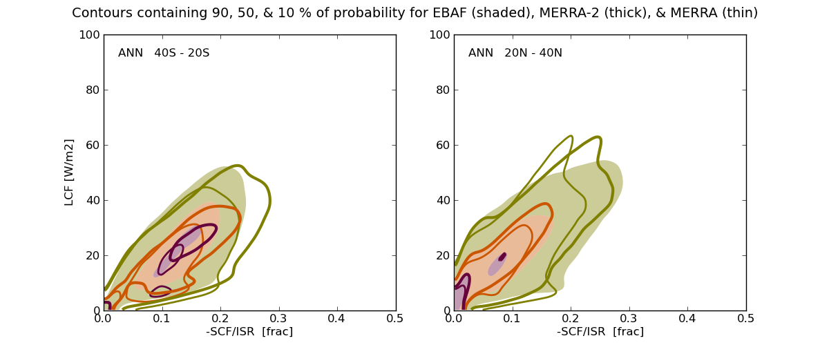
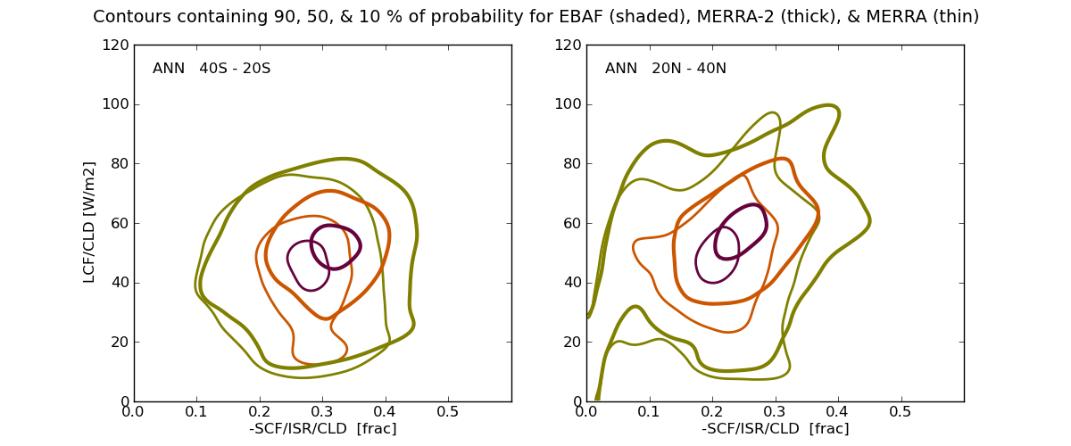
Clearly undilution is working to remove the cloud fraction / cloud occurrence dilution. The undiluted (overcast equivalent) case shows that MERRA-2 mid-latitude clouds are a little brighter and higher than in MERRA. Its not a big difference, but the diluted EBAF data suggests that the data is somewhere in between MERRA and MERRA-2.

Slide 18
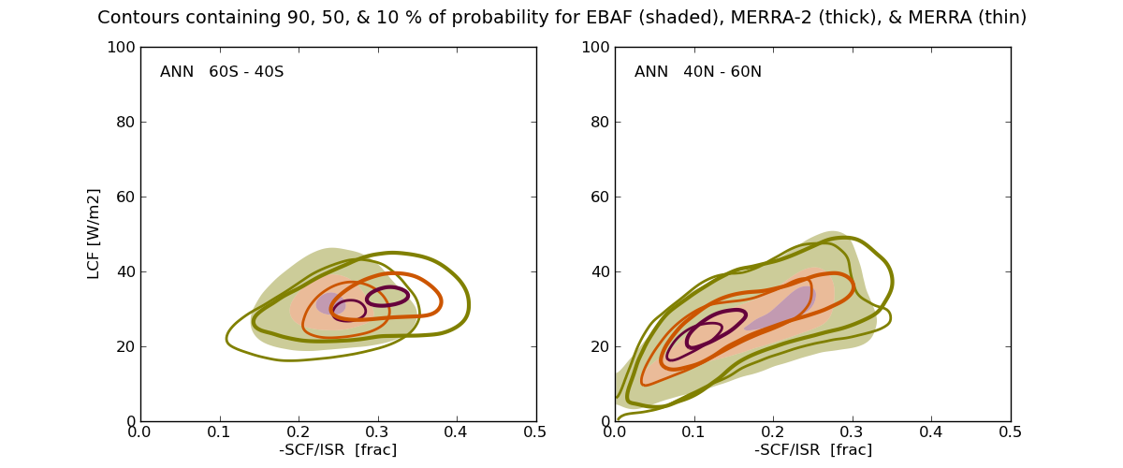
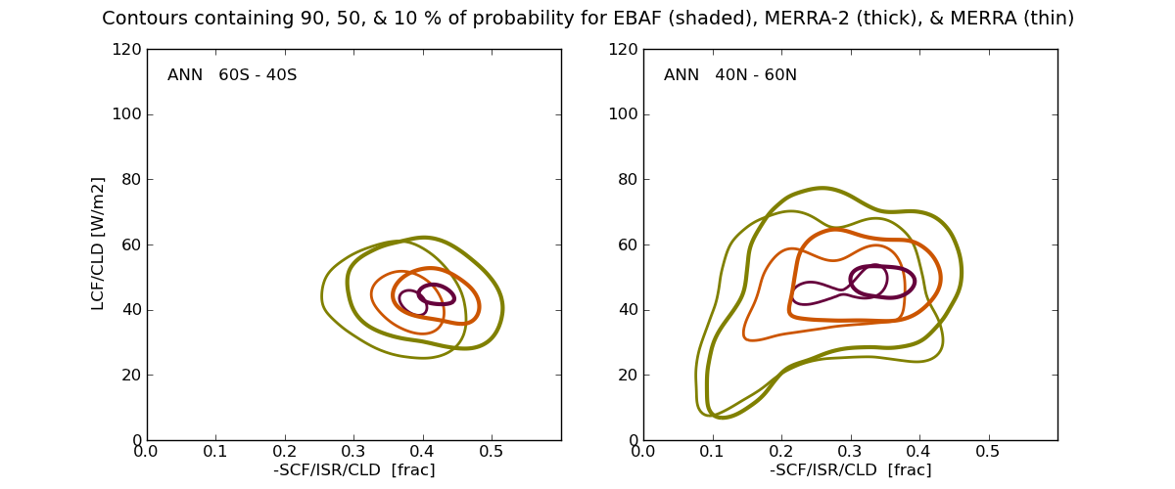
Southern Ocean cloud is inherently brighter in MERRA-2 than MERRA. The same appears to also be true, though less evident, for Northern high-latitudes.

Slide 19
MERRA-2 Cloud Forcing Summary
The good:
Better overall global cloud forcing pattern.
In particular, tropical ITCZ, subtropical cloud minima, and transition to mid/high-latitude cloud have a more realistic pattern.
Continental cloud is also improved.
The not so good:
Tropical cloud is too bright.
Southern Ocean cloud is too bright.
Have just started looking at surface CRF.

