Slide 1
Overview
MERRA-2 Water and Energy
Diurnal Cycle of Pr/MJO (Winston)
Water Cycle (Pete R. and Andrea)
Energy Budget
Implied Ocean Heat Transport (Yury/Andrea)

Slide 2
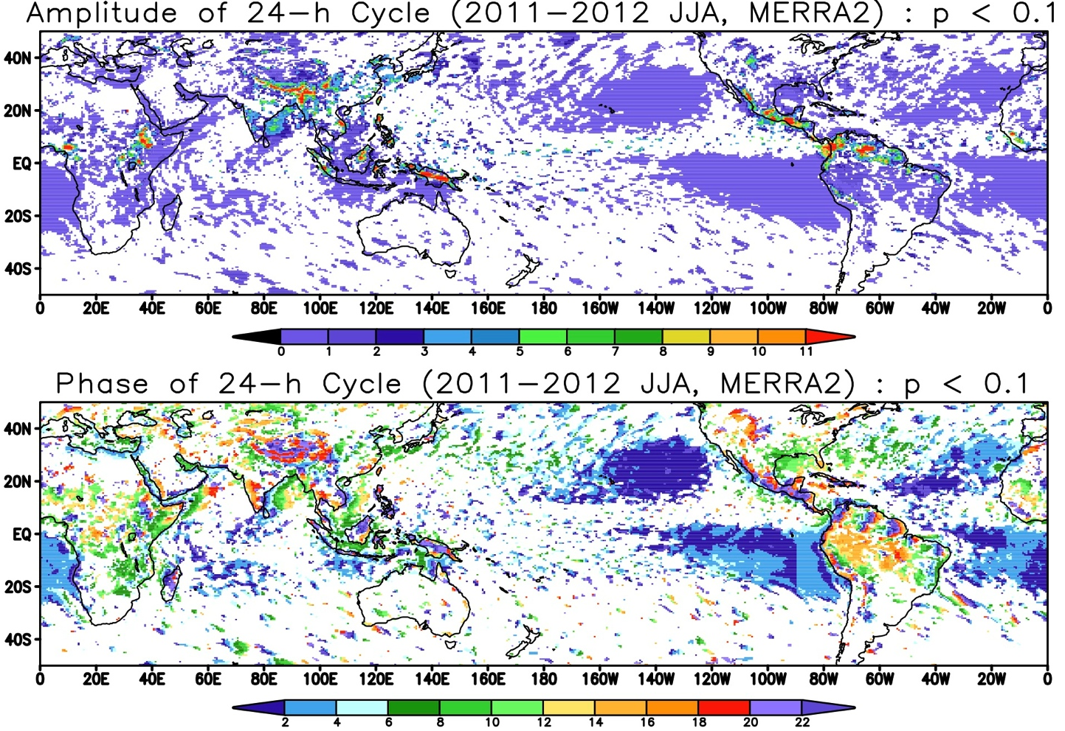
Diurnal Precipitation – MERRA-2
Contributed by Winston Chao

Slide 3
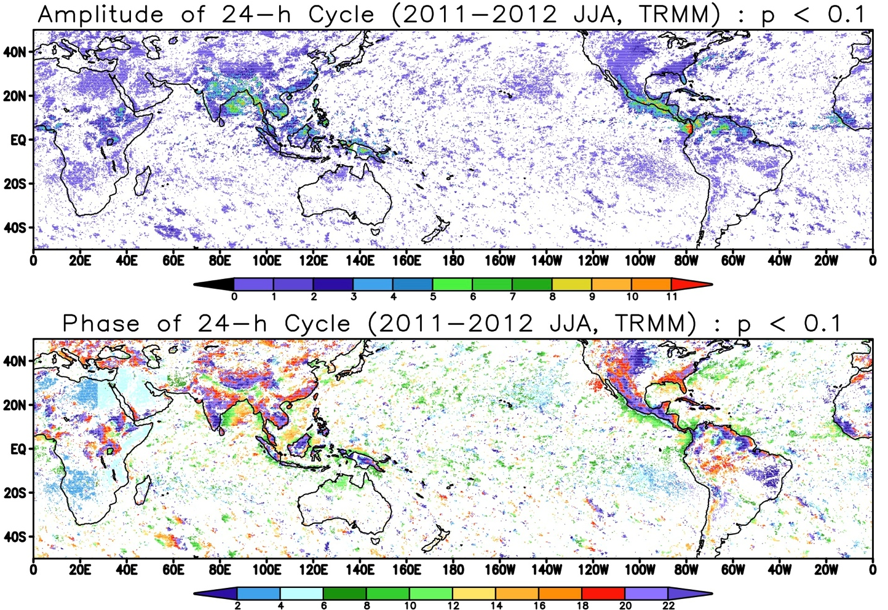
Diurnal Precipitation: TRMM
Contributed by Winston Chao

Slide 4
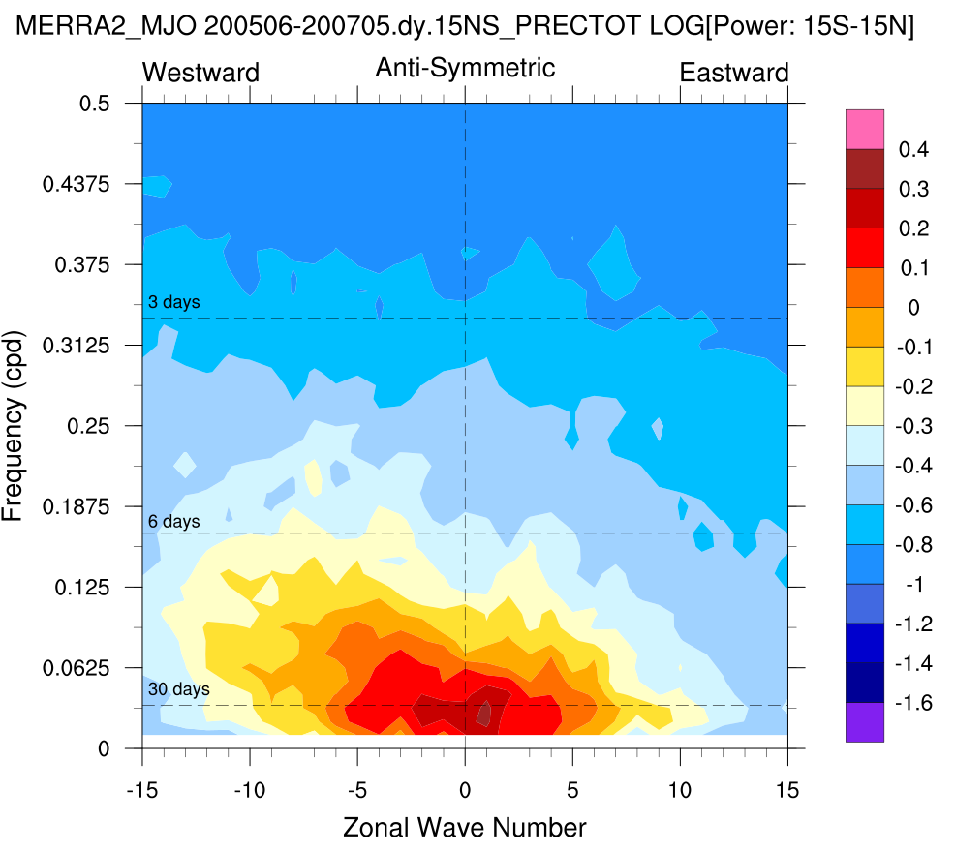
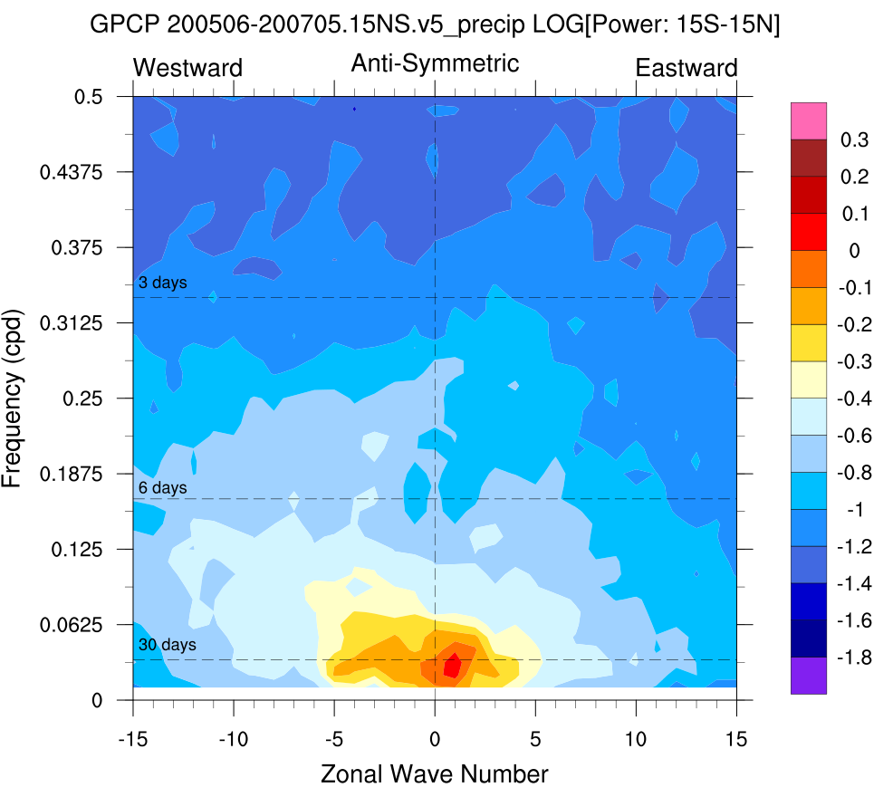
MJO: MERRA-2, GPCP
MERRA-2 MJO more intense than observed in GPCP, in both Hovemoller and W-K diagrams
Contributed by Winston Chao

Slide 5
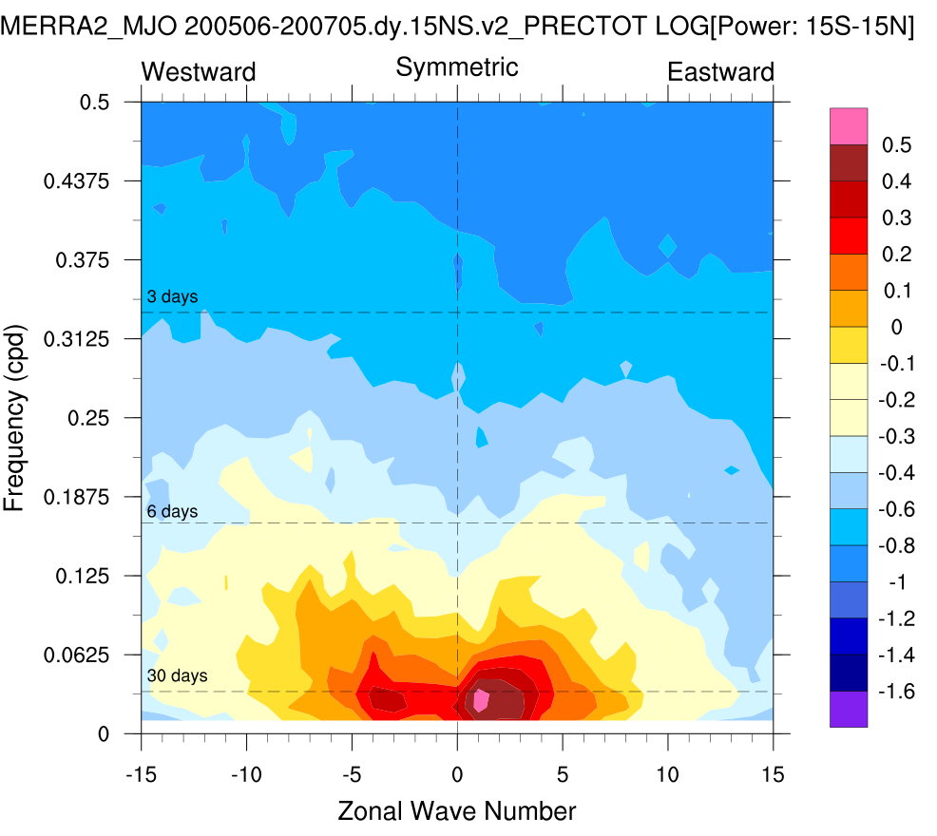
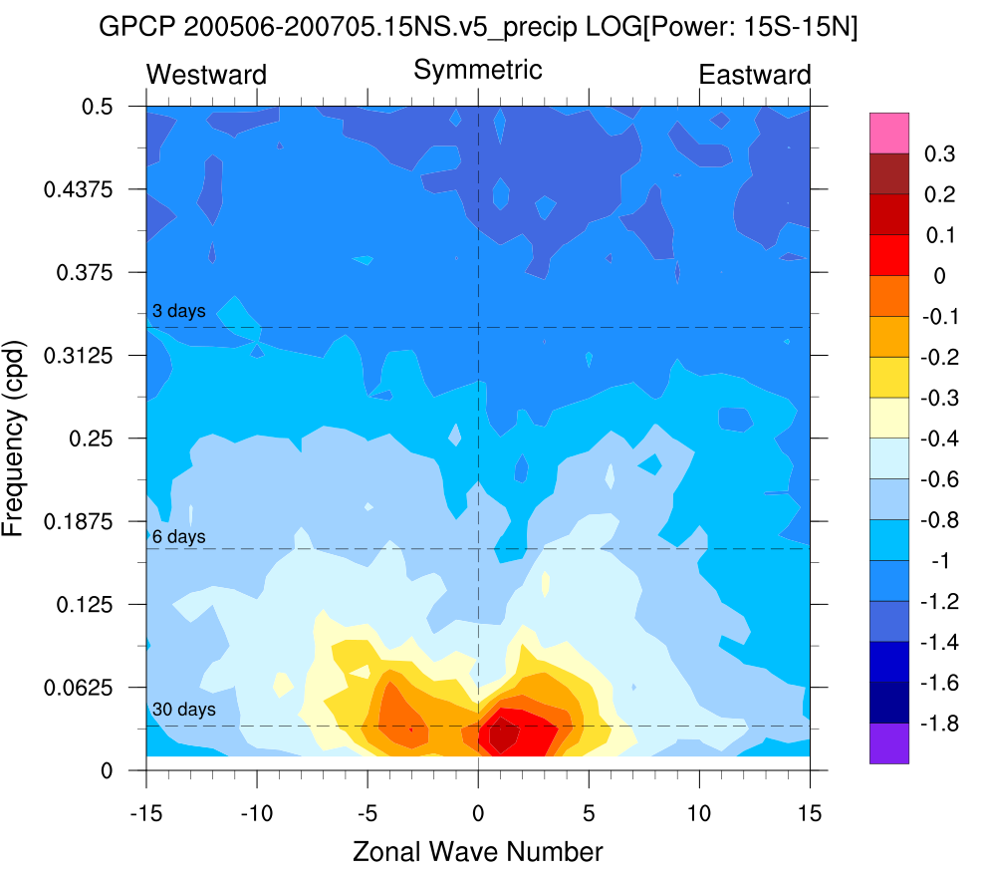

Slide 6
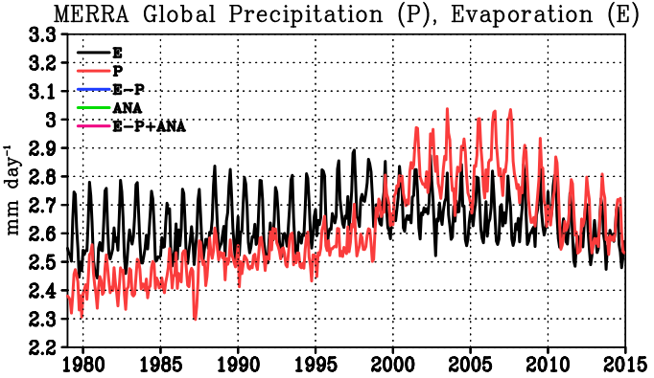
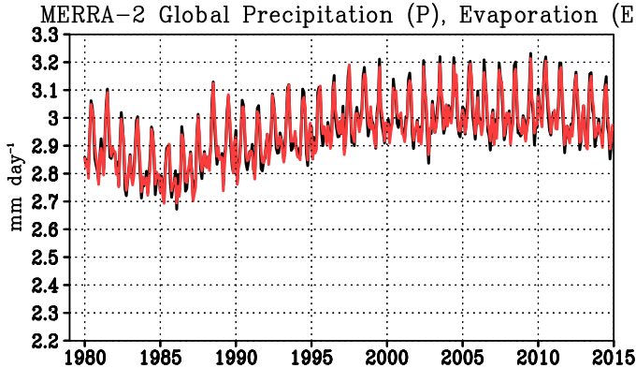
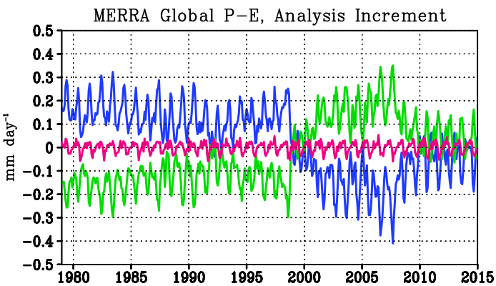
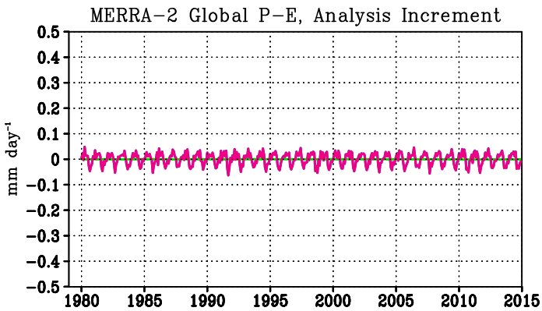
Globally precipitation, evaporation and analysis forcing
Surface pressure and water vapor analyses are penalized for global imbalances (Takacs et al., NASA GMAO Tech Memo, 2015)
MERRA-2
MERRA
MERRA-2
In MERRA, imbalances of P and E result from analysis adjustments, sensitive to changes in the observing system.
In MERRA-2, unphysical changes in total mass are ameliorated and global balance between P, E is maintained
Notes:
Globally integrated precipitation (top), evaporation, and analysis forcing (bottom)
Take enough time to describe balancing clearly

Slide 7
Land/Ocean Water Mass Budgets
Land evap follows the bias corrected precip. Land model precip follows the analysis increment trend
Ocean Precipitation and evaporation track each others variability, than the analysis increment
Increment jump in 2003 due to AIRS

Slide 8
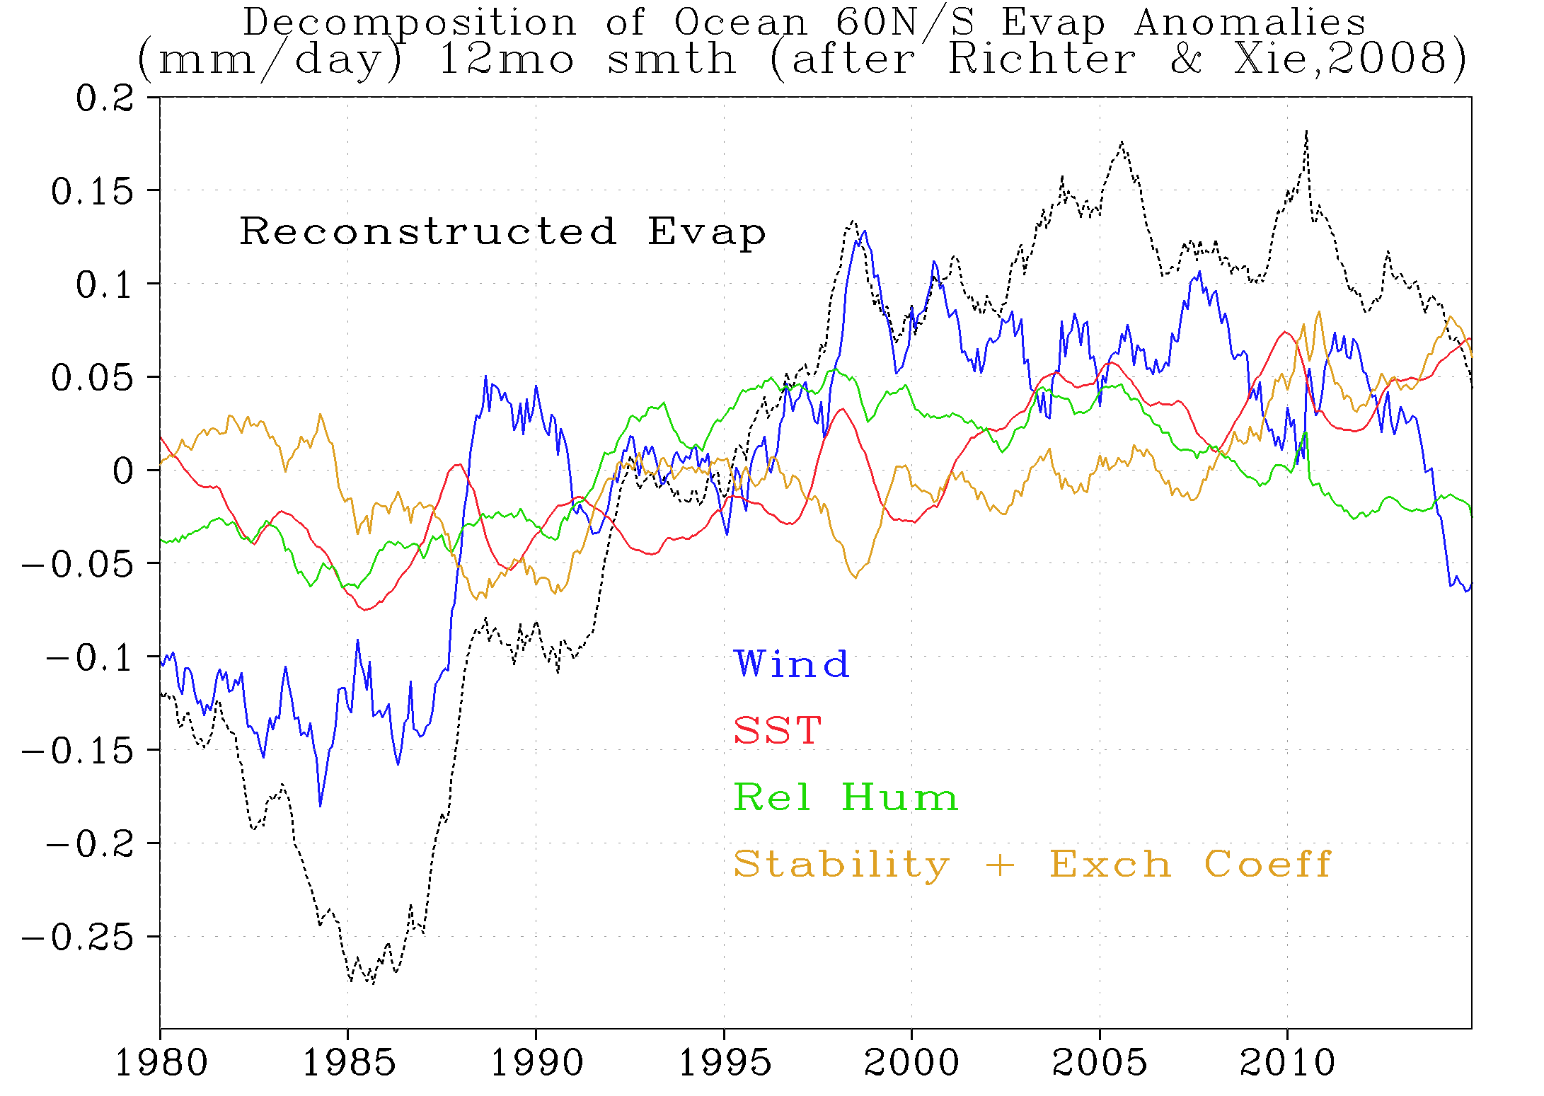
Decomposition of Ocean Evap
1st order Taylor’s series expansion of anomalies around the mean annual cycle
SST affects low frequency
Wind jump at SSMI
Stability/RH jump in 1992
Post 2000 steady Evap
Pete Robertson (MSFC) and thanks to Andrea Molod

Slide 9
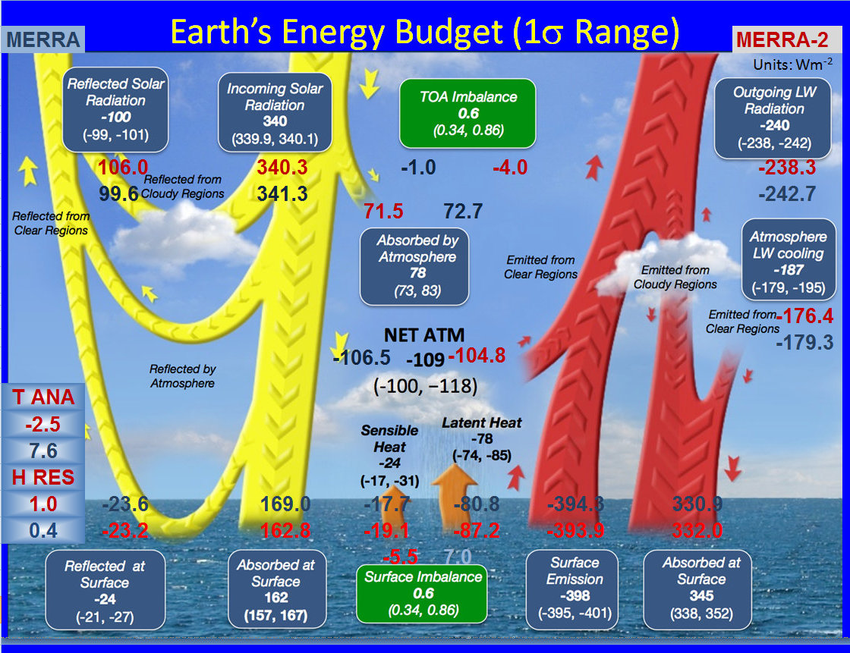

Slide 10
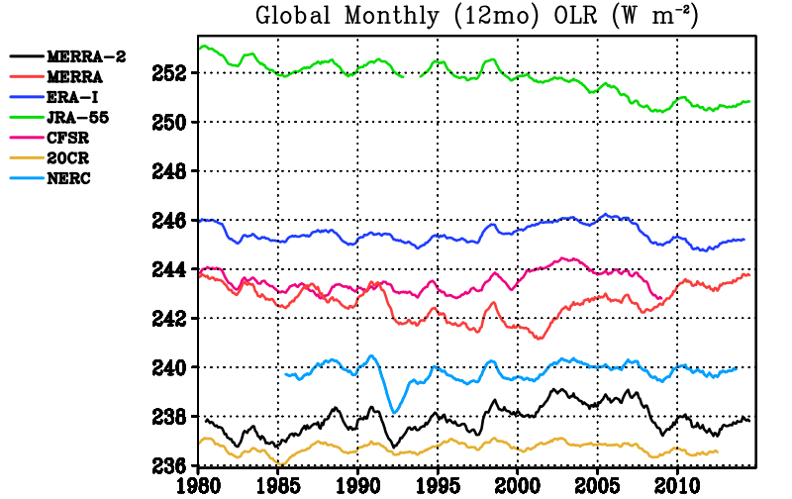
Global OLR

Slide 11
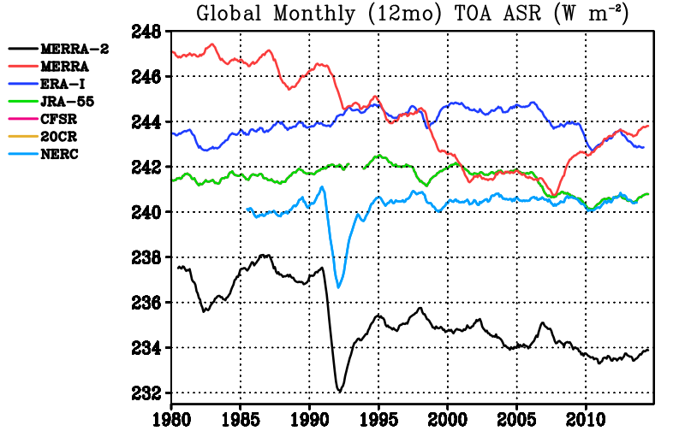
Global TOA Absorbed SW

Slide 12
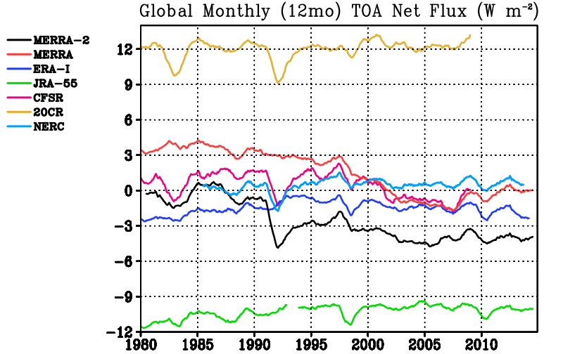
Global TOA Net

Slide 13
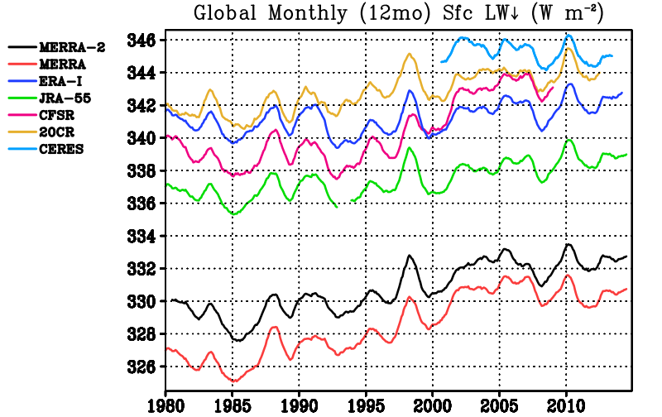
Global Surface Downward LW

Slide 14
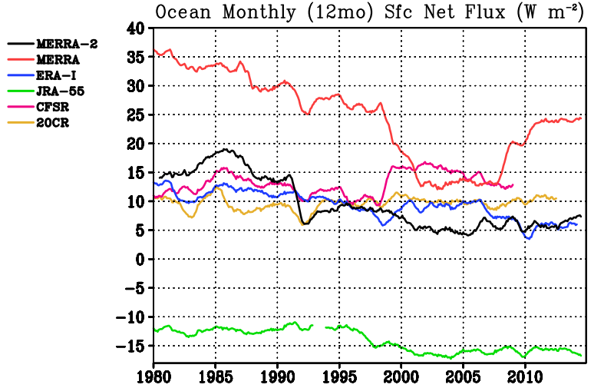
Ocean Surface Net Flux
Positive down

Slide 15
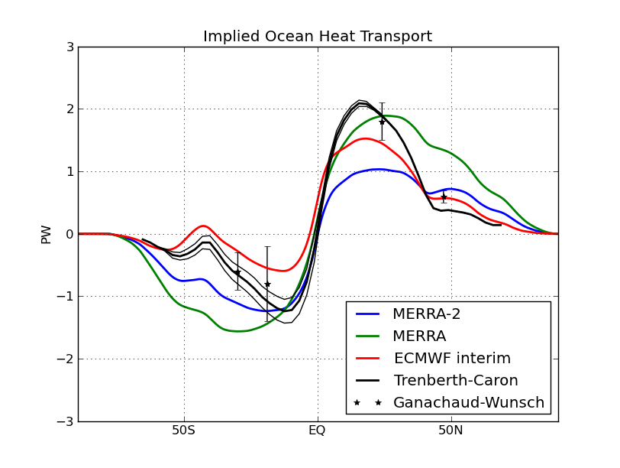
Implied Northward Ocean Heat Transport
Some improvements in the transport, but underestimate the Northern peak

Slide 16
Main Points
Water cycle is more stable, but this does not mean that the effect of changing observing system is gone.
  Ocean Evap drives the global water cycle (AIRS impacts Pr)
  At Global Scales, obs that affect evap appear more prominent, Increment still has impact on precip
Recent period energy balance
  looks OK in TOA OLR
  too much reflected at TOA
  too little Sfc LW down (Needs further study)

Slide 17
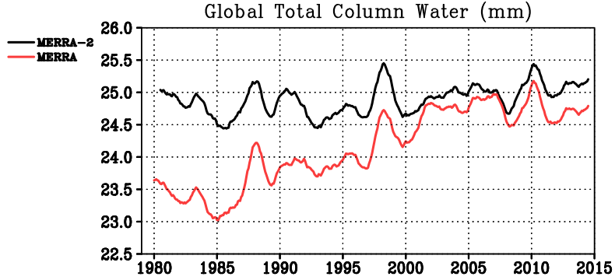
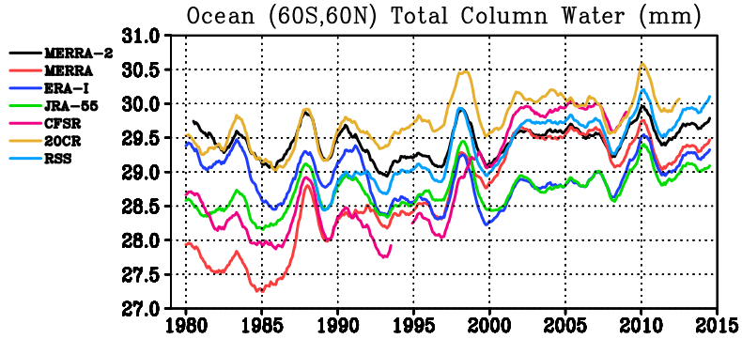
Time Series of Total Precipitable Water
F08
F11
N15
MW data sources with large impact on MERRA have much less impact on MERRA-2 Global TPW

Slide 18
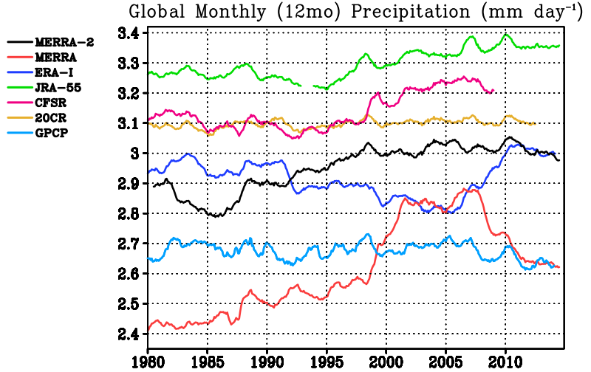
Time series of global precipitation
N16
N15
F08
F11
MW data sources with large impact on MERRA have somewhat less impact on MERRA-2 Precipitation

Slide 19
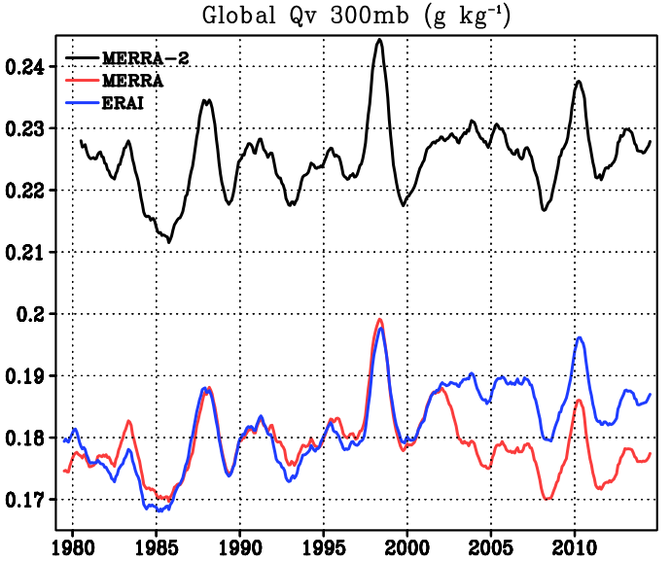
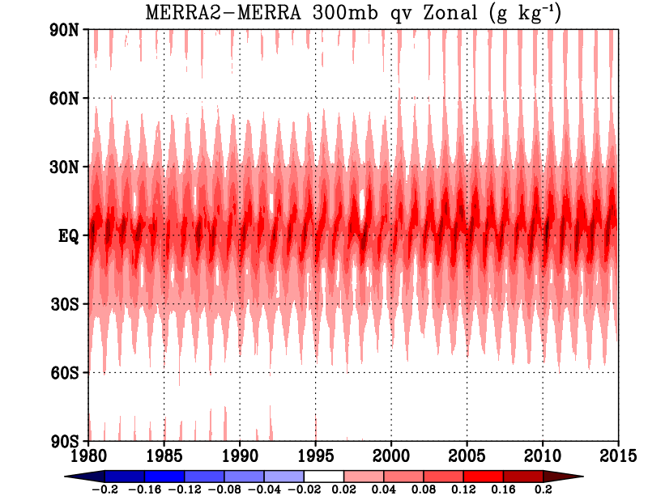
Upper Tropospheric Humidity
MERRA lacking some data used in M2 and ERA after 2002
MERRA-2 increase in qv primarily in the tropics
~1Wm-2 decrease in CERES OLR algorithm using M2

Slide 20
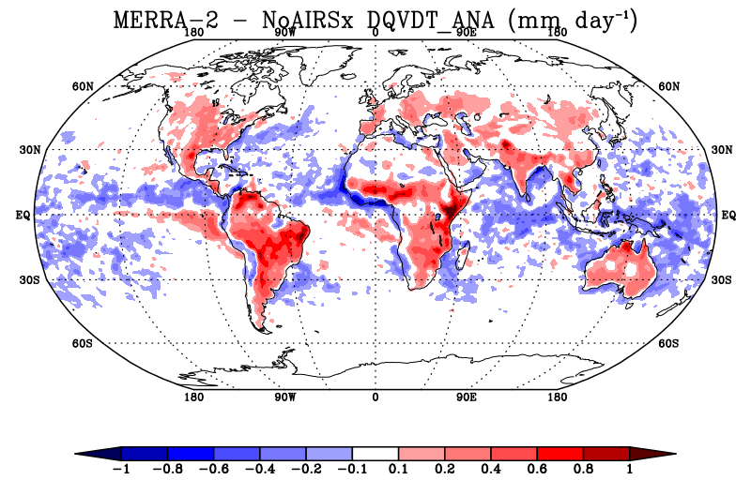
Aside: AIRS Withholding Experiment

Slide 21
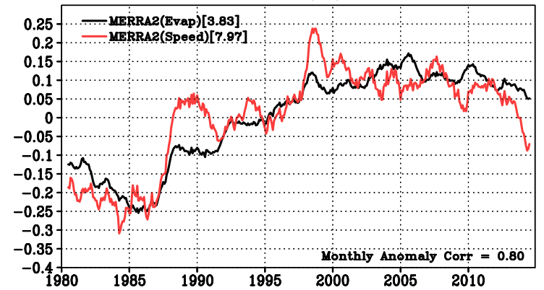
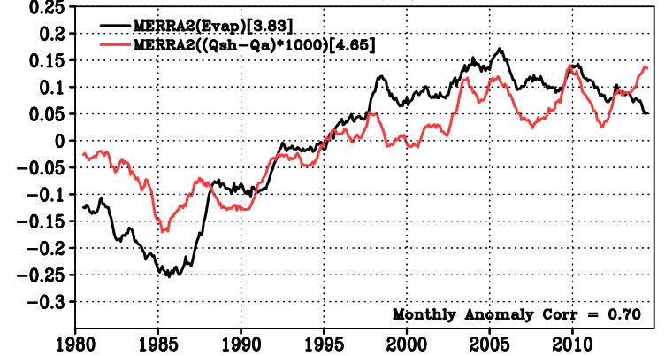
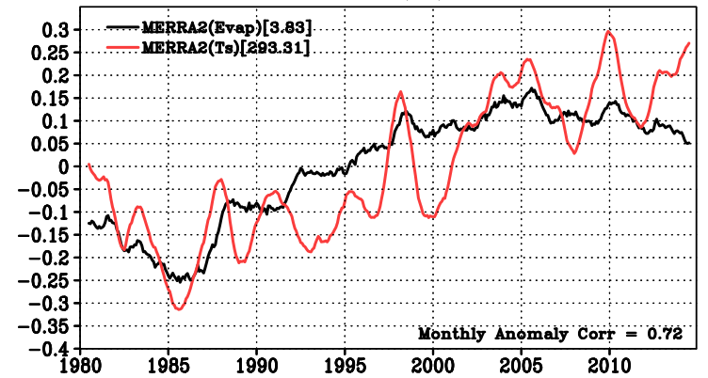
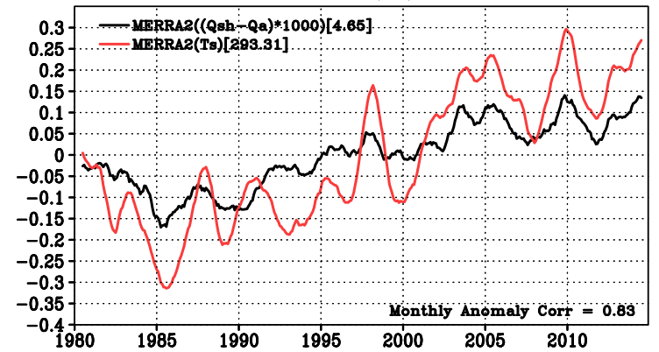
Ocean Evap 60S-60N
Changes in the Wind obs shock the Evap
SST increasing trend leads to increasing evap
After 1998, Evap levels off, increasing SST, decreasing winds

Slide 24
Decomposition of MERRA2 Ocean Evaporation
Following Richter and Xie (2008) we can write the bulk formula for evaporation as
where
, , and
and q_{o}, a, b, c are constants.
We then make a 1st order Taylor’s series expansion of anomalies around the mean annual cycle,
where the partial derivatives are “sensitivities” built from monthly resolved climatology and δ( ) denotes a monthly anomaly.
Notes:
Data are monthly means of qsh, qlml, tlml, speed(lml), SST.

