Slide 1
NOAA Reanalysis
NOAA has a strong interest in Reanalysis, with goals including: climate monitoring, climate model evaluation, forecasts initialization and verification.
NOAA has pioneered in many areas of reanalysis: R1 reanalysis (Kalnay et al, 1996); first attempt at atmosphere/ocean coupled reanalysis with CFSR (Saha et al., 2010); first attempt at 20th century reanalysis using only surface air pressure (Compo et al, 2010); ensemble coupled data assimilation approaches developed at GFDL.
A new set of products has recently been completed.
Research is ongoing both at NCEP and ESRL to improve upon these products.

Slide 2
NOAA Reanalysis
Future strategy includes a more holistic NOAA approach to reanalysis with common data assimilation/model infrastructure common to reanalysis for the whole of the 20th century involving groups at NCEP and OAR/ESRL, leveraging OAR/GFDL work.
OAR/CPO supports research towards the development of next generation NOAA reanalysis; fostering NOAA-wide collaborations to develop the next-generation climate reanalysis, growing synergies with efforts at NASA (many already exist) and coordination with broader international community efforts.

Slide 3
NOAA Reanalysis
WCRP could help to foster this by having a dedicated reanalysis group (this is under discussion..)
At the horizon, research to improve the way we do atmospheric reanalysis (treatment of biases in observations and models; issues in the stratosphere; optimization of data assimilation techniques); further exploring integration among atmosphere, ocean and land components of the data assimilation system; a multi-model approach?

Slide 4
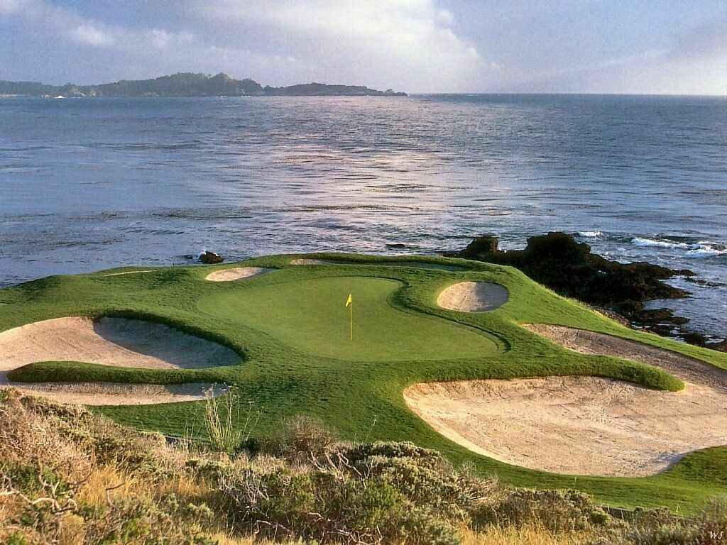
NOAA Reanalysis at Pebble Beach
Bob Kistler is on the tee. Jack Woolen is carrying the bag. Hua-Lu Pan got a hole in one. Dave Behringer is in Camp Springs packing for the new UMD facility. Gil Compo has an historical problem finding his ball. Louis Uccellini is forecasting snow.

