Slide 1
JMA’s priority and plans on reanalysis
Kazutoshi ONOGI
Japan Meteorological Agency (JMA)
11 May 2012
4th WCRP International Conference on Reanalysis

Slide 2
JRA History & Plan
1st JRA-25 (completed in 2006)
2nd JRA-55 (to be completed in 2013)
Being calculated.
Next JRA?
JMA has a plan of the next global atmospheric reanalysis (JRA-??) in the future but its details has not been discussed yet.
2

Slide 3
Basic Policy of JRA
An operationally quality proven data assimilation and forecast system should be used in JMA reanalysis.
JMA is an operational organization rather than a research institute.
JMA has many kinds of operational climate information services.
The JRA products are utilized in the services.
Contribution to climate monitoring and seasonal forecast are main purposes.
The JRA products have to fill a certain quality level to reproduce various meteorological phenomena.
3

Slide 4
Priority for the next JRA
Reducing the systematic biases that still exist in JRA-55
Physical processes must be improved; (e.g.)
Reduction of overestimated precipitation in the tropics
Improvement of land surface processes
Gravity wave scheme
Enhancement of horizontal and vertical resolution.
A reanalysis from (e.g.) 1948 onward is possible.
We think upper radiosonde observations are essential for our purpose.
4

Slide 5
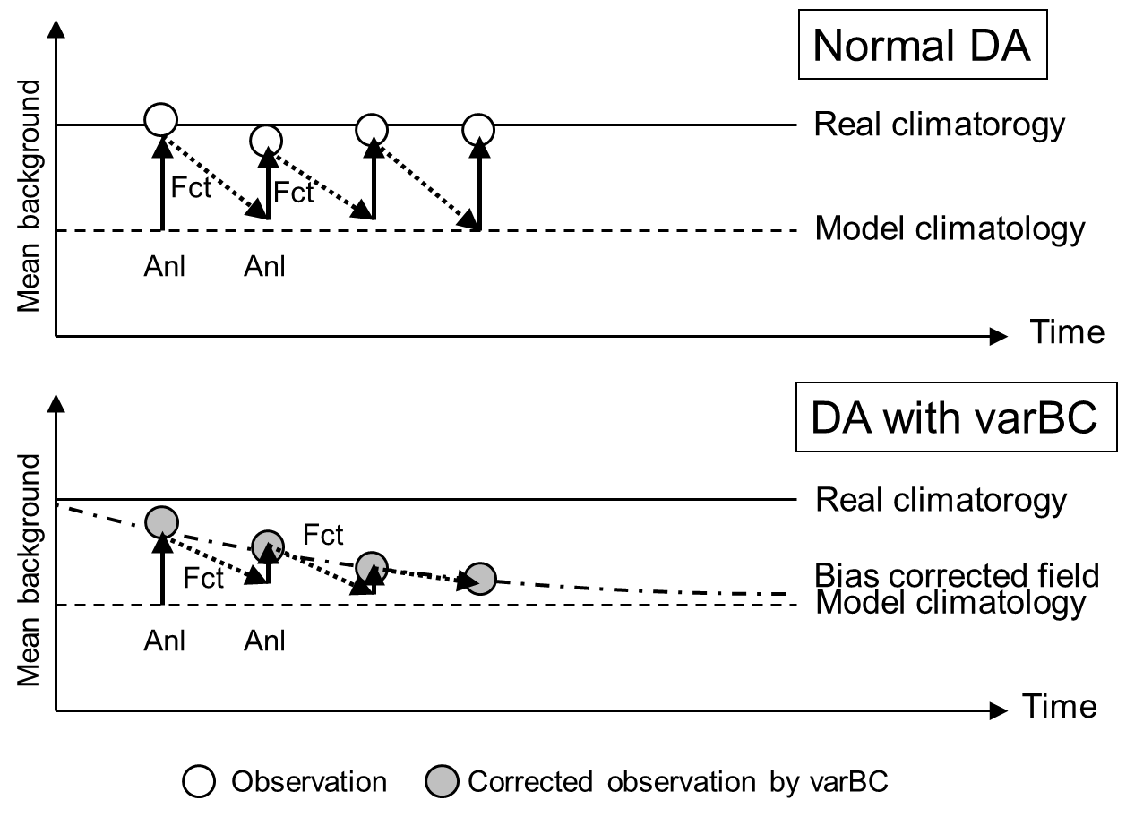
Model bias and VarBC
Model Bias, Observation and Analysis
Model climatology
Real climatology
Forecast
background (B)
With Observation (O)
Analysis (A1)
Without Observation
Analysis (A2)
(E. Kalnay)
If a model has systematic bias;
Change of observing system can be a cause of a jump in a time series.
Variational Bias Correction is a superior method to remove such “jumps” but the field converges asymptotically to the model climatology without anchoring observations.
If we can make model bias smaller,
influence of observing system changes become smaller.
5

Slide 6
Practical problems on works for reanalysis
Difficulty to maintain Climate Data Assimilation System (CDAS) for long years
Data Assimilation (DA) system of a CDAS is getting old with time.
New satellite data (e.g. radiance) cannot be assimilated easily in the old DA system.
On the other hand, a satellite cannot be operated forever.
Once a satellite data being used become unavailable, quality of CDAS must be degraded.
Usually in an operational center, development for the latest operational NWP model has higher priority than development for CDAS.
6

Slide 7
Practical problems on works for reanalysis
Reanalysis product providing services
Amount of reanalysis products is very large.
The data service requires sufficient and powerful computer resources.
Data server, storage, telecommunication line…
7

Slide 8
JMA contributions for research com.
Data services for research community
From JMA
While computer resources are not sufficient.
From NCAR
http://rda.ucar.edu/datasets/ds625.0/
We are ready to provide the past GMS/MTSAT data reprocessed by MSC/JMA.
Reprocessed AMV/CSR data of geostationary satellites are quite effective to improve quality of reanalysis products.
JMA has provided quality information of the past satellite data for ERA-Interim.
A seconded staff from JMA is at ERA group / ECMWF.

Slide 9
JMA contributions (continuation)
Japanese Domestic Advisory Committee
For JRA-55
10 Japanese professors are the members.
Toshiki Iwasaki (Chair), Kimio Hanawa, Tetsuzo Yasunari, Toshio Koike, Masahide Kimoto, Hisashi Nakamura, Hiroshi L. Tanaka, Yukari N. Takayabu, Toshihiko Hirooka, Shinjiro Kanae
Advices from the JRA AC were adopted.
Sub-products (JRA-55C, JRA-55AMIP)
Interim report of JRA-55 (Ebita et al. 2011, SOLA)

Slide 10
Plan of JMA CDAS (JCDAS)
We have a plan to replace with a new version of JMA Climate Data Assimilation System (JCDAS).
Currently JRA-25 based JCDAS is operationally produced and the products are available for research.
After the completion of JRA-55, the JRA-25 based JCDAS will be replaced with JRA-55 based JCDAS.
We are confident that it is an improvement of our services.
Note that current JRA-25 based JCDAS will be stopped in spring 2014.
We will have adequate get-acquainted period for notice.
Please understand that we do not have sufficient computer resources to provide 2 versions of JCDAS in parallel.

Slide 11
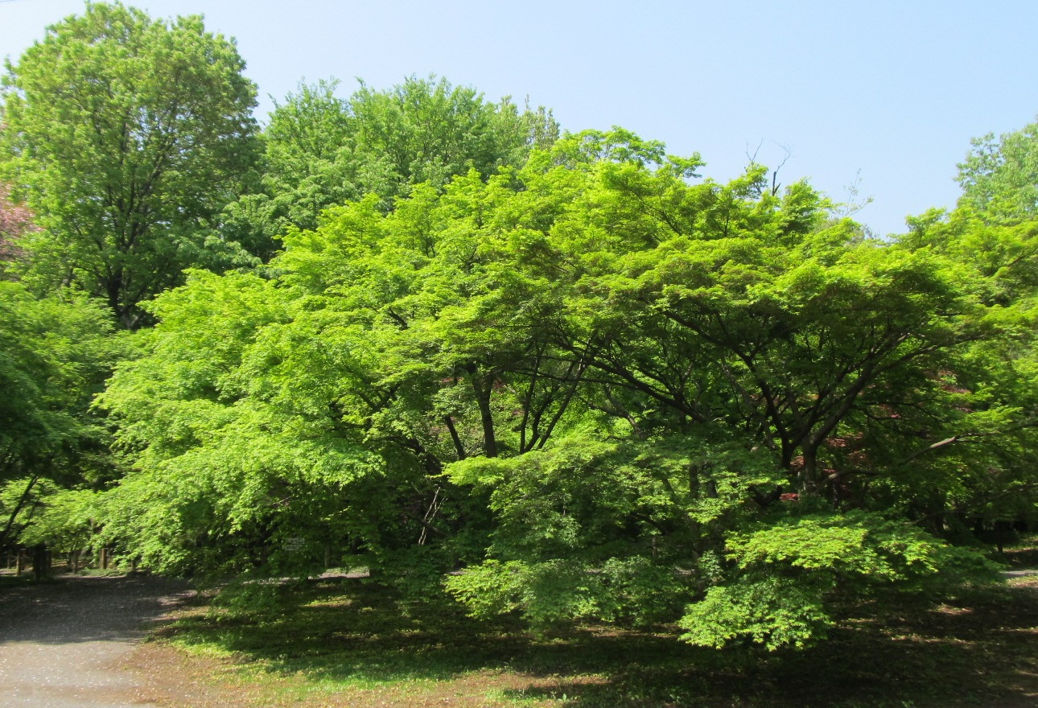
Competition with Collaboration

