Slide 1
4th WCRP International Conference on Reanalyses
DOE’s Climate Modeling Efforts
PMs: Dorothy Koch, Renu Joseph, Bob Vallario
Division Director: Gary Geernaert
Climate Modeling Programs
Climate and Environmental Sciences Division
Biological and Environmental Sciences
Renu Joseph May 11, 2012

Slide 2
Discussion Topics
Current and future plans, programs and priorities for developing and/or fostering the use of reanalysis products.
Agency perspectives on associated opportunities and challenges to develop a common understanding.
Requirements of agencies/entities and the scientific community to fulfill their respective mission.
How the agencies and the scientific community can sustain each other in this process in a collaborative way

Slide 3
DOE’s Office of Science
William Brinkman Director
Patricia Dehmer Deputy Director
Basic Energy Sciences
Biological and Environmental Research (BER)
Sharlene Weatherwax, Associate Director
High Energy Physics
Nuclear Physics
Fusion Energy Sciences
Advanced Scientific Computing Research
Biological Systems Science
Sharlene Weatherwax, Director
Climate and Environmental Sciences
Gary Geernaert, Director

Slide 4
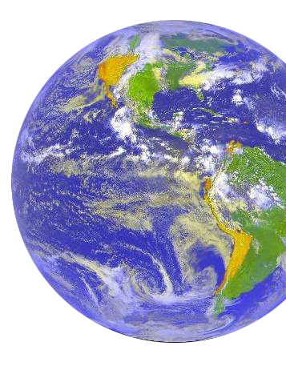
Why DOE? The Energy-Climate Nexus
Greenhouse gases are emitted during energy production… and climate change will impact energy production
DOE seeks to:
Understand the effects of GHG emissions on Earth’s climate and the biosphere
Provide world-leading capabilities in climate modeling and process research on clouds and aerosols, and the carbon cycle
Provide unique, world-leading capabilities in cloud and aerosol observations and large scale ecological experiments
Build foundational science to support effective energy and environmental decision making

Slide 5
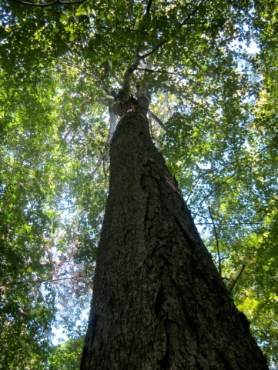
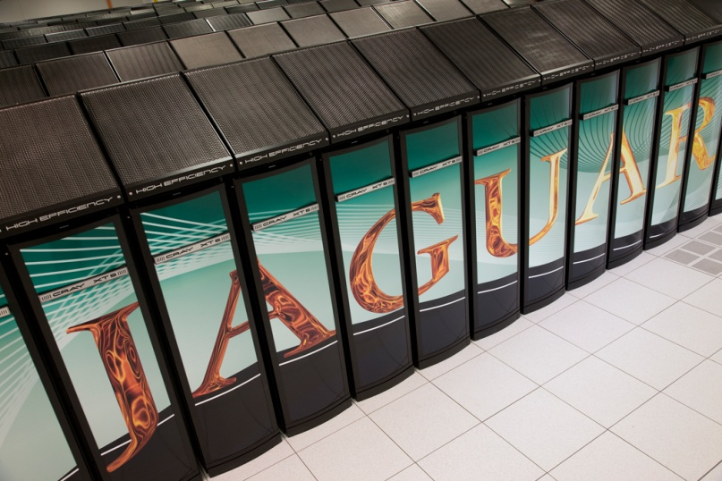
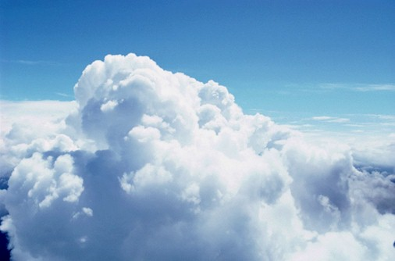
Climate and Environmental Sciences Division
Climate and Environmental Sciences
Atmospheric Science
Climate and Earth System Modeling
Regional & Global Climate Modeling (Renu Joseph)
Earth System Modeling (Dorothy Koch)
Integrated Assessment (Bob Vallario)
Environmental System Science
Terrestrial Ecosystem Science (Mike Kuperberg, Dan Stover)
Subsurface Biogeochemical Research (David Lesmes)
Atmospheric System Research
(Ashley Williamson)
Atmospheric Radiation Measurement Climate Research Facility (Wanda Ferrell)
Environmental Molecular Sciences Laboratory (Paul Bayer)

Slide 6
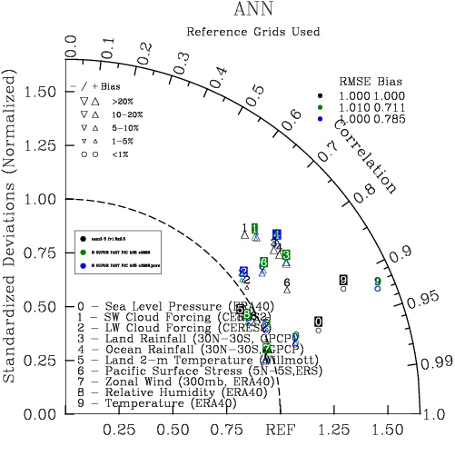
Overarching Goal for Climate Modeling
To advance fundamental understanding of climate variability and climate change by developing and analyzing Climate and Earth System Models at temporal scales ranging from decades to centuries and spatial scales ranging from global to regional to understand climate and energy impacts at global and regional scales.
Development
Analysis
Global
Multiscale
Regional
Regional and Global
Climate Modeling
Integrated Assessment
Research Program
Earth System Modeling
Notes:
Develops improved representations of specific model components - along with better coupling mechanisms - and integrating them into Earth System Models that take advantage of DOE’s high-performance computing capabilities.
Develops, evaluates and uses Regional and Global Climate Models to obtain more accurate projections of future climate at higher resolution.
Develops Integrated Assessment Models to determine the impacts from and possible mitigation of climate change.

Slide 7
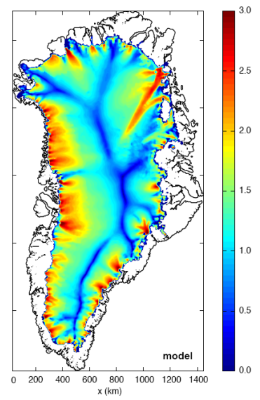
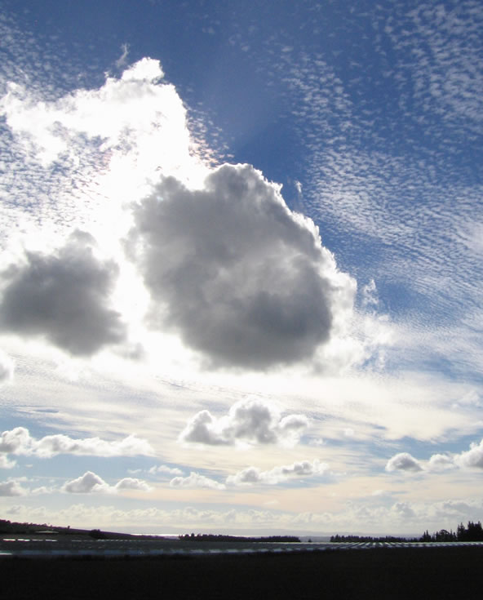
Earth System Modeling
Develop model physics of system components (CESM)
Couple individual components
Test and improve components using observations (“Test-bed”)
SciDAC partnership with Advanced Scientific Computing (ASCR)
Optimize computationally intensive processes and codes
Evaluate process feedbacks and potential for abrupt climate change

Slide 8
Regional and Global Climate Modeling
What: Evaluation and application of Regional and Global Climate Models to understand high resolution patterns and causes of climate change
Why: Need to understand climate variability and change as evidenced in model projections; need to provide feedback on improving model components and coupled system to model developers
DOE Niche:
Model Intercomparison Efforts
Data dissemination and Visualization for Model Intercomparison efforts and evaluation
Metrics for evaluation of climate models
Uncertainty Quantification to inform model development
Detection and Attribution
Arctic System Modeling
Collaborations: NSF, NOAA & USDA
If successful, impact: Credible scientific input to decision makers at a local scale.

Slide 9
Program for Climate Model Diagnosis and Intercomparison: PCMDI
Leadership of software development and infrastructure support for “community modeling” activities
Scientific leadership of “community modeling” activities (e.g., AMIP, CMIP)
Development and application of “broad brush” climate model performance metrics
Studies of aerosol, cloud, precipitation, and radiation processes
PCMDI
Climate change detection and attribution research
CAPT project (Cloud Associated Project Testbed)
Diagnosis of global climate models (variability, hydrological cycle, land surface processes, ocean heat content and circulation)

Slide 10
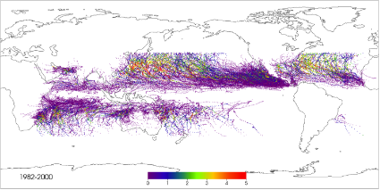
Plans and Priorities for fostering the use of reanalysis products
Developing Diagnostic tools for:
Easy analysis and diagnostics capabilities: Dedicated infrastructure to support increasing data volume and focused investments in “user-friendly” software tools to work with the data.
Working on getting MERRA on the portal
Cyclone Detection
Spatial Extreme Value Analysis
Notes:
Ncep reanalyses
Merra reanalyses

Slide 11
Plans and Priorities for fostering the use of reanalysis products.
LLNL CAPT project:
CAM atmospheric simulation (fixed SSTs).
Climate run
Initialized with ECMWF , Day 2
Errors are similar and intrinsic to model
Figure courtesy of Steve Klein, LLNL

Slide 12
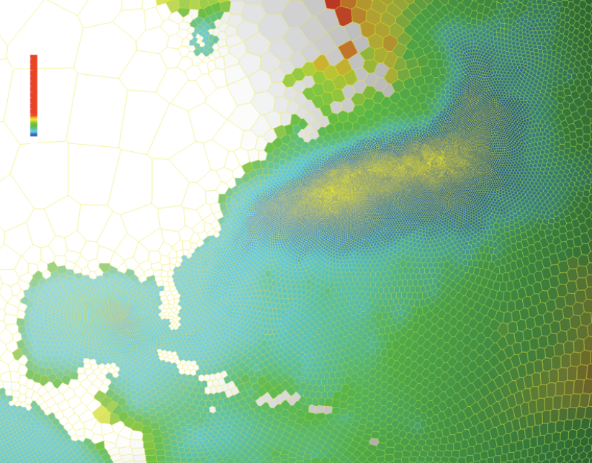
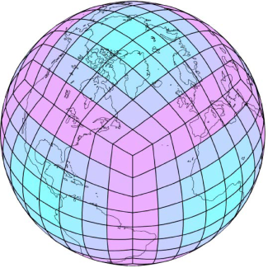
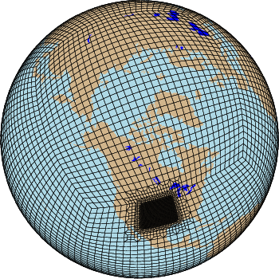
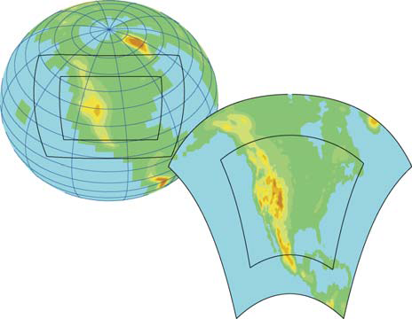
Opportunities and Challenges fostering the use of Reanalysis Products
Next Generation Analysis Needs:
Validation and Verification of high resolution models: There is considerable interest in high resolution models, with uniform or variable resolution models including the ability to ingest observations from field campaigns
Need higher resolution reanalysis products

Slide 13
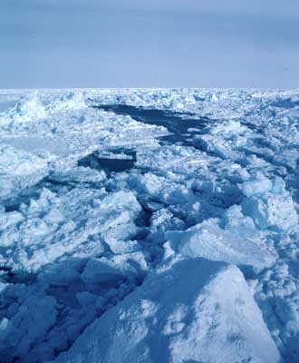
Opportunities and Challenges fostering the use of Reanalysis Products
Next Generation Analysis Needs:
Validation and Verification of high resolution models: There is considerable interest in high resolution models, with uniform or variable resolution models including the ability to ingest observations from field campaigns
Validation of more components of the ESMs: As climate models evolve into more complex ESMs is there an opportunity to create reanalysis products for more variables.
Reanalysis for new evaluation of new components like the Carbon cycle
What are the other new fields that can be produced?
Sea-ice

Slide 14
How DOE and the scientific community can sustain each other in this process in a collaborative way
The Lab-University funding distribution is 50-50 in most programs
All our funding is peer reviewed
Through solicitations
Science Focus Areas
Workshops
Interagency activities
USGCRP
US CLIVAR
ESPC
Interagency Solicitations (EaSM, NMME, etc)

