Slide 1
4th WCRP International Conference on Reanalysis
Wrap Up
Friday, 11 May 2012, Silver Spring MD

Slide 2
Keynote: Adrian Simmons
Ongoing business remains challenging and important
–recovery of observational data from past years
–improvement of assimilating models
–improvement of assimilation methods, including the treatment of model error
But we tend to shift from direct use of tried-and-tested NWP systems
–adjusting (statically or dynamically) background errors for earlier, more poorly observed periods
–developing longer-window data assimilation, in which reanalysis can benefit from additional observations made after the analysis time
And there are questions to be asked
–should we expect a single method to be optimal across the centuries?
–how quickly and fully should coupling be introduced with the ocean circulation, with atmospheric chemistry, …?
should global producers provide global downscaling to higher resolution?
Notes:
Quoted verbatim from Adrian's slide #10

Slide 3
Keynote Cont.
How do producers secure funding with a sufficient time horizon?
–to enable appropriate planning, preparation and execution of reanalyses
–to allow appropriate international coordination
How many comprehensive global reanalyses do users need?
–covering which periods, how often refreshed, when to be terminated?
–are three or four main centres producing for global consumption enough?
–how many from around the Capital Beltway?
–is regional reanalysis a better focus for potential new entrants?
To what extent is international coordination needed?
- development of input datasets (observations, forcing fields, emissions, …)
–over timing of mainstream production
–over running of supplementary data assimilations and model integrations
–over linking of activities with climate modelling (ESG-ongoing)
- Contributions to State of the Climate
and how formal can or should this be?
Notes:
Again Nearly verbatim copy

Slide 4
Status and Plans
GMAO - Developing IESA components; MERRA Innovations quick look
NCEP - CFSRL underway with noted improvements - Hybrid 3D-V EnKF
  Collaborations with GMAO on Assim. e.g. cloud affected radiances
ESRL - Sfc based reanalysis shows skill throughout the Trop., need long record - extremes and CMIP5
JRA go go! shows improvement - planned are a family of experiments

Slide 5
Status and Plans Cont.
ECMWF - ERA CLIM - Building a succession of reanalyses - ensemble model, pressure, land, satellite era
Ocean Reanalyses - Thriving - data record issues, new data opportunities GRACE, SMOS Aquarius
Are there too many? No
When to run a new reanalysis? If a development represents a contribution beyond current capability

Slide 6
Atmospheric Reanalyses
Why Bother?
  Regional reanalyses provide value-added information beyond the global reanalyses (e.g. Surface met.)
Regional Ensembles
  Ensemble mean provides some additional benefit, uncertainty
  Systematic bias in the forcing reanalysis can have adverse impact on regional downscaling
Extremes
  Climate models need only represent well the first 4 moments of daily variability, but long reanalyses are needed for statistical significance

Slide 7
Atmospheric reanalysis Cont.
Arctic shows variability among global reanalyses; uncertainty related data volume
Reanalyses initialize model simulations
  Can expose errors in GCMs
  Need assimilated obs (and Innov./Feedback)
  Better characterization of reanalysis uncertainty
An underlying objective of reanalysis is to improve the background models

Slide 8
Integrated Analysis
As reanalyses have evolved a broad range of Earth system research activities are growing
Aerosol - Sulfate, pollution, fire assimilated and interacting - Increments provide assessment
Land - SM, Snow, T - Coupling strength
Isotope - Proxy modeling for Paleo
Arctic – regional reanalyses to get at the rapid changes in sea ice - Glacier mass budgets

Slide 9
Ocean Reanalyses
A large number of ocean reanalyses are being produced - ensembles have benefit
Need to control biases, but how:
  e.g. bias correcting forcing data, variational correction via EnKF
Biases also affected changing observing system, how to address the radical variations of the ocean observations
Historical reanalyses El Nino looks promising; High ensemble skill
Resolution may improve MOC

Slide 10
Land Reanalysis
Precipitation bias correction of atm reanalysis needed for hydrologic application
ET from recent global reanalysis products, e.g., CFSR, MERRA, MERRA-Land, ERA-Interim, JRA, can be useful in land-atmosphere coupling studies.
Hourly surface data should have benefit, resolve the diurnal, evaluate parameterizations
NCEP CFSR GLDAS replay to improved spin-up initial conditions and one continuous simulation to support the proposed Global Drought Monitor activities.
Full assimilation: soil moisture, snow, temperature to be realized; but subject to observing system variations

Slide 11
Data assimilation
- emerging hybrid Var/EnKf, but also other, non-Gaussian techniques such as Particle Filters being explored
- some potential identified in ocean-atmosphere coupling
- stratosphere/mesosphere and deep ocean: poorly observed, difficult (impossible?) to anchoring
- model and obs covariances: many open questions (background, update, inflation, localization, multivariate, balance)
- bias correction: several methods but noted both models and obs have biases
- Weak constraint 4dVAR – estimate/correct model bias
- seamless nesting to work across scale with heterogeneous grids

Slide 12
User Applications
Examples were presented:
drought
precipitation extremes
tropical cyclones
climate projections
regional downscaling
wind farm investment and reinsurance
...
But there exist discrepancies between reanalyses (uncertainty), need to factor this into the decision making

Slide 13
In Situ Observations
Homogenization of radiosondes has had tremendous positive impact, further developments are crucial
Integrated Global Radiosonde Archive (IGRA): potential to double data base, focus on 'big wins'
changes in radiosonde hardware and processing sometime difficult to identify
  humidity homogenization important, but very difficult
ICOADS input to almost all reanalyses, essential for community but budget cuts
GRUAN essential because non ref observations have biases, need some redundancy to constrain structural uncertainty and detect trends; How to best use GRUAN?

Slide 14
Remotely Sensed Observations
Conflicting goals in atmospheric reanalyses
  time homogeneous data sets
  utilization of the best newest data sets
  response: Families of reanalyses
Reprocessings are critical (e.g. AMV)
How to make better use of sat data bias estimates? Entrain data reprocessing? Intercalibrations?
centralized and decentralized facilities: expand potential for applications
geolocation land/ocean boundaries

Slide 15
Next Steps
Next Conference?
  4-5 years, likely Europe
Other potential meetings?
  Reanalysis "Summer School"; grad/ECS training
  User's Workshop - perhaps geared more toward ECS - may have issues
International Coordination?
  Input Observations - share best practices, expertise among all reanalysis developers
  Processing timing coordination?
  State of the Climate - coordinated comparisons - possibly through reanalysis.org
  Reanalysis projects should only use data that can be passed through e.g. feedback files

Slide 16
Report
Excellent work from the rapporteurs!
Will compile a first draft, and ask program committee and session chairs to review
Second draft will be posted online for open review (reanalysis.org) and announced to conference registrants (3-4 week period)
Final doc will be a WCRP report, summary submitted to EOS

Slide 17
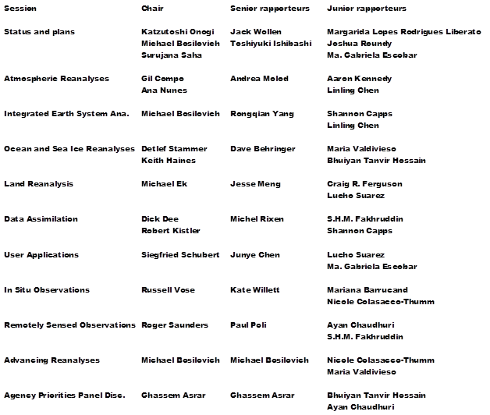
Acknowledgements

Slide 18
Thanks for the time and effort
Program Committee: Ghassem Asrar, Gilbert Compo, Dick Dee, Bart van den Hurk, Kazutoshi Onogi, Robert Kistler, Suru Saha, Roger Saunders, Adrian Simmons, Detlef Stammer, Kevin Trenberth, Russ Vose, Peter van Oevelen
Session Chairs: Michael Ek, Siegfried Schubert, Ana Nunes, Keith Haines
Support: NOAA, NASA, ESA, NSF, DoE, and WCRP; ESSIC, USRA and EGU

