Slide 1
An Intercomparison of
Temperature Trends in the
U.S. Historical Climatology Network
and Recent Atmospheric Renalyses
Russell Vose
Scott Applequist
Matthew Menne
Claude Williams
Peter Thorne

Slide 2
Climate Monitoring
NOAA/NCDC State of the Climate Reports
Monthly on-line publications
Generate numerous media inquiries
U.S. Historical Climatology Network (HCN)
National-scale temperature time series
1895-present, 1218 stations, bias-adjusted records
A role for reanalyses? (Dee et al., 2011)
Near-surface air temperature not ingested in atmospheric analyses
Serve as a counterpart to the purely instrumental record

Slide 3
Purpose of Research
Compare HCN and reanalysis trends
Use six reanalyses to bracket range of plausible trends
Note relative position of HCN in the reanalysis context
Two-part comparison
Trends in area-averaged time series (mean, max, min)
Spatial patterns in trends (mean only)
Compare over 1979-2008
Era common to HCN and all of the reanalyses
But most reanalyses are available in near-real time

Slide 4
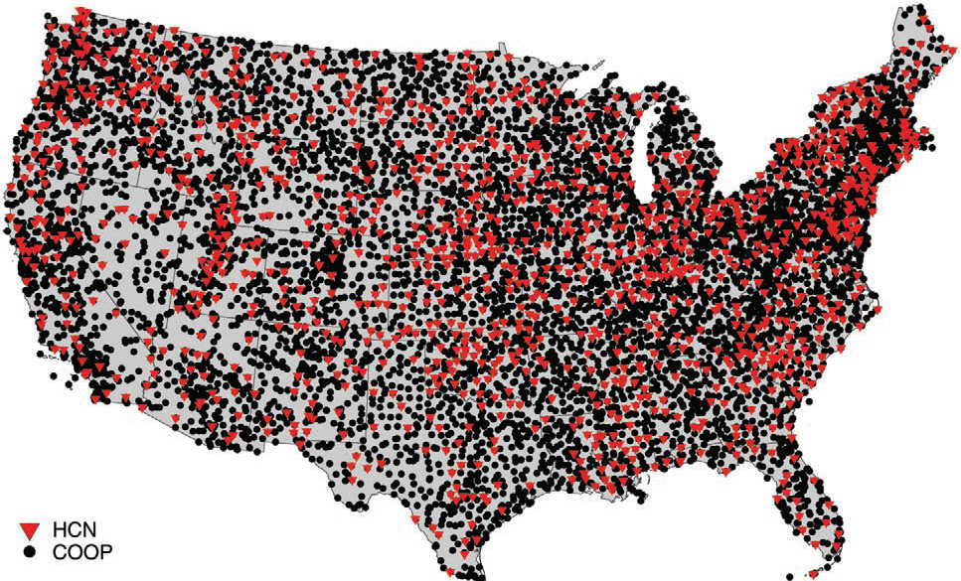
HCN Is a Subset of COOP

Slide 5
HCN Has Bias Adjustments
Account for historical changes in:
Observation time, instrumentation, location
Documented in Karl et al. (1986), Vose et al. (2003), Vose and Menne (2004), Menne et al. (2009), Williams et al. (2012)
Address multiple changes from 1979-2008:
Two net cold biases in maximum temperature
Offsetting cold/warm biases in minimum temperature
Also minimize bias from suboptimal siting:
Poor- and good-exposure sites have comparable U.S. series
Adjusted series agrees well with Climate Reference Network
Explored further in Menne et al. (2010), Fall et al. (2011) – some debate on this point

Slide 6
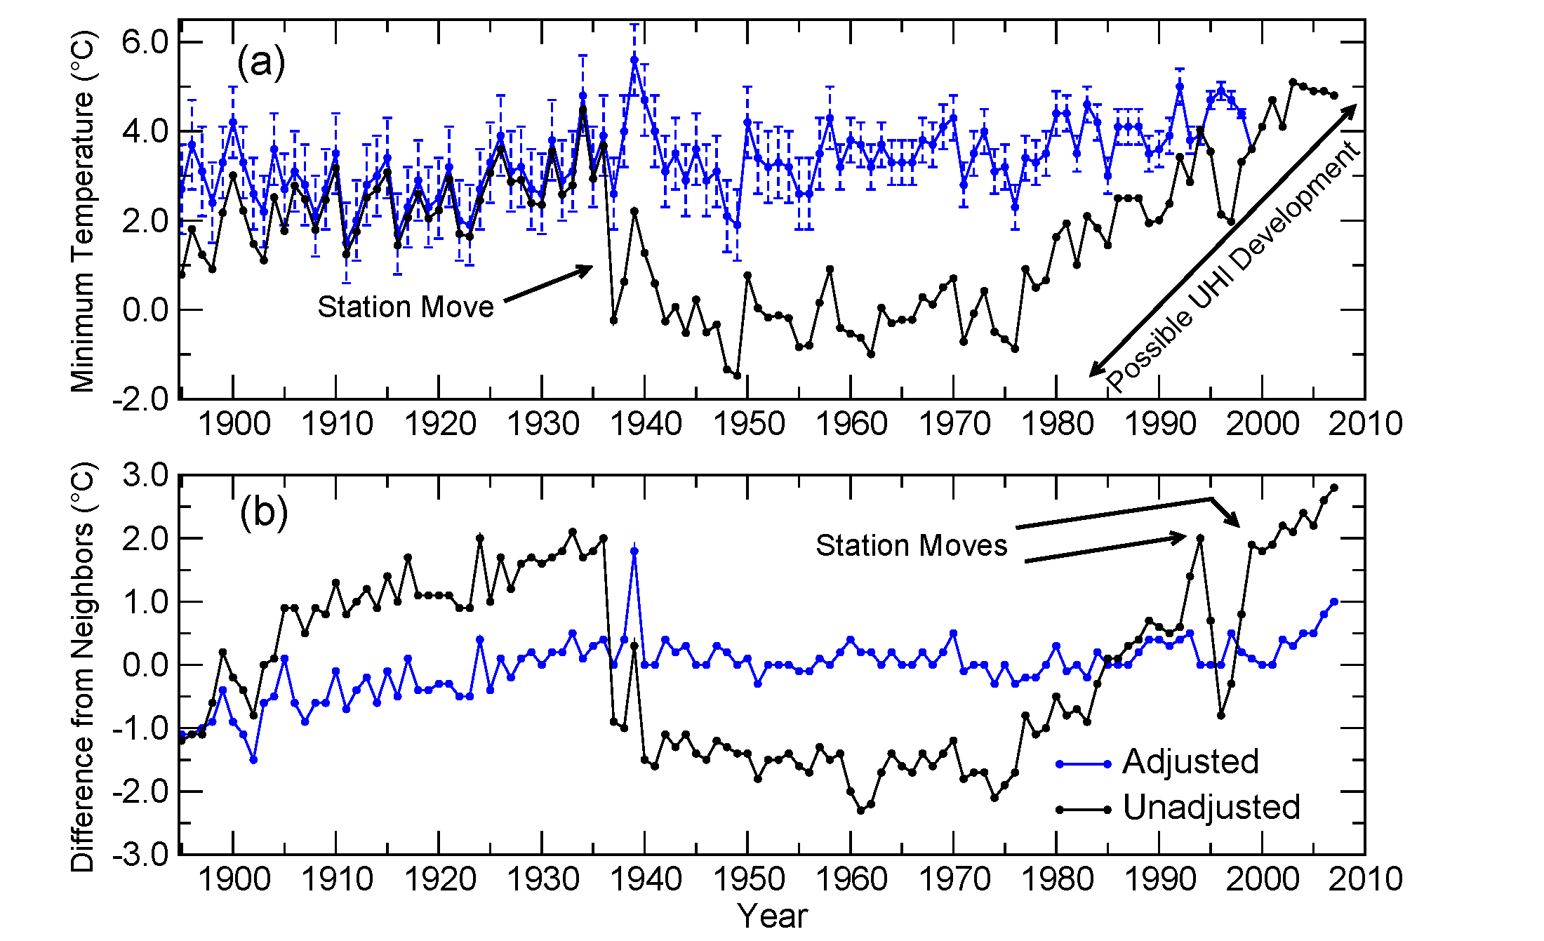
Bias Adjustments: Reno, NV

Slide 7
Compare HCN with 6 Reanalyses
Near-surface air temperature from:
20CR (Compo et al., 2010)
CFSR (Saha et al., 2010)
ERA-INT (Dee et al., 2011)
JRA-25 (Onogi et al., 2007)
MERRA (Rienecker et al., 2011)
NARR (Mesinger et al., 2006)
Substantial differences across the suite:
Temporal resolution (2 are 1-hr, 3 are 3-hr, 1 is 6-hr)
Spatial resolution (half < 50 km and half > 125 km)
Distinct data assimilation schemes and input datasets

Slide 8
Why Use Multiple Reanalyses?
Makes no a priori assumptions
Except that trends are generally credible
Reasonable for North America (e.g., Simmons et al., 2011)
Quantifies structural uncertainty
From differences in data assimilation and input datasets
Manifest as an array of possible trend values
Helps avoid pitfalls
Systematic biases across the reanalyses (Bosilovich et al., 2009)
Observing system changes (Bosilovich et al., 2011)

Slide 9
Computing U.S. Time Series
HCN
Long-term (1979-2008) mean computed at each station
Annual values converted to anomalies by subtracting long-term mean
Anomalies gridded (Willmott et al., 1985), then area-averaged
Reanalyses
Long-term mean computed at each U.S. grid box using all hours
Annual values converted to anomalies by subtracting long-term mean
Anomalies area-averaged

Slide 10
Mean Temperature

Slide 11
Mean Temperature Trends

Slide 12
Mean Temperature Recap
All trends are positive and statistically significant (in both HCN and the reanalyses)
The trend in the adjusted HCN is roughly comparable to the ensemble mean of the reanalyses
The HCN adjustments improve consistency with the reanalysis suite

Slide 13
Maximum/Minimum Trends

Slide 14
Maximum Temperature

Slide 15
Minimum Temperature

Slide 16
Maximum/Minimum Recap
All trends are positive and statistically significant (in both HCN and the reanalyses)
The HCN adjustments improve consistency with the reanalyses (more warming in maximum temperature)
The HCN adjustments may not fully compensate for some recent changes (HCN trends too small?)

Slide 17
Grid-Box Trends
Mean temperature only
Compute reanalysis trend by box
Compute HCN trend by box
Interpolate HCN anomalies to reanalysis grid
Makes sense because HCN denser than half the reanalyses

Slide 18
Grid-Box Trends
Assign each box to one of five categories based on its reanalysis and HCN trends

Slide 20
Grid-Box Trend Recap
The adjusted HCN and the reanalyses agree in their depiction of widespread warming
It is hard to verify the subtleties in the HCN pattern given the lack of consistency in the reanalyses

Slide 21
Final Messages
There is broad agreement between the adjusted HCN and the reanalyses
The HCN adjustments improve consistency with the reanalyses but may not address some recent changes
It’s probably unwise to use a single reanalysis to scrutinize small-scale trends in surface temperature

