Slide 1






Global Ocean Reanalyses
at Eddy-Permitting Resolution:
Insights from the European Project MyOcean
Bernard Barnier, LEGI-CNRS, Université de Grenoble
and
Cabanes C, Dombrowski E, Dussin R, Ferry N, Garric G, Guinehut S, Gregorio S, Haines K, Masina S, Molines J-M, Mullet S, Parent L, Rio M-H, Storto A, Testut C-E, Valdivieso M, Zuo H., …

Slide 2
OUTLINES
1 – Objectives of MYOCEAN reanalysis project
2 – Ocean Weather
3 – Ocean Observational Network
4 – MyOcean Reanalysis Systems
5 – Production/Validation of reanalysis products
6 – Conclusion

Slide 3
OUTLINES
1 – Objectives of MYOCEAN reanalysis project
2 – Ocean Weather
3 – Ocean Observational Network
4 – MyOcean Reanalysis Systems
5 – Production/Validation of reanalysis products
6 – Conclusion

Slide 4
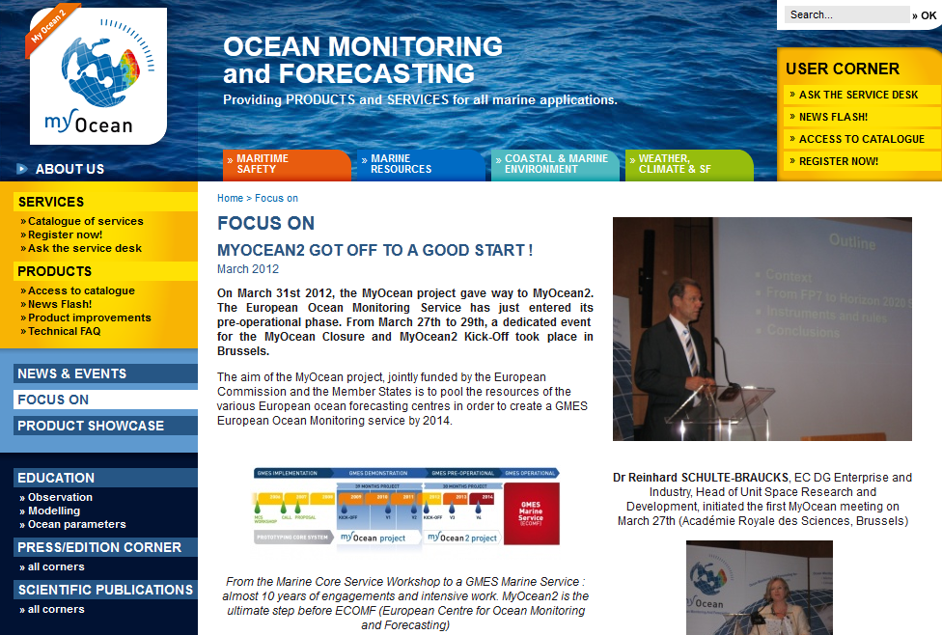
1 - Objectives

Slide 5
1 - Objectives
The aim of the MyOcean project, jointly funded by the European Commission and the Member States is to pool the resources of the various European ocean forecasting centres in order to create a by 2014.
European Ocean Monitoring Service

Slide 6
1 - Objectives
European Ocean Monitoring service
which includes global ocean reanalyses

Slide 7
1 - Objectives
Objective of MyOcean global ocean reanalysis project
to provide a series of eddy permitting (1/4°) global ocean simulations
  Covering the recent period during which altimeter data are available (period starting with the launch of TOPEX/POSEIDON and ERS-1 satellites early in the 90’s)
  Constrained by assimilation of observations and describing the space-time evolution of the following variables:
Physical Ocean Sea-ice
    Sea surface height above geoid Sea-ice area fraction
    Sea water potential temperature Sea-ice thickness
    Sea water salinity
    Ocean current zonal velocity Sea-ice zonal velocity
    Ocean current Meridional velocity Sea-ice meridional velocity

Slide 8
1 - Objectives
Objective of MyOcean global ocean reanalysis project
to provide a series of eddy permitting (1/4°) global ocean simulations
  Covering the recent period during which altimeter data are available (period starting with the launch of TOPEX/POSEIDON and ERS-1 satellites early in the 90’s)
  Constrained by assimilation of observations and describing the space-time evolution of the following variables:
Ocean Sea-ice
    Sea surface height above geoid Sea-ice area fraction
    Sea water potential temperature Sea-ice thickness
    Sea water salinity
    Ocean current zonal velocity Sea-ice zonal velocity
    Ocean current Meridional velocity Sea-ice meridional velocity
  In simple words:
  The reanalysis should
    describe the evolution of the
    “ocean weather”
    in a way that is
    relevant for understanding the climate
    (i.e. we want Eddies AND Climate)

Slide 9
1 - Objectives
The reanalysis
Covers the “Altimetric Era” from 1st January 1993 until 31 December 2010.
Numerical products available for users:
    - monthly mean averages
    from surface to bottom (5000 m).
    one reanalysis (GLORYS) available daily upon request
The reanalysis product consists of an ensemble of
  - 3 global ocean reanalyses datasets at ¼° horizontal resolution
  1 reference simulation with no data assimilation
  1 Statistical estimate (no model involved): (ARMOR3D)
The products are distributed on the model native grid (ORCA025)
  - nearly isotropic
  - resolution in latitude : 0.25°x cosine(latitude)
  - resolution in longitude : 0.25°
From ~25 km to ~8 km

Slide 10







1 - Objectives
Research Teams involved
    Mercator Ocean in Toulouse - France
    CMCC in Bologna - Italy
    NCEO - University of Reading - UK
    CNRS-LEGI in Grenoble – France
    Coriolis Data Center in Brest – France
    CLS in Toulouse - France

Slide 11
OUTLINES
1 – Objectives of MYOCEAN reanalysis project
2 – Ocean Weather
3 – Ocean Observational Network
4 – MyOcean Reanalysis Systems
5 – Production/Validation of reanalysis products
6 – Conclusion

Slide 12
2 - Ocean Weather
Ocean Mesoscale variability are often described as ...
... the "weather system" (or synoptic circulation) of the global ocean
by a dynamical analogy with the synoptic variability in the Atmosphere.
Dynamical properties of Ocean Mesoscale (Atmopheric Synoptic) Eddies
McWilliams, 2008
Quasi-geostrophic equilibrium
Characteristic velocitiy small compared to the celerity of internal gravity waves
They are generated by instabilities of the large scale flow, and such, are equally influenced by stratification (vertical shear) and rotation
Rossby Nb
Froude Nb
Burger Nb

Slide 13
2 - Ocean Weather
Ocean Mesoscale variability are often described as ...
... the "weather system" (or synoptic circulation) of the global ocean
by a dynamical analogy with the synoptic variability in the Atmosphere.
Characteristic length scales:
                N = Brunt-Vaïsala frequency
                H = thermocline depth
                H = troposphere height
Dynamical properties of Ocean Mesoscale (Atmopheric Synoptic) Eddies
McWilliams, 2008
Quasi-geostrophic equilibrium
Characteristic velocitiy small compared to the celerity of internal gravity waves
They are generated by instabilities of the large scale flow, and such, are equally influenced by stratification (vertical shear) and rotation
Rossby Nb
Froude Nb
Burger Nb

Slide 14
2 - Ocean Weather
Eddy Length scale : at mid-latitude (f=10⁻⁴ s⁻¹)
Atmosphere
  N=10⁻² s⁻¹
  H=10⁴ m
Latm=1000 km
Ocean
  N=5×10⁻³ s⁻¹ and
  H=10³ m
Loce=50 km
The eddy Length scale is therefore 20 times smaller in the ocean than in the atmosphere

Slide 15
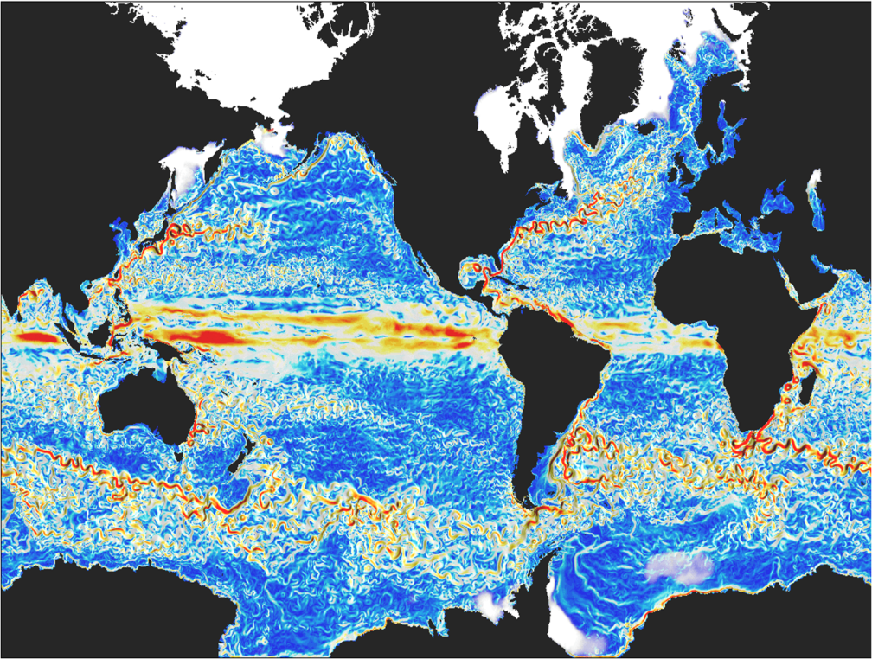
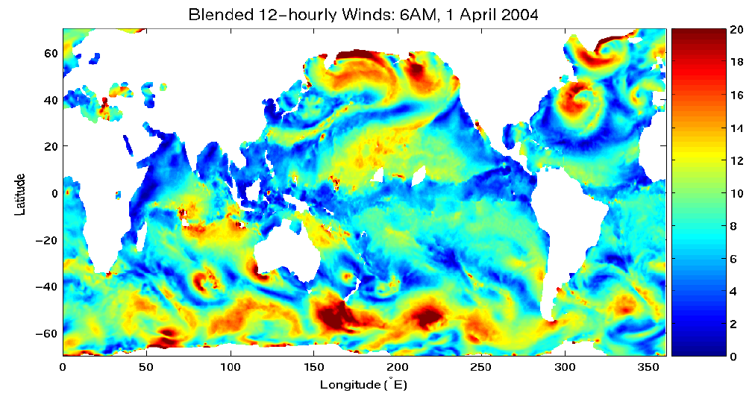
2 - Ocean Weather
(Zhang et al., )
Atmospheric wind speed (12h)
Ocean current speed (model simulation, 5 day mean)

Slide 16
2 - Ocean Weather

Slide 17
2 - Ocean Weather
(Zhang et al., )
Atmospheric surface wind speed (12h)
Ocean current speed (model simulation, 5 day mean)
The difference in the eddy scale is so large that the
analogy with atmospheric synoptic scale does not simply hold
in terms of “impact on the general circulation”.

Slide 18
2 - Ocean Weather
(Zhang et al., )
Atmosphere:
The totality of the MHT is done the synoptic transient features
Ocean:
A large part of the MHT is done by poleward Mean Currents flowing along continents
Meridional Heat Transport (MHT) at mid latitudes

Slide 19
2 - Ocean Weather
Observing the ocean:
  Very fine observation network to sample
Modelling the ocean:
  Very fine grid resolution is required to represent
Data Assimilation:
  Challenge of undersampled features such as
the large scale currents and fronts
- the ocean eddies

Slide 20
3 - Ocean Observational Network
OUTLINES
1 – Objectives of MYOCEAN reanalysis project
2 – Ocean Weather System
3 – Ocean Observational Network
4 – MyOcean Reanalysis Systems
5 – Production/Validation of reanalysis products
6 – Conclusion

Slide 21
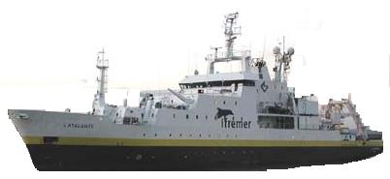
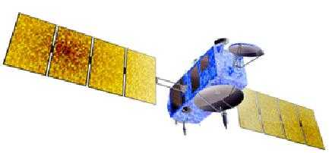
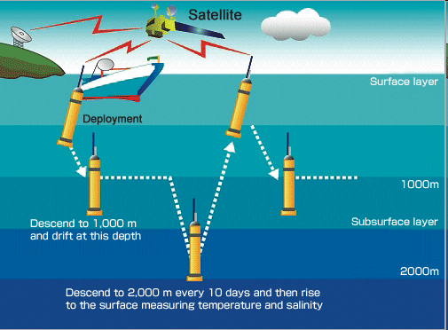
3 - Ocean Observational Network
Observing the Ocean
Continuous improvement of in situ and satellite means of observing the ocean
1960-1970’s 1980 -1990’s 2000-2010’s
Exploring to observing
the global ocean
Ships +
Satellites +
Altimetry
Topex/Poseidon, ERS, JASON
Radiometry, radars
SST, Surface Winds, Ocean Colour …
Autonomous floats ARGO
Profiles 10m – 2000 m
every10 days
Hydrographic sections
XBTs

Slide 22
3 - Ocean Observational Network
Why altimetry is so important?
Because of the direct link between
  the gradients of sea surface elevation η
  and
  the surface geostrophic currents U_{s},V_{s}
Altimetry gives access to Ocean Currents
Crucial to constrain model dynamics

Slide 23
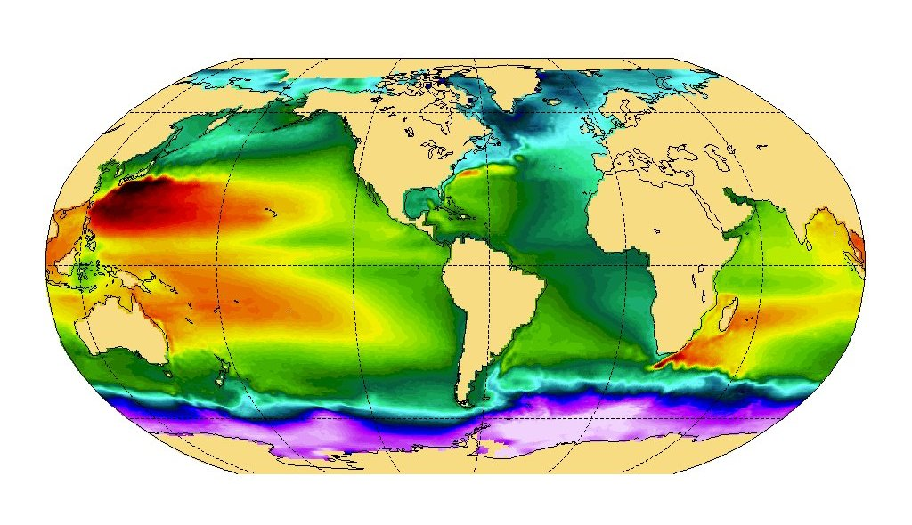
3 - Ocean Observational Network
Mean Sea Surface Height (1993-1999 observed by space-borne altimetry (CNES/CLS2009).
240°W 120°W 0°E
60°N
0
60°S
Notes:
23

Slide 24
3 - Ocean Observational Network
Mean Sea Surface Height (1993-1999 observed by space-borne altimetry (CNES/CLS2009).
240°W 120°W 0°E
60°N
0
60°S
Altimetry is useful to constrain large scale gyres circulation patterns
Notes:
24

Slide 25
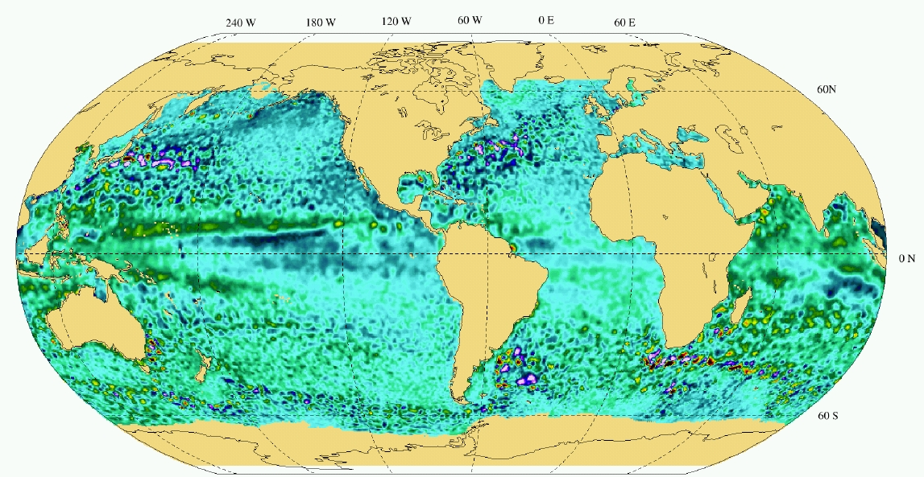
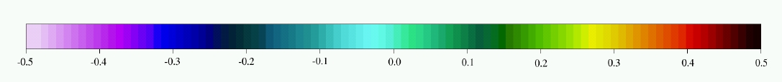
Sea Surface Height Anomaly (19 May 2004) (altimetry)
3 - Ocean Observational Network
Ubiquity of mesocale transient patterns
Altymetry provides a view of the ocean circulation at synoptic scales
(few 100 km, week)
-0.5 -0.4 -0.3 -0.2 -0.1 0.0 0.1 0.2 0.3 0.4 0.5
Notes:
25

Slide 26
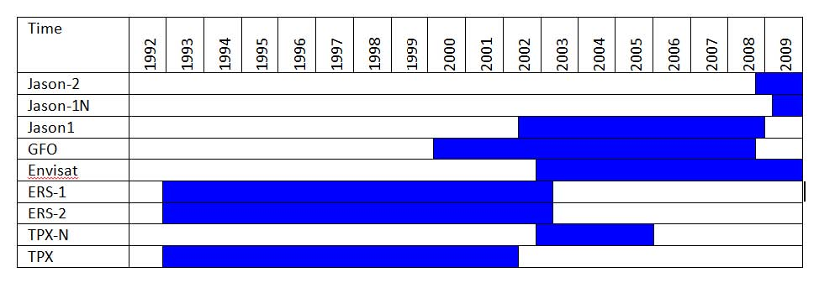
3 - Ocean Observational Network
Synoptic on a weekly basis
1993 to present: Several Altimeters
Notes:
26

Slide 27
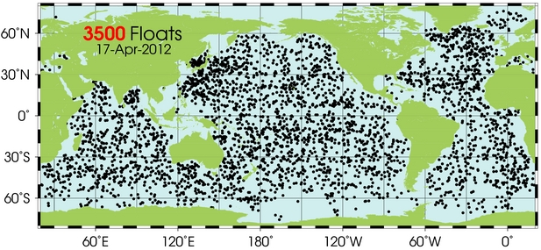
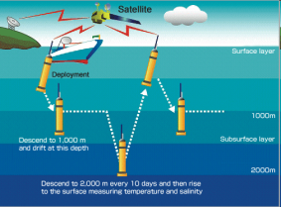
3 - Ocean Observational Network
In-situ Observations
T Profiles (50-400m) in 1975
1975
2012
ARGO Floats
~3500 profiles 10m-2000m every 10 days

Slide 28
3 - Ocean Observational Network
0-2000m: 300 million grid points

Slide 29
3 - Ocean Observational Network

Slide 30
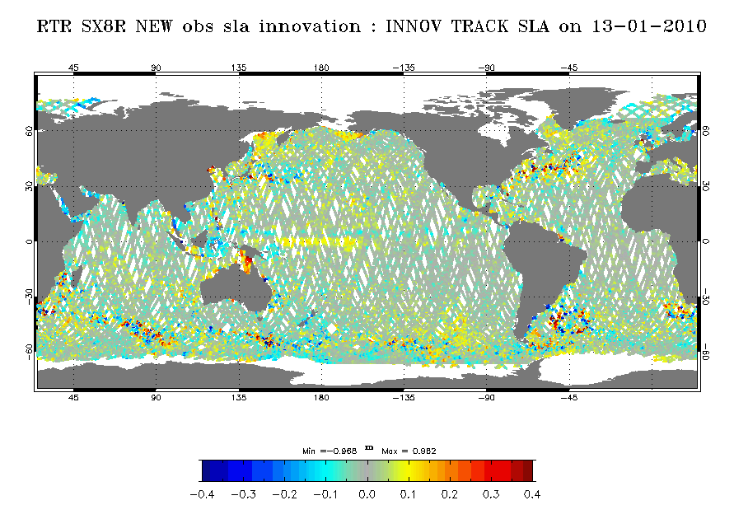
3 - Ocean Observational Network
Quasi synoptic sampling at the surface
(ssh and SST)
Drastically Undersampled (aliased?) eddy field 0-2000 m
(ARGO, XBT, ..)
Very few observations in the deep ocean ‘below 2000m)
(past Hydrography)
Challenge for data assimilation

Slide 31
3 – MyOcean Reanalysis systems
OUTLINES
1 – Objectives of MYOCEAN reanalysis project
2 – Ocean Weather System
3 – Ocean Observational Network
4 – MyOcean Reanalysis Systems
5 – Production/Validation of reanalysis products
6 – Conclusion

Slide 32
4 – Reanalysis Systems
3 different Reanalysis Systems
  Mainly differing by the data assimilation method
        SEEK Filter
        3DVAR
        OI
  Share the “same” Ocean Model Configuration and Forcing
  Assimilate the “same” observations data sets
Ocean Model and Forcing
Assimilation methods
Assimilated observations
1 statistical estimate ARMOR3D

Slide 33
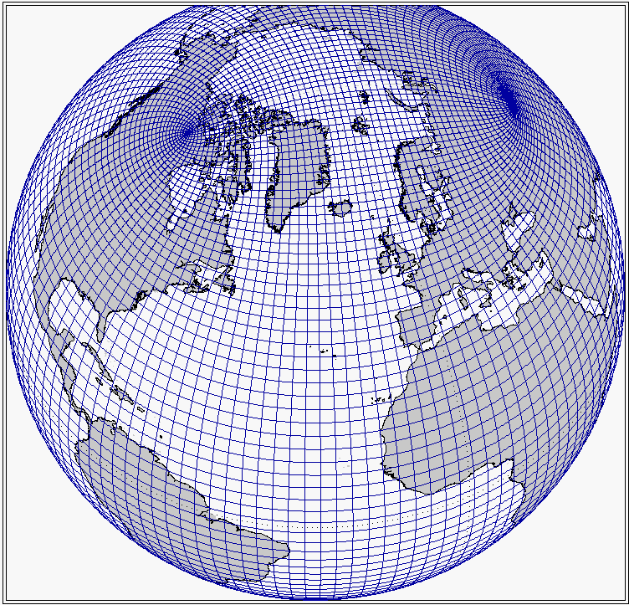
4 – Reanalysis Systems
Model: DRAKKAR ORCA025 configuration
NEMO3.2 OGCM + LIM2 EVP Sea-Ice model:
Resolution: Eddy Permitting
  - Global 1/4° ORCA-type grid (1442x1021 grid points)
  46, 50, or 75 vertical levels from 1 m at the surface
  to 200 m at the bottom
Initialization: December 1991
  - Levitus 1998 climatology + Sea-Ice Concentration from NSDIC Bootstart products
Parameterizations: Filtered free surface, Partial step, Energy and Enstrophy conserving advection scheme, Isopycnal diffusion for tracers, Biharmonic for momentum, TKE turbulence scheme
Atmospheric forcing:
  - Bulk CORE Formulation (as in Large&Yeager, 2004)
  - ERA-Interim* reanalysis products:
  3 hourly for turbulent fluxes
  Daily for radiation (analytical diurnal cycle for solar)
*With in house corrections.
Notes:
33

Slide 34
4 – Reanalysis Systems
Model: DRAKKAR ORCA025 configuration
NEMO3.2 OGCM + LIM2 EVP Sea-Ice model:
Resolution:
  - Global 1/4° ORCA-type grid (1442x1021 grid points)
  46, 50, or 75 vertical levels from 1 m at the surface
  to 200 m at the bottom
Initialization: December 1991
  - Levitus 1998 climatology + Sea-Ice Concentration from NSDIC Bootstart products
Parameterizations: Filtered free surface, Partial step, Energy and Enstrophy conserving advection scheme, Isopycnal diffusion for tracers, Biharmonic for momentum, TKE turbulence scheme
Atmospheric forcing:
  - Bulk CORE Formulation (Large&Yeager, 2004)
  - ERA-Interim reanalysis products:
  3 hourly for turbulent fluxes
  Daily for radiation (analytical diurnal cycle for solar)
    In house correction of the radiation based on GEWEX satellites fluxes products.
DRAKKAR Model configurations are developed for CLIMATE and OPERATIONAL applications.
  - Study the variability of the ocean circulation observed in the last 50 years (1950-2010). (Drakkar group, Clivar Exchange, 2007)
  Perform real time analysis and forecast
In total, more than a 1000 years of simulation in a series of coordinated experiments performed in France, Germany, UK, …
  - deep understanding of the model sensitivity to forcing, parameters
  - continuous improvement of the model configuration, performance on super computers
Notes:
34

Slide 35
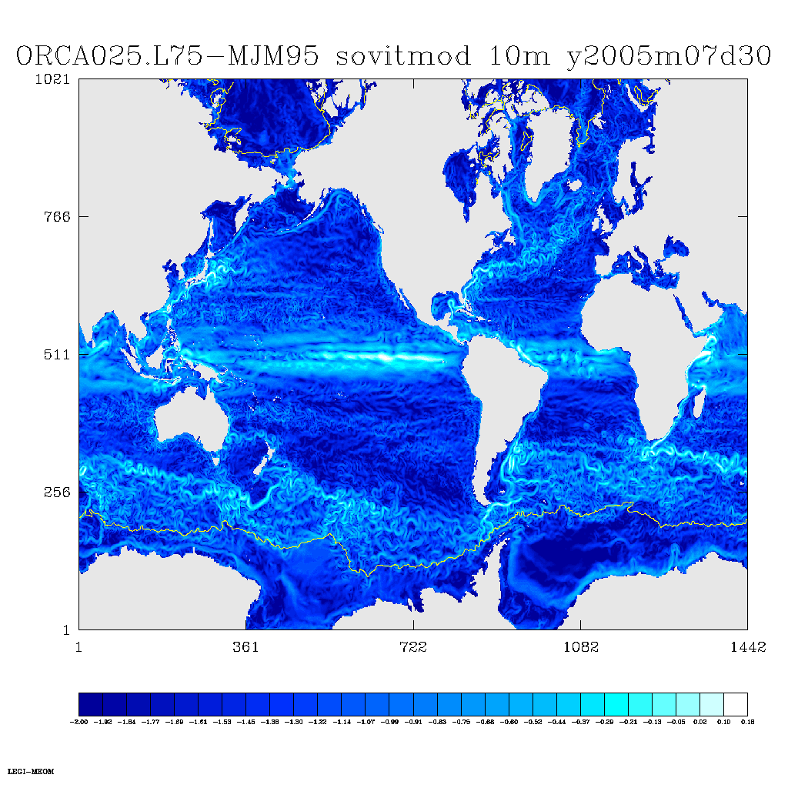
Eddy Permitting

Slide 36
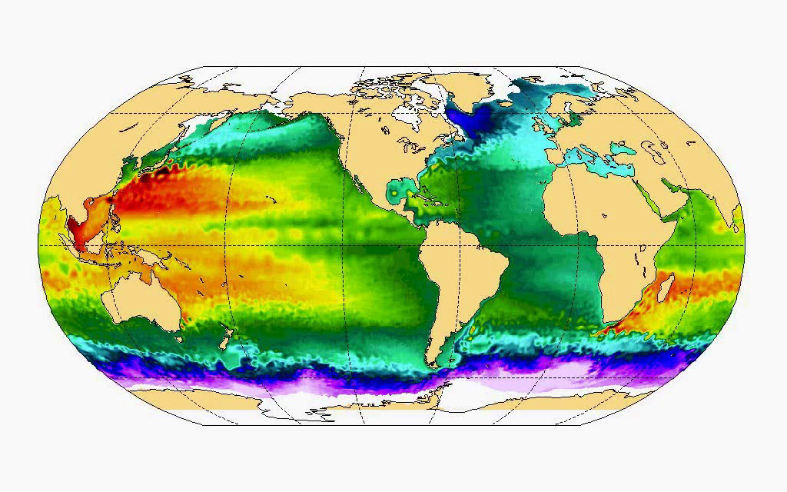
Eddy Permitting
The MyOcean ¼° eddy-permitting global OGCM

Slide 37
4 – Reanalysis Systems
Data Assimilation Methods: GLORYS (Mercator)
SAM2v1, SEEK (Kalman Filter) formulation (presentation of L. Parent)
  SEEK Filter (5days window)
    - Innovation is calculated from the First Guess at Appropriate Time (FGAT) approximation
    - Control vector comprises the barotropic height, T, S, U and V
    - Background error covariance calculated from an ensemble of 3D anomalies from a reference simulation
    Adaptive error variance is consistent with innovation vector (a posteriori diagnostic)
    The SEEK filter is weakly sensitive to the number of obs. to assimilate
  Bias correction for T and S:
    3D-VAR bias correction method to correct …
      … slowly varying large-scale temperature and salinity biases
      … when enough observations are present.
  Incremental Analysis Updates (IAU):
    inserting where increments over all model time steps (smooth trajectory)
  Many other customized items
Notes:
37

Slide 38
4 – Reanalysis Systems
Data Assimilation Methods: C-GLORS (CMCC)
Global OceanVar, 3DVAR/FGAT formulation (presentation of A. Storto)
3DVAR
  Innovation is calculated from the First Guess at Appropriate Time (FGAT) approximation. “Direct initialization” applied (no IAU);
  Control vector comprises T and S only
  Vertical covariances modeled through seasonal bi-variate EOFs of T, S from free-run seasonal anomalies
  Horizontal correlations modeled through first-order recursive filter with 3D correlation length-scales
  SLA assimilation through “local hydrostatic adjustment” (adjoin of the dynamic height formula)
Observation usage:
  Nudging to NOAA sea-ice concentration observations (15-day relaxation time scale)
Notes:
38

Slide 39
4 – Reanalysis Systems
Data Assimilation Methods: University of Reading
(presentation of M. Valdevieso)
OI/FGAT formulation from UKMO operational FOAM System
Experiment | Model | Data Assimilation | Observations | SSS Restoring | Initial Condition
UR025.3 MyOcean v1 | NEMO v2.3 ORCA025_LIM2(1/4º by 46L) | OI with S(T) Ref. Smith and Haines (2009) | EN3_v2a | 180 d (Ocean) 36 d (Ice) | End state of UR025.1
UR025.4 MyOcean v2.1 | NEMO v3.2 ORCA025_LIM2 (1/4º by 75L) | UK Met Office NEMO – FOAM System Ref. Storkey et al. (2010), Martin et al. (2007) | EN3_v2a_ XBTMBTBiasCor Satellite + in situ SST, AVISO SLA, OSI-SAF Sea Ice Conc | No | EN3 Climatology

Slide 40
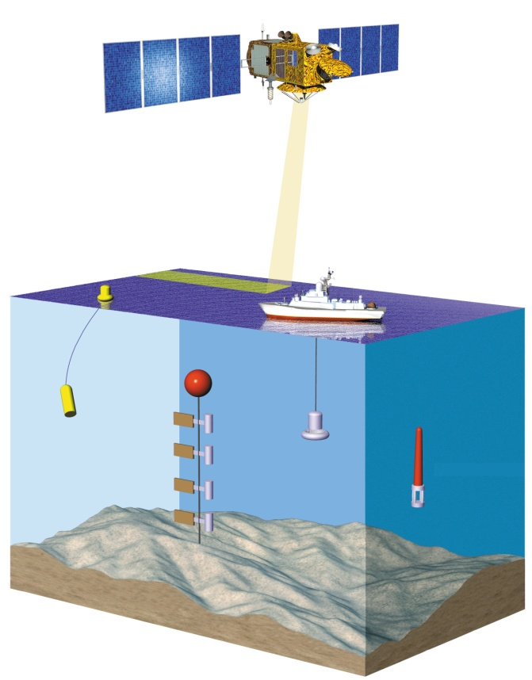
Global T/S ➔ Armor3D - Method
ARMOR3D: The statistical re-analysis (CLS)
4 – Reanalysis Systems
1
Vertical projection of satellite data (SLA, SST) to get “synthetic profiles”
Combination of synthetic and in-situ profiles
T(x,y,z,t) = α(x,y,z,t).SLA_{steric} + β(x,y,z,t).SST’ + T_{clim} (x,y,z,t)
S(x,y,z,t) = α’(x,y,z,t).SLA_{steric} + S_{clim} (x,y,z,t)
2
SLA, SST
synthetic T(z), S(z)
multiple linear regression
1
optimal interpolation
2
in-situ T(z), S(z)
Armor3D T(z), S(z)

Slide 41
Assimilated data: Delayed time data base
(CORA, EN3, SST, AVISO, …)
4 – Reanalysis Systems
Satellite :
Sea level: Sea Level Anomalies (along track) and Mean
Dynamic Topography from SALTO/DUACS (AVISO)
SST :
Daily NOAA ¼° AVHRR (+ AMSR-E for C-GLOR)
In Situ :
T,S profiles from ARGO, XBTs, Hydrography, etc… from 2 data bases:
CORA03: A quality controlled delayed time data based specifically developed by the CORIOLIS data center (Brest) for MyOcean Reanalyses (Cabanes et al., 2012)
EN3 : from UKMO

Slide 42
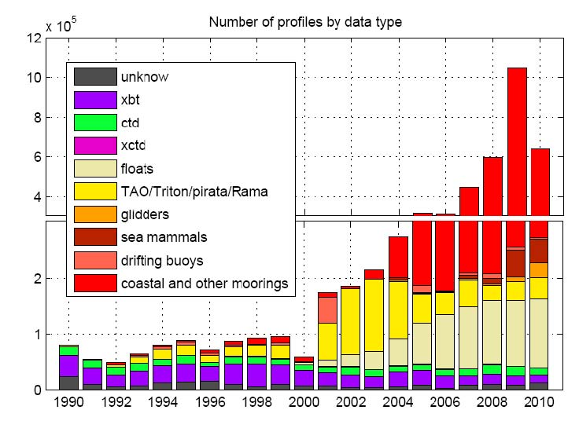
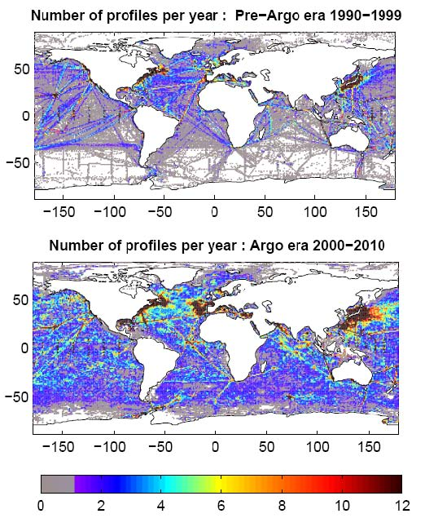
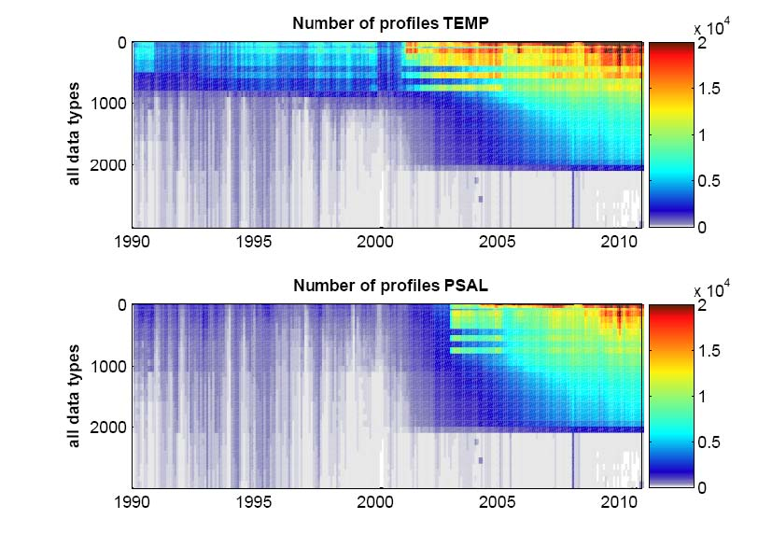
4 – Reanalysis Systems
Data coverage (CORA03, Cabanes et al., 2012)
Nb of profiles/year per 1°x1° box
Nb of profiles/year per 1°x1° box

Slide 43
OUTLINES
1 – Objectives of MYOCEAN reanalysis project
2 – Ocean Weather
3 – Ocean Observational Network
4 – MyOcean Reanalysis Systems
5 – Production/Validation of reanalysis products
6 – Conclusion

Slide 44
5 – Production
Production of Reanalyses (1992-2010) and of a Reference Run
GLORYS2V1 reanalysis (Mercator)
NEC XS8: 4 nodes of 8 procs. each
Memory: 170 GB
CPU for 1 year: 2000 hours
Elapsed for 1 year: 4.5 days (~3 months for the whole reanalysis)
Storage: 1 TB per year for daily outputs (netcdf format).
0,5 TB/year for additional outputs (on-line diagnostics, increments, restarts, etc..)
~20 TB + 10 TB in total
C-GLOR reanalysis (CMCC)
UR025 reanalysis (University of Reading)
MJM95 reference run – no assimilation (LEGI-CNRS)
ARMOR3D

Slide 45
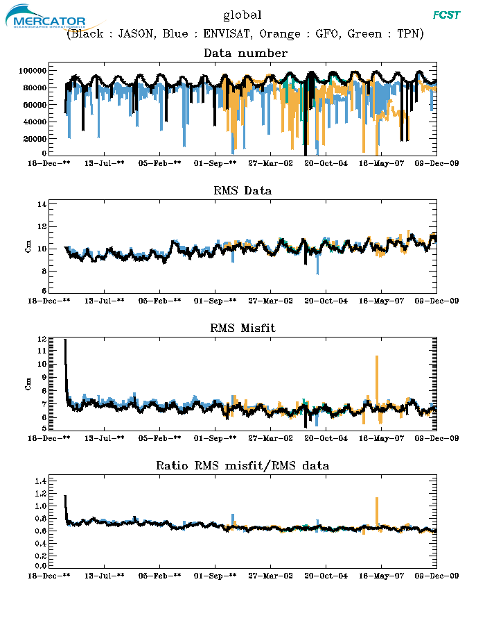
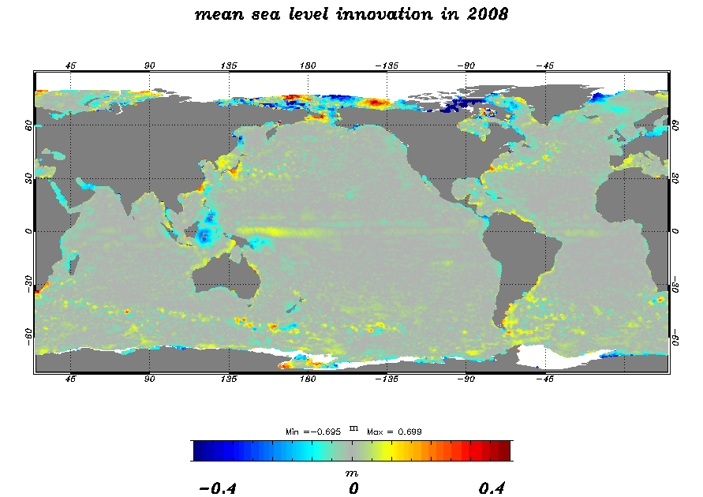
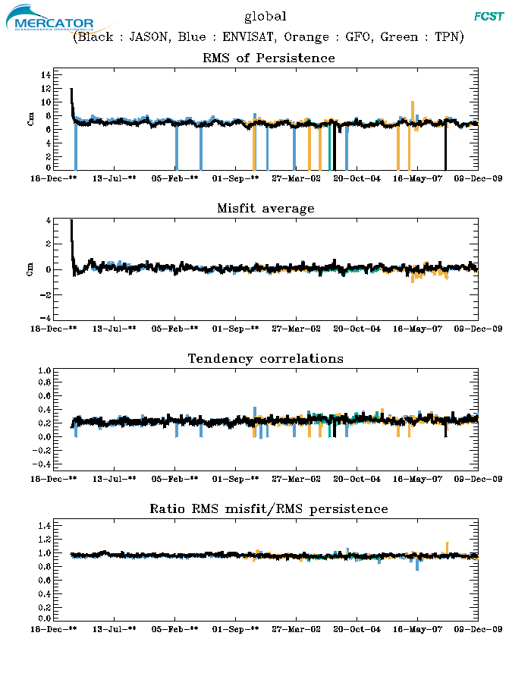
Data assimilation diagnostics: Sea Level
5 –Validation: data assimilation diagnostics
Innovation statistics
GLORYS
RMS ~7cm
No global BIAS
1992 2009
Notes:
SLA forecast error is stable throughout the reanalysis, ~7cm rms
No global misfit , no regional misfit except in some specific areas.

Slide 46
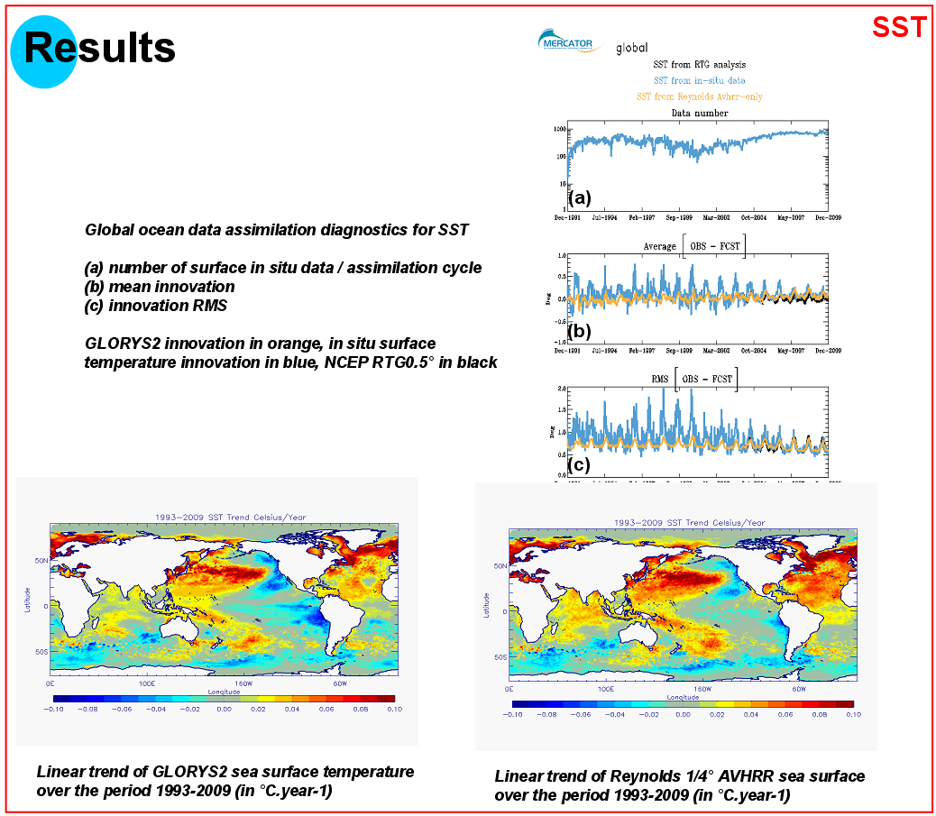
Data assimilation diagnostics: SST
5 –Validation: data assimilation diagnostics
GLORYS
1000
100
10
0
Nb of Surface insitu data/ assim cycle
Mean Innovation
Innovation RMS
1
0
-1
2.0
1.0
0

Slide 47
Data assimilation diagnostics: In-situ temperature
5 –Validation: data assimilation diagnostics
ARGO is “getting in”
GLORYS
Innovation statistics
Global misfit average
Global misfit RMS
RMS is stable
Small BIAS

Slide 48
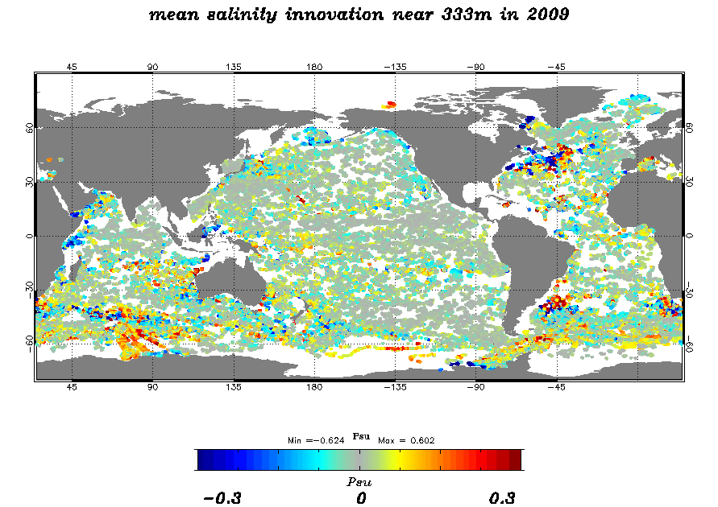
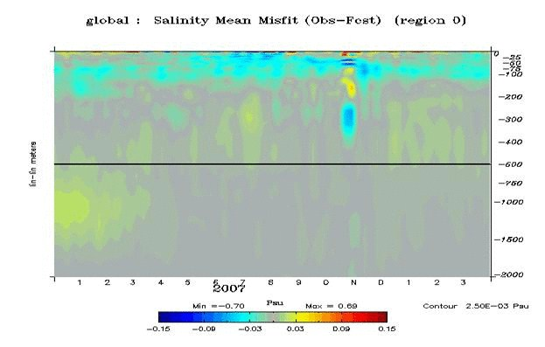
Data assimilation diagnostics: In-situ salinity
5 –Validation: data assimilation diagnostics
GLORYS
Innovation (Obs-Forecast) statistics
Mean Salinity Innovation in 2009
Global Salinity RMS in 2007

Slide 49
Inter-comparison of reanalyses
GLORYS2V1 reanalysis
C-GLOR reanalysis
UR025 reanalysis
MJM95 reference run – no assimilation
ARMOR3D
Following GODAE Metrics

Slide 50
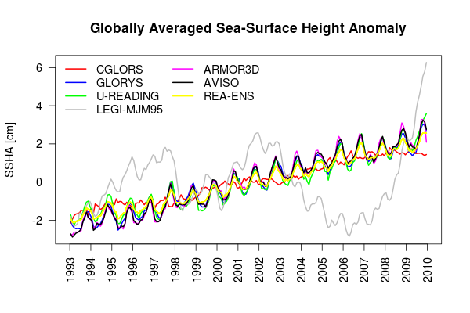
Inter-comparison of reanalyses:
Sea Level
5 –Validation: Intercomparison
Reanalyses have skills - Free run has no skill

Slide 51
Inter-comparison of reanalyses:
Sea Level
5 –Validation: Intercomparison
Sea Level Trend global
Exp | St.Dev. | Trend | A.A. | S-A. A. | Corr.
CGLORS | 1.08 | 0.22 | 0.13 | 0.05 | 0.923
GLORYS | 1.44 | 0.28 | 0.59 | 0.07 | 0.994
U-READ. | 1.39 | 0.26 | 0.61 | 0.14 | 0.979
LEGI | 1.69 | 0.04 | 0.57 | 0.23 | 0.176
ARMOR | 1.56 | 0.30 | 0.53 | 0.21 | 0.998
AVISO | 1.55 | 0.30 | 0.53 | 0.15 | -
REA-ENS | 1.27 | 0.25 | 0.36 | 0.08 | 0.993

Slide 52
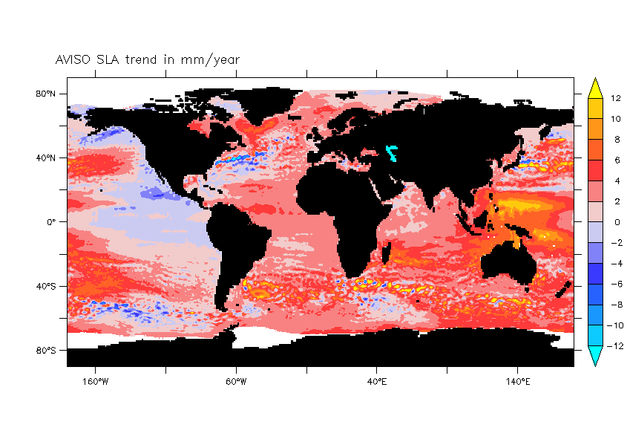
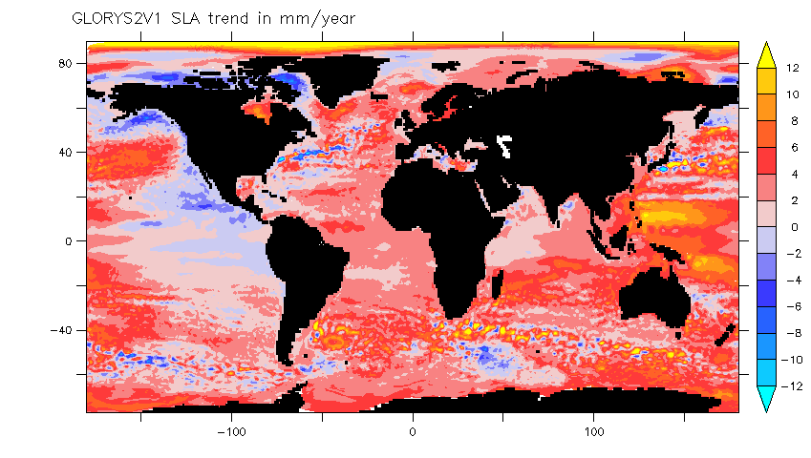
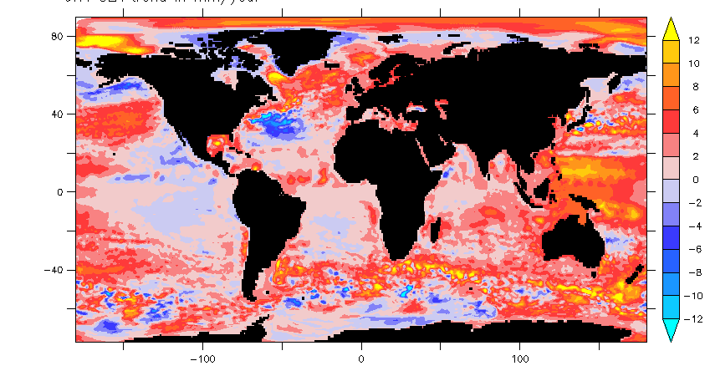
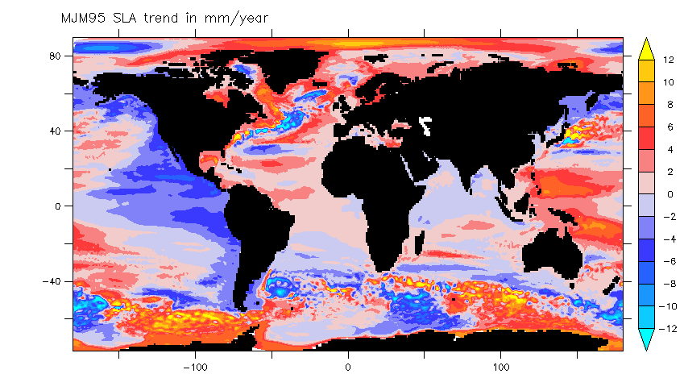
Inter-comparison of reanalyses:
Sea Level
5 –Validation: Intercomparison
Regional Sea Level trend over 1993-2009
AVISO
GLORYS2V1
UR025.4
MJM95

Slide 53
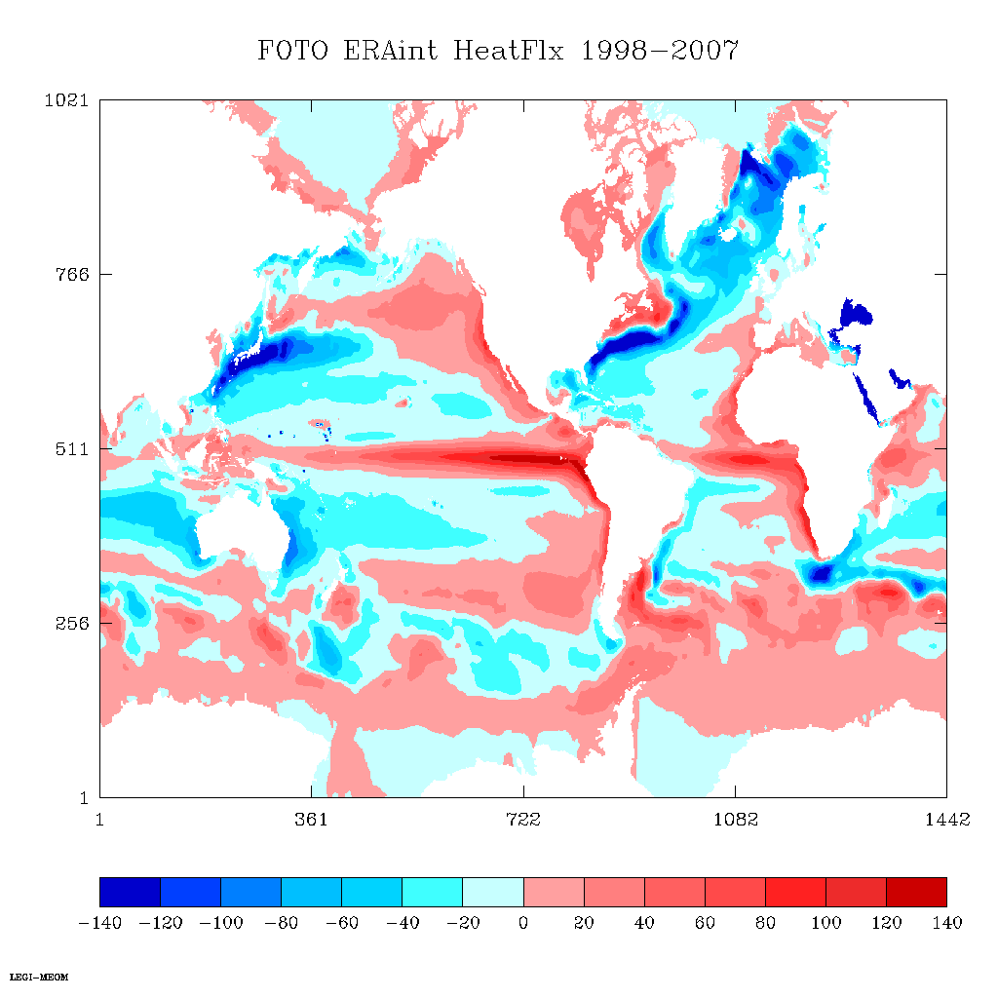
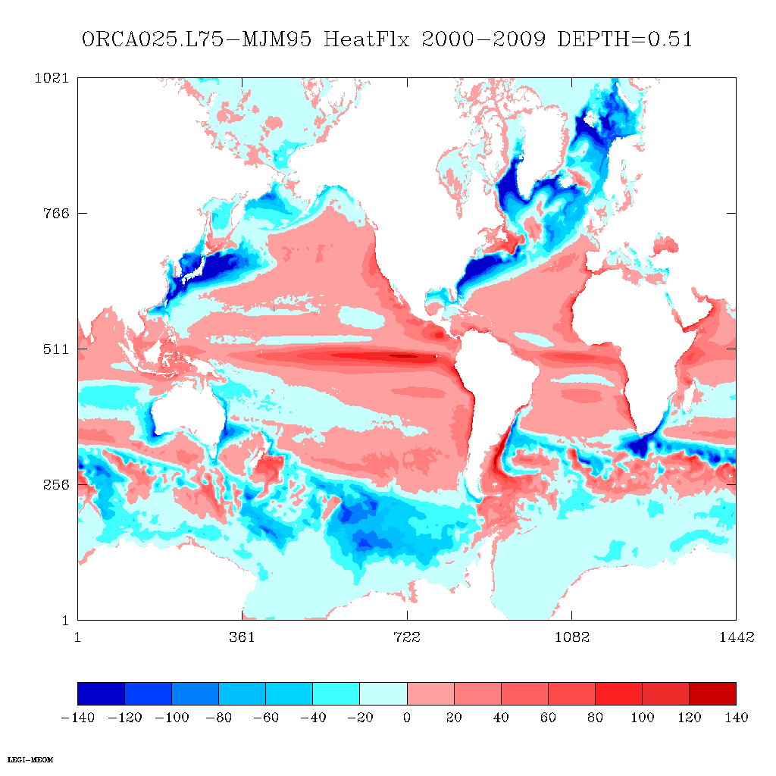
Inter-comparison of reanalyses:
Surface Heat Flux
5 –Validation: Intercomparison
ERAi original
Model output
Atmospheric variables ERAi
(θa, qa, Ua, radsw, radlw)
Bulk formulae
Model dependant fluxes
(evaporation, wind, turbulent heat flux, radiative fluxes)
MJM95
Assimilation
SST obs.
SST

Slide 54
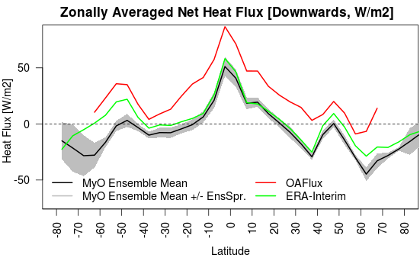
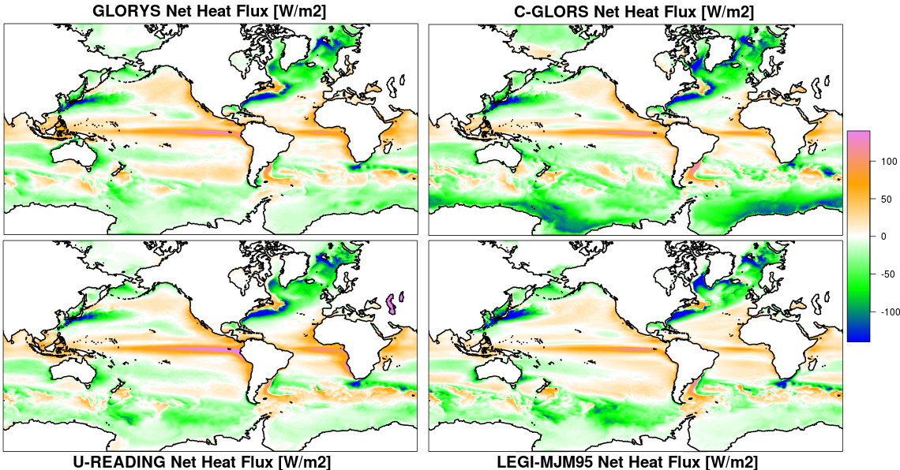
Inter-comparison of reanalyses:
Surface Heat Flux
5 –Validation: Intercomparison
Time-mean Net Heat Flux 1993-2009 (Downwards)
Exp | GLO | 60-60
CGLORS | -5.9 | -1.4
GLORYS | 3.5 | 6.3
U-READ. | 4.1 | 7.0
LEGI | 0.6 | 3.2
ERA-INT | 8.6 | 10.8
MyO-ENS | 0.6 | 3.8
OAFlux | - | 29.1

Slide 55
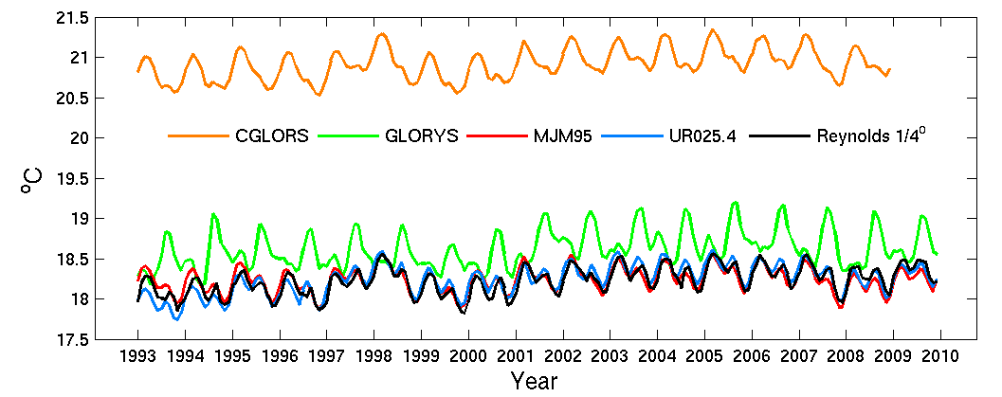
Inter-comparison of reanalyses:
Global Mean SST
5 –Validation: Intercomparison
 | Mean [ºC] | RMS [ºC] | Trend [ºC yr¹] | Correlation
CGLORS | 20.91 | 0.19 | 0.0152 | 0.86
GLORYS2v1 | 18.61 | 0.23 | 0.0155 | 0.30
MJM95 | 18.23 | 0.15 | 0.0045 | 0.86
UR025.4 | 18.24 | 0.19 | 0.0198 | 0.88
Reynolds | 18.22 | 0.17 | 0.0164 | 1

Slide 56
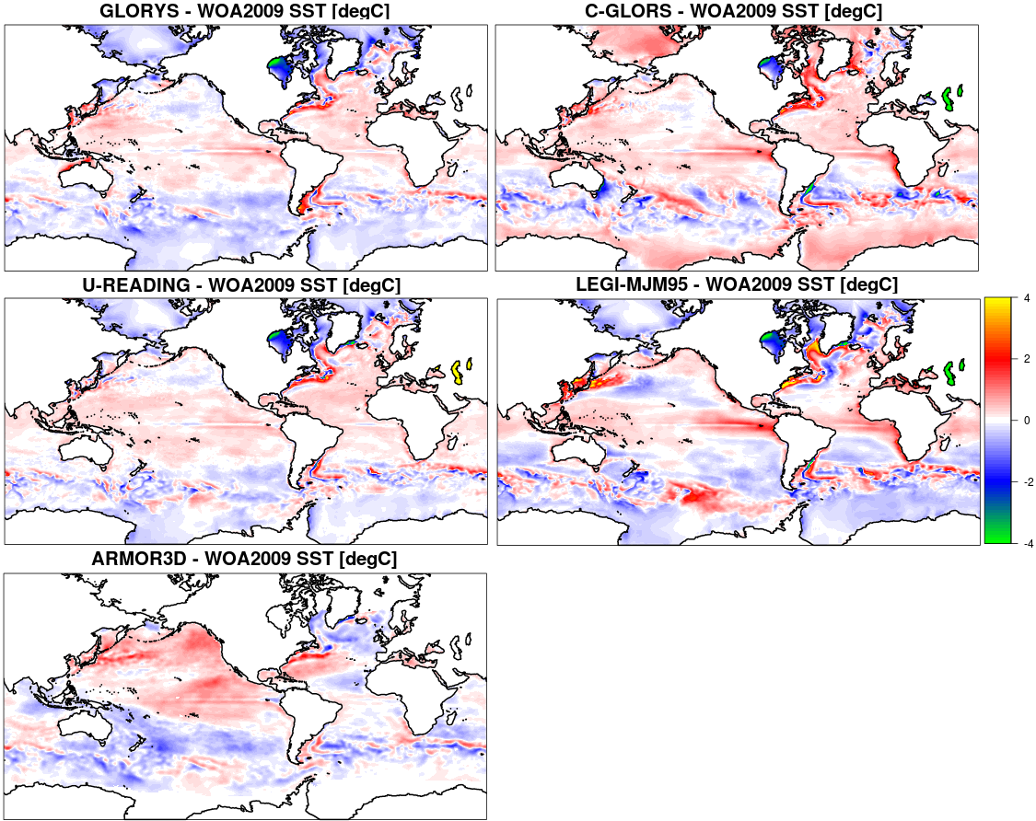
5 –Validation: Intercomparison
Intercomparison of reanalyses:
SST
Time-mean SST minus WOA2009

Slide 57
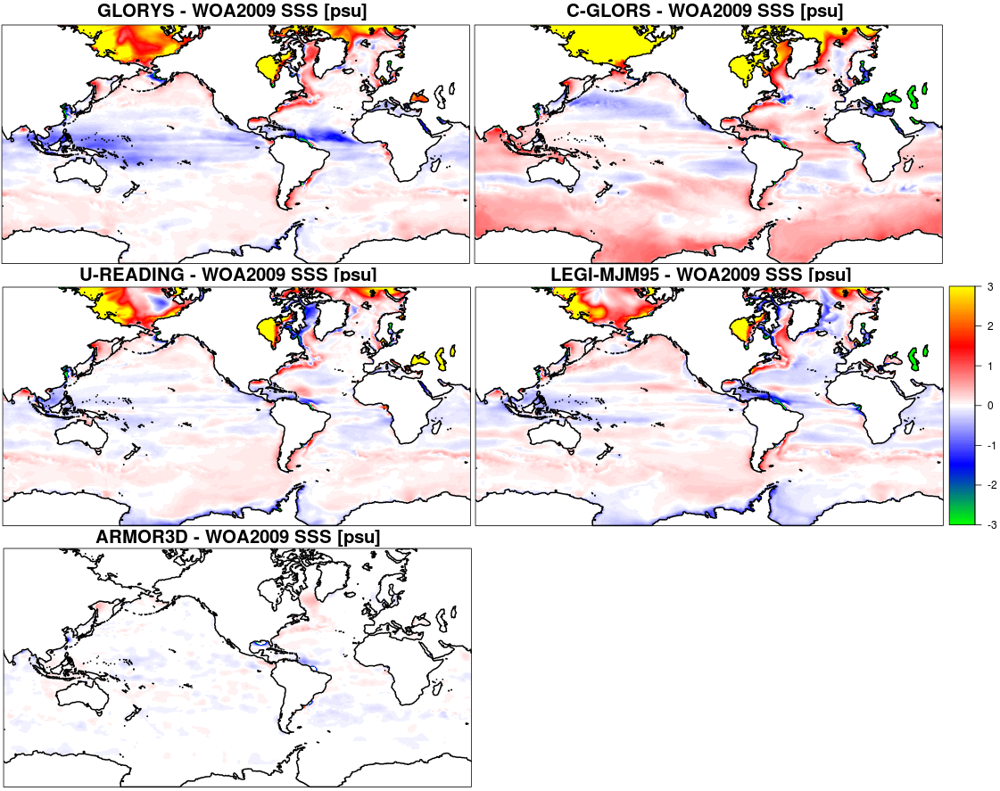
5 –Validation: Intercomparison
SSS relaxation
Intercomparison of reanalyses:
SSS
Time-mean SSS minus WOA2009

Slide 58
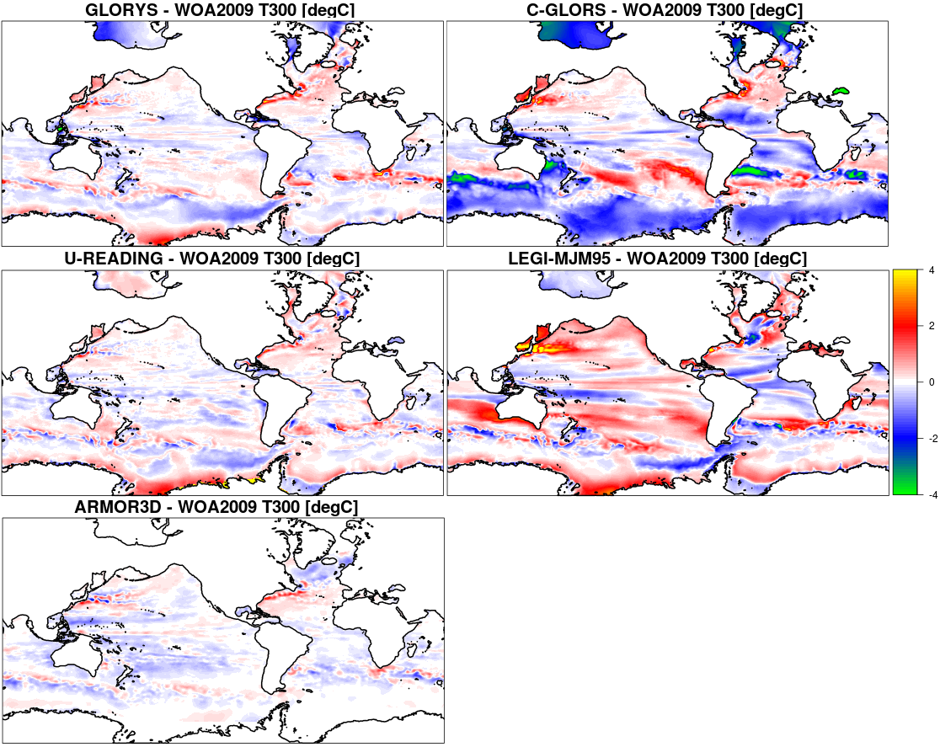
5 –Validation: Intercomparison
Intercomparison of reanalyses:
T at 300 m Depth
Time-mean T300 minus WOA2009

Slide 59
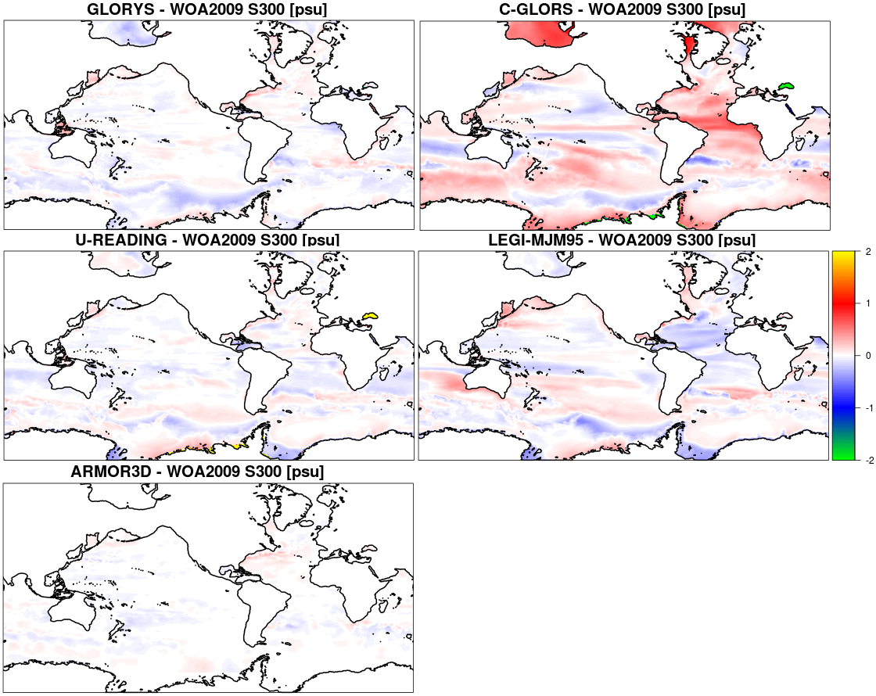
5 –Validation: Intercomparison
Intercomparison of reanalyses:
S at 300 m
Time-mean S300 minus WOA2009

Slide 60
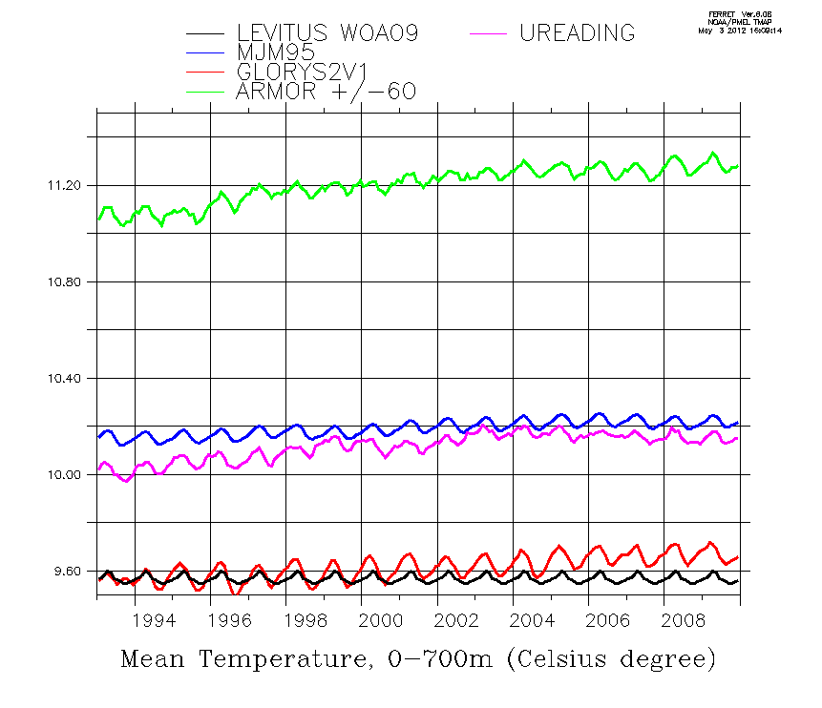
Inter-comparison of reanalyses:
Global Mean 0-700 m Heat Content
5 –Validation: Intercomparison

Slide 61
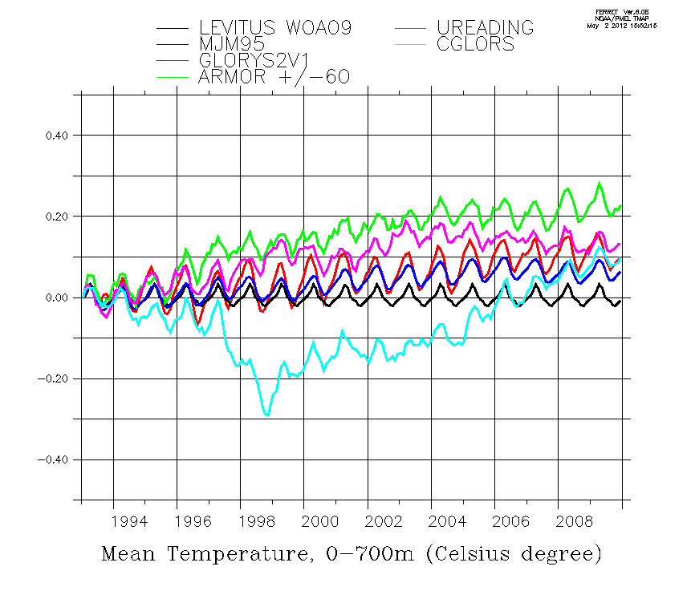
Inter-comparison of reanalyses:
Global Mean 0-700 m Heat Content
5 –Validation: Intercomparison
Difference from first year mean

Slide 62
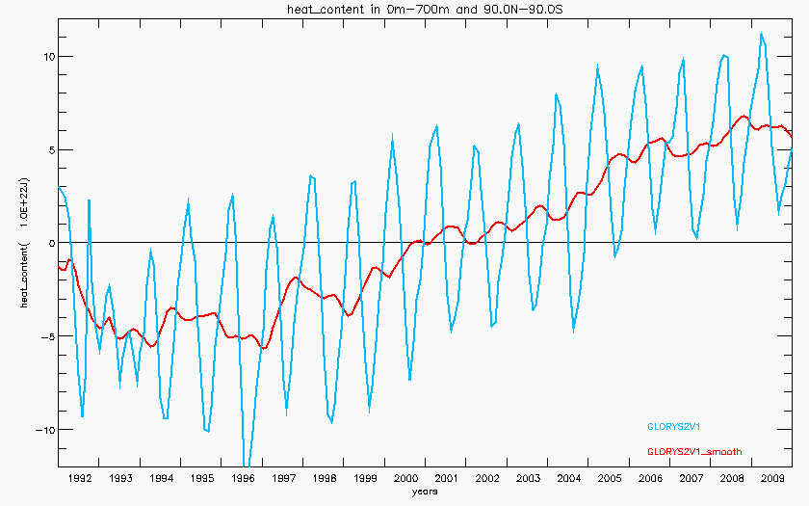
Inter-comparison of reanalyses:
Global Mean 0-700 m Heat Content
5 –Validation: Intercomparison
Ocean Heat Content 0-700m
10²² J
Levitus et al., GRL 2005
GLORYS2V1
Notes:
GLORYS2V1 and Levitus 2009 estimate: same trends

Slide 63
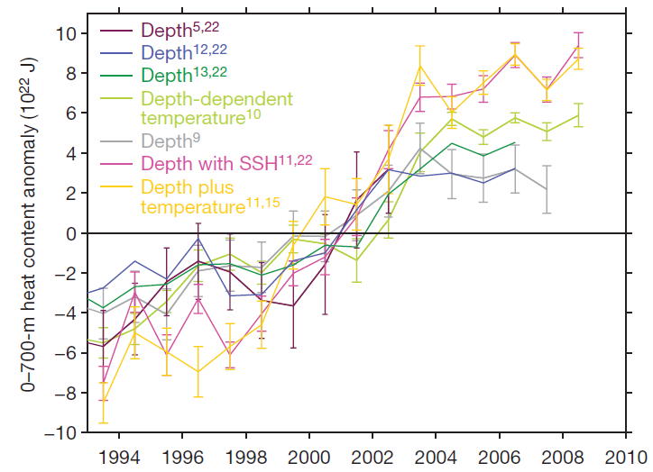
Inter-comparison of reanalyses:
Global Mean 0-700 m Heat Content
5 –Validation: Intercomparison
Lyman et al. 2010

Slide 64
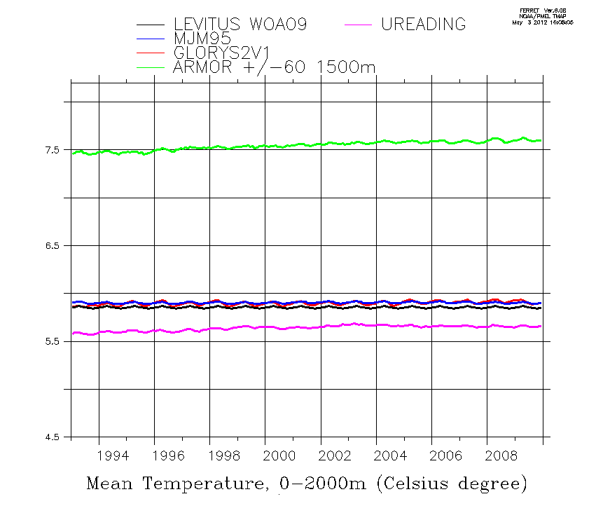
Inter-comparison of reanalyses:
Global Mean 0-2000 m Heat Content
5 –Validation: Intercomparison

Slide 65
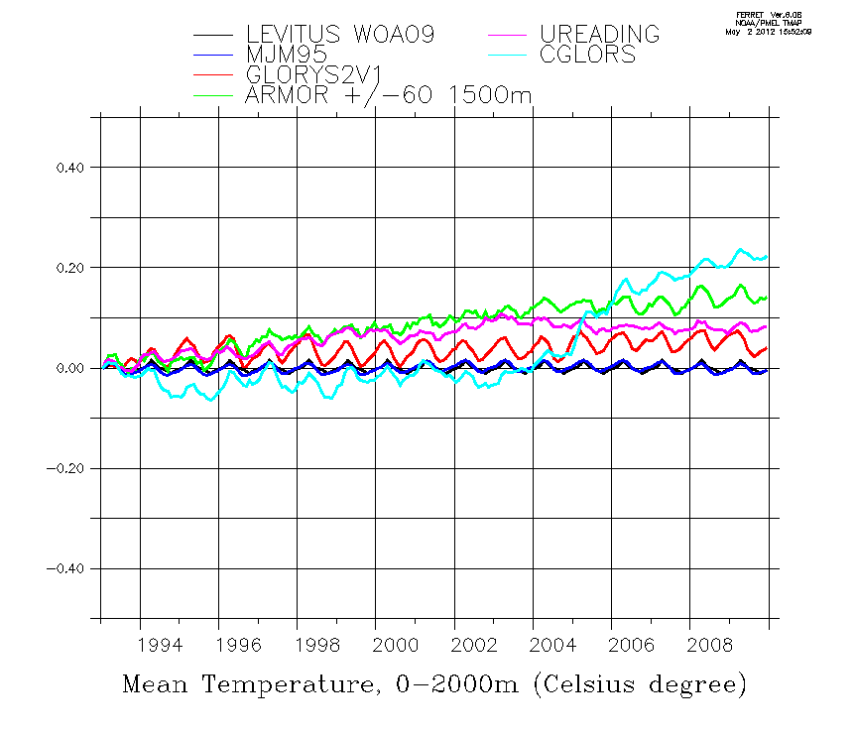
Inter-comparison of reanalyses:
Global Mean 0-2000 m Heat Content
5 –Validation: Intercomparison
Difference from first year mean

Slide 66
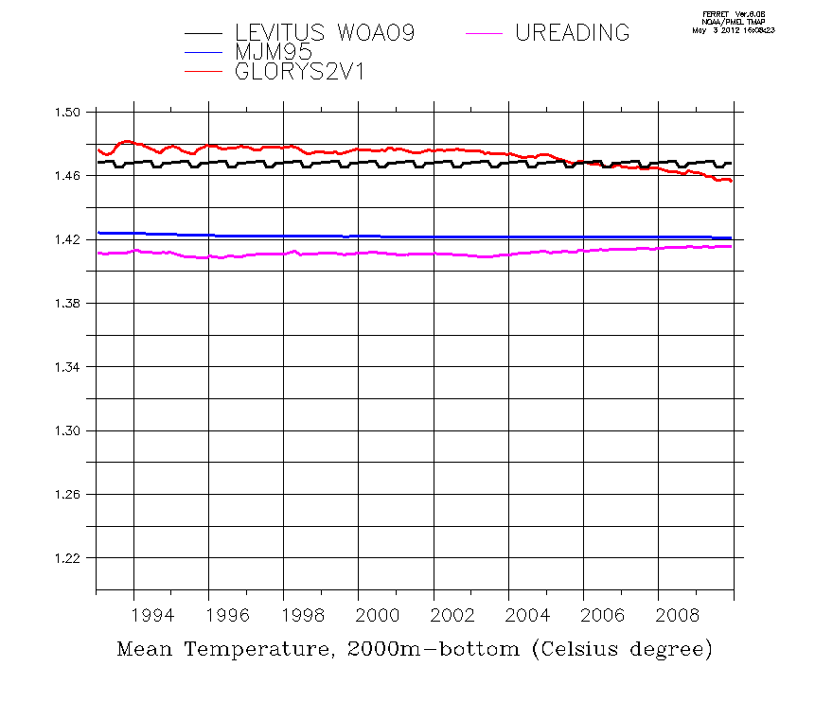
Inter-comparison of reanalyses:
Global Mean 2000 m to bottom Heat Content
5 –Validation: Intercomparison

Slide 67
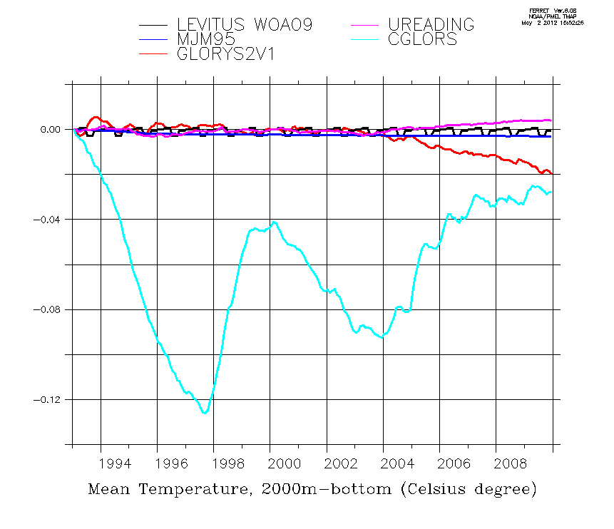
Inter-comparison of reanalyses:
Global Mean 2000 m to bottom Heat Content
5 –Validation: Intercomparison
Difference from first year mean

Slide 68
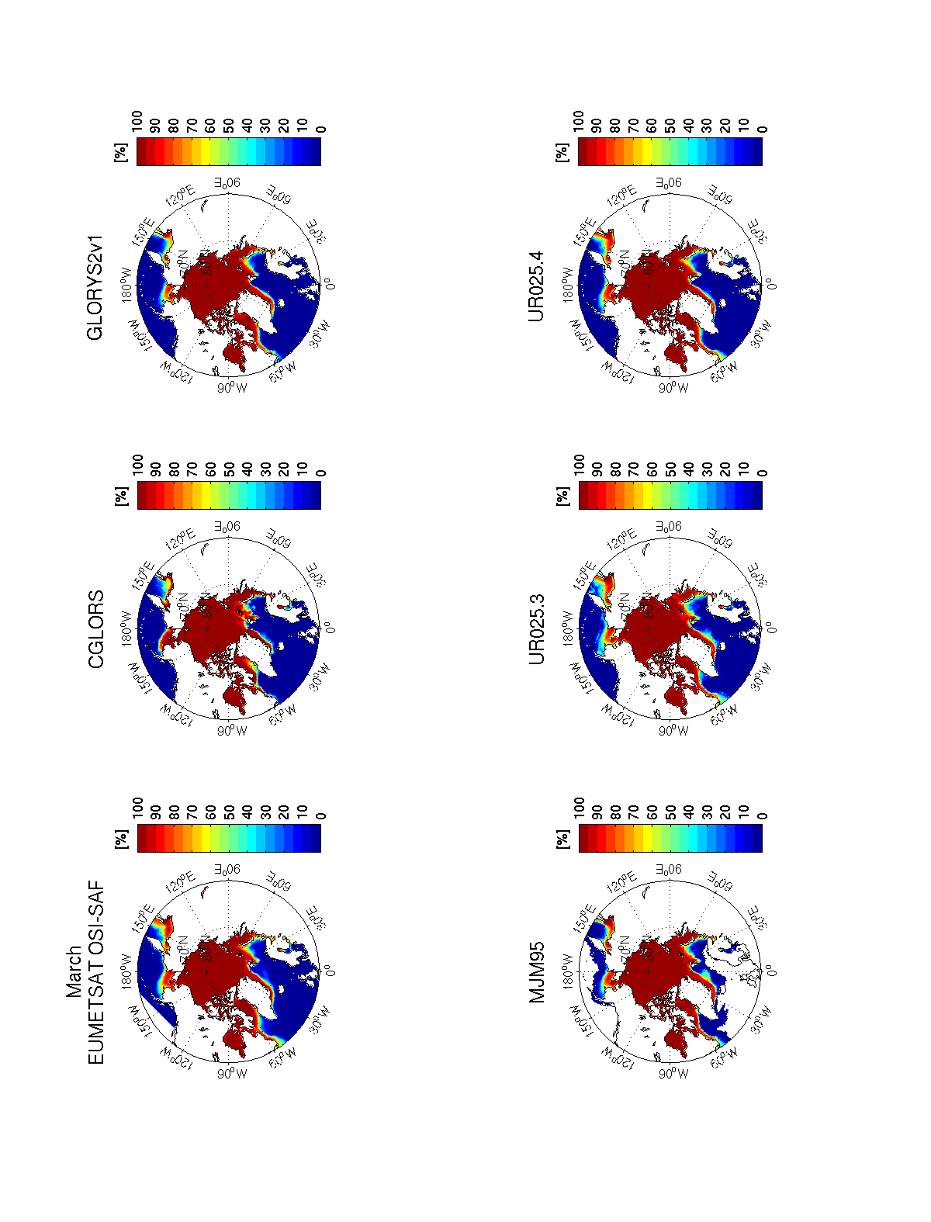
Inter-comparison of reanalyses:
Sea Ice Concentration
5 –Validation: Intercomparison
Northern Hemisphere – March

Slide 69
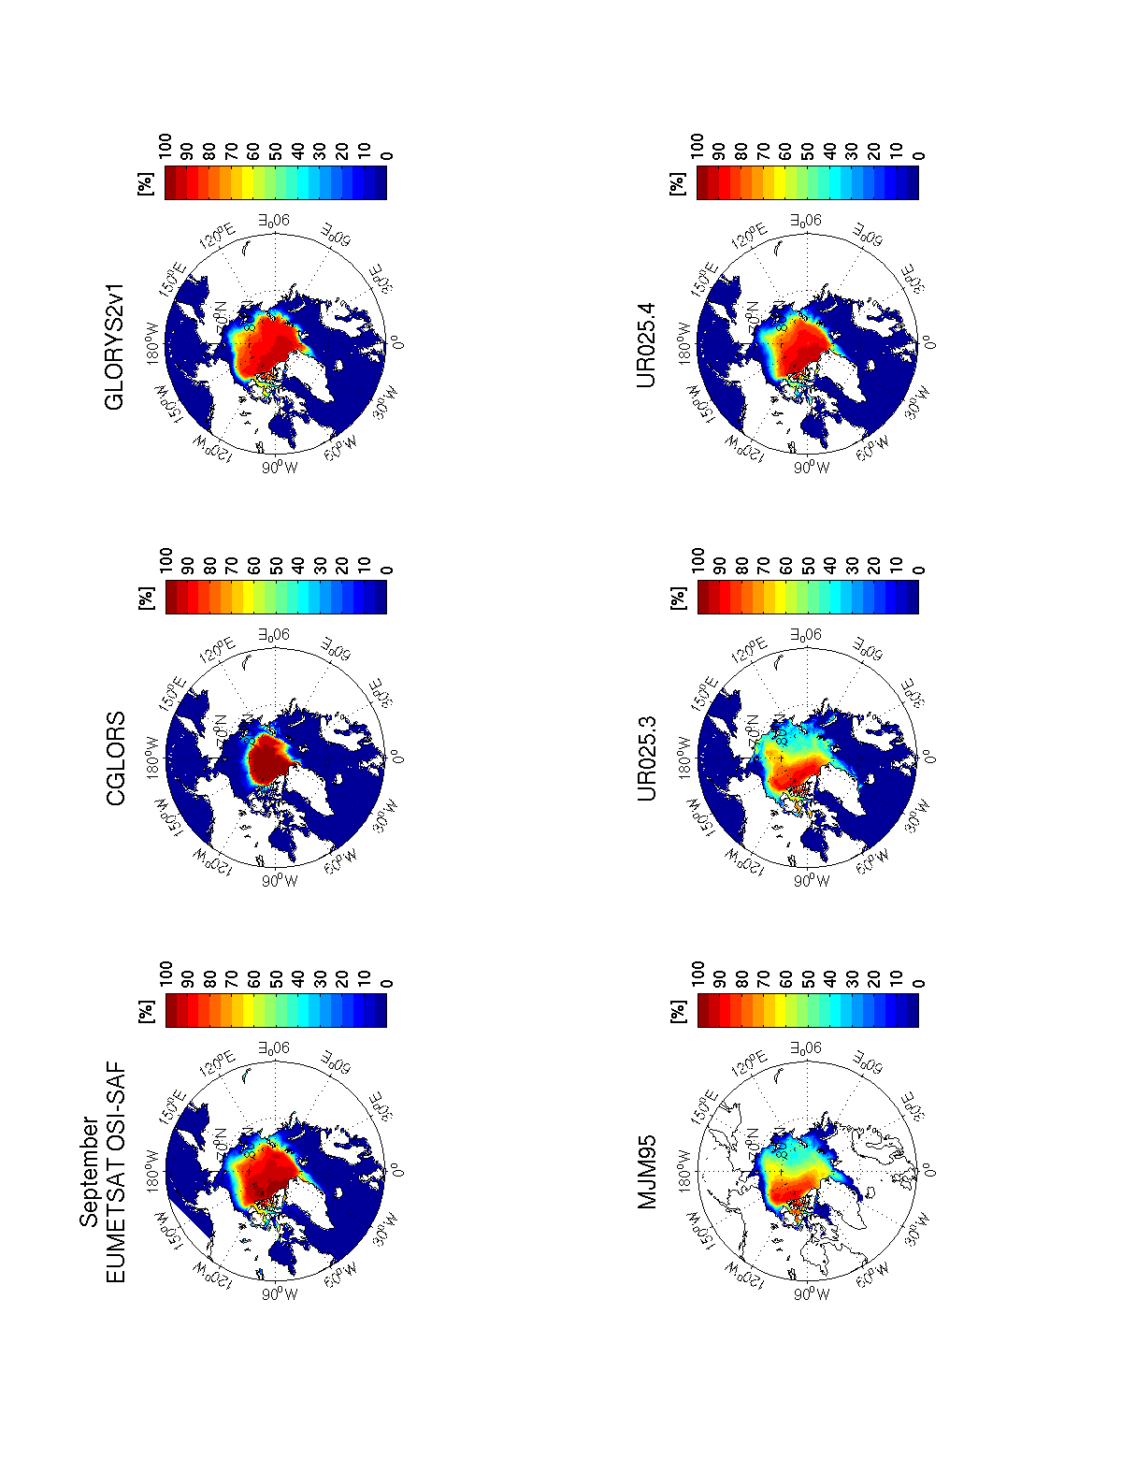
Inter-comparison of reanalyses:
Sea Ice Concentration
5 –Validation: Intercomparison
Northern Hemisphere – September

Slide 70

Inter-comparison of reanalyses:
Sea Ice Concentration
5 –Validation: Intercomparison
Southern Hemisphere – March

Slide 71

Inter-comparison of reanalyses:
Sea Ice Concentration
5 –Validation: Intercomparison
Southern Hemisphere – September

Slide 72

Inter-comparison of reanalyses:
Sea Ice Extent
5 –Validation: Intercomparison
Northern Hemisphere interannual sea-ice extent

Slide 73

Inter-comparison of reanalyses:
Sea Ice Extent
5 –Validation: Intercomparison
Northern Hemisphere interannual sea-ice extent

Slide 74





Inter-comparison of reanalyses:
Surface Currents
5 –Validation: Intercomparison
Mean surface zonal velocity (positive eastward)

Slide 75

Inter-comparison of reanalyses:
Atlantic Meridional Overturning at 26.5N
5 –Validation: Intercomparison
Rapid/Mocha array at 26.5°N
To Monitoring the AMOC

Slide 76

Inter-comparison of reanalyses:
Atlantic Meridional Overturning at 26.5N
5 –Validation: Intercomparison
RAPID-MOCHA array
Notes:
Reduction in ensemble spread when ARGO network sets up

Slide 77

5 –Validation: Intercomparison
FOCUS on RAPID time period (April 2004-Dec 2009)
Reanalysis | Correlation
ARMOR3D | 0.25
CMCC | 0.42
GLORYS2V1 | 0.39
UR025.4 | 0.36
MJM95 (CTRL) | 0.63
REA ENSEMBLE | 0.57
REA ENSEMBLE no MJM95 | 0.53
RAPID-MOCHA array
ARMOR3D, C-GLORSv2, GLORYS2V1, UR025.4, MJM95 ensemble mean ± 1 STD
Notes:
Reference run MJM95 without data assimilation outperforms all reanalysis en terms of correlation
But it is possible to improve the estimate of the AMOC using several reanalyses: REA ENSEMBLE without MJM95 has a better skill than any of the reanalyses.

Slide 78

Inter-comparison of reanalyses:
Atlantic Meridional Overturning at 26.5N
5 –Validation: Intercomparison
Impact of ARGO floats in the reanalyses
AMOC streamfunction profile at 26.5N;
Mean
Before ARGO
  MJM95 1992-2001
  GLORYS2 1992-2001
  MJM95 2002-2009
  GLORYS2 2002-2009
  GLORYS1 2002-2008
  RAPID 2004-2010
After ARGO
AMOC streamfunction profile at 26.5N;
STD

Slide 79

Inter-comparison of reanalyses:
Inter-basin exchanges
5 –Validation: Intercomparison
Drake Passage

Slide 80

Inter-comparison of reanalyses:
Inter-basin exchanges
5 –Validation: Intercomparison
Indonesian Through Flow

Slide 81
Inter-comparison of reanalyses:
Inter-basin exchanges
5 –Validation: Intercomparison
4
2
5
3
1
6
7
Sv
1
2
3
4
5
6
7

Slide 82
OUTLINES
1 – Objectives of MYOCEAN reanalysis project
2 – Ocean Weather
3 – Ocean Observational Network
4 – MyOcean Reanalysis Systems
5 – Production/Validation of reanalysis products
6 – Conclusion

Slide 83
6 - Conclusion
A set of Eddy Permitting Global Ocean Sea-Ice Reanalyses
  covering the “Altimetry Era (1993 – 2010)
have been produced in a coordinate way:
  Sharing
        - dynamical model (ORCA025)
        - atmospheric (ERAi) forcing
        - assimilation data
  Differing by data assimilation method
        - Kalman Filter GLORYS
        3D-VAR C-GLOR
        OI UR25
  Backed by
        - a free run (no assimilation) MJM95
        - a “statistical estimate” ARMOR3D

Slide 84
6 - Conclusion
Availability of reanalysis products (MYOCEAN Web site)
Higher frequency product (daily) available (GLORYS)
Intercomparison of the Reanalysis products in on going, but already several conclusions
- Skills for sea level changes
- Skills for upper ocean heat content changes
    - Importance of Altimetry and ARGO and Atm Forcing is demonstrated
    - Skills for air-sea fluxes?
    - Skills for Meridional circulation?
Important flaws have been identified
    - application of the assimilation method
    lack of observations at depth
    model flaws?
Very large room for improvements in MyOcean 2
    - thorough evaluation of reanalysis product
    - production on new set of coordinated reanalyses

Slide 85
Next challenges
  Representing the “eddy field” in long term reanalyses?
  Maintain and extend observational network (link with operational forecast).
    Speak for Altimetry (Jason and SWOT) and ARGO.
    Search for more historical data
  Data assimilation challenges
    - high resolution surface observations from satellite
    - low resolution in-situ observation (ARGO)
    - Constraining the deep ocean
    - surface boundary conditions (link with atmospheric reanalyses).
    - using of Ocean color and other “images from space”
  Modelling
    - understanding the modes linking Surface and Deep oceans at scales observed by satellites
    - toward eddy-resolving reanalyses (1/12°)
6 - Conclusion

Slide 86
Global T/S ➔ Armor3D - Method
ARMOR3D: The statistical re-analysis (CLS)
4 – Reanalysis Systems
1
Vertical projection of satellite data (SLA, SST) to get “synthetic profiles”
Combination of synthetic and in-situ profiles
T(x,y,z,t) = α(x,y,z,t).SLA_{steric} + β(x,y,z,t).SST’ + T_{clim} (x,y,z,t)
S(x,y,z,t) = α’(x,y,z,t).SLA_{steric} + S_{clim} (x,y,z,t)
2
SLA, SST
synthetic T(z), S(z)
multiple linear regression
1
optimal interpolation
2
in-situ T(z), S(z)
Armor3D T(z), S(z)

Slide 87




Armor3D - 1993-2009 reanalysis
4 – Reanalysis Systems
SSALTO-DUACS MSLA 1/3° weekly DT - 04/07/2007
NCEP Reynolds OI-SST 1/4° daily - 04/07/2007
Arivo climatology – July – T at 100 m
Synthetic T’ – at 100m

Slide 88



Armor3D - 1993-2009 reanalysis
4 – Reanalysis Systems
Synthetic T’ – at 100m
In-situ observations – Coriolis data center
Armor3D T’
Argo T’

Slide 89

Inter-comparison of reanalyses:
Sea Level
5 –Validation: Intercomparison
Regional Sea Level trend over 1993-2009
AVISO
C-GLORS
There are things that still do not work

Slide 90

Inter-comparison of reanalyses:
Global Mean 0-700 m Heat Content
5 –Validation: Intercomparison
Difference from first year mean

