Slide 1
VARIATIONAL BIAS CORRECTION FOR RADIOSONDE DATA
Marco Milan, Christina Tavolato, Leopold Heimberger
Washington 9/05/2012

Slide 2
MOTIVATION
Radiosondes data often used as reference for other data
Radiosondes data, especially at high altitudes, are not unbiased
Changes bias due to:
  Change of radiosonde
  Change of locations for the same radiosonde
  Other equipment changes
Vertically constant wind direction bias in many radiosondes
Unadjusted biases affect trends and observations usage
A bias adjustment, which takes into account all these problems, is needed

Slide 3
OUTLINE
Previous works:
  Radiosonde adjustment during ERA-INTERIM
Current approach
  Variational Bias correction (VarBC)
  Possible bias models
  Grouping of data (radiosonde types, elevation angles, …)
Preliminary results
Conclusions

Slide 4
ERA-Interim adjustment
Wind
No adjustment is done for radiosonde winds
Temperature
Adjustment of annual mean bias
  Use of RAOBCORE (Haimberger et al. 2007, 2008)
  Based on time series of individual stations
  Detection of shifts in background departure
  Adjustments can change temperature trends
Adjustment of daily/seasonal bias
  Method based on solar elevation adjustment (Andrae et al. 2004)
  Based on station groups
  Four classes of solar elevation
  Adjustments calculated from the statistics of background departures over the previous 12 months

Slide 5
ERA-Interim adjustment
Russian radiosonde, 12 UTC, 200hPa
Start from 1979, when satellite data are available
First guess departure, using uncorrected radiosondes
Bias correction to apply
Bias correction only until 2008, not applied any more
After 2008 less departure but still existing, a bias adjustment is needed
Limited departure probably due to changes on radiosondes dataset in the Russian federation

Slide 6
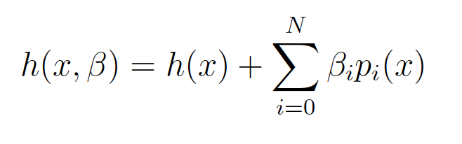
Variational Bias correction
The observations are considered biased, a linear predictor model is used as observation operator in the 4DVAR equations:
Introduction of a “bias term” in the variational cost function
With x^{b} and β^{b} a priori estimations of model state and bias control parameters
A large B_{β} allows the parameter estimates to respond more quickly to the latest observation.
The adjustment of the radiosondes depends on the resulting fit of the analysis to all other OBS, given the background from the model.

Slide 7
Variational Bias correction
Bias in observations can change during the time (wind and temperature)
Seasonal and daily variations in bias exist (temperature)
The bias model :
  Must be chosen according to observations and physical origins of the bias.
We assume the model unbiased, the presence of model bias attributes a wrong bias to the observations where there are not enough observations to correct the analysis
Notes:
VarBC can be applied in the period where RAOBCORE detects a shift (temperature)

Slide 8
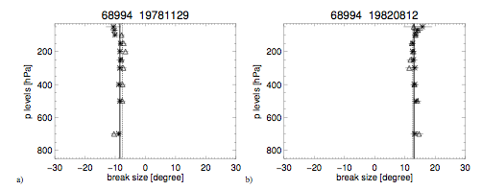
Wind direction bias
Marion Island – Indian Ocean (extreme bias)
  FG-departure wind direction compared to ERA-40
  1978, 1982: Wind direction change throughout the whole profile
Gruber and Haimberger, 2008

Slide 9
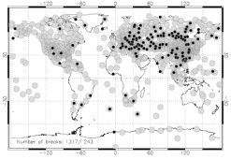
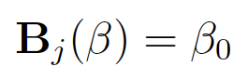
Wind direction bias
Wide areas with wind direction bias over Asia
Isolated stations which have strong influences on the analysis
Gruber and Haimberger, 2008
Due to constant vertical bias only a constant bias parameter is needed
Constant wind direction bias parameter for the whole profile of each station
b

Slide 10
Wind direction bias
One constant predictor
Problem:
  Model: u,v
  Control variable in cost function: wind direction
Transformation:
  From u,v
  Wind direction
  Bias model
  Bias back to u,v
Notes:
Radiosonde: wind direction, absolute value of wind

Slide 11
Wind test for bias correction
Test setup:
  15 degree wind direction bias added to 4 radiosonde stations from day 4 onwards:
    Bethel, Alaska - 70219
    Athens, Greece - 16716
    Marion Island, Indian Ocean - 68994
    Aktynbinsk, Russia – 35229
Evaluation of first experimental runs July and December 2011

Slide 12
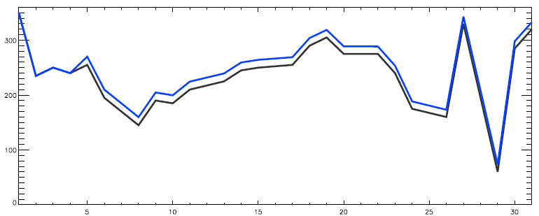
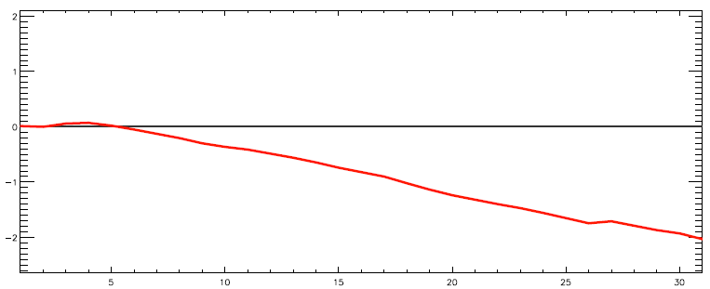
Wind July 2011
Bethel, 70219
OBSERVATIONS
DEGREE
500 hPa but same bias over the whole profile
To correct 15 degree
Bias correction around 2 degree after 31 days
The bias correction is in the “right” direction but the amount is too low
Control
Bias + VarBC
July
BIAS CORRECTION
DEGREE
July

Slide 13
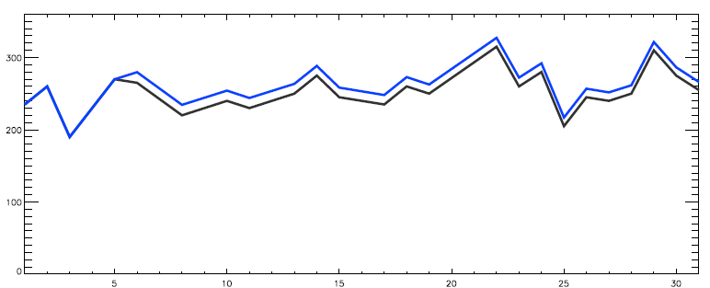
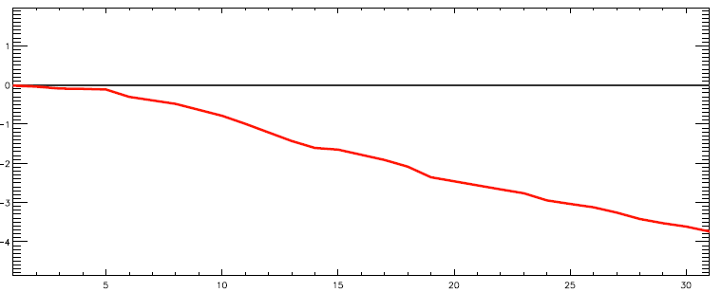
Wind July 2011
Marion Island, 68994
OBSERVATIONS
500 hPa but same bias over the whole profile
To correct 15 degree
Bias correction around 4 degree after 31 days
The bias correction is in the “right” direction but the amount is too low
In this case the correction is larger
DEGREE
Control
Bias + VarBC
July
BIAS CORRECTION
DEGREE
July

Slide 14
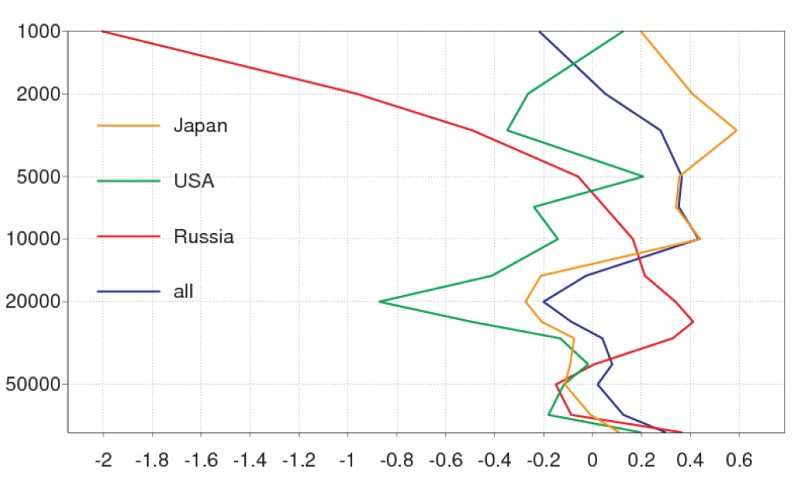
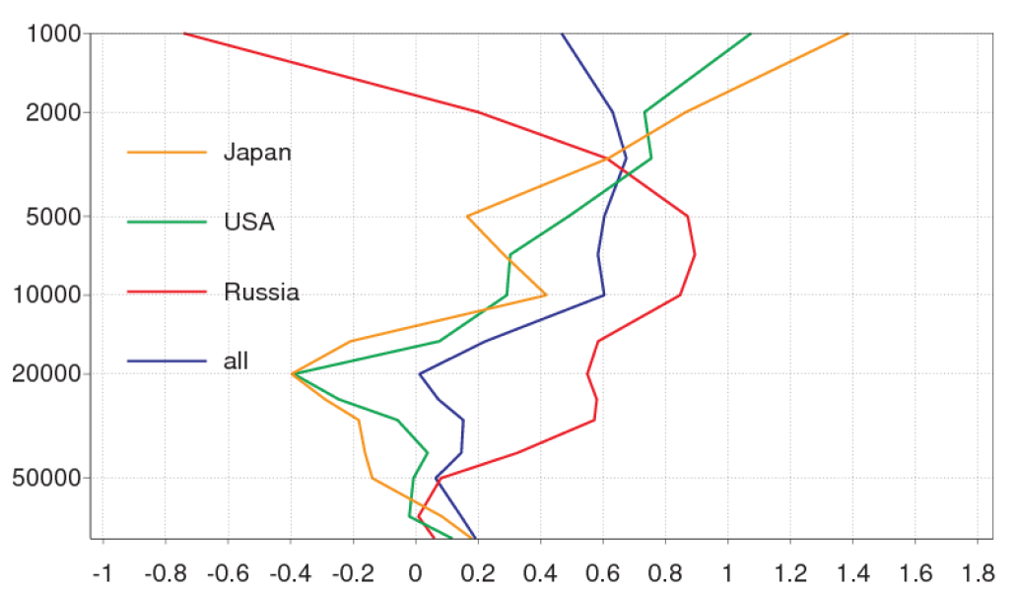
First guess departure T
Night Θ < -7.5°
Analysis of July 2011
Average of first guess departure
Results divided by station type
Large differences between different station types (necessity of grouping)
Different behaviour between stations at night and at large solar elevations
  Russian stations near 50 hPa positive departure for large solar angles, around 0 during the night
  Japanese and USA stations different path, positive departure in the upper levels
Height dependencies are visible
Bias depends on RS-type, pressure and solar angle
k
Θ > 22.5°
k

Slide 15
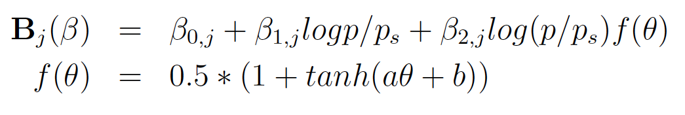
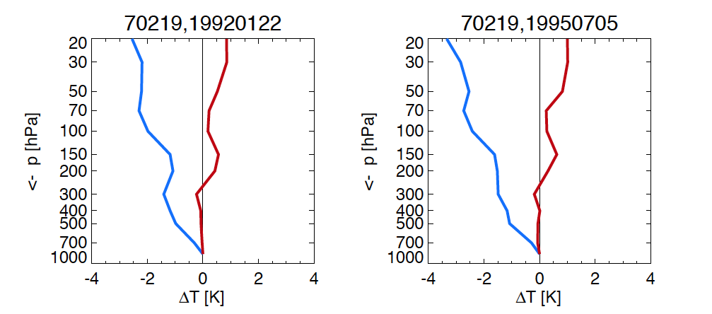
Radiosonde temperature
bias correction
Bias model
  First approach, seems suitable for US and Japanese radiosondes at some periods
  Not suitable for vertically nonlinear bias profiles
No functional relationships, instead estimate bias parameters for pressure layers, solar elevations and station groups
  More bias parameters need to be estimated
First results (test) using only a vertically constant bias parameter valid for all solar elevations
b
b

Slide 16
00 UTC
12 UTC

Slide 17
Radiosonde temperature
bias correction
Bias model
  First approach, seems suitable for US and Japanese radiosondes at some periods
  Not suitable for vertically nonlinear bias profiles
No functional relationships, instead estimate β₀ for different pressure layers, solar elevations and station groups
  More bias parameters need to be estimated
First results (test) using only a vertically constant bias parameter valid for all solar elevations
b
b

Slide 18
Bias adjustment
NIGHT
Time series for vertical mean bias correction
Generally very small bias corrections
For higher solar elevations larger bias corrections
Radiosonde types with larger first-guess departure (Russia) have also the higher bias corrections
The bias corrections are in the “right” direction but the amount is too low
SOLAR ELEVATION > 22.5°

Slide 19
First-guess departure T
bias correction
Station 23921, Russia
Vertically averaged first guess departure positive at most times
We expect a bias correction which converges to a positive value of about 0.4K
The bias correction for this station increases until a value around 0.02K and then decreases (negative fg-departure)
The bias correction is in the “right” direction but the amount is too low
B too small?
This is just a start, much development still needed
<T>=0.389 K

Slide 20
CONCLUSIONS AND OUTLOOK
Variational bias correction for temperature for radiosondes is far away from a final solution. For wind a constant parameter could be sufficient
A different approach as in ERA-INTERIM
First results: too small bias corrections but in the right directions
VarBC can be applied where RAOBCORE detects the shifts
Anchoring using “trusted” radiosondes and nowadays GPS data
Temperature
Use of a “physical approach” (function of predictors) taking into account grouping of radiosondes
Different predictors and functions for different groups have to be tested (work in progress)
Wind
The Bias is normally quite constant over the whole profile
Larger B_{β} in order to have faster adjustments

Slide 21
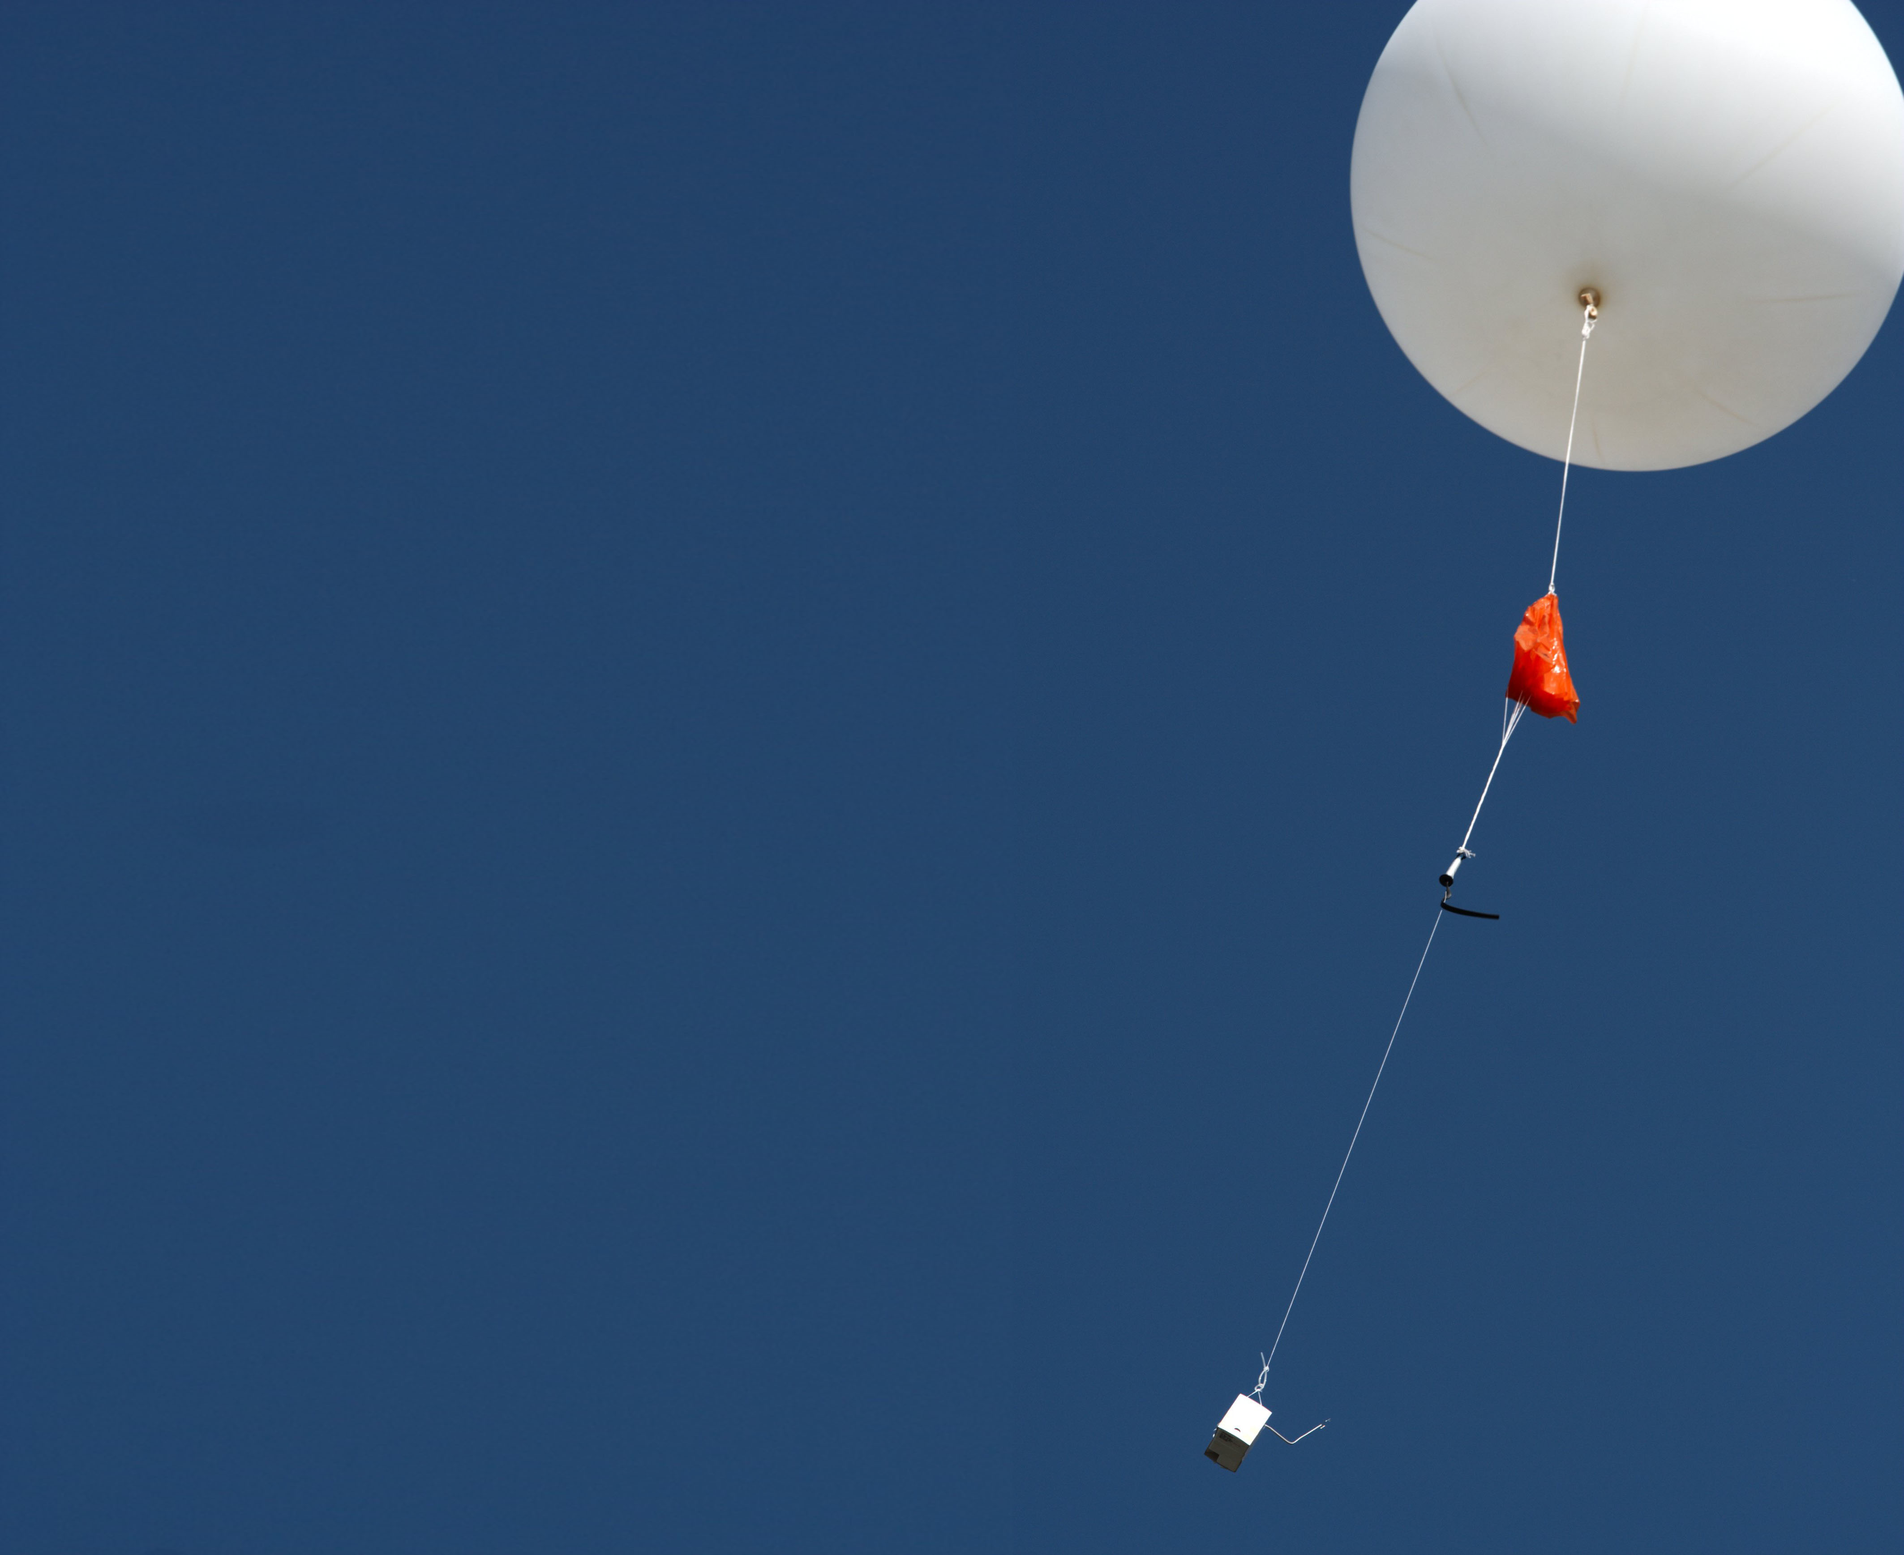
THANK YOU
FOR
YOUR ATTENTION

Slide 22
QUESTIONS
Definition of the matrix B_{β}
RMS
Examples Temp

Slide 23
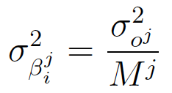
DEFINITION OF B_{b}
We do not know the actual error covariances of β (B_{β})
We use B_{b} to control the adaptivity of the bias parameters:
  Increase B_{b} for faster bias adjustments; decrease for slower adjustments
We take diagonal B_{β} related to the diagonal of R:
for i=1,…,N^{j} number of predictors for the variable j
In this way the part in the cost function related to the bias parameter background constraint for the variable j has the same weight as M^{j} new observations.

Slide 24
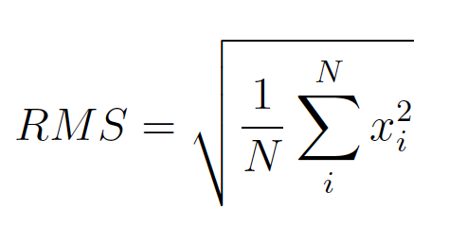
RMS first guess departure T
The negative departures do not counteract the positive departures
RMS give more weight to the larger first guess departure
The Russian stations has larger RMS in the upper levels and near 200 hPa
Japanese’s stations RMS in the upper levels larger for higher solar angles
USA stations better than Russian’s and Japanese’s for Θ > 22.5°
Groups for different stations are desirable
Night Θ < -7.5°
Θ > 22.5°

Slide 25
First-guess departure
bias correction
<T>=0.137K
Station 27730, Russia
Vertical averaged first guess departure change from positive to negative
The negative bias corrections could counteract the positive
The bias corrections could be too slow

