Slide 1
Some Problems in CFSRR Investigated and Solutions Tested for CFSRL
Jack Woollen, Bob Kistler, Craig Long,
Daryl Kleist, Xingren Wu, Suru Saha,
Wesley Ebisuzaki

Slide 2
Introduction
Following an intense effort to complete the CFSRR reanalysis for 1979-2010, which contained many new features, and had to be conducted in a very strict timeframe, problems became evident in the results. Several were serious enough that a lower resolution rerun of the CFSRR (named the CFSRL), was proposed to address and correct them, and to run through the period 1948 to the present as a replacement for the R1 product. The presentation describes our experience addressing four problems affecting the atmospheric part of the CFSRR, pre-1998, and how they are to resolved in the CFSRL system.

Slide 3
We looked at 4 issues:
SSU bias correction
Asian radiosonde radiation corrections
Tropical tropospheric cold bias
QBO wind analysis

Slide 4
We accomplished 3 objectives:
Devise and/or install a solution for each issue
Run 8 years of “CFSRL” testing
(1979-1986) for validation
Run 2 additional 2-year experiments to further develop the QBO analysis
(82-83, 98-99)

Slide 5
Issue #1
Extreme Stratospheric Temperature Variations
With Jumps At Processing Stream
Boundaries

Slide 6
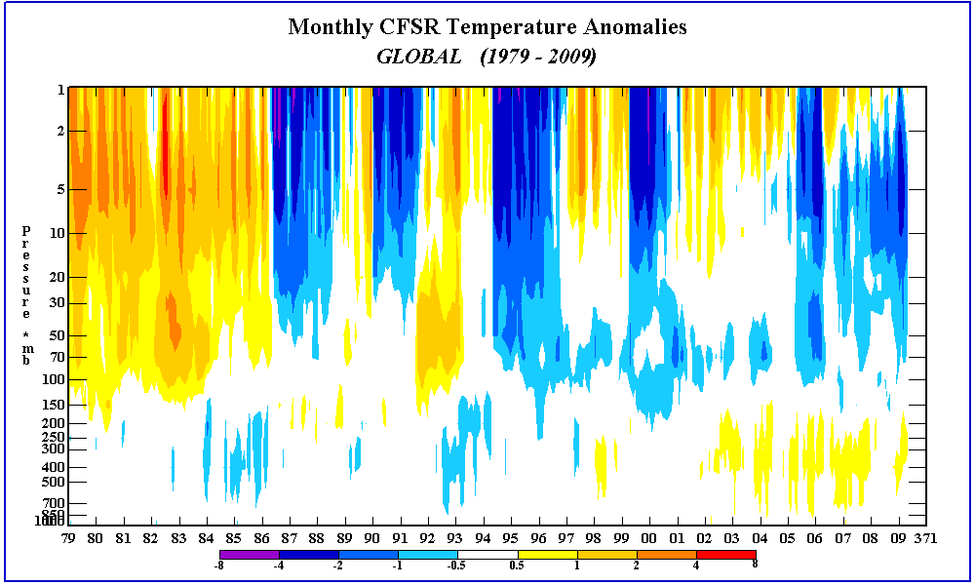

Slide 7
Prior to 1998 the SSU assimilation is implicated, especially bias correction of channel 3
Model warm bias feeds into SSU bias correction and heats up the stratosphere
until a stream (or satellite) boundary occurs when the bias correction resets…

Slide 8
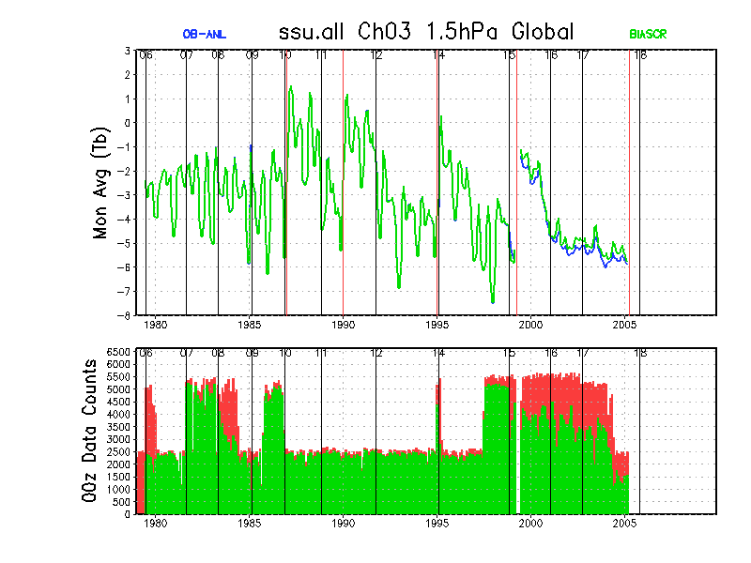

Slide 9
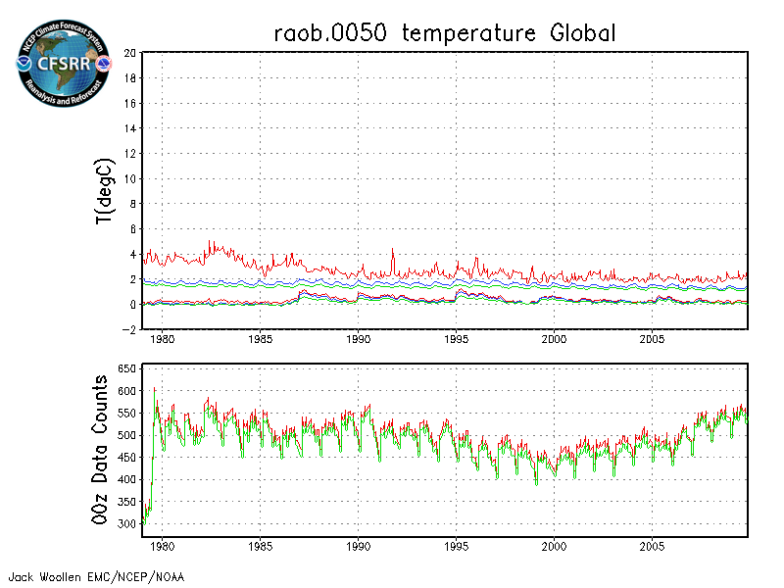
Problem Propogates Downward
Glitches in 50mb raob temp bias at boundaries

Slide 10
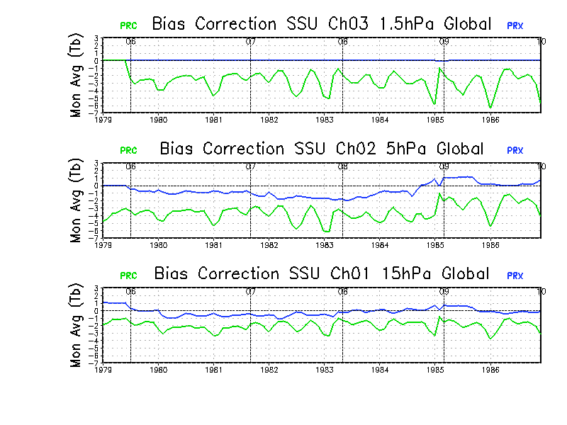
So turn off the SSU channel 3 bias correction
With Ch3 bias correction off Ch1&2 look better too
Dee et al, “Importance Of Satellites For Stratospheric Data Assimilation”, 2007

Slide 11
Issue #2
CFSRR Radiosonde Radiation Correction (RC)
Four separate operational tables used
Creates discontinuities in temp analysis
Interact with variational satellite bias corrections
Highlights the need to use a continuous radiosonde correction in CFSRL, as in ERA, JRA, MERRA, etc.

Slide 12
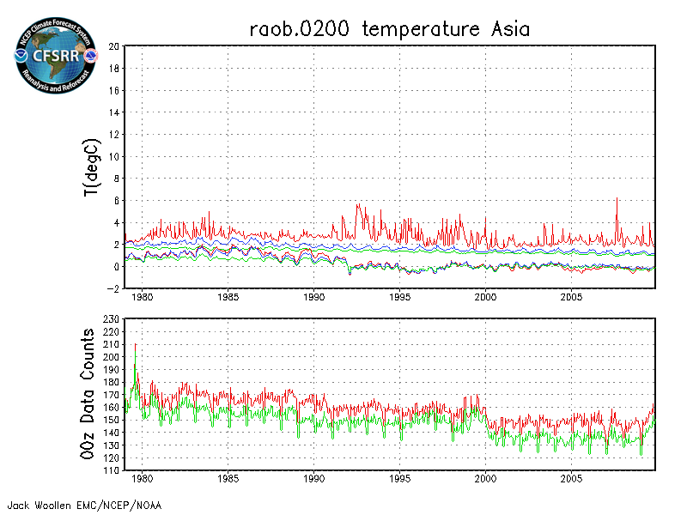
Large change in (o-a) bias wrt radiosondes
at 200mb over Asia in 1992

Slide 13
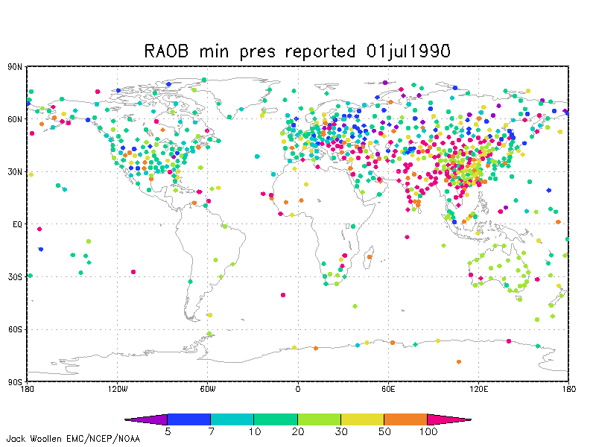
Asia Region

Slide 14
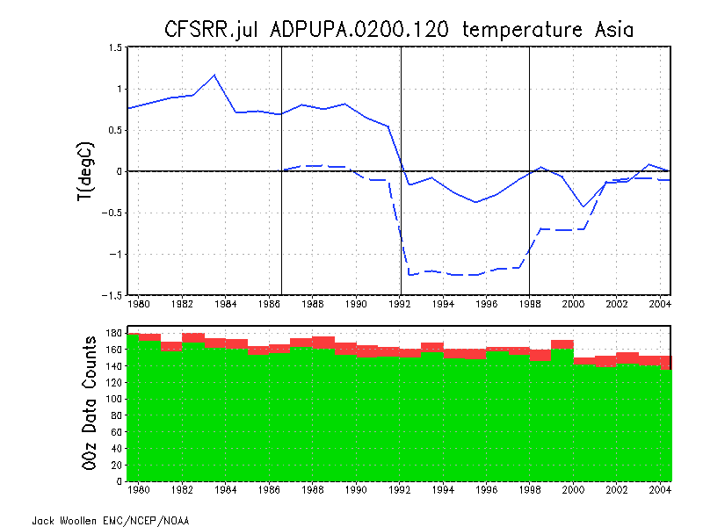
CFSRR R2 CFSRL
RCOB-AN
RCOB-OB
RC table change in 1992 explains the jump

Slide 15
CFSRR R2 CFSRL
But CFSR basically ignores the uncorrected
radiosonde prior to 1992

Slide 16
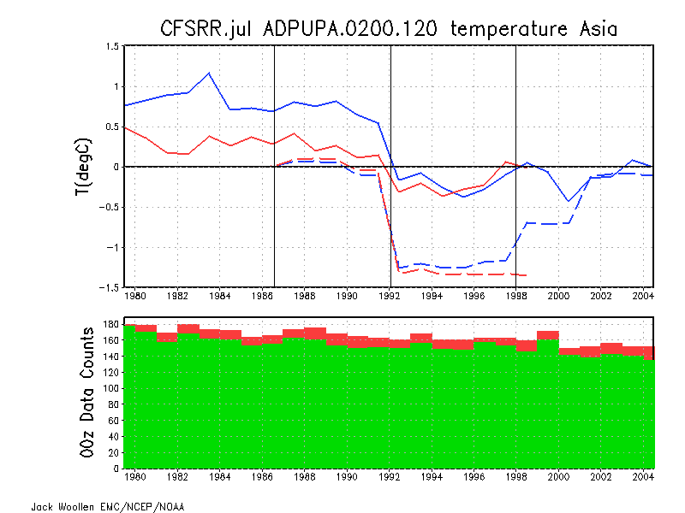
CFSRR R2 CFSRL
Results different from R2 due to resolution and
VBC’d radiances vs retrievals

Slide 17
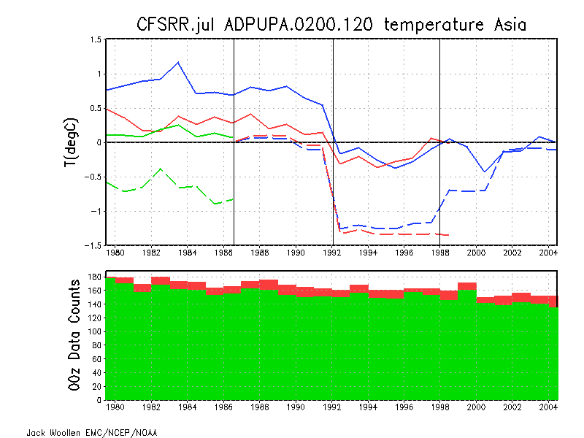
CFSRR R2 CFSRL
Test of a simple adaptive correction for CFSRL
Need to apply RAOBCORE type corrections also

Slide 18
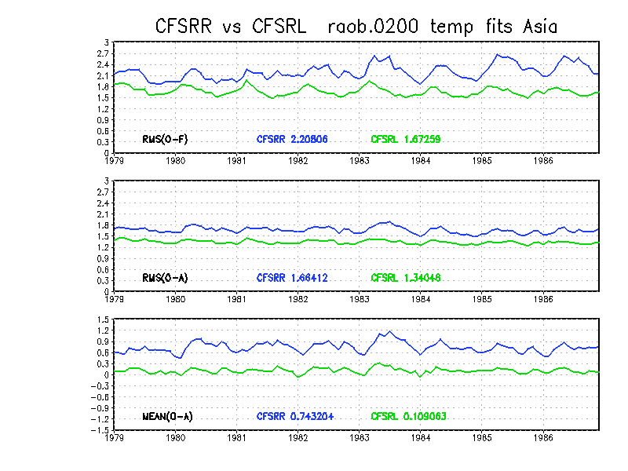
Improved Fits To Analysis And Forecast

Slide 19
Issue #3
Significant differences from other reanalyses
In tropical tropospheric temperature

Slide 20
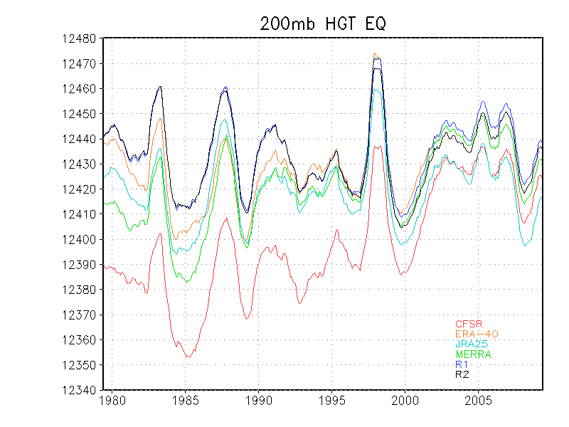
R1/R2
CFSR

Slide 21
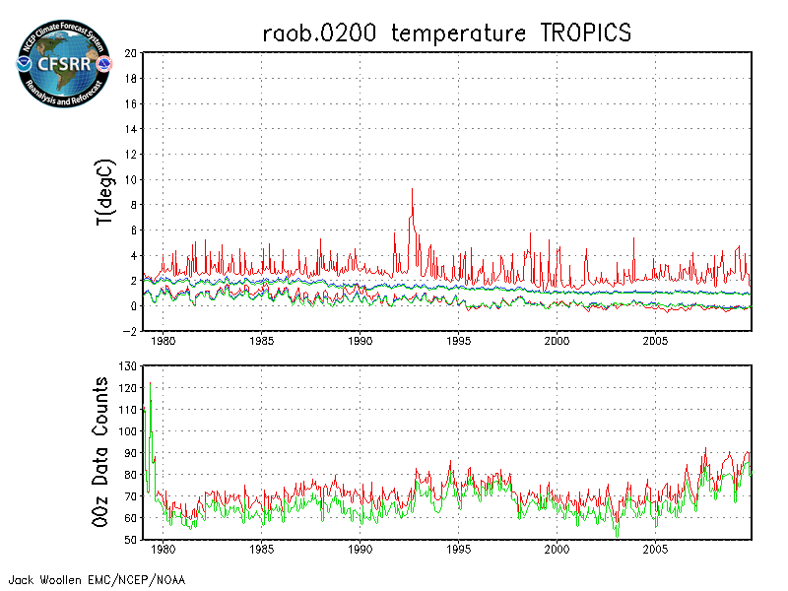
20N-20S
CFSRR Cold bias compared to radiosondes

Slide 22
CFSRR didn’t draw for the radiosonde temperature data in the tropics
_________________________
Solution: adjust the GSI structure functions to increase the forecast variance in the tropical region, top to bottom
__________________________
Analysis fits improved and large biases disappeared

Slide 23
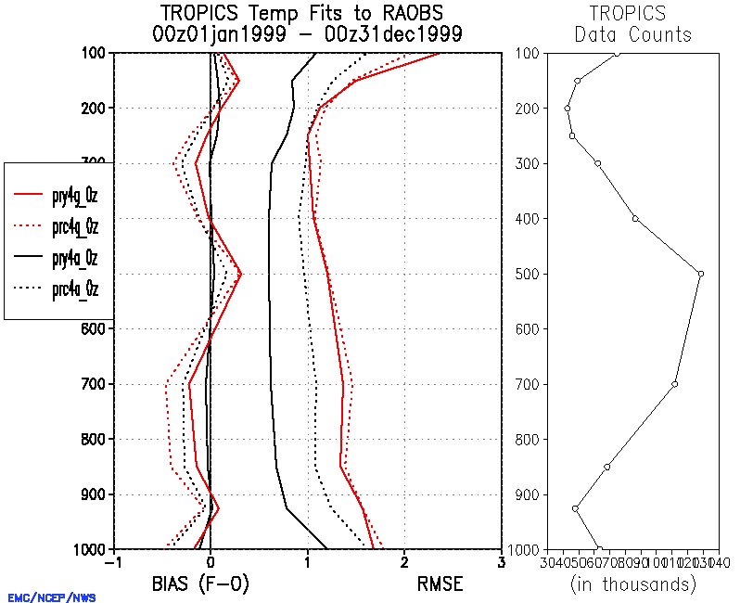
CFSRL (solid lines) versus CFSRR (dotted lines)
Analysis fits improved
____________________
Forecast fits not so much
AN FC
Diagram from Fanglin Yang

Slide 24
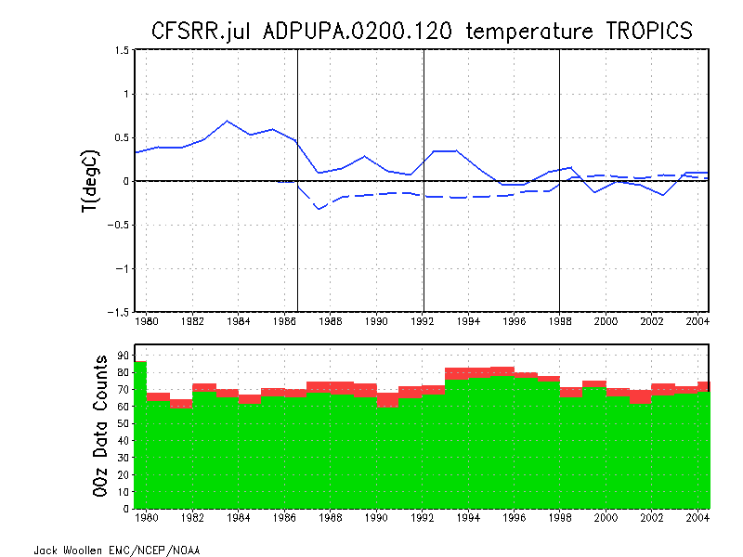
CFSRR R2 CFSRL
RCOB-AN
RCOB-OB
Radiation correction not very large
Poor initial fit in CFSRR gets better over time with
observation density increase

Slide 25
CFSRR R2 CFSRL
CFSR analyzed sat radiance – R2 analyzed retrievals
Must explain the opposite biases

Slide 26
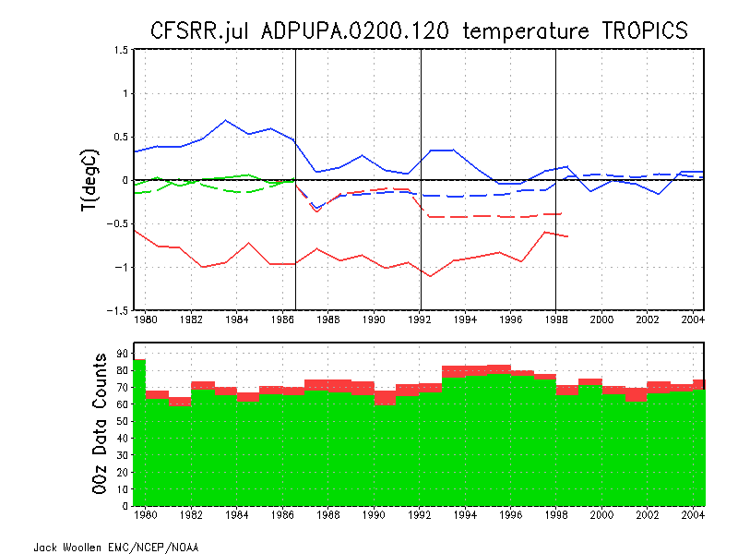
CFSRR R2 CFSRL
New Radiosonde RC seems not to play much of a role
in the CFSRL improvement here

Slide 27
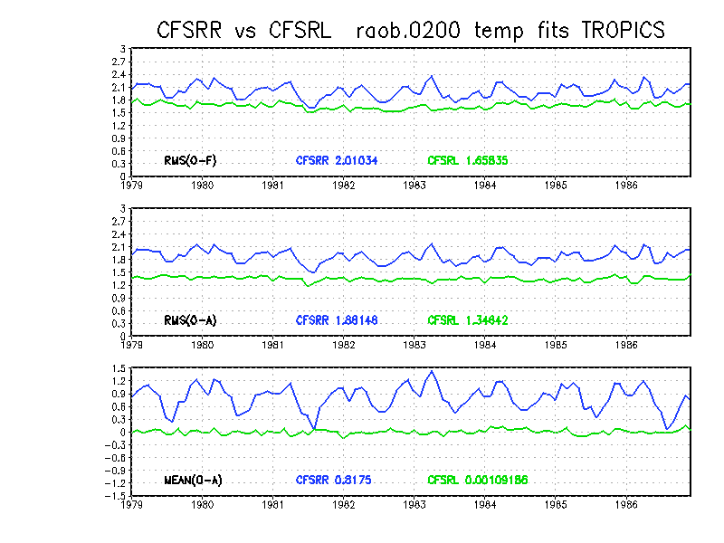
Improvements From Tropical Structure Function Changes

Slide 28
Issue #4
QBO Wind Reversals Not Captured Well
Discovered too late to fix in CFSRR
Caught by surprise – not a problem in R1 or R2
Bogus ERA40 winds into CFSR QBO region Jul1981 - Dec1998

Slide 29
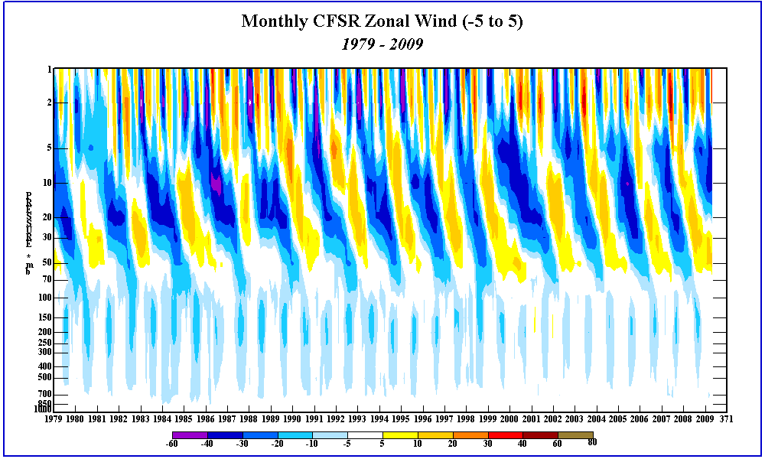

Slide 30
CFSR captured one transition (weakly)
before bogusing began
CFSR QBO improves after 1998
So bogusing ended

Slide 31
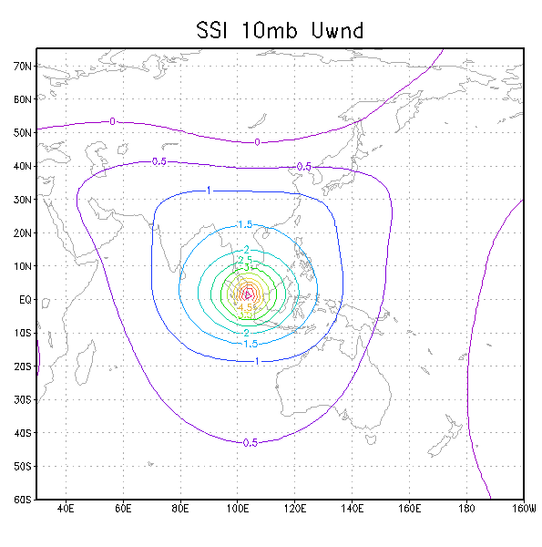
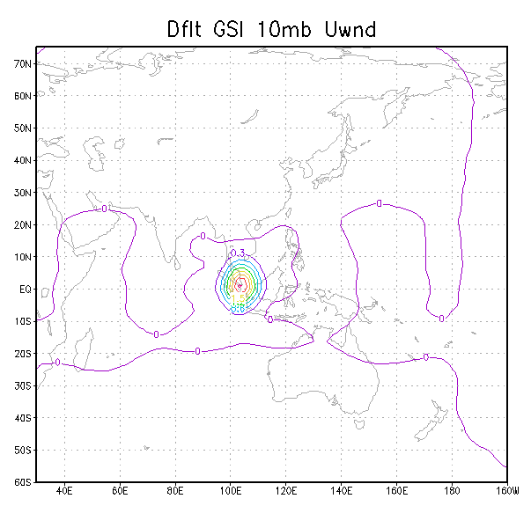
Problem seems to be due to overly narrow tropical FE structure function pre-1998
Single u component impact
R2
CFSR

Slide 32
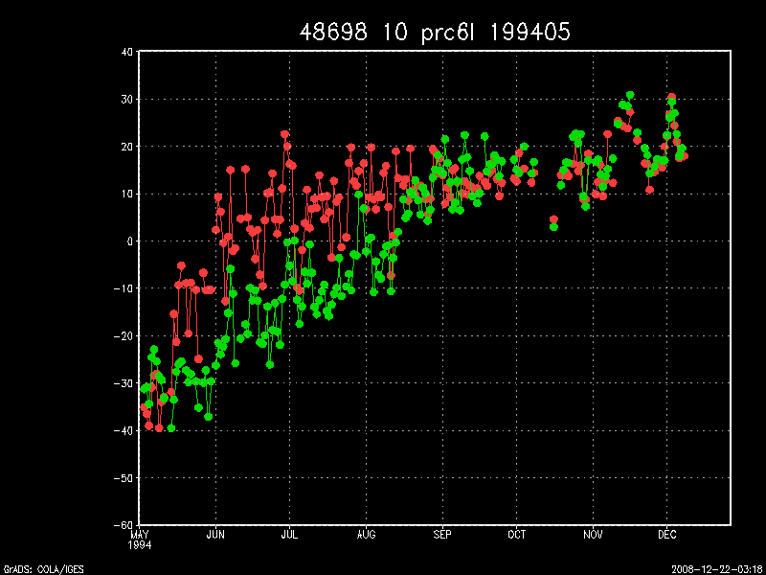
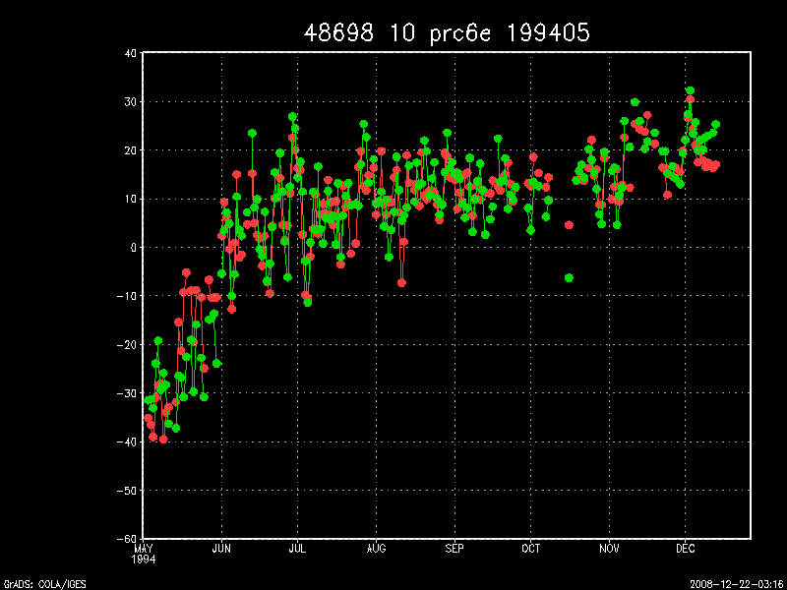
Inflated variance appears to solve problem in test run starting in May1994
U-comp wind Singapore raob vs reanalysis 10mb
Original SF
Inflated variance (SF*4)

Slide 33
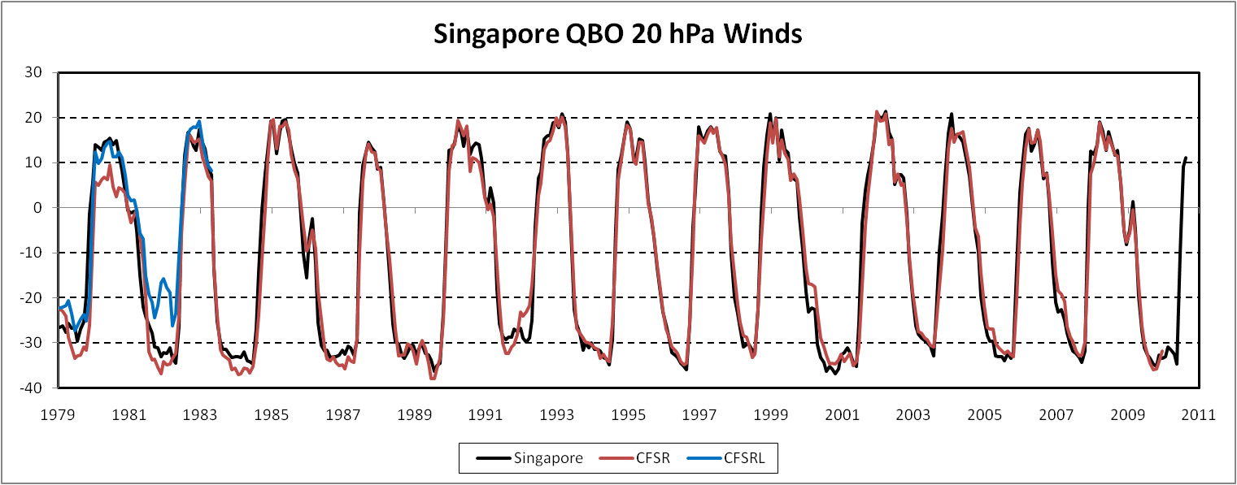
However, zonal wind compared to Singapore ob
shows the prx (SF*4) system still not capturing the wind phase shifts sufficiently in early 1980’s
Large bias in 1982 easterly phase shift

Slide 34
Need additional work to fix the QBO
Is the SSU data interfering with the QBO wind analysis?
Damp the effect of SSU channels by raising ob errors.
How else can the impact of the data be increased?
Assimilate synoptic observations all day.
It turned out both of these measures had a similar positive effect on the QBO analysis,
but each at different levels

Slide 35
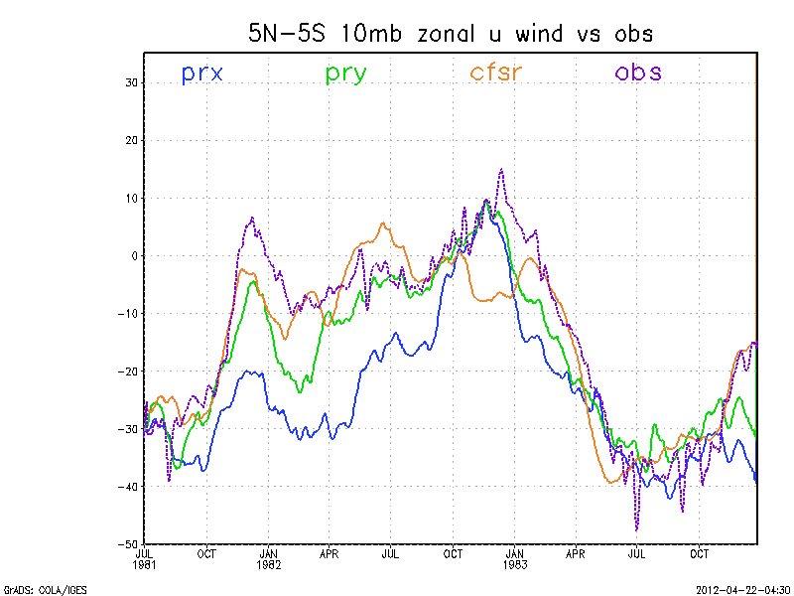
_

Slide 36
_
pry approach better at fitting the sparse 10mb data

Slide 37
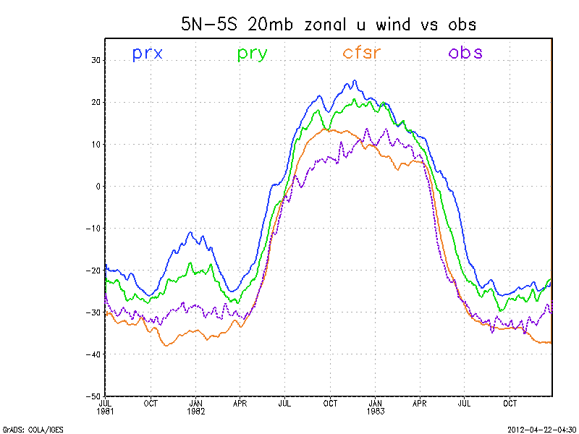
_
IC bias

Slide 38
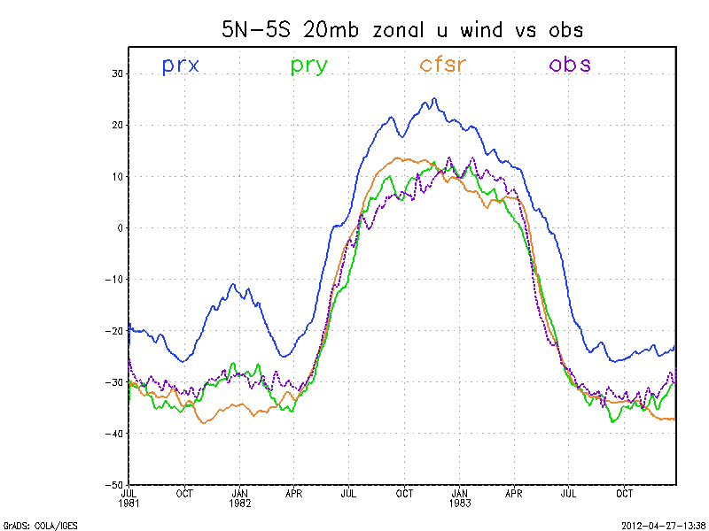
_
Initial bias removed for display

Slide 39
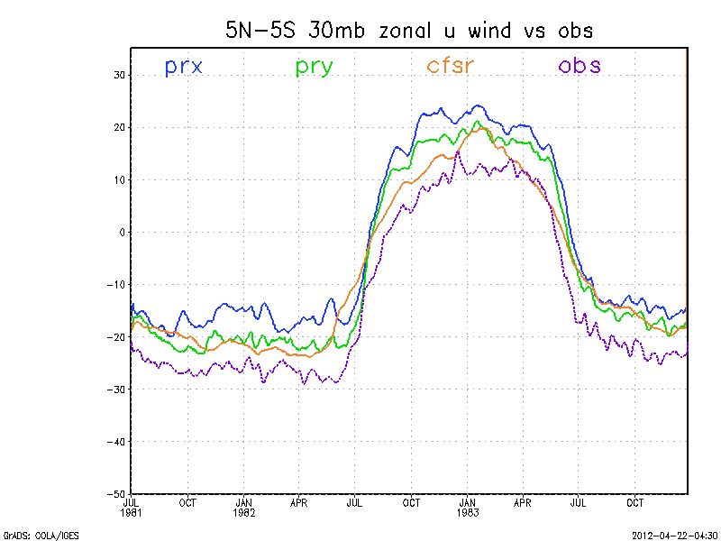
_
IC bias

Slide 40
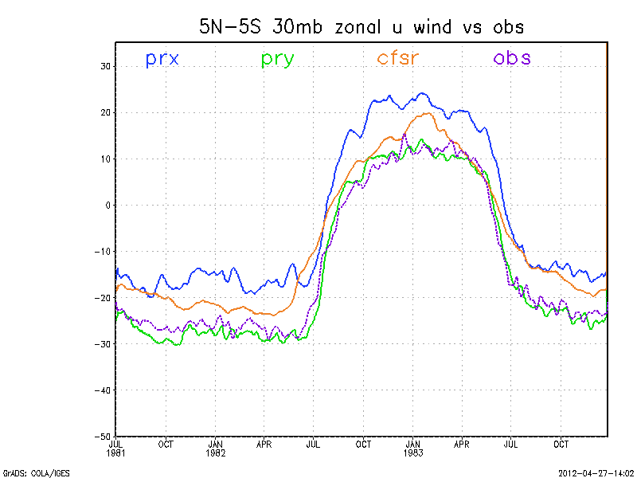
_
Initial bias removed for display

Slide 41
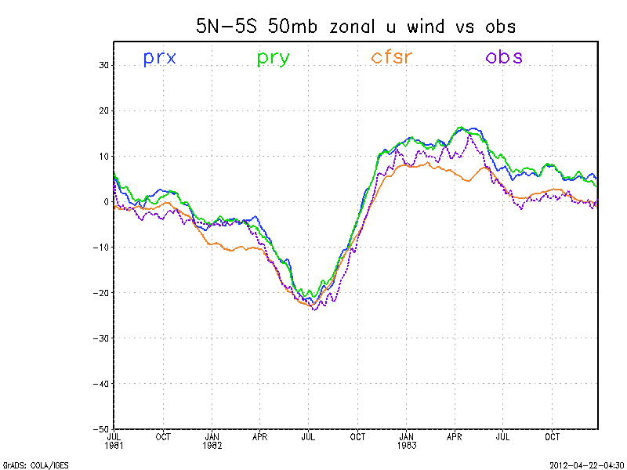
_
IC bias

Slide 42
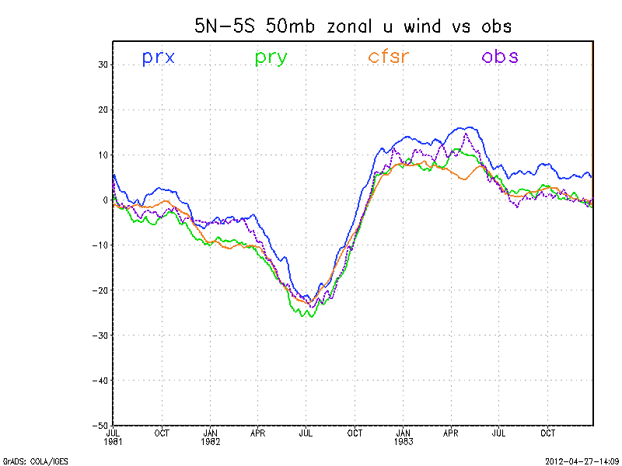
_
Initial bias removed for display

Slide 43
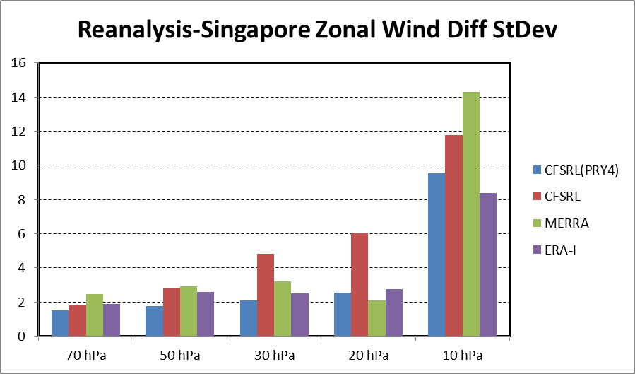
1982-1983
CFSRR

Slide 44
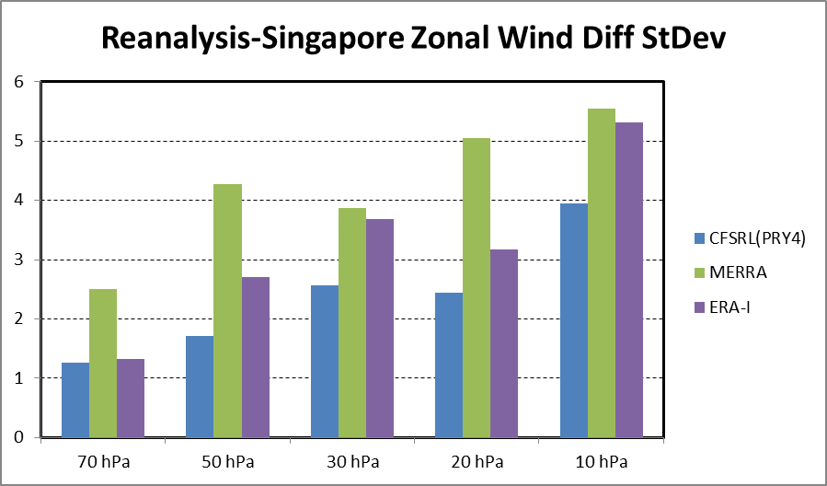
1998-1999

Slide 45
The End
Thanks!

Slide 46
Some reference slides

Slide 47
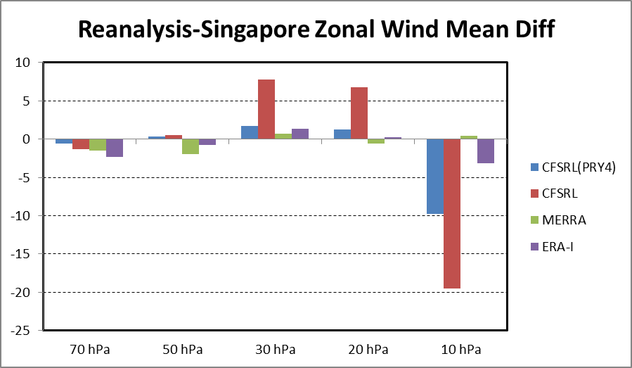
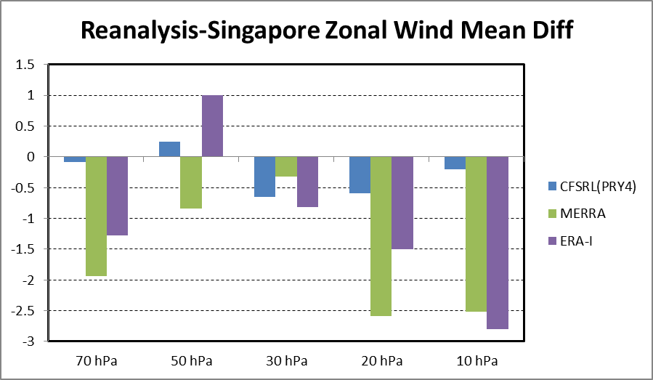
Reanalysis Comparisons with Singapore Winds
(Means Diff and Diff Variability)
1982-1984
1998-1999

Slide 48
Adaptive RC procedure updated from R1 for CFSRL
Each month the composite (F-O) statistics for temperature are computed for each WMO block (01-99)
A profile of percentages of the (F-O) stats is defined as follows:
pob>=700 tfrac=0 pob==500 tfrac=.8*.333 pob==400 tfrac=.8*.666 pob< 400 tfrac=.8 A data density factor is defined: ddf=min(1,cnt/15) A limiting factor is defined: abs(cor)<=tfrac*2.5 Next months corrections in each block is: cor=(F-O)*tfrac*ddf.
Finally the absolute value of the correction is limited to be <=tfrac*2.5.

