Slide 1
EnKF
Look Ma, no Hands!
Ensemble data Assimilation
without Ensembles
Christian L. Keppenne^{1,2}, Guillaume Vernieres^{1,2},
Robin M. Kovach^{1,2}, Michele.M. Rienecker¹
¹NASA Global Modeling and Assimilation Office
²Science Systems and Applications, Inc. (SSAI)
4th World Climate Research Program International Conference on Reanalyses
Silver Spring, MD, May 07-11, 2012

Slide 2
Ensemble data assimilation and EnKF
Use of ensemble of model states to represent forecast errors
Evensen (1996) and in the title of 400+ other research papers
Commonly cited advantages:
Works better than…
Economical: EnKF offers Kalman filter like analysis at small fraction of cost
Adaptively estimates background errors and error statistics
Amplitude
Spatial distribution
Cross-field ensemble statistics make it easy to update unobserved variables
Sounds good but…
Hardly ever works in practice (ensemble size) unless EnKF is augmented with OI in “hybrid” scheme
Still much more expensive than conventional analysis scheme
In practice, amplitude result of covariance inflation/perturbation choice
Agreed
Id., especially important in ocean assimilation

Slide 3
We don’t hate the EnKF!
Of course, it helps to have more than just one shot.
EnKF use at GMAO
Ocean data assimilation since 2001 (Keppenne et al.)
Land assimilation and initialization since 2002 (Reichle et al.)
Ensemble-based 4DVAR planned for next generation ADAS (Todling et al.)
Objective
Maximize assimilation performance when only 1 model trajectory is available to estimate bckground covariances

Slide 4
3 EnKF alternatives
Steady state ensemble (a.k.a. enOI, asymptotic EnKF, SE*K)
Ensemble in time (LIFE)
Ensemble in space (SAFE)
Other acronyms throughout:
RMSF: rms observation minus forecast errors
RMSA: rms observation minus analysis errors

Slide 5
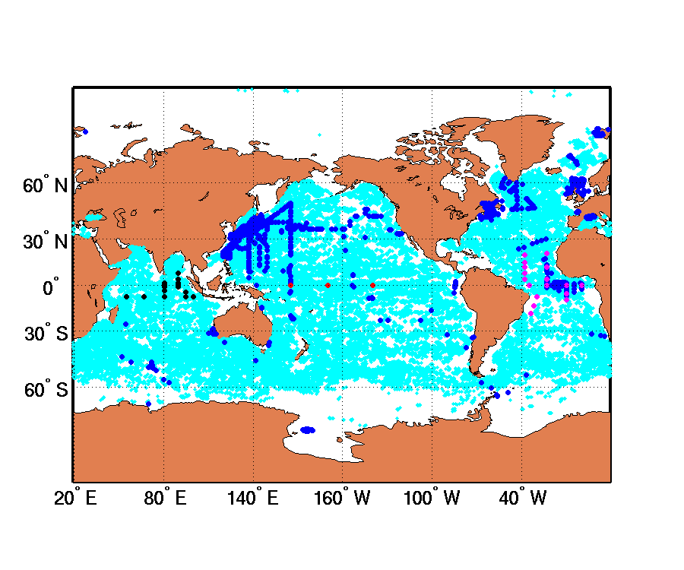
Experimental context
Model:
GFDL MOM4p1 (OGCM component of GEOS-5 modeling system)
LANL CICE IGCM
Resolution: 720x410x40
Tripolar grid – cartesian below 60ºN (same as NCEP GODAS)
Forcing:
Surface fields from 2009-2011 coupled GEOS-5 run replaying MERRA
Time span covered: 2010-2011
Data assimilated:
Temperature profiles from ARGO, TAO, XBT, CTD & RAMA
Ice fractional coverage from NSIDC
Reynolds SSTs
Data used for validation:
ARGO S, CTD S, RAMA S, Pirata S
ADCP u & v
- PIOMAS ice thickness
ARGO
CTD
PIRATA
RAMA
ADCP

Slide 6
Steady state ensemble: asymptotic ensemble filter (EnOI)
Ensemble of leading EOFs of forecast anomalies
Baseline ensemble
Ensemble of 20 coupled GEOS5 runs without data assimilation
Signal EOFs
“Signal EOFS” of baseline ensemble variability
1st stage analysis
Ensemble OI using signal EOFs
2nd stage analysis
Ensemble forecasts
Forecast-error EOFs
Ensemble forecasts initialized from perturbations of 1st stage analysis
EOFs of large ensemble of drift-removed 30-60 day forecasts
Ensemble OI with 20-leading forecast-error EOFs

Slide 7
Ensemble in time:
Lagged instantiation of forecast errors (LIFE)
Analysis increment Δx_{k} at time t_{k} computed from ensemble
(x’_{k}, x’_{k-1}, .., x’_{k-n}) of high-pass filtered lagged background
states of current model run
Window centering effect:
W/o high-pass filtering,
ensemble is dominated by lag = 0 and lag = n instances
ARGO
CTD
PIRATA
RAMA
ADCP
ARGO T (active)
RAMA S (passive)
ARGO S (passive)
Control
LIFE HP-filtered
LIFE unfiltered
CTD S (passive)
Pirata S (passive)

Slide 8
Ensemble in time:
Lagged instantiation of forecast errors (LIFE)
Analysis increment Δx_{k} at time t_{k} computed from ensemble (x’_{k}, x’_{k-1}, .., x’_{k-n}) of high-pass filtered lagged background states of current model run
Window centering effect:
W/o high-pass filtering,
ensemble is dominated by lag = 0 and lag = n instances
ARGO T (active)
ARGO
CTD
Control
LIFE HP-filtered
LIFE unfiltered
PIRATA
RAMA
ADCP

Slide 9
Ensemble in space:
Space adaptive forecast errors (SAFE)
Covariances computed as if an ensemble were sampled near every gridpoint
Univariate update of observed variable
Local variance estimated from spatial distribution of variables in high-pass filtered background
projection onto un-observed variables
Local cross-field covariances computed from local spatial distribution of variables in high-pass filtered background serve to update un-observed variables

Slide 10
Assimilation procedure
. 5-day assimilation interval
Incremental update
SSTs processed first, T profiles second, ice last
Flow adaptive error-covariance localization
. SST and T profiles assimilation: x, y, z, t, T localization
. Ice assimilation: x, y, z localization
Multi-scale assimilation used with T profiles and ice
(unexplained part of innovation processed a 2nd time with shortened covariance localization scales)
Logistic transformation of ice field to enhance covariances
Adaptive error covariance inflation so as to maintain:
trace(HPH^{t}R⁻¹)/n_{obs} = pre-specified target value
(1 when assimilating SSTs and T profiles, 1 for NH ice, 0.1 for SH ice)
Comparison benchmark:
univariate OI enhanced with flow adaptive covariance localization (EUOI)

Slide 11
Multi-scale procedure
Error-covariance localization scales (x,y,z,t,T or ρ) repeatedly reduced
Each time
background is updated
error covariances are rescaled: P_{k}= rms(oma_{k-1})/rms(omf_{k-1})P_{k-1}
ARGO
CTD
RMS OMF/OMA ARGO T (active)
PIRATA
RAMA
ADCP
Control
SAFE multi-scale (k=1)
SAFE multi-scale (k=2)
ARGO S (passive)
CTD S (passive)
Control
SAFE mono-scale
SAFE multi-scale 1st iter. (k=1)
PIRATA S (passive)
RAMA S (passive)

Slide 12
Multi-scale procedure
Covariance localization scales (x,y,z,t,T or ρ) repeatedly reduced
Each time
background is updated
error covariances are rescaled: P_{k}= rms(oma_{k-1})/rms(omf_{k-1})P_{k-1}
unexplained portion of innovation is reprocessed
ARGO S (passive)
CTD S (passive)
PIRATA S (passive)
RAMA S (passive)
ARGO
CTD
PIRATA
Control
SAFE mono-scale
SAFE multi-scale 1st iter. (k=1)
RAMA
ADCP

Slide 13
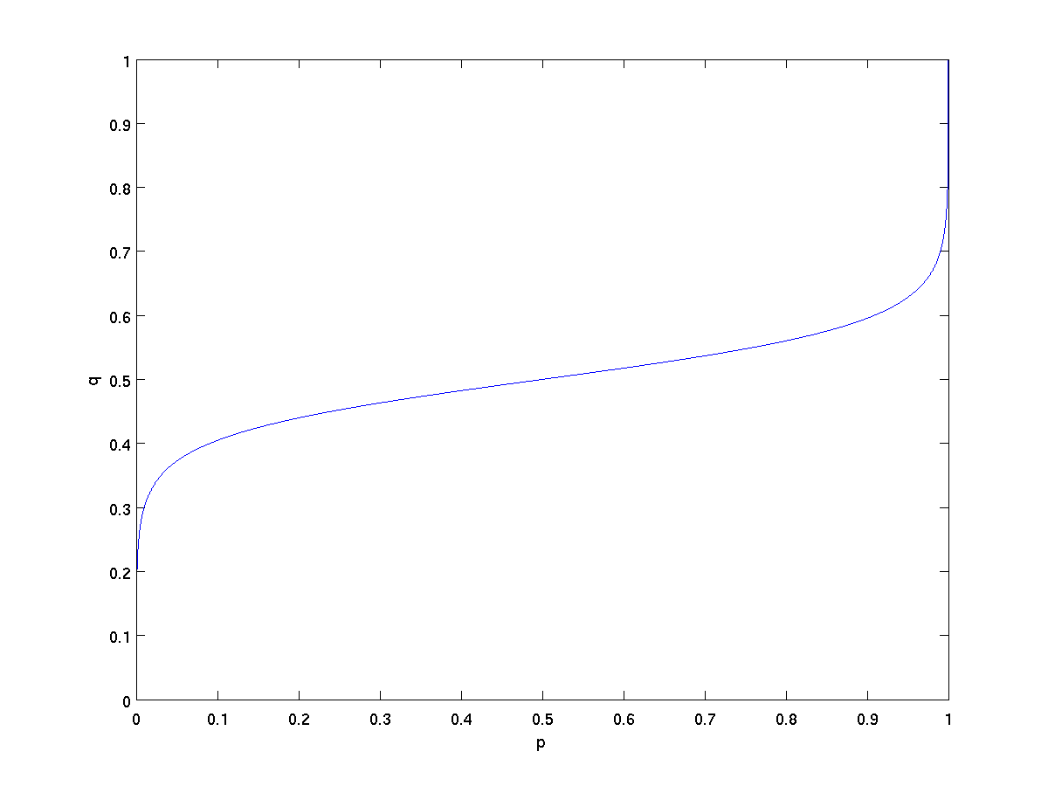
Logistic ice transformation
Ice fraction p in [0, 1] replaced with q = log(p’/(1 - p’))
where p’ = min(1 - ε, max(ε, p))
q is rescaled to [0, 1]
Purpose:
enhance spatial variance in SAFE
enhance ensemble variance in LIFE/EnOI
q
s p
s q
p
= sqrt(diag(P)) from 20 leading EOFs used in EnOI for P and Q
s p
s q

Slide 14
Logistic ice transformation
Ice fraction p in [0, 1] replaced with q = log(p’/(1 - p’))
where p’ = min(1 - ε, max(ε, p))
q is rescaled to [0, 1]
Purpose:
enhance spatial variance in SAFE
enhance ensemble variance in LIFE/EnOI
q
p

Slide 15
Logistic ice transformation vital in SAFE, LIFE
NB: In current un-coupled configuration,
forcing melts ice in Summer unless ice is assimilated!
P and Q and corresponding s from baseline run with no assimilation
07/31/2010: p
07/31/2010: q
07/31/2010: SAFE p σ
07/31/2010: SAFE q σ
01/31/2010: p
01/31/2010: q
01/31/2010: SAFE p σ
01/31/2010: SAFE q σ

Slide 16
T-profile assimilation configuration summary
 | EnOI | Ensemble in space (SAFE) | Ensemble in time (LIFE) | Enhanced Univariate OI (EUOI)
updated | T, S, u, v | T, S, u, v | T, S, u, v | T
multi-scale | Bi-scale | Bi-scale | Bi-scale | Mono-scale

Slide 17
T-profile assimilation configuration summary
 | EnOI | Ensemble in space (SAFE) | Ensemble in time (LIFE) | Enhanced Univariate OI (EUOI)
Covariance localization | adaptive (T) | Adaptive (T) | Adaptive (T) | adaptive (T)
Background-error covariance model | static: 20 leading EOFs of ensemble of 30-60 day forecast anomalies | adaptive: SAFE methodology | adaptive: 20 (5-day) lags of 30-day high-pass trajectory | static: vertical dependence only
updated | T, S, u, v | T, S, u, v | T, S, u, v | T
multi-scale | Repeat with halved x,y,z,T scales | Repeat with halved x,y,z,T scales | Repeat with halved x,y,z,T scales | Mono-scale

Slide 18
SAFE
LIFE
Background-error variance estimates (T at equator)
03/31/2011
06/26/2011
09/26/2011
12/31/2011
EnOI

Slide 19
T-Profiles assimilation results
Above 200m:
SAFE ≈ EnOI ≈ LIFE > EUOI > control
ARGO RMS passive S OMF/OMA
Control
EUOI
SAFE
LIFE
EnOI
Below 200m:
SAFE > LIFE > EnOI > control > EUOI
ARGO
CTD
PIRATA
RAMA
ADCP

Slide 20
SAFE ≈ EnOI ≈ LIFE > control > EUOI
T-Profiles assimilation results
Pirata S (passive)
Pirata, RAMA, CTD RMS passive S OMF/OMA
Control
EUOI
SAFE
LIFE
EnOI
SAFE ≈ EnOI ≈ LIFE ≈ EUOI > control
RAMA S (passive)
Multivariate update in SAFE, LIFE & EnOI preserves S when it is not assimilated
ARGO
SAFE ≈ EnOI ≈ LIFE ≈ EUOI > control
CTD
CTD S (passive)
PIRATA
RAMA
ADCP

Slide 21
T-Profiles assimilation results
ADCP passive U, V RMS OMF/OMA
Control
EUOI
SAFE
LIFE
EnOI
Control > SAFE ≈ EnOI ≈ LIFE > EUOI
ADCP U (passive)
Not much to write home about in terms of current but SAFE, LIFE & EnOI all do better than univariate T + ice assimilation
Control ≈ SAFE ≈ EnOI ≈ LIFE > EUOI
ADCP V (passive)
ARGO
CTD
PIRATA
RAMA
ADCP

Slide 22
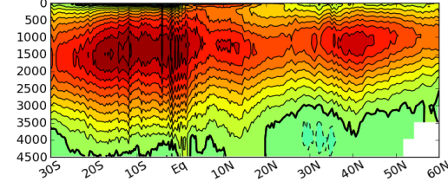
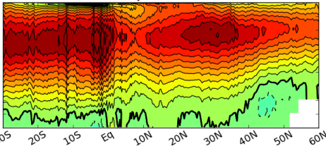
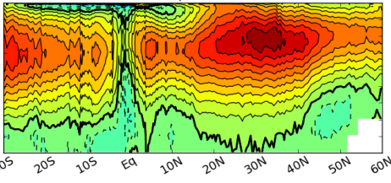
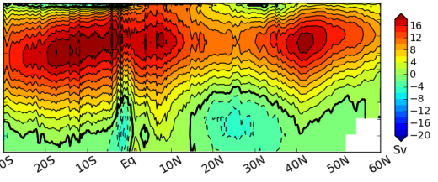
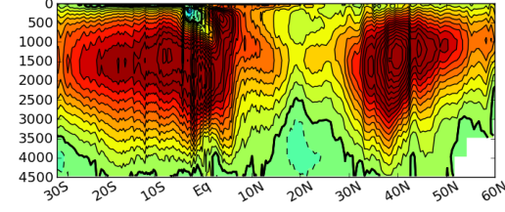
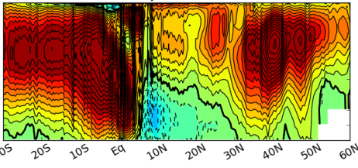
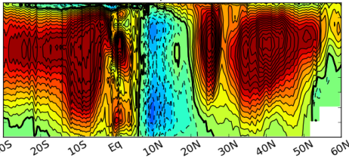
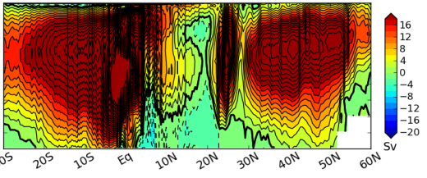
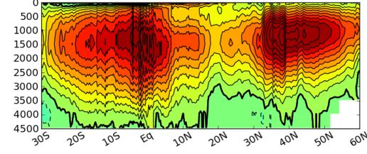
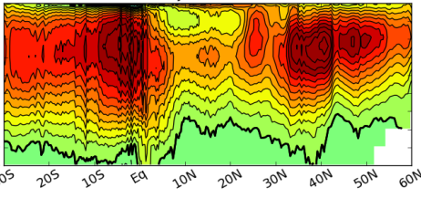
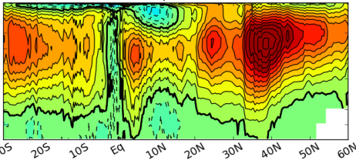
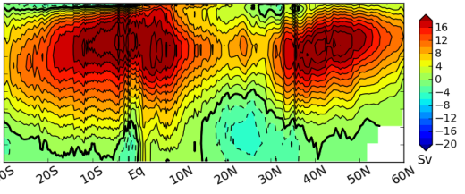
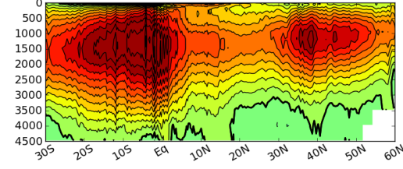
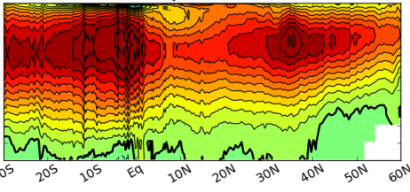
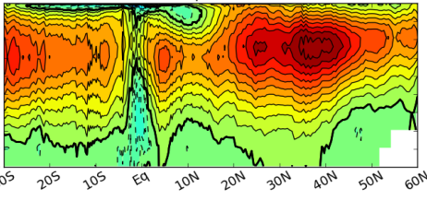
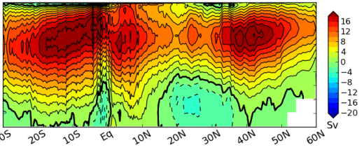
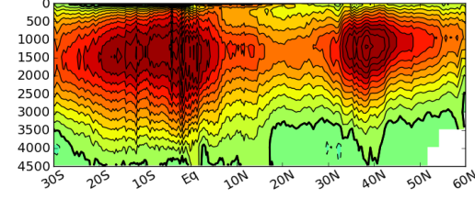
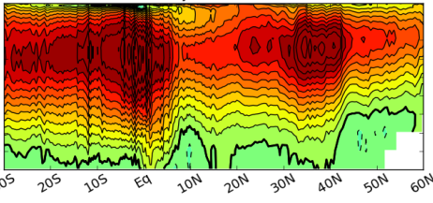
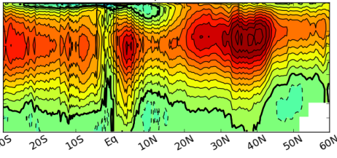
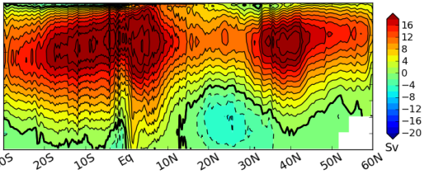
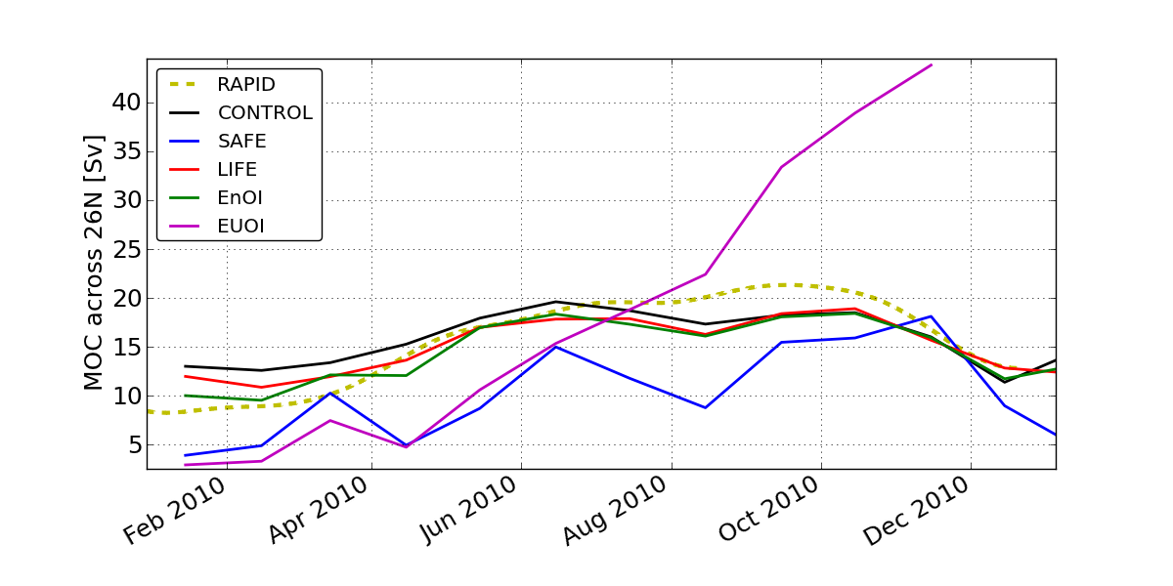
Atlantic meridional overturning circulation
03/2010
06/2010
09/2010
12/2010
Control
EUOI
SAFE
LIFE
EnOI
AMOC 26ºN compared to rapid array during 2010
EnOI ≈ LIFE ≈ control > SAFE > EUOI

Slide 23
Multivariate ice update procedure (SAFE, LIFE, EnOI)
Stage 1:
Compute Δice assimilation increment + use of <ice,T> and <ice,S>
covariances to compute ΔT and ΔS increments
Stage 2:
Calculate (T_{fr},S_{fr}) that minimize [(T- T_{fr})/σ_{T} ]²+ [(S- S_{fr})/σ_{S} ]²
Stage 3:
Validation of stage 1 correction to ensure:
If Δice < > 0, then T analysis >= <= (1-ice) T_{ocean} + ice T_{fr}

Slide 24
NSIDC Ice fraction assimilation configuration summary
 | EnOI | Ensemble in space (SAFE) | Ensemble in time (LIFE) | Enhanced Univariate OI (EUOI)
Covariance localization | adaptive (ρ) | Adaptive (ρ) | Adaptive (ρ) | adaptive (ρ)
Background-error covariance model | static: 20 leading EOFs of ensemble of 30-60 day forecast anomalies | adaptive: SAFE methodology | adaptive: 20 (5-day) lags of 30-day high-pass trajectory | static: vertical dependence only
updated | Ice, T, S | Ice, T, S | Ice, T, S | Ice
multi-scale | Repeat with halved x,y scales | Repeat with halved x,y scales | Repeat with halved x,y scales | Mono-scale

Slide 25
NSIDC Ice fraction assimilation configuration summary
 | EnOI | Ensemble in space (SAFE) | Ensemble in time (LIFE) | Enhanced Univariate OI (EUOI)
updated | Ice, T, S | Ice, T, S | Ice, T, S | Ice
multi-scale | Bi-scale | Bi-scale | Bi-scale | Mono-scale

Slide 26
Ice fraction assimilation results
Northern hemisphere ice:
SAFE > EnOI > LIFE > EUOI > control
NH ice
NSIDC RMS ice OMF/OMA
Control
EUOI
SAFE
LIFE
EnOI
Can’t do without update of T, S when assimilating ice in NH!
Southern hemisphere ice:
SAFE > EnOI ≈LIFE ≈ EUOI > control
SH ice

Slide 27
Ice assimilation results
01/01/2011
NSIDC
control
EUOI
SAFE
LIFE
EnOI
SH ice
NH ice

Slide 28
Ice assimilation results
05/01/2011
NSIDC
control
EUOI
SAFE
LIFE
EnOI
SH ice
NH ice

Slide 29
Ice assimilation results
09/01/2011
NSIDC
control
EUOI
SAFE
LIFE
EnOI
SH ice
NH ice

Slide 30
Ice assimilation results
Initial ice thickness 01/01/2010
Ice thickness at end of run (12/01/2011)
PIOMAS clim. (not assimilated)
control
EUOI
SAFE
LIFE
EnOI

Slide 31
Conclusions
Some benefits of ensemble data assimilation schemes
- estimating background-error spatial distribution, - multivariate update of unobserved variables,
are available with background-error covariances estimated from a single model run.

