Slide 1
Diagnosis of data assimilation systems
Toshiyuki Ishibashi
MRI/JMA, Japan
ishibasi[AT]mri-jma.go.jp
* MRI: Meteorological Research Institute.
**JMA: Japan Meteorological Agency.
Notes:
Thank you Dr. Boukabara.
I am Toshiyuki Ishibashi from MRI/JMA Japan.
Today, I am glad to make a presentation in this EMC seminar, and
Thank you Dr. Masutani for preparing this seminar ,and thank you every one for preparing my visit.
Now, I would like to talk about “Estimation of linear observation impact and its applications.”
(I’m going to give a talk on “title”.)

Slide 2
Contents
Observation impact estimation
  Definitions
  ADJ (Adjoint)-based estimation
  TL (Tangent linear)-based estimation
Error covariance matrix optimization
  Optimization and observation impact
  Sensitivity based optimization
Analysis error estimation
  Data assimilation theory based method
Summary
  TL (Tangent linear)-based estimation
  Data assimilation theory based method
Notes:
I will talk about three topics,
First, Observation impact estimation.
Second, Error covariance matrix optimization.
Third, Analysis error estimation.
Then , finally, I will summarize my talk.

Slide 3
1. Observation impact estimation

Slide 4
Two types of observation impact
Observation impact
Basic definition
  The observation impact is defined as “the variations of analyses and forecasts caused by changes of observation data”.
Non-linear observation impact
  This is the observation impact that has no limitations on the changes of observation data, so the changes includes perturbations in observation data values, and additions of observation datasets.
  Estimation methods:
    OSE (observing system experiment).
Linear observation impact
  This is the observation impact that has an limitation on the changes of observation data, which is Kalman gain is invariant.
  Estimation methods are
    ADJ-based method
      Langland and Baker (2004), Errico (2007), Cardinali (2009), Tremolet (2008)
    TL-based method
      Ishibashi (2011)
    DFS
      Cardinali et al (2004), Desroziers et al (2005)
These two observation impacts are different quantities, so, in general, they cannot work as a proxy for each other.
Notes:
First, Let’s think about definitions of observation impact.
We know two types of observation impact definition, The first type is “non-linear impact” and
the second is “linear impact”.
The “non-linear observation impact” is defined as the variations in an analysis (and forecast) field when we add changes to observation data.
(perturbations in observation data values, addition of observation datasets to the DAS).
The “linear observation impact” is defined as the variations in an analysis (and forecast) field when we add changes to observation data
Under the condition that the Kalman gain is invariant.
These two types of observation impact are different quantities, so, in general, they cannot work as a proxy for
each other.
Hereafter, we see linear observation impact estimation.
QA
Q Explain the differences of the two types of ODI definitions.
A Suppose two DASs. DAS_1 assimilates observation data P, and DAS_2 assimilates observation data P and Q.
The differences between analysis (and forecast) field between DAS_1 and DAS_2 are Non-linear impact,
And not linear impact since K is different between these DASs.
If one want to know action od K on dataset P in DAS_2, one has to use Linear impact estimation methods, not to
Break K.
Q AD and DFS is not linear since quadratic measurement.
A yes, in principal, quadratic measure include nonlinear effect between another datasets, so AD and DFS approximate that
such interaction can be negligible. The validity of this approximation depends on the way to division of observation datasets.

Slide 5
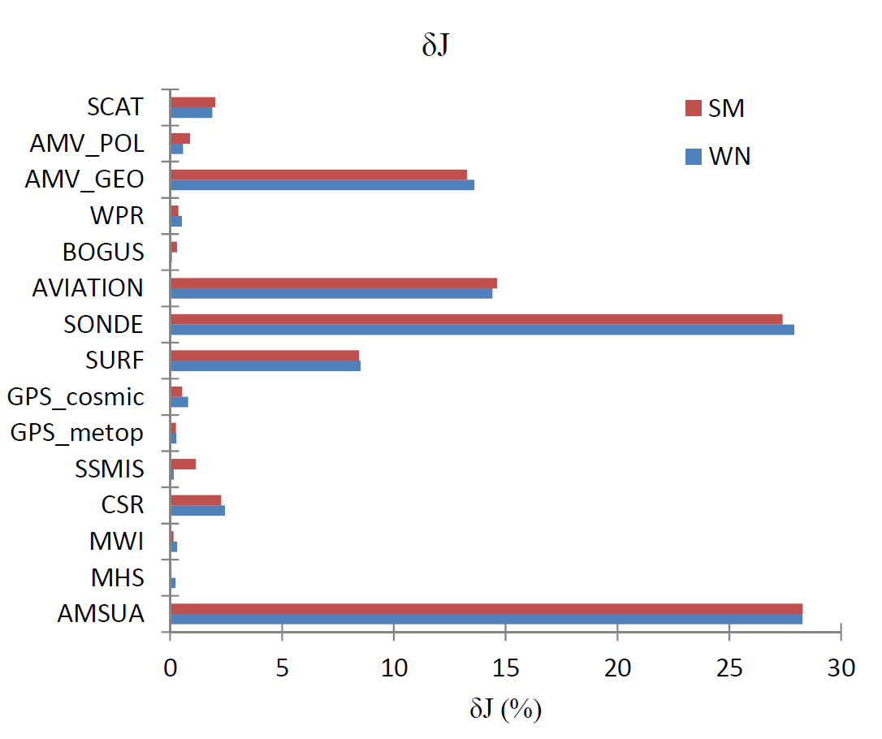

ADJ-based estimation in JMA global 4D-Var
δJ DRY
JMA global 4D-Var
Evaluation periods are:
Summer: Aug 2010,
Winter: Jan 2010.
* 00UTC analyses only.
Using dry total energy norm.
Forecast error evaluation time is 15hours.
Notes:
This figure shows results of AD-based estimation in JMA global DAS during August and January of 2010.
Here, JMA global data assimilation system is 4D-Var system, with a single outer loop.
Although, model resolution of operational system is about 20km for outer and 60km for inner, this results is calculated
low resolution version experimental system, so 60km outer and 120km innner, both system is the same except for these
Horizontal resolutions. Both has 60km vertical levels.
Forecast error evaluztion time is 15hr, norm is dry total energy norm.
The horizontal axis is the forecast error reduction by each observation dataset.
The vertical axis is the observation dataset names.
We can see that most contributing dataset type is AMSU-A, which is temperature sensitive radiance data, and radio sonde.
The next is aviation, which is airplane observatoins of temperature and winds, and AMV_GEO, which is geostationary satellite winds, and SURF pressure.
This figure confirm us that past OSEs for introduction of new observation data are adequate.
This figure also tells us some problems, The first is radnaicen contribution is not enough large, it is as the sama as the radio sonde,
Since previous studies of other NWP centers reported more radiance contributions, We can gess there is many room for imrpvement of radiance data usage.
The humidity sensor contributios not large, although oane of the reasons is using DTE, onother reason is large inflation rate of these observation data, which are needed for
Forecast model dry and wet biases in mid and low level troposphere in convective area.
27hr evaluation is about same.

Slide 6

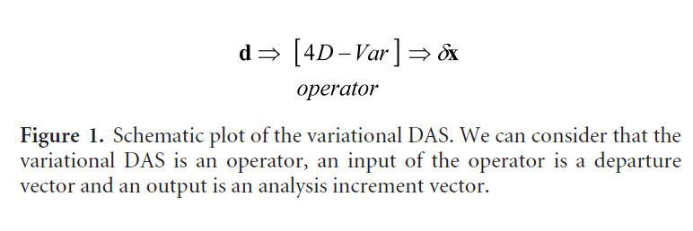
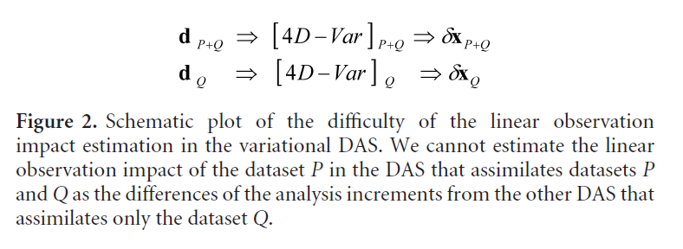
TL(Tangent linear)-based method
K
K’
Ishibashi (2011) QJRMS
Notes:
This figure shows the space structure of PIVs along 50 degrees south latitude.
Like this, the TL-based method can calculate space structure of observation impacts.

Slide 7
Formulation of TL-based method
Linear decomposition of analysis increments
Two datasets P and Q
Here, we introduced partial increment vectors (PIVs), as follows;
The PIV represent a linear observation impact of each dataset.
However, PIV calculation requires explicit construction of K.
Linear decomposition of departures
We can calculate PIVs by using PDVs without explicit construction of K in 4D-Var.
Here, we introduced partial departure vectors (PDVs), as follows;

Slide 8
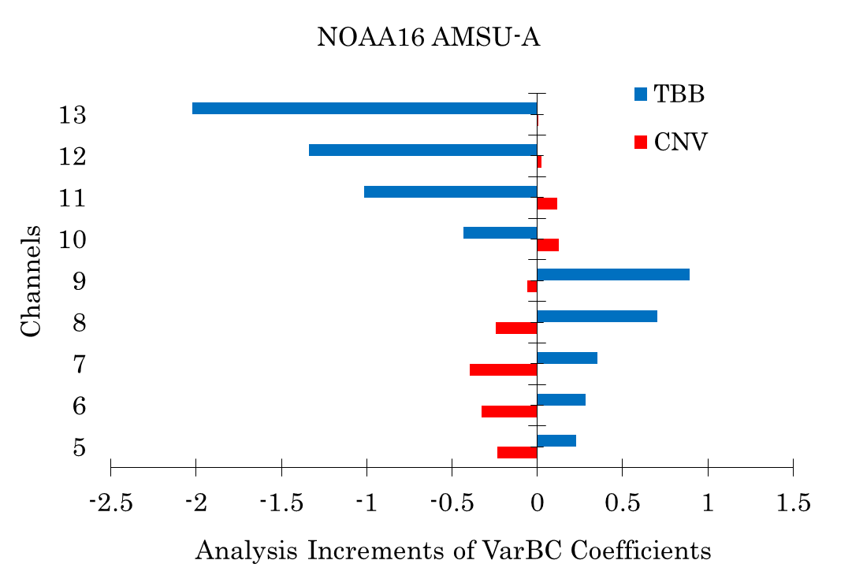
TL-based method
This figure shows the CNV-PIV and the TBB-PIV for VarBC (variational bias correction) variables of the AMSU-A sensor of the NOAA16 satellite.
We can find finite contribution from the CNV.
This result suggests the existence of a stability effect of the CNV for the VarBC variables (Auligné et al., 2007) at least qualitatively.

Slide 9
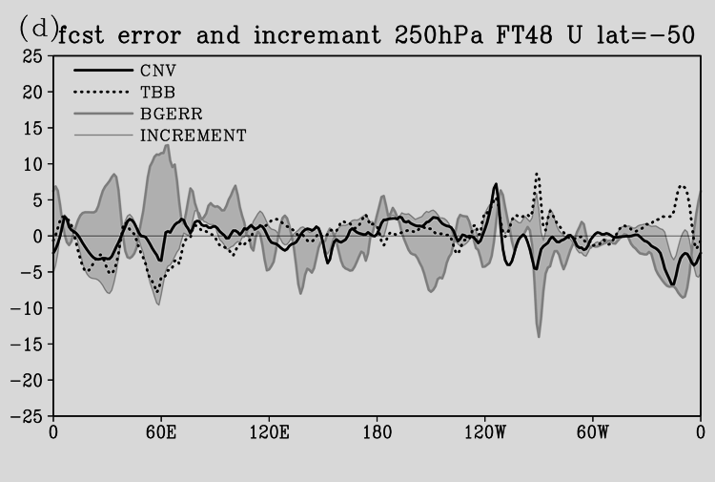
TL-based method
Ishibashi (2011) QJRMS
Notes:
This figure shows the space structure of PIVs along 50 degrees south latitude.
Like this, the TL-based method can calculate space structure of observation impacts.

Slide 10
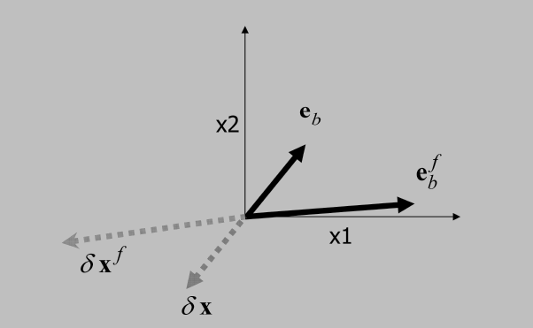
TL-based method
Ishibashi (2011) QJRMS
Notes:
This figure shows the space structure of PIVs along 50 degrees south latitude.
Like this, the TL-based method can calculate space structure of observation impacts.

Slide 11
2. Covariance matrix optimization

Slide 12
Relationships between observation impact estimations and covariance optimizations
Two types of error covariance matrix optimization methods.
  Expectation-based method
    This method optimizes error covariance matrices based on the theoretical relation ships;
    Desroziers and Ivanov (2001), Desroziers et al (2005), and Chapnik et al (2004, 2006)
  Sensitivity-based method
    This method uses sensitivity of forecast errors respect to covariance matrices;
    Daescu (2008) , Daescu and Todling (2010).
Each optimization methods include a linear observation impact estimation.
  Expectation-based method includes DFS calculation.
  Sensitivity-based method includes ADJ-based estimation.
Here, Let’s see the sensitivity-based method

Slide 13
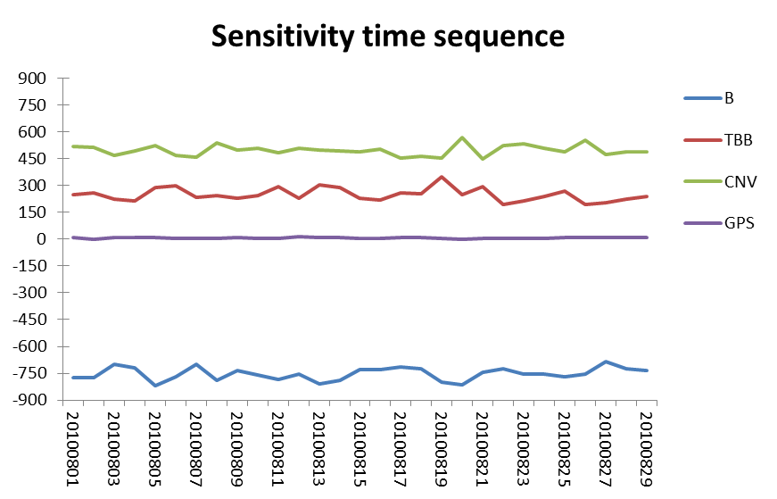
Diagnoses of the JMA global 4D-Var
Sensitivity calculation results in August 2010.
Using dry total energy norm with 15hr forecasts.
The results show that B is too small and R is too large in average.

Slide 14
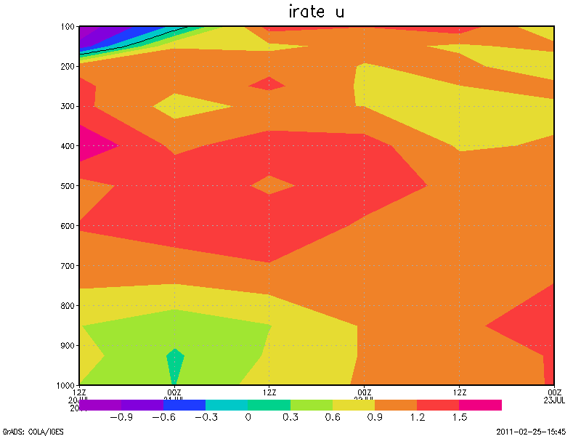
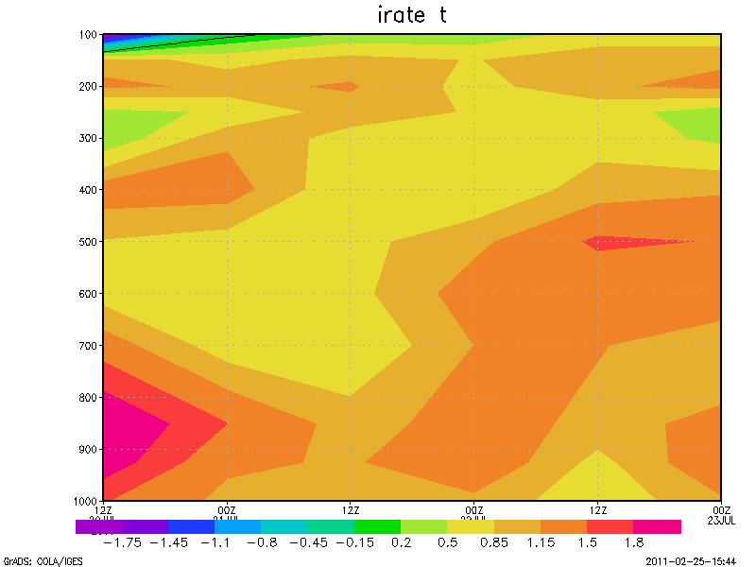
Impact of error covariance optimization on forecast accuracy
Improvement rate: Zonal wind
Improvement rate: Temperature
Pressure
(1000 - 100 hPa)
Forecast time (3days)
ｈPa
Results of a single case experiment of covariance optimization using the sensitivity method.
TEST uses optimized R, CNTL uses original R (operational setting).
The figure shows normalized forecast RMSE differences between TEST and CNTL: (CNTL – TEST)/CNTL.
Warm (cold) color areas are forecast error decrease (increase) areas.
Notes:
These figures show improvement of forecast accuracy by the optimization of R with D08.

Slide 15
3. Analysis error estimation
Background
We want to know analysis errors of a DAS because the analysis error information is useful to improve current DASs and to design future observational systems which can detect the analysis errors.
Analysis error estimation is the same with construction of more accurate analysis than current DASs. Such analyses can be used as “pseudo truth”.
Previous studies
“Key analysis error” (Rabier et al 1996, Klinker et al 1998, Isaksen et al 2005) can generate more accurate forecasts than current DASs.
However, there are inconsistency between key analysis errors and observation information. SOSE (Marseille 2007) can reduce this problem.
Our approach
We construct the pseudo truth based on the data assimilation theory.
We construct the pseudo truth based on ADJ-based method.
Notes:
This slide shows the formulation of AD-based method under TL-approximation:
・ The definition of scalar forecast error F is
・ The variation of F caused by an analysis is
Each term of dF is a inner product between the first-order quantities of TL approximation.
, as a result, both terms become the second order quantities of TLA.
・ For example, a linear observation impact of a dataset P is calculated as follows;
Q df caused by analysis ?
A analysis changes initial state by adding dx to background field. This change is df.
Q So, background field will change, not invariant, so depature is not only observaiton funciton but also xb ?
A no, changes are not on bg but on initla field. So bg is invariant in linear inpact analysis.
Q Explain second order of TLA, which have to ignore in TLA?
A no this second order is inner product of firest order of TLA so fully have meening, not second order of TLA and 0 order.
Q first term express only invalidity of the sysrtem?
A I do not think so, both are same magnitude, and if DAS is optimal dx=-eb so firest term become -2eCe and second is eCe
So if first must be vanish in optimal DAS. So firest term does not vanish for optimal DAS.

Slide 16
Data assimilation theory based method
Conditional PDF
Ordinary 4D-Var
Extended 4D-Var with reference analyses information
Add reference analysis fields information
X: analysis,
Y: observations
X_{b} : background field
Xref: reference analyses
Analytical solution has an error covariance matrix A of reference information in Kalman gain, and forecast error in input data, as follows,

Slide 17
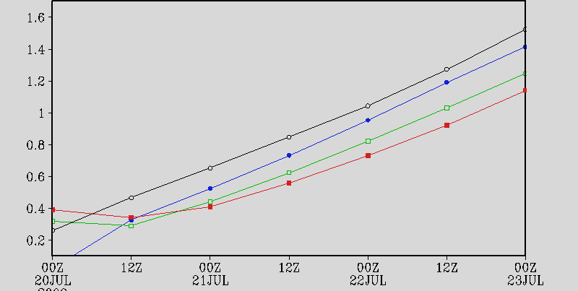
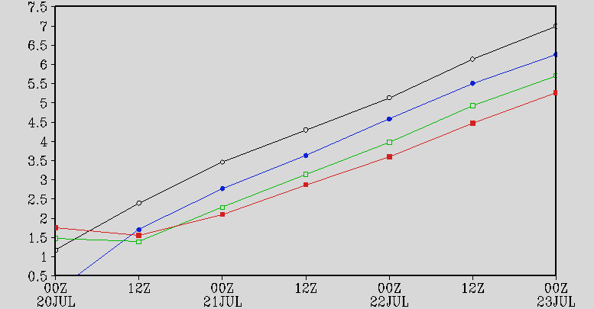
Accuracy of optimized forecasts
500hPa Temperature
250hPa Zonal wind
*Inflation factor is one.
Optimized forecast with four reference analyses of every 6hours.
Optimized forecast with only two reference analyses
Original forecast
Original forecast from 6 hours after initial.

Slide 18
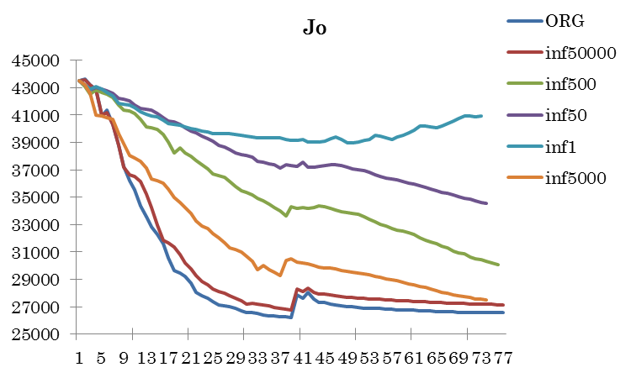
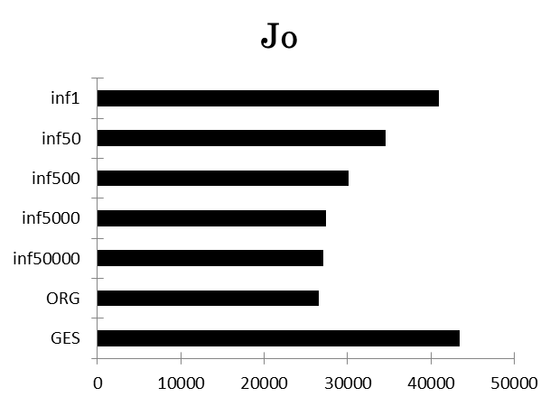
Assimilation of reference analyses
The inflation factor dominates the fittings of analysis to observations.
The inflation factors larger than 500 achieve good fitting nearly the original 4D-Var.

Slide 19
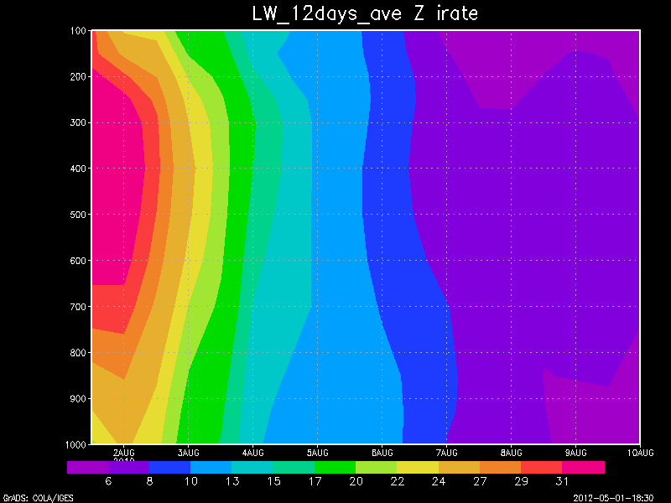
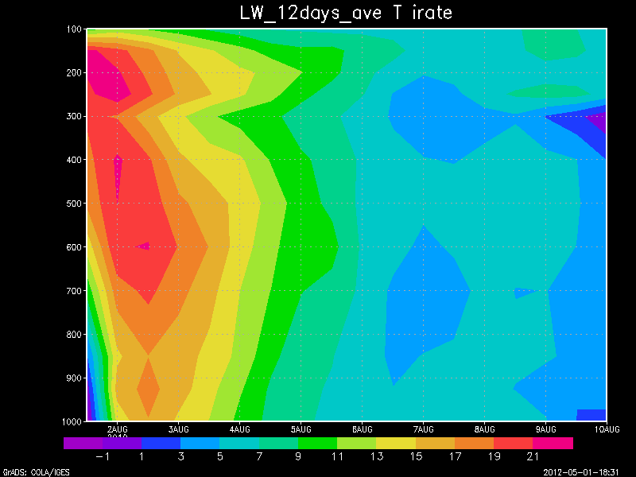
Two weeks statistics
Forecast accuracy keeps until 9days with 95% statistical significance until 6 or 7days.

Slide 20
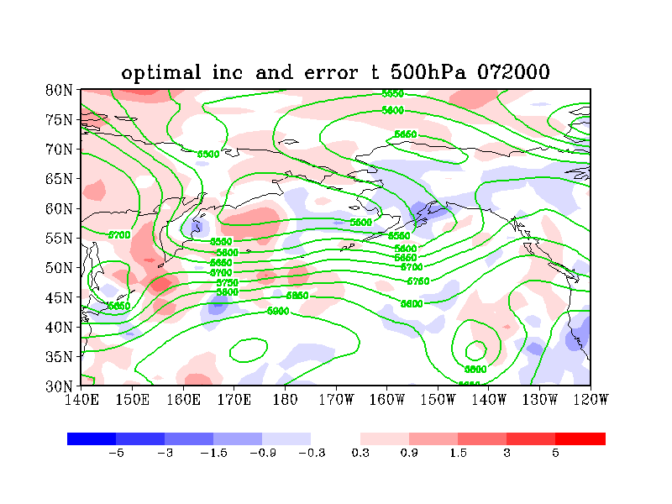
Optimized analysis increments and background error
072000
Color shade: Optimized increments, red=plus, blue=minus.
Green contour: 500hPa height.
Black contour: Integrated background error, solid lines=plus, dotted lines=minus.

Slide 21
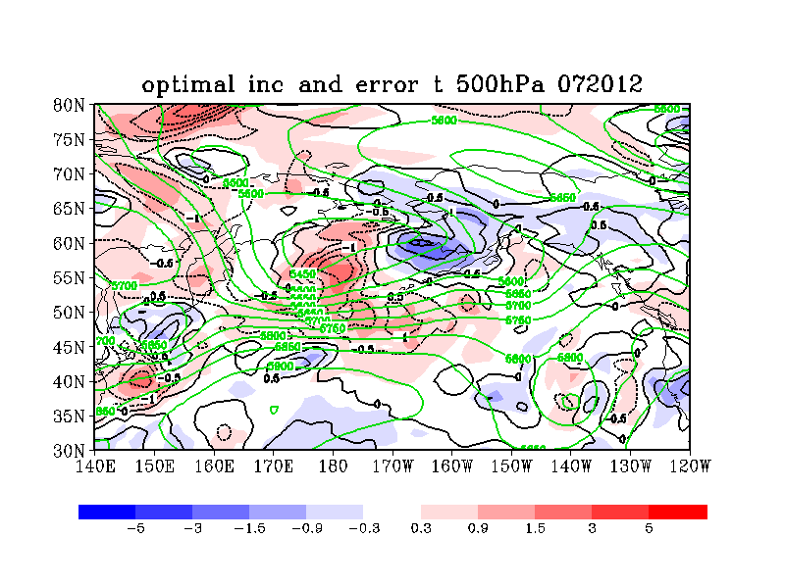
Optimized analysis increments and background error
072012
Color shade: Optimized increments, red=plus, blue=minus.
Green contour: 500hPa height.
Black contour: Integrated background error, solid lines=plus, dotted lines=minus.

Slide 22
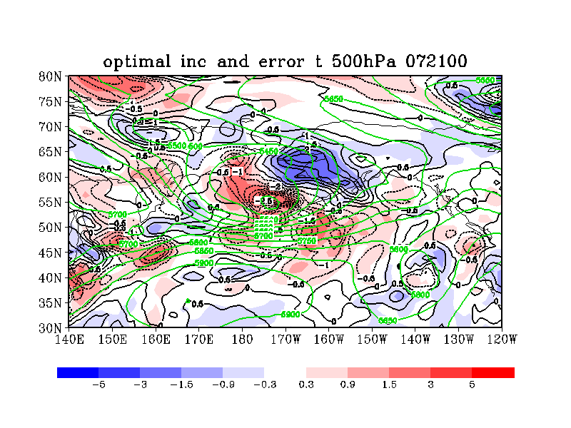
Optimized analysis increments and background error
072100
Color shade: Optimized increments, red=plus, blue=minus.
Green contour: 500hPa height.
Black contour: Integrated background error, solid lines=plus, dotted lines=minus.

Slide 23
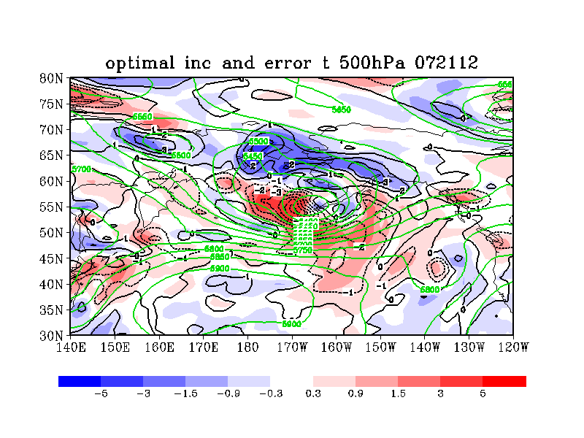
Optimized analysis increments and background error
072112
Color shade: Optimized increments, red=plus, blue=minus.
Green contour: 500hPa height.
Black contour: Integrated background error, solid lines=plus, dotted lines=minus.

Slide 24
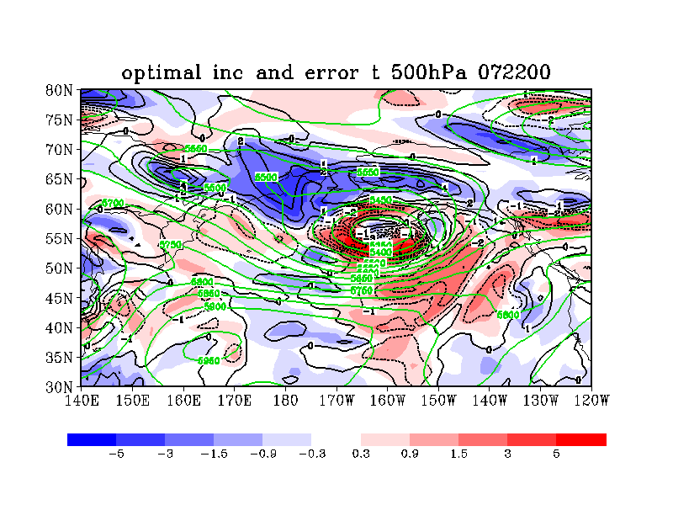
Optimized analysis increments and background error
072200
Color shade: Optimized increments, red=plus, blue=minus.
Green contour: 500hPa height.
Black contour: Integrated background error, solid lines=plus, dotted lines=minus.

Slide 25
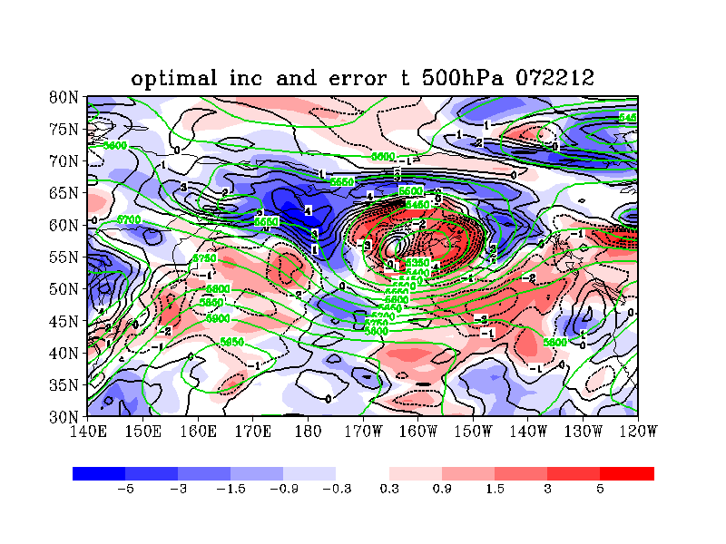
Optimized analysis increments and background error
072212
Color shade: Optimized increments, red=plus, blue=minus.
Green contour: 500hPa height.
Black contour: Integrated background error, solid lines=plus, dotted lines=minus.

Slide 26
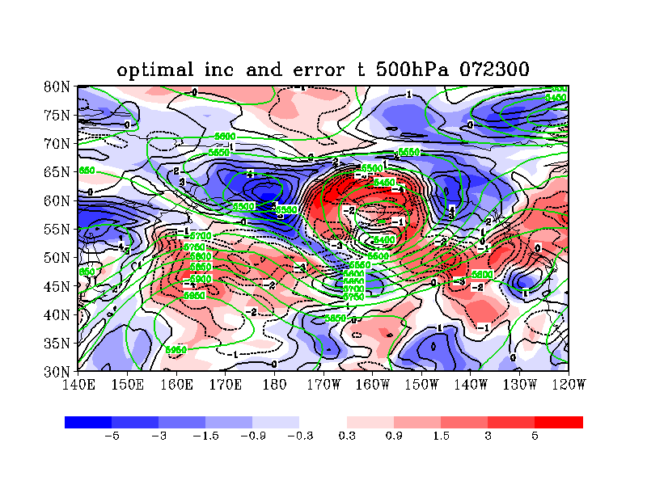
Optimized analysis increments and background error
072300
Color shade: Optimized increments, red=plus, blue=minus.
Green contour: 500hPa height.
Black contour: Integrated background error, solid lines=plus, dotted lines=minus.

Slide 27
Comparison between original analysis and optimized analysis

Slide 28
Optimized :FT48 500hPa T

Slide 29
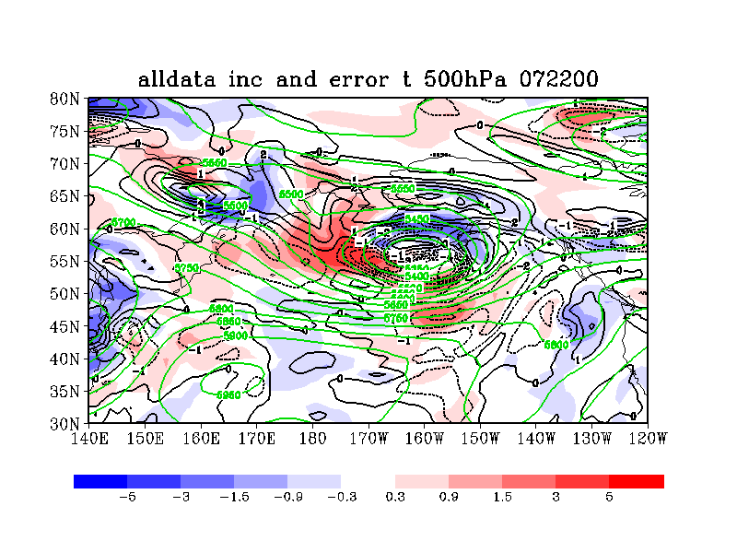
Original: FT48 500hPa T

Slide 30
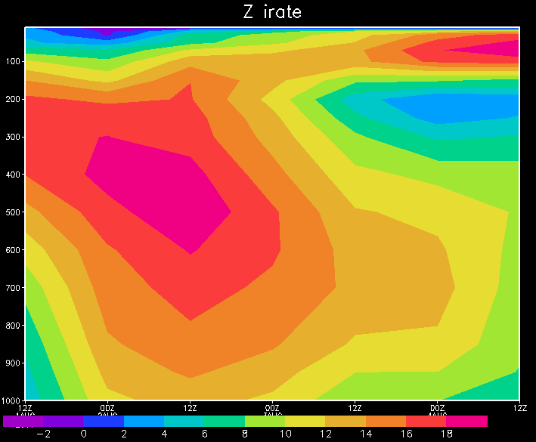
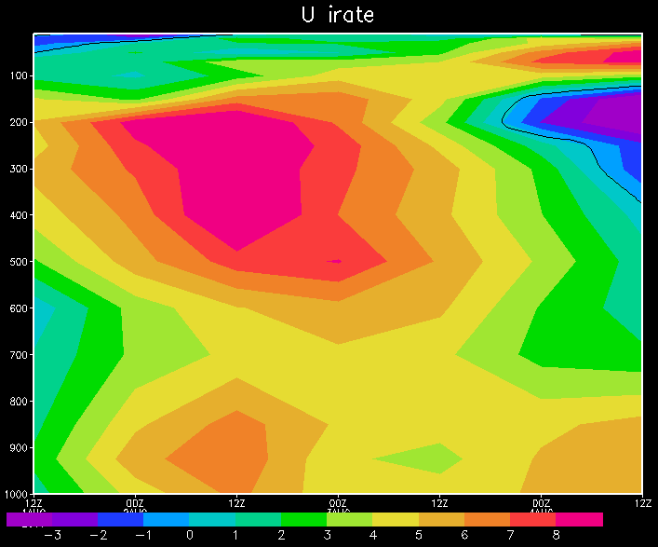
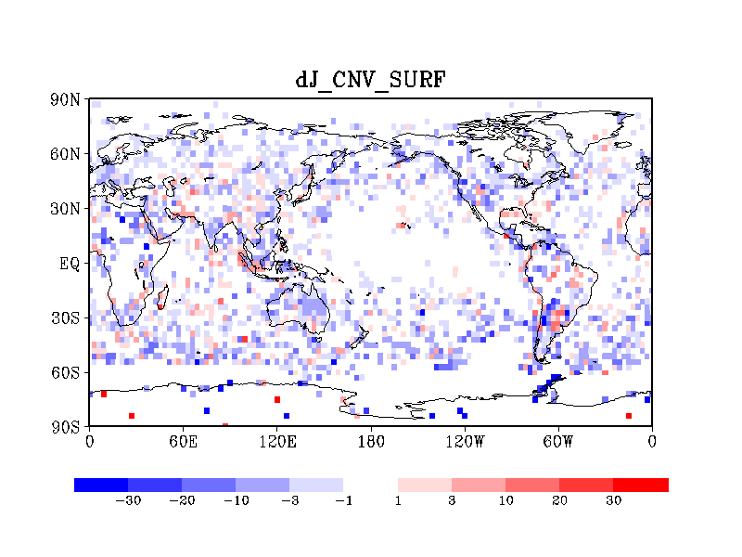
Pseudo truth with ADJ-based method
Improvement rate: Height
Improvement rate: Zonal wind
Pressure
(1000 - 1 hPa)
Forecast time (3days)
Notes:
This figure shows the space structure of PIVs along 50 degrees south latitude.
Like this, the TL-based method can calculate space structure of observation impacts.

Slide 31
Maxwell demon ?
We know only statistical property of data, R and B.
Lets think about a system on thermal equilibrium at temperature T. We know only statistical property of the system, temperature T. While, if we can know velocity of each particle, we can get usable energy from this max entropy state, This is the Maxwell demon.
We know property of each observation and can use this information.
Notes:
This figure shows the space structure of PIVs along 50 degrees south latitude.
Like this, the TL-based method can calculate space structure of observation impacts.

Slide 32
Summary
Observation impact
We defined two types of observation impact; the linear impact and the non-linear impact.
Diagnoses of the JMA global 4D-Var shows almost all observational dataset types contribute forecast error reduction in monthly averages.
The diagnoses imply that it is possible to derive more information from radiance data by improving usage of these data.
The TL-based method has been introduced.
We can see time evolutions and space distribution of each dataset impact, and evaluate them by comparison with integrated background errors.
Covariance matrix optimization
Optimization methods include observation impact estimations.
Sensitivity based method diagnosed the JMA GDAS has too large (small) R (B).
The single case experiment of optimization showed the explicit forecast error reductions.
Analysis error estimation
We constructed new method based on data assimilation theory. The method assimilate reference analysis fields.
The method reduce forecast error explicitly and also consistent with observations when inflation factor is used.

Slide 33

Thank you very much for kind attention.
Comments or Questions ?
Please speak very slowly!
One sentence question welcome!!
More long complicated questions also welcome,
but answer will be after this session or by email.
I’m so sorry for my insufficient English.

Slide 34
BACKUPSLIDES

Slide 35
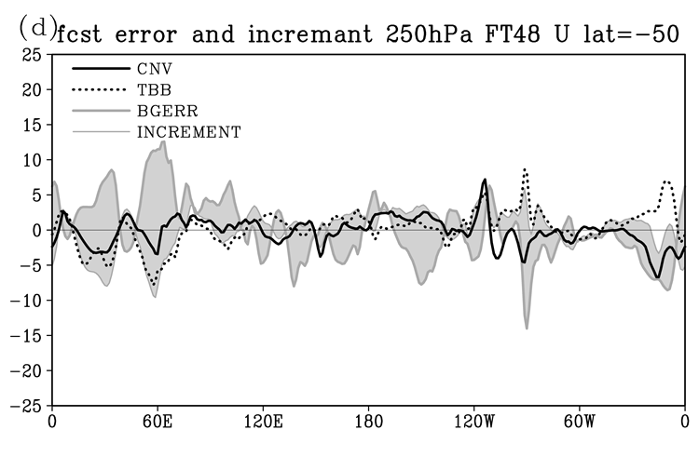
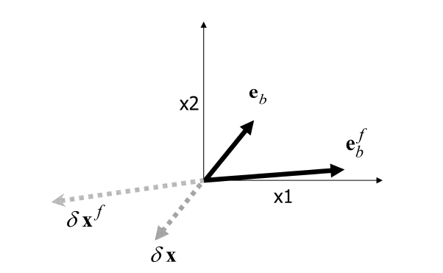
TL-based method
Ishibashi (2011) QJRMS
Notes:
This figure shows the space structure of PIVs along 50 degrees south latitude.
Like this, the TL-based method can calculate space structure of observation impacts.

Slide 36
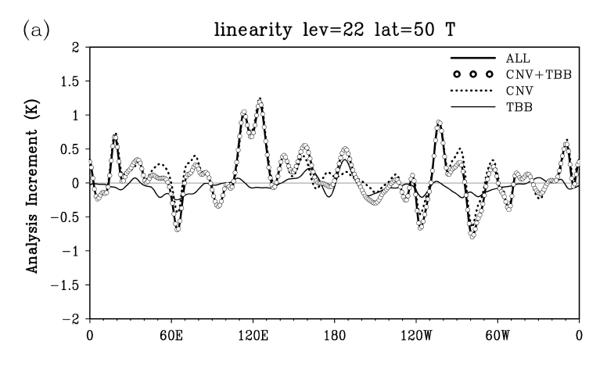
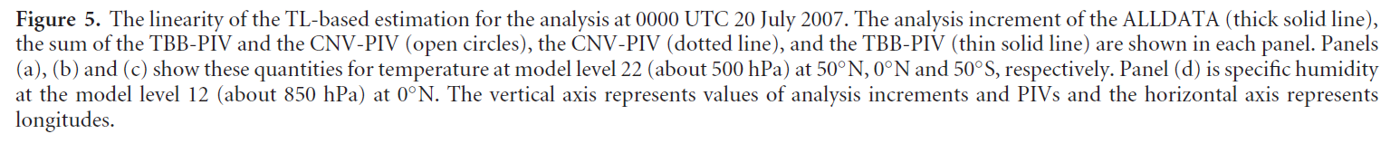
TL-based method
Ishibashi (2011) QJRMS
Notes:
This figure shows the space structure of PIVs along 50 degrees south latitude.
Like this, the TL-based method can calculate space structure of observation impacts.

Slide 37
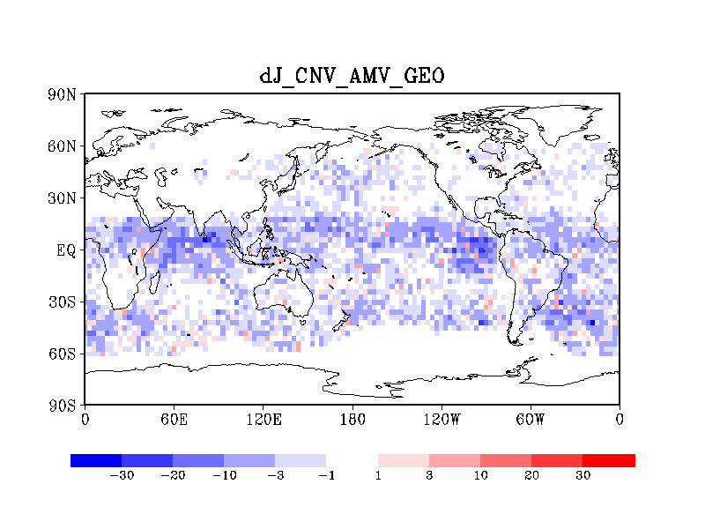
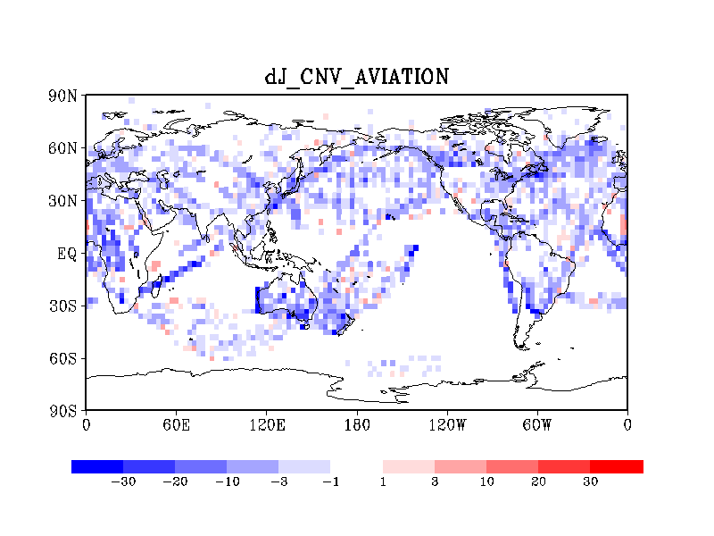
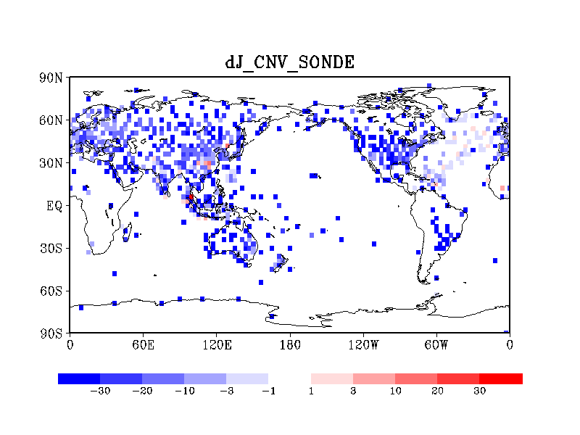
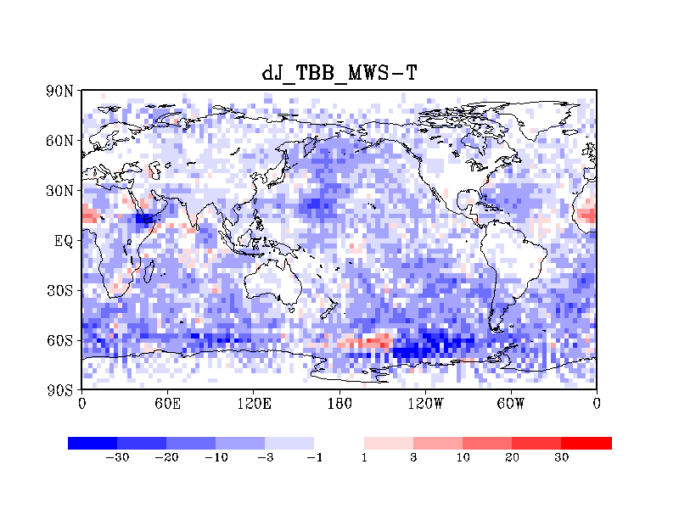
Vertically integrated contribution map
Notes:
This slide shows vertically integrated contributions of each a dataset types.
Blue points are observations which reduce forecast errors, and red points are those increase them.
We can find that blue is dominant. However, red points also exist. These points degenerate forecast accuracy in monthly average.
It is hoped that these red points can be eliminated in operational QCs.

Slide 38
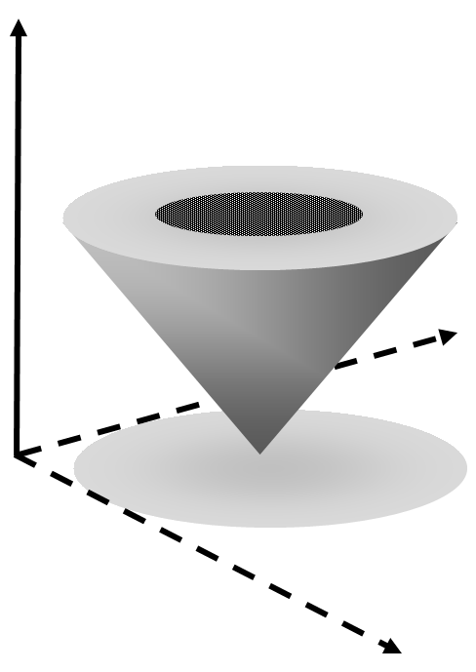
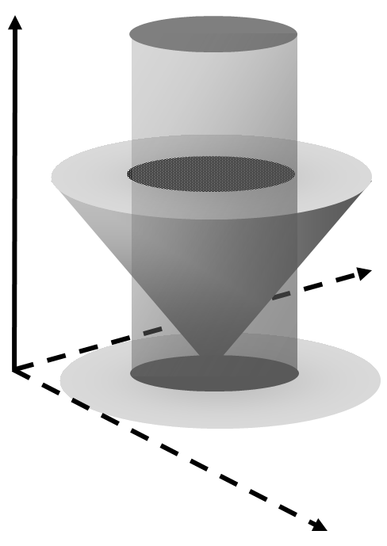
Fast and slow growing error modes
Fast growing mode
Slow growing mode plane
Key analysis error based optimized analysis increment vector exist within grey corn. Precession motions are free with in the corn.
Slow modes are constrained by observations and a background field, so constrain of these data is nearly cylinder shape.
The both achieve narrow corn constrain.
Notes:
Since, forecast error information constrain only fast growing modes, the corn has very wide top circle.

Slide 39
3. Analysis error estimation
We want to know analysis errors of a DAS because of following reasons;
If we know the analysis errors, we can start researches on what parts of the DAS causes those errors toward improvement of the DAS.
We can start to design future observational systems, which can detect the analysis errors of current DASs.
Since, analysis error estimation is the same with construction of more accurate analysis than current DASs. Such analyses may be able to use as “pseudo truth”. The pseudo truth can be used validation of forecasts and operational analyses, and those of OSSEs. or directly use as in re-analyses.
Our approach is
“Collect more information and integrate them correctly”
Notes:
This slide shows the formulation of AD-based method under TL-approximation:
・ The definition of scalar forecast error F is
・ The variation of F caused by an analysis is
Each term of dF is a inner product between the first-order quantities of TL approximation.
, as a result, both terms become the second order quantities of TLA.
・ For example, a linear observation impact of a dataset P is calculated as follows;
Q df caused by analysis ?
A analysis changes initial state by adding dx to background field. This change is df.
Q So, background field will change, not invariant, so depature is not only observaiton funciton but also xb ?
A no, changes are not on bg but on initla field. So bg is invariant in linear inpact analysis.
Q Explain second order of TLA, which have to ignore in TLA?
A no this second order is inner product of firest order of TLA so fully have meening, not second order of TLA and 0 order.
Q first term express only invalidity of the sysrtem?
A I do not think so, both are same magnitude, and if DAS is optimal dx=-eb so firest term become -2eCe and second is eCe
So if first must be vanish in optimal DAS. So firest term does not vanish for optimal DAS.

Slide 40
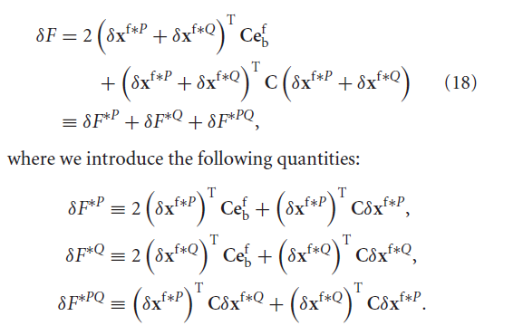

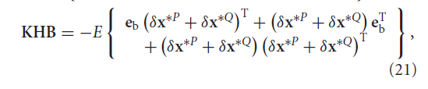
Formulation of ADJ-based method using PIVs
Ishibashi (2011) QJRMS
Notes:
This figure shows the space structure of PIVs along 50 degrees south latitude.
Like this, the TL-based method can calculate space structure of observation impacts.

Slide 41
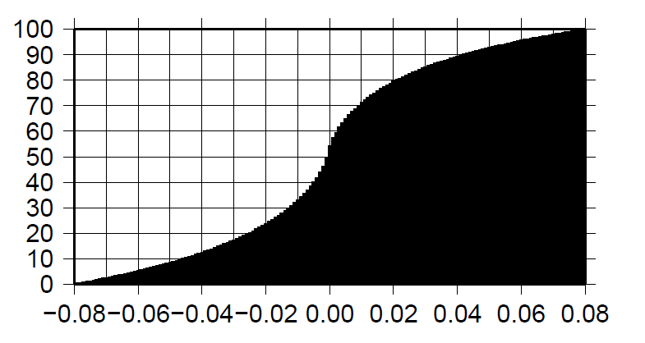
PDF
SONDE
AMSU-A
About a half observations decrease forecast errors, and the other increase them.
The slope of PDF is different between these data. SONDE is shallower than AMSU-A.
We can guess that the gradient of the slope depends on R and B settings and real information amount of data.
Notes:
These are accumulated PDFs of DJs of SONDE and AMSU-A.
The horizontal axis is DJ of individual data point, and the vertical axis is accumulated probability.
We can find that about a half observations decrease forecast errors and the other half increase them.
We can also find a difference in slopes of PDF gradients. SONDE is more shallow and AMSU-A is more vertical.
We can guess the slope depends on R and B settiongs and real information cntent of these data.

Slide 42
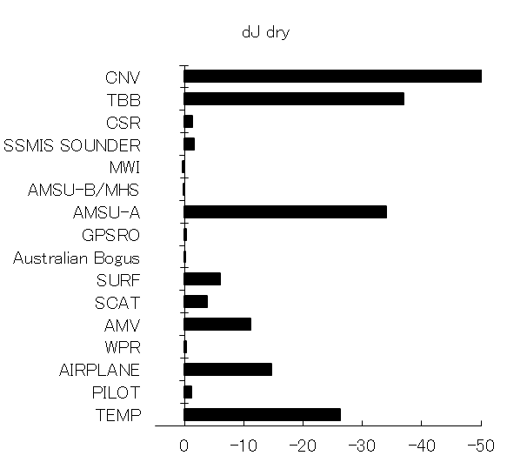
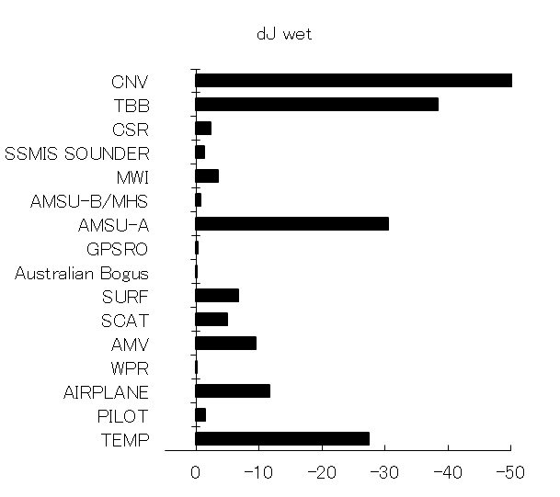
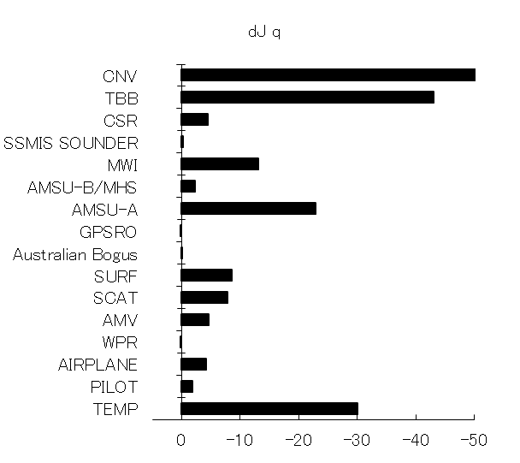
Norm dependency
JMA DRY TE
JMA WET TE
JMA Specific humidity
Impacts of humidity sensor (MWI, AMSUB/MHS, and CSR) become clear when we use WET TE or Q norm than DRY TE norm.
Impacts of humidity non sensitive data (AMSU-A, AMV, etc) are still large in the case of WET and Q norm.
Notes:
Next, let’s compare the JMA results with those of ECMWF.
This figure is results of AD-based impact estimation in ECMEF adapted from Cardinali 2009.
These two FSOs are calculated in different settings; ECMEF result are four months average and using 24 hour forecast,
while the JMA results are a single analysis snap shot and using 15hour forecast.
But we can find some basic differences between these two FSOs. First, the large contribution from AIS, IASI, and GPSRO in ECMWF.
In JMA, these data are not assimilated or only partially used. The AIRS IASI are now in developing stage, and the operational use of cosmic data in JMA was
started in Nov 2010.
Second, the contributions of water vapor sensors are clear in ECMWF, but not clear in in JMA.
These are AD-based estimation results using wet TE norm and using MSE of specific humidity norm.
We can find, in these norm, the contribution of water vapor sensors are clear.

Slide 43
Wrong data detection
This figures shows impacts of AMSU-A/METOP2 in two NWP systems, TEST and CNTL.
  CNTL uses adequate observation error settings (operational settings).
  TEST uses inadequately small observation error setting for channel eight.
The AD-based method can detect wrong observations which degenerate forecast accuracy.
Solid line: CNTL
Black square: TEST
Relative forecast error reduction
δe

Slide 44
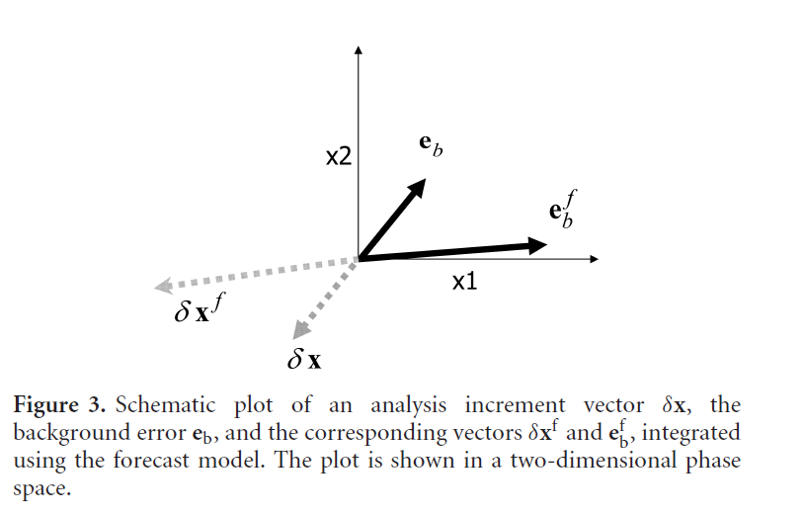
TL-based method
Notes:
This figure shows the space structure of PIVs along 50 degrees south latitude.
Like this, the TL-based method can calculate space structure of observation impacts.

Slide 45
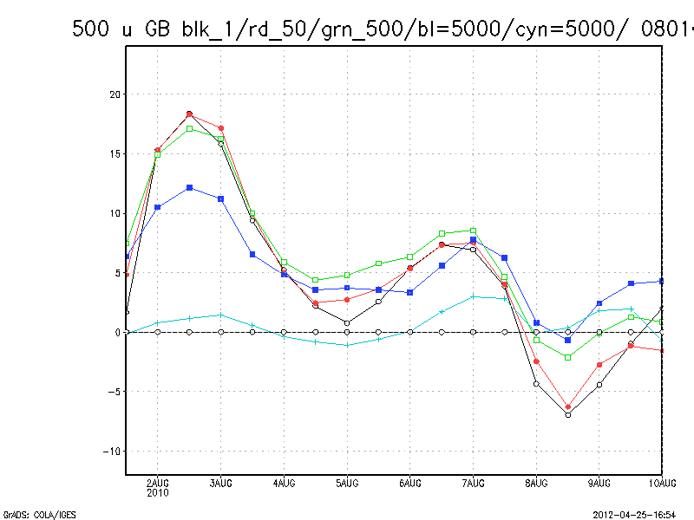
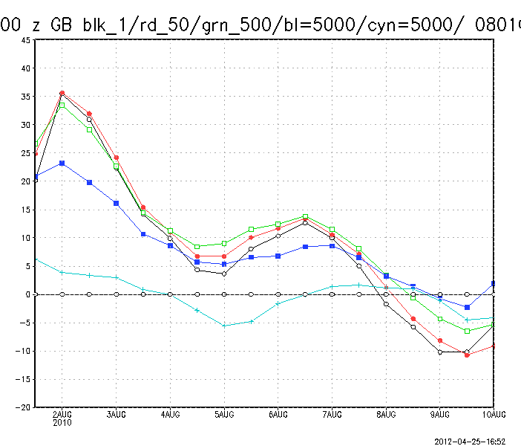
Inflation and forecast accuracy
Inflation factors smaller than 500 have almost same forecast accuracy during fast 4days, and after 5days, larger inflation factors have smaller forecast errors,
Inflation 5000 has smaller improvement during 4days, however, smaller errors after 5days.

Slide 46
Variances of functions of analyses
In linear analyses, we consider four independent variables, a background field xb , observations y, a background error covariance matrix B, and an observation error covariance matrix R.
We can evaluate impacts of each variable.

Slide 47
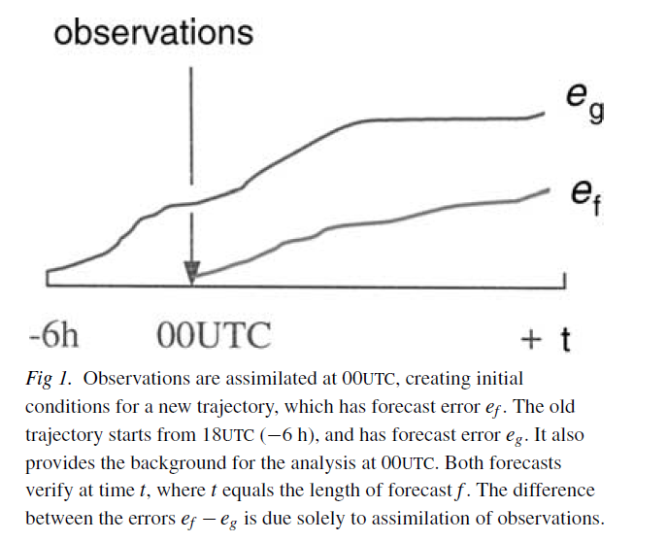
AD-based estimation
Langland and Baker (2004) Tellus
Notes:
This figure is adapted from LB 2004, showing basic idea of AD-based method.
The horizontal axis is forecast time, vertical is forecast RMSE. We think two forecasts,
One starts from 00UTC analysis, and the other starts background of 00UTC analysis (6hr before analysis).
Forecast errors are measured at the same time t. The differences between eg and ef are due to observations assimilated 00UTC analysis.
So from the difference, we can evaluate observation impact assimilated 00UTC analysis.

Slide 48
AD-based estimation
The formulation of AD-based method under TL approximation:
Definition of a scalar function F of a forecast error vector:
Variation of F caused by an analysis
Each term is a inner product between the first-order quantities of TL
approximation.
For example, a linear observation impact of a dataset P is calculated as follows;
C: norm define matrix
M: tangent linear model
e^{f}: forecast error vector
e_{b}: background error
δx: analysis increment
Notes:
This slide shows the formulation of AD-based method under TL-approximation:
・ The definition of scalar forecast error F is
・ The variation of F caused by an analysis is
Each term of dF is a inner product between the first-order quantities of TL approximation.
, as a result, both terms become the second order quantities of TLA.
・ For example, a linear observation impact of a dataset P is calculated as follows;
Q: df caused by analysis ?
A: analysis changes initial state by adding dx to background field. This change is df.
Q: So, background field will change, not invariant, so departure is not only observation function but also xb ?
A: no, changes are not on bg but on initial field. So bg is invariant in linear impact analysis.
Q: Explain second order of TLA, which have to ignore in TLA?
A: No, this second order is inner product of first order of TLA. so fully have meaning, not second order of TLA and 0 order.
Q: first term express only invalidity of the system?
A: For, ordering of Errico paper. I do not think so, both are same magnitude, and if DAS is optimal dx=-eb so first term become -2eCe and second is eCe
So if first must be vanish in optimal DAS. So first term does not vanish for optimal DAS.
Please notice that Cardinali 2009? papers ordering different.

Slide 49
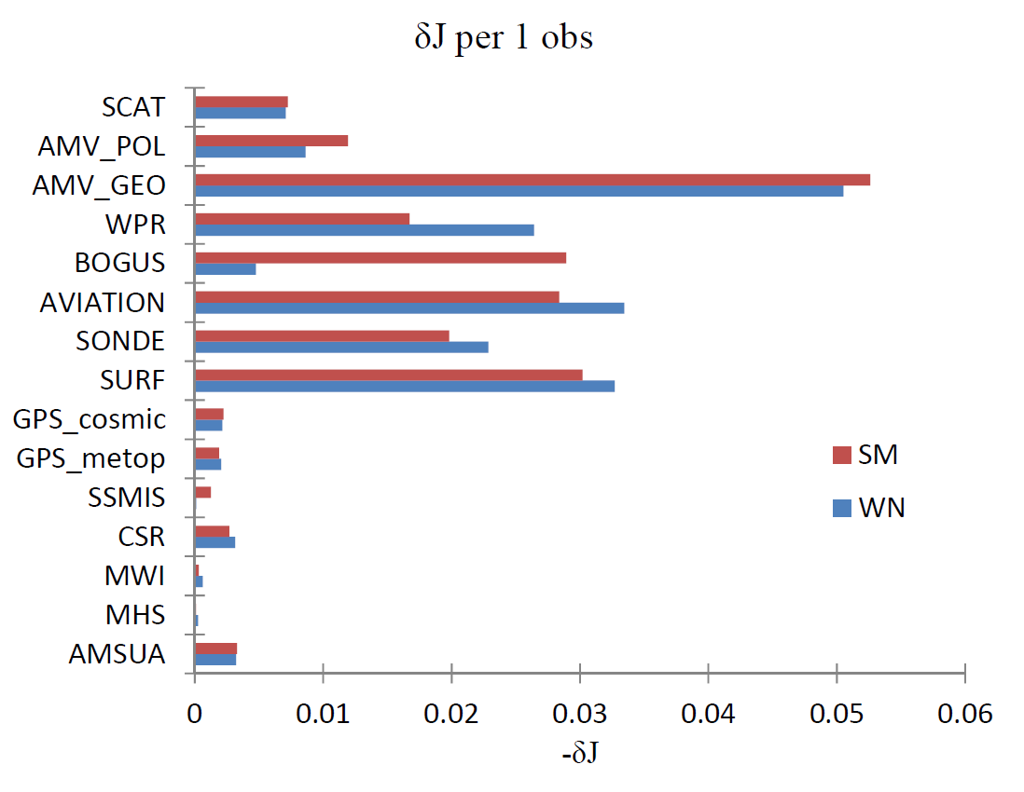
AD-based estimation in JMA global 4D-Var
δJ DRY
Notes:
This figure shows results of AD-based estimation in JMA global DAS for a single analysis at 00UTC Jul 20 2009.
C is given as dry total energy norm .
The horizontal axis is the forecast error reduction by each observation dataset.
The vertical axis is the observation dataset names; TBB is radiance data total and CNV is conventional data total.
We can see the forecast error reduction by the Radiance total (TBB) is smaller than that of the conventional total.
But the satellite total (TBB+SCAT+AMV) is larger than the non-satellite totals.
The largest contribution is from AMSU-A, and the next is Sonde data.

Slide 50
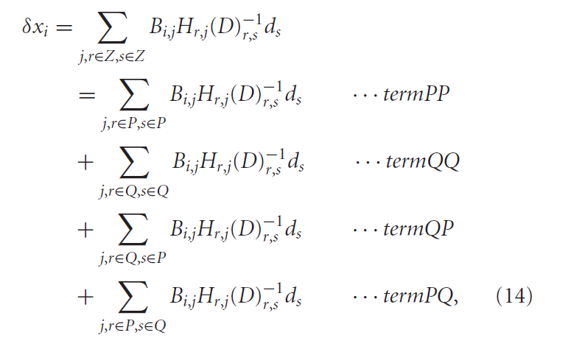
TL-based method
K
K’
Only the case that D is block diagonal.
Ishibashi (2011) QJRMS
Notes:
This figure shows the space structure of PIVs along 50 degrees south latitude.
Like this, the TL-based method can calculate space structure of observation impacts.

Slide 51
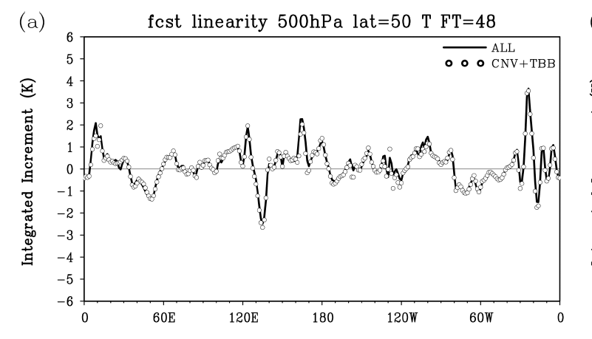
TL-based method
Ishibashi (2011) QJRMS
Notes:
This figure shows the space structure of PIVs along 50 degrees south latitude.
Like this, the TL-based method can calculate space structure of observation impacts.

Slide 52
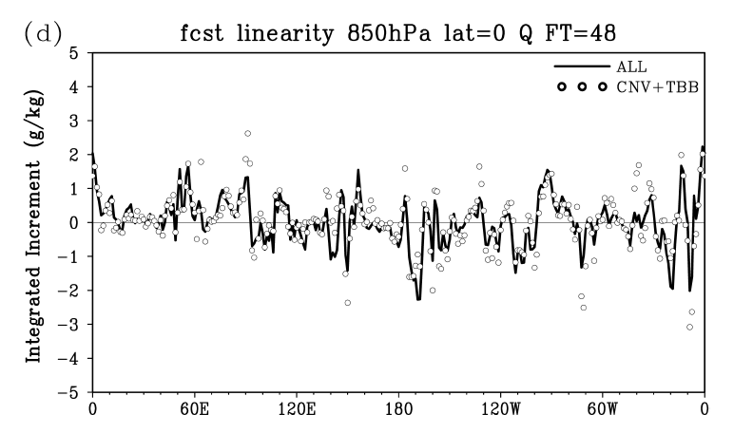
TL-based method
Ishibashi (2011) QJRMS
Notes:
This figure shows the space structure of PIVs along 50 degrees south latitude.
Like this, the TL-based method can calculate space structure of observation impacts.

Slide 53


TL-based method
Ishibashi (2011) QJRMS
Notes:
This figure shows the space structure of PIVs along 50 degrees south latitude.
Like this, the TL-based method can calculate space structure of observation impacts.

Slide 54




Formulation of AD-based method using Taylor series
Errico (2007) Tellus
Notes:
This slide shows the formulation of AD-based method under TL-approximation:
・ The definition of scalar forecast error F is
・ The variation of F caused by an analysis is
Each term of dF is a inner product between the first-order quantities of TL approximation.
, as a result, both terms become the second order quantities of TLA.
・ For example, a linear observation impact of a dataset P is calculated as follows;
Q df caused by analysis ?
A analysis changes initial state by adding dx to background field. This change is df.
Q So, background field will change, not invariant, so depature is not only observaiton funciton but also xb ?
A no, changes are not on bg but on initla field. So bg is invariant in linear inpact analysis.
Q Explain second order of TLA, which have to ignore in TLA?
A no this second order is inner product of firest order of TLA so fully have meening, not second order of TLA and 0 order.
Q first term express only invalidity of the sysrtem?
A I do not think so, both are same magnitude, and if DAS is optimal dx=-eb so firest term become -2eCe and second is eCe
So if first must be vanish in optimal DAS. So firest term does not vanish for optimal DAS.

Slide 55

Cross terms
Ishibashi (2011) QJRMS
Notes:
This figure shows the space structure of PIVs along 50 degrees south latitude.
Like this, the TL-based method can calculate space structure of observation impacts.

Slide 56
Sensitivity on covariance matrices

Slide 57


Diagnoses of the JMA global 4D-Var
Radiances

Slide 58


Diagnoses of the JMA global 4D-Var

Slide 59


Cycle experiment with static optimization
FT24 500hPa
FT48 500hPa
0
Improvement rate
0
ｈPa
U
V
T
Cycle days
Cycle days
Forecast errors increase as the cycle advances, within a week.
This may bes because of this method does not take into account cycle (nonlinear) effect, variations of background fields caused by the static optimization.
Notes:
These figures show improvement of forecast accuracy by the optimization of R with D08.

Slide 60


Cycle experiment with online optimization
Improvement rate: Zonal wind
Improvement rate: Temperature
Pressure
(1000 - 100 hPa)
Forecast time (3days)
One week averaged improvement rate.
To treat nonlinear effects, here, tuning coefficients are calculated each 00UTC analysis and renewed.
Some improvement can be fond but not enough.
Notes:
These figures show improvement of forecast accuracy by the optimization of R with D08.

Slide 61
Key analysis error
The relationship between sensitivity vector and analysis error vector （Rabier et al, 1996）
C is metrics,
M is TL model,
a is a scalar coefficient.
Analytical determination of the coefficient a (Isaksen et al, 2005)

Slide 62
Key analysis error
Geometric illustration of the coefficient ‘a’
Analysis error estimation using sensitivity vector
1. Measure forecast error:
is enough large to measure with enough accuracy
Forecast error
2. Propagate information using an adjoint model toward initial time.
Analysis error is too small to measure directly.
time
Optimization: To subtract an estimated analysis error from the original analysis.

Slide 63



Accuracy of optimized forecast
T500hPa
U250hPa
Optimization time is FT 15hr.
Vertical axis is RMSE, horizontal axis is forecast time, zero to three days.
Q850hPa
Red: optimized forecast
Black: Original forecast
(Blue: forecast from an original next analysis time original )

Slide 64
Variational formulation of key analysis error
Cost function
Klinker et al 1998
Minimize J(δx)
Here,
M: TL model, δx：analysis increment vector, A: norm define matrix.
Analysis increment
This method put 100% confidence on reference analysis information, since any compatible information are used.
This property causes inconsistency between observations and a background field (Klinker et al 1998, Isaksen et al 2005, Pu, Carron).
So, previous studies stop iteration at once or dozen times to avoid over fitting.

Slide 65

Problem of key analysis error
Jo terms
SOSE: Sensitivity observing system experiment (Marseille et al 2008)
Although the optimized analysis based on the key analysis error can generate more accurate forecasts, there is problems that the optimized analyses are inconsistent with observations (Isaksen et al 2005) .
Next, we consider to achieve analysis fields that are able to generate more accurate forecasts and consistent with observations, simultaneously.

Slide 66

SOSE
Adapted from Marseille et al (2008 Tellus A)
Notes:
First, Let’s think about definitions of observation impact.
We know two types of observation impact definition, The first type is “non-linear impact” and
the second is “linear impact”.
The “non-linear observation impact” is defined as the variations in an analysis (and forecast) field when we add changes to observation data.
(perturbations in observation data values, addition of observation datasets to the DAS).
The “linear observation impact” is defined as the variations in an analysis (and forecast) field when we add changes to observation data
Under the condition that the Kalman gain is invariant.
These two types of observation impact are different quantities, so, in general, they cannot work as a proxy for
each other.
QA
Q Explain the differences of the two types of ODI definitions.
A Suppose two DASs. DAS_1 assimilates observation data P, and DAS_2 assimilates observation data P and Q.
The differences between analysis (and forecast) field between DAS_1 and DAS_2 are Non-linear impact,
And not linear impact since K is different between these DASs.
If one want to know action od K on dataset P in DAS_2, one has to use Linear impact estimation methods, not to
Break K.
Q AD and DFS is not linear since quadratic measurement.
A yes, in principal, quadratic measure is nonlinear effect between another datasets, so AD and DFS approximate that
such interaction can be negligible. The validity of this approximation depends on the way to division of observation datasets.

Slide 67
Data assimilation theory based method
We ignore cross terms. Validity of this assumption is checked by forecast errors and observation fitting.
We give A as diagonal matric, and variances of A are give as 30% of forecast error variance of background field multiplied by inflation factor f.

Slide 68



Two weeks statistics
Forecast accuracy keeps until 9days with 95% statistical significance until 6 or 7days.

Slide 69
845
Thank you for listening
Comments or Questions ?
Please speak very slowly!
One sentence question welcome!!
Mathematical language also welcome!
More long complicate questions also welcome,
but answer will be after this session or by email.
So sorry my very developing stage English.

Slide 70
Cycle experiment with static optimization
FT24 500hPa
FT48 500hPa
0
Improvement rate
0
ｈPa
U
V
T
Cycle days
Cycle days
Forecast errors increase as the cycle advances, within a week.
This may bes because of this method does not take into account cycle (nonlinear) effect, variations of background fields caused by the static optimization.
Notes:
These figures show improvement of forecast accuracy by the optimization of R with D08.

Slide 71
Cycle experiment with online optimization
Improvement rate: Zonal wind
Improvement rate: Temperature
Pressure
(1000 - 100 hPa)
Forecast time (3days)
One week averaged improvement rate.
To treat nonlinear effects, here, tuning coefficients are calculated each 00UTC analysis and renewed.
Some improvement can be fond but not enough. Because convergence of coefficients is bad. Because large STD.
Notes:
These figures show improvement of forecast accuracy by the optimization of R with D08.

Slide 72
845

Slide 73



“One opt” vs “two opt”
T500hPa
U250hPa
A = I で与えている。
Q850hPa
赤：FT9FT15で最適化
緑：FT9でのみ最適化
黒：最適化なし
青：6時間後の初期値からの予報

Slide 74


TL-based method
Before
After
Notes:
This figure shows the space structure of PIVs along 50 degrees south latitude.
Like this, the TL-based method can calculate space structure of observation impacts.

Slide 75
Sensitivity on covariance matrices

Slide 76

2. Covariance matrix optimization
STD of background err
STD of departure
In general, B is too large especially for humidity sensitive sensors.

Slide 77

2. Covariance matrix optimization
STD of background err
STD of departure
STD of observation err
STD of departure
In general, R is too large especially for humidity sensitive sensors.

Slide 78
Variational formulation of key analysis error
Cost function
Klinker et al 1998
Minimize J(δx)
Here,
?
M: TL model, δx：analysis increment vector, A: error covariance matrix of these information
Analysis increment
We can see the sensitivity analysis is an approximate of this optimization wit only once iteration.
感度場による解析が解析解の良い近似となる条件
これを満たす場合は2とおりある。
①
がMの特異値1/aに属する特異ベクトルである。
②
①は任意の摂動が特異値-aで発展することを意味する。少なくとも，変数変換をしない場合は物理的にありえない。

Slide 80


Slide 81


Slide 82


Slide 85


Slide 86


Slide 87


Slide 88


Slide 89


Slide 90


Slide 92
SONDE

Slide 93

COSMIC

Slide 94
Optimization with DIC
2
Theoretical relationships;
  Where, Jo and Jb are observation term, and background term of cost function, respectively
In real DASs, these relation ships are generally not satisfied because error covariance matrices using in the DASs are different from true ones.
DIC tunes B and R using in the DASs to satisfy these relation ships.

Slide 95

DIC experimental results in DAS/JMA
About four times iteration of DIC are enough to convergence of tuning coefficients.
DIC shows optimal observation error settings of satellite radiance are 20 to 30% of current settings.
After DIC optimization, relation ships between value of cost function and observation data number further meet the theoretical relationship; J=0.5N.
However, we have also found OSE with these optimized covariance matrices concluded in significant forecast error increase. This is because our forecast model has large dry (wet) biases in mid (low) altitude troposphere, and DIC improve these biased in analysis fields, but model give wrong strong response (rain out watervapors in ITCZ and breal Hadley circulation)

Slide 96
DFS in DAS/JMA
Definision of DFS
Radiance total < Conventional total
Satellite total > others
  Sattelite includes raiances, scatterometer derived winds, and satellite winds
  Others=conventional – AMV-SCAT
Largest contribution from AMSU-A/B.
JMA DFS
JMA DFS
Conventional total
Conventional total
Conventional total
Conventional total
SCAT
SCAT
SCAT
SCAT
SCAT
AMV
AMV
AMV
AMV
AMV
AMV
aviation
aviation
aviation
aviation
aviation
aviation
aviation
sonde
sonde
sonde
sonde
sonde
sonde
sonde
sonde
Radiance total
Radiance total
Radiance total
Radiance total
Radiance total
Radiance total
Radiance total
Radiance total
Radiance total
Ref: Result in ECMWF ( copied from Rabier 2005)
DFS (%)
DFS (%)
DFS (%)
DFS (%)
DFS (%)
DFS (%)
DFS (%)
DFS (%)
DFS (%)
DFS (%)
Pilot+Temp<Amsu-A

Slide 97

Optimization with D08
K

Slide 98

Maxwell demon ?
Only Statistical property, R and B.
From Bennett CH and Schumacher B (2011)
Thermal equilibrium at temperature T.
We can get usable energy from max entropy state with Maxwell demon.
It knows velocity of each particle, while we know only statistical property, temperature.
We know property of each observation and can use this information.
Notes:
This figure shows the space structure of PIVs along 50 degrees south latitude.
Like this, the TL-based method can calculate space structure of observation impacts.

Slide 99
Adjoint Method
(Langrad and Baker 2004, Errico 2007)
Jは予報場の特徴を表す適当なスカラー関数
モデル空間の4DVARの解析とLB2004の感度解析は、ともにAを係数行列とする連立方程式を解く問題である。両者の違いは右辺ベクトルの違いだけである。

Slide 100
845
Thank you for listening
Comments or Questions ?
Please speak very slowly!

