Slide 1
Data Assimilation for Reanalysis
Dick Dee
Massimo Bonavita, Mike Fisher, Paul Poli, David Tan
ECMWF
WCRP 4th International Conference on Reanalyses
7-11 May 2012
Silver Spring, Maryland

Slide 2
Reanalysis of the instrumental record
Special challenges for data assimilation:
Maintaining temporal consistency
Time-varying background errors
Using sparse observations
Uncertainty estimates
Computational cost
Some advantages as well:
Knowledge of the complete data record
No strict real-time requirement
Iteration (we have a second chance)
Topics for this talk:
Ensemble Data Assimilation
Long-window 4D-Var
Use of weak-constraint 4D-Var to control model biases
log(data count)
satellites
upper-air
surface
1900
1938
1957
1979
2012

Slide 3
Approach taken in ERA-CLIM
Develop a 20th-century climate reanalysis from the bottom up:
Model + boundary conditions, atmospheric forcing data
Reanalysis of surface observations only
Reanalysis of early upper-air observations
Reanalysis of reprocessed satellite data
Beyond ERA-CLIM:
Comprehensive 20C atmospheric reanalysis
Some form of coupling with the ocean
Should begin production by end of 2014
This is a long-term project!

Slide 4
Choice of data assimilation method
ECMWF systems are based on 4D-Var analysis
Has been successfully used in ERA-Interim
Variational bias correction is important for reanalysis
Options: longer analysis window, accounting for model errors
Major shortcoming: Background errors are not dynamic
Uses a stationary covariance model
Flow-dependence induced by balance operators
Manually tuned (model-dependent)
What about an ensemble Kalman filter (EnKF)?
Implemented at ECMWF in collaboration with Jeff Whitaker

Slide 5
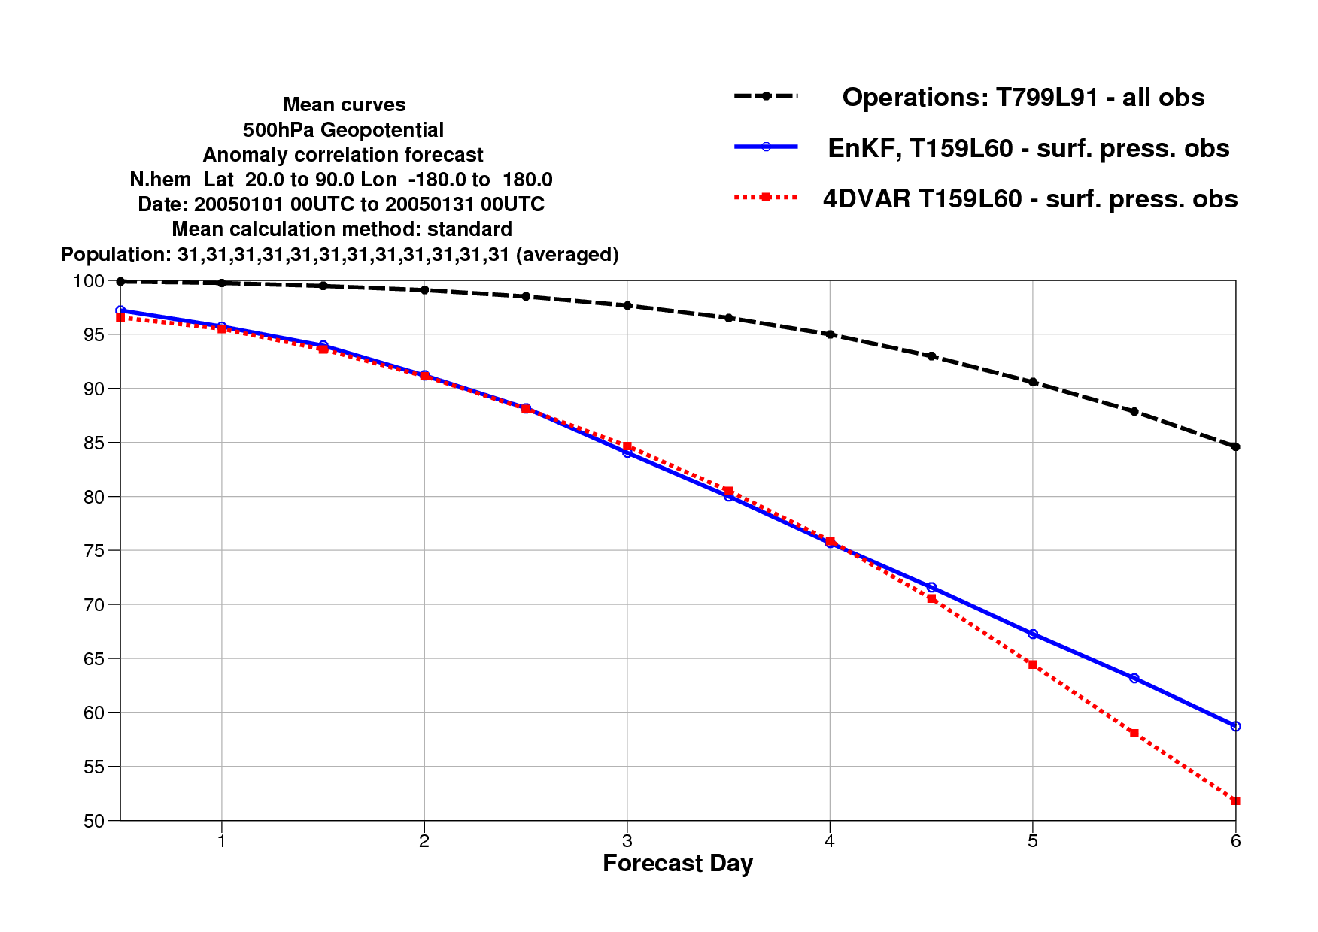
EnKF vs 4D-Var experiments
Assimilating surface pressure observations only

Slide 6
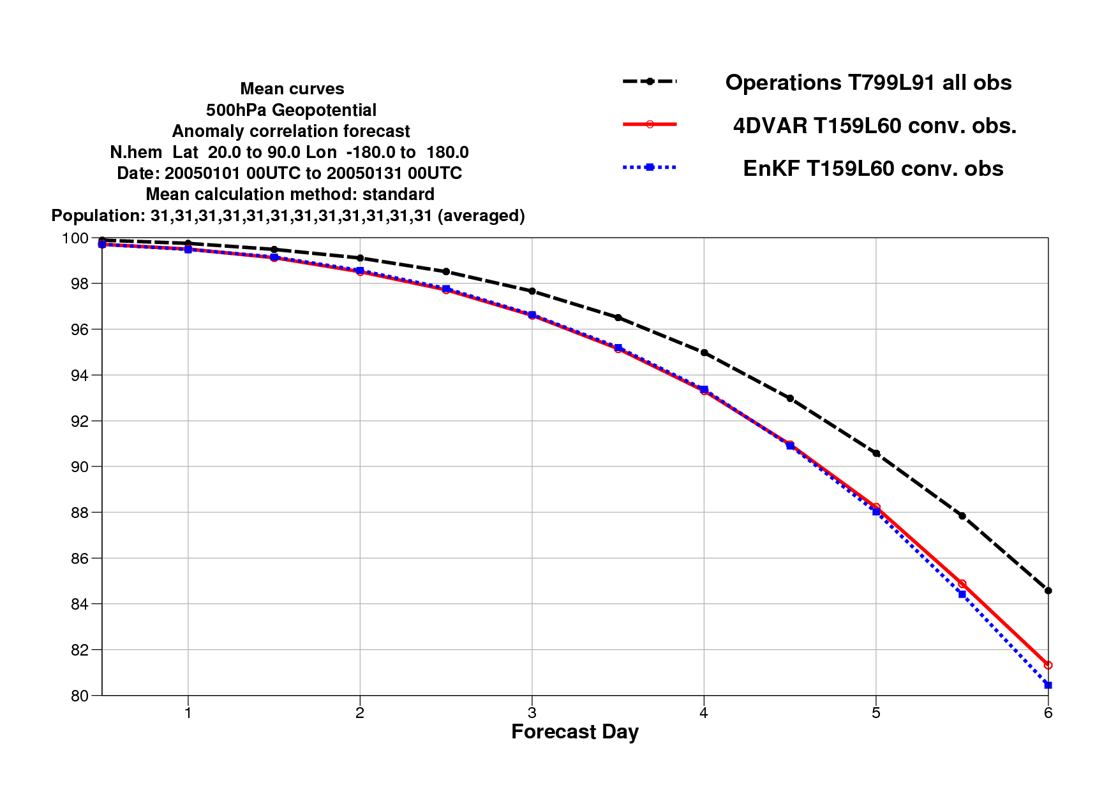
EnKF vs 4D-Var experiments
Assimilating all conventional observations

Slide 7
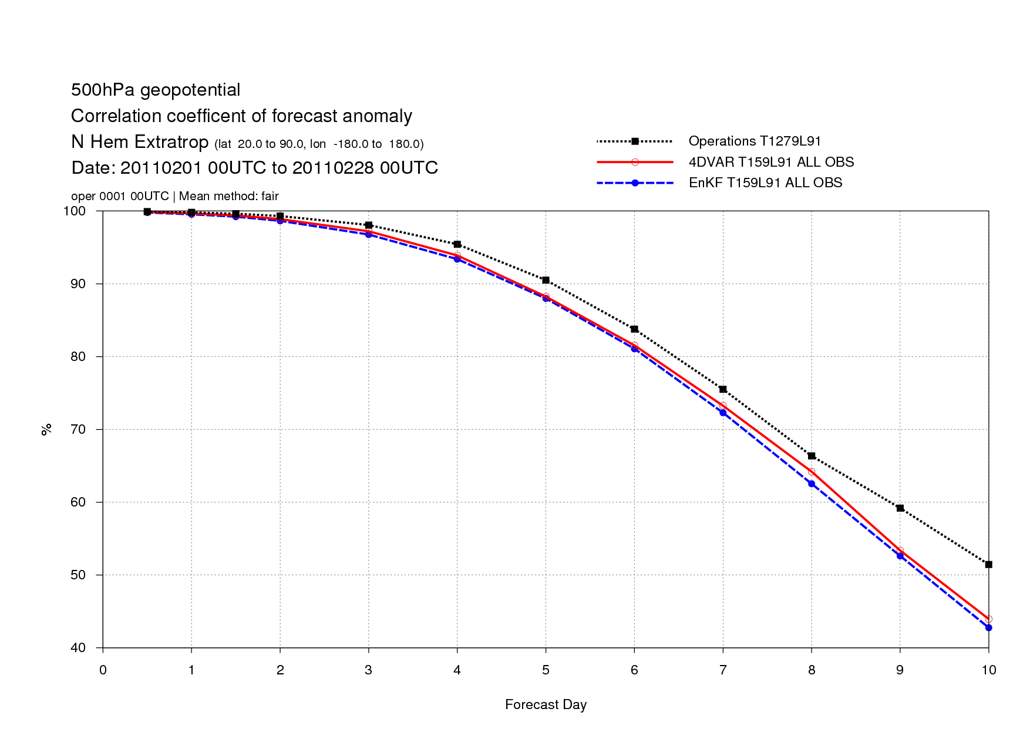
EnKF vs 4D-Var experiments
Assimilating all conventional and satellite observations

Slide 8
Development of a hybrid EDA/EnKF
An ensemble of low-resolution (T399) 4D-Var data assimilations (EDA) is now used to estimate analysis and background errors for the operational forecasting system (T1279)
The EDA also creates perturbations for the ensemble prediction system (EPS)

Slide 9
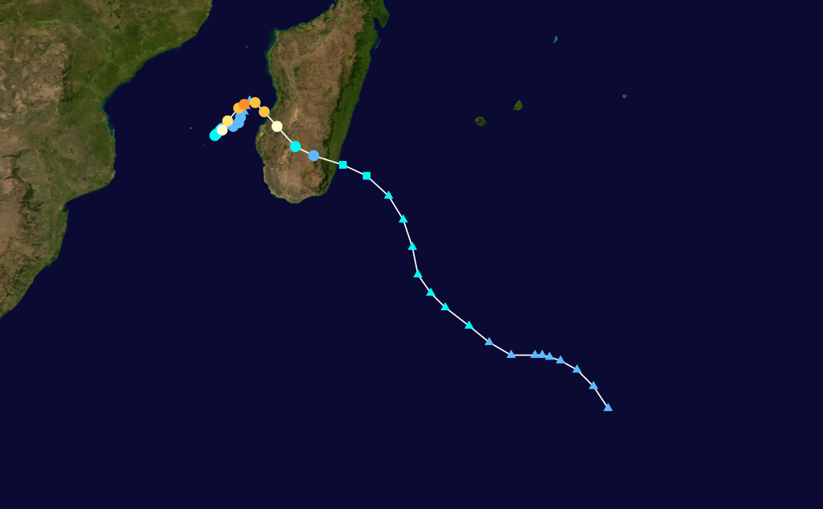
Flow-dependent background errors
Hurricane Fanele
Indian Ocean, January 2009

Slide 10
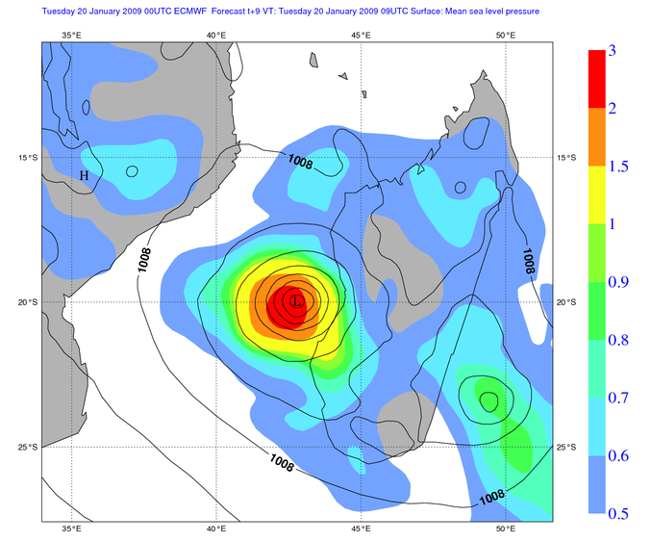
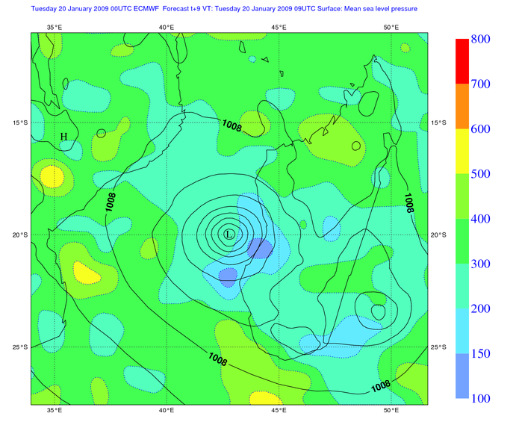
EDA with 20 members
Surface pressure error standard deviation [hPa]
Correlation length scales [km]
Variance estimates are fully flow-dependent; correlations not yet

Slide 11
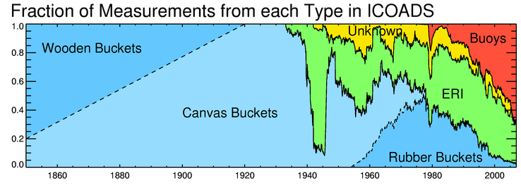
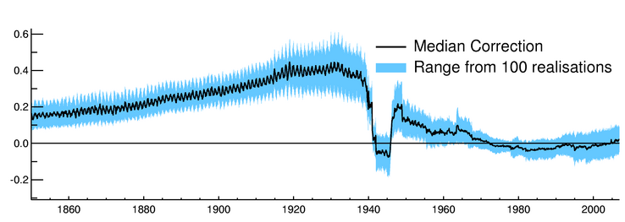
EDA configuration for ERA-20C
Ensemble of reanalyses from 1900, surface observations only, T159/L91/N10
10 members defined by:
Different HadISST2 realizations
Stochastic physics in the forecast model
Randomly perturbed observations
Background error variances estimated from ensemble
Still relying on stationary correlation structures
Bias corrections used in HadISST2

Slide 12
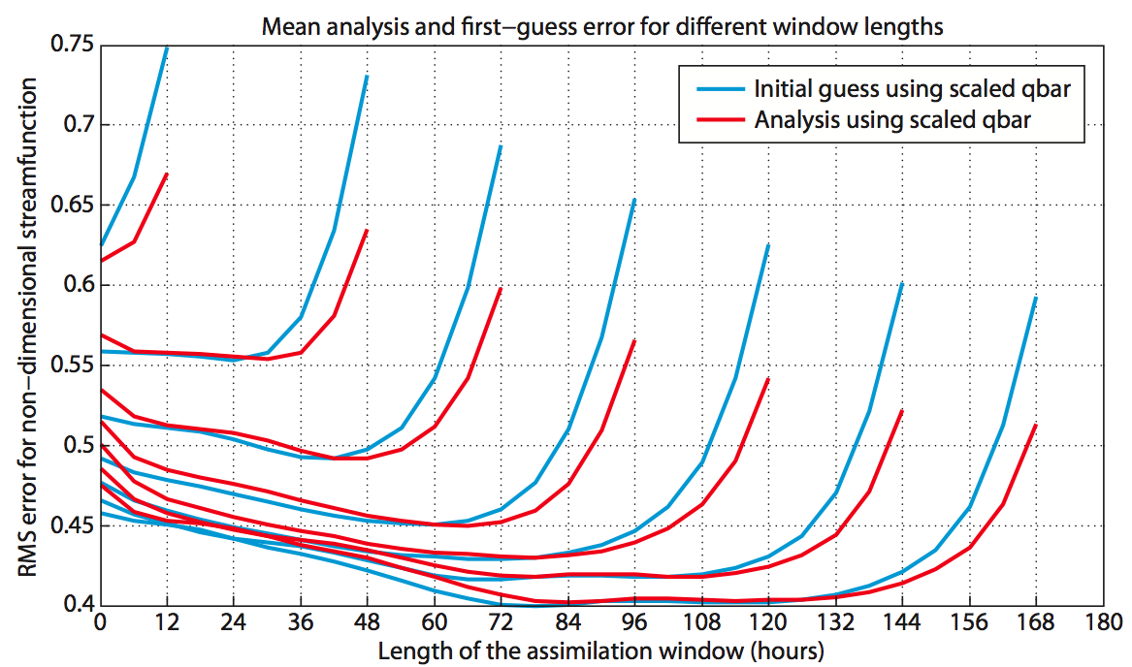
Long-window 4D-Var
Experiments with a 2-level QG model with realistic model errors
Longer windows –> smaller background errors
Analysis errors are smallest in the interior of the window
This is easier to exploit in reanalysis than in forecasting

Slide 13
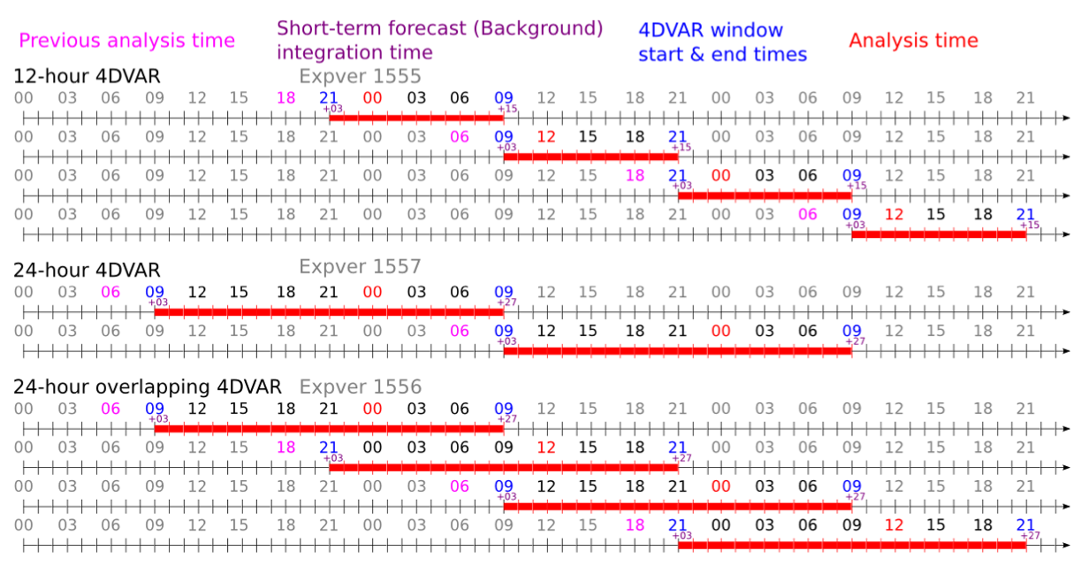
Cycling schemes
Overlap is necessary for even longer windows, to get an accurate first guess

Slide 14
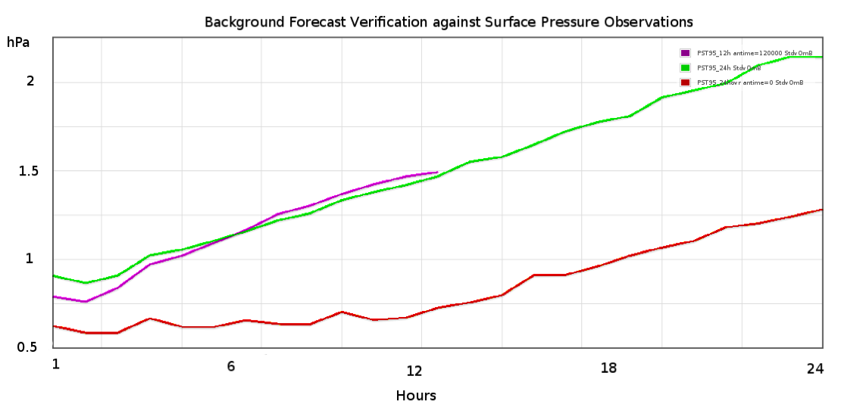
Assimilating surface pressure only
Background forecasts verified against surface pressure observations
24h windows
12h windows
Overlapping 24h windows
Hours from start of window
Overlapping 24h windows is much better – but too expensive for ERA-20C

Slide 15
ERA-20C will use 24h 4D-Var

Slide 16
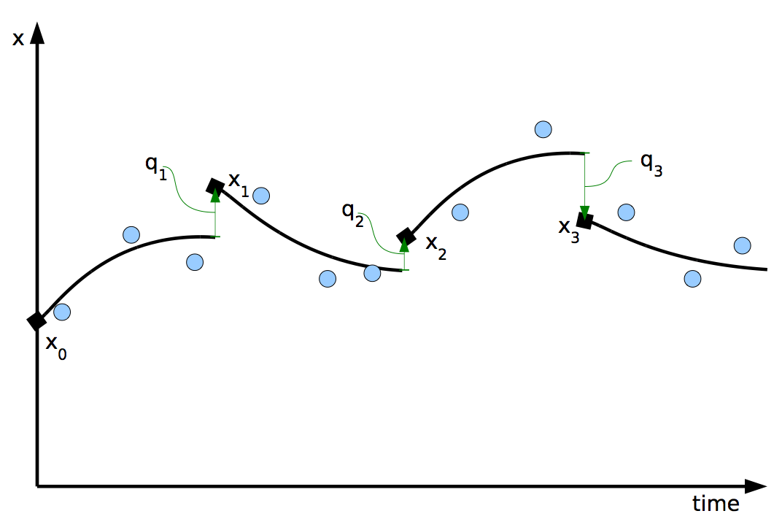
Weak-constraint 4D-Var
Implementation of long-window 4D-Var requires the addition of model error terms in the variational analysis equation:
Weak-constraint 4D-Var can also be used to estimate persistent model errors.

Slide 17
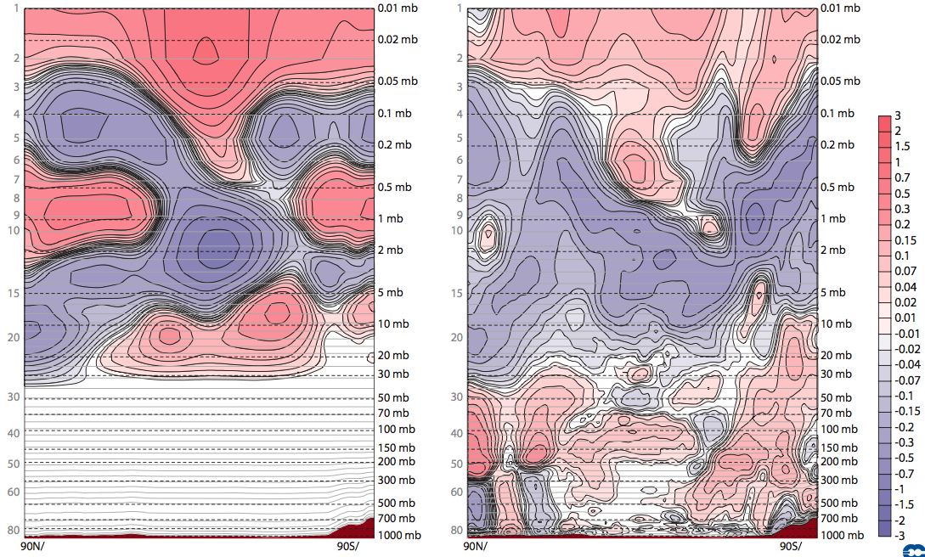
Model bias estimates from weak-constraint 4D-Var
Estimated persistent model error [K/12h]
10-day minus 5-day forecast drift [K/day]

Slide 18
Controlling model bias in reanalysis
Can we use model error estimates from weak-constraint 4D-Var to control the effect of model bias in the absence of observations?
For a given model, estimate persistent model errors in the recent (well-observed) period
Apply these as a correction to the model in the past (poorly-observed) period
A similar approach has been successfully applied in ECMWF’s ocean reanalysis (Magdalena Balmaseda).
Experiment:
Estimate persistent stratospheric model error in a fully observed system, using weak-constraint 4D-Var
Apply the estimate to correct the model in an assimilation of surface pressure observations only

Slide 19
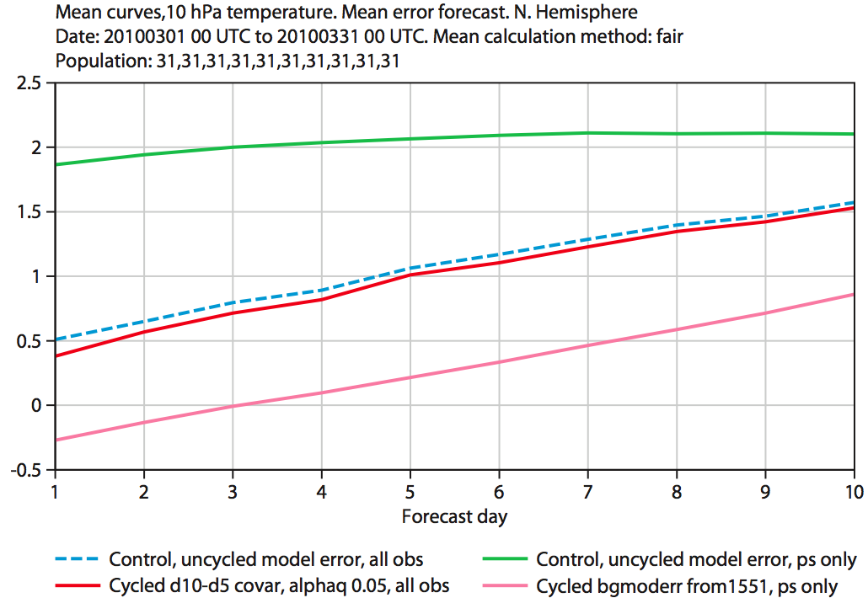
Mean forecast errors, T at 10hPa

Slide 20
Summary
ERA-CLIM uses the ECMWF Integrated Forecast System (IFS):
Ensemble of data assimilations (EDA)
Long-window weak-constraints 4D-Var
Variational bias correction of observations
For climate reanalysis:
Use prior knowledge of the full data record for QC and bias correction
Use the ensemble to represent key uncertainties (SST/sea-ice)
Configure the analysis window to make best use of sparse observations
Use weak-constraints 4D-Var to estimate and correct model biases
Coupling the ocean
CFSR is the starting point
Focus on controlling model drift with SST observations

Slide 21
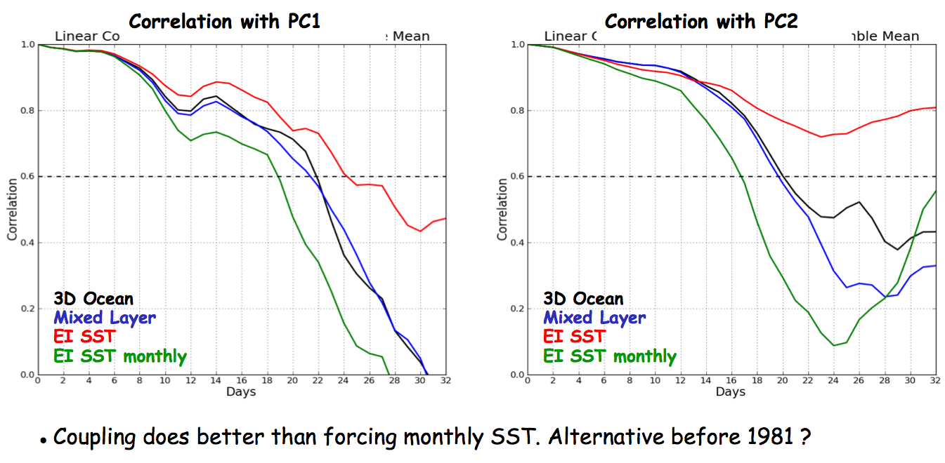
Need for a coupled system
Representation of the MJO in seasonal forecasting
(E. de Boisseson and M. Almaseda)

