Slide 1


Land Surface Climatology in the NCEP
Climate Forecast System Reanalysis
(CFSR)
Jesse Meng*, Michael Ek, Rongqian Yang, Helin Wei, and Youlong Xia
NOAA/NCEP/EMC

Slide 2
NCEP CFSR
Global Reanalysis of the atmosphere, ocean, seaice and land
over the 32-year period (1979-2010)
Analysis Systems : Operational GDAS
Atmospheric (GSI)
Ocean-ice (GODAS)
Land (GLDAS/LIS)
Atmospheric Model : Operational GFS
New Noah Land Model
Ocean Model : New MOM4 Ocean Model
New Sea Ice Model

Slide 3
CFS/CDAS Execution (24-hr span) : Note daily GLDAS
Atmos. Analysis
0Z GSI
6Z GSI
12Z GSI
18Z GSI
0Z GSI
0Z GODAS
6Z GODAS
12Z GODAS
18Z GODAS
0Z GODAS
Ocean Analysis
0Z GLDAS
6Z GLDAS
12Z GLDAS
18Z GLDAS
0Z GLDAS
Land Analysis
Time
Suru Saha, NOAA/NCEP/EMC

Slide 4
GFS and CFS: Land Model Upgrade
Noah LSM (new) versus OSU LSM (old):
Noah LSM (vegetation, snow, ice)
  4 soil layers (10, 30, 60, 100 cm)
  Frozen soil physics included
  Add glacial ice treatment
  Two snowpack states (SWE, density)
  Surface fluxes weighted by
  snow cover fraction
  Improved seasonal cycle of vegetation
  Spatially varying root depth
  Runoff and infiltration account for sub-grid variability in precipitation & soil moisture
  Improved thermal conduction in soil/snow
  Higher canopy resistance
  Improved evaporation treatment over bare soil and snowpack
OSU LSM
  2 soil layers (10, 190 cm)
  No frozen soil physics
  Only one snowpack state (SWE)
  Surface fluxes not weighted by snow fraction
  Vegetation fraction never less than 50 percent
  Spatially constant root depth
  Runoff & infiltration do not account for subgrid variability of precipitation & soil moisture
  Poor soil and snow thermal conductivity, especially for thin snowpack
Noah LSM replaced OSU LSM in NCEP operations
Global Forecast System (GFS) in late May 2005
Climate Forecast System v2 (CFSv2) in March 2011

Slide 5
Land Information System
Land Surface
Characteristics
Topography
Land Cover
Soil
Noah LSM
CFSR
land analysis
Soil Moisture
Soil Temperature
Snow
Precipitation
Forcing
CFSR
surface file
gdas1.t00z.sfcanl
Non-precip
Meteorological
Forcing
Land Variables
Soil Moisture
Soil Temperature
Snow
Christa Peters-Lidard et al., NASA/GSFC/HSB

Slide 6
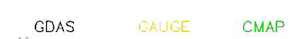
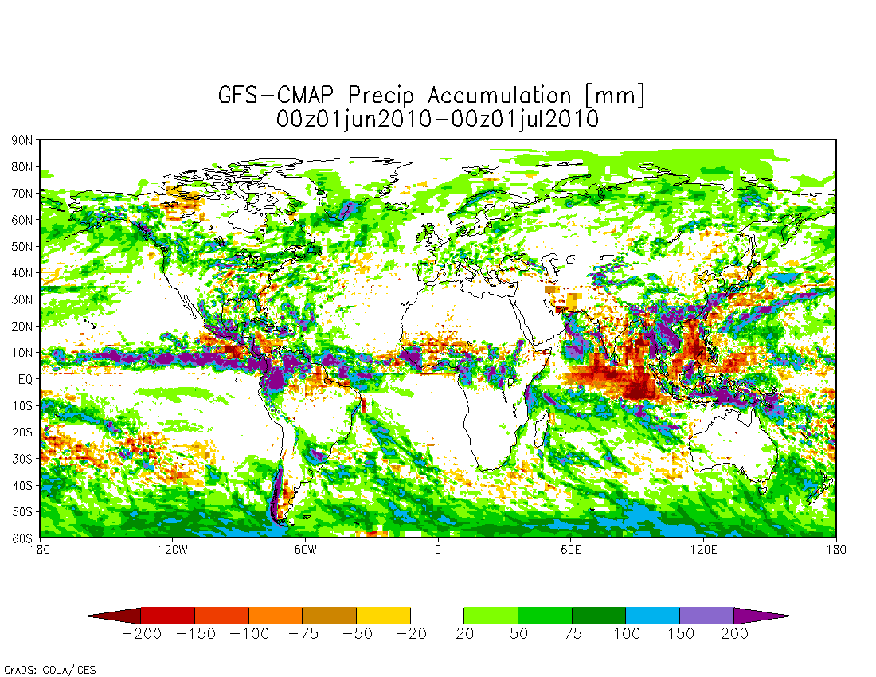
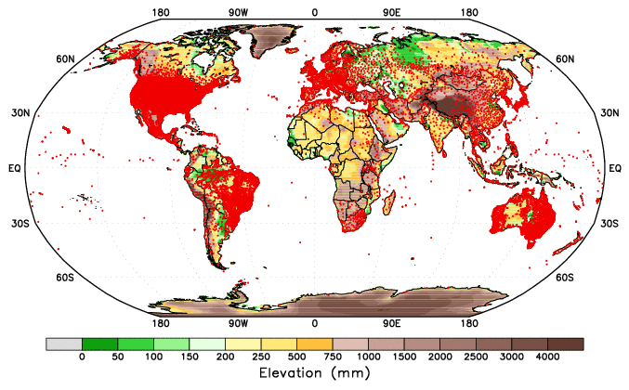
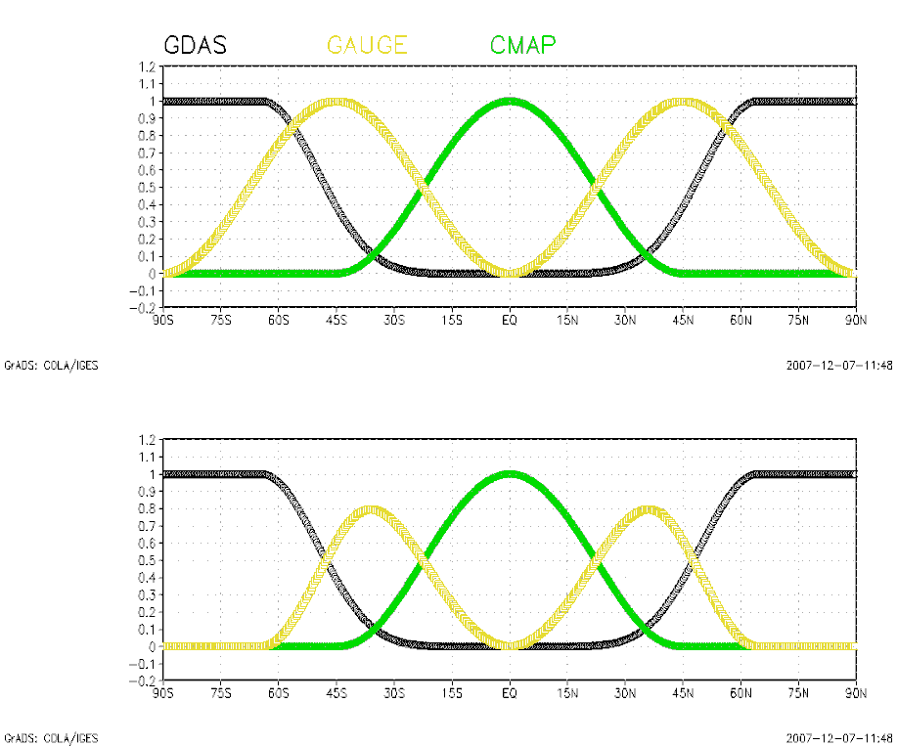
GLDAS/LIS Precip Forcing
Precip Diff CFS-CMAP
Precip Gauge locations
A blended precip forcing is used in GLDAS with the heavier weights of
CFS/GDAS – high lats
Gauge – mid lats
CMAP – tropics.

Slide 7
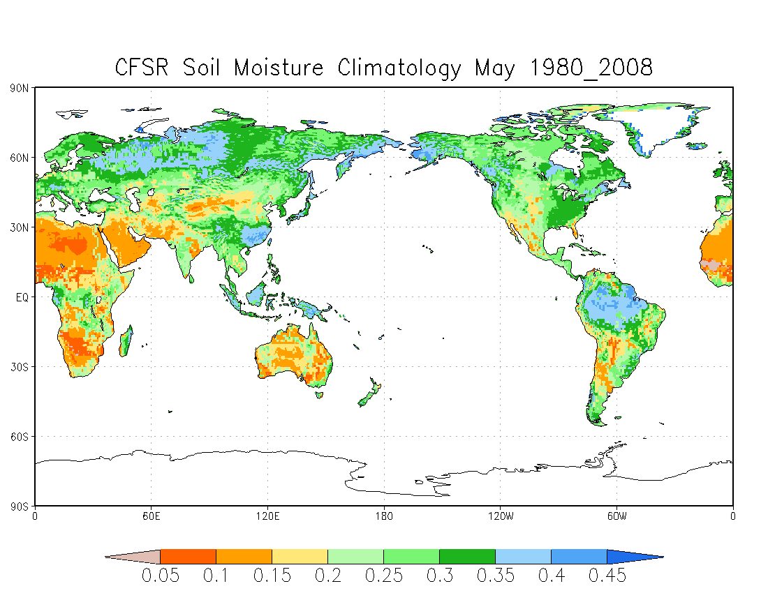
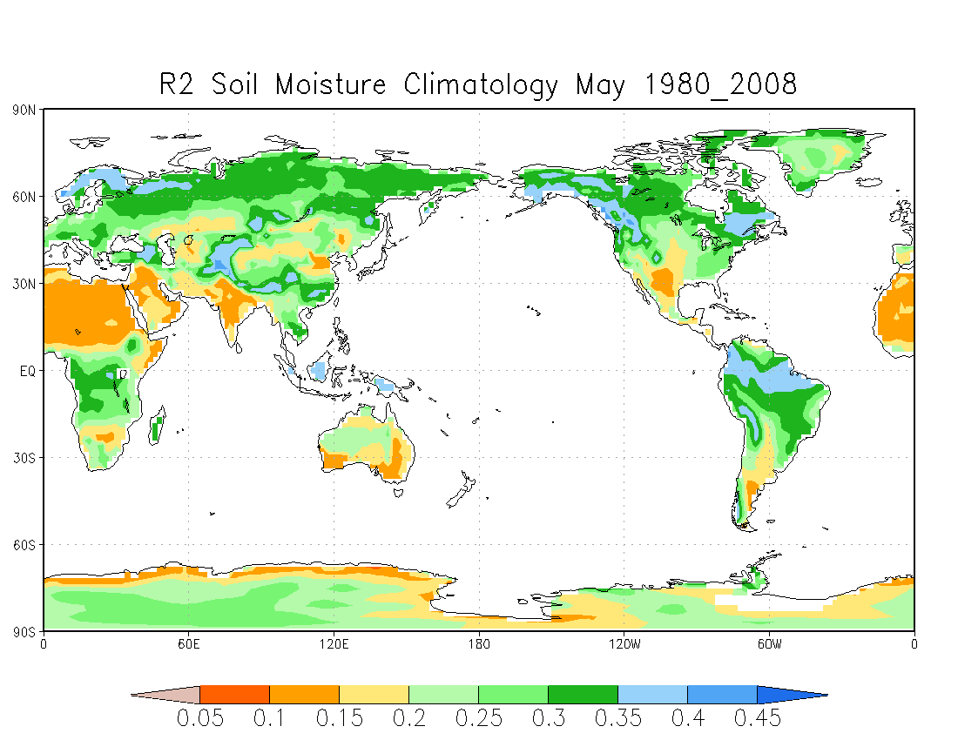

Slide 8
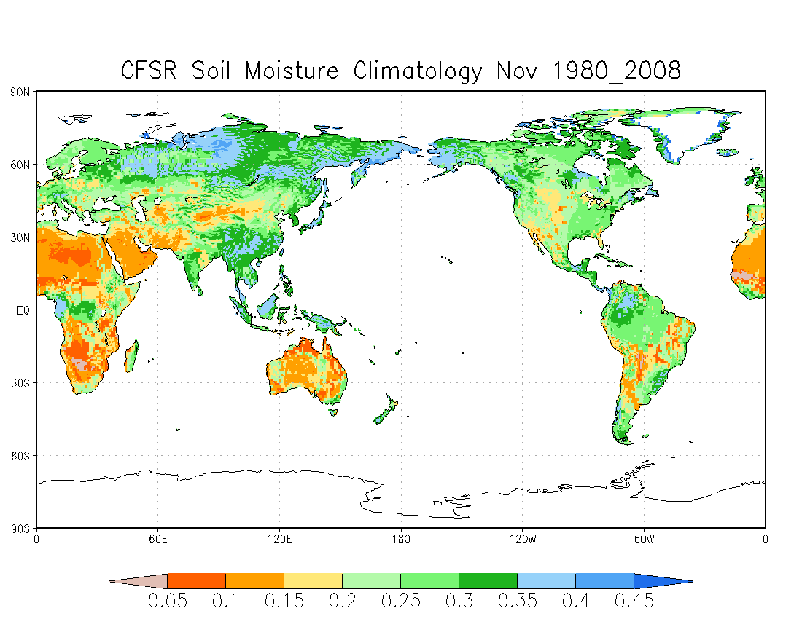
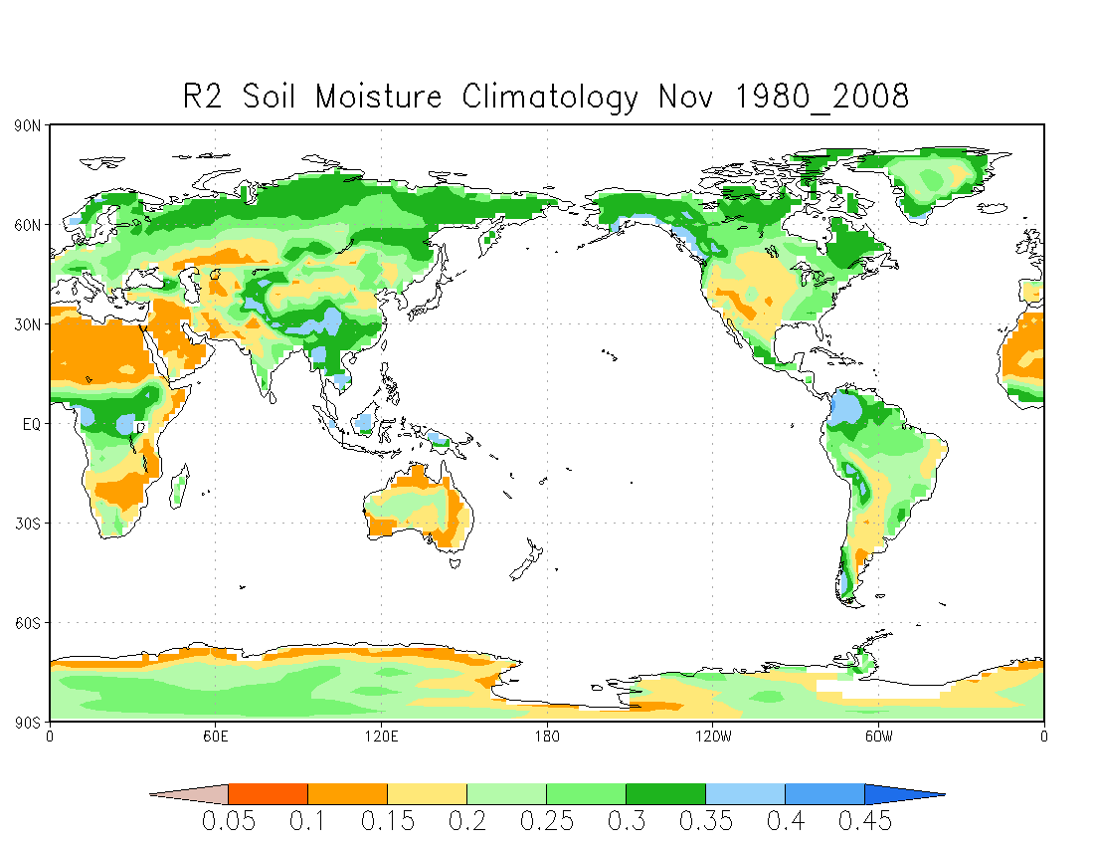

Slide 9
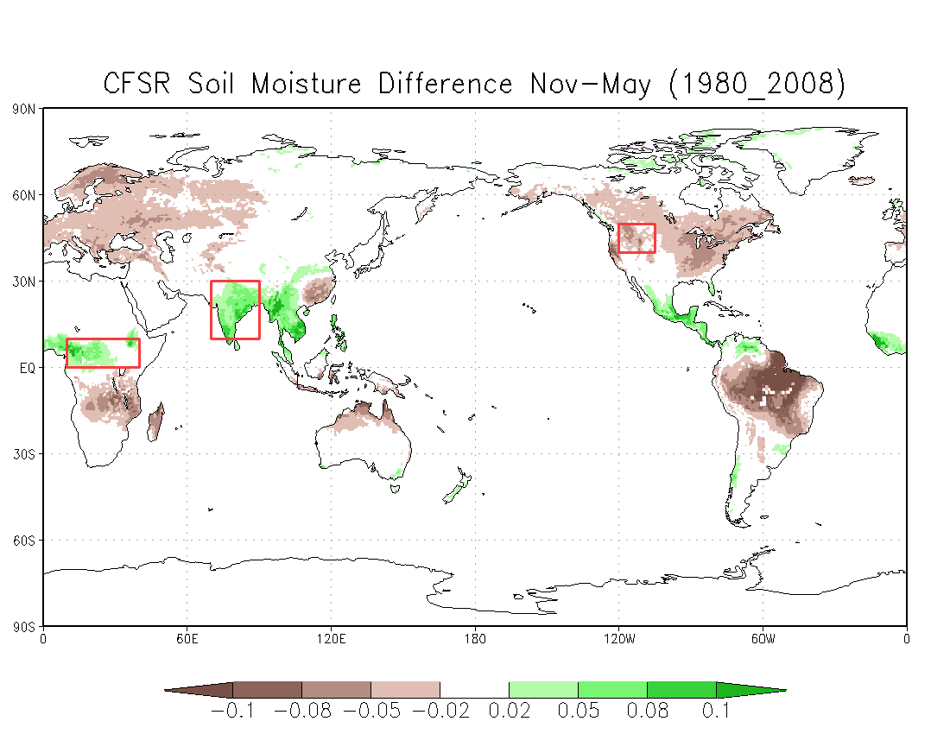
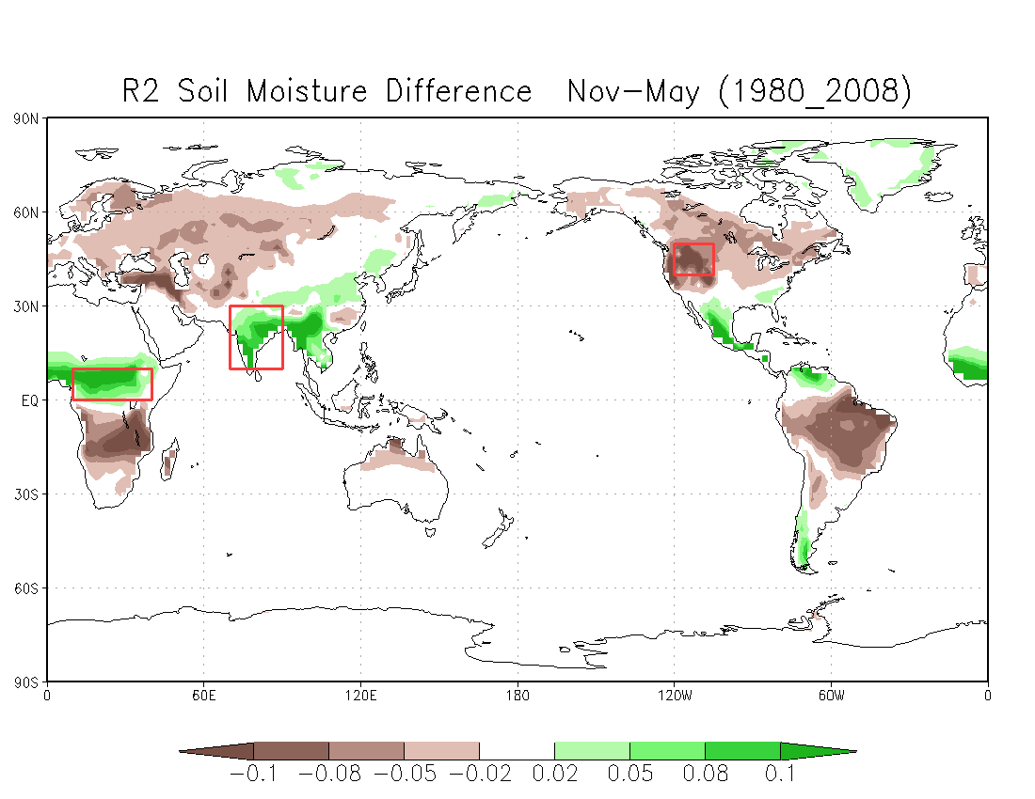

Slide 10
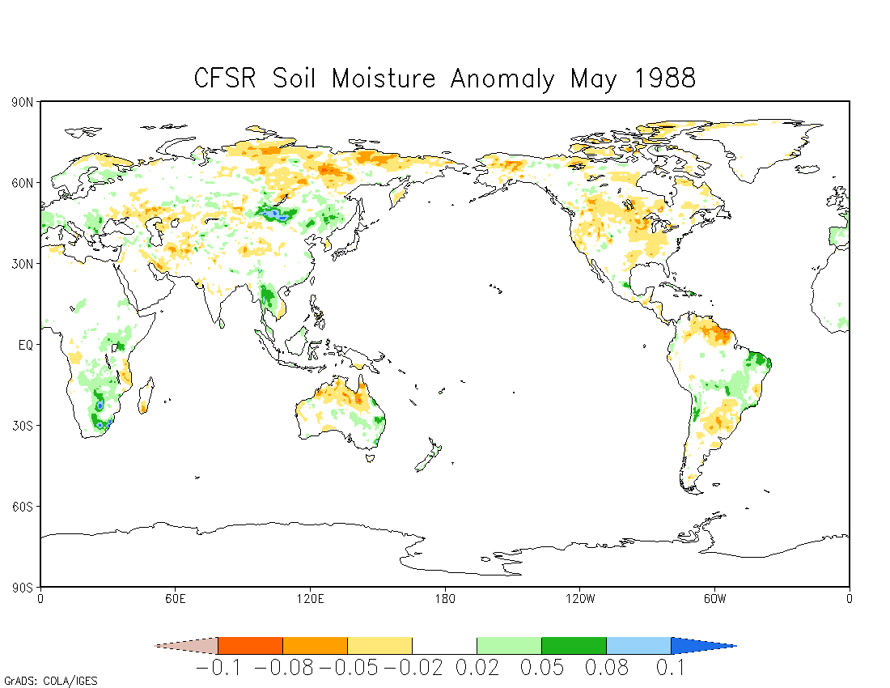
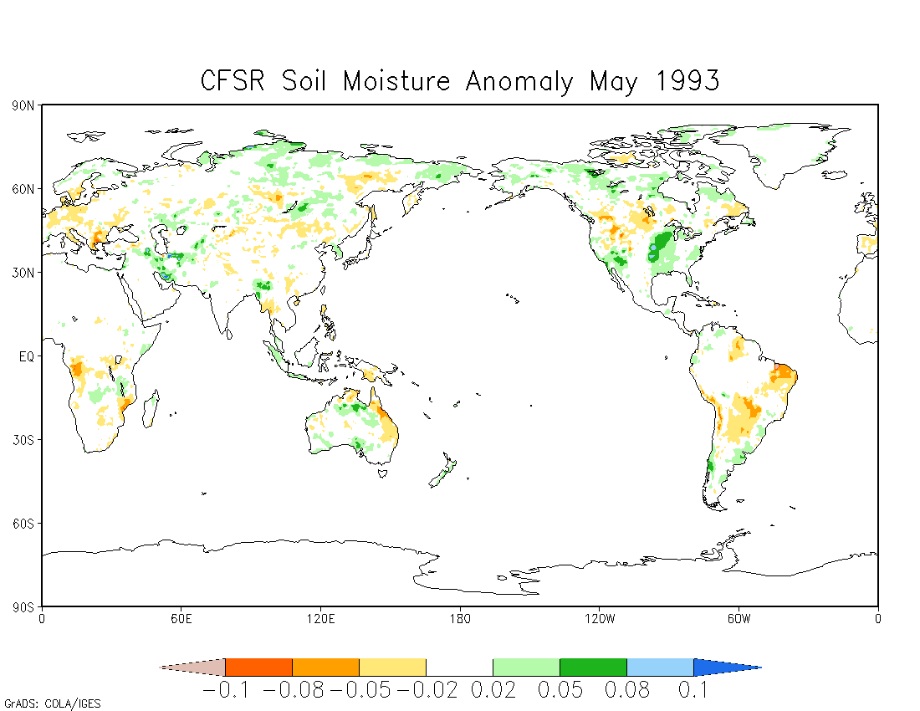

Slide 11
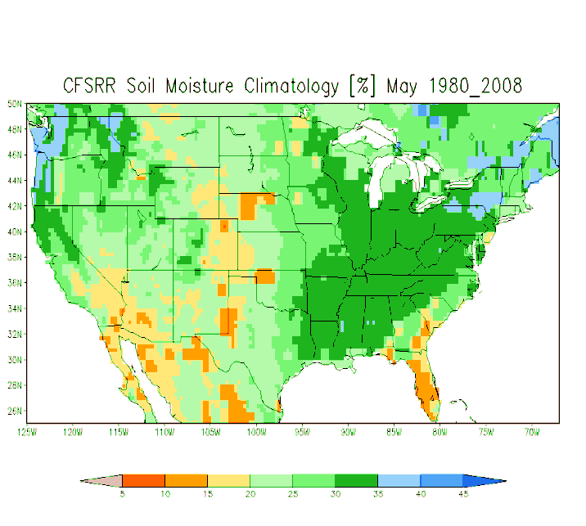
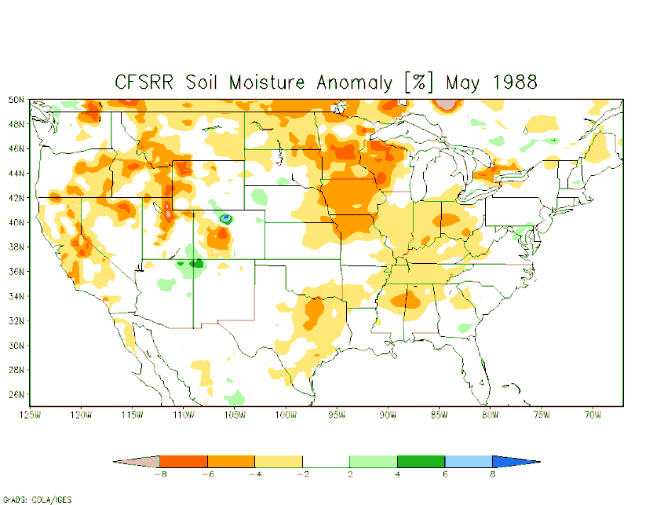
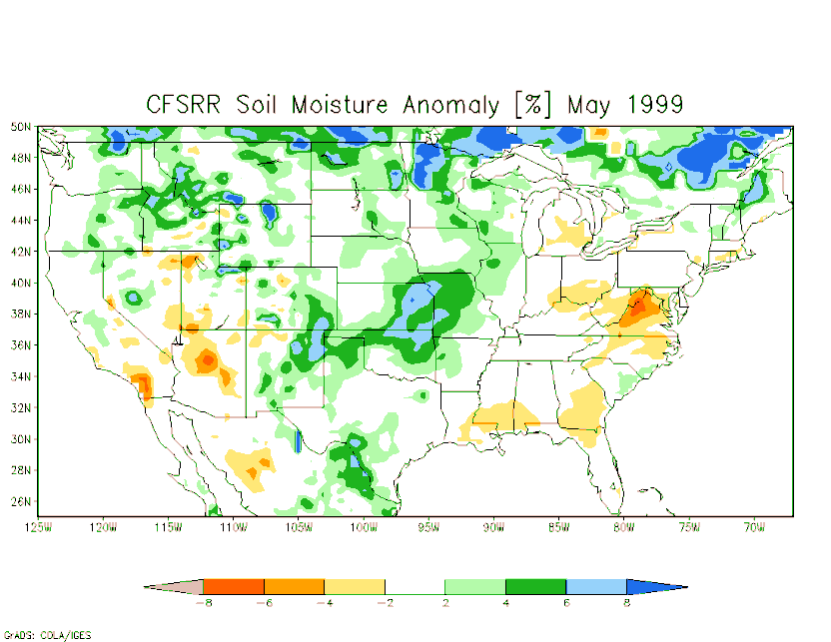
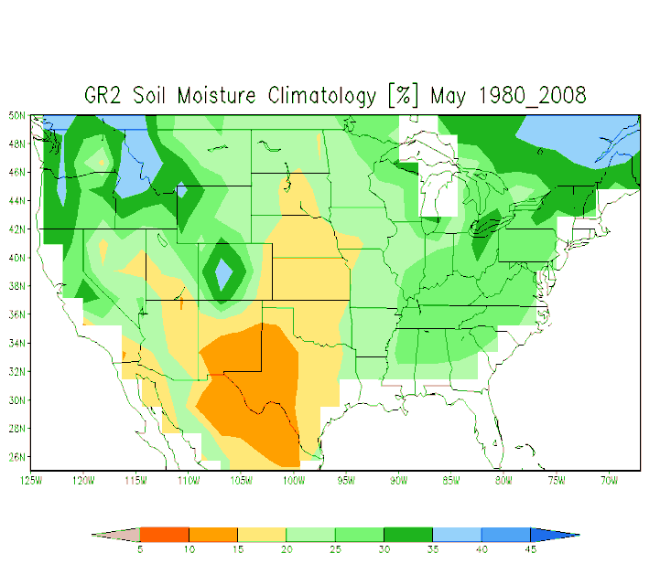
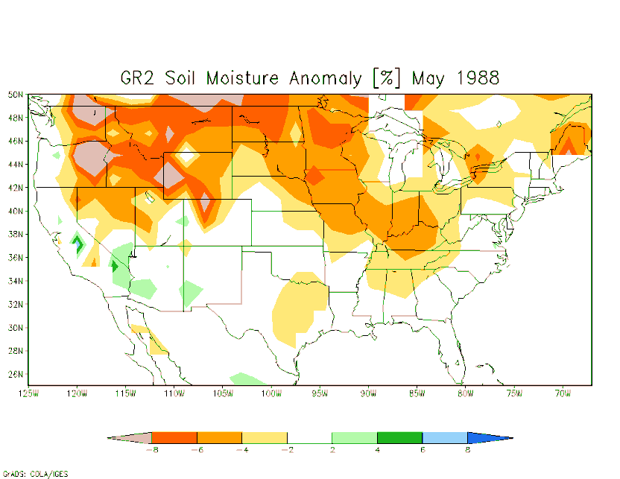
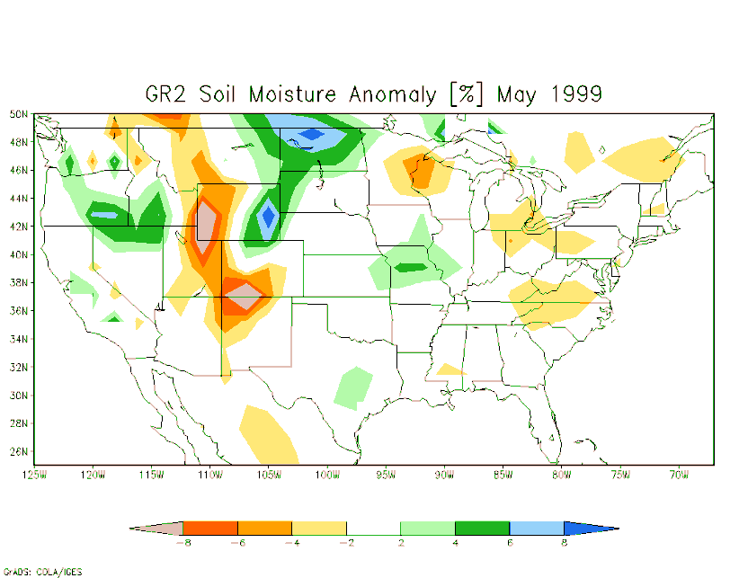
CONUS soil moisture
May climatology and anomaly
CFSR
CFSR 1988
CFSR 1999
R2
R2 1988
R2 1999

Slide 12
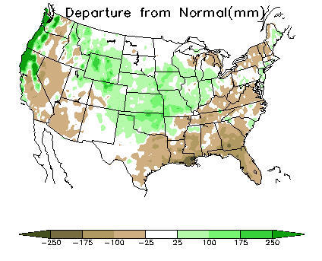
CONUS soil moisture
May climatology and anomaly
CFSR 1999
CPC 90-day obs precip anomaly
ended 30Apr1999
GR2 1999
CFSR soil moisture anomaly corresponds
well with observed precip anomaly.

Slide 13
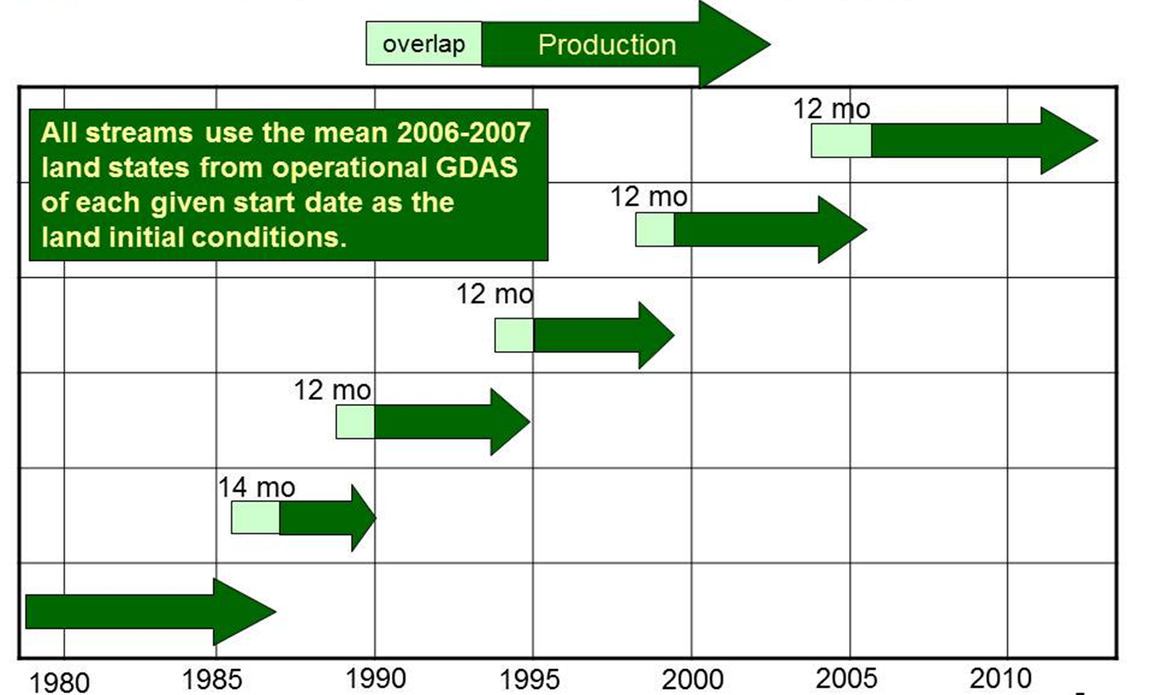
CFSR Production Streams

Slide 14
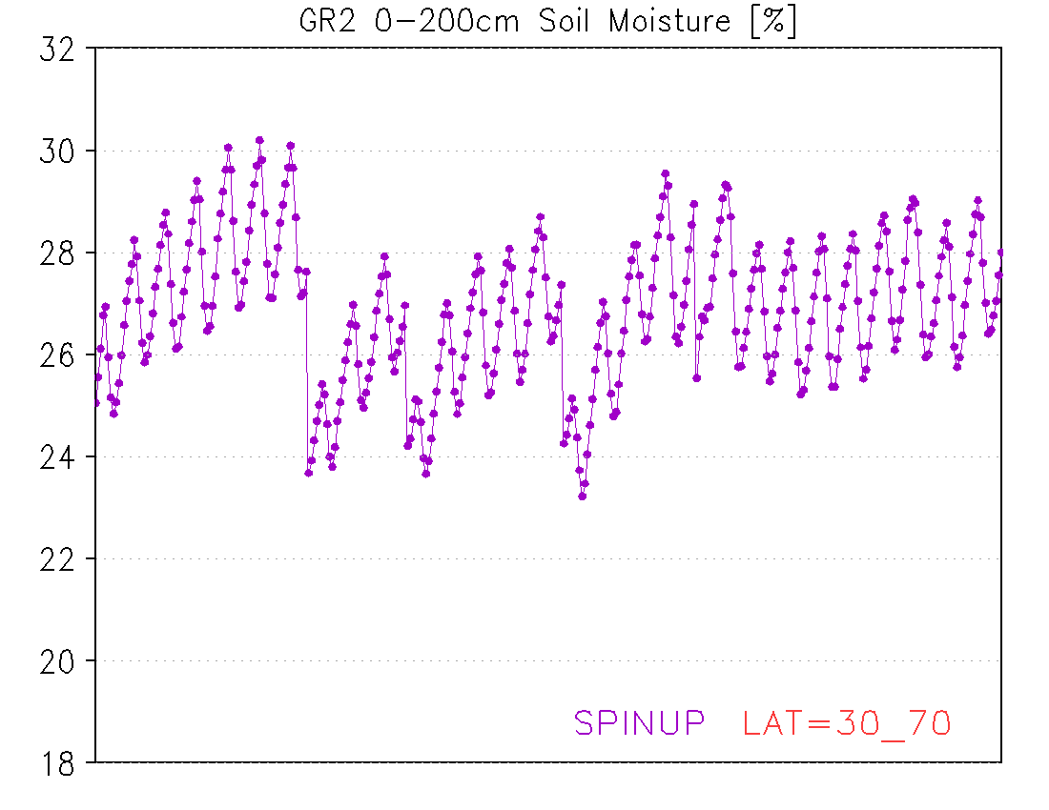
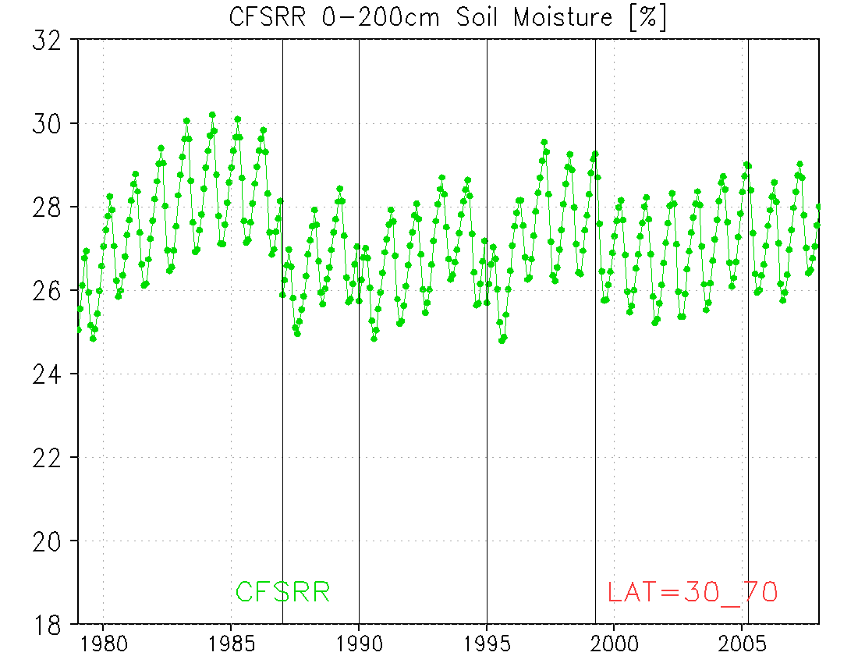
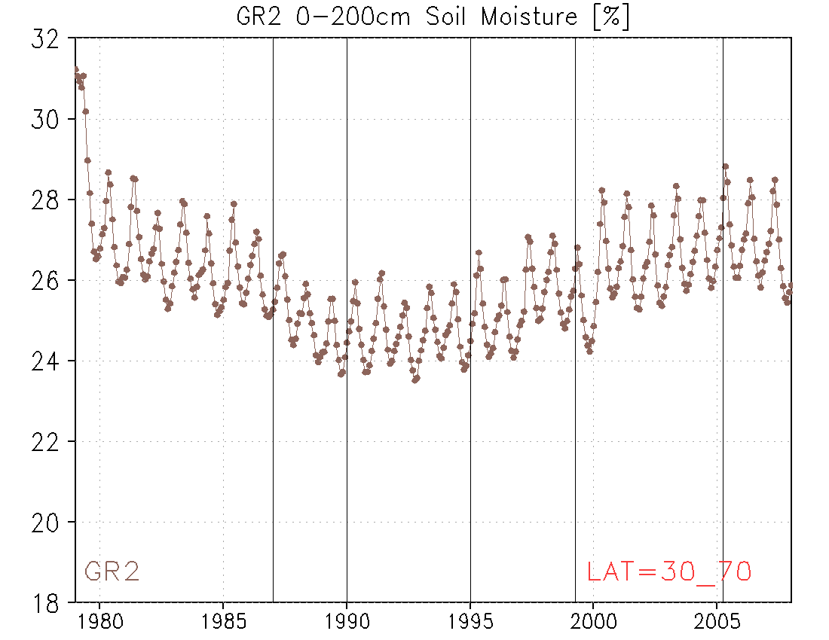
CFSRR 0-200cm Soil Moisture [%]
Overlapping between streams is
essential.
With at least 12-month overlapping,
the discontinuity between streams is
reduced.
R2, while executing one single
continuous stream, also showed an
upward trend over the past two decades.

Slide 15
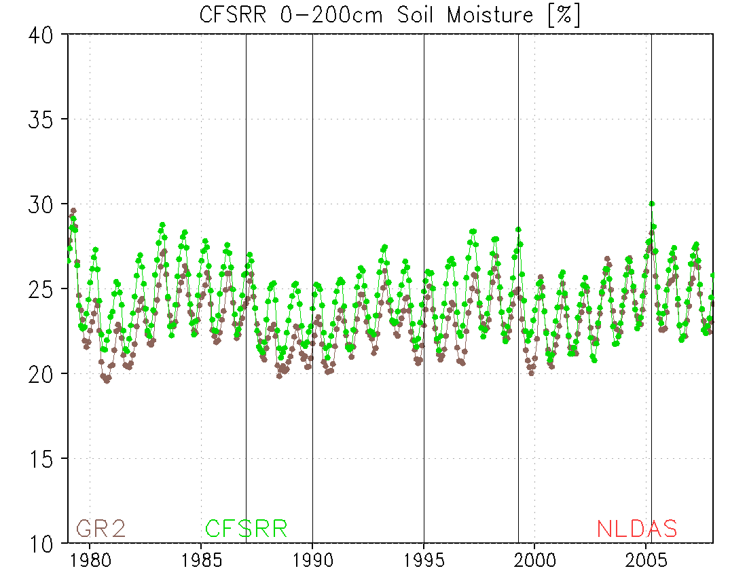
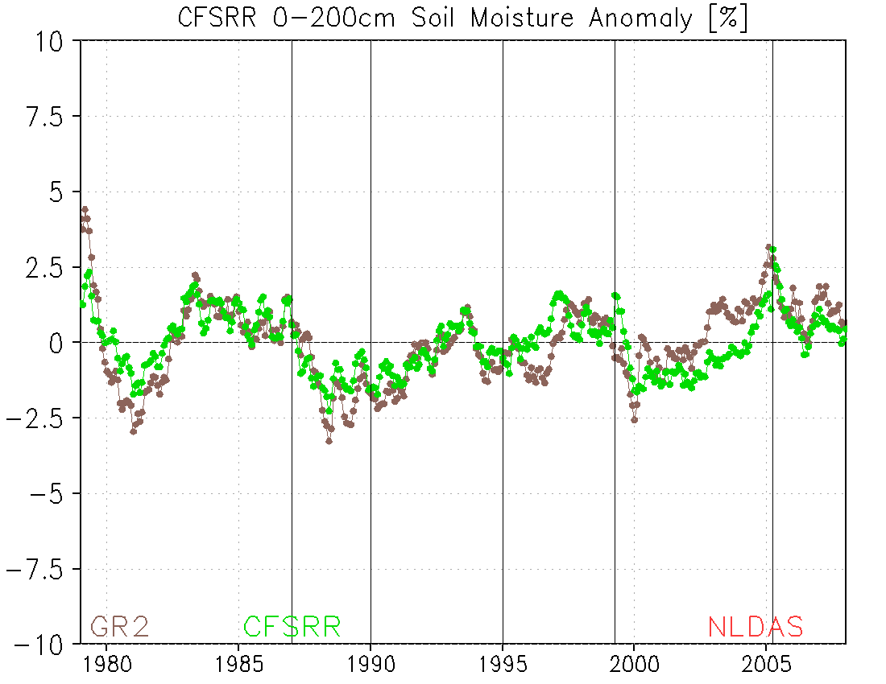
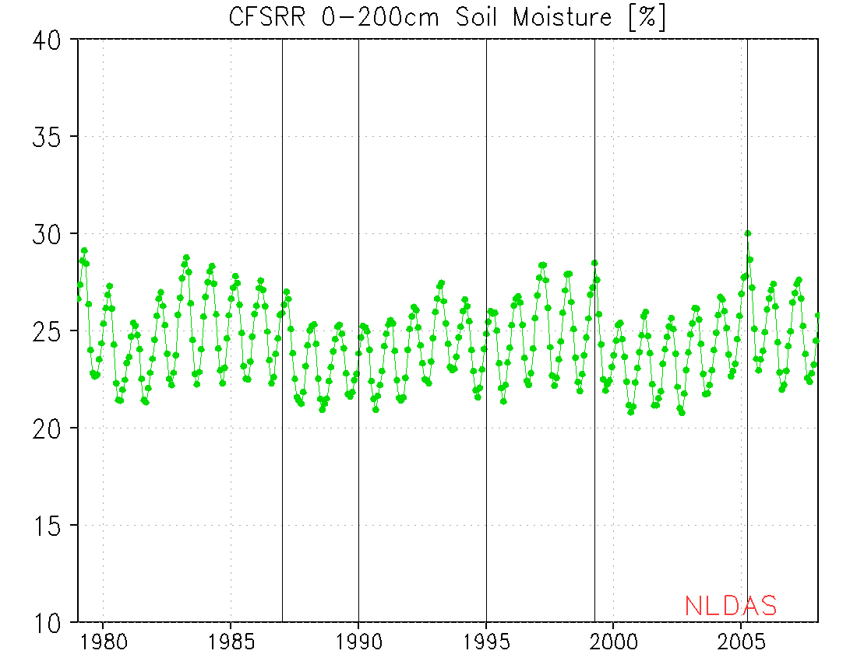
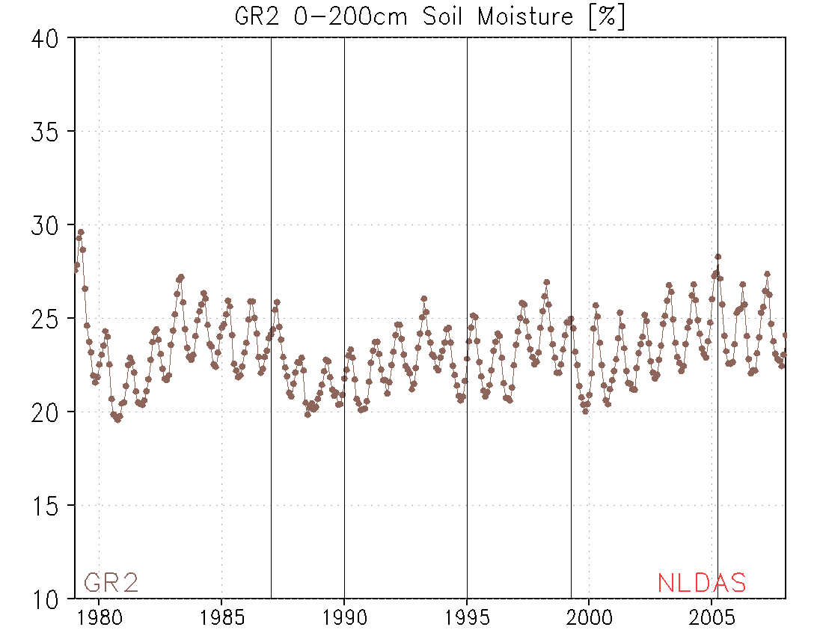
CONUS 2-meter soil moisture
SMC Total
SMC Anomaly
CFSR – 6 streams
R2 – 1 stream
Trend? Natural or model driven?

Slide 16
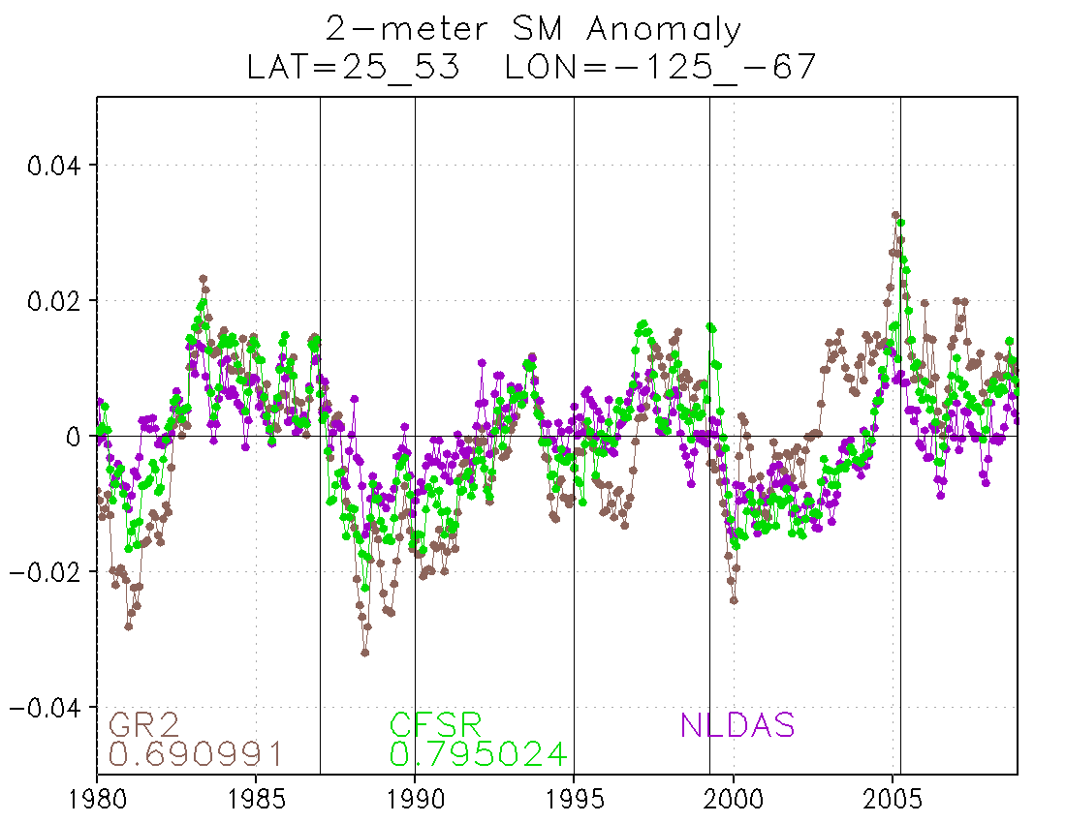
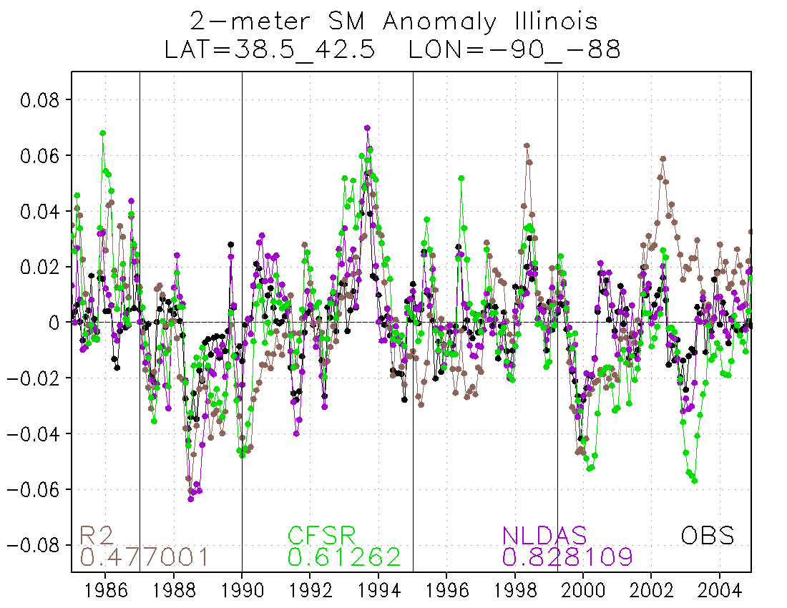
CONUS
Illinois

Slide 17
Water Balance Equation
P – E – R – ΔW/Δt + updates = residual
P: Precipitation
E: Evaporation
R: Runoff
ΔW/Δt : Storage change in Soil Moisture and Snow Water Equivalent
updates: Soil moisture and Snow updates in land analysis
R1/R2 data do not close water balance;
CFSR does.

Slide 18
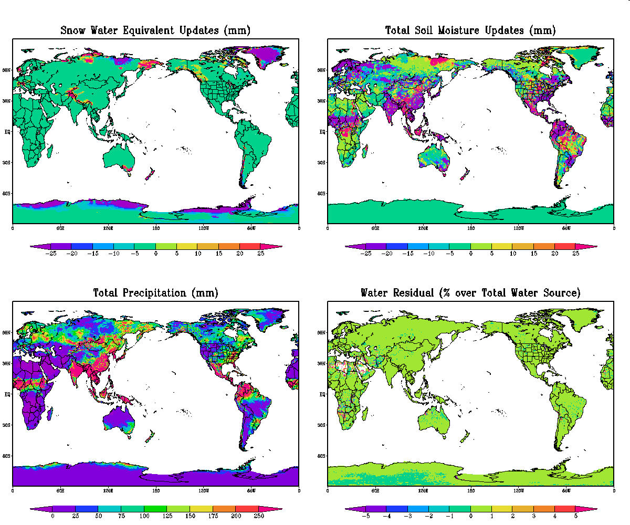
Surface Water Budget

Slide 19
Energy Balance Equation
SW + LW – SH - LH – G – SNOHF = residual
SW: Net Solar Radiation
LW: Net Longware Radiation
SH: Sensible Heat Flux
LH: Latent Heat Flux
G: Ground Heat Flux
SNOHF: Snow Melt/Freeze Heat Flux
R1/R2 data do not close energy balance;
CFSR does.

Slide 20
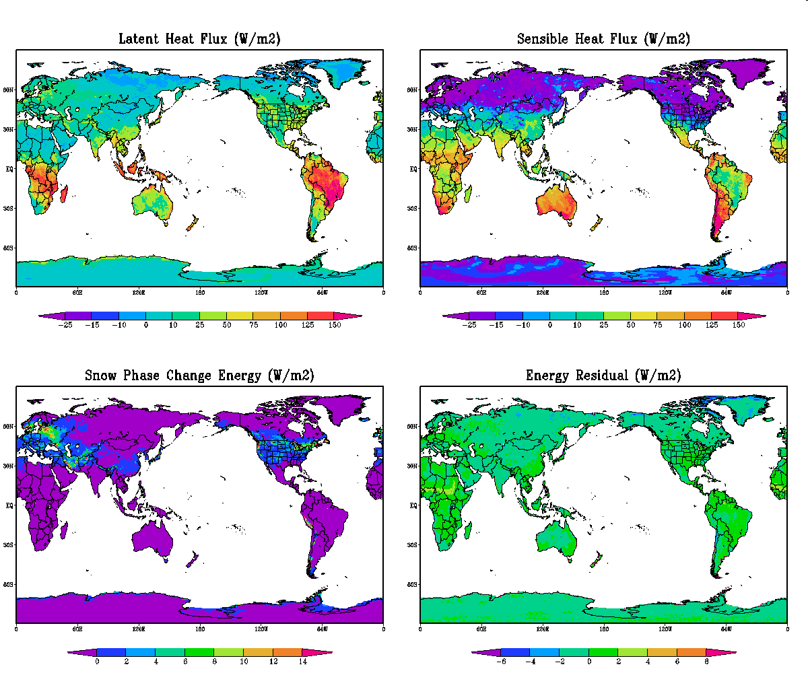
Surface Energy Budget

Slide 21
Global Drought Monitor
One-stream GLDAS
Motivation: CFSR was executed in 6 streams.
Solution: Proposing a One-stream GLDAS (1979-realtime).
Configuration: Same as CFSR (LIS T382).
Forcing: CFSR surface forcing and blended precip forcing.
Initial condition: Spin up land states for 1 January, 1979.
Spin up: 1978 went from weak warm ENSO to neutral,
with a similar condition, 2003 was selected for spin up.
Start with CFSR land states of 1 January, 2003,
execute 5-year recursive spin up with 2003 forcing, then
another 5-year recursive spin up with 1979 forcing.
CFSR 20030101
2003
2003
2003
2003
2003
1979
1979
1979
1979
1979
GLDAS 1979 - realtime

Slide 22
Conclusions
CFSR and R2 carry similar seasonal soil moisture climatology, with differences due to model physics upgrades and forcing, mostly precipitation.
On regional scale of CONUS, anomaly correlation of (CFSR,NLDAS) soil moisture time series is higher than (R2,NLDAS).
On local scale of Illinois, anomaly correlation of (CFSR,obs) soil moisture time series is higher than (R2,obs) but lower than (NLDAS,obs).
Land surface water and energy budget closure.
A retrospective one-stream GLDAS is in process to resolve the issues of spin up and stream discontinuity to support the proposed Global Drought Monitor.

