Slide 1
4th World Climate Research Programme International Conference on Reanalyses
Silver Spring, MD, May 9, 2012
Land Surface Analysis
and Reanalysis
at the NASA GMAO
Rolf Reichle
G. De Lannoy, C. Draper, B. Forman, R. Koster,
Q. Liu, S. Mahanama, A. Toure, and many others
Global Modeling and Assimilation Office, NASA
Rolf.Reichle@nasa.gov
301-614-5693

Slide 2
Outline
Introduction
MERRA-Land Motivation and data product design Validation
Developments in land surface analysis Soil moisture Snow

Slide 3
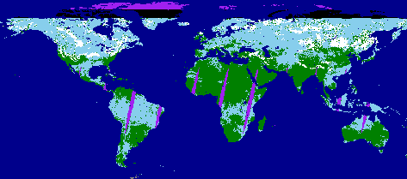
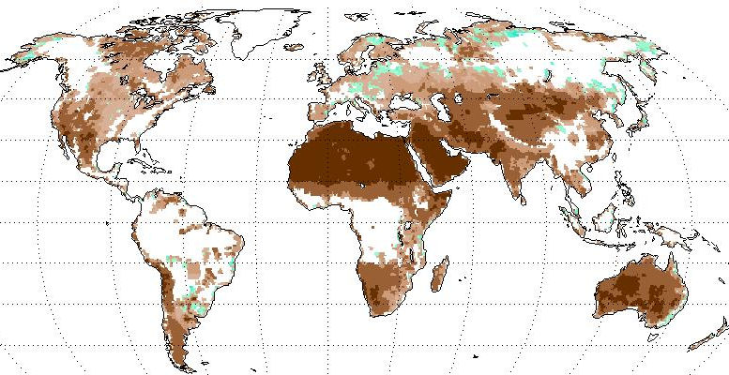
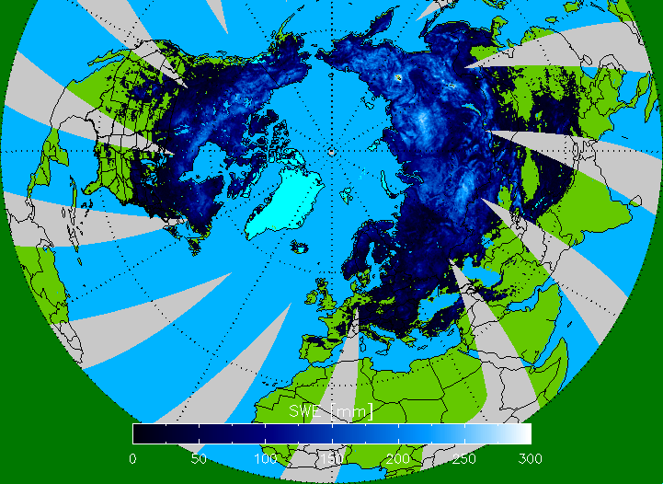
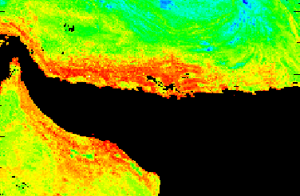
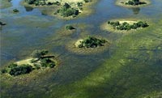
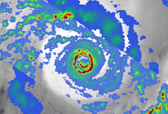
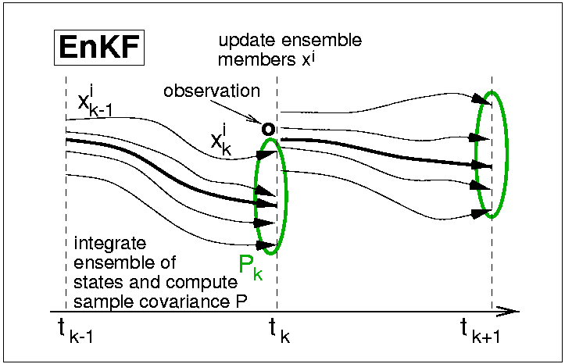
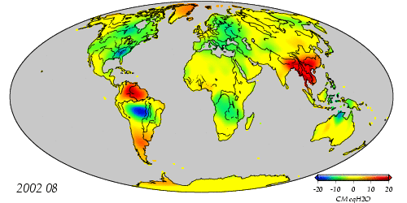
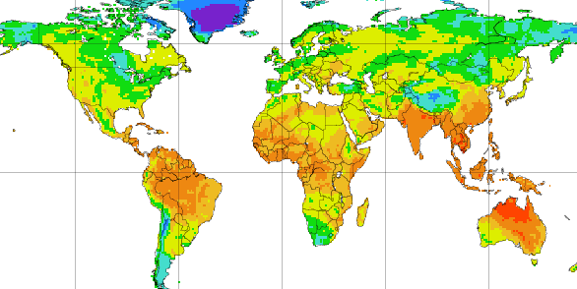
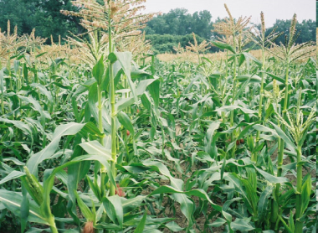
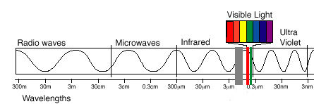
Satellite observations
Snow cover fraction
(MODIS, VIIRS)
Snow water equivalent
(AMSR-E, SSM/I, SCLP)
Surface soil moisture
(SMMR, TRMM, AMSR-E, ASCAT, SMOS, SMAP)
Land surface temperature (MODIS, AVHRR,GOES,… )
Water surface elevation (SWOT)
Precipitation
(TRMM, GPM)
Terrestrial water storage (GRACE)
Land data assimilation system
veg., snow, radiation
soil moisture
snow,
precip.
Radiation
(CERES, CLARREO )
LST
Vegetation/Carbon
(AVHRR, MODIS, DESDynI, ICESat-II, HyspIRI, LIST, ASCENDS )
Notes:
Discuss mw v IR v gravity

Slide 4
A generic land data assimilation system
Land surface OBSERVATIONS
(Satellite and conventional)
Forcings
Precipitation, radiation,
air temperature, …
Parameters
Soil, vegetation, albedo, …
States
Soil moisture, snow, terrestrial water storage, …
Land surface model
Weights based on uncertainties.
“Model” estimates
Analysis
“Optimal”
land surface estimates
Land data assimilation system
Atmosphere-ocean modeling & analysis system
APPLICATIONS

Slide 5
A generic land data assimilation system
Land surface OBSERVATIONS
(Satellite and conventional)
Forcings
Precipitation, radiation,
air temperature, …
Parameters
Soil, vegetation, albedo, …
States
Soil moisture, snow, terrestrial water storage, …
Land surface model
Weights based on uncertainties.
“Model” estimates
Analysis
Subsystem is often called “LDAS”
“Optimal”
land surface estimates
Land data assimilation system
Atmosphere-ocean modeling & analysis system
APPLICATIONS

Slide 6
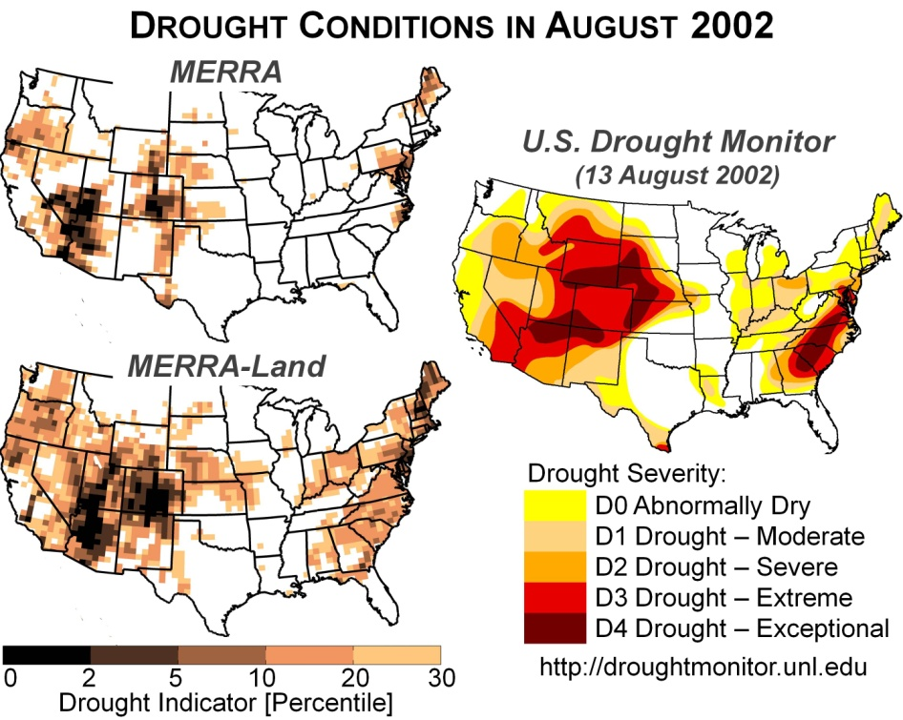
A generic land data assimilation system
Example:
The MERRA-Land data product
http://gmao.gsfc.nasa.gov/research/merra/merra-land.php
Land surface OBSERVATIONS
(Satellite and conventional)
Forcings
Precipitation, radiation,
air temperature, …
Parameters
Soil, vegetation, albedo, …
States
Soil moisture, snow, terrestrial water storage, …
Land surface model
Weights based on uncertainties.
“Model” estimates
Analysis
Subsystem is often called “LDAS”
“Optimal”
land surface estimates
Land data assimilation system
Atmosphere-ocean modeling & analysis system
APPLICATIONS

Slide 7
A generic land data assimilation system
Land surface OBSERVATIONS
(Satellite and conventional)
Forcings
Precipitation, radiation,
air temperature, …
Parameters
Soil, vegetation, albedo, …
States
Soil moisture, snow, terrestrial water storage, …
Land surface model
Weights based on uncertainties.
“Model” estimates
Analysis
“Optimal”
land surface estimates
Land data assimilation system
“uncoupled” or “off-line” land assimilation
Atmosphere-ocean modeling & analysis system
APPLICATIONS

Slide 8
A generic land data assimilation system
Land surface OBSERVATIONS
(Satellite and conventional)
Forcings
Precipitation, radiation,
air temperature, …
Parameters
Soil, vegetation, albedo, …
States
Soil moisture, snow, terrestrial water storage, …
Land surface model
Weights based on uncertainties.
“Model” estimates
Analysis
Example: The SMAP Level 4 Surface and Root Zone Soil Moisture (L4_SM) Product
“Optimal”
land surface estimates
Land data assimilation system
“uncoupled” or “off-line” land assimilation
Atmosphere-ocean modeling & analysis system
APPLICATIONS

Slide 9
A generic land data assimilation system
Land surface OBSERVATIONS
(Satellite and conventional)
Forcings
Precipitation, radiation,
air temperature, …
Parameters
Soil, vegetation, albedo, …
States
Soil moisture, snow, terrestrial water storage, …
Land surface model
Weights based on uncertainties.
“Model” estimates
Analysis
“Optimal”
land surface estimates
Land data assimilation system
Ultimate goal, under development: Coupled land-atmosphere assimilation
Atmosphere-ocean modeling & analysis system
APPLICATIONS

Slide 10
Outline
Introduction
MERRA-Land Motivation and data product design Validation
Developments in land surface analysis Soil moisture Snow

Slide 11
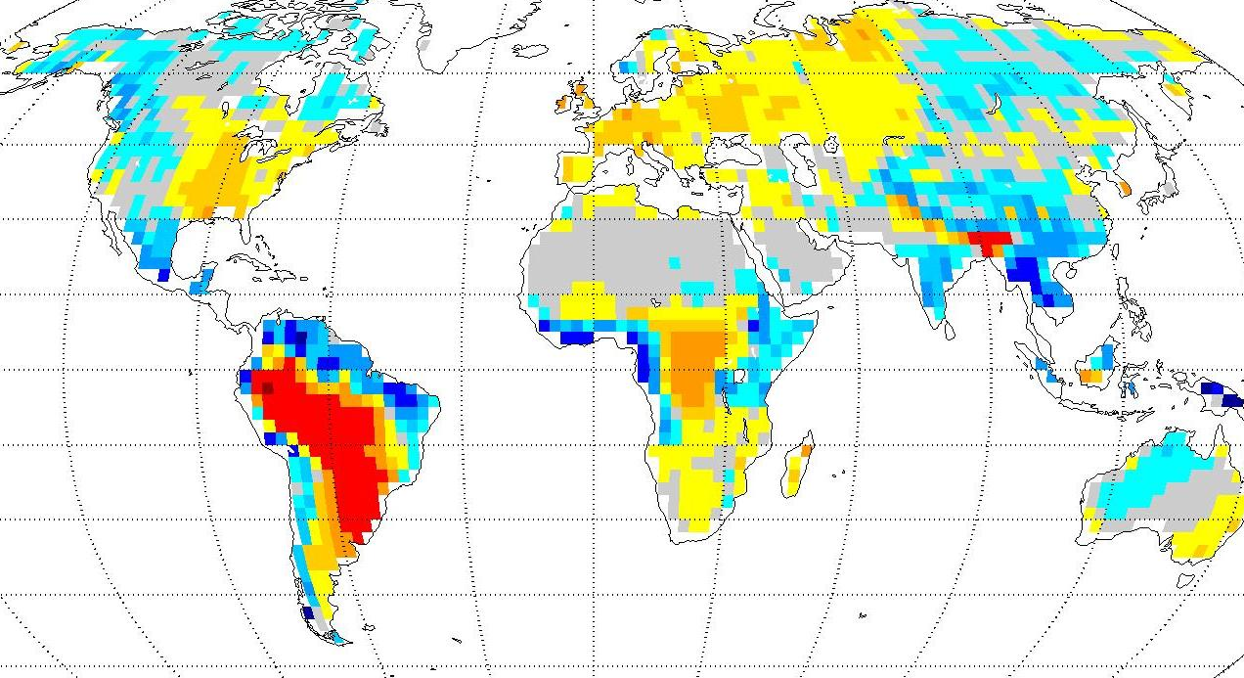
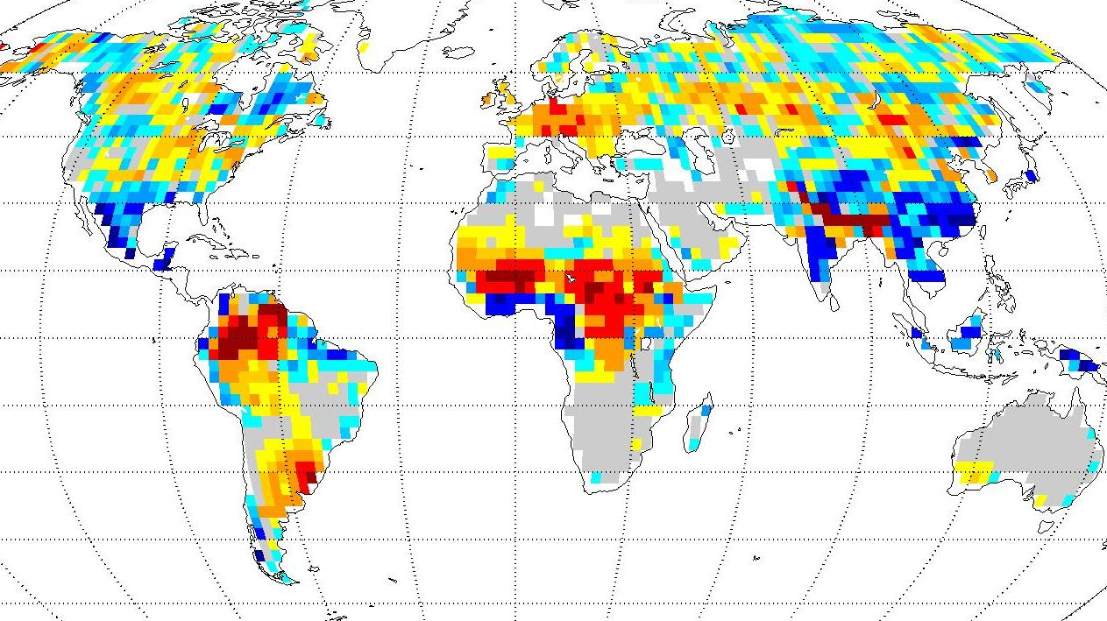

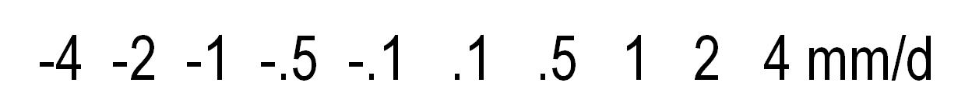
Motivation for MERRA-Land: Precipitation
MERRA – GPCPv2.1
1981-2008 [mean=-0.03 mm/d]
Aug 1994 [mean=-0.04 mm/d]
Long-term bias
Synoptic-scale errors
→ Correct MERRA precipitation with gauge-based precipitation observations to the extent possible.
Reichle et al. J Clim (2011)
doi:10.1175/JCLI-D-10-05033.1

Slide 12
MERRA-Land precipitation corrections
MERRA
  Reanalysis
  Hourly
  0.5° x 0.67°
Use gauge-based NOAA CPC Global Unified (CPCU) precipitation b/c of improved latency and spatial/temporal resolution.
CPCU
  Gauges
  Daily
  0.5° x 0.5°
Rescale MERRA
separately for each day and 0.5° x 0.67° grid cell
For each day and each 0.5° x 0.67° grid cell, the corrected MERRA precipitation (almost) matches CPCU observations.
MERRA + CPCU
  (hourly, 0.5° x 0.67°)

Slide 13
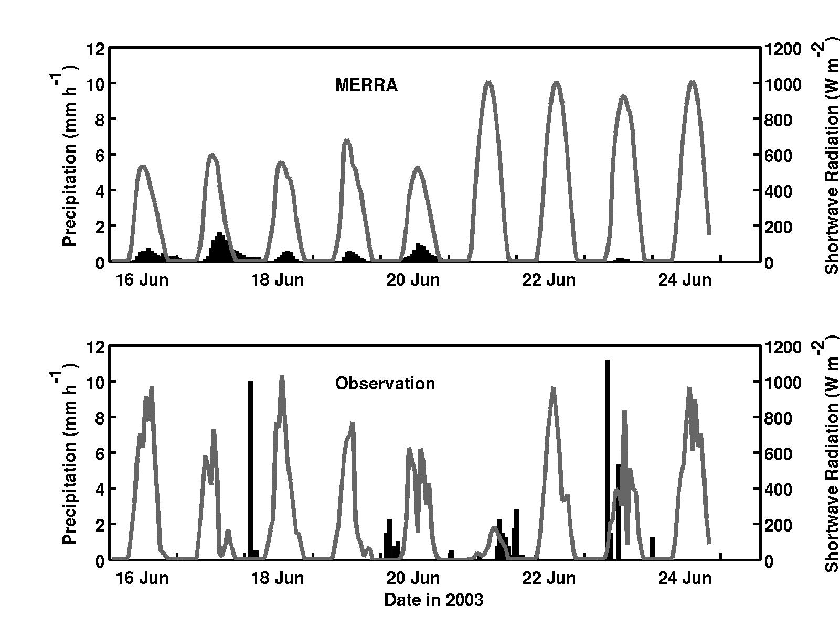



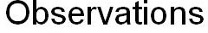
MERRA precipitation and radiation forcing
MERRA precip. has short-term errors in
intensity,
timing, and
consistency with SW radiation forcing.
Near Gainesville, FL
Too much canopy evaporation
→ not enough water reaches the soil!
Additional fix:
Change Catchment model interception parameters.

Slide 14
Land-only (“off-line”) replay
Gauge-based estimates
Precipitation |  | MERRA |  | MERRA + CPCU
Surface Tair, Qair, SW, LW, etc. |  | MERRA |  | MERRA
Catchment model version |  | MERRA (v5.2.0) |  | “Fortuna” (v5.7.2)
Data product |  | MERRA “replay” [Close to MERRA but not perfect.] |  | MERRA-Land
Latest GEOS-5 model version
1980-2012, hourly, 0.5⁰ by 0.67⁰
Available at NASA GES-DISC
(alongside MERRA)

Slide 15
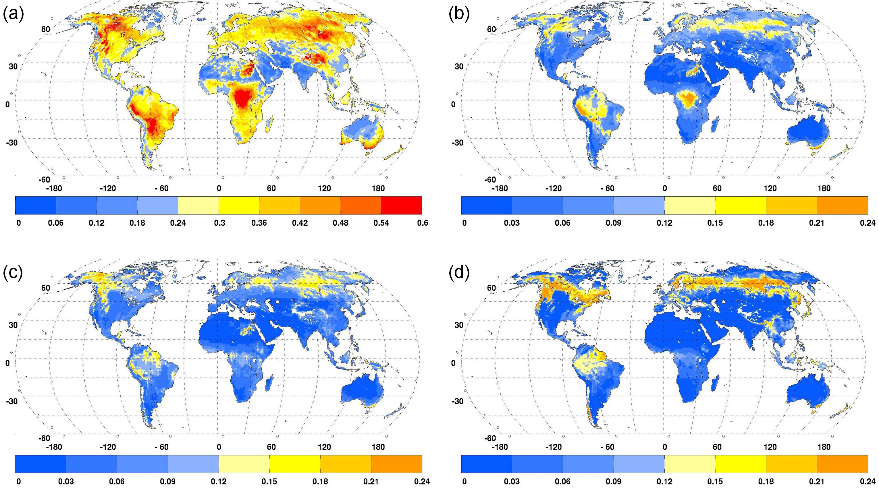
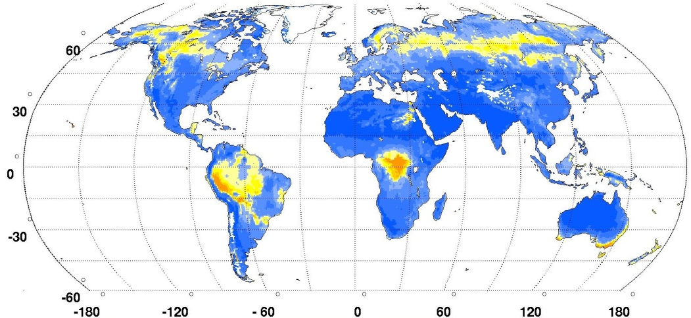

Interception loss frac. = canopy evap. / rainfall (2003-2007)
MERRA
Revised Catchment model
(b)
I = 0.31
I = 0.07
MERRA-Land (“final")
“Observations” (Miralles et al. 2010)
(c)
I = 0.06
I = 0.06
Improvement everywhere from revised interception parameters (b).
Additional improvement from precipitation corrections (c).
Notes:
Figure 3. 2003-2007 average interception loss fraction (dimensionless) from (a) MERRA, (b) revised Catchment model with MERRA forcing, (c) MERRA-Land, and (d) observations-based estimates from Miralles et al. (2010). Note the different colorbar in (a).

Slide 16
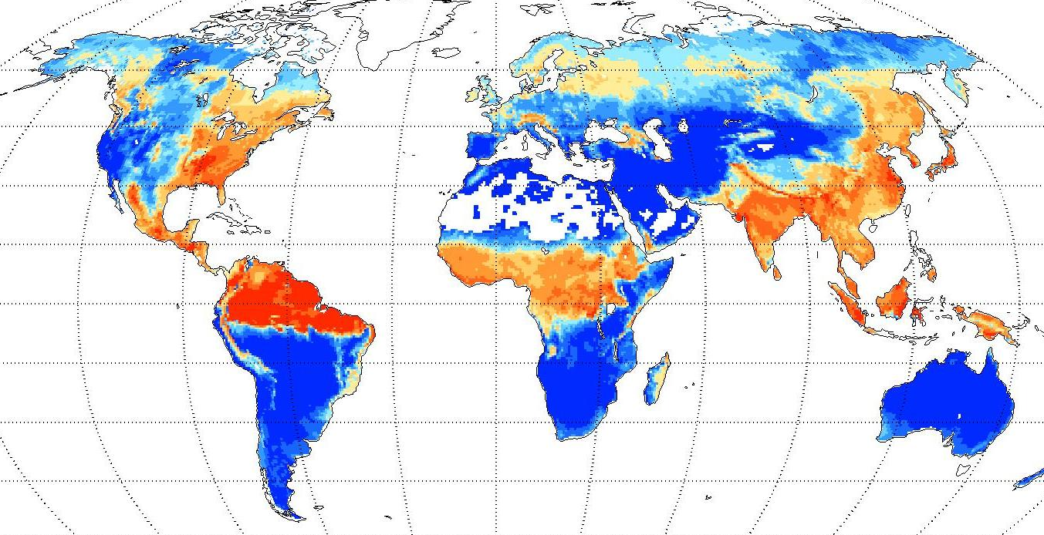
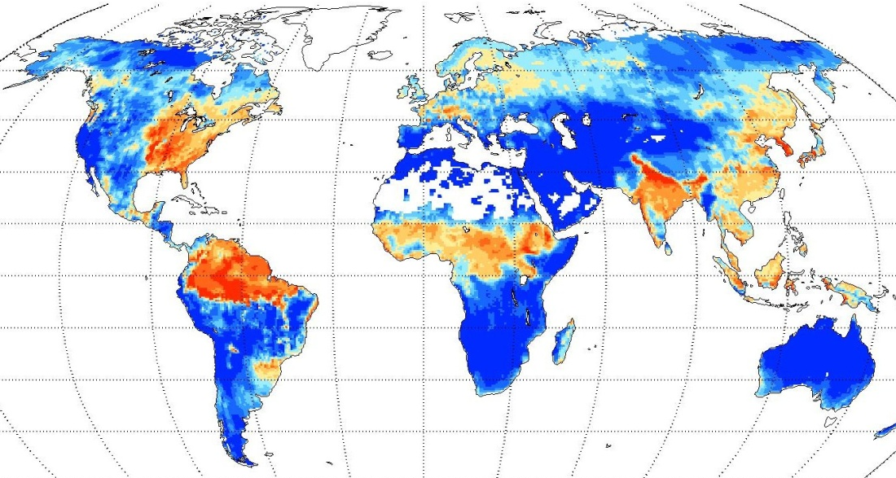
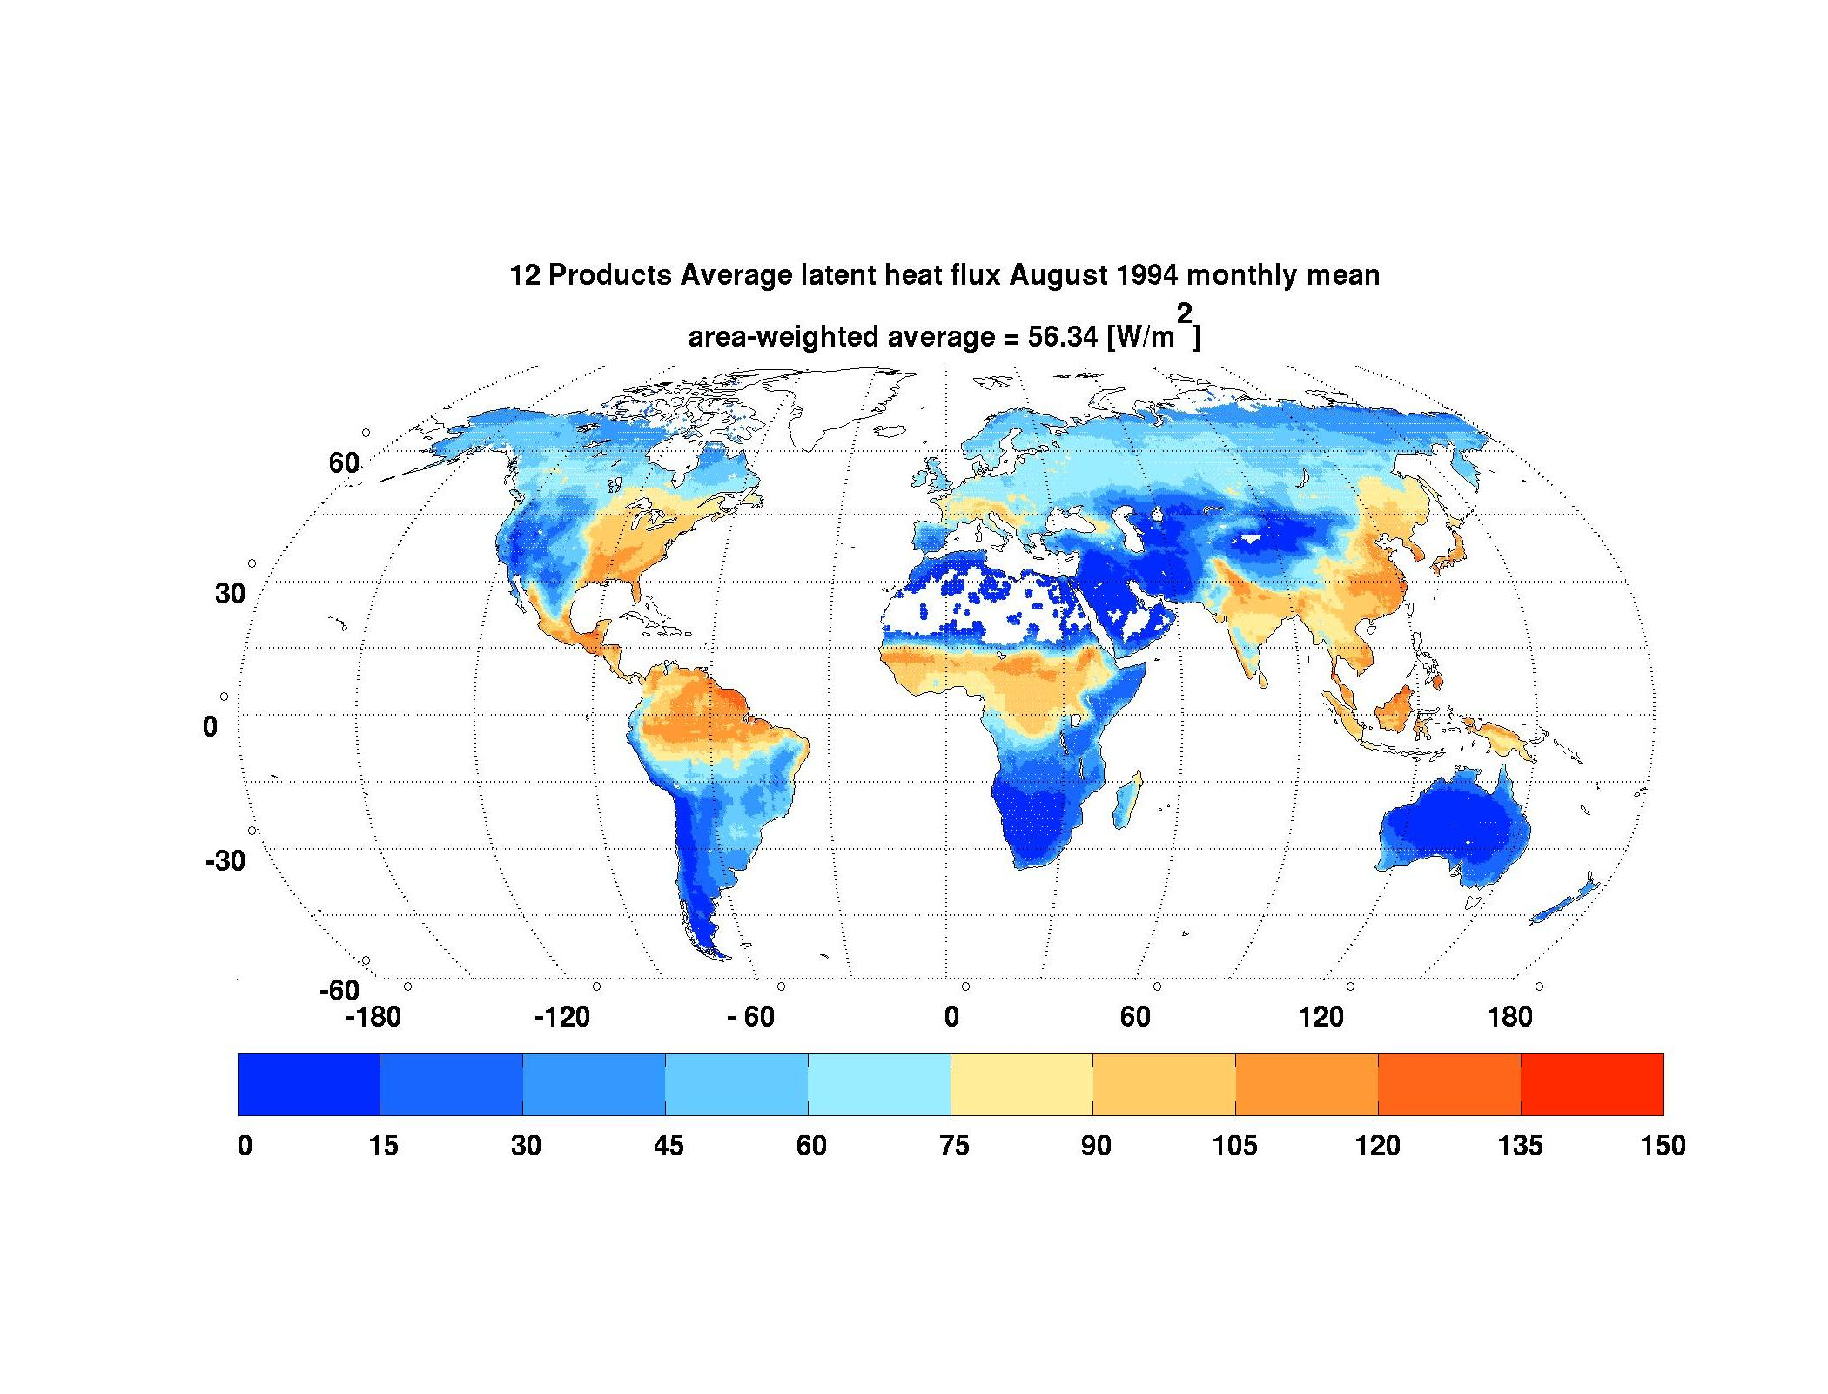
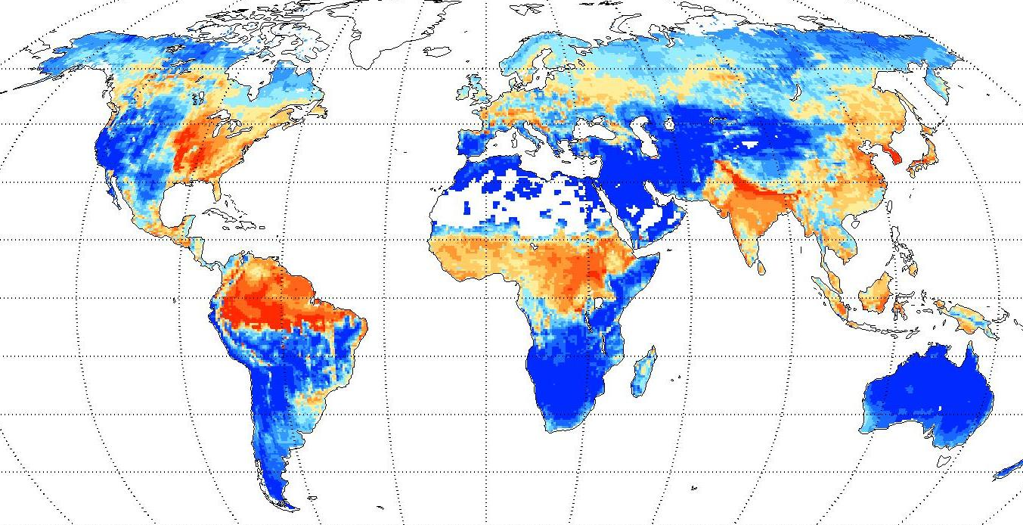
Latent heat flux (August 1994)
MERRA
MERRA-Land has more realistic LH over Amazon during dry season.
Attributed to revised interception parameters and precipitation corrections.
mean = 58 Wm⁻²
Multi-product average
(Jimenez et al. 2011)
MERRA-Land (“final”)
mean = 49 Wm⁻²
mean = 56.3 Wm⁻²
W/m²
Notes:
Figure 4. Average latent heat flux (W m⁻²) for August 1994 from (a) MERRA, (b) MERRA-Land, and (c) the Jimenez et al. (2010) multi-product average.

Slide 17
Outline
Introduction
MERRA-Land Motivation and data product design Validation
Developments in land surface analysis Soil moisture Snow

Slide 18
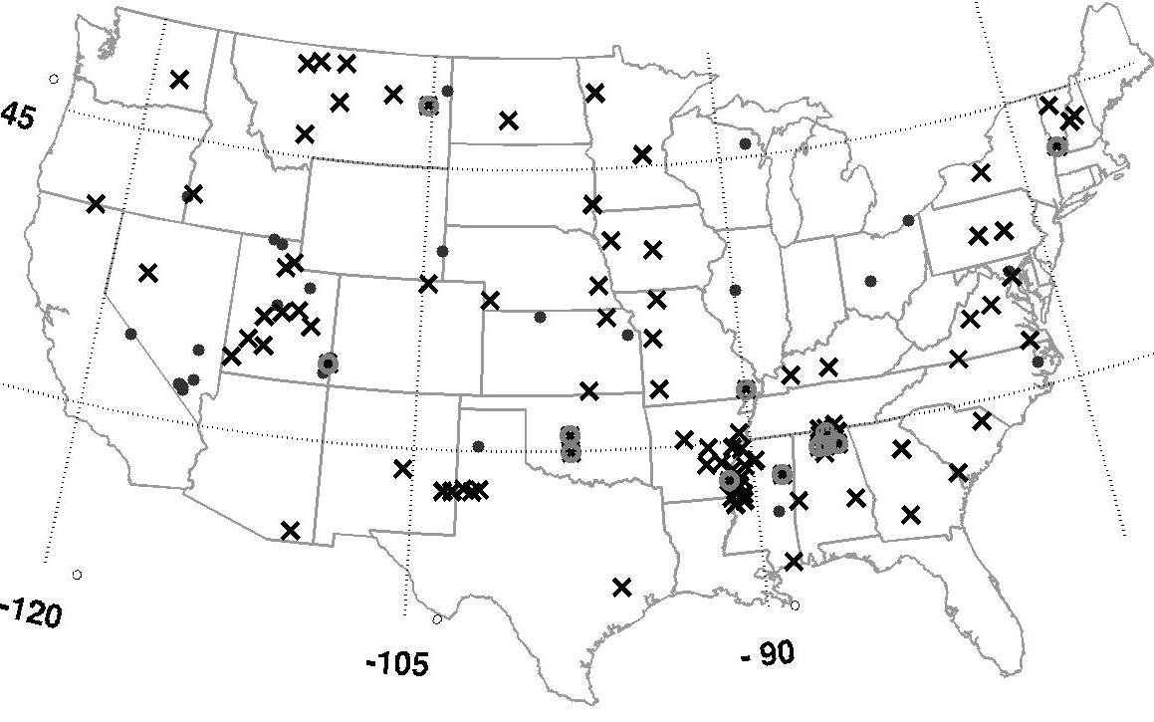
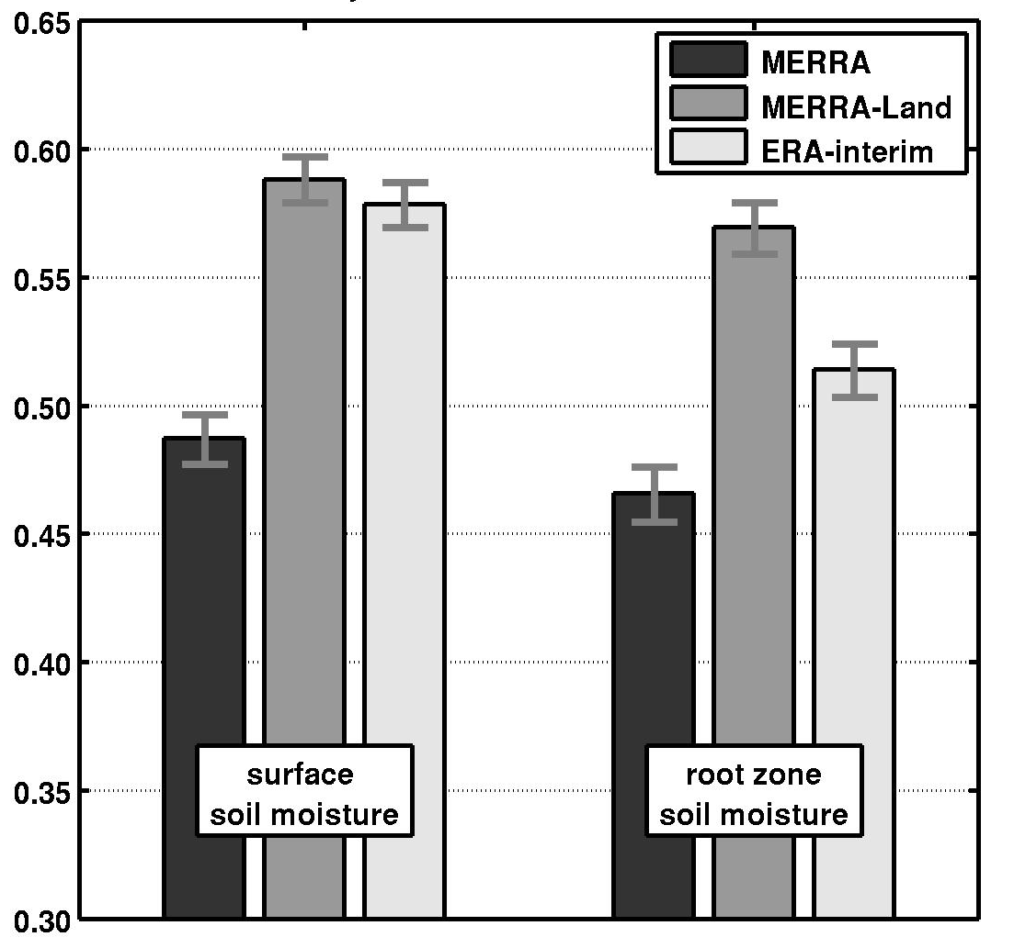
Soil moisture validation (2002-2009)
Skill (pentad anomaly R)
v. SCAN in situ observations
MERRA-Land has better soil moisture anomalies than MERRA (attributed to precipitation corrections).
MERRA-Land root zone skill better than ERA-Interim.
Notes:
Figure 6. Soil moisture validation against SCAN in situ measurements (Appendix b). (a) Locations of SCAN sites that were (crosses) used for surface and root zone soil moisture validation (85 sites), (circles) used only for surface soil moisture validation (12 sites), and (dots) not used. (b) Skill (pentad anomaly R) versus SCAN in situ surface and root zone soil moisture anomalies for MERRA and MERRA-Land estimates (2002-2009). Error bars indicate approximate 95% confidence intervals.

Slide 19
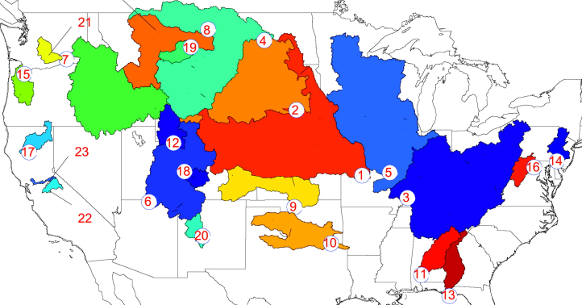
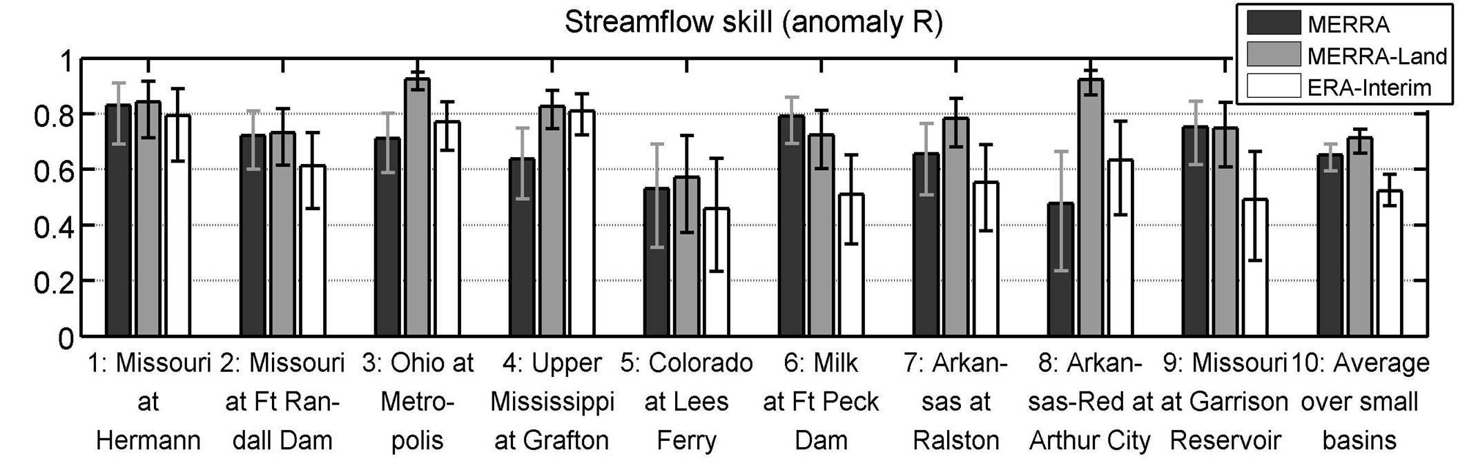
Runoff
Validation against naturalized streamflow observations from 9 “large” and 9 “small” basins (~1989-2009).
NB: Numbering does not match figure below.
Precipitation corrections yield significantly better runoff for 3 basins.
MERRA and MERRA-Land (0.5 deg) better than ERA-Interim (“1.5 deg”).
Not shown: In all cases the revised interception parameters yield improved runoff anomalies (albeit not significant).
Notes:
Figure 7. Seasonal anomaly time series correlation coefficients for runoff estimates from MERRA, MERRA-Land, and ERA-Interim for the basins and time periods listed in Table 2.

Slide 20
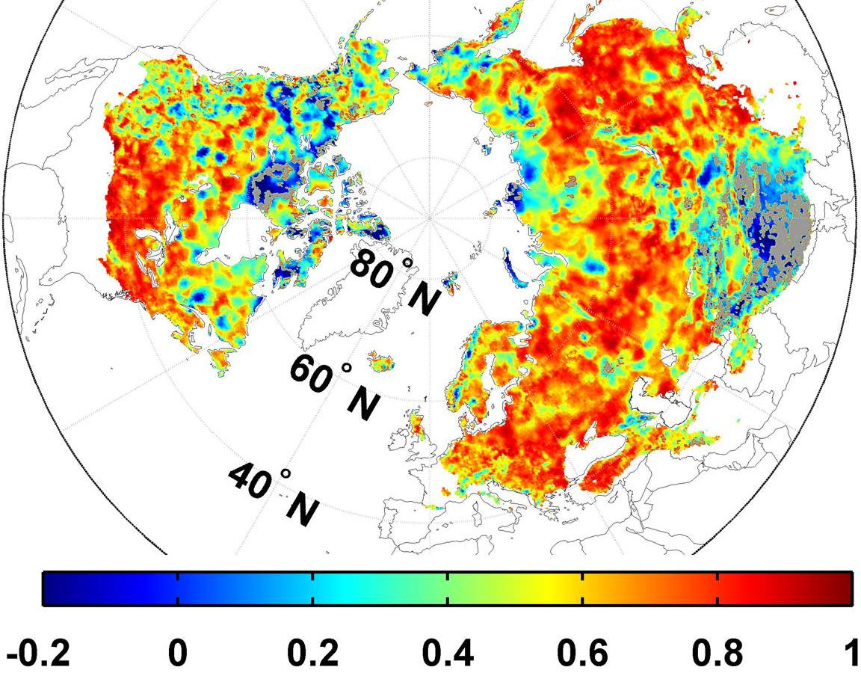
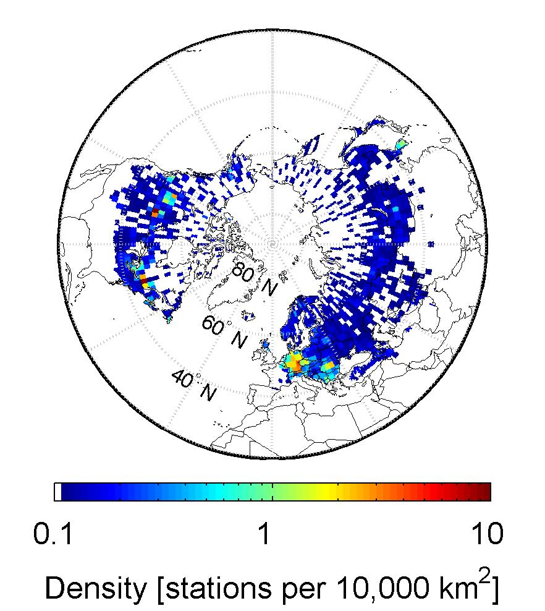
Snow depth
MERRA-Land v. CMC snow analysis
Pentad anomaly R (2002-2009)
Note: No snow analysis in MERRA or MERRA-Land.
CMC snow analysis
Density [stations/10,000 km²]
Low R values in areas w/o in situ obs.
NOT SHOWN
MERRA and MERRA-Land have similar skill.
Similar results for comparison vs. in situ obs. (583 stations).
Similar results for snow water equivalent (SWE).
Step in 1998/99 in CPCU high-lat avg precip. → step in snow mass.
Notes:
Figure 8. (a) Skill (pentad anomaly R) of MERRA-Land snow depth versus CMC estimates (2002-2009). R values that are not statistically different from zero at the 5% significance level are shown in gray. (b) Maximum density of in situ snow depth measurements available for CMC snow analysis.

Slide 21
http://gmao.gsfc.nasa.gov/merra/merra-land.php

Slide 22
Outline
Introduction
MERRA-Land Motivation and data product design Validation
Developments in land surface analysis Soil moisture Snow

Slide 23
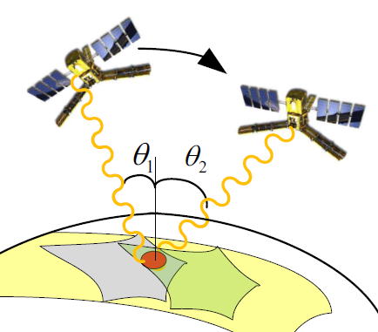
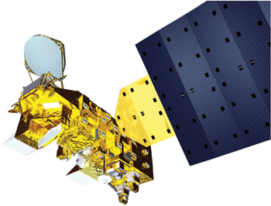
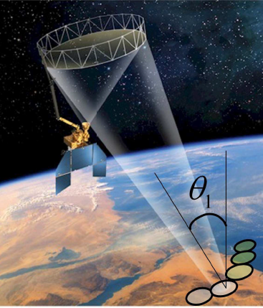
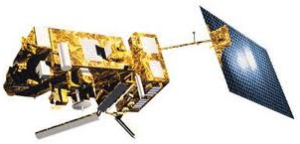
Satellite remote sensing of (surface) soil moisture
AMSR-E (Aqua)
SMOS
2009-present
L-band passive
40 km resolution
interferometric & multi-angular
2002-2011
C/X-band passive
40 km resolution
SMAP
Launch: 2014
L-band active/passive
3-40 km resolution
ASCAT (Met-op)
Frequency band | Sensing depth
C/X-band | 1 cm
L-band | 5 cm
2007-present
C-band active
40 km resolution

Slide 24
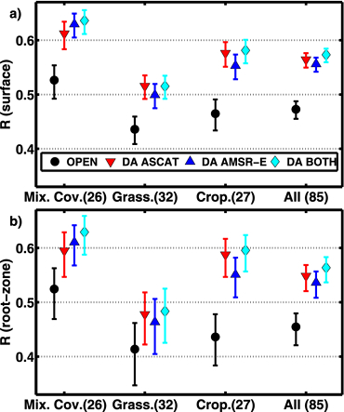
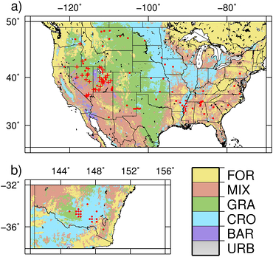
Soil moisture assimilation
Skill increases significantly through data assimilation.
Similar improvements from AMSR-E and ASCAT.
Root-zone not observed by satellite. Improvements may be critical for applications.
Metric: Anom. time series corr. coeff.
Anomalies ≡ mean seasonal cycle removed
Validated with in situ data
Draper et al. (2012), GRL, doi:10.1029/2011GL050655.

Slide 25
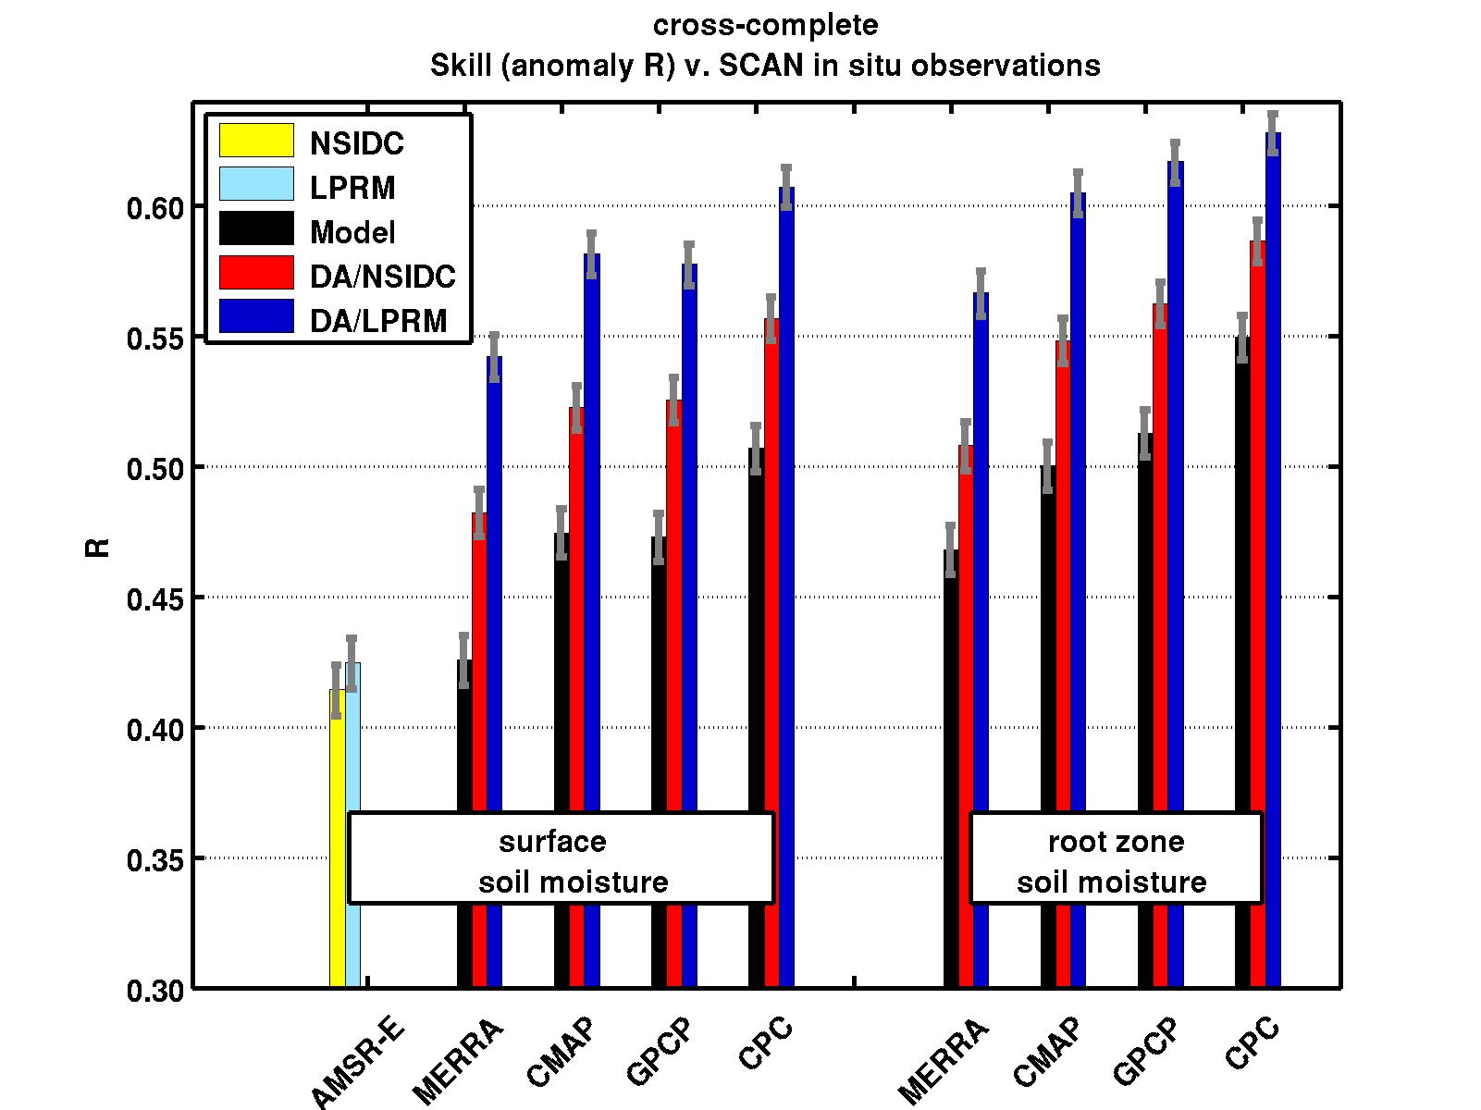
Precipitation corrections v. retrieval assimilation
Skill v. SCAN in situ obs
Anomalies ≡ mean seasonal cycle removed
Skill metric: Anom. time series corr. coeff. R
Soil moisture skill increases with
precipitation corrections and
assimilation of surface soil moisture retrievals.
Improved root zone soil moisture!
Different precipitation forcing inputs
Liu et al. JHM (2011) doi:10.1175/JHM-D-10-05000.

Slide 26
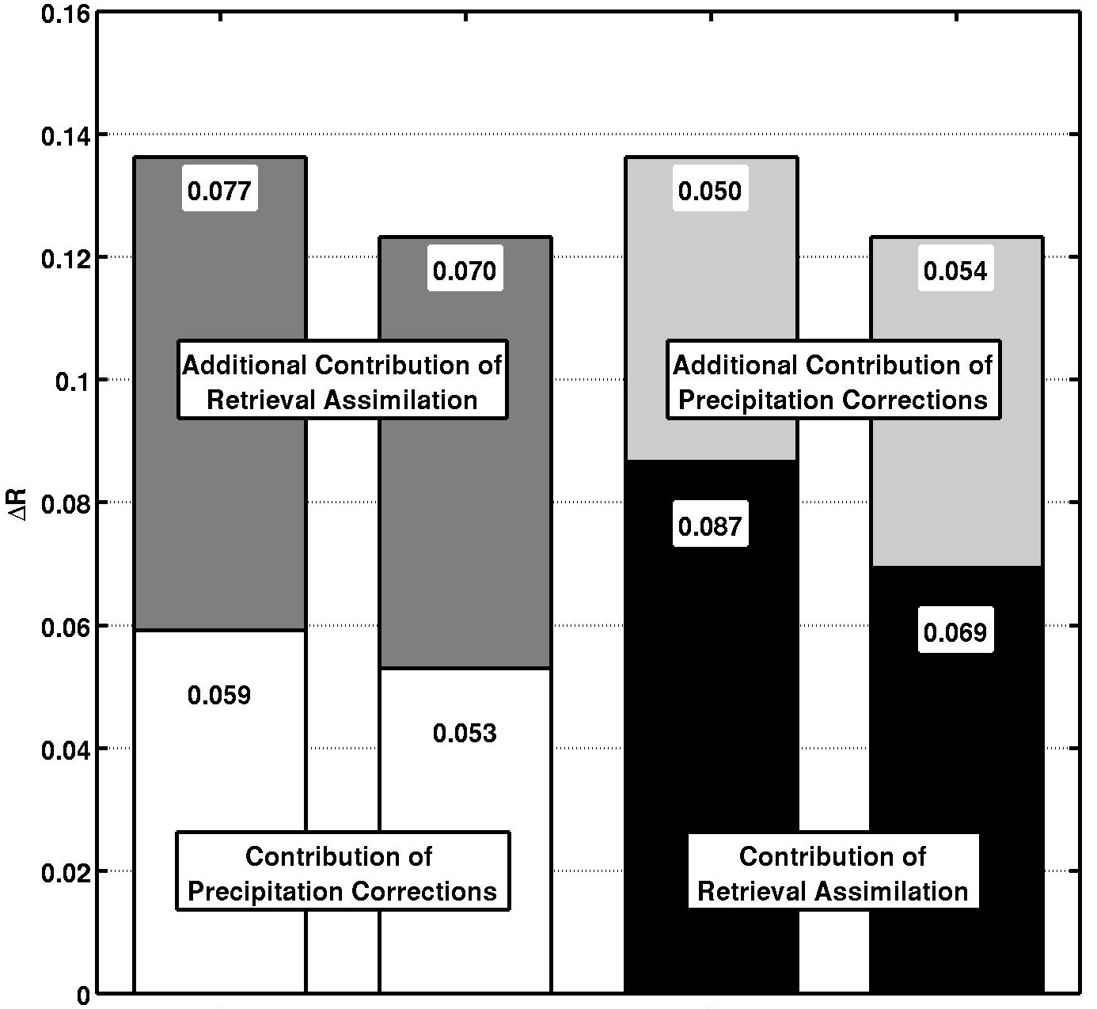
Precipitation corrections v. retrieval assimilation
ΔR = skill improvement over reference model integration
Precipitation corrections and retrieval assimilation contribute approximately:
evenly and
independently
to skill improvement.
Results from single sensor per watershed (SCAN data) are consistent with those from distributed CalVal in situ sensors.
Additional Contribution of Retrieval Assimilation
Additional Contribution of Precipitation Corrections
Contribution of Precipitation Corrections
Contribution of Retrieval Assimilation
surface
root zone
surface
root zone
Liu et al. JHM (2011) doi:10.1175/JHM-D-10-05000.

Slide 27
Soil moisture assimilation
For the SMAP L4_SM product use brightness temperature (radiance) assimilation.
Need L-band radiative transfer model (RTM).

Slide 28
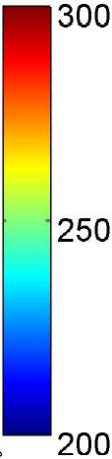
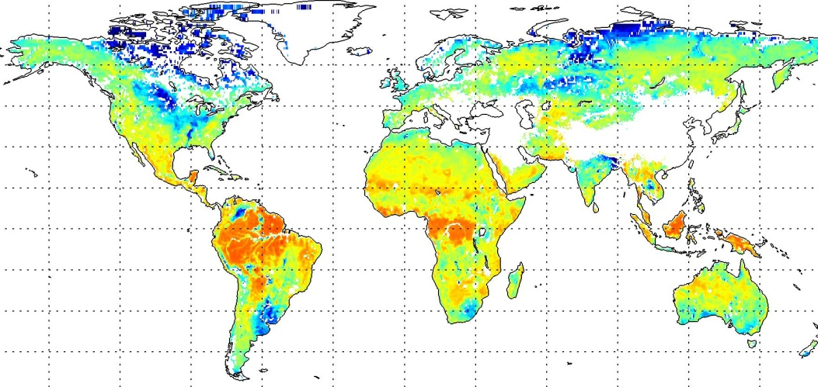
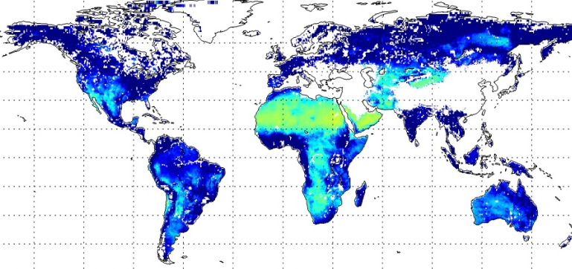
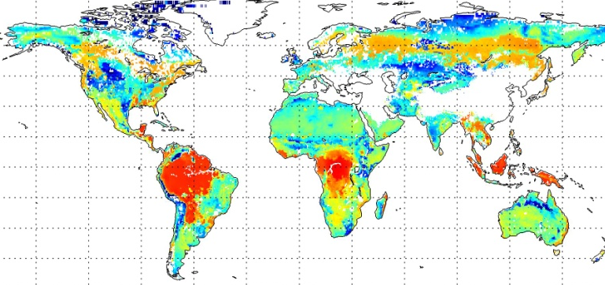
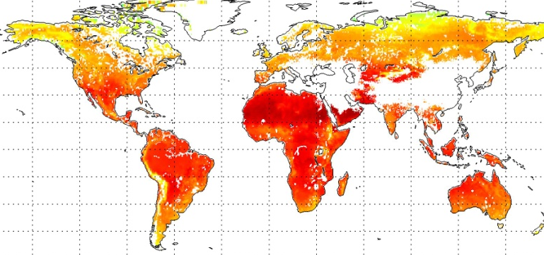
L-band brightness temp.: SMOS vs. Catchment/RTM
Annual mean [K]
H-pol 42.5⁰
1/1/2011 – 1/1/2012
(validation period)
Literature values for parameters yield strongly biased Tb.
SMOS
RTM parameters
Prescribed:
SMAP Level2 ATBD
LMEB literature
SMOS-monitoring at ECMWF (CMEM-EC)
SMAP
LMEB
Model
CMEM-EC

Slide 29
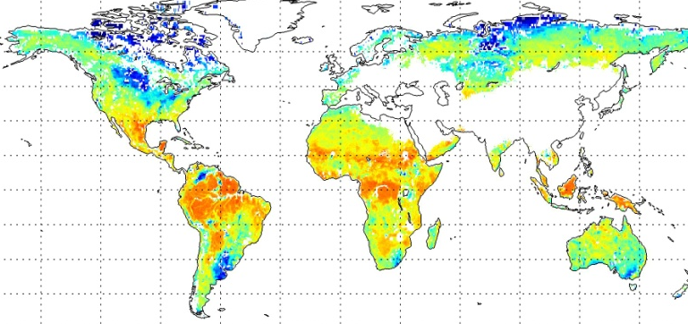
L-band brightness temp.: SMOS vs. Catchment/RTM
Annual mean [K]
H-pol 42.5⁰
1/1/2011 – 1/1/2012
(validation period)
Calibrated parameters yield mostly unbiased long-term mean Tb.
SMOS
RTM parameters
Prescribed:
SMAP Level2 ATBD
LMEB literature
SMOS-monitoring at ECMWF (CMEM-EC)
SMAP
LMEB
Calibrated:
From multi-angular calibration during
1/1/2010 – 1/1/2011
Model
CMEM-EC
Calibrated

Slide 30
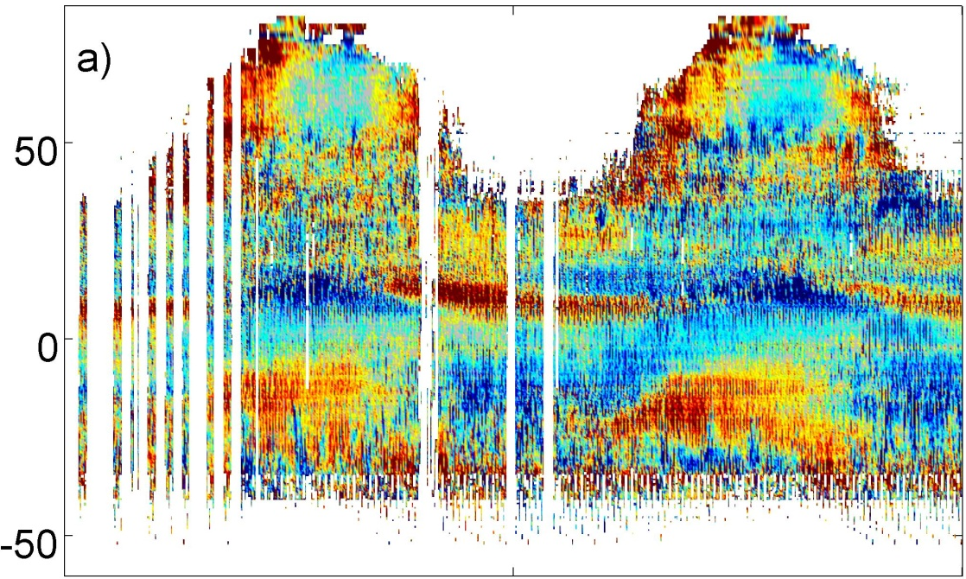
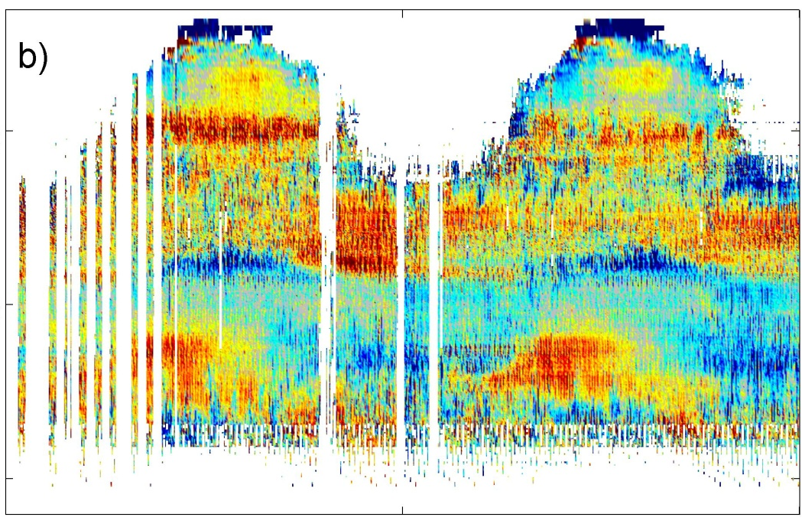
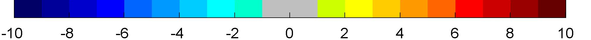
L-band brightness temp.: SMOS vs. Catchment/RTM
Seasonally varying, residual biases after calibration.
Need to address in assimilation system.
RFI in V-pol from Distant-Early-Warning (DEW) Line?
Suppressed in H-pol through calibration?
H-pol
V-pol
Latitude
Time (1/1/2010-1/1/2012)
Time (1/1/2010-1/1/2012)
K
Bias ≡ SMOS minus Model, average over 6 angles, ascending only

Slide 31
Outline
Introduction
MERRA-Land Motivation and data product design Validation
Developments in land surface analysis Soil moisture Snow

Slide 32
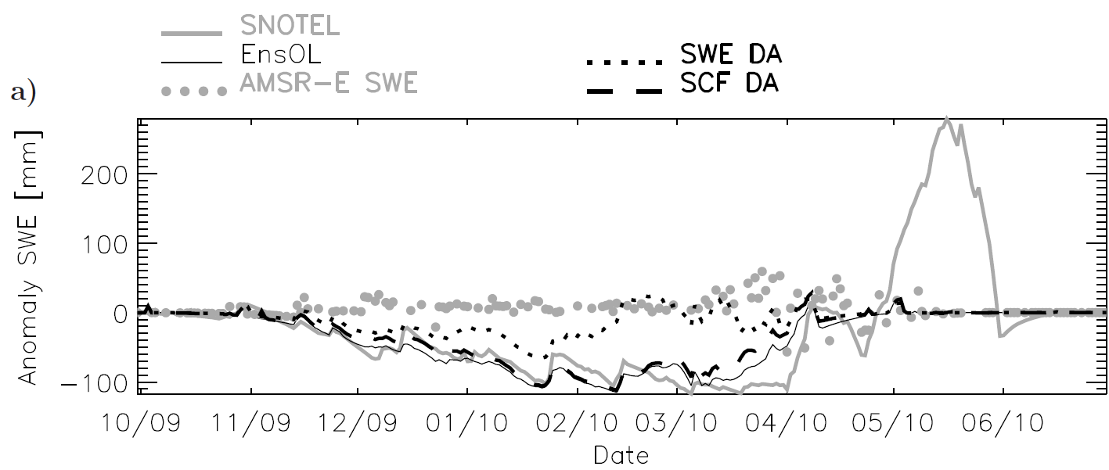
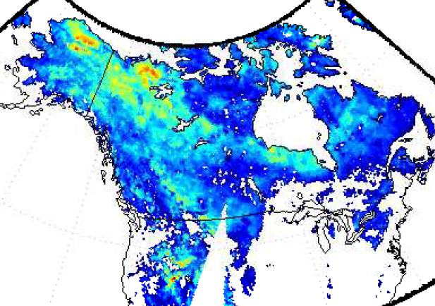
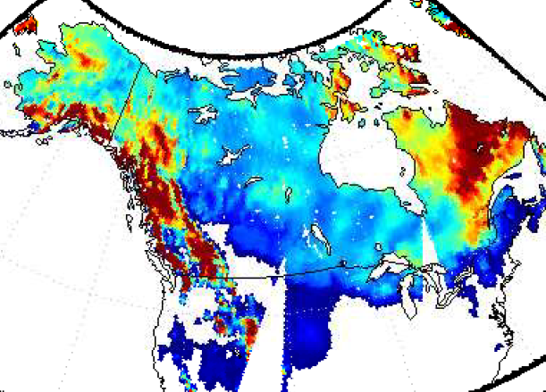
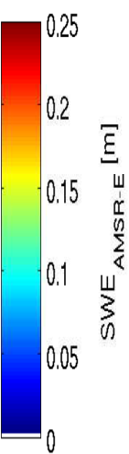
Assimilate AMSR-E snow water equivalent (SWE)?
SWE anomalies (40.38N, 106.66W)
Example 1: Anomaly time series at SNOTEL site.
De Lannoy et al. WRR (2012)
AMSR-E
MERRA
cm
Example 2: Snapshot over North America
SWE
1 Mar 2004
Satellite SWE retrievals not (yet) suitable for assimilation.
Radiance assimilation?

Slide 33






GEOS-5 vs. AMSR-E brightness temp. (18 GHz, V-pol)
Artificial Neural Network for GEOS-5 global snow model
Input: Snow water equivalent, density, liquid water content, snow/air/soil temperature)
Output: Tb (H-/V-pol, 10/18/36 GHz)
Robust forward modeling of AMSR-E Tb using GEOS-5.
Bias [K]
Forman et al. (2012), IEEE/TGARS, submitted.
Anom. R [-]
RMSE [K]

Slide 34
Satellite observations
SUMMARY
Supplemental MERRA-Land data product provides enhanced land surface reanalysis estimates (through use of precipitation observations and land model improvements).
Retrieval-based soil moisture assimilation can further improve reanalysis. Radiance-based soil moisture analysis for SMOS and SMAP requires careful calibration of radiative transfer model.
Snow water equivalent retrievals not (yet) suitable for assimilation. Developed neural network-based forward operator for radiance assimilation.
Other topics: Assimilation of skin temperature, snow cover, and terrestrial water storage not discussed in this presentation.
OUTLOOK
Focus has been on univariate, off-line assimilation. Need multi-variate analysis of soil moisture, LST, snow cover, and snow water equivalent.
We are integrating land and atmospheric assimilation to allow feedbacks in coupled land-atmosphere analysis system.
Assimilate satellite-based vegetation/carbon observations.
Snow cover fraction
(MODIS, VIIRS)
Snow water equivalent
(AMSR-E, SSM/I, SCLP)
Surface soil moisture
(SMMR, TRMM, AMSR-E, ASCAT, SMOS, SMAP)
Land surface temperature (MODIS, AVHRR,GOES,… )
Water surface elevation (SWOT)
Precipitation
(TRMM, GPM)
Terrestrial water storage (GRACE)
Land data assimilation system
veg., snow, radiation
soil moisture
snow,
precip.
Radiation
(CERES, CLARREO )
LST
Vegetation/Carbon
(AVHRR, MODIS, DESDynI, ICESat-II, HyspIRI, LIST, ASCENDS )
Notes:
Discuss mw v IR v gravity

Slide 35
THANK YOU FOR YOUR ATTENTION!

Slide 36
Snow cover extent (SCE) v. MODIS
Larger bias in MERRA-Land snow cover extent vs. MODIS (compared to same in MERRA) due to parameter change in snow model (WEMIN).

Slide 37



Land surface temperature (LST) assimilation
Assimilate ISCCP LST retrievals into two off-line land models.
Validate against in situ obs.
“Model” LST better than ISCCP.
Assimilation reduces RMSE (by up to ~0.7 K), increases anomaly R (by up to 0.05).
Model formulation impacts assimilation: Dynamic bias correction key for CLSM.
Fluxes can be MUCH worse if bias is not addressed (not shown).
Reichle et al. (2010), JHM, doi:10.1175/2010JHM1262.1.

Slide 38


Assimilation of GRACE terrestrial water storage (TWS)
GRACE measures
large-scale TWS
= groundwater
+ soil moisture
+ snow
+ surface water
Assimilation yields:
fine-scale information subject to GRACE basin-scale constraints
better runoff than model (not shown).
Terrestrial water storage anomaly (Jan. 2003 – Jun. 2006 loop)
GRACE
Assimilation
Zaitchik et al. (2008) J. Hydrometeorology, doi:10.1175/2007JHM951.1

Slide 39

Assimilation of GRACE terrestrial water storage (TWS)
Validation against observed groundwater:
RMSE = 23.5 mm
R² = 0.35
RMSE = 18.5 mm
R² = 0.49
Assimilation disaggregates GRACE data into snow, soil moisture, and groundwater.
Assimilation estimates of groundwater better than model estimates.
Zaitchik et al. (2008) J. Hydrometeorology, doi:10.1175/2007JHM951.1

