Slide 1
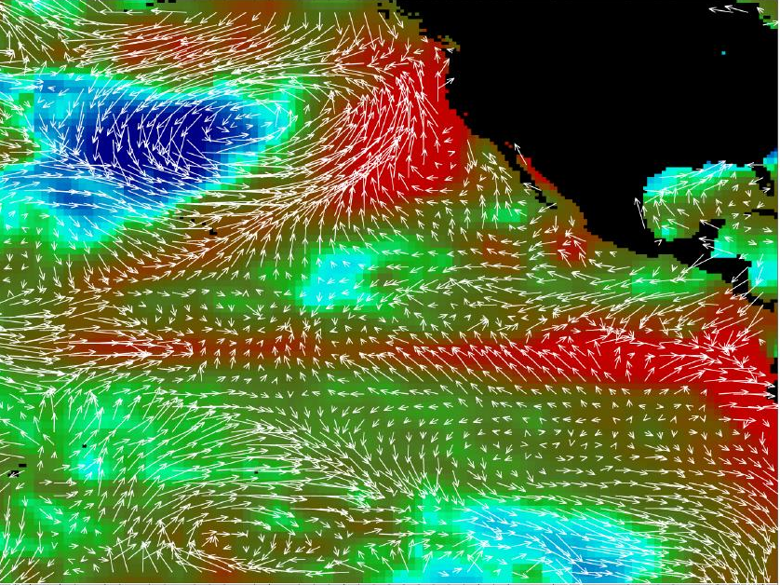
UNCERTAINTY IN DETECTING HISTORICAL OCEAN CLIMATE VARIABILITY
James Carton (Univ. MD)
Hank Seidel & Ben Giese (TAMU)
NSCAT Winds, AVHRR SST’ in late May, 1997 (NASA)
Notes:
SST’ from -2 to 2C. Suppose the 1997-8 El Nino/La Nina had occurred in the 1920s. How well would we have resolved it?

Slide 2
Summary
Present a plan for evaluating the potential of historical ocean reanalysis
Provide an example: could we have resolved the climate anomalies of the late 1990s if they had occurred earlier in the 20th century?

Slide 3
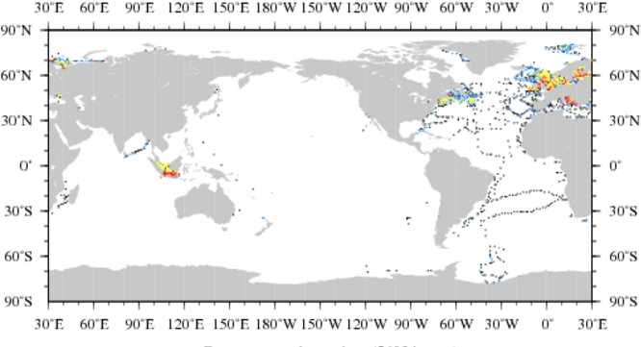
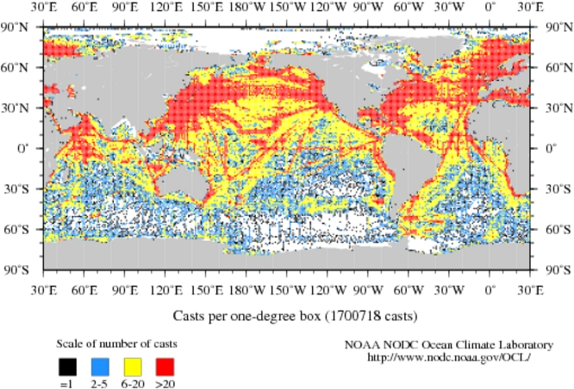
Sampling Problem
1910-1919
(56,034 profiles)
1980-1989
(1.7M profiles)

Slide 4
Gradual deepening of the historical profile data
Temperature
Salinity
Data from WODB-2009 (total: 7x10⁶ )

Slide 5
20CRv2 wind stress curl anomaly in the subtropical North Atlantic (20-40N)
ensemble average
ensemble spread
Time →
Notes:
(20-40oN, 70oW-10oW)

Slide 6
Plan
Carry out simulation (Nature Run) forced by 20CRv2 ensemble mean surface forcing
Sample Nature Run at the locations, depths, times, variables that actually exist in the NODC and ICOADS archives.
Shift the dates of observations to the 1990s (1927->1997; 1947->1997; 1967->1997, etc)
Assimilate observations into SODA, and use ‘degraded’ surface forcing
Climatological monthly forcing
Single 20CRv2 ensemble member

Slide 7
Nature Run (and a comparison to observations)
0/300m heat content anom. along Equator
A simulation of the circulation of the global ocean using a 0.4ºx0.25º OGCM through 1998 driven by 20CRv2 monthly surface fluxes.
Time ->
Colors: Nature Run
Contours: SODA reanalysis
Longitude ->

Slide 8
5 experiments:
1920s
1940s
1960s
1980s
2000s

Slide 9
RMS HC’ (0-300m) (1995-1999)
clim forcing
Observed

Slide 10
North Atlantic Temp/Sal error (with depth and time)
clim forcing
Experiments

Slide 11
El Nino: HC’ Sept.-Nov., 1997
clim forcing
Notes:
Anomalies in the Indo-Pacific region for September-November, 1997 relative to the base period January 1995-December, 1998. a) 0/300 heat content and b) SST. Profile observation coverage during the four months September-November of the corresponding year for each experiment (1927, 1947, 1967, 1997, 2007) is superimposed on heat content.

Slide 12
How good was the 1990s observing system?
Ensemble winds
El Nino
50cm/s contour
Truth
15ºC
Our Estimate
La Nina
Truth
Our Estimate
Notes:
Figure 9a. El Nino conditions during September-November, 1997 relative to the 1995-6 average for Expt. W1920s in which historical winds are combined with data assimilation. Uppermost row shows Nature Run. The lower three rows show results using three different 20Cr2 forcing ensemble members. 0/300m heat content (lefthand panels). Temperature anomalies (colors) along 0oN (righthand panels). Depth of the 15oC and 20oC contours are superimposed (solid lines) as well as zonal velocity (50 cm/s contour, dashed).

Slide 13
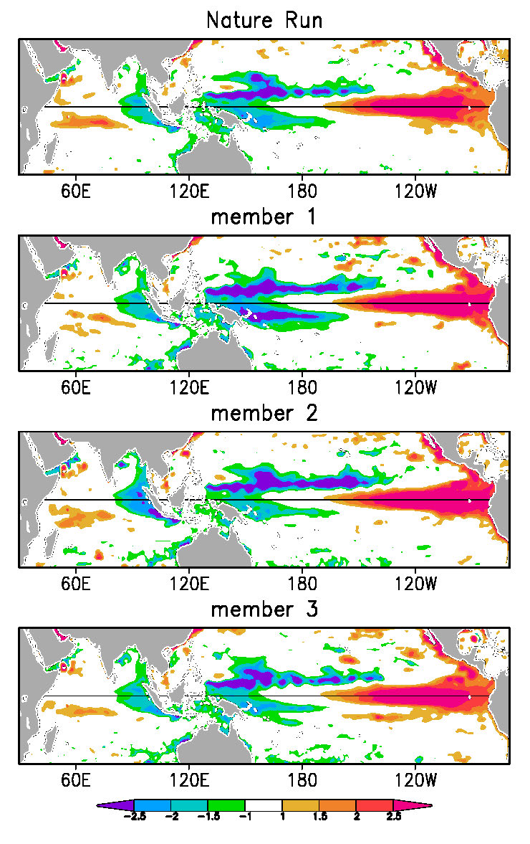
1920s experiment HC’ Sept.-Nov., 1997
Ensemble winds

Slide 14
Summary
The plan for evaluating the potential of historical ocean reanalysis
Made possible by ensemble atmospheric reanalysis
Improved assimilation methods, e.g. coupled assimilation, may offer additional potential
Could we have resolved the climate anomalies of the late 1990s if they had occurred earlier in the 20th century?
prior to the ~1960s the historical observing network alone provided limited information.
20Crv2 winds and fluxes dramatically improves our estimates prior to the 1940s (however, 20CRv2 uncertainty is likely underestimated in tropics)
Carton, Seidel, and Giese (JGR, Feb 2012)

