Slide 1
Historical Ocean Ensemble Reanalyses
With:
TAMU NOAA/CIRES UMD
Hank Seidel Gil Compo James Carton
Chunxue Yang Prashant Sardeshmukh Gennady Chepurin

Slide 2
SODA Efforts
SODA – UMD:
With Dave Behringer/NOAA: Implement LETKF
Develop a coupled ensemble filter
Improve Arctic – Fresh and Salt water fluxes – Sea Ice
SODA – TAMU:
Historical reanalysis: mid-1800s to present
Develop OARCA – Ocean Atmosphere Reanalyses for Climate
Applications

Slide 3
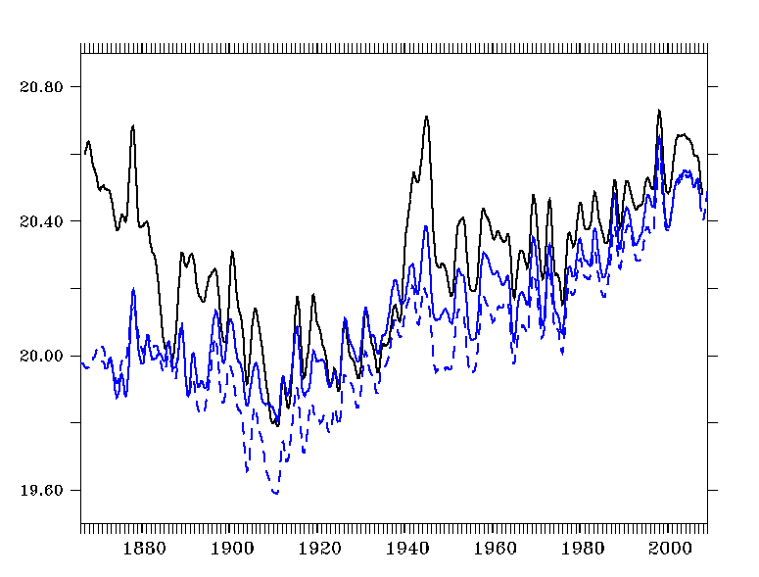
60S-60N Zonal Averaged SST
SODA 2.2.4 (black) 20CRv2 Ensemble Mean Forcing
HadISST (blue)
ERSST (dashed)

Slide 4
SODA 2.2.6
8 Ensemble Members
Winds
20CRv2 ensemble member daily stress 1871 – 2008
Heat and Salt fluxes
Bulk formulae using 20CRv2 daily variables
SODA Data Assimilation
Only ICOADS 2.5 SST data (no hydrography)

Slide 5
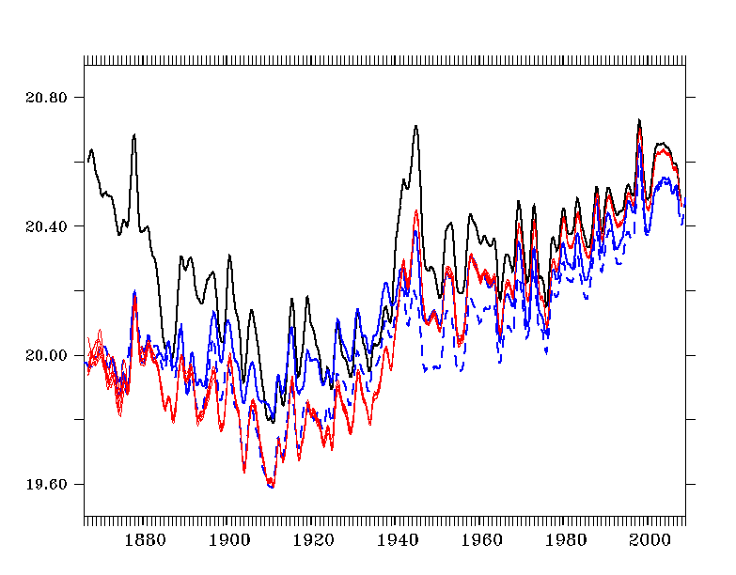
60S-60N Zonal Averaged SST
SODA 2.2.4
(black)
HadISST (blue)
ERSST (dashed)
SODA 2.2.6 (red)
Ensembles

Slide 6
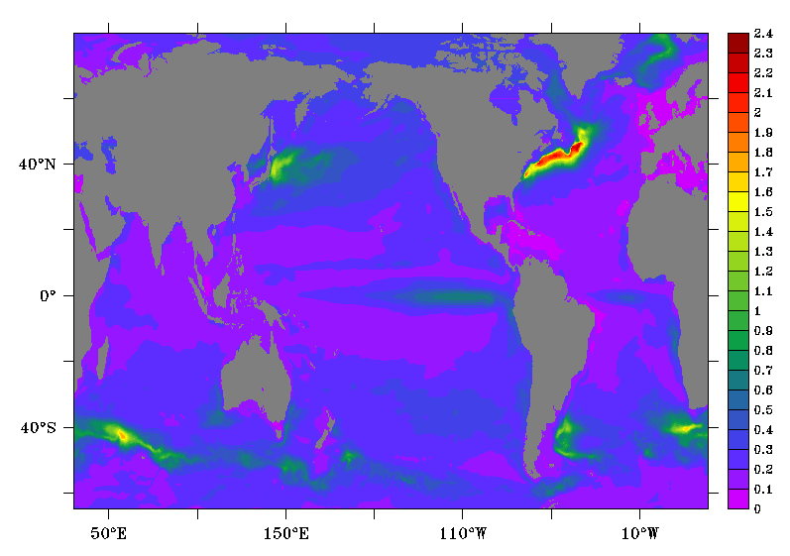
Ensemble SST Spread

Slide 7
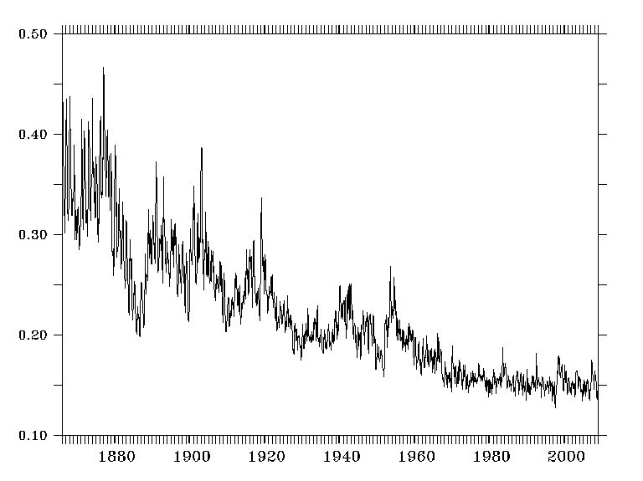
Ensemble SST Spread 60S-60N Zonal Average

Slide 8
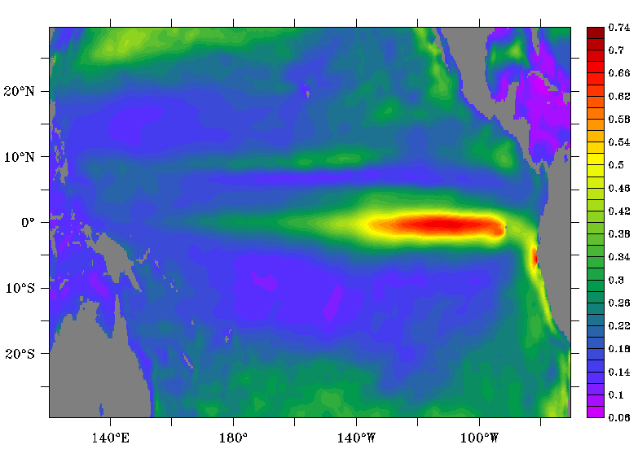
Ensemble SST Spread

Slide 9
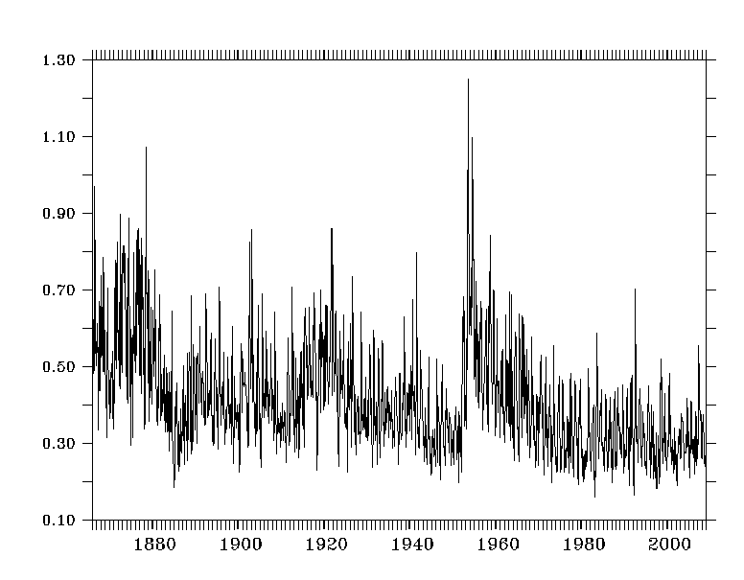
Ensemble SST Spread 140w-90W 5S-5N

Slide 10
Nino 3.4 SST Anomaly

Slide 11
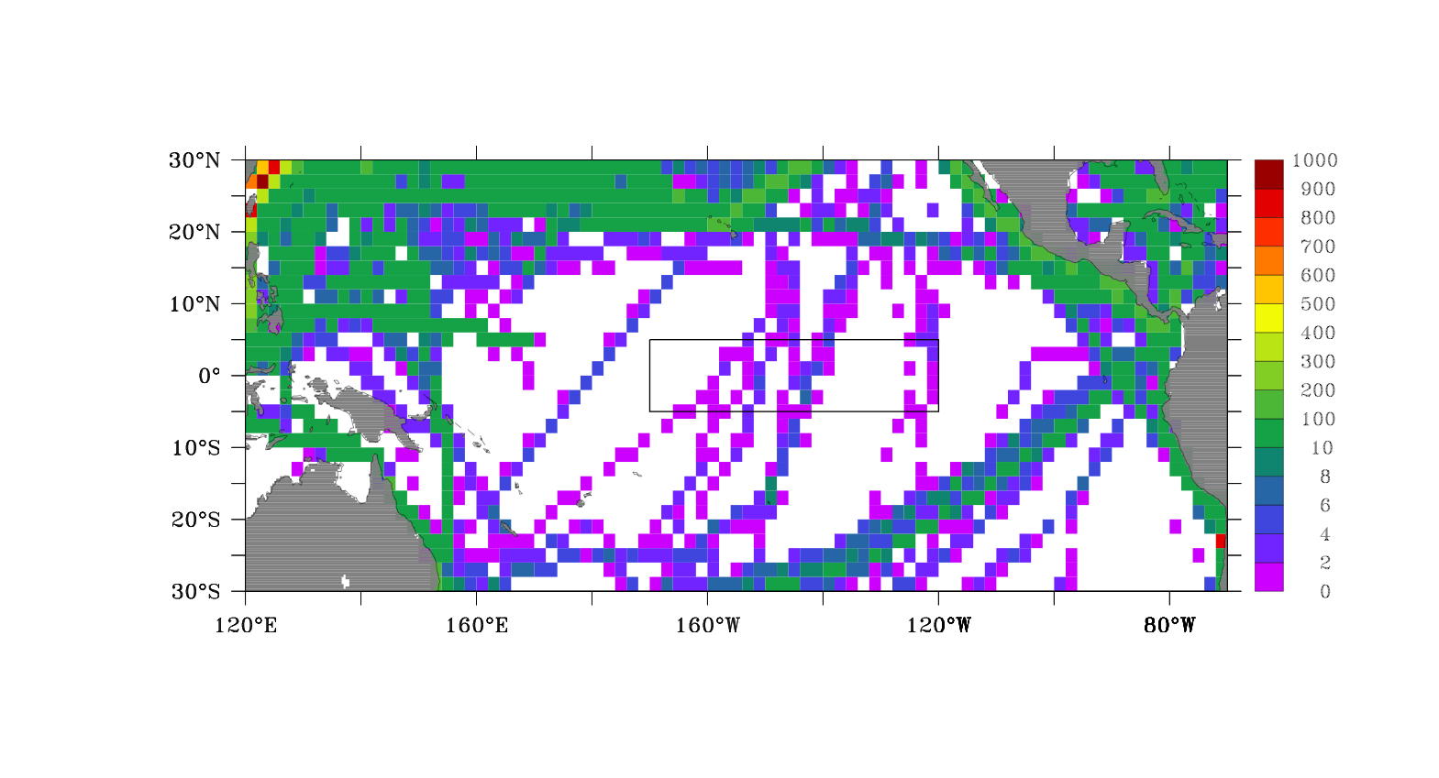
ICOADS Num. Obs. 1918-1919

Slide 12
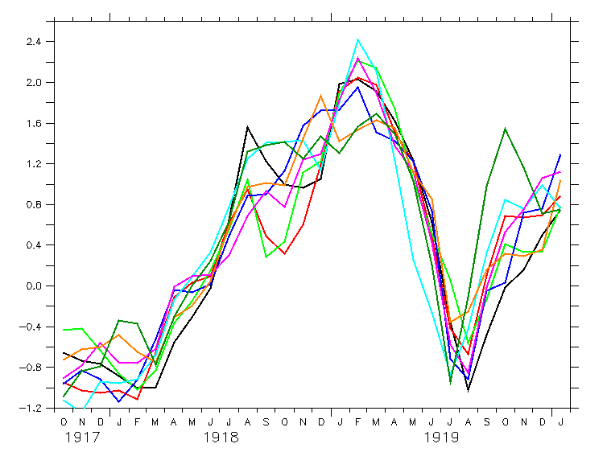
Nino 3.4 SST Anomaly - 8 Ensembles

Slide 13
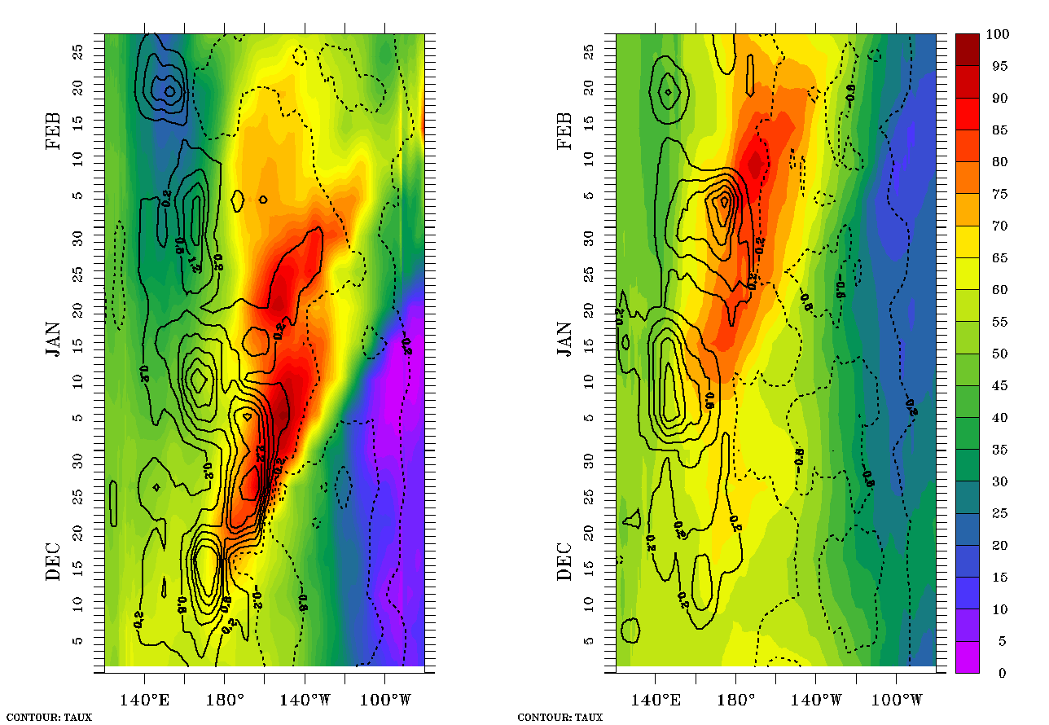
Shading: SSH Contours: Zonal wind stress
Ens 7 - Strong ENSO
Ens 5 - Weaker ENSO
1918 1919

Slide 14
Conclusions
We conduct an 8-member ensemble ocean reanalysis for the period from 1871-2008
Significant differences in ENSO in the different Ensemble members.
These differences should drive significant differences in the atmosphere.
OARCA – Ocean Atmosphere Reanalysis for Climate Applications (1800s to present)

