Slide 1
An eddy-resolving ocean reanalysis using the 1/12° global HYbrid Coordinate Ocean Model (HYCOM) and the Navy Coupled Ocean Data Assimilation (NCODA) scheme E.J. Metzger¹, R.A. Allard¹, R. Broome², D.S. Franklin², O.M. Smedstad² and A.J. Wallcraft¹ ¹Naval Research Laboratory ²QinetiQ North America 4th WCRP International Conference on Reanalyses 7-11 May 2012 Silver Spring, MD, USA

Slide 2
HYCOM/NCODA Ocean Reanalysis
Of those ocean reanalyses listed on http://reanalysis.org, only a few have eddy-permitting resolution and none are capable of fully resolving oceanic mesoscale features (eddies and current meanders) across the globe
This project addresses the need for a long time period eddy-resolving ocean reanalysis
Funded by the DoD Modeling and Simulation Coordination Office (M&S CO)
Goal to the sponsor: provide physically consistent environmental scenarios for planning, wargaming and scenarios to support the warfighter
Numerous other applications and research opportunities
Notes:
Most are coarse resolution and cannot represent mesoscale eddies, but a couple are eddy-permitting: Simple Ocean Data Assimilation (SODA) = 0.25° resolution, Estimating the Circulation and Climate of the Ocean (ECCO2) = 18 km.

Slide 3
HYbrid Coordinate Ocean Model
Tri-pole latitudinal grid resolution (km)
Curvi-linear
grid: north
of 47°N
Mercator
projection:
66°S to
47°N
Uniform
cylindrical:
south of
66°S
32 hybrid coordinate surfaces, thermobaricity, σ₂*
K-Profile Parameterization (KPP) mixed layer model
Monthly river runoff
Surface salinity relaxation to U.S. Navy GDEM4 climatology
Thermodynamic “energy loan” ice model
Notes:
Thermobaricity: thermal expansion coefficient of sea water increases with pressure.
σ₂*: potential density referenced to 2000 m

Slide 4
Navy Coupled Ocean Data Assimilation
Ocean/Ice
Obs.
Sequential Incremental Analysis Update (IAU)
Analysis-Forecast-Analysis
NCODA analysis once per day that is
incrementally inserted over a 6 hour window
SST: GAC/LAC MCSST,
GOES, Ship, Buoy
Profiles: XBTs, CTDs, Argo floats
Buoys: Fixed and drifting
Altimeter SSH anomaly
SSM/I sea ice concentration
Ocean QC
Innovations
3DVar
Increments
3DVar - simultaneous analysis of
ice concentration and 5 ocean
variables: temperature, salinity,
geopotential, layer pressure, and
velocity (u,v)
HYCOM
First Guess

Slide 5
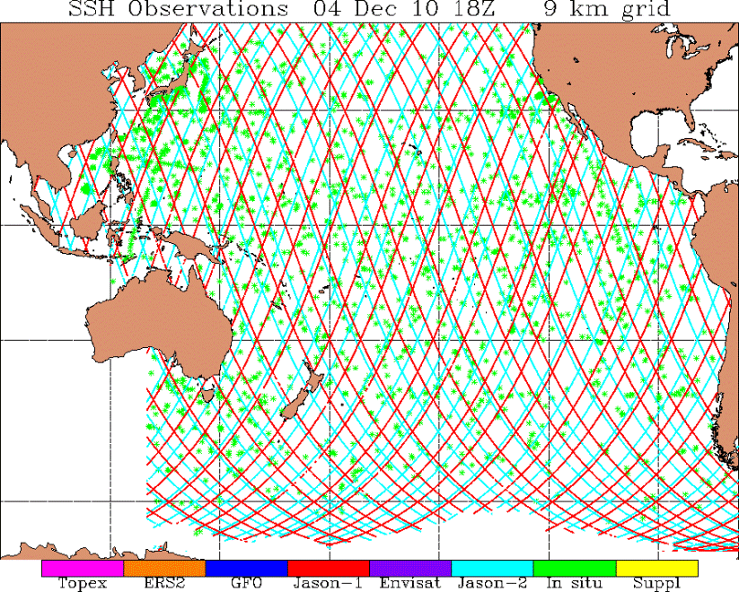
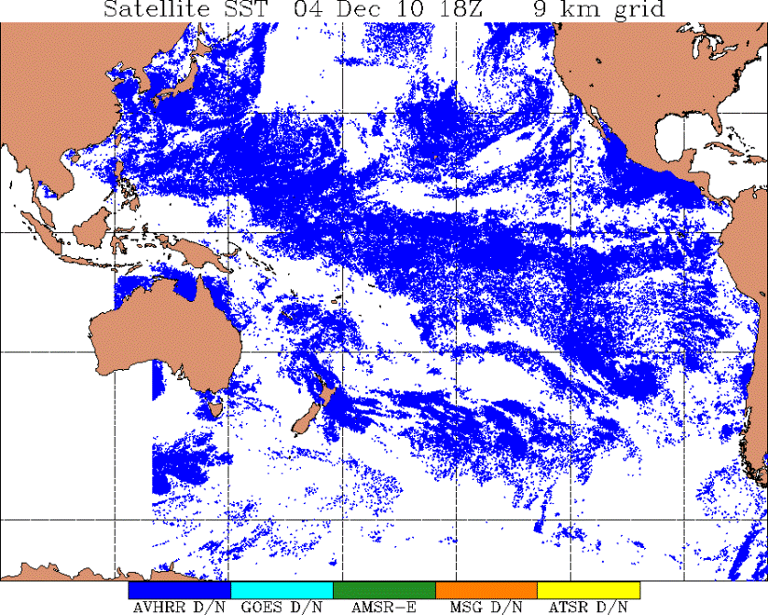
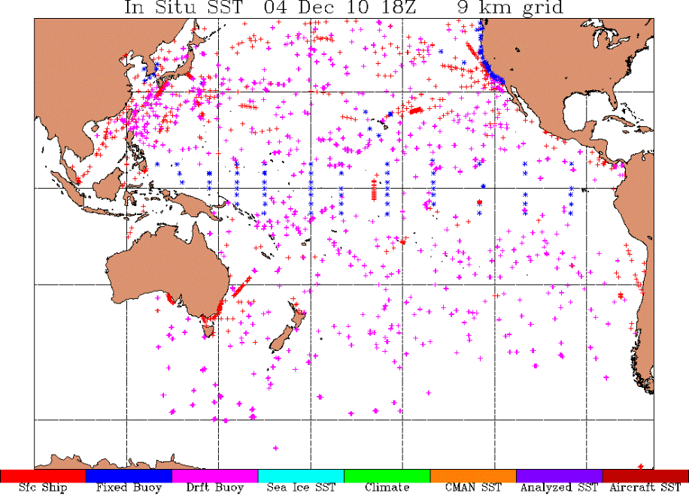
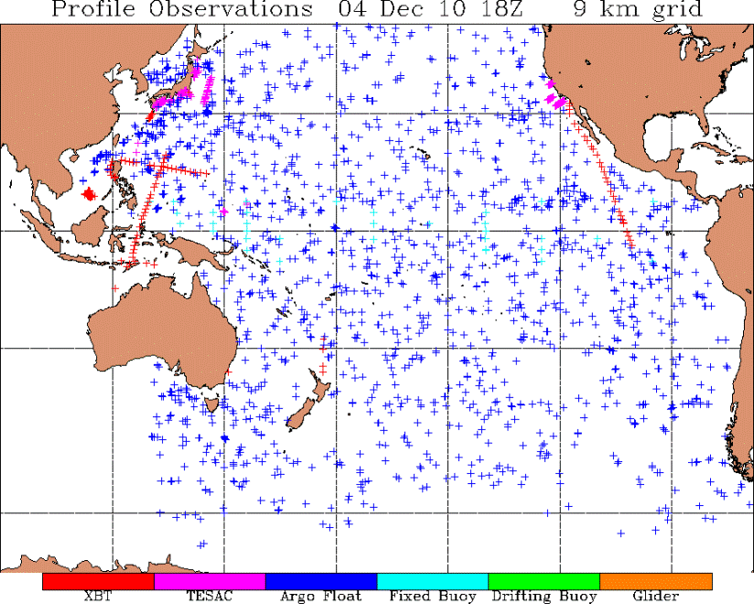
Observations to be Assimilated via NCODA
SSH Observations
SST Observations
3-day data window
24-hr data window
In-situ SST
Profile Observations
10-day data window
10-day data window
Notes:
Attempted to locate and process as much available observational data as possible within the constraints of the project

Slide 6
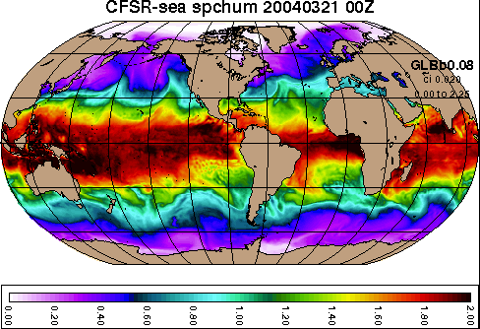
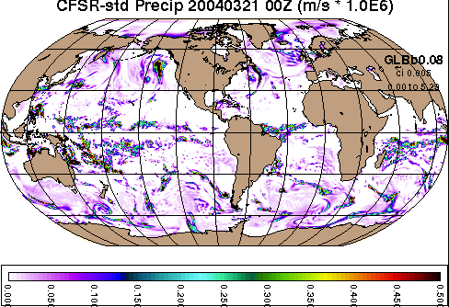
Atmospheric Forcing NCEP Climate Forecast System Reanalysis (CFSR)
Surface Specific Humidity (kg/kg x 10²)
Time frame: 1993-2009 (altimeter period)
Horizontal resolution: 0.3125° gaussian
Temporal resolution: 1-hourly
Inputs:
Bulk-derived wind stress
Wind speed
Radiative fluxes
Thermal fluxes
Precipitation
Net Surface Shortwave (W/m²)
Precipitation (m/s x 10⁶)

Slide 7
Modifications to CFSR Wind Forcing
QuikSCAT Scaling
Offset
Bias
Based on a regression analysis from 11 years (1999-2009) of
monthly contemporaneous CFSR and QuikSCAT wind speed data

Slide 8
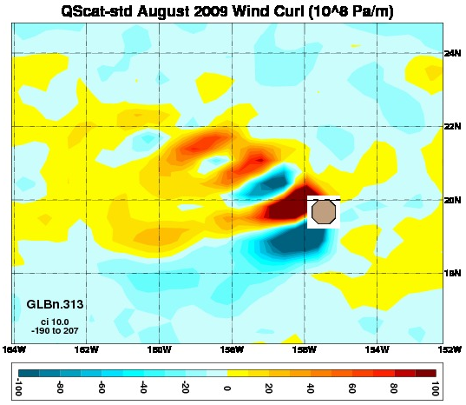
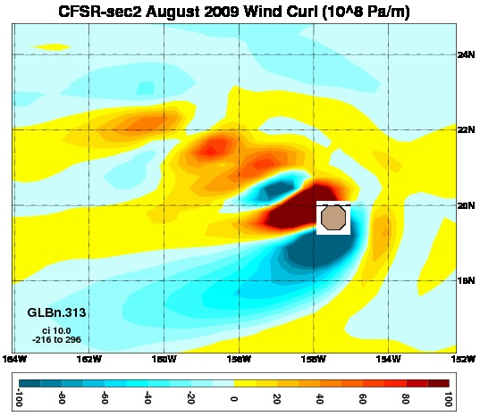
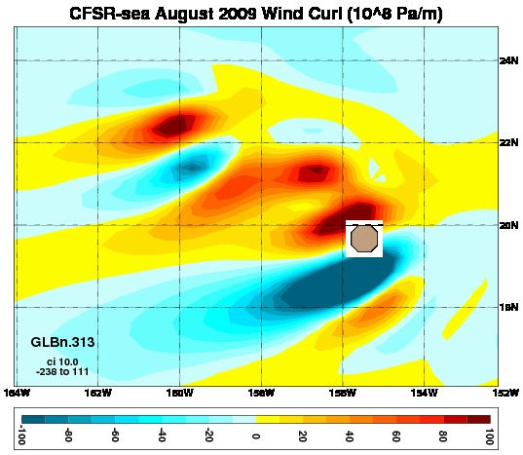
Modifications to CFSR Wind Forcing
Wind Stress Curl – August 2009
QuikSCAT
More realistic curl over
Hawaii after QuikSCAT
correction
CFSR after
correction
Hawaii
CFSR before
correction
Wind stress curl plotted over Hawaii
on the 0.3125° CFSR grid

Slide 9
Pre Spin-up Simulations
1-layer barotropic linear 1/16° Navy Layered Ocean Model simulation using the CFSR climatology to determine the 1st order Sverdrup response to the wind forcing
0.72° and 0.24° global HYCOM (non-assimilative) using the 1993-2009 CFSR climatology
Compared these against existing simulations forced with different atmospheric products and found no gross errors in ocean model response

Slide 10
Spin-up and Reanalysis Simulations
Spin-up 1/12° non-assimilative global HYCOM with CFSR climatology (12 model years) - done
Extend climatological spin-up with 1993-2009 1-hourly CFSR forcing using 1/12° non-assimilative global HYCOM – done
Extend climatological spin-up with Oct 1992-2009 1-hourly CFSR forcing using 1/12° assimilative HYCOM/NCODA – started
Begin in Oct 1992, allow 3 month adjustment period

Slide 11
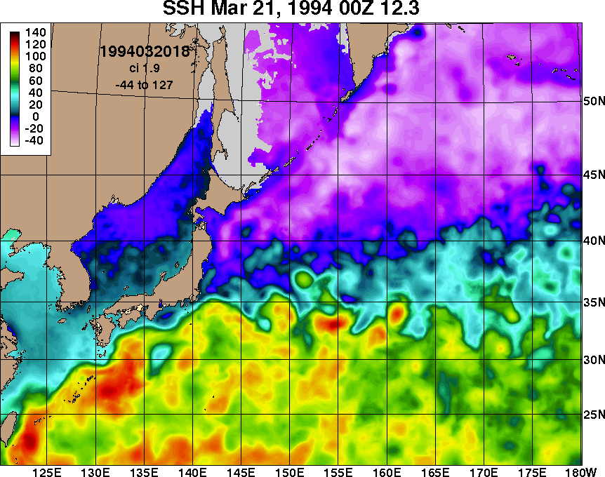
Preliminary Results SSH animation: Gulf Stream and Kuroshio
Month-long animation: 21 March – 20 April 1994
TOPEX/POSEIDON only altimeter flying at this time
Gray area = sea ice

Slide 12
Computational Requirements
Computer time via the DoD High Performance Computing Modernization Office
Currently integrating the ocean reanalysis on the Navy DoD Supercomputing Resource Center (DSRC) IBM Power 6
Using 949 processors
Integrate ~10 model days every 24 hrs of wall time
17 year reanalysis will take ~1¾ years to complete

Slide 13
Output and Storage
HYCOM 3D native grid archive files (compressed):
Single hour: ~7 Gb
Saving 3-hourly output:
~20 Tb / model year
~340 Tb for the entire reanalysis
HYCOM 3D constant .08° grid (±80° lat) netCDF files remapped to 40 z-levels (compressed):
Single hour: ~1.2 Gb
Saving 3-hourly output:
~3.5 Tb / model year
~59 Tb for the entire reanalysis
Subset of the output to be placed on the hycom.org data server
Still to be determined

