Slide 1
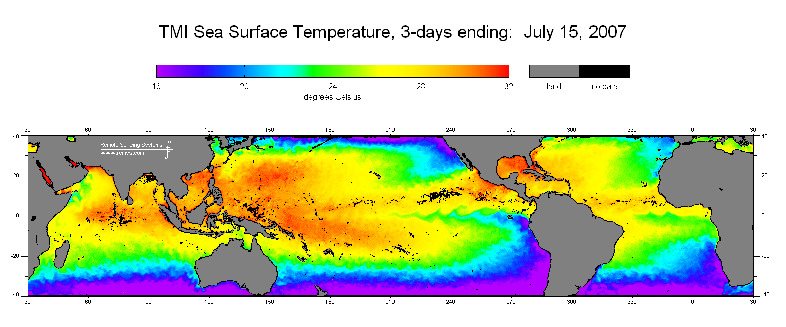
Ocean-Atmosphere Characteristics of Tropical Instability Waves(TIW) Simulated in the NCEP Climate Forecast System Reanalysis
4th World Climate Research Program International Conference on Reanalyses
8 May 2012
Caihong Wen, Yan Xue and Arun Kumar
Climate Prediction Center
NCEP/NWS/NOAA
SST from TMI on July 15,2007
http://www.ssmi.com/tmi/tmi_3day.html
Notes:
Instability of equatorial currents and fronts
Mesoscale ocean-atmosphere interactions

Slide 2
Impact of TIW on Climate & Marine Ecosystem
Momentum and heat budget (Jochum and Murtugudde 2006)
Nutrient distribution (e.g. Strutton et al. 2001)
Interannual variations, i.e ENSO (e.g. An 2008; Zhang and Busalacchi 2008)
Mean ocean and atmosphere states
Challenges:
In situ observations
----- too sparse
Satellite Observations
---- limited surface variables and record
NWP reanalysis products (e.g. NCEP R1,R2)
----- coarse resolution, SST boundary conditions

Slide 3

CFSR:
Much higher resolution : 1979-2009
Atmosphere:T382(~38km) Ocean:0.25º ~0.5º
The guess forecasts was generated from a 6-h coupled system
Assimilation of ¼ degree daily OI SST Analysis
Purpose: Assess capability of the CFSR in capturing ocean-atmosphere interactions associated with TIWs
Data:
CFSR : SST, HFLX,τ,P,T2m, WS,q, currents
Daily data 2001-2008
Satellite observations: TMI SST and QuikSCAT winds
In situ: TAO

Slide 4
SST at 110W,2N
20-40 day band-pass filtered SST at 110W,2N
SST TIW Annual Mean Variance
CFSR TMI

Slide 5
Coupling of SST and Surface Wind

Slide 6

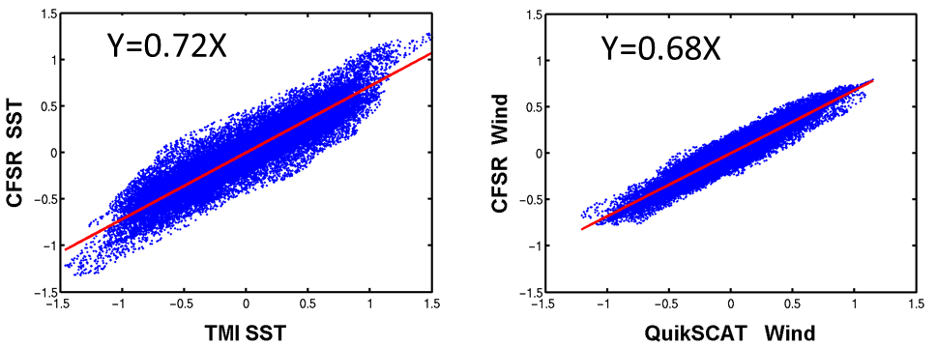
150º W – 110º W, 2ºN, June-January,2001-2008
Both SST and wind perturbations are about 70% of the satellite observations.
Coupling Strength (coefficient ms⁻¹ per degree)
CFSR: 0.6
Satellite: 0.66
The CFSR well reproduced the observed linear SST-Wind relationship

Slide 7
150º W – 110º W, 2ºN, June-January,2001-2008
Both SST and wind perturbations are about 70% of the satellite observations.
Coupling Strength (coefficient ~0.6 ms⁻¹ per degree)
The CFSR well reproduced the observed linear SST-Wind relationship

Slide 8
Wind Stress Response and Feedback
Wind Stress Curl (10⁻⁷N m⁻³C⁻¹)
Does the perturbations of wind stress curl feed back to TIW through Ekman dynamics?

Slide 9
Wind Stress Response and Feedback
Wind Stress Curl (10⁻⁷N m⁻³C⁻¹)
Does the perturbations of wind stress curl feed back to TIW through Ekman dynamics?
W_{e} is much weaker than W, indicating the small feedback effect on TIW growth
Caveat: (1) Difficult to estimate Ekman pumping near the equator; (2) Impact of surface current on wind stress is neglect in the CFSR
W at 55m (10⁻⁵ms⁻¹C⁻¹⁾
Comparison of W & W_{e} along 2N
W
W_{e}

Slide 10
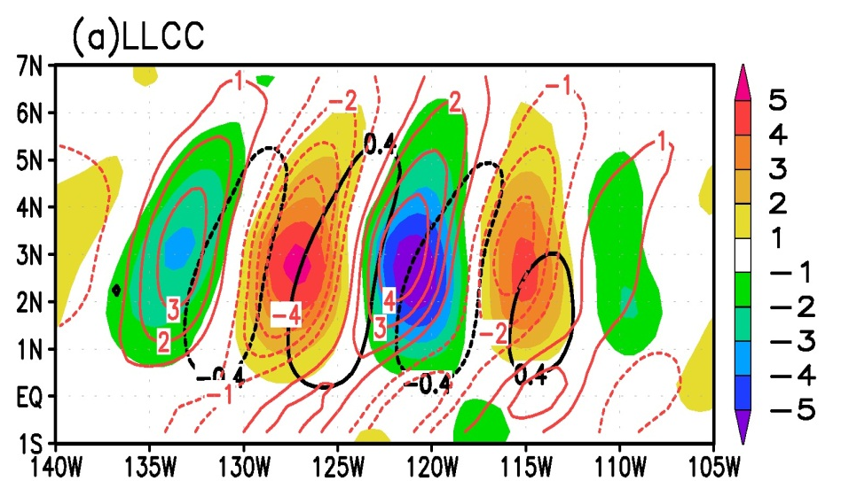
3-D Atmosphere Response
Low-level Cloud Cover (% º C⁻¹ )
Low-level Cloud Cover (% º C⁻¹ )
Pressure(hpa)
Consistency among different levels in the CFSR
PBL height

Slide 11
Uncertainties in Atmosphere Response
CFSR: ~ 10 Pa ºC⁻¹
TAO: ~ 10 PaºC⁻¹ (Cronin et al.2003)
Radiosonde : little TIW signal (Hashizume et al. 2002)
CFSR: Mainly confined in the PBL
Radiosonde: Strong temperature inversion (Hashizume et al. 2002)

Slide 12
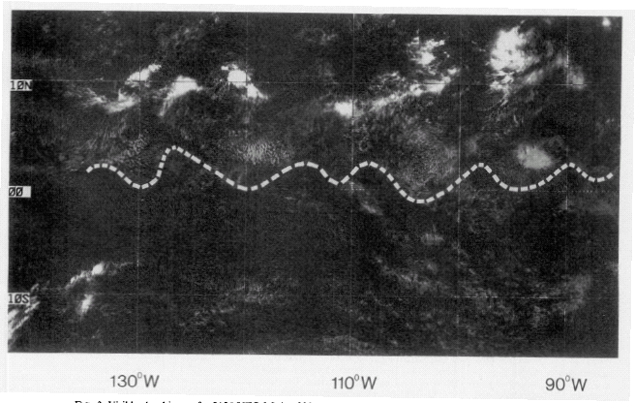
Response and Feedback of Surface Heat Flux
Solar heat flux and SST
Satellite Visible Cloud and SST
CFSR SW & Low-level Cloud Cover
Deser et al. 1993
Deser et al.(1993) :
4.2% per degree
Over and upstream of positive SST anomalies
Change in solar radiation of
~ 10 W/m² per degree
Damping of local SST
CFSR:
5% per degree
Down stream of positive SST anomalies
Change in solar radiation of
~9W/m² per degree
Damping of local SST

Slide 13
Response and Feedback of Surface Heat Flux
Latent heat flux and SST
Latent Heat Flux
CFSR :
25 W/m² per ºC of latent heat flux
40 W/m² per ºC of net heat flux, resulting in -0.5 º C per month (MLD=50m)
Zhang and McPhaden(1995): ~ 50 W/m² per ºC of latent heat flux
Thum et al. (2002): ~ 40 W/m² per ºC of latent heat flux, resulting
-0.5º C per month (MLD=50m)
Net Heat Flux

Slide 14
Summary
An in-phase relationship between SST and surface wind was well represented in the CFSR;
The CFSR exhibits coherent patterns associated with TIWs both in the ocean and the atmosphere ;
The feedback of wind stress curl perturbation to TIWs is negligible;
Uncertainties exist in surface pressure and vertical structure;
Surface net heat flux are dominated by latent heat fluxes and have a large negative feedback to TIW SSTs variability.
Wen, C., Y. Xue and A. Kumar,2012: Ocean–atmosphere characteristics of tropical instability waves simulated in the NCEP climate forecast system reanaylsis, J. Climate. doi:10.1175/JCLI-D-11-00477.1, In press(available online).

Slide 15
Annual mean (2001-2008) of (a) EKE (cm2 s-2) at 5m; (b) EKE (cm2 s-2) at 110o W; (c) EKE (cm2 s-2) along 0oN. In (b) and (c), blue line presents the annual mean 20oC isotherm depth.

Slide 16
Yan et al. 2011

