Slide 1
Surface Water and energy budgets over the northern hemisphere in three data assimilation Systems
Rongqian Yang, Michael Ek and Jesse Meng
The EMC Land/Hydro Team
EMC/NCEP/NWS
5200 Auth Road, Camp Springs, MD 20746, USA
4th WCRP International Conference On Reanalyses, 7-11 May, 2012
Silver Springs, MD USA

Slide 2
Outline
Introduction of the latest NCEP Climate Forecast System Reanalysis (CFSR), NCEP-DOE AMIP II Reanalysis (GR2) and NCEP Global Land Data Assimilation System (GLDAS/Noah)
Comparison of the land model and data assimilation techniques used in the reanalysis systems
Comparison of surface water budget terms
Comparison of surface energy budget terms
Summary

Slide 3
CFSR versus GR2
Atmosphere: model resolution increased from T62/L28 - T382/L64 (~38 km) resolution and equipped with more advanced physics.
Land: upgraded from the 2-layer OSU to the 4-layer Noah LSM.
Ocean: The global GFDL MOM4 replaced observed SST.
Sea Ice: Inclusion of a 3-layer global ocean ice model replaced sea-ice SST.
GLDAS
The GLDAS is a Land only analysis, driven by observed precipitation
and near-surface meteorological forcing with no feedback to the above atmosphere (the same land model is Noah as used in CFSR)

Slide 4
Surface water and energy in the systems are impacted by
The land model physics
How the observations (precipitation and snow) are assimilated in the systems and the efficiency of assimilation techniques (e.g. background model biases)

Slide 5
Land Model COMPARISON Noah LSM (CFSR) versus OSU LSM (GR2)
Noah LSM (vegetation, snow, ice)
4 soil layers (10, 30, 60, 100 cm)
Frozen soil physics included
Add glacial ice treatment
Two snowpack states (SWE, density)
Surface fluxes weighted by
snow cover fraction
Improved seasonal cycle of vegetation
Spatially varying root depth
Runoff and infiltration account for sub-grid variability in precipitation & soil moisture
Improved thermal conduction in soil/snow
Higher canopy resistance
Improved evaporation treatment over bare soil and snowpack
OSU LSM
2 soil layers (10, 190 cm)
No frozen soil physics
Only one snowpack state (SWE)
Surface fluxes not weighted by snow fraction
Vegetation fraction never less than 50 percent
Spatially constant root depth
Runoff & infiltration do not account for subgrid variability of precipitation & soil moisture
Poor soil and snow thermal conductivity, especially for thin snowpack
Noah LSM replaced OSU LSM in operational NCEP medium-range
Global Forecast System (GFS) in late May 2005

Slide 6
Assimilation of precipitation and snow in GR2 (OSU LSM)
Precipitation
Model precipitation, nudges soil moisture (1st layer) during the next 5 days using the difference
between observation and model precipitation
direct use of the observed precipitation
Snow
Weekly snow cover, model snowdepth is used if consistent
otherwise adjusted to snow cover without affecting soil moisture
direct use of snow cover.

Slide 7
Assimilation of precipitation and snow in CFSR (Noah LSM)
Precipitation
“Semi-coupled” approach, uses observed precipitation to drive a
parallel Noah LSM run with atmospheric forcing from the online surface analysis and the resulting land states are used to update model’s
land states daily
implicit use of observed precipitation
Snow
Observed snow cover and snow depth are used to adjust
(if more than twice or less than half of analysis) model’s snow depth everyday otherwise untouched
implicit use of observed snow.
s

Slide 8
Study period and observations used in comparison
1979-2008 summer (JJA) and winter (JFM) seasonal climatology, seasonal cycle (averaged over N.H.) and time series of the anomalies (3-month running mean).
Precipitation is from CFSR used in driving off-line Noah.
Radiation and surface temperature are from NASA/GEWEX Surface Radiation Budget (SRB) release 3.0.

Slide 9
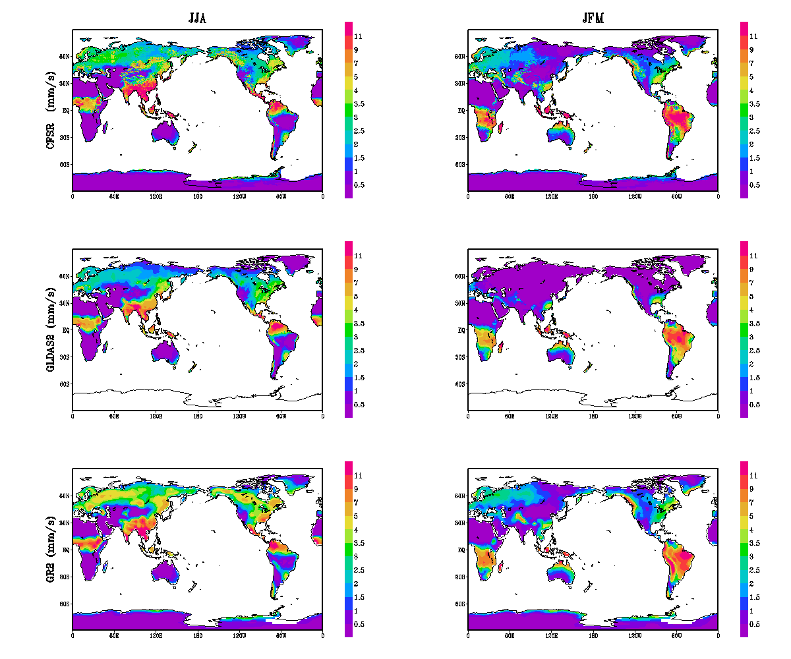
Precipitation
CFSR
GLDAS
Lower in summer,
closer in winter,
both higher than GLDAS
GR2

Slide 10
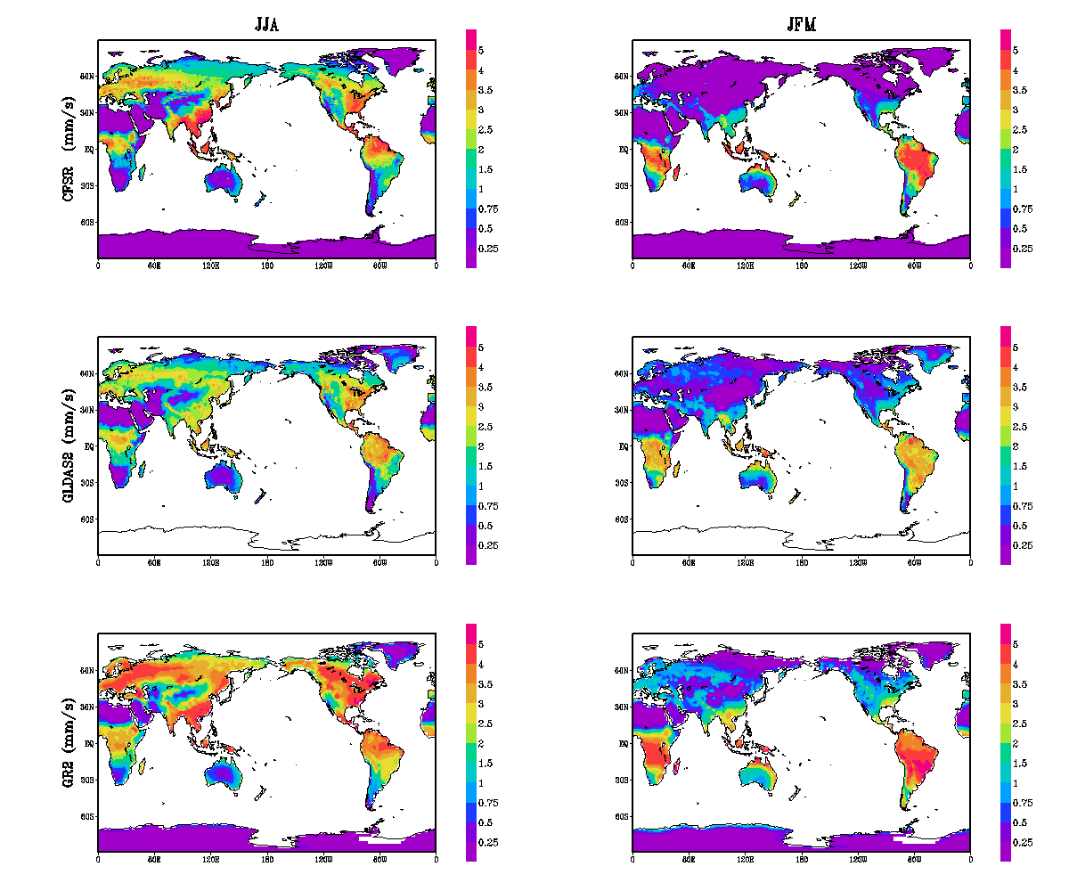
Evaporation
CFSR
GLDAS
Much Lower in both summer and winter
Slightly higher in summer and much lower in winter than GLDAS
GR2

Slide 11
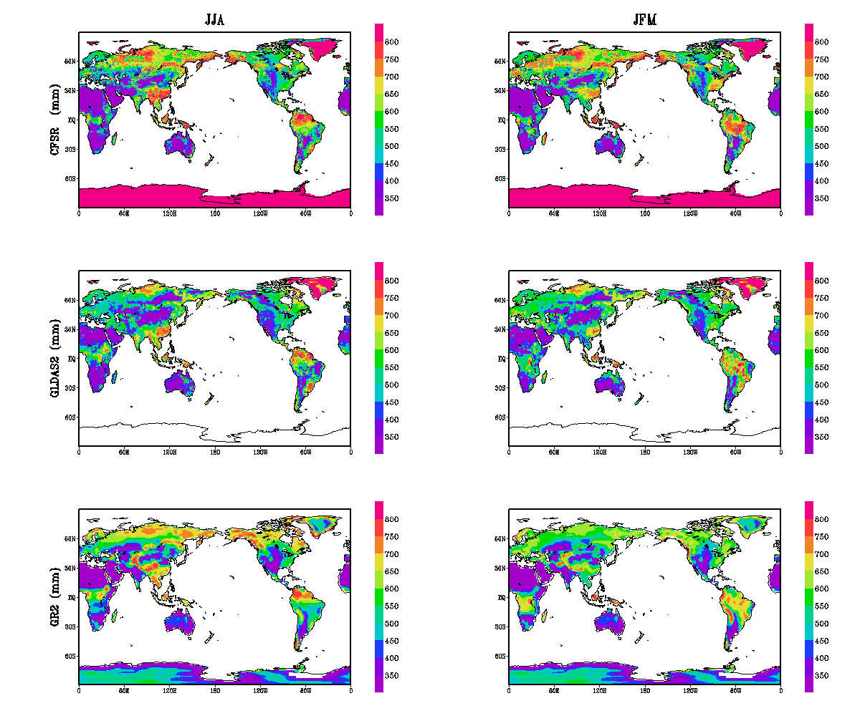
Soil Moisture
CFSR
GLDAS
Mixed in both summer and winter
GR2 closer to GLDAS
GR2

Slide 12
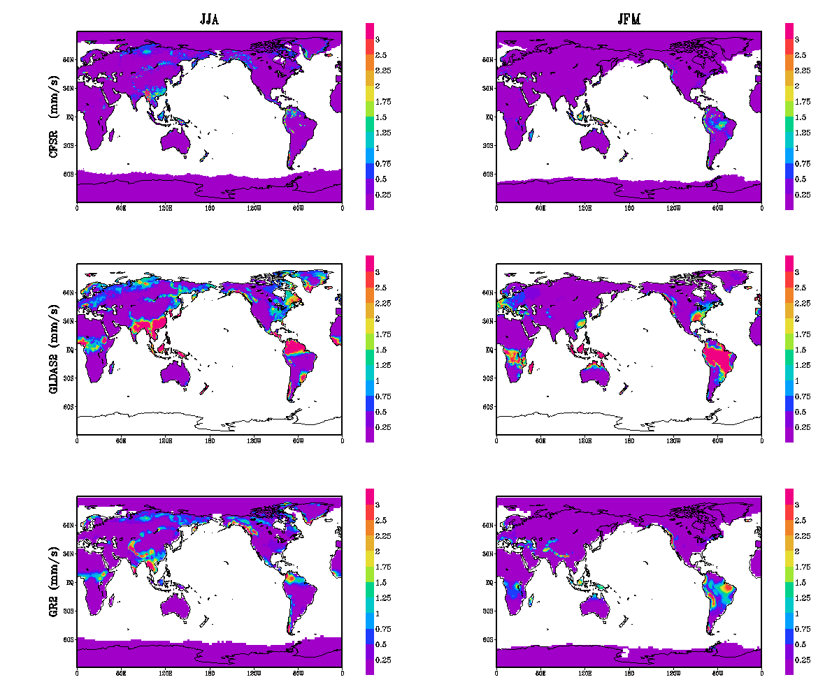
Surface Runoff
CFSR
GLDAS
Lower in both summer and winter
Both lower than GLDAS
GR2

Slide 13
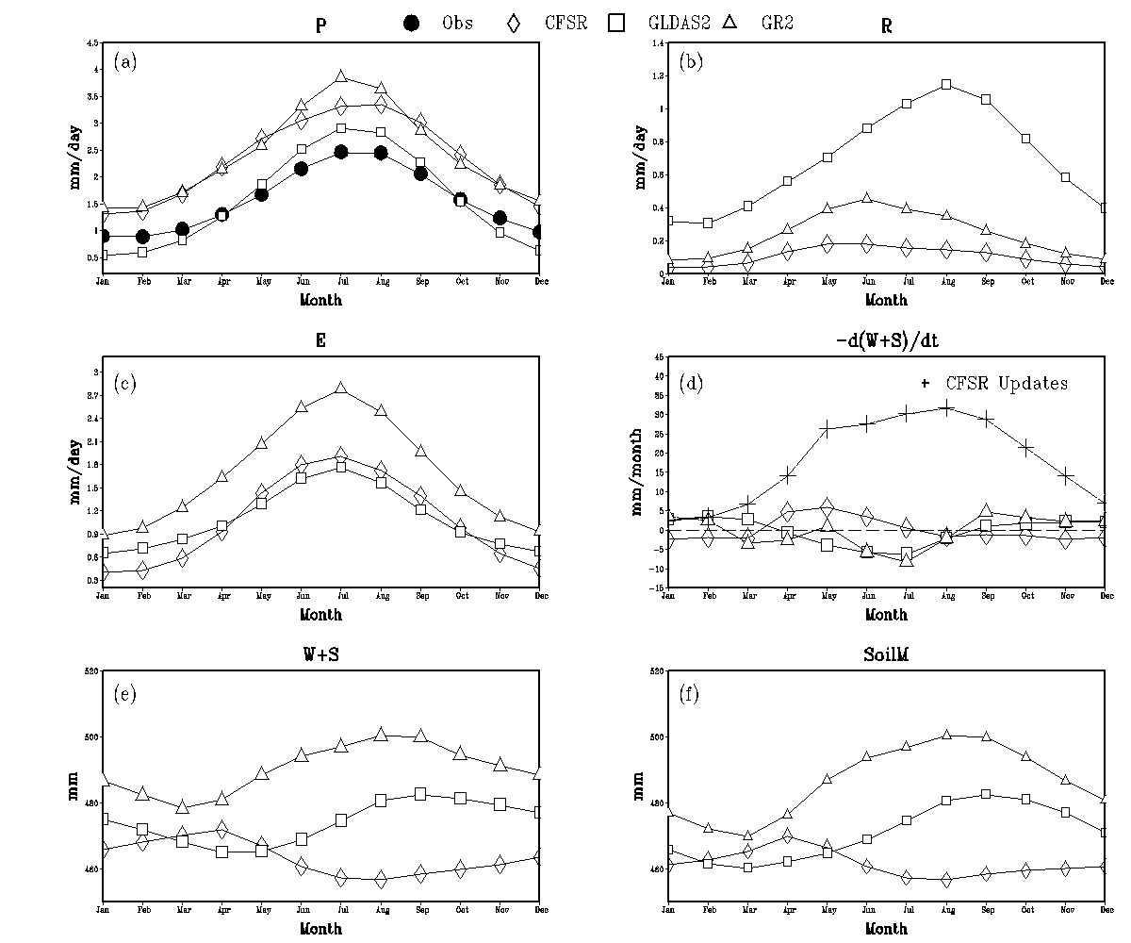
Water Budget Components Climatology (N.H.)
Lowest in CFSR both lower than
GLDAS
highest
GR2, agree with precip
CFSR
Remove SM
Damped
Seasonal
cycle

Slide 14
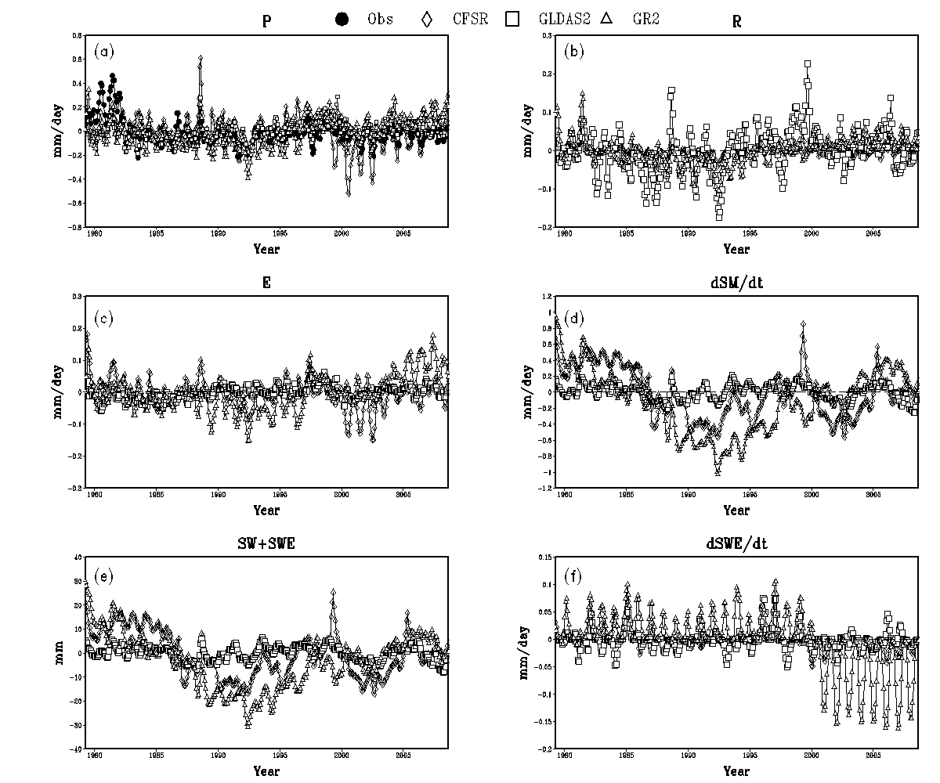
Water Budget Components Anomaly (N.H.)
Anomaly fields comparable, GR2 has the largest inter-annual variability

Slide 15
Energy Terms

Slide 16
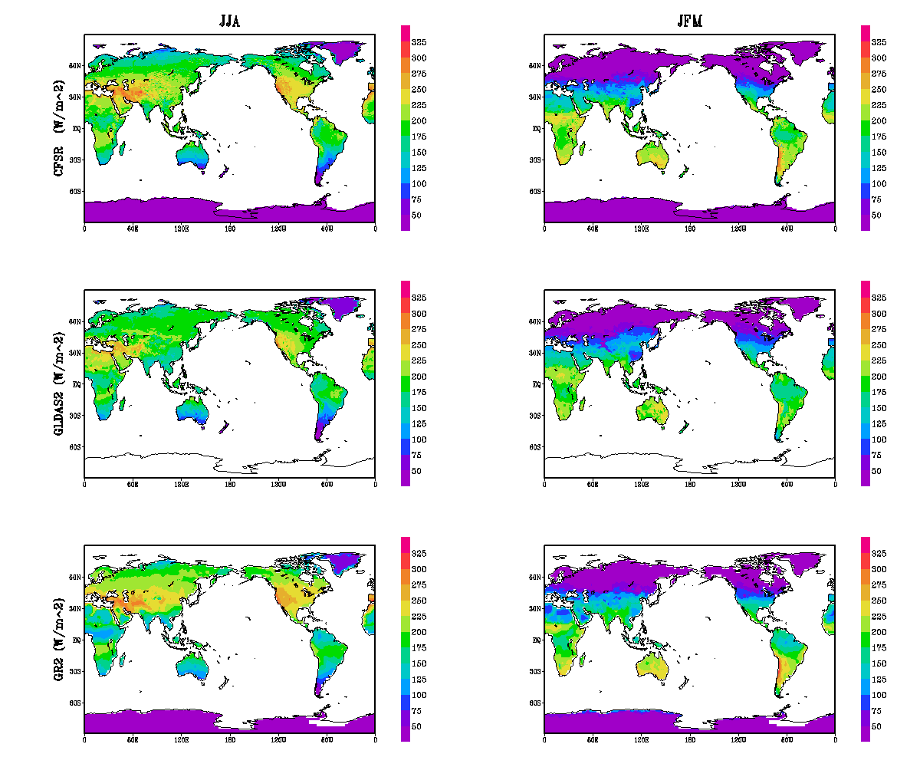
Net Shortwave
CFSR
GLDAS
Slightly Lower in summer, closer in winter
Both close to GLDAS
GR2

Slide 17
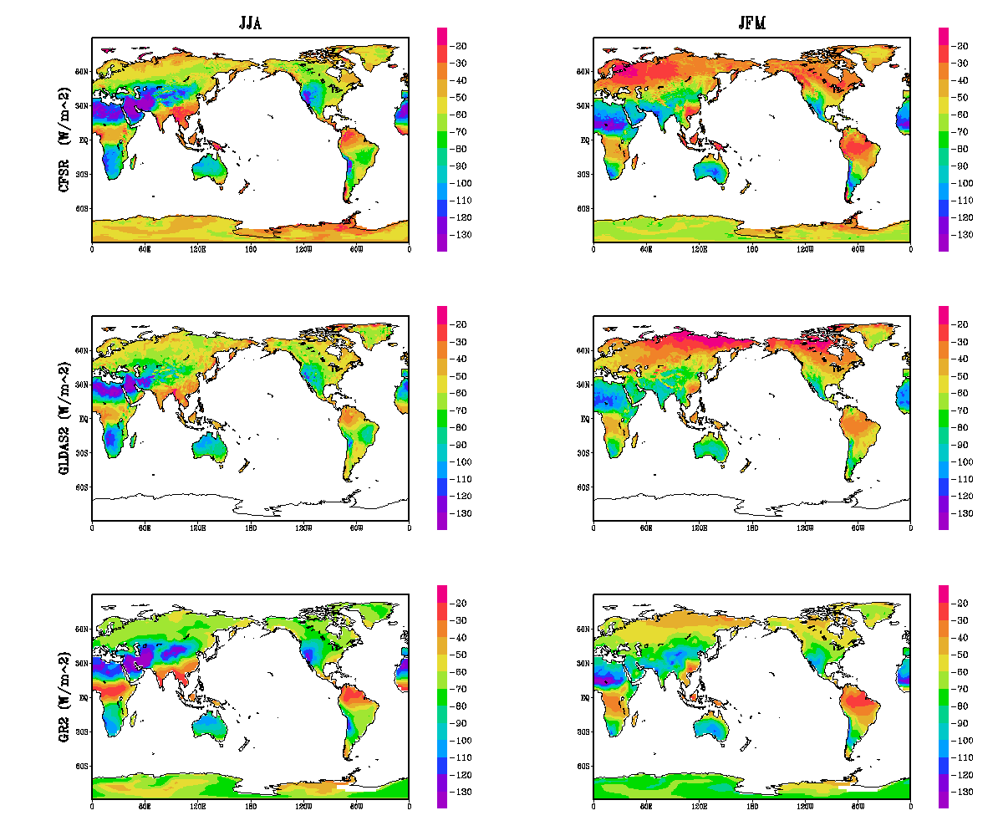
Net Longwave
CFSR
GLDAS
higher in winter, closer in summer
Close to
GLDAS
GR2

Slide 18
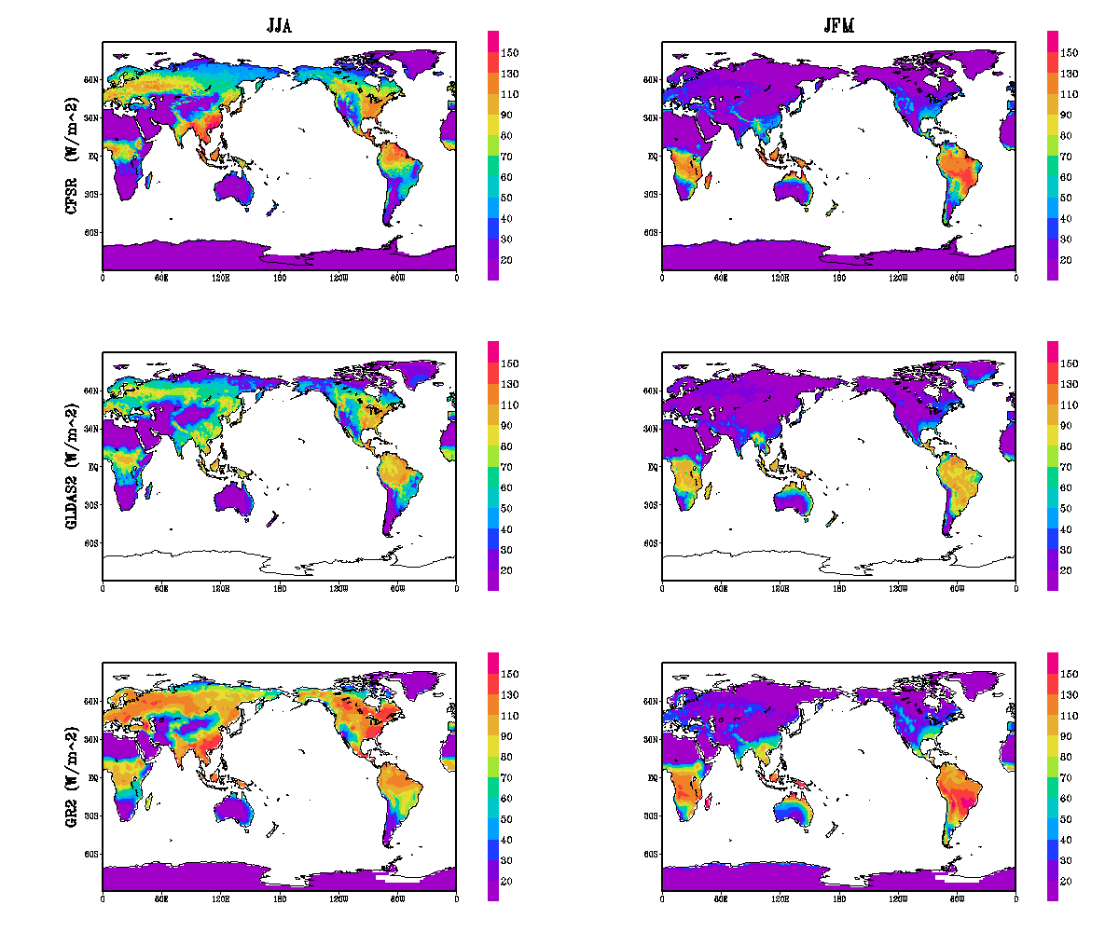
Latent Heat Flux
CFSR
GLDAS
Consistent with precip
Lower in summer, closer in winter
Both higher than GLDAS
GR2

Slide 19
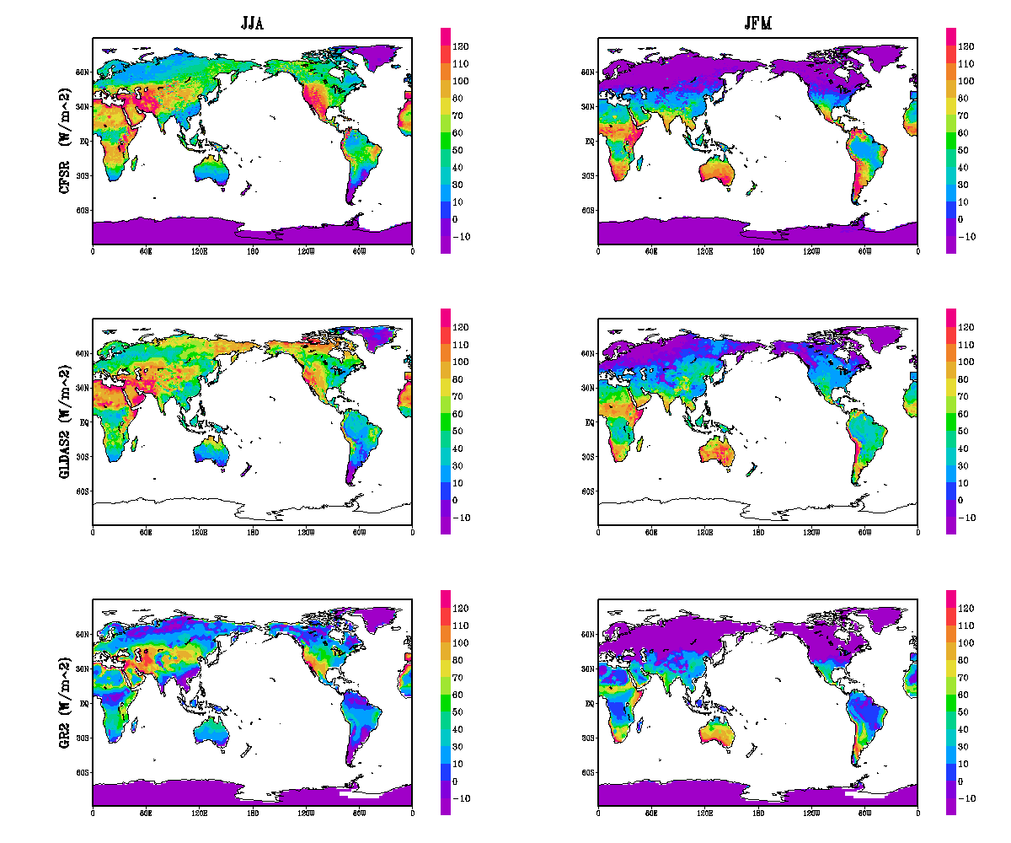
Sensible Heat Flux
CFSR
GLDAS
Higher in both
seasons
Closer to GLDAS
GR2

Slide 20
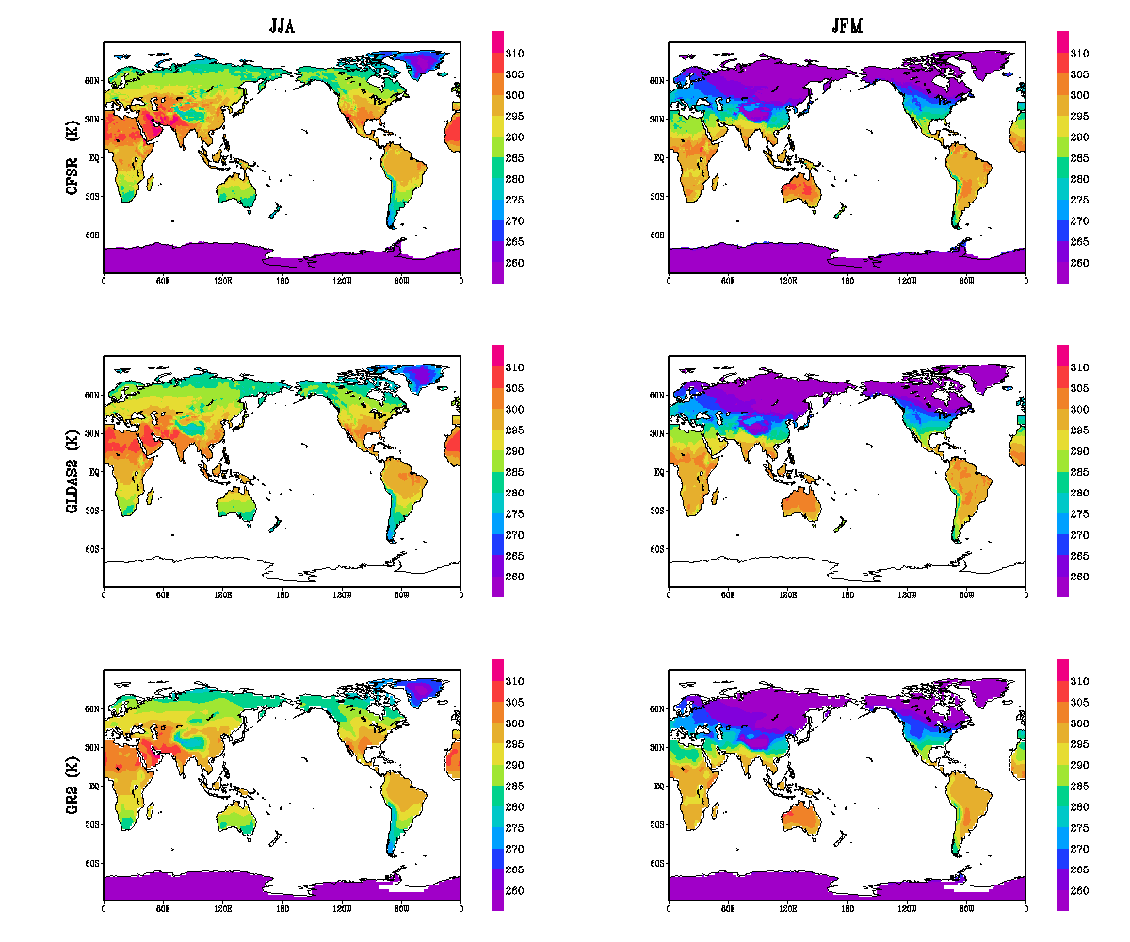
Surface Temperature
CFSR
GLDAS
Close to each other in both seasons
both close to GLDAS with GR2 slightly lower in summer
GR2

Slide 21
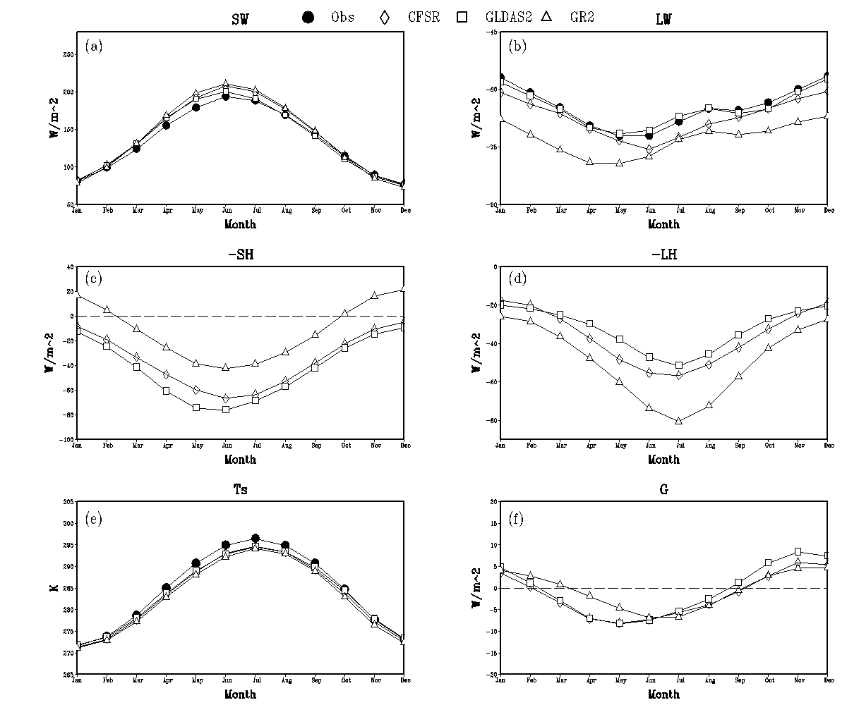
Energy Budget Components Climatology (N.H.)
SW close,
less
LW cooling,
closer to GLDAS
High SH, low LH, closer to GLDAS
Comparable,,closer to GLDAS

Slide 22
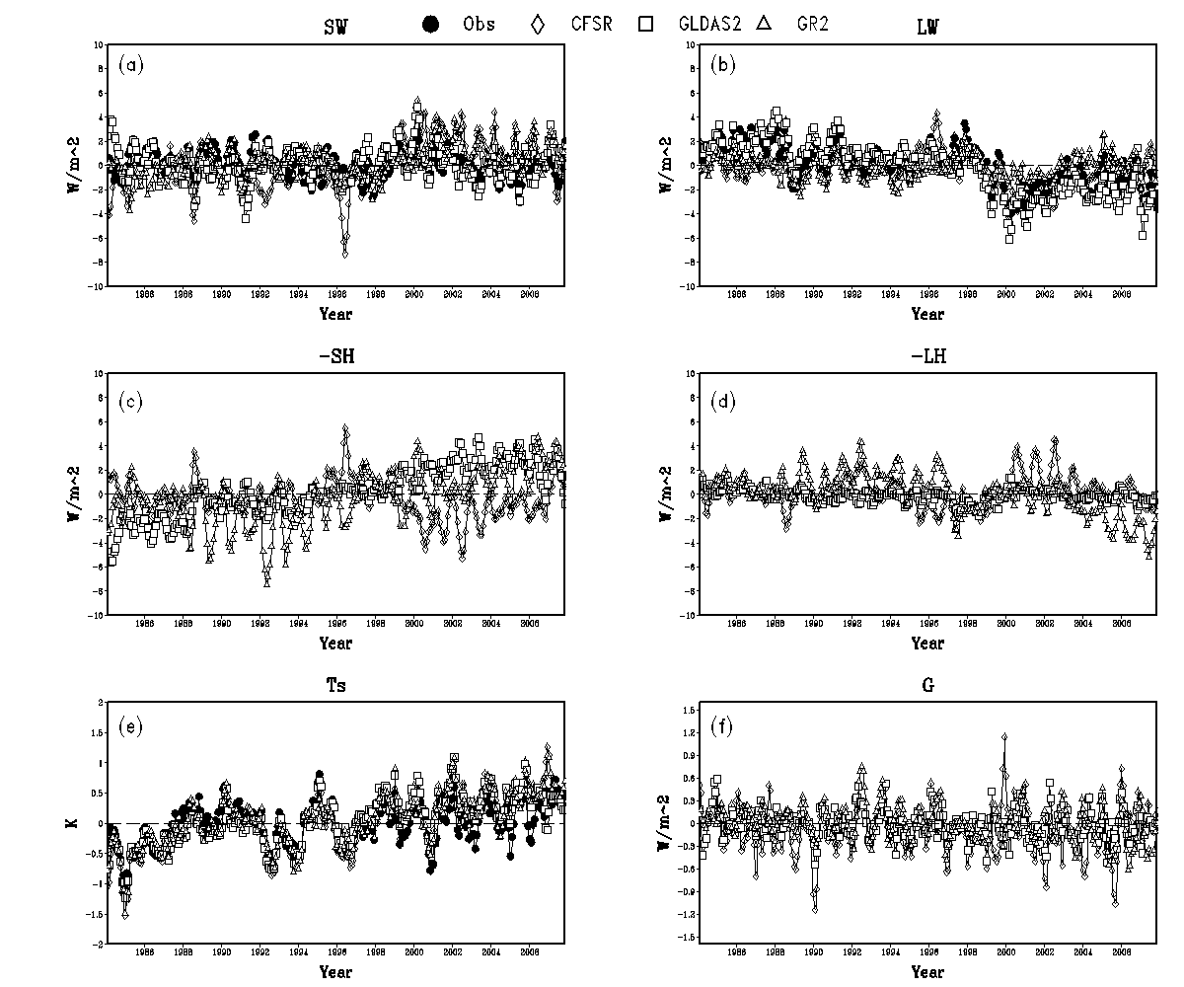
Energy Budget Components Anomaly (N.H.)
Anomaly fields comparable, GR2 has the largest inter-annual variability

Slide 23
Summary
The new NCEP CFSR has many improvements, especially summer high bias in precipitation in the GR2 via the new Noah LSM and advances in atmospheric model physics.
The budget terms in CFSR are in closer agreement with the offline GLDAS using the same land model, implying that land-atmosphere interaction is well represented in the CFSR.
Surface water budgets are mainly impacted by precipitation, which is determined by background model bias and efficiency of the assimilation technique.
The direct removal of soil water in GR2 is not efficient as the background model has a high bias. The adjustment made to soil moisture in the CFSR via the semi-coupled GLDAS approach does improve soil moisture in the CFS, which is very important to summer-season predictions .
Surface energy budgets are in better agreements with each other and with the satellite retrievals.
The inter-annual variability in both surface water and energy terms are close to each other.

