Slide 1




20th century Isotope Reanalysis Reproduction of isotopic time series in corals, tree-rings, and tropical ice cores
H
¹⁸O
H
D
¹⁶O
H
Kei Yoshimura (AORI, U-Tokyo)
An economic way to dynamically downscale an ensemble mean field
First direct comparisons with hisotrical isotopic proxy data

Slide 2
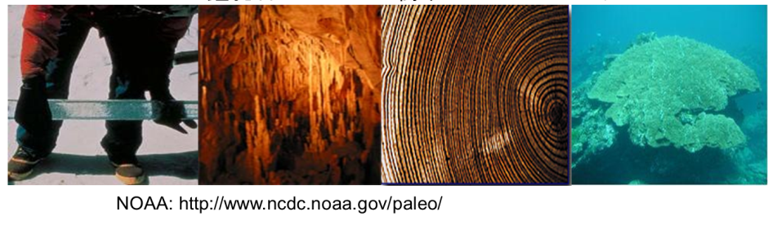
Stable Isotope Information: known as “Time capsule of climate”
Much longer records than man-made observation
  Oceanic sediment δ¹⁸O (millions yBP)
  Icesheet cores δ¹⁸O・δD (~800 kyBP)
  Icecap cores δ¹⁸O・δD (~20 kyBP)
  Speleothem δ¹⁸O (~2000 yBP)
  Treering δ¹⁸O (~1000 yBP)
  Coral δ¹⁸O (~400 yBP)
Still some difficulties in interpretation

Slide 3
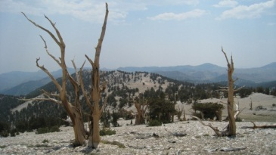
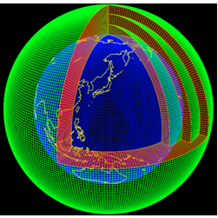
Forward Proxy Modeling Approach
Real World
Model World
Evaluate the reliability of the Forward model.
Circulation
Circulation
Temperature
Temperature
Real Proxyδ¹⁸O
Simulated Proxyδ¹⁸O
Snow/Glacier
Snow/Glacier
Precipitation
Precipitation
Etc.Etc.
Source
Etc.Etc.
Source
The impact from each component is not fully quantifiable.
The impact from each component is explicitly quantifiable.

Slide 4
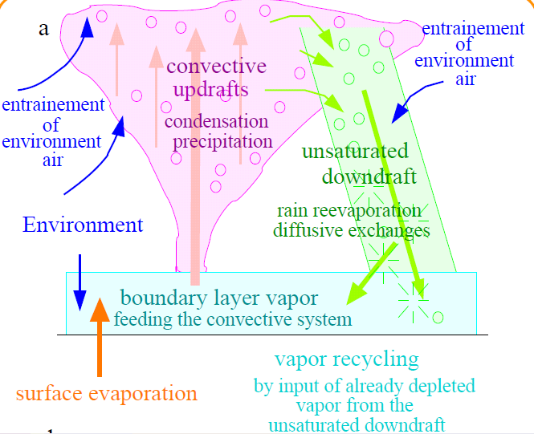
Forward modeling:
Isotope-GCM/RCM and Offline Modules
Atmospheric Advection
Precipitation processes
*Snow/
Icecore ¹⁸O
*Sea water ¹⁸O
Land surface
processes
*Cellulose ¹⁸O
*: Offline modules
Incorporate water isotopes as passive tracers in models. Whenever water phase change takes place, isotopic water (HDO, H₂¹⁸O) behave differently to ordinary water (H₂¹⁶O).

Slide 5
Spectral Nudging:
Poor man’s data assimilation
Use large scale (>1000km) winds to constrain dynamical field, so that the isotopic field is also constrained and reproduced in daily to inter-annual time scales.
Yoshimura and Kanamitsu, 2008; Yoshimura et al., 2008

Slide 6
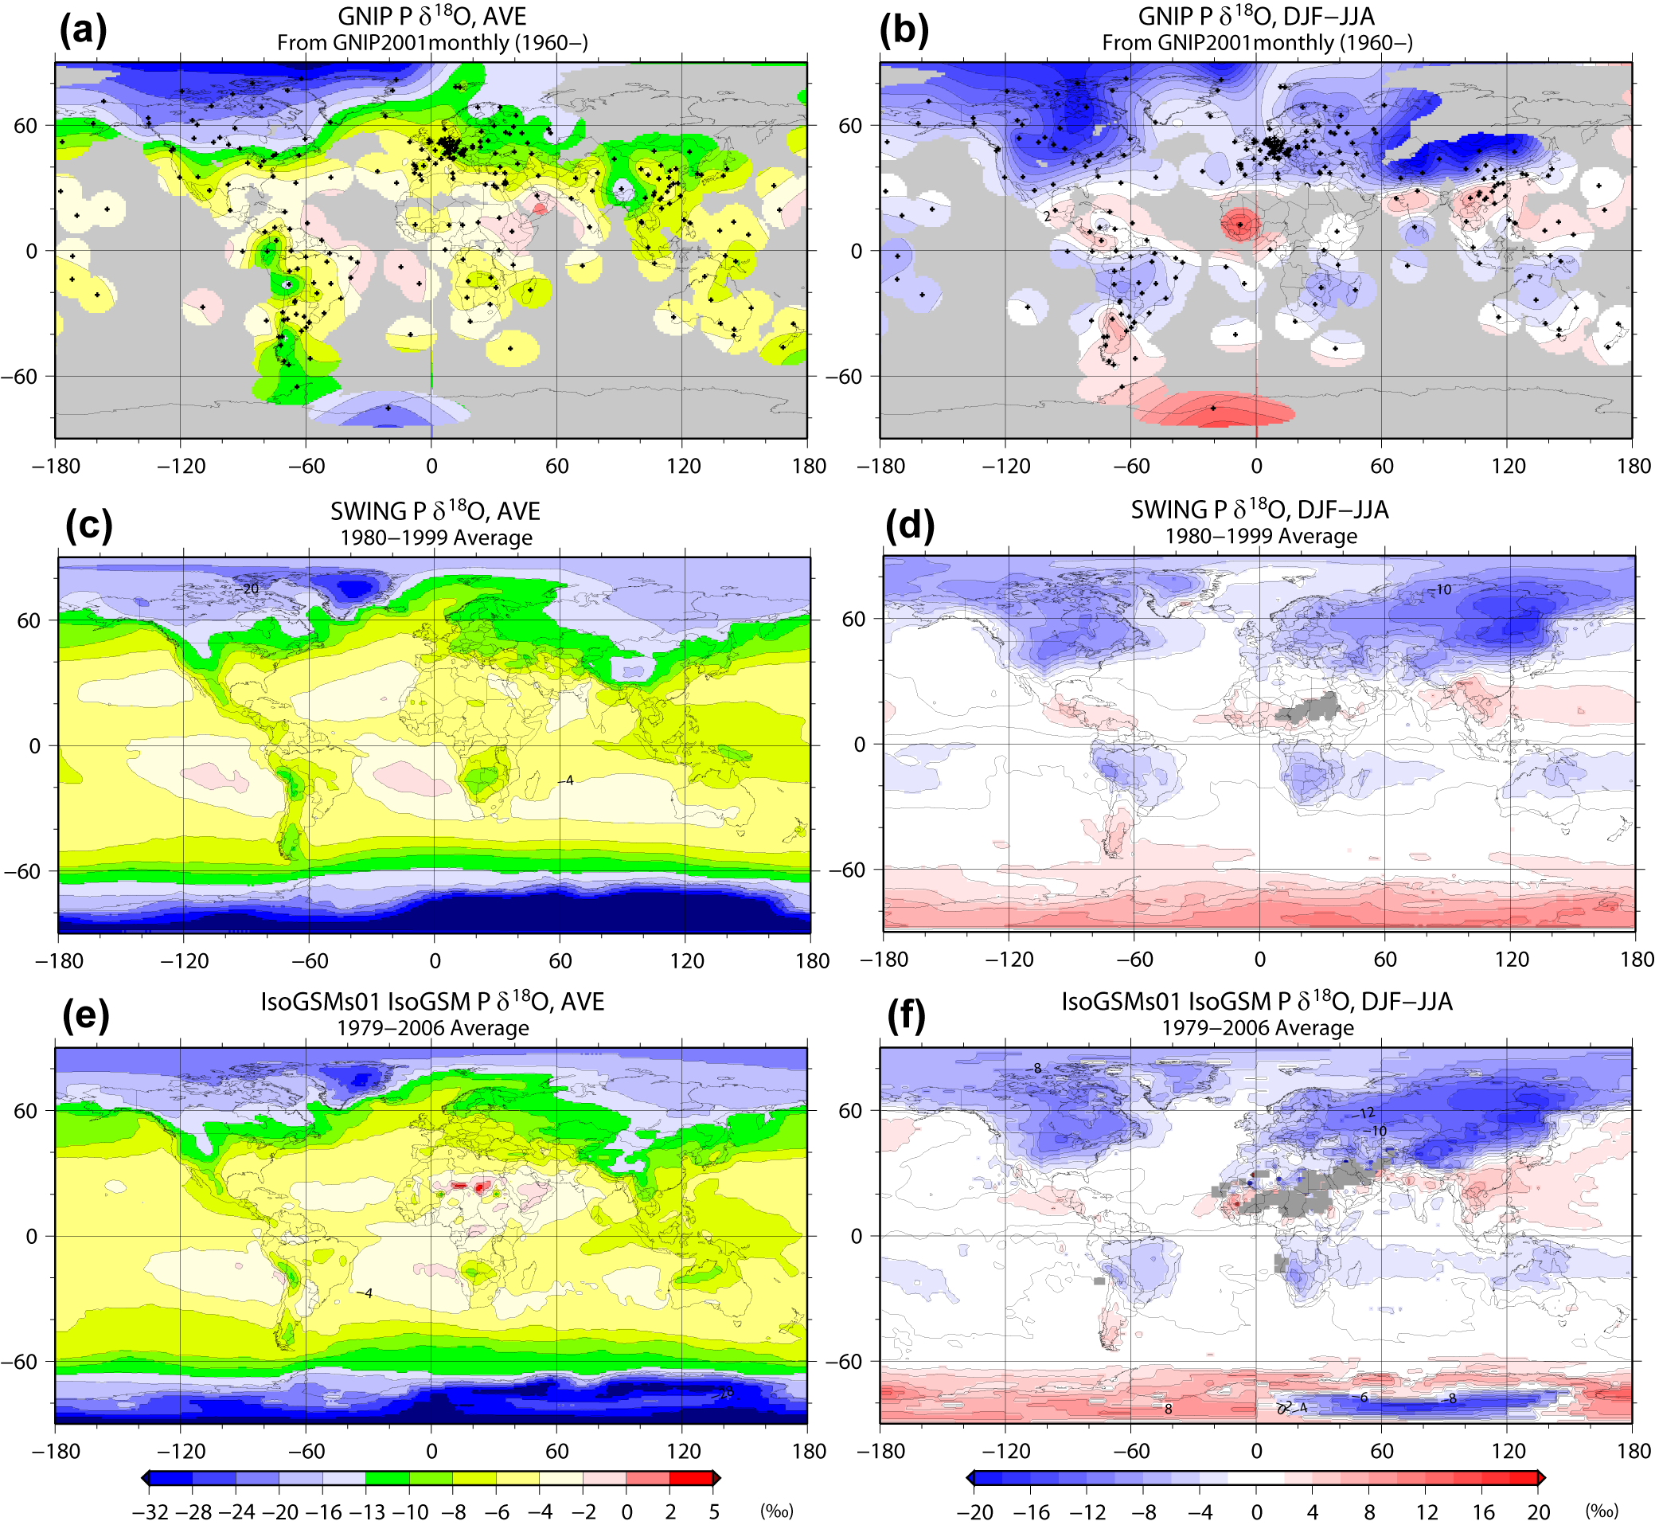
Validation: Comparison in δ¹⁸O in Precip
Yoshimura et al., 2008

Slide 7


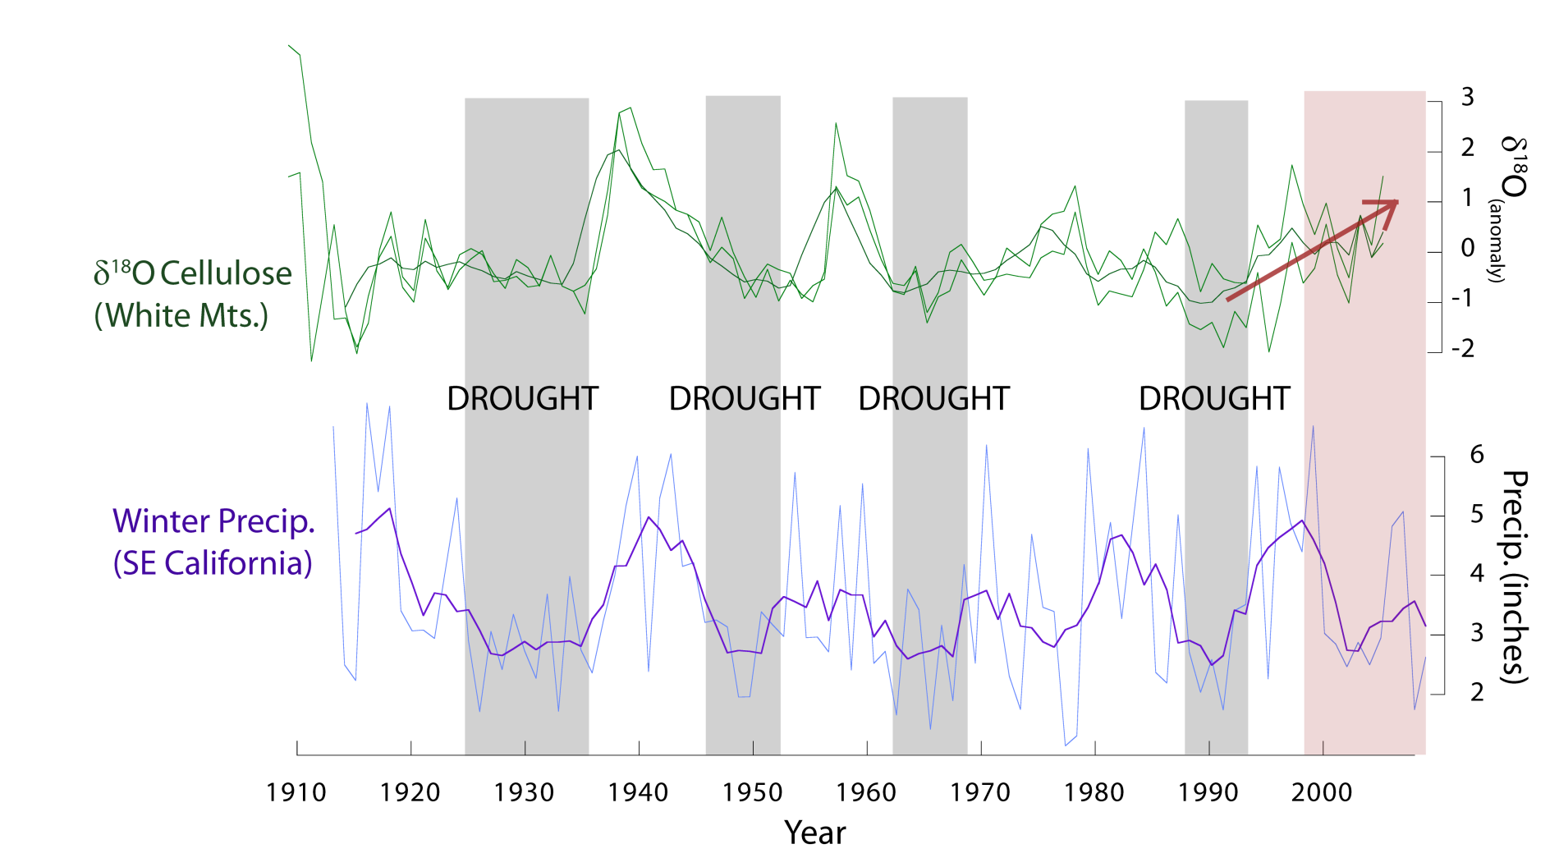
Comparisons with Proxies
nudged
Coral near
Philippines
free
Extension of simulation needed!!
Bristolcone pine tree
at SW CA
other proxy data (treerings/corals/etc)
precipitation data
Stott et al., prep
Kojima et al., submitted
Notes:
7

Slide 8
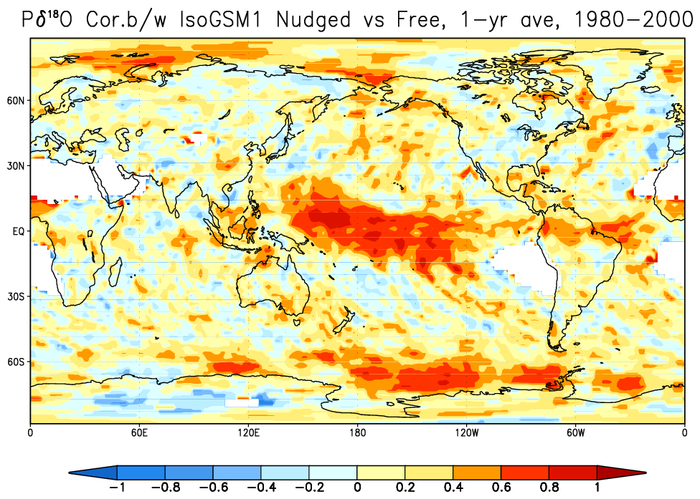
Correlation b/w Nudged vs AMIP
Interannual variability in precipitation δ¹⁸O is NOT constrained by SST except tropic regions.
➔ Atmospheric modes play independent roles for δ¹⁸O.

Slide 9
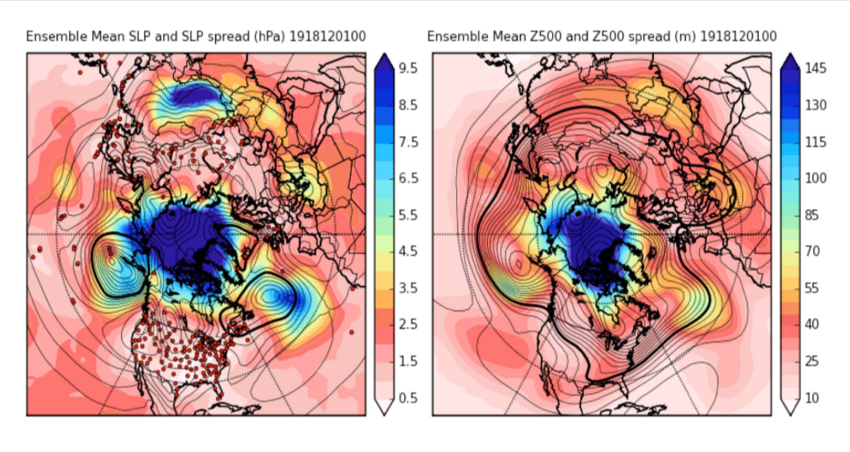
20th century Reanalysis
(Compo et al., 2011)
1 December 1918
Using only surface pressure data historically recorded since 1870’s
Ensemble Kalman Filter for data assimilation (56 member)
T62L28 GFS with NOAH LSM
SLP
500 hPa GPH
Whitaker et al. (2009)
Reanalysis skill is comparable to current Day-3 forecast skill (Whitaker et al., 2009)
Ensemble Mean (EM) fields are publically available.

Slide 10
A Problem for Poor man’s Data Assim.
Are the ensemble mean fields appropriate as lateral boundary conditions for spectral nudging?

Slide 11
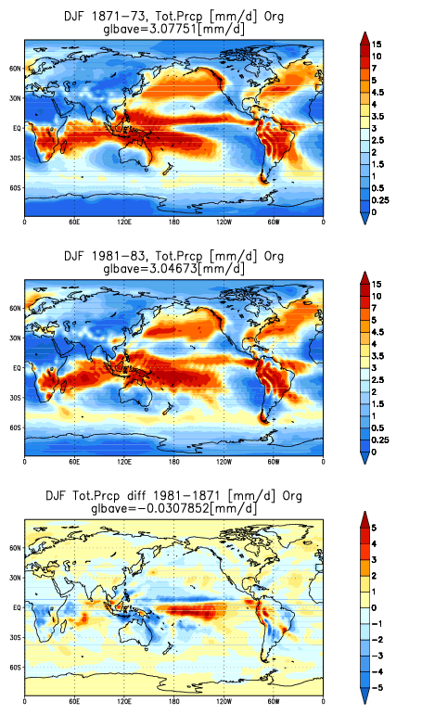
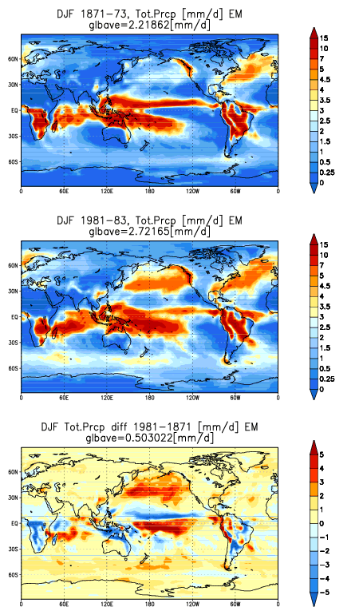
NO!!
ORIG
EM
19C
20C
Diff

Slide 12
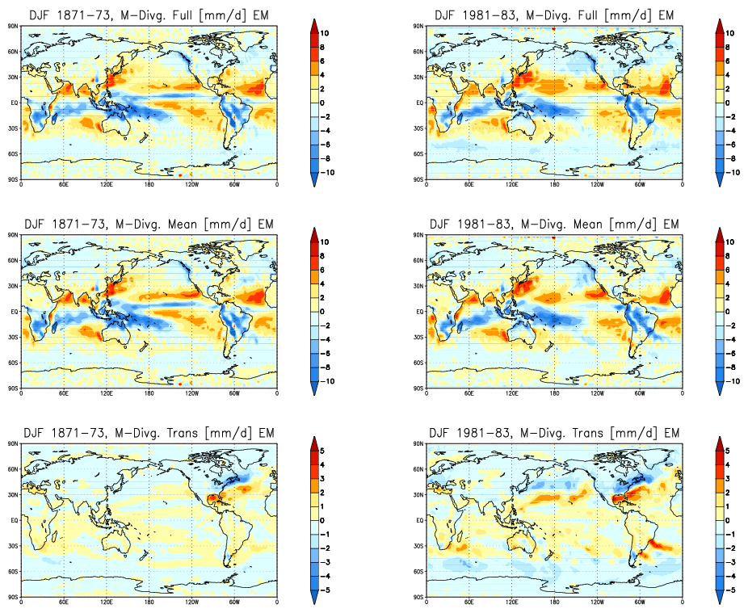
Transient component of moisture divergence is smoothed out in EM
19C
20C
Total divergence
Mean
Transient
No di/convergence

Slide 13
Straight forward remedy:
Downscale a single member many times and making an average of them.
Too Expensive!!
(for a poor man)
Poor Man’s
DA
XX-member
With isotopic info
Ensemble
Averaging
Ensemble
Mean Isotopic Info
…
Is there any other way
to reduce computation?

Slide 14
Modification of single member by ensemble mean increment (MS method)
where F is full field of physical variable, n is an ensemble member, bar indicates ensemble mean, and <> indicates running mean (e.g. one-month).
The downscaling will be performed using F_{n}^{new} as a lateral boundary forcing.
Other members
Single member forecast F_{n}
Monthly running mean
of a single member <F_{n}>
Monthly running mean
of all members <F^{bar}>
increment
Time
Corrected member
Yoshimura et al., in prep

Slide 15
Specification of experiments
Atmospheric Forcing: 20thC Reanalysis (Compo et al., 2011)
  Also regarded as “truth”.
Experiments: Different by the atmospheric forcings.
  EM: Ensemble mean is used.
  S1: Arbitrary chosen single member (run01) is used.
  S3: Mean of the runs in which arbitrary chosen three single members (run01, run11, & run21) are used.
  S6: Similar to S3, but 6 single members (S3 + run31, run41, & run51) are used.
  MS: Modified single member is used.
Periods:
  1871-2008 for EM and MS.
  1871-1873 and 1981-1983 for S1-S6.
Model: IsoGSM with global spectral nudging (Yoshimura et al., 2008)

Slide 16
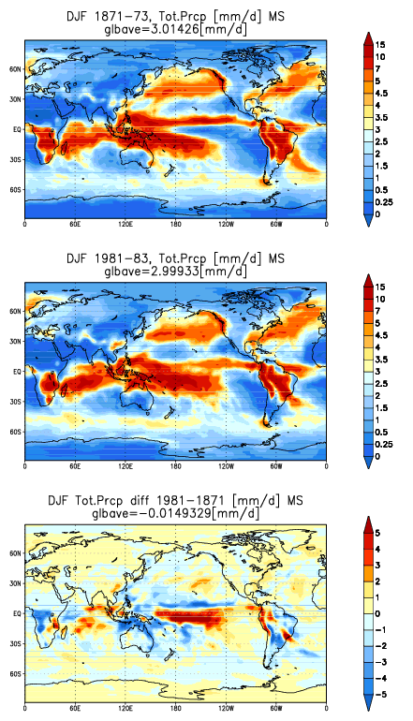
Seasonal mean precipitation with MS field
ORIG
EM
MS
19C
20C
Diff

Slide 17
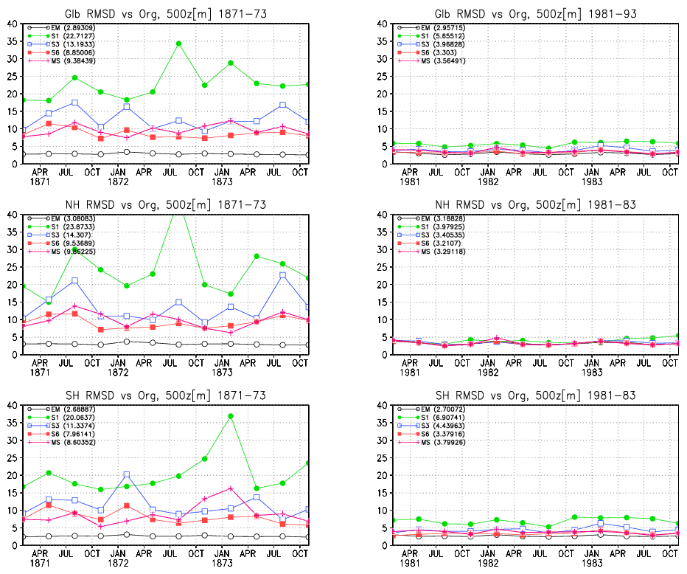
RMSD in 500Z against “truth”
19C
20C
Single Mem
Globe
6-Mem Ave
MS
EM
NH
SH

Slide 18
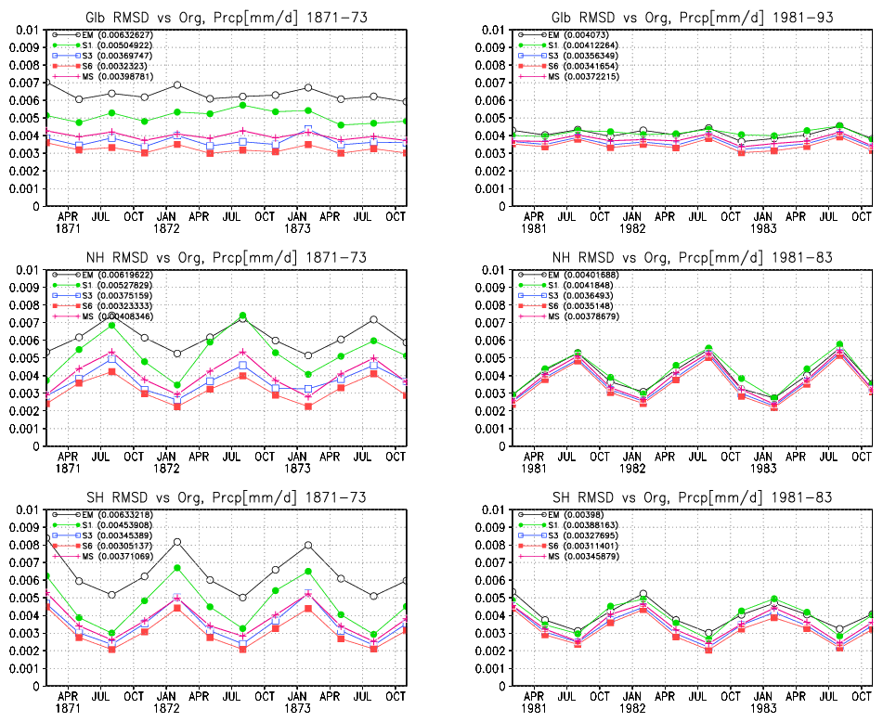
RMSD in Precipitation against “truth”
19C
20C
EM
MS
Single Mem
Globe
6-Mem Ave
NH
SH

Slide 19
Seawater δ¹⁸O from Coral and Model
Bunaken (2N 125E)
Modeled δ¹⁸Osw(‰)
Coral δ¹⁸Osw(‰)
Philippine (13N 124E)
Modeled δ¹⁸Osw(‰)
Coral δ¹⁸Osw(‰)
Yoshimura et al., in prep
Notes:
モデルの計算期間を延長した

Slide 20
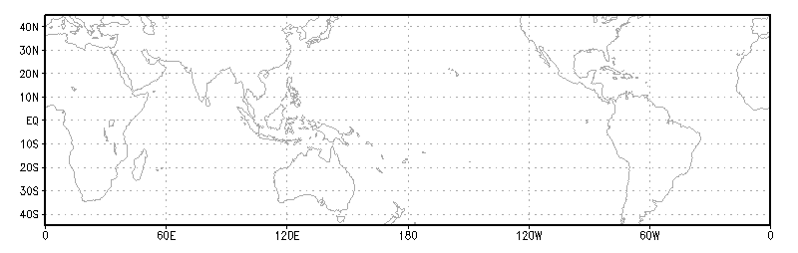
Reproducibility of Interannual δ¹⁸O_{sw} and Precip Amount
Correlation
Std Dev of Annual Precip (mm/year)
Large Precip Variability
→ Local precipitation is recorded
Small Precip Variability
→ Other factors (current, river flow, etc) may play big roles.
Kojima et al., 2011.
Notes:
年平均降水量の標準偏差

Slide 21
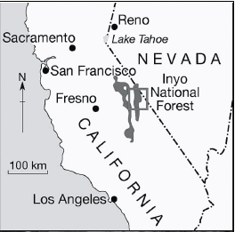
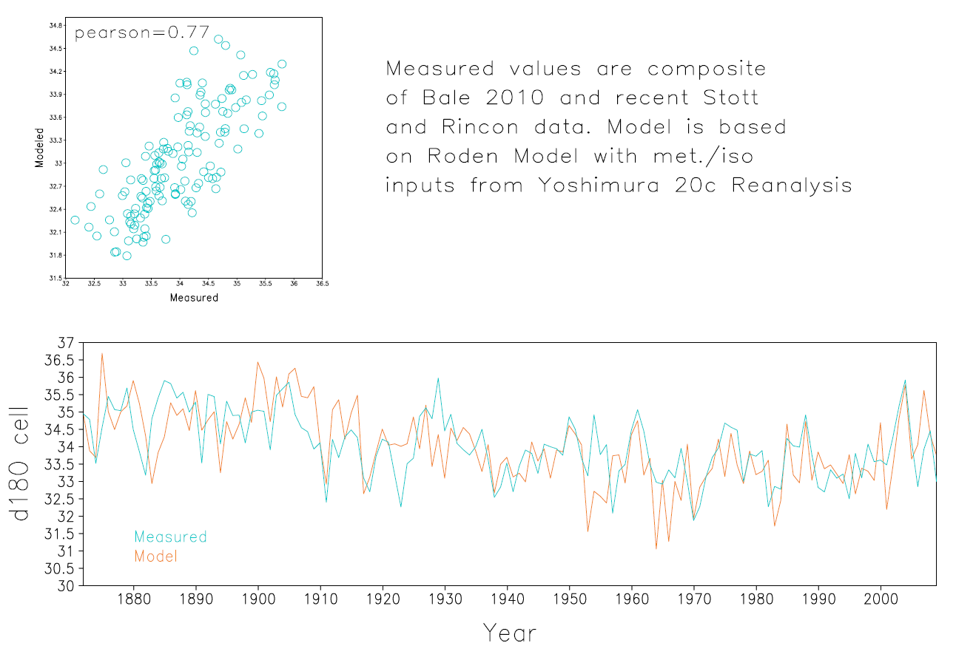
Treering δ¹⁸O in West US
Courtesy of L. Stott

Slide 22
Isotope Simulator for Ice-cap Cores
To reproduce low-latitudinal icecore data, we need to consider both:
Complex topography
Detailed snow/Ice fractionation
Okazaki and Yoshimura, in prep

Slide 23
Summary
First 20th century Quasi Reanalysis for Isotope is now available.
  Global, 6-hourly, 180km-scale, 1871-2008.
  Higher resolution can be provided upon request.
  Usage from interdisciplinary communities is most welcome!
A relatively economical way to dynamically downscale the ensemble mean fields is proposed. Cost would be 1/6.
Though number is limited, comparisons with paleoclimate proxy data show nice performance for 19th-21st centuries.
This effort helps to develop the “forward proxy modeling” approach to more comprehensively and more quantitatively interpret the proxy data.
Moreover, this study may contribute for development of the proxy-constrained (paleo) Reanalysis.

Slide 24

Thank you very much.
In memory of Kana
Dr. Masao Kanamitsu
（died 2011/8/17)
Acknowledge to:
M. Kanamitsu, G. Compo, N. Buenning, L. Stott, M. Zhu, A. Okazaki, K. Kojima

Slide 25
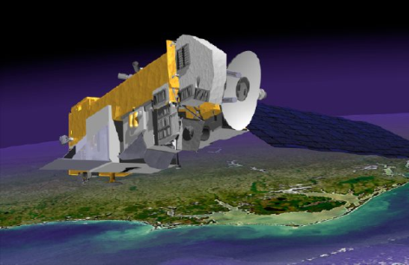
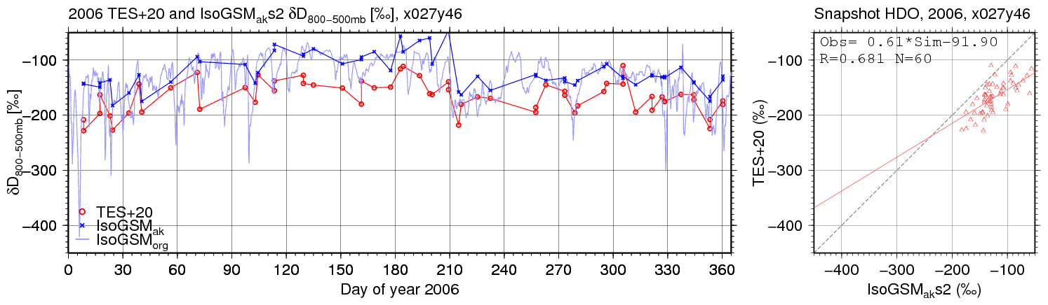
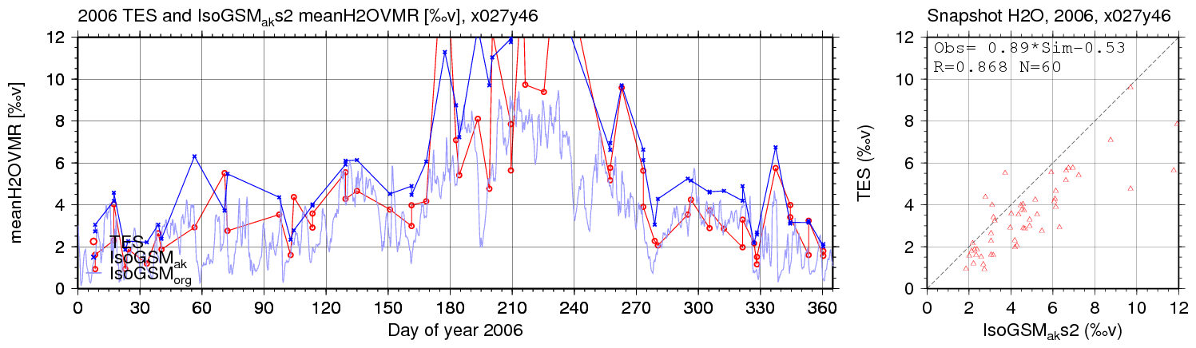
Short-term variability for TES
(a)
With AK
Obs
Without AK
Isotope Ratio
(b)
(c)
Water Vapor
(d)

Slide 26
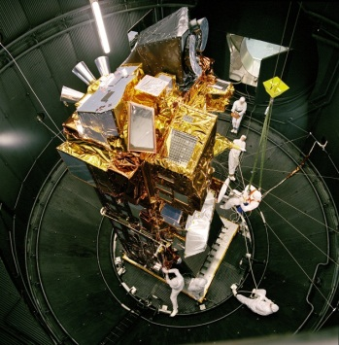
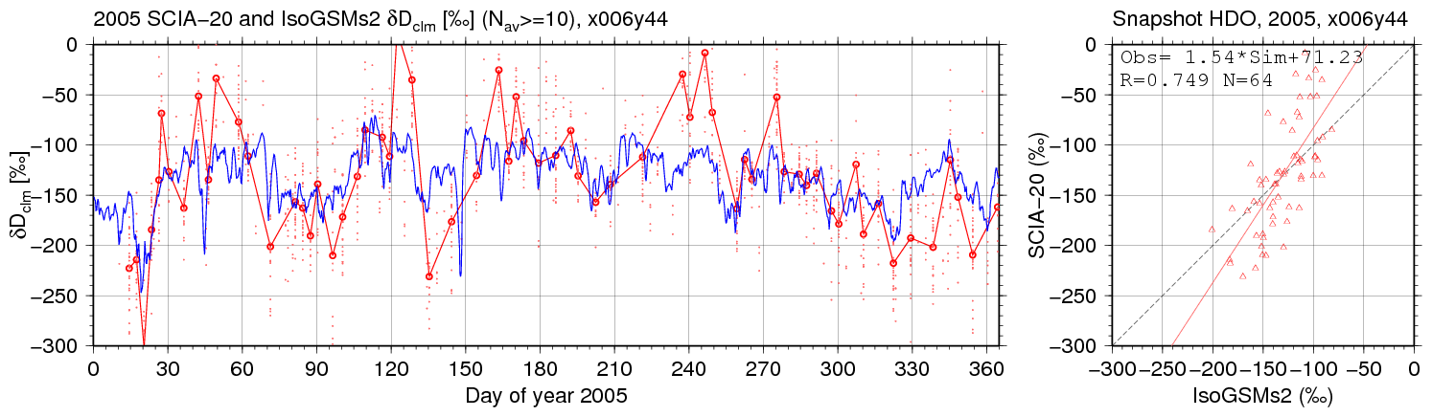
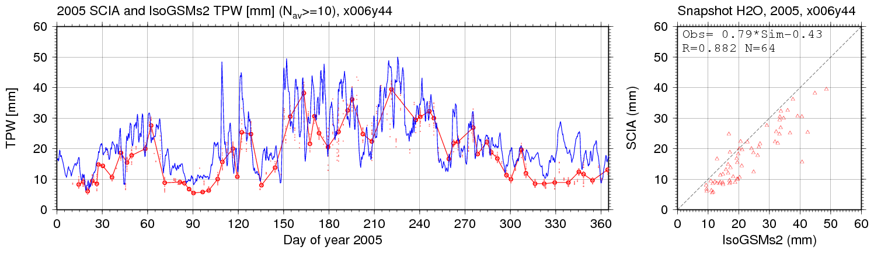
Short-term variability for SCIA
(a)
Obs
Model
Isotope Ratio
(b)
(c)
Water Vapor
(d)

Slide 27
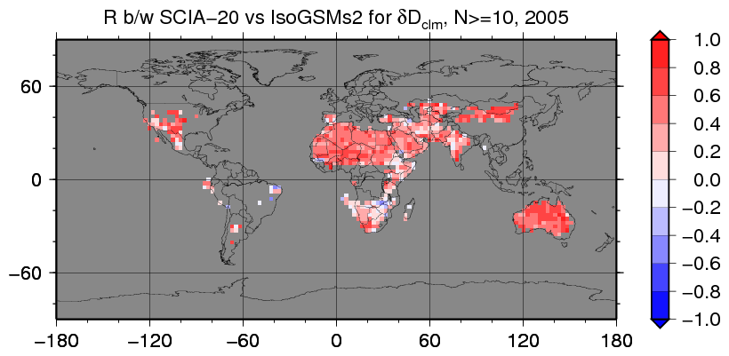
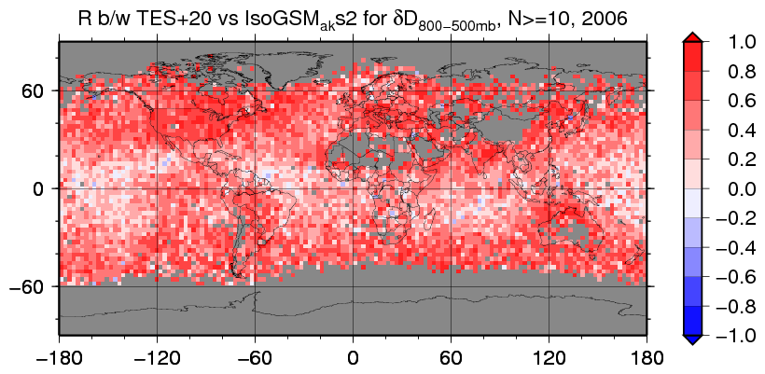
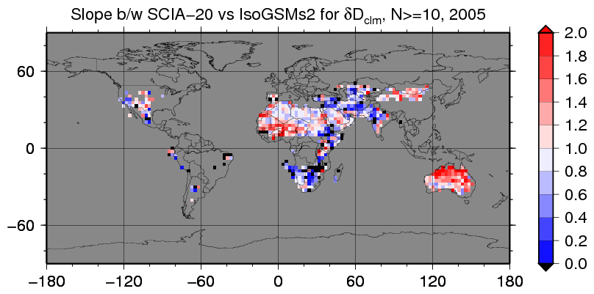
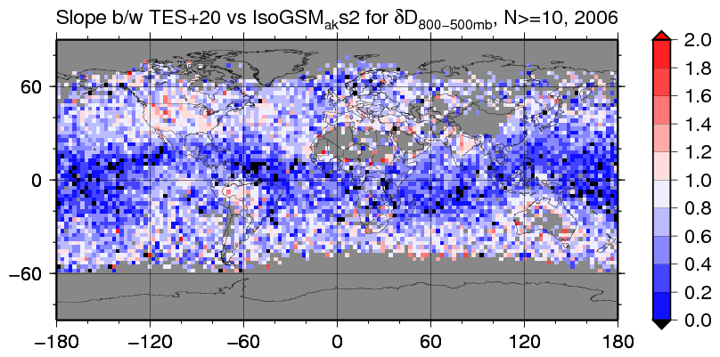
Correlation and Slope b/w RS & Model
SCIAMACHY / surface-PBL
TES / Mid-tropspheric vapor
X
Y
Correlation
X
X
Y
Slope
Model’s problematic vapor circulation can be corrected by data assimilation over desert lands (SCIA) and sub tropical oceans (TES).

Slide 28
Summary of Part 1
Use of ensemble mean field as atmospheric forcings for downscaling study makes big shortcomings, particularly too small precipitation, when the spread of ensemble members is large.
Downscaling of each single ensemble member is straightforward, but requires lots of resources and time.
To avoid these problems, we propose a new method which modifies a single member field to have the same monthly skills as ensemble mean field (MS method) .
Use of the MS method clearly improves skill than direct usage of a single member. About the same skill as when 3 members are directly used.

Slide 29
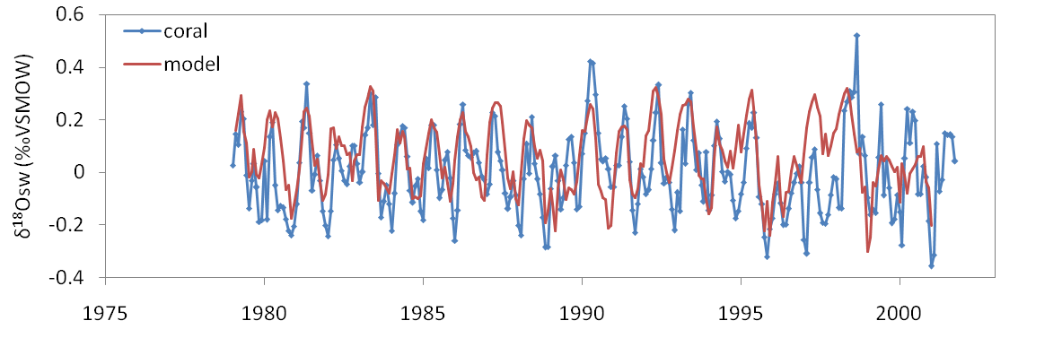
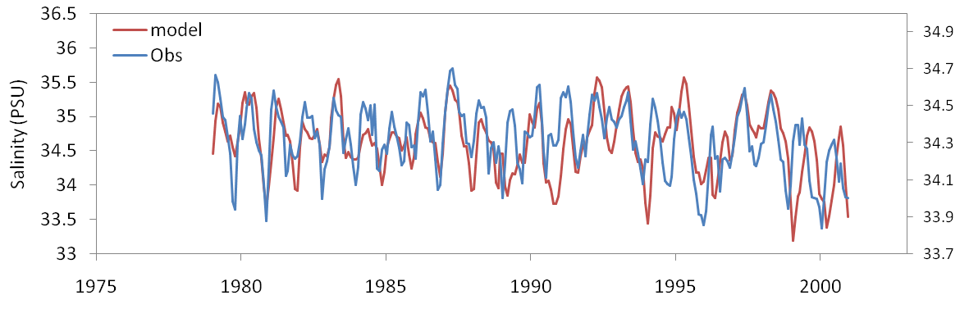
Seawater δ¹⁸O from Coral and Model near Philippines
δ¹⁸Osw (Red: Model Blue: Coral)
R= 0.54
SSS (Red: Model Blue: SODA)
R= 0.55
Kojima et al., submitted
Notes:
Parameters are probably valid.

Slide 30
Icecap δ¹⁸O at Mt Huascaranm, Peru lon=-77.6 ; lat=-9.1
Model
Thompson et al., 1995

Slide 31
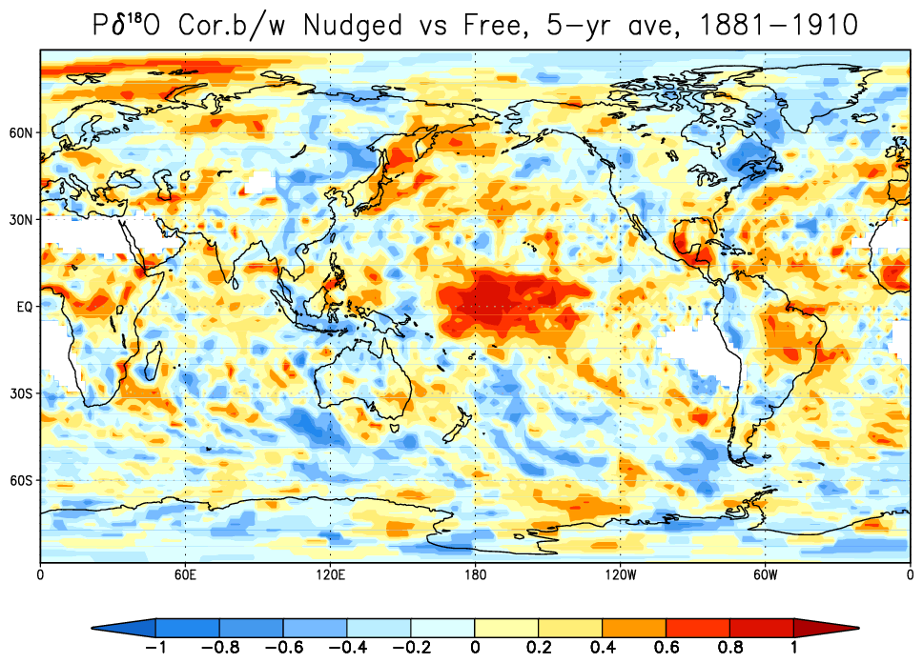
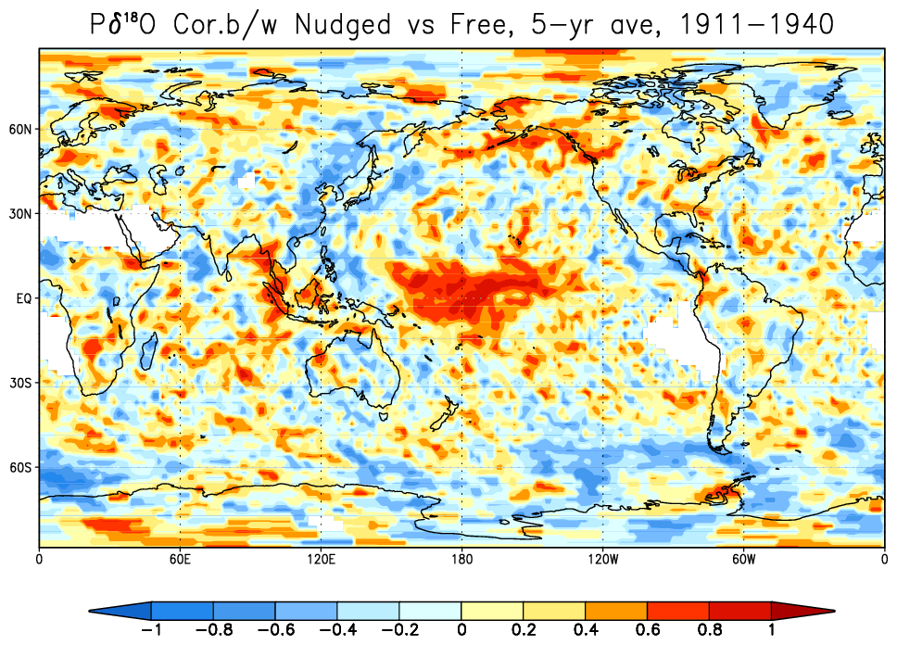
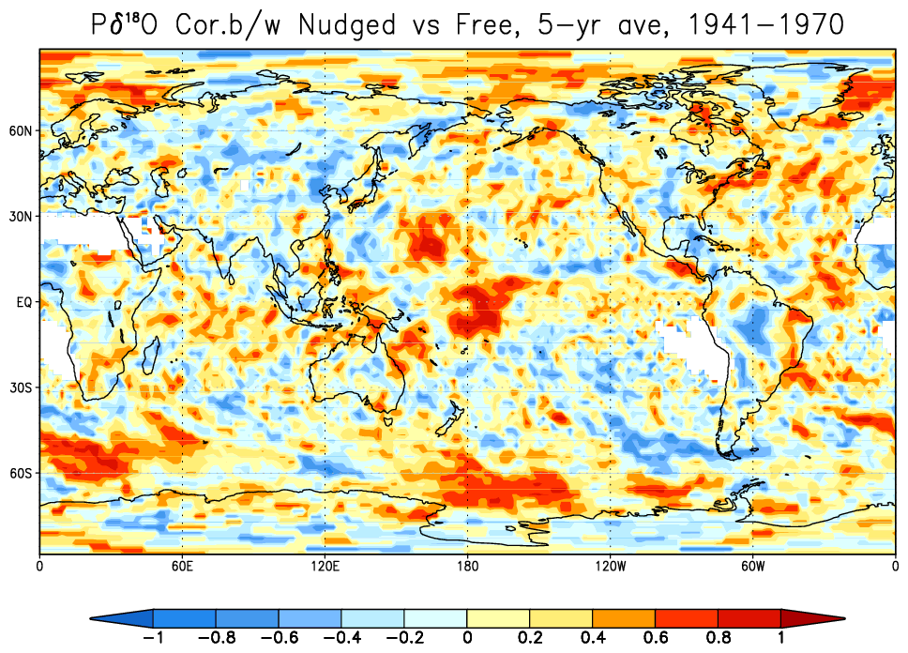
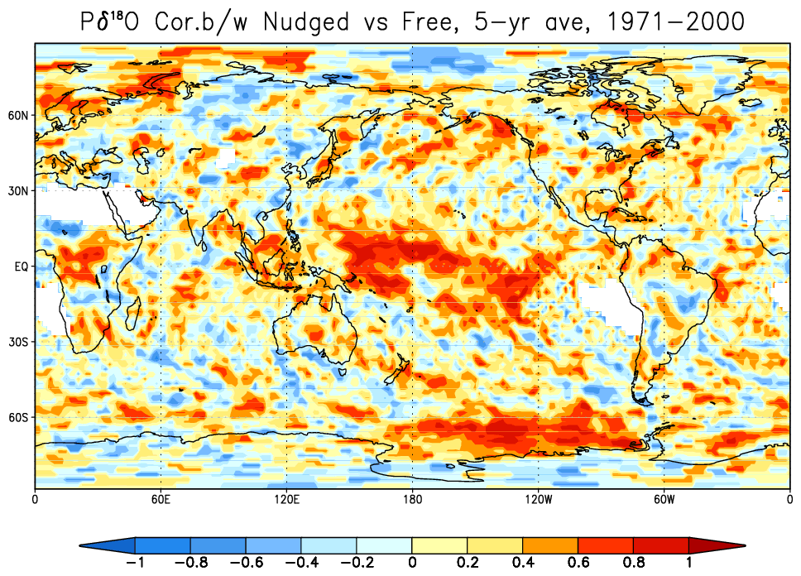
5-yr running mean correlation

Slide 32
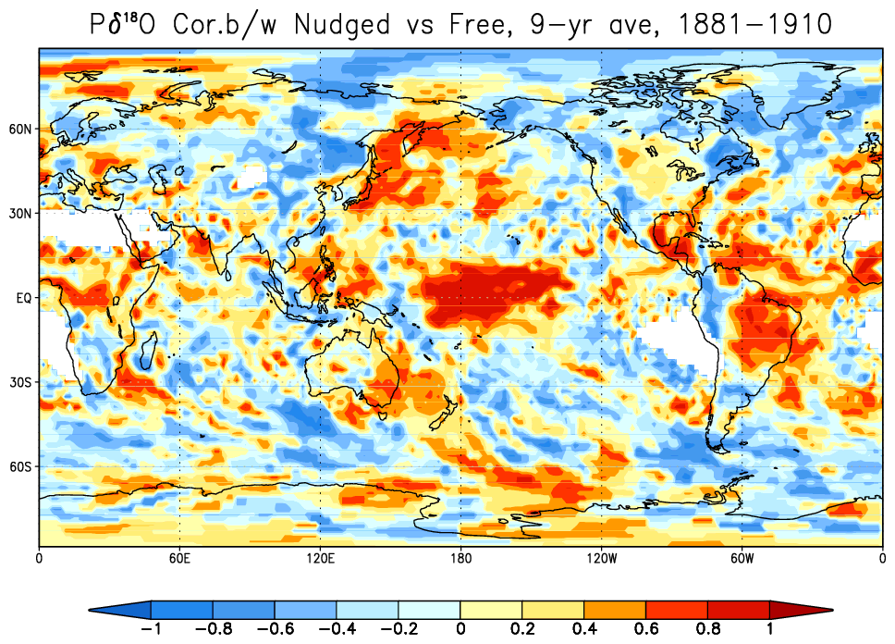
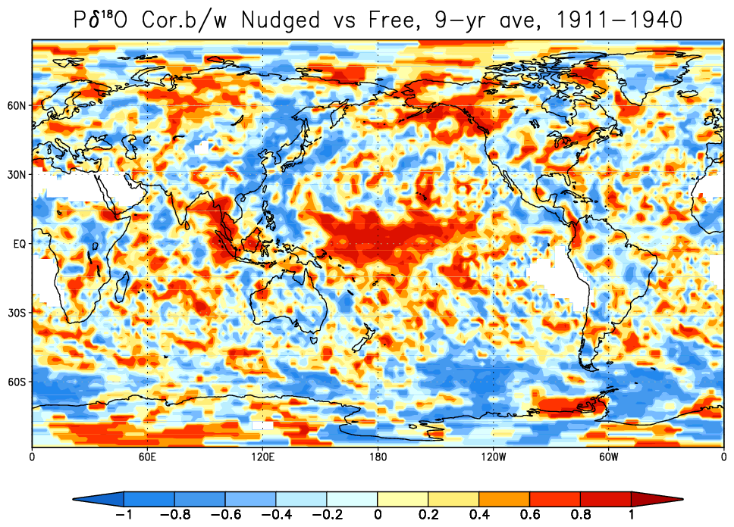
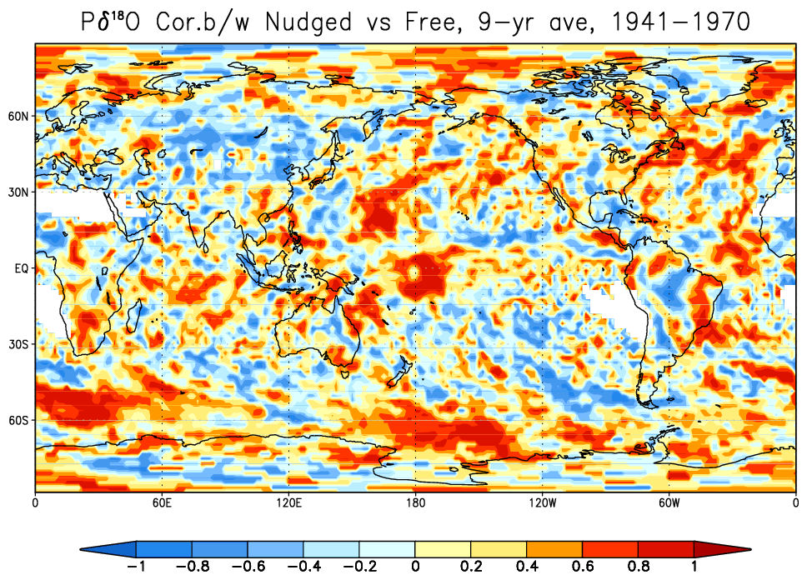
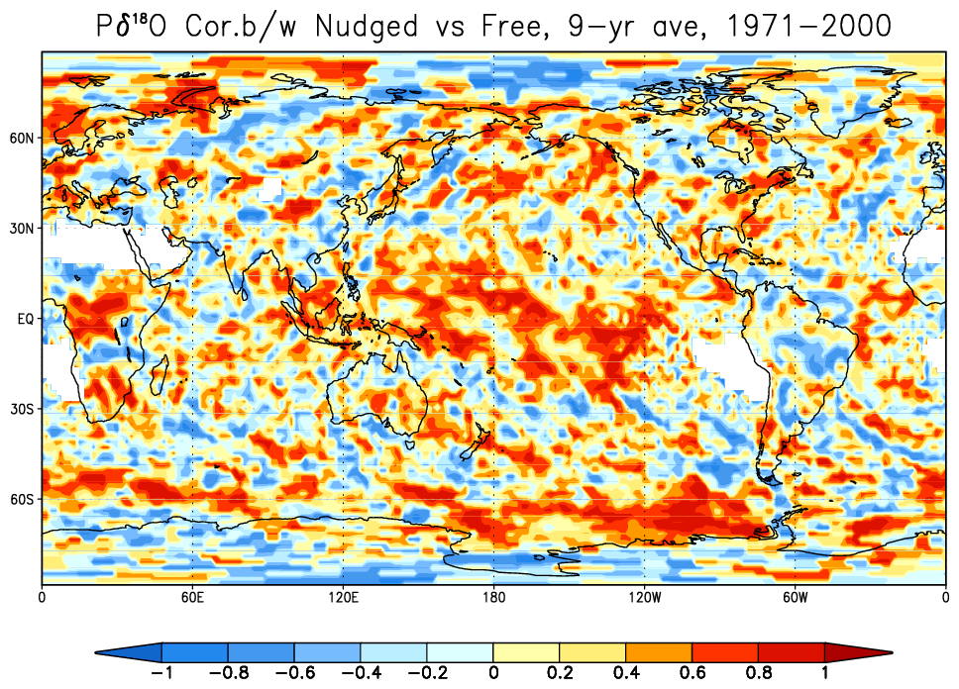
9-yr running mean correlation

Slide 33
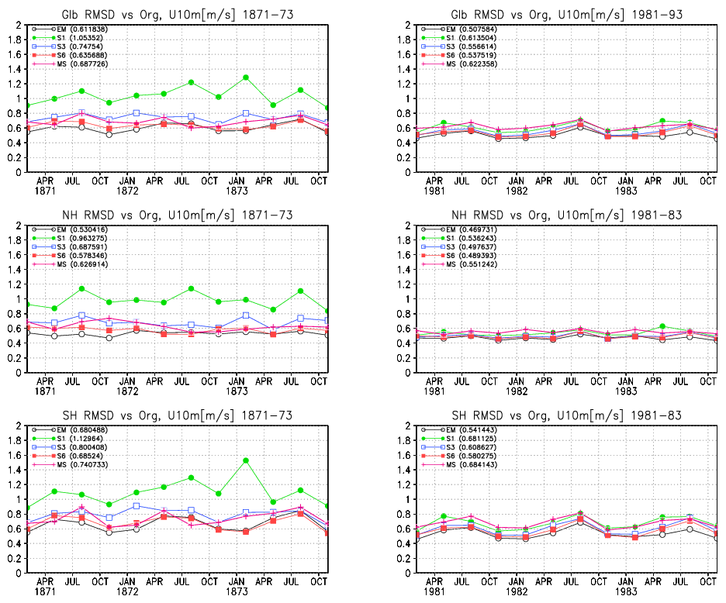
RMSD in Wind against “truth”
19C
20C
Globe
NH
SH

Slide 34
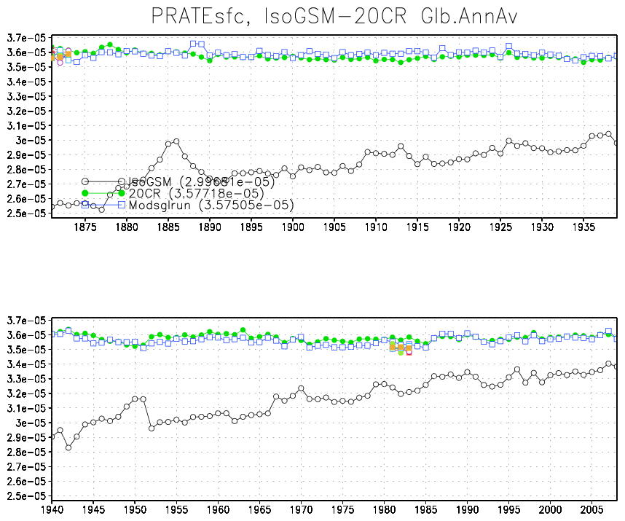
Long term global precipitation
MS
EM
Figure 10: Global mean precipitation by each experiments from 1871 to 2008. Original 20th century Reanalysis (green), EM (black), and MS (blue) are shown for all period. Those runs with the direct use of single members (which consists S6) are shown only for 1871-73 and 1981-83.

Slide 35
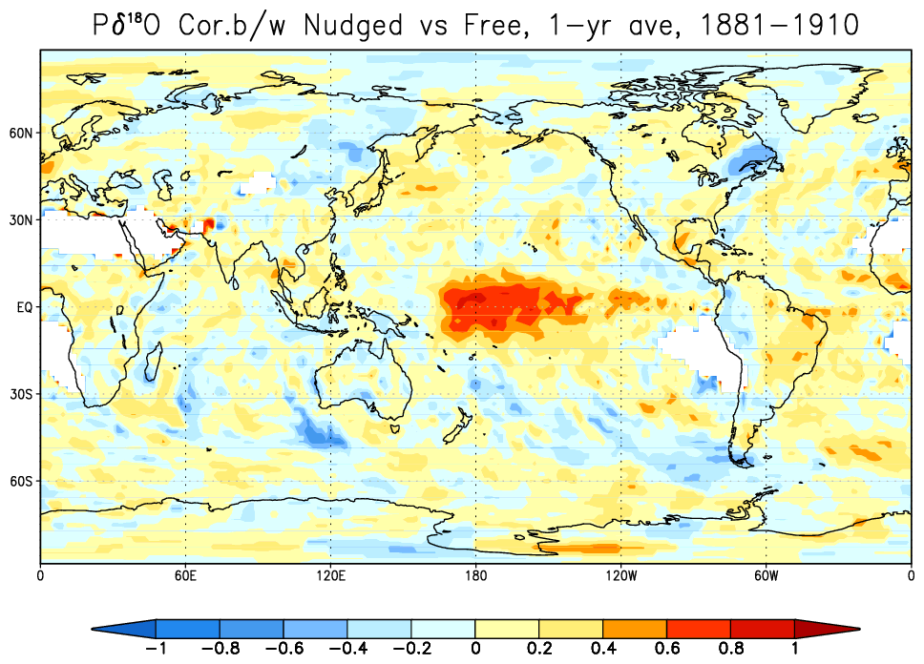
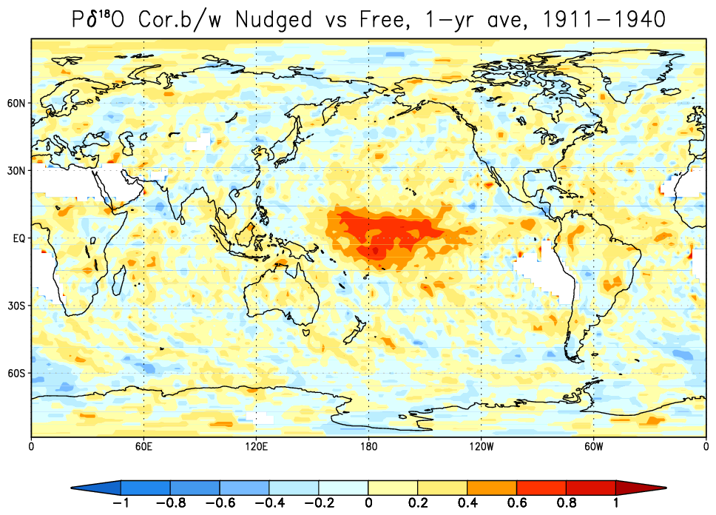
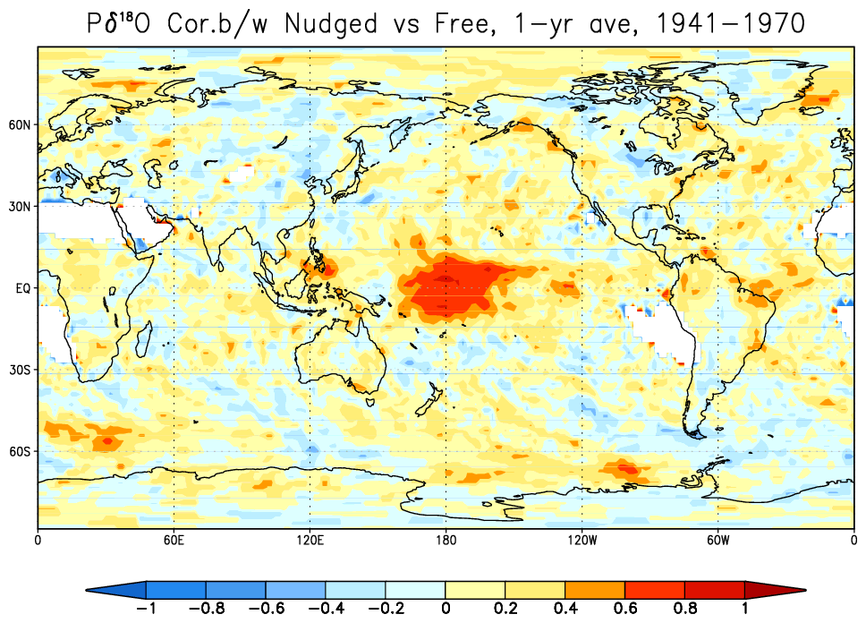
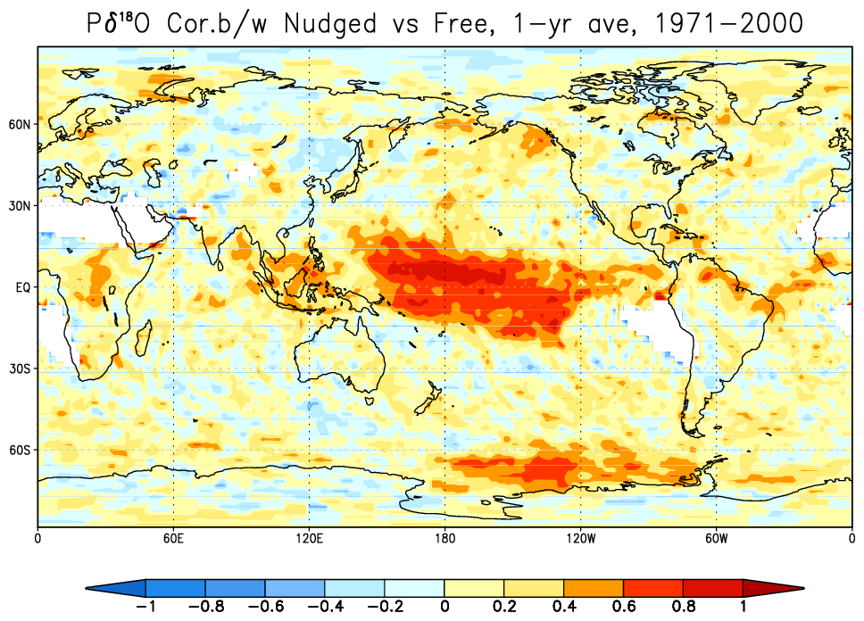
Nudged vs Un-nudged in Different Period
1881-1910
1911-1940
1941-1970
1971-2000

Slide 36
Icecore δ¹⁸O at Eclipse Icefield lon=-139.47 ; lat=60.51
Model
Data
Model
Data
Data: Yalcin et al., 2003; 2006

Slide 37
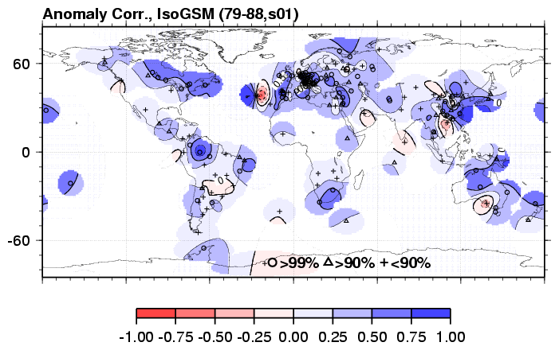
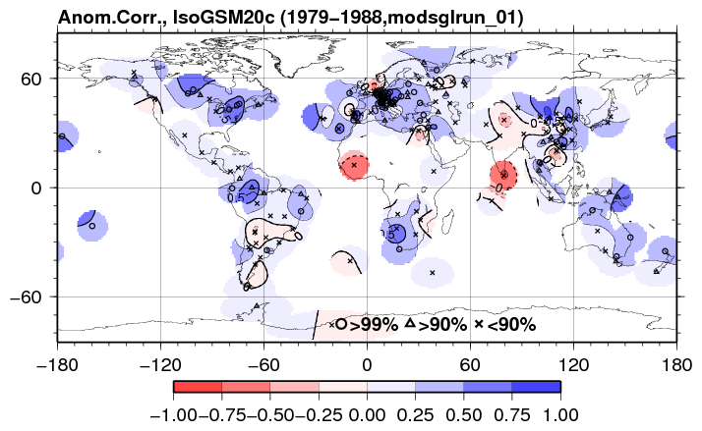
Comparison with GNIP data
Bad
Good
Bad
Good
Number of GNIP sites where correlation is significant for 1980-1999
 |  | ECHAM | GISS-E | IsoGSM-R2 | IsoGSM-20C
Correlation | NH (210) | 147 | 171 (81%) | 174 (83%) | 171 (81%)
 | Tropics (142) | 68 | 82 (58%) | 96 (68%) | 105 (73%)
 | SH (37) | 22 (60%) | 18 | 25 (68%) | 25 (67%)
Anomaly Correlation | NH (146) | 13 (9%) | 12 | 114 (78%) | 93 (63%)
 | Tropics (67) | 9 | 12 (18%) | 32 (48%) | 34 (50%)
 | SH (29) | 1 | 3 (10%) | 12 (41%) | 12 (41%)

Slide 38
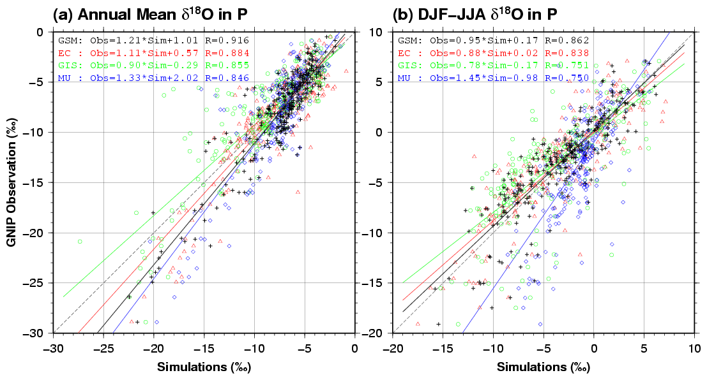
Validation: Comparison in δ¹⁸O in Precip
Yoshimura et al., 2008
Many other validation studies available.
Uemura et al., 2008; Abe et al., 2009; Frankenberg et al., 2009; Pfahl and Wernli, 2009; Schneider et al, 2010; Galewsky and Hurley, 2010; Yoshimura et al., 2010; Berkelhammer et al., 2011; Yoshimura et al., 2011; Pfahl et al., 2011; Welp et al., 2011; Zhu et al., 2012; etc.

Slide 39

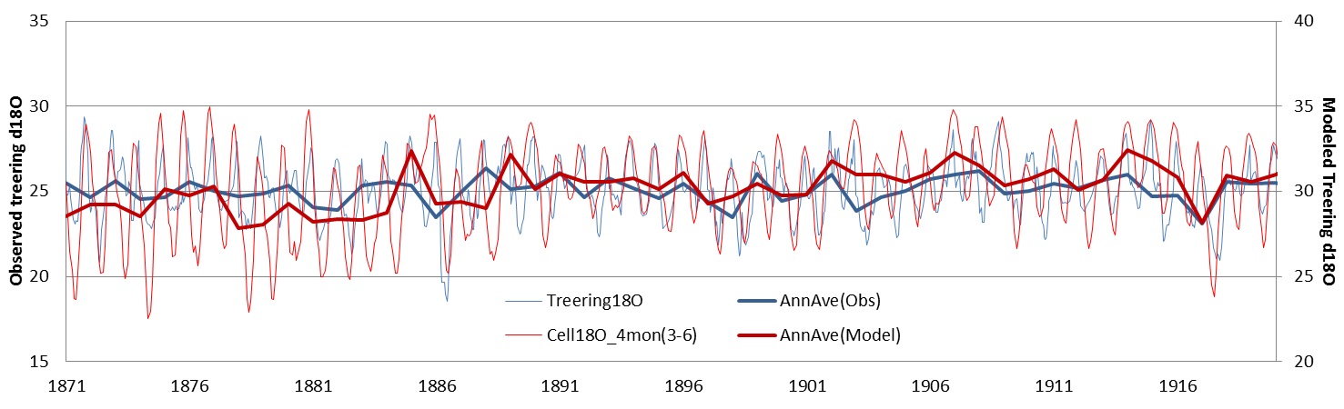
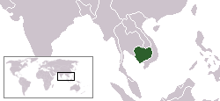
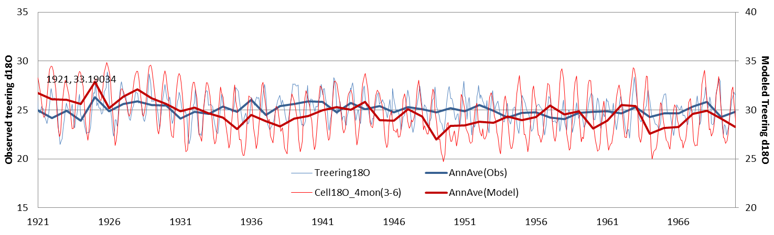
Treering δ¹⁸O in Cambodia
Larger amplitude?
@Kirirom national park
Wrong phase?
Data: Zhu et al., 2012

Slide 40
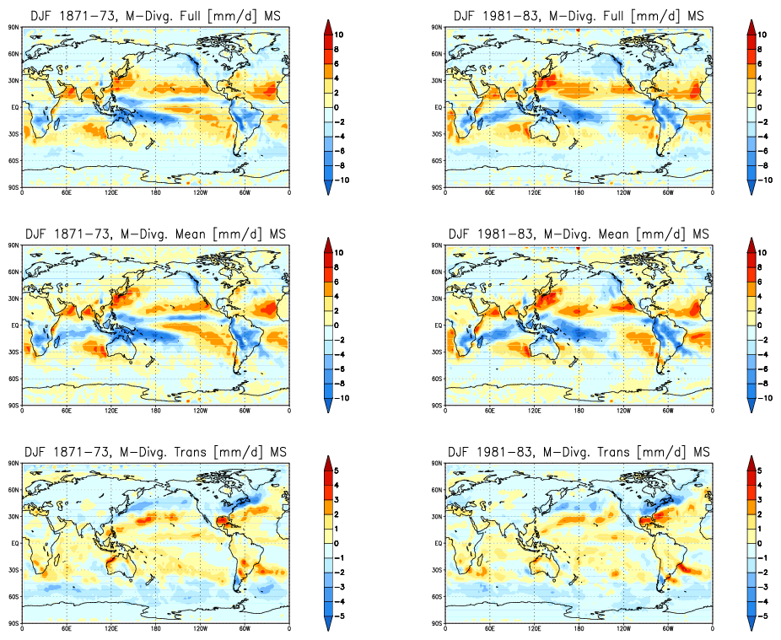
DJF mean of moisture divergence in MS
19C
20C
Total divergence
Mean
Transient
Appropriate
di/convergence

