Slide 1
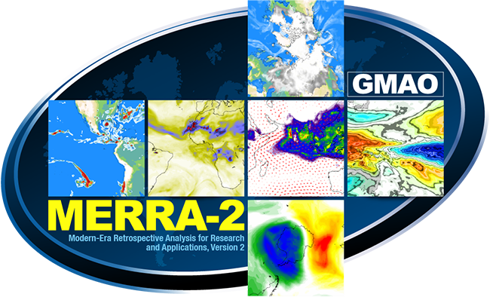
Modern Era Retrospective analysis for Research and Applications (MERRA-2): Introduction, Cold and Wind
Presented by Michael Bosilovich
Acknowledgements: Ron Gelaro, Amal El-Akkraoui (it takes a team)
Allison Collow, Natalie Thomas, Amin Dezfuli
Stephanie Schollaert-Uz, Helen Amos, Paul Stackhouse (NASA LaRC)

Slide 2
Atmospheric Reanalyses
A retrospective analysis of historical meteorological observations (some systems include land, ocean, aerosol, biology analysis)
3 Critical Components
Observations, provides reality, but the data is irregularly available in space and time, and many different types
Model, provides a complete and consistent background estimate and forecast (most reanalysis data derived here)
Data assimilation, considers the uncertainty of the model and obs data, merge for a forecast initial condition
A global continuous representation of the weather and climate

Slide 3
Available Data https://gmao.gsfc.nasa.gov/reanalysis/MERRA-2/data_access/
Global coverage, ~50km resolution, 72 atmospheric layers
Surface Meteorology – Temperature, moisture, wind, pressure …
Upper Atmosphere – Surface Layer to Lower Stratosphere
Radiation components
All-sky, Clear Sky, Aerosol interactions
Assimilated Aerosols (AOD, speciated to 5 types)
Climatology Fields (1991-2020 v2, 1981-2010 v1)
Extreme Indices – Temperature, Heat Wave, Drought, and Cold

Slide 4
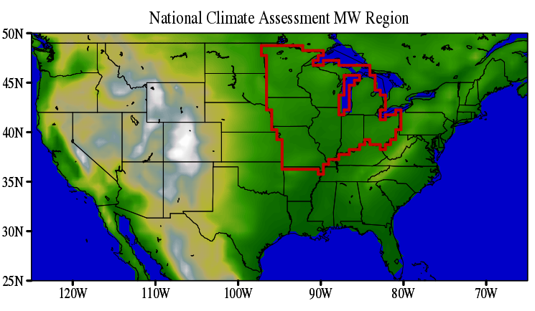
National Climate Assessment Midwest Region
On MERRA-2 ~50km grid

Slide 5
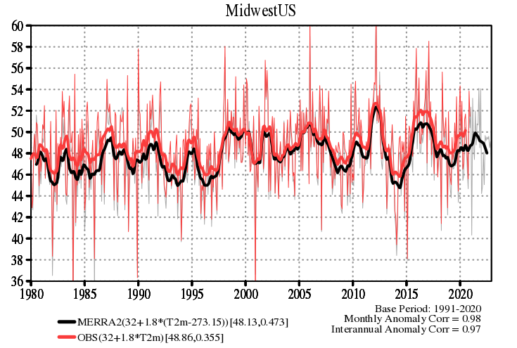
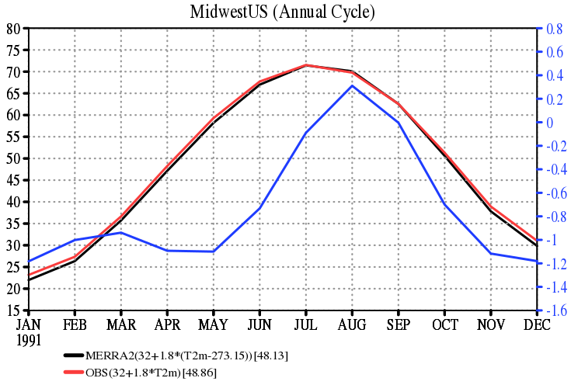
Midwest Mean Temperature and Variations
MERRA-2
CRU obs
Difference
Interannual variations correlate to Observations well
MERRA-2 is ~-1℉ cold, Nov through May
Trend is a little more than the observed +0.35 ℉/decade

Slide 6
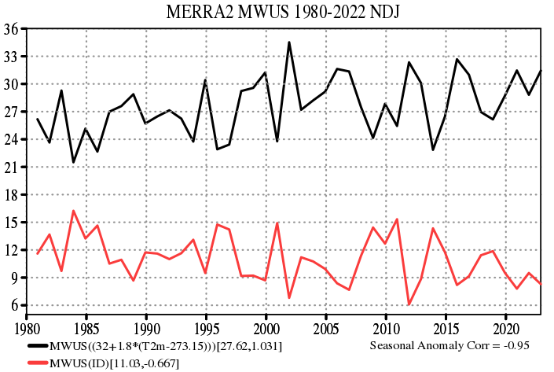
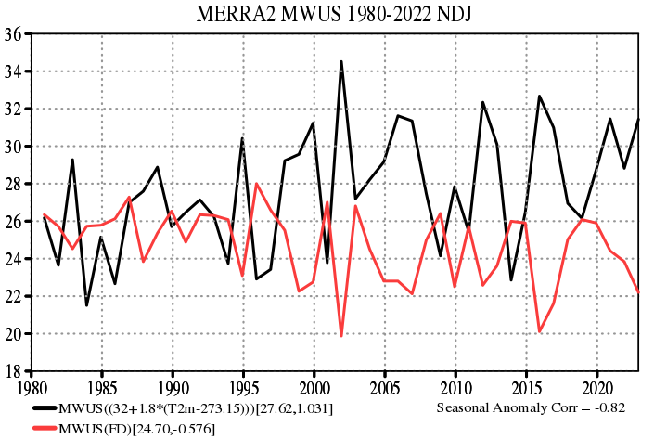
MERRA-2 MidWest Cold Temperature Indices (NDJ)
Icing Days (ID) - count of days when daily maximum 2m temperature is below freezing
Frost Days (FD) - count of days when daily minimum 2 m temperature is below freezing
T2m(℉) ID(days)
T2m(℉) FD(days)

Slide 7
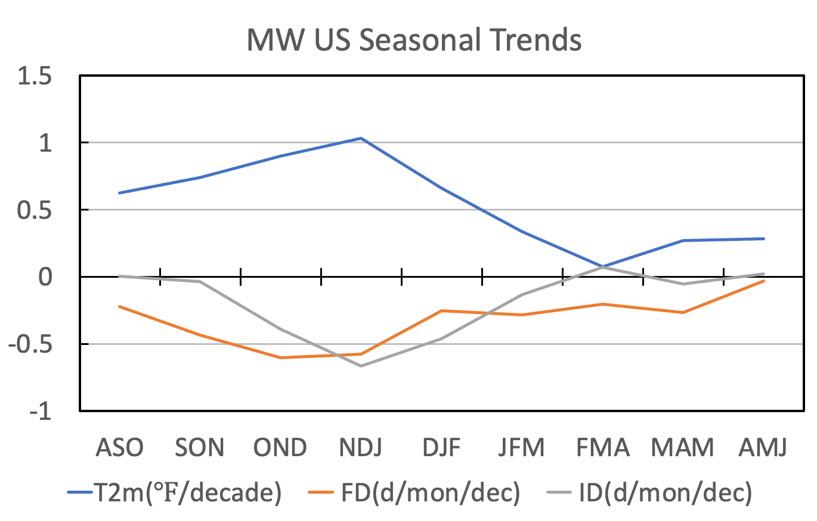
MERRA-2 Midwest Frost and Icing Days Trends*
*Not Published results, need further vetting and testing
Midwest warming peaks in NDJ
Icing Days decreasing ~6.5% per month per decade
Frost days decreasing ~3.0% per month per decade

Slide 8
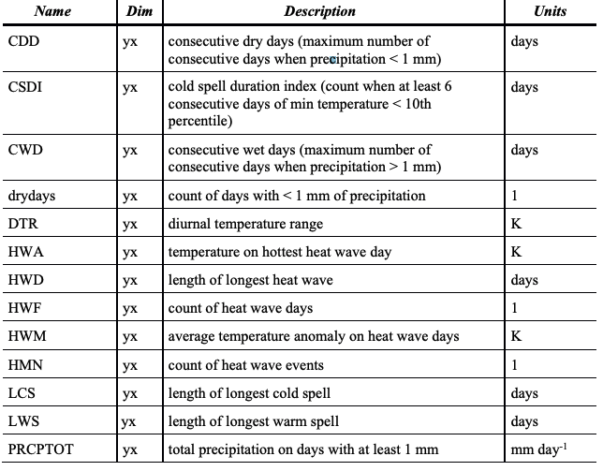
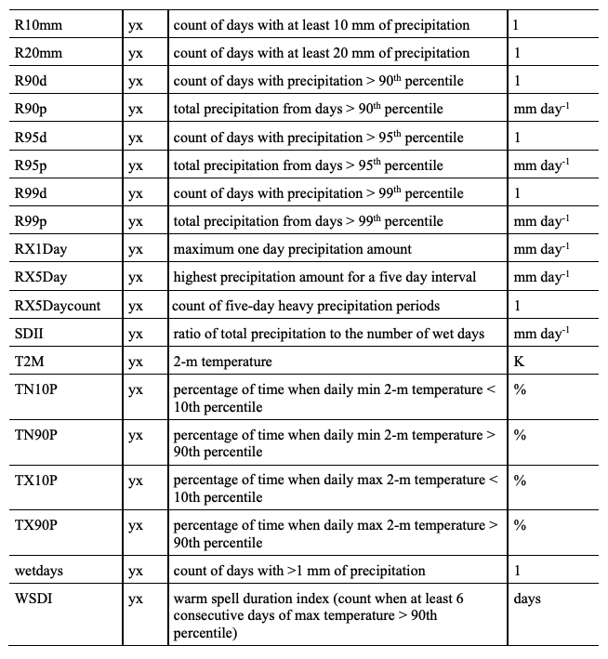
MERRA-2 derived Extreme Indices
Most of our research has leaned toward heatwaves and extreme precipitation

Slide 9
MERRA-2 Applied Users Workshop
A diverse series of uses of the reanalysis data
Agriculture, Solar Energy, Wind Energy, Building codes, Pavement Engineering, Vector born disease
Needs:
Consistency in data (minimizing discontinuity)
Timely data and regular data release
Sufficiently long data records (>30yrs)
Land observation assimilation priority
Bias and Uncertainty Estimates (Documentation)
In conjunction with the Goddard Applied Sciences Team

Slide 10
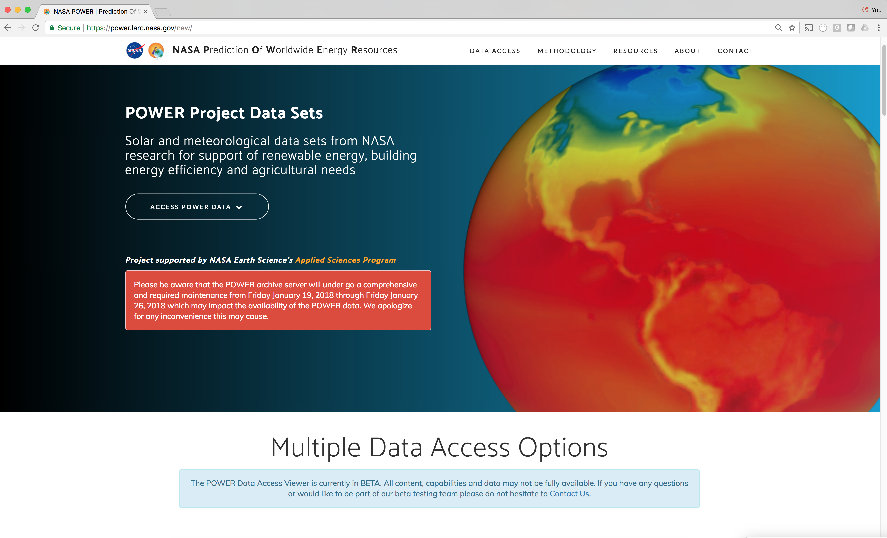
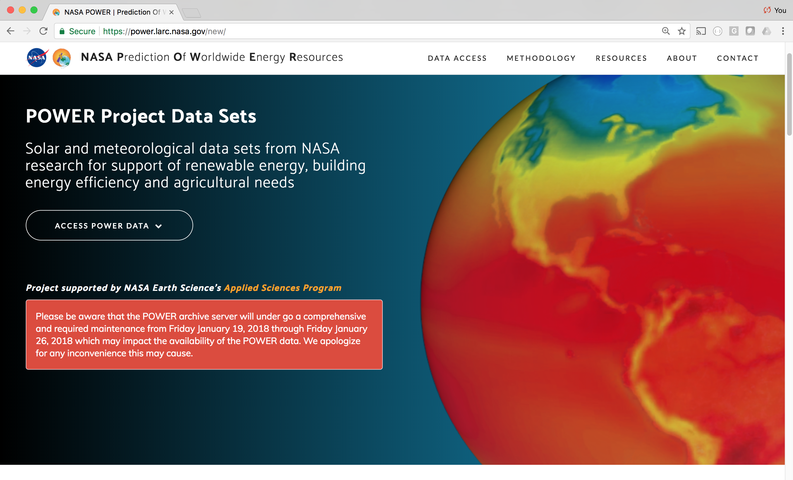
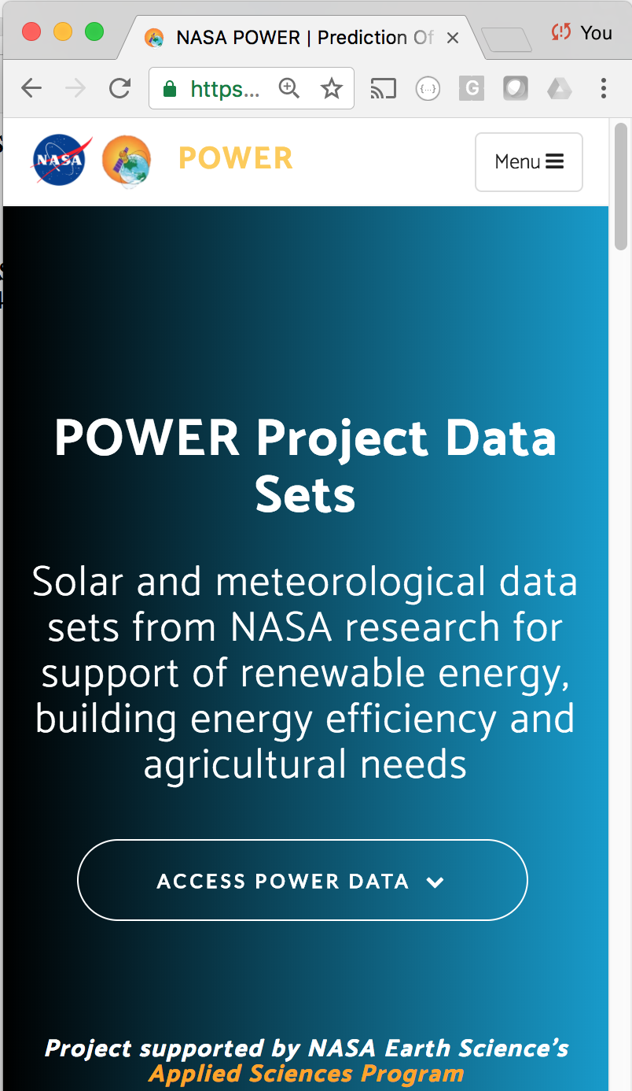
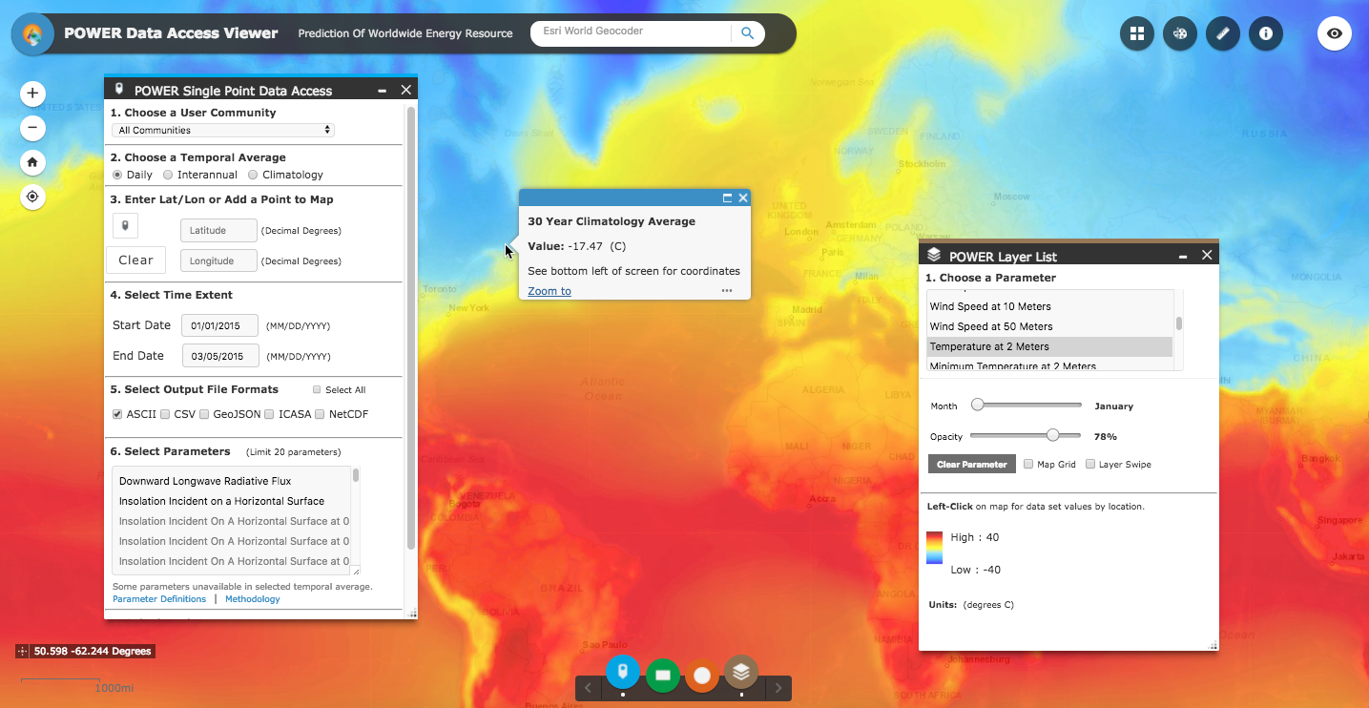
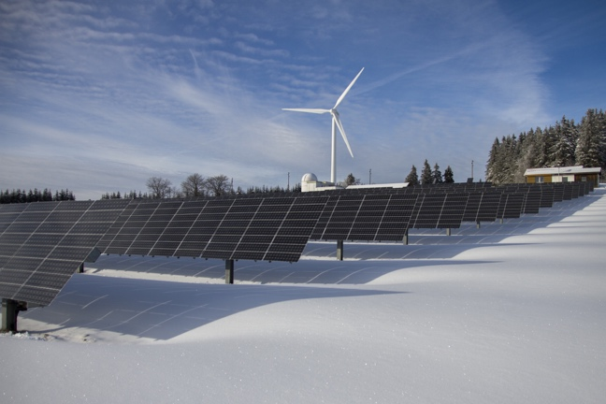
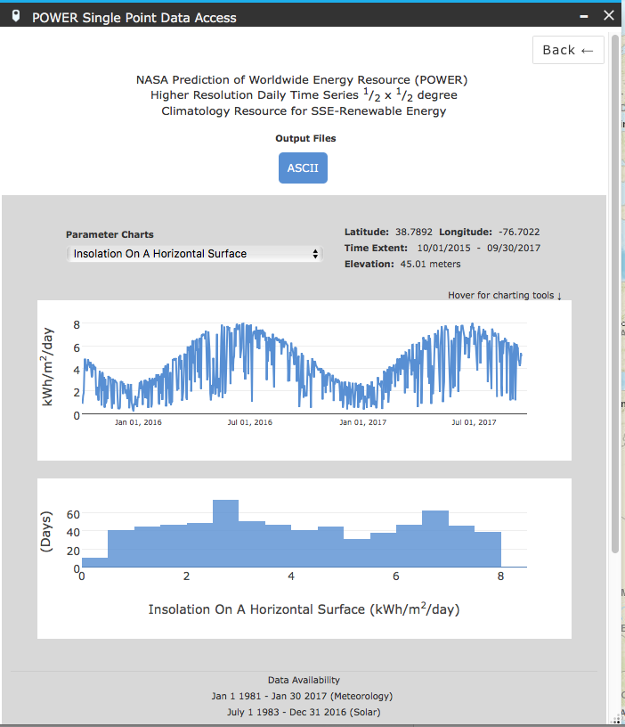
NASA’s POWER Project Prediction Of Worldwide Energy Resources (POWER)
https://power.larc.nasa.gov
Integrate Earth Science mission observational data, analysis and modeling from NASA Earth Science and provide customized accessibility solutions for energy related and agricultural applications.
Geospatially Enabling NASA ES Data For:
Renewable Energy Applications (ie., solar and wind technologies): Users such as Nokia
Solar, Customer First Renewables, RETScreen Users worldwide, Friesen Energy, …
Energy-Efficient Building Design (i.e., building climate zones): ASHRAE society, 3M, Johnson Controls, Lockheed Martin, Universities (U. of MI, Auburn, MIT), State Govt. (PA for solar hot water heating), Local Govt. (Public Schools in Hawaii), …
Agricultural Crop Modeling Applications: USDA, Ferrero (Nutella), World Agroforestry, AfricaRice, Global Yield Cap Atlas, Lumigrow, …
POWER-GIS v1 Usage
2018/05/01 – 2020/12/31
Requests | > 144 Million
Unique Users | 294,342
Data Volume | 13.8 TB
Photo credits: nrdc.org, solvay.com, harvestreturns.com
Courtesy P. Stackhouse, LaRC
Notes:
Within NASA’s Earth Sciences, is an Applied Science program that is specifically aimed at providing NASA research data products for societal benefit. This program supports the NASA POWER project.
NASA Earth Science Missions support:
- CERES (Clouds and Earth’s Radiant Energy System): helps monitor the sunlight and thermal infrared energy exchange between the Earth-Atmosphere and space; also estimates the exchange at the surface.
- NASA GEWEX (Global Energy and Water Cycle Exchange program; a World Climate Research Programme element) Surface Radiation Budget project: provides long-term estimates of the same quantities as CERES but starting in 1983 and uses image data as a basis
- NASA GSFC (Goddard Space Flight Center) GMAO (Global Modeling and Assimilation Office) MERRA-2 (Modern-Era Reanalysis assimilation for Research and Applications): provides long-term global estimates of surface and atmospheric weather related parameters optimized to observations.
POWER acronym: Currently the web site only provides historical data products. The original vision included developing a framework through which statistics on longer-term forecasts could also be provided but that vision hasn’t yet been realized.

Slide 11
Estimated $40B of wind energy planning linked back to MERRA
Webinar still online:
https://register.gotowebinar.com/register/5438883075075107073

Slide 12
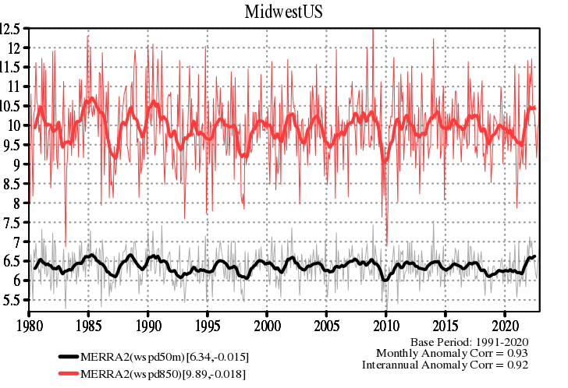
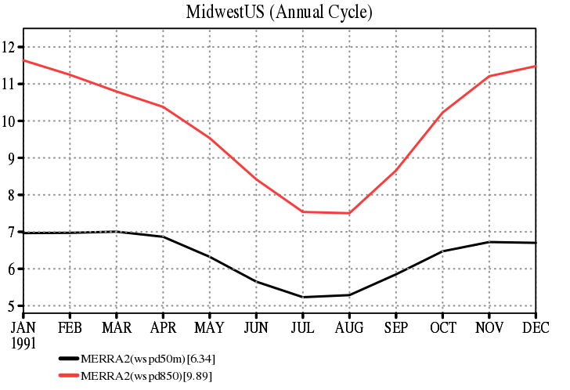
MERRA-2 Midwest Mean wind speeds examples
50m agl
850hPa
m/s
How to evaluate wind speeds?
Metrics for extreme winds? Mean/max daily Gusts? Daily Variance?

Slide 13
Future: Reanalysis of the 21st Century (R21C)
Production begins in the near future
Increased spatial resolution - ~25km
Improved data assimilation which includes and ensemble spread which represents weather uncertainty
A Boundary Layer Height data collection – wind and other state fields on vertical coordinate every 100m up to 4km
1 hourly, global, ~25km
Many more technical updates that should greatly improve the data quality

Slide 14
Extremes in GMAO S2S
GMAO Subseasonal to Seasonal (S2S) v3 is expected soon
Seasonal prediction of heat waves
Subseasonal Extreme precipitation events (such as the recent California rains)
HOWEVER, prediction skill at these time scales is difficult even for mean anomalous
Decadal Predictions: New project in development

Slide 15
Some Online Resources
Michael.Bosilovich@nasa.gov
MERRA-2 Documentation: https://gmao.gsfc.nasa.gov/reanalysis/MERRA-2/docs/
NASA’s Prediction Of Worldwide Energy Resources (POWER) https://power.larc.nasa.gov
NASA Goddard Applied Sciences https://science.gsfc.nasa.gov/610/applied-sciences/
NASA GES DISC: Access, portals and AWS https://disc.gsfc.nasa.gov/datasets?project=MERRA-2
GMAO FLUID Visualization of Weather, Climate and Extremes https://fluid.nccs.nasa.gov/reanalysis/

Slide 16
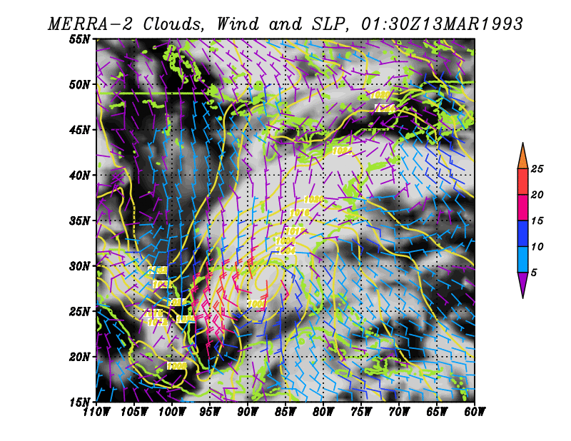
Storm of the Century (March 1993)

