Slide 1
Carbon in the Earth’s Atmosphere
Lesley Ott
Climate Scientist​
NASA Goddard Space Flight Center​

Slide 2
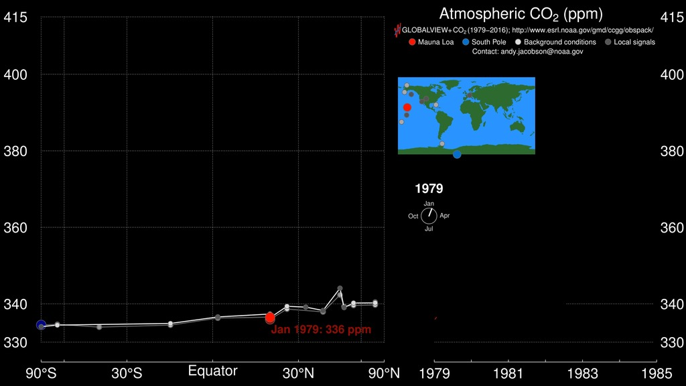
http://svs.gsfc.nasa.gov/30556
Notes:
2. Carbon dioxide pump handle (1:01) - http://svs.gsfc.nasa.gov/30556 Atmospheric CO₂ Trends Fossil fuel combustion and other human activities are now increasing the atmospheric carbon dioxide (CO₂) abundance to unprecedented rates. It is estimated that approximately 36 billion tons of CO₂ are added to the atmosphere each year. The large graph shown here is an animated version of the standard Keeling curve from 1980 to September 2014. The red line denotes ground-based measurements from the Mauna Loa Observatory in Hawaii, while yellow denotes observations from the South Pole Observatory. Purple denotes the global trend. The smaller graph in the upper left shows satellite measurements of tropospheric CO₂ concentrations (white dots) at different latitudes from September 2002 to September 2014, obtained by the Atmospheric Infrared Sounder (AIRS) and Advanced Microwave Sounding Unit (AMSU) instruments. Note how the Northern Hemisphere has greater variably and generally higher levels of CO₂ than the Southern Hemisphere. In May of 2013, these emissions pushed the monthly average CO₂ concentrations above 400 parts per million (ppm)—a level that has not been reached during the past 800,000 years. These ever-increasing levels are raising concerns about greenhouse-gas-induced climate change. Data from NASA’s Orbiting Carbon Observatory-2 (OCO-2), launched in July 2014, are helping scientists better identify how human activities, as well as the natural processes on Earth are influencing rising concentrations of atmospheric CO₂ and the global carbon cycle.

Slide 3
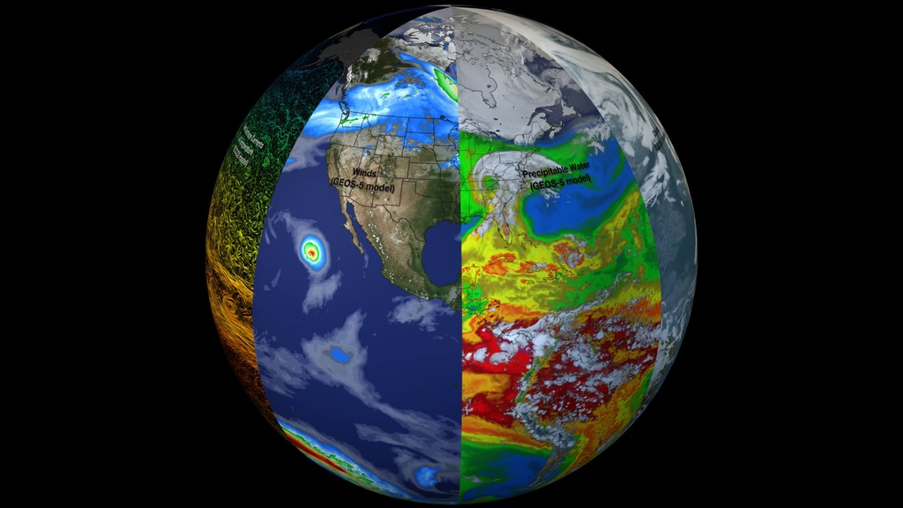
http://svs.gsfc.nasa.gov/30701
Notes:
3. System of systems/beachball (0:33) - http://svs.gsfc.nasa.gov/30701 Earth: A System of Systems This visualization reveals that the Earth system, like the human body, comprises diverse components that interact in complex ways. Heat absorbed by the ocean is transported by ocean currents—shown here as ECCO2 model output. This energy is constantly released into Earth’s atmosphere. Heat and moisture from the ocean and land influence Earth’s weather patterns—represented here as 500 mb wind speeds from GEOS-5. Moisture in the atmosphere—represented as precipitable water from the GEOS-5 model—forms clouds and precipitation—shown here using the GPM IMERG product. Precipitation significantly impacts water availability, which influences soil moisture and ocean salinity—shown here as data from SMAP. Lastly, data from multiple satellites show the density of plant growth on land and chlorophyll concentrations in the ocean. While scientists learn a great deal from studying each of these components individually, improved observational and computational capabilities increasingly allow them to study the interactions between these interrelated geophysical and biological parameters, leading to unprecedented insight into how the Earth system works—and how it might change in the future.

Slide 4
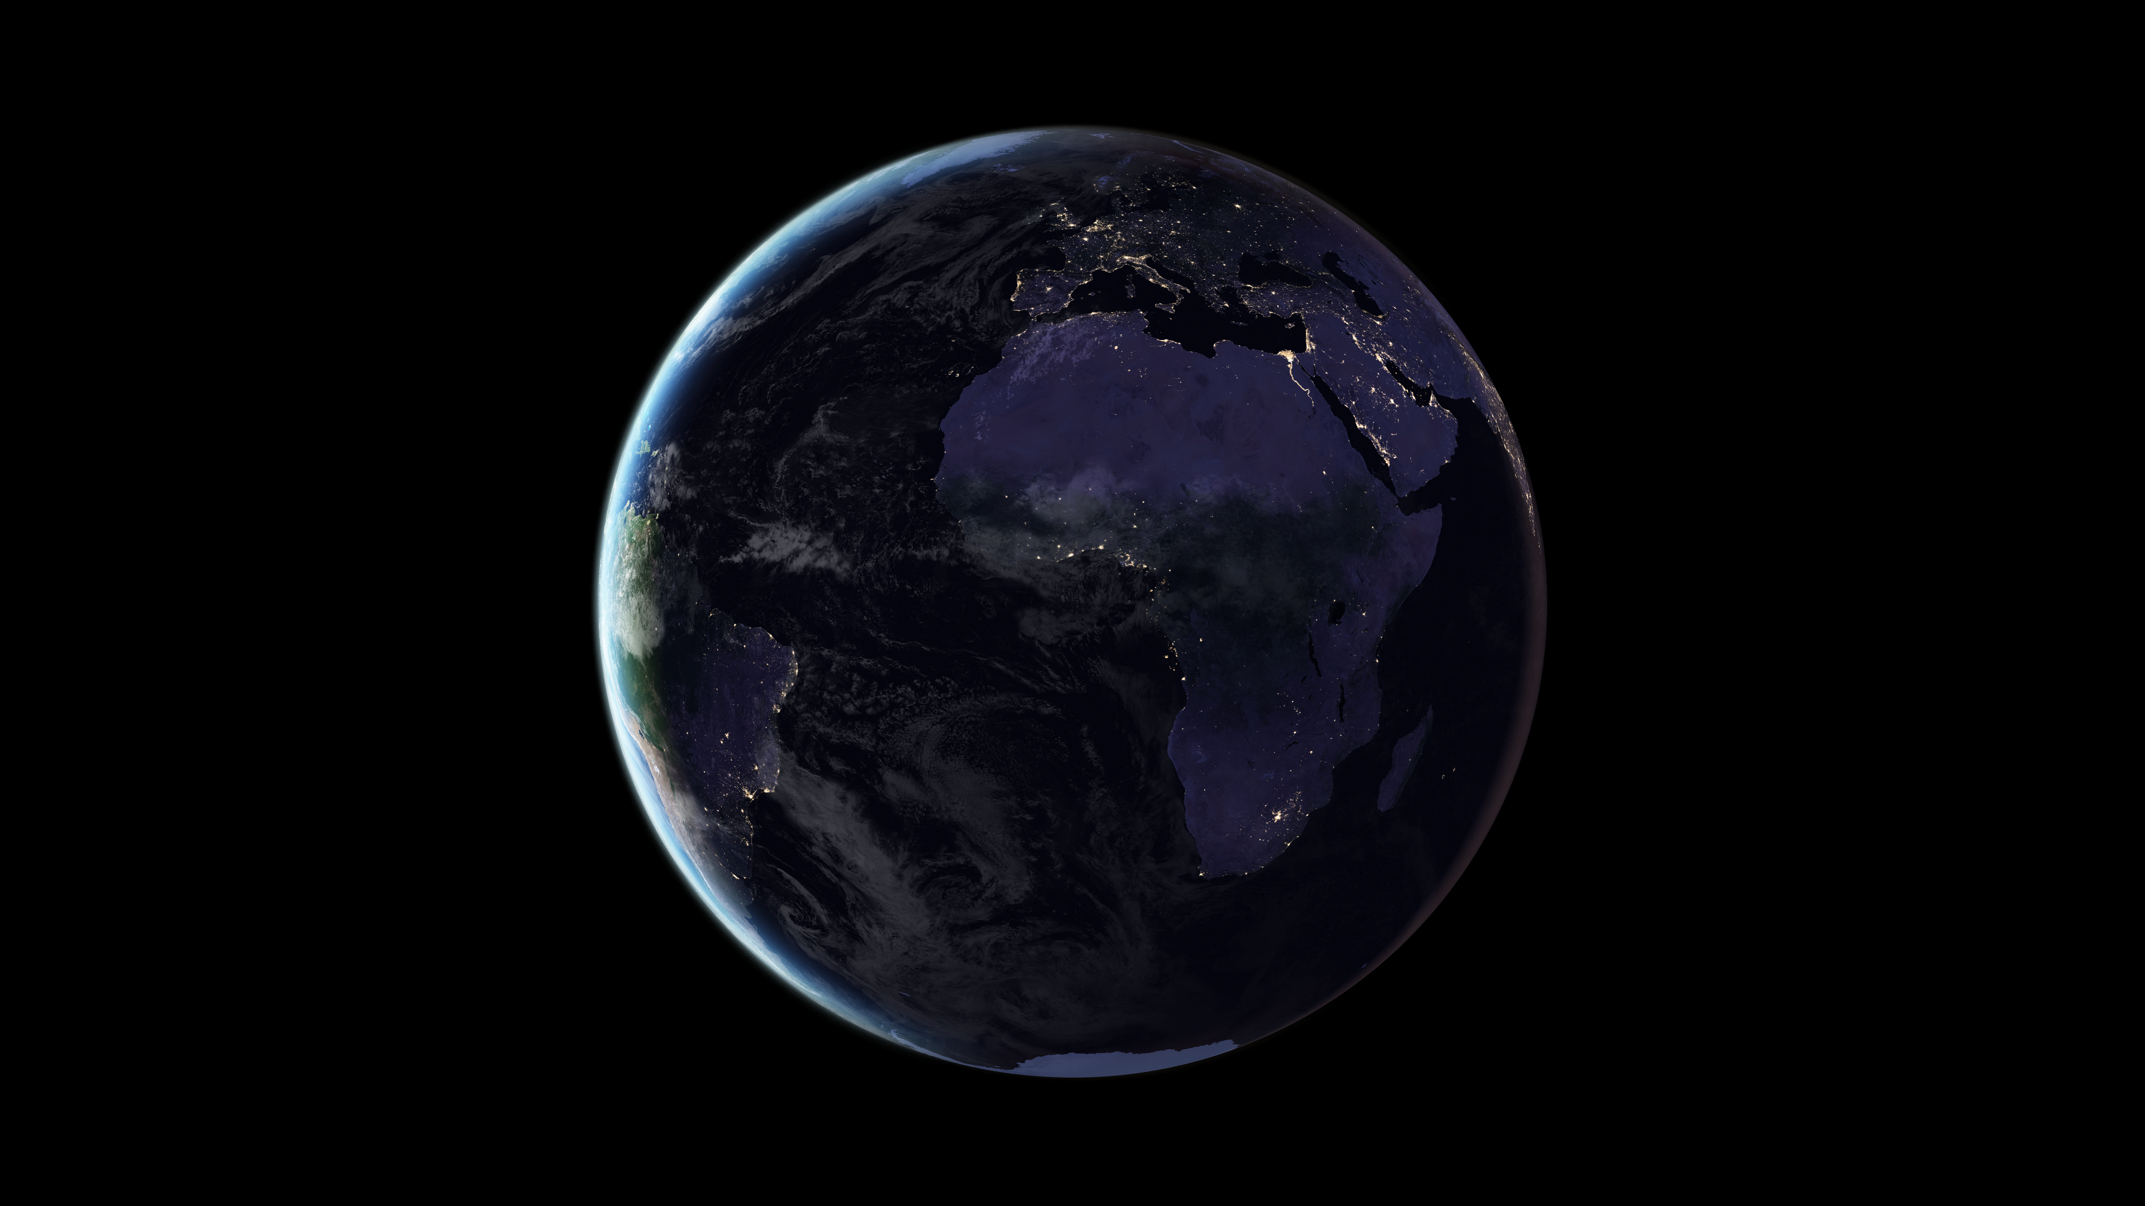
https://svs.gsfc.nasa.gov/30878

Slide 5
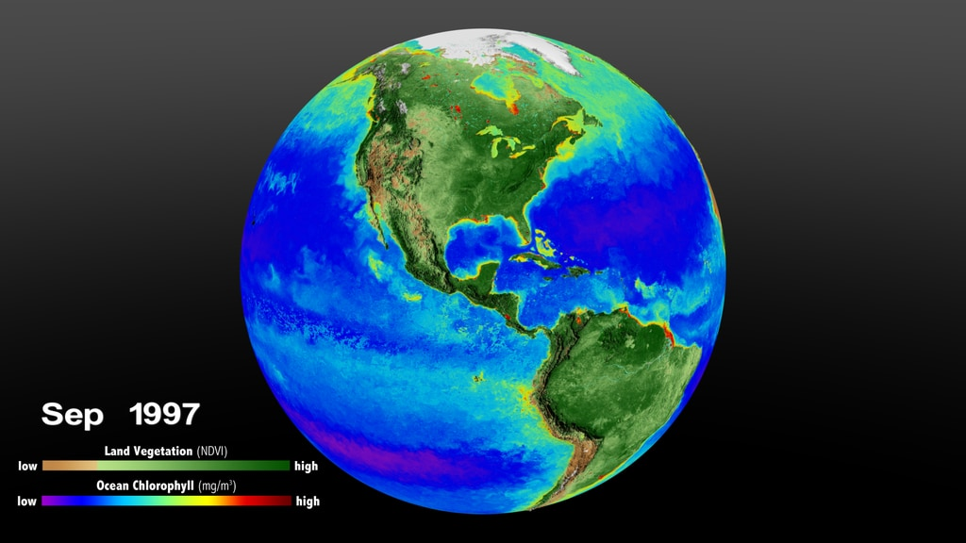
https://svs.gsfc.nasa.gov/4813

Slide 6
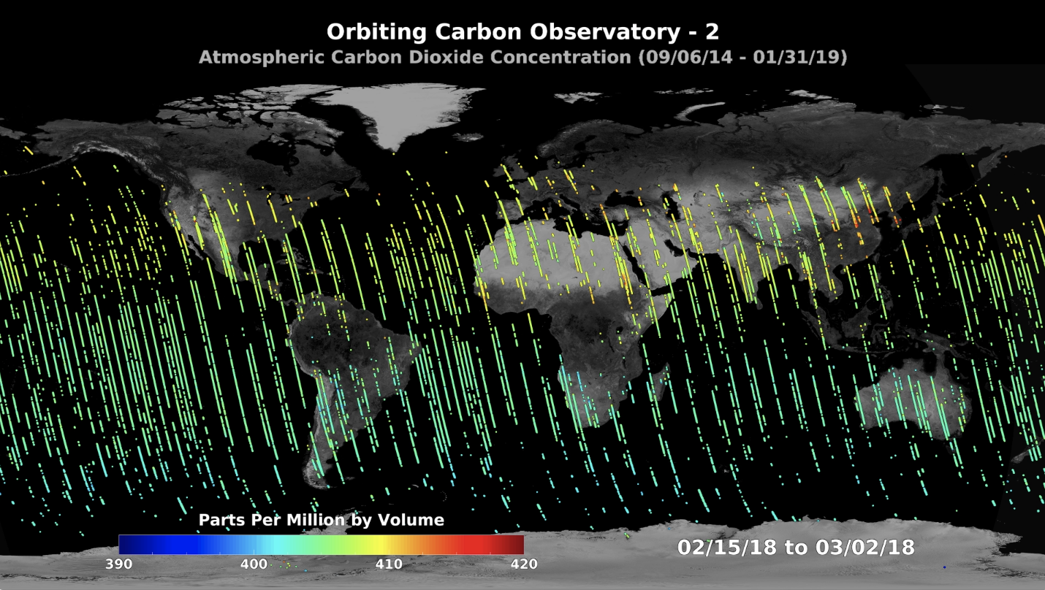
https://svs.gsfc.nasa.gov/hyperwall/index/download/events/2019-aogs/schwandner/T3_OCO-2_Dot_Plot_JPL-20190430-OCOs-0002-OCO2-XCO2-390-420.mov

Slide 7
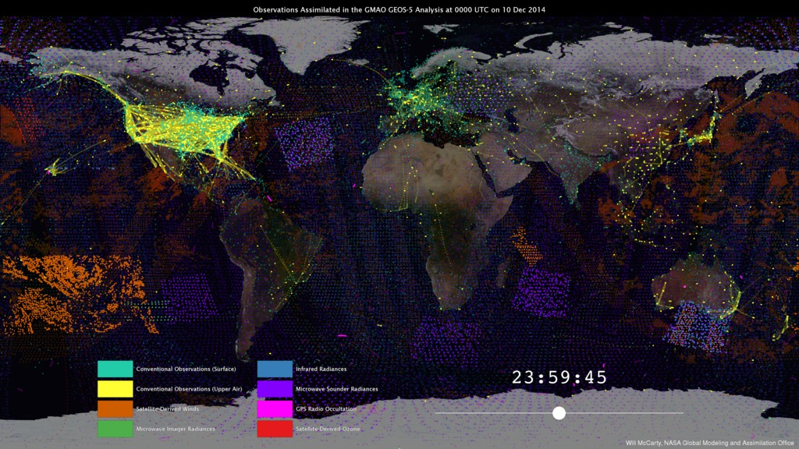
http://svs.gsfc.nasa.gov/30590
Notes:
9. From Observations to Models (0:49) - http://svs.gsfc.nasa.gov/30590 From Observations to Models NASA’s Global Modeling and Assimilation Office (GMAO) uses the Goddard Earth Observing System Model, Version 5 Data Assimilation System (GEOS-5 DAS) to produce global numerical weather forecasts four times a day. For each forecast, it is necessary to combine the latest observations from satellites, aircraft, and ground stations with a short-term, 6-hour forecast—a process known as data assimilation. The GEOS-­5 DAS assimilates more than 5 million observations during each 6-hour assimilation period. These observations are assembled from a number of sources from around the globe, including NASA, NOAA, EUMETSAT, commercial airlines, the U.S. Department of Defense, and many others. This visualization shows how different observation types have different strategies. One of the main challenges of data assimilation is to understand how all these observations are alike, how they differ, and how they interact with each other.

Slide 8
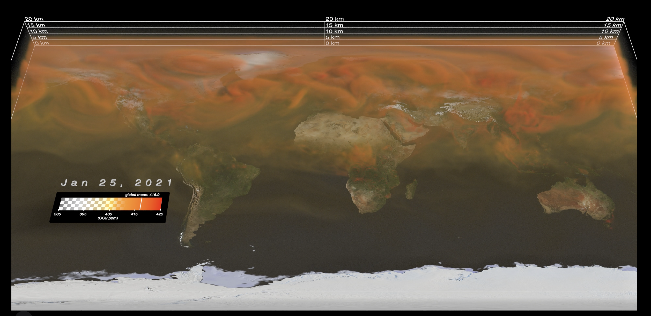
https://svs.gsfc.nasa.gov/prepub/eleni/co2_gmao/drafts/co2volume_10-15-2021e_HQ_2021-10-15_1633_2160p30.mp4

Slide 9
New animation: cov19_movie_globe_16day_xco2_diff_2020.mp4

Slide 10
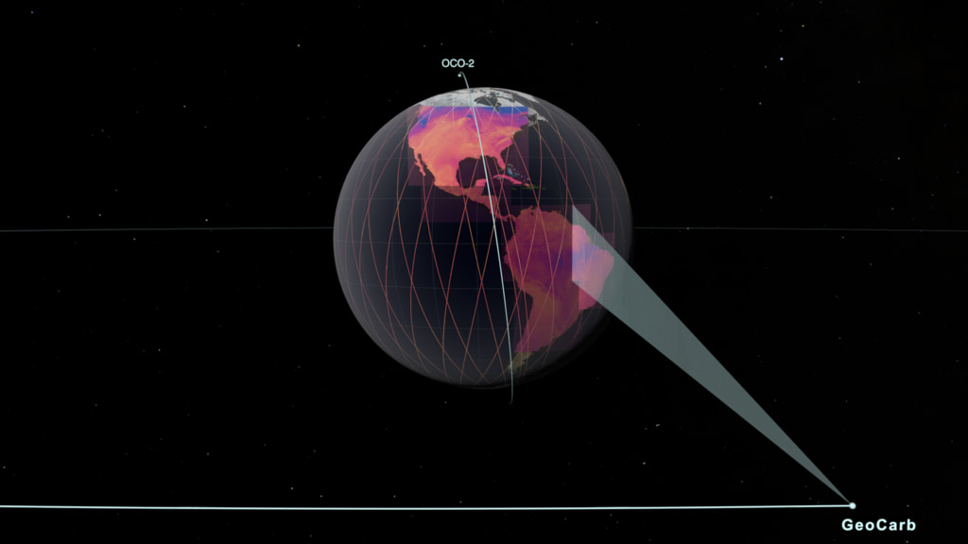
https://svs.gsfc.nasa.gov/4890

