Slide 1
Low latency flux and concentration datasets in support of greenhouse gas monitoring based on NASA’s GEOS modeling and data assimilation system
Lesley Ott¹, Brad Weir^{1,2}, Nikolay Balashov1,3, Benjamin Poulter¹, Tomohiro Oda⁴, Cecile Rousseaux¹, Joanna Joiner¹, and Sourish Basu^{1,3}
¹NASA Goddard Space Flight Center
²Morgan State University
⁴University of Maryland, College Park
³Universities Space Research Association with contributions from: Kevin Bowman (JPL), Alexey Shiklomanov (NASA)

Slide 2
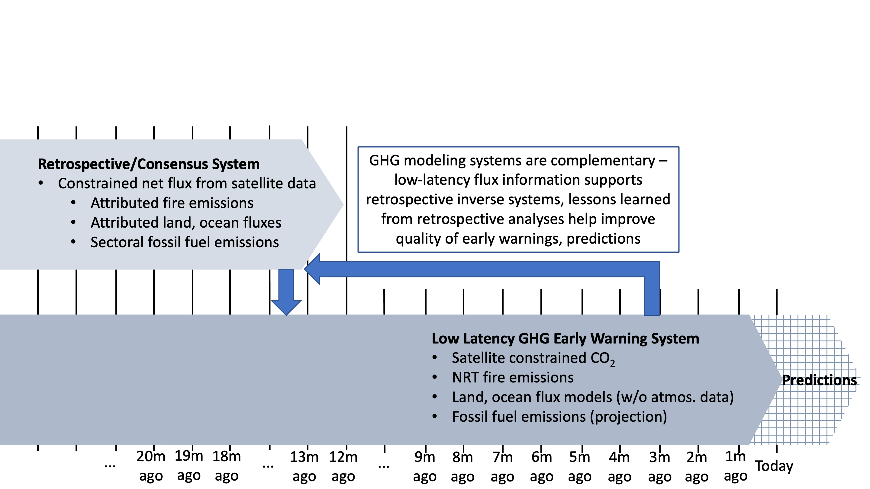
Ecosystem of carbon monitoring tools

Slide 3
Ecosystem of carbon monitoring tools – emphasis on low latency, concentration monitoring
Applications of low latency information
Examples of users
Communication via NASA visualization, outreach tools
General public, students
Rapid detection of anomalies
State/local managers, private industry
Quantified climate impacts
Federal agencies
Boundary conditions for regional models
State/local managers, private industry
Independent verification with aircraft data
Scientists

Slide 4
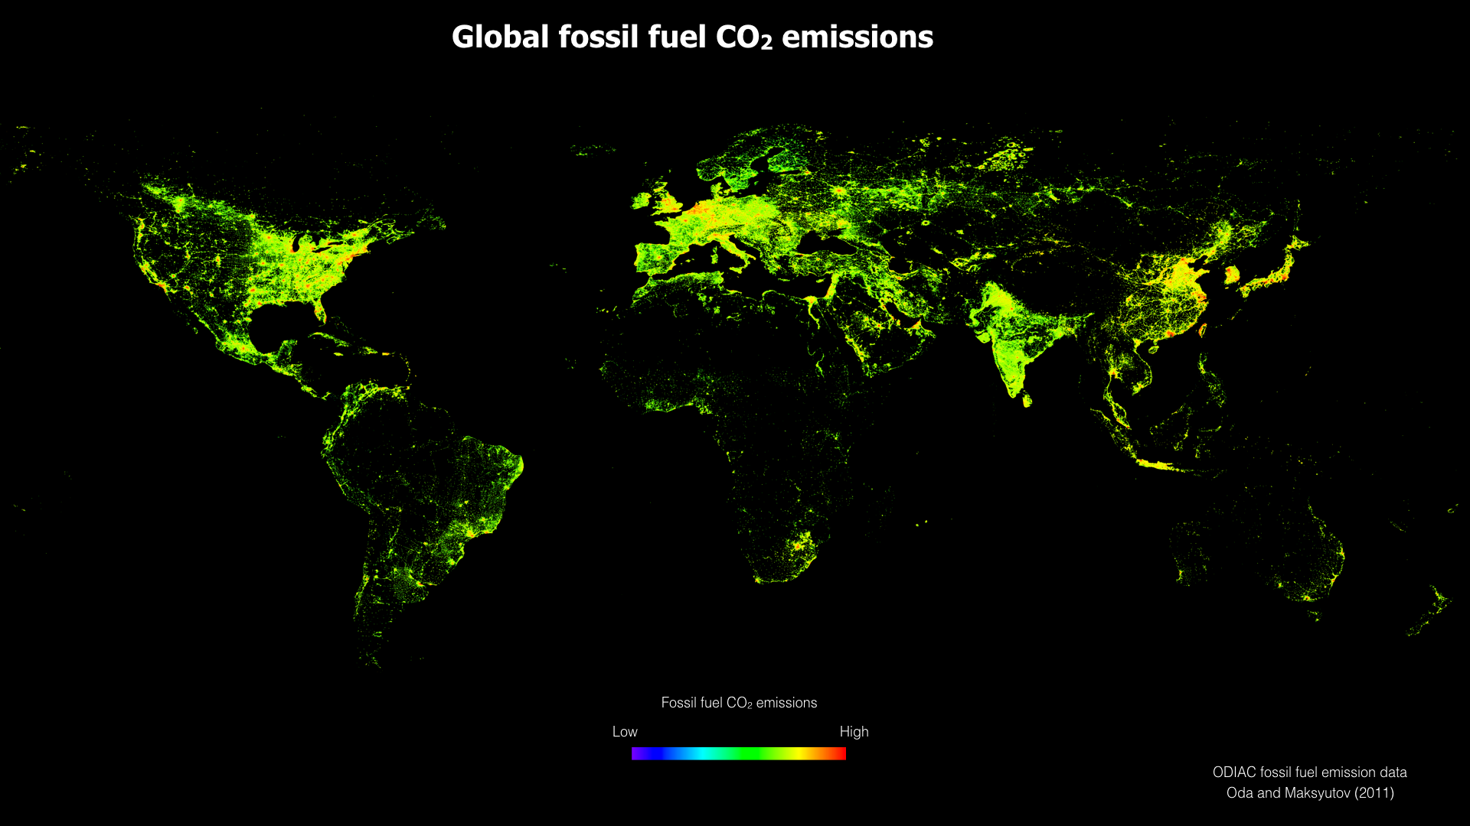
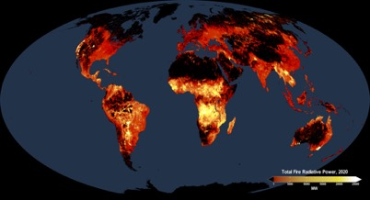
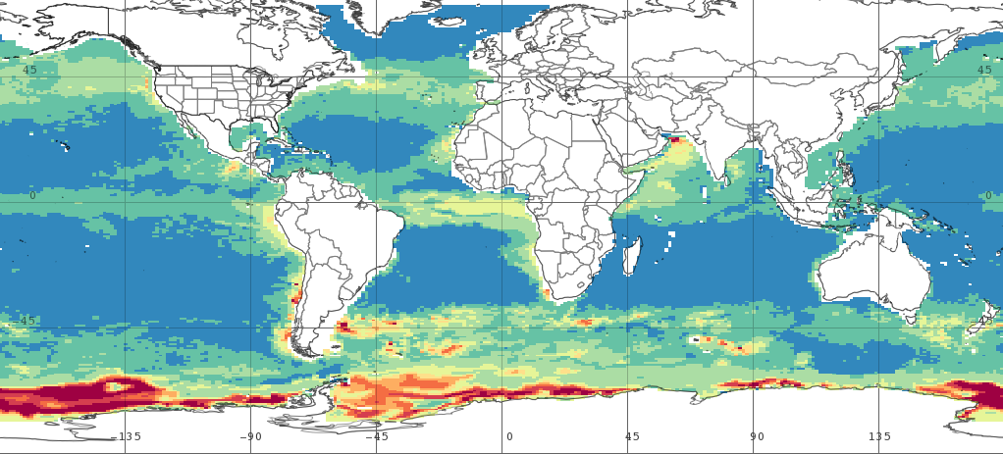
Observationally informed flux estimates
Fossil Fuel Emissions
Terrestrial Carbon Flux
Fire Emissions
Ocean Carbon Flux
Provided by the Open-source Data Inventory for Anthropogenic CO₂
National emissions are redistributed using powerplant database, nighttime lights observations
http://odiac.org
Provided by the CASA-GFED3 vegetation model
Driven by MODIS, AVHRR observations of vegetation greenness, burned area
Data available from NASA GES-DISC
Provided by the Quick Fire Emissions Dataset (QFED)
Driven by MODIS fire radiative power, calibrated against GFED
Data available from NASA GMAO
Provided by the NASA Ocean Biogeochemical Model (NOBM)
Driven by assimilation of ocean color data, MERRA-2 forcing
Data available from GES DISC, Giovanni

Slide 5
Atmospheric concentration analysis for the most complete, data constrained view of atmospheric CO₂
16 days OCO-2 XCO₂ – 4/1-16/2020
16-day average L3 XCO₂
NASA’s OCO-2 satellite, launched in 2014, measures the column-averaged dry air mole fraction of CO₂ (XCO₂) in sunlit, clear sky conditions.
Bias-corrected OCO-2 retrievals are assimilated into the GEOS Constituent Data Assimilation System (CoDAS) to produce gap-filled 3-dimenstional CO₂ fields.
When OCO-2 data are unavailable, gaps are filled using:
  All previous good quality OCO-2 retrievals
  MERRA-2 wind and atmospheric transport fields (~6M per 6-hr period)
  Observationally-informed flux package (e.g. night lights, NDVI, FRP, surface growth rate)
Currently supporting the OCO Science Team and beyond as a an L3 product

Slide 6
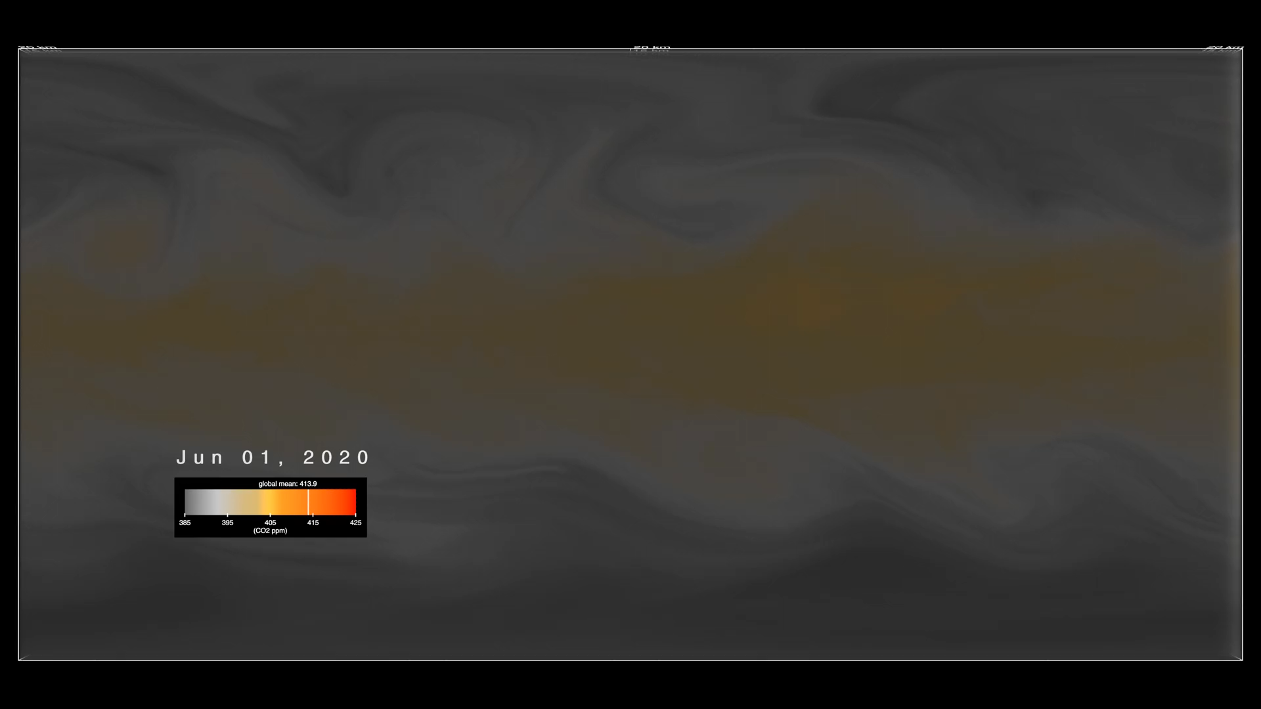

Slide 7
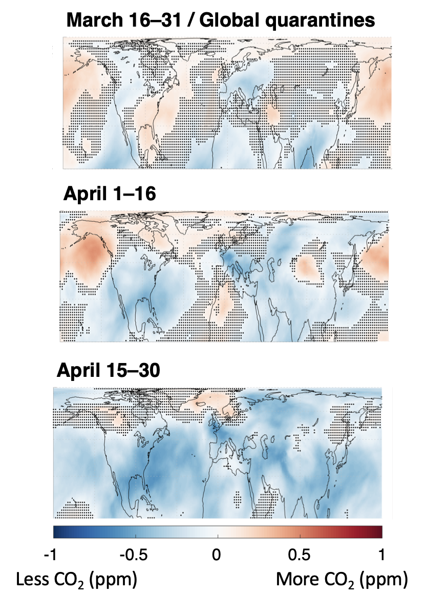
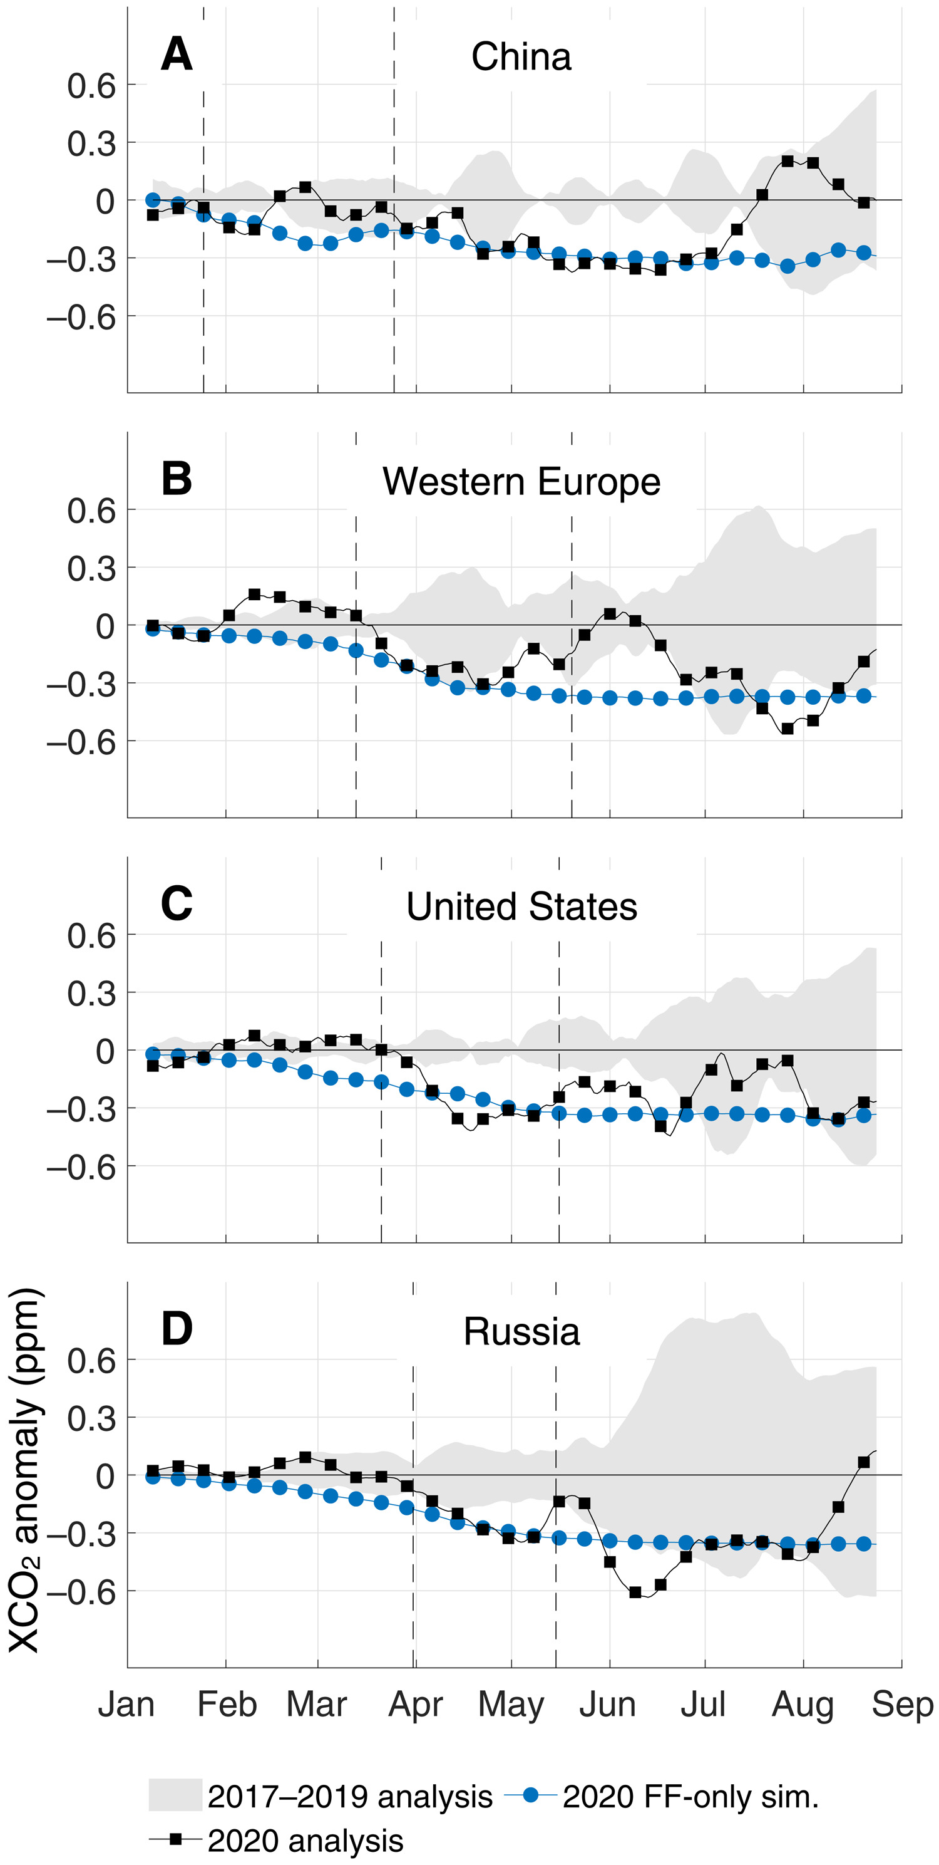
Progression of XCO₂ Anomalies in OCO-2-GEOS Data – COVID-19 Pandemic
OCO-2-GEOS analyses were compared with simulations using CarbonMonitor emissions, demonstrating general consistency in NH winter-spring, and the growing influence of the land biosphere in summer

Slide 8
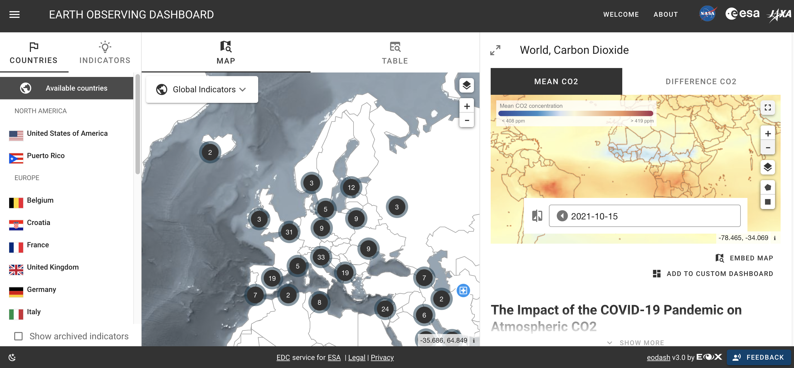

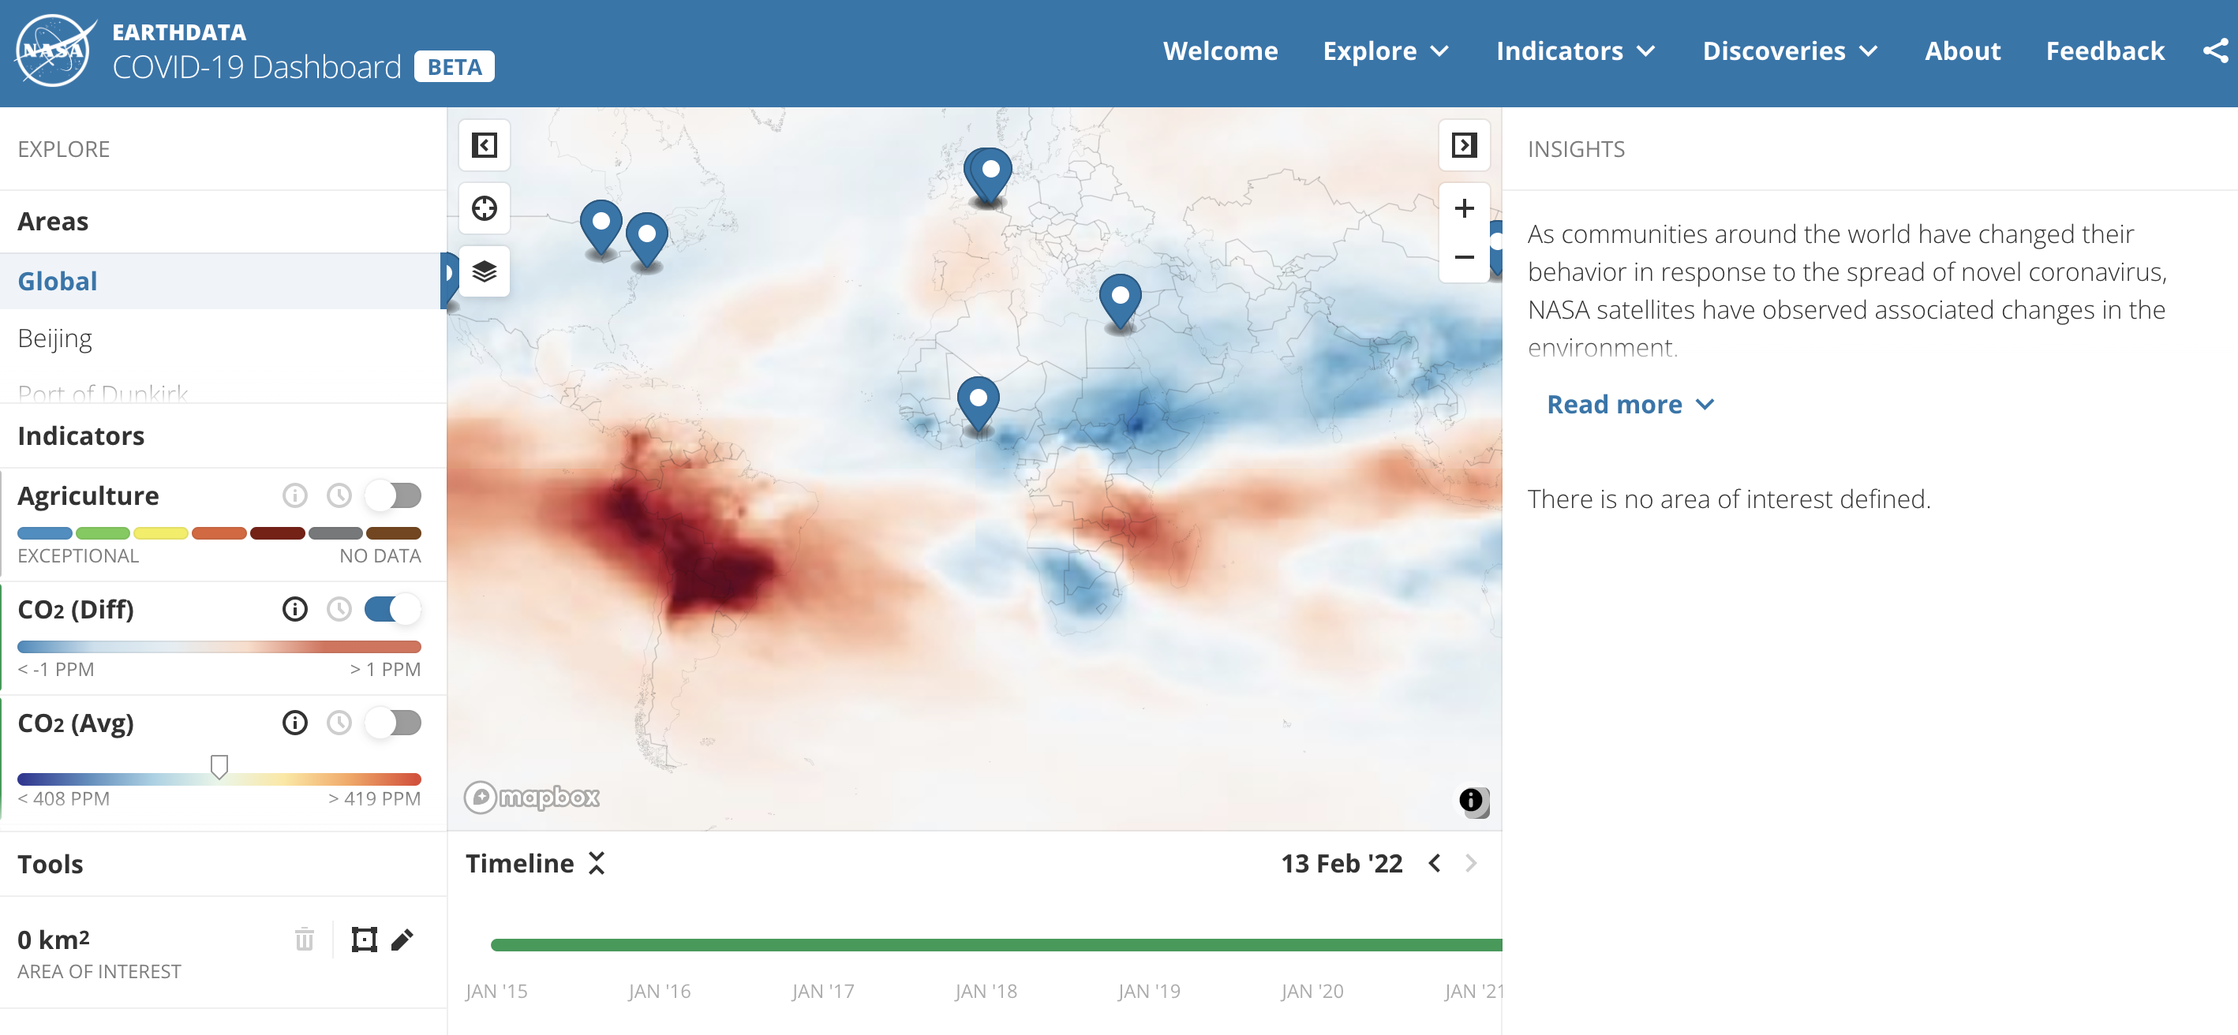
Data from GEOS monitoring system support multiple dashboards designed to make information on recent environmental changes more accessible
https://eodashboard.org/
https://www.earthdata.nasa.gov/covid19/
https://www.eodashboardhackathon.org/

Slide 9
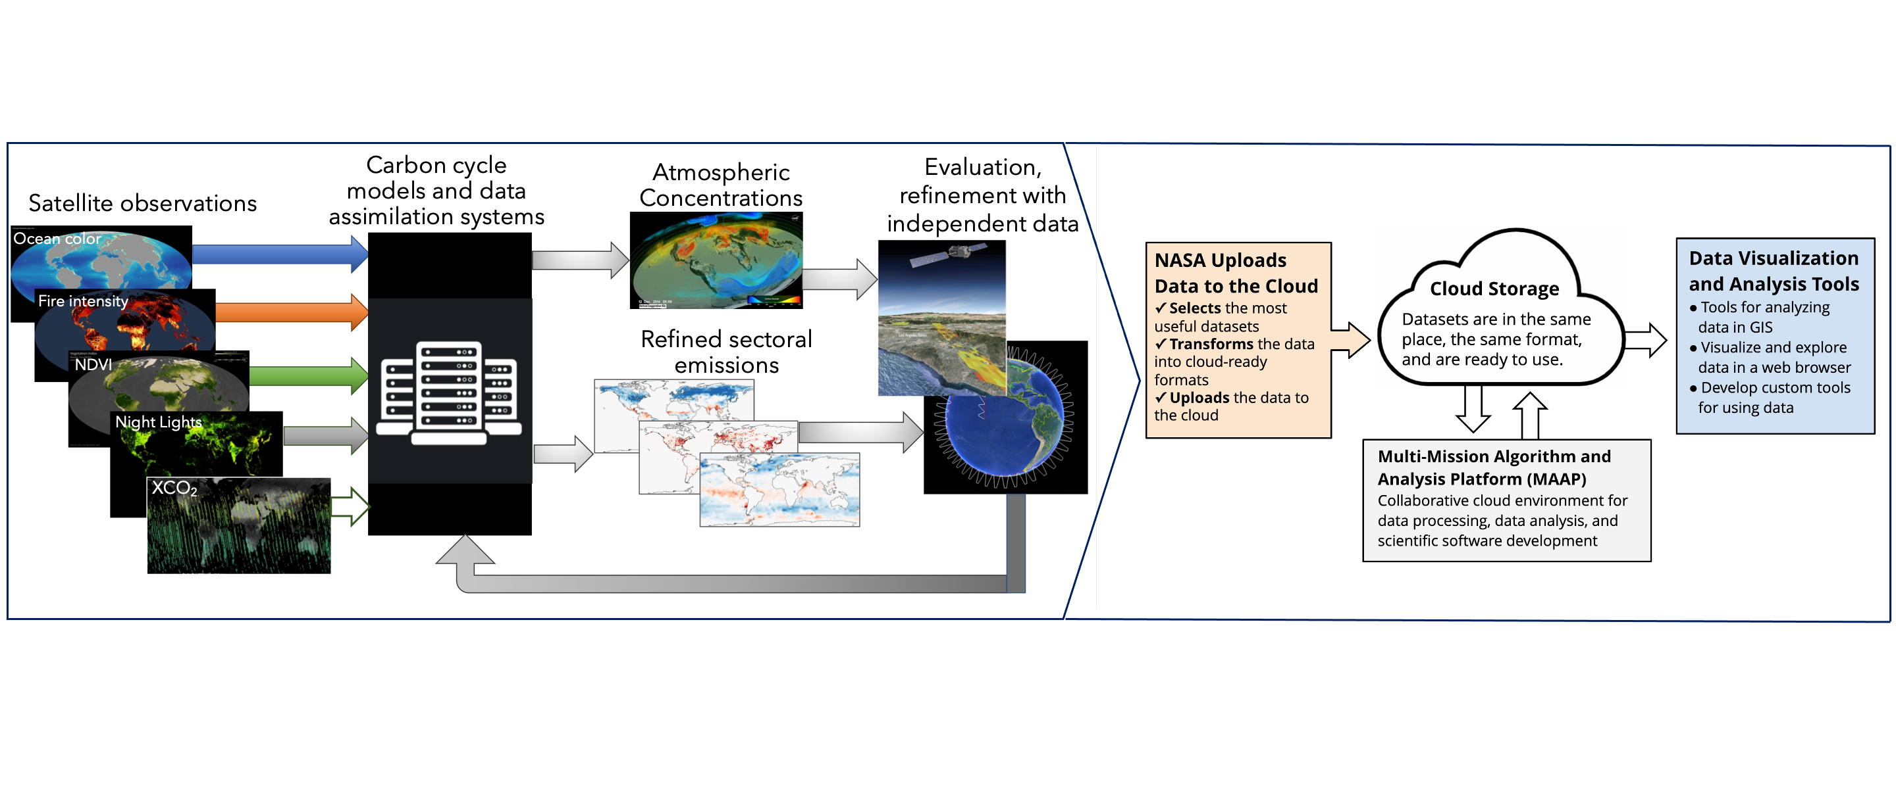
EIS: Advancing access, transparency, and integration of mature GHG modeling data products
NASA ESDS platform for Earth data visualization and analysis​
Observationally derived carbon monitoring products
The Earth Information System (EIS) – Greenhouse Gas pilot project combines NASA investments in observations, data assimilation, and inverse modeling with advanced information technologies to provide accessible, transparent low-latency carbon products for scientific and policy-relevant needs.
Y1 Priorities:
Make current GHG data more accessible
Improve delivery, reliability of GHG data
Improve transparency of data, methods
Demonstrate interoperability
Ensure support for priority non-science applications

Slide 10
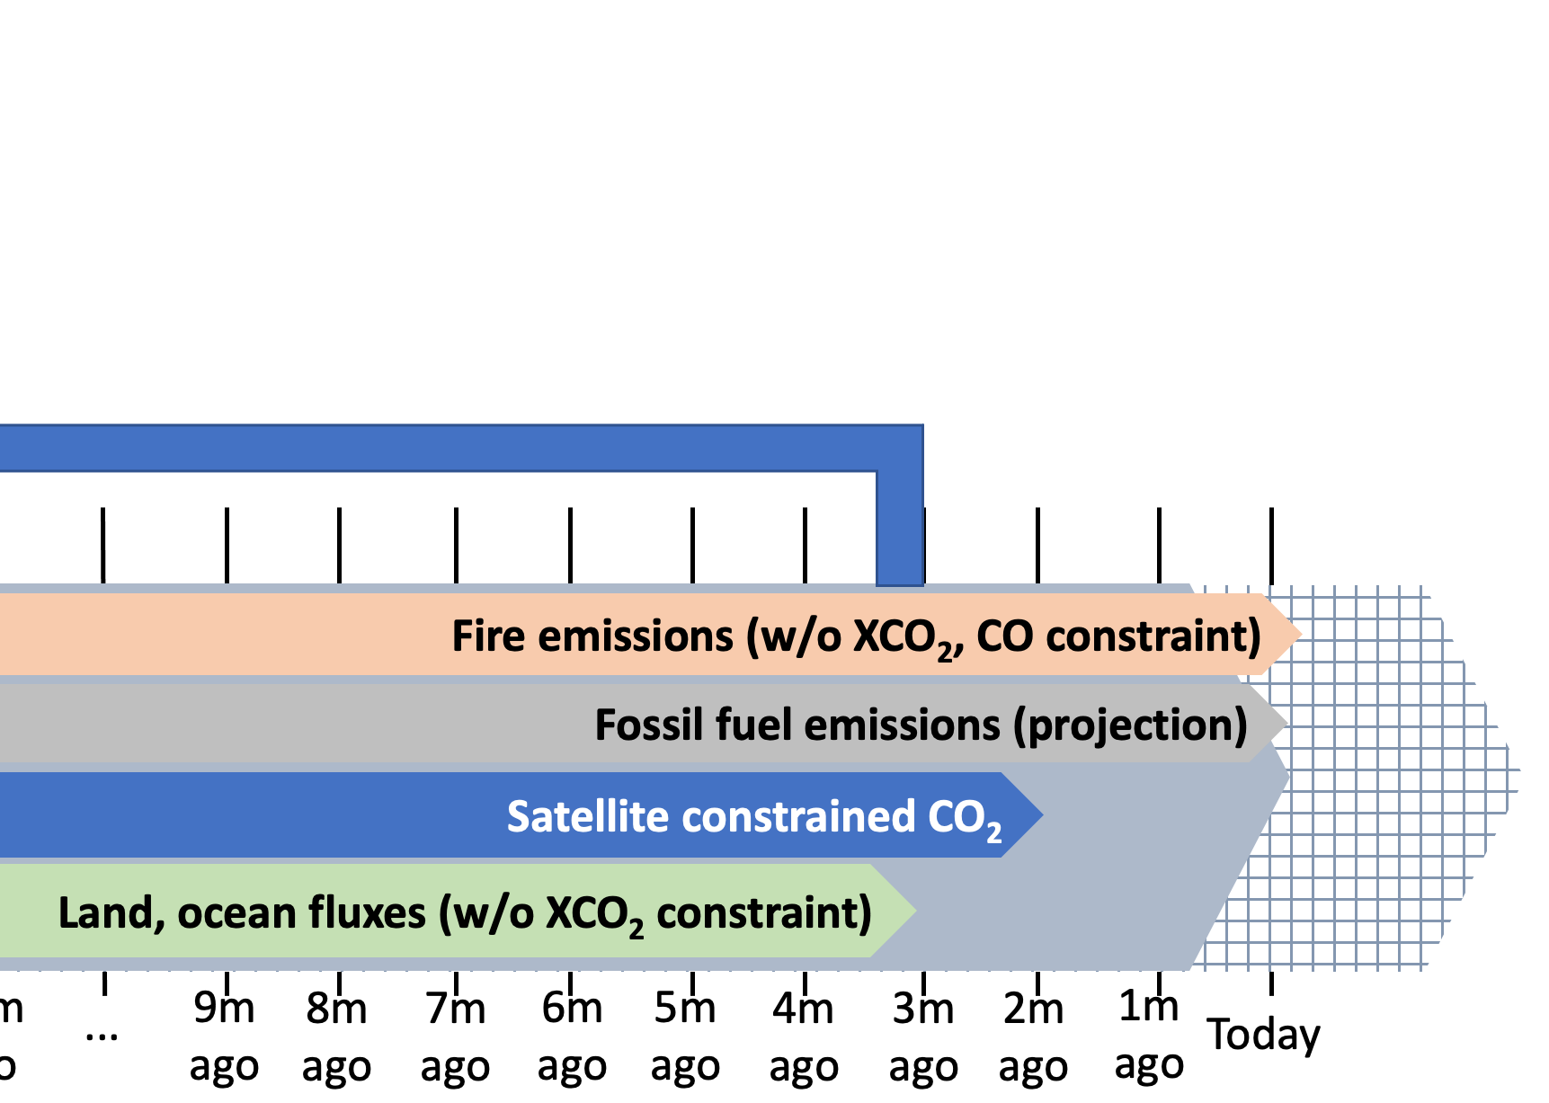
Developing robust, low latency carbon monitoring tools – ongoing work and challenges
New techniques needed to (current delay 1-2m) to link low latency systems to reduce delays in satellite retrievals predictions
Improve workflow for land, ocean models needed to contextualize anomalies, support inversions (current delays 1-12m depending on model)
Evaluate credibility of fossil fuel emission projection methods
Improve data services, connection between on-premise and cloud computing
Cloud-based services
Communication via NASA visualization, outreach tools
Rapid detection of anomalies
Quantified climate impacts
Boundary conditions for regional models
Independent verification with aircraft data

