Slide 1
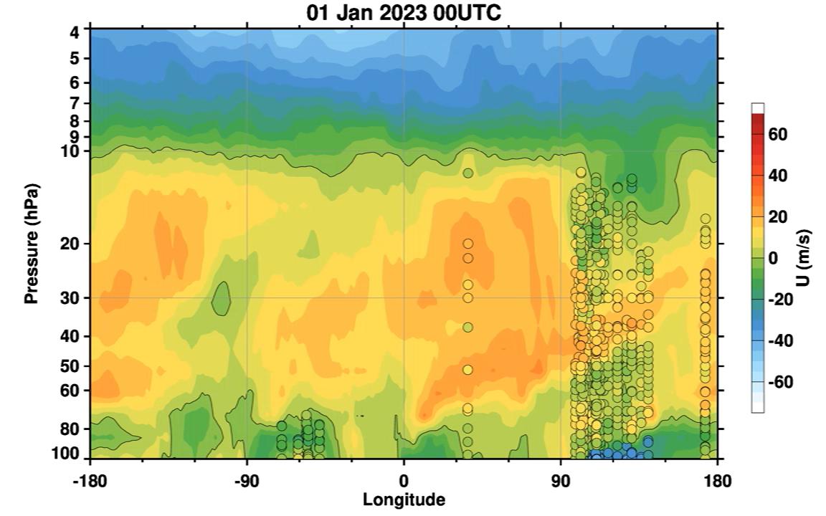
Tropical Winds and Upper Air Soundings
January 2023
Zonal Wind Component
Contours
MERRA-2 ASM Files
Circles
Rawinsonde Values
Note: The downward propagating features are atmospheric Kelvin waves.
Note: For visualization, rawinsonde values at 00 and 12 UTC are persisted for the 12 hours following.
Notes:
Rawinsonde stations are from 5S to 5 N latitude. There are no current stations located from -180 to -90: one quarter of the globe. Current coverage is good over S.E. Asia and fair over S. American allowing the nearly zonally uniform Quasi-Biennial Oscillation to be well represented, moreover even the Kelvin wave appear to be well captured in longitude.

Slide 2
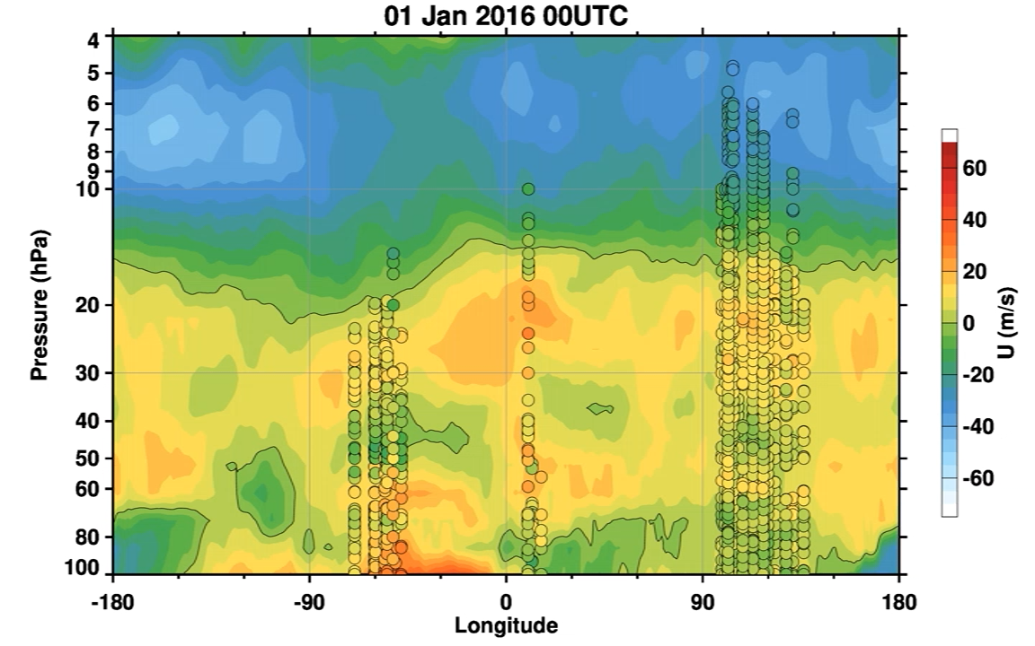
Tropical Winds and Upper Air Soundings
January 2023
Zonal Wind Component
Contours
MERRA-2 ASM Files
Circles
Rawinsonde Values
Note: The downward propagating features are atmospheric Kelvin waves.
Note: For visualization, rawinsonde values at 00 and 12 UTC are persisted for the 12 hours following.
Notes:
Rawinsonde stations are from 5S to 5 N latitude. There are no current stations located from -180 to -90: one quarter of the globe. Current coverage is good over S.E. Asia and fair over S. American allowing the nearly zonally uniform Quasi-Biennial Oscillation to be well represented, moreover even the Kelvin wave appear to be well captured in longitude.
January 2016 had a large number of rawinsondes that also achieved high altitude.

