Slide 1
Tracer Transport and Dynamics associated with the 2016 QBO
Lawrence Coy, Paul Newman, Steven Pawson, Leslie Lait, Natalya Kramarova
NASA Goddard Space Flight Center
Global Modeling and Assimilation Office
Atmospheric chemistry and Dynamics Laboratory

Slide 2
Outline
Overview of 2015-16 QBO Structure
Record Breaking Tropical Waves
Ozone Response
Forecasting the QBO Disruption

Slide 3
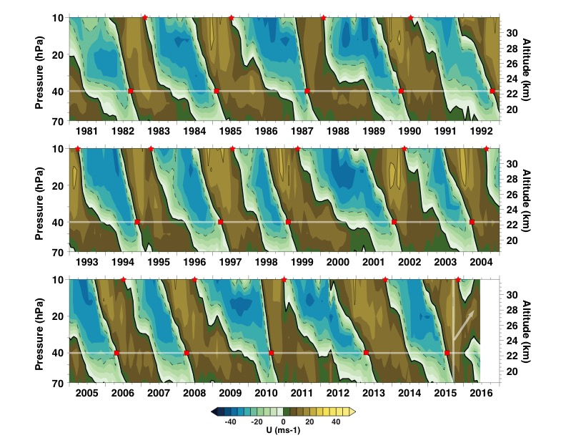
Singapore
Upward Westerlies
Easterlies Appear in Strong Westerlies
Newman et al. 2016 GRL

Slide 4
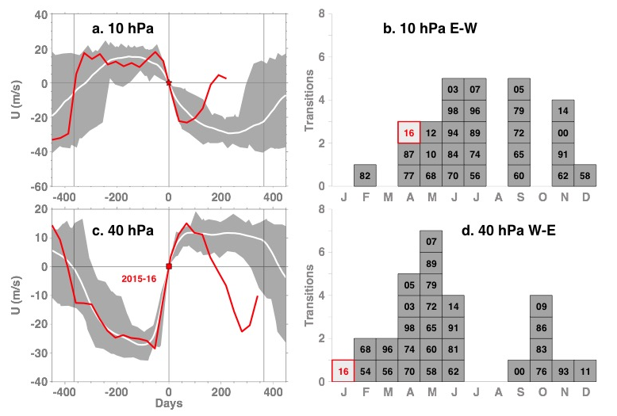
Singapore (1954-2016)
Zonal Wind
Transition Months
Unique 40 hPa Transition Month
Newman et al. 2016 GRL

Slide 5
14 MERRA-2 Zonal Mean Zonal Wind Transitions:
Very Similar.
2016 (Red), Westerlies change back to Easterlies very quickly.
2014
Jan
2015
Jan
2016

Slide 6
2016 Easterlies at 40 hPa create an “extra” shear layer.
2016

Slide 7
What Happened
Expected Evolution
Anomaly
Expected Variability
Rapid change at all levels.
QBO Reboot?
Coy et al. submitted to J. Climate

Slide 8
Summary: Not “Business as Usual”
Extensive Upward Displacement of Westerlies
Acceleration at 40 hPa not Associated with Vertical Wind Shear
Simultaneous Accelerations over Large Vertical Domain
Unusual Mid-Winter W-E Transition
Increased Vertical Structure

Slide 9
Momentum Flux (Horizontal)
MERRA-2 10º S-10º N 40 hPa
4
Huge Peak in Feb 2016
- 4
Huge Peak in Feb 2016
1980
1990
2000
2010
Unprecedented Wave Forcing of the Zonal Mean Zonal Wind
Coy et al. submitted to J. Climate
From MERRA-2 Monthly Averaged Files

Slide 10
Zonal Wind (ms-1) and EP Flux (Arrows)
QBO Westerlies
QBO Split
Waves Propagate across the Equator from the Northern Hemisphere.
Coy et al. submitted to J. Climate
From MERRA-2 Monthly Averaged Files

Slide 11
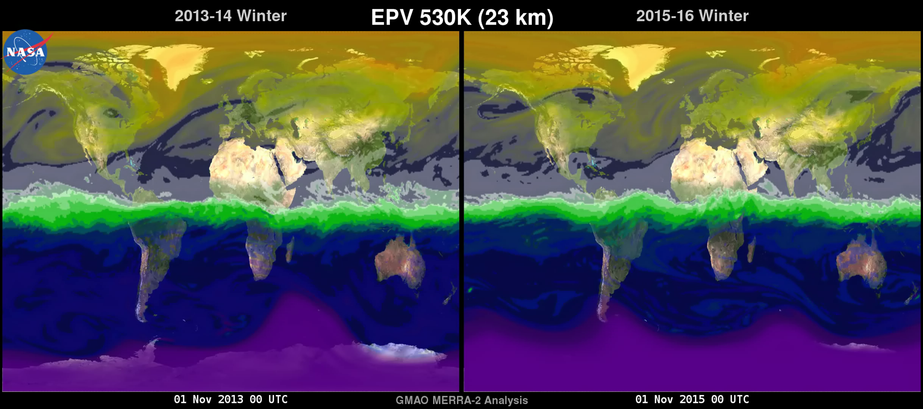
Coy et al. submitted to J. Climate

Slide 12
Momentum and Heat Fluxes (40 hPa)
2016
Momentum
Heat
1980-2015 Range
Normalized by the Standard Deviation
Coy et al. submitted to J. Climate

Slide 13
Horizontal Momentum Flux (February)
2016
2014
Momentum
Heat
Large (+9) 40 hPa and
Large (+3) upper troposphere momentum flux.
40
2011
1998
Normalized by the Standard Deviation (mean removed)
Coy et al. submitted to J. Climate

Slide 14
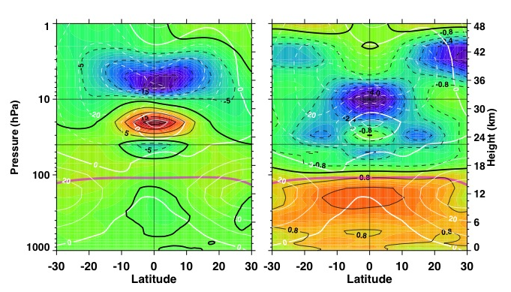
Wind
Temperature
Cold Temperature → Upward Motion
(upward westerlies)
Extensive Warm Upper Tropopause Temperatures: ENSO
MERRA-2 January – May 2016 Anomalies
Newman et al. 2016 GRL

Slide 15
Summary: Wave Activity
Record Positive Horizontal Momentum Fluxes at 40 hPa in Tropics
Southward EP Fluxes at 40 hPa → Waves Originate in NH
QBO Westerlies Effectively “Cut” by Wave Forcing
Upward Motion above 40 hPa → Rising Westerlies

Slide 16
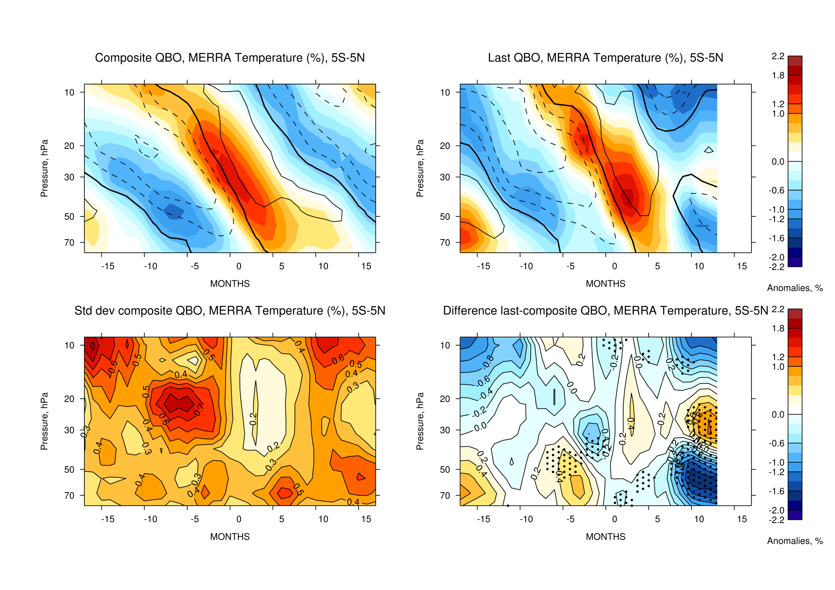
Temperature (%)
MLS Time Period
10
What Happened
Expected Evolution
50
Expected Variability
Anomaly
-15
Months
15
MERRA-2 2004-2015 Anomalies

Slide 17
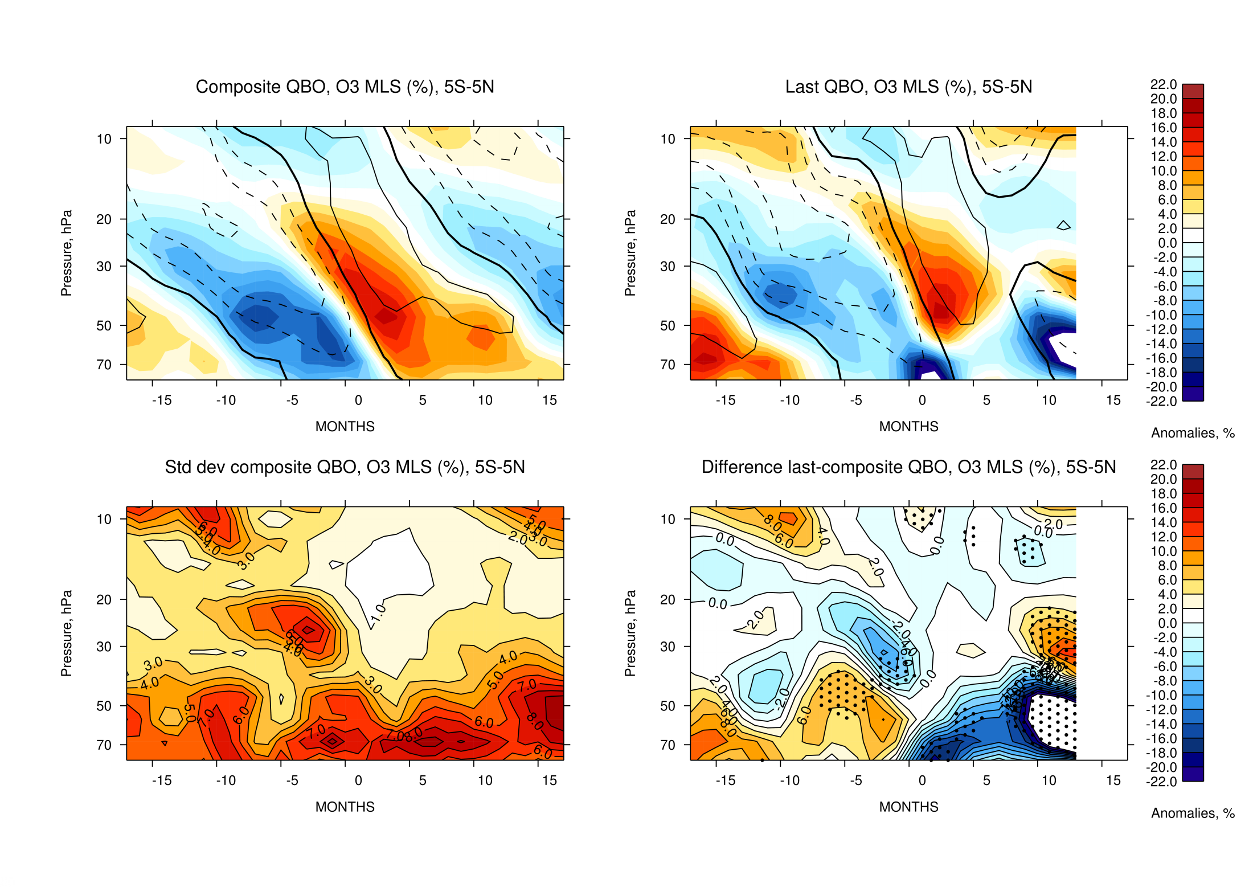
MLS Ozone (%)
MLS Time Period
10
What Happened
Expected Evolution
50
Expected Variability
Anomaly
Low Ozone Anomaly
-15
Months
15
MLS 2004-2015 Anomalies

Slide 18
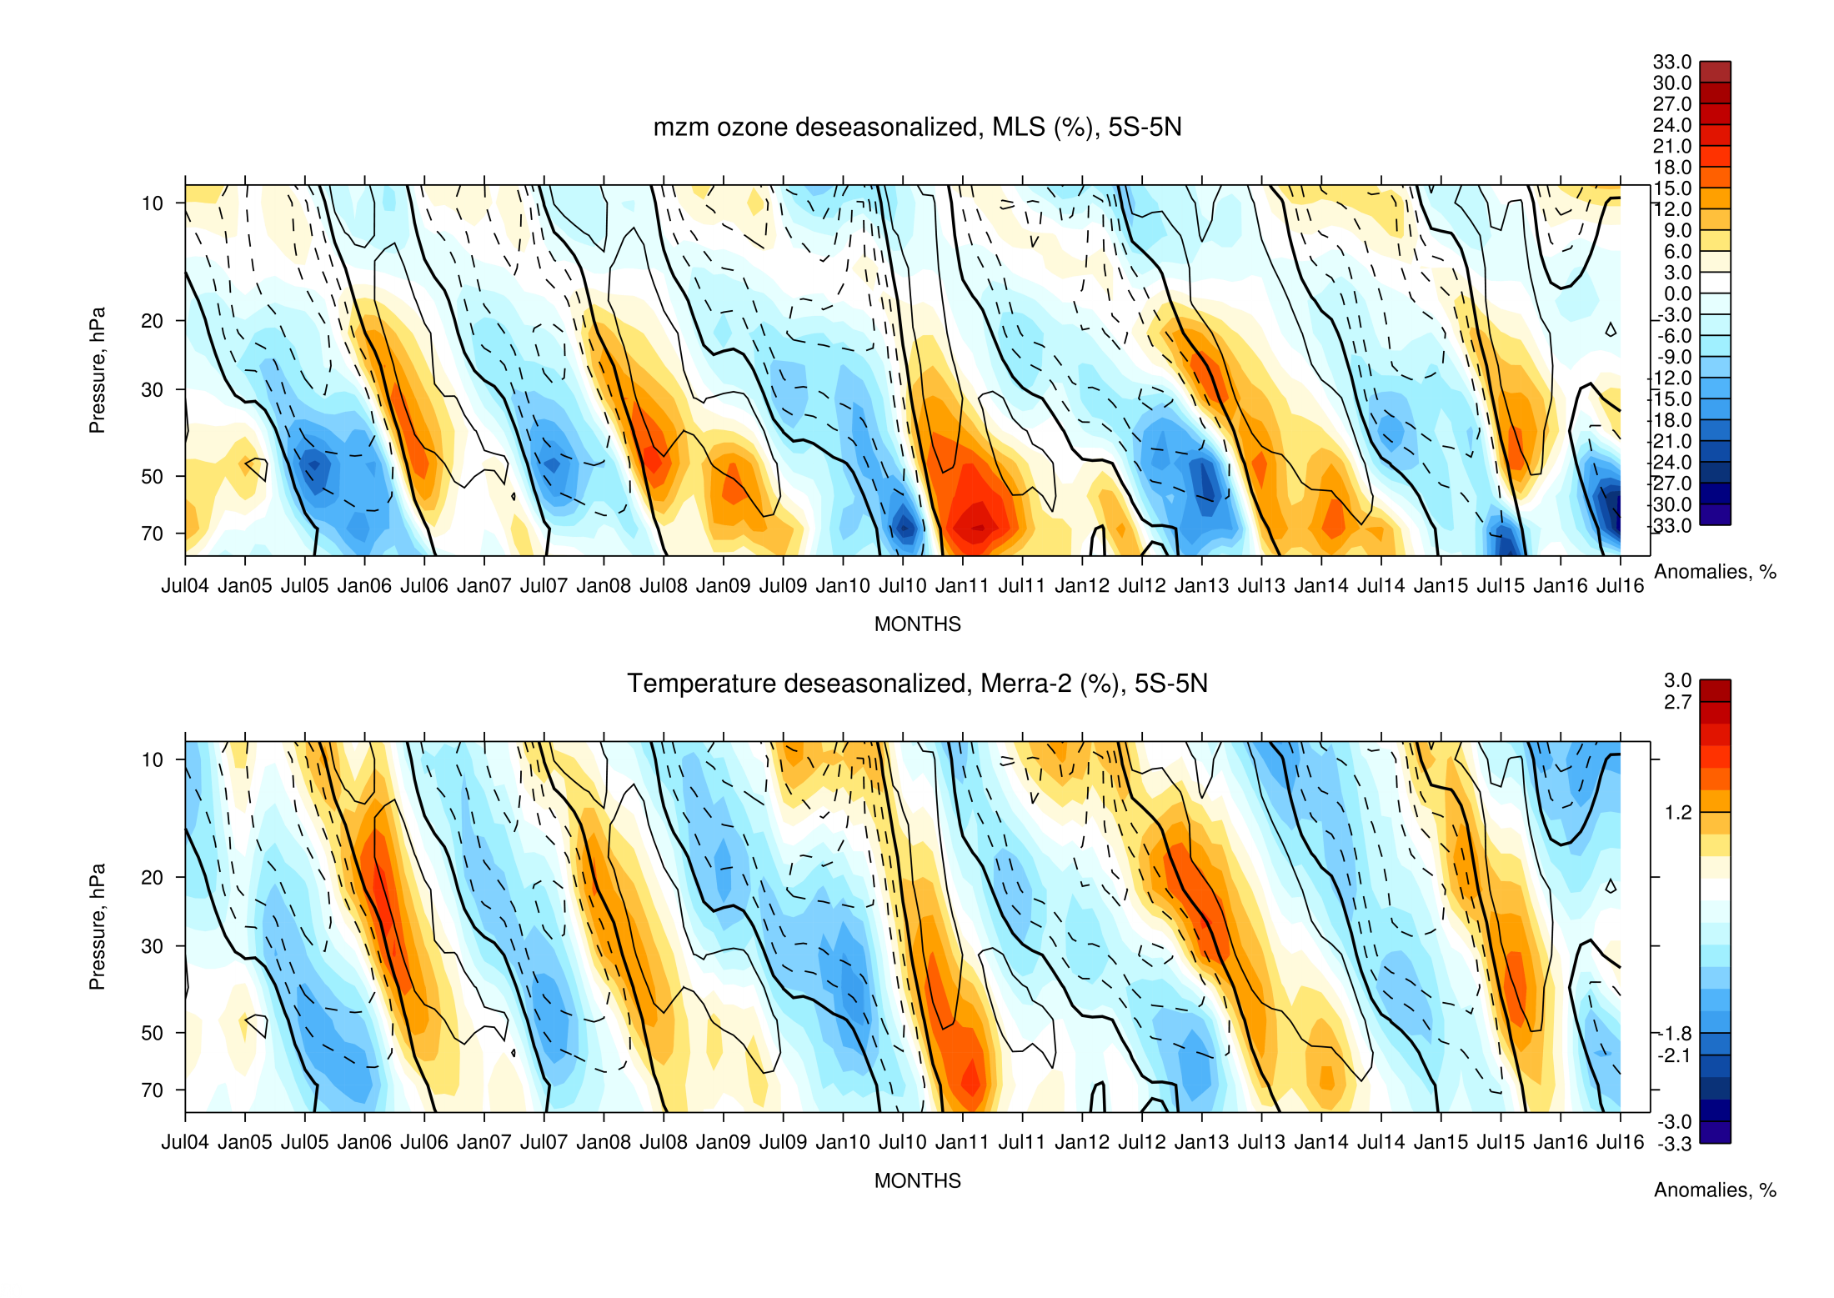
MLS Ozone (%)
10
50
2004
2016

Slide 19
Summary: Ozone
Ozone Reflects Disrupted QBO
Low Ozone Anomaly Below 40 hPa, High Ozone Above

Slide 20
Seasonal Forecasts
Zonal Mean Zonal Wind 10ºS-10ºN
(Low Horizontal Resolution)
MERRA-2
1 Jul Fcst
Forecast calls for descent of vertical shear zones
Disrupted
MERRA-2
1 Jan Fcst
4
Forecast erroneously called for descent of early Jan vertical shear zones
Normal
100
2015
2016
2017
2018

Slide 21
Higher Horizontal Resolution 10-Day Forecasts
Good Overall 10-Day Forecasts
Some Bias
Opportunity?
Fcst – Analysis Difference
May Highlight 40 hPa Wave Forcing

Slide 22
Summary: Seasonal Forecasts
Unable to predict QBO disruption with low-res seasonal fcst system
Routine 10-day forecasts consistently predict QBO disruption
New GMAO seasonal system in early 2017

Slide 23

AKA
Rogue
Oddball
Disrupted
Unexpected
Weird
Anomalis
Rebooted
Hiccup
Death Spiral

Slide 24
Summary: Quasi-Biennial Oscillation
Strange Days
Structure
The 2016 anomalous QBO structure is unprecedented since records were begun in 1953 (62 years).
Evolution
The descending westerlies appear to be split by easterlies.
Waves
MERRA-2 shows unprecedentedly large lower stratosphere (~40 hPa) tropical momentum fluxes in February 2016 with very large fluxes in December 2015 and January 2016 as well.
Future → Continued Forecast Studies and Trace Gas Analyses – New, Higher-Res. Seasonal Forecast System (2017).

Slide 25
Backup Slides

Slide 26
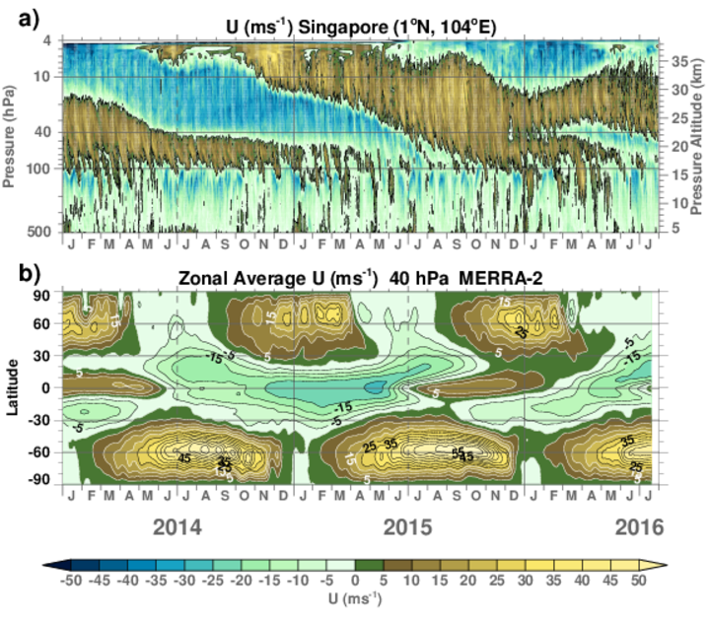
Zonal Mean Zonal Wind
Pressure
Singapore
2014
2016
MERRA-2
40 hPa
Latitude

Slide 27
Seasonal Forecasts
Zonal Mean Zonal Wind 10ºS-10ºN
MERRA-2
1 May Fcst
Forecast calls for descent of early May vertical shear zones
Disrupted
4
MERRA-2
2 Dec Fcst
Forecast erroneously called for descent of early Dec vertical shear zones
Normal
100
2014
2015
2016
2017

Slide 29
W star (km month⁻¹) Dec-Feb
1980-2015Mean Subtracted
Upward Advection of Westerlies
10
40
Coy et al. submitted to J. Climate

