Slide 1

SPARC-Reanalysis Intercomparison Project (S-RiP) and SPARC Data Assimilation (DA) Workshops
12-16 October 2015
Universite Pierre et Marie Curie (UPMC)
Paris, France
S-RIP/SPARC-DA Joint Session on Reanalysis
NASA Activities
Lawrence Coy* , Kris Wargan*, Will McCarty, Steven Pawson
PLUS
All the NASA Goddard Space Flight Center GMAO
An Introduction to MERRA-2
NASA Global Modeling and Assimilation Office (GMAO)
Goddard Space Flight Center, Greenbelt, Maryland, USA
*Science Systems and Applications, Inc. (SSAI), Lanham, MD

Slide 2
MERRA-2
Modern-Era Retrospective analysis for Research and Applications-2
New Reanalysis (2015)
Covering 1980 to the present (35 years, ongoing)
The original MERRA reanalysis was a success!
However…
It was unable to accommodate new data types or system improvements, and also, old satellite instruments fail. Therefore a new reanalysis, based on model and data assimilation improvements was necessary.

Slide 3
MERRA-2 Release
Friday, 9 October 2015
File Specification Document
Office Note (#9): gmao.gsfc.nasa.gov/pubs/on/
Note: The file specification document includes a list of the citable doi numbers for each of the data collections and the collections used should be cited in each MERRA-2 publication.
MERRA-2 system-description documents:
Published:
Molod et al. (2015) GMD paper
Takacs et al. (2015) Technical Memorandum
New Technical Memorandum to appear over the next weeks:
" Observations,” McCarty et al.
"Climate Validation,” Bosilovich et al.
"Aerosols,” Randles et al.
They will appear in the "Technical Memoranda" section of gmao.gsfc.nasa.gov/pubs

Slide 4
MERRA-2 Release
Friday, 9 October 2015
Acknowledgements: NASA MAP, NCCS, GES-DISC
Papers with GMAO co-authors should give credit in the "Acknowledgements" to NASA's Modeling, Analysis and Prediction (MAP) program for supporting the work and to the allocation of High-Performance Computing (HPC) awards allocated to GMAO to produce the MERRA-2 dataset on Discover.
MERRA-2 users should acknowledge the GES-DISC for data provision (or HPC, if they are collaborators who have access to our data via NCCS).
Journal Special Section for MERRA-2 papers:
J. Climate and other AMS journals. Contact Mike Bosilovich (NASA GMAO)

Slide 5
Outline
MERRA-2 Overview
Ozone Assimilation
QBO
Cubed Sphere
MLS Temperature
SSU
Recent Developments

Slide 6
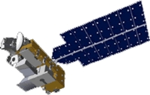
MERRA-2
MERRA-2 System Notes:
Latest satellite data (IASI, GPSRO, ATMS, CRIS)
Updated satellite data (SBUV v8, SSMI v7, AMV)
Assimilated and interactive aerosols (black and organic carbon, sea salt and dust)
Global constraint on water vapor mass analysis increments
Revised planetary boundary layer parameterization
Bias corrected land precipitation forcing
All output data in native spatial resolution in netcdf4
Updated gravity wave drag tuning
Run on Cubed Sphere grid
Aura MLS temperatures included above 5 hPa
CRTM used for SSU
Middle Atmosphere Change Highlights

Slide 7
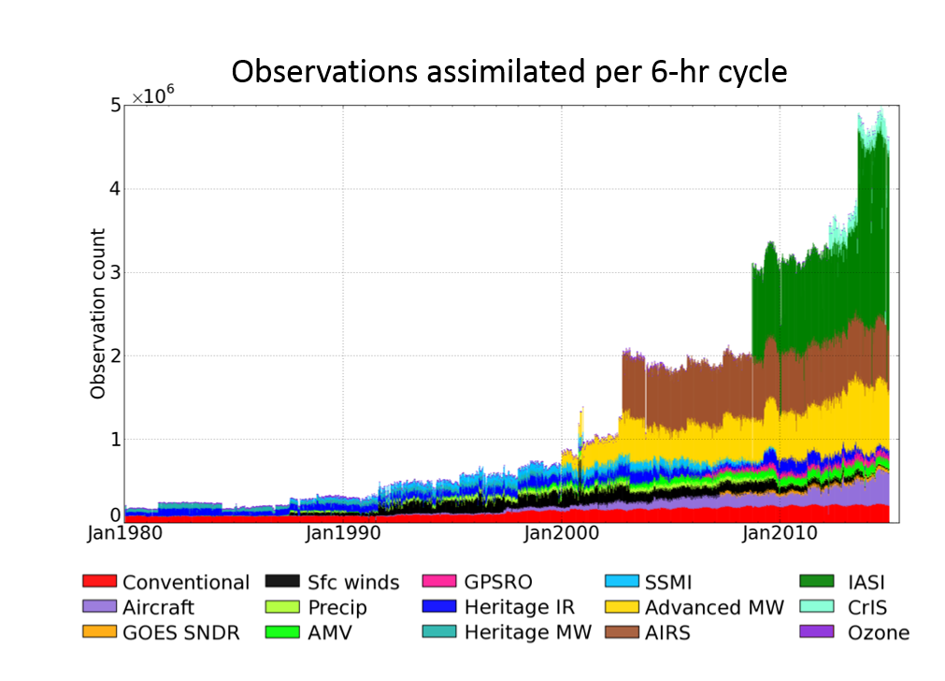
Input Observations for MERRA-2
1 January 1980 – 31 December 2014

Slide 8
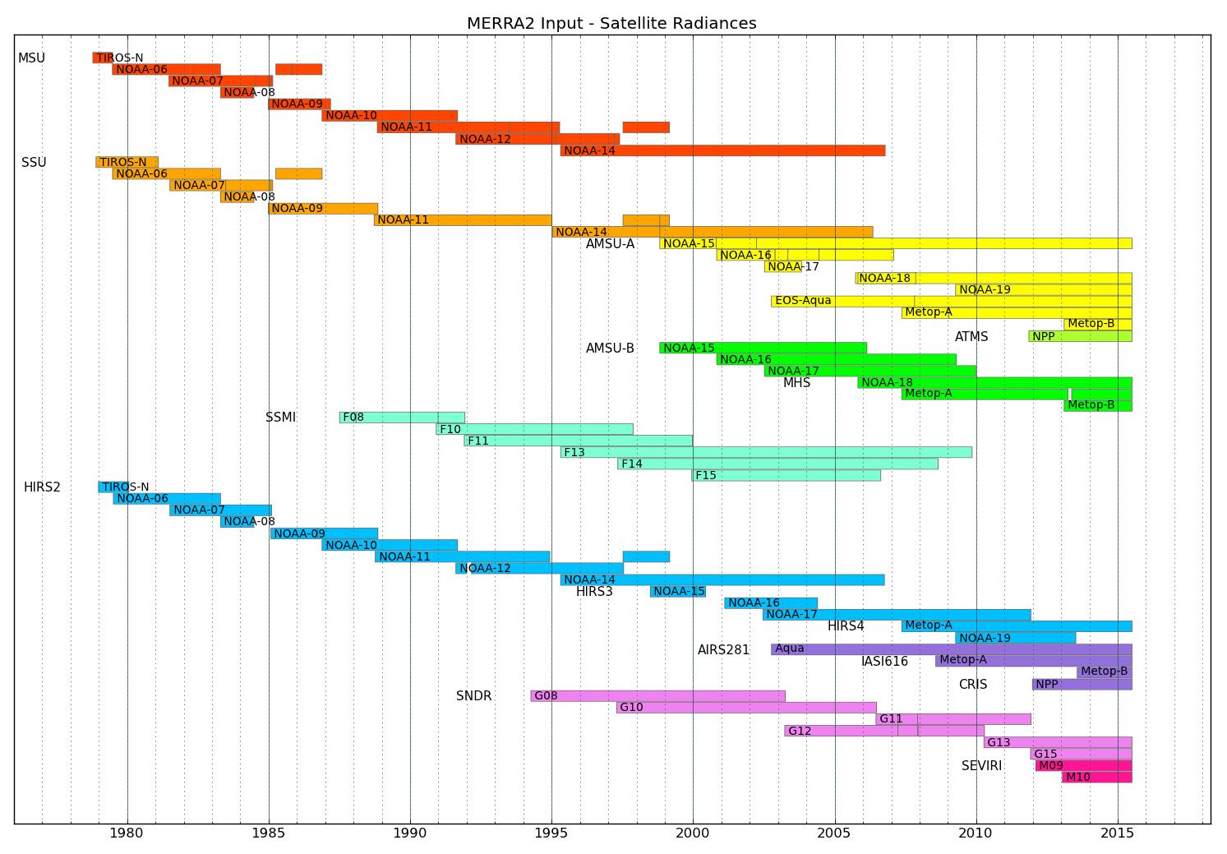
MERRA-2 Input - Satellite Radiances
MSU
SSU
AMSU-A
AMSU-B
SSMI
HIRS
AIRS, IASI, CRIS
SNDR
SEVIRI
1980
1990
2000
2010
2015

Slide 9
Ozone: Input data streams
Nimbus-7
MERRA-2
NOAA-11
NOAA-14
NOAA-16
N-17
MLS
OMI
Nimbus-7
NOAA-11
NOAA-11
MERRA
N-9
NOAA-16
NOAA-17
N-19
MERRA-2:
Improved SBUV/2 version
MLS and OMI replaces SBUV/2 in 2004

Slide 10
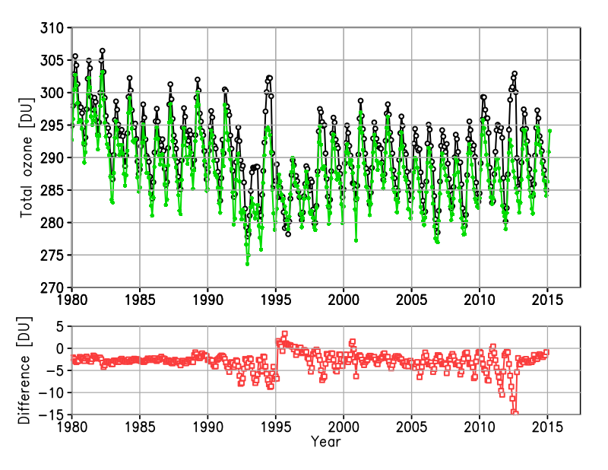
Globally averaged total ozone
Kris Wargan Slide…
Ozone Assimilation System
Poor SBUV coverage
MERRA
MERRA-2
Chlorine trends
Solar cycle maxima
Mt. Pinatubo
Mostly high-latitude differences.
Again: SBUV coverage is an issue
N-16
N-17
Nimbus-7
N-11
N-14
Aura
MERRA-2 is slightly lower globally
1994: NOAA-11 SBUV loses coverage in SH extratropics → both reanalysis develop high bias; less of a problem in MERRA-2
Large differences in austral winter during the EOS Aura period
Overall, the evolution of global ozone is in qualitative agreement with known science

Slide 11
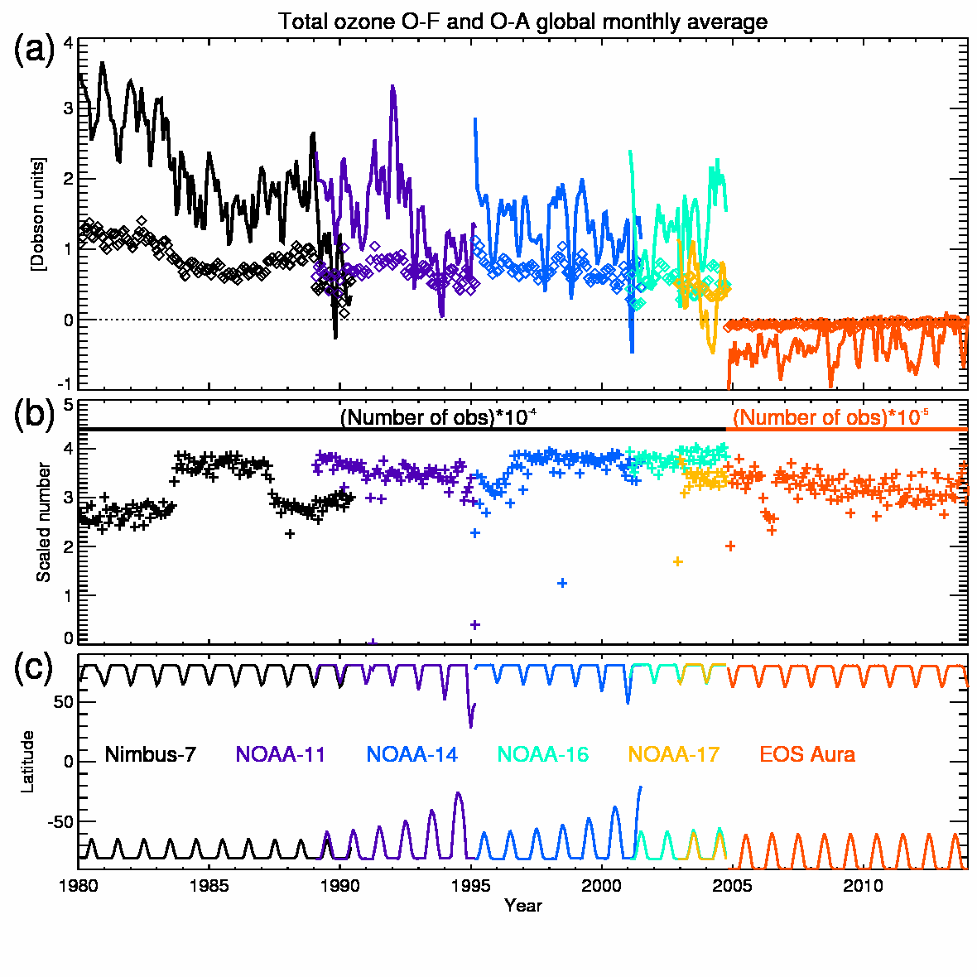
Total Ozone O-F and O-A Global Monthly Average
Global mean monthly O-Fs (solid) and O-As (diamonds)
Monthly data counts
Highest Observed Latitudes
1980
2014

Slide 12
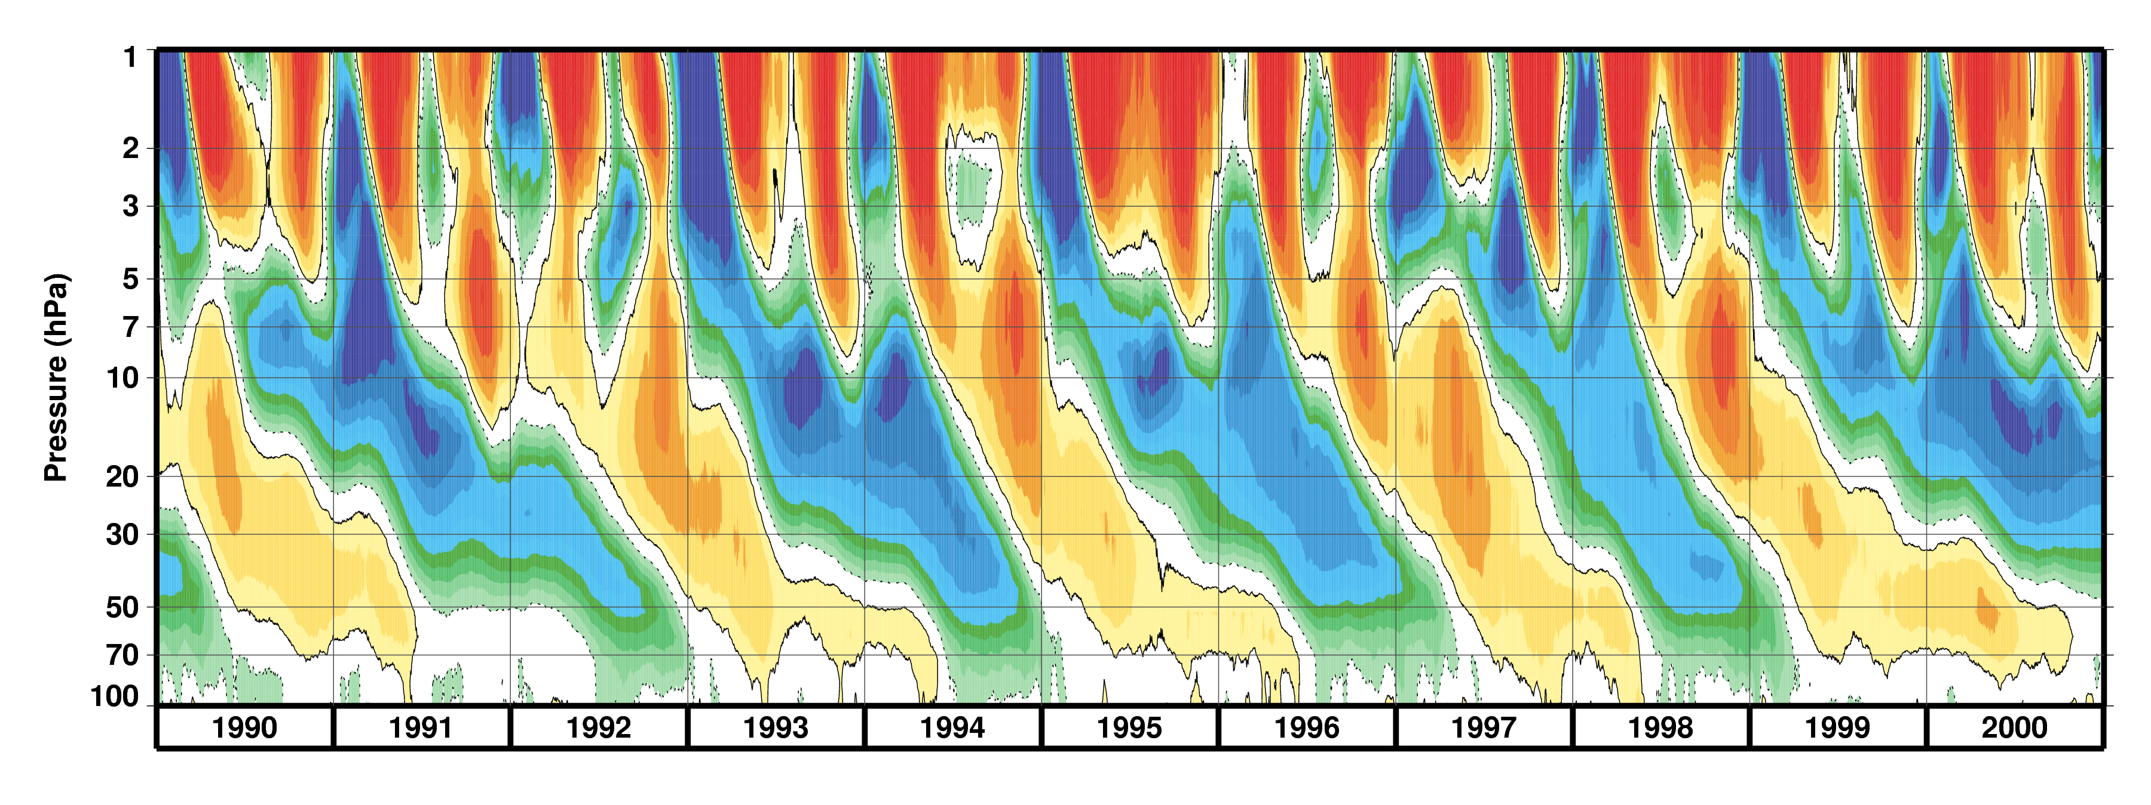
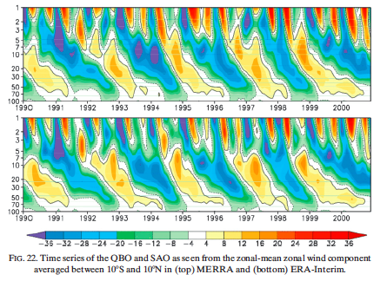
QBO
Quasi-Biennial Oscillation
Zonally Averaged Zonal Wind (ms⁻¹)
MERRA-2
Mid-Stratospheric westerlies are stronger; Semi-annual oscillation is more westerly.
MERRA-2
1 hPa
MERRA
(Rienecker et al., 2011)
100 hPa
ERA-Interim
(Rienecker et al., 2011)
1990
2001

Slide 13
QBO Zonal Wind at Singapore (104ºE, 1ºN)
50 hPa
Singapore (gray shading)
MERRA
MERRA-2
MERRA-2 fits the Singapore observations better, especially during the westerly phase of the QBO.

Slide 14
Nairobi
MERRA
MERRA-2
QBO Ozone at Nairobi (37ºE, 1ºS)
30 hPa
50 hPa
Ozone
Difference
1998
2014
1998
2014
Note: Ozonesondes are not included in the MERRA-2 Analysis

Slide 15
Quasi-Biennial Oscillation (Filtered)
Zonal Wind
1
10
100
Ozone
1
10
100
1980
2015
Years →
Notes:
10s – 10n monthly averaged U fields, from pressure level files.

Slide 16
Quasi-Biennial Oscillation
Zonal Wind and Meridional Circulation Composites

Slide 17
MERRA Quasi-Biennial Oscillation
Zonal Wind Forcings

Slide 18
MERRA-2 Quasi-Biennial Oscillation
Zonal Wind Forcings
Increased GWD
Decreased Analysis Increments

Slide 19
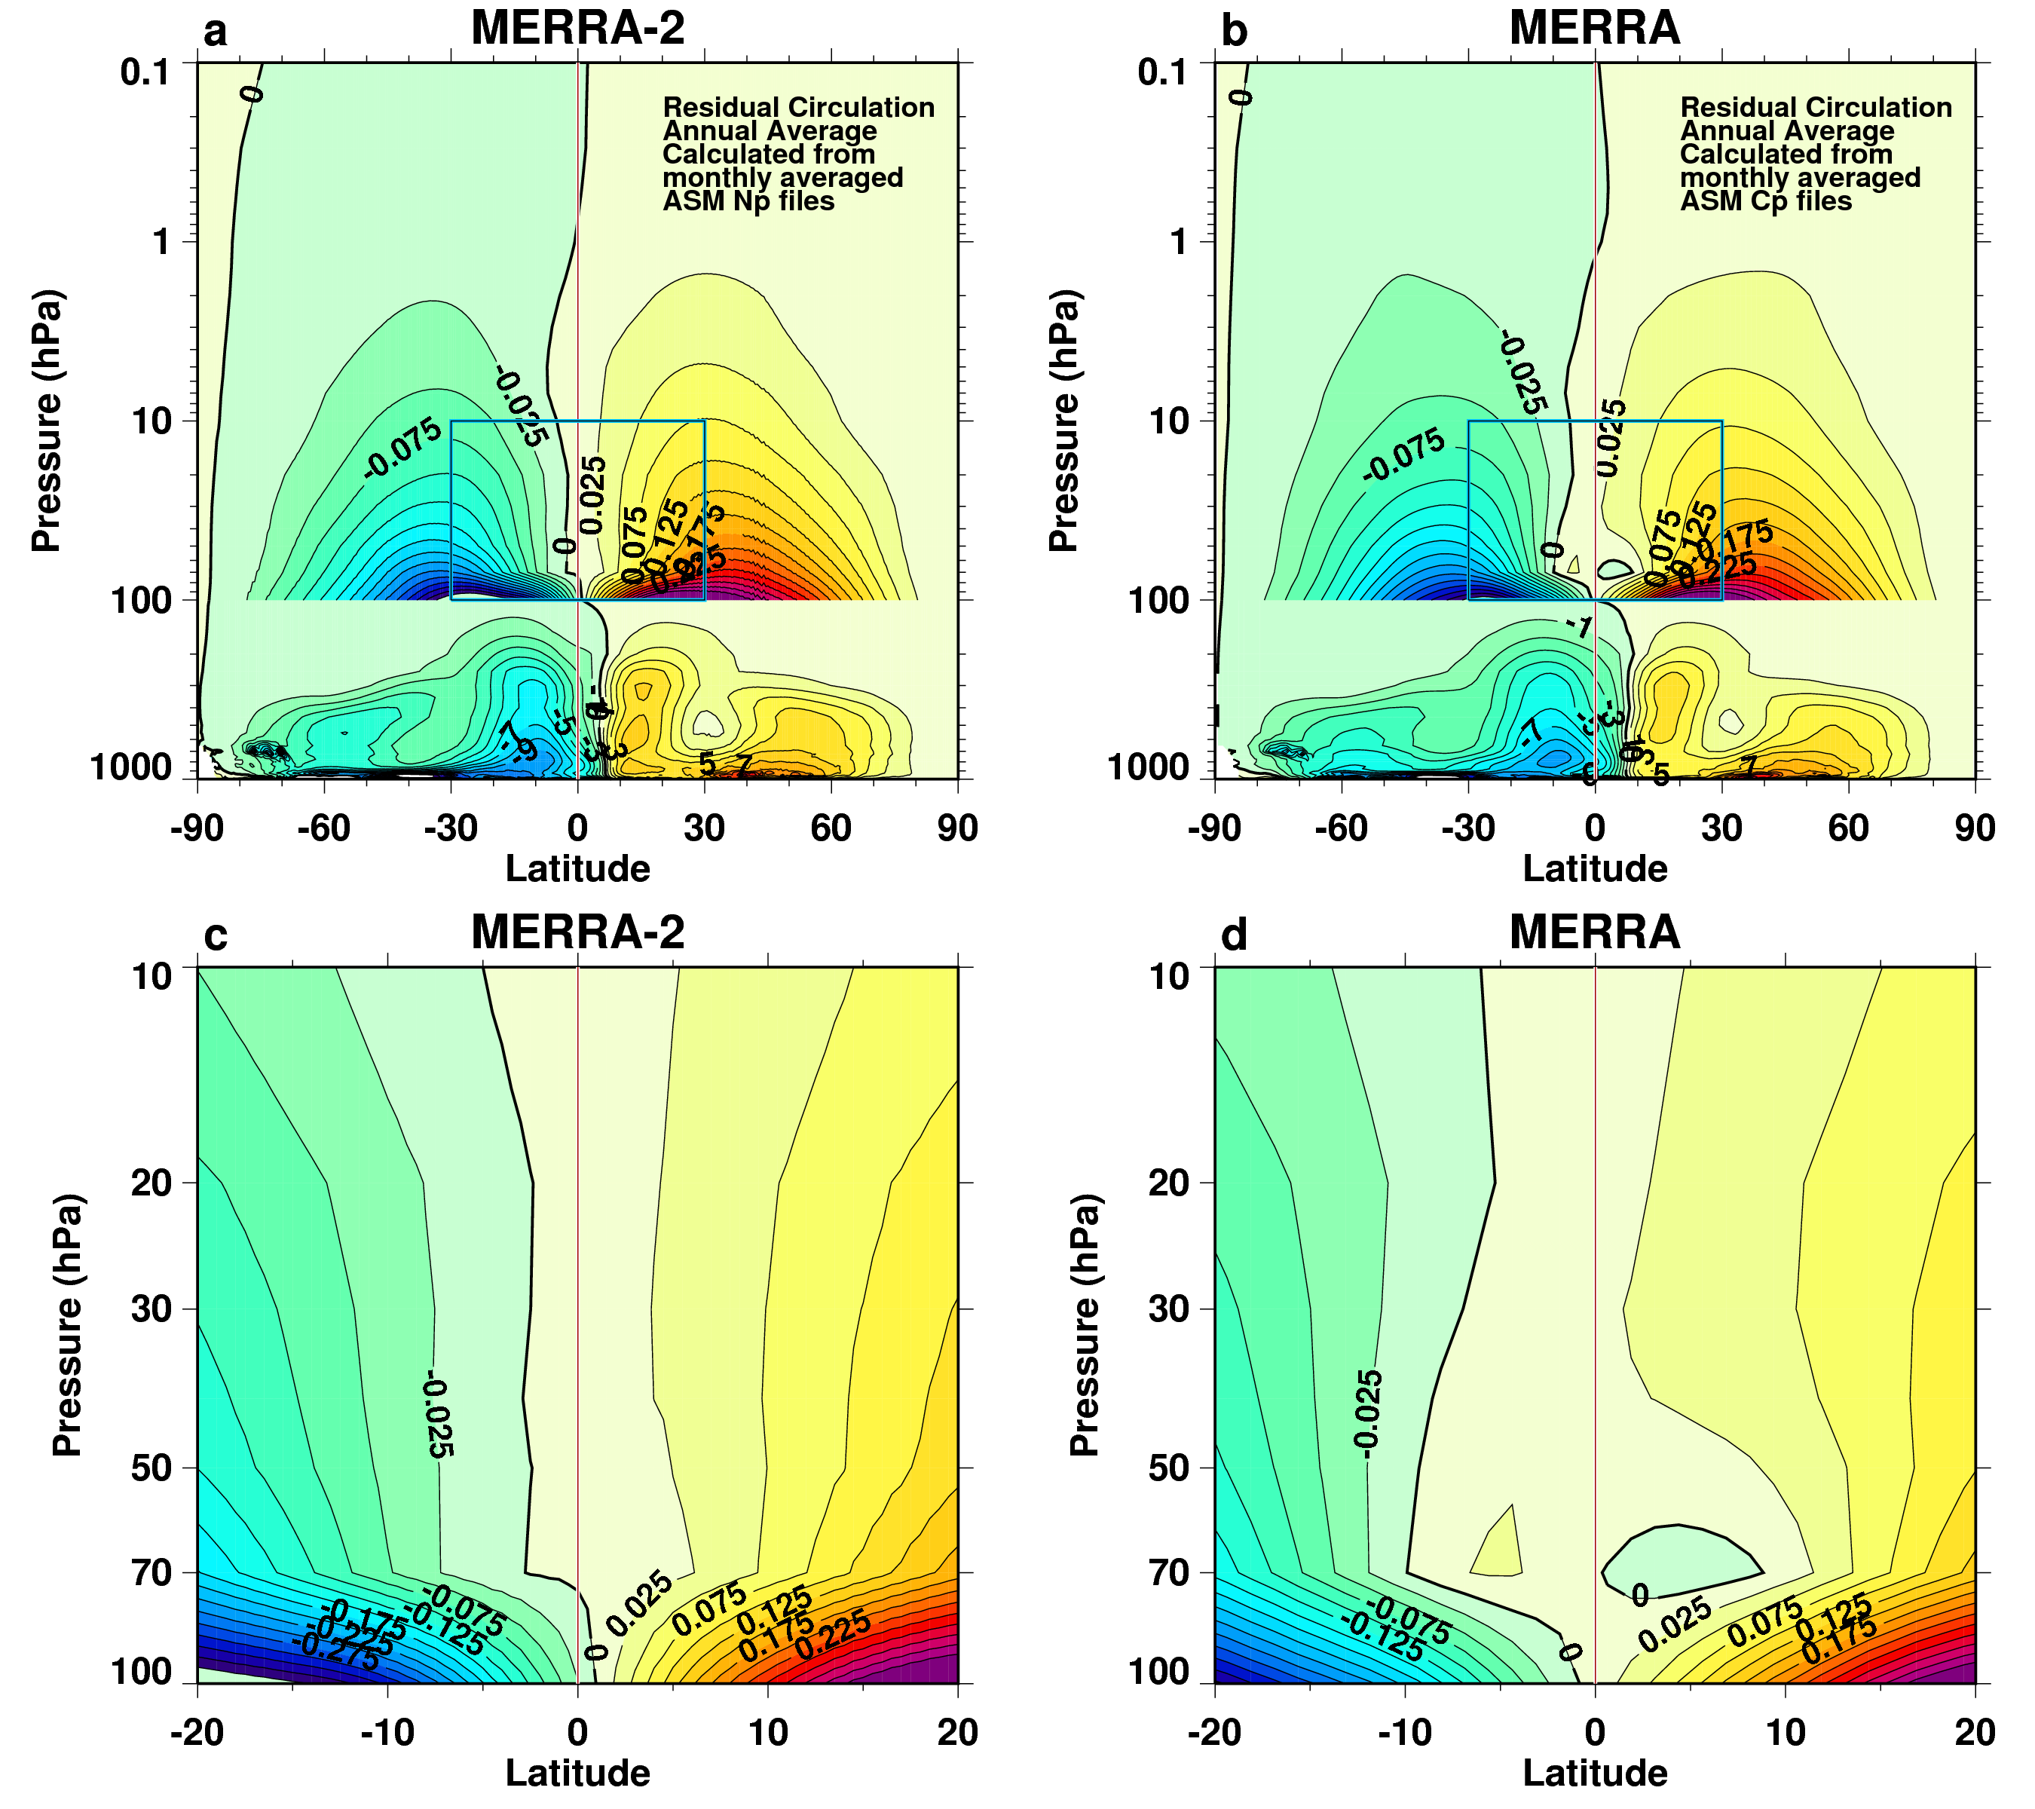
Residual Circulation (Annual)
0.1
Global
1000
-90
90
-90
90
10
Tropical Lower Stratosphere
MERRA shows a Region of Downward Motion near the equator
100
-20
20
-20
20
Notes:
Residual Mean Meridional Circulation stream function, annual average, for MERRA-2 (a and c) and MERRA (b and d). The bottom panels show a close up of the -20 to 20 degree latitude range and the 100 – 10 hPa pressure altitude range to highlight equatorial, lower stratospheric, differences between MERRA-2 and MERRA. The contour interval is 1 from 1000—100 hPa and .025 from 100—0.1 hPa. The units are 10¹⁰ Kg s⁻¹. The circulation is based on v, T, v’T’, and omega from monthly averaged ASM collections. Only the reduced horizontal resolution Cp files are available for MERRA. The stream function is integrated from v with omega used for the upper boundary. The average stability is based on the monthly averaged T field. Only months with both MERRA-2 and MERRA availability were used.

Slide 20
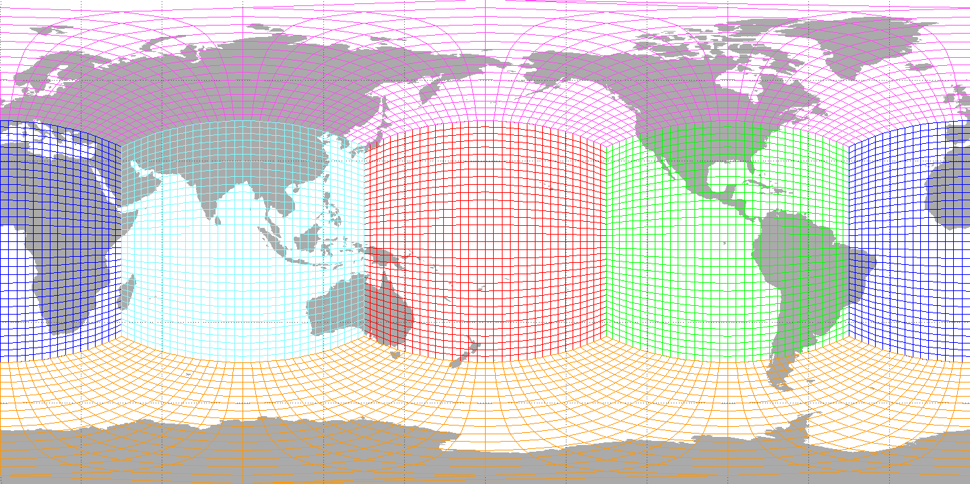
Cubed Sphere Grid and Cross Polar Flow
One consequence of using the cubed sphere for MERRA-2 is the improvement of analyzed winds over the pole. Strong winds across the pole are common during the Northern Hemisphere winter season.
Notes:
U read from MERRA-2 analysis fields

Slide 21
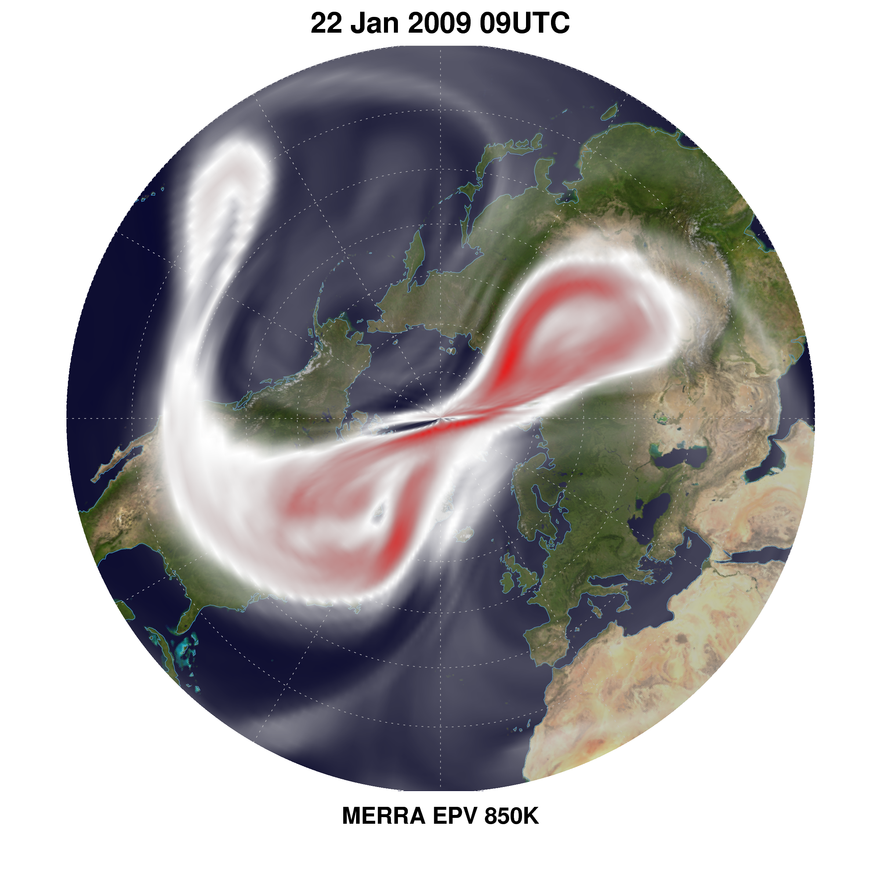
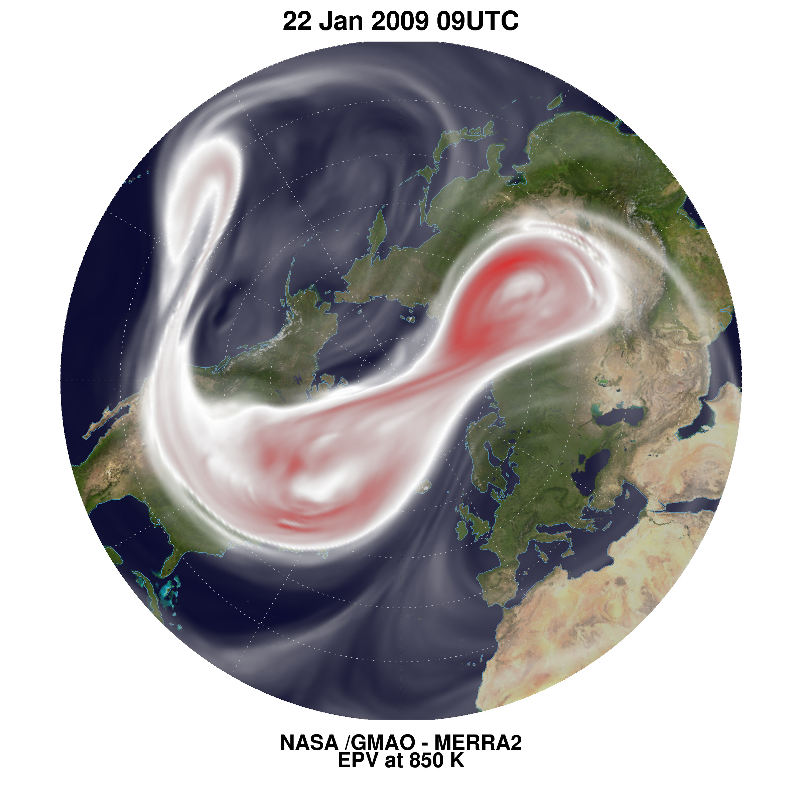
Cross Polar Flow Improvements
MERRA
MERRA-2
Polar Flow Anomalous Structure
Polar Vorticity
Mid-Stratosphere Level
Improved Vortex Edge
EPV at 850 K

Slide 22
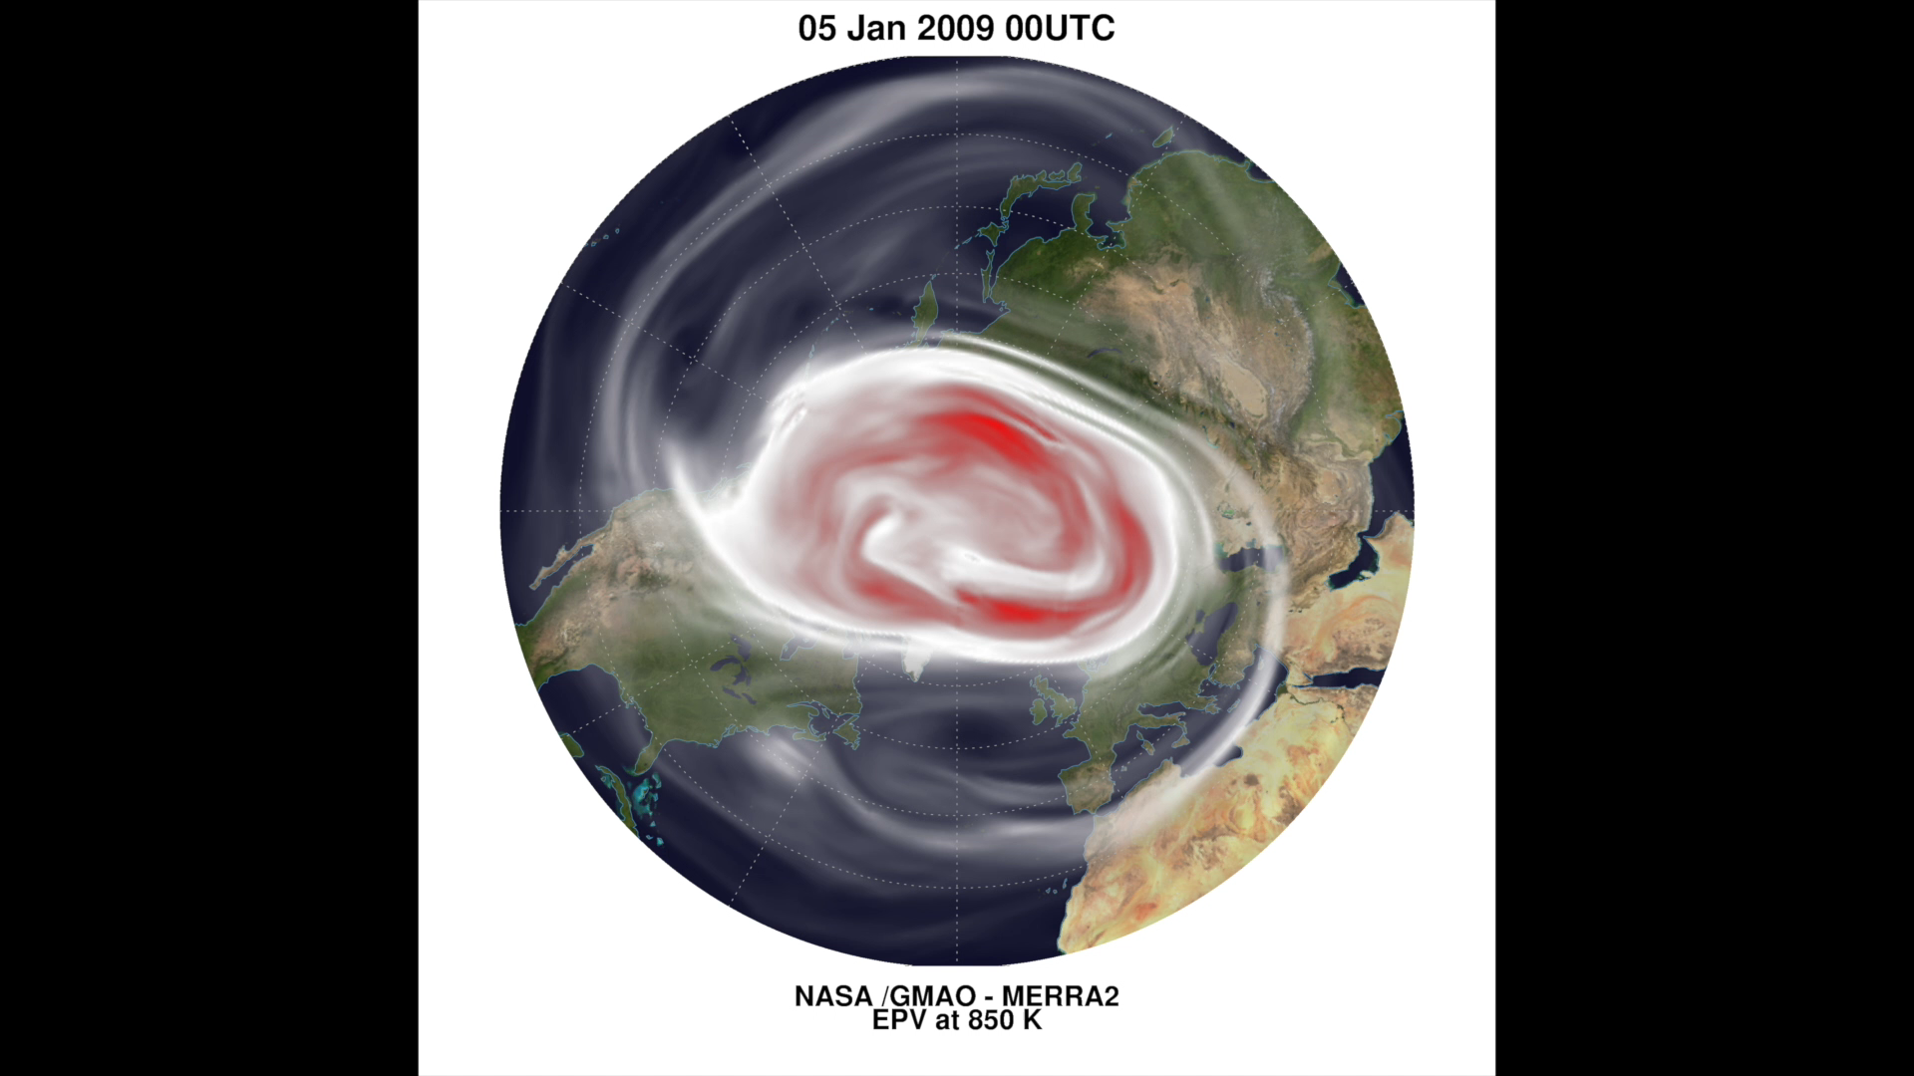
Cross Polar Flow Improvements

Slide 23
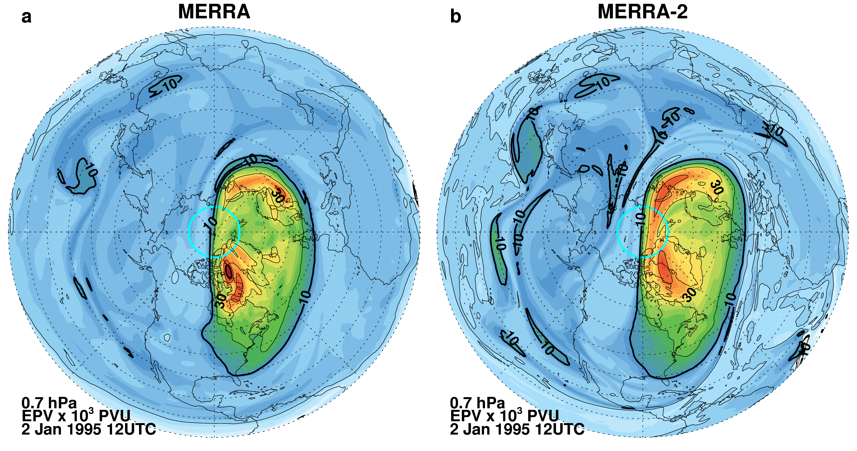
Cross Polar Flow
2 January 1995 12 UTC
0.7 hPa
Influence of the pole on EPV
Polar Wind > 170 ms⁻¹
MERRA-2 EPV has a more continuous high EPV region (red) near the pole, created by downward motion, While MERRA has two distinct high EPV regions with relatively low EPV (green) near the pole.
Notes:
Cross polar flow at 1 hPa is greater than 170 m/s.
EPV read from MERRA and MERRA-2 Diagnostic files.

Slide 24
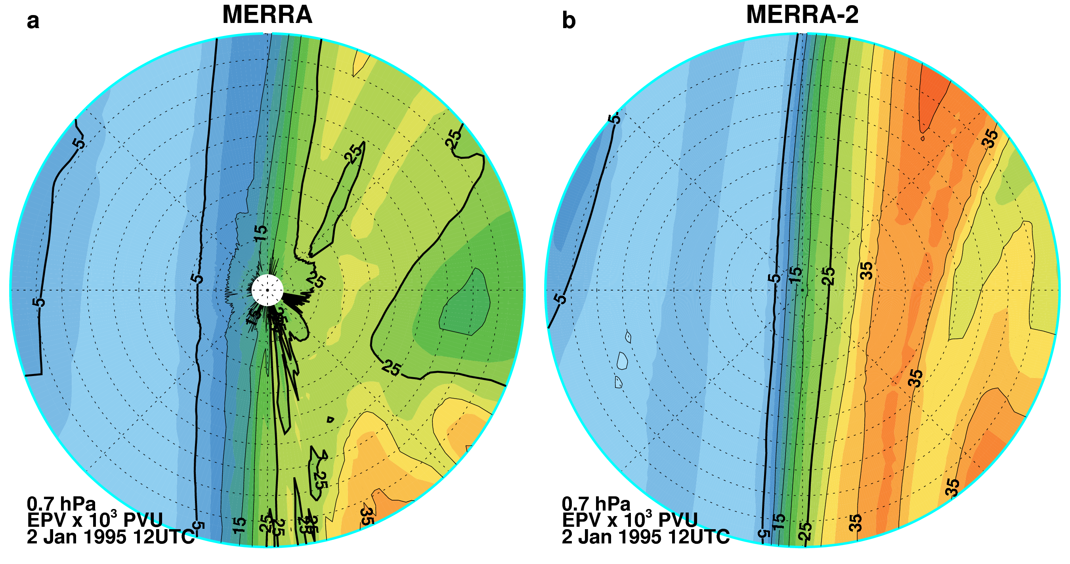
MERRA-2: Use of the cubed-sphere grid greatly improves the EPV fields near the pole.
Stratospheric researchers celebrate!
Cross Polar Flow
2 January 1995 12 UTC
0.7 hPa
Polar Wind > 170 ms⁻¹
80ºN to the NP
MERRA diagnostic EPV contains small-scale structures radiating from the pole that are not evident in MERRA-2.
Notes:
Cross polar flow at 1 hPa is greater than 170 m/s.
EPV read from MERRA and MERRA-2 Diagnostic files.

Slide 25
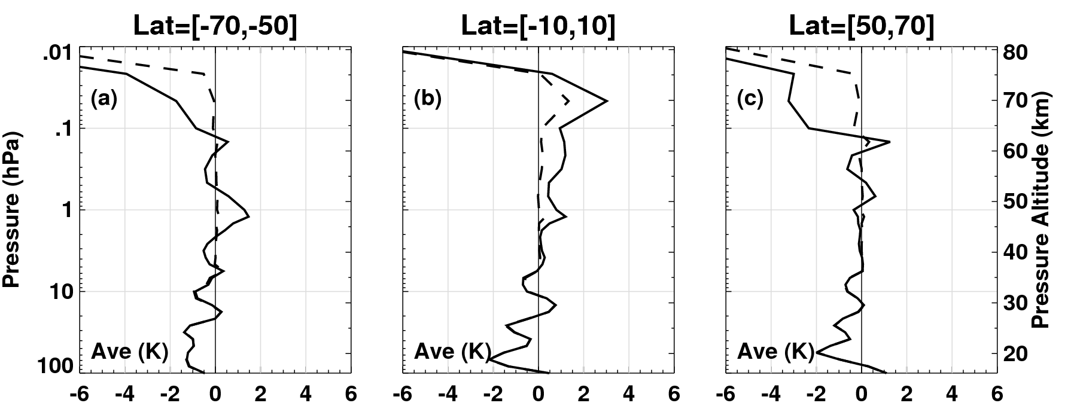
Effects of New Data Types: Aura MLS Temperature Profiles
The Aura MLS temperature profiles are being assimilated at altitudes greater than 5 hPa to improve the stratopause and lower mesosphere temperatures in MERRA-2.
The Aura MLS temperature profiles are available starting in August 2004.
Here we examine an example of stratopause/lower mesosphere dynamics during January 2010.
January 2010
Mean
O–F (Solid)
O-A (Dashed)
SH
EQ
NH
0.01
100

Slide 26
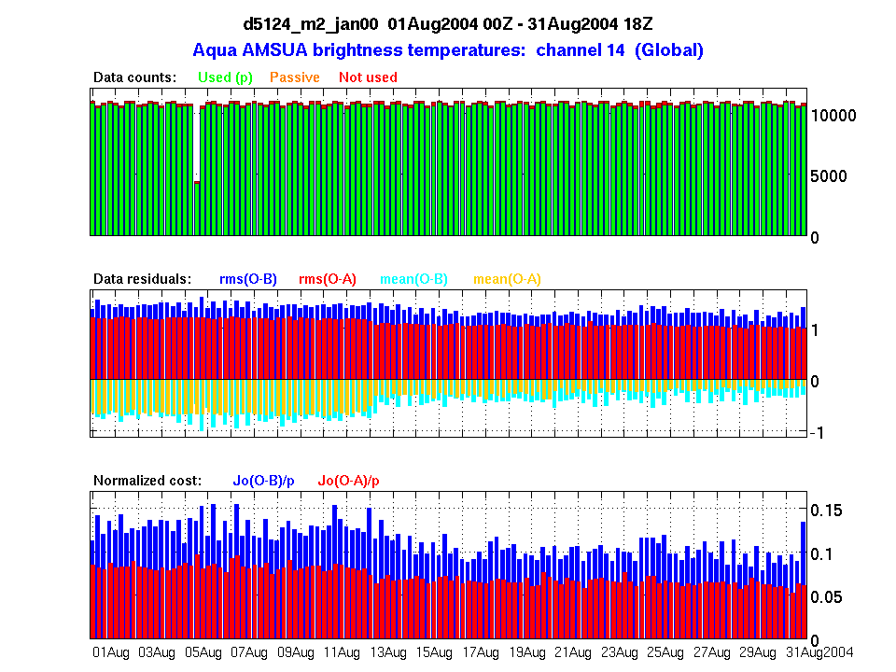
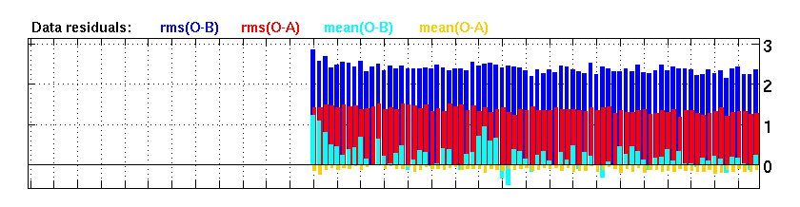
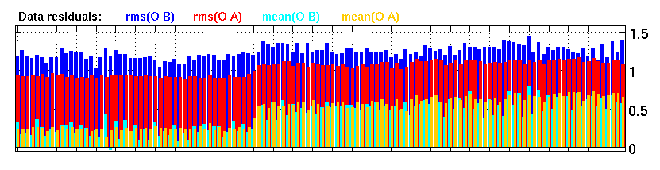
MLS Temperature at 1 hPa
Aura
MLS T (K)
Aqua
AMSUA Ch 14
NOAA-16
AMSUA Ch 14
1
13
31
August 2004
Start of MLS Data

Slide 27
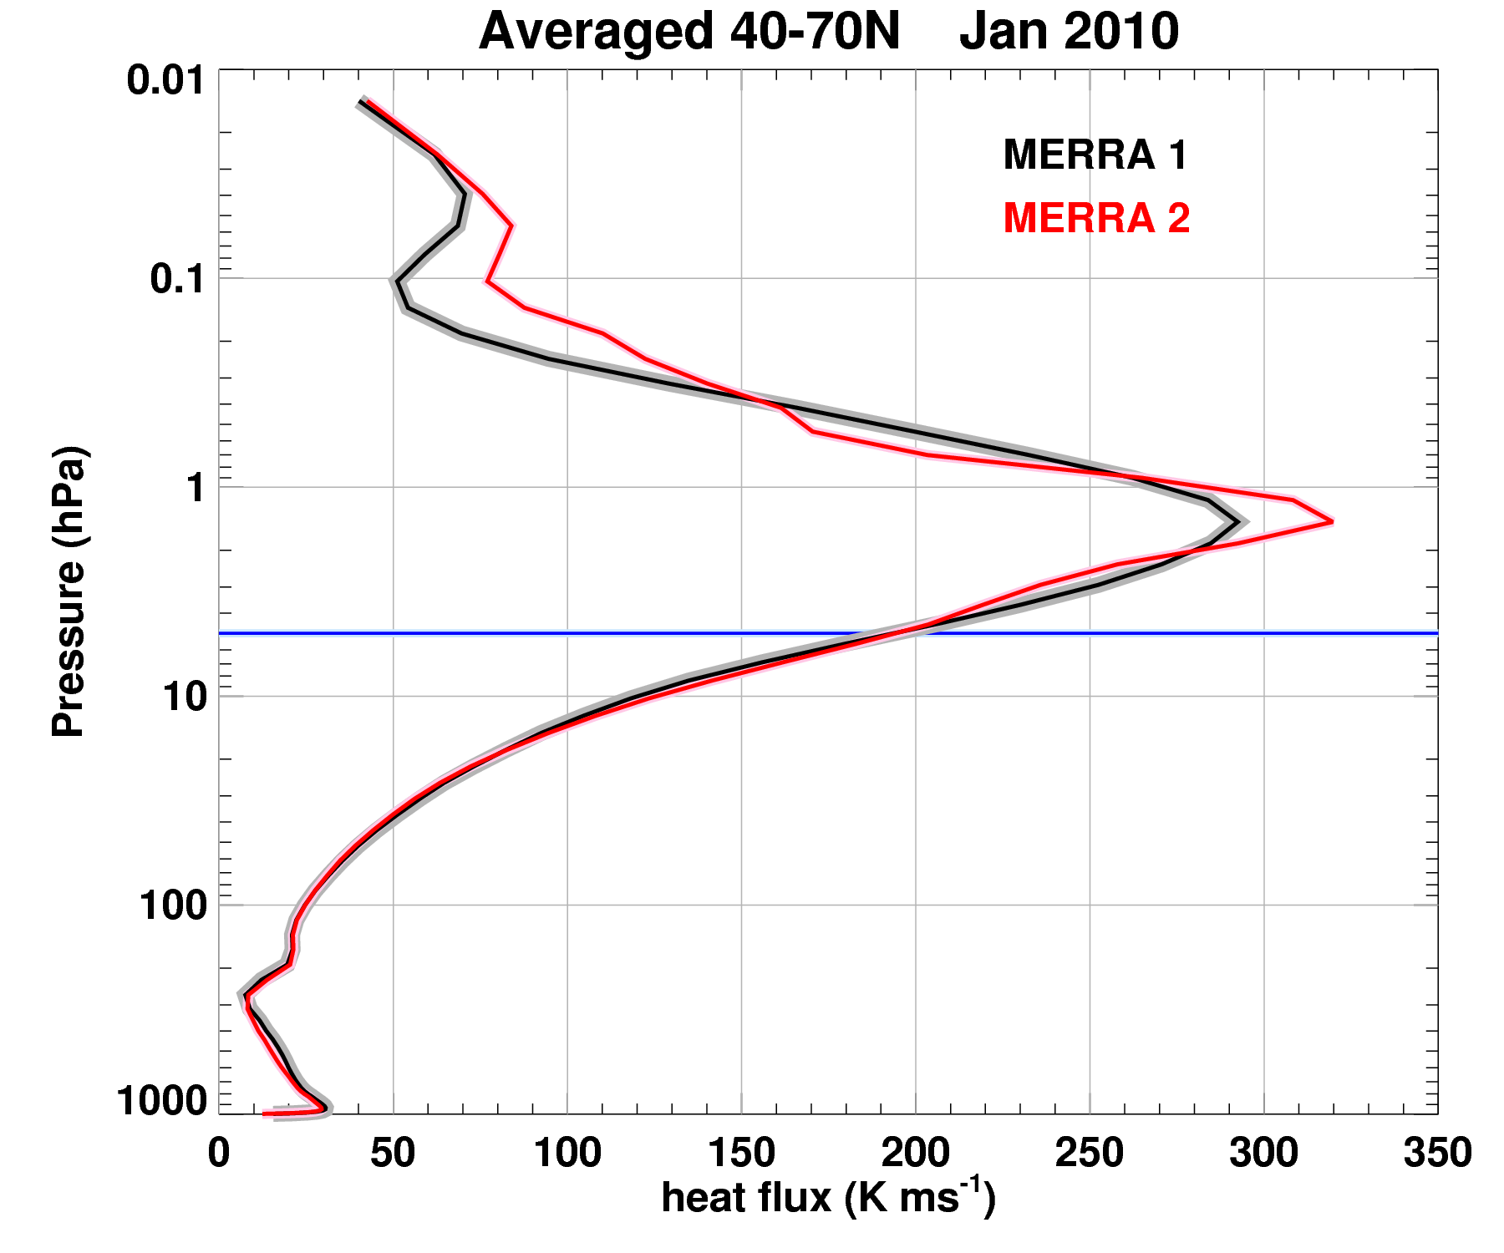
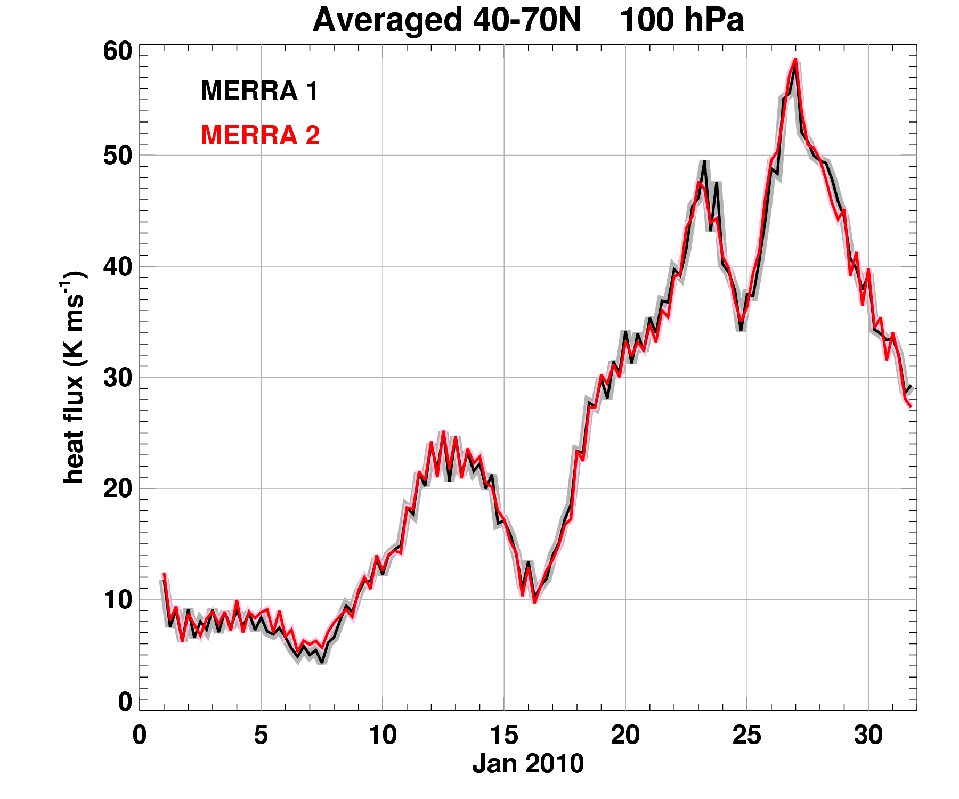
Stratospheric Dynamics
(January 2010, Major Sudden Stratospheric Warming Case)
Above 5 hPa, the addition of MLS temperatures creates significant MERRA and MERRA-2 differences.
At 100 hPa MERRA and MERRA-2 both show similar heat fluxes.
40-70ºN Jan 2010
40-70ºN 100 hPa
0.01
60
Heat Flux (K ms⁻¹)
Pressure (hPa)
5 hPa
0
1000
1
31
0
350
January 2010
Heat Flux (K ms⁻¹)
Note: Newman and Nash (JGR, 2000) compared 5 analyses and found meridional heat flux differences up to 15% during disturbed conditions. Since the meridional heat flux is proportional to the vertical EP (wave activity) flux it represents an important measure of stratospheric dynamics.

Slide 28
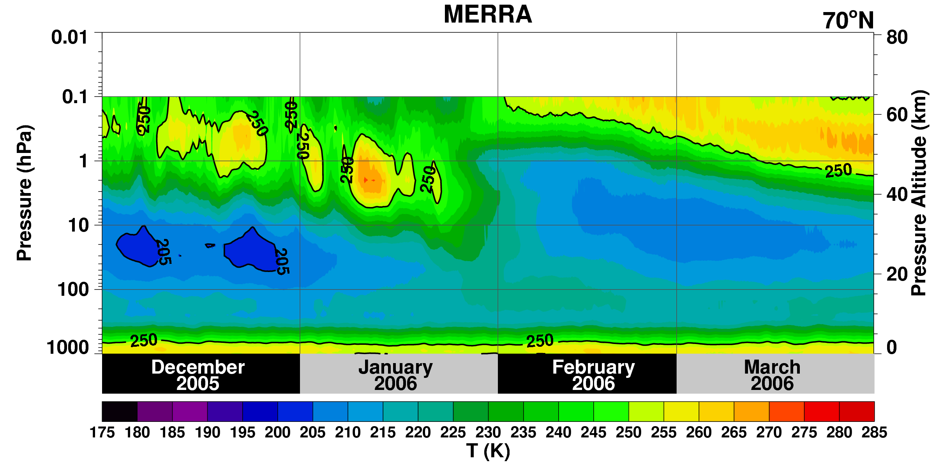
MERRA Zonally Average Temperature at 70ºN
NH Winter of 2005-2006
Major Stratospheric Sudden Warming of January 2006
Polar stratopause should descend, vanish, and reform at high altitudes

Slide 29
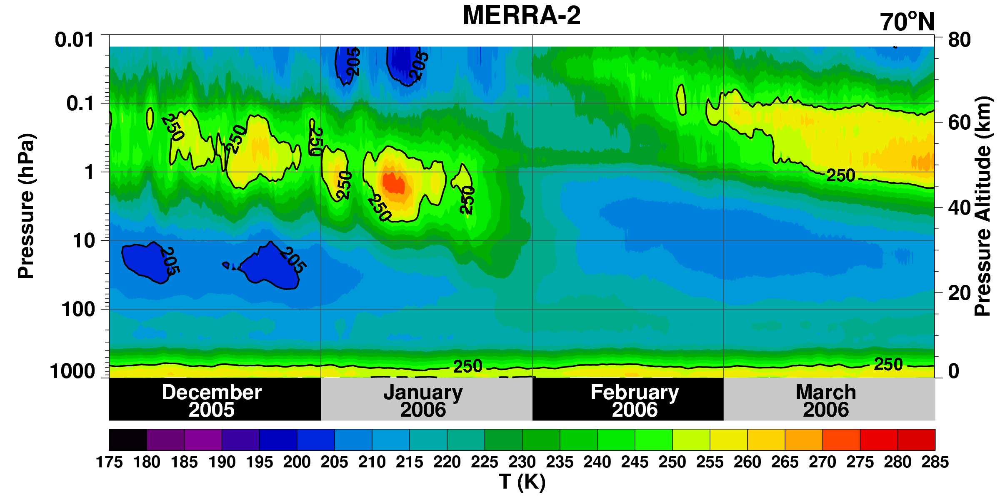
MERRA-2 Zonally Average Temperature at 70ºN
NH Winter of 2005-2006
Major Stratospheric Sudden Warming of January 2006
Polar stratopause descends, vanishes, and reforms at high altitudes
Addition of MLS temperature profiles improves these dynamics

Slide 30
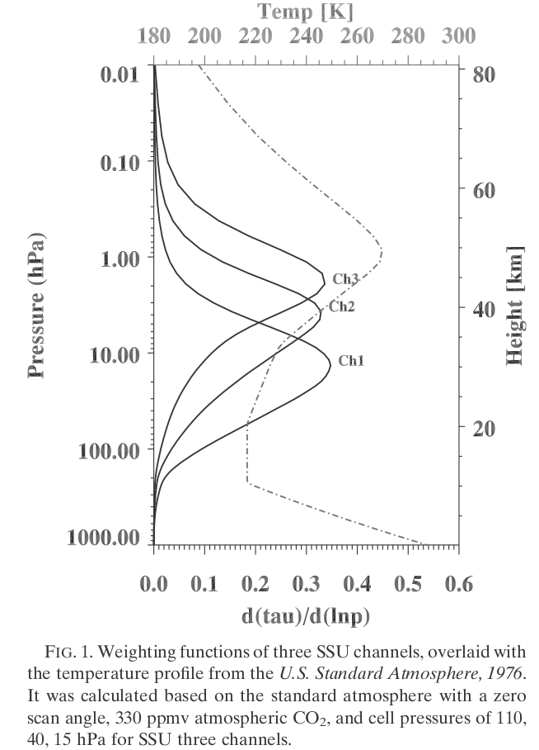
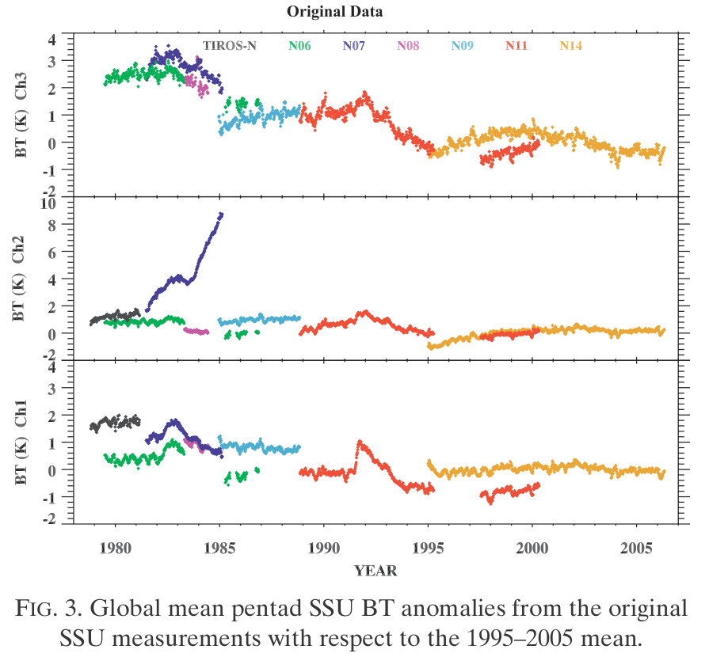
SSU Assimilation
SSU Channels 1, 2, and 3
MERRA: Forward radiances: GLA-TOVS
MERRA-2: Forward radiances: CRTM
CH 3
CH 2
CH 3
CH 2
CH 1
CH 1
1979
2006
From Wang et al., 2012, J. Climate

Slide 31
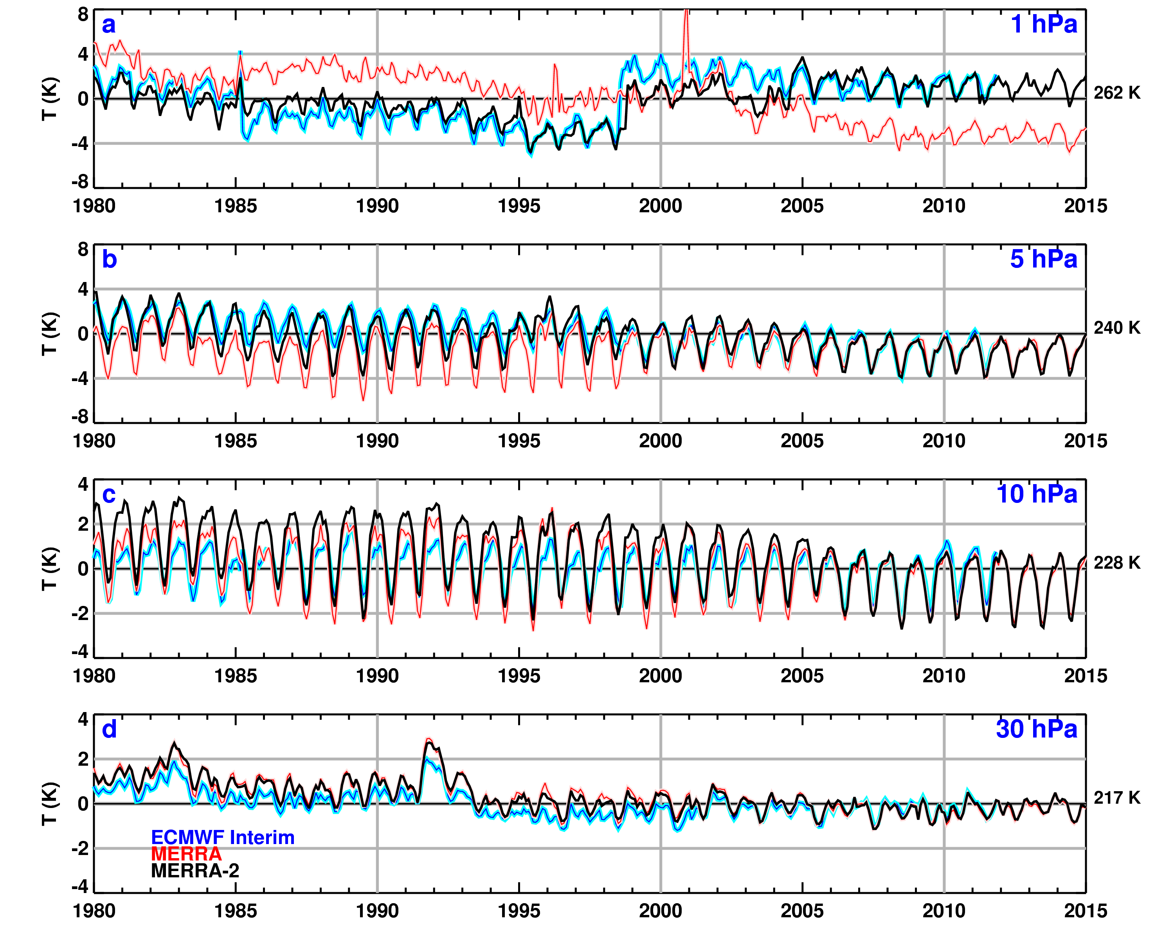
Global Averaged Temperature
Improved stability in the early TOVS years
Smaller annual cycle in the TOVS era
Overall good agreement in the ATOVS ERA
Volcanic heating visible at 30 hPa
MLS does no harm!

Slide 32
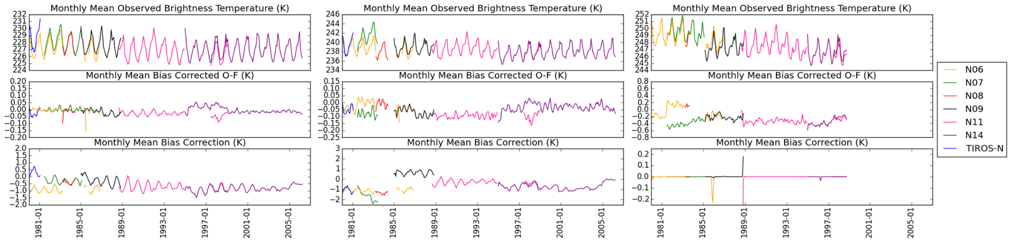
SSU
Channel 1

Slide 33
SSU
Channel 2

Slide 34
SSU
Channel 3
The highest peaking band (Channel 3) from the SSU was assimilated without bias correction.

Slide 35
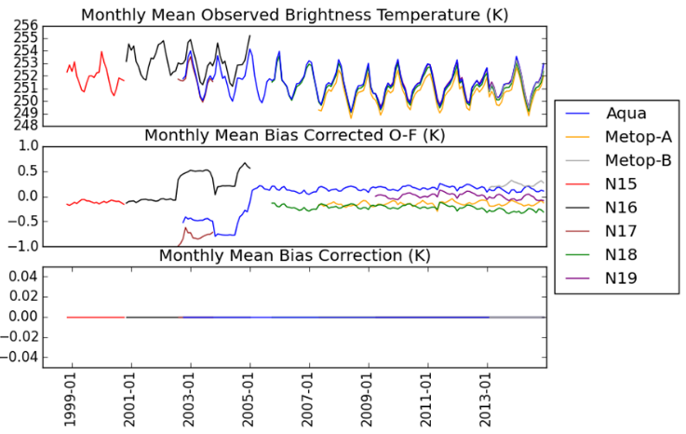
AMSU-A
Channel 14

Slide 36
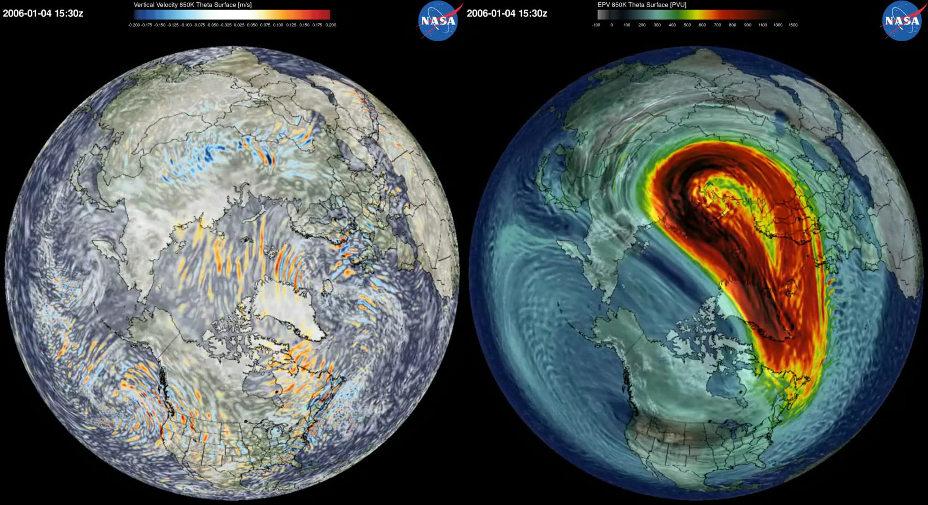
New MERRA-2 Based Experiment (not released)
MERRA-2 Replay (non hydrostatic)
12 km horizontal resolution (1/8 degree gridded files)
1999 12 – 2011 06 (as of 6 Oct 2015, ongoing)
Vertical Velocity
850 K
EPV
Excellent for GW Studies
January 2006

Slide 37
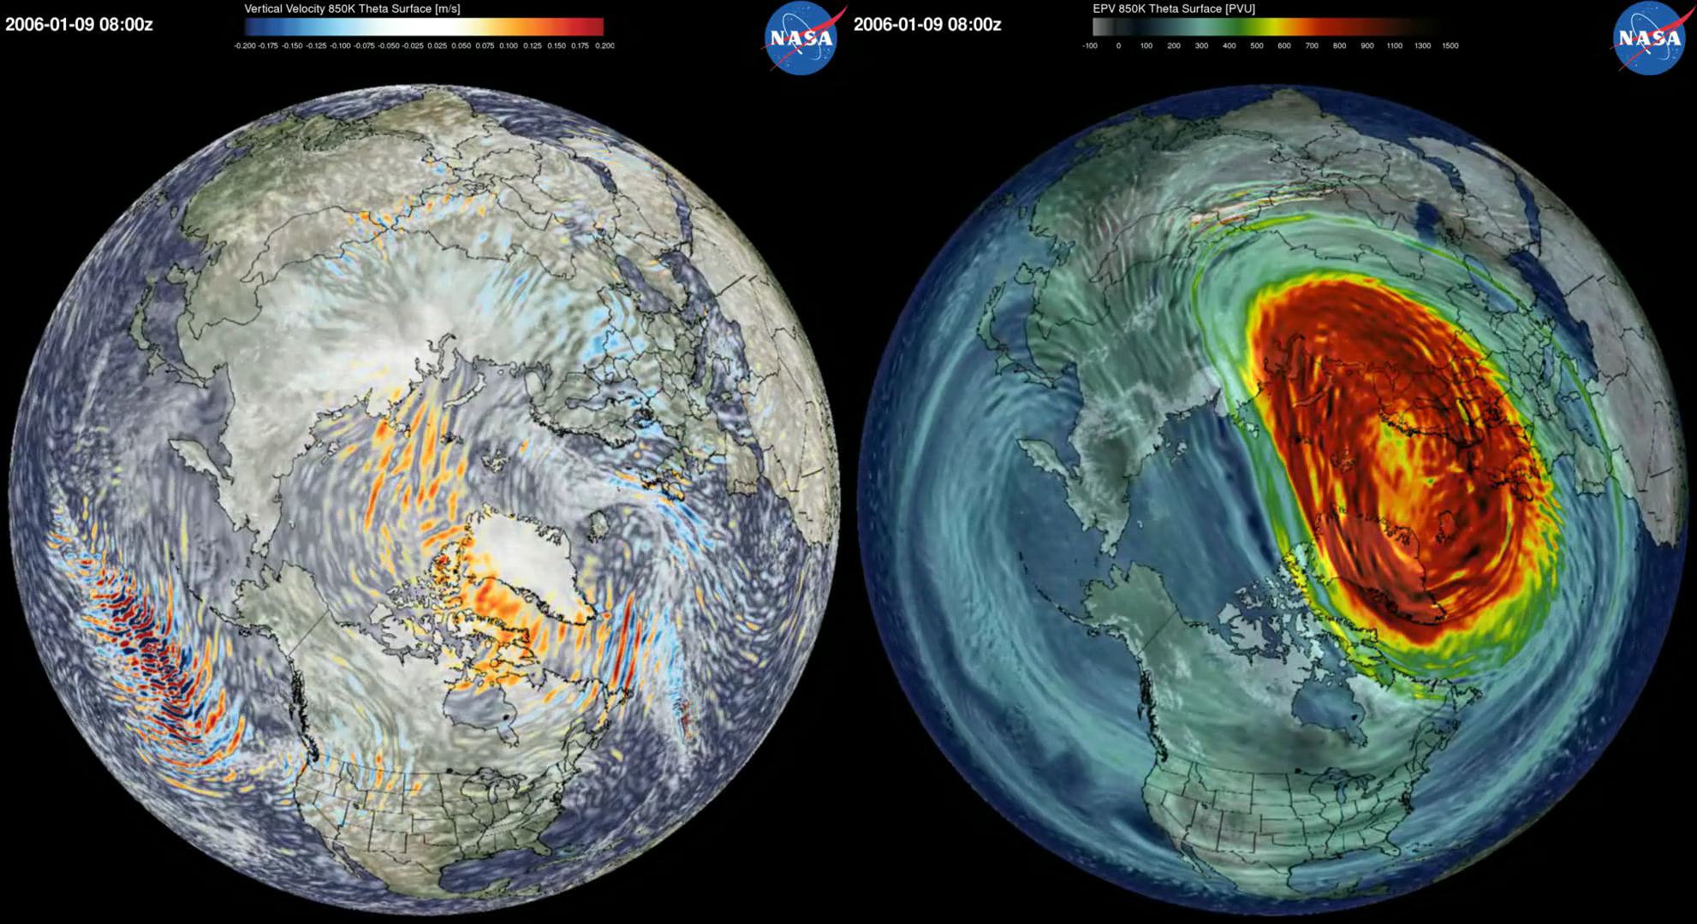
New MERRA-2 Based Experiment (not released)
MERRA-2 Replay (non hydrostatic)
12 km horizontal resolution (1/8 degree gridded files)
1999 12 – 2011 06 (as of 6 Oct 2015, ongoing)
Vertical Velocity
850 K
EPV
Excellent for GW Studies
January 2006

Slide 38
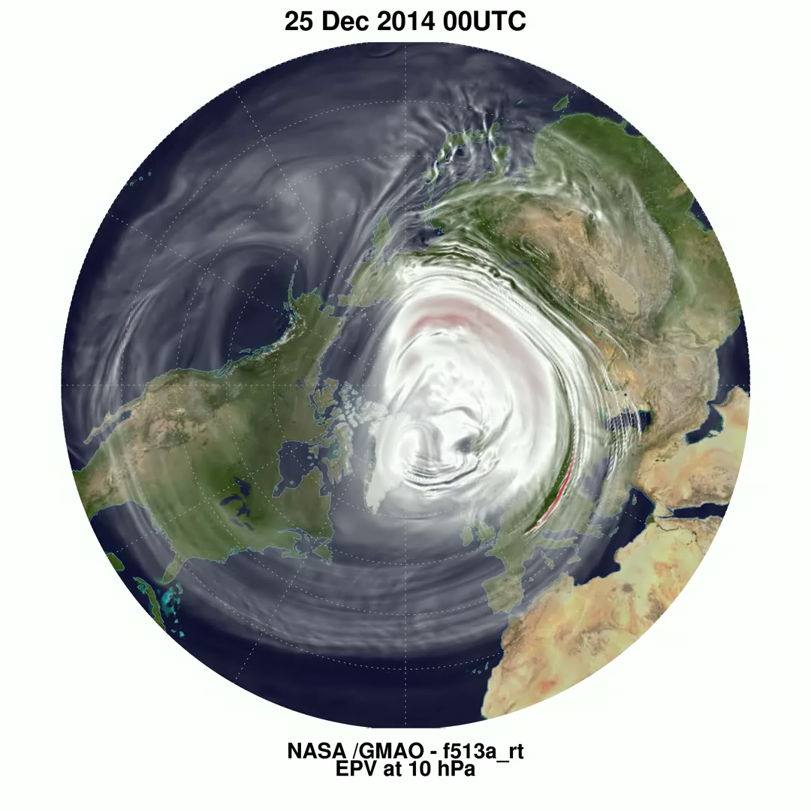
Future Directions
Minor Warming of January 2015
COMING SOON: 137 Levels Currently under development.
Near-real-time system development.
12 km horizontal resolution.

Slide 39
MERRA-2 Stratosphere Summary
MERRA-2 enables the continuation of the successful MERRA system with recent observations incorporated along with model updates.
Specific Middle Atmosphere Benefits Include:
Improved ozone (latest SBUV/2 Version 8.6, MLS+OMI, no periods with missing SBUV/2 data)
Potential improvements in lower stratosphere tropical circulations including the QBO.
Improved representation of cross polar flow.
Improved upper stratosphere and lower mesosphere temperatures (MLS, after August 2004).
New CRTM-based SSU assimilation significantly impacts stratospheric temperatures, particularly in the 1980s and early 1990s.

