Slide 1
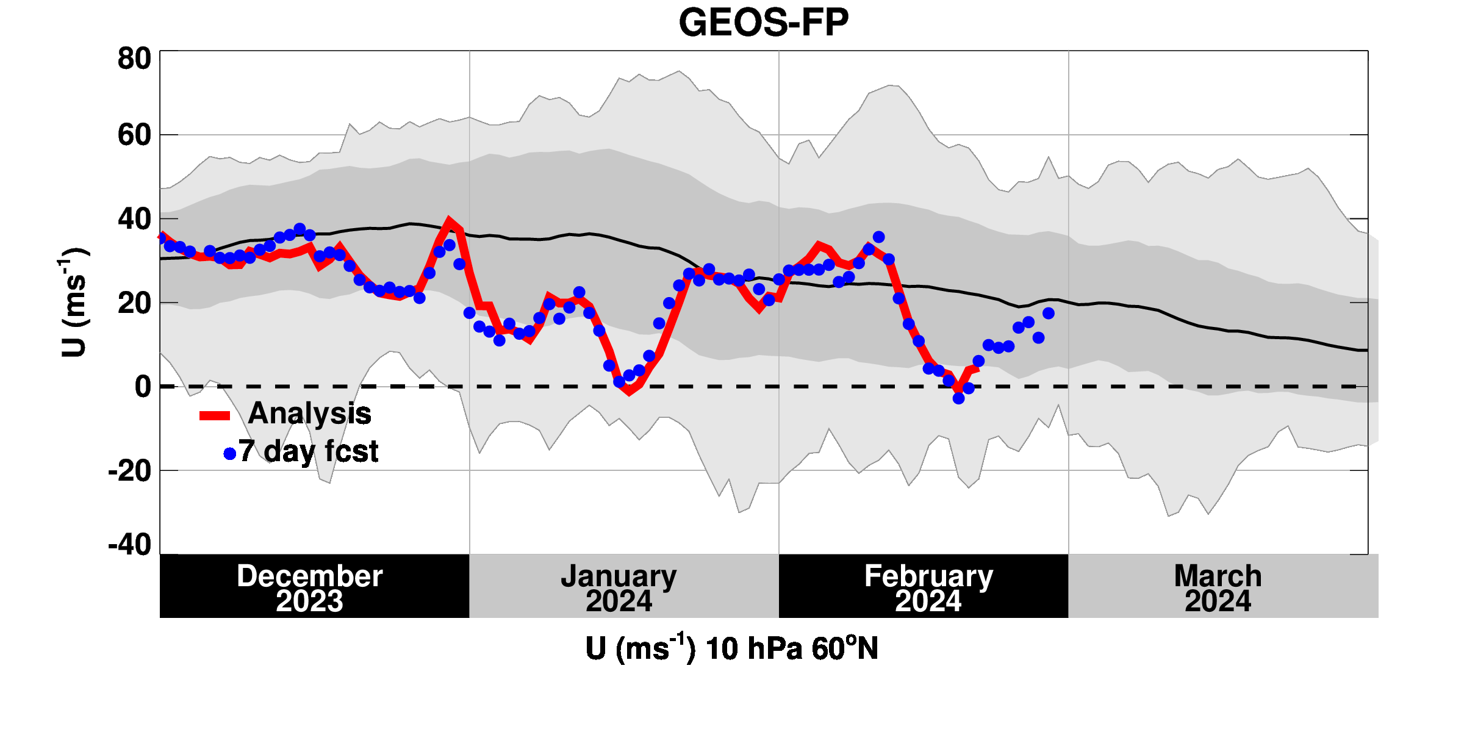
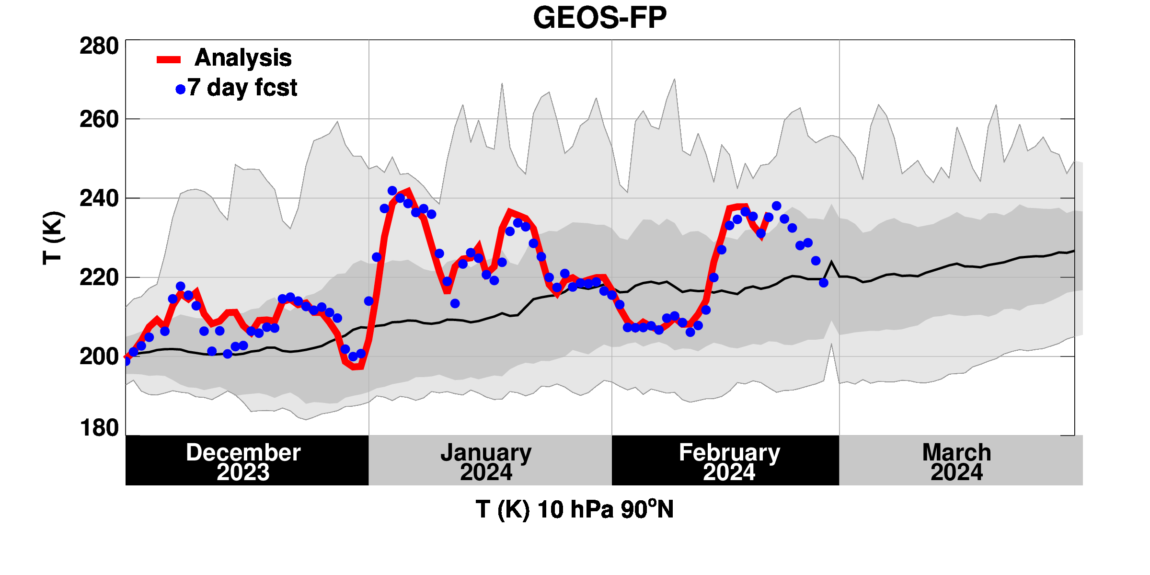
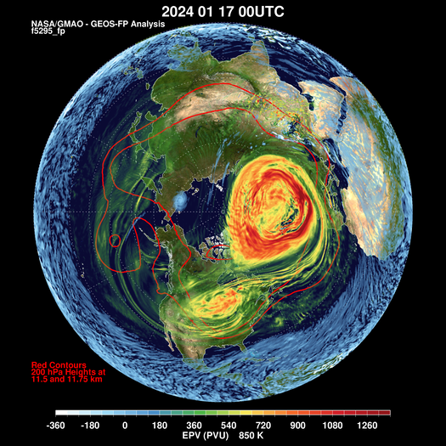
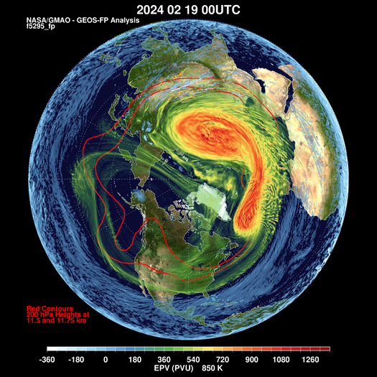
Two Major Stratospheric Warmings (?)
The NH winter of 2023-2024 has had two Major Stratospheric Sudden Warming (SSW) Events
How “major” are these events?
MERRA-2 Climatology
Mean: Black
Standard Deviation: Dark Gray
Records: Light Gray
Zonal mean, zonal wind (m/s)
10 hPa, 60ºN
Below average winds
Winds < 0
Warmings
Temperature (K)
10 hPa, 90ºN
Minor?
Above average temperatures
17
19

Slide 2
Warming Comparison
17 January 2024
19 February 2024
Vortex is off the pole but remains coherent in both warmings.
The two warmings vary in longitude.

Slide 3
Warming Comparison
17 January 2024
19 February 2024
Vortex is off the pole but remains coherent in both warmings.
The two warmings vary in longitude.

Slide 4
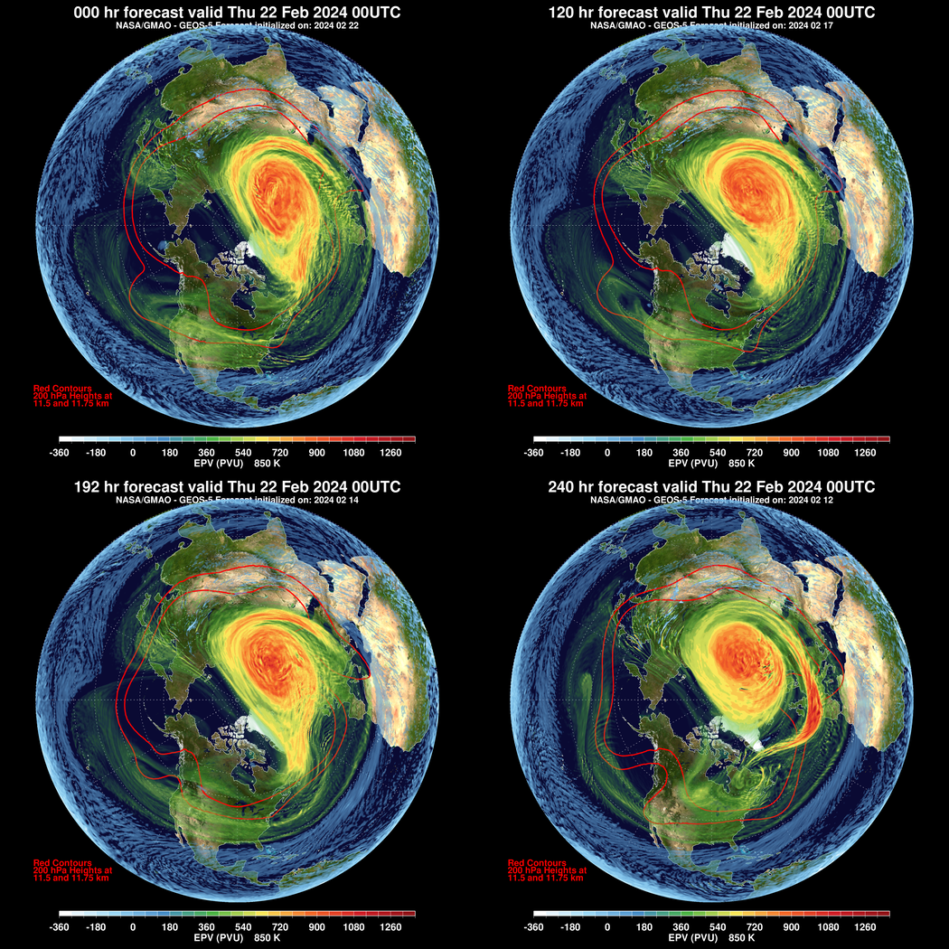
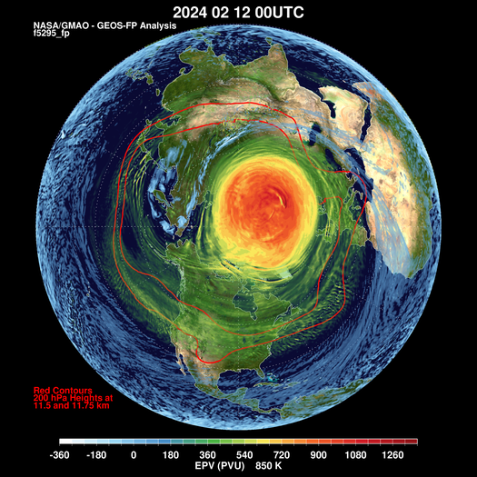
What’s Happening Now?
Forecast Validation for 22 February 2024
Analysis
5-Day Forecast
Good Forecast for this time, even out to 10-days.
12 February 2024 Analysis
10-Day Forecast
8-Day Forecast

Slide 5
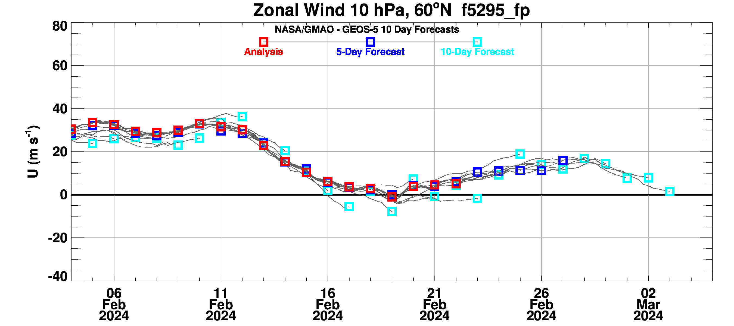
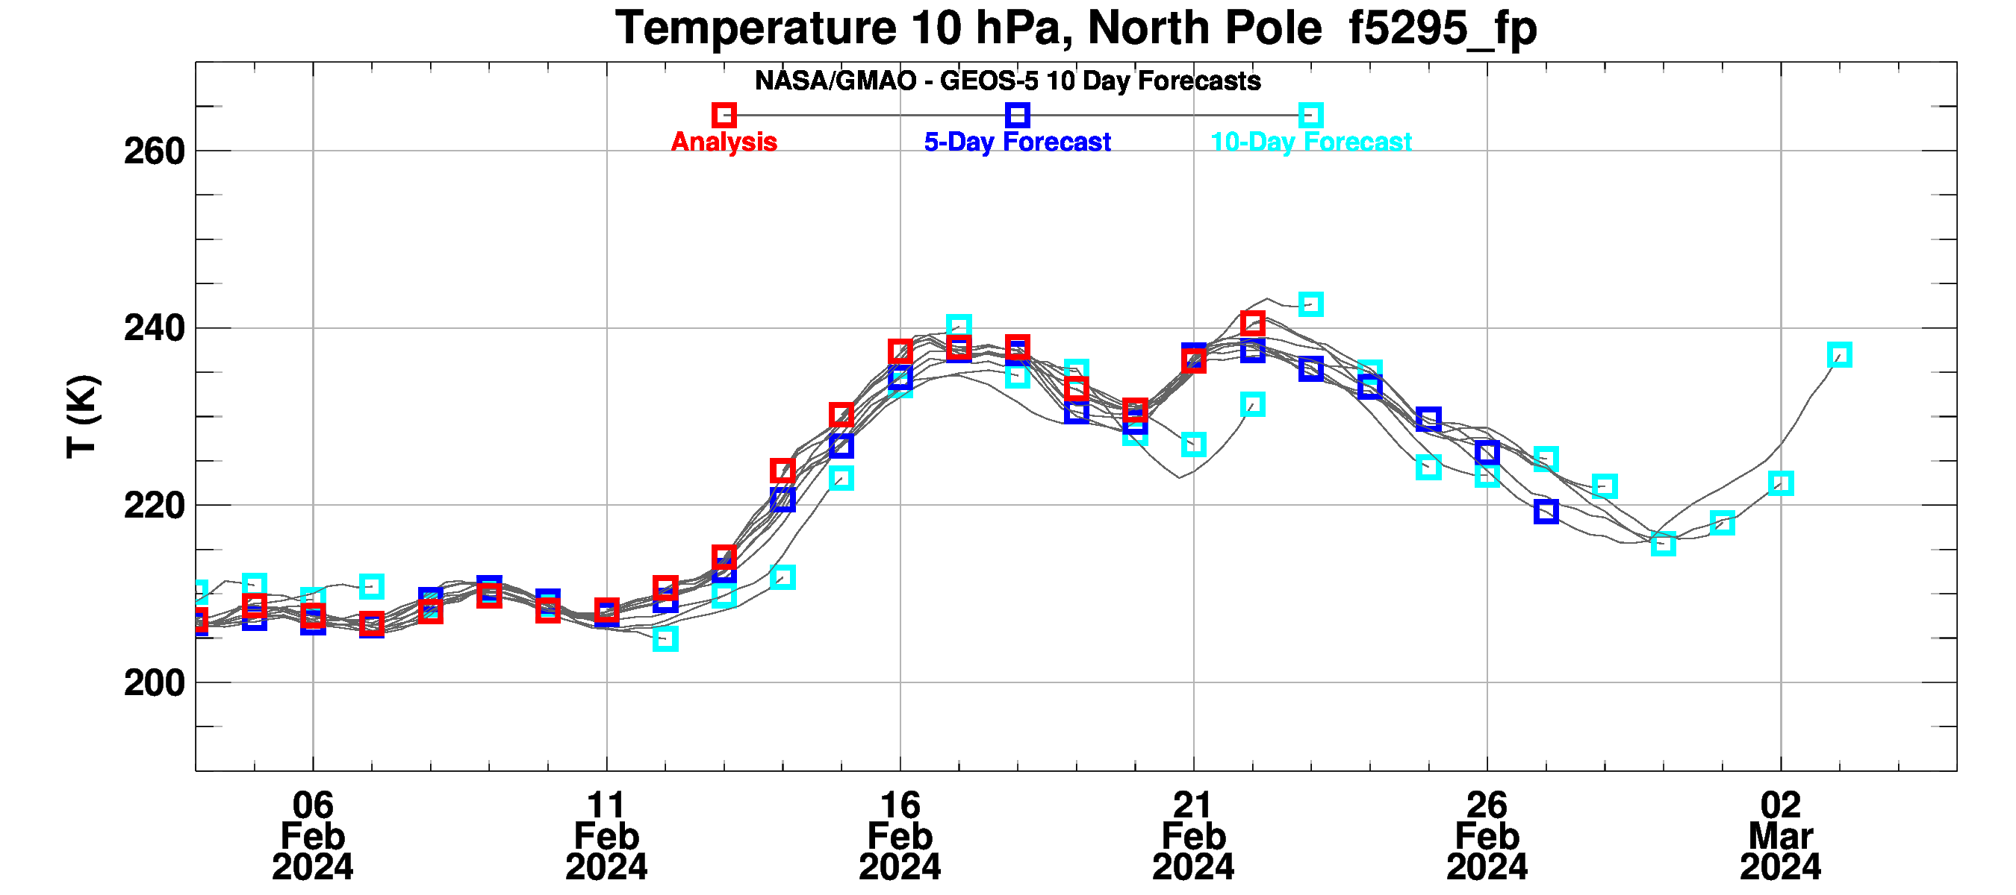
The Future: A Third SSW?
Wind < 0 ?
Temperature Increasing
However, some folks say that there must be a 20-day interval to count as separate SSW events!
https://gmao.gsfc.nasa.gov/gmaoftp/larrycoy/strat_fcst/epv_850_fcst.mp4

