Slide 1
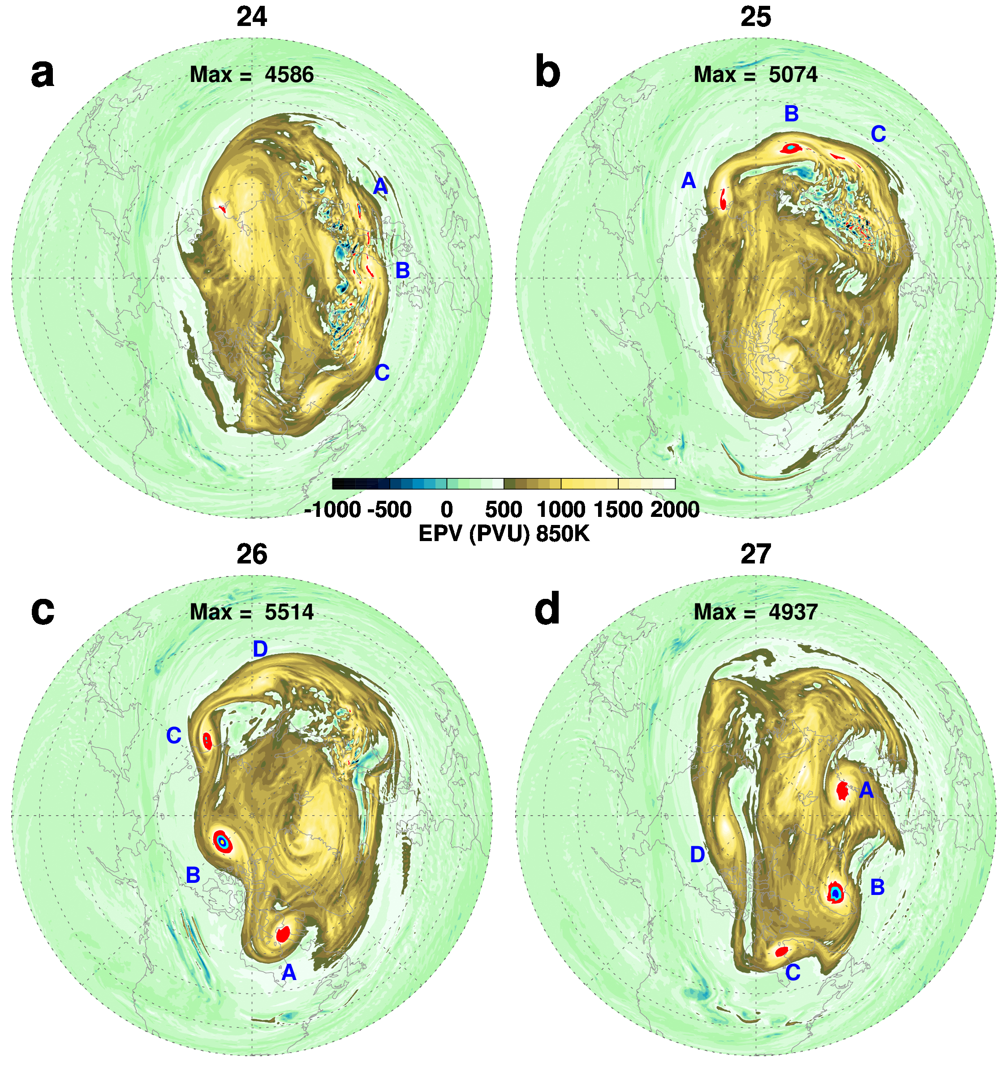
Ertel’s potential vorticity on the 850 K potential temperature surface
f5271_fp
Jan
Jan
Breaking GW Region
Propagation of “mini-vortices” January 2022
Vortex Edge (~500 PVU)
During January 2022, the middle stratosphere (~10 hPa) was disturbed by breaking gravity waves that in turn created an unstable flow, generating strong (very high PV) mini-vortices along the edge of the stratospheric polar vortex.
3000 4000 5000
Jan
Jan
Max EPV Value
How real are these mini-vortices and breaking gravity wave signatures and the extremely high EPV values associated with them?
Examine other GMAO systems, such as X0048…
Mini-Vortex

Slide 2
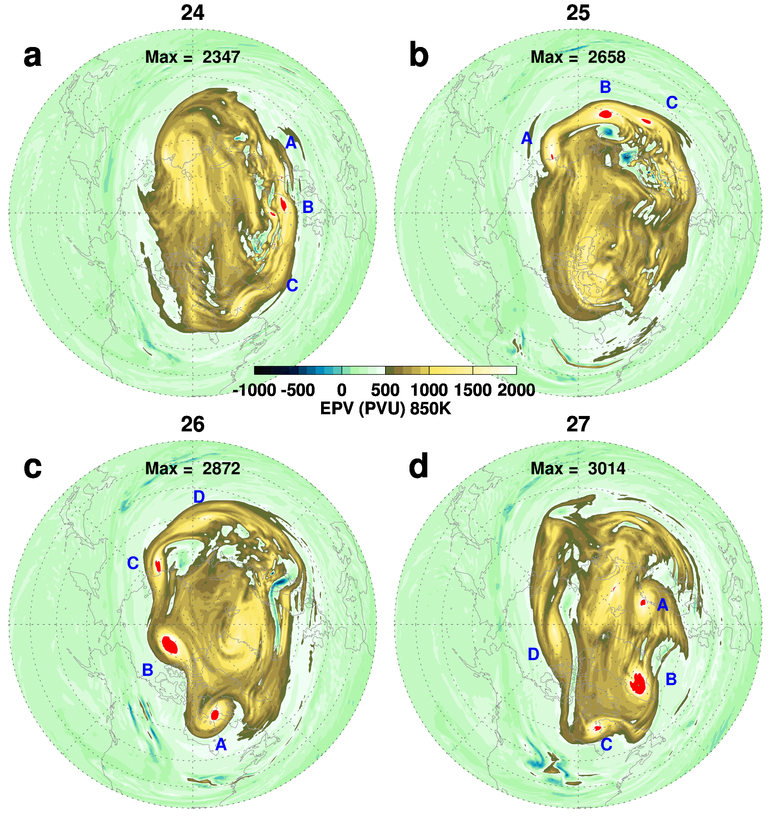
Ertel’s potential vorticity on the 850 K potential temperature surface
X0048
Jan
Jan
Propagation of “mini-vortices” January 2022
Huzzah! X0048 also shows the mini-vortices.
The maximum EPV values are smaller than the FP values, however this is consistent with the lower horizontal resolution in X0048.
And, there are still signs of very small scale EPV values in the breaking region.
Once again consistent with the lower horizontal resolution in X0048.
3000 4000 5000
Jan
Jan
Do the mini-vortices persist at lower horizontal resolution…?

Slide 3
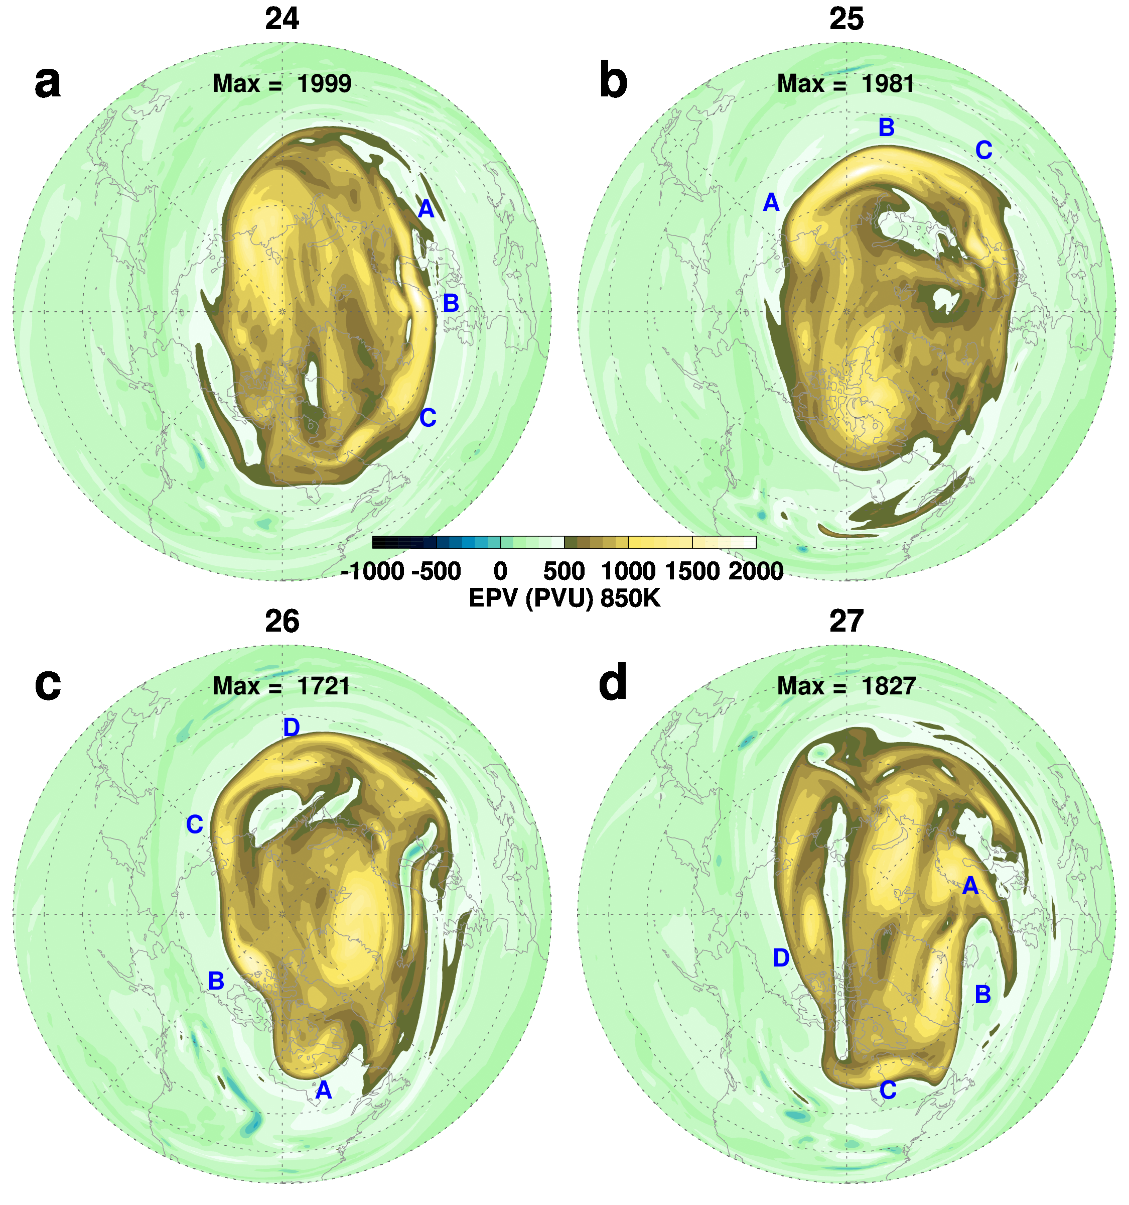
Ertel’s potential vorticity on the 850 K potential temperature surface
MERRA-2
Jan
Jan
Propagation of “mini-vortices” January 2022
Well, at this resolution the large values of EPV are gone, however the signature of the mini-vortices remains.
Note that the breaking GW signature is gone.
While not as dynamic looking as at higher resolution, the presence of these muted mini-vortex features is consistent with the more detailed representation seen at higher resolution.
We may even be able to use MERRA-2 to develop a climatology of these mini-vortices.
Conclusion: The mini-vortices are real---go ahead and publish results!
3000 4000 5000
Jan
Jan

Slide 4
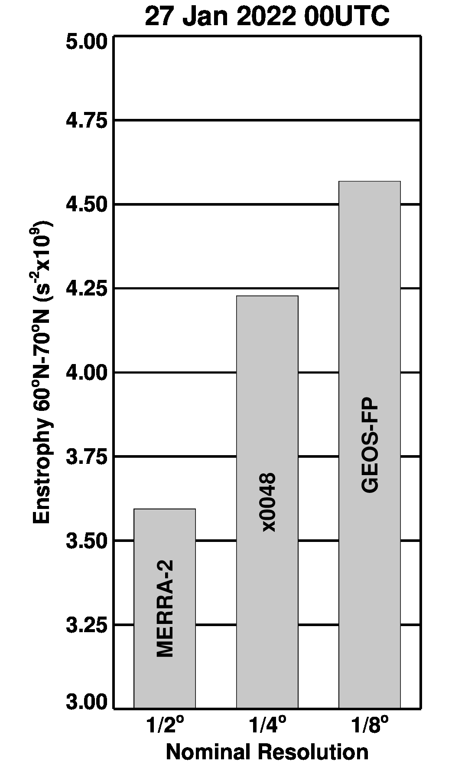
Increasing Resolution
Enstrophy increases with increasing resolution, however, the increase from x0048 is smaller suggesting that the mesoscale features are converging.

