Slide 1
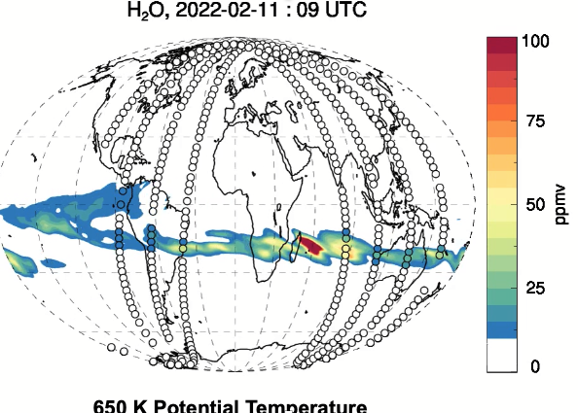
Stratospheric Circulation Changes Associated with the Hunga Tonga-Hunga Ha’apai Eruption
Lawrence Coy
Paul A. Newman
Gary Partyka
Susan E. Strahan
Krzysztof Wargan
Steven Pawson
NASA Goddard Space Flight Center
Earth Sciences
11 Feb 2022
Location: 20ºS 175ºW
Eruption Date: 15 January 2022
M2-SCREAM: MERRA-2 Stratospheric Composition Reanalysis of Aura Microwave Limb Sounder
MERRA-2: Modern-Era Retrospective analysis for Research and Applications, Version 2
Notes:
Hello, I’m Larry Coy and my talk today is Stratospheric Circulation Changes Associated the Hunga Tonga-Hunga Ha’apai Eruption. My co-authors are Paul Newman, Gary Partyka, Susan Strahan, Kris Wargan, and Steven Pawson. We’re all from the NASA Goddard Space Flight Center. The Tonga volcano of January 2022 injected a huge amount of water vapor into the stratosphere, increasing the total stratospheric water vapor by about 10 per cent. Since water vapor is a strong IR emitter, stratospheric cooling is expected along with changes in the stratospheric circulation.

Slide 2
Stratospheric Circulation Changes Associated with the Hunga Tonga-Hunga Ha’apai Eruption
Outline:
The data going into MERRA-2 can capture the effects of the Tonga water vapor, even though MERRA-2 physics does not include the water vapor perturbation
Evaluation of the changes in the MERRA-2 winds, temperatures, and circulations associated with the Tonga water vapor perturbation
11 Feb 2022
Location: 20ºS 175ºW
Eruption Date: 15 January 2022
M2-SCREAM: MERRA-2 Stratospheric Composition Reanalysis of Aura Microwave Limb Sounder
MERRA-2: Modern-Era Retrospective analysis for Research and Applications, Version 2
Notes:
Today I’ll show how the data going into MERRA-2 can capture the effects of the Tonga water vapor anomaly, even though the MERRA-2 physics doesn’t include the water vapor perturbation. I’ll then present some of the changes in the lower stratospheric circulation created by the Tonga water vapor anomaly. Most of these results come from the MERRA-2 data assimilation system. The MERRA-2 years from 1980 through 2021 provide a baseline climatology for evaluation of the 2022 changes

Slide 3
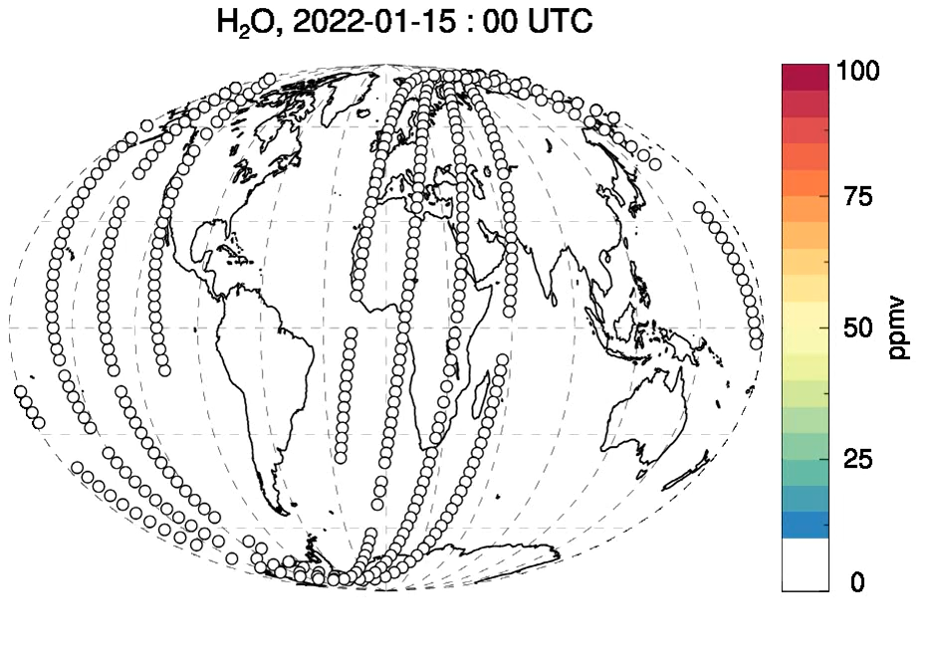
Water vapor from eruption spreads around the globe
Special M2-SCREAM assimilates the MLS water vapor measurements.
K. Wargan, 2022
Location: 20ºS 175ºW
Eruption Date: 15 January 2022
Note: Standard GMAO assimilation products do not assimilation middle atmosphere water vapor.
650 K Potential Temperature Surface ~26 km
Notes:
I want to start today with an animation from the M2-SCREAM system created by Kris Wargan that shows the spread of the volcanic water in the lower stratosphere starting from January 15th 2022, the date of the main Tonga eruption. M2-SCREAM assimilates the MLS water vapor measurements shown in the circles. This is a great illustration of how data assimilation can change orbital observations into global fields. Note that it takes some time for the observations to begin capture the water vapor from the eruption. The rapid longitudinal spread of the water vapor perturbation seen here justifies the examination of zonally averaged circulation changes. Most of the water anomaly was close to 26 km or about 20 hPa, so the following figures will focus on that level.

Slide 4
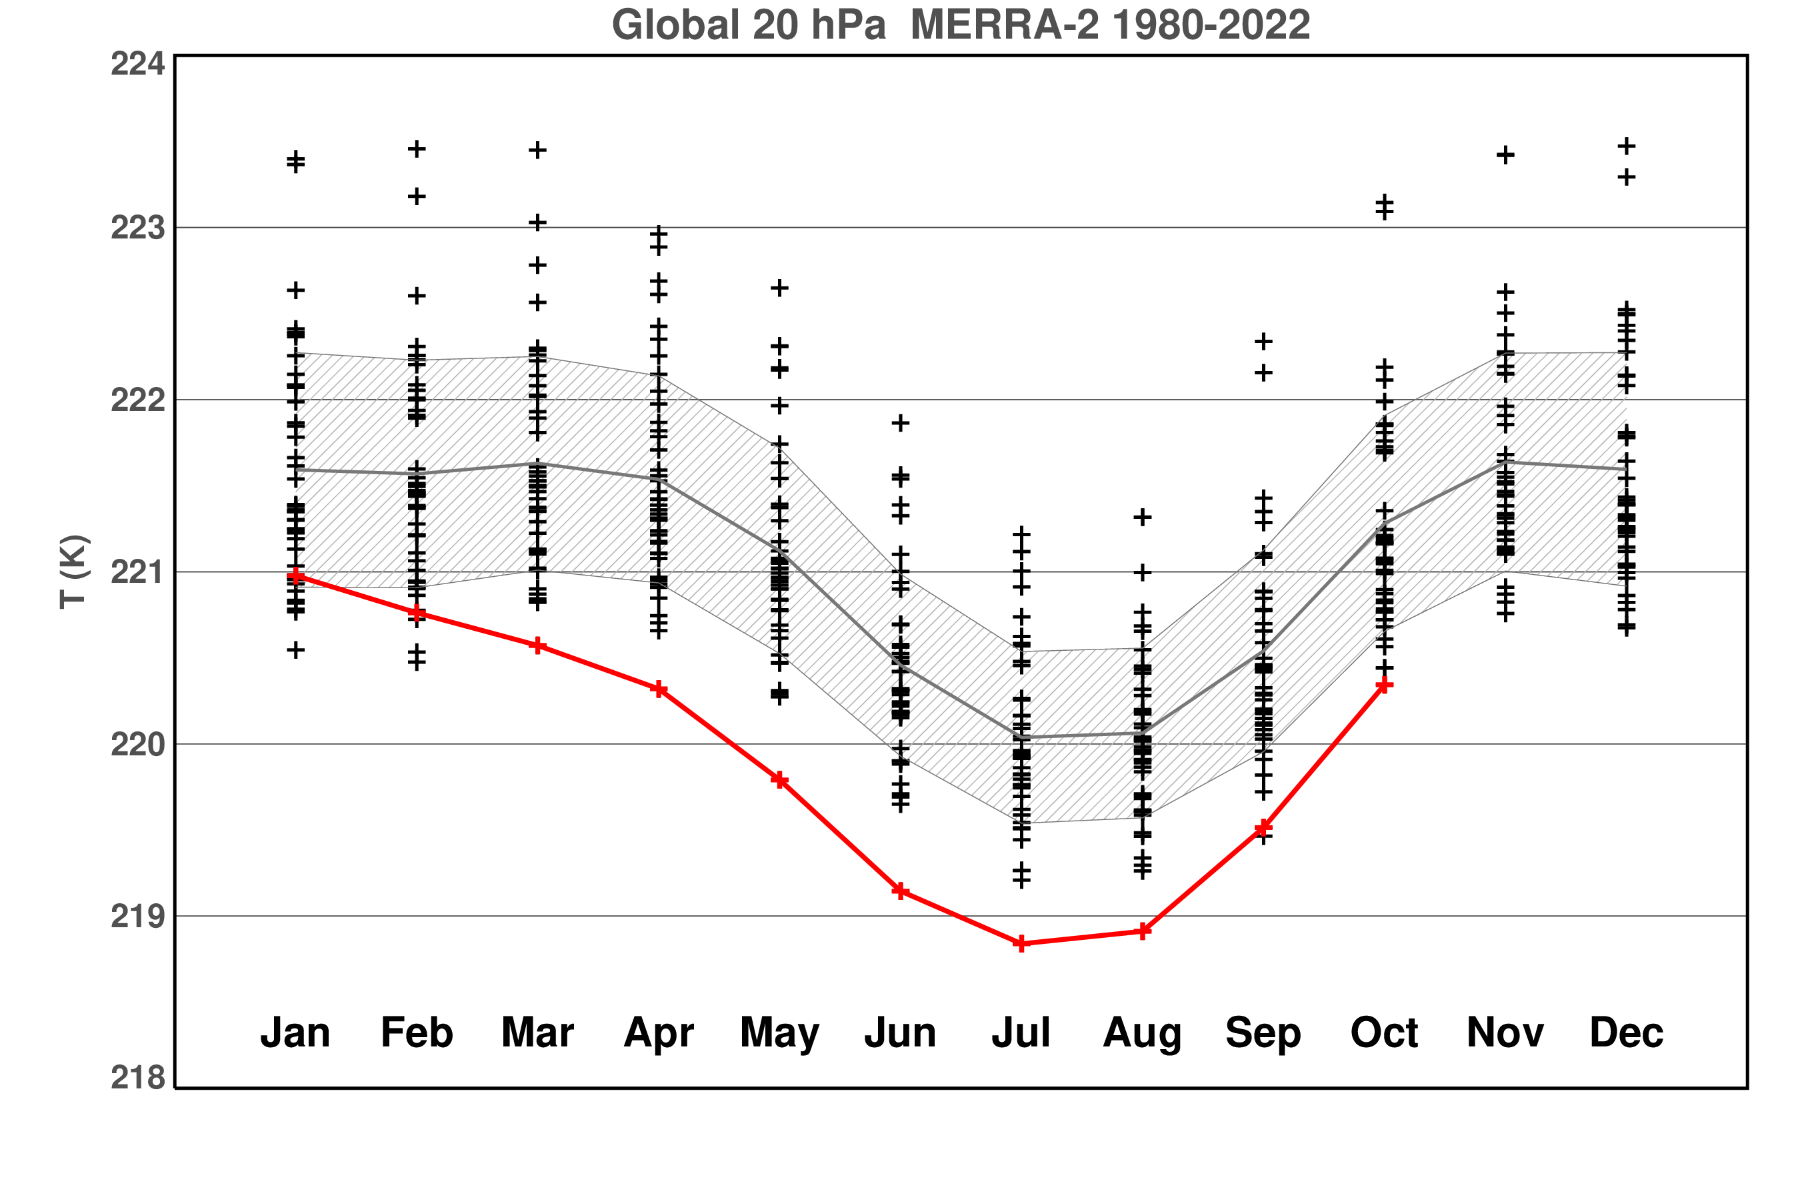
MERRA-2: unusually low global temperatures at 20 hPa
Global Mean Temperature
20 hPa (~27 km)
MERRA-2
Monthly Averaged
42 Years: 1980-2021
2022 global temperatures at 20 hPa were much lower than in past years
1 K
2022
Notes:
The excess water vapor is expected to radiatively cool to space, and indeed, comparing the monthly averaged 2022 global temperatures to past years shows much lower temperatures in 2022. The black plus symbols denote values for the years 1980 to 2021 while the red curve denotes 2022. MERRA-2 assimilates temperature observations that capture this ususual cooling even though the water vapor anomaly is not included.

Slide 5
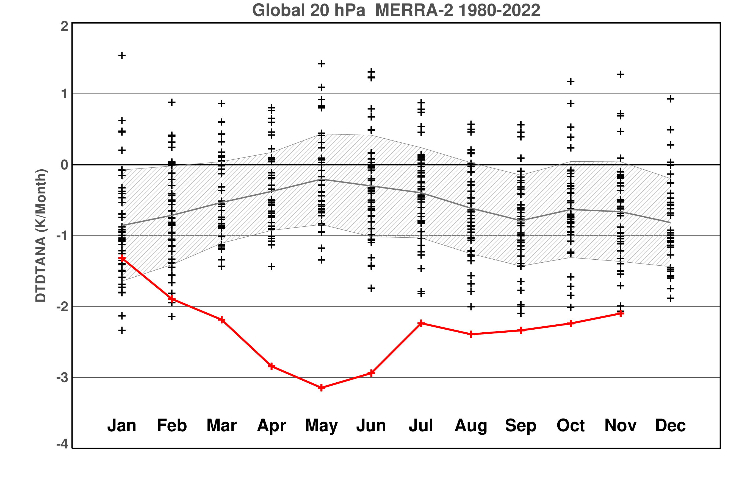
Missing water vapor cooling in 2022 created extreme temperature increments at 20 hPa
2
42 Years: 1980-2021
Global Mean Temperature Increments
20 hPa (~27 km)
MERRA-2
Monthly Averaged
1
0
T Increments (K/month)
-1
-2
1 K/month
-3
2022
-4
Notes:
The MERRA-2 system uses the observations to generate temperature tendency fields, also called temperature increments. The gray, average, curve shows that at 20 hPa the MERRA-2 model has a global bias that warms at about ¾ K per month compared to the observations, so the increments act to cool slightly on average to match the observations. There is a fair amount of interannual variability as well. In 2022 however, the globally averaged increments fell to about -3 K/month in April through June, much lower than in any of the past years and remained at record low values for July through November. The results that follow focus mainly on June and October.

Slide 6
Data analysis generated tendencies can capture missing radiative effects
Thermodynamic Equation
Horizonal and vertical advection
DT/dt | = | Dynamics Tendency
 | + | Radiative Tendency
 | + | Data Analysis Tendency
Corrected Radiative Tendency
Also known as increments
Notes:
How to interpret these temperature increments? Typically, the data analysis tendency corrects both the dynamical and radiative tendencies, however with the extremely large increments in 2022 and the knowledge of the volcanic water perturbation, we can ascribe most of the increments as being a correction to the radiative tendency. That is, the temperature increments provide the missing radiative cooling. This give confidence that the stratospheric residual mean circulation perturbations will also reflect the water perturbation correctly.

Slide 7
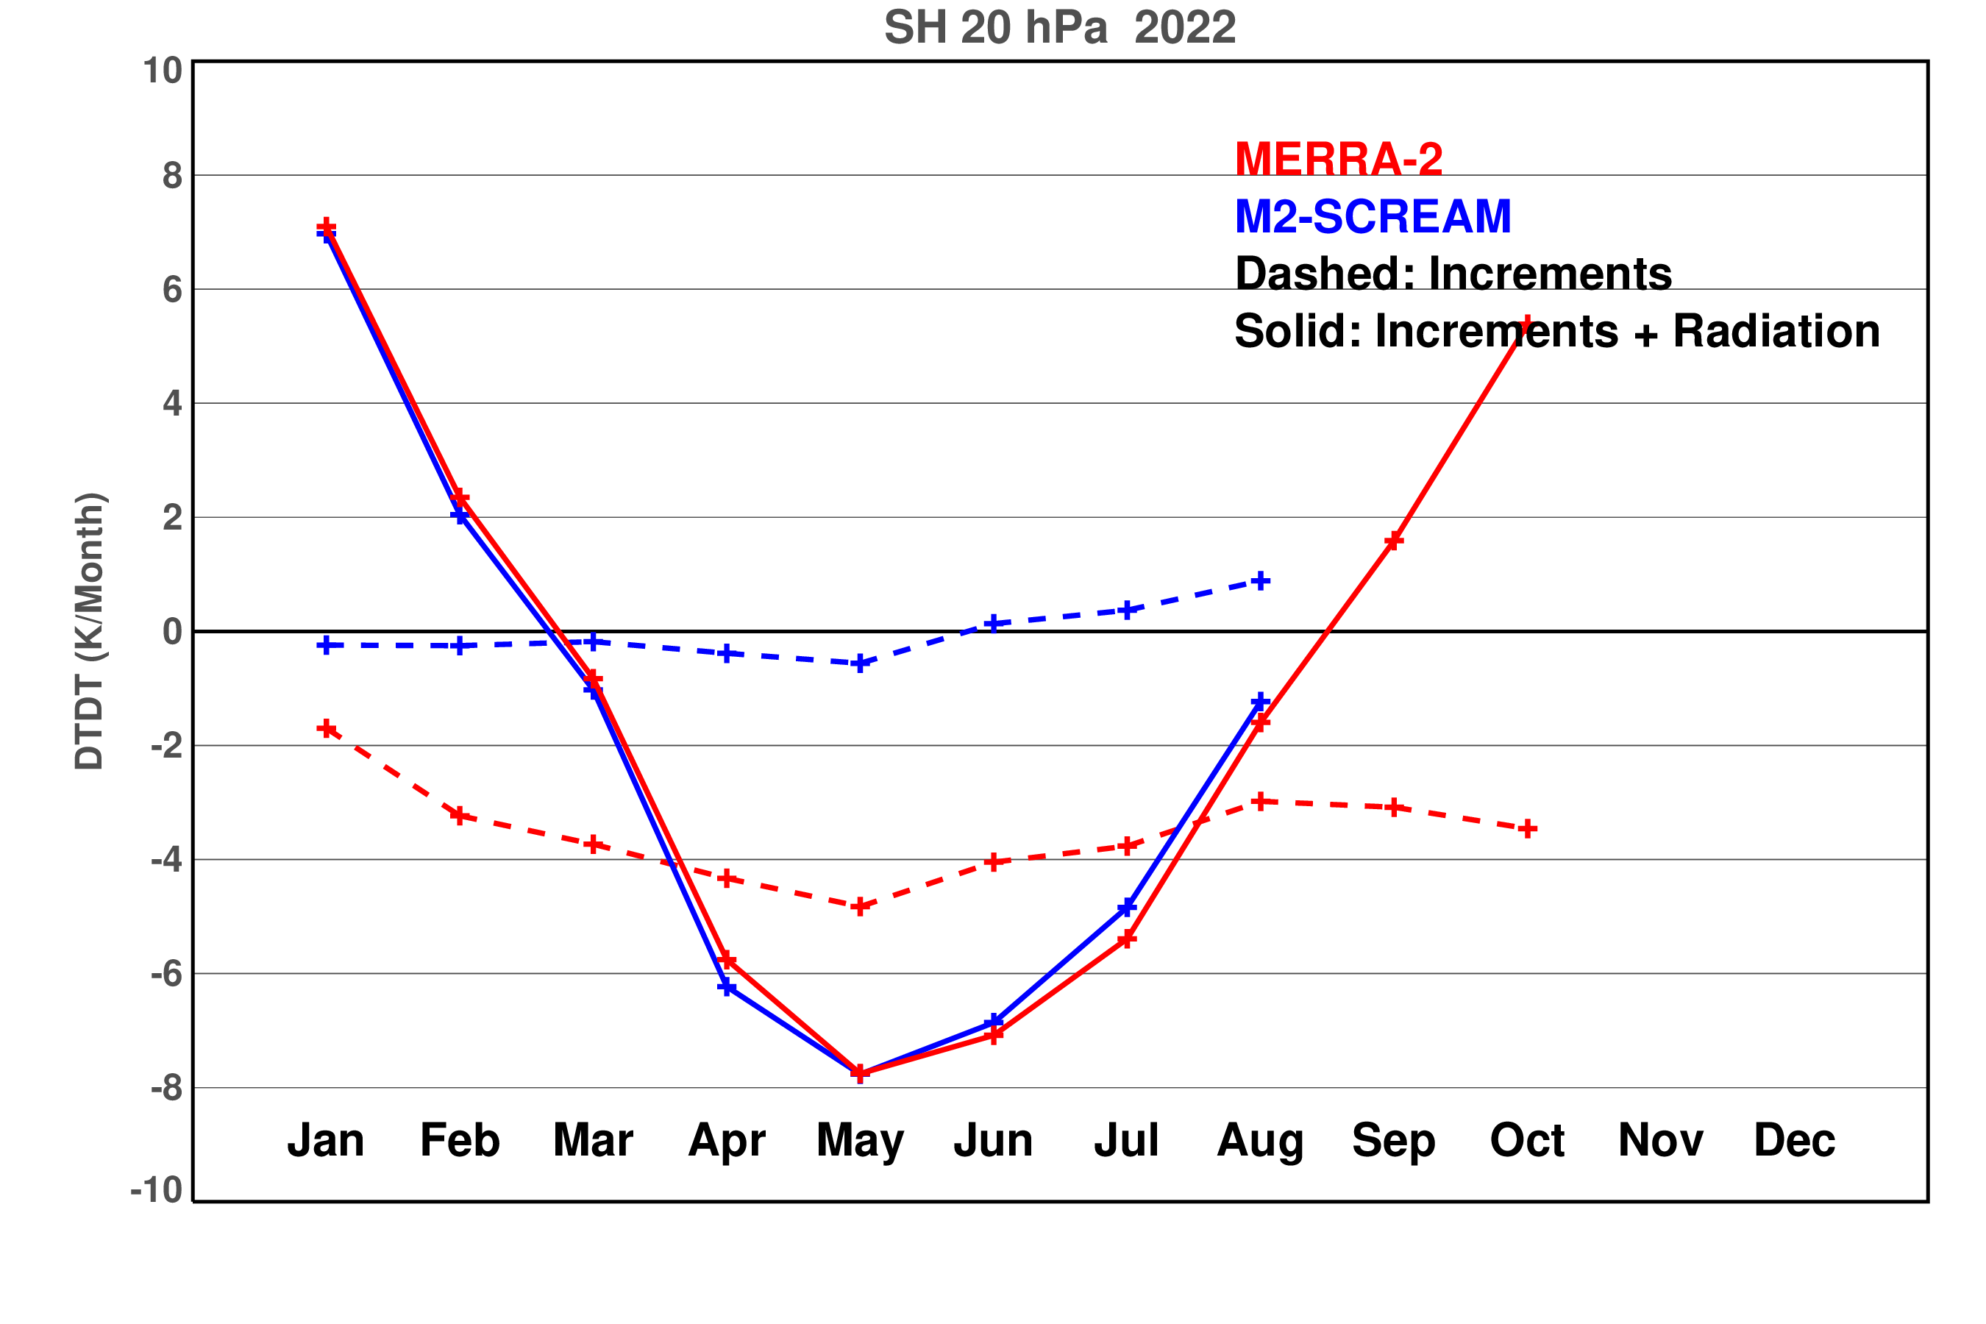
MERRA-2 data analysis increments capture the perturbed water vapor cooling.
10
2022
Southern Hemisphere
Mean Temperature Increments
20 hPa (~27 km)
Monthly Averaged
T Increments (K/month)
0
M2-SCREAM
Increments near zero
Strong radiative cooling
M2-SCREAM
MERRA-2
Increments large
Sum is strongly cooling
4 K/month
-10
Notes:
We can gain further confidence that the temperature increments are correcting the radiative tendency by examining the M2-SCREAM assimilation that includes the Tonga water vapor. In the Southern Hemisphere shown here, the assimilation including the water vapor perturbation, M2-SCREAM, has much smaller temperature increments than MERRA-2 as indicated by the dashed curves. However, the sum of the temperature increments and radiative tendencies, the sold curves, are nearly identical for M2-SCREAM and MERRA-2, indicating that the MERRA-2 increments are making up for the missing water vapor cooling.

Slide 8
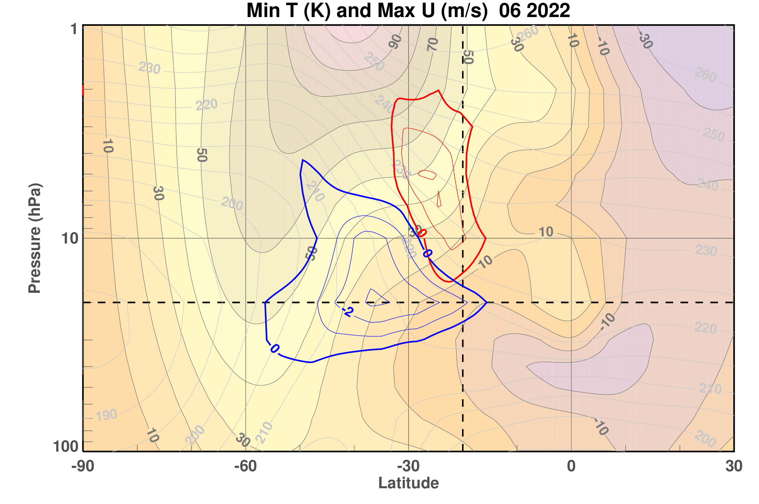
Record low temperature and strong winds were seen in June 2022
48 km
Exceed Strong Wind Records by 10 m/s
Exceed Cold Records by -3K
20 hPa
Note: Records are outside of the SH polar vortex
16 km
90 S
30 N
Vortex Edge
Volcano
WRT 1980-2021 MERRA-2
Notes:
With the knowledge that MERRA-2 is correctly representing the Tonga water vapor cooling, we move on to the temperature and circulation changes. The remainder of the talk shows zonally averaged cross sections from 90 south to 30 north and from 100 to 1 hPa. The zonal mean zonal winds are plotted in the background with filled contours. Five months after the eruption, June 2022 shows record low temperatures and record positive winds, with respect to the MERRA-2 climatology. The low temperatures extend from the edge of the polar vortex to the latitude of the volcano, and from about 30 hPa into the upper stratosphere. The record strong winds are located above the record low temperatures.

Slide 9
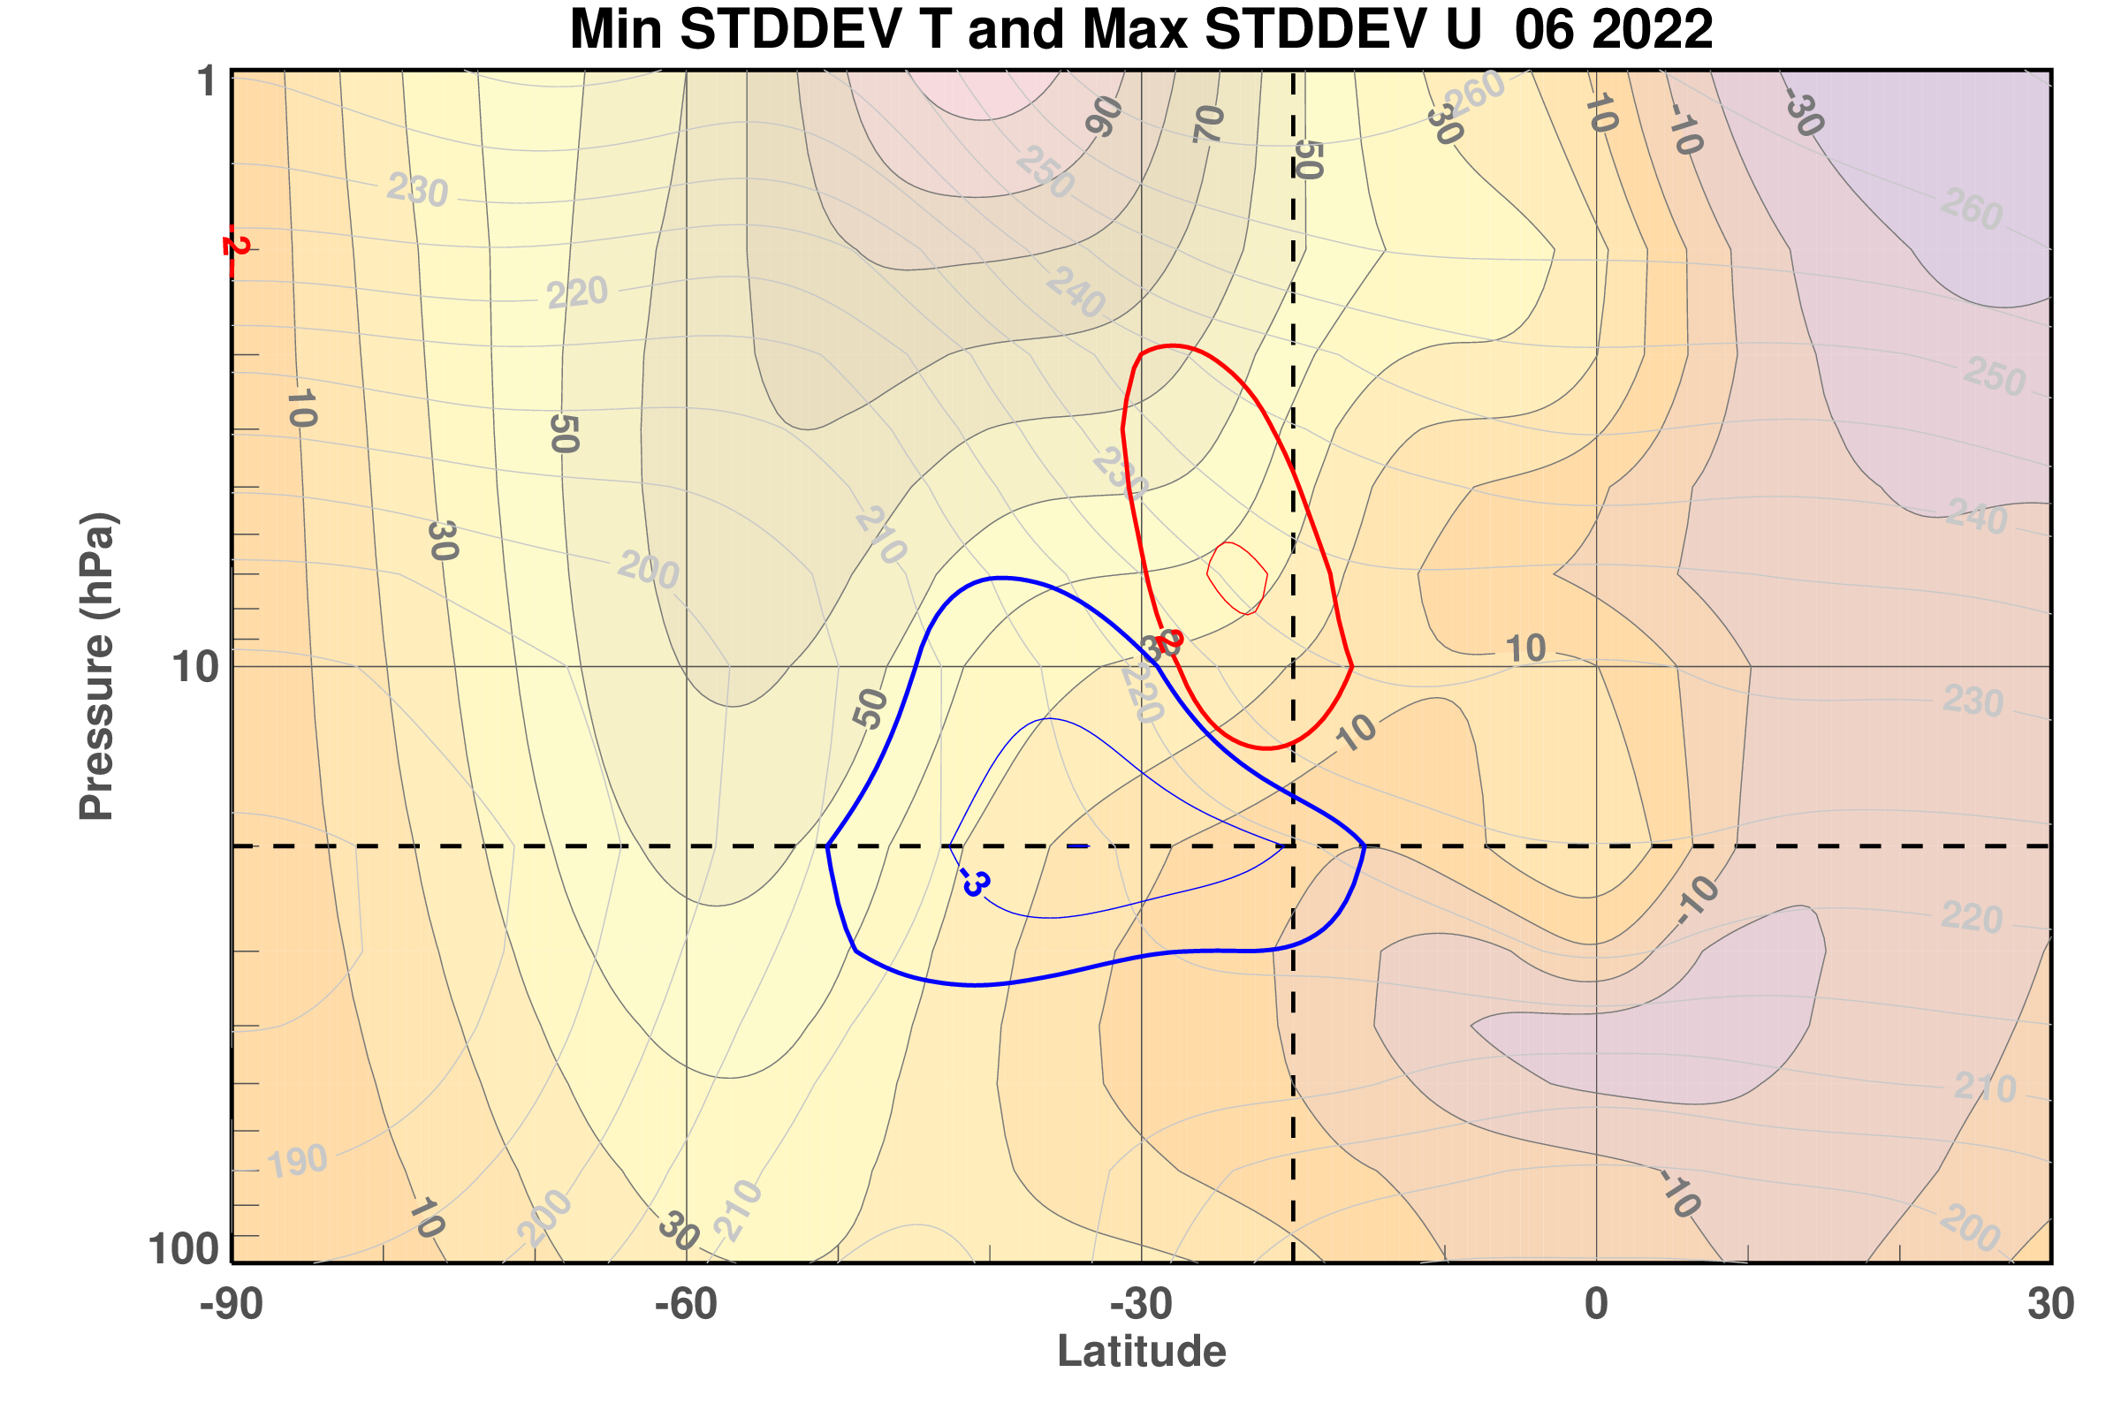
Temperatures were more than 3 standard deviations below the mean
Winds were more than 3 standard deviations above the mean
48 km
June 2022
Wind
2 and 3 contours
20 hPa
Temperature
-2 and -3 contours
16 km
90 S
30 N
Vortex Edge
Volcano
WRT 1980-2021 MERRA-2
Notes:
The same fields can be normalized by their standard deviations showing that the records are 2 to 3 standard deviations from the climate mean.

Slide 10
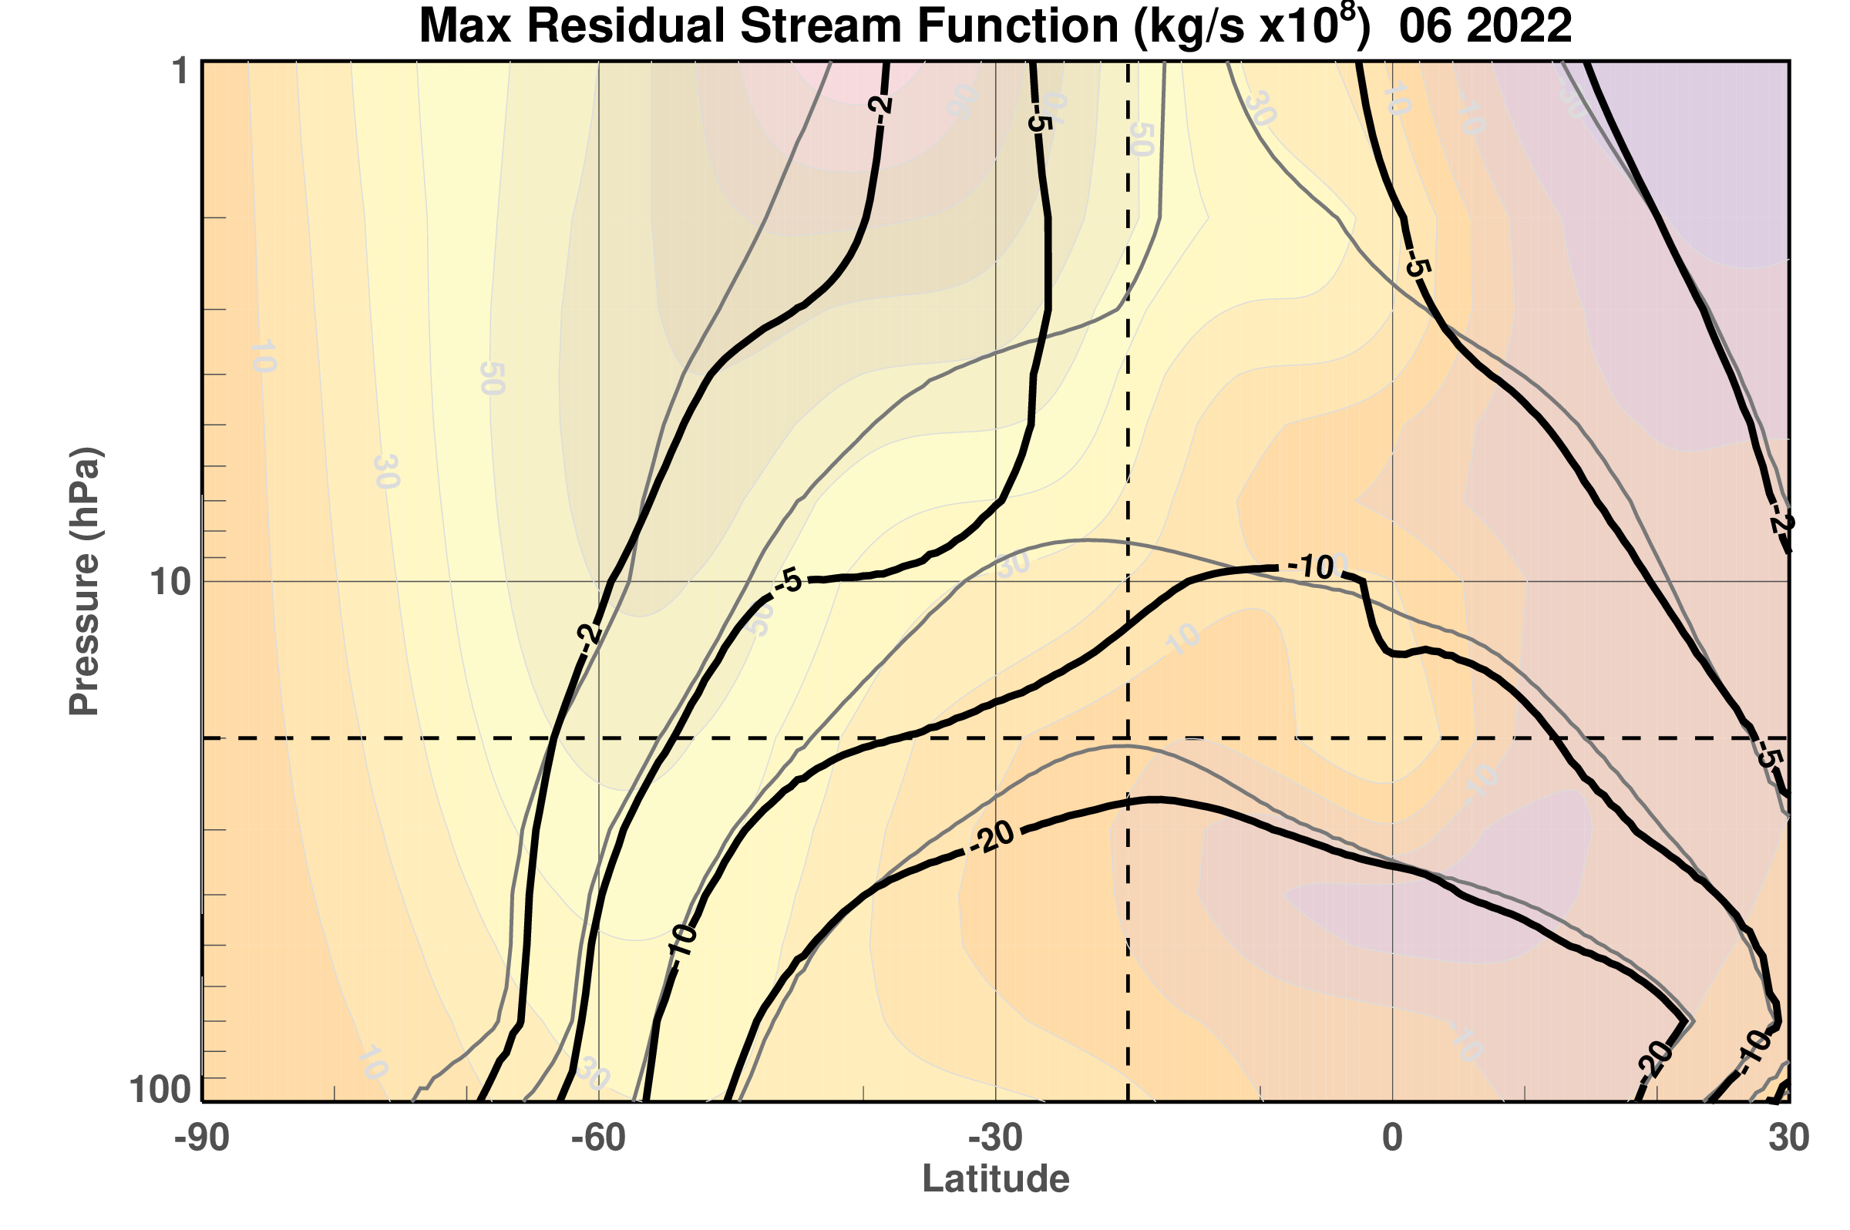
The residual mean stream function was greatly distorted in June 2022
48 km
June 2022
Gray
1980-2021 Average
Black
2022
20 hPa
16 km
90 S
30 N
Vortex Edge
Volcano
WRT 1980-2021 MERRA-2
Notes:
The residual mean circulation during June 2022 denoted by the dark curves is highly distorted compared to the gray curves of the climatology with most of the differences near the location of the temperature and wind extremes. Note that the 2022 circulation shows a region where the descent is weakened. We can difference these fields to examine the circulation extremes.

Slide 11
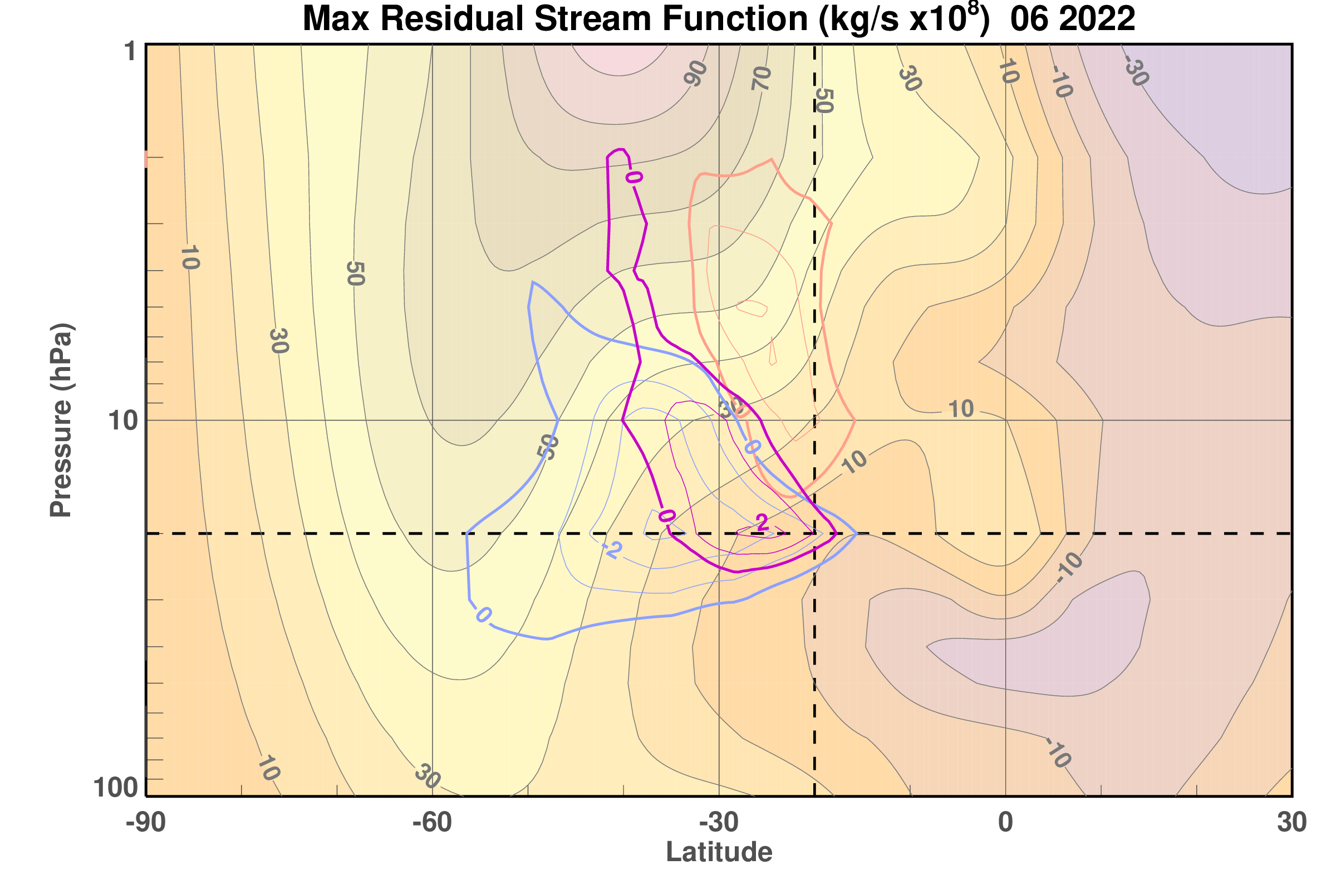
The residual circulation had a record strong anomaly near the volcano location
48 km
June 2022
Residual Circulation Record Maximum Anomaly
20 hPa
16 km
90 S
30 N
Vortex Edge
Volcano
WRT 1980-2021 MERRA-2
Notes:
The magenta contours show the record clockwise residual mean circulation for June 2022. Note that there is not really an upward mean motion, just a weakening of the normal downward circulation and that the location of the record circulation anomaly corresponds closely to the record wind and temperatures, shown by the light blue and red contours.

Slide 12
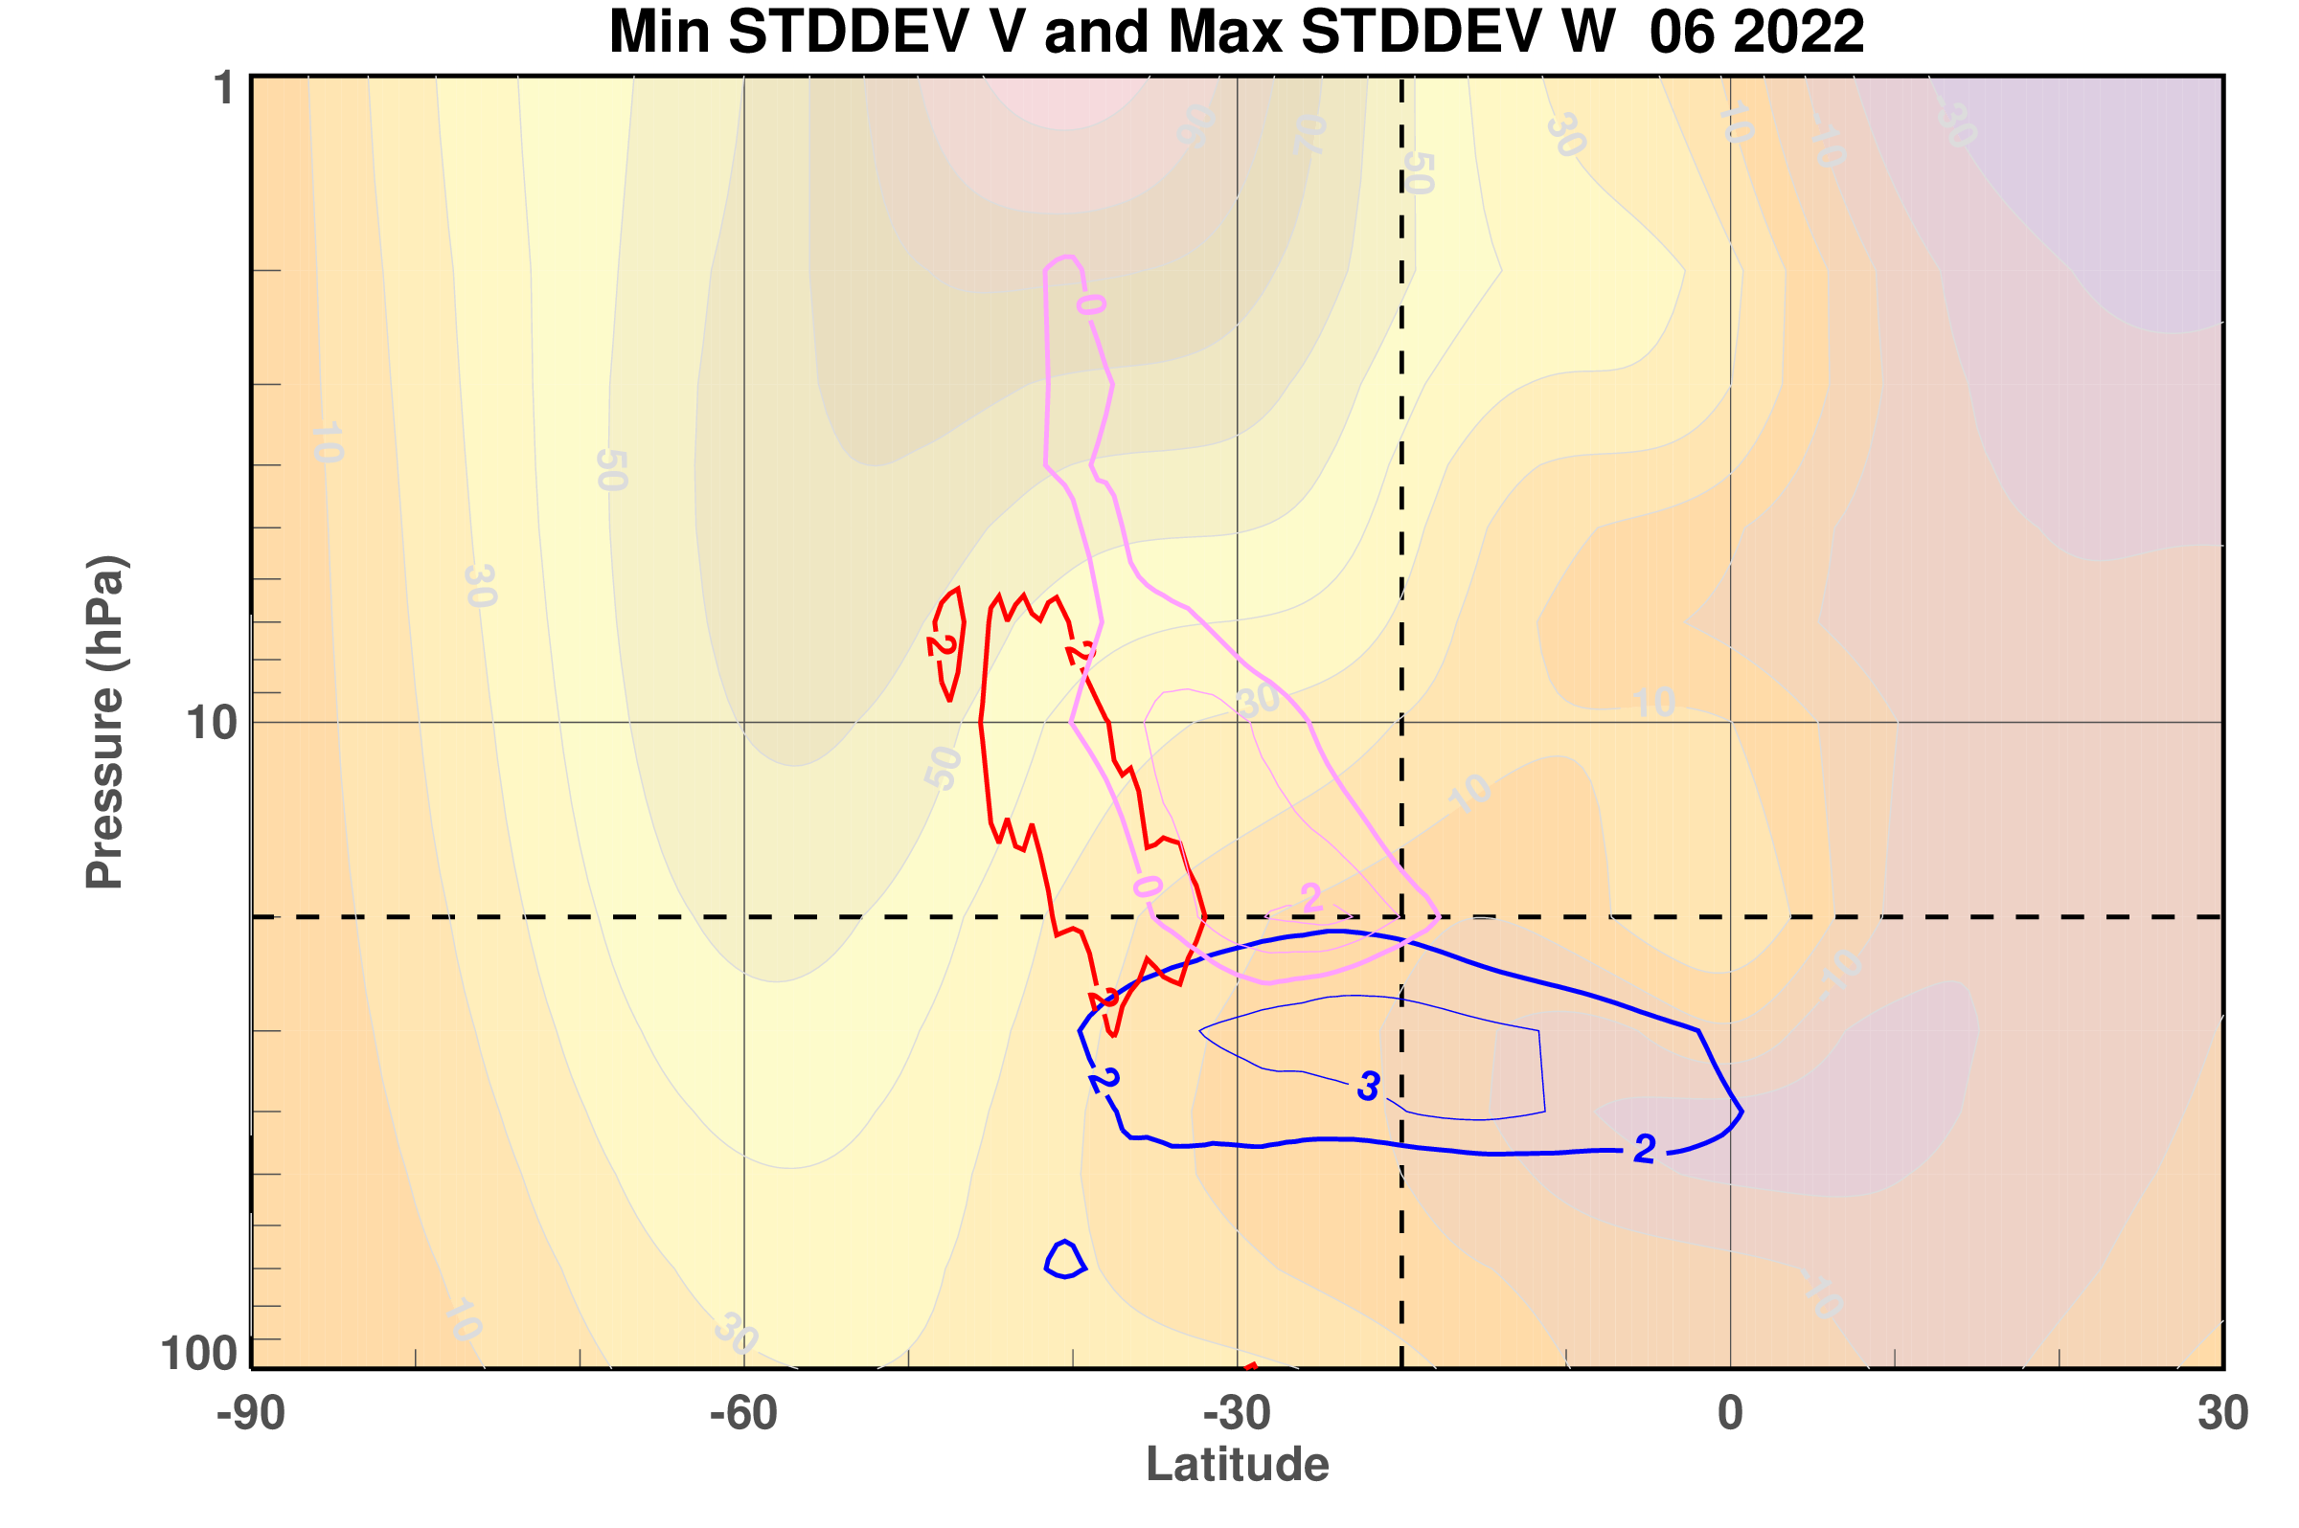
Vertical residual circulation anomaly was more than 2 standard deviations above the mean
Meridional residual circulation anomaly was more than 3 standard deviations below the mean
48 km
June 2022
Vertical Wind
2 contour
20 hPa
Meridional Wind
-2 and -3 contours
16 km
90 S
30 N
Vortex Edge
Volcano
WRT 1980-2021 MERRA-2
Notes:
The June circulation anomaly can also be expressed in terms of the w star and v stars anomalies, in this case normalized by their standard deviations from the mean. The meridional wind, v star, is more than three standard deviations below the mean while the vertical motion, w star, is more than two standard deviations above the mean. In summary, in June 2022, in the lower stratosphere,, significant temperature, wind, and circulations anomalies are associated with the eruption injected water vapor.

Slide 13
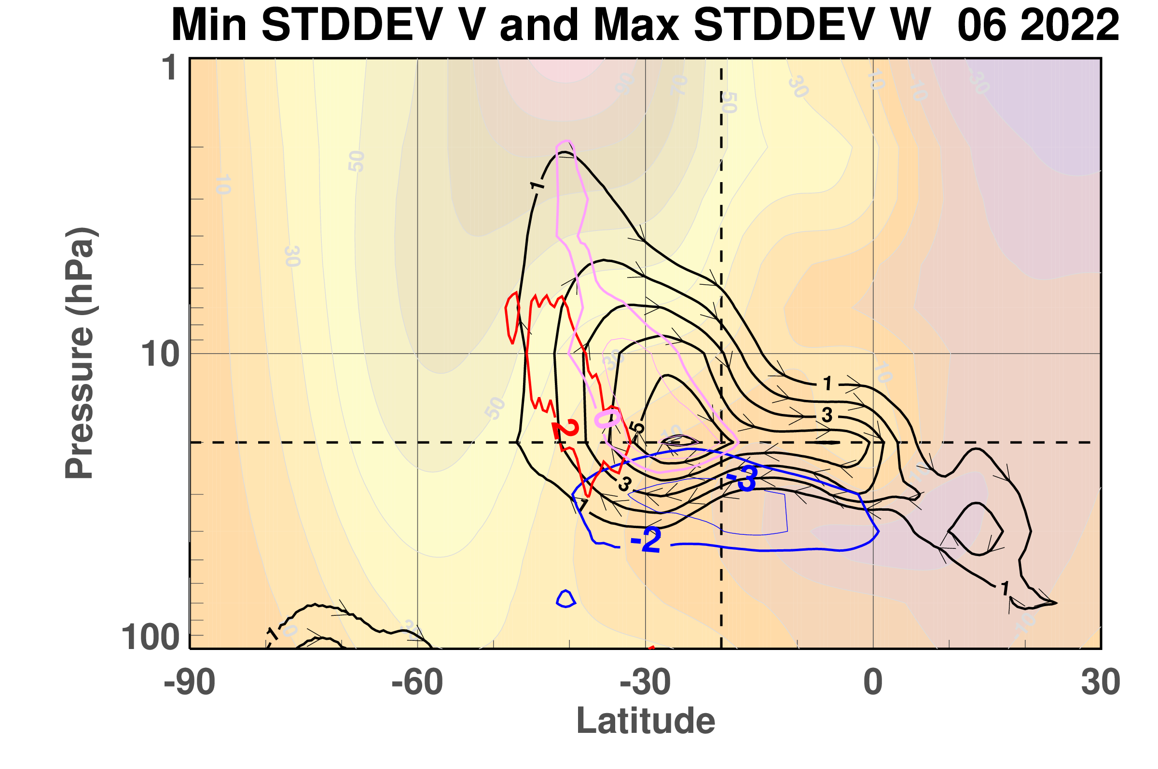
Clockwise circulation anomaly is centered in the lower stratosphere during June 2022
48 km
Clockwise Residual Circulation Anomaly
Vertical Wind
2 contour
20 hPa
Meridional Wind
-2 and -3 contours
16 km
90 S
30 N
Volcano
WRT 1980-2021 MERRA-2
Notes:
Here’s the same thing again but this time with the anomalous clockwise circulation plotted. It looks like a duck with a tail pointing upward well into the stratosphere.

Slide 14
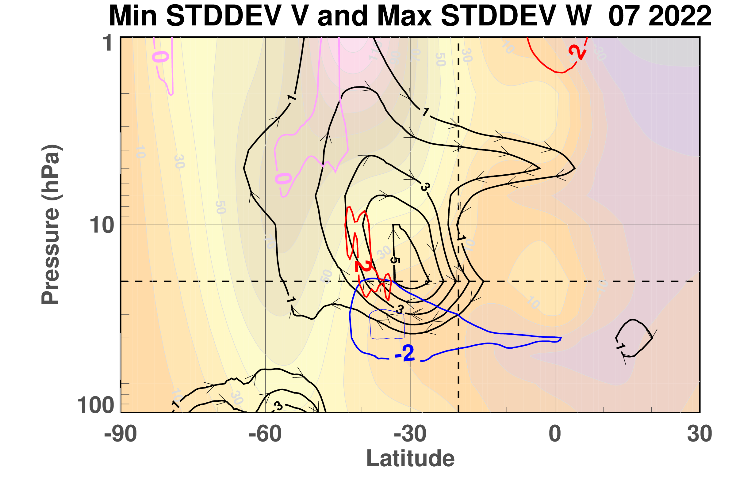
Clockwise circulation anomaly extends to higher altitudes during July 2022
48 km
Clockwise Residual Circulation Anomaly
Vertical Wind
2 contour
20 hPa
Meridional Wind
-2 and -3 contours
16 km
90 S
30 N
Volcano
WRT 1980-2021 MERRA-2
Notes:
Turning to the next month, July, shows the anomalous circulation extending even more upward, suggesting the the effects of the water vapor anomaly are now extending out of the diagram and into the mesosphere. Note the the record circulation in magenta is now in the upper stratosphere. However, the residual circulation winds with large standard deviations are still around 20 hPa.

Slide 15
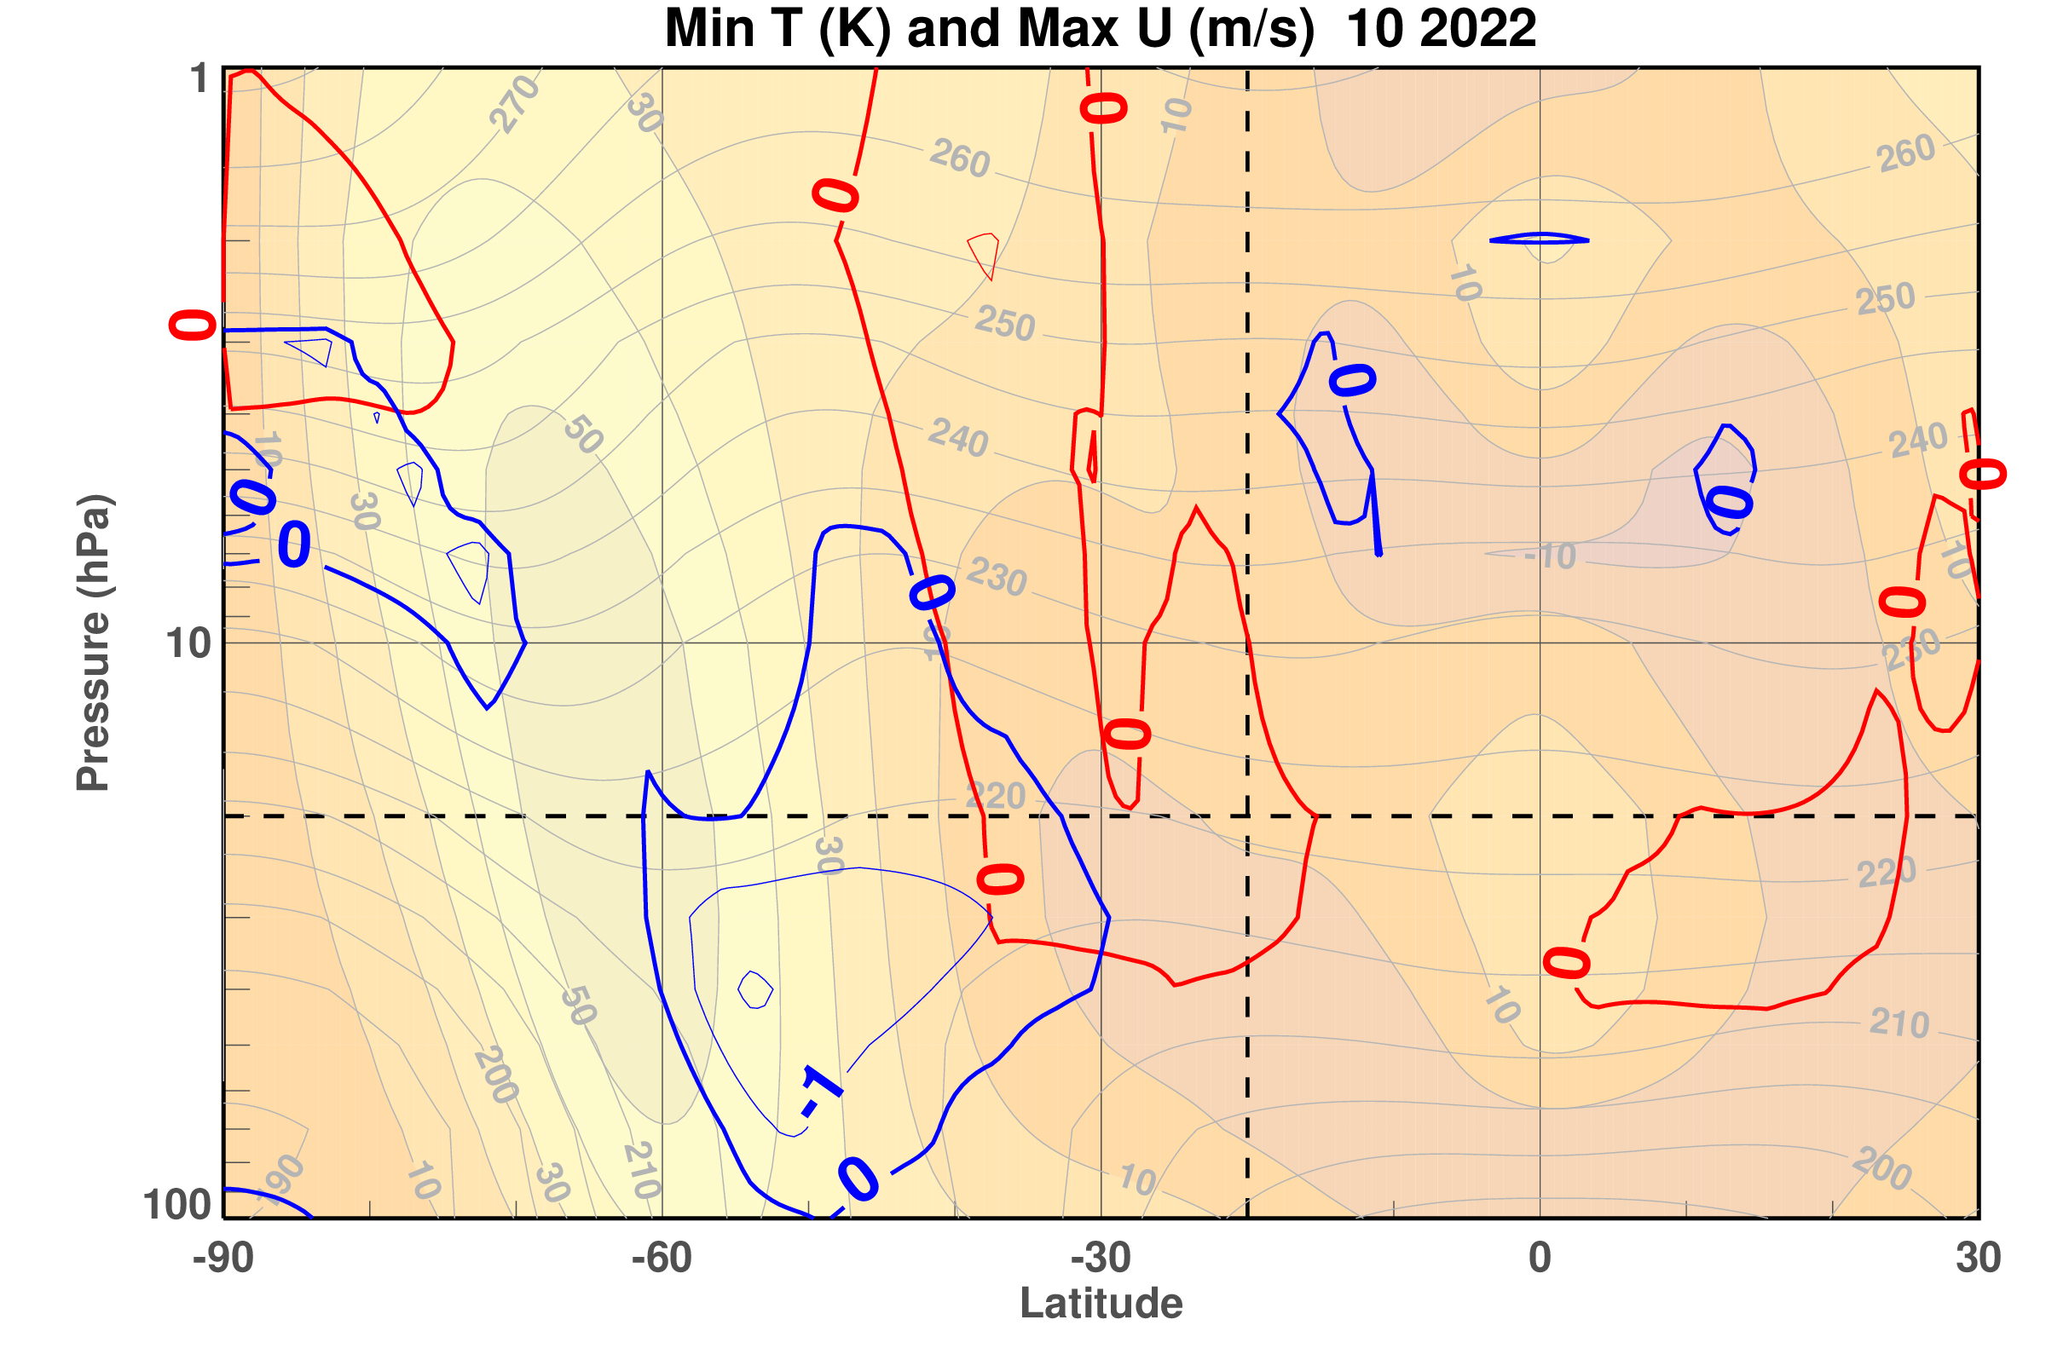
Record low temperatures and strong winds descended in October 2022
48 km
Exceed Strong Wind Records by less than 5 m/s
Record Cold in polar upper stratosphere
Exceed Cold Records by -2K
20 hPa
16 km
90 S
30 N
Vortex Edge
Volcano
WRT 1980-2021 MERRA-2
Notes:
Turning now to October, we find there are still record low temperatures but that they now centered at 40 hPa instead of 20 hPa and extend from 100 to approximately 8 hPa. They are still outside of the mean polar vortex winds and extend to 30 south. Note also that some record cold values are showing up in the polar upper stratosphere. The record positive wind covers a broad region but with values less than 5 m/s.

Slide 16
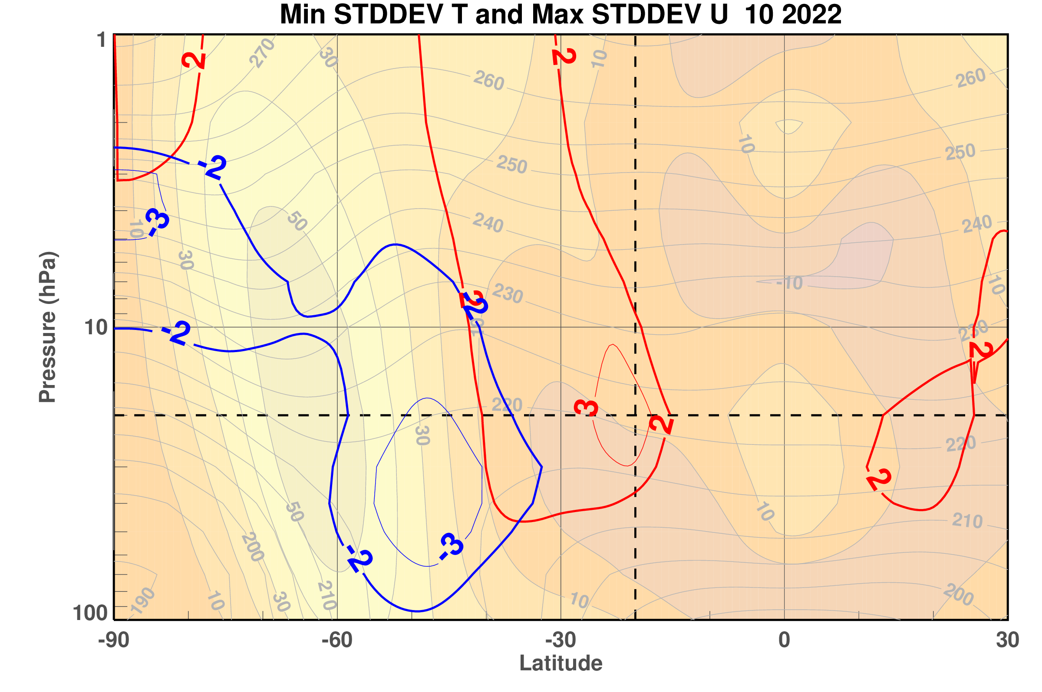
Temperatures were more than 3 standard deviations below the mean
Winds were more than 3 standard deviations above the mean
October 2022
48 km
Exceed Strong Wind Records by 3 standard deviations
Cold in polar upper stratosphere
20 hPa
Exceed Cold Records by -3 standard deviations
16 km
90 S
30 N
Vortex Edge
Volcano
WRT 1980-2021 MERRA-2
Notes:
When normalized by their standard deviations, the October 2022 temperature and wind anomalies remain strong, deviating by more than three standard deviations from the climatology .

Slide 17
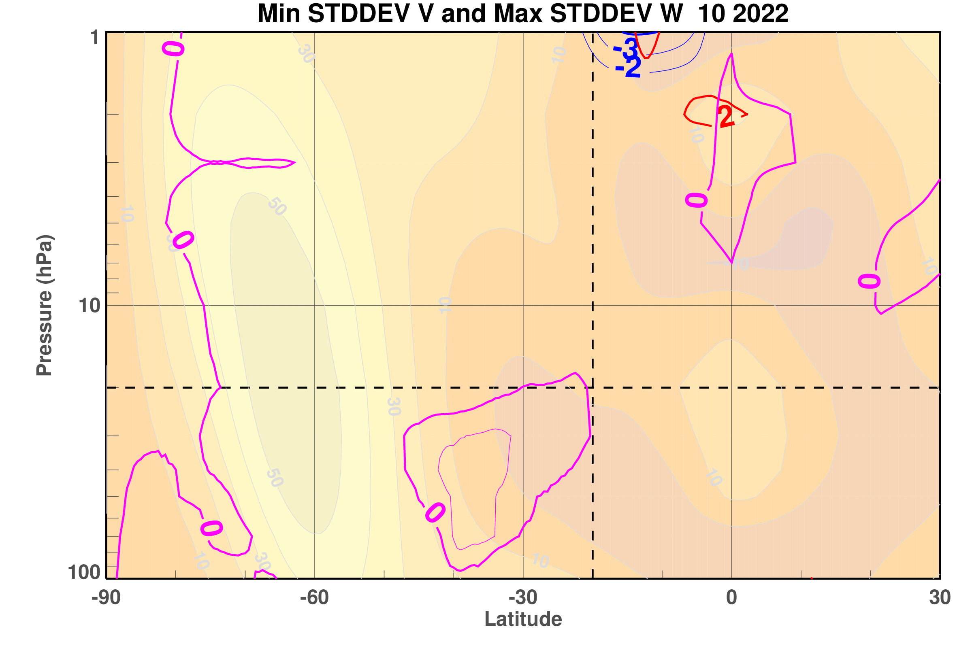
The residual circulation record anomaly descends with time
48 km
October 2022
Residual Circulation Record Maximum Anomaly
20 hPa
16 km
90 S
30 N
Vortex Edge
Volcano
WRT 1980-2021 MERRA-2
Notes:
The October residual circulation anomaly has descended from the June location is is now mostly below 20 hPa.

Slide 18
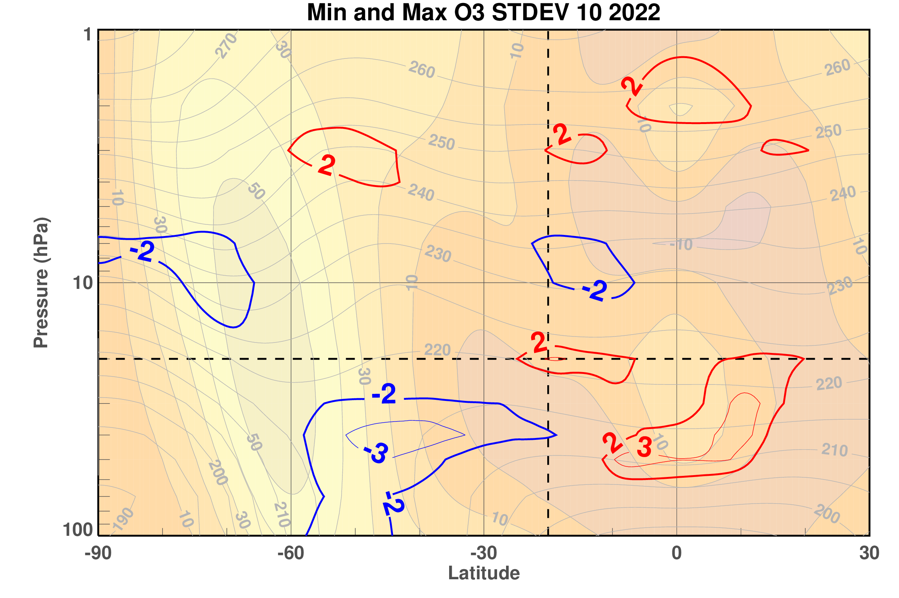
Low ozone is associated with the upward circulation anomaly
48 km
October 2022
Ozone anomalies
Standard deviations
20 hPa
Ozone
-2 and -3 contours
Ozone
2 and 3 contours
16 km
90 S
30 N
Vortex Edge
Volcano
WRT 1980-2021 MERRA-2
Notes:
We have not looked in detail at how these circulation anomalies effect ozone in the lower stratosphere. However, this figure for October 2022 ozone variability show high than normal ozone in the region of anomalous upward circulation perturbation, suggesting the the increase in ozone there may be created by reduced downward transport.

Slide 19
Conclusions
Data assimilation can provide assessment of model biases and even missing model physics, such as the anomalous water vapor.
Water vapor from the Hunga-Tonga Hunga Ha-apai eruption disrupted the global middle atmosphere circulation for at least 10 months and is expected to continue for years.
Future ensemble forecast experiments will include the anomalous water vapor.
Reference: Coy, L., Newman, P. A., Wargan, K., Partyka, G., Strahan, S. E., & Pawson, S. (2022). Stratospheric circulation changes associated with the Hunga Tonga-Hunga Ha'apai eruption. Geophysical Research Letters, 49, e2022GL100982. https://doi.org/10.1029/2022GL100982
Notes:
In conclusion, data assimilation can provide assessment of model biases and even missing model physics, such as the anomalous water vapor. Water vapor from the Hunga-Tonga Hunga Ha-apai eruption disrupted the global middle atmosphere circulation for at least 10 months and is expected to continue for years. To further study the circulation effects of the Tonga volcano, we are planning future ensemble forecast experiments that will include the anomalous water vapor. Thank you.

