Slide 1
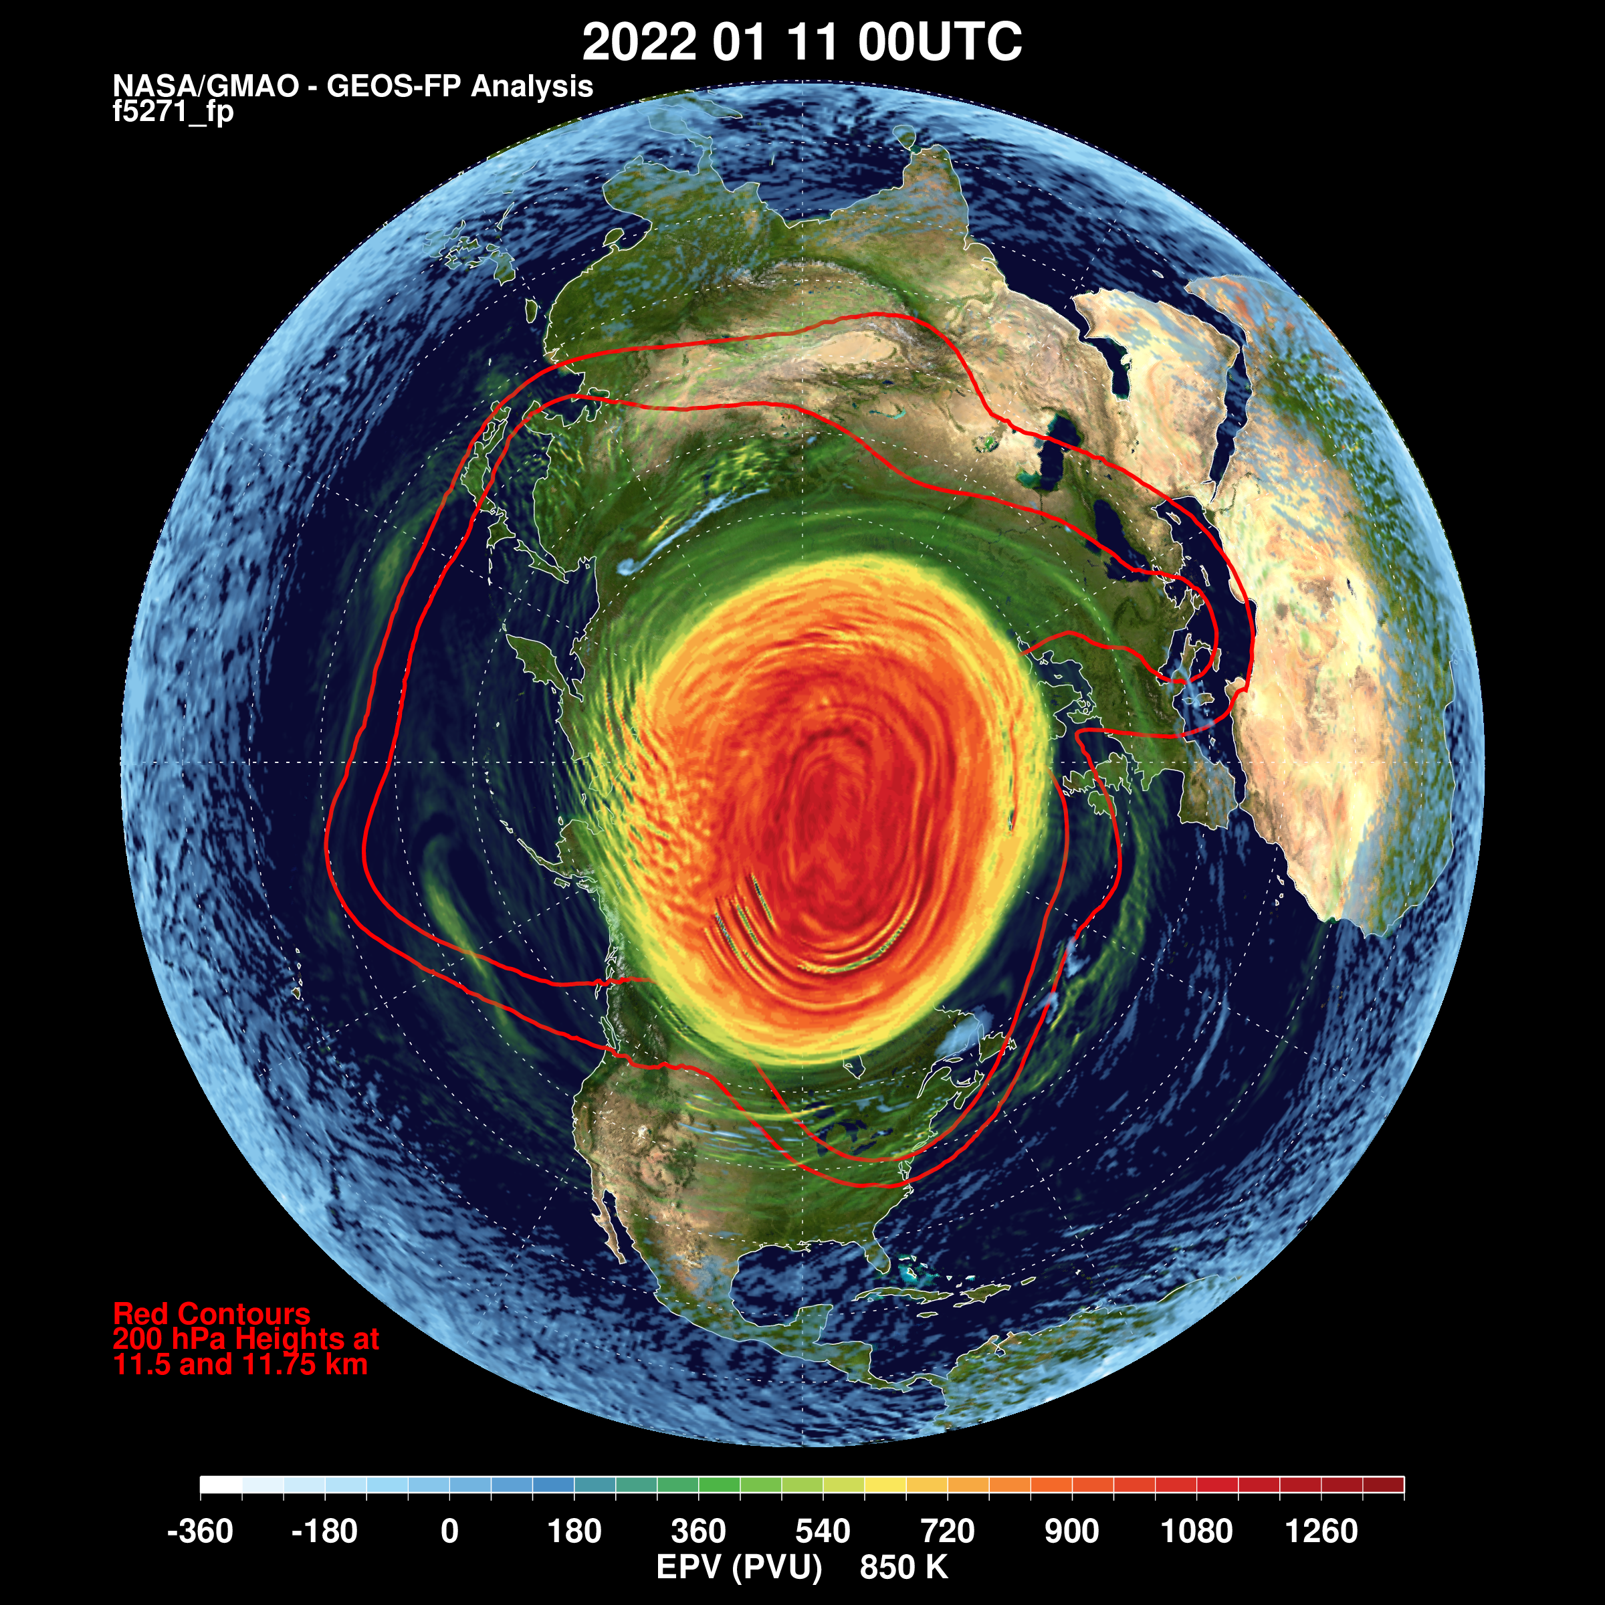
The generation of mixing across the stratospheric polar vortex edge by breaking gravity waves
The Northern Hemisphere winter of 2021-2022 stayed relatively peaceful, without a major stratospheric sudden warming event.
EPV 850K
Lawrence Coy
Paul Newman
Steven Pawson
NASA Goddard Space Flight Center
December 17, 2022
11 January 2022
Notes:
Hello! I’m Larry Coy from NASA Goddard Space Flight Center and the title of my talk today is “The generation of mixing across the stratospheric polar vortex edge by breaking gravity waves”. My co-authors are Paul Newman and Steven Pawson. I work at the Global Modeling and Data Assimilation Office and we focus on global analyses. For the past few years these global analyses have been routinely done at high horizontal resolution, ¼ degree, allowing for some gravity waves to be resolved. Today, I want to report on a case from last winter when Gravity Waves acted to dramatically disturb the Northern Hemisphere winter vortex. The 2021-2022 winter polar vortex was considered somewhat dull as planetary activity was weak and no major mid-winter warmings occurred. Nevertheless, in just 16 days, the zonal mid-stratospheric flow pictured here on the 11th of January changed to…

Slide 2
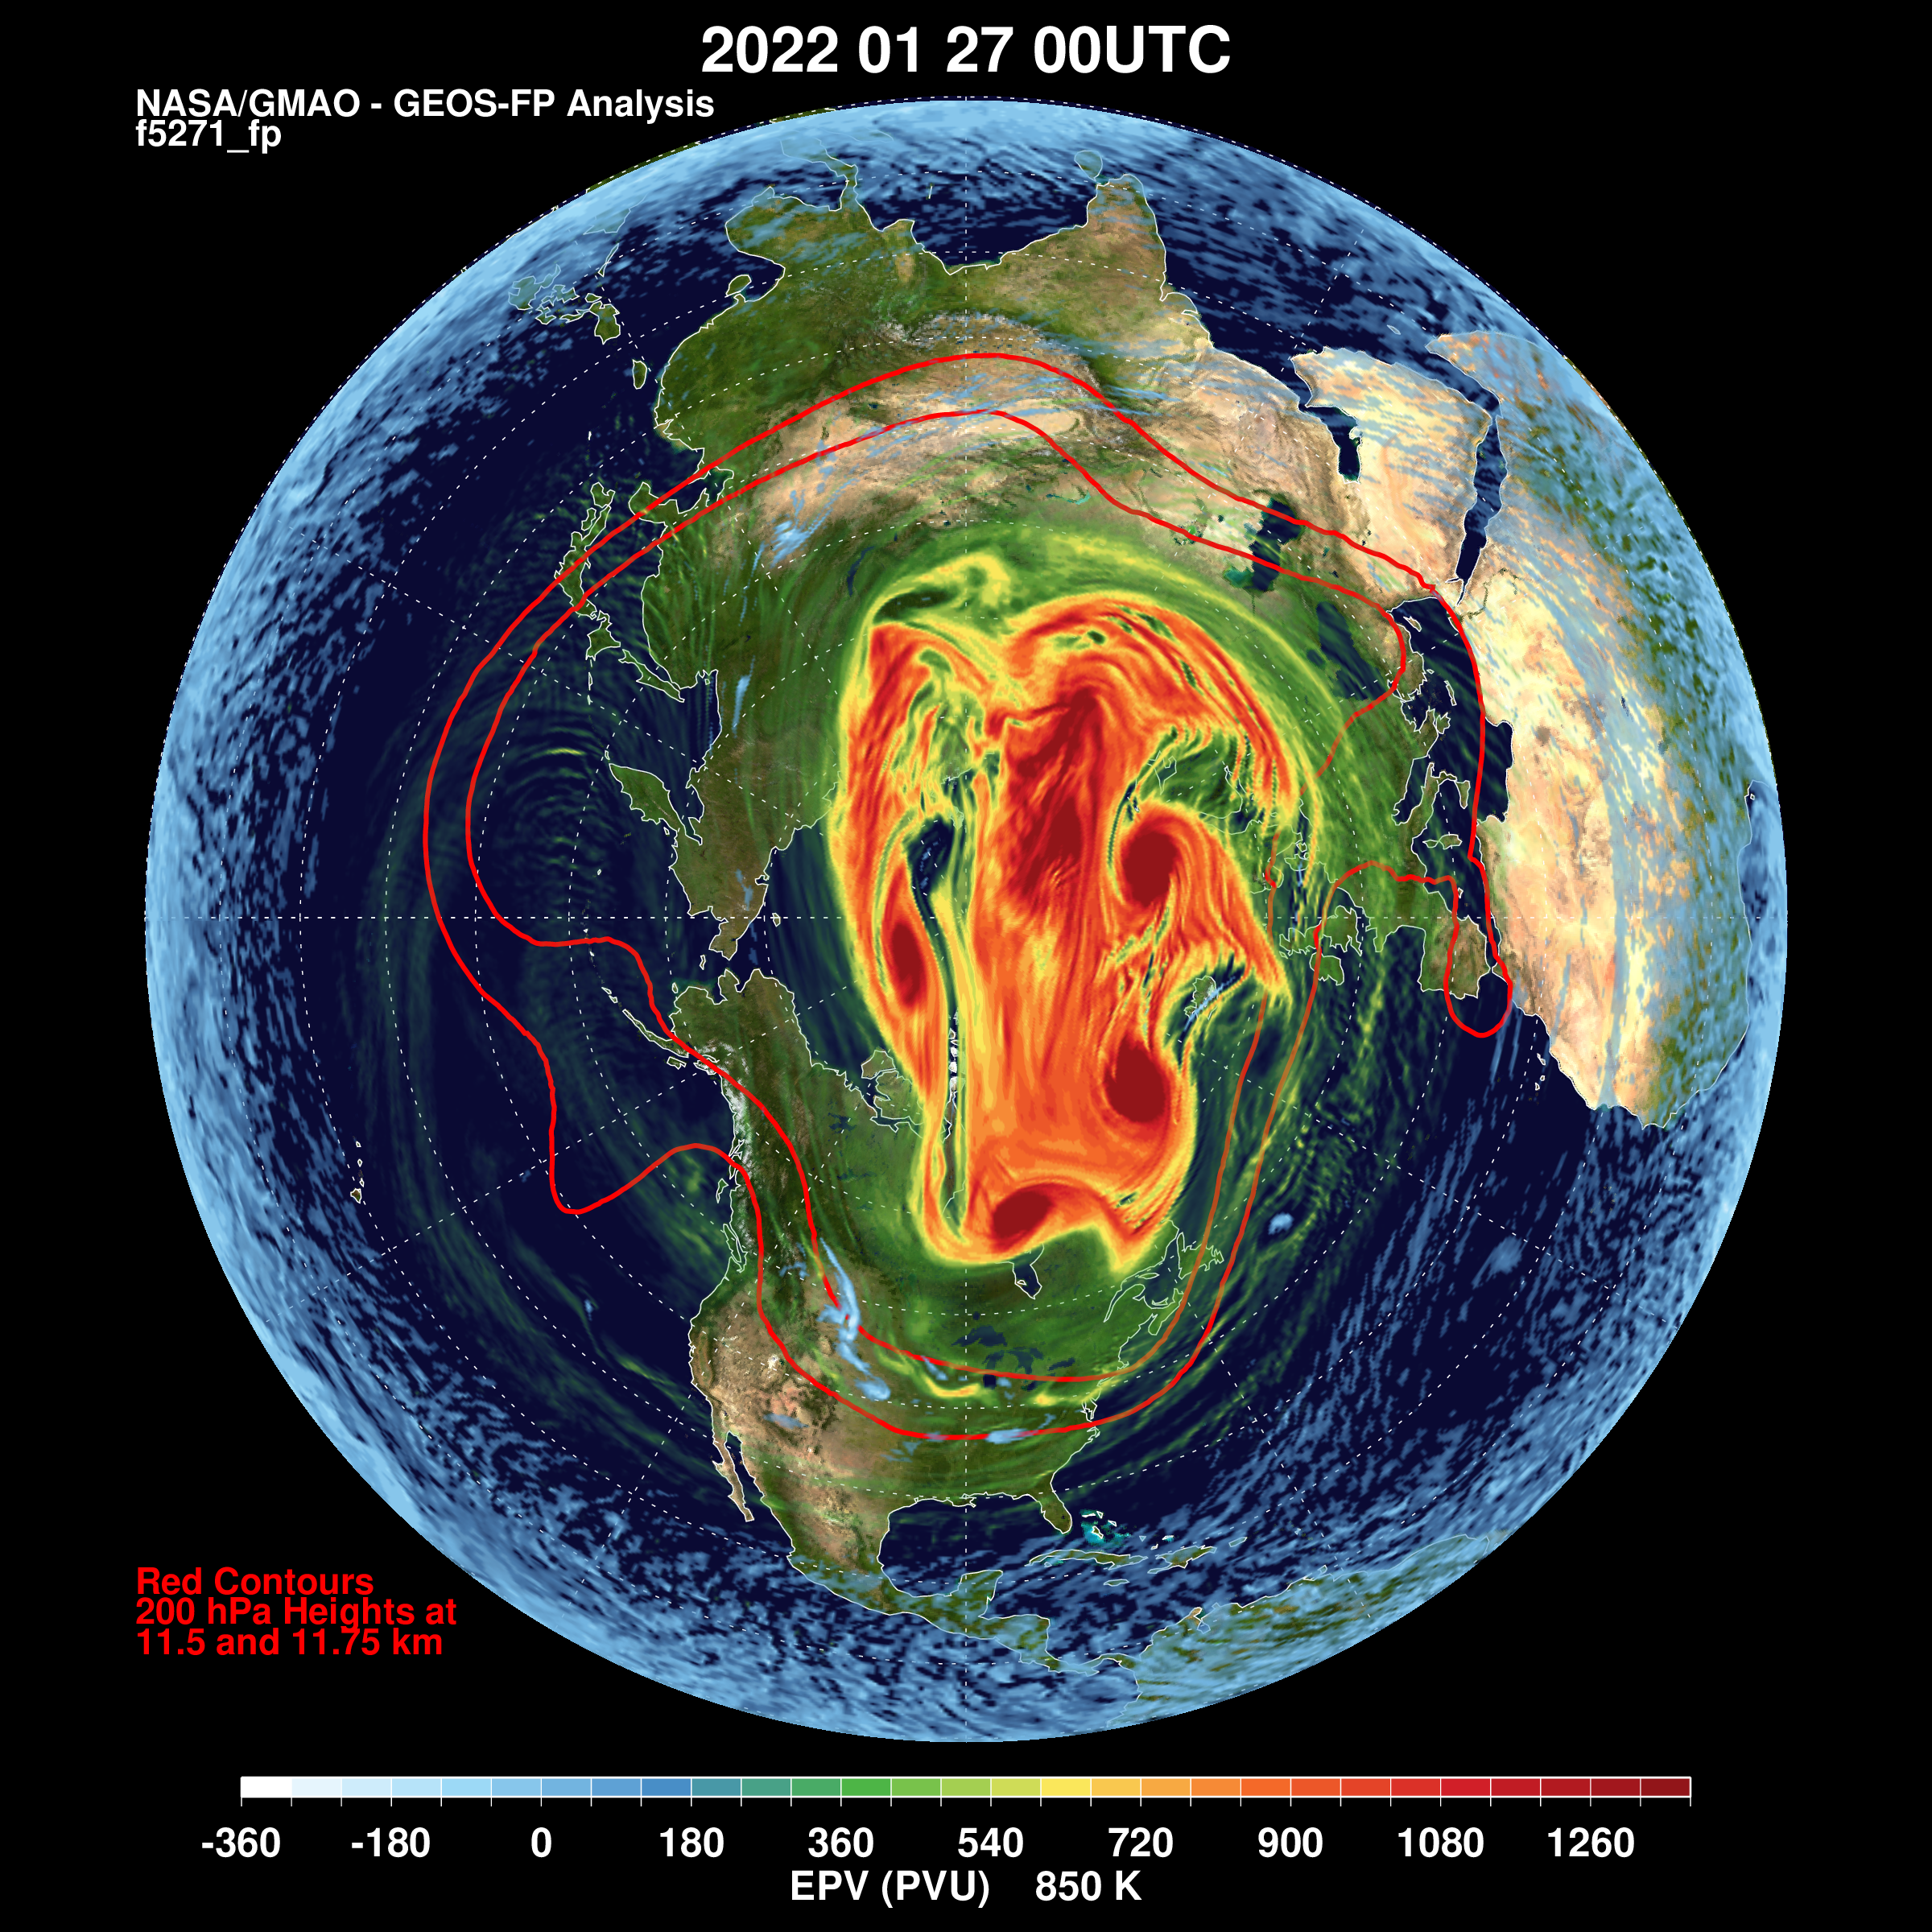
The generation of mixing across the stratospheric polar vortex edge by breaking gravity waves
Yet by the end of January, the vortex was highly disturbed.
How did this happen?
EPV 850K
X
X
X
X
Off-Scale Vortices
Lawrence Coy
Paul Newman
Steven Pawson
NASA Goddard Space Flight Center
December 17, 2022
27 January 2022
Notes:
…this very disturbed creature. These small horizontal scale, high potential vorticity (or PV), features are way off my usual potential vorticity scale. This is a dramatic change. The main question is, how did this happen? And of course what role did gravity waves play? To start, we can take a look at some inbetween times.

Slide 3
Gravity waves over Northern Europe disturbed the stratospheric polar vortex
Breaking Gravity Waves
Breaking Gravity Waves
EPV 850K
14 January 2022
17 January 2022
Notes:
These examples, from the 14th and 17th of January show, very strong , very small scale, potential vorticity structures, a signature of gravity wave breaking, that is overturning gravity waves. These disturbances are occurring just inside the vortex edge and are separating some high PV from the main part of the vortex, creating a kind of PV filament. Past experience with breaking planetary scale waves has shown PV filaments to often be unstable and “roll up” into smaller scale vortices and the 17th shows some evidence of such disturbances around the vortex edge. The two red lines denote upper tropospheric heights at 200 hPa showing strong flow at that level heading under the breaking region. Keep in mind that the breaking gravity wave PV signature is at a much smaller scale than the vortex roll up eddies. That these really small pv features really are breaking gravity waves can be seen in vertical cross sections.

Slide 4
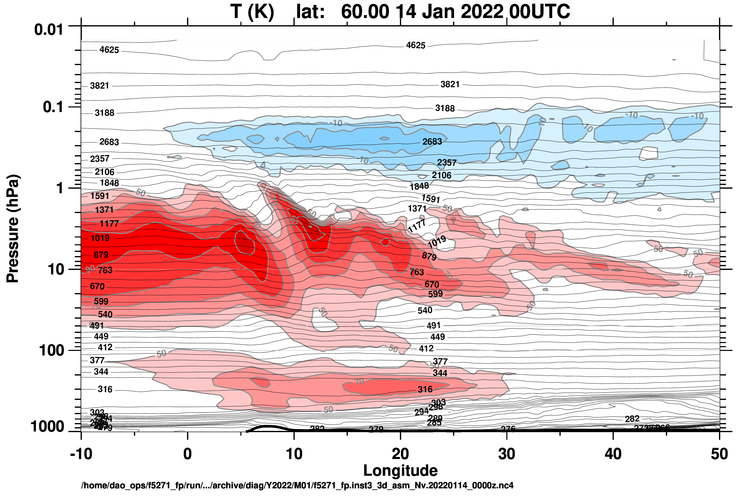
Breaking gravity waves over Northern Europe slowed the upper stratospheric zonal wind
14 Jan 2022
60ºN, 10ºW-50ºE
Zonal Wind -20-0 m/s
Zonal Wind 50-100 m/s
Upper Stratosphere
Longitude
Orography
Notes:
Here’s the longitude altitude cross section at 60N on the 14th over Europe. The potential temperature and winds both show clear evidence of gravity waves and the strong zonal flow from the west shown in red weakens as it crosses the wave region suggesting momentum deposition by the gravity waves and hence gravity wave breaking there. The lack of waves above the stratosphere also shows that the vertical wave propagation is confined to the stratosphere, and this is more evidence that the gravity waves dissipate by breaking in the upper stratosphere.

Slide 5
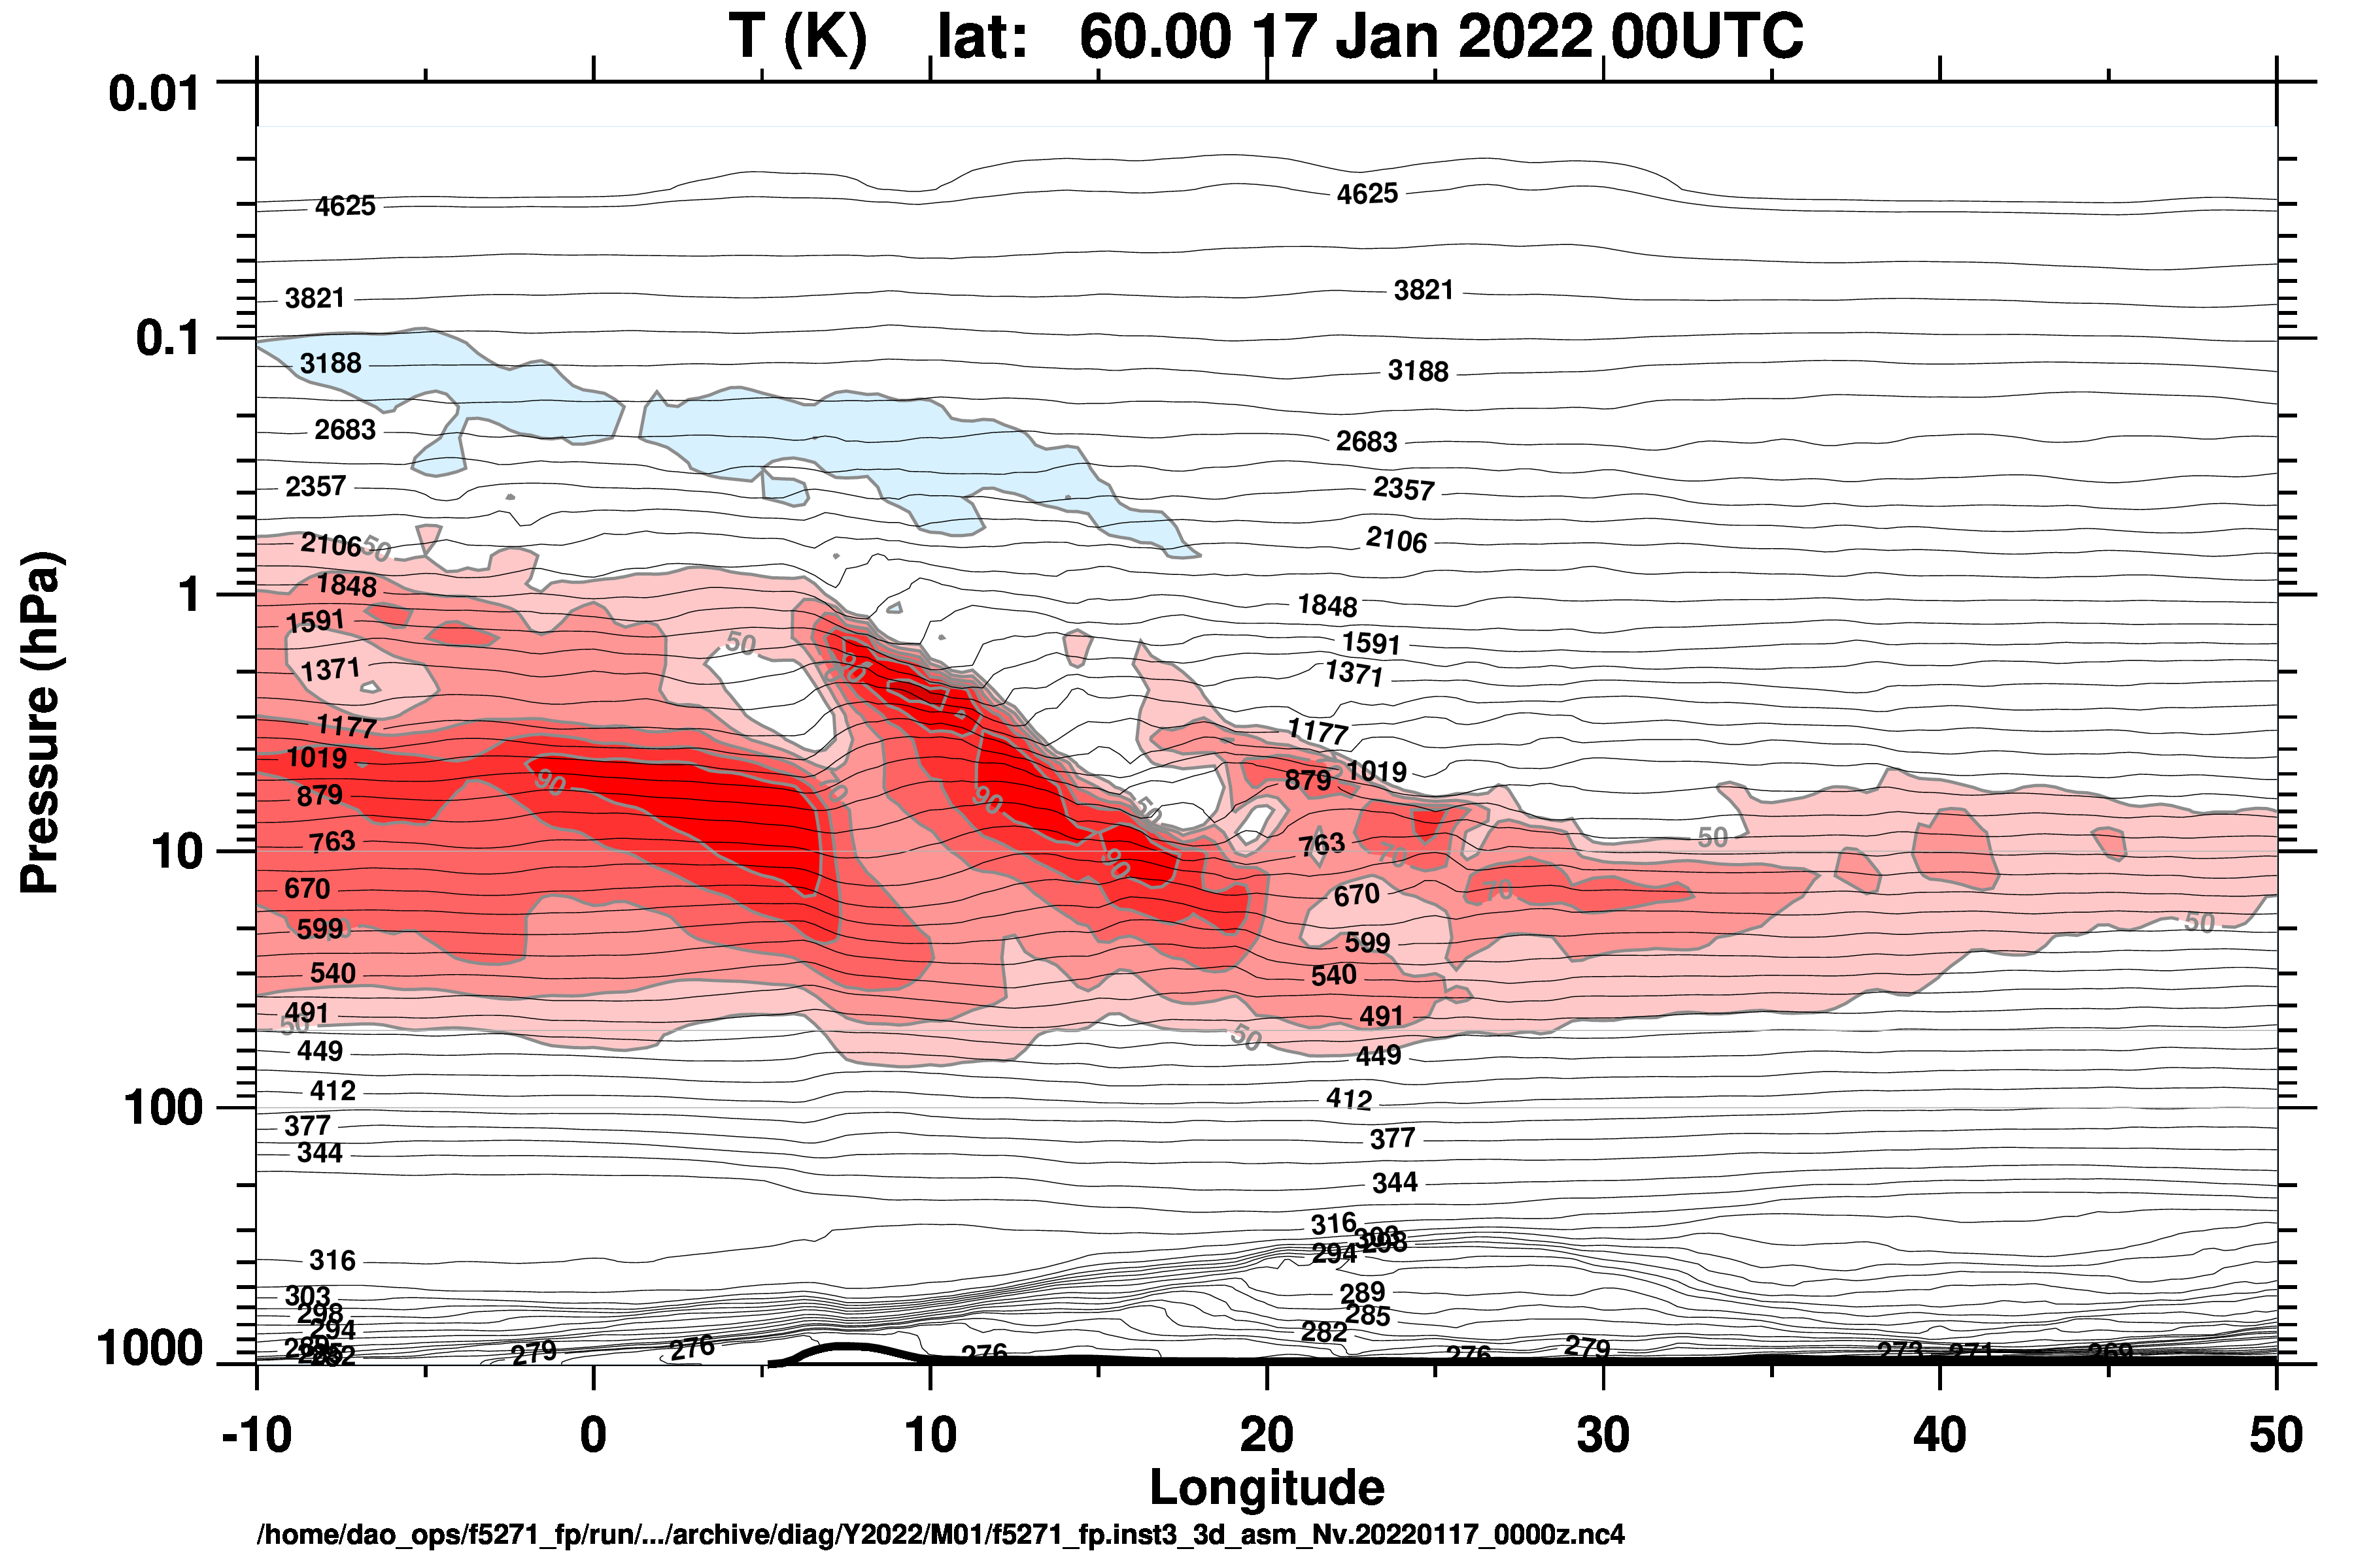
Breaking gravity waves over Northern Europe slowed the upper stratospheric zonal wind
17 Jan 2022
60ºN, 10ºW-50ºE
Zonal Wind 0 m/s
Zonal Wind 50-90 m/s
Upper Stratosphere
Longitude
Orography
Notes:
The 17th shows more of the same, confirming that the very smallest scale potential vorticity fluctuations are indeed showing regions of breaking gravity waves.

Slide 6
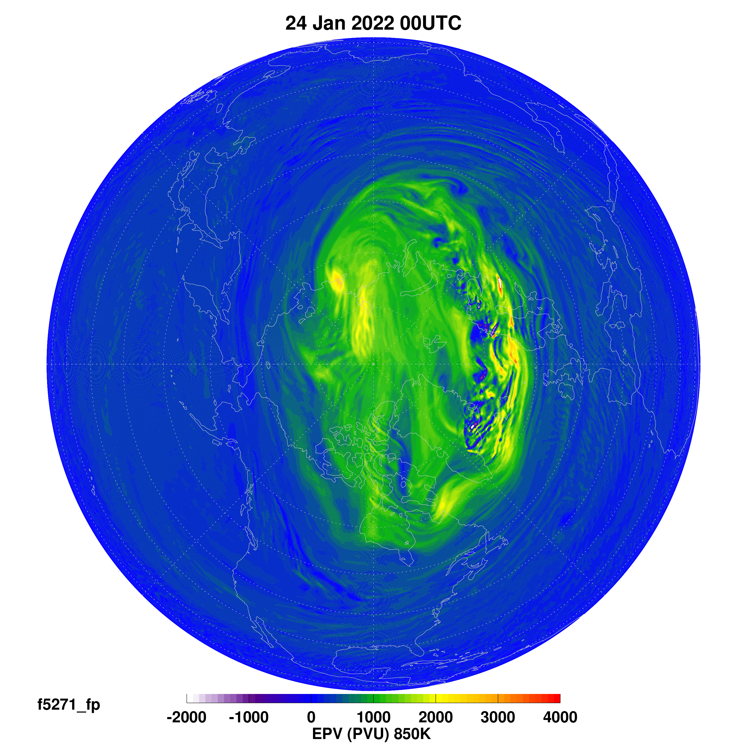
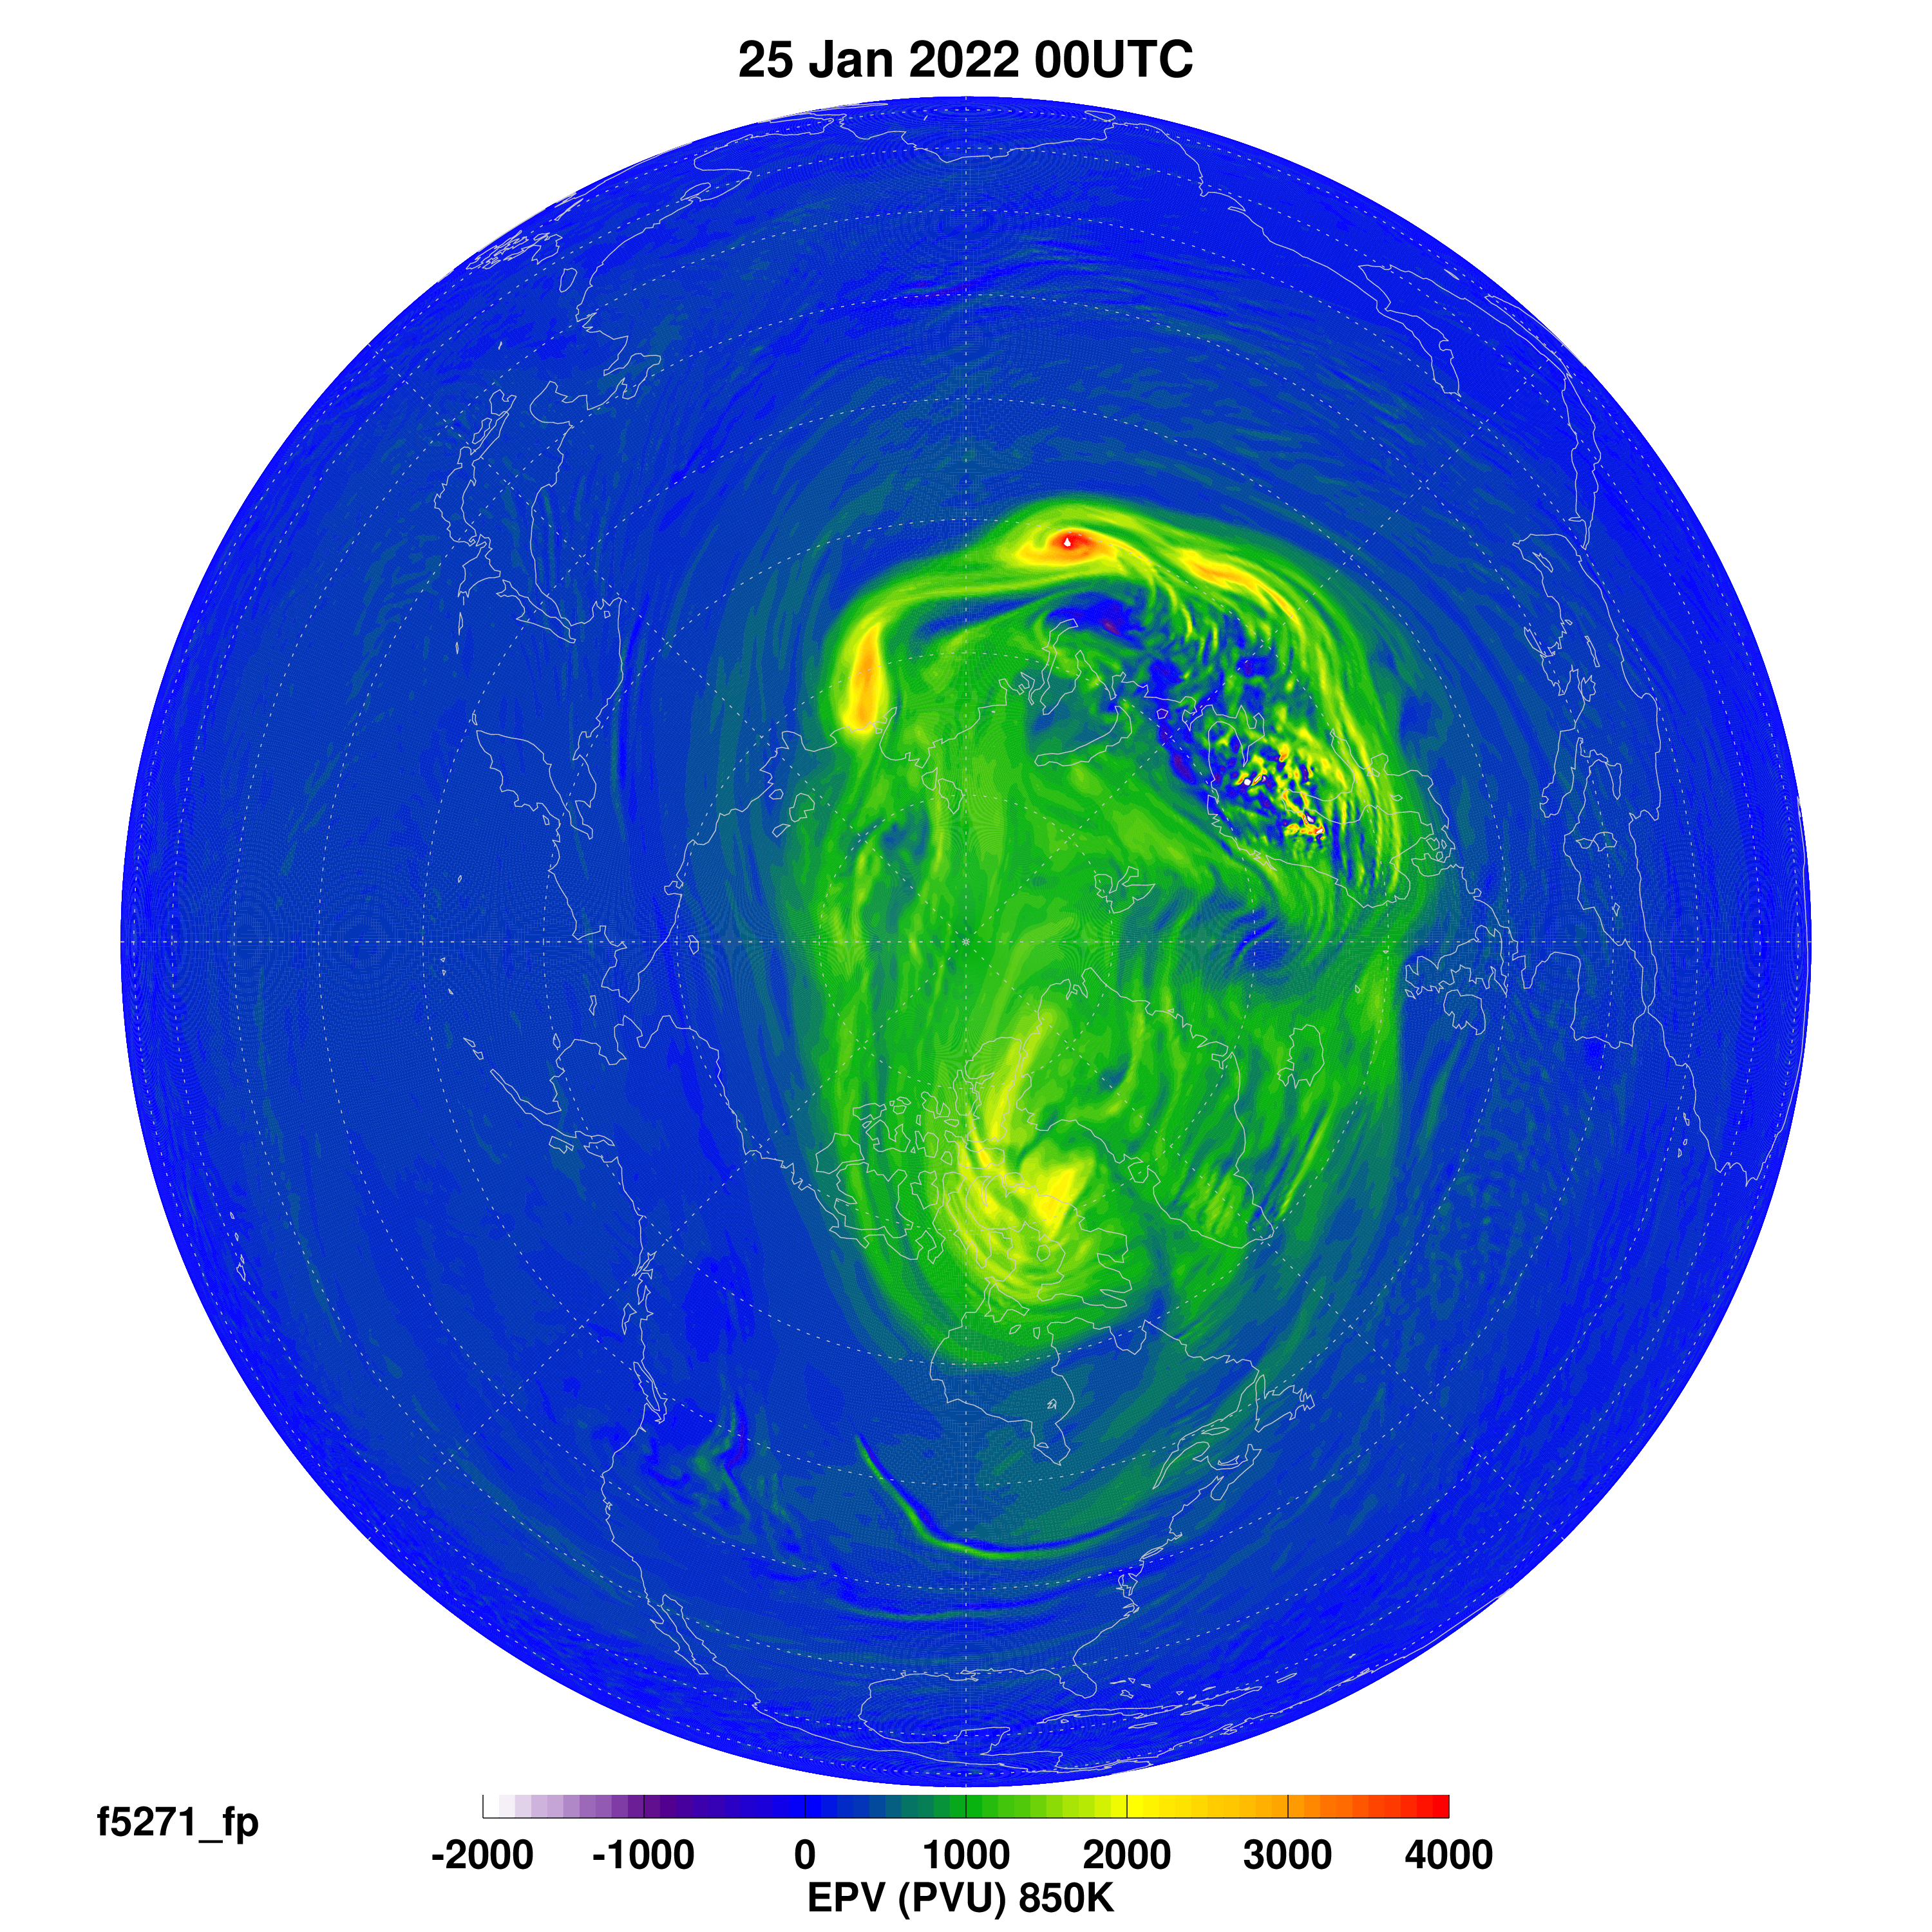
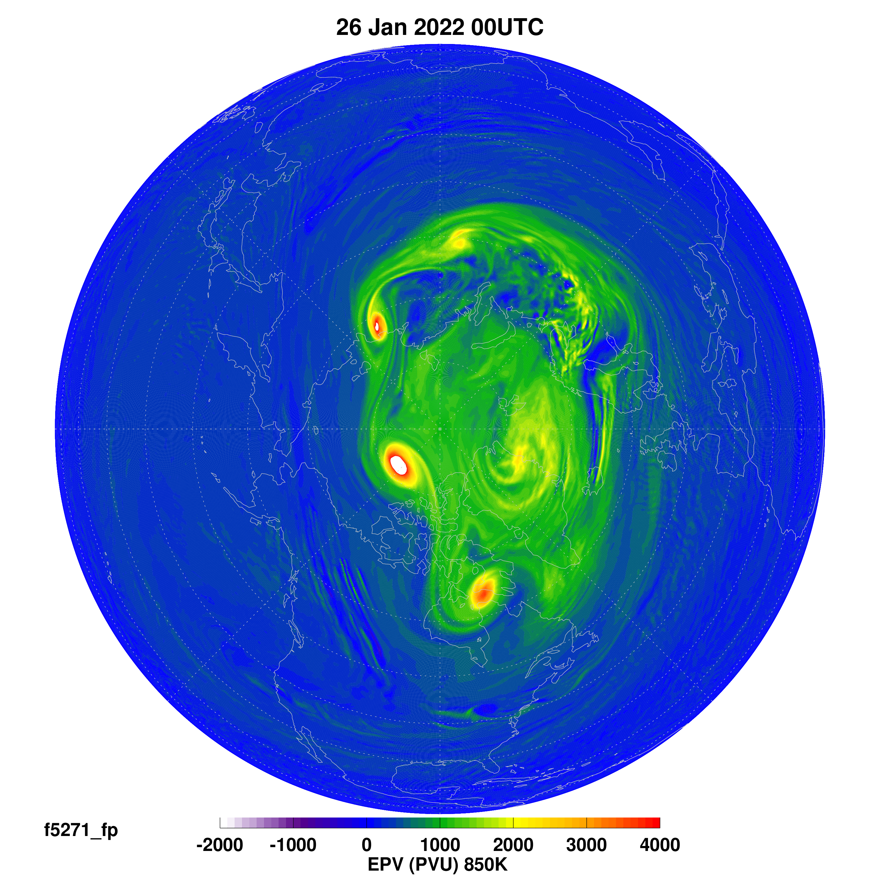
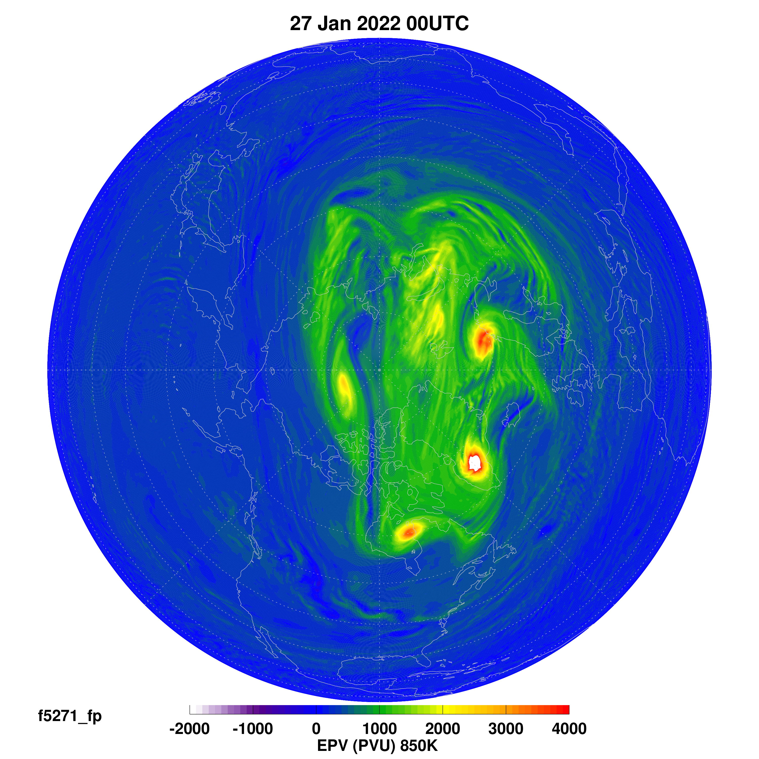
These breaking gravity waves created unstable flow around the vortex that led to well defined high EPV eddies
Breaking Gravity Waves
Breaking Gravity Waves
B
D
C
A
C
A
B
D
B
A
C
24
25
Mixing
26
27
January 2022
Notes:
Going back to the formation and character of the PV eddies, we can look at the three days leading up to the 27th. The small scale eddies begin near the breaking gravity wave regions and then grow and propagate around the vortex. This can make a great animation, but here I’ve just identified them by letters at each time. I’ve increased the PV scale for these plots but they are still off scale at the highest PV. You can see the potential for mixing into the vortex in some places, for example here near the “A” PV eddy on the 26th.

Slide 7
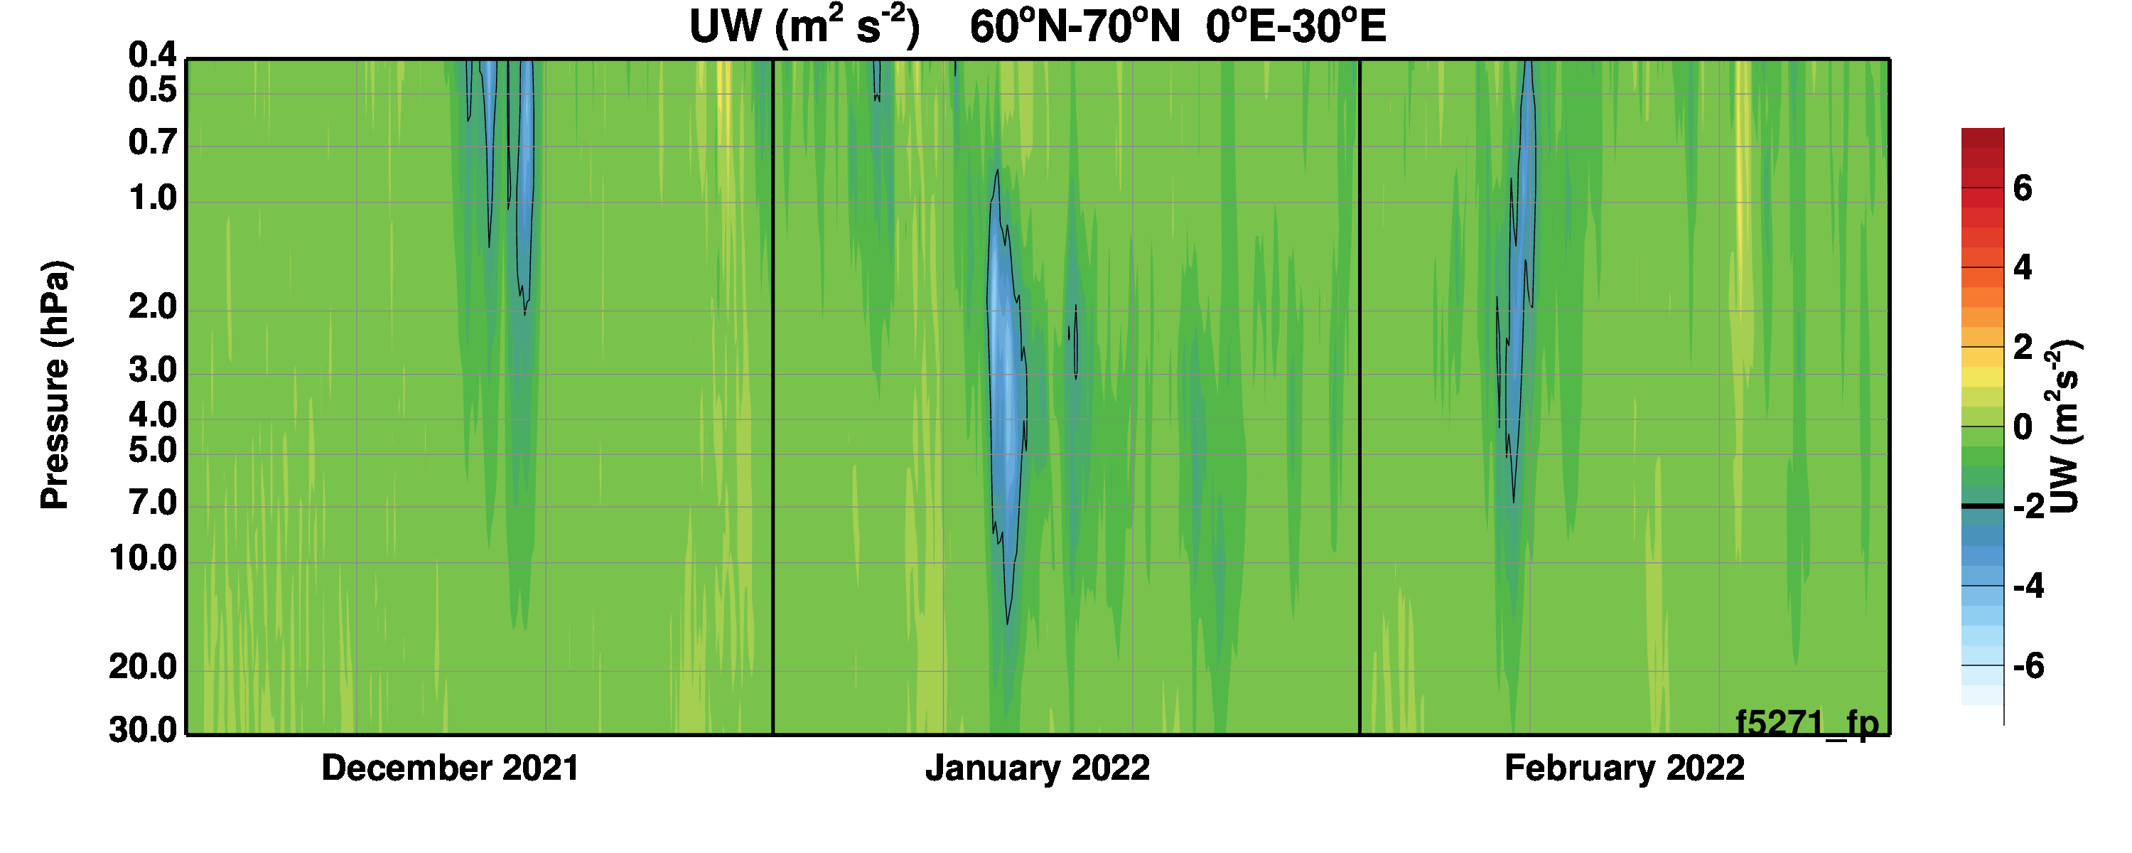
Strong gravity wave momentum fluxes appeared in January 2022 over the wave breaking region
Upper Stratosphere
Lower Stratosphere
Strong Wave Activity
Notes:
Returning to the resolved gravity waves, the resolved momentum flux over Northern Europe shows a strong increase right when the gravity wave activity increases.

Slide 8
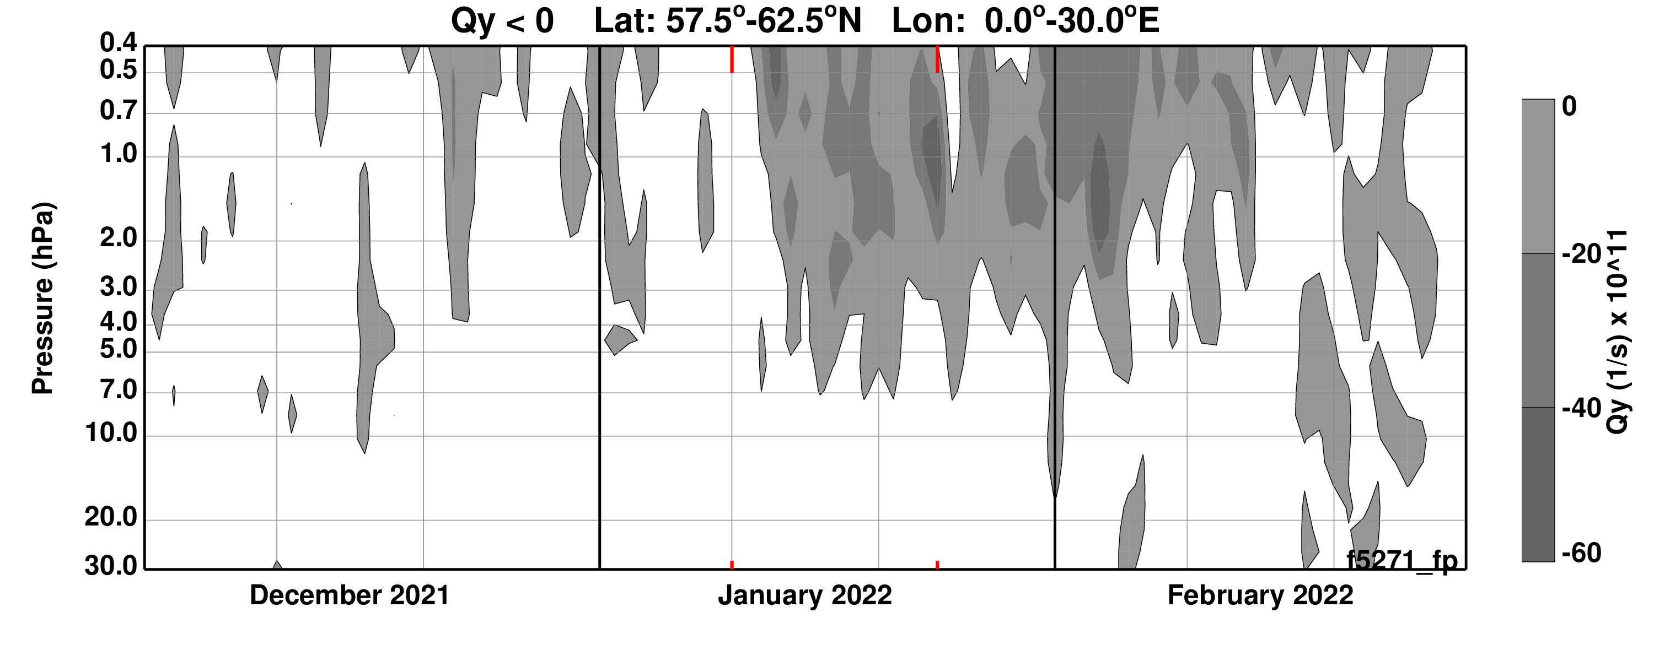
This gravity wave activity developed a persistent region conducive to jet instability (negative Qy)
Upper Stratosphere
Upper Stratosphere
Lower Stratosphere
Lower Stratosphere
Strong Wave Activity
Notes:
As the gravity waves slow the zonal wind the conditions for flow instability can change. Here the gray shading shows that as the gravity wave activity increases a persistent region of negative Q bar y, the meridional potential vorticity gradient, forms. Negative Q bar y is one measure of potential instability. In other words, the breaking gravity waves can lead to instability of the polar vortex flow.

Slide 9
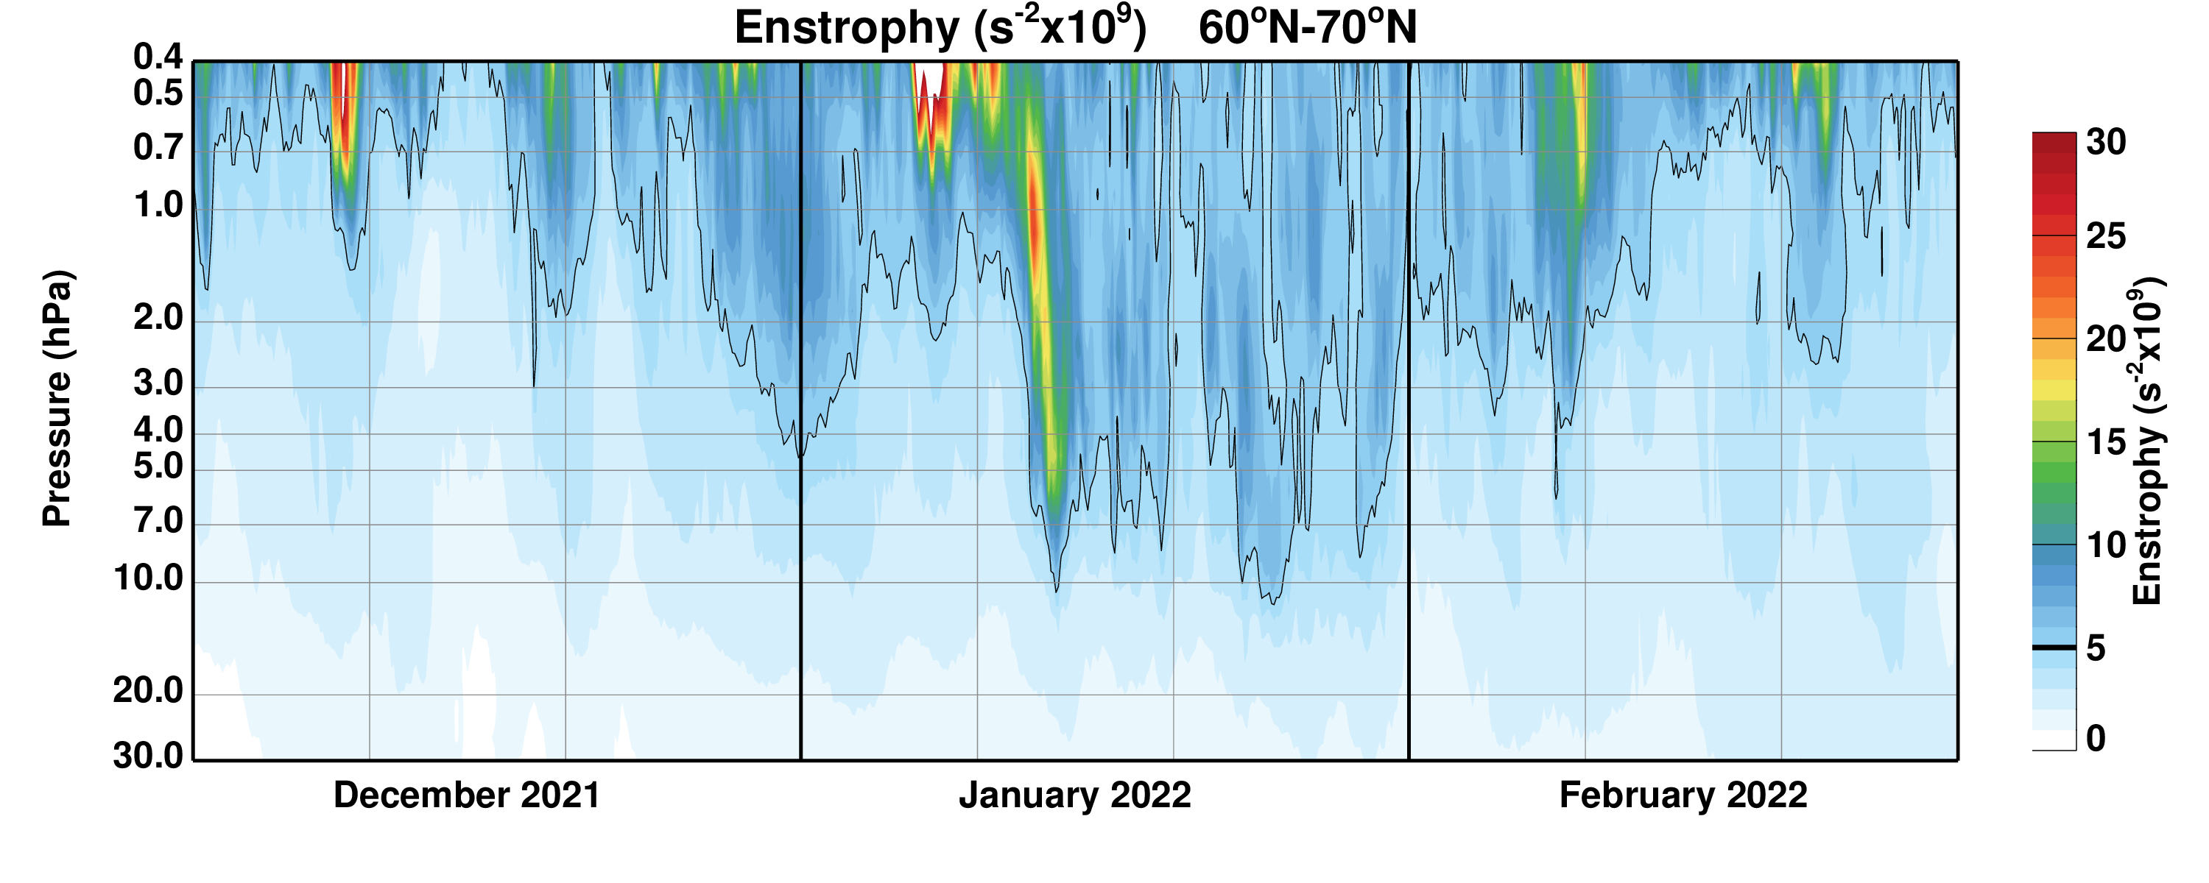
The breaking gravity waves and subsequent eddies increased the enstropy (square of the vorticity) in the polar region
Upper Stratosphere
Lower Stratosphere
Strong Wave Activity
Notes:
Looking in the polar region, we can characterize the polar vortex change from early to late January by an increase in enstrophy (the square of the vorticity field). Note the strong increase in January coincident with the gravity wave increase. This diagnostic can differentiate between a peaceful, undisturbed vortex, and one dominated by small scale fluctuations due either to breaking gravity waves or potential vorticity eddies. The vortex was especially disturbed during the second half of January 2022.

Slide 10
The character of the EPV field changed in response to the breaking gravity waves
Little GW Activity
Highs near pole
Lows south
Strong GW Activity
Highs and Lows near Orography
Still Strong GW Activity
Strong Eddy Tracked
Notes:
We can locate the regions of breaking gravity waves by locating the highest and lowest potential vorticity values at each three hourly analysis time. Here January is divided into three times: early, mid-month, and late. At first the PV is distributed as in the climate mean, with low PV toward the equator and high PV toward the pole. But by mid-January, the breaking gravity waves have created mixed high and low regions as in the PV maps shown earlier. These are over Europe with some activity from Greenland as well. Later in the month these gravity wave breaking regions are still active along with Iceland, however, a new feature appears, as for several days one of the propagating PV eddies has taken over the highest PV spot.

Slide 11
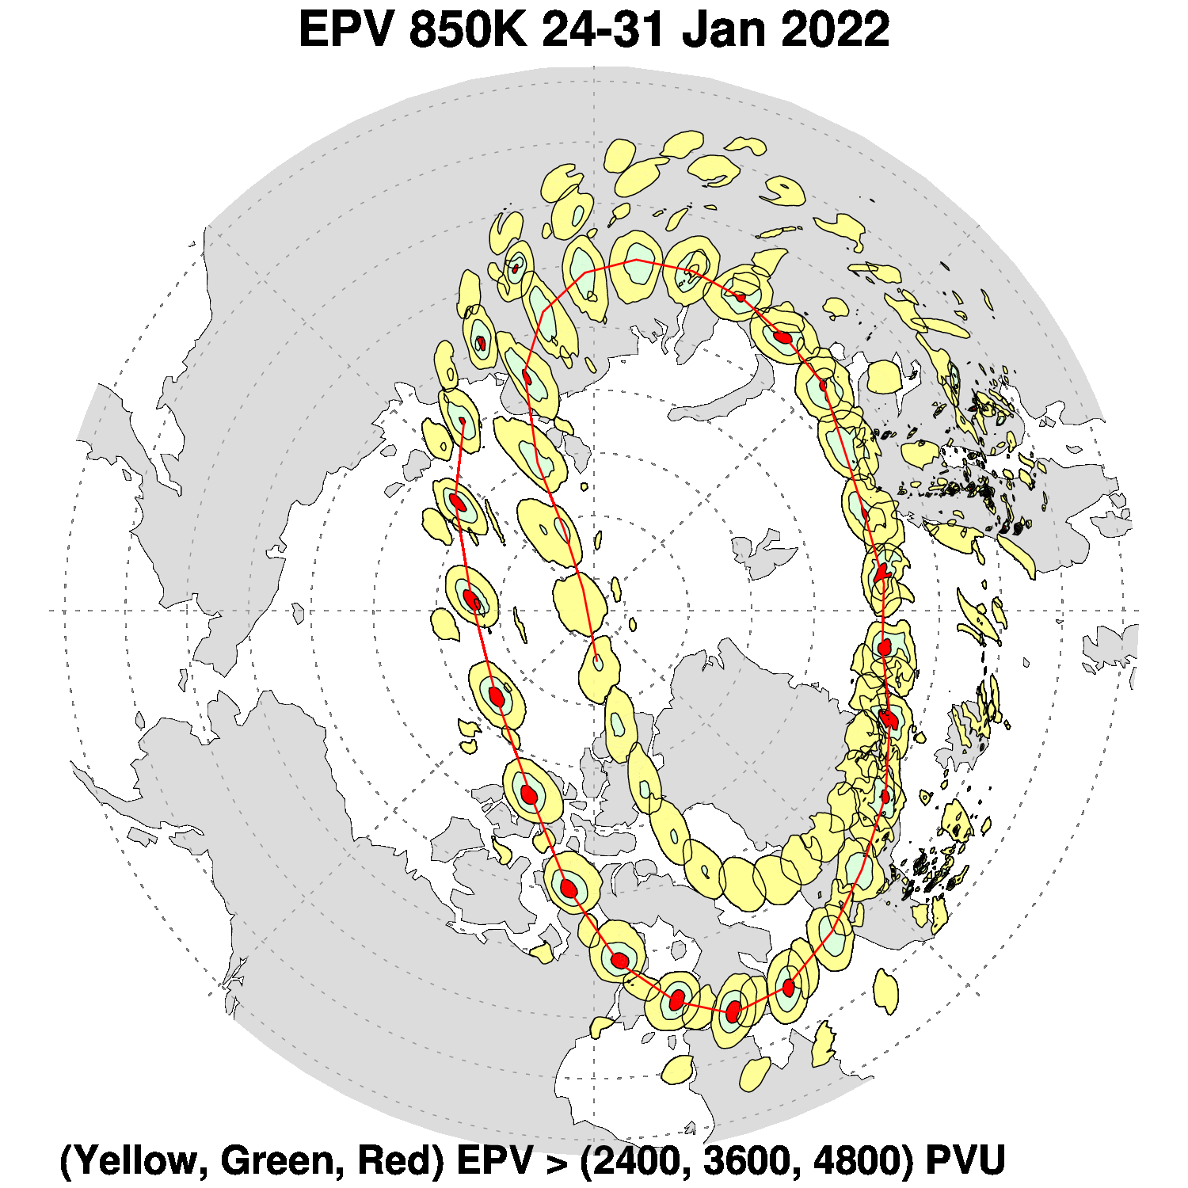
High EPV eddy, originating in the breaking gravity wave region, is tracked twice around the vortex
25
28
29
EPV plotted every three hours
26
30
27
Notes:
Here is another view of the highest PV eddy as only the very highest PV values are plotted for each three hourly analysis. You can see the origin of the eddy from the breaking gravity wave region and growth from the 25th to the 26th and then the continued propagation around the edge of the polar vortex. What kind of vertical structure do these polar eddies have? Well, we can take a latitude cross section through the strong eddy on the 26th along the blue line.

Slide 12
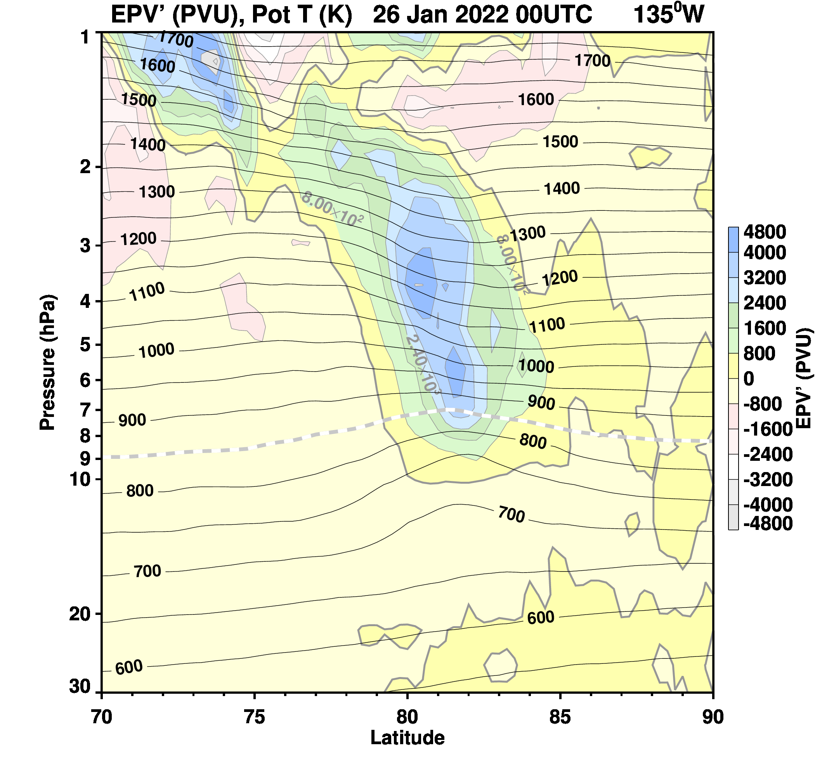
Eddy structure extends from about 20 to 2 hPa
1 hPa
EPV deviation from the zonal mean
Potential temperature cross section
2 hPa
20—2 hPa
850K
10 hPa
20 hPa
30 hPa
70N
90N
Notes:
The PV anomaly extends from about 20 to 2 hPa. Note that the PV eddy doesn’t extend down to the lower stratosphere where the potential temperature surfaces remain nearly linear toward the pole. The PV eddies are mainly in the upper stratosphere, above 10 hPa, leaving the lower stratosphere polar vortex undisturbed.

Slide 13
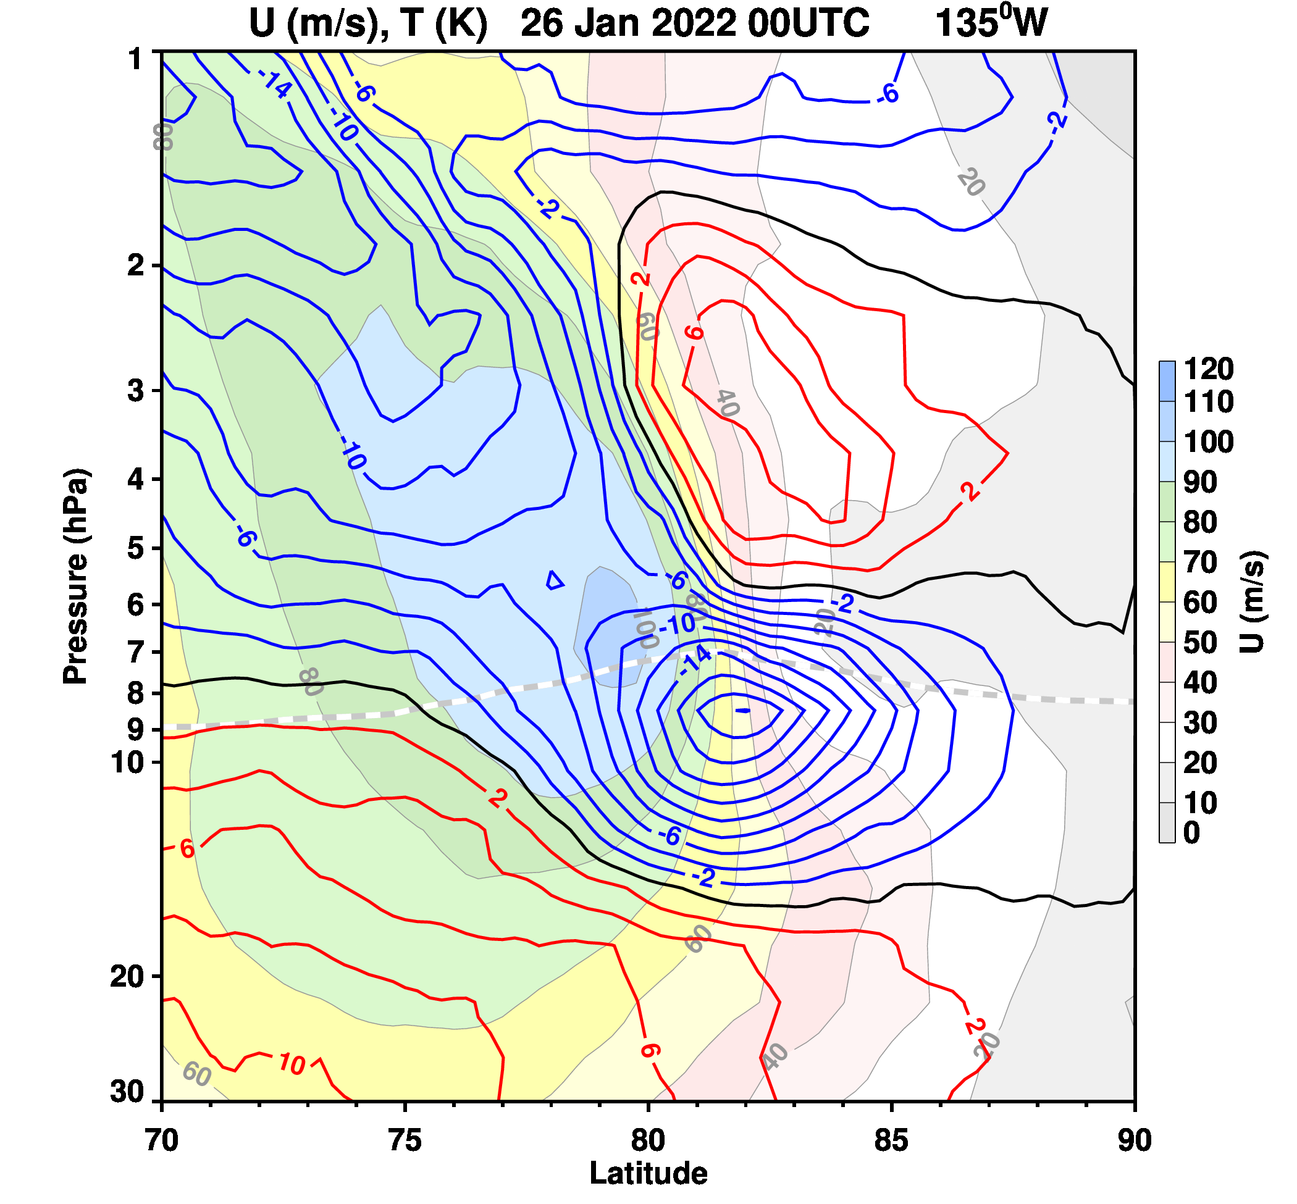
The zonal wind gradient is strong at the center of the PV eddy.
1 hPa
Zonal wind deviation from the zonal mean
Temperature deviation from zonal mean
2 hPa
20—2 hPa
850K
10 hPa
20 hPa
30 hPa
70N
90N
Notes:
The PV eddy is is cold below about 10 hPa, the blue contours, and warm above, the red contours, while the filled color contours show the strong zonal wind gradient associated with the strong vorticity at the center of the eddy.

Slide 14
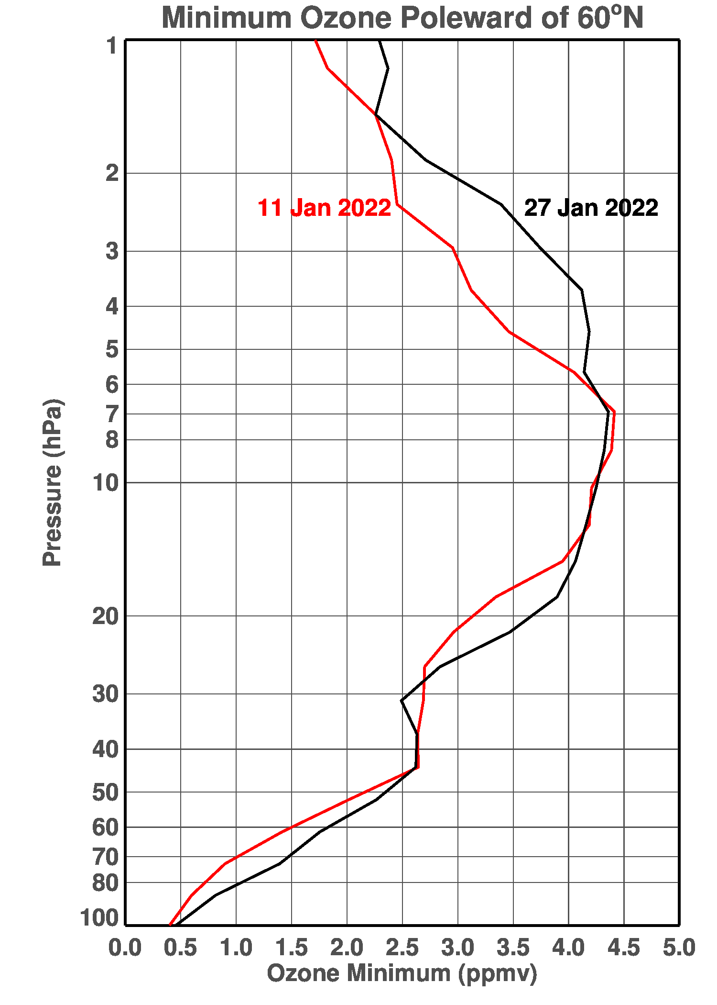
Mixing may have increased polar ozone in the upper stratosphere
11 to 27 January 2022
Minimum Value of Ozone Increases in the NH Polar Region
Notes:
What about mixing? Well, more needs to be done to study mixing but just to show one early result, we found that the minimum value of ozone increased from the 11th to the 27th of January in the upper stratosphere, suggesting that mixing of high ozone into the upper stratosphere polar region during this time may have been influence by the PV eddies.

Slide 15
In summary, breaking gravity waves can significantly disturb the polar vortex in the upper stratosphere
Gravity Waves breaking in the middle stratosphere (~10 hPa) can disturb the polar vortex edge, creating high and low EPV values.
If widespread the GW breaking can create significant EPV disturbances along the vortex edge.
If unstable, the perturbed EPV can lead to the formation of small vortices along the edge of the polar vortex.
These vortices can potentially lead to increased mixing of trace gases into the polar vortex.
Breaking Gravity Wave Region
D
C
B
A
Notes:
In summary, breaking gravity wave can significantly disturb the upper stratospheric polar vortex.
If wave breaking can create significant instabilities in the vortex PV distribution, it can then lead to eddies along the vortex edge and possibly mixing into the polar vortex.
Thank you.

