Slide 1

Supporting local government public health and air quality decision-making with a sub-city scale air quality forecasting system from data fusion of models, satellite, in-situ measurements, and low-cost sensors
K. Emma Knowland, Carl Malings, Nathan Pavlovic
January 26, 2o24
Notes:
Feel free to add any graphics
Supporting local government public health and air quality decision-making with a sub-city scale air quality forecasting system from data fusion of models, satellite, in-situ measurements, and low-cost sensors

Slide 2
Project Summary
Supporting local government public health and air quality decision-making with a sub-city scale air quality forecasting system from data fusion of models, satellite, in-situ measurements, and low-cost sensors
Supporting decision-making with a sub-city scale data fusion system
PI: K. Emma Knowland, Science PIs: Carl Malings, Nathan Pavlovic
NNH21ZDA001N-HAQ:A.37 Earth Science Applications: Health and Air Quality
To address the needs of three end-user groups (Dakar, Senegal; Rio de Janeiro, Brazil; US EPA) for sub-city scale air quality (AQ) estimates and forecasts we will expand an existing AQ data fusion tool (currently ARL 6) implemented in Google Earth Engine (GEE) by our project team members at Sonoma Technology, Inc. (STI) using new methods developed by the NASA GMAO (currently ARL 3) which will give it the capability of providing sub-city scale resolution and hourly frequency estimates and forecasts of three key AQ indicators: PM2.5, NO2, and O3. We will implement the new data fusion capabilities into the existing GEE tool in consultation with our end-users to best address their needs for sub-city scale AQ estimates and forecasts, combining global models and Earth Observations with local ground-based observations and/or LCS where available.
CONUS, Global South

Slide 3
Earth Observations,
Models, and/or Technologies
Satellite Sensor/Model/Tech. | Product Used | Temporal Coverage and Latency required | Comments
NASA GEOS-CF | “surface” PM2.5, NO2, O3 | Global, 0.25x0.25 degree, historical estimates & daily 5-day forecast | Historical estimates & forecasts available on Google Earth Engine (GEE)
ESA TROPOMI | Tropospheric column NO2, Total column O3 | Global, ~5.5x3.5km resolution, 1-2 day latency preferred | Available in GEE
NASA MODIS | MAIAC AOD | Global, 1x1km resolution, 1-2 day latency preferred | Available in GEE
ECMWF CAMS | “surface” PM2.5, NO2, O3 | Global, 40x40km, historical estimates & twice-daily 5-day forecast | Available in GEE, optional additional dataset
Supporting decision-making with a sub-city scale data fusion system

Slide 4
Earth Observations,
Models, and/or Technologies (cont.)
Future needs in Google Earth Engine and Future missions.
Satellite Sensor/Model/Tech. | Product Used | Temporal Coverage and Latency required | Comments
NASA/NOAA VIIRS¹ | AOD | Global, 6x6km resolution, 1-2 day latency preferred | Replacement for MODIS AOD
Regulatory air quality monitoring data | Surface PM_{2.5}, NO₂, O₃ monitor data from reference instruments | Site-specific, 1-2 day latency preferred | Provided by end-users or air quality data aggregators
Low-cost sensor air quality monitoring data | Surface PM_{2.5}, NO₂, O₃ monitor data from low-cost instruments | Site-specific, 1-2 day latency preferred | Provided by end-users or air quality data aggregators
NASA MAIA | Proposed surface PM_{2.5} data product | Primary and Secondary targets | Future missions Optional additional datasets once available
NASA TEMPO | Proposed aerosol, NO₂, O₃ profile products | Geostationary over North America
¹Ideally we would like to use the 0.75 km MAIAC VIIRS AOD product, anticipated to be available soon
Supporting decision-making with a sub-city scale data fusion system

Slide 5
Project Partners/Collaborators
Role | Name | Affiliation | Organization Type
PI | K. Emma Knowland | Morgan State University/GESTAR-II, NASA GSFC GMAO | University, Co-operative Agreement
Science PI | Carl Malings | Morgan State University/GESTAR-II, NASA GSFC GMAO | University, Co-operative Agreement
Science PI | Nathan Pavlovic | SonomaTech, Inc | Private Sector
Co-I, Institutional PI | Stephen Cohn | NASA GSFC GMAO | Government
Co-I | Christoph Keller | Morgan State University/GESTAR-II, NASA GSFC GMAO | University, Co-operative Agreement
Collaborator | John White | U.S. Environmental Protection Agency (EPA) | Government
Collaborator | Sean Khan | United Nations Environment Programme (UNEP) | Intergovernmental organization
Collaborator | Randall Martin | Washington University in St. Louis | University
Collaborator | Dan Westervelt | Lamont-Doherty Earth Observatory | University
Collaborator | Sean Wihera | Clarity | Private Sector
Supporting decision-making with a sub-city scale data fusion system

Slide 6
Project End-users & Stakeholders
Organization Name | Organization Type | Decision Making Activity
City of Rio de Janiero, Brazil (Instituto Pereira Passos, Prefeitura do Rio de Janeiro; Contacts: Felipe Mandarino & Bruno Boscaro) | Government | Advance warning system for potential air-quality related hospital visits
City of Dakar, Senegal (Contact: UNEP) | Government | Analysis and forecasting for transportation policy for AQ exceedance abatement strategies
US EPA (State Air Quality managers from Mississippi, Idaho, Oregon, Colorado) | Government | Incorporating low-cost sensors into their Air Quality forecasting and information systems
Engagement plan and recent updates
Monthly meetings with City of Rio de Janiero partners and the NASA-Rio partnership scientists from Goddard and NYU. Knowland received additional funding to support this project as part of the NASA-Rio partnership and visited Rio in Nov 2023.
Supporting decision-making with a sub-city scale data fusion system

Slide 7
Schedule & Milestones (Proposed)
GMAO:
Keller, Cohn
* with LDEO (Westervelt) & Clarity (Wihera)
⁺ with WUSTL (Martin)
Knowland
Malings
STI: Pavlovic, AQ scientists, software engineers
US EPA (White) & UNEP (Khan) supporting end-users
Objective & Tasks | Objective & Tasks | Year 1 |  | Year 2 |  | Year 3
1 | a. Import new datasets to GEE, including GEOS-CF and RGM and LCS data
 | b. Merge existing GMAO and UNEP/STI data fusion methodologies
 | c. Refine data fusion system, including uncertainty quantification capabilities⁺
 | d. Incorporate LCS in the data fusion system, with uncertainty quantification*
 | e. Implement data fusion system into GEE tool, including interfaces
 | f. Refine GEE tool, especially input/output capability and interfaces
2 | a. Assess the status and identify key end-user needs for the GEE tool
 | b. Train end-users in the functionality and capabilities of the GEE tool*
 | c. Pilot deployment of GEE tool in end-user domains of interest
3 | a. Validate data fusion system in end-user domains of interest⁺
 | b. Integrate GEE tool into end-user decision-making processes
 | c. Evaluate the project’s impact on decision-making outcomes
 | d. Integrate GEE tool with US EPA AirNow-Tech and UNEP GEMS Air systems
 | e. Transfer GEE tool to US EPA, UNEP, end-users for operational use
Anticipated Application Readiness Level (ARL) metric |  | 3 |  | 4 | 5 | 6,7 | 8,9
Supporting decision-making with a sub-city scale data fusion system

Slide 8
Schedule & Milestones (Revised)
GMAO:
Keller, Cohn
* with LDEO (Westervelt) & Clarity (Wihera)
⁺ with WUSTL (Martin)
Knowland
Malings
STI: Pavlovic, AQ scientists, software engineers
US EPA (White) & UNEP (Khan) supporting end-users
Objective & Tasks | Objective & Tasks | Year 1 |  | Year 2 |  | Year 3
1 | a. Import new datasets to GEE, including GEOS-CF and RGM and LCS data
 | b. Merge existing GMAO and UNEP/STI data fusion methodologies
 | c. Refine data fusion system, including uncertainty quantification capabilities⁺
 | d. Incorporate LCS in the data fusion system, with uncertainty quantification*
 | e. Implement data fusion system into GEE tool, including interfaces
 | f. Refine GEE tool, especially input/output capability and interfaces
2 | a. Assess the status and identify key end-user needs for the GEE tool
 | b. Train end-users in the functionality and capabilities of the GEE tool*
 | c. Pilot deployment of GEE tool in end-user domains of interest
3 | a. Validate data fusion system in end-user domains of interest⁺
 | b. Integrate GEE tool into end-user decision-making processes
 | c. Evaluate the project’s impact on decision-making outcomes
 | d. Integrate GEE tool with US EPA AirNow-Tech and UNEP GEMS Air systems
 | e. Transfer GEE tool to US EPA, UNEP, end-users for operational use
Anticipated Application Readiness Level (ARL) metric |  | 2 | 3 | 4 | 5 | 6,7 | 8,9
Q2 Y2: Obj. 1: Malings et al. making progress on uncertainty quantification (manuscript with co-authors for comment), STI have working prototype for Rio in GEE. Need AirNow data in GEE for prototype over USA.
Supporting decision-making with a sub-city scale data fusion system

Slide 9
Schedule & Milestones (Revised)
GMAO:
Keller, Cohn
* with LDEO (Westervelt) & Clarity (Wihera)
⁺ with WUSTL (Martin)
Knowland
Malings
STI: Pavlovic, AQ scientists, software engineers
US EPA (White) & UNEP (Khan) supporting end-users
Objective & Tasks | Objective & Tasks | Year 1 |  | Year 2 |  | Year 3
1 | a. Import new datasets to GEE, including GEOS-CF and RGM and LCS data
 | b. Merge existing GMAO and UNEP/STI data fusion methodologies
 | c. Refine data fusion system, including uncertainty quantification capabilities⁺
 | d. Incorporate LCS in the data fusion system, with uncertainty quantification*
 | e. Implement data fusion system into GEE tool, including interfaces
 | f. Refine GEE tool, especially input/output capability and interfaces
2 | a. Assess the status and identify key end-user needs for the GEE tool
 | b. Train end-users in the functionality and capabilities of the GEE tool*
 | c. Pilot deployment of GEE tool in end-user domains of interest
3 | a. Validate data fusion system in end-user domains of interest⁺
 | b. Integrate GEE tool into end-user decision-making processes
 | c. Evaluate the project’s impact on decision-making outcomes
 | d. Integrate GEE tool with US EPA AirNow-Tech and UNEP GEMS Air systems
 | e. Transfer GEE tool to US EPA, UNEP, end-users for operational use
Anticipated Application Readiness Level (ARL) metric |  | 2 | 3 | 4 | 5 | 6,7 | 8,9
Q2 Y2: Obj. 2: end-user needs include tool can identify where new monitoring stations (reg or LCS) should be sited.
Supporting decision-making with a sub-city scale data fusion system

Slide 10
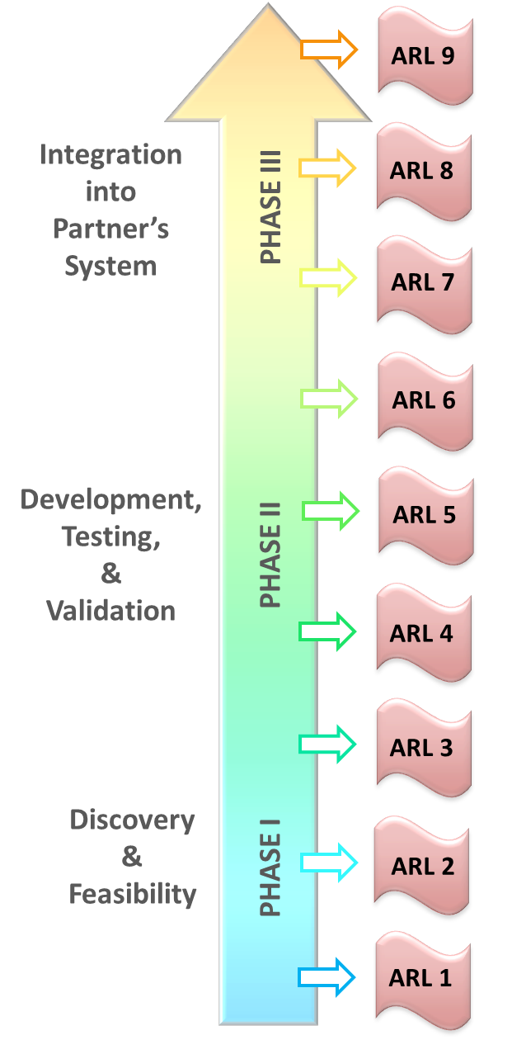
ARL Performance
Start-of-Project ARL = 2 (July 26, 2022)
  Fundamental data fusion methodology published in peer-reviewed journal: Malings et al. 2021: https://doi.org/10.1029/2021EA001743
  Nathan Pavlovic (Sonoma Technologies, Inc.) had implemented a similar methodology in Google Earth Engine on behalf of end-user UNEP
Goal ARL = 9
Current ARL = 4 (January 26, 2024)
  See subsequent slides
October 26, 2023
April 26, 2023
July 26, 2022
July 26, 2022
Supporting decision-making with a sub-city scale data fusion system

Slide 11
Current ARL-Supporting Evidence
Add details of support for your current ARL level (feel free to use as many slides as you would like)
These descriptions will be used to report progress to our upper-level management through Science Mission Directorate weekly summaries.
Supporting decision-making with a sub-city scale data fusion system

Slide 12
Current ARL-Supporting Evidence
ARL 2, Milestone 1: Independent Application Components Formulated and Created
Testing of an offline version of the proposed data fusion tool (implemented in Python, run on the NCCS Discover computing cluster) for surface NO₂ forecasting showed that the proposed method (solid lines) typically outperformed the baseline methods (dashed lines) in five cities during the testing period. Results published in Malings et al., 2021 (https://doi.org/10.1029/2021EA001743).
Supporting decision-making with a sub-city scale data fusion system

Slide 13
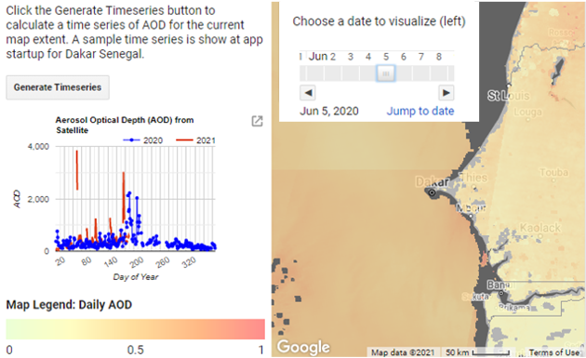
Current ARL-Supporting Evidence
ARL 2, Milestone 1: Independent Application Components Formulated and Created
Prior to the project proposal, Nathan Pavlovic of Sonoma Technologies, Inc, had implemented a Google Earth Engine data fusion tool for estimating surface PM_{2.5} concentrations by combining model (ECMWF CAMS), satellite (MODIS), and ground-based monitor data. This work was done on behalf of UNEP, a project end-user, and included development of a user interface, as shown here.
Supporting decision-making with a sub-city scale data fusion system

Slide 14
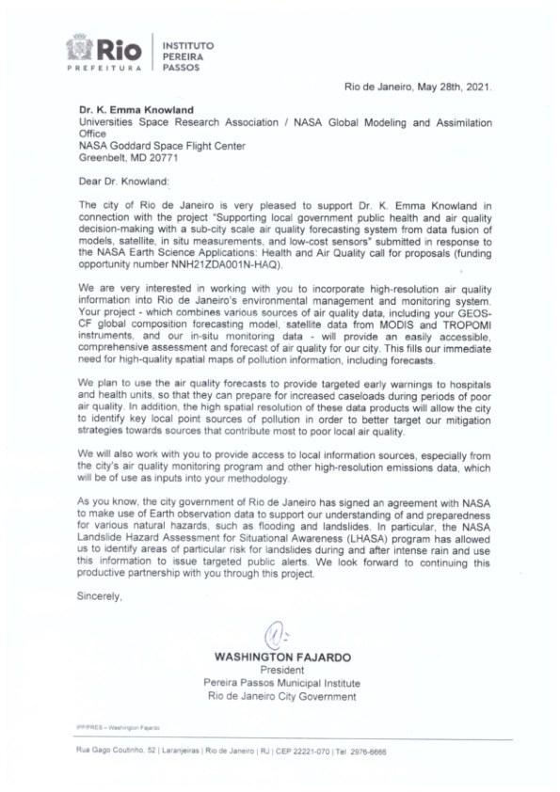
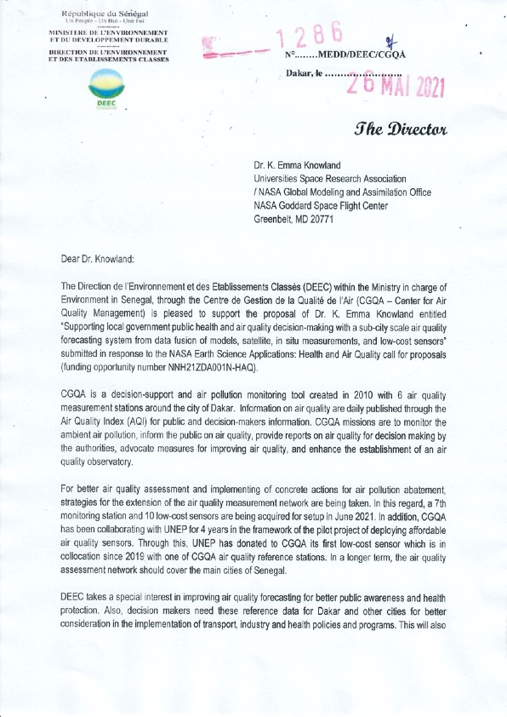
Current ARL-Supporting Evidence
ARL 2, Milestone 2: Decision making activity to be enhanced by the application identified
During the project proposal phased, end-users in Rio de Janeiro, Dakar, and at US EPA presented their use cases for our proposed data fusion tool. End-users in Rio de Janeiro were most interested in using air quality forecasts to support public health early warning. End-users in Dakar were most interested in tracking sub-city scale air quality changes due to new transportation policies. End-users at US EPA were most interested in low-cost sensor data integration.
End-user letters of support outlining the decision making activities to be enhanced by this application.
Supporting decision-making with a sub-city scale data fusion system

Slide 15
Current ARL-Supporting Evidence
ARL 3, Milestone 1: Components of the application tested and validated independently
Task 1a: Import new datasets to GEE, including GEOS-CF and RGM and LCS data
Data Set Type | Data Sources | Status | Notes
Satellite Data Sets | MODIS AOD | Active GEE Ingest
 | VIIRS AOD | Not Ingested | Potential replacement for MODIS AOD
 | TROPOMI NO2 | Active GEE Ingest
Model Data Sets | CAMS | Active GEE Ingest (PM2.5, AOD) | Total column (CO, O3, NO2, AOD components), No surface concentrations beyond PM2.5.
 | GEOS-CF Replay | Active GEE Ingest
 | GEOS-CF Forecast | Active GEE Ingest
RGM Data Sets | Publicly-available data sets | Reviewed sources. Some data available in Google Cloud; others available through public API. | Data refresh frequency in Google Cloud likely insufficient for this application.
 | End-user data sets | Rio data currently being ingested via API | Dakar having difficulties with monitors (no data since 2019).
LCS Data Sets | Publicly-available data sets | Reviewed sources and assessed potential ingest pathway. | Discussion with Clarity regarding data access and quality control.
 | End-user data sets | Discussed with end-users. | Dakar may have new LCS soon.
A preliminary list of key data sets, characteristics, and real-time sources has been developed. The list of data sources will be refined to meet the needs of methodologies and reflect available stakeholder datasets and needs.
Supporting decision-making with a sub-city scale data fusion system

Slide 16
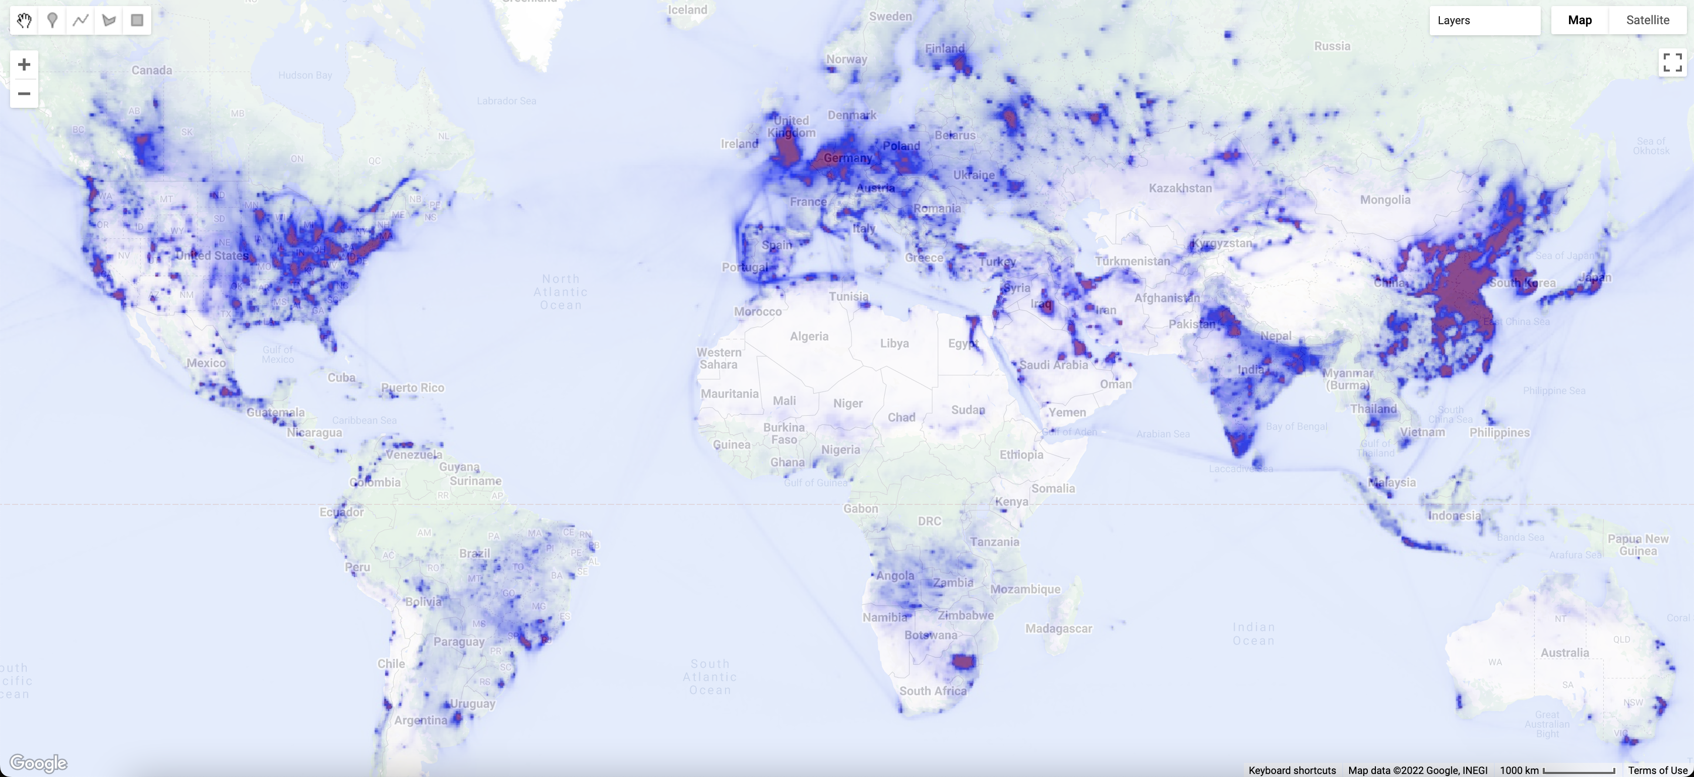
Current ARL-Supporting Evidence
ARL 3, Milestone 1: Components of the application tested and validated independently
Task 1a: Import new datasets to GEE, including GEOS-CF and RGM and LCS data
GEOS-CF historical estimate files (“replay” files) are currently available on Google Earth Engine as ee.ImageCollection("NASA/GEOS-CF/v1/rpl/tavg1hr").
GEOS-CF forecast files are currently available on Google Earth Engine as ee.ImageCollection("NASA/GEOS-CF/v1/fcst/tavg1hr").
Next steps:
Need others ground-based observations in GEE; have discussed with end-users regarding the best sources for these data.
GEOS-CF Surface NO₂, average week of Sept 8-15, 2022, visualized in Google Earth Engine
Supporting decision-making with a sub-city scale data fusion system

Slide 17
Current ARL-Supporting Evidence
ARL 3, Milestone 1: Components of the application tested and validated independently
Task 1b: Merge existing GMAO and UNEP/STI data fusion methodologies
A conceptual framework for the data fusion system, including the system for surface NO₂ forecasting developed by GMAO and the system of surface PM_{2.5} estimation developed by UNEP/STI, has been developed. Meetings between developers at STI and scientists at GMAO will continue to refine this framework as the project advances.
Model surface concentration
Model column concentration
Satellite column concentration
Surface measurement data
LCS raw data
Phase 1 Adjusted Surface Conc.
Phase 2 Adjusted Surface Conc.
near-realtime updating
Phase 1: Combination of model & satellite data (Mv01 Method, Revised)
Calibration Period (e.g. prior month)
Phase 3 Adjusted Surface Conc.
Model surface concentration
Model surface-to-column ratios at satellite pixels
Model column concentration
B
linear mapping P1 from A to B
average difference of model and mapped satellite
Calibrated LCS
Satellite column concentration
inferred surface concentration satellite pixels
A
average satellite col. mapped to surface via P1
Phase 4 Adjusted Surface Conc.
Forecast Period (e.g. next day)
Model surface concentration
add difference pattern to forecast
adjusted surface forecast
Supporting decision-making with a sub-city scale data fusion system

Slide 18
Current ARL-Supporting Evidence
ARL 3, Milestone 1: Components of the application tested and validated independently
Task 1b: Merge existing GMAO and UNEP/STI data fusion methodologies
A conceptual framework for the data fusion methodologies, including the method for surface NO₂ forecasting developed by GMAO and the system of surface PM_{2.5} estimation method developed by UNEP/STI, has been developed. Meetings between scientists at STI and GMAO will continue to refine this framework as the project advances.
Model column concentration
Model surface concentration
Satellite column concentration
Surface measurement data
LCS raw data
Phase 1 Adjusted Surface Conc.
Phase 2 Adjusted Surface Conc.
near-realtime updating
UNEP/STI (for PM_{2.5})
Phase 3 Adjusted Surface Conc.
GMAO (for NO₂)
Calibrated LCS
Phase 4 Adjusted Surface Conc.
Joint Development (for PM_{2.5}, NO₂, O₃)
Supporting decision-making with a sub-city scale data fusion system

Slide 19
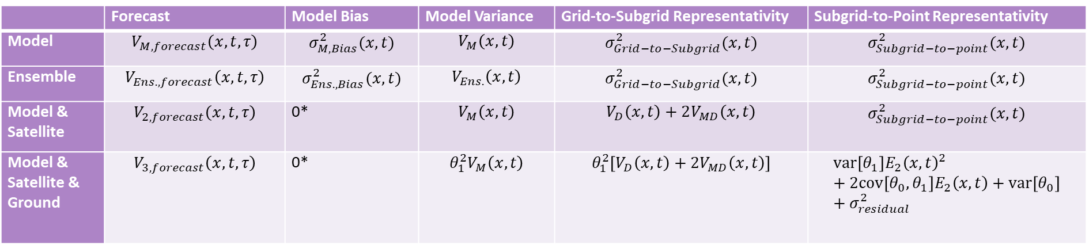
Current ARL-Supporting Evidence
ARL 3, Milestone 1: Components of the application tested and validated independently
Task 1c: Refine data fusion system, including uncertainty quantification capabilities
 | Forecast | Model Bias | Model Variance | Grid-to-Subgrid Representativity | Subgrid-to-Point Representativity
Model | $$V_{M,forecast}\left(x,t,τ\right)$$ | $$σ_{M,Bias}^{2}(x,t)$$ | $$V_{M}\left(x,t\right)$$ | $$σ_{Grid−to−Subgrid}^{2}(x,t)$$ | $$σ_{Subgrid−to−point}^{2}(x,t)$$
Ensemble | $$V_{Ens.,forecast}\left(x,t,τ\right)$$ | $$σ_{Ens.,Bias}^{2}(x,t)$$ | $$V_{Ens.}\left(x,t\right)$$ | $$σ_{Grid−to−Subgrid}^{2}(x,t)$$ | $$σ_{Subgrid−to−point}^{2}(x,t)$$
Model & Satellite | $$V_{2,forecast}\left(x,t,τ\right)$$ | 0* | $$V_{M}\left(x,t\right)$$ | $$V_{D}\left(x,t\right)+2V_{MD}\left(x,t\right)$$ | $$σ_{Subgrid−to−point}^{2}(x,t)$$
Model & Satellite & Ground | $$V_{3,forecast}\left(x,t,τ\right)$$ | 0* | $$θ_{1}^{2}V_{M}\left(x,t\right)$$ | $$θ_{1}^{2}\left[V_{D}\left(x,t\right)+2V_{MD}\left(x,t\right)\right]$$ | $$var\left[θ_{1}\right]E_{2}{\left(x,t\right)}^{2}+2cov\left[θ_{0},θ_{1}\right]E_{2}\left(x,t\right)+var\left[θ_{0}\right]+σ_{residual}^{2}$$
A conceptual framework for the quantification of uncertainty through the data fusion framework has been created and is in the early stages of validation.
Supporting decision-making with a sub-city scale data fusion system

Slide 20
Current ARL-Supporting Evidence
ARL 3, Milestone 1: Components of the application tested and validated independently
Task 1c: Refine data fusion system, including uncertainty quantification capabilities
Phase 1
Model
Phase 2
+ Satellite Data
Phase 3
+ Ground Data
Phase 4
+ Kriging
Preliminary testing of the uncertainty quantification framework shows that most estimated confidence intervals across different data fusion phases (1-4) and site types (colored boxplots in the figure) capture roughly the expected number of observations (75%, the “target” in the figure). The overconfidence observed for “microscale” sites is expected based on known limitations of the current approach.
Next Steps:
Implement uncertainty quantification capabilities in GEE prototype, validate approach in target regions of interest
underconfident
target: 75%
overconfident
representative scale of monitor sites
local regional
Supporting decision-making with a sub-city scale data fusion system

Slide 21
Current ARL-Supporting Evidence
ARL 3, Milestone 1: Components of the application tested and validated independently
Task 1d: Incorporate LCS in the data fusion system
Initial progress towards the integration of low-cost sensor (LCS) data was made using an offline prototype (Python) version of the proposed data fusion system. Testing in London showed a notable benefit to incorporating LCS data for short-term forecast accuracy, while long-term performance still relied mainly on the availability of regulatory monitor (RGM) data. Results presented at the Air Sensors International Conference, Pasadena, CA, 2022.
lcs (persistence)
short-term benefits from in-situ LCS data
lcs (climatology)
model
model+sat
model+recalibrated lcs
model+sat+recalibrated lcs
long-term benefit to calibration with RGM
model+sat+rgm+recalibrated lcs
forecasting results for London, October & November 2019
cross-validation: leave-one-site-out, considering only regulatory sites
plotted results represent average metrics across validation sites
Carl Malings, K. Emma Knowland, Christoph Keller, Stephen Cohn. “Air quality forecasting at sub-city scale by combining models, satellites, and surface measures”. Air Sensors International Conference. Pasadena, California, USA. May 11-13, 2022.
Supporting decision-making with a sub-city scale data fusion system

Slide 22
Current ARL-Supporting Evidence
ARL 3, Milestone 3: A convincing case for the viability of your application concept has been made
Task 1e: Implement data fusion system into GEE tool
Dataset Ingest
Job Scheduler
Google Earth Engine Data Collections
A draft framework application specification, outlining key Google cloud and GEE operational system components, has been developed. System component specifications and functions will be developed as the project progresses, accounting for end user needs and input.
RGM and LCS Datasets
Air Quality Forecasts
Data Fusion System
Retrieve data
Model and Satellite
(Raster) Datasets
Run Fusion and Forecasting Methodologies
Export to Collection
GEE Visualization and Exploration Tools
US EPA and UNEP Systems Integration
Supporting decision-making with a sub-city scale data fusion system

Slide 23
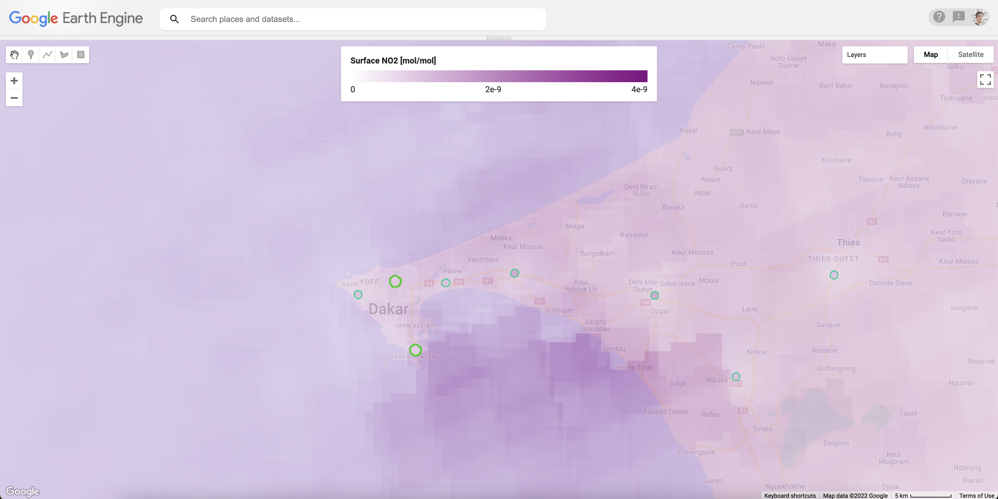
Current ARL-Supporting Evidence
ARL 3, Milestone 3: A convincing case for the viability of your application concept has been made
Task 1e: Implement data fusion system into GEE tool
A prototype of the data fusion tool was implemented in Google Earth Engine. The prototype operated with actual (historical) GEOS-CF model and TROPOMI satellite data, while using synthetic surface monitor data. Comparison of synthetic surface data with the results of data fusion using different inputs showed the expected outcomes. Results presented at AGU 2022 and AMS 2023 conferences.
fused model & satellite estimate of surface NO₂
ground data at monitor sites (synthetic)
Supporting decision-making with a sub-city scale data fusion system

Slide 24
Current ARL-Supporting Evidence
ARL 3, Milestone 3: A convincing case for the viability of your application concept has been made
Task 1e: Implement data fusion system into GEE tool
Synthetic surface data (target)
A prototype of the data fusion tool was implemented in Google Earth Engine. The prototype operated with actual (historical) GEOS-CF model and TROPOMI satellite data, while using synthetic surface monitor data. Comparison of synthetic surface data with the results of data fusion using different inputs showed the expected outcomes. Results presented at AGU 2022 and AMS 2023 conferences.
Comparison during Calibration Period
4E-9
Regulatory Monitor (RGM)
Model
Model & Satellite
Model & Satellite & RGM
with NRT updating
Subsequent steps of the data fusion methodology
3E-9
Surface NO₂ [mol/mol]
2E-9
1E-9
0E0
September 18,
September 19,
September 20,
September 21,
September 22,
September 23,
September 24,
2022
2022
2022
2022
2022
2022
2022
Supporting decision-making with a sub-city scale data fusion system

Slide 25
Current ARL-Supporting Evidence
ARL 3, Milestone 2: Detailed characterization of user decision-making has been completed
GMAO and STI hosted meetings with each end-users group identified for the project. Initial decision support use-cases for the tool written in the project proposal were conformed, and additional potential use cases were discussed. Some end-users (Rio, Denver/Boulder) have air quality forecasting capabilities, so improvements due to the new system can be quantitatively assessed. For most end-users, near-term air quality forecasting will be a new capability, and so quantitatively evaluating the benefits of the new system will be more difficult.
Relevant meetings (2023)
02/28 – Meeting with Dakar end-users, discussion of decision-making support needs to be addressed through this project.
02/28 – Meeting with Rio end-users, discussion of decision-making support needs to be addressed through this project.
04/03 – Meeting with UNEP
04/10 – Meeting with US EPA, discussion of decision-making support needs to be addressed through this project.
04/11 – Follow-up meeting with Rio end-users, discussion of relevant air quality indices and indicators to be used (monthly meetings continue with Rio on the second Tuesday of the month)
04/20 – Meeting with Sean Wihera (Clarity)
Supporting decision-making with a sub-city scale data fusion system

Slide 26
Current ARL-Supporting Evidence
ARL 3, Milestone 2: Detailed characterization of user decision-making has been completed
GMAO and STI hosted meetings with each end-users group identified for the project. Initial decision support use-cases for the tool written in the project proposal were conformed, and additional potential use cases were discussed. Some end-users (Rio, Denver/Boulder) have air quality forecasting capabilities, so improvements due to the new system can be quantitatively assessed. For most end-users, near-term air quality forecasting will be a new capability, and so quantitatively evaluating the benefits of the new system will be more difficult.
Relevant meetings (2023, continued)
05/01-04 – TEMPO meeting, where E. Knowland met IDEQ and CDPHE contacts
05/09 – Meeting with MDEQ stakeholders
05/15 – Meeting with Sally Pusede and Aissatou Faye (U. Virginia) who are also working in Dakar on Air Quality
05/18 – Meeting with IDEQ stakeholders
06/20 – Meeting with EPA collaborators
07/13 – Meeting with ODEQ stakeholders
07/24 – Meeting with EPA collaborators at EPA
08/10 – Meeting with CDPHE stakeholders
Supporting decision-making with a sub-city scale data fusion system

Slide 27
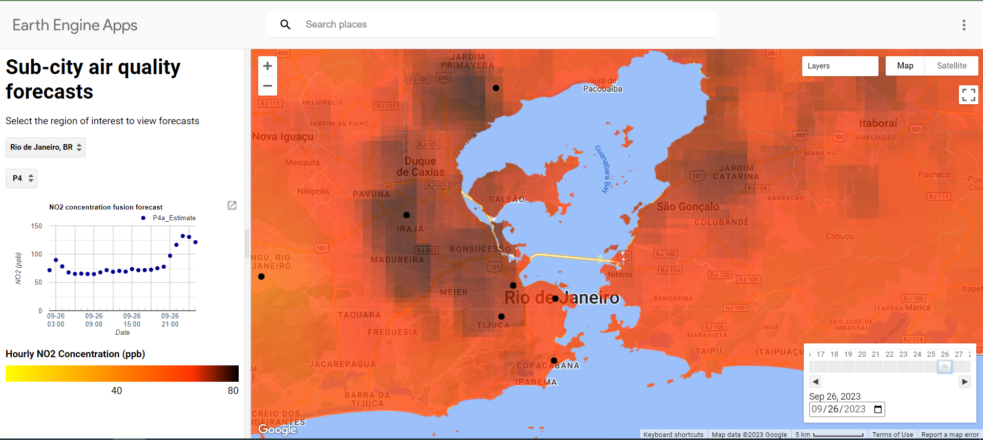
Current ARL-Supporting Evidence
ARL 4, Milestone 1: Components of eventual application system have been brought together and technical integration issues have been worked out.
Task 1e. Implement data fusion system into GEE tool, including interfaces
Supporting decision-making with a sub-city scale data fusion system

Slide 28
Current ARL-Supporting Evidence
ARL 4, Milestone 1: Components of eventual application system have been brought together and technical integration issues have been worked out.
Task 1e: Implement data fusion system into GEE tool, including interfaces
A prototype of the data fusion tool is implemented in Google Earth Engine (screenshot of user interface at left). The prototype operates with actual GEOS-CF forecasts and TROPOMI satellite data, as well as regulatory monitoring data in Rio de Janeiro (obtained via API).
Results have been presented to end-users in Rio for initial feedback.
Region Selector
Data Fusion Phase Control
Forecast Time Series
Date Selector
Monitor sites
Supporting decision-making with a sub-city scale data fusion system

Slide 29
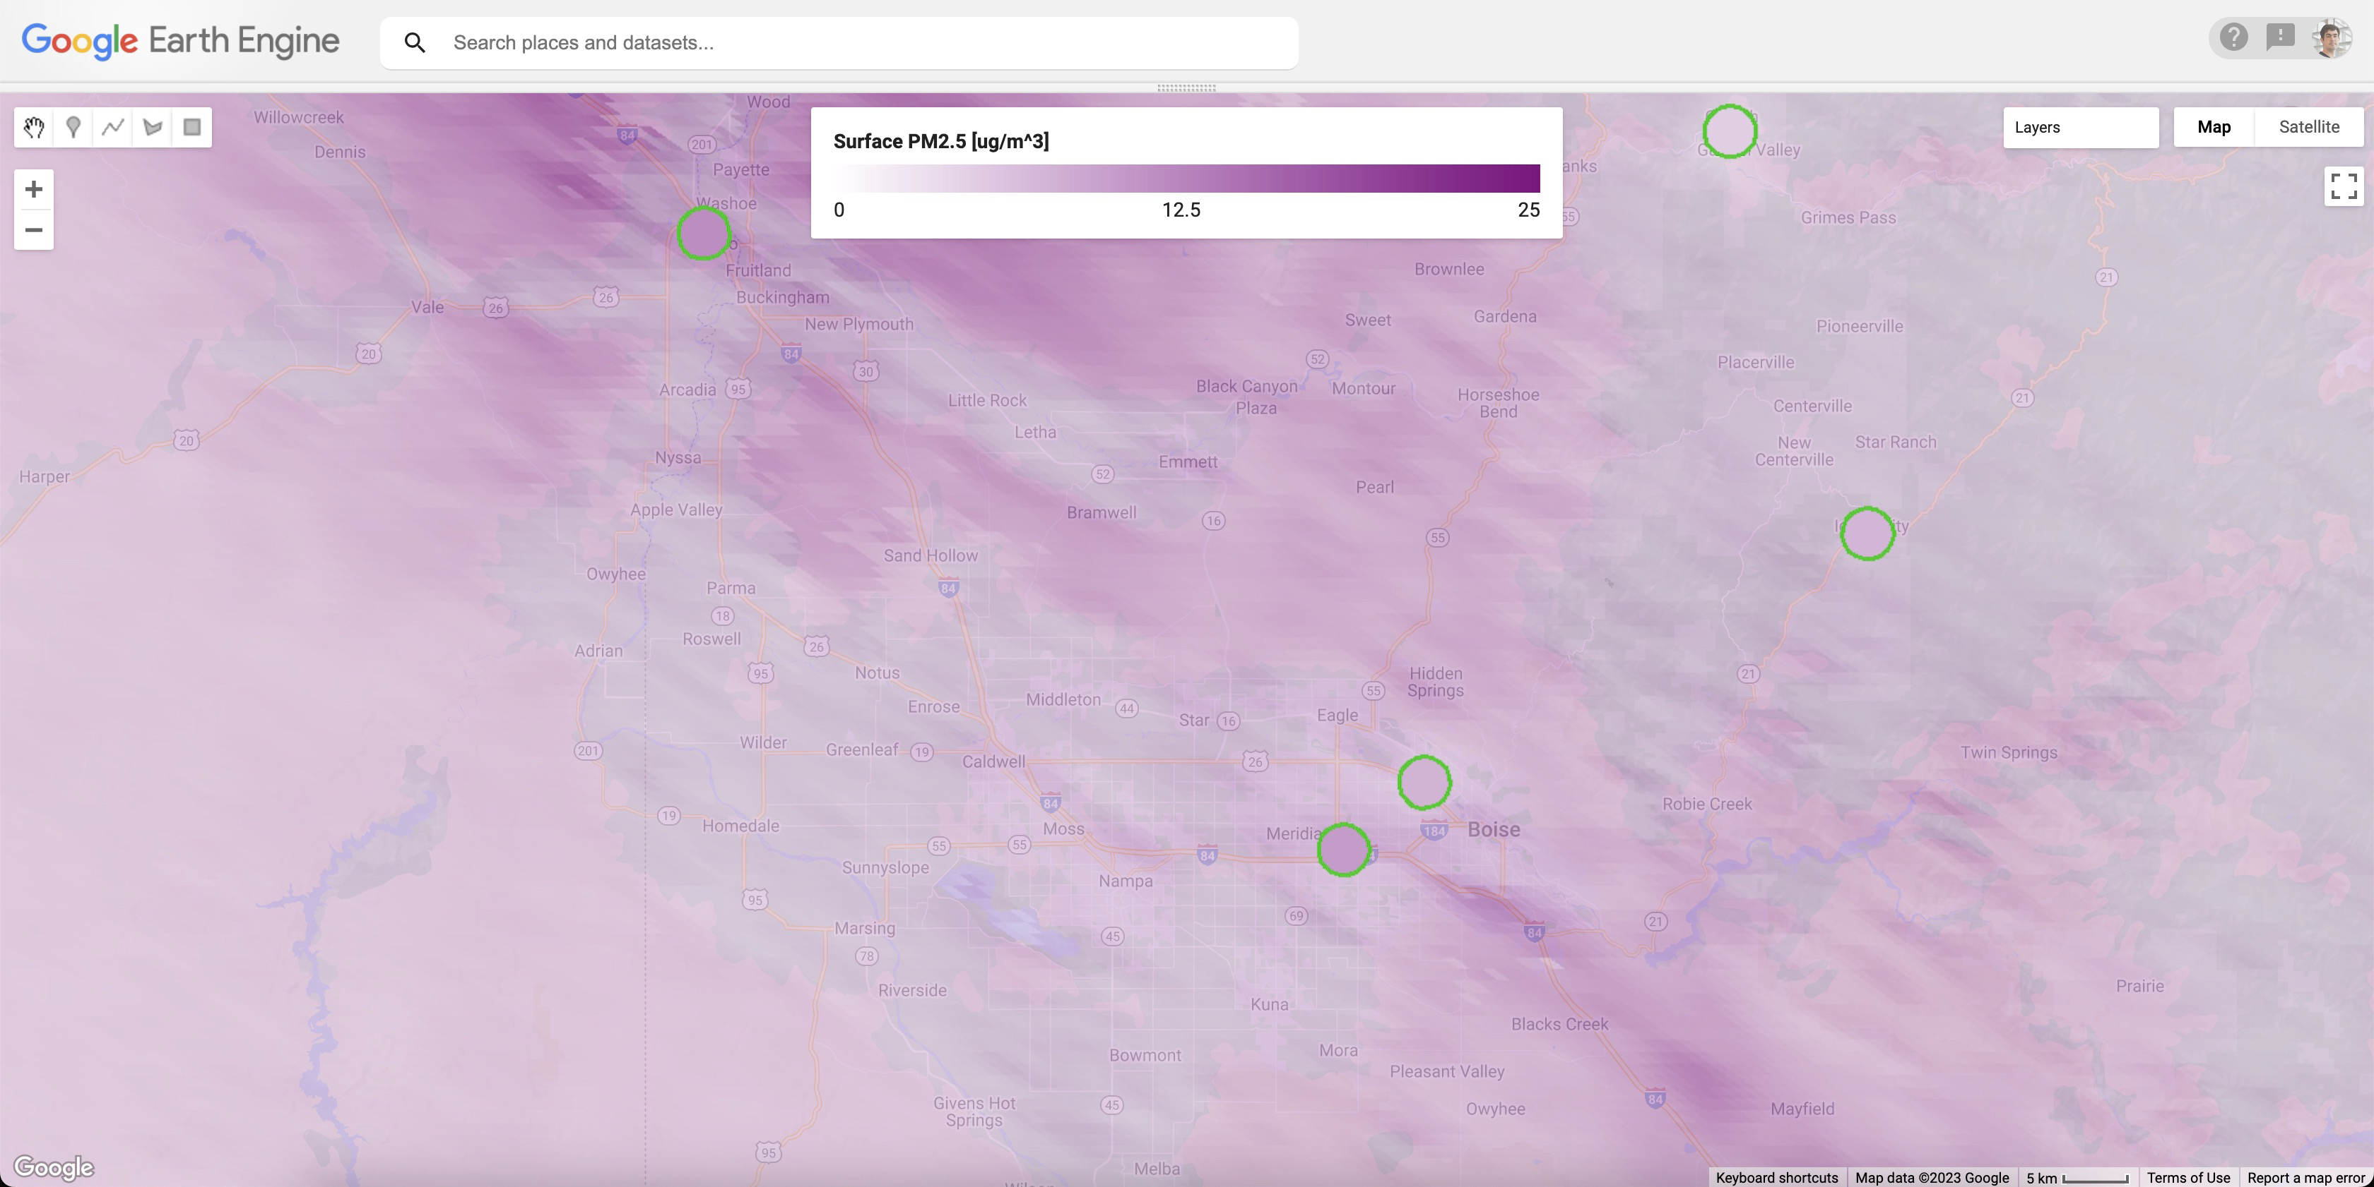
Current ARL-Supporting Evidence
ARL 4, Milestone 1: Components of eventual application system have been brought together and technical integration issues have been worked out.
Task 1b: Merge existing GMAO and UNEP/STI data fusion methodologies
Screenshot of Google Earth Engine interface testing the estimation of surface PM_{2.5} concentration using GEOS-CF, MODIS, and surface monitor data from US EPA. This indicates reasonable agreement between inferred concentrations and surface measurements. In this test, a static EPA monitor dataset was used; active data ingest of EPA monitor data is a next step.
Supporting decision-making with a sub-city scale data fusion system

Slide 30
Current ARL-Supporting Evidence
ARL 4, Milestone 2: Organizational challenges and human process issues have been identified and managed
Task 1a. Import new datasets to GEE, including GEOS-CF and RGM and LCS data
Monitoring data from Rio is being ingested into GEE (as locally generated and private data files, rather than a public dataset available to other GEE users) via the city’s open data portal (https://www.data.rio/datasets/PCRJ::qualidade-do-ar-dados-hor%C3%A1rios/explore?layer=2) and is currently being used in a prototype version of the data fusion tool.
Ground monitor stations with data in Rio
Forecasts based on integrating ground-based monitor data
Supporting decision-making with a sub-city scale data fusion system

Slide 31
Current ARL-Supporting Evidence
ARL 4, Milestone 2: Organizational challenges and human process issues have been identified and managed
Task 2a. Assess the status and identify key end-user needs for the GEE tool
During meetings with end-users, proposed capabilities of the data fusion tool have been presented, and alignments with existing air quality management resources and practices have been discussed.
In Rio de Janeiro, needs for sub-city scale air quality forecasts in support of health management and early warning have been emphasized. Ongoing discussions have covered how outputs of the data fusion tool might be translated to health impacts using existing frameworks (e.g., a children’s air quality health index being developed for the city). Integration of outputs into the city’s existing data analysis and management systems (especially relevant GIS tools) have also been discussed.
For Dakar, initial meetings emphasized the need to integrate local information with regional information on transported pollutants, especially for Saharan dust. Also, difficulties in operating local regulatory monitors, as well as the potential to augment these in the near future with low-cost monitors, have been discusses; the data fusion tool under development will thus need to be robust against missing data sources, and be able to incorporate new sources as they become available. We will include options to switch (automatically or manually) between operational “modes” of the data fusion based on which data are available.
In meetings with US EPA, as well as state air quality managers in Mississippi, Oregon, Colorado, and Idaho, desired features of the data fusion tool were discussed. Each region has phenomena of interest which impact their local air quality (coastal breezes, wildfires, atmospheric inversions); the tool’s ability to capture these unique interactions will need to be tested and verified for each region. In general, the ability to combine multiple information sources to support forecasting was seen as a strength of the proposed tool which would enhance the existing capabilities for each region. Integration of low-cost sensor data was also seen as a potential strength, although potential users have expressed some skepticism with data quality from low-cost sensors; the data fusion tool must therefore have a robust capability for verifying low-cost sensor data suitability before it is incorporated, and should also have an option to exclude certain low-cost sensor data if the user deems the data untrustworthy.
Supporting decision-making with a sub-city scale data fusion system

Slide 32
Costing Status (as of October 17, 2023)
Current Year (FY24)^{1,2}
Institution | Budget | Obligated | Unobligated | Costed | Uncosted
GSFC | $45,615 | $0 | $45,615 | $0 | $45,615
Morgan State Uni. | $165,723 | $0 | $165,723 | $0 | $165,723
Sonoma Tech, Inc | $119,883 | $0 | $119,883 | $0 | $119,883
Prior Year (FY23)^{3,4,5}
Institution | Budget | Obligated | Unobligated | Costed | Uncosted
GSFC | $51,877.00 | $29,096.00 | $22,781.00 | $29,096.00 | $22,781.00
MSU | $162,866 | $162,866 | $0 | $194,986.10 | $0
STI | $119,954 | $119,954 | $0 | $37,464 | $82,490
For FY2024, Morgan State University and GSFC have not received the modifications for Year 3 funding. N.b., GSFC received funds as of 10/19. GESTAR-II office at MSU has not been notified that they have received the funds yet
Since FY 2024 just started, expenses have yet to be incurred for FY2024
Merit and C.O.L. adjustments for July 2023-Oct 2023 will be applied to MSU salaries in late October 2023.
FY23 Costed for MSU is higher than budget because Year 1/FY22 funds were obligated in FY23 and expenses for FY22 and FY23 were incurred in FY23. There remains funds uncosted for FY22 and FY23 obligated funds.
First subaward for STI started December 2023. Total Costed for STI is lower than reality as there was a delay in processing subaward for Year 2 of the project. Payments to STI are being processed by the state of Maryland. The anticipated total costed for FY23 is $111,399.62.
Supporting decision-making with a sub-city scale data fusion system

Slide 33
Costing Status (as of October 17, 2023)
Project to Date (FY22-24)^{4,5}
Institution | Budget | Obligated | Unobligated | Costed | Uncosted
GSFC | $97,492 | $29,096 | $68,396 | $29,096 | $68,396
MSU | $429,517 | $263,794 | $165,723 | $194,986 | $234,531
STI | $289,845 | $169,962 | $119,883 | $37,464 | $202,373
For FY2024, Morgan State University and GSFC have not received the modifications for Year 3 funding.
Since FY 2024 just started, expenses have yet to be incurred for FY2024
Merit and C.O.L. adjustments for July 2023-Oct 2023 will be applied to MSU salaries in late October 2023.
FY23 Costed for MSU is because Year 1/FY22 funds were obligated in FY23 and expenses for FY22 and FY23 were incurred in FY23. There remains funds uncosted for FY22 and FY23 obligated funds.
First subaward for STI started December 2023. Total Costed for STI is lower than reality as there was a delay in processing subaward for Year 2 of the project. Payments to STI are being processed by the state of Maryland. The anticipated total costed for FY23 is $111,399.62.
Supporting decision-making with a sub-city scale data fusion system

Slide 34
Costing Status (April 2023 report)
Current Year (FY23) ⁴
Institution | Budget | Obligated | Unobligated | Costed | Uncosted
GSFC | $51,877.00 | $11,093.07 | $40,783.93 | $11,093.07 | $40,783.93
Morgan State University | $162,866 | $162,866 | $0 | $98,404.49 | $64,461.51
Sonoma Tech, Inc | $119,954 | $119,954 | $0 | $26,720.88 | $93,232.12
Prior Year (FY22) ¹
Institution | Budget | Obligated | Unobligated | Costed | Uncosted
MSU | $100,928 | $100,928 | $0 | $0 | $100,928
STI ^{2,3} | $50,008 | $50,008 | $0 | $0 | $50,008
¹ GSFC Center Costs were not budgeted for FY22 in the original MSU budget. After the first installment to MSU in Fall 2023, the budget was updated to properly include the GSFC costs and have been added to FY23-FY25 but includes the FY22 costs
² Subaward for STI was not in place till December 2023.
³ MSU received 4 invoices from STI for December through March, which PI Knowland approved. GESTAR-II financial analysts were not made aware until last week that STI needed to submit a W9 to MSU; now received, payments to STI are being processed by the state of Maryland
⁴ FY23 funds received at MSU in March 2023. Spending down FY22 funds till now.
Supporting decision-making with a sub-city scale data fusion system

Slide 35
Challenges and Risks
Rank | Type* | Risk | Mitigation Action | Date first noted/Date resolved (if applicable)
1 | T | Lack of ground-based monitor data (especially in Dakar) | Use historical datasets (2010-2019) for validation; design the GEE tool to be robust to missing data | 2/28/2023
2 | T | NASA EOS satellites approaching end of life | Need to test alternative satellite products than MODIS | Start of project
3 | T | Google Earth Engine service changes and availability | Work with Google team and collaborators to understand and adapt to service changes | Start of Project
4 | ES | Changes in end-user priorities | Can be adjusted for so long as requirements remain within project scope | Start of project
5 | T | Changes to collaborator systems and development timelines | Coordinate with collaborating entities to adjust plans within scope | 2/28/2023
6 | PM | Stakeholder personnel changes | Good communication with contacts to manage handover of project to new employee | 1/15/2023
7 | T | Air Quality Model updates may impact their availability in GEE | Coordinate with GEE to ensure minimum disruption in data availability | Start of project
* Please designate risk type as: Technical (T), Budget (B), End-User/Stakeholder (ES), or Project Management (PM)
Supporting decision-making with a sub-city scale data fusion system
Notes:
Please address any of the following that apply:
- Technical challenges & risks (e.g., loss of satellite during project, accuracy not sufficient, significant technical hurdle)
- Operations challenges & risks
- Management challenges & risks (e.g., partners and/or end-users don’t focus on project as promised)
- Schedule challenges & risks.
- Policy challenges & risk
Budget challenges &risks

Slide 36
Accomplishments since Last Update
Progress on Project Tasks
  Task 1a: GEOS-CF high-time-frequency forecast datasets are available in GEE (hourly-average datasets still needed). Discussions with end-users have identified pathways for accessing local data in near-real-time. Dakar has noted problems with local air quality monitors preventing data availability but have identified new low-cost sensor deployments as an alternative data source.
  Task 1b: STI has implemented the merged data fusion methodology for NO₂; methodology implementation for PM_{2.5} is in progress; further discussions on modifications to the methodology for O₃ are ongoing.
  Task 1c: Preliminary testing of the uncertainty quantification framework has been tested, with promising results (presented at MAC-MAQ 2023 conference)
  Task 1d: Discussion with Clarity has identified pathways for LCS data access and quality control.
  Task 1e: A complete prototype of the system for NO2 has been implemented and includes real ground-based observation data for Rio. Good progress on PM2.5 has been made but not complete.
  Task 2a: Initial meetings with all end-user groups (Dakar, Rio, US EPA), as well as a follow-on meeting with Rio, have confirmed initial end-user needs.
Supporting decision-making with a sub-city scale data fusion system

Slide 37
Accomplishments since Last Update
Presentations related to the project
  Emma Knowland gave a virtual presentation on the project titled “Data Fusion for Urban Air Quality Assessment & Forecasting​” as part of the AmeriGEO Week 2023 OneHealth Side Event, August 8, 2023.
  Carl Malings presented project preliminary results on the uncertainty quantification methodology in a poster entitled “Data fusion with uncertainty quantification for sub-city-scale air quality assessment and forecasting” at the Meteorology and Climate Modeling for Air Quality (MAC-MAQ) Conference in Davis, California, September 13-15, 2023.
  Emma Knowland and Carl Malings presented the project and the preliminary results on the uncertainty quantification methodology at an internal NASA GMAO office meeting on October 12, 2023.
  Carl Malings presented project preliminary results as part of an invited graduate seminar presentation entitled “Air Quality Analysis with Sensors, Satellites, and Models” as part of the University of Arkansas Little Rock, Donaghey College of Science, Technology, Engineering, and Mathematics Colloquium Series, October 13, 2023.
  Nathan Pavlovic gave invited presentation on preliminary results and progress on implementation entitled “Data Fusion with Uncertainty Quantification for Sub-City-Scale Assessments and Forecasting of PM2.5 and Trace Gases” at the American Association for Aerosol Research 41st Annual Conference in Portland, Oregon, October 3, 2023.
  Justin Coughlin of Sonoma Technology, Inc gave a presentation on Google Earth Engine processing and implementation entitled “Sub-city air quality forecasting system: Supporting local government decision-making with data fusion approaches” at the Google Geo for Good Summit 2023, in Mountain View, California, October 12, 2023.
Supporting decision-making with a sub-city scale data fusion system

Slide 38
Accomplishments since Last Update
Progress on Project Tasks
  Task
Supporting decision-making with a sub-city scale data fusion system

Slide 39
Accomplishments since Last Update
Presentations related to the project
  Emma Knowland presented
  Carl Malings presented
  Nathan Pavlovic presented
  Justin Coughlin presented
Supporting decision-making with a sub-city scale data fusion system

Slide 40
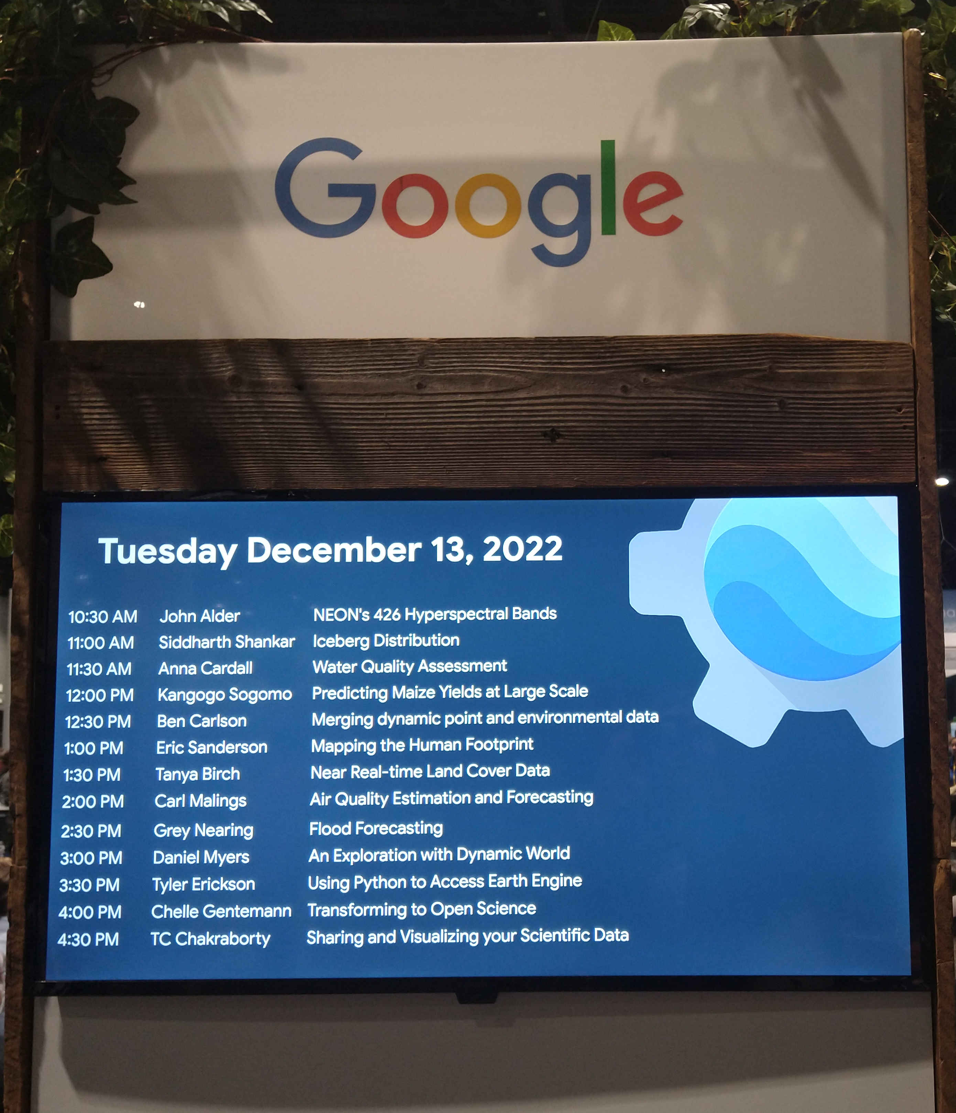
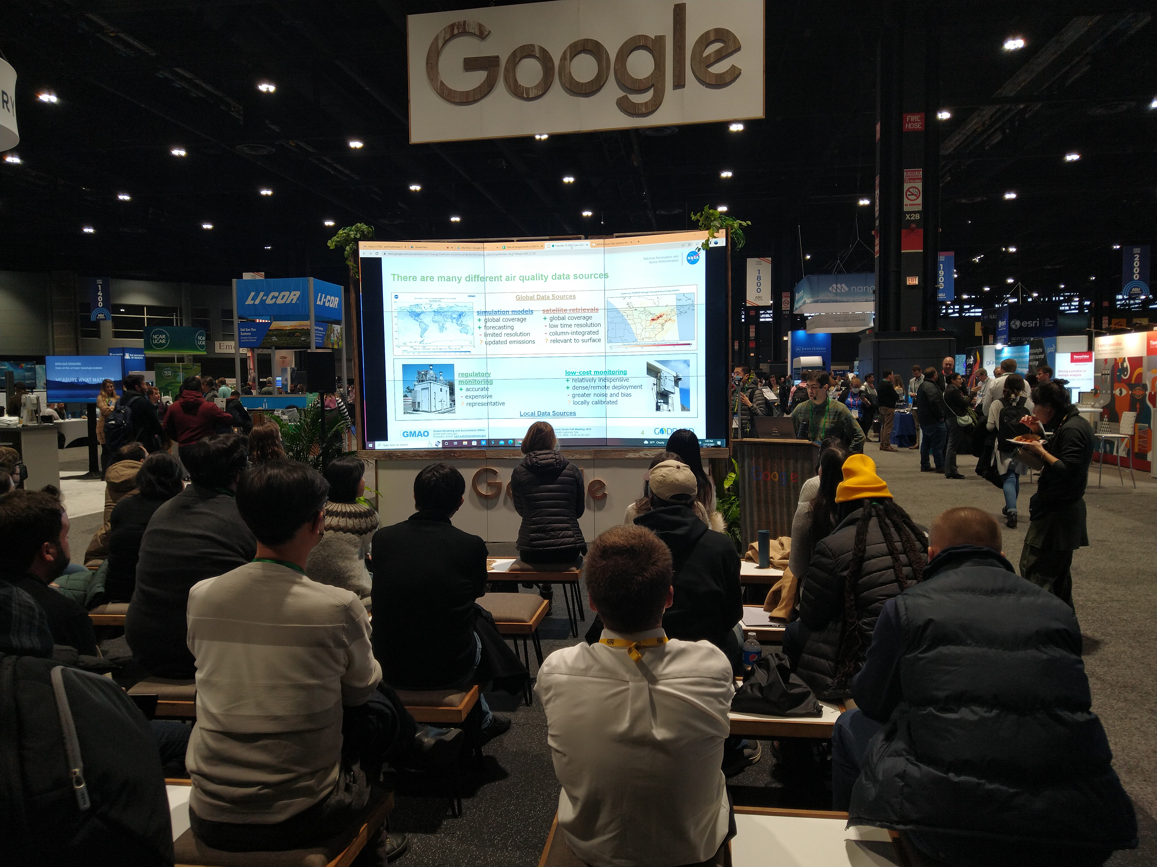
Highlight Image
Project Co-I Carl Malings making an invited presentation at the Google AGU booth, December 13, 2022.
Recording now available on Google’s youtube channel
Supporting decision-making with a sub-city scale data fusion system

Slide 41
Optional Materials
This space is for additional material that can be used to inform leadership on some results and progress from your project. This information will be used to highlight your work with NASA management, the Applied Science Program, and HAQ quarterly newsletters.
Options include, but are not limited to:
  ARL highlights
  Additional images from research findings and fieldwork applications
  List of presentations at conferences or other events (slide decks are welcome!)
  List of publications
  Unsung Hero nomination (100-word summary: Beyond a brief summary of their role on a project, we want to convey why people like working with this person)
  Any other project outcome (e.g. exciting results, public engagement, unexpected connections)
Supporting decision-making with a sub-city scale data fusion system

