Slide 1
NASA GEOS Aerosol DA System and PM_{2.5}
K. Emma Knowland
Morgan State University/GESTAR-II
NASA Global Modeling and Assimilation Office (GMAO)
In collaboration with:
NASA GMAO: Allison Collow, Patricia Castellanos, Virginie Buchard, Arlindo da Silva, Anton Darmenov
Atmospheric Chemistry and Dynamics Lab: Peter Colarco, Mian Chin

Slide 2
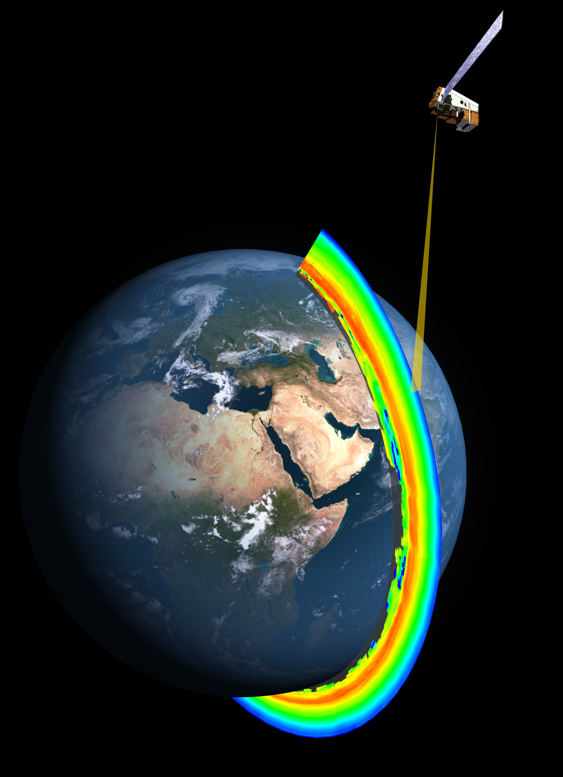
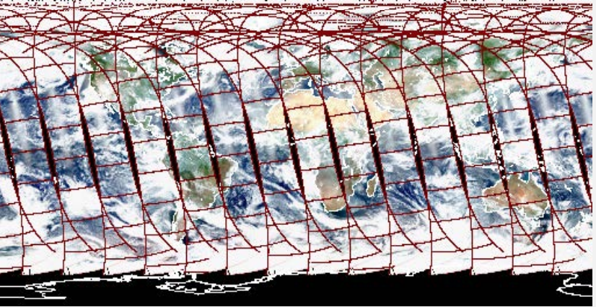
NASA GMAO global meteorology and chemistry products
GEOS
OMPS (O₃)
https://modis.gsfc.nasa.gov/
NASA/NOAA
www.nasa.gov
2
k.e.knowland@nasa.gov

Slide 3
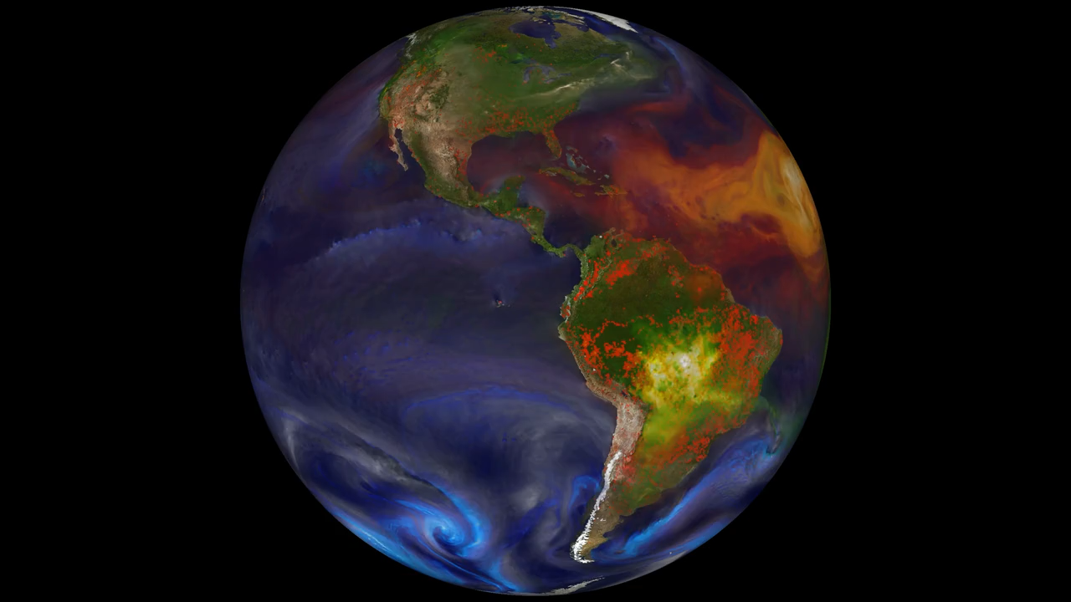
GEOS current capabilities
https://svs.gsfc.nasa.gov/30017
3
k.e.knowland@nasa.gov

Slide 4
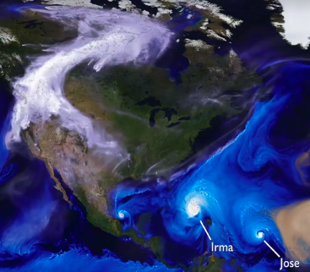
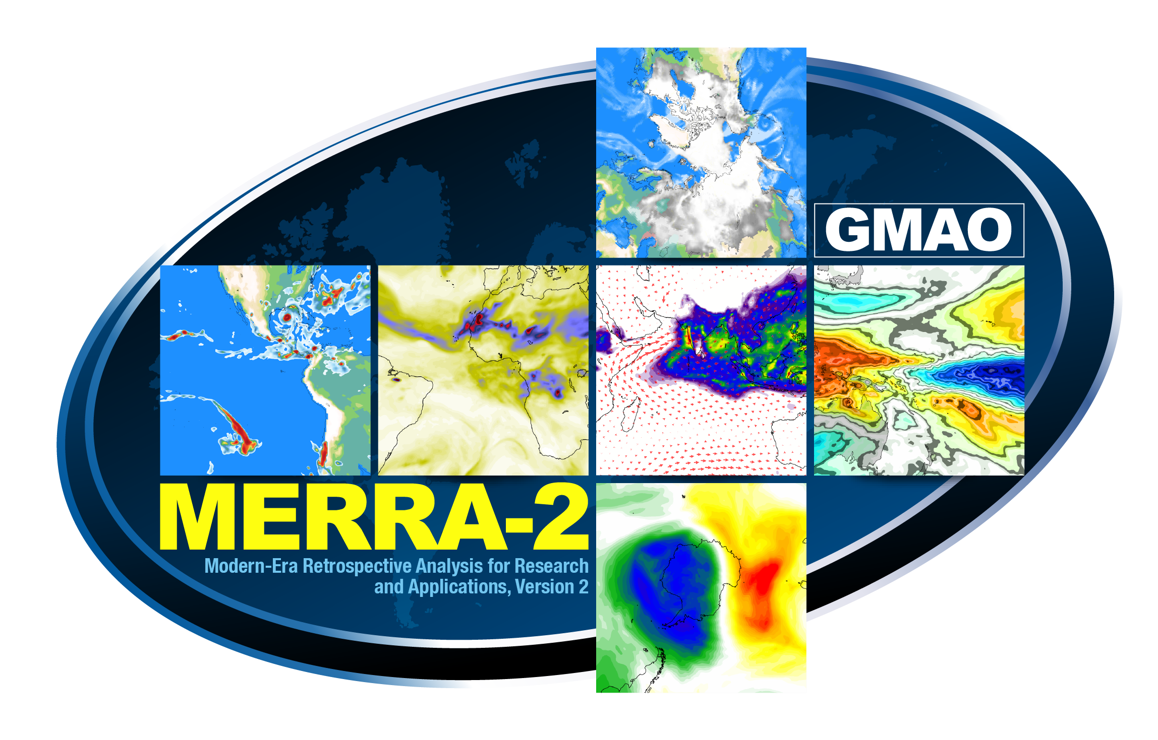
NASA GMAO global meteorology and chemistry products
GEOS
Forecasting
Reanalysis
GEOS FP
MERRA-2
4
https://gmao.gsfc.nasa.gov/GMAO_products/
k.e.knowland@nasa.gov

Slide 5
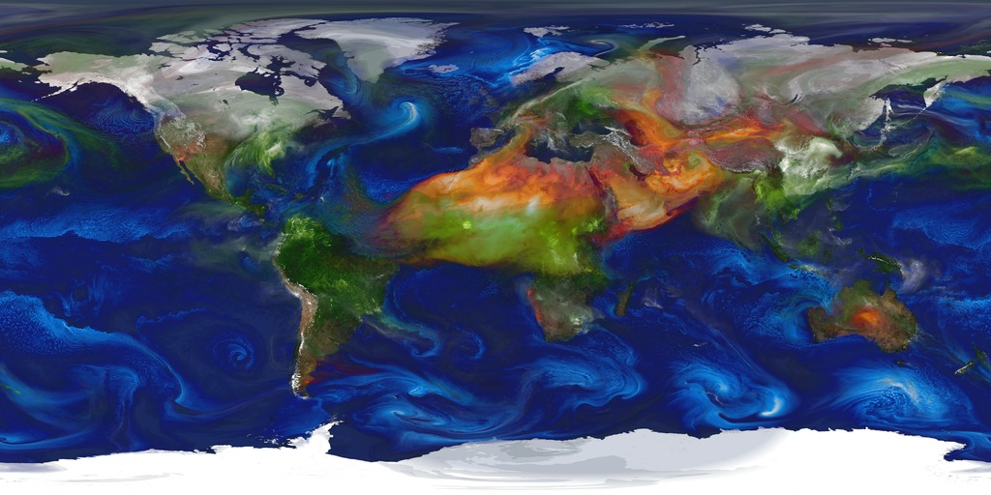
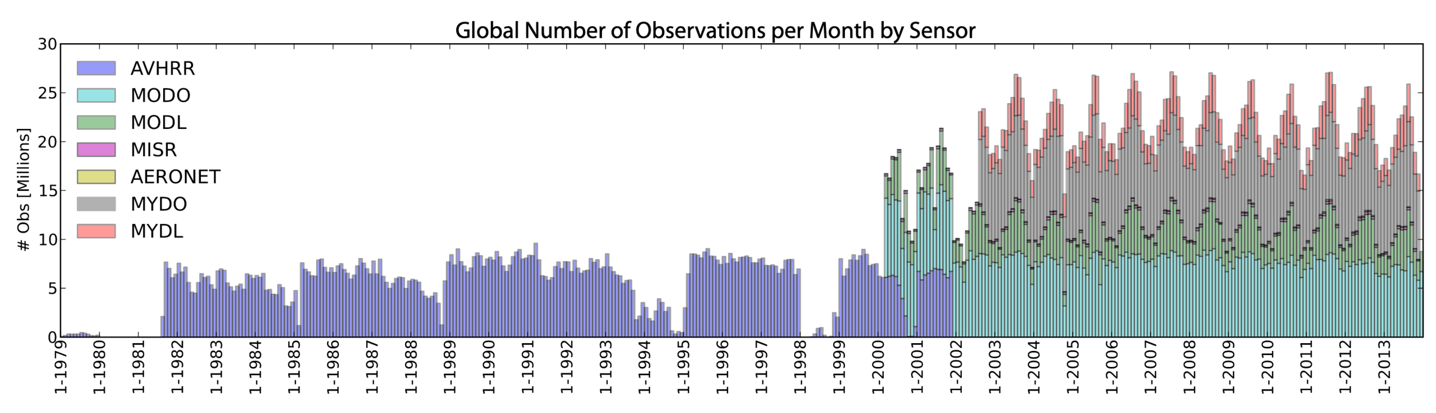
GEOS aerosol data assimilation system
GEOS AGCM
GOCART aerosol module
DA
(Meteorology, aerosol, ozone)
GEOS FP, MERRA-2, GEOS FP-IT, G5NR, …
Emissions
Biomass Burning: HFED, QFED
Anthropogenic: Edgar & AeroCom Phase II
Aerosol Observing system
Bias-corrected AOD (550 nm)
Particulate matter (PM):
  Organic Carbon
  Black Carbon
  Sea salt
  Sulfate
  Dust
  Nitrate (GEOS FP)
Randles et al., 2016; NASA/TM–2016-104606/Vol. 45
Randles et al., 2017; DOI: 10.1175/JCLI-D-16-0609.1
5
k.e.knowland@nasa.gov

Slide 6

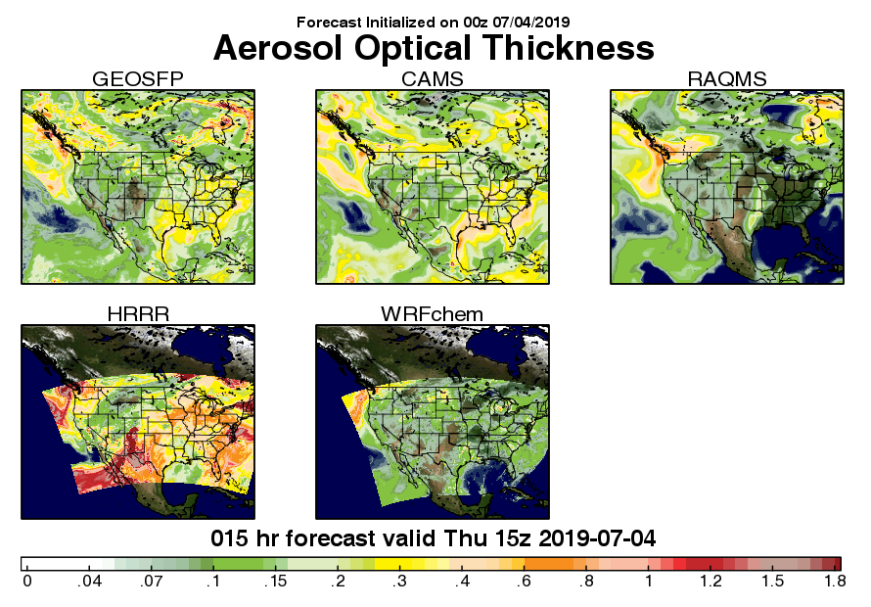
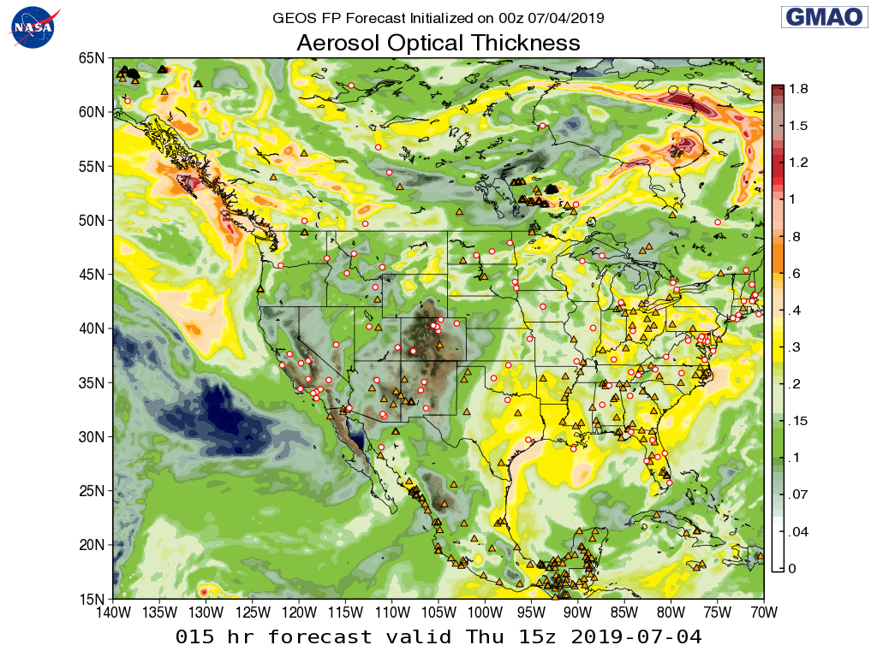
GMAO Field Campaign Support
https://fluid.nccs.nasa.gov/missions/
6
k.e.knowland@nasa.gov

Slide 7
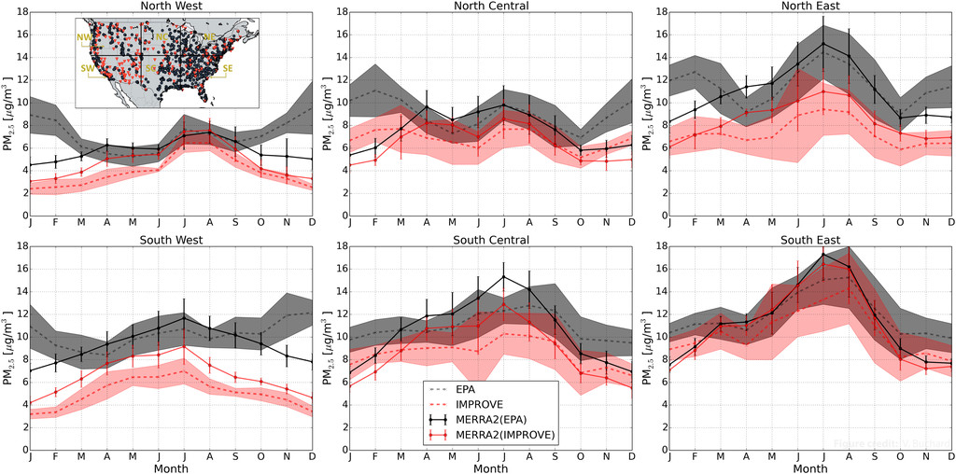
How best to evaluate the analyzed PM_{2.5}?
Available ground-based networks of PM_{2.5}
Buchard et al., 2017; DOI: 10.1175/JCLI-D-16-0613.1
7
k.e.knowland@nasa.gov

Slide 8
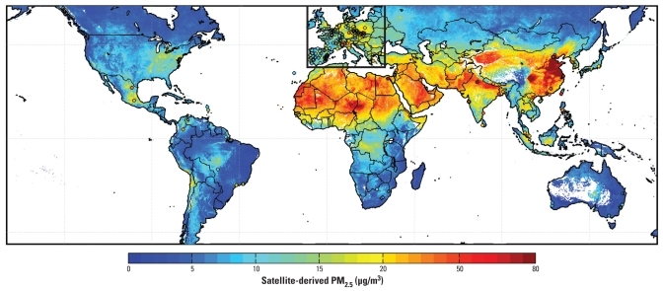
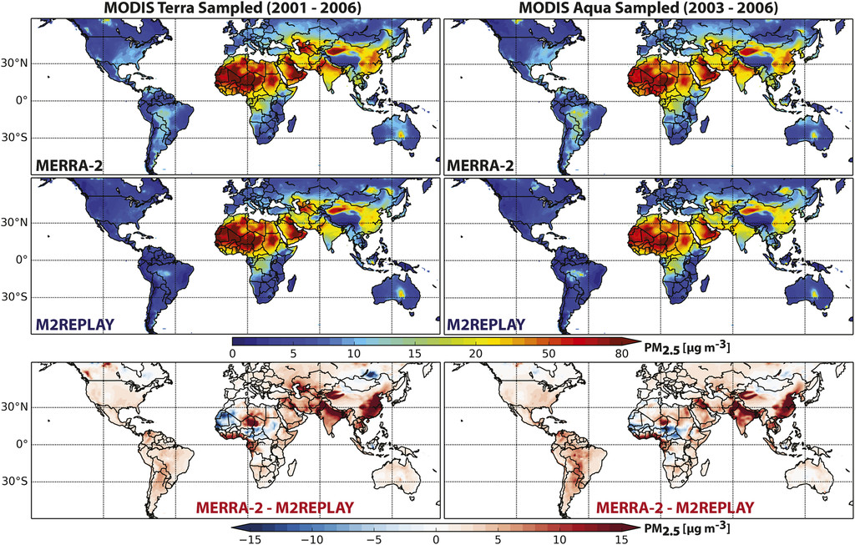
How best to evaluate the analyzed PM_{2.5}?
Satellite-based AOD estimate PM_{2.5}
van Donkelaar et al., 2010; DOI: 10.1289/ehp.0901623
Buchard et al., 2017; DOI: 10.1175/JCLI-D-16-0613.1
8
k.e.knowland@nasa.gov

Slide 9
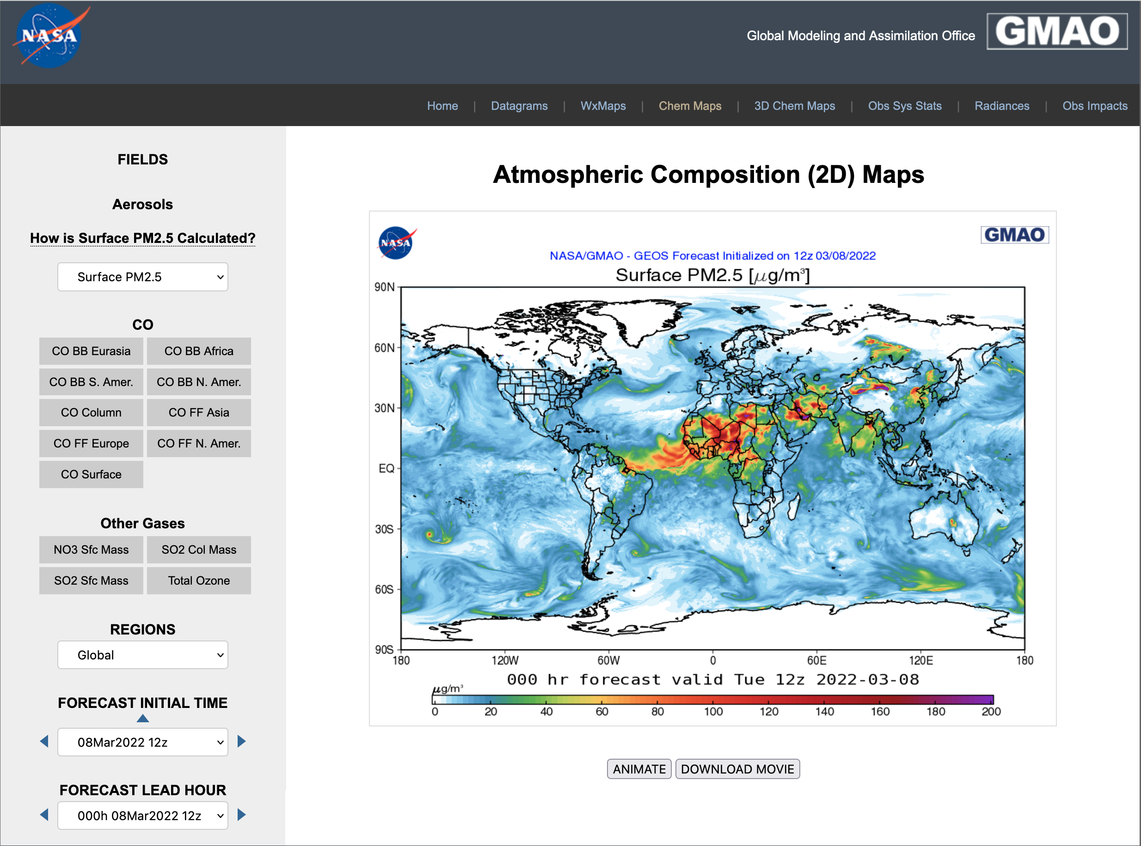
GEOS FP and MERRA-2 PM_{2.5} available online
FLUID is a mobile-friendly website
https://fluid.nccs.nasa.gov/wxmaps/chem2d
Select Surface PM_{2.5}
Select the region
Select Forecast
Animate
9
k.e.knowland@nasa.gov

Slide 10
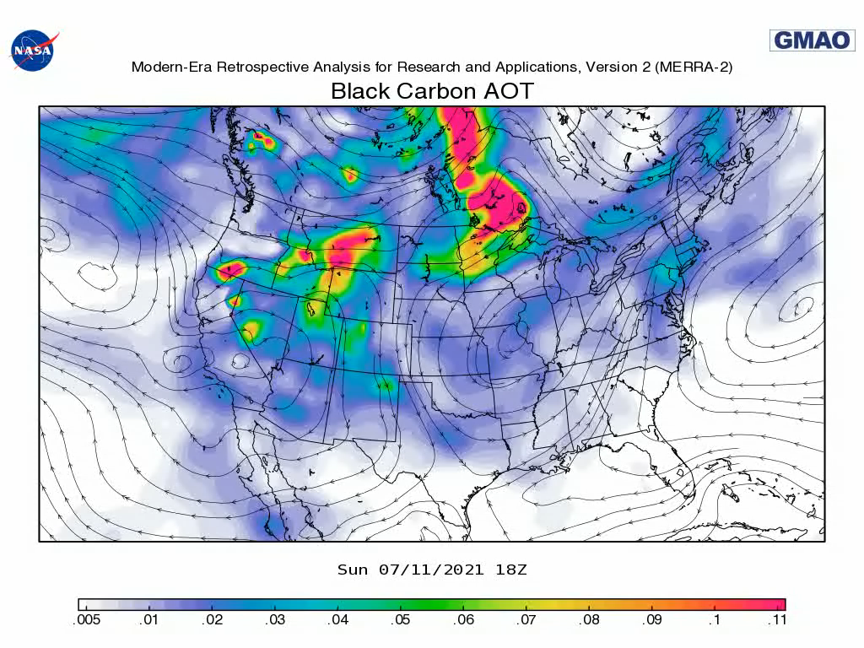
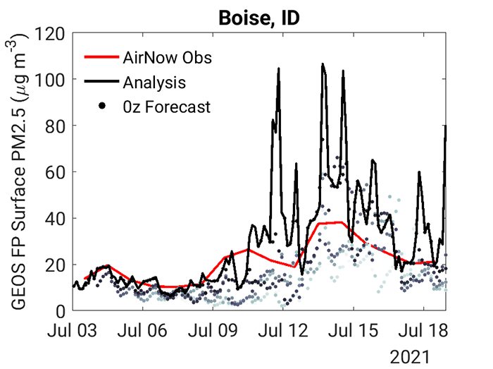
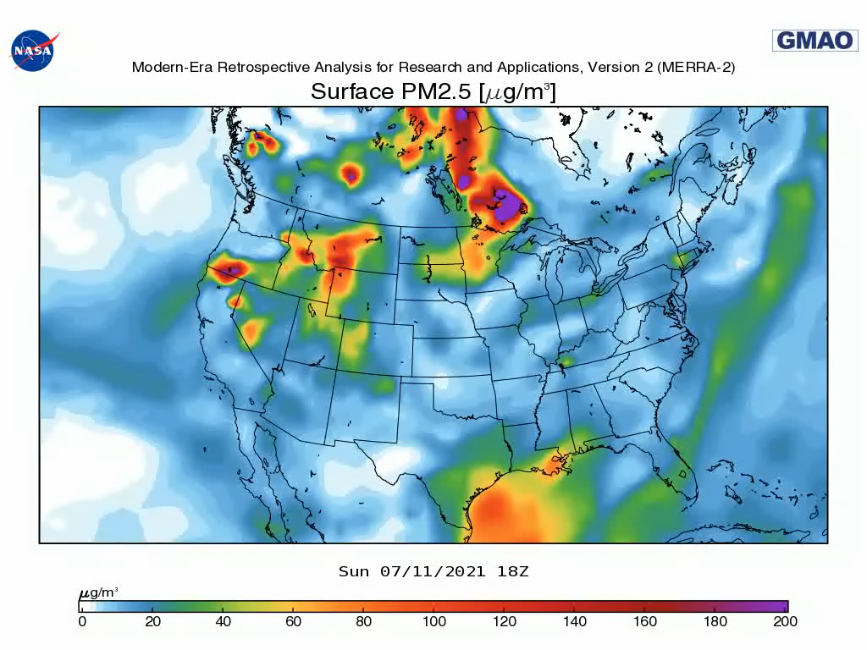
Wildfires are major source of PM_{2.5} in
North America
https://gmao.gsfc.nasa.gov/research/science_snapshots/2021/na_biomass_burning_2021.php
10
k.e.knowland@nasa.gov

Slide 11
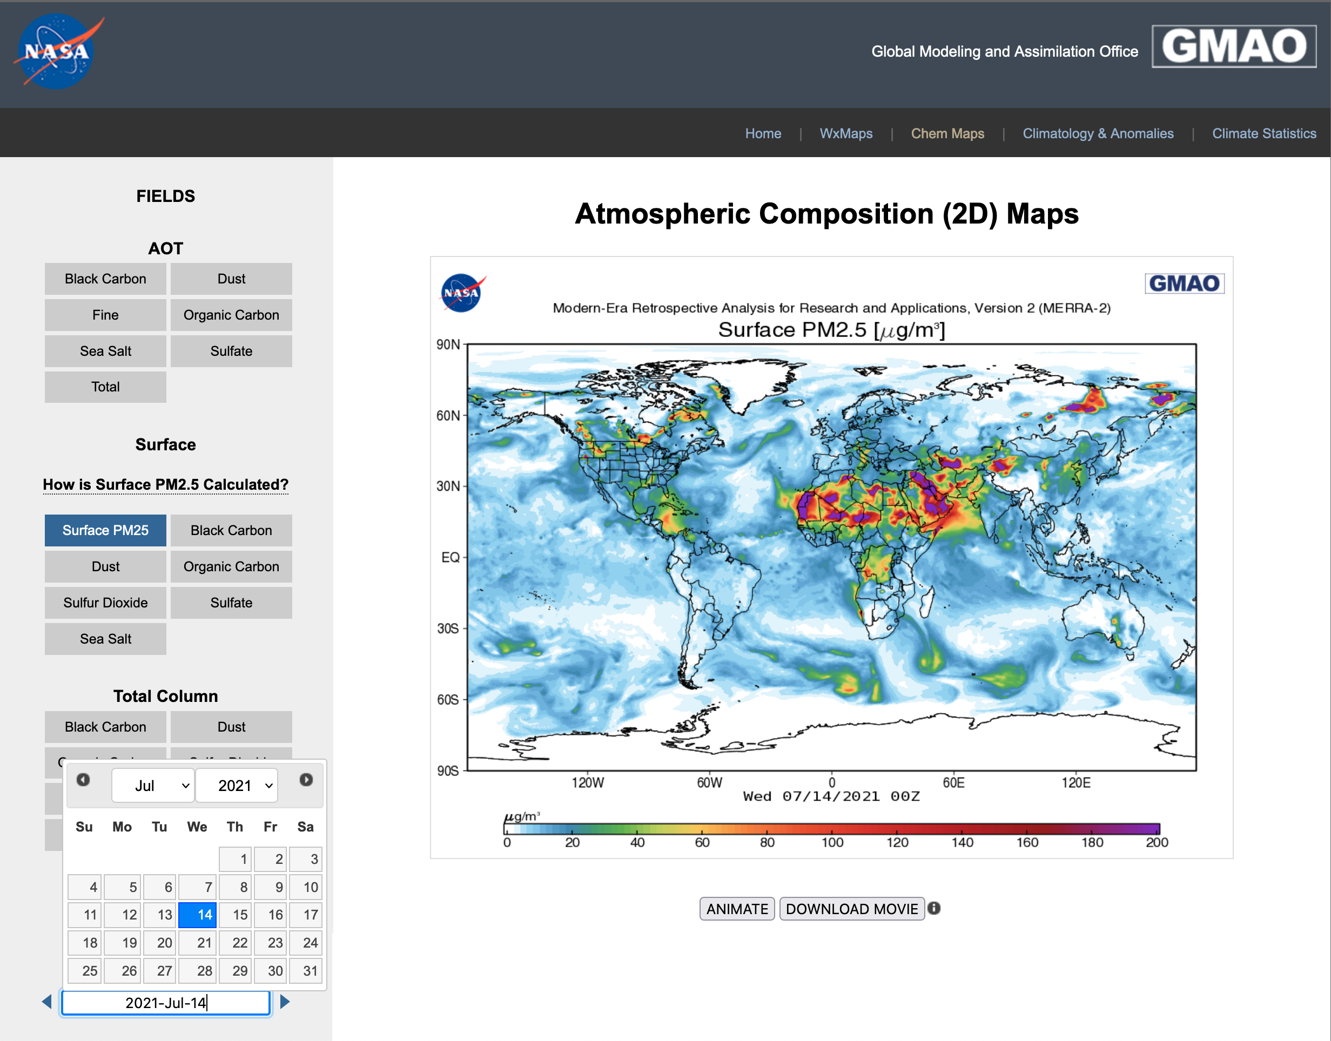
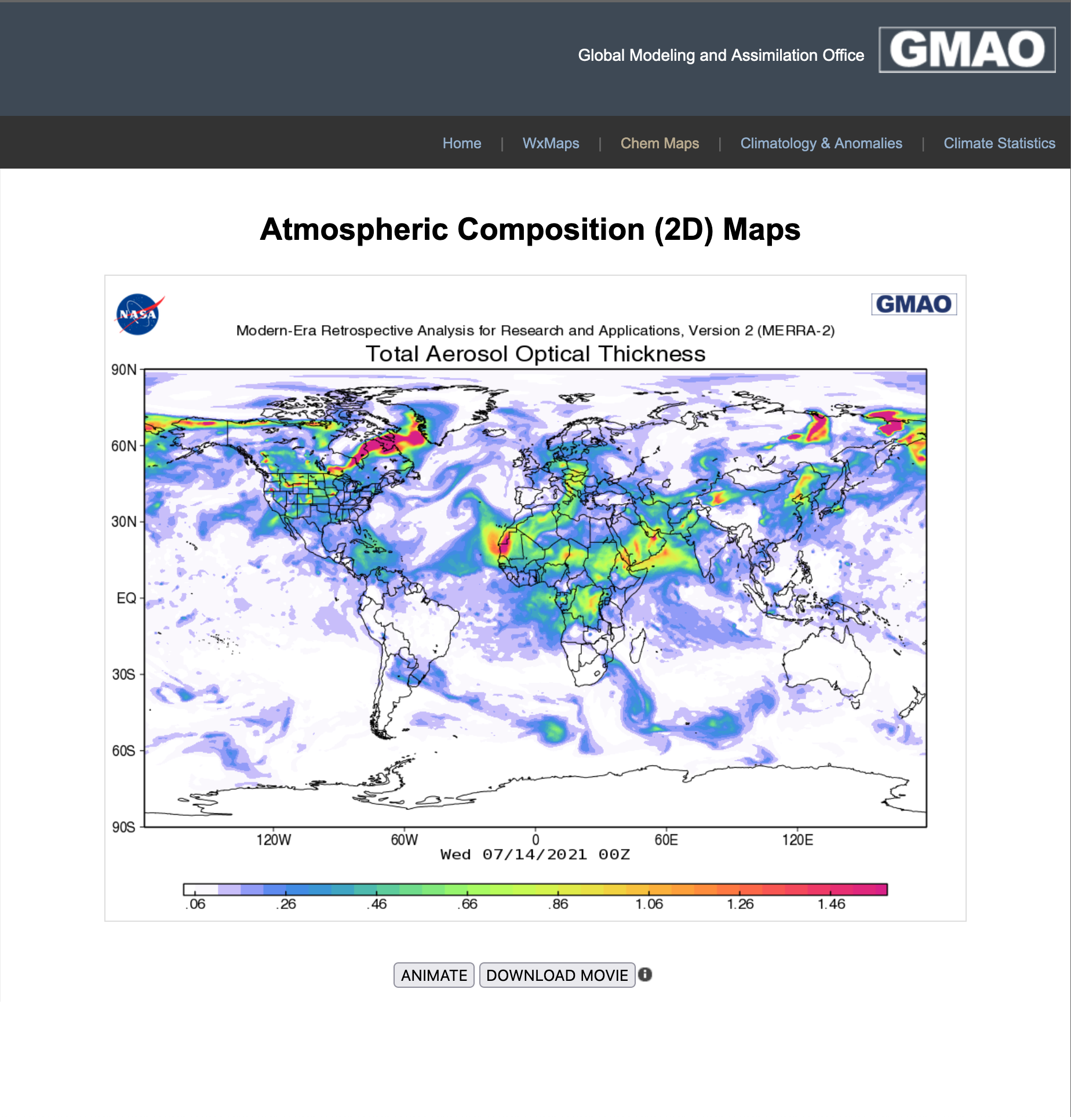
Dive into the GEOS Aerosol analyses
11
k.e.knowland@nasa.gov

Slide 12
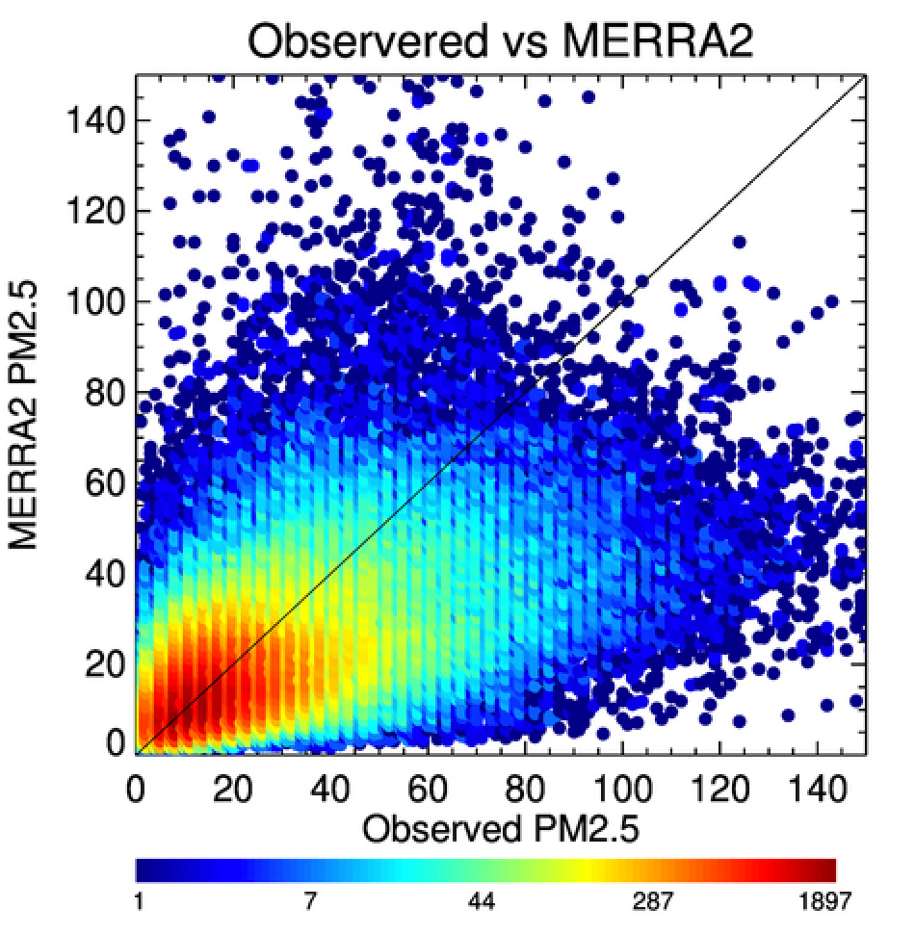
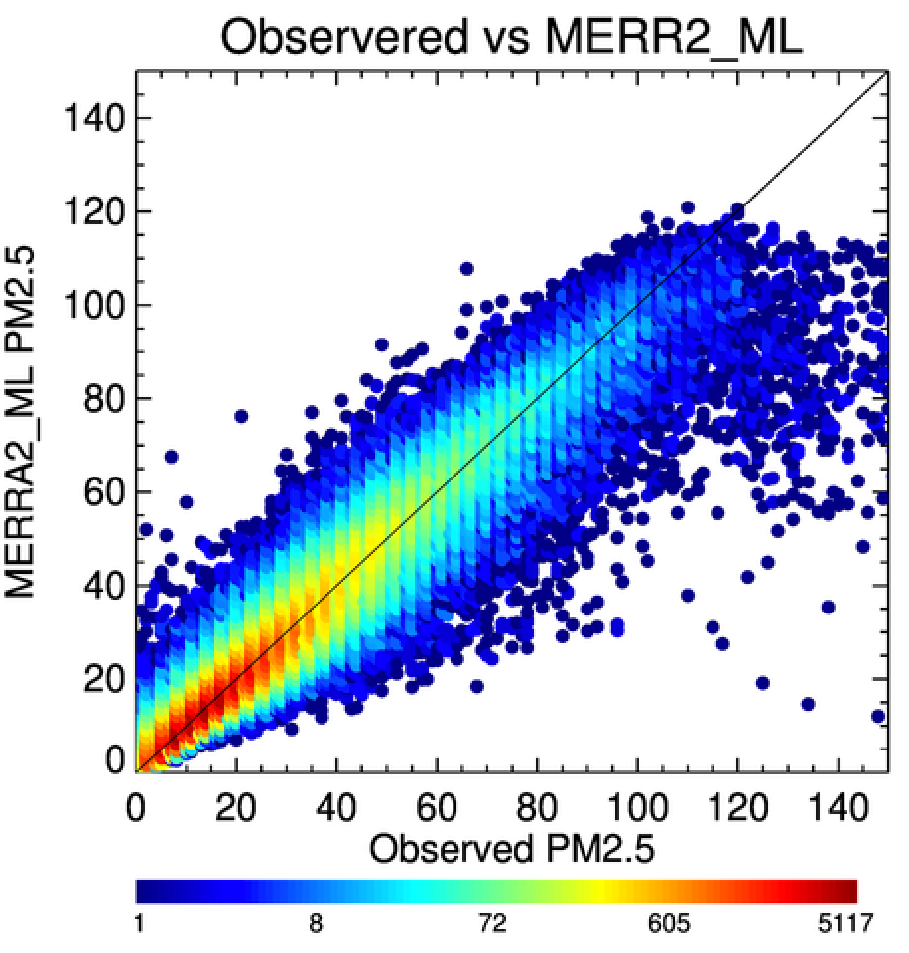
Machine Learning algorithms can help improve on biases in model PM_{2.5} estimates
Gupta et al., 2021; DOI: 10.4209/aaqr.210105
12
k.e.knowland@nasa.gov

Slide 13
Summary
GEOS Aerosol Data Assimilation System assimilates 2D column integrated AOD at 1 wavelength (550 nm)
Surface PM_{2.5} can be calculated from the speciated aerosol concentrations from the model’s lowest layer
Surface PM_{2.5} maps are now available on FLUID for GEOS FP and MERRA-2
References
Randles et al., 2016; NASA/TM–2016-104606/Vol. 45
Randles et al., 2017; DOI: 10.1175/JCLI-D-16-0609.1
Buchard et al., 2017; DOI: 10.1175/JCLI-D-16-0613.1
Gupta et al., 2021; DOI: 10.4209/aaqr.210105
13
https://gmao.gsfc.nasa.gov/GMAO_products/
k.e.knowland@nasa.gov

