Slide 1

NASA GEOS-CF: Overview, Applications, Future Direction
K. Emma Knowland
Co-author: Christoph Keller^{1,2}, Viral Shah^{2,3}, Pam Wales^{1,2}, Kris Wargan^{2,3}, Brad Weir^{1,2}, Lesley Ott², Steven Pawson²
In collaboration with many other scientists from NASA Goddard Space Flight Center and our partners
¹ Morgan State University/GESTAR-II
² NASA Global Modeling and Assimilation Office (GMAO)
³ Science Systems and Applications, Inc. (SSAI)
27 October 2023

Slide 2
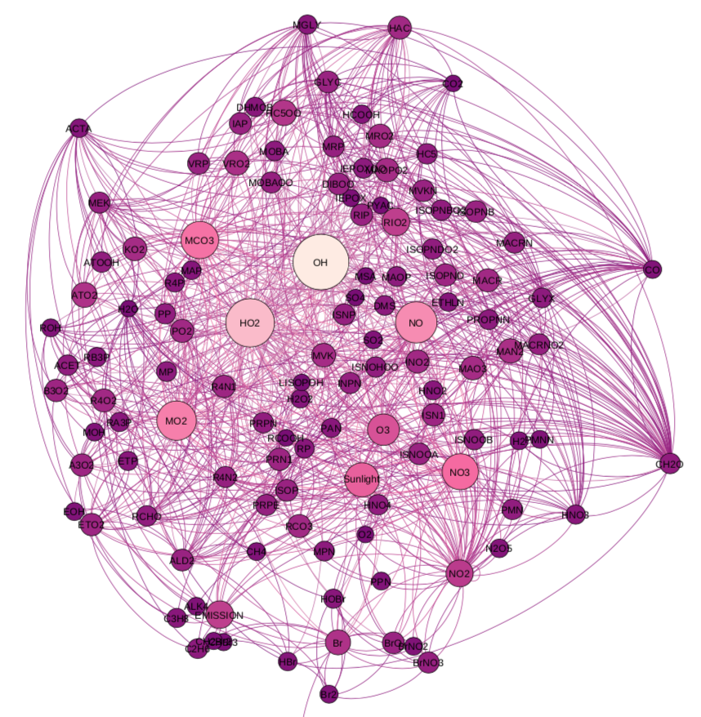
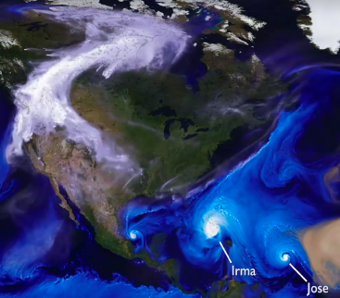

GEOS-CF produces daily global forecasts of atmospheric composition at 0.25° resolution
Ozone (O₃)
Nitrogen Dioxide (NO₂)
GEOS NWP
GEOS - Chem
Fine Particulate Matter (PM_{2.5})
Keller, C. A., Knowland, K. E., et al. (2021). Description of the NASA GEOS composition forecast modeling system GEOS-CF v1.0. Journal of Advances in Modeling Earth Systems (JAMES), 13, e2020MS002413. https://doi.org/10.1029/2020MS002413
Knowland, K. E., Keller, C. A., et al. (2022). NASA GEOS Composition Forecast Modeling System GEOS‐CF v1.0: Stratospheric Composition. JAMES https://doi.org/10.1029/2021MS002852
Knowland, K. E., Keller, C. A., and Lucchesi, R. 2022. "File Specification for GEOS-CF Products." GMAO Office Note No. 17 (Version 1.3), available from http://gmao.gsfc.nasa.gov/pubs/office_notes
https://gmao.gsfc.nasa.gov/weather_prediction/GEOS-CF/
k.e.knowland@nasa.gov

Slide 3
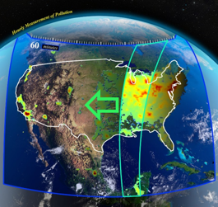

GEOS-CF v1 Status
Daily GEOS-CF global 5-day composition forecasts at 0.25° (25km) resolution are generated in near-real time:
  High-resolution historical estimates for fields are available since January 2018
  Forecast visualizations and links to data available at fluid.nccs.nasa.gov/cf and /cf_map
Applications include:
  NASA field missions (e.g., SCOAPE, FIREX-AQ, ACT-America, TRACER-AQ)
  Daily alerts sent to NASA TOLNet lidar teams (Matt Johnson, NASA Ames)
  TEMPO a priori for trace gas retrieval
  Cloud platforms, e.g., Google Earth Engine, WRI Resource Watch, CDC Tracker
Keller, C. A., et al. (2021). Description of the NASA GEOS composition forecast modeling system GEOS-CF v1.0. Journal of Advances in Modeling Earth Systems, 13, e2020MS002413. https://doi.org/10.1029/2020MS002413
Knowland, K. E., et al. (2022). NASA GEOS Composition Forecast Modeling System GEOS‐CF v1.0: Stratospheric Composition. JAMES https://doi.org/10.1029/2021MS002852
https://gmao.gsfc.nasa.gov/weather_prediction/GEOS-CF/
k.e.knowland@nasa.gov
Notes:
Running with full chemistry for the entire GEOS atmosphere (from the surface to the mesosphere) is very computationally expensive, so GEOS-CF is run once per day and separate from GEOS FP. After 2 weeks, our forecasts are archived; however the 5-day forecasts of the model’s “surface” concentrations of the five most-requested pollutants (PM2.5, O3, NO2, SO2, and CO) are available since January 2019. The first version of GEOS-CF ran for many years without more than a couple bug fixes so that we could thoroughly understand the system and two papers were published led by Christoph and myself on the GEOS-CF modeling system and both tropospheric and stratospheric composition.
I’ll next go through some of the examples of the applications, our reason to push our system to be state-of-the-science.

Slide 4

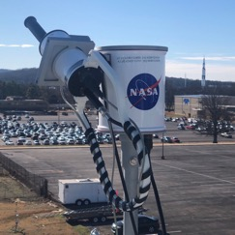
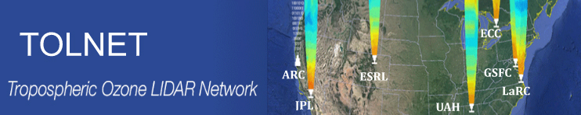
Realistic tropospheric and stratospheric composition is critical for many NASA applications
Realistic troposphere and stratosphere in GEOS-CF are essential to support a broad range of NASA applications, including:
  Satellite retrievals of trace gases
  Airborne campaigns
  Stratosphere-troposphere exchange
https://gmao.gsfc.nasa.gov/weather_prediction/GEOS-CF/
k.e.knowland@nasa.gov
Notes:
It is important to note that the NASA GMAO products are designed to be research products and support many different NASA activities – which measure throughout the full atmosphere, therefore GEOS-CF is not optimized for capturing surface air quality. The GEOS-CF replay and forecasts can be used to support ground-based, balloon, and satellite-based instrument teams, as well as field and aircraft campaigns, which measure trace gases in the troposphere and the stratosphere.
The upcoming TEMPO geostationary satellite designed to monitor pollution over much of North America is to be launched in spring 2023 and we are working with the retrieval team to use GEOS-CF as their prior for trace gas retrievals.
For surface air quality, it is also important that the GEOS-CF simulates the stratosphere to troposphere transport correctly as these layers have very different chemical and meteorological conditions. We work with two ground-based instrument networks which observe ozone, the PANDORA instruments, which can also measure other species, and the Tropospheric ozone LIDAR Network, TOLNET.

Slide 5
TEMPO specific collection: “sat_inst_1hr_r721x361_v72”
Regional Chemistry and Meteorology Diagnostics to support TEMPO satellite
Frequency: hourly instantaneous from 00:00 UTC
Spatial Grid: 3D, model-level, subset region of full horizontal resolution
Dimensions: longitude=721, latitude=361, every 0.25º
longitude: 0º to -180º
latitude: 0º to 90º
vertical level: 72 layers
Granule Size: ~258 MB per file
Start date: 00 UTC 1 January 2022
Mode: Replay only; Forecasts available based on mission requirements
Knowland et al., 2022. "File Specification for GEOS-CF Products." GMAO Office Note No. 17 (Version 1.3), available from http://gmao.gsfc.nasa.gov/pubs/office_notes
Name | Dim | Description | Units
BrO | tzyx | Bromine monoxide (BrO, MW = 96.00 g mol-1) volume mixing ratio dry air | mol mol-1
FRSEAICE | tyx | ice covered fraction of tile | 1
FRSNO | tyx | fractional area of land snowcover | 1
GLYX | tzyx | Glyoxal (CHOCHO, MW = 58.00 g mol-1) volume mixing ratio dry air | mol mol-1
HCHO | tzyx | Formaldehyde (CH2O, MW = 30.00 g mol-1) volume mixing ratio dry air | mol mol-1
HNO2 | tzyx | Nitrous acid (HNO2, MW = 47.00 g mol-1) volume mixing ratio dry air | mol mol-1
IO | tzyx | Iodine monoxide (IO, MW = 143.00 g mol-1) volume mixing ratio dry air | mol mol-1
NO2 | tzyx | Nitrogen dioxide (NO2, MW = 46.00 g mol-1) volume mixing ratio dry air | mol mol-1
O3 | tzyx | Ozone (O3, MW = 48.00 g mol-1) volume mixing ratio dry air | mol mol-1
OClO | tzyx | Chlorine dioxide (OClO, MW = 67.00 g mol-1) volume mixing ratio dry air | mol mol-1
PHIS | tyx | surface geopotential height | m+2 s-2
PS | tyx | surface pressure | Pa
Q | tzyx | specific humidity | kg kg-1
SNODP | tyx | snow depth | m
SNOMAS | tyx | Total snow storage land | kg m-2
SO2 | tzyx | Sulfur dioxide (SO2, MW = 64.00 g mol-1) volume mixing ratio dry air | mol mol-1
T | tzyx | air temperature | K
TROPPB | tyx | tropopause pressure based on blended estimate | Pa
U2M | tyx | 2-meter eastward wind | m s-1
V2M | tyx | 2-meter northward wind | m s-1
ZPBL | tyx | planetary boundary layer height | m
https://gmao.gsfc.nasa.gov/weather_prediction/GEOS-CF/
k.e.knowland@nasa.gov

Slide 6
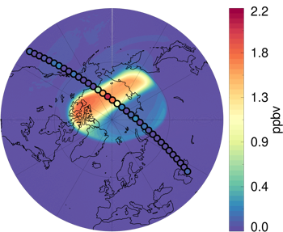
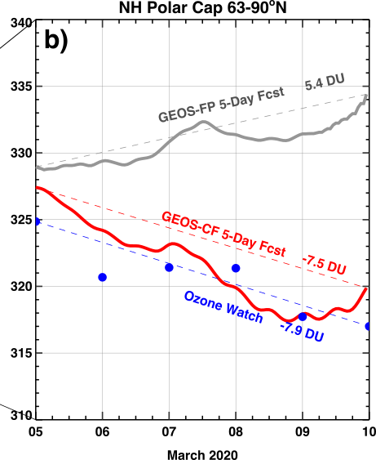
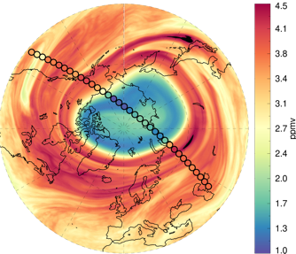
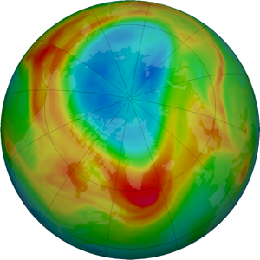
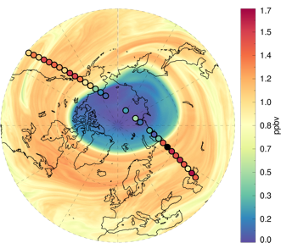

GEOS-CF with stratospheric chemistry adds near-real-time stratospheric ozone forecasting capability to the NASA GMAO
ClO
March 5, 2020
GEOS-CF
March 10, 2020
Ozonewatch
5 March 2020 Forecast
Ozone
Average Column Ozone (DU)
NH Polar Cap
HCl
5-Days
Ozonewatch.gsfc.nasa.gov
Knowland et al., JAMES, 2022, https://doi.org/10.1029/2021MS002852
https://gmao.gsfc.nasa.gov/weather_prediction/GEOS-CF/
k.e.knowland@nasa.gov

Slide 7
Spinning up GEOS-CF version 2
Model update to GEOS-Chem v14.0
GEOS AGCM update
CEDS emission inventory (latest release through 2019)
Constituent Data Assimilation System (CoDAS)
  Multi-constituent assimilation with O₃, NO₂, SO₂
Output will include simulated CO₂ and CH₄ (GOCART)
https://gmao.gsfc.nasa.gov/weather_prediction/GEOS-CF/
k.e.knowland@nasa.gov
Notes:
Simulated CO2 and CH4 obtained from GEOS-GHG project forward.

Slide 8
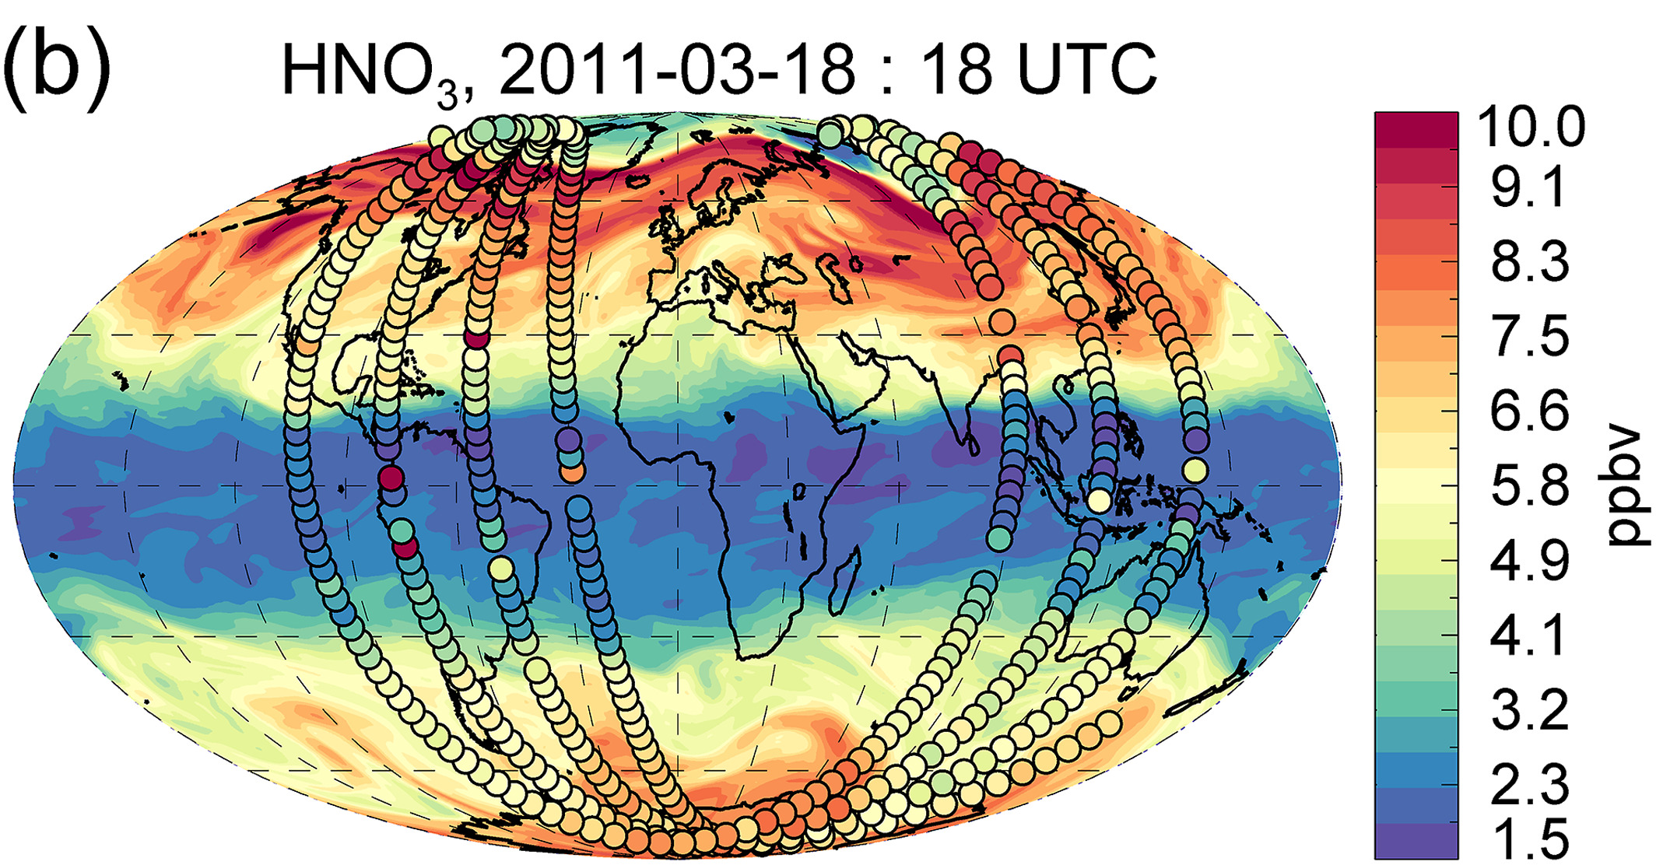
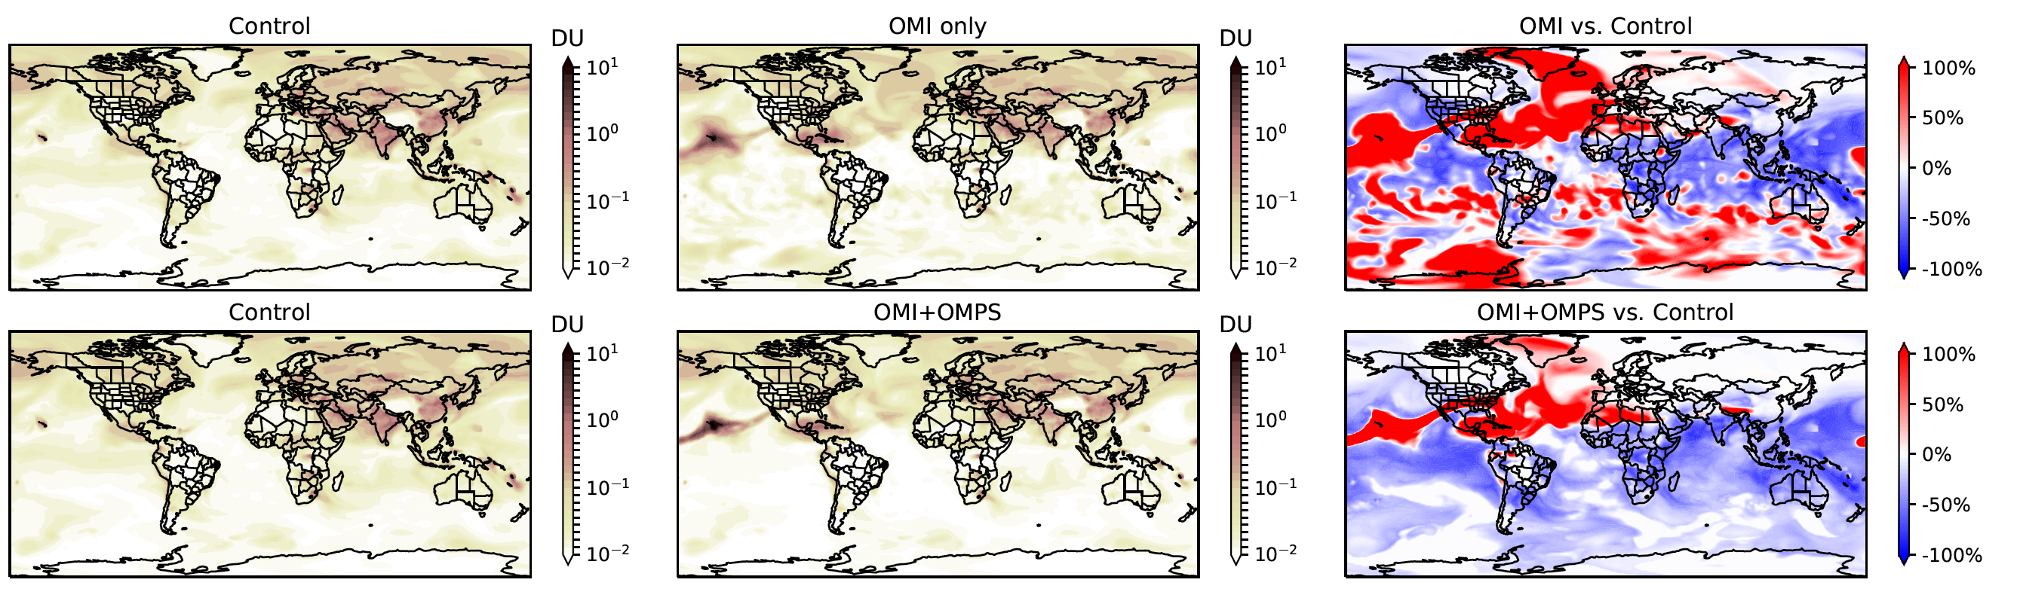
Constituent Data Assimilation System (CoDAS)
Designed to be tracer agnostic: can assimilate any type of retrieved constituent observations with an averaging kernel or at a point
  CoDAS builds on the Gridpoint Statistical Interpolation scheme developed at NCEP and GMAO
M2-SCREAM
GEOS-GHG
GEOS-CF v2
Wargan et al., ESS (2023).
DOI: 10.1029/2022EA002632
Weir et al., Sci. Adv. (2021) DOI:10.1126/sciadv.abf9415
https://gmao.gsfc.nasa.gov/research/science_snapshots/2022/mauna-loa.php
GMAO involved and invested in the constituent DA with JEDI
https://gmao.gsfc.nasa.gov/weather_prediction/GEOS-CF/
k.e.knowland@nasa.gov
8

Slide 9
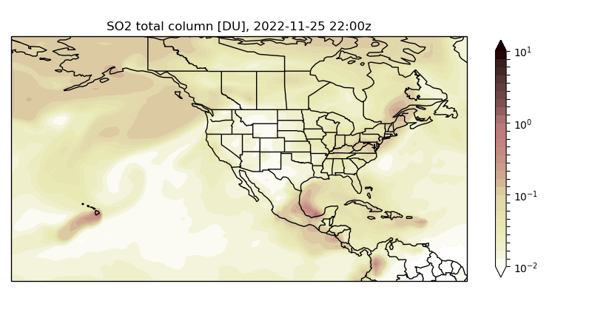
SO₂ assimilation: Mauna Loa’s smoking gun
Simulated SO₂ total column [DU] for Dec 6, 2022
Evolution of assimilated SO₂ from the Mauna Loa eruption in November 2022
Mauna Loa eruption only captured in runs with assimilation
The resulting volcanic plume of sulfur dioxide (SO₂) can be seen from space with satellite instruments such as NASA’s Ozone Monitoring Instrument (OMI).
https://gmao.gsfc.nasa.gov/research/science_snapshots/2022/mauna-loa.php
https://gmao.gsfc.nasa.gov/weather_prediction/GEOS-CF/
k.e.knowland@nasa.gov
Notes:
Hawaii’s Mauna Loa began erupting on Nov. 27, 2022. The resulting volcanic plume of sulfur dioxide (SO₂) can be seen from space with satellite instruments such as NASA’s Ozone Monitoring Instrument (OMI). Combining these observations with atmospheric models such as GEOS provides a powerful tool to simulate and predict the nature of these plumes in near real-time. Experiments using the GEOS model highlight the value of actively assimilating OMI SO₂ into the model in order to realistically capture active volcanic plumes. Without assimilation (control run), the model solely relies on historical estimates of persistent degassing, missing the large release of SO₂ from Mauna Loa’s eruption. On the other hand, the assimilation experiment adds SO₂ over the source region, as informed by OMI. Once released, the SO₂ gets lifted and dispersed eastward by the atmospheric winds.
The capability to assimilate tropospheric trace gases is the latest extension of GMAO’s constituent assimilation system. This feature will be included in future GMAO products.

Slide 10
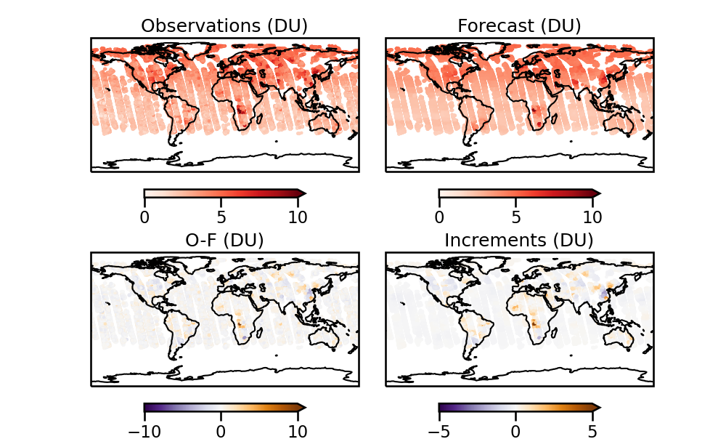
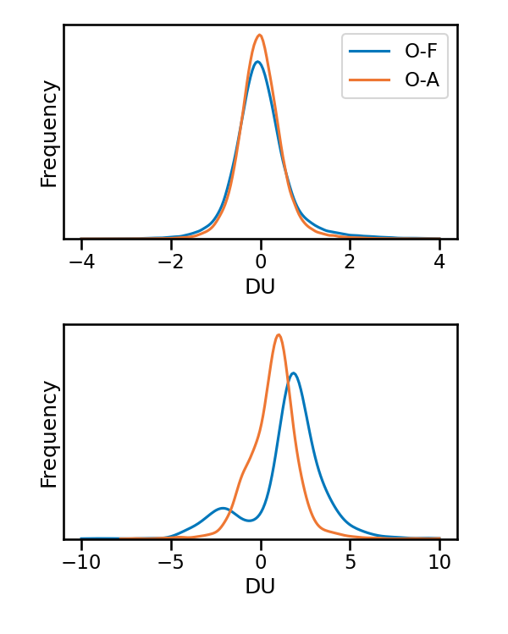
NO₂ assimilation ➡️ Improved NO₂ in polluted areas
Assimilating OMI NO₂ total slant columns
Frequency distributions
of O-F and O-A
Global
Mostly
Strat NO₂ in remote atmosphere
Polluted areas
A slight high bias in the background
(column > 6 DU)
Increments smaller than O-F’s –
reflects the ratio of observation to background errors
https://gmao.gsfc.nasa.gov/weather_prediction/GEOS-CF/
k.e.knowland@nasa.gov
Notes:
Assimilating total slant columns
1-month test run at c90 resolution
(results for 2018-07-15)
Overall improvements are small (lifetime, 3Dvar, overpass time). It’s hard to see improvement in the system because of how system is designed.

Slide 11
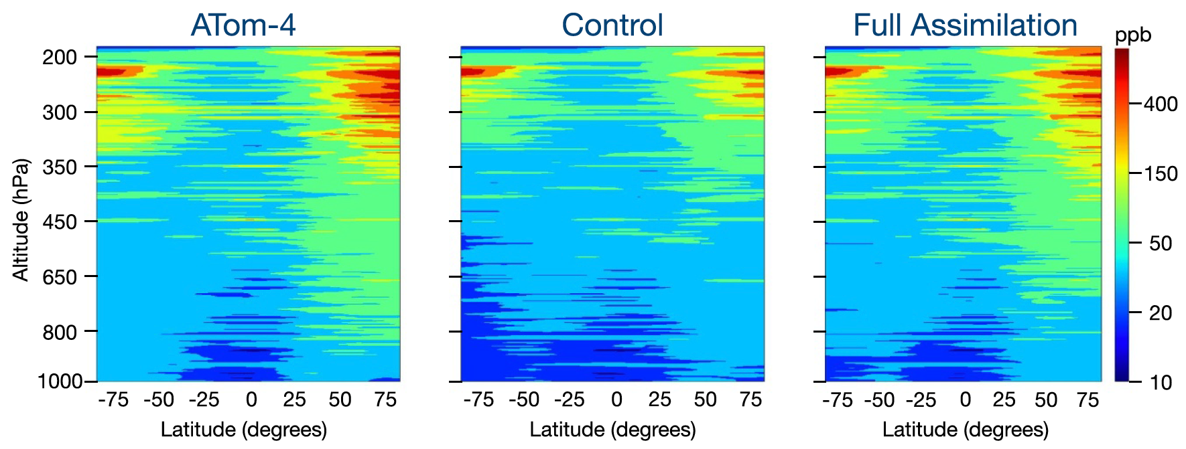
Ozone assimilation ➡️ Improved tropospheric ozone
Ozone assimilation of MLS v4.2 profiles, Total Column Ozone from OMI, and 9.6-micron radiances drastically improves the representation of ozone in the remote atmosphere according to this comparison to ATom-4 measurements and a version of the GEOS-CF v2 system used in testing.
Figure reproduced from Makoto M Kelp et al 2023 Environ. Res. Lett. 18 094036 DOI 10.1088/1748-9326/acf0b7
https://gmao.gsfc.nasa.gov/weather_prediction/GEOS-CF/
k.e.knowland@nasa.gov
11

Slide 12
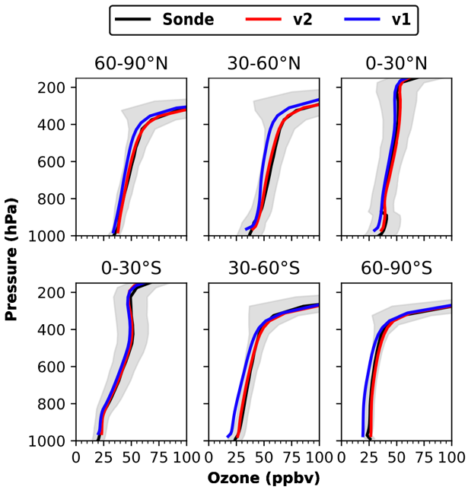
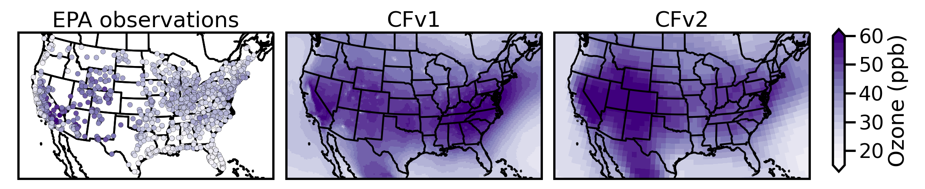
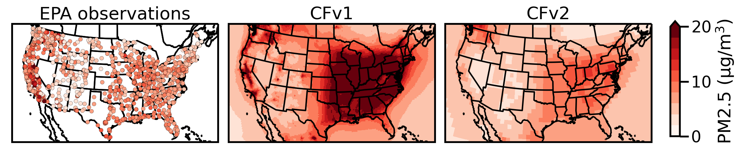
GEOS-CF v2 updates (including DA) positively impact O₃ and PM_{2.5}
New Meteorology ➡️ Improved summertime (JJA) surface O₃
GEOS-CF v1 uses HTAP v2.2 which is now >10 years behind
Using latest CEDS with current estimates ➡️ Improved annual PM_{2.5}
Ozone assimilation ➡️ Improved tropospheric ozone
https://gmao.gsfc.nasa.gov/weather_prediction/GEOS-CF/
k.e.knowland@nasa.gov
Notes:
O3 sfc jja, pm annual mean

Slide 13
Lines of development and legacy systems
GEOS Composition Reanalysis for the 21st Century
GEOS CR development
MERRA-2 Stratospheric Composition Reanalysis with Aura MLS
(M2-SCREAM)
Greenhouse Gas data assimilation (GEOS-GHG)
M2-SCREAM pathfinder for composition reanalysis with coupled chemistry model and multi-constituent data assimilation
Assimilation of chemically reactive carbon species: CO₂ and CH₄
GEOS-CF v2 near-real time system with multi-constituent data assimilation of (mainly) tropospheric constituents
Air quality / tropospheric chemistry modeling and assimilation
https://gmao.gsfc.nasa.gov/weather_prediction/GEOS-CF/
k.e.knowland@nasa.gov
13

Slide 14
GEOS Composition Reanalysis of the 21st Century System Design
Assimilation of selected gases important for stratospheric and tropospheric chemistry, with CoDAS
Model: GEOS AGCM with the GEOS-Chem full chemistry model and a carbon module (developed from legacy GOCART)
  Coupling GEOS-Chem to GOCART aerosols under development
Constrained by temperature, winds, surface pressure, tropospheric water vapor from a GMAO reanalysis (“meteorological replay” technique)
https://gmao.gsfc.nasa.gov/weather_prediction/GEOS-CF/
k.e.knowland@nasa.gov
14

Slide 15
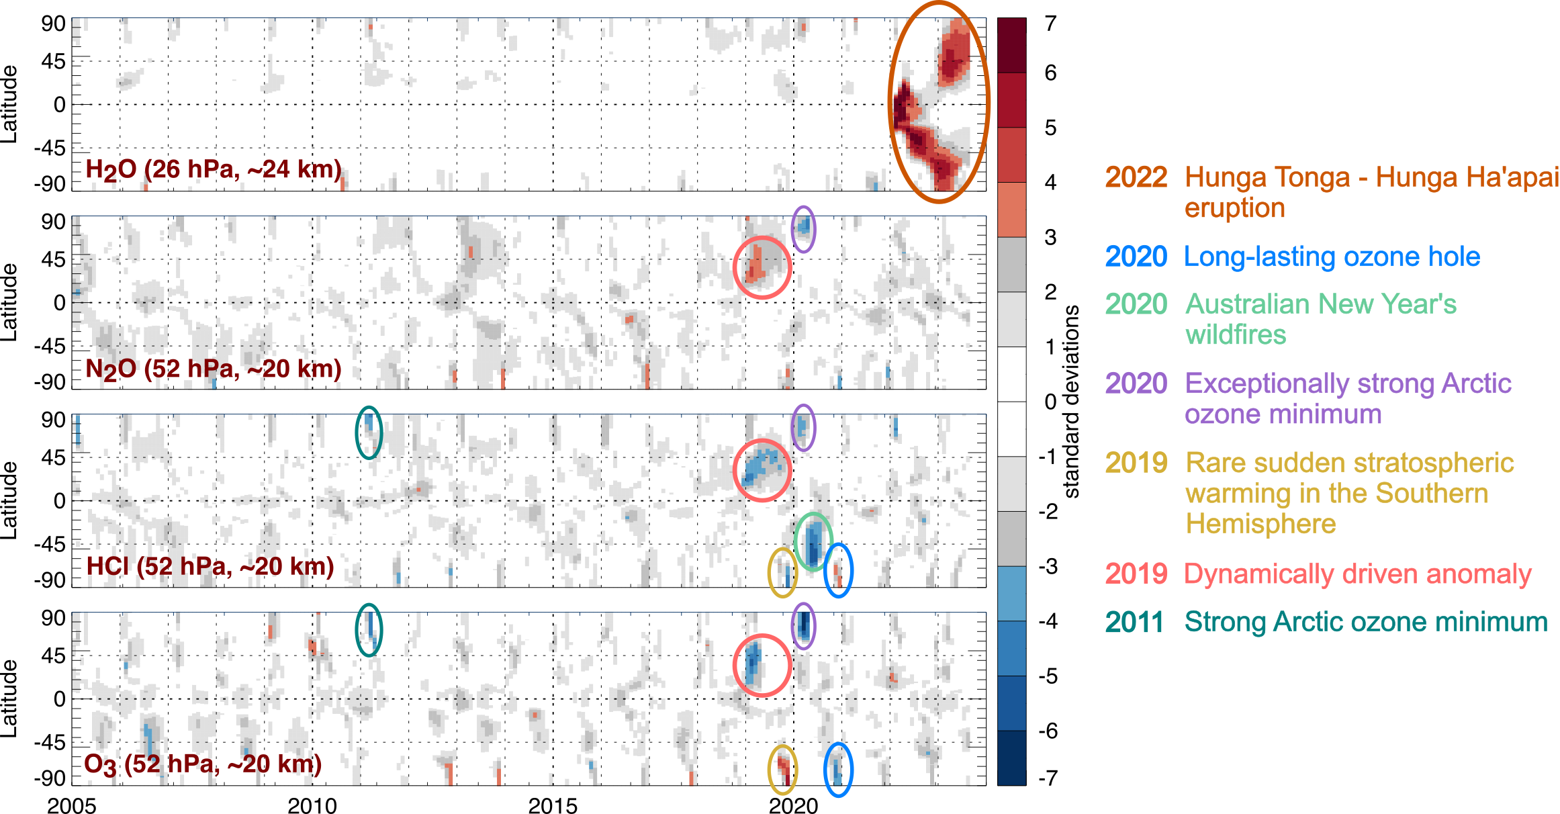
Our surprising stratosphere
Detrended anomalies in constituent fields from M2-SCREAM
A series of large stratospheric perturbations occurred in the last five years.
Continuing measurements of the stratosphere will be essential for reanalyses.
https://gmao.gsfc.nasa.gov/weather_prediction/GEOS-CF/
k.e.knowland@nasa.gov

Slide 16
Assimilated species and sensors
Retrievals
Sensor | Molecules | Observation type
OMI, TROPOMI, OMPS | NO₂, SO₂, O₃ | Column
SCIAMACHY, GOSAT, TROPOMI | CH₄ | Column
SCIAMACHY, GOSAT, OCO | CO₂ | Column
MOPITT TIR & NIR | CO | Column
MLS | O₃, HCl, HNO₃, N₂O, H₂O, CH₃Cl, CO | Stratospheric limb profiles
OMPS-LP | O₃ | Stratospheric limb profiles
established new
Radiances
Sensor | Wavelength | Comment
AIRS, IASI (MetOp-A,B), CrIS FSR (potentially) | 9.6 μm | Ozone-sensitive channels
https://gmao.gsfc.nasa.gov/weather_prediction/GEOS-CF/
k.e.knowland@nasa.gov
16

Slide 17
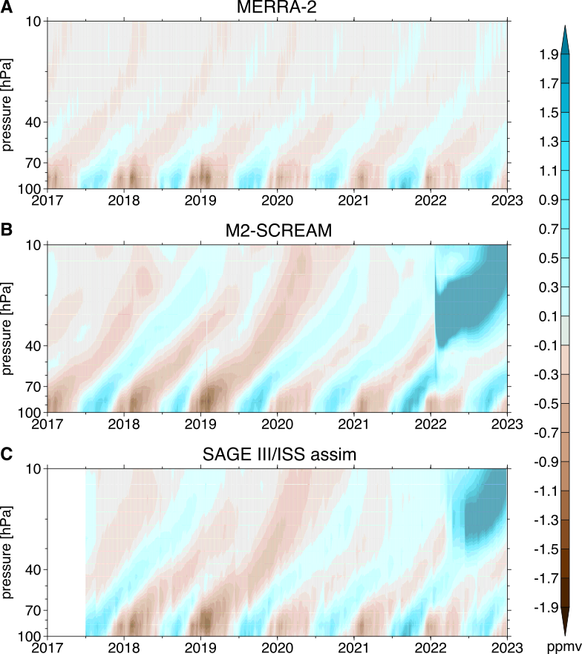
Preparing for the end of EOS missions
The assimilation of SAGE water vapor is now possible in the GEOS CoDAS framework to carry-on the trend and climate assessments after the Aura mission.
There is a clear benefit to assimilating the less frequent SAGE III/ISS water vapor observations, especially after anomalous events like the period following the Hunga Tonga Eruption.
Tropical tape recorder signal assessed as anomalies in water vapor for 15°S to 15°N. Figure from Knowland et al. in prep
https://gmao.gsfc.nasa.gov/weather_prediction/GEOS-CF/
k.e.knowland@nasa.gov
Notes:
Assimilating water vapor only from the SAGE III occultation instrument onboard the ISS in a M2-SCREAM like system is able to represent similar stratospheric water vapor as an assimilation with MLS and compared well with independent observations from frost-point hygrometers and ACE-FTS.

Slide 18
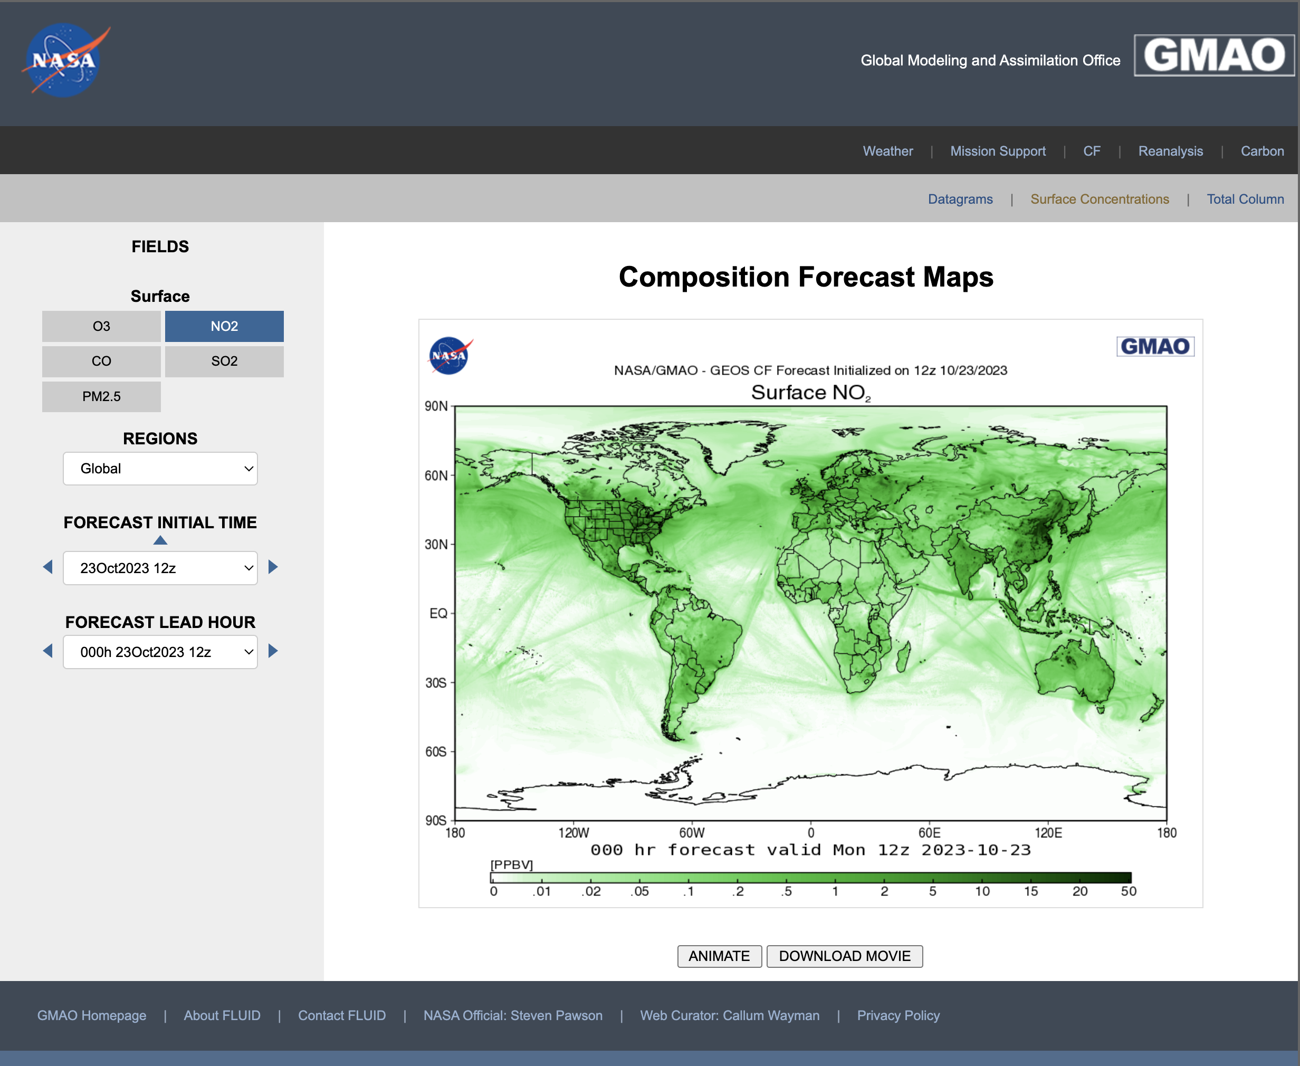
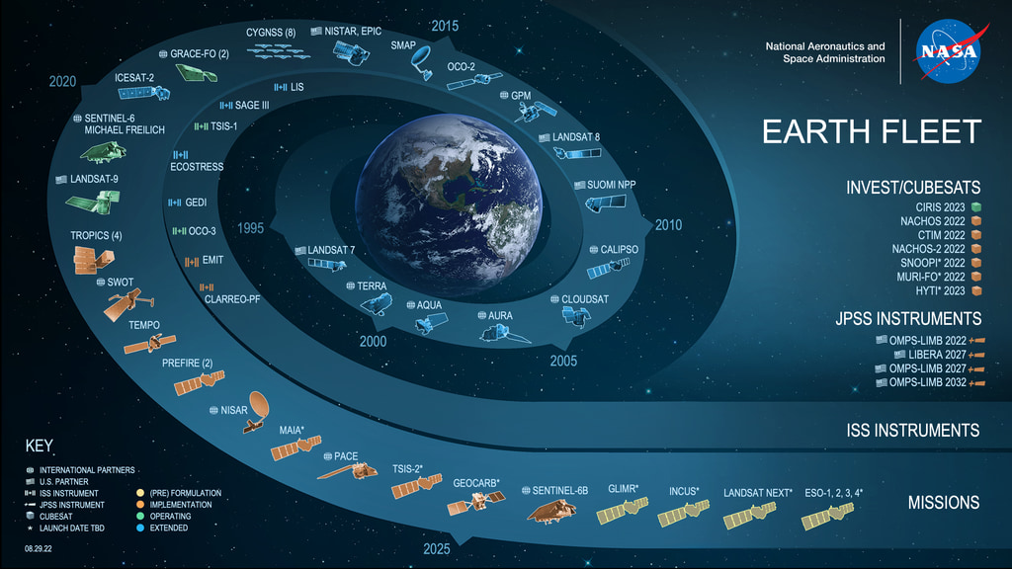
Summary
GMAO has a state-of-the-science Earth System model and data assimilation system
Daily GEOS-CF global 5-day composition forecasts at 0.25° (25km) resolution are generated in near-real time
GEOS-CF v2 will include CoDAS with O₃, NO₂, and SO₂
GEOS Composition Reanalysis builds on the development of tropospheric and stratospheric composition modeling and assimilation at GMAO
Involved and invested in new data assimilation infrastructure for multi-constituent data assimilation system
NASA products are research products
Thank you for listening!
K. Emma Knowland
k.e.knowland@nasa.gov
Notes:
GMAO’s GEOS systems are central to NASA’s Earth Science Mission. They provide NASA’s platform for model-based mission support, research, and applications. They are key to many inter-agency collaborations.

